Slide 1
LINAC Heat Management
A New Approach
P. Knudsen
Engineering Division, Cryo Group

Slide 2
JLab Heat Management
Using electric heat applied to the 2-K super-fluid helium within the cryo-module cavities to control the LINAC pressure provides the greatest range and stability – as opposed to regulating the cold compressor mass flow
Currently JLab uses two inter-linked ‘high-level’ functions to control the electric heat
  Auto Heat: ST = 2.5 minutes
    Applies to all ‘non-swing’ cryo-modules (whose heat is not in ‘manual’ or ‘kill’), except FEL
    Output: % electric heat
  Swing Heat: ST = 10 seconds
    Applies to 3 cryo-modules in each LINAC
      1L19, 1L20, 1L21, 2L18, 2L19, 2L20
    Output: CAPHEATI and CAPHTRMGN

Slide 3
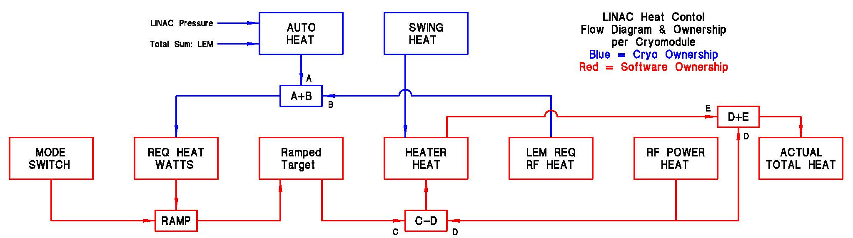
JLab Heat Management
Block diagram of present ‘high-level’ function

Slide 4
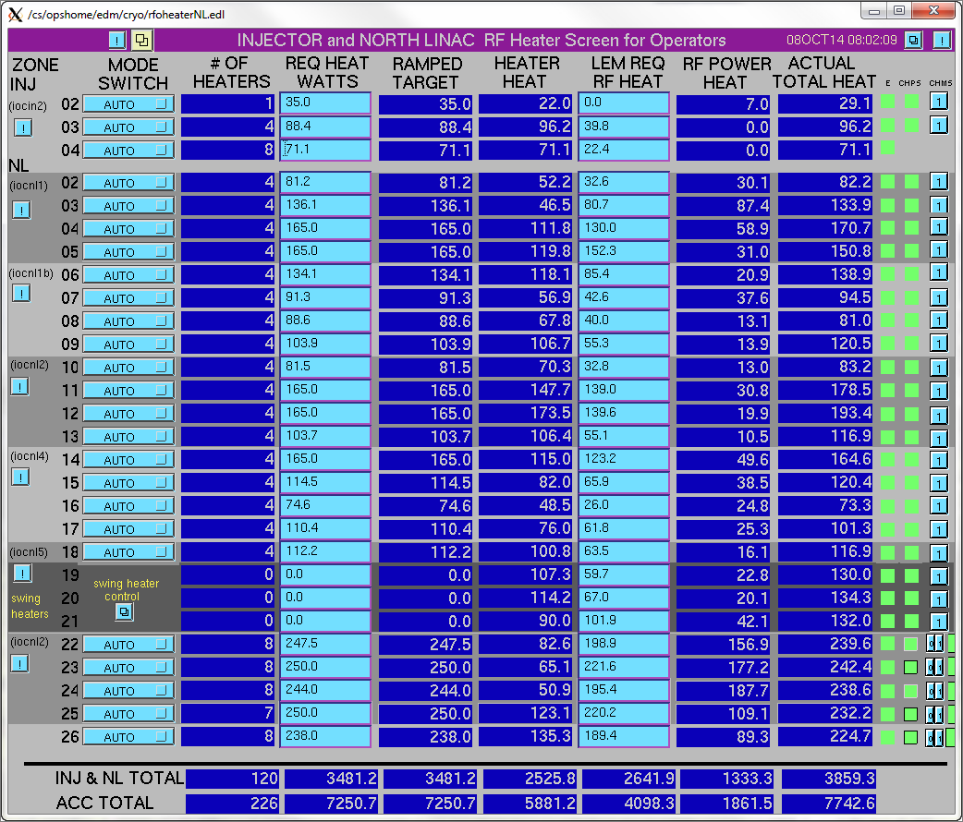
JLab Heat Management
North LINAC RF Heater Screen (EPICS)

Slide 5
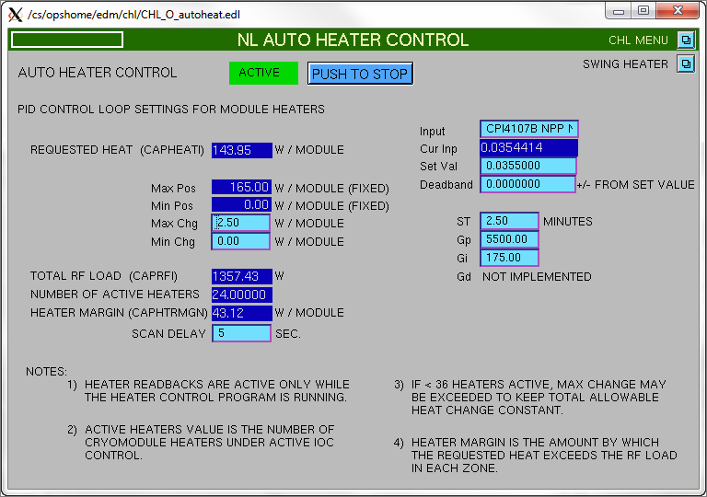
JLab Heat Management
North LINAC Auto Heater Control Screen (EPICS)

Slide 6
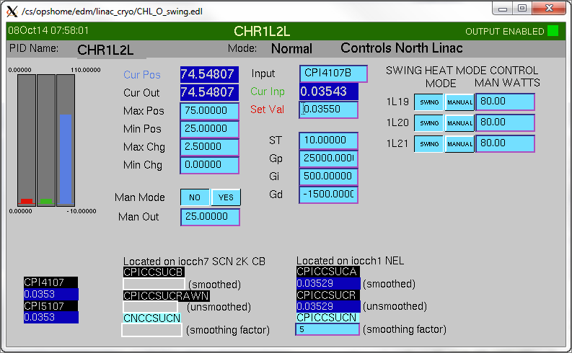
JLab Heat Management
North LINAC Swing Heat Control Screen (EPICS)

Slide 7
JLab Heat Management
Issues with present JLab ‘high-level’ heat control function
  Fast heat response for only 3 cryo-modules per LINAC (using Swing Heat)
    Why not use all cryo-modules under one control function?
  Heat added to each cryo-module is basically uniform
    As opposed to trying to keep the total heat load (RF losses + electric heat) uniform which would provide better management of the total electric heat
  Heat added is based upon a feed-back loop
    A more predictive model for the heat required to stabilize the LINAC pressure is possible

Slide 8
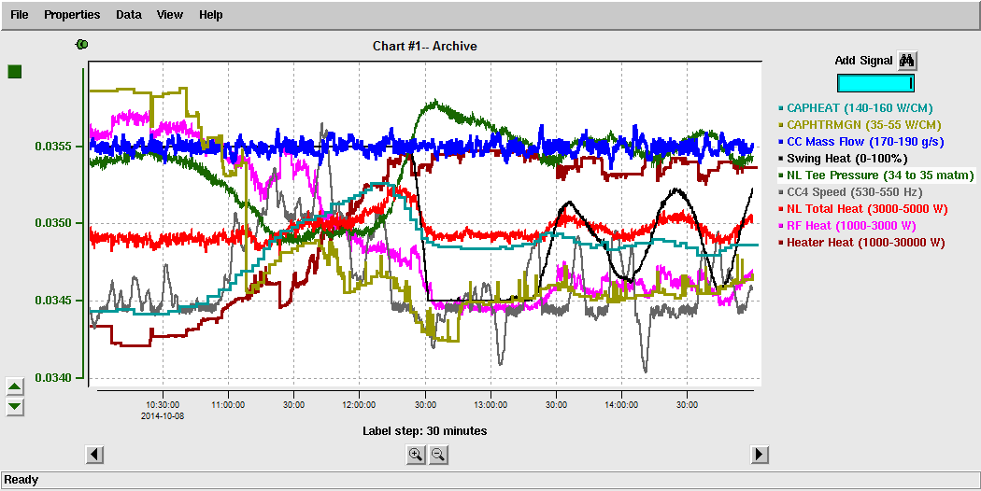
JLab Heat Management
Typical ‘High-Level’ response

Slide 9
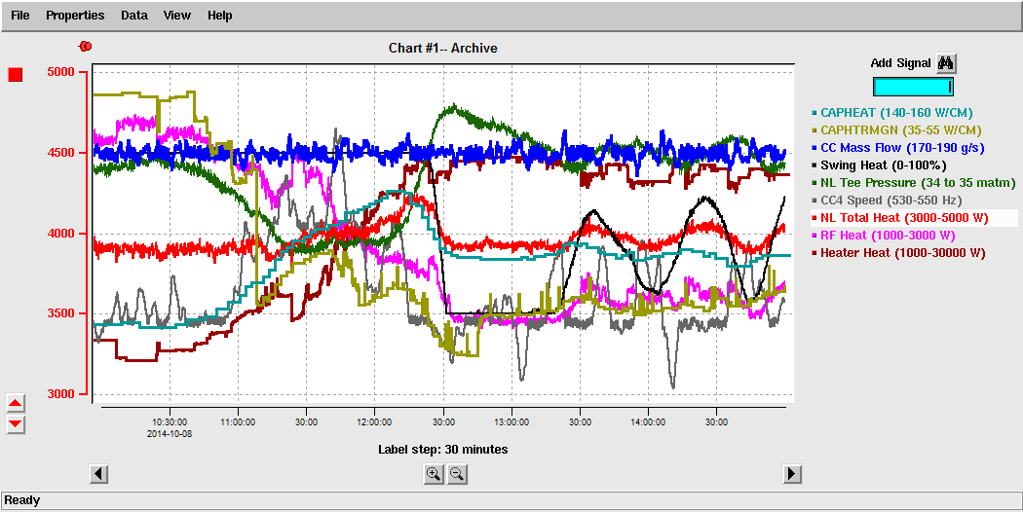
JLab Heat Management
Typical ‘High-Level’ response

Slide 10
JLab Heat Management
In addition, to the ‘high-level’ algorithms, since RF input to the cryo-module cavities is turned OFF and ON very quickly, a ‘low level’ heat compensation is used,
  To keep liquid level in cavities steady
    Overfilling could trip the cold compressors due to flashing liquid in the return transfer-line
    Liquid level loss can trip the RF off to prevent a non-immersed cavity surface
  And, in theory, is equal to the cavity RF losses which manifest as heat in to the superfluid helium
    From the reaction of the LINAC pressure when RF is turned OFF and ON, it is known that this compensation value is often not known well

Slide 11
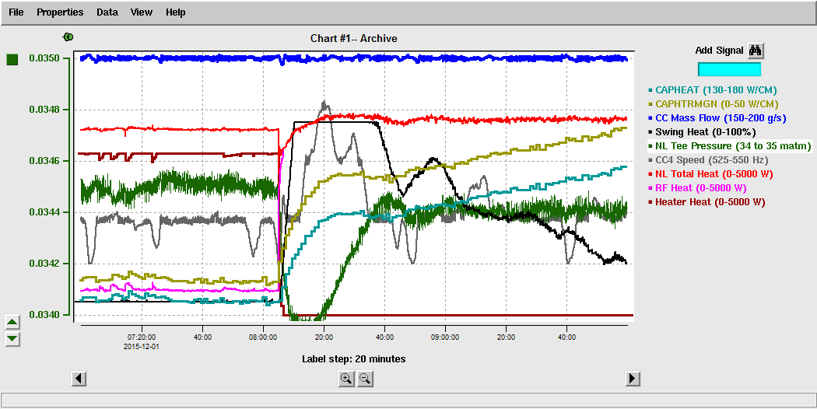
JLab Heat Management
Typical ‘Low-Level’ response (can be much more severe)

Slide 12
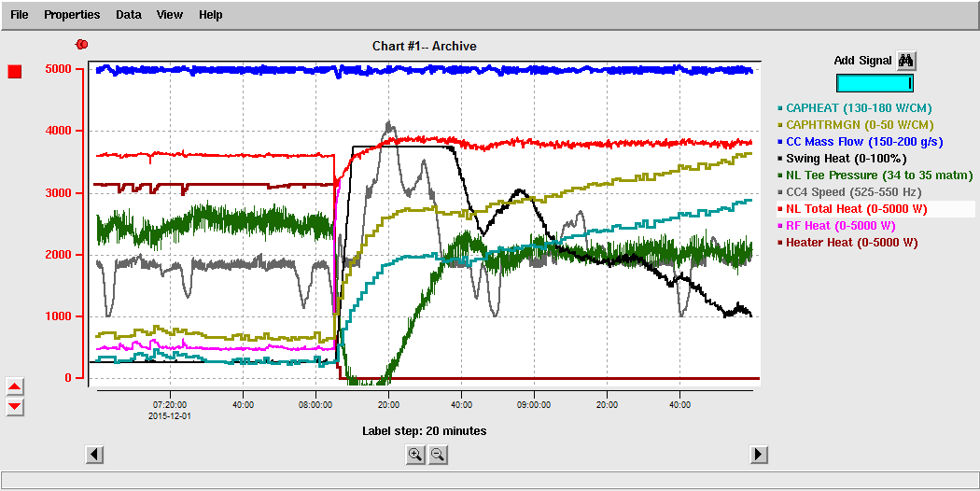
JLab Heat Management
Typical ‘Low-Level’ response (can be much more severe)

Slide 13
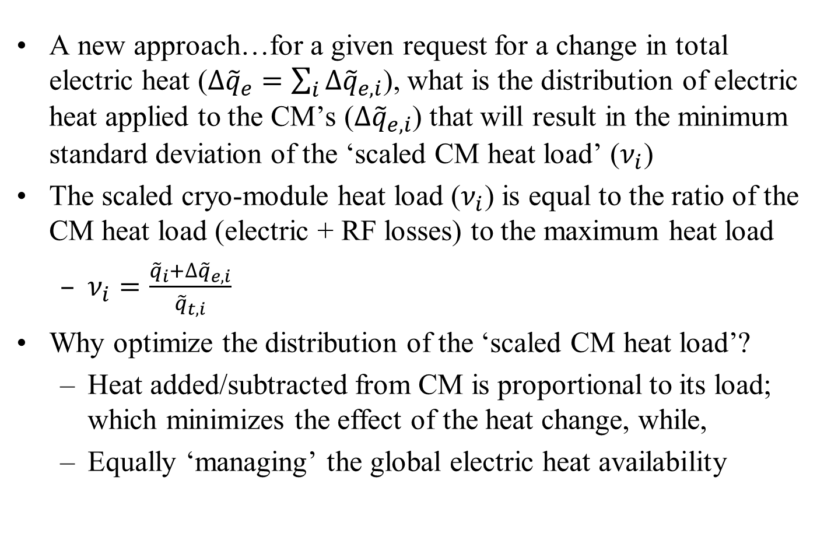
New Approach for ‘High-Level’ Function
A new approach…for a given request for a change in total electric heat ($∆{\tilde{q}}_{e}=\sum_{i}{∆{\tilde{q}}_{e,i}}$), what is the distribution of electric heat applied to the CM’s ($∆{\tilde{q}}_{e,i}$) that will result in the minimum standard deviation of the ‘scaled CM heat load’ ($ν_{i}$)
The scaled cryo-module heat load ($ν_{i}$) is equal to the ratio of the CM heat load (electric + RF losses) to the maximum heat load
  $ν_{i}=\frac{{\tilde{q}}_{i}+∆{\tilde{q}}_{e,i}}{{\tilde{q}}_{t,i}}$
Why optimize the distribution of the ‘scaled CM heat load’?
  Heat added/subtracted from CM is proportional to its load; which minimizes the effect of the heat change, while,
  Equally ‘managing’ the global electric heat availability

Slide 14
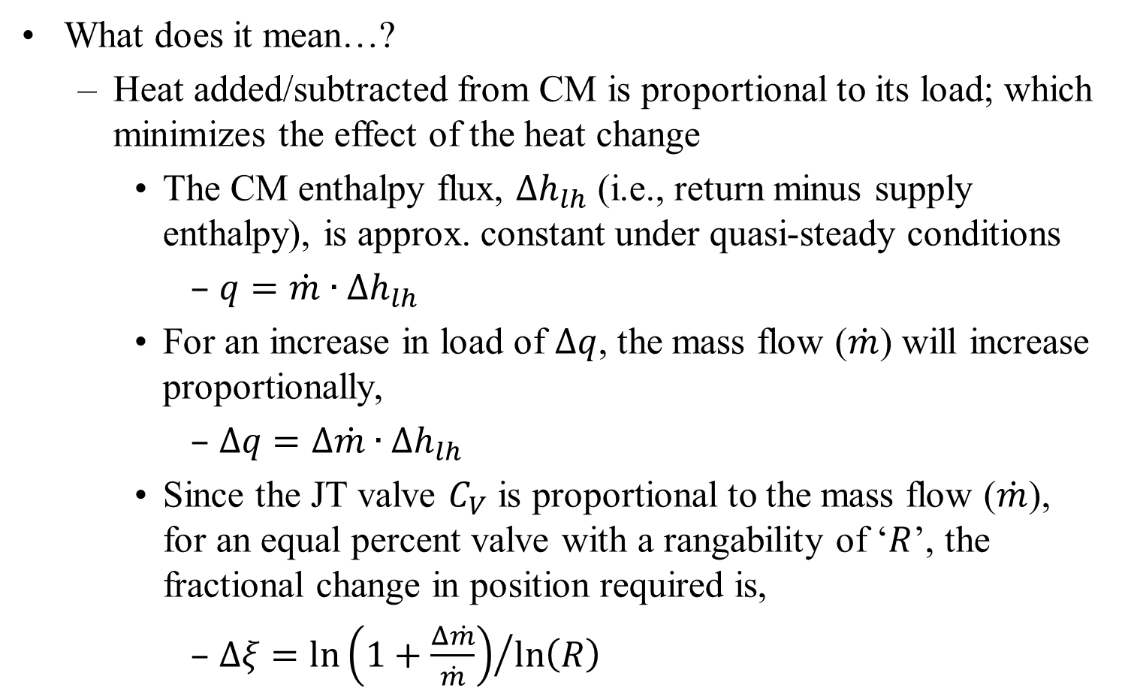
New Approach for ‘High-Level’ Function
What does it mean…?
  Heat added/subtracted from CM is proportional to its load; which minimizes the effect of the heat change
    The CM enthalpy flux, $∆h_{lh}$ (i.e., return minus supply enthalpy), is approx. constant under quasi-steady conditions
      $q=\dot{m}∙∆h_{lh}$
    For an increase in load of $∆q$, the mass flow ($\dot{m}$) will increase proportionally,
      $∆q=∆\dot{m}∙∆h_{lh}$
    Since the JT valve $C_{V}$ is proportional to the mass flow ($\dot{m}$), for an equal percent valve with a rangability of ‘$R$’, the fractional change in position required is,
      $∆ξ={\ln\left(1+\frac{Δ\dot{m}}{\dot{m}}\right)}/{\ln\left(R\right)}$

Slide 15
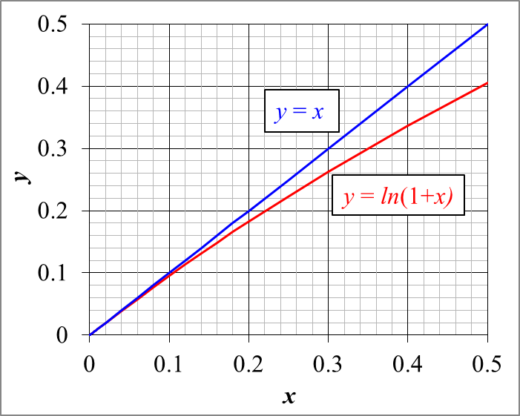
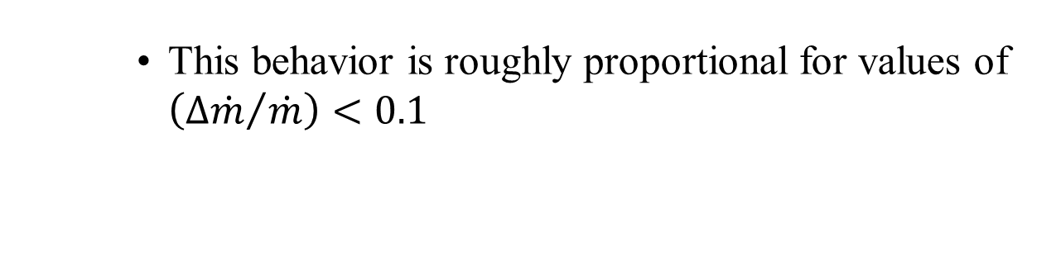
New Approach for ‘High-Level’ Function
    This behavior is roughly proportional for values of $\left({Δ\dot{m}}/{\dot{m}}\right)<0.1$

Slide 16
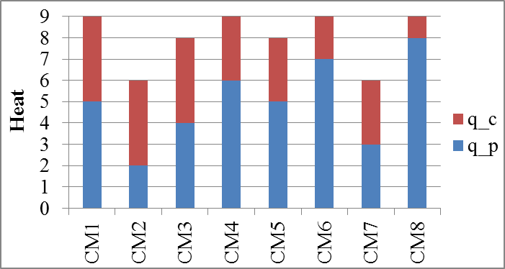
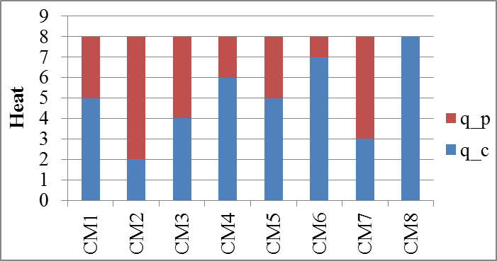
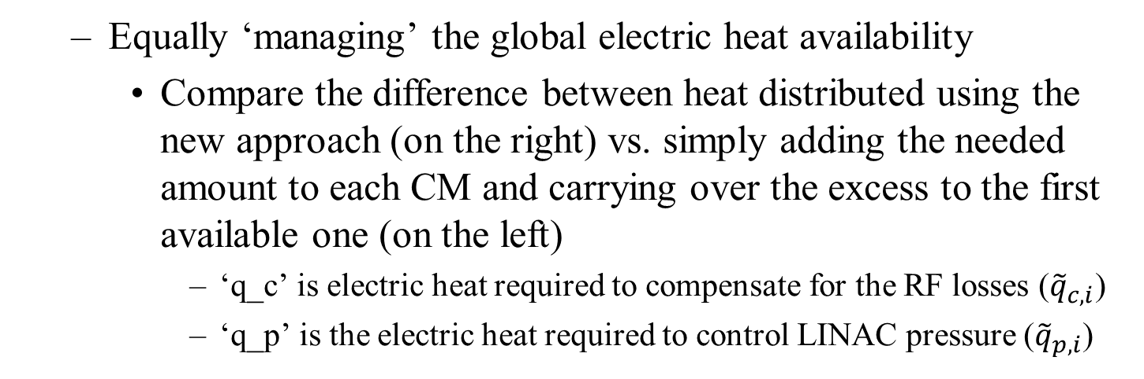
New Approach for ‘High-Level’ Function
  Equally ‘managing’ the global electric heat availability
    Compare the difference between heat distributed using the new approach (on the right) vs. simply adding the needed amount to each CM and carrying over the excess to the first available one (on the left)
      ‘q_c’ is electric heat required to compensate for the RF losses (${\tilde{q}}_{c,i}$)
      ‘q_p’ is the electric heat required to control LINAC pressure (${\tilde{q}}_{p,i}$)

Slide 17
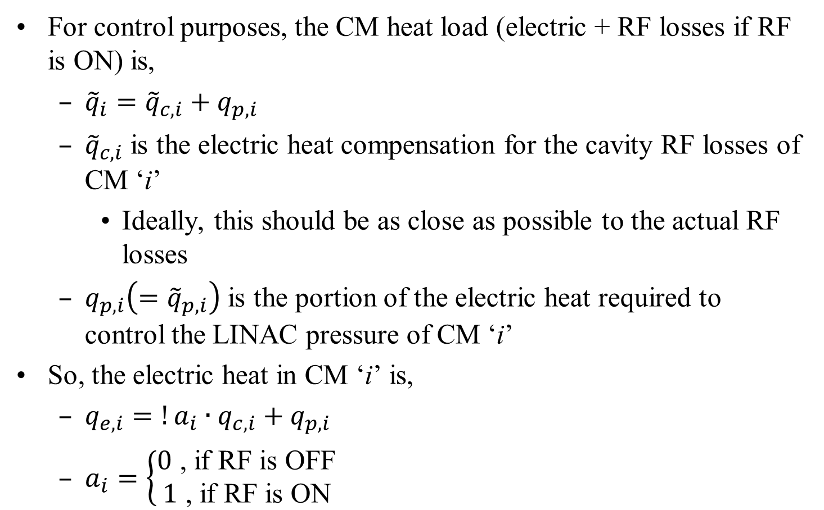
New Approach for ‘High-Level’ Function
For control purposes, the CM heat load (electric + RF losses if RF is ON) is,
  ${\tilde{q}}_{i}={\tilde{q}}_{c,i}+q_{p,i}$
  ${\tilde{q}}_{c,i}$ is the electric heat compensation for the cavity RF losses of CM ‘i’
    Ideally, this should be as close as possible to the actual RF losses
  $q_{p,i}\left(={\tilde{q}}_{p,i}\right)$ is the portion of the electric heat required to control the LINAC pressure of CM ‘i’
So, the electric heat in CM ‘i’ is,
  $q_{e,i}=!a_{i}∙q_{c,i}+q_{p,i}$
  $a_{i}=\left\{\begin{aligned}0\text{ , }\text{if} \text{RF} \text{is} \text{OFF} \\ 1\text{ , }\text{if} \text{RF} \text{is} \text{ON}\end{aligned}\right.$

Slide 18
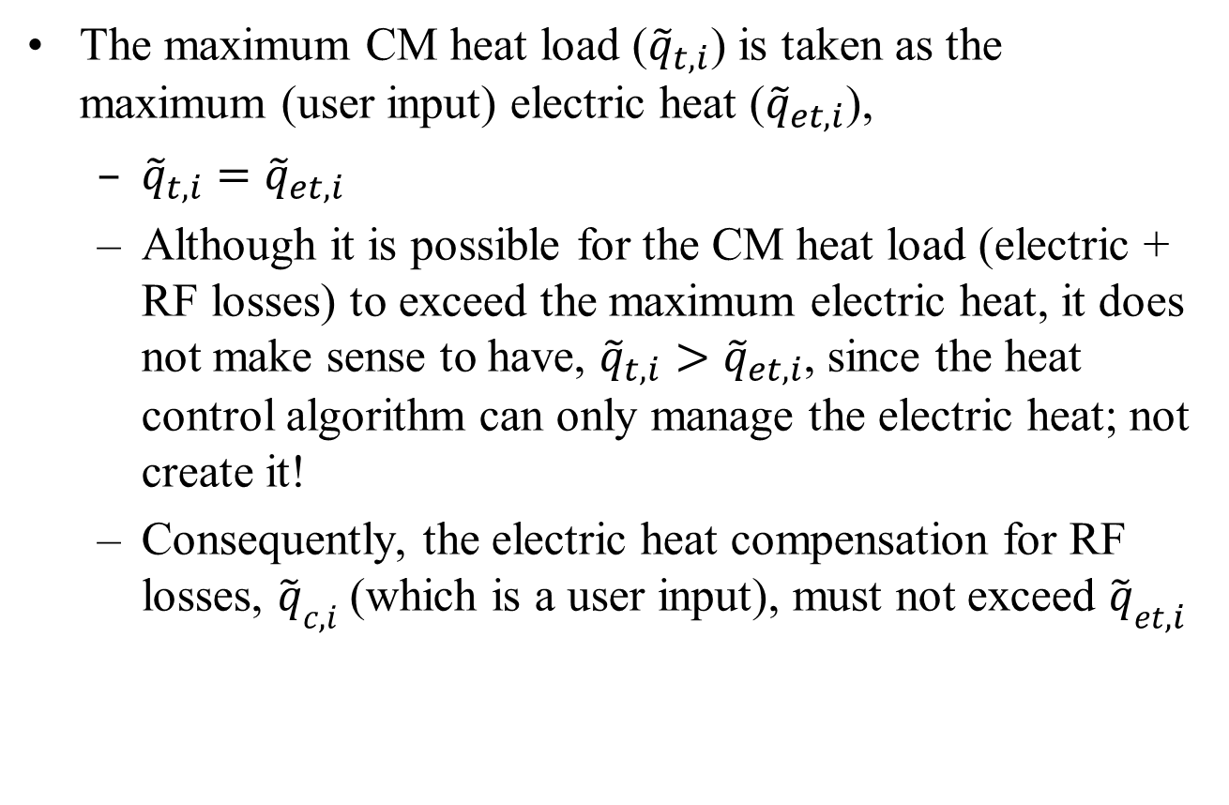
New Approach for ‘High-Level’ Function
The maximum CM heat load (${\tilde{q}}_{t,i}$) is taken as the maximum (user input) electric heat (${\tilde{q}}_{et,i}$),
  ${\tilde{q}}_{t,i}={\tilde{q}}_{et,i}$
  Although it is possible for the CM heat load (electric + RF losses) to exceed the maximum electric heat, it does not make sense to have, ${\tilde{q}}_{t,i}>{\tilde{q}}_{et,i}$, since the heat control algorithm can only manage the electric heat; not create it!
  Consequently, the electric heat compensation for RF losses, ${\tilde{q}}_{c,i}$ (which is a user input), must not exceed ${\tilde{q}}_{et,i}$

Slide 19
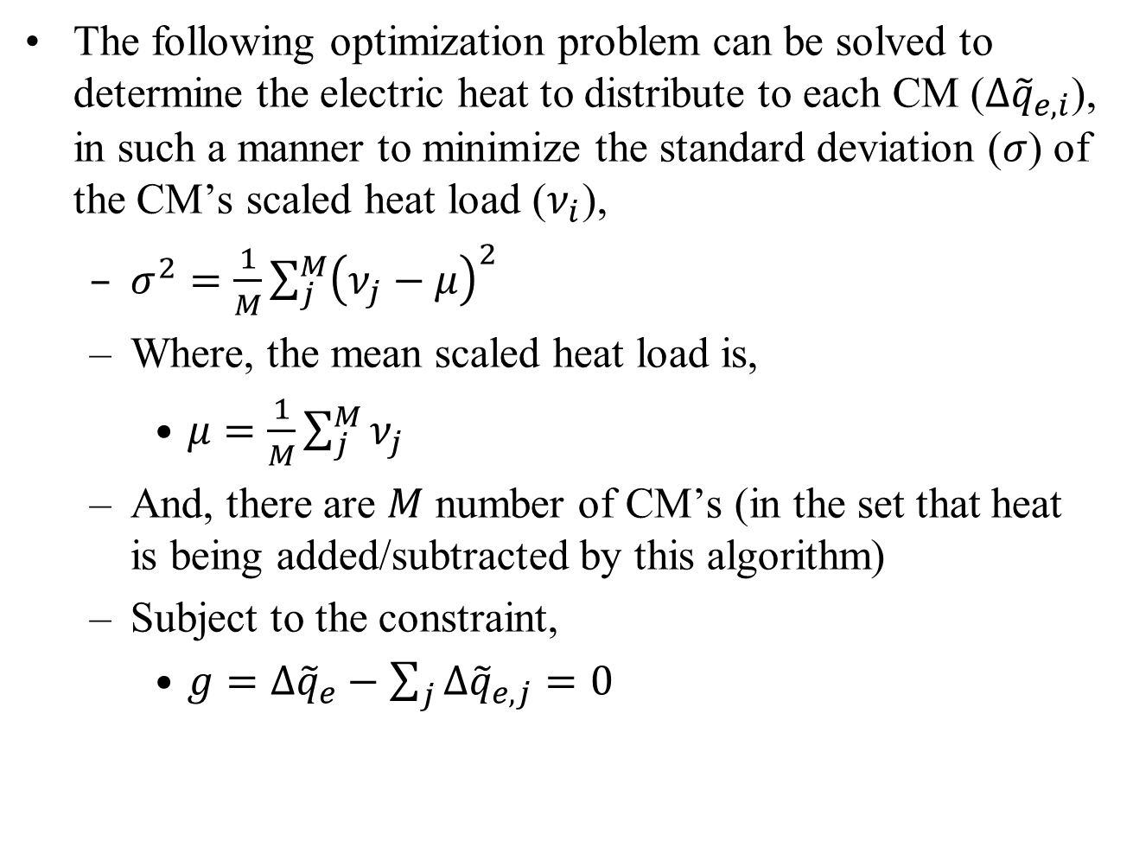
New Approach for ‘High-Level’ Function
The following optimization problem can be solved to determine the electric heat to distribute to each CM ($∆{\tilde{q}}_{e,i}$), in such a manner to minimize the standard deviation ($σ$) of the CM’s scaled heat load ($ν_{i}$),
  $σ^{2}=\frac{1}{M}\sum_{j}^{M}{{\left(ν_{j}−μ\right)}^{2}}$
  Where, the mean scaled heat load is,
    $μ=\frac{1}{M}\sum_{j}^{M}{ν_{j}}$
  And, there are $M$ number of CM’s (in the set that heat is being added/subtracted by this algorithm)
  Subject to the constraint,
    $g=∆{\tilde{q}}_{e}−\sum_{j}{∆{\tilde{q}}_{e,j}=0}$

Slide 20
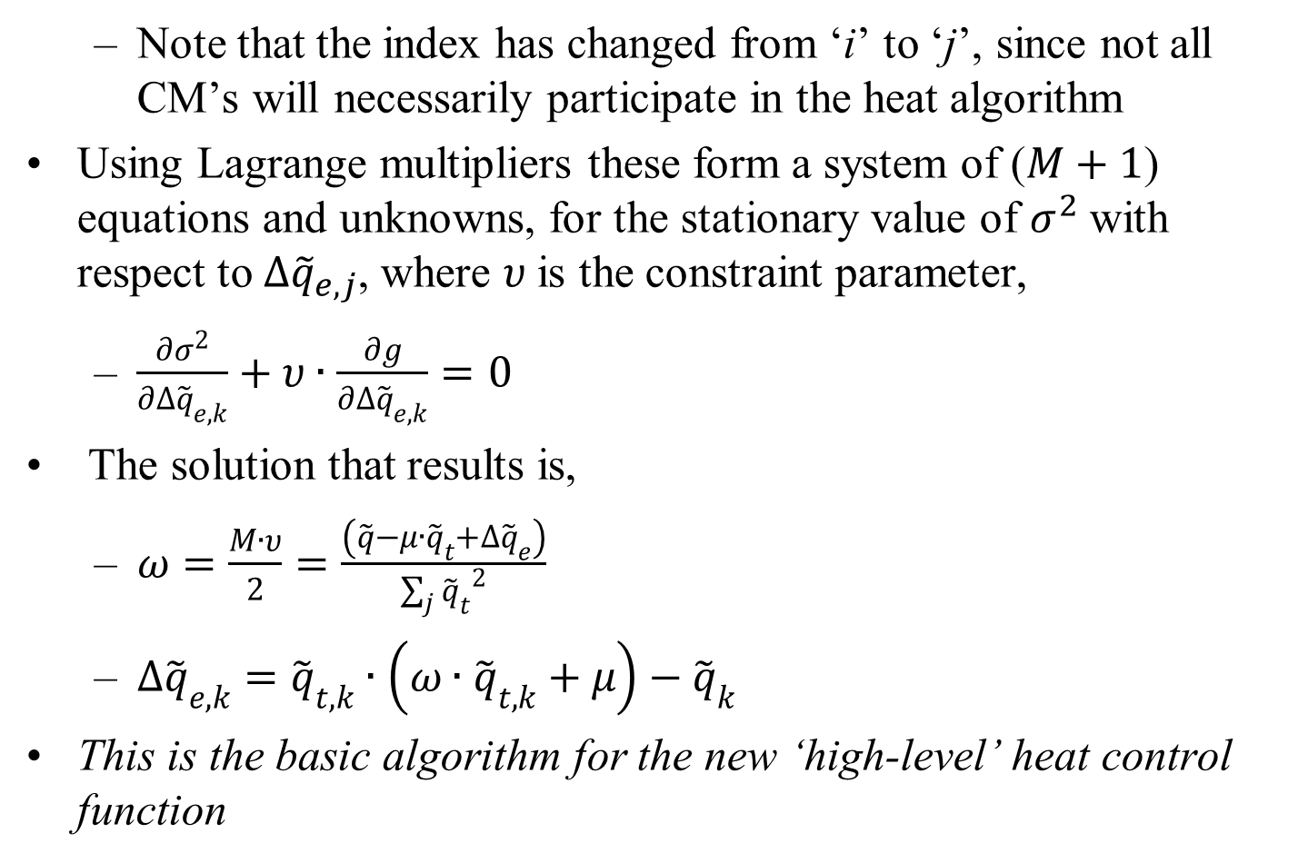
New Approach for ‘High-Level’ Function
  Note that the index has changed from ‘i’ to ‘j’, since not all CM’s will necessarily participate in the heat algorithm
Using Lagrange multipliers these form a system of ($M+1$) equations and unknowns, for the stationary value of $σ^{2}$with respect to ${∆\tilde{q}}_{e,j}$, where $υ$is the constraint parameter,
  $\frac{∂σ^{2}}{∂{∆\tilde{q}}_{e,k}}+υ∙\frac{∂g}{∂{∆\tilde{q}}_{e,k}}=0$
The solution that results is,
  $ω=\frac{M∙υ}{2}=\frac{\left(\tilde{q}−μ∙{\tilde{q}}_{t}+∆{\tilde{q}}_{e}\right)}{\sum_{j}{{{\tilde{q}}_{t}}^{2}}}$
  $∆{\tilde{q}}_{e,k}={\tilde{q}}_{t,k}∙\left(ω∙{\tilde{q}}_{t,k}+μ\right)−{\tilde{q}}_{k}$
This is the basic algorithm for the new ‘high-level’ heat control function

Slide 21
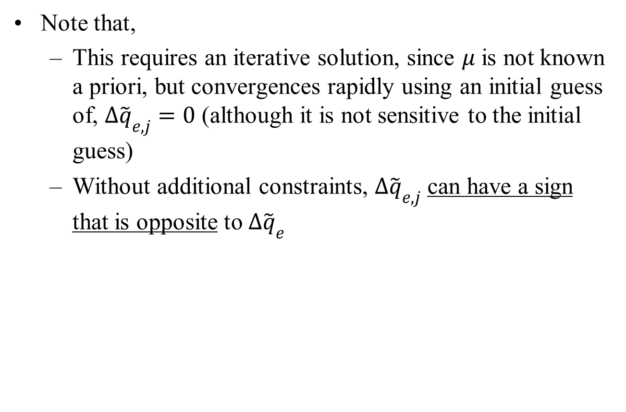
New Approach for ‘High-Level’ Function
Note that,
  This requires an iterative solution, since $μ$ is not known a priori, but convergences rapidly using an initial guess of, $∆{\tilde{q}}_{e,j}=0$ (although it is not sensitive to the initial guess)
  Without additional constraints, $∆{\tilde{q}}_{e,j}$ can have a sign that is opposite to $∆{\tilde{q}}_{e}$

Slide 22
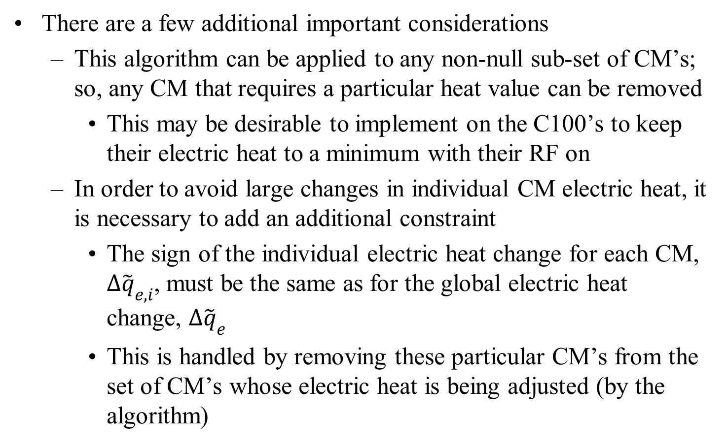
New Approach for ‘High-Level’ Function
There are a few additional important considerations
  This algorithm can be applied to any non-null sub-set of CM’s; so, any CM that requires a particular heat value can be removed
    This may be desirable to implement on the C100’s to keep their electric heat to a minimum with their RF on
  In order to avoid large changes in individual CM electric heat, it is necessary to add an additional constraint
    The sign of the individual electric heat change for each CM, $∆{\tilde{q}}_{e,i}$, must be the same as for the global electric heat change, $∆{\tilde{q}}_{e}$
    This is handled by removing these particular CM’s from the set of CM’s whose electric heat is being adjusted (by the algorithm)

Slide 23
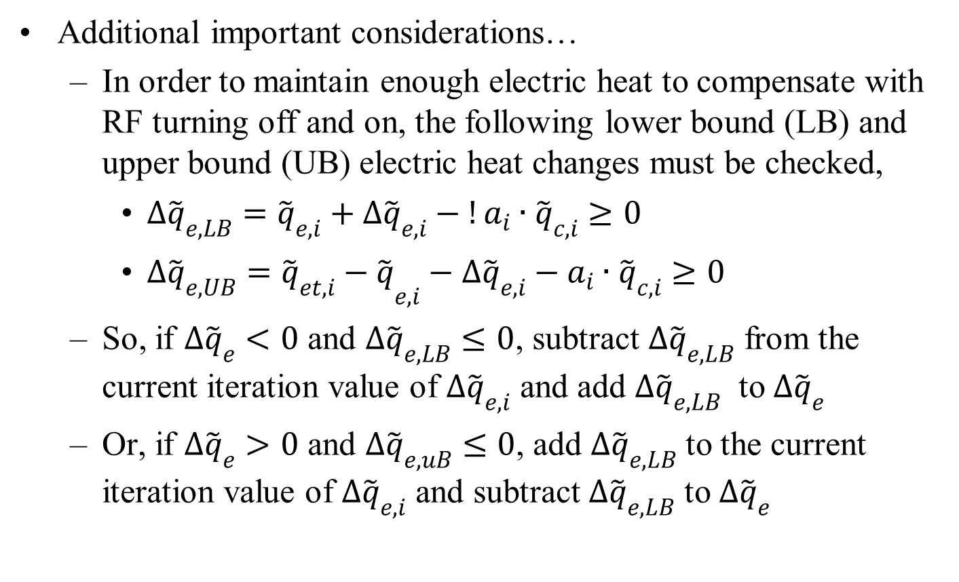
New Approach for ‘High-Level’ Function
Additional important considerations…
  In order to maintain enough electric heat to compensate with RF turning off and on, the following lower bound (LB) and upper bound (UB) electric heat changes must be checked,
    $∆{\tilde{q}}_{e,LB}={\tilde{q}}_{e,i}+∆{\tilde{q}}_{e,i}−!a_{i}∙{\tilde{q}}_{c,i}≥0$
    $∆{\tilde{q}}_{e,UB}={{\tilde{q}}_{et,i}−\tilde{q}}_{e,i}−∆{\tilde{q}}_{e,i}−a_{i}∙{\tilde{q}}_{c,i}≥0$
  So, if $∆{\tilde{q}}_{e}<0$ and $∆{\tilde{q}}_{e,LB}≤0$, subtract $∆{\tilde{q}}_{e,LB}$ from the current iteration value of $∆{\tilde{q}}_{e,i}$ and add $∆{\tilde{q}}_{e,LB}$ to $∆{\tilde{q}}_{e}$
  Or, if $∆{\tilde{q}}_{e}>0$ and $∆{\tilde{q}}_{e,uB}≤0$, add $∆{\tilde{q}}_{e,LB}$ to the current iteration value of $∆{\tilde{q}}_{e,i}$ and subtract $∆{\tilde{q}}_{e,LB}$ to $∆{\tilde{q}}_{e}$

Slide 24
New Approach for ‘High-Level’ Function
A function simulator using MS Excel and VBA code has been developed for this ‘high-level’ heat management function

Slide 25
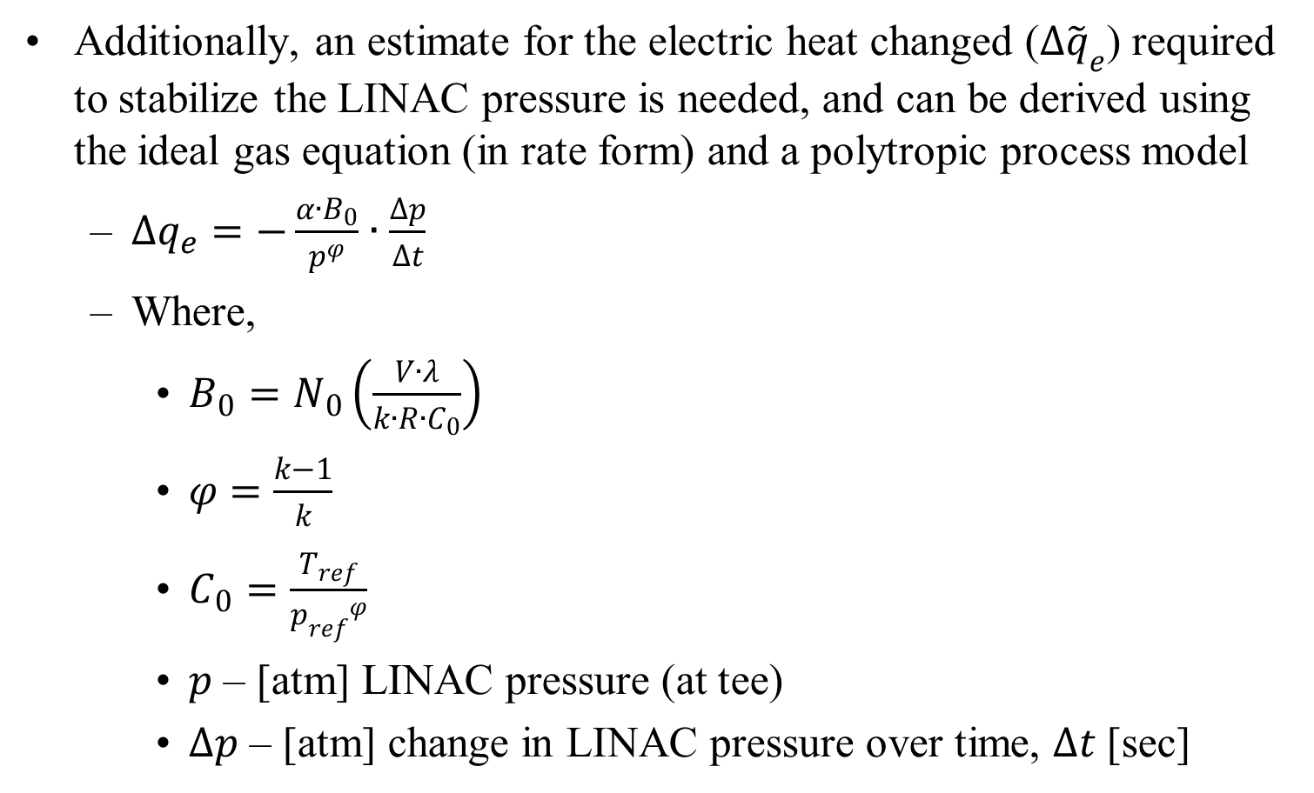
Simple LINAC Model
Additionally, an estimate for the electric heat changed ($∆{\tilde{q}}_{e}$) required to stabilize the LINAC pressure is needed, and can be derived using the ideal gas equation (in rate form) and a polytropic process model
  $∆q_{e}=−\frac{{α∙B}_{0}}{p^{φ}}∙\frac{∆p}{∆t}$
  Where,
    $B_{0}=N_{0}\left(\frac{V∙λ}{k∙R∙C_{0}}\right)$
    $φ=\frac{k−1}{k}$
    $C_{0}=\frac{T_{ref}}{{p_{ref}}^{φ}}$
    $p$ – [atm] LINAC pressure (at tee)
    $∆p$ – [atm] change in LINAC pressure over time, $∆t$ [sec]

Slide 26
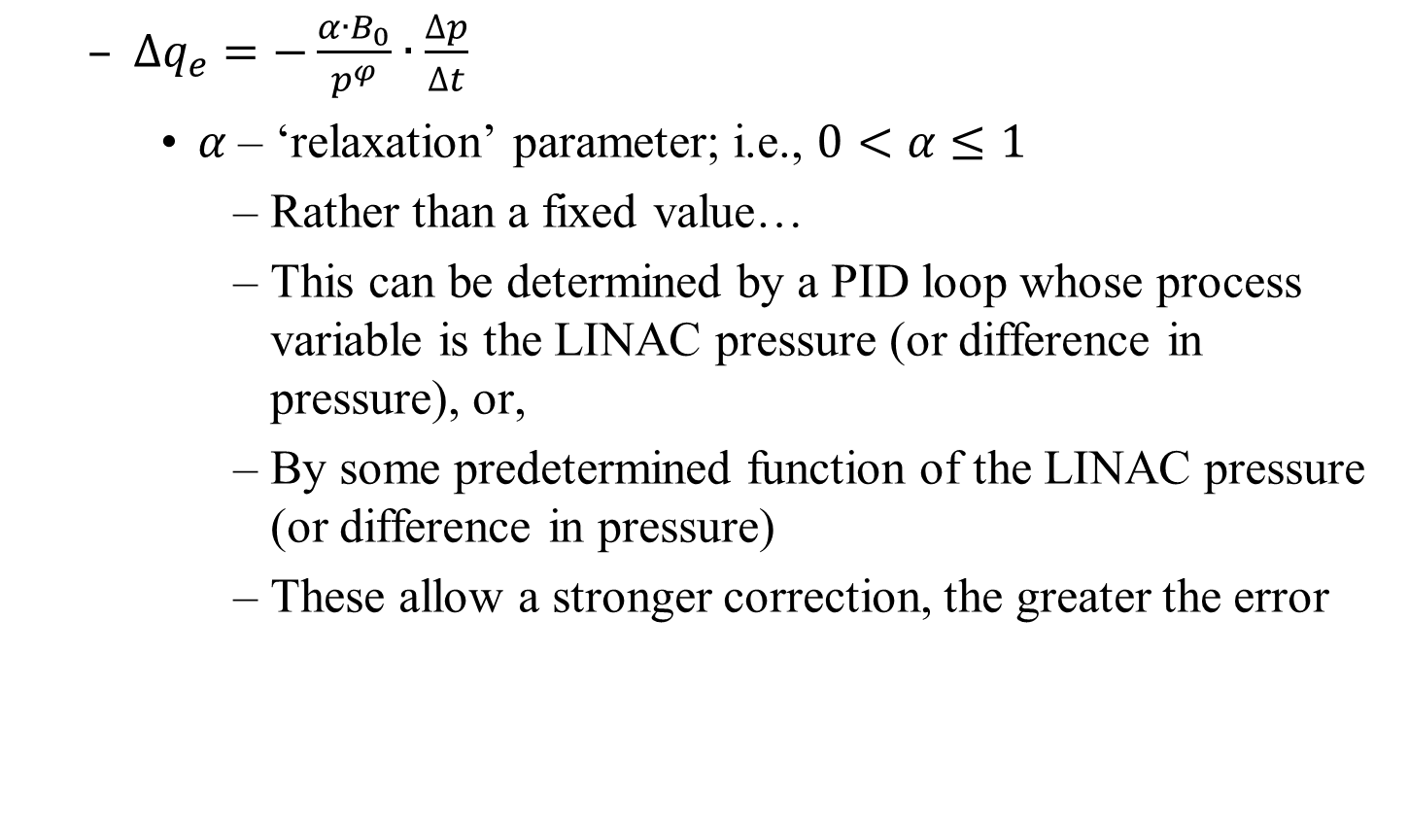
Simple LINAC Model
  $∆q_{e}=−\frac{{α∙B}_{0}}{p^{φ}}∙\frac{∆p}{∆t}$
    $α$ – ‘relaxation’ parameter; i.e., $0<α≤1$
      Rather than a fixed value…
      This can be determined by a PID loop whose process variable is the LINAC pressure (or difference in pressure), or,
      By some predetermined function of the LINAC pressure (or difference in pressure)
      These allow a stronger correction, the greater the error

Slide 27
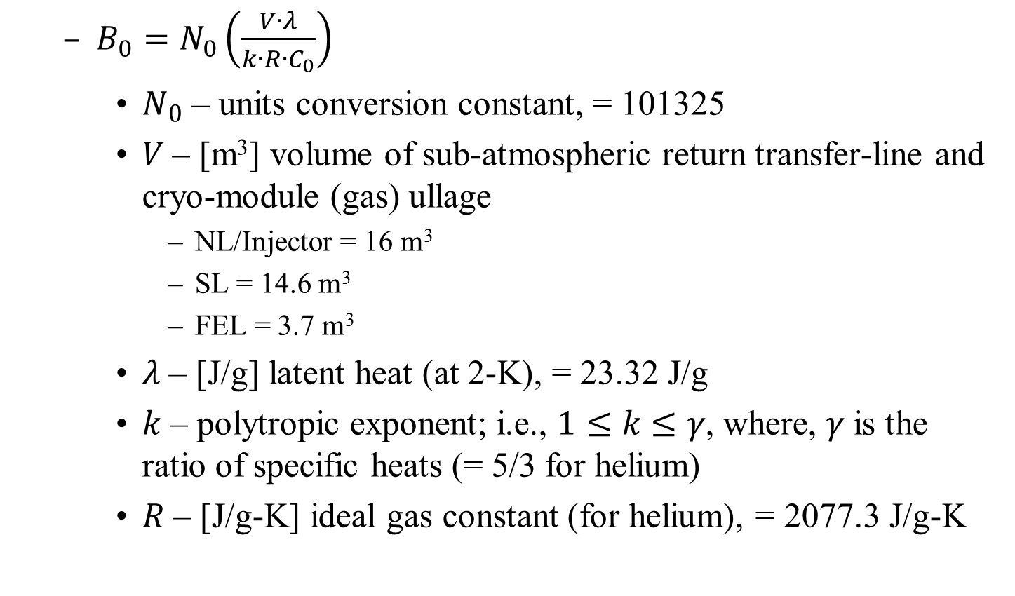
Simple LINAC Model
  $B_{0}=N_{0}\left(\frac{V∙λ}{k∙R∙C_{0}}\right)$
    $N_{0}$ – units conversion constant, = 101325
    $V$ – [m³] volume of sub-atmospheric return transfer-line and cryo-module (gas) ullage
      NL/Injector = 16 m³
      SL = 14.6 m³
      FEL = 3.7 m³
    $λ$ – [J/g] latent heat (at 2-K), = 23.32 J/g
    $k$ – polytropic exponent; i.e., $1≤k≤γ$, where, $γ$ is the ratio of specific heats (= 5/3 for helium)
    $R$ – [J/g-K] ideal gas constant (for helium), = 2077.3 J/g-K

Slide 28
Conclusion
What has been developed…
  A new algorithm for the‘high-level’ heat management function to replace Swing Heat and Auto Heat
    Electric heat is added/subtracted in a manner to both minimize the effect of heat change, while,
    Managing equally the global electric heat availability
  A model to predict the electric heat change required to stabilize the LINAC pressure
A similar scheme has been implemented at SNS and provided good results for the last 12 years

