Slide 1
LHe Pressure in CEBAF CMs and Impact on C100 performance
Ed Daly
June 29, 2016
2016 Ops Staytreat

Slide 2
Outline
Introduction
C100 vs Original CEBAF CMs
Proposed Specification
Evaluating Performance
Initial Results / Lessons Learned
Future Plans

Slide 3
Introduction
Performance of SRF cavity performance depends in part on the local surface resistance – a function of the bulk Nb temperature
Surface temperature is maintained by convective heat transfer into the superfluid helium (SFHe) surrounding the cavity
Dissipated RF power is conducted through the SFHe to the liquid-vapor interface where helium gas evolves
Gas is pumped away through the cryomodule (CM) internal piping into the u-tubes and then into the return transfer line.
Saturated pressure at the liquid vapor interface determined by the local gas evolution rate and the piping sizes sets the local bath temperature
Local pressure directly impacts the cavity performance
In the C100 CMs, there is pressure-dependent heat transfer limitation due to its particular internal piping configuration

Slide 4
C100 vs Original CEBAF Helium Vessel
C100 CM Cavity/HV
Original CEBAF CM HV
For the original CEBAF CMs, each cavity pair is immersed in SFHe inside the 24” diameter helium vessel
  Large area for pumping away helium gas
C100 has individual helium vessels and helium piping
  Eliminates seals between the cavity vacuum and the helium bath
  Original CEBAF CMs suffered from some number of superfluid leaks
  Large area for pumping away helium gas
Helium enters the C100 HV through the fill line from the bottom directly below the center cell and exits through the riser or “chimney” directly above the center cell.

Slide 5
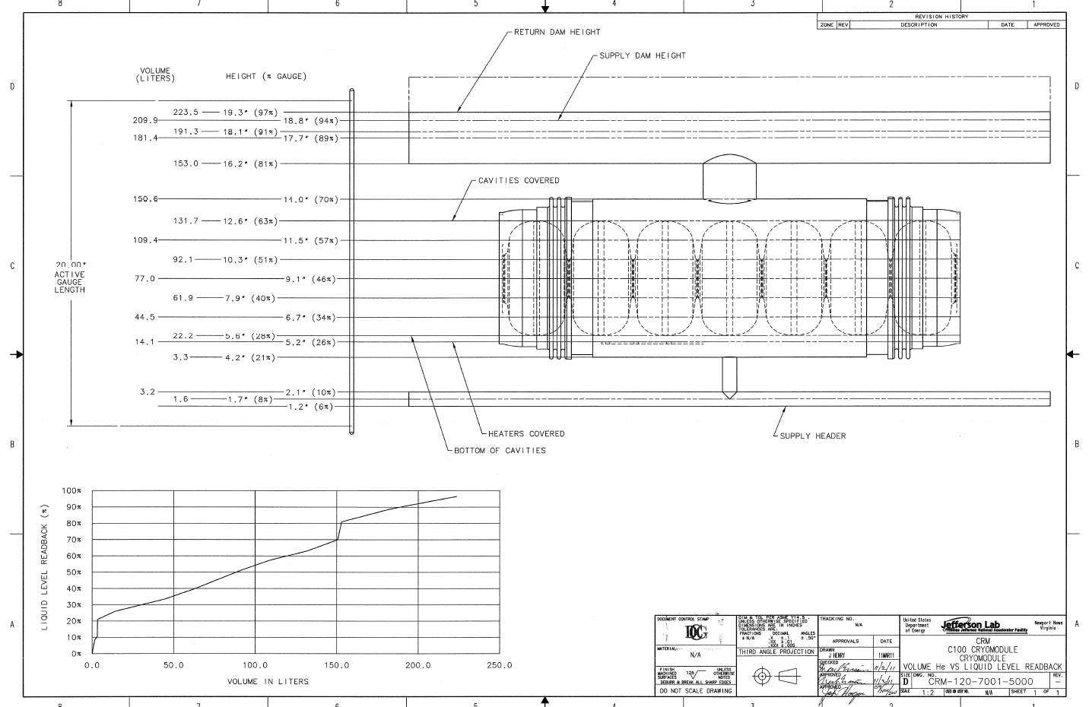
C100 HV Helium Volume vs. Liquid Level Readback
C100 CM’s have ~300 liters LHe (~1/5 of CEBAF CM)

Slide 6
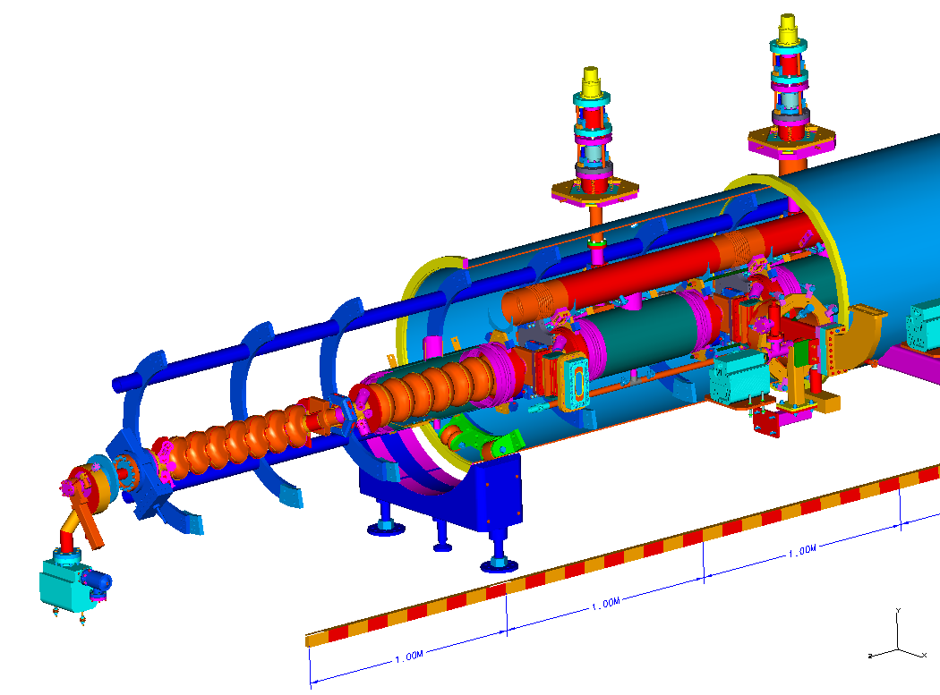
C100 CM Cut-Away
Return header is normally just below half full – 92% liquid level readback

Slide 7
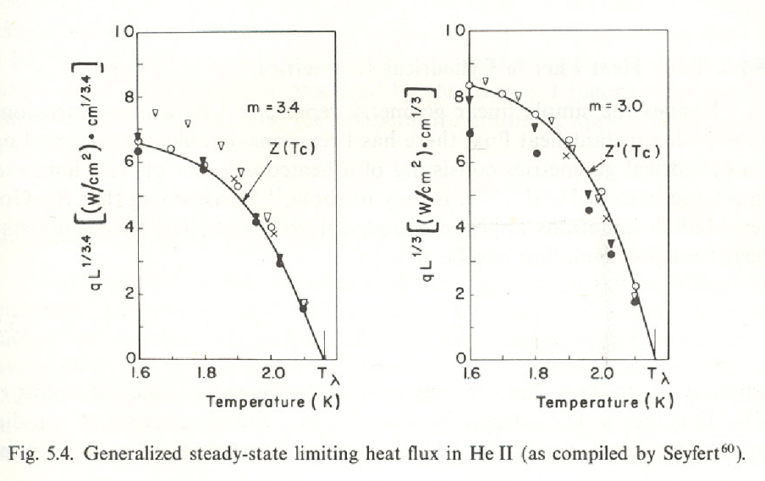
Critical Heat Flux in Superfluid Helium
SFHe is an excellent conductor of heat up to a critical heat flux beyond which the properties change dramatically – transition from liquid to gas occurs
Empirical relationship observed in experiments in narrow channels and internal flow configurations
Relatively strong function of bath pressure and temperature and weak function of length
The critical heat flux in saturated liquid at 2 K is two times larger than at 2.1 K

Slide 8
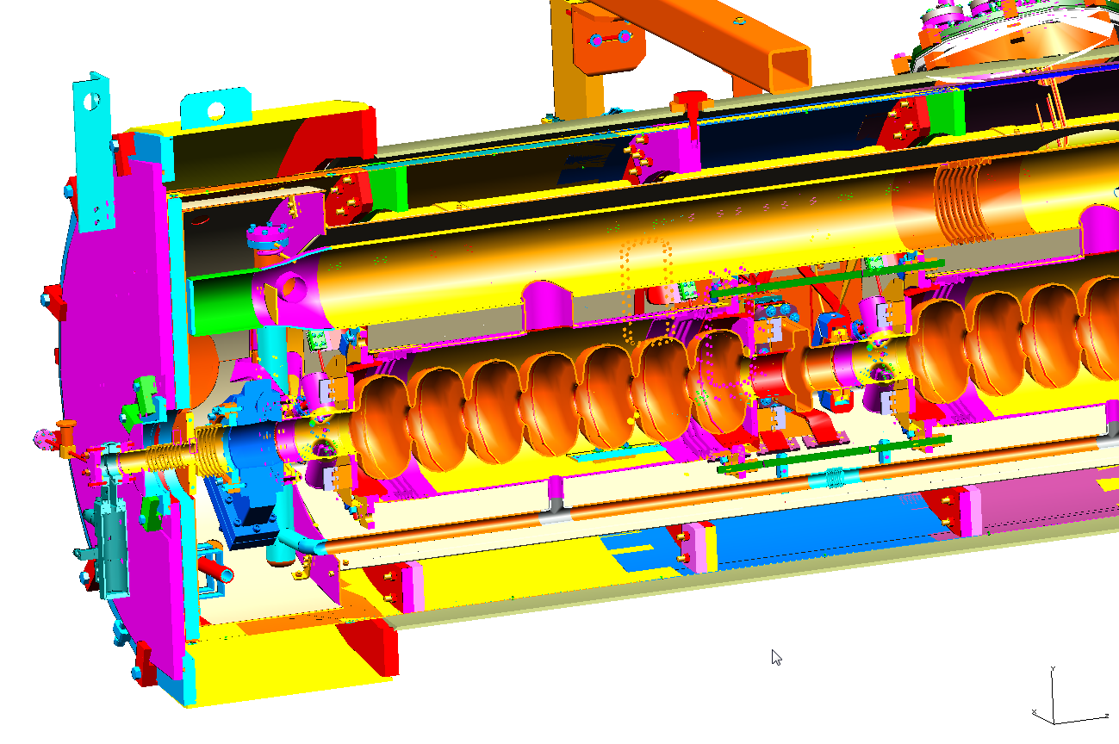
C100 – “It’s the chimney…”
Notes:
Interior Page Design 1

Slide 9
Specifications for Bath Temperature and Pressure
For C100 cavities, Qo value is 8 x 10^9 at 19.2 MV/m
  27 W dissipated in each cavity; 3 W for coupler; Total = 30 W
  Design value for power dissipation was doubled and the lines were sized to avoid any type of limitation in the heat flow due to the critical heat flux.
Interface point for the CM pressure was defined as 0.0375 atm at the bottom of the return bayonet in the end can assuming a total design heat load of 300 W
  Pressure corresponds to a temperature of 2.07 K
  Critical heat flow for a single riser is 65 W; More than 500 W for the CM
  As the bath pressure rises, the critical heat flow is reduced.
IMPACTS ON PERFORMANCE
If the bath pressure rises to 0.044 atm, or about 2.13 K, the critical heat flow is about 30 W per cavity
  Neglecting increased surface resistance due to increase BCS losses, operating a C100 CM set at design gradient at this bath pressure would cause the critical heat flux to be exceeded in the riser.
Operating cavities at higher bath pressure increases BCS losses which adversely impacts Qo values used by LEM for machine set-up
  The actual dissipated power could be ~50% larger than computed by LEM.

Slide 10
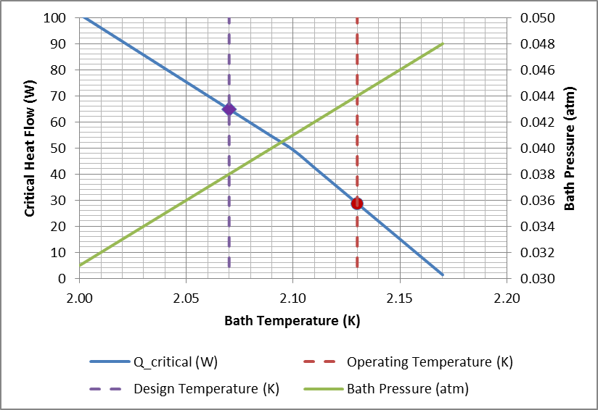
Critical Heat Flow HV Riser & Pressure vs Temperature (TN-15-038)

Slide 11
Critical Heat Flow HV Riser & Pressure vs Temperature (TN-15-038)
3. Determine Max Heat Flow
1. Pick Bath Pressure
2. Determine Bath Temp

Slide 12
Varying CM Pressure to Gauge Performance
Routinely close RT completely in CMs to measure cavity Qo’s during commissioning activities
  No helium flow so control mass approach
  Relate dP/dt to cavity heater power to calculate dissipated RF power using relative measurement of pressure
Propose to close RT partially in CMs to measure total CM dissipated power at EMAXOP
  Steady helium flow so control volume approach
  Relate cavity heater power to dissipated RF power at a fixed pressure determined by RT position
  Find pressure by using piping feature (critical heat flux)
  Project heat load margin (if it exists)

Slide 13
Testing Procedure: Determine Heat Load Margin (1/2)
Connect the RT valves in the zone(s) to be tested. Follow procedure used as part of Qo testing which includes posting the appropriate ODH signage prior to start of testing.
Establish Power Permit for linac(s)
Set up strip charts for given zone to include the following signals:
  CPI – Return End Can, LL, JT Position and CPI - Linac Tee
  Heater Power(s), cavity GMES, total heater power and total CM voltage
With RT valve at maximum position, stabilize LHe level and JT position at EMAXOP for each cavity with heaters OFF.
  If LHe level does not stabilize, then Linac pressure must be lowered at a later time.
  Post images of strip charted signals to elog
  No further testing on this CM → Pressure too high at CHL Tee
Record module CPI (local pressure)

Slide 14
Testing Procedure: Determine Heat Load Margin (2/2)
Begin to raise pressure until Critical Heat Flow is Exceeded
Close RT valve at 1% per minute until an increase of 0.5 milli-atm is observed.
Wait 15 minutes to ensure stable operations.
Step the RT valve close at 1% per 10 minutes until boiling onset is observed.
  Onset is defined as instability in LL of greater than 2% over 5 to 10 second time scales.
  Record CPI (local He pressure) at boiling onset. Record JT position at boiling onset.
  Post images of strip charted signals to elog.
Leave RT valve in this position. → Relative pressure consistent with RF Power is known
Verify CM total heat at transition pressure
Turn off RF and then turn on total heater power to 200 Watts, 1/8 per cavity heater.
Step total heater power at 10 W per minute. JT position should respond and increase as well.
Raise heater power until LL and JT position become stable at the RT valve setting found above.
  This total heater power supports the pressure drop measured above and should be equivalent total cavity dissipated power.
  Post images of strip charted signals to elog.
Open RT to maximum position at 2% per minute.
Back-Out
Disconnect the RT valves in the zone(s) that were tested. Follow procedure used as part of Qo testing which includes removing the ODH signage that was placed prior to start of testing.

Slide 15
Results from Initial Testing
OLO4 – Demonstrated cavity performance was related to helium bath pressure
1L22 – Demonstrated technique was useful but results were limited due to cavity voltage settings
2L24 – Limited by RT valve operational issues

Slide 16
Lessons Learned from Initial Measurements
RT valve operations are unreliable → Need to resolve this
  Need this for future Qo measurements in any case
Ensure max gradients during test set-up
Pause for less time between RT valve moves
PI should be present if possible during testing
Provide cavity heater power sufficient for testing

Slide 17
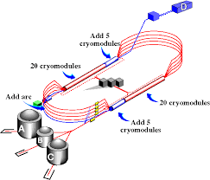
Monitor Pressure Extremes to Gauge Performance
Distribute 6 gauges at ends of linac and near tees to determine pressure response to variance heat load / mass flow configurations
P-1L26
P-1L11
P-OLO4
X
P-2L14
P-2L26

Slide 18
CM Process Piping Impacts
Contributions to overall pressure drop
  Piping from He bath to end can bayonet
  Piping from end can bayonet to transfer line
End Can sized for 300 W at pressure in bath
  Need to consider this heat flow as part of specification
  2.07 K at bottom of bayonet at 300 W equivalent mass flow
Section of Return End Can

Slide 19
Summary
Specification - 2.07 K at Bottom of Bayonet in End Can
Procedure enables characterization of CM heat load in steady flow conditions → Quantify C100 RF Heat Loads
  Initial results limited by set up and hardware issues
  Confirm performance of C100 CMs
Apply Lessons Learned prior to future testing where possible
Plan for monitoring pressure at key points in the cryogenic distribution system can provide feedback on CM operating conditions
Link performance to thermodynamic models in order to confirm total system heat load

Slide 20
Issues and Open Questions
What is the impact of 2.07K in the CM bath at full heat load for Distribution System? For CHLs?
How to utilize pressure monitoring in distribution system?
RT Valve Operations
  What does it take to have reliable RT operations?
  Can we re-connect the RT valves in order to characterize heat loads in a troubleshooting mode? Impact on Safety?
What other methods can be used to measure RF heat loads in steady state?
Individual cavity heaters for C100?

Slide 21
            Back Up

Slide 22
Addition of Pressure Transducers (L. King)
COMMENT ON Determine LHe Operating Pressure
Lognumber 3370675. Submitted by king on Wed, 01/13/2016 - 16:59.
Last updated on Wed, 01/13/2016 - 17:24
Logbooks: ELOG SRFLOG
External References: ATLis: Determine LHe Operating Pressure (OK)
Auxiliary 50 Torr Baratrons were previously installed on cryomodule return end cans at 0L04, 1L11, 1L26, 2L14 and 2L26 (all MKS part no. 627B-23610). The signals are read back using FCC ADC inputs and are completely independent of their corresponding Epics "CPI" signals.
The output is 0-10Vdc for 0-50 Torr; so divide readback by 152 to get atms (760/5), or multiply readback by 5 to get Torr.
Loc. MKS999 ser. no. Nominal(100T) SRF(50T) Readback Location for 50T
0L04 s/n 017662474 CPI0L0560 R042ADC2 (0L04-2 FCC, rear input)
1L11 s/n 017662477 CPI1L1160 R501ADC2 (SRF 70 MHz FCC#1, rear input)
1L26 s/n 017662478 CPI1L2660 R1Q7ADC1 (1L26-7 FCC, front input)
2L14 s/n 017662476 CPI2L1460 not read back, FCC#4 back to EESRF spares
2L26 s/n 017662479 CPI2L2660 R2Q1ADC1 (2L26-1 FCC, front input)
Prior to installation, all five of these added 50 Torr Baratron pressure sensors were check/cal'd, meaning they were zeroed at 1e-5 torr, per the MKS procedure, and then checked for relative accuracy while all were connected to a common vacuum header. At ~40 Torr, they all read within +/- 0.25T of each other. The MKS stated absolute accuracy is 1 Torr.
The specific FCC ADC inputs used for readbacks were selected for having the lowest offset voltage (0.001 V or less), and were checked for linearity over their 0-10V range with a calibrated voltage source. The FCC50x signals are not Archived. I recommend turning off ADEL in the data collection preferences of Mya for these signals, for a smaller deadband.
The mid-linac locations (1L11 & 2L14) were selected from dwgs. 73300-D-1000 and 73300-D-2000, but appear to be off by one zone. Ideally, the sensors would be closer to the "tee" from the CHL, which, in the tunnel, looks like 1L12 and 2L15.

Slide 23
0L04 - Estimation of Pressure in Helium Bath
Use known heater power settings to determine when the transition was occurring by observing the change in liquid level (LL) readback
At measured pressure of 0.041 atm, a heater heat of 142 W was applied uniformly over the eight cavity heaters
  The LL readback was stable.
Ramped Heater heat until LL readback fluctuated
  Measured pressure was 0.0435 atm
  Heater heat was 240 W, or 30 W per cavity
  30 W corresponds to bath temperature and pressure of 2.13 K and 0.044 atm
Using the cavity heaters and the LL as an indicator, the local bath pressure can be estimated.

Slide 24
1L22 LHe Operating Pressure Testing :(ATLis 15879)
M. McCaughan
Lognumber 3371834. Submitted by michaelm on Thu, 01/21/2016 - 19:13.
Last updated on Thu, 01/21/2016 - 19:14
Logbooks: SRFLOG ELOG
Entry Makers: michaelm
15:39 RF power heat show at ~186 W with zone at gradient (Ops drive highs in SEL mode). Autoheat placed into independent mode and REQ Heat watts reduced from auto volue of ~220 W down to 150 W (Below RF heat being produced so heater will drop to 0 W...) Allowing the heaters to ramp there and the JT to stabilize.
15:54 Heater reaches 0W.
16:10 JT settled ~55.1% CPI1L2260 .0398 ATM, other pressure signals of note in Fig. 1-3 taken for baseline.
RT initial max ~93.72. Starting to walk RT closed.
17:00 RT 68%, JT 55.1%. Reached .0403 on CPI1L2260. Hold for 15 min. (Fig. 4-6).
17:15 Resume closing the RT
17:25 RT 63%. NL RF dropped due to PSS, stopping for 15 min settle after the zone was recovered. (Fig 7-9)
17:40 Resuming closing the RT. (Fig 10-12)
18:43 JT = 57.5% CPI1L2260 = .0460 atm (Fig. 13-15)
18:45 RF off, heaters on in manual mode at 150 W.
18:58 Fig. (16/17). I have reached the set point limit of the supply (250 W, which makes 223.5 W actual total measured heat) and the JT still has not reached the desired setting. I will dwell at this setting and wait for improvement or until it stabilizes.
19:03 The heater has proven inadequate to task for reaching the desired JT settings with the liquid level of interest. Restoring the zone to normal operational settings. (Fig. 18/19)
Fig. 20: N. Linac T pressure over the time period of interest.

Slide 25
1L22 LHe Operating Pressure Testing :(ATLis 15879)
Some Analysis (E. Daly)
At P = 0.044 atm, the riser would choke with 229 W according to calculations.
Riser choking at 190 W meaning that local bath pressure is slightly higher - estimated as 0.0445 atm. --> Calibrated baratron, Measurement point OK.
Static heat load of 20 W could be added to heater heat which would reduce the difference between estimate (229 W) and actual (190 + 20 = 210 W).
Pressure margin = 0.044 - 0.039 = 0.005 atm.
  Good result - we are far from the choking limit at this total voltage.
Some Questions
What was total voltage prior to closing RT valve when the module was at 0.0389 atm? R1QXGMES: 125.335, Not set at spec’d gradient
How stable was the pressure at the Tee during this test run? Pressure at the T was relatively constant, around 2.19 (units?)

Slide 26
1L22 LHe Operating Pressure Testing :
M. McCaughan – Email Comments
Testing took most of a shift on a cryomodule... 5-6 hours if one paused for 1 minute/step instead of 10 minutes/step after the first pressure change step (it still took around an hour to reach boiling point from there in my experience...).
We attempted 2L24 that evening and had issue with boiling from the outset that first evening (2L24 RT valve wasn't controlling properly). The following evening Anna found RTs in neither module were functional (despite repeated attempts by cryo to correct upstairs).
We were able to test 1L26 the first evening and 1L22 & 0L04 the second evening.
We could potentially revise the test plan and come back for more testing on an RF maintenance day during the run or for a few day following the end of the run to assess the other modules... we would have to coordinate this effort via an ATLis prioritized by the B-Team.

