Slide 1
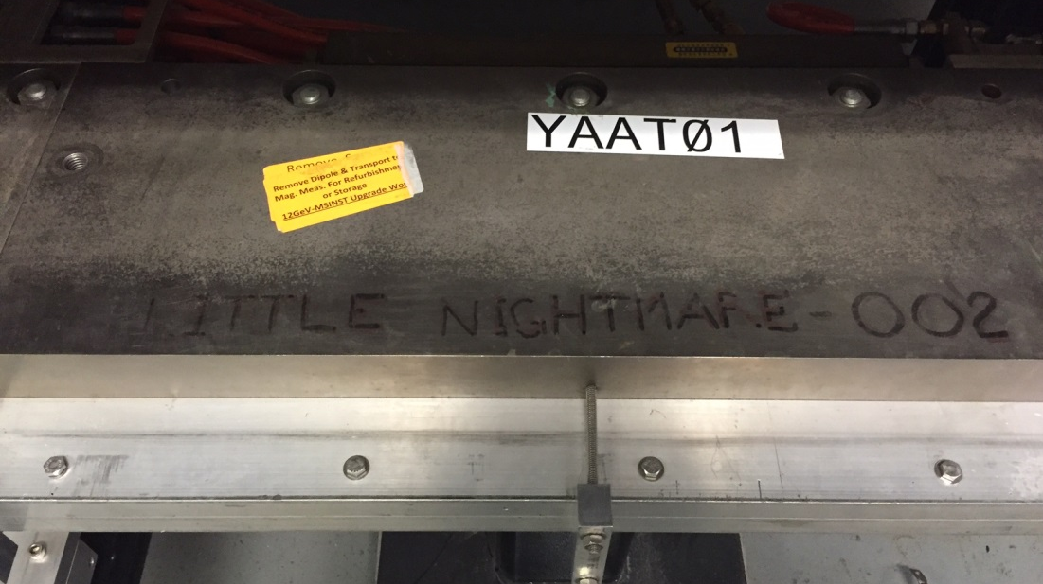
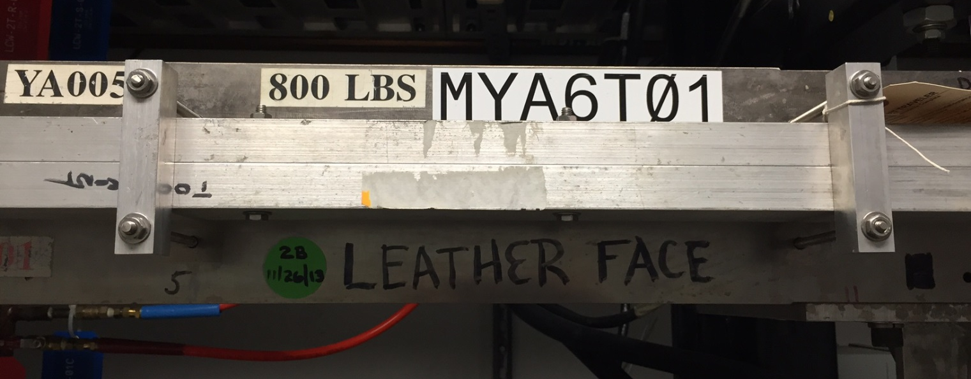
Magnet Reliability
Joseph Meyers
Magnet Measurement Facility

Slide 2
Magnet Agenda
Overview of the magnets in tunnel and spares on-hand
Magnet reliability
Notable events
Issues and open questions

Slide 3
Overview of Magnet Inventory
Magnet Type |  | # In Tunnel | # Magnet Spares | Magnet Spare Comments
Box Supply Powered | DIPOLE | 443 | 12 | 1m(3), 2m(3), 3m(2), 4m(1)
 | SEPTUM | 25 | 8 | YA(1), YB(1), YR(6), ZA(0)
Trim Card Powered | QUAD | 853 | 27 | QA(7), QB(8), QC(8), QP(2), QR(2)
 | CORRECTOR | 1063 | 25 | BC(7), BT(8), BD(2), BM(2), DB(6)

Slide 4
Overview of Coil Inventory
Magnet Type |  | Spare Coils
DIPOLE | ARC | 1m(~6), 2m(~12), 3m(12), 4m(0)
 | BCOM | 8-turn & 10-turn 1m(~30), trapezoidal-shaped(~10)
 | DOGLEG | BW/BY(8), CW/CV/CX(0)
SEPTUM | THIN | YA(0)
 | THICK | YB(0), YR(2), ZA(1 Right)
82 magnets have new coils
72 dipoles (16%)
10 septa (40%)
386 magnets have original coils
371 dipoles (84%)
15 septa (60%)
Over 82% magnets operate with original coil packs dating back to 1990’s.

Slide 5
Magnet Agenda
Overview of the magnets in tunnel and spares on-hand
Magnet reliability
Notable events
Issues and open questions

Slide 6
Magnet Reliability
Type | # of Failures* | R(5 yrs) | R(1o yrs) | MTTR (hrs) | Availability | Estimate # of Failures in 15 yrs**
DIPOLES | 2 | 99.77% | 99.54% | 76.1 | 99.9996% | 3.1
SEPTUMS | 2 | 95.99% | 92.14% | 290.9 | 99.9433% | 3.1
TRIM | 3 | 99.97% | 99.95% | 48.0 | 99.9999% | 1.5
* Data gathered from Downtime Manager (https://accweb.acc.jlab.org/dtm) and ATLis (http://opsweb.acc.jlab.org/CSUEApps/atlis/atlis.php)
** Operating 25 weeks per year

Slide 7
Magnet Agenda
Overview of the magnets in tunnel and spares on-hand
Magnet reliability
Notable events
Issues and open questions

Slide 8
Notable Event: MJC5A14 Shorted
Date: 02/09/2016
Cause: Insufficient work planning for in-situ repairs
Downtime: 76.1 hours
Repair: Replaced with spare JC magnet.
Mitigation: MMF technician will QC the magnets following in-situ repairs that require disassembly of any coil connections.
Magnet Reliability JSA Ops 2016 Stay Treat J. Meyers

Slide 9
Notable Event: MZAAR03 Failure
Date: 04/15/2014
Cause: Magnet design allows debris get between coils and chamber.
Downtime: 245.8 hours
Repair: Replace damaged coil with spare ZA coil.
Mitigation: Added more insulation between coil and chamber. Attached longer coil support plate to prevent the coils from bowing. Caulked areas that would prevent debris from getting near coils.

Slide 10
Magnet Agenda
Overview of the magnets in tunnel and spares on-hand
Magnet reliability
Notable events
Issues and open questions

Slide 11
Issues and Open Questions:
Reliability improvements
Do not exceed design currents.
Keep LCW on.
Proactive Action #1: LCW valves clearly labeled and are components of HCO.
Proactive Action #2: Temperature monitoring with RTD’s on Septas.
Invest in new coil spares.
Investigating leak at MYR6T02

Slide 12
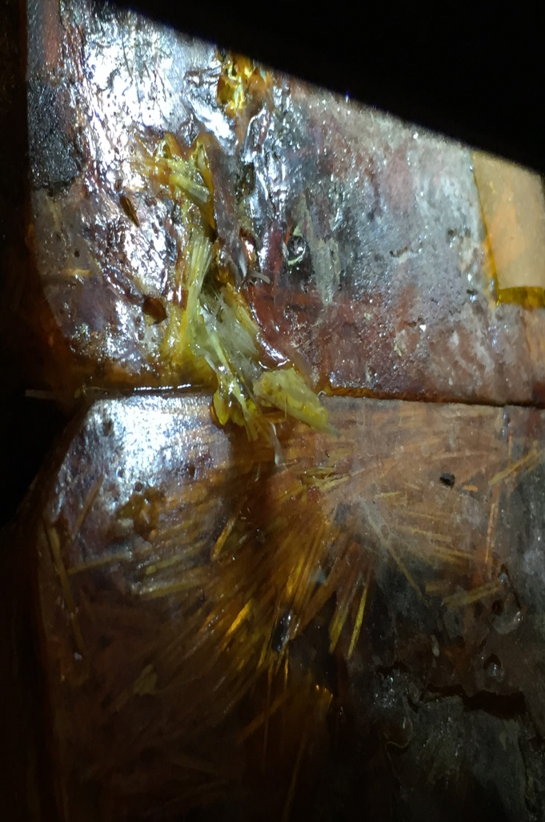
MYR6T02 Status
Found coil leak in January 2016.
Last measured in June 2013.
Fixing YR6T02 by replacing damaged coil with spare YR coil.
Investigate the cause of the leak.

Slide 13
Thank you for your attention.
Many thanks to Randy Michaud, Dr. Ken Baggett, Tommy Hiatt, Sarin Phillip and Mike Beck for your help.

