Slide 1
Modeling SNS Availability Using BlockSim
Geoffrey Milanovich
Spallation Neutron Source

Slide 2
Contributors
G. Dodson for initial RAMI study and discussions
Vivian Chang (summer student from Carnegie Mellon) for building much of the accelerator RBD
S. Passmore for reliability data

Slide 3
Outline
SNS Availability Numbers
Modeling an Entire Accelerator in BlockSim
Possible uses of Reliability Model

Slide 4
Downtime by Fiscal Year (07-15) comparison
Presentation_name

Slide 5
Downtime by Fiscal Year (07-15) comparison
Presentation_name

Slide 6
NP availability by week

Slide 7
Down Time – Pareto Chart for FY16 to date

Slide 8
In February 2016, the accelerator experienced 50 faults of 0.3 hours or more that affected neutron production
12.2 hrs. for (1) water leak into RFQ Xmtr oil tank
11.3 hrs. for (16) CCL 4 Window 1 vacuum faults and associated NEG pump regen
7.8 hrs. for (1) CCL Mod 2 smoke alarm/tank swap, and C phase IGBT failure
8.7 hrs. for (14) Ion Source plasma outages/Edmp faults/arcing events & conditioning
6.7 hrs. for (1) failed Group 3 controller in Ion Source Big Blue Box
4.4 hrs. for (13) RFQ out of closed loop faults
2.8 hrs. for (1) failed SCL LLRF oscillator
2.5 hrs. for (3) BL4B IPPS communication faults
2.5 hrs. for (1) DTL Mod 5 oil temperature fault
2.0 hrs. for (1) Ion source water leak
1.9 hrs. for (2) SCL filament power supply failures
1.3 hrs. for (1) instance of excessive beam loss; suspected RF issue
Note that the graph and down time table above represent all faults for beam operation – neutron production and accelerator physics.

Slide 9
Reliability Tracking – Metrics
“Machine Health Report” weekly – prepared by Ops – Tracks chronic long term problems
Traditional Metrics weekly
Reviews of any events > 4 hours
So far, it has been obvious when a system needs help

Slide 10
Accelerator Improvement Projects
HVCM upgrades – 400 hours downtime to 70 hours
Warm linac vacuum change from ion pumps to turbo pumps – every warm RF trip damages SCL and possibly is 20 minutes DT
MPS improvements – reduce delays to reduce # bad pulses
Superconducting Linac plasma processing

Slide 11
Non-AIP Improvements
Errant beam tuning – Reduce frequency and effect of bad pulses
Ion source continual improvement – 100 hrs DT to 40
Target development – mostly infant mortality, think we reached actual end of life on last target

Slide 12
Reliability Estimates, in the Beginning
“the spreadsheet” – numbers from industry, design specs, LANL, JLab, experts, and guesses
Exponential distributions only (constant failure rate)
For 160 hours mission time, availability:
Source – 87%
Linac – 80%
Modulators – 99%

Slide 13
RBD/BlockSim Advantages
Reliability Block Diagram (RBD) – “graphical representation of the components of the system and how they are reliability-wise related”
Many failure distributions allowed
Standby, load share, failure of switching to standby
Analytical solution of very complex diagrams (but not an accelerator)
Monte Carlo simulation – maintenance phases, spares, crews
Notes:
Weibull, Gumbel, Gamma, Exponential, Normal, Logistic, Arrhenius-Weibull
Fast! 1000 simulations of 4 weeks on 4 yr old Macbook Pro running Vista in Parallels < 4 minutes

Slide 14
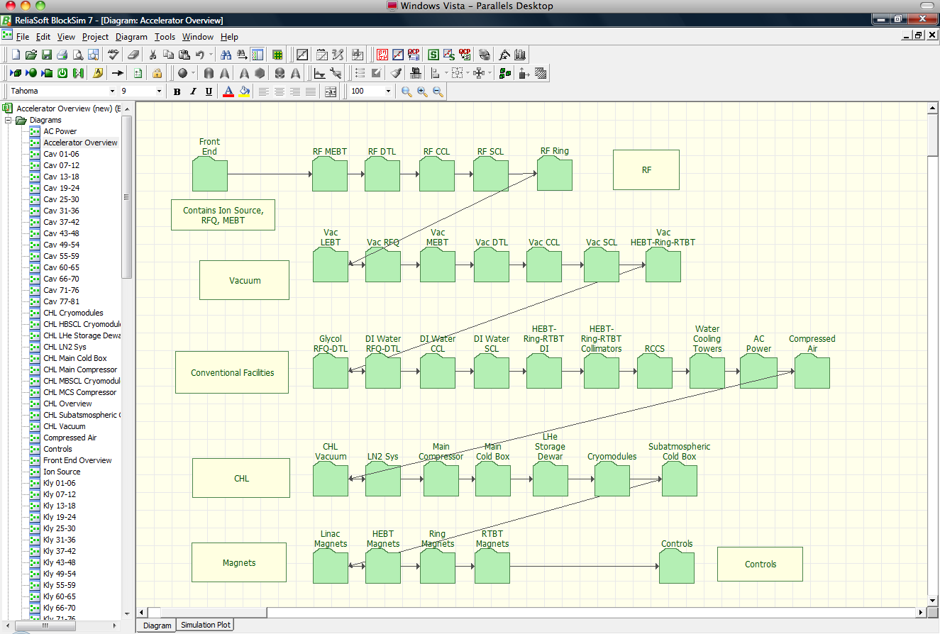
BlockSim 7/8 Model

Slide 15
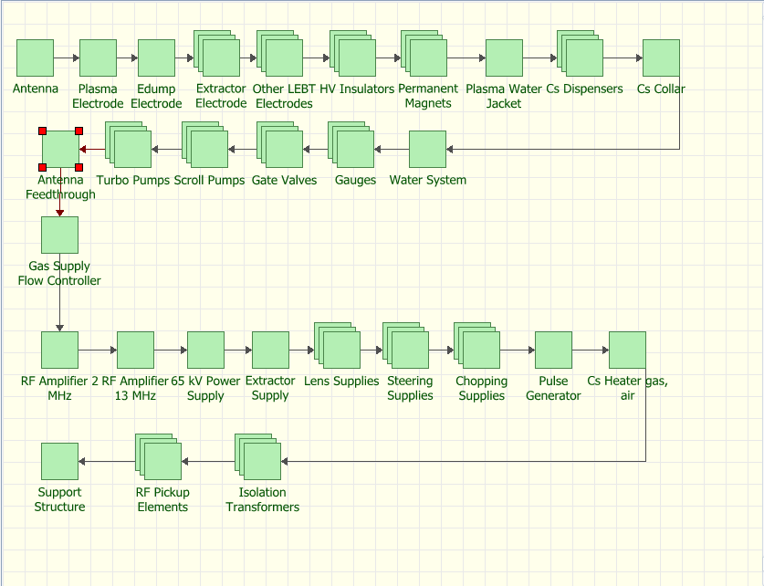
Ion Source

Slide 16
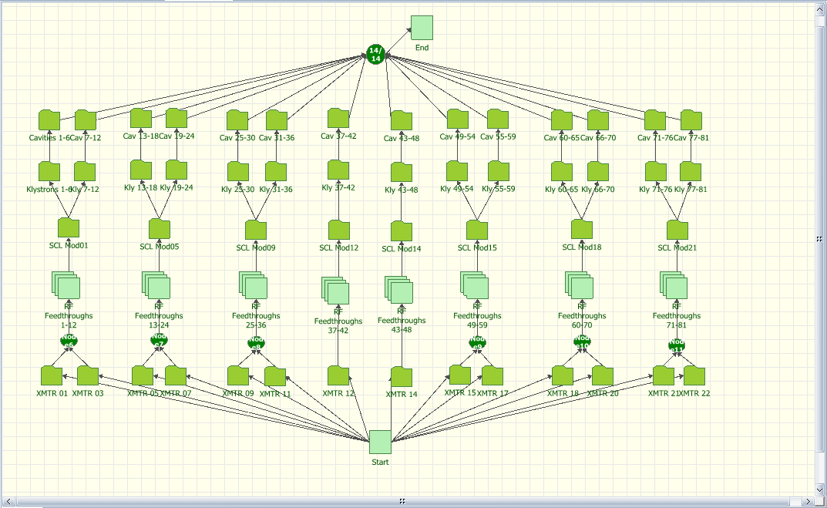
RF Systems

Slide 17
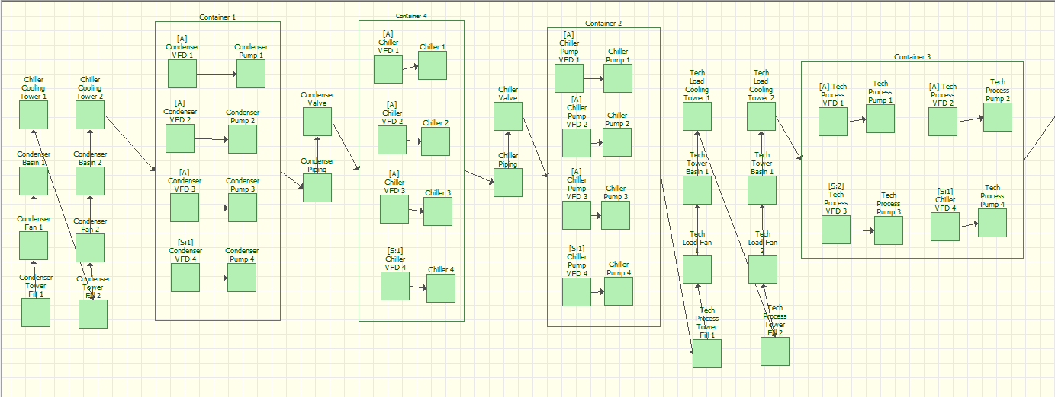
Standby Containers

Slide 18
Full Accelerator Simulation Results
Used exponential distributions (random failures)
86% - corrector power supplies, circulators, PPS modules, water valves, JT valves, etc.
Change values for PS controllers and circulators from 50k to 100k
89% - RF feedthroughs, JT valves, etc.
Change RF feedthrough from 100k to 4m (1 every 7 years), JT valves from 87k to 400k (1 every 5 years), etc
92% - Finally! But only for 1 seed

Slide 19
Possible Uses of RBD
Major component upgrade cost/benefits analysis – e.g. hot spare water pumps
Compare different AIP proposals
Planning maintenance cycles, if you have good data
Notes:
2.8 million hours total. 6200 hrs operation per year. Efficiency 67%, gain 51 dB. SLAC klystrons – 2856 MHz, 65 MW peak, 41 kW average, 3.5 us gain 50 dB, efficiency 45%, density 8 A/cm^2

Slide 20
Conclusions
SNS is middle aged - how long will it last?
We still can not predict the wear-out curve – until it begins! But we can model maintenance plans
RBD could be useful for large capital projects or long term scheduling, not so much for day to day running

