Slide 1
Challenges to RHIC Availability
Peter Ingrassia
JLAB Staytreat
28 June 2016.

Slide 2
Collider-Accelerator Department
e-Lens
polarimeter
CeCPoP
TANDEMS

Slide 3
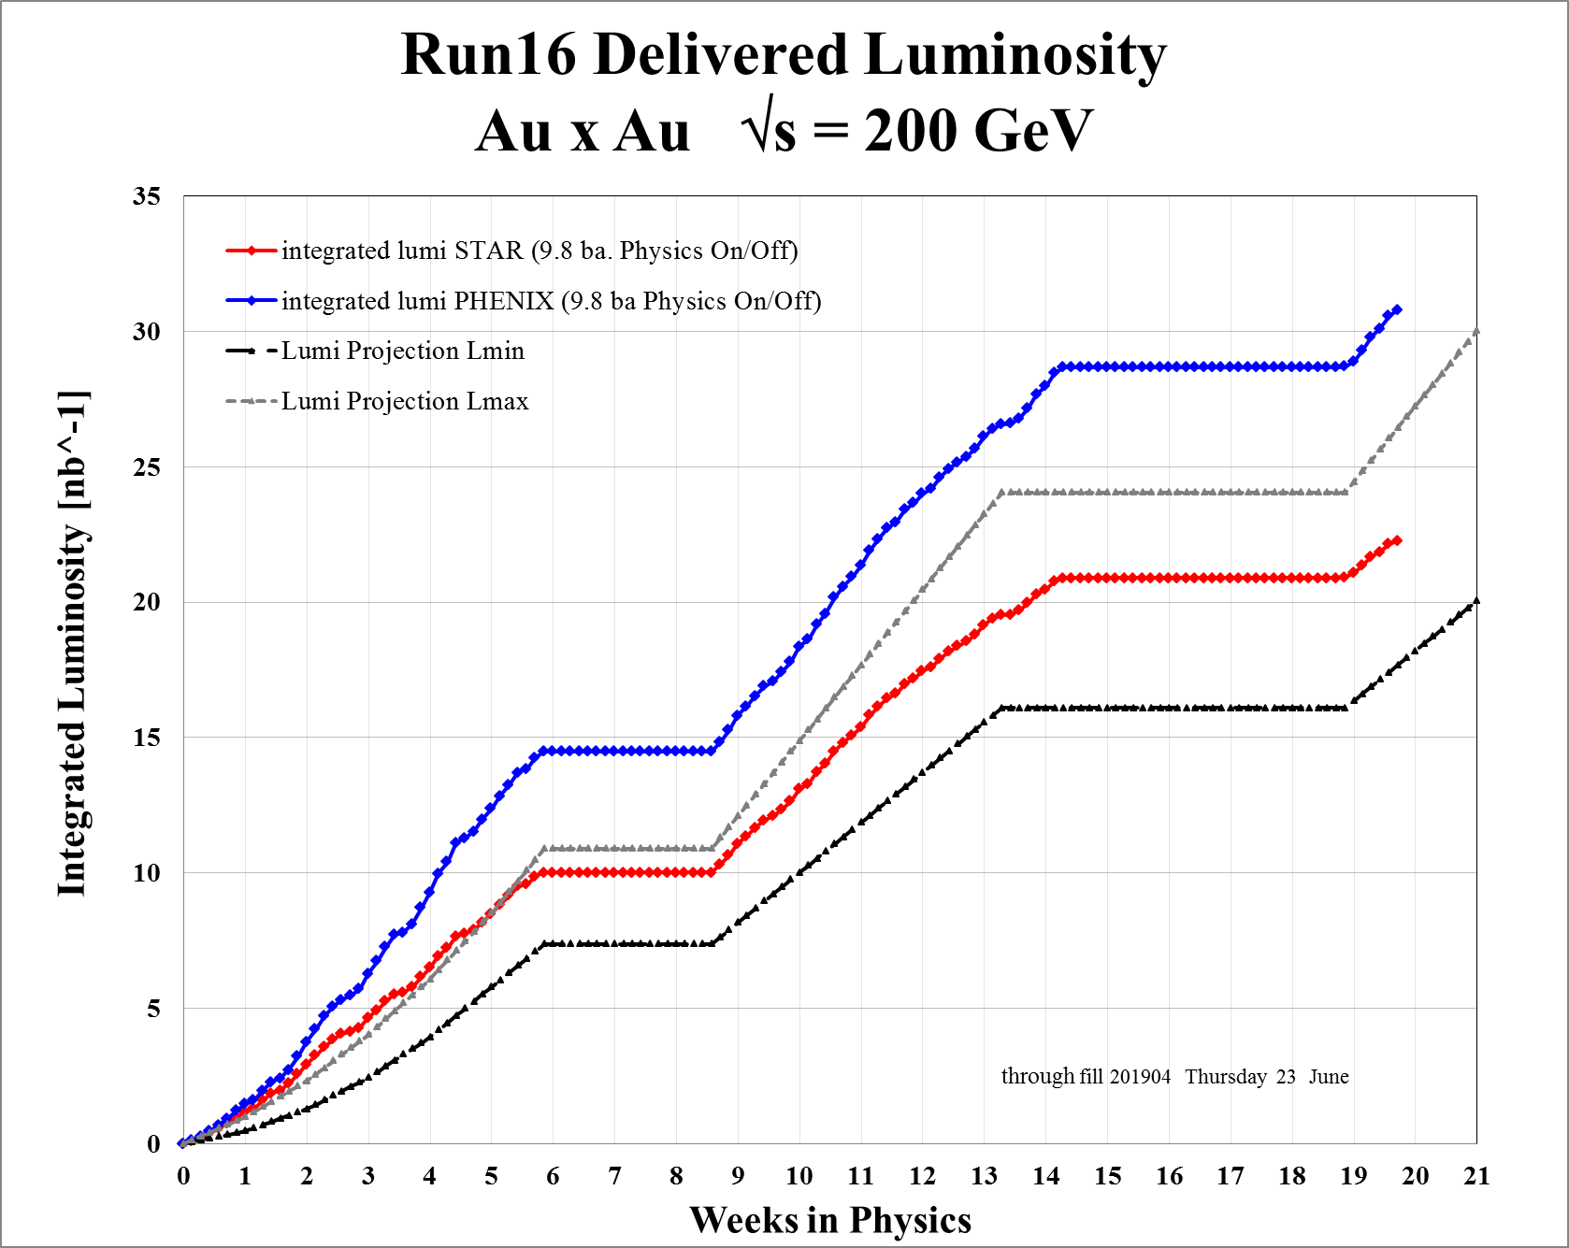
dAu
diode

Slide 4
RHIC -- a “Capable” Hadron Collider
Run(FY) | B species | Y species | E_{b} [GeV/n] | E_{y} [GeV/n] |  | Run (FY) | B species | Y species | E_{b} [GeV/n] | E_{y} [GeV/n]
16-1 | Au | Au | 100 | 100 |  | 9-1A | p^ | p^ | 249.9 | 249.9
16-2A | d | Au | 101.3 | 99.4 |  | 9-1B | p^ | p^ | 100.2 | 100.2
16-2B | d | Au | 31.3 | 31.1 |  | 9-1C | p^ | p^ | 100.2 | 100.2
16-2C | d | Au | 9.8 | 9.8 |  | 8-1 | d | Au | 100.7 | 100
16-2D | d | Au | 19.6 | 19.4 |  | 8-2 | p^ | p^ | 100.2 | 100.2
15-1 | p^ | p^ | 100.2 | 100.2 |  | 8-3A | Au | Au | 4.6 | 4.6
15-2 | Au | p^ | 103.36 | 97.37 |  | 8-3B | Au | Au | 2.5 | 2.5
15-3 | p^ | Al | 103.36 | 98.64 |  | 7-A | Au | Au | 100 | 100
14-1A | Au | Au | 7.3 | 7.3 |  | 7-B | Au | Au | 4.6 | 4.6
14-1B | Au | Au | 100 | 100 |  | 6-1A | p^ | p^ | 100.2 | 100.2
14-2 | ³He | Au | 103.9 | 100 |  | 6-1B | p^ | p^ | 11.25 | 11.25
13 | p^ | p^ | 254.9 | 254.9 |  | 6-1C | p^ | p^ | 31.2 | 31.2
12-1A | p^ | p^ | 100.2 | 100.2 |  | 6-1D | p^ | p^ | 250 | 250
12-1B | p^ | p^ | 254.9 | 254.9 |  | 5-1A | ⁶³Cu | ⁶³Cu | 100 | 100
12-2 | ²³⁸U | ²³⁸U | 96.4 | 96.4 |  | 5-1B | ⁶³Cu | ⁶³Cu | 31.2 | 31.2
12-3 | ⁶³Cu | Au | 99.9 | 100 |  | 5-1C | ⁶³Cu | ⁶³Cu | 11.2 | 11.2
12-4 | Au | Au | 2.5 | 2.5 |  | 5-2A | p^ | p^ | 100.2 | 100.2
11-1 | p^ | p^ | 249.9 | 249.9 |  | 5-2B | p^ | p^ | 204.9 | 204.9
11-2A | Au | Au | 9.8 | 9.8 |  | 4-1A | Au | Au | 100 | 100
11-2B | Au | Au | 100 | 100 |  | 4-1B | Au | Au | 31.2 | 31.2
11-2C | Au | Au | 13.5 | 13.5 |  | 4-2 | p^ | p^ | 100.2 | 100.2
10-1A | Au | Au | 100 | 100 |  | 3-1 | d | Au | 100.7 | 100
10-1B | Au | Au | 31.2 | 31.2 |  | 3-2 | p^ | p^ | 100.2 | 100.2
10-1C | Au | Au | 19.5 | 19.5 |  | 2-1A | Au | Au | 100 | 100
10-1D | Au | Au | 3.85 | 3.85 |  | 2-1B | Au | Au | 9.8 | 9.8
10-1E | Au | Au | 5.75 | 5.75 |  | 2-2 | p^ | p^ | 100.2 | 100.2
10-1F | Au | Au | 2.5 | 2.5 |  | 1-1A | Au | Au | 27.9 | 27.9
 |  |  |  |  |  | 1-1B | Au | Au | 65.2 | 65.2
 |  |  |  |  |  | 1-2 | p^ | p^ | 24.3 | 25.1

Slide 5
This Presentation
Measuring Availability
Availability arithmetic
Run16 Availability
RHIC Availability history from Run-2
Major System Reliability
Tracking Reliability
Working with system owners to improve reliability
MTBF review from Run-7
Specific Issues to reach reliability goals
Challenge I “Burn in” RHIC PS
Challenge II Reproducibility
Challenge III Abort kicker pre-fire
Experiment protection -- bumps
fec (front end computer & network switch) resets
Challenge IV Intensity (Au) related issues
Cryo PLC location
Rf – beam loading

Slide 6
Measuring Availability: DOE Availability Arithmetic
Availability = (Research + Studies + Tuning/Setup) (Research + Studies + Tuning/Setup + Failure)

Slide 7
Run16 availability 82.7%

Slide 8
RHIC Availability History

Slide 9
Systems Reliability
Tracking Reliability
Operators make entries for each failure or state change to a database using OpLog application.
Component level failures not recorded by operators – determination by the equipment owners.
Oplog is used to generate reports of failure statistics
All the charts in this talk use data from Oplog reports

Slide 10
Working with system owners to improve reliability.
At the weekly “Time Meeting” availability and equipment reliability data are shown.
Daily “RHIC” meetings review significant faults for previous 24/48 hours.
Reliability Improvement by Embarrassment!
Dirty laundry is aired – no group wants to be cited.
Repeat offenders cannot hide.
System owners are proactive maintain high reliability rates with little prodding from management.

Slide 11
RHIC + Injectors MTBF, MTTR, <Failure hours/da>

Slide 12
“Burn In”
Ken Baggett …’talk to how things may have changed after start up (i.e. was there a "burn in" period required before your availability hit a steady state)’.

Slide 13
“Burn In” – Experiments trend in the wrong direction
Experiments are embedded in the lattice.
Evolved such that they are more complex and able to make measurements of greater precision.
Si components more sensitive to damage.
Run 16 CeCPoP

Slide 14
Challenge I -- RHIC Power Supplies
Supplies from vendors needed engineered improvements
“Off Trips”
Voltage Drop outs
Soft start circuit
Doubled FET resistors
Replaced FET fuses
One PC board replacing 3 PC boards

Slide 15
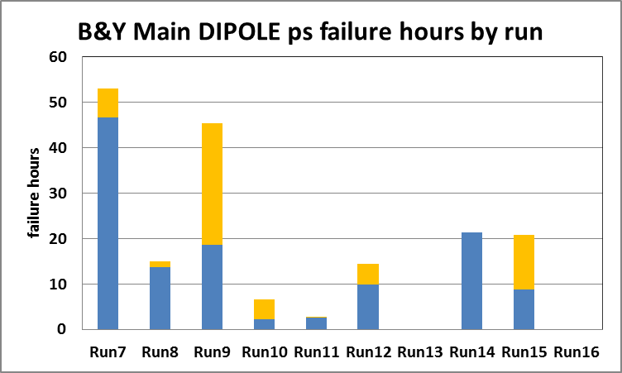
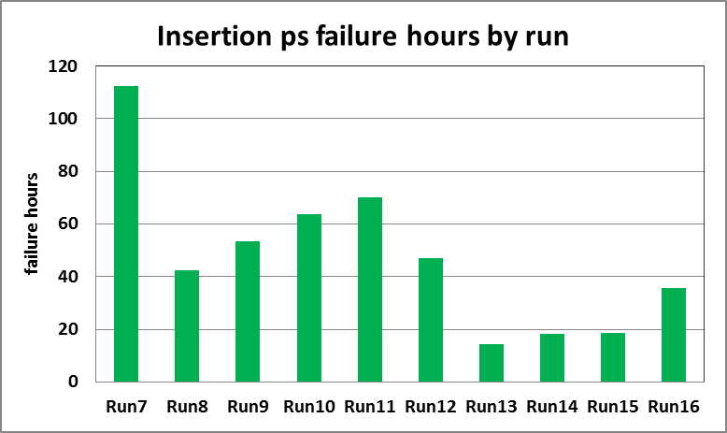
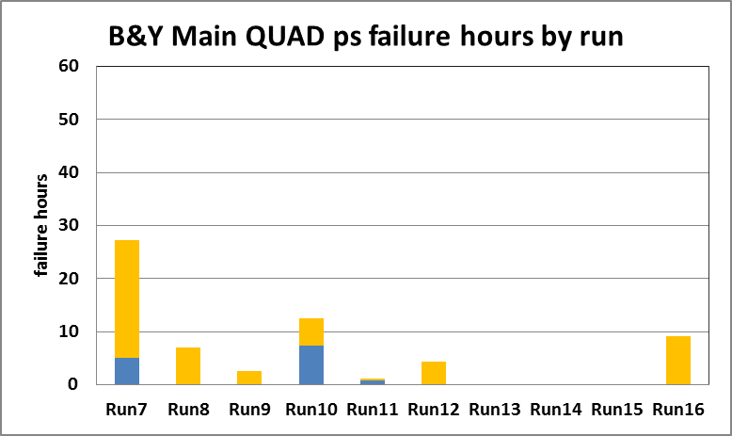
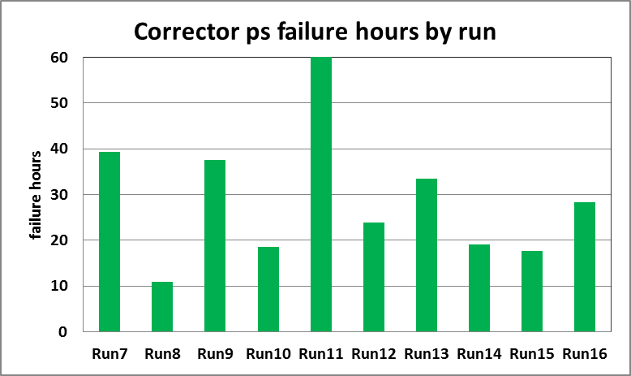
“Burn In” -- RHIC Power Supplies
IR focus and steering
trim dipoles, sextupoles, octupoles etc.

Slide 16
Challenge II – Reproducibility BLM Interlocks & Human Error
“Feedbacks”
Tune/Coupling
Orbit
Made the RHIC more reproducible
Reduced Tuning/Setup times
Reduced number of failed ramp attempts

Slide 17
Challenge II – Reproducibility Controls
Controls plays a large role with regard to reproducibility.
Controls systems reliability is very good.
Controls (hardware) challenged by intensity issues (more in Challenge III)

Slide 18
Challenge III – Pulsed Power Abort Kicker Pre-Fire
Abort Kicker Pre-fire
Power Supply charged (armed) for HOURS.
21kA @ 33 kV
Purpose to abort beam to protect RHIC (MPS) or prior to a re-fill
Spontaneous discharge at the wrong time has caused damage to experiment detectors.
 |  |  | Summary of Abort Kicker Pre-Fire |  |  |  | <15/yr> |  | KAD
Ring | FY08 | FY09 | FY10 | FY11 | FY12 | FY13 | FY14 | FY15 | FY16 | Totals
Blue | 2 | 11 | 12 | 9 | 2 | 8 | 6 | 1 | 9 | 60
Yellow | 2 | 2 | 8 | 15 | 8 | 14 | 12 | 7 | 4 | 72

Slide 19
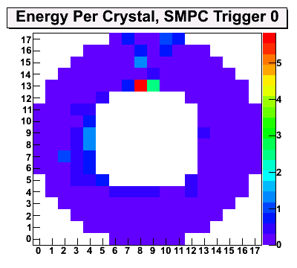
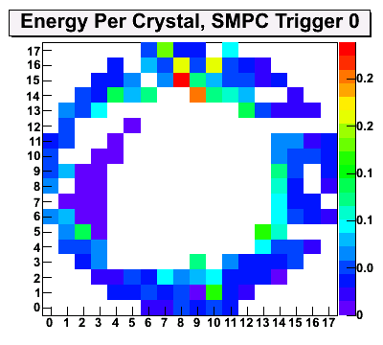
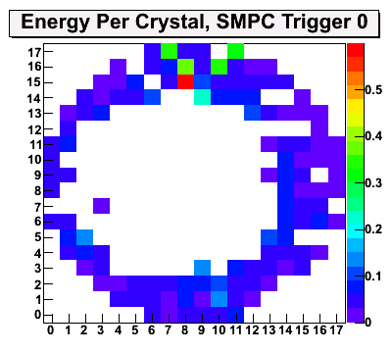
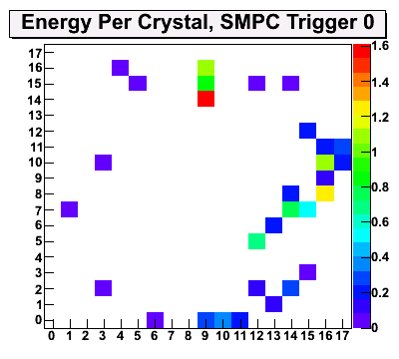
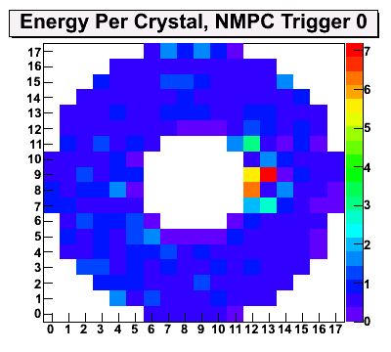
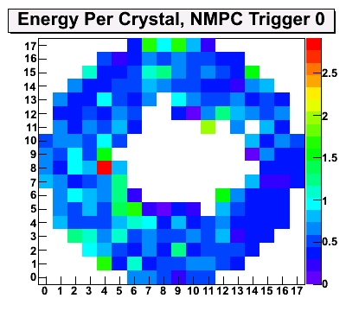
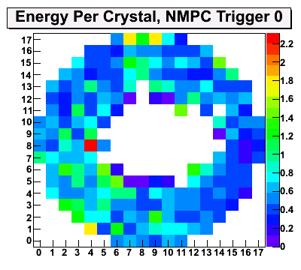
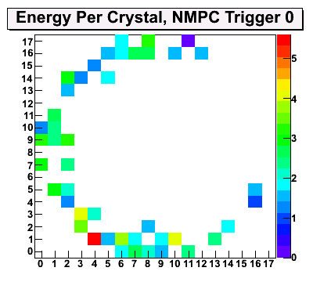
WHY PROTECTION BUMPS? PHENIX RUN15 MPC Damage
Store
19050
May 11
Damaged South
Impacted North
19116/18
May 28
We got lucky
No addt’l damage
19134
June 1
The end of the MPC in Run 15
South
North
Matin L. Purschke

Slide 20
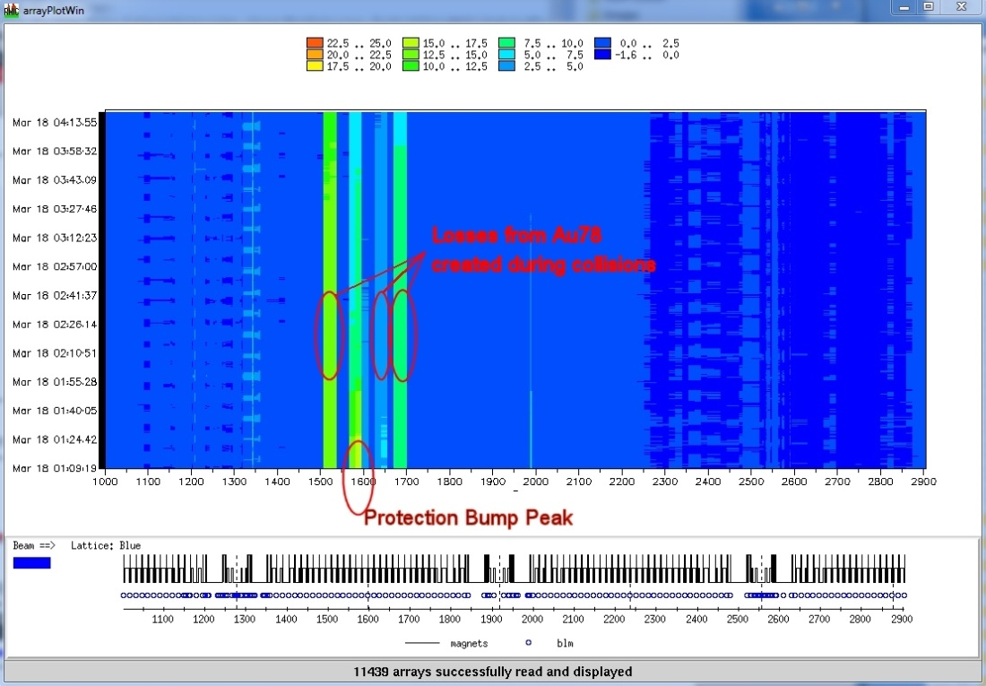
Abort Kicker Pre-fire Protection Bump
Bump generated in 11 o’clock arc pushes orbit to -21mm. In a pre-fire condition bunches kicked by the pre-firing module will crash into the cryostat at that location, preventing damage to the experiments. In 1 o’clock arc is a compensation bump to adjust for off-center orbit in quads and sextupoles in the pre-fire bump.
Chronic losses in the arc are due to Au⁺⁷⁸ beam created during collisions and off-momentum particles at the protection bump peak. The peak loss is located at g10-lm20 loss monitor, located just downstream of dipole 19 where the failure occurred

Slide 21
Cryostat Cut Open
Cryogenic lines
End Volume
Containing Diode
Beam Pipe

Slide 22
End Volume Cut Open

Slide 23
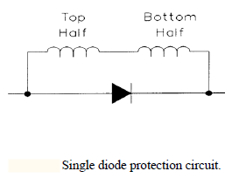
Damaged Diode
When a magnet coil is no longer superconducting (beam heating) the diode “turns on” and routes electrical current around the normal conducting magnet in order to protect it.

Slide 24
“RHIC Alcoves” are a feature -- (3 per sextant) house power supplies, front end computers, network switches, etc.

Slide 25
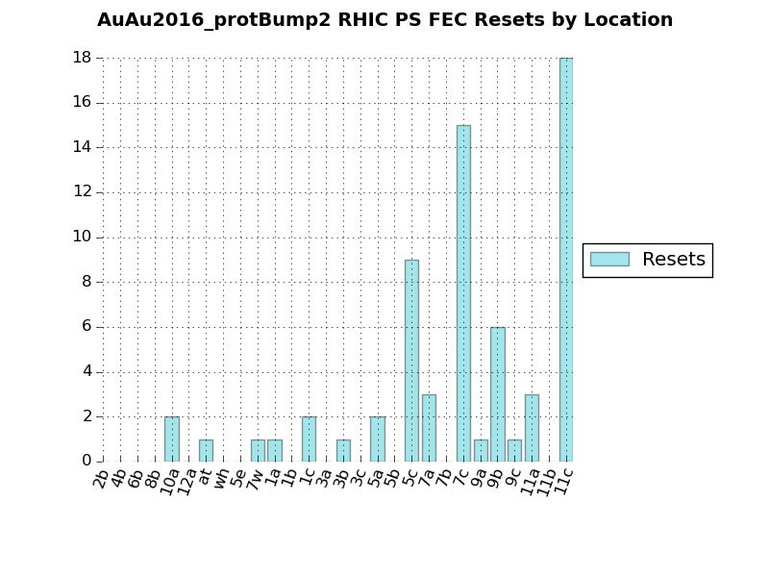
Abort Kicker Pre-fire – Controls
Run16
Chronic Losses due to protection bumps
Plagued by trips radiation upsets of FEC memory
Band Aid work around – reset front ends prior to each fill
Top plot before Run16 diode failure

Slide 26
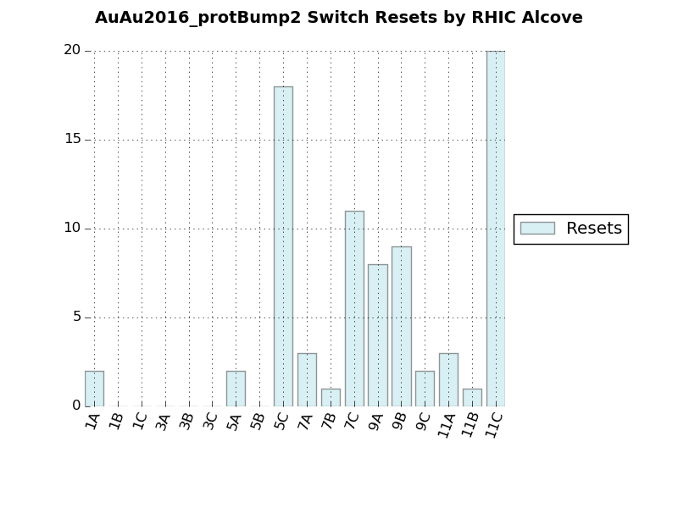
Abort Kicker Prefire– Controls
Run16
Chronic losses due to protection bumps
Plagued by resets of network switches
Top plot before Run16 diode failure
Bottom plot after peak bump displacement relocated

Slide 27
Increased circulating beam current

Slide 28
Challenge IV Intensity –– Cryogenics
An early challenge
Some Cryogenic Controls were located in alcoves in the tunnel.
Too many radiation related upsets
Moved 66% of controls out of the tunnel.
Migration halted with added workload (ERL, 56MHz, CeC, sPHENIX)

Slide 29
Cryogenics cryo controls-free alcoves

Slide 30
Intensity (Au) Effects – RHIC Rf (1)
RHIC Rf -- WARM
Primarily two Systems
B&Y Acceleration 2 each
B&Y Storage 5 each
Others
Landaus
9 MHz (proton ops)
SRF
56 MHz (gold ops)
CeCPoP (2)

Slide 31
Intensity (Au) Effects – RHIC Rf (2)
Run16
Plagued by trips of storage cavities – beam loading. Improvements did not keep pace with intensity increase.
Group focus was on SRF (56 MHz & CeCPoP 704MHz)
Lost focus – forgot to condition cavities after 19 day diode replacement outage.

Slide 32
Intensity (Au) Effects – Losses
Au ion losses at injection affected controls (alcove 5A) for power supplies.
Loss of control led to power supply trips and beam loss that caused a hole in a ceramic vacuum chamber associated with one of the injection kickers.
“Leak checking with a flashlight”.

Slide 33
Issues and Open Questions
Ever Higher per bunch Intensities
Machine Protection
Abort Kicker Pre-fire
Experiment protection
Rf system and beam loading
Trying to do too many things…
e.g. Rf & Cryogenic groups focused on SRF for new electron machines.
Electrical Infrastructure – lurking in the background
AGS electrical feeders are decades old – Run11
AGS first began operation in 1960

