Slide 1
NL C100 Vacuum Spikes and Valve Trips
Jim Kortze
EESIC
2016 Ops StayTreat

Slide 2
Outline
Explanation of Background/Problems
“Fast Spike” explanation
Trips vs. Gradient vs. Vacuum vs. Location
Mitigation efforts
Issues and Open Questions

Slide 3
Explanation of Background/Problems
During the Spring 2016 runs, it was observed that the vacuum valves in the NL C100 zones were tripping closed on short duration ion pump pressure spikes (“Fast Spikes”) . The rate at which these spikes occur has increased since the Fall 2015 run.
In addition to causing downtime, cycling the vacuum valves may release particles into the beamline, which can degrade cryomodule performance.

Slide 4
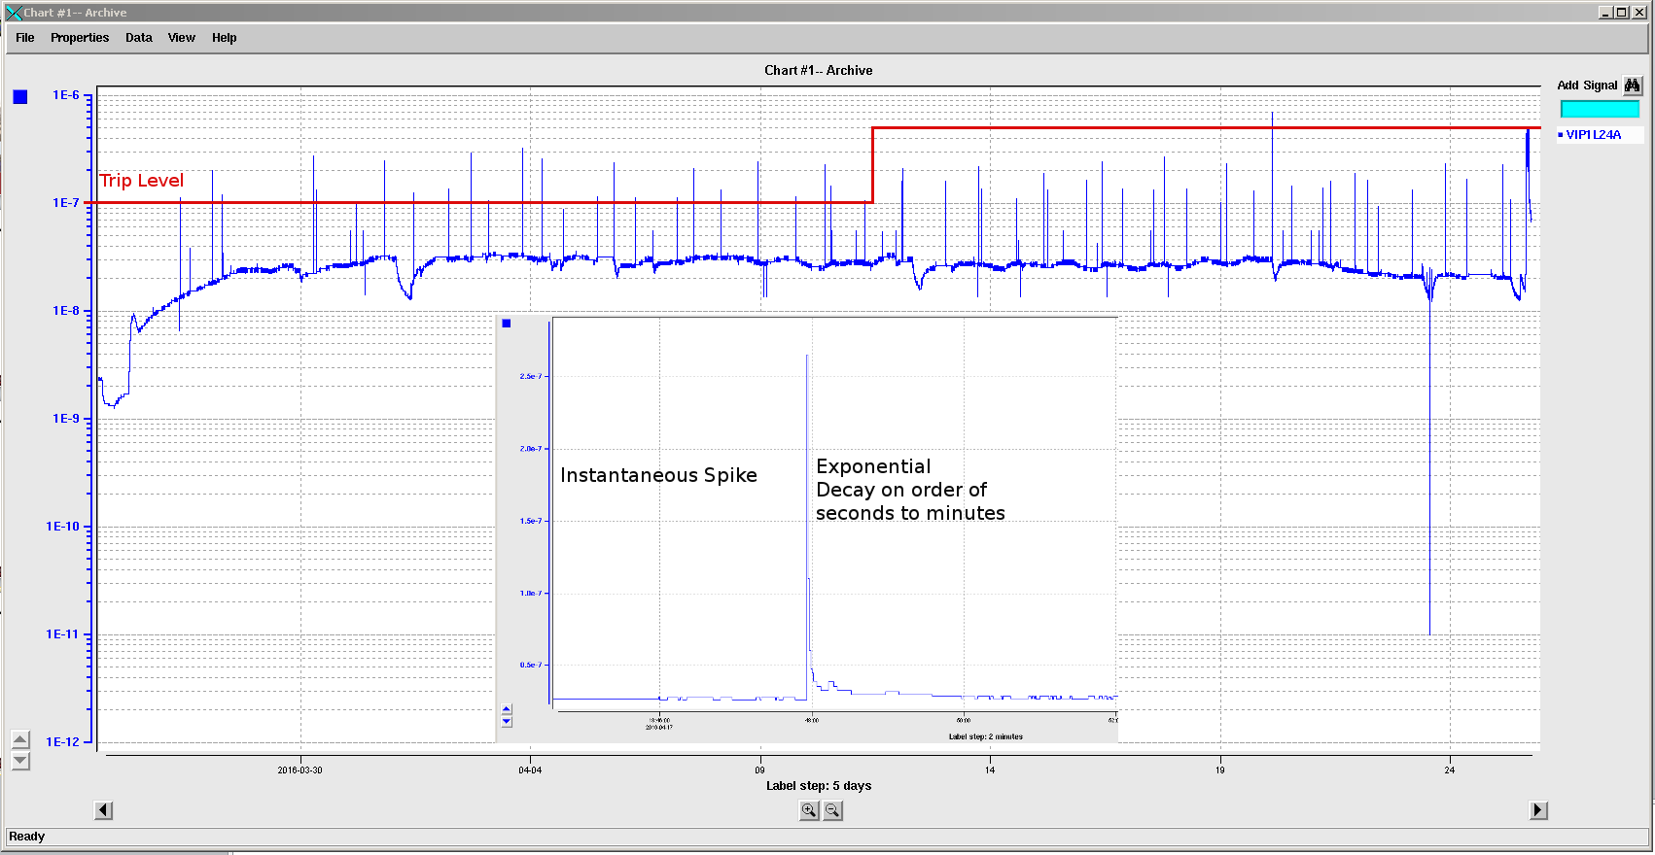
Anatomy of a “Fast” Vacuum Spike

Slide 5
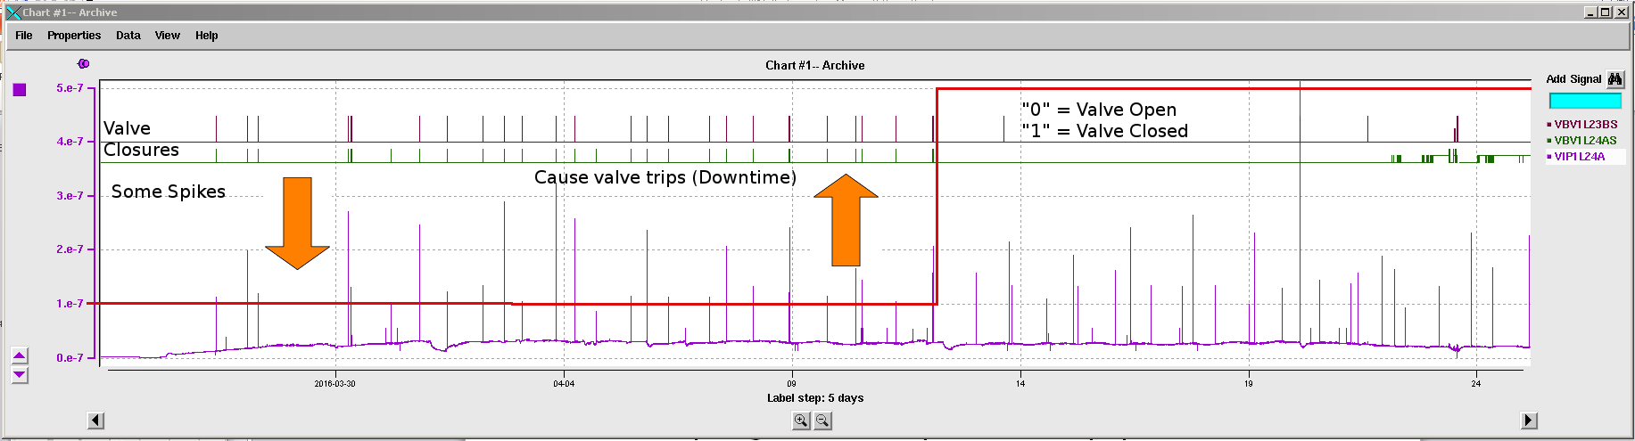
The Fast spikes cause Valve Trips
Red indicates the trip threshold… Raised from 1E-7 torr to 5E-7 torr on 04/12/16, to ignore spikes and minimize downtime

Slide 6
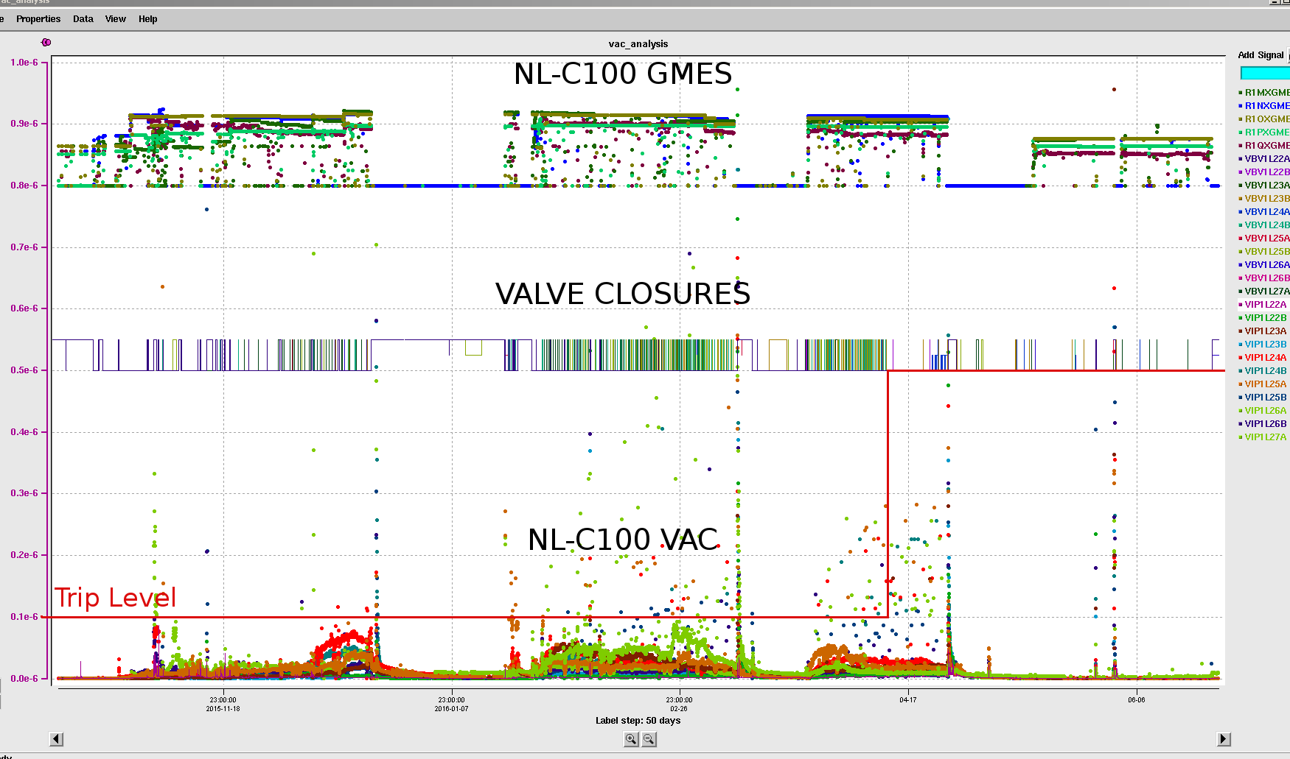
GMES vs. VAC vs. VALVE TRIPS

Slide 7
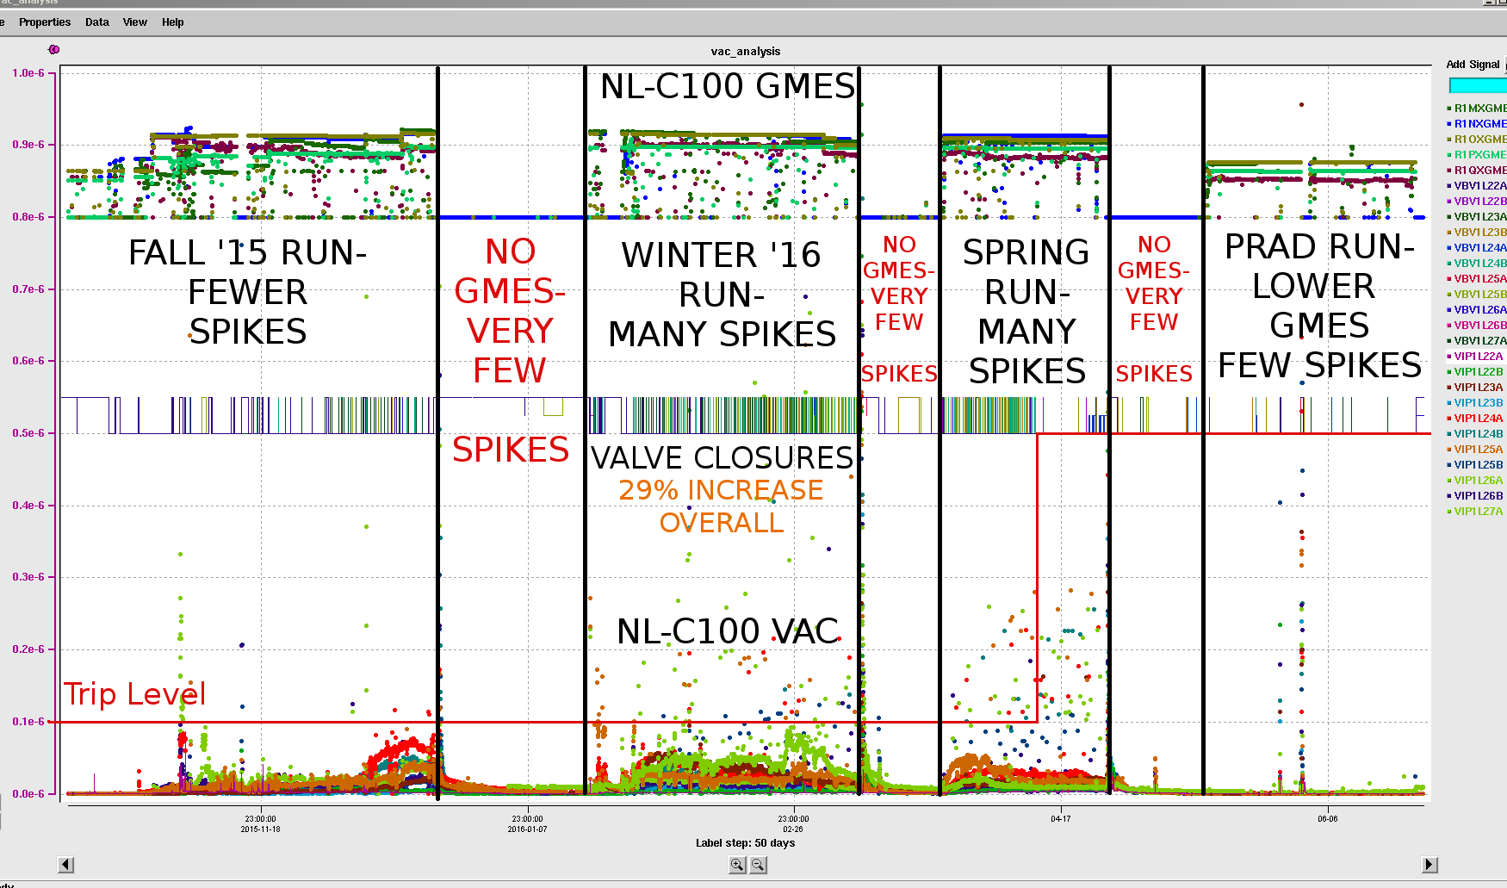
GMES vs. VAC vs. VALVE TRIPS

Slide 8
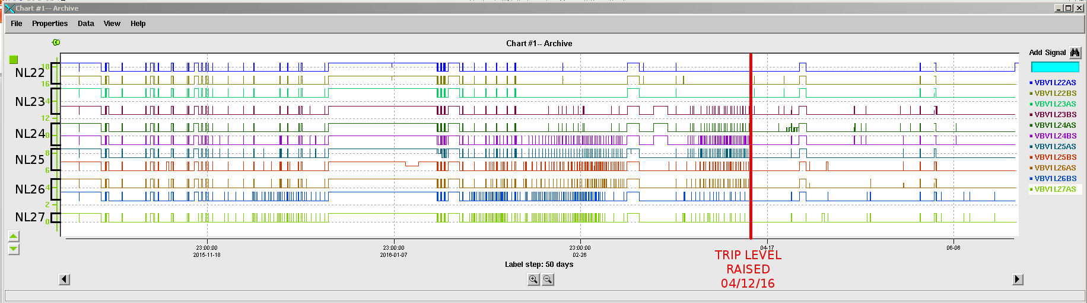
NL VALVE CLOSURES BY LOCATION
Valve Trips increase the further you go down the LINAC
While the majority of these valve closures are trips, this graphic also includes intentional closures

Slide 9
Mitigation Efforts
Raised trip limit: Increased from 1E-7 torr to 5E-7 torr on select pumps, on 4/12/2016. Decreased trips but ignores root problem. Not effective if vacuum floor rises.
Radiation shielding installed on VIP1L24A- Beam Test plan submitted to observe any positive changes.
Lock out RF operation when valves are closed- Firmware change planned for Summer ‘16 SAD- RF ops with valves closed unnecessarily increases the vacuum floor.

Slide 10
Issues and Open Questions
Vacuum diagnostics “reports” the problem- doesn’t cause it… how to find the cause?
  The fast trip is implemented locally on the ion pump controller- diagnostic error cannot cause a fast trip.
  The vacuum spikes “look like” real vacuum– the exponential decay is indicative of a vacuum pumping response.
Ion Pump Noble Gas Instability has been considered, but C100 vacuum signatures don’t match the commonly accepted signature. Also shouldn’t happen with new pumps.

Slide 11
Issues and Open Questions
Other possible causes- Ion pump reaction to higher vacuum levels? Field emission? Radiation?
How is a good trip threshold decided upon? As the vacuum floor rises, additional trip level increases will be necessary.
Consider implementing controls changes – Increase fast trip limit to a higher level, and implement firmware “Medium” trip limit, with spike counter or leaky bucket algorithm.
Questions/ Comments?

Slide 12
Acknowledgements
Many thanks to Clyde Mounts, Rongli Geng, Chad Seaton, Bob Legg, Tom Powers, EESIC, and VAC/Install

