Slide 1

4-6 GeV CEBAF Reliability Overview
Operations StayTreat
6/28/16
Steve Suhring

Slide 2
Early Challenges at CEBAF
New machine
  From the ground up
  First large scale application of SRF
  No ‘statistics’ on system/component performance
New People
  No shared experience
New Management
  Clarity of vision
  Practices under development
    HCO, on-call, repair escalation

Slide 3
Vocabulary
Availability / Reliability
  Not cleanly understood
  Machine? System? Component?
MTTR, MTBF*, etc.
  Theoretically useful
  Difficult early on when statistics weren’t there
  *Mean Time To Repair, Mean Time Between Failures

Slide 4
CEBAF Vocabulary
  Lost Time: Not doing Physics, for whatever reason
  New phrase
  No ‘free ride’ for simultaneous failures
  Accountability for Beam Studies time
Whack-a-Mole: a. An ancient arcade game revolving around a mallet and a mole.
b. CEBAF slang for putting effort where effort is due.

Slide 5
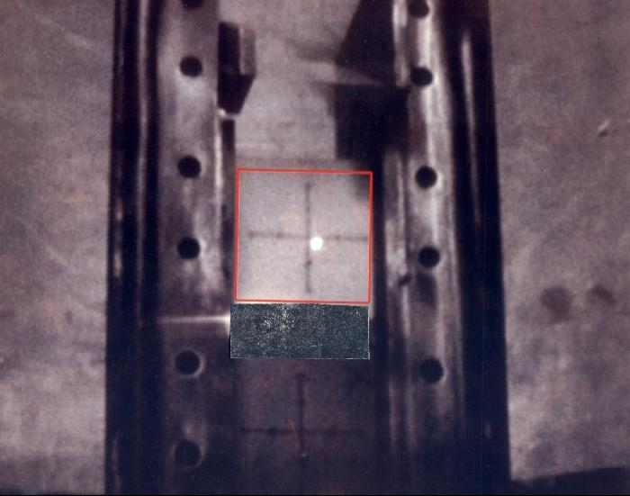
1994 First Beam on Target at JLab

Slide 6
Lost Time Tracking
1st: Dredging through paper logbooks
2nd: Simple web interface for Operations to use
  Records dumped into an Excel spreadsheet.
  Labor intensive to edit, parse, use.
This effort resulted in a large database used
to guide CEBAF improvement efforts, and
b. for reliability statistics as new machines were in the planning stages.

Slide 7
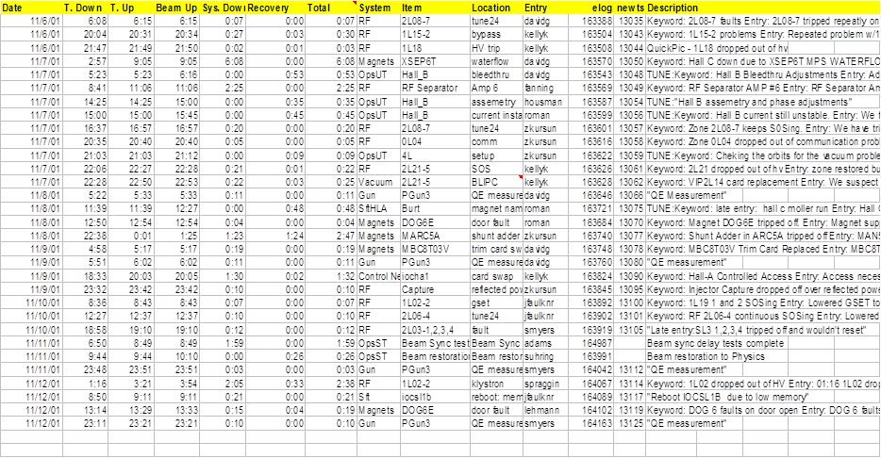
Lost Time Spreadsheet Eye Chart

Slide 8
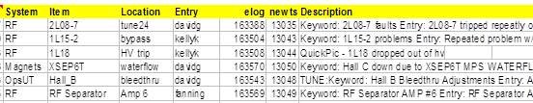
Lost Time Spreadsheet Eye Chart

Slide 9
Lost Time Trending
Weekly Reports
  Recent Opportunities for Improvement
  Comparison to previous week
Lost Time Roll-Up
  Included Availability numbers taken from DOE Metric / Contract definitions

Slide 10
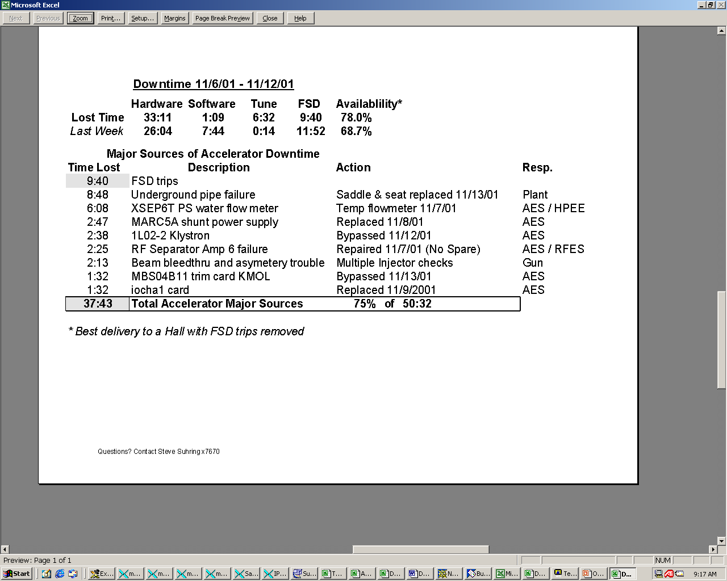
Weekly Report Example

Slide 11
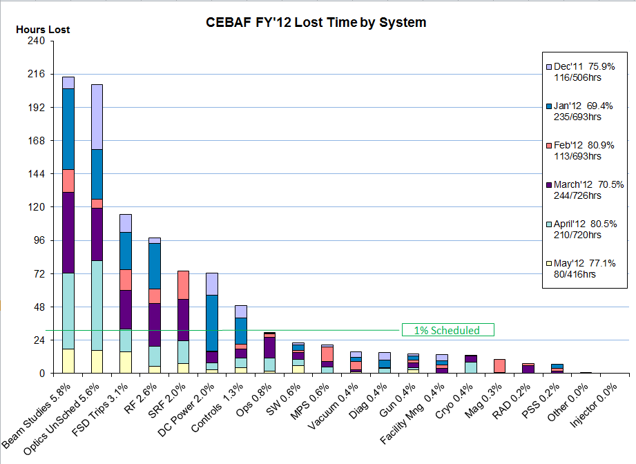
XX

Slide 12
Summary from 2002 Accelerator Reliability Workshop
We do a good job responding to problems as they arise.
BUT
Engineering support is needed for expanded early warning (predictive) diagnostics.
Detailed analysis of system failures is necessary to raise machine availability to >80%.
Maintaining machine availability over the long term will require significant resource commitment.

Slide 13
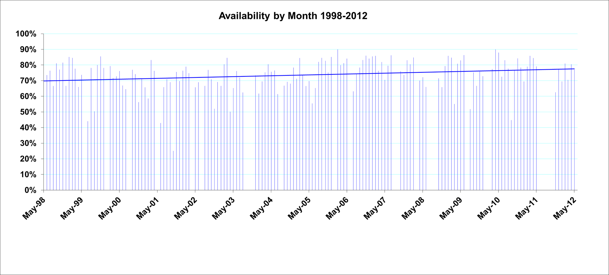
4/6GeV Availability Trend

Slide 14
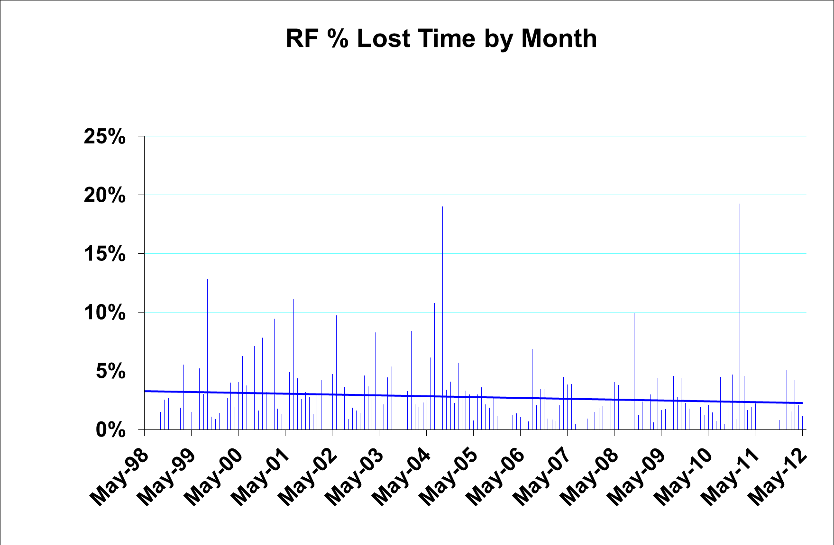
0L03-2 instability
Chopper 1Y vacuum interlock
RF Separator Amp

Slide 15
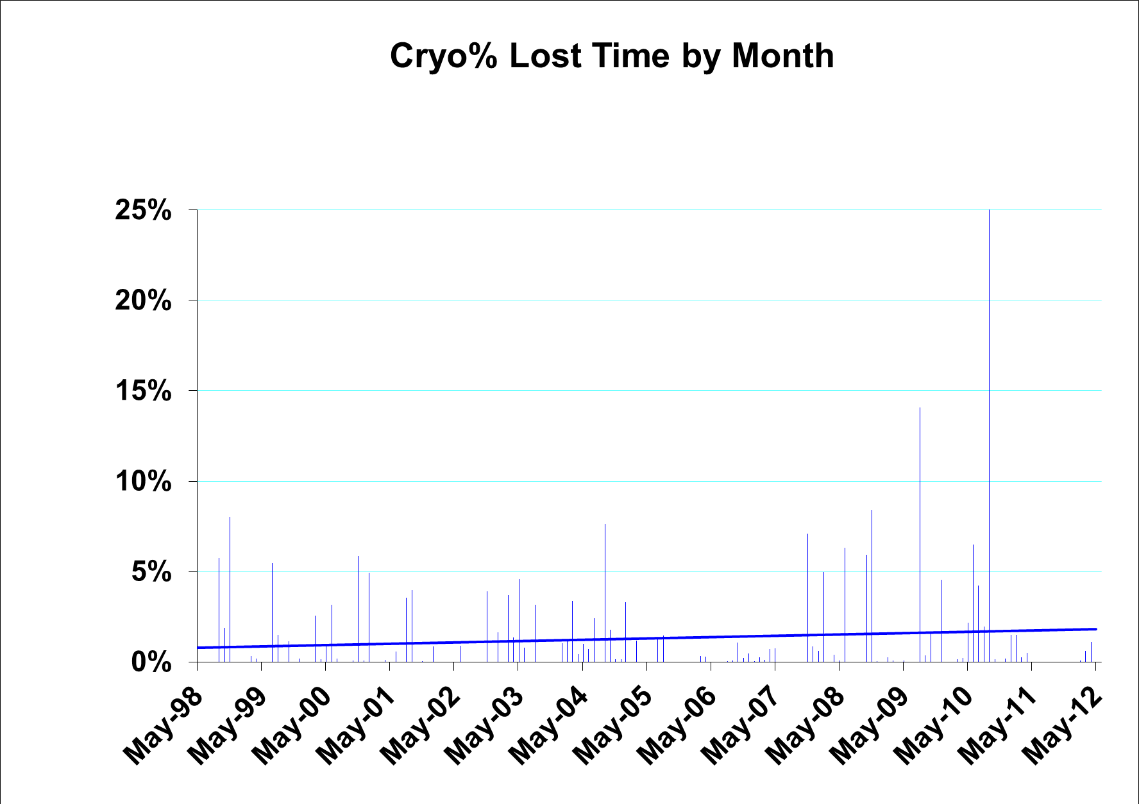
T3 replacement

Slide 16
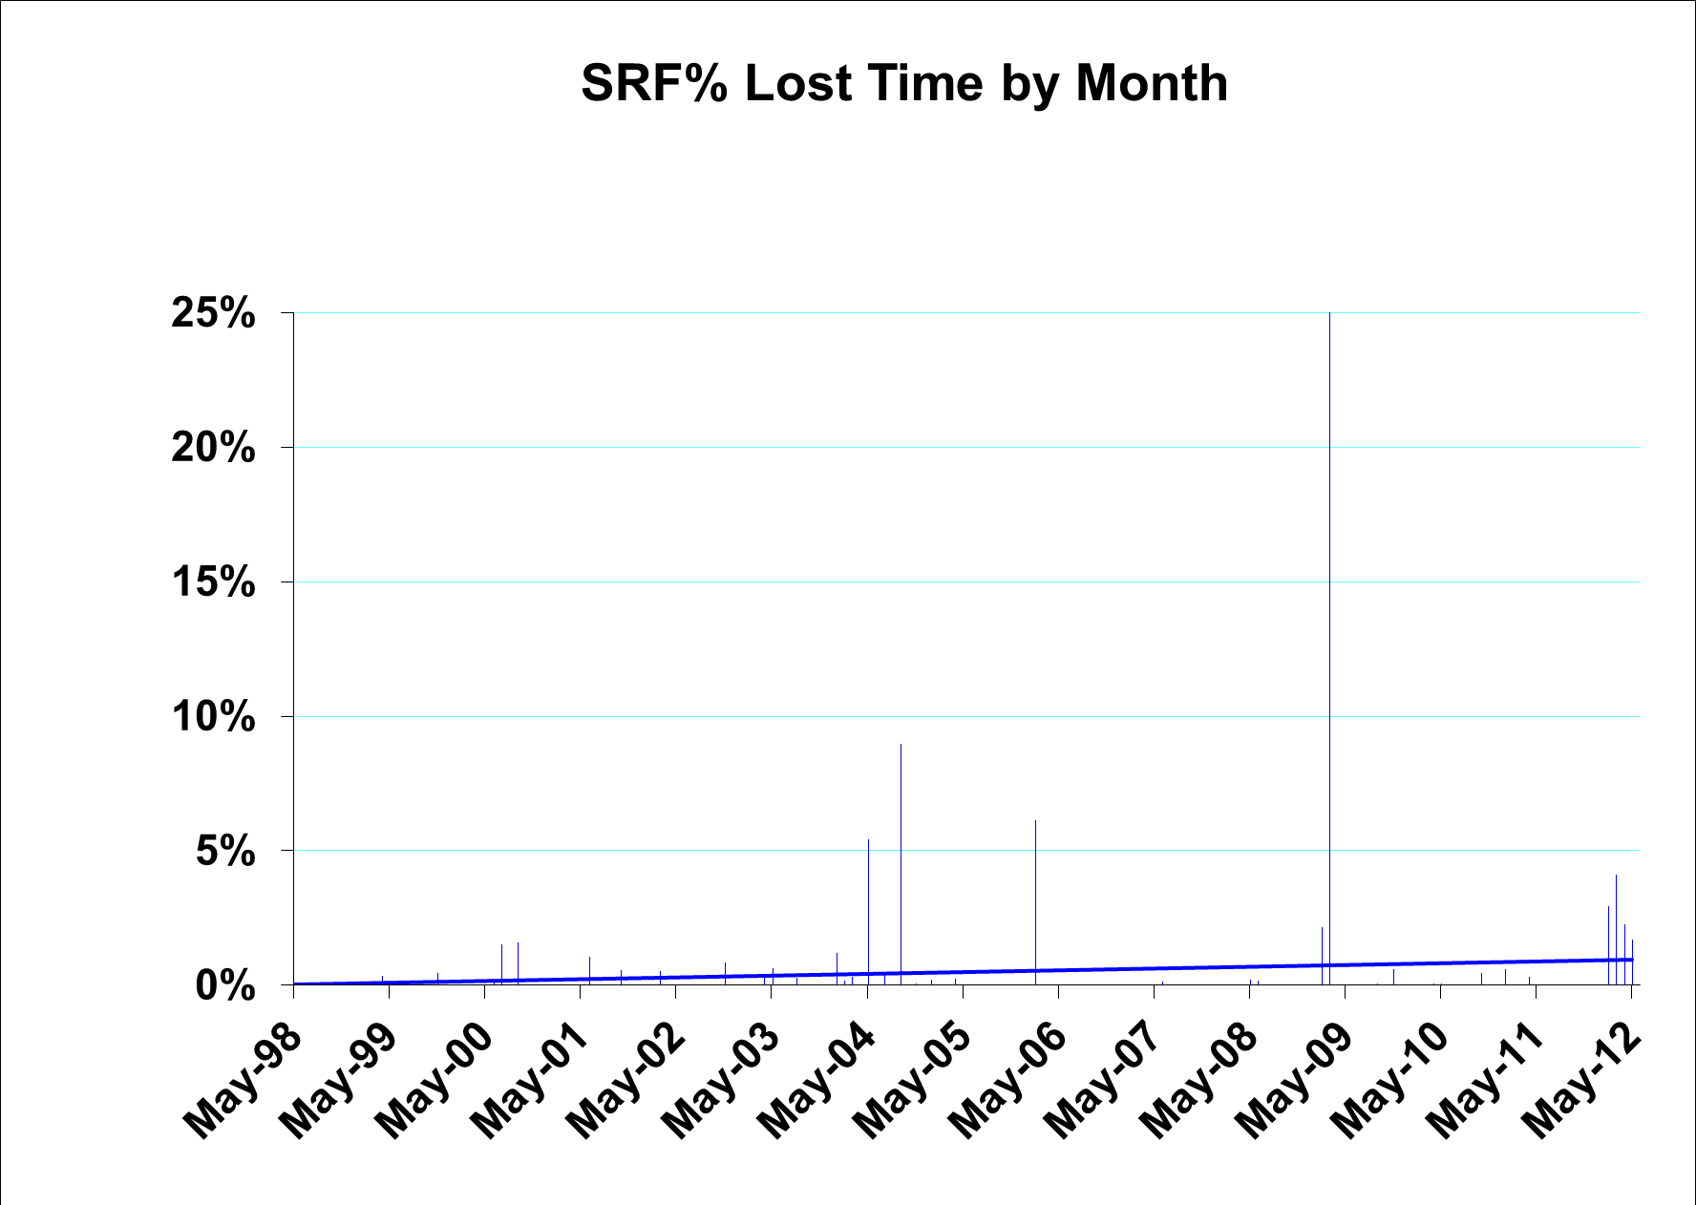
1L04 Renaissance failure & removal
Initial C100s

Slide 17
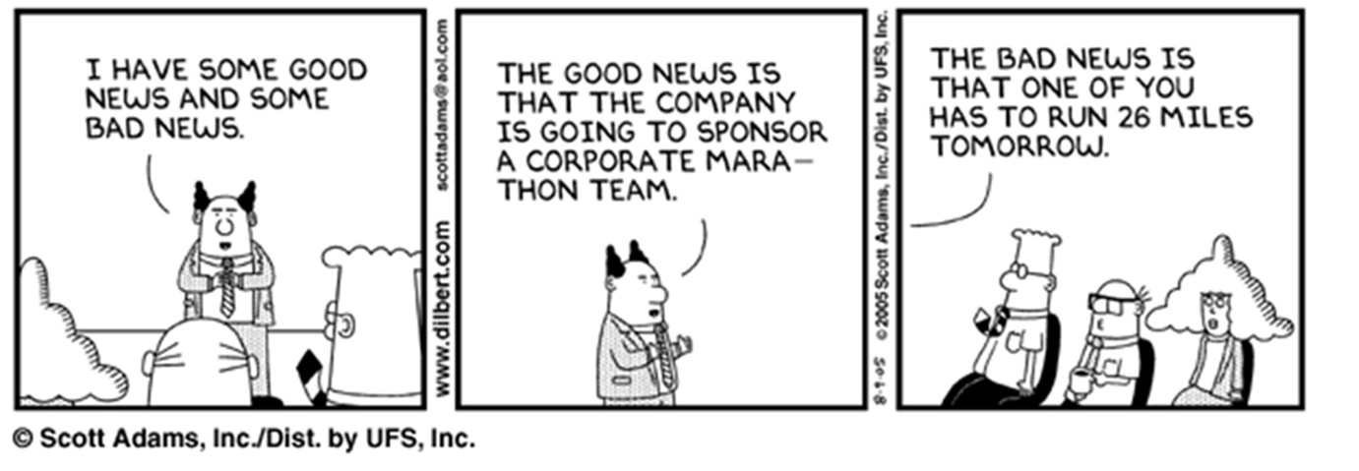
UPGRADE CAPTION CONTEST
THE GOOD NEWS IS
THAT THE DOE IS GOING TO SPONSOR A 12 GeV UPGRADE.
THE BAD NEWS IS
THAT IT WILL BE BUILT ON THE BACK OF THE OLD 6GeV MACHINE.

Slide 18
Issues and Open Questions
  How can the machine reliability and availability numbers be improved?

Slide 19
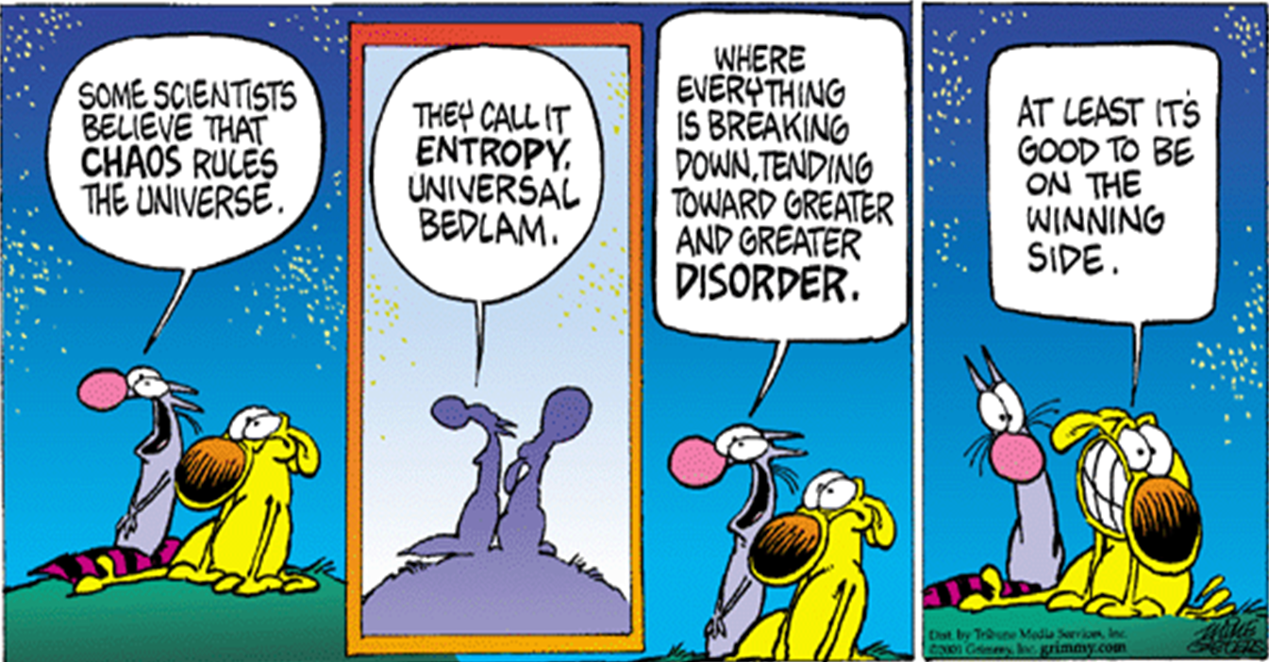
The Reliability Challenge

Slide 21
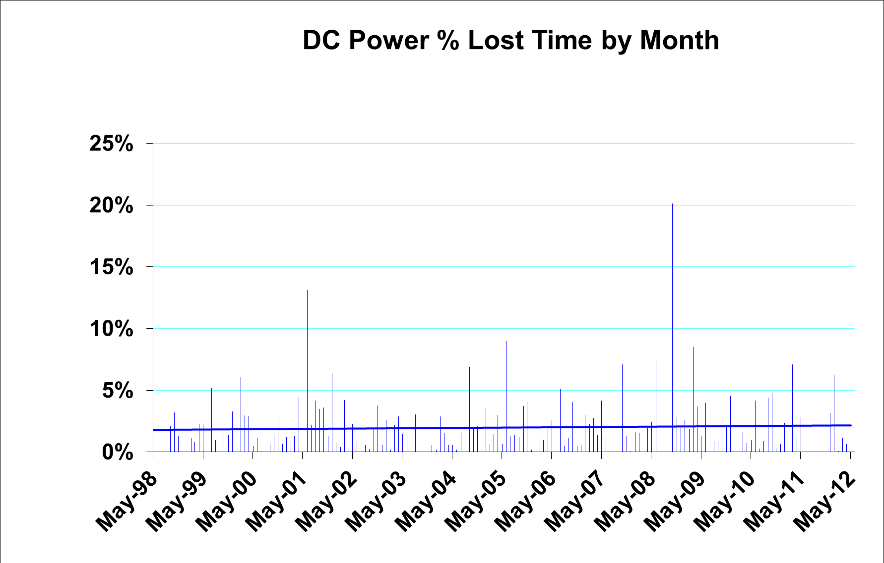
MAM3S03 mismatch
MARC4A / RSEP9A regulation
Shunt airflow

