Slide 1
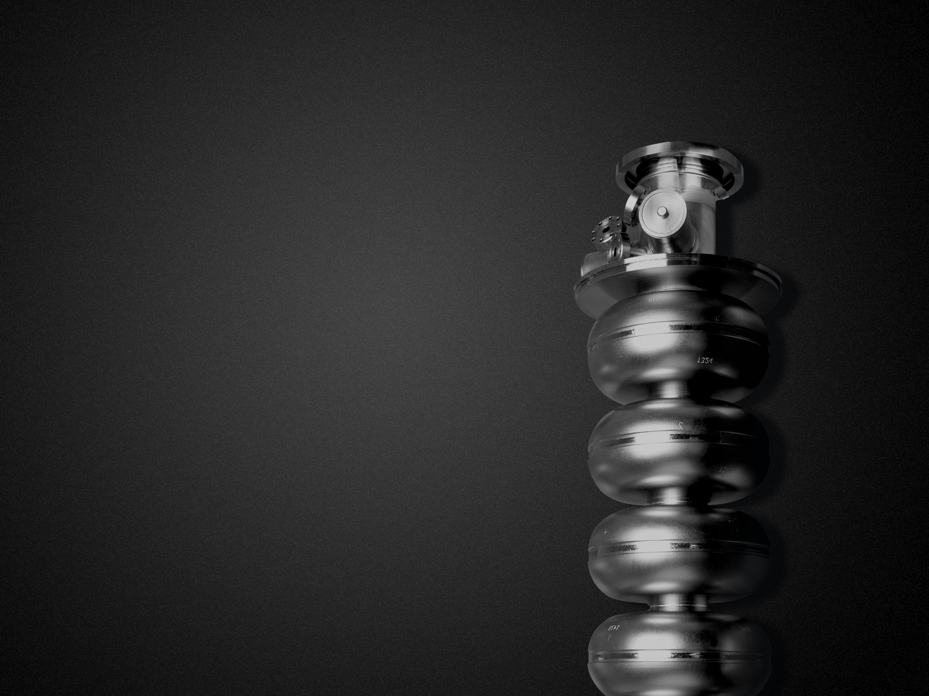
C100 Activation Status and Projections
JLab Ops Staytreat 2016
P. Degtiarenko, D. Hamlette, G. Kharashvili, V. Vylet, K. Welch, M. Washington
Radiation Control Department
Notes:
Title Page

Slide 2

concerns related to field emitted radiation
Activation:
  ALARA
  Complicates machine maintenance and other work in the affected areas
  Future accelerators
  Decommissioning
Radiation damage:
  Material degradation
  Damage to semiconductor electronics
JLab Ops Staytreat, 6/28/2016 Slide 2 of 24
Notes:
Interior Page Design 1

Slide 3
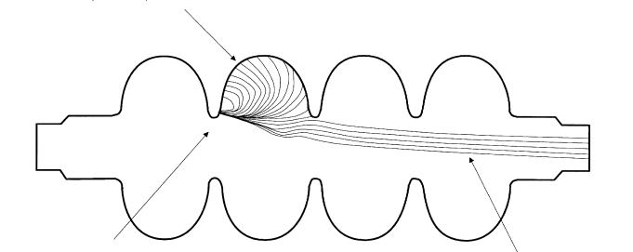
what happens to field emitted electrons
Low energy electrons below photonuclear reaction thresholds
Electromagnetic cascade
҉
Iris
Electrons capable of accelerating up to the full gradient
In C100s cascade can propagate from cavity to cavity
JLab Ops Staytreat, 6/28/2016 Slide 3 of 24
Notes:
Interior Page Design 1

Slide 4
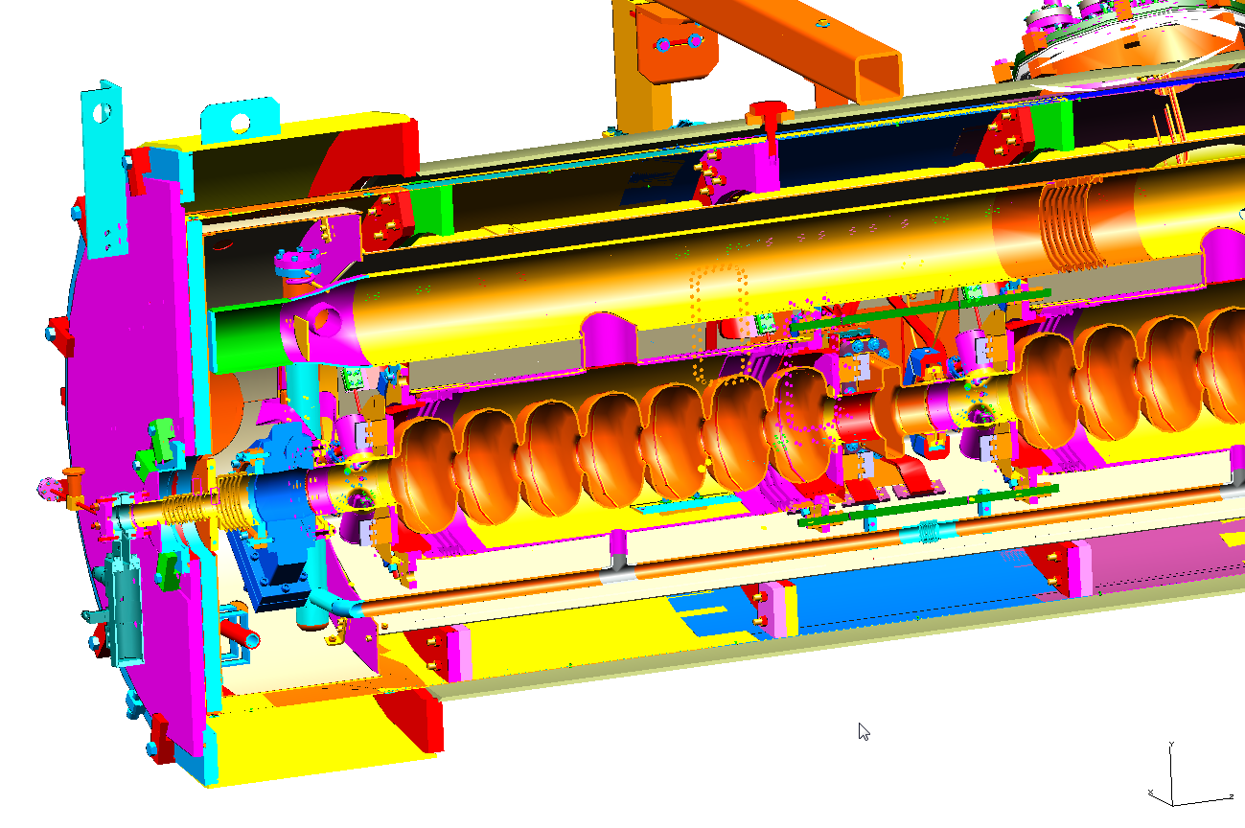
C100
JLab Ops Staytreat, 6/28/2016 Slide 4 of 24
Notes:
Interior Page Design 1

Slide 5
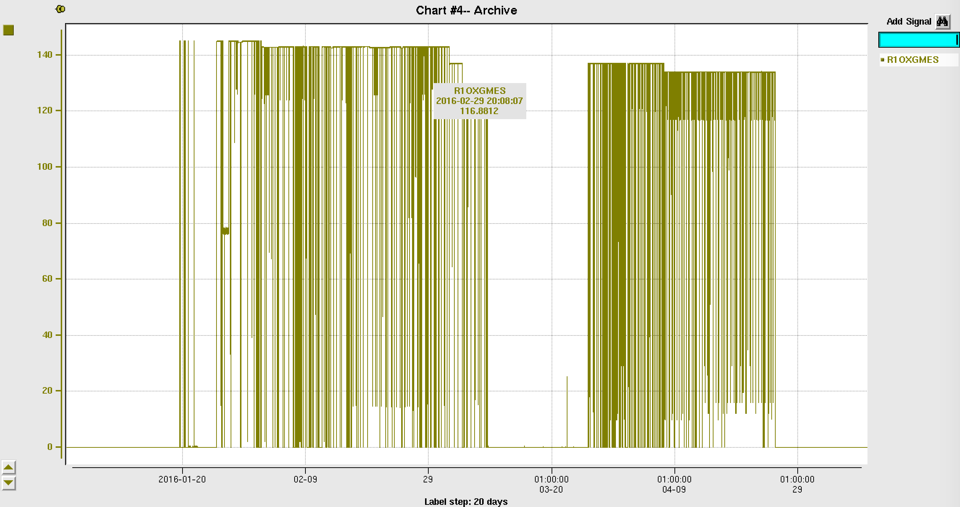
1L24 GRADIENTS JAN-APR 2016
99 MeV
94 MeV
Survey results:
  20 mrem/h at 30 cm ~1h after the end of the run
  6.3 mrem/h at 30 cm ~2 weeks after the end of run
JLab Ops Staytreat, 6/28/2016 Slide 5 of 24
Notes:
Interior Page Design 1

Slide 6
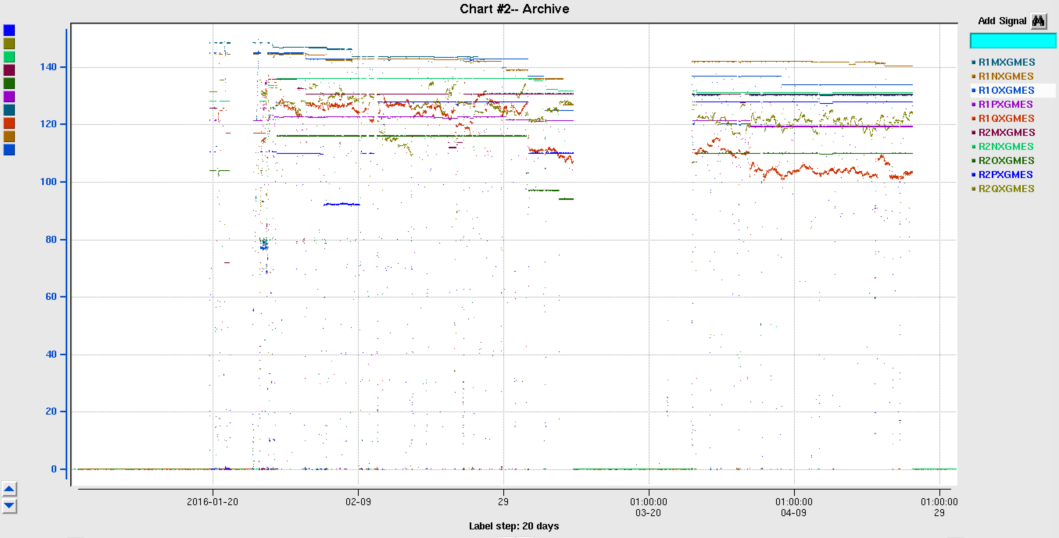
ALL C100s JAN-APR 2016
Survey results:
  Up to 37 mrem/h at 30 cm after ~1 hour of decay
  Up to 8 mrem/h at 30 cm after ~ 2 weeks of decay
Radiation areas (> 5 mrem/h) persisted for days and in some cases - weeks
JLab Ops Staytreat, 6/28/2016 Slide 6 of 24
Notes:
Interior Page Design 1

Slide 7
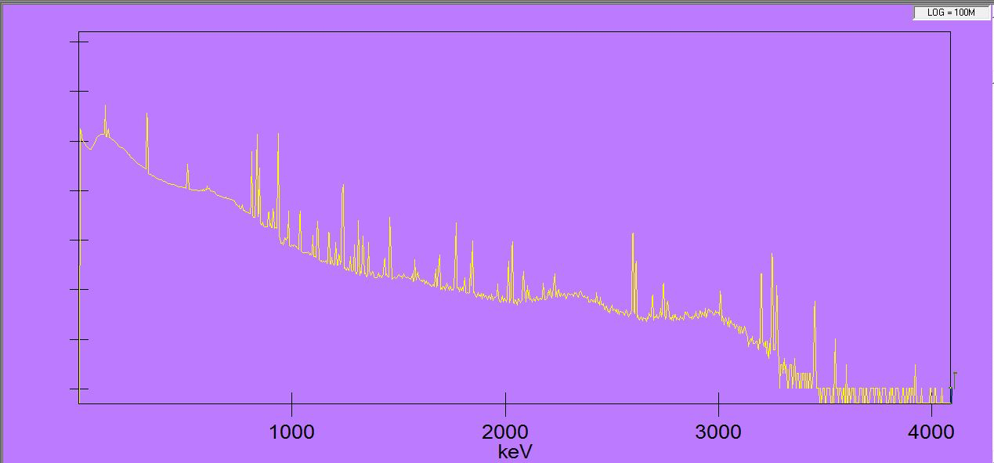
typical gamma spectrum near activated c100 cm
⁵⁷Co – 271 d
Other notable nuclides:
⁶⁰Co – 5.27 y
⁵⁷Ni – 35.6 h
⁵⁶Ni – 6.1 d
⁵²Mn – 5.6 d
²⁴Na – 15 h
⁵⁵Co – 17.5 h
⁴⁸V – 16 d
^{44m}Sc – 58.6 h
⁵¹Cr – 28 d
^{92m}Nb – 10.15 d
⁵⁸Co – 71 d
511 keV
⁵⁶Co - 77 d
⁵⁶Co - 77 d
⁵⁴Mn – 312 d
⁵⁶Co - 77 d
JLab Ops Staytreat, 6/28/2016 Slide 7 of 24
Notes:
Interior Page Design 1

Slide 8
dose rates after 3-4 months of running
JLab Ops Staytreat, 6/28/2016 Slide 8 of 24
Notes:
Interior Page Design 1

Slide 9
5 year projections
RF: 4 months ON, 2 months OFF, 4 months ON, 2 months OFF, …
Decay times:
JLab Ops Staytreat, 6/28/2016 Slide 9 of 24
Notes:
Interior Page Design 1

Slide 10
projection of activation over next 5 years
If C100 field emissions remain at current levels, during the next 5 years:
  Short-term (< 2 days) dose rates will increase by ~30%
  Long-term (weeks) dose rates will increase by ~ factor of 2
All C100 zones are subject to becoming radiation areas on permanent basis
No high radiation areas are anticipated due to the field-emissions at current levels
JLab Ops Staytreat, 6/28/2016 Slide 10 of 24
Notes:
Interior Page Design 1

Slide 11
radiation damage
Dose & Displacement Damage
Radiation Damage to Materials/Electronics
!!! A Rough Overview Only !!!
commercial COTS hardened electronics
accelerators
Semiconductors
Polymers
Ceramics
Metals and alloys
1E1 1E2 1E3 1E4 1E5 1E6 1E7 1E8 1E9 1E10 1E11 Gy
1E12 1E13 1E14 1E15 1E16 1E17 1E18 1E19 1E20 1E21 1E22 n/cm²
- no damage
- mild to severe damage
- destruction
!!! Assumption !!!
(depends on particle energy spectra)
1 neutron (1MeV) /cm² ~ 3.3E-11 Gy
© Lockheed Martin
JLab Ops Staytreat, 6/28/2016 Slide 11 of 24
Notes:
Interior Page Design 1

Slide 12
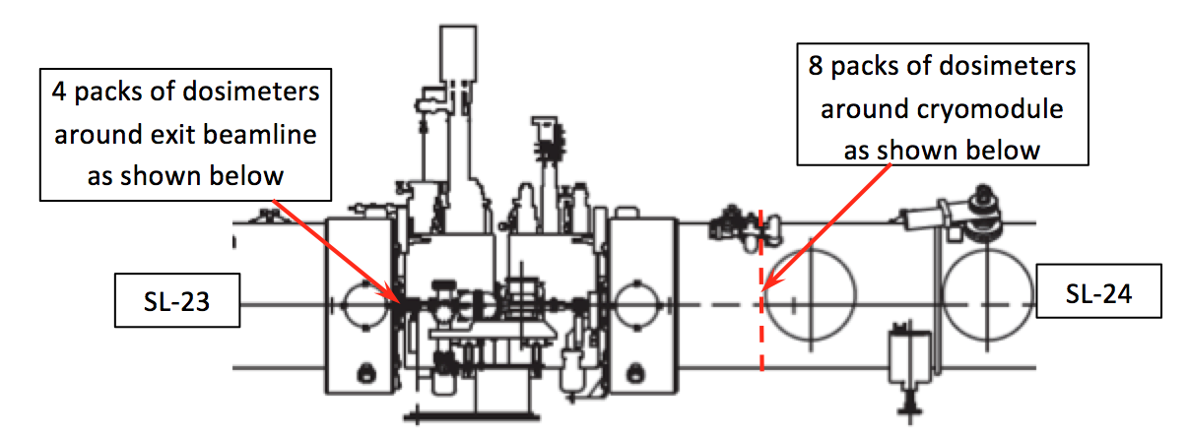
high range passive dosimetry– march-april 2016
1L24 – 1L25 and 2L23 – 2L24 were monitored
JLab Ops Staytreat, 6/28/2016 Slide 12 of 24
Notes:
Interior Page Design 1

Slide 13
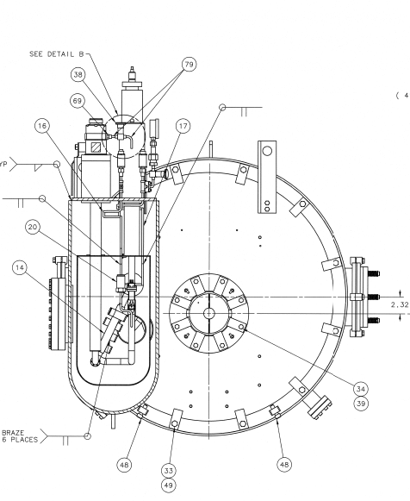
Location | 1L25 Dose (krad) | 1L25 Avg dose rate (rad/h) | 2L24 Dose (krad) | 2L24 Avg dose rate (rad/h)
C1 | 184 | 263 | 259 | 372
C3 | 202 | 288 | 290 | 416
C4 | 144 | 205 | 169 | 242
C6 | 172 | 246 | 274 | 394
C7 | 124 | 177 | 270 | 388
C9 | 146 | 209 | 299 | 430
C11 | 142 | 203 | 206 | 296
C12 | 142 | 203 | 209 | 300
C11
C12
C1
C9
C3
C7
C4
C6
Detector placement around C100 CM
JLab Ops Staytreat, 6/28/2016 Slide 13 of 24
Notes:
Interior Page Design 1

Slide 14
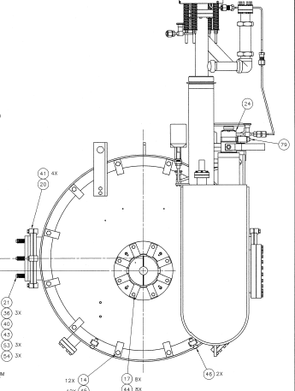
Location | Dose (krad)** | Avg dose rate (rad/h)
1L24 - B1 | 10,000 | 14,000
1L24 - B2 | 3532 | 5000
1L24 - B3 | 2916 | 4166
1L24 - B4 | 3614 | 5163
2L23 - B1 | 3243 | 4659
2L23 - B2 | 3123 | 4487
2L23 - B3 | 2334 | 3353
2L23 - B4 | 2961 | 4254
B1
B4
B2
B3
Detector placement around Beamline
**All doses are above the range of the device
JLab Ops Staytreat, 6/28/2016 Slide 14 of 24
Notes:
Interior Page Design 1

Slide 15
radiation damage
8 months per year @ 300 rad/h
5 Y
1 Y
10 Y
commercial COTS hardened electronics
accelerators
Semiconductors
Polymers
Ceramics
Metals and alloys
1E1 1E2 1E3 1E4 1E5 1E6 1E7 1E8 1E9 1E10 1E11 Gy
1E12 1E13 1E14 1E15 1E16 1E17 1E18 1E19 1E20 1E21 1E22 n/cm²
- no damage
- mild to severe damage
- destruction
!!! Assumption !!!
(depends on particle energy spectra)
1 neutron (1MeV) /cm² ~ 3.3E-11 Gy
© Lockheed Martin
JLab Ops Staytreat, 6/28/2016 Slide 15 of 24
Notes:
Interior Page Design 1

Slide 16
radiation damage
8 months per year @ 4000 rad/h
1 Y
5 Y
10 Y
commercial COTS hardened electronics
accelerators
Semiconductors
Polymers
Ceramics
Metals and alloys
1E1 1E2 1E3 1E4 1E5 1E6 1E7 1E8 1E9 1E10 1E11 Gy
1E12 1E13 1E14 1E15 1E16 1E17 1E18 1E19 1E20 1E21 1E22 n/cm²
- no damage
- mild to severe damage
- destruction
!!! Assumption !!!
(depends on particle energy spectra)
1 neutron (1MeV) /cm² ~ 3.3E-11 Gy
© Lockheed Martin
JLab Ops Staytreat, 6/28/2016 Slide 16 of 24
Notes:
Interior Page Design 1

Slide 17
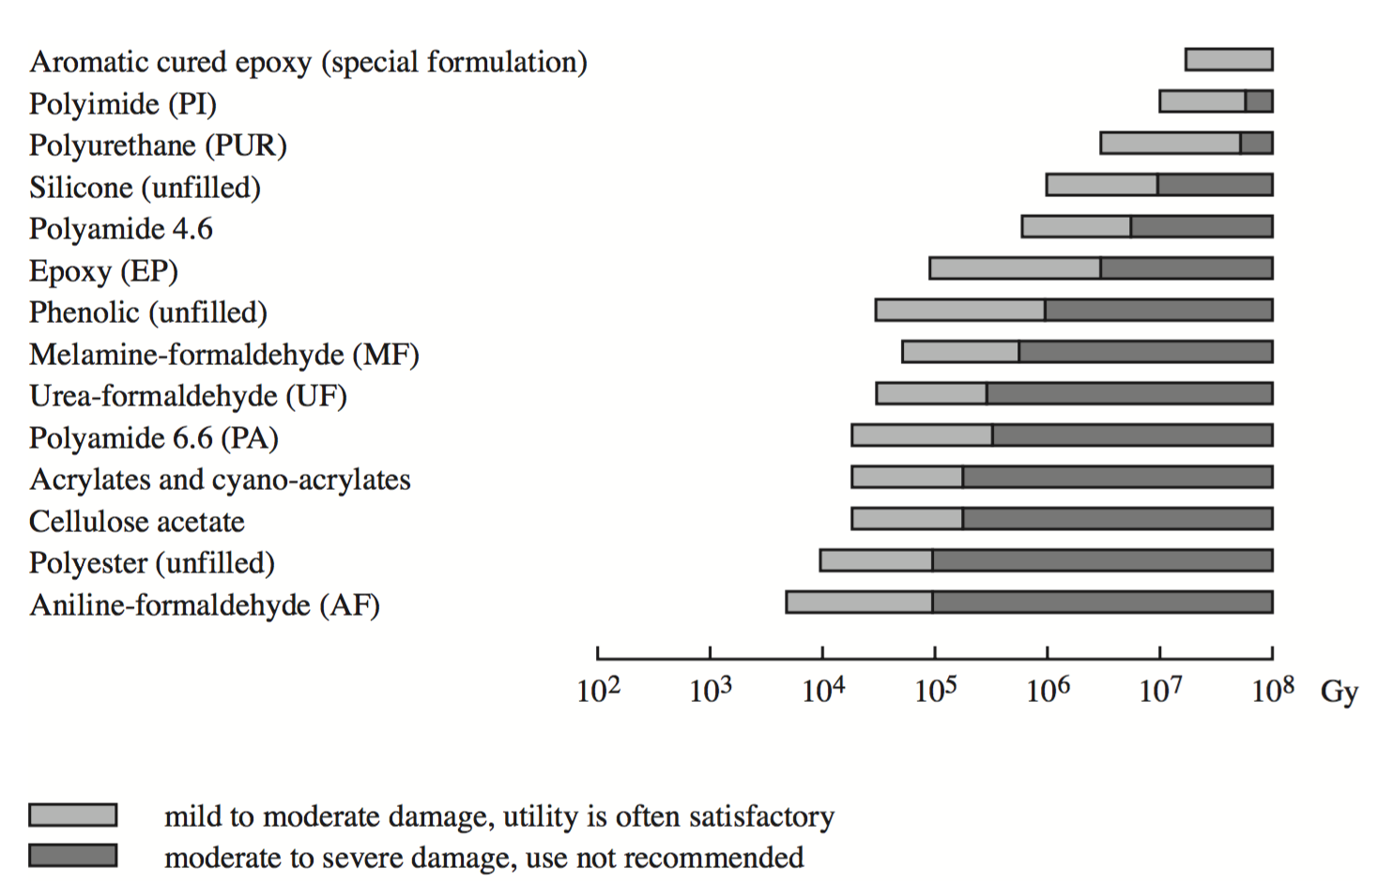
damage projections in adhesives – c100 circumference
1 Y
5 Y
10 Y
Source: CERN Rad. Damage Report, 2001
F. Guarino, C. Hauviller, M. Tavlet
JLab Ops Staytreat, 6/28/2016 Slide 17 of 24
Notes:
Interior Page Design 1

Slide 18
damage projections in adhesives – warm regions between c100s
10 Y
1 Y
5 Y
Source: CERN Rad. Damage Report, 2001
F. Guarino, C. Hauviller, M. Tavlet
JLab Ops Staytreat, 6/28/2016 Slide 18 of 24
Notes:
Interior Page Design 1

Slide 19
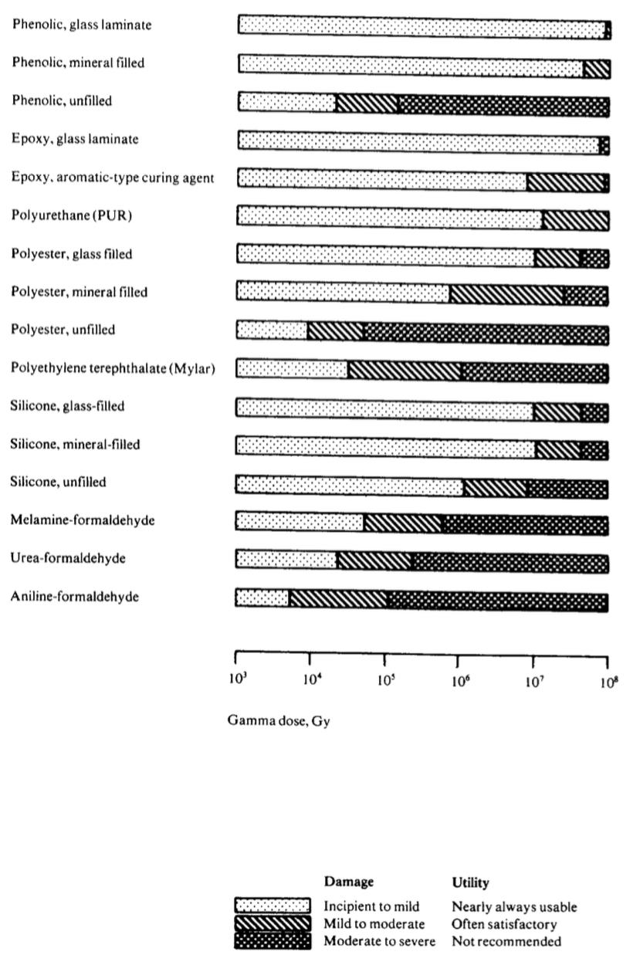
1 Y
5 Y
10 Y
damage projections in materials – at C100 circumference
note that mylar superinsulation is almost certainly exposed to higher dose rates
Source: CERN Rad. Damage Data, 1982
JLab Ops Staytreat, 6/28/2016 Slide 19 of 24
Notes:
Interior Page Design 1

Slide 20
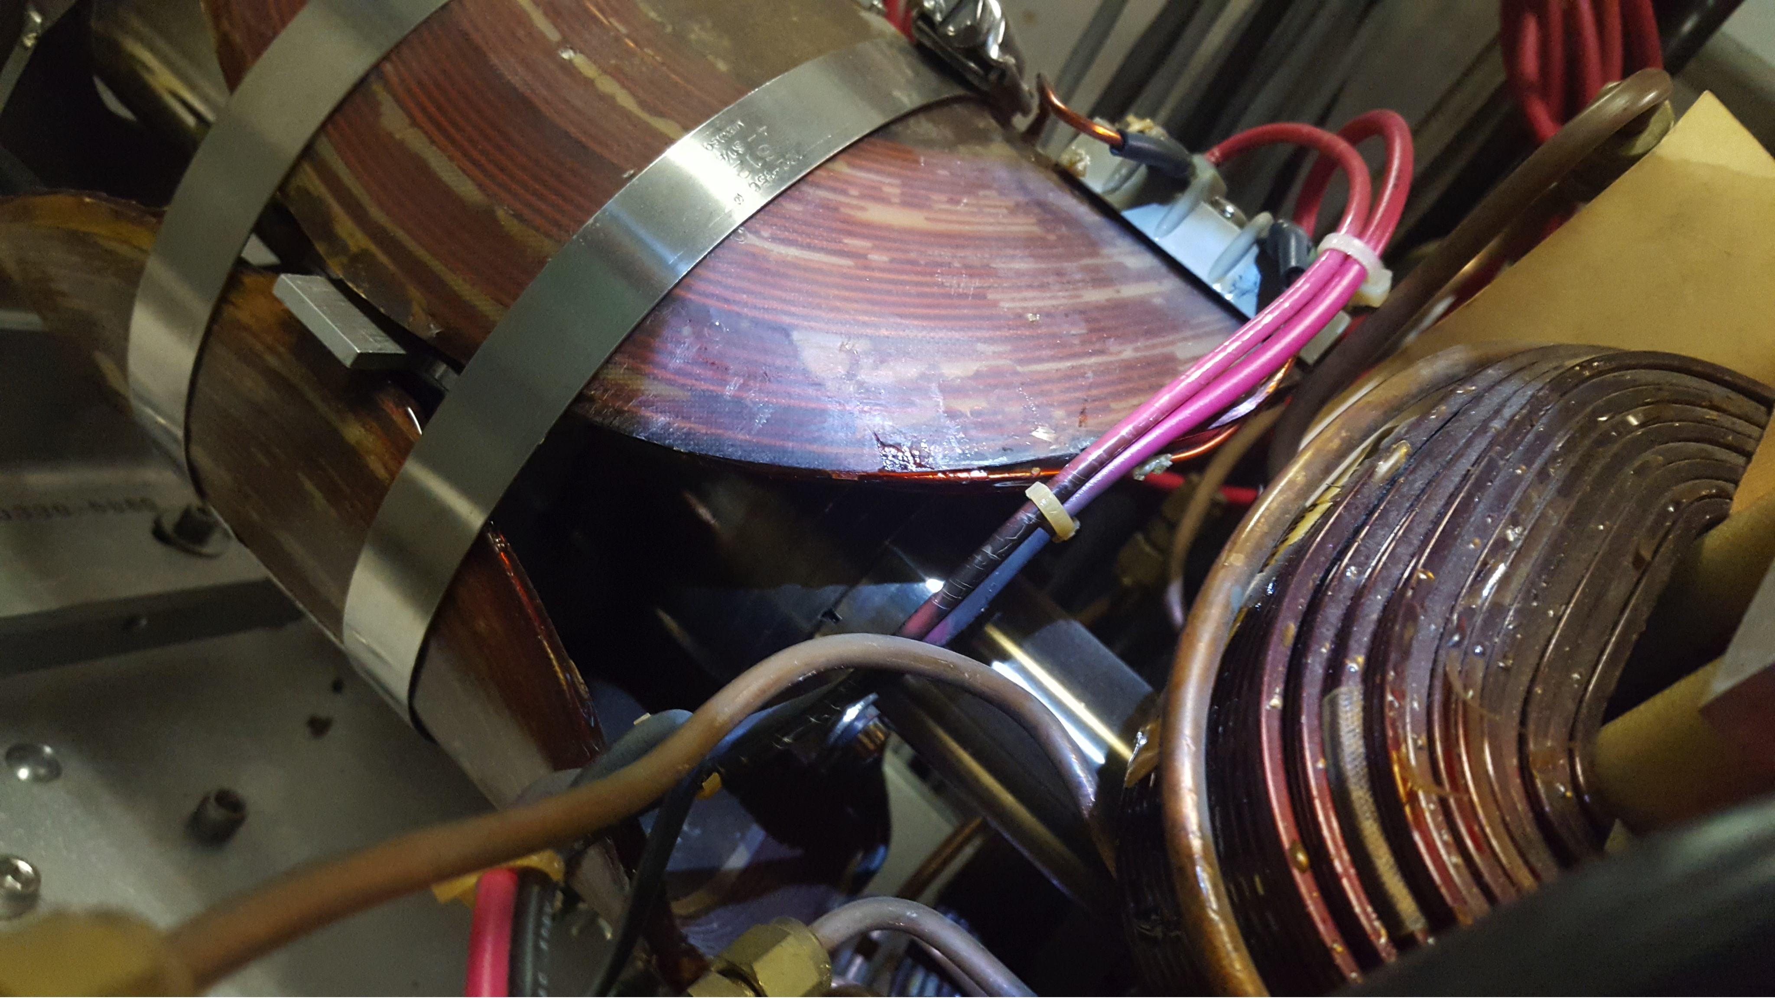
damaged db magnet – picture from david gelhaar
JLab Ops Staytreat, 6/28/2016 Slide 20 of 24
Notes:
Interior Page Design 1

Slide 21
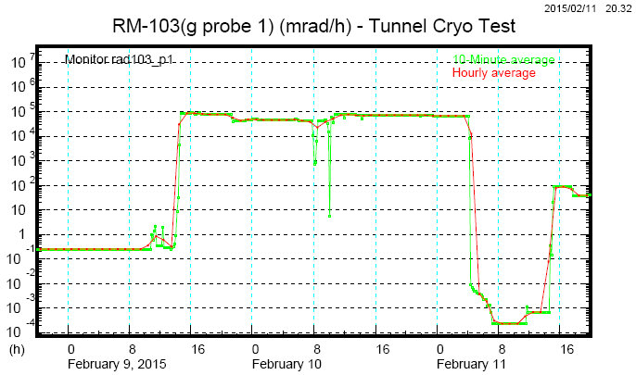
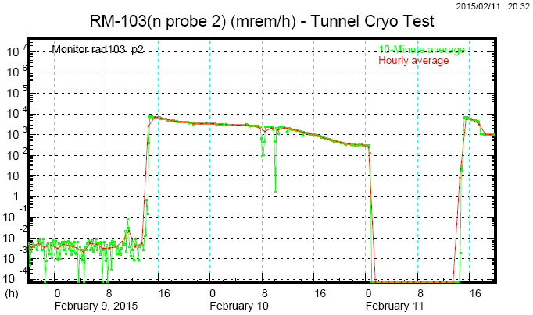
active radiation monitoring around c100 cryomodules - γ, n
Dose rates observed at 1 ft : ~100 rad/h γ, ~10 rem/h n
JLab standard CARM probes do not survive for long
Need for radiation-hard Ionization Chambers with remote front-end and DAQ electronics, using long cables
Typical neutron proportional counters won’t work: long cables, high rates, sensitivity to gammas
Need for neutron-sensitive Ion chambers
Gammas
Neutrons
Decline of sensitivity
Failure
Probe #1
#2
Failure
JLab Ops Staytreat, 6/28/2016 Slide 21 of 24
Notes:
Interior Page Design 1

Slide 22
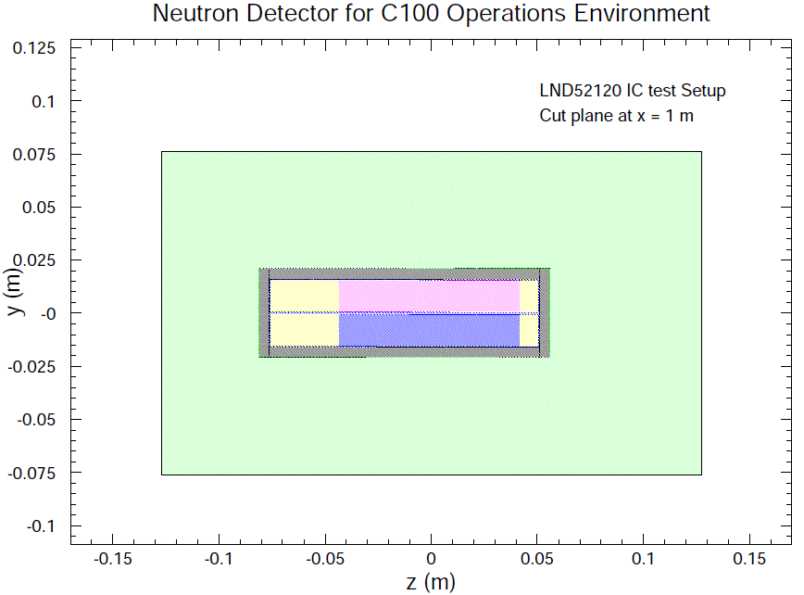
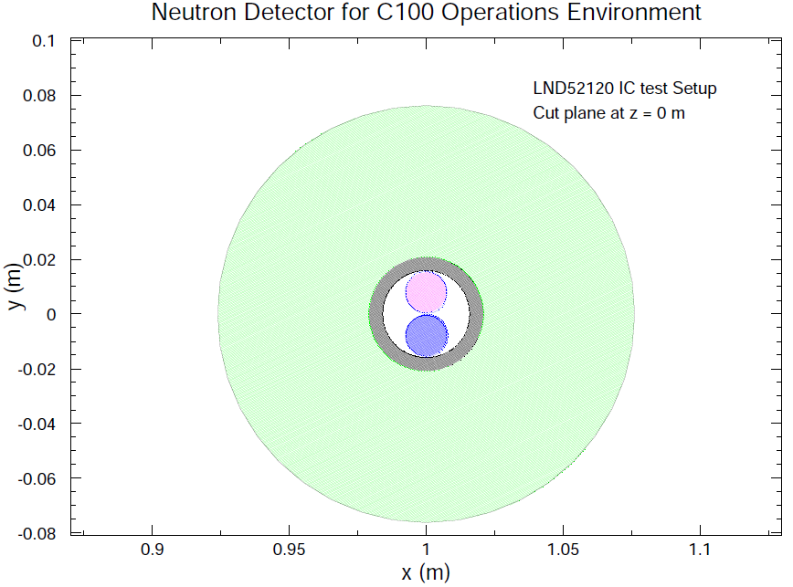
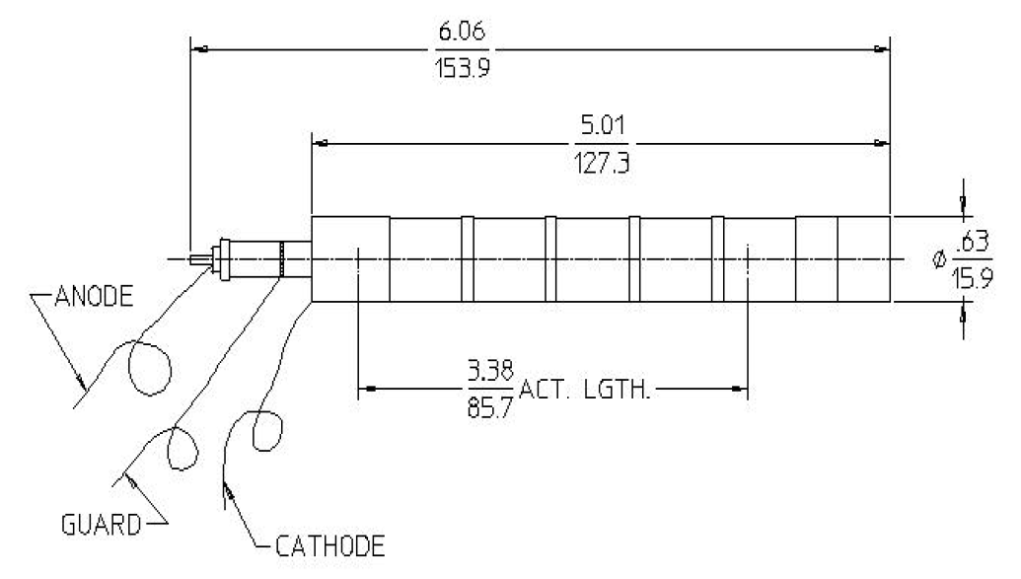
LND 50413 ¹⁰Boron-lined IC: too big (18x40 cm), expensive
Other manufacturers?
Propose to use two small LND ICs, filled with ³He and ⁴He, placed together in a poly moderator, with lead or tungsten shield (1 atm gas)
³He and ⁴He: ~0.1 pA in 1 rad/h γ
³He: ~10 pA in 1 rem/h n field
Poly cylinder
³He
⁴He
Lead shield
LND 52120
³He
⁴He
Poly cylinder
³He: $950 at 1 atm
⁴He: $750
JLab Ops Staytreat, 6/28/2016 Slide 22 of 24
Notes:
Interior Page Design 1

Slide 23
summary
Multiple attempts to monitor activation and dose rates:
  Useful data
  Detector failures due to high radiation fields
Attempts to relate the field emitted radiation to the operating parameters have not been successful
Current RadCon activities:
  Surveys
  Periodic monitoring of activation
  Occasional prompt dose rate measurements
Future continuous gamma and neutron monitoring:
  Gradient team (Bob Legg) is working on deployment of high range ion chambers
  We suggest to find or develop radiation hard neutron monitors
Field emitted radiation and activation should be taken into account in the gradient optimization process
JLab Ops Staytreat, 6/28/2016 Slide 23 of 24
Notes:
Interior Page Design 1

Slide 24
open issues / concerns
Material degradation
Inability to do real time monitoring
Upgrades and design of other machines
JLab Ops Staytreat, 6/28/2016 Slide 24 of 24
Notes:
Interior Page Design 1

