Slide 1

Warm Region Radiation
Damage and Plans
Keith Cole
6/28/2016

Slide 2
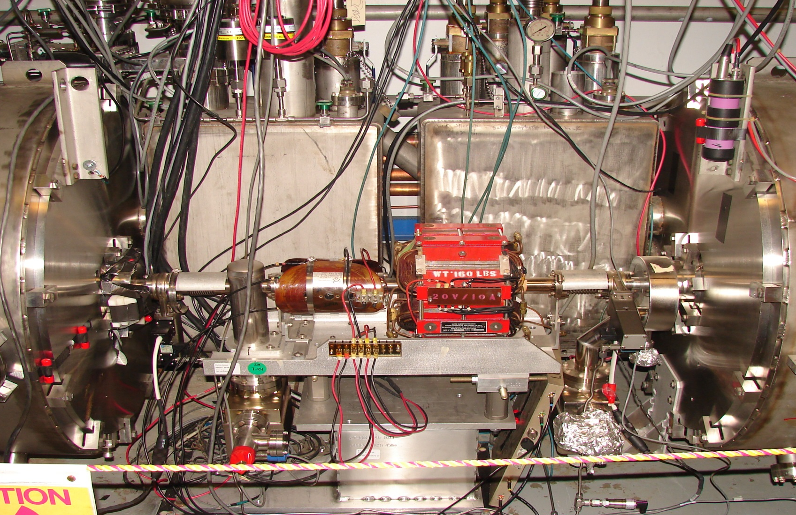
Warm Region Radiation Damage Status
Affected Engineering Systems C100 areas
DC Power – DB Corrector, visible cable damage
Vacuum- VBV position switches, solenoids
I&C – Vacuum & BPM cable damage

Slide 3
Warm Region Radiation Damage Plans
Relocate hardware and cabling using distance to our advantage
Install shielding to protect hardware
Preemptive cable replacement to avoid lost time, maintenance function
Cable jumpers that can be quickly replaced
Use radiation tolerant components when available

Slide 4
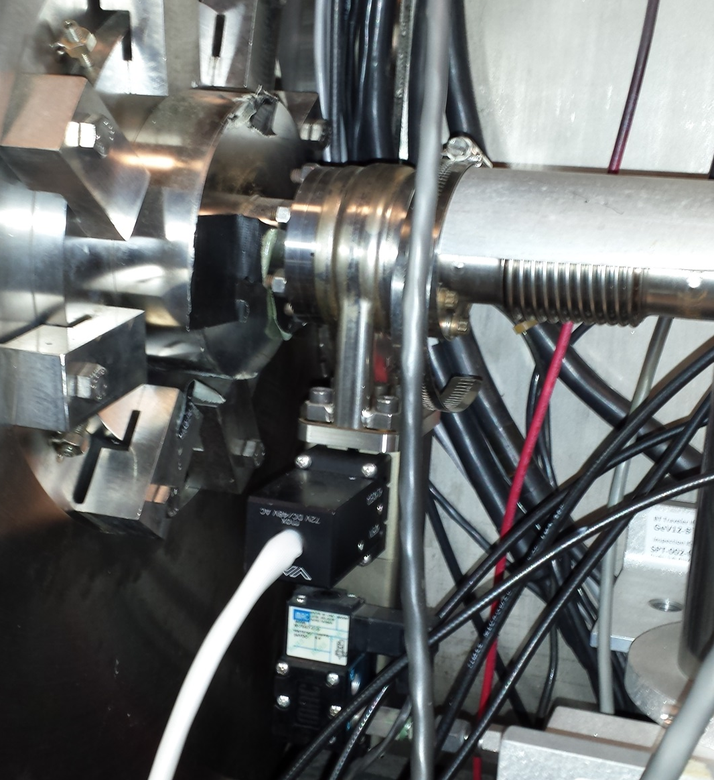
Warm Region Radiation Damage Plans
Vacuum Group
Valve solenoid failures at zones NL24, 25, 26, SL23, 25
Install new solenoids, relocate to floor of tunnel
and install lead shielding
(G. Marble) Summer 2016
18 High temp valve position switches left to be replaced
DiPette Stay-treat 2015
High temp Valve position switch
Valve Solenoid

Slide 5
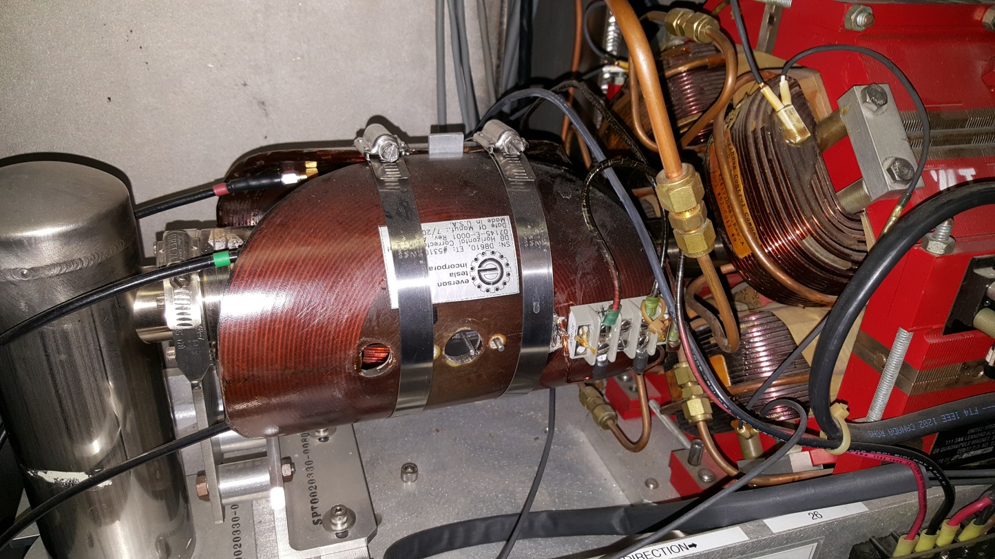
Warm Region Radiation Damage Plans
DC Power Group
Inspect magnets during Summer SAD and develop a plan
6 spares on hand
MDB2L26V corrector before replacement

Slide 6
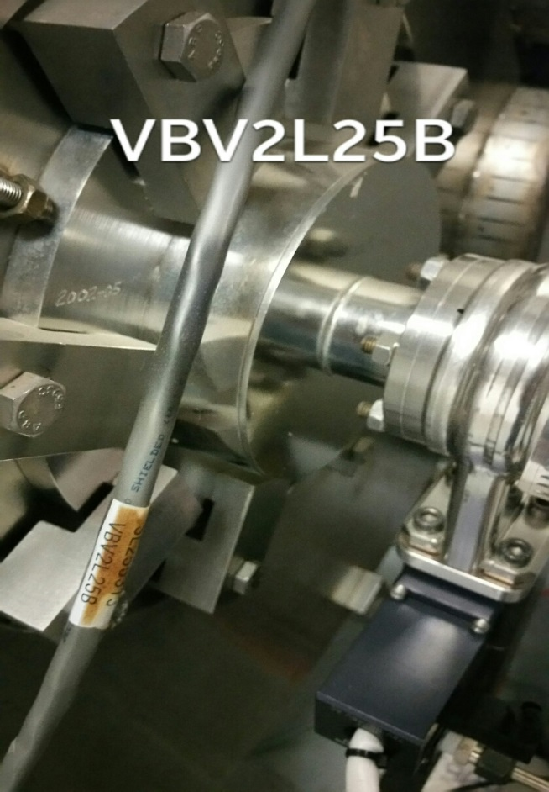
Warm Region Radiation Damage Plans
I&C Group
Valve position cable in NL24 failed
Cables in NL24, 25, 26, SL24, 25 show signs of damage
Replace damaged Valve position and HV cables with jumpers that can be quickly replaced
(G. Greenfield) Summer 2016
ALARA, maintenance function in C100 Zones, reroute to avoid proximity to beam pipe
C50 valve cable replacement complete
VBV2L25B

Slide 7
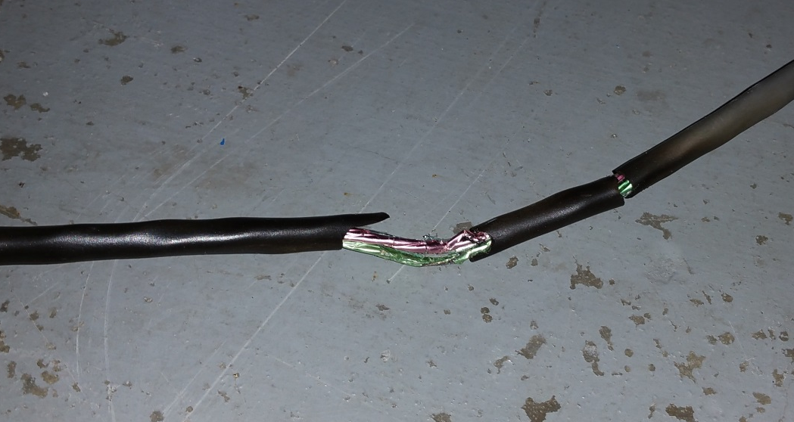
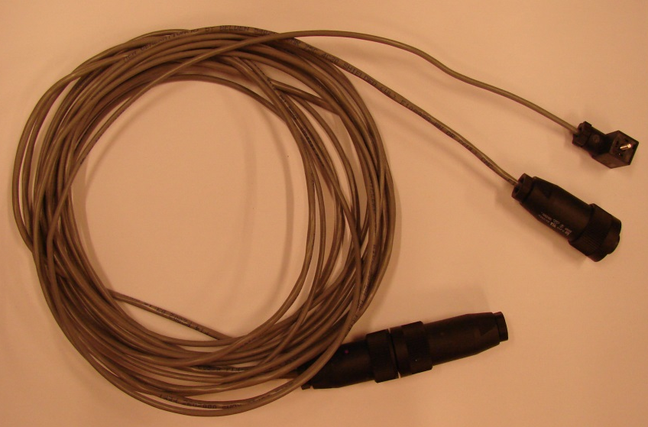
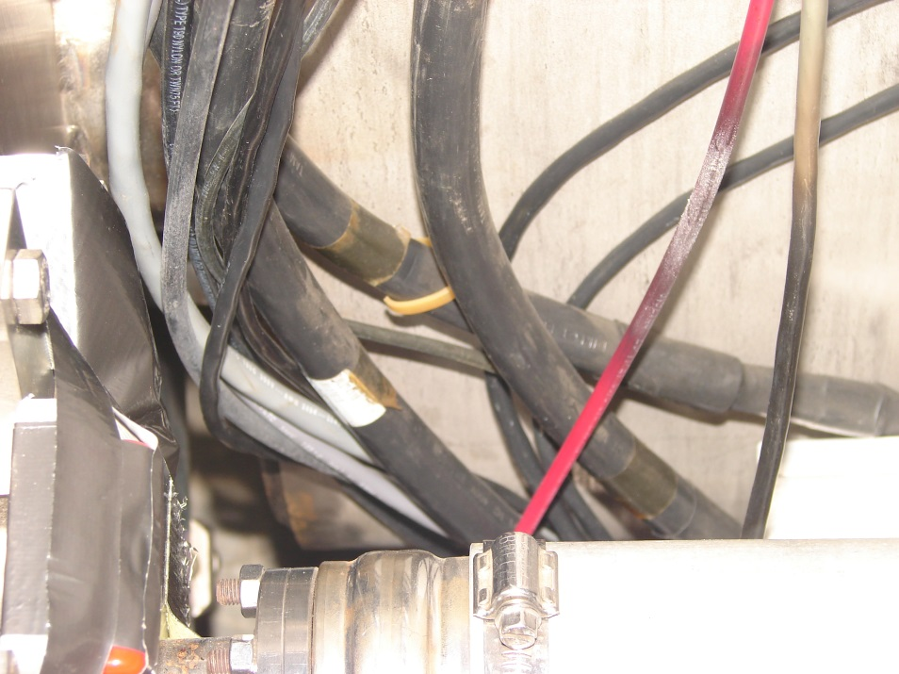
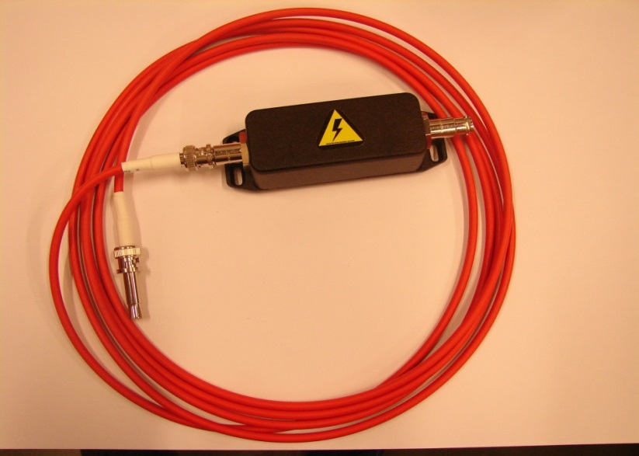
Warm Region Radiation Damage Plans
NL24 Valve cable
NL24 HV cable

Slide 8
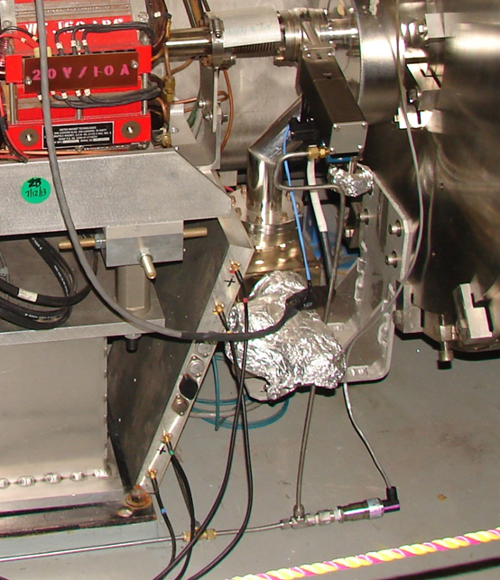
Warm Region Radiation Damage Plans
I&C Group
Relocate BPM RF Modules to top of cable tray
Route cables away from beam pipe
(Pete Francis) Summer 2016

Slide 9
Labor and Costs
Vacuum – Parts $6K Labor 3Wks
I&C – Parts $7K Labor 6 Wks
DC Power - $1K for new DB magnet

Slide 10
Warm Region Radiation Damage and Plans
Jim Coleman
Debbie Bruhwel
Anthony DiPette
Eric Diggs
Pete Francis
George Greenfield
Debbie Griffith
Leo Ketchum
Jim Kortze
Greg Marble
Joe Meyers
Elliott Smythe
Steve Suhring

Slide 11
Issues and Open Questions
Preventive Maintenance issues will require more resources as the machine hardware ages
Managing hardware failure rates
BPM and Magnet cables still in close proximity to beam pipe
Researching radiation tolerant cable options

