Slide 1
Tools Integration (Vision)
Ken Baggett
EES Deputy and Ops Liaison

Slide 2
What do we use our tools to do?
Job Planning – ATLis, EES Project Database, MS Project, TaskJuggler, BAT, AWP, spreadsheets…
Scheduling – ATLis, SAD Calendar
Documenting/Tracking – HCO, ABIL, ELOG, ATLis…
Data Interpretation/Calculations – qsUtility, fOpt, CS…
Data Storage – CED, Archiver…
In all cases, we use our tools to improve performance.
  If a tool we use doesn’t pass this test, we need to fix it or get rid of it.
This talk will concentrate on tools required in typical maintenance support scenarios

Slide 3
Repair Needed: Scenario
Downtime and/or Ops PR created
Write ATLis /Post to ELOG
Add to SAD calendar
Update ABIL
Update Work Map
Update whiteboard
Downgrade HCO
If longer than 1 shift
DO THE WORK
If applicable
Update ATLis / ELOG
Close Ops PR / Downtime
Remove ABIL
(ops)
(worker)
(Operability)
(worker)
(worker)
(worker)
(worker)
(worker)

Slide 4
Current Design
Strengths
  Coverage of scheduling, planning, personnel safety, machine safety
  Detailed text comments encouraged and permitted
  Accepted in the culture
  Several tools have similar system alignments
Weaknesses
  Tools are isolated and typically stand alone
  Workers are required to enter redundant information in multiple places
  Information is not shared between tools
  Information is primarily feed forward

Slide 5
Feedback Loops
Feedback Loops: occur when the output of the system becomes the input of the next cycle of the system
  Feedback is necessary for learning
Reinforcing loop: amplify a system’s output with each cycle
Balancing loops: stabilize a system’s output with each cycle
Our work planning tools seem to be in a reinforcing feedback loop.
  The success of one tool causes the desire to create more tools or increase the scope for the existing tools.
  We don’t always take into account the value gained vs the additional work committed
  To be successful over the long term, requirements must be balanced against the scope of tasks.
Is this a positive or negative loop?
New Software Request
New software deemed useful to someone in organization
Programmer develops new software
Users instructed to utilize the software

Slide 6
Repair Needed: Scenario
Downtime and/or Ops PR created
Write ATLis /Post to ELOG
Add to SAD calendar
Update ABIL
Update Work Map
Update whiteboard
Downgrade HCO
If longer than 1 shift
DO THE WORK
If applicable
Update ATLis / ELOG
Close Ops PR / Downtime
Remove ABIL
(ops)
(worker)
(Operability)
(worker)
(worker)
(worker)
(worker)
(worker)
3 minutes
20 minutes
7 minutes
20 minutes
5 minutes
Total of 90 minutes for Task Documentation
15 minutes
5 minutes
15 minutes

Slide 7
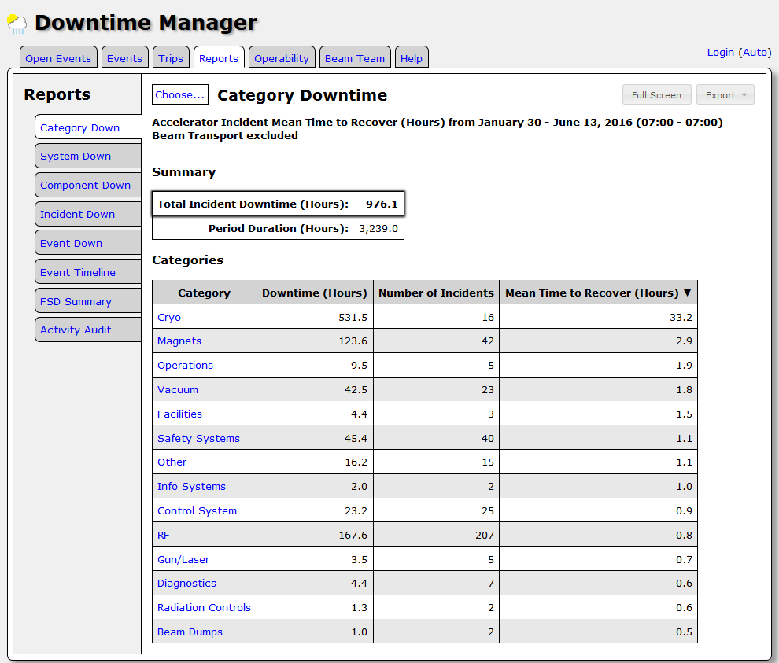

Slide 8
Using our Documentation in Feedback loops
What will feedback do in our tools?
  It should provide users with “in your face”, and sometimes redundant, information
  It should provide necessary information to encourage a desired behavior
Example: 2003, Garden Grove CA. Driver Speeding
    Walkers and cyclists were getting hit in 25 MPH school zones
    Ticketing / brighter speed limit signs didn’t work
  Dynamic speed displays added
    Your speed displayed, no punitive follow up
    Everyone with a speedometer already knew their speed
    BUT… still reduced average speeds by 14%
In our case, we want workers to easily see previous problems, fixes, comments, lessons learned, and safety aspects associated with work on a component.
  Value added: Documented feedback provided during job planning stage.
    Don’t simply rely on skill-of-the-trade or the expert’s memory.
  Goal: Improved performance for repairs and operations

Slide 9
How about a Central Hub?
Develop a software “central hub” for users to start from.
  Improve tool coupling
  Move to a component based work planning system
Strengthen the ties between component level information and all tools to improve feedback to the users
  Make sure tools transfer a basic amount of information between each other
    Data will be used for database queries
    Work details (comments) are currently captured in the ATLis or ELOGs or HCO or any combination…. and searching for them can be painful
  Abstract redundancy away from the user
    automatically transfer sub-system, component, and user information associated with tasks
This will require a little more up front work.
  Need to select System, Sub-system, and components at the beginning of process
  “Blanket” ATLis’s won’t be as simple
We spend significant effort to plan, schedule and document our work.
  We can, and should, improve the feedback loop (balance costs and rewards)
  Work should be easily accessible months or years later

Slide 10
A Proposed Integrated Framework
Central
HUB
HCO
JLIST
ATLis
ABIL
DOWNTIME
OPS-PR
CED

Slide 11
Vision
Our tools must be designed to integrate previous cycle information into the next task
  Failing to utilize information/data from previous experience to drive DAILY improvement has been identified as one of the primary reasons for systems failing over time
Improving the user’s experience:
  Easily retrieve component details associated with the component / subsystem
    ATLis entries
    Elogs
    ABIL entries
    HCO status changes
  Ensure ties between tools minimize the need for comments in multiple tools
    Minimize load on the worker
    Maximize information available about the component history
    Information such as MTTR can be automatically provided to the user at the end of a task.
      Could be provided along with past data
      Could encourage comments about the repair

Slide 12
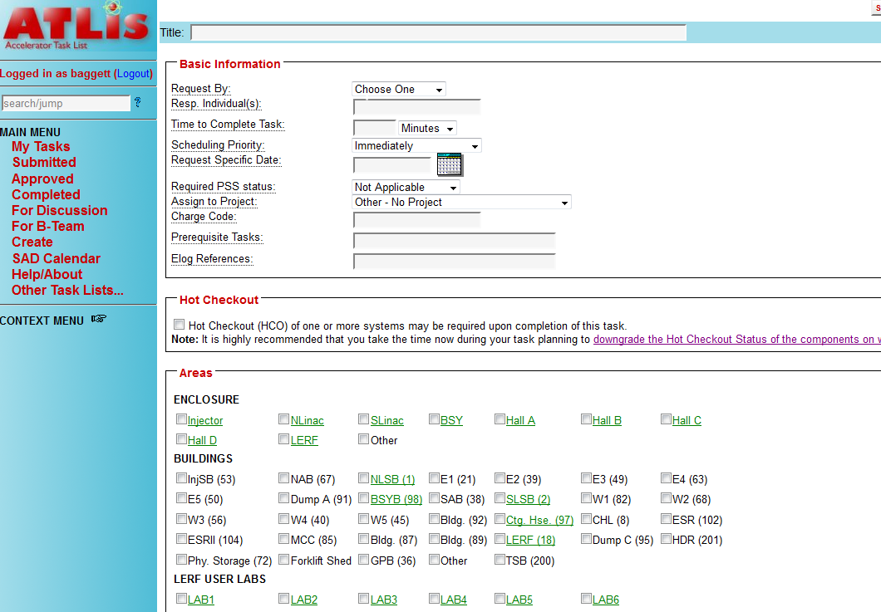
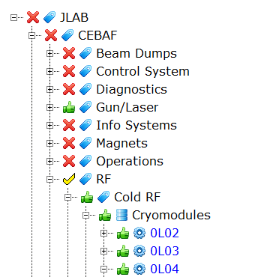
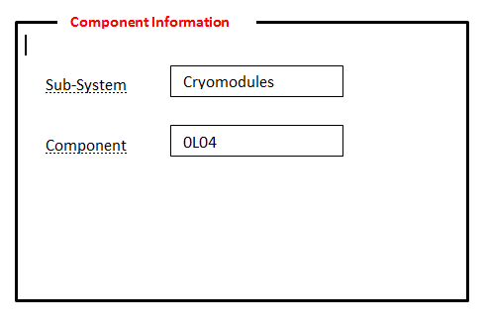
Vision
The central hub would allow the user to drill down to the component or subsystem level
The subsystem level would provide links to downtime, Ops-Prs, and ATLis
The component level would provide links to downtime, ops-pr, ATLis, ABIL, HCO, and Jlist
Once the user selects the subsystem or component, they pick the tool they want to use.
Information would be automatically fed to the other tool to facilitate the processes.
ATLis
Ops-PR
DownTime
ABIL
HCO
JLIST

Slide 13
Issues and Questions
Several tools exist to guide our everyday activities here at JLab.
  And next year there will surely be more tools . - Too many?
The improvement that new tools make to the Jlab “system” should always justify implementation costs and employee efforts. - Do they?
There has been significant effort to keep software coupled, but some tools were developed in different times and under different circumstances
  Stepping back and tying the tools together using a more structured, component centric, approach can provide a more robust overall system. - Can we?
The next iteration of the tool should provide, by design, an improved feedback mechanism with the users, and use cases, in mind
  Provide better searchability, reduced redundancy, simple and consistent interfaces.
  give users easy access to all relevant information about components.
  clearly provide users a “value added” – Will it?

