Slide 1

Plans for improved reliability and margin of the 5th pass separators
Tomasz Plawski
Jefferson Lab
OPS Staytreat, June 29, 2016
Arne Freyberger, Ives Roblin, Anna Solopova, Mike Spata, Haipeng Wang
Brian Bevins, Reza Kazimi, George Lahti
Rama Bachimanchi, Larry Farrish, Curt Hovater, Clyde Mounts, Rick Nelson , Mark Wissmann
Anthony DiPette

Slide 2
Outline
750 MHz Cavity Design and Performance
December 2015 Commissioning
April 2016 Re-Commissioning
May 26 2016 Cavity Test
Plans for Larger Deflection Angle and Improved Reliability
- Cavities Testing, Reworking and Move
- IOT Strengthening and RF Power Distribution Improvements
- Resonance Control System Modification
- Other Possible Improvements

Slide 3
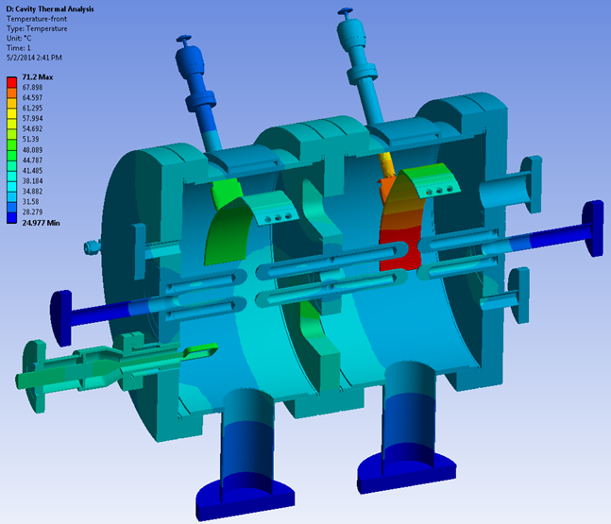
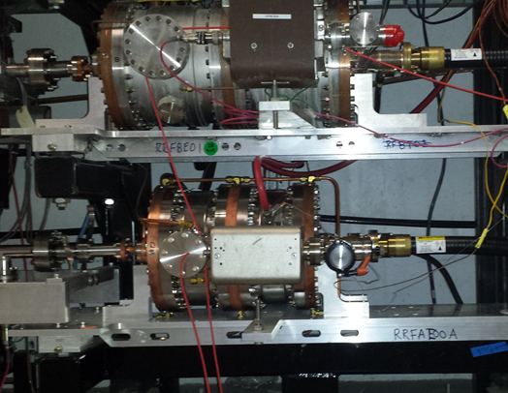
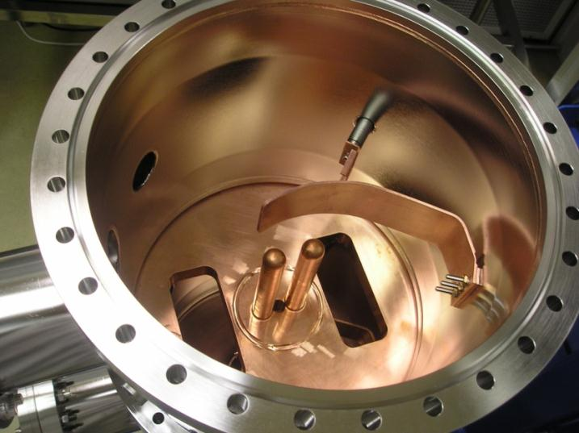
750 MHz Cavity Design and Performance

Slide 4
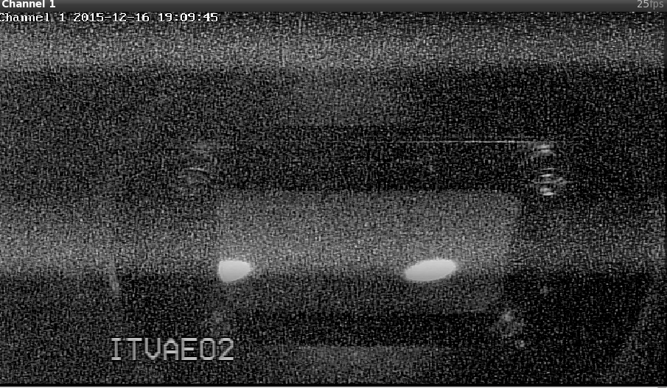
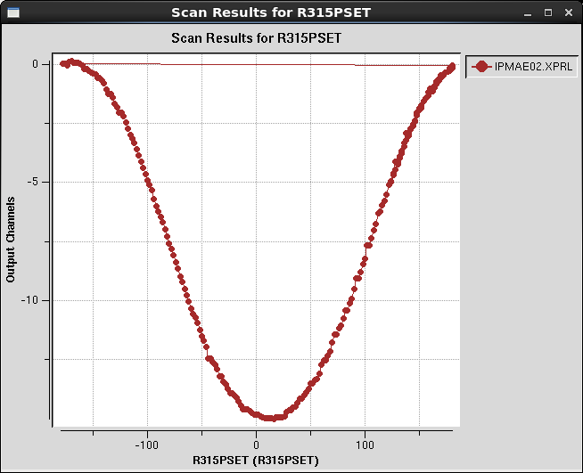
December 16 2015 Commissioning
Separation was below 16.5 mm but beams were getting through
Small beam size
RF power from IOT – 10.95 kW
Resonance Control parameters within specification window

Slide 5
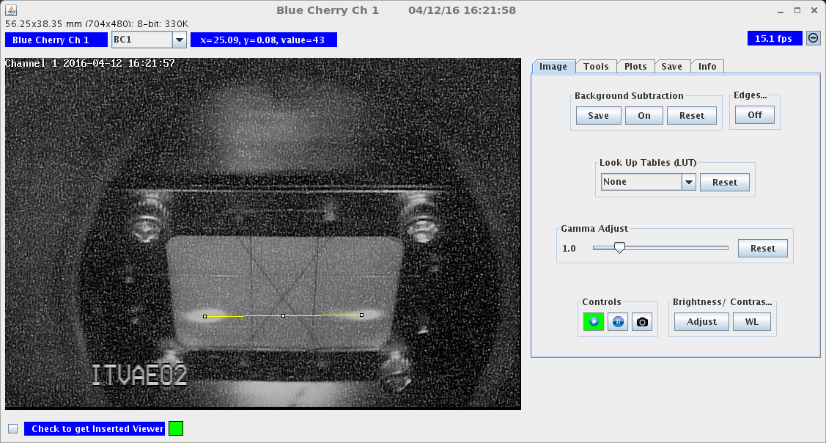
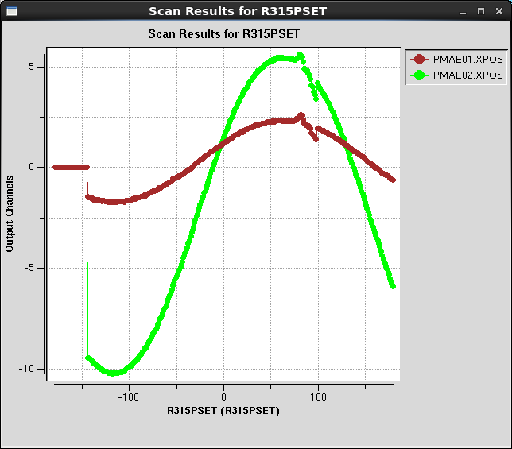
April 12 2016 Re-Commissioning
Shunt impedance measurements for the four 750 MHz cavities ( average for all four cavities - 89 MOhms)
Larger (compare to December commissioning) beam size
RF power from IOT – 11.65 kW
Water Skid Resonance Control ( for cavity 3 and 4) below critical 500 W and full LCW flow – not reliable operation !

Slide 6
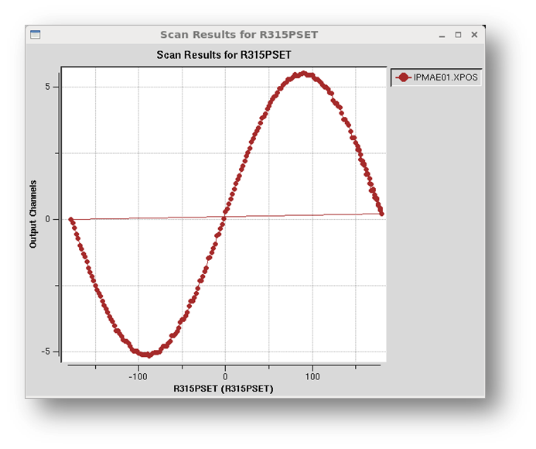
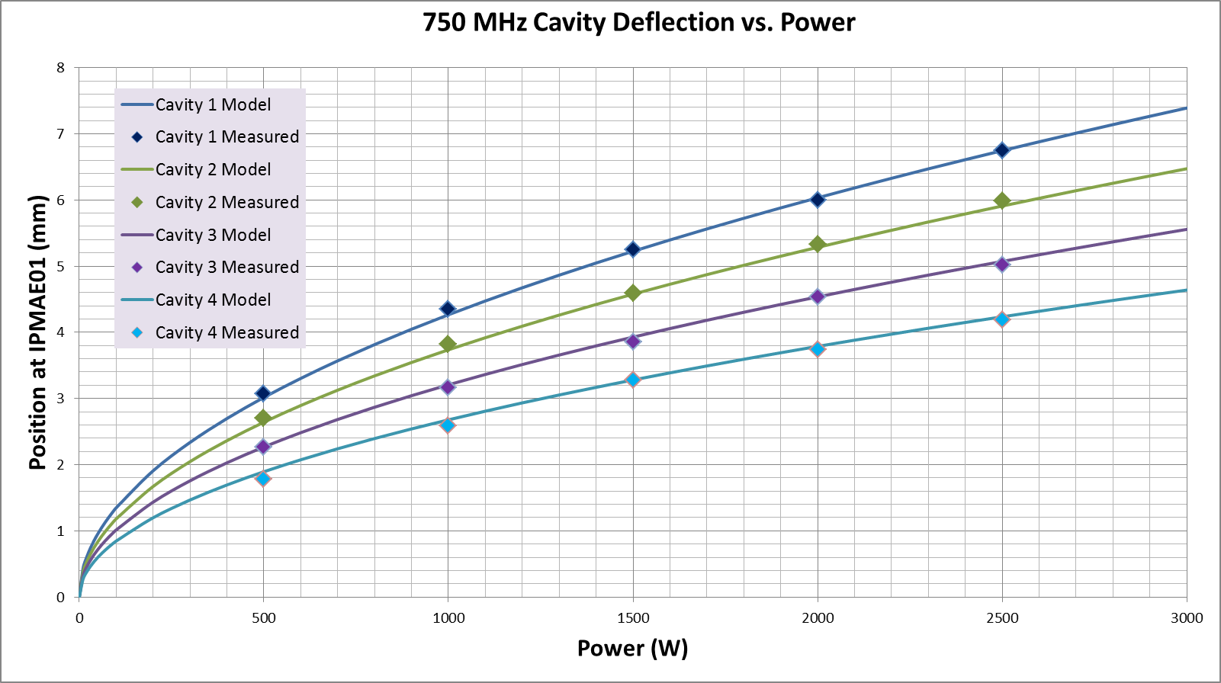

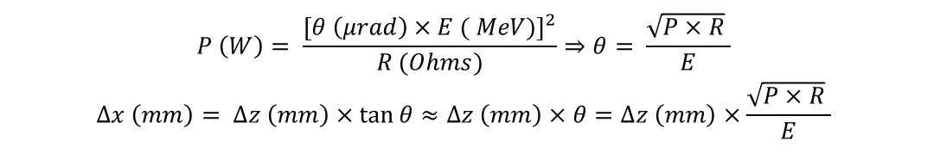
May 26 2016 Cavity Test
$$P \left(W\right)= \frac{{\left[θ \left(μrad\right)×E ( MeV)\right]}^{2}}{R (Ohms)}⇒θ= \frac{\sqrt{P×R} }{E}$$
$$∆x \left(mm\right)= ∆z \left(mm\right)×\tan{θ≈∆z \left(mm\right)×θ}=∆z \left(mm\right)×\frac{\sqrt{P×R} }{E}$$
$$Rs=104±2 MΩ$$
1st pass beam into 5th pass beamline
Deflection measured separately for every cavity at multiple RF power levels
Measured Rsh is about 15% higher then estimated based on beam deflection for all four cavities !
Phasing error, imprecise vector sum compensation during phasing ?
We need to investigate this discrepancy during next commissioning

Slide 7
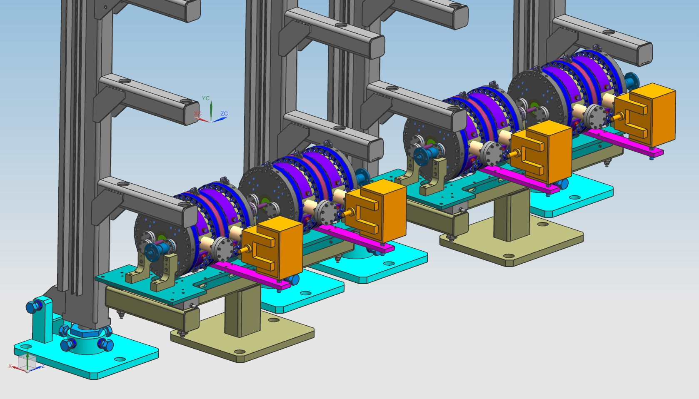
Cavities Move
 | AsFound | Proposed | Proposed: decrease RF kick, maintain 16.5mm, maintain quad setting | Sort
750MHz angular kick (rad) | 1.50E-04 | 1.50E-04 | 1.37E-04 | 1.50E-04
Required Separation at AE02(mm) | 16.5 | 16.5 | 16.5 | 16.5
Sep(CG) to Quad(mm) | 11899 | 13631 | 13631 | 12106.5751
Beam offset at Quad (mm) | 1.78 | 2.04 | 1.87 | 1.82E+00
Quad to YA (mm) | 18264 | 18264 | 18264 | 18264
Angle after quad (rad) | 3.54E-04 | 3.84E-04 | 3.50E-04 | 3.58E-04
Quad kick(rad) | 2.04E-04 | 2.34E-04 | 2.13E-04 | 2.08E-04
Maximum Separation at YA(mm) | 16.5 | 18.1 | 16.5 | 16.7
Gain(%) |  | 9.70% | 8.70% | 1.20%
Gain(mm) |  | 1.6
Two of the four girders will be modified
4 cavities will be consolidated onto two girders
Larger distance to quad
Expected deflection improvement: 8 %

Slide 8
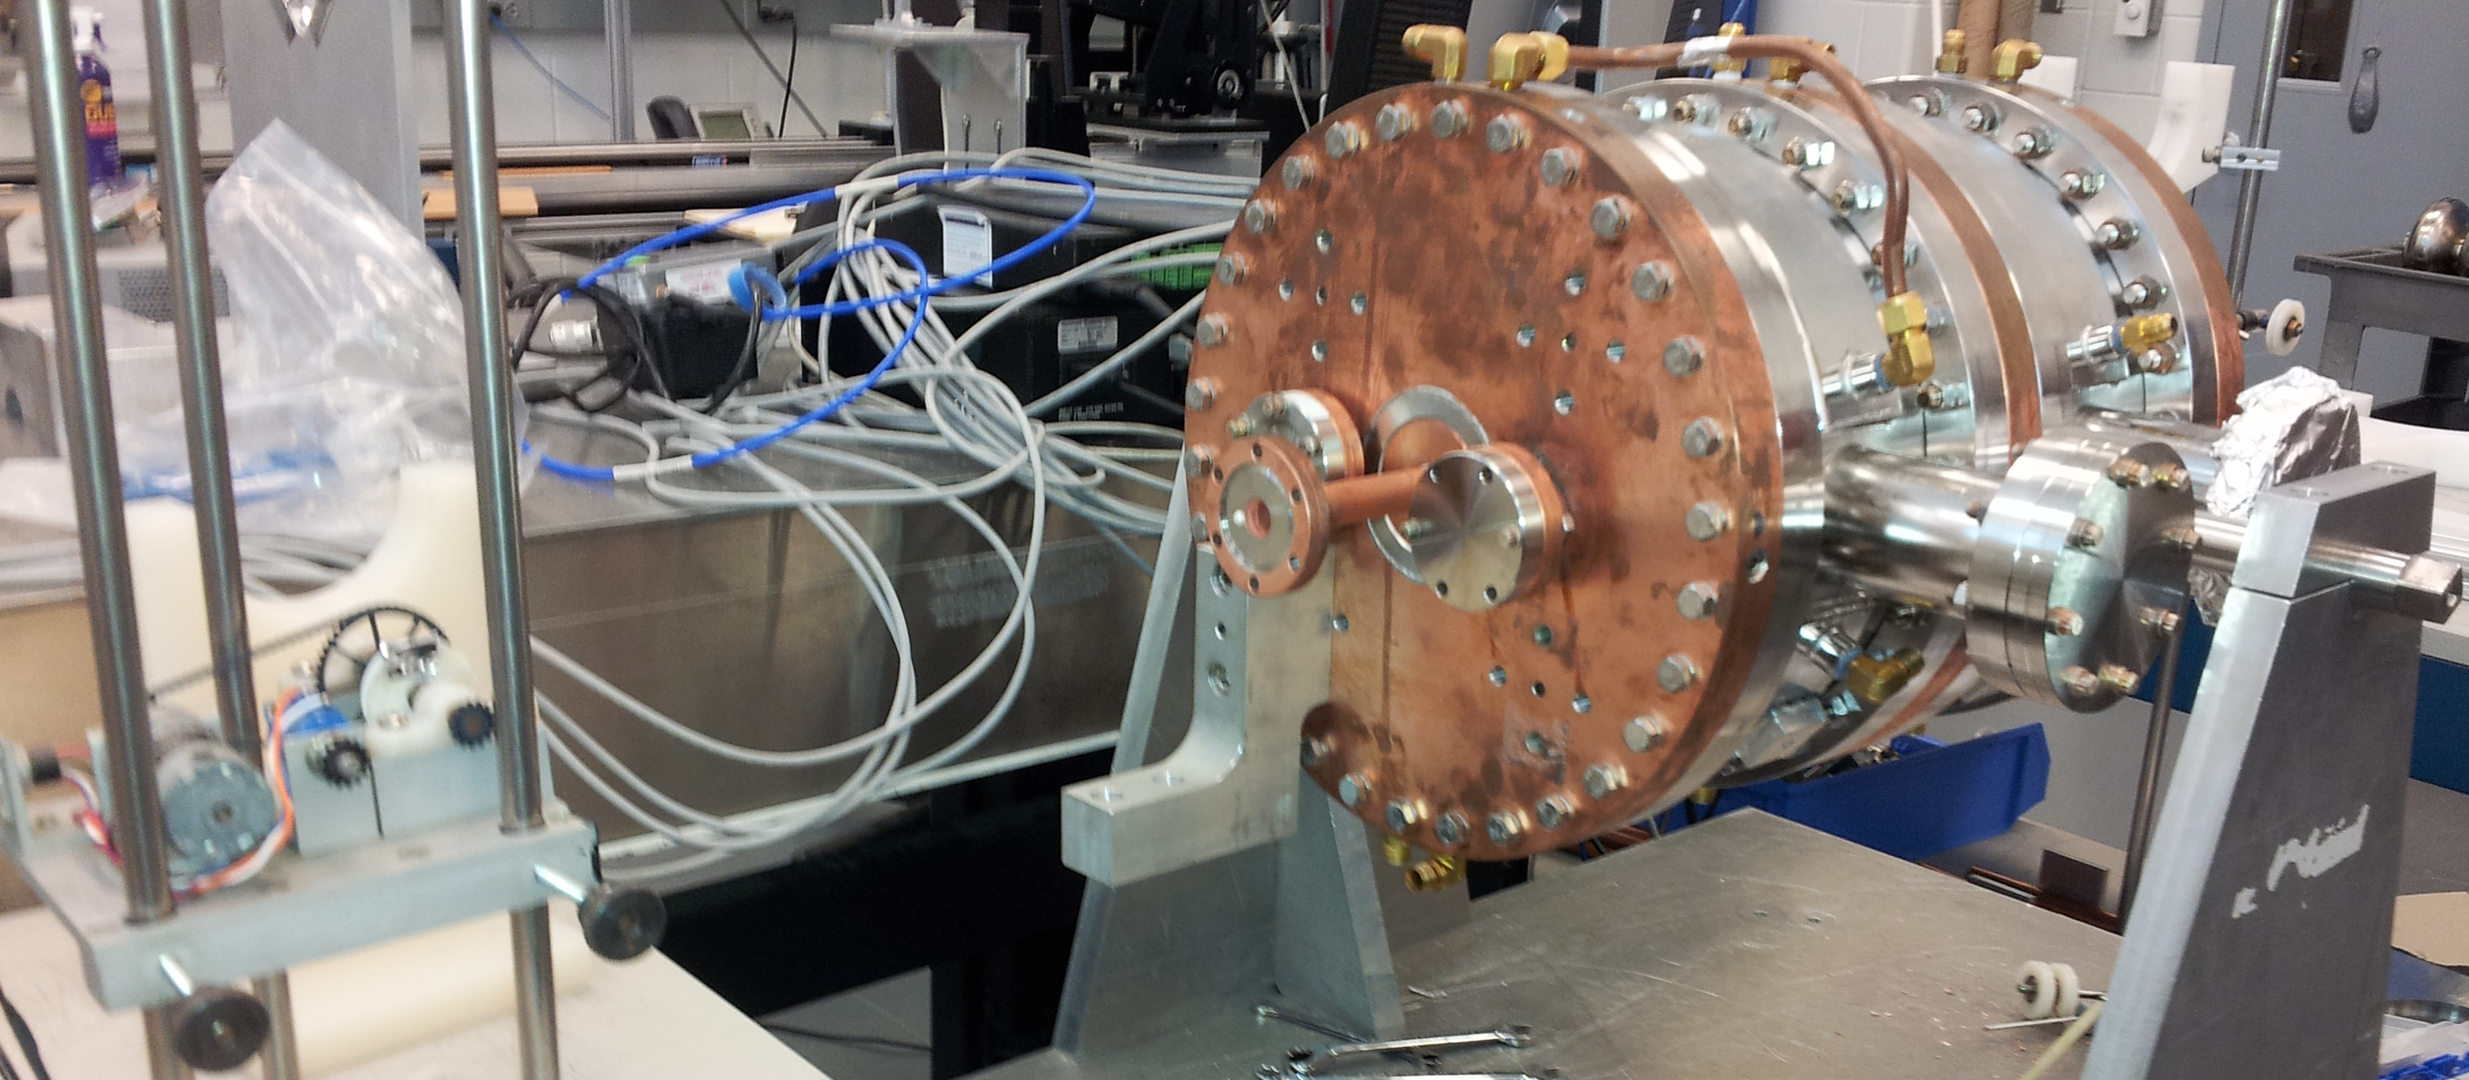
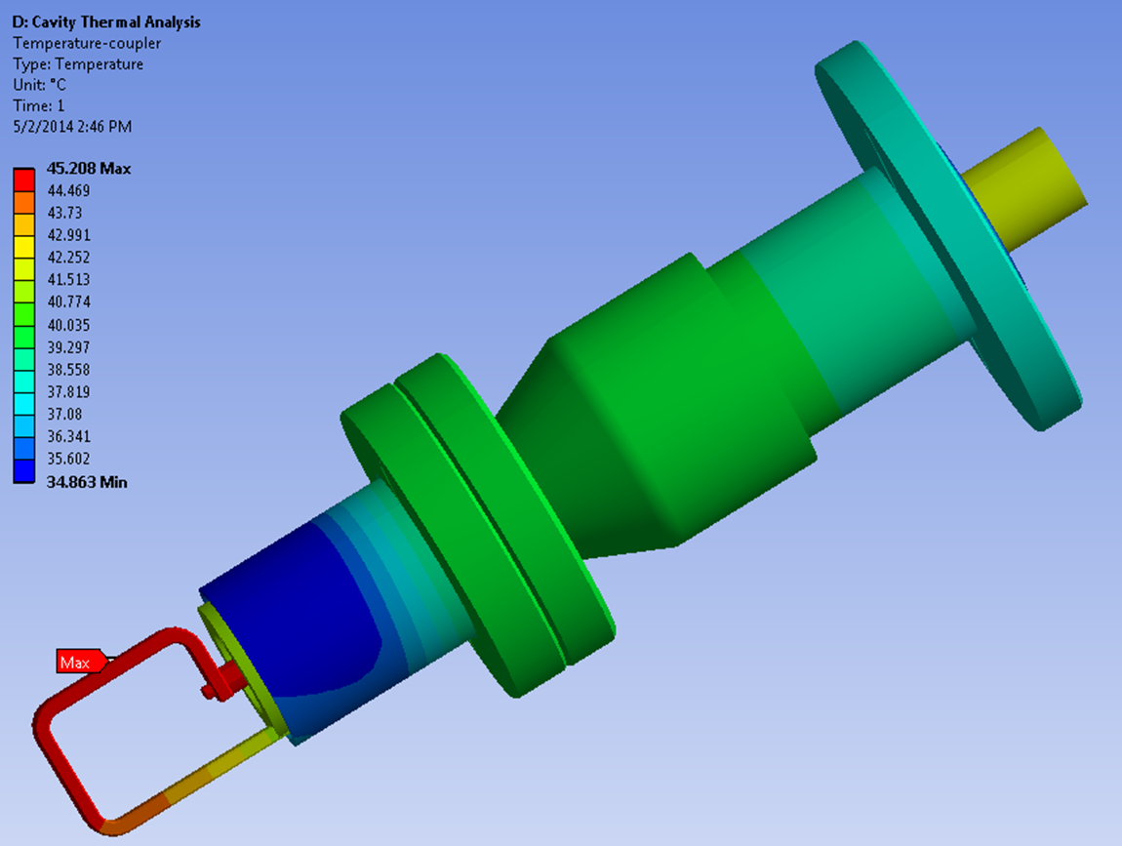
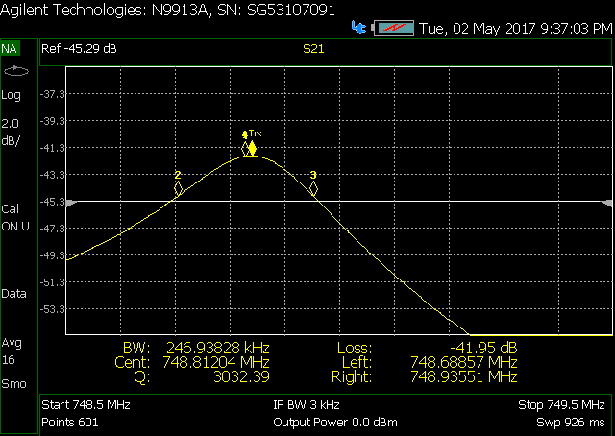
Cavities Testing and Reworking
Q_{L} at different temperatures test - done
Coupler relocation ( imposed by cavities moving) – in progress
Critical coupling, tuner plates positioning, field flatness – in progress
Parameters variance between cavities explanation – in progress
T1=92 F Q_{L} = 3032
T2= 130 F Q_{L} = 3010

Slide 9
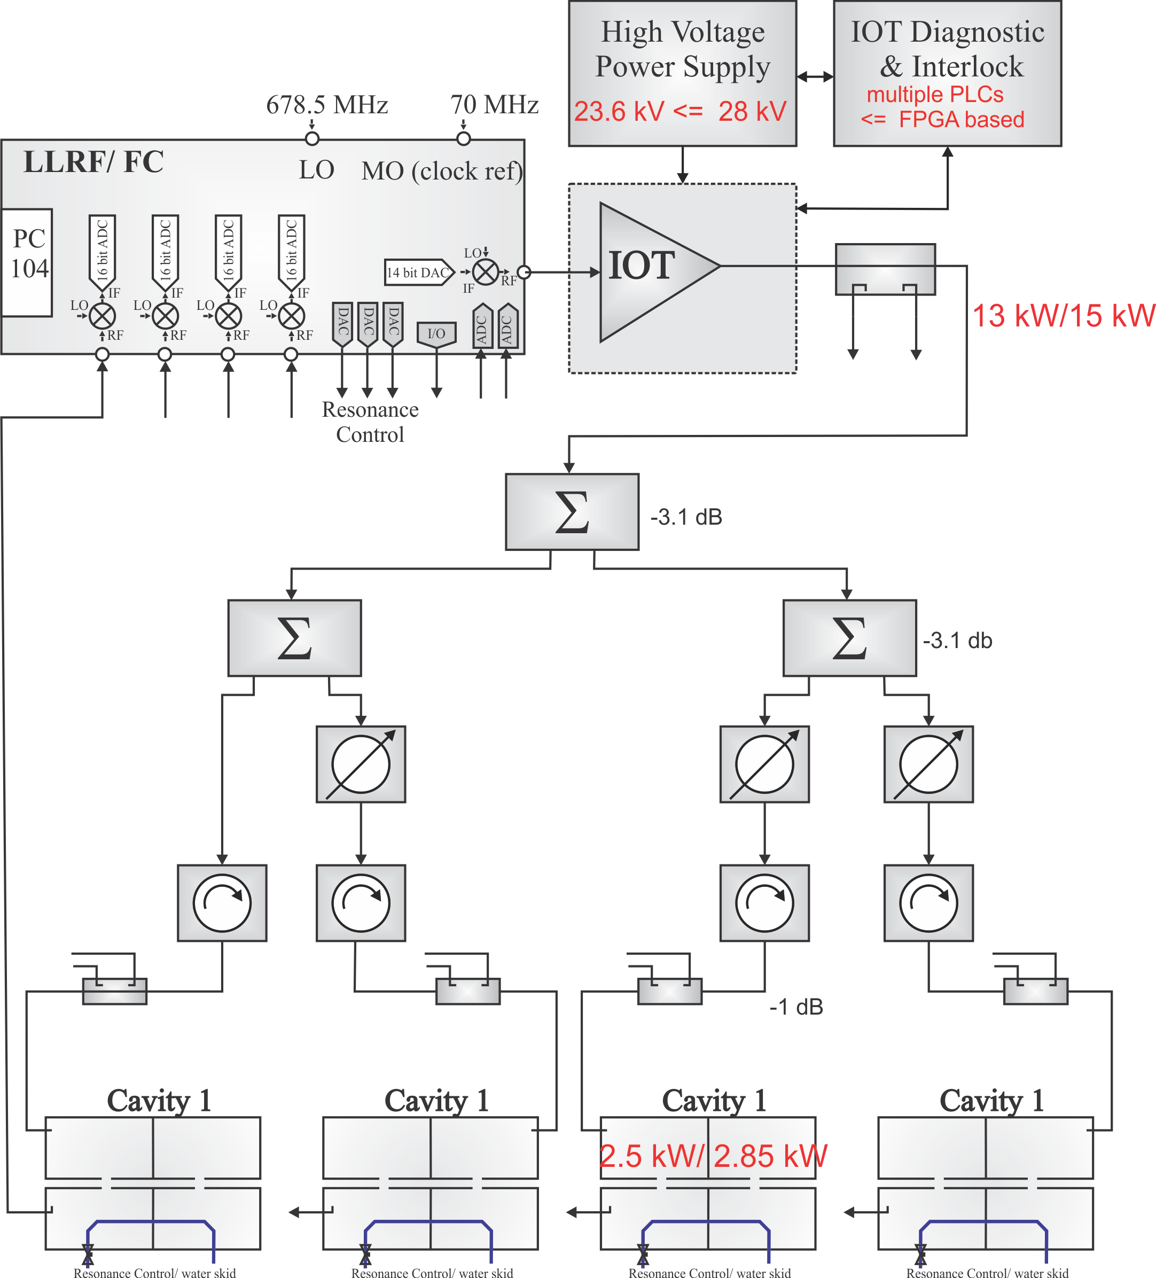
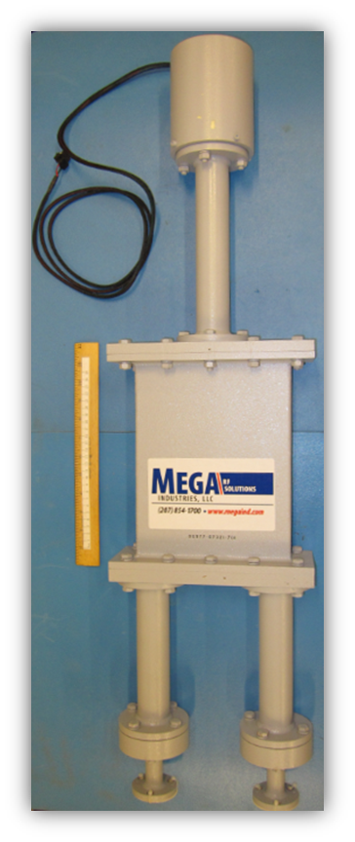
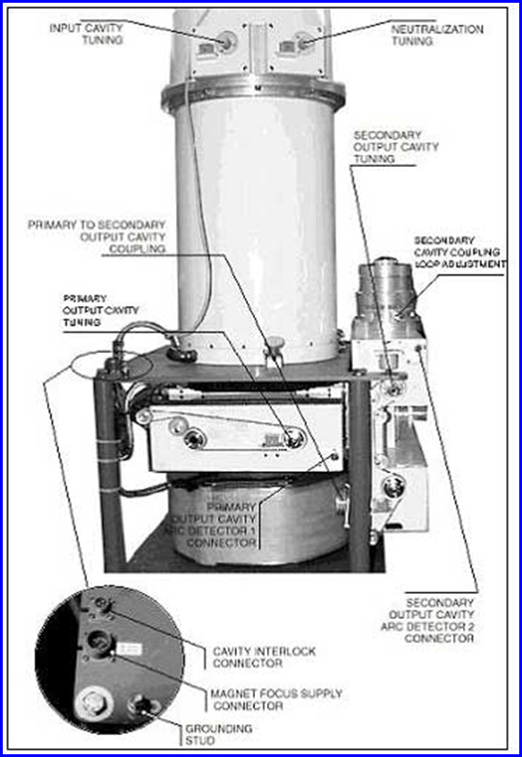
IOT Strengthening and RF Power Distribution Improvements
High Voltage transformer adjustment - IOT RF power 15 kW
1 5/8" Heliax cable adjustment and placement on modified girder - this summer
High Power Phase Shifter rework – this summer , replacement (future)
New FPGA based IOT/HV interlock/monitor system – winter ?

Slide 10
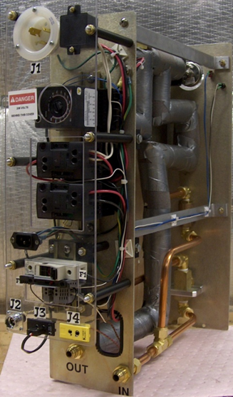
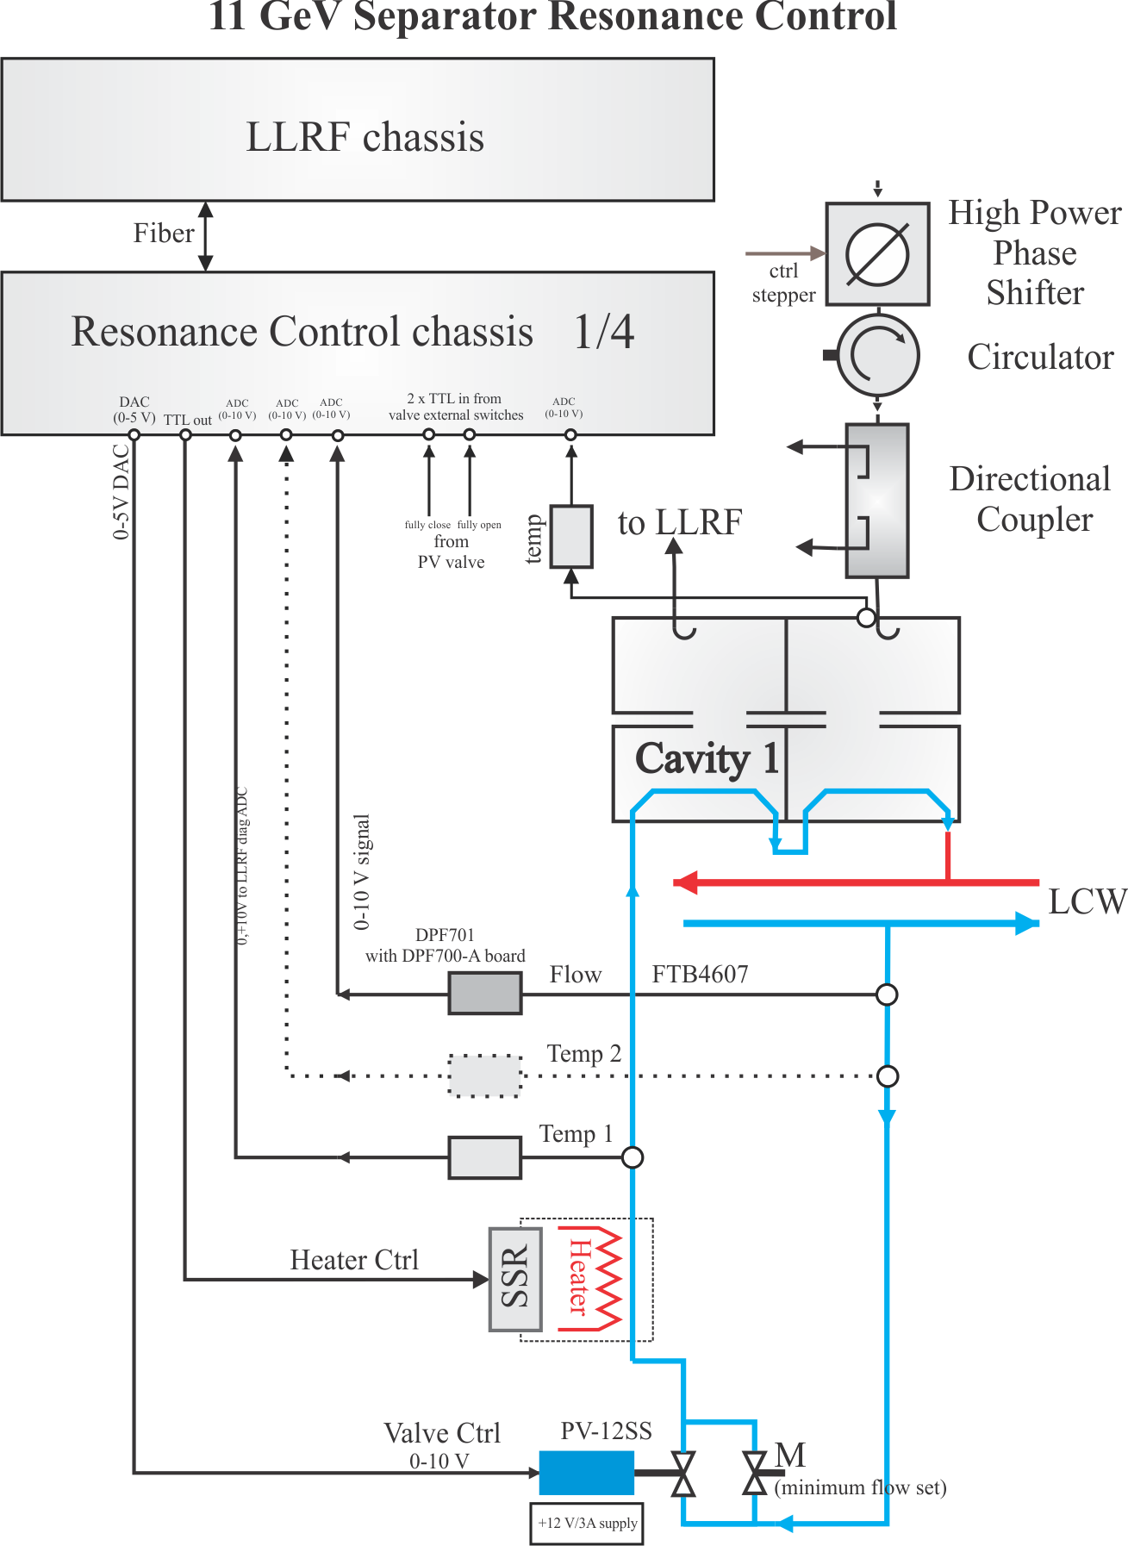
Resonance Control System Modification
Increase heater power form 4.5 kW to 6 kW - in progress
Use more precise LCW valve ( future ?)
Pre-detune cavity to operate it at higher temperature (this summer)
Control software modification in order to minimize recovery time:
  Better valve linearization ( this summer)
  Replace Smith Predictor with Model Predictive Controller (future)

Slide 11
Other Possible Improvements
Close Loop Cooling System – expensive but will significantly improve cavity performance
Silver Plated Cavities – increased electrical conductivity but a lot of uncertainness hence requires research
5th cavity - we have 4 kW amplifier but infrastructure, LLRF, resonance control need to be build

Slide 12
Summary
This summer we are looking for 18-19% of performance improvement but 10 % depends on unknown IOT reliability

Slide 13
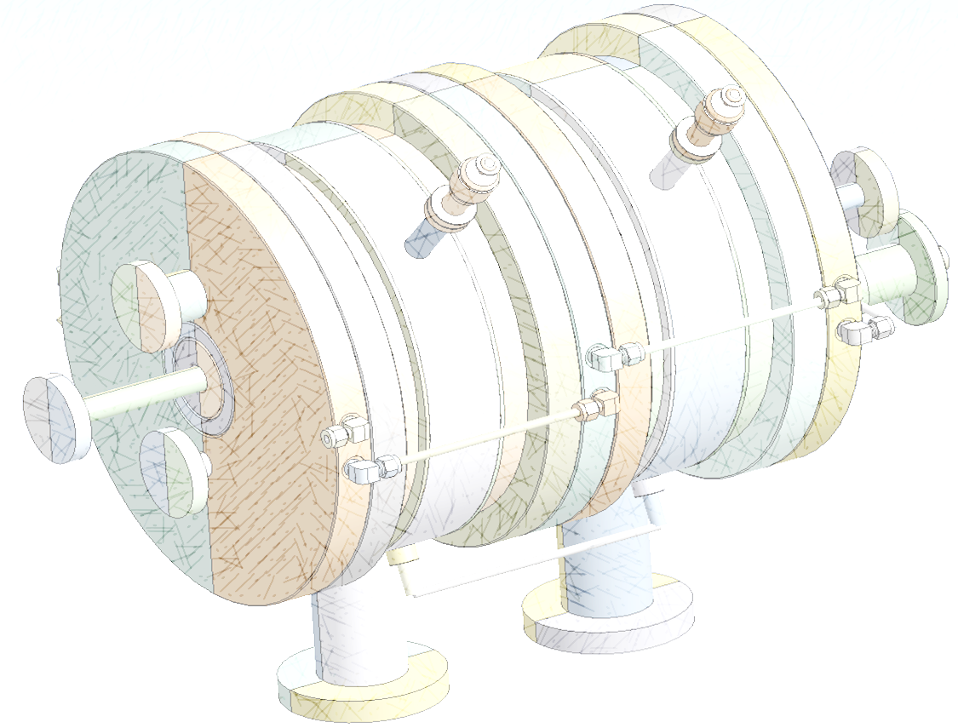
Thank you for your attention !

Slide 14
Backup Slides

Slide 15
