Slide 1

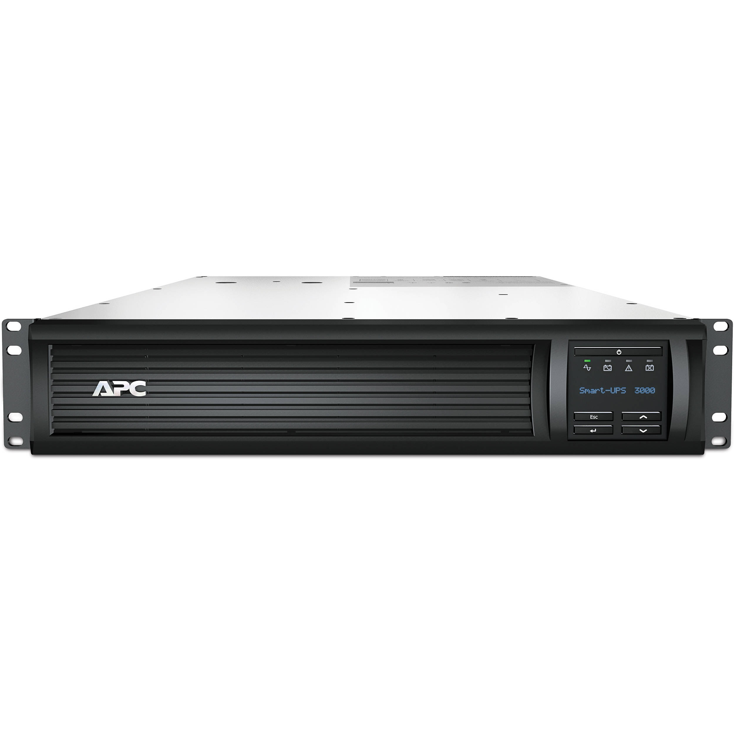

Anthony Cuffe
2016 Operations Stay Treat
Improving System Reliability
A Case Study of Accelerator UPSs
Notes:
Title Page Design 3

Slide 2

Summary A Case Study of Improving UPS Reliability
Typical UPS Usage
Backstory
Initial Status and Analysis
Reliability Study
Maximizing Availability, Reliability and Manageability
Automation, Monitoring and Logging Tools
Results
Key Points
Q & A

Slide 3
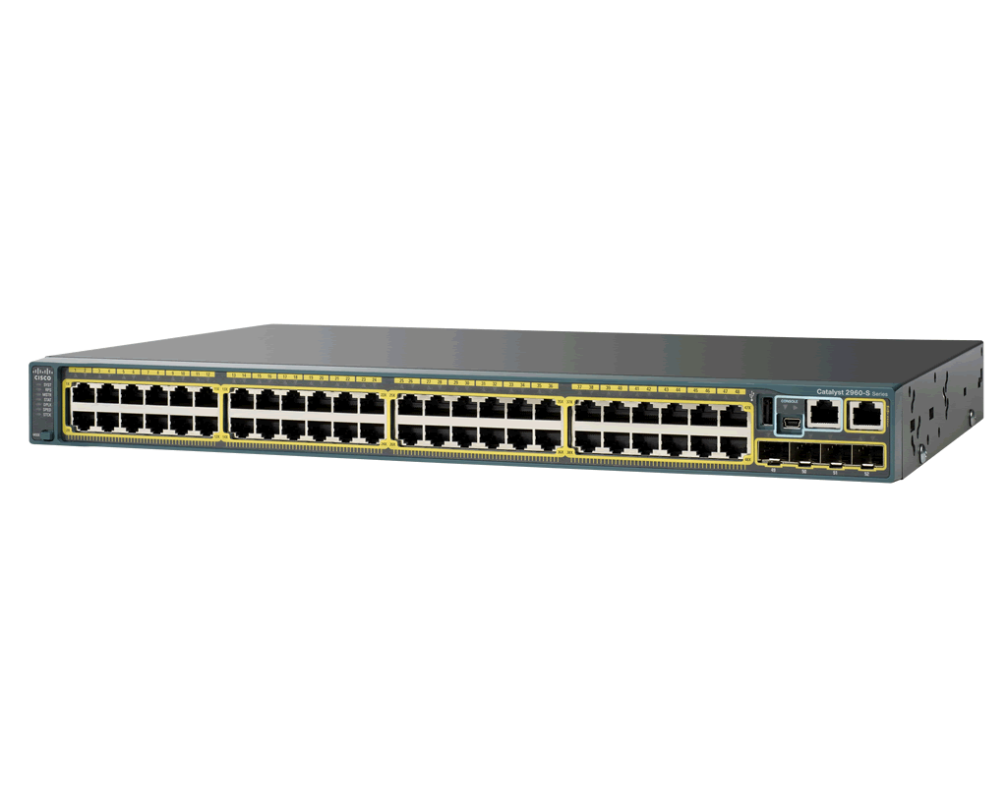




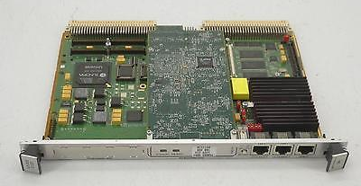
Typical UPS Usage in A.C.E.
Line Power
&
Battery Power
Line Power
Protection from Power Loss and Poor Line Quality for:
  Critical Workstations and Servers
  Network Infrastructure
  RF, Vacuum and other critical IOCs

Slide 4
Backstory What just happened?
Historically our group maintained around 10-15 rack-mounted, enterprise grade UPSs.
        … This was manageable without much effort.
After a re-org, our group became the proud owners of 100+ UPSs.
    … And most of them weren’t shiny and new!
After staging through denial, anger, bargaining, and depression, we accepted it.
        … This is how we got over most our grief.

Slide 5
Initial Status The Reality of Square One
Responsible for 100+ UPSs (and growing!)
~10 were outright failed
~10 were in a faulted state
40+ were found to be 8-16 years old (5 year lifetime)
Configuration was manual, onerous and inconsistent
Deployment took a very long time (1++ hour)
Monitoring was impossible
  Sheer volume of error messages (X,000+/per day)
  System age
Our attitudes towards the system were awful
  Dread
  Apathy
  A few resumes were tuned up

Slide 6
Initial Analysis Is the system worth improving?
Is the system’s functionality still necessary?
  Servers, network gear and critical IOCs need to survive power interruptions.
  UPSs provide the only low-cost solution to fulfill this need.
Is the benefit worth the cost and staff time?
  ~ $50K to make the overall system reliable and ~$10-20K/year to maintain
  The recovery costs and reduced beam availability associated with frequent power-outages greatly exceeds the cost of maintaining UPSs for critical systems.
Is it possible to improve the cost/benefit ratio?
  We felt we could decrease the time spent maintaining these systems by applying practices common to our other systems.
  The benefit could be improved with better reliability and selective application.
  Costs could be spread over years with a well maintained system.
Do you have management buy in?
  We had to convince management that the benefit would be worth the time, effort and procurement dollars.
  It is impossible to improve or maintain a system without resources!
Cost Benefit Analysis

Slide 7
Reliability Study UPS Failure Rate
Near Constant Failures
Safe Zone
Increasing Failures
Failure Rate
FY17?
Where we think we are now
Where we were
Chassis Failures
Wear Out Failures
Battery Failures
Random
Burn-In Failures
Rare
Suggested Lifespan 6-10 Years
Time
1st Weeks
4 Years
6 Years
10 Years
15 Years
* Curve estimated based on experience, dependent on operating environment

Slide 8

Improving Availability
Availability Depends on Reliability and Manageability
$$AVAILABILITY \text{≈} \frac{MTBF}{(MTBF+MTTR)}$$
Maximize Reliability
  Make MTBF as big as possible
  Mitigate unreliability where MTBF cannot be reduced
Maximize Manageability
  Make MTTR as small as possible
  Proactive replacement/maintenance where MTTR cannot be reduced
MTTR - Mean Time to Repair.
MTBF - Mean Time Between Failures.
Availability, Reliability and Manageability

Slide 9
Maximize Reliability Increase MTBF
Get the System to a Manageable State (stability point).
  Inventory audit – You have to know what is out there.
  Replace failed units.
  Repair/replace units in error/faulted state.
Reduce Complexity
    Get rid of unnecessary units.
    Remove unnecessary components (PDUs, Transfer Switches …)
    Reduce unwanted loads on the system.
Implement Redundancy
  Design/Deploy systems with redundant power supplies.
  Implement redundant systems so failures are actually tolerable.
Monitor for Faults, Failures and Predicted Failures
  Email Alerts – from units themselves and active polling
  Alerts for low Runtimes, Faults and Failures
  Performance Graphing for historical perspective and statistics
  Failure Prediction
  Centralized Logging for history and analytics

Slide 10
Maximize Maintainability Decrease MTTR
Corrective rather than Preventative maintenance
  Predicted failures are replaced before problems arise
  Actual failures are replaced quickly
  Batteries are replaced when there are faults not on a schedule
  Configuration changes and updates are done globally
On the shelf spares
Implement redundancy wherever possible
  MTBF and MTTR are zero if system is redundant!
  Critical systems always have dual power supplies and UPSs
Automate as much as possible
  Research available tools (open source and vendor provided!)
  Automation produces consistent and complete configuration
  Custom scripts can automate tasks and deployment (~5 min)
  “If you do something more than once, you should write a script to do it!”

Slide 11
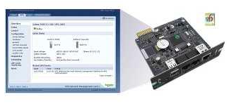
Vendor Tools Automation and Monitoring
APC UPS Network Management Tools
Monitoring, Control and Remote Access
  Web browser
  Command line interface
  SNMP, SSH, FTP ...
Event and Data Logging
Scheduled Self-Tests
Email Notification
  Faults, Failures & Warnings
  Self-Test Results
  Configuration Changes

Slide 12
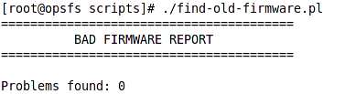
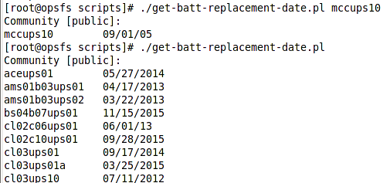
Custom Tools Automation
Scripting Framework
  Global management tasks via custom scripts
  Scripts leverage vendor tools
  Simple text file database of UPSs
  Centralized configuration management
  Configuration consistency checks
  Information gathering tools
  Automated reporting tools (daily and manual reports)

Slide 13
Custom Tools Automation
Rapid Deployment System (~5 mins)
  Automated deployment with custom scripts
  Process leverages vendor provided tools
  Easy and well documented procedure
  Consistent and complete configuration
  Rapid and automated reconfiguration
[upsadm@node scripts]# ./deploy_new_ups.pl mccups13
Username [apc]:
Password [apc]:
Community [public]:
Ready to run on the following UPSes.
mccups13
Continue (y/N):

Slide 14
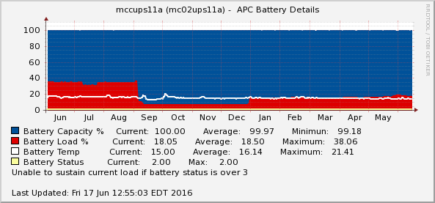
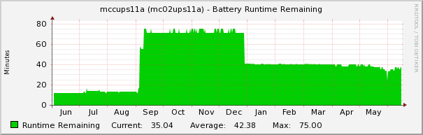
Monitoring Tools Graphing with Cacti
Cacti – Open Source Polling and Graphing Framework
Performance Monitoring via SNMP
Adaptable to Graph Virtually Anything
Historical Statistics
Problem Identification
Failure Prediction
Global Overview
Free

Slide 15
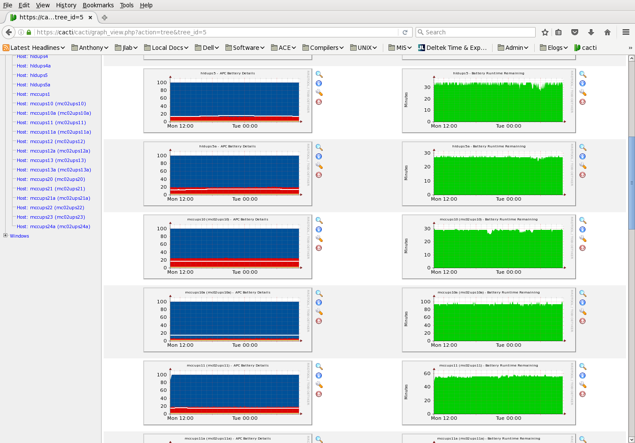
Monitoring Tools Cacti
Custom Global Overviews

Slide 16
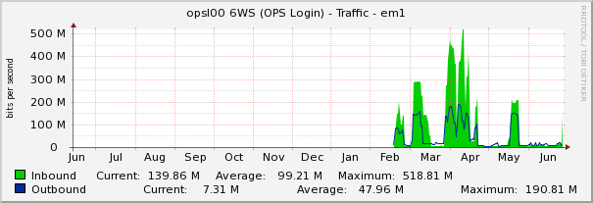
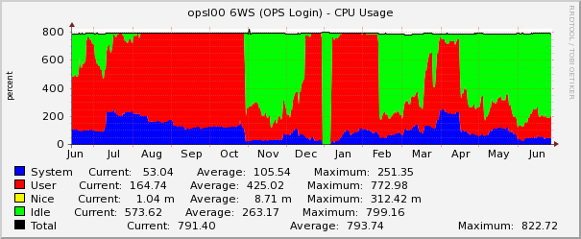
Monitoring Tools Cacti
Adaptable to Graph Virtually Anything
    … even mis-behaving users

Slide 17
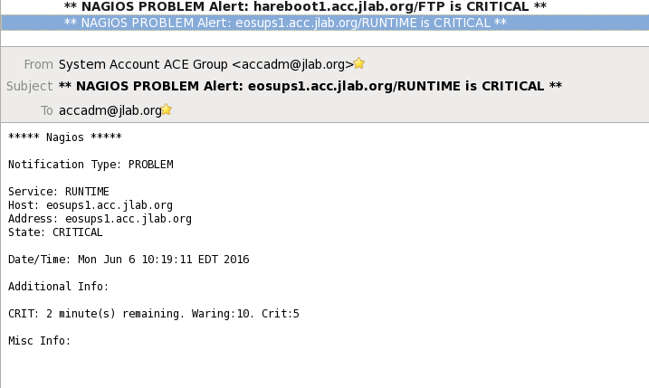
Monitoring Tools Status Polling with Nagios
Nagios – Open Source Monitoring Framework
System and Service Status Polling via SSH, SNMP, …
  Runtime Warnings
  Fault and Failure Detection
  Active and Negative Service Monitoring (want SSH but not FTP running)
Easily adapted to almost any need and for multiple groups
  Already monitoring services for others groups like AHLA
  Group based service/system notification
Email/SMS Alerts
Web based H.U.D
Monitor for Monitoring
Free

Slide 18
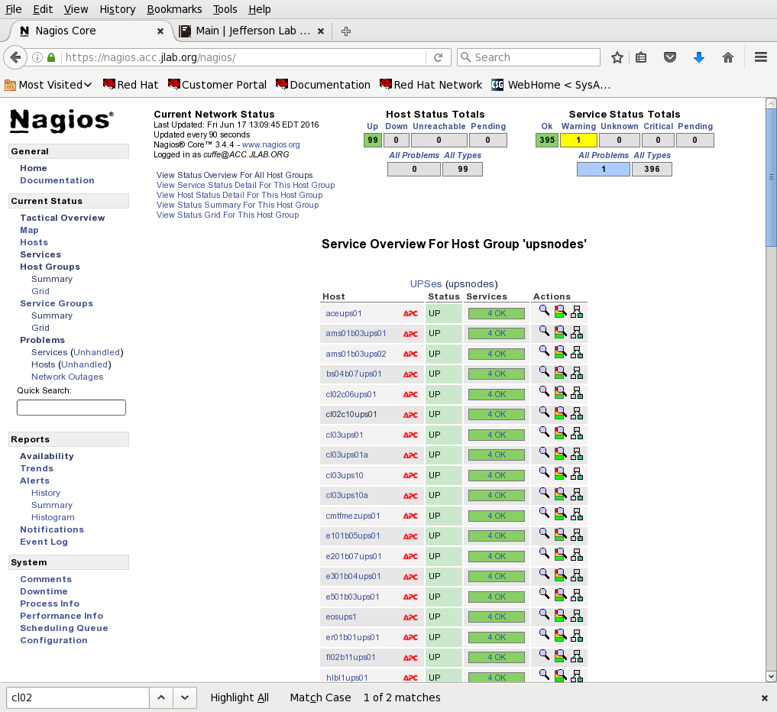
Monitoring Tools Status Polling with Nagios
Heads-Up-Display

Slide 19
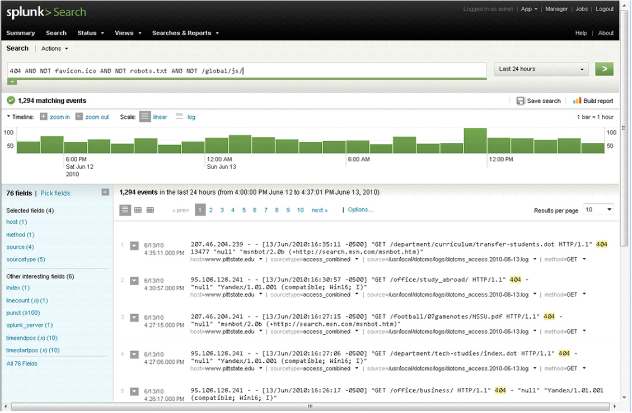
Logging Tools Centralized Logging w/Analytics
Swatch (Syslog Watch)
  Filter and Summary Tool for centralized logging – filter out normal, noisy logs
  Daily Reporting via Email
  Extensible Filtering – easily add custom filters
  Open Source
Splunk
Splunk is a fully featured, powerful platform that collects and indexes any machine data from virtually any source in real time. We feed it our centralized logs.
  Index any Text Data
  Interactive Search Results
  Monitoring and Alerting
  Reporting and Analysis
  Event Correlation
  Custom Dashboards
  Add-in apps
  Already extended to other groups
  Not Free but DOE contract in works!

Slide 20
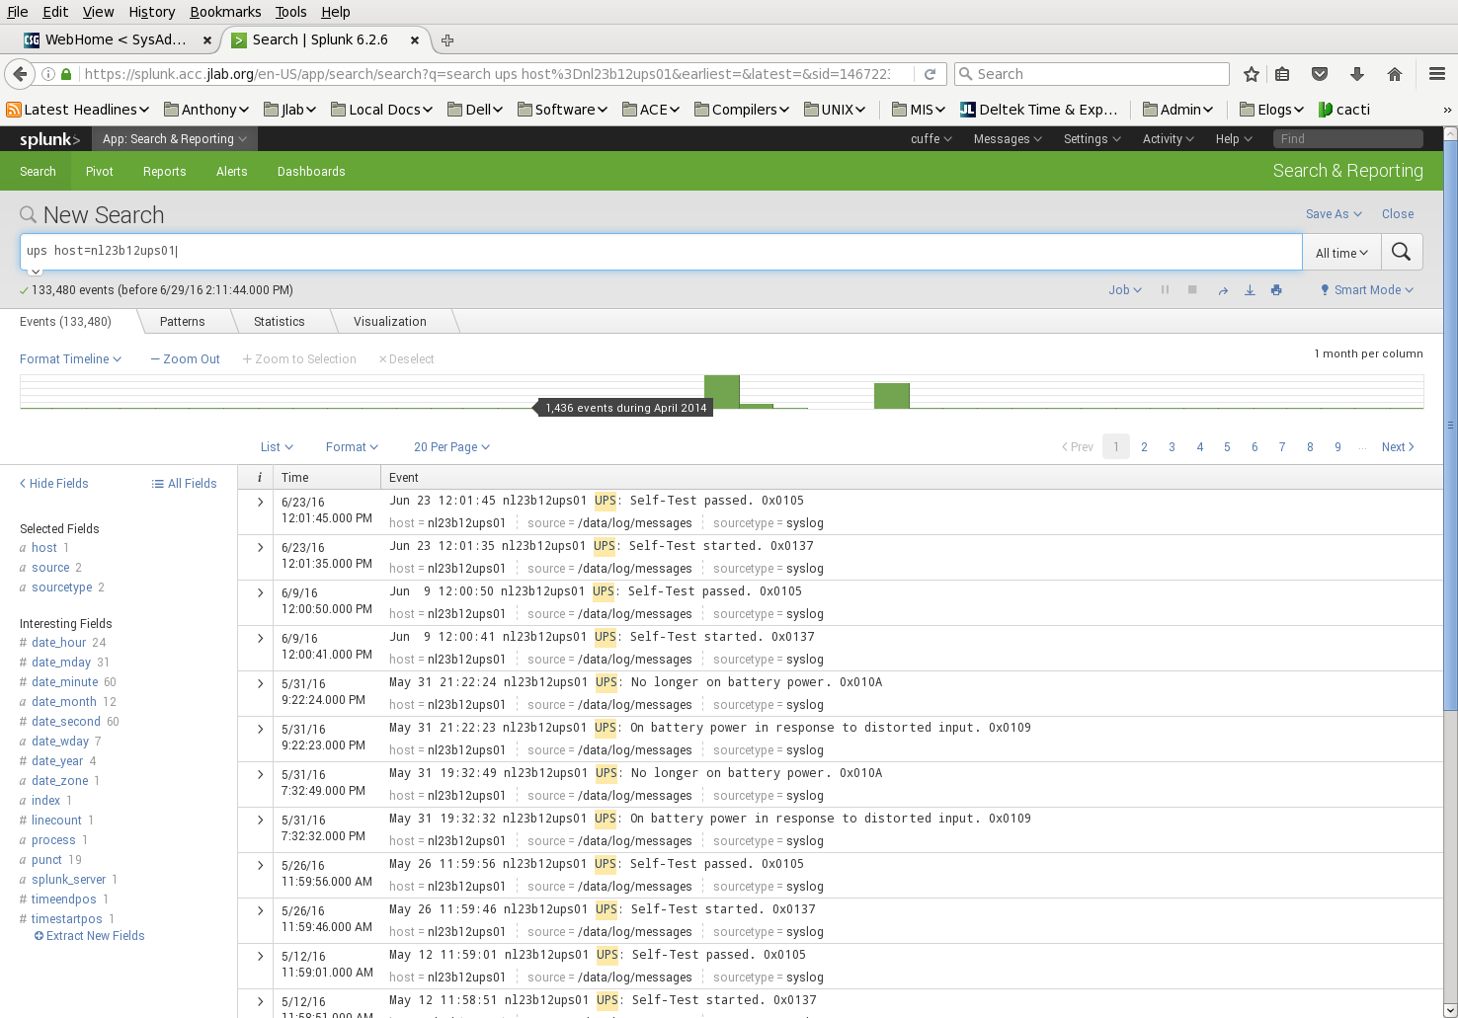
Logging Tools Splunk
Deep-Dive Your Data

Slide 21
Results Higher Availability with Lower TCO?
Before (10–15 units):
  Configuration was manual, onerous and inconsistent
  Deployment took a long time (+1 hour)
  Attitudes towards system were apathetic or dreadful
  Monitoring was nonexistent or a deluge.
  Failures were commonplace and faults were ignored.
After (100+ units):
  Configuration is automatic, fast and consistent.
  Deployment is very quick (~5 minutes).
  Replacement is now simply a routine task .
  Monitoring is proactive, accurate and very predictive.
  Failures are rare and faults are dealt with quickly.

Slide 22
Key Points to Take Away
Buy in by management a must.
  You cannot maintain a system without resources!!
Redundancy wherever possible
  MTTR and MTBF are virtually zero with redundancy!
Automate as much as possible
  Ensures standardization.
  Reduces staff time.
  Improves the culture.
Monitor as much as possible
  Failure notification and prediction is critical!
  Fixing things before they break means zero downtime!
  What you don’t know usually hits you hardest!
  Pretty graphs and real data translate into better budgets!
Find or create tools to make things faster and easier
  Research vendor and open source solutions
  Simple solutions like shell scripts can be very powerful
  Leverage the expertise of other groups

Slide 23
Q & A

