Slide 1
Data-Driven Machine Retuning
2016 StayTreat

Slide 2
Run Until It Breaks (or Cries)
The operations paradigm at CEBAF seems to be (mostly) “Run Until It Breaks”
A reasonable reactive paradigm for repairs
Preventive maintenance occurs during SADs or opportunistically behind failures
History: CEBAF used to be scheduled preventive maintenance
Corresponding optics paradigm: “Run Until They Cry”
Users tasked with monitoring beam quality after setup
No tuning until:
Scheduled configuration change
Hardware (or beam studies) breaks
Users cry topic of this discussion
Terry will cover tune time tracking in DTM

Slide 3
Run Until They Cry
Is it the right paradigm for optics tuning?
Pros:
Gives priority hall control over program
Potentially long intervals between tuning
Great (?) beam after aggressive tuning
Cons:
Optics adopts a reactive stance
Retuning mentality: “fix everything while we’re here”
Possibly longer tune time when it occurs
Retune usually a change that improves symptom
Harder to identify root causes
Users remember when they cry too much

Slide 4
Daily Invasive Measurements
We currently (sometimes) perform some daily invasive optics measurements
Daily QE measurements
Daily fopts
Useful to detect gross beam transport changes after 1S (but not injector)
See next page for plot of fopt frequency
Suggests that we did not do enough systematic tuning during January restoration
Routine fopts are probably not be cost-effective
Can easily (even often) be degenerate
Not precise enough to drive small optics changes
Benefit: tracking medium-term dispersion

Slide 5
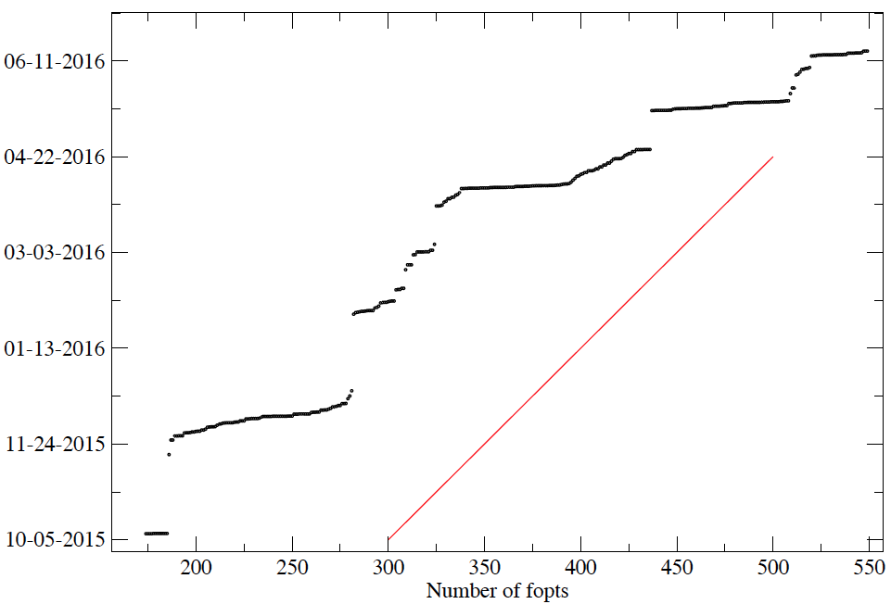
Frequency of fopts
PRad setup
End 12 GeV Run
Tuning
Apr 5-7 restoration
Tuning
Late Jan restoration
1/day
Winter SAD
Nov 9 restoration
More than 1/day

Slide 6
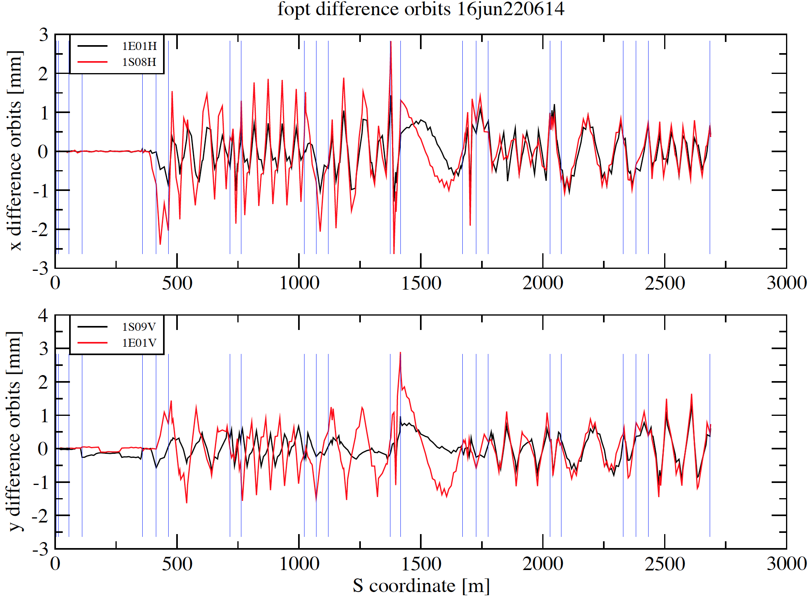
(Random) Degenerate fopt
Degenerate
SE A R L S E A R L S E A R L S E A
Degenerate
SE A R L S E A R L S E A R L S E A

Slide 7
Daily Invasive Measurements: Profiles
Cost/benefit of daily beam profile data collection?
Viewers: not precise enough
Also not amenable to automated capture/analysis
SLMs: archivable, parasitic at certain locations
Need to be treated analytically: priority?
Daily fast harp scans (3-5 mm/s) may be cost effective in finding/characterizing small drifts
particularly correlated with fopt/rayTrace
simple to automate: ~45s/harp of tune beam
Routine profile measurements give precise tracking of transverse injector beam parameters
Reinstitute 0L07-10 emittance measurements?

Slide 8
Daily Invasive Measurements: rayTrace
Cost/benefit of daily rayTrace instead of fopt?
Avoids fopt degeneracy
With tool development, data acquisition time is about the same
Analysis tools are being resurrected/developed
Large potential to benefit startup/config change
Potentially precise enough to
drive fine retuning
localize/identify drifting magnet power supplies
characterize complete transport stability

Slide 9
Issues and Open Questions
We are tasked with improving accelerator reliability
How do we minimize “crying users” tune time?
Is the current “fix it when they cry” paradigm right?
Can daily/routine optics measurements and improved routine analysis catch optics problems before they are big enough to make users cry?
If so, can we learn root causes well enough to fix them quickly (even routinely)?
Can this also provide input to priorities in preventive maintenance?
Can we raise priority of analyzed SLM data?
Are routine rayTrace and/or harp scans cost-effective?

