Slide 1
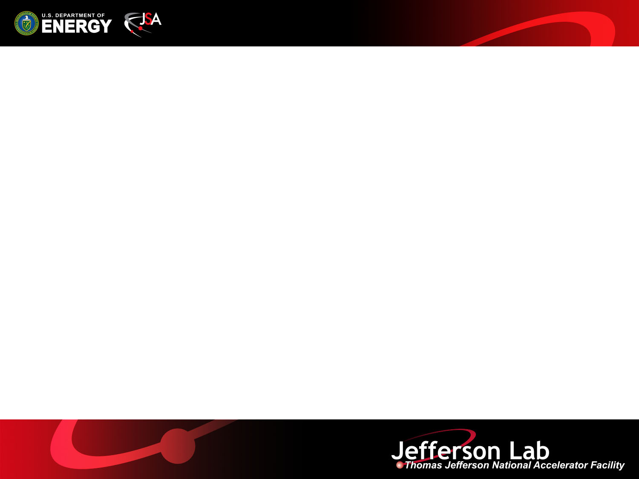
SRF R&D overview
R. Rimmer
For
SRFR&D Dept.

Slide 2
Overview
CEBAF support
JLab EIC
Partnerships/WFO
SRF Core R&D
    Efficiency, Energy, Intensity frontiers
Education

Slide 3
CEBAF support
“C75” cavity R&D
  New cell shape, ingot material, minimal changes to cryomodule
Investigating gradient loss in CEBAF
  New field emitter turn on, improved particulate control
Investigating Q loss in CEBAF-style modules
  “Magnetic hygiene”, search for sources of trapped flux
  Possible contributions from coupler losses
Helping to maximize C100 and overall linac availability
  Support linac PIT, helium processing etc.
Other RF or SRF development projects
  750 MHz separators, new Quarter CM, new warm capture, etc.

Slide 4
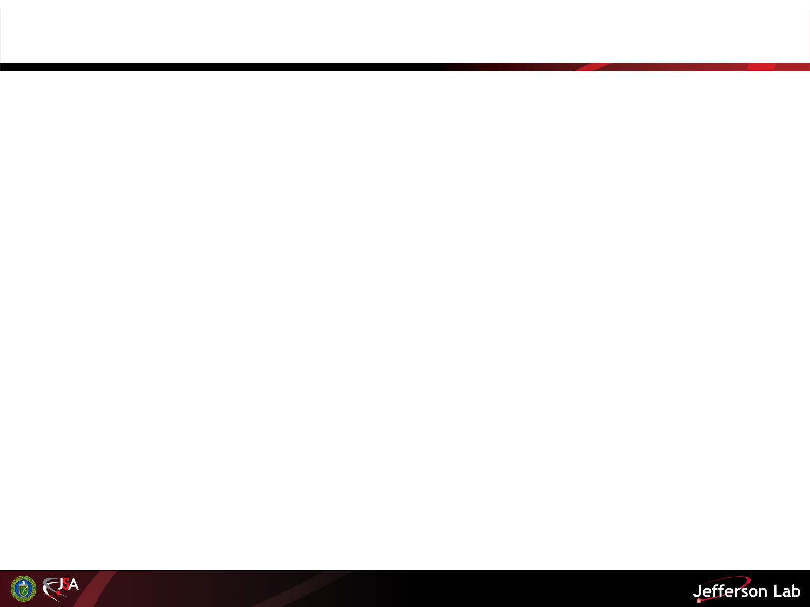
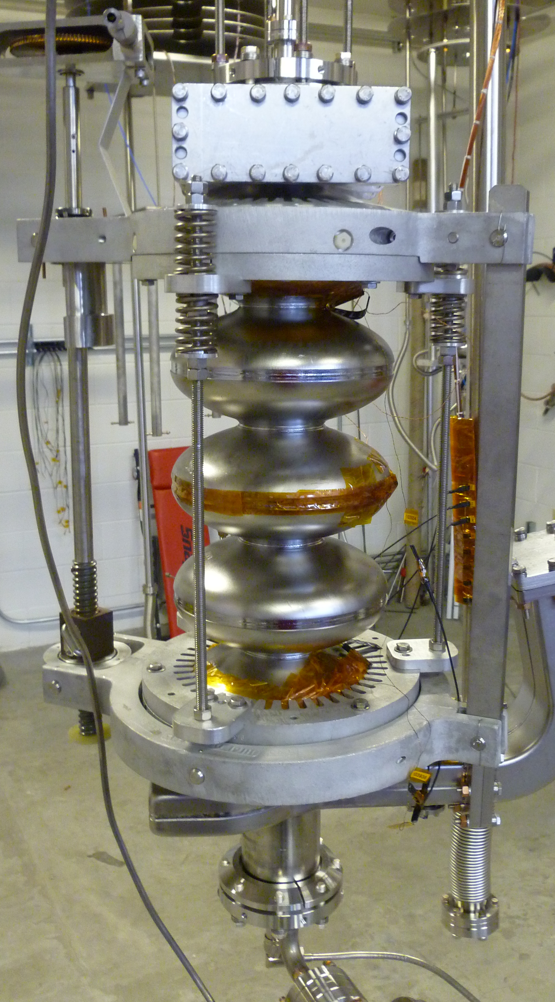
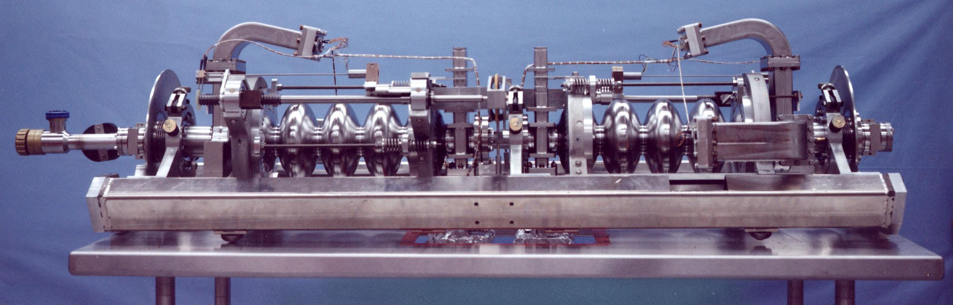
Investigation of low-Q in CEBAF cryomodules
Systematic investigation of the impact of residual magnetic field on Q₀ of 5-cell cavity in the VTA
~15% additional losses from trapped residual field from magnetized tuner components
Q₀ successfully recovered by degaussing tuner components
Investigating other possible contributions such as waveguide and cold window losses
G. Ciovati

Slide 5
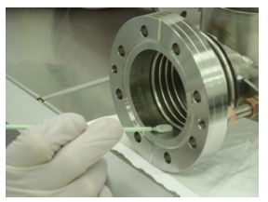
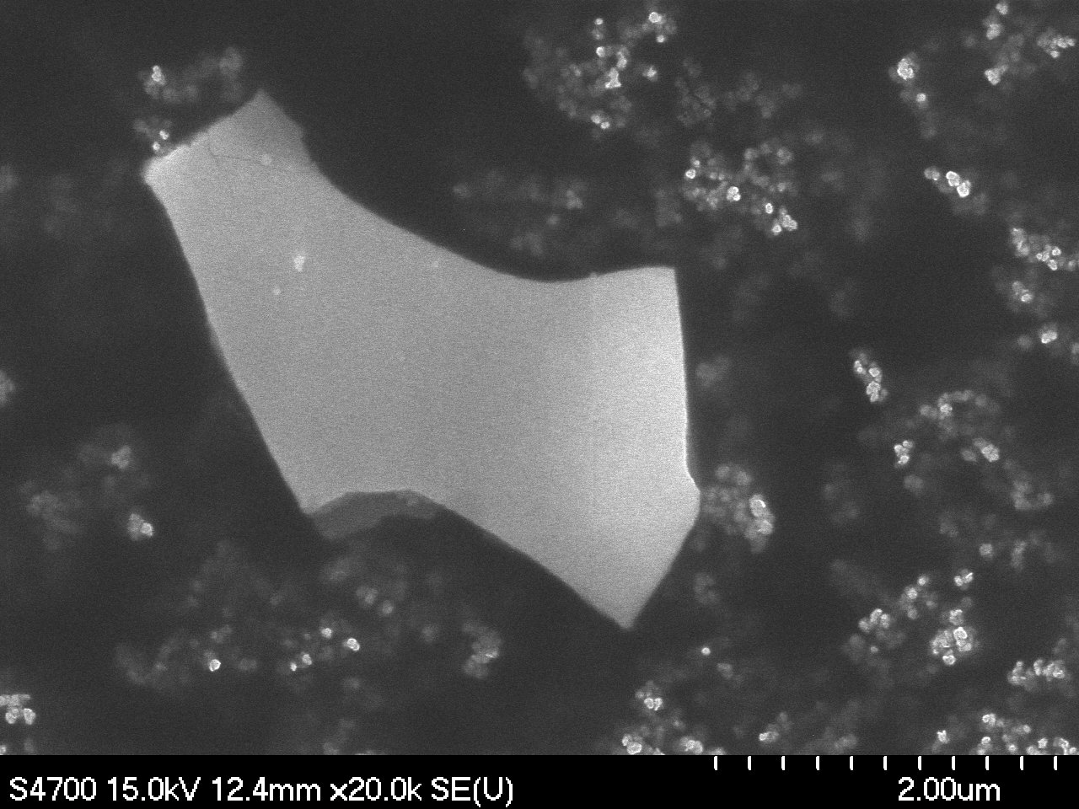
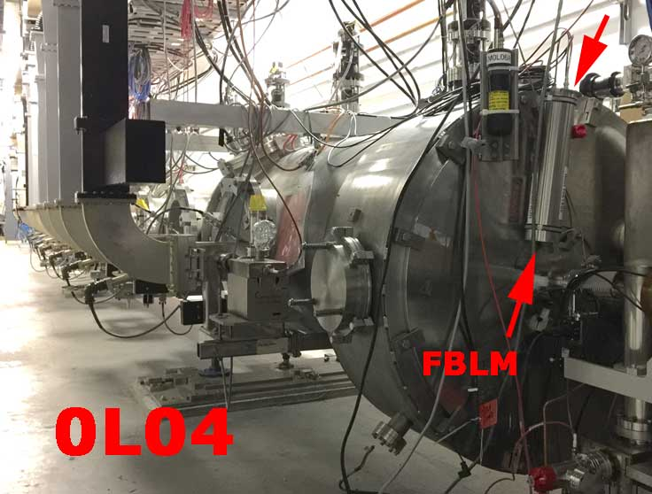
Field emission study, improved particulate control
Turn-on of new field emitters in cavities in CEBAF tunnel causes trip rate increase.
Running at Eacc=15-20 MV/m, new C100 cavities more vulnerable if cause the same.
A new initiative aims to understanding sources of problem and provide knowledge-driven mitigation.
  First result: Pointing to particulates generated by beam line ion pumps (SRF2015 poster).
  First test of new diagnostics: Fast X-ray detection near C100 module.
A mini-workshop was organized on February 29, 2016 with a focus on the beam-line particulate field emitters.
  https://www.jlab.org/indico/conferenceDisplay.py?confId=139
R. Geng

Slide 6
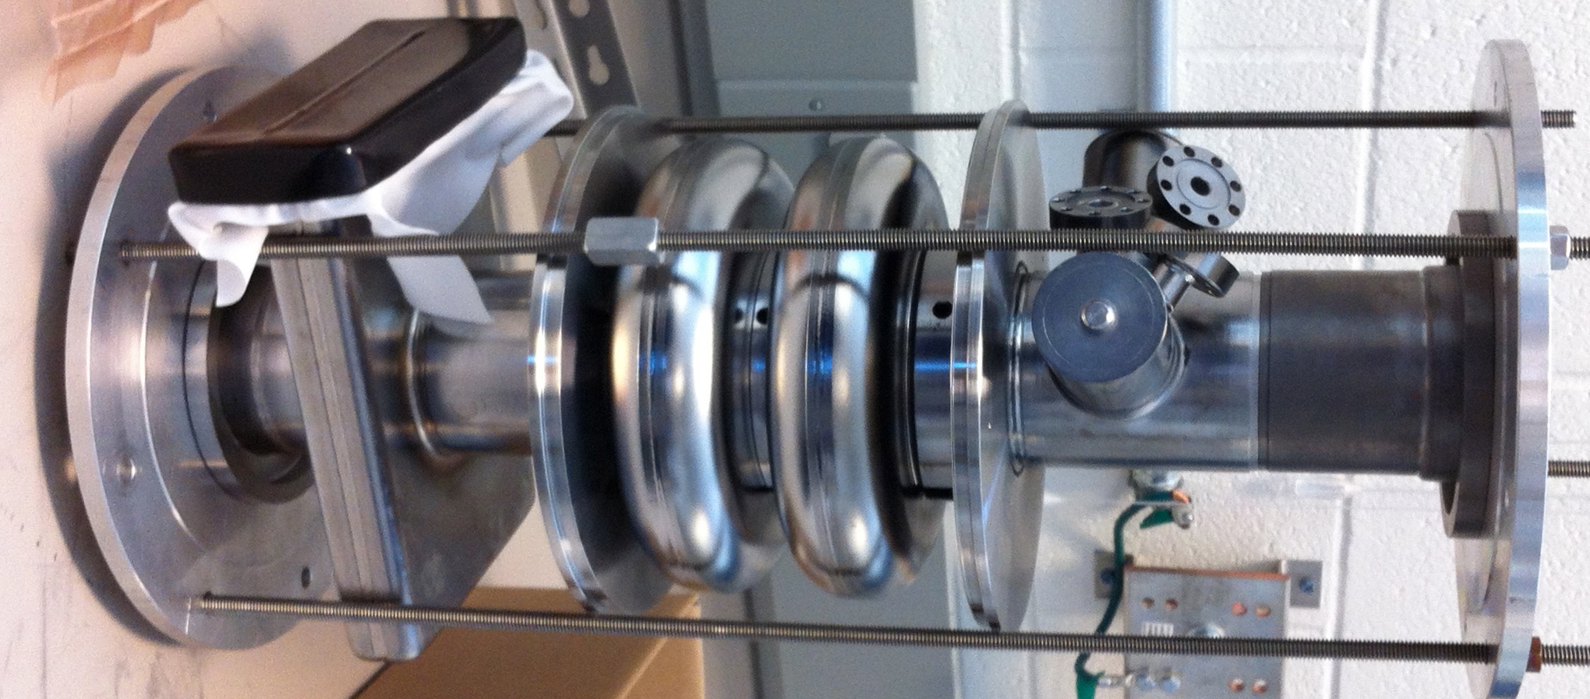
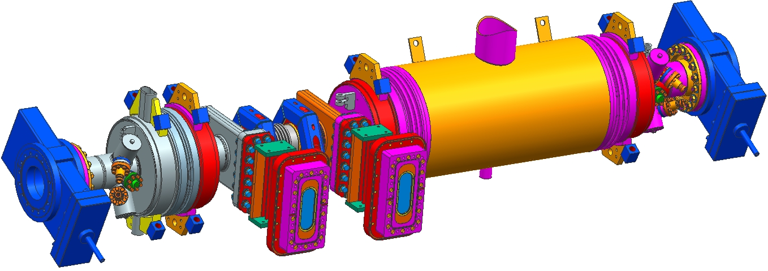
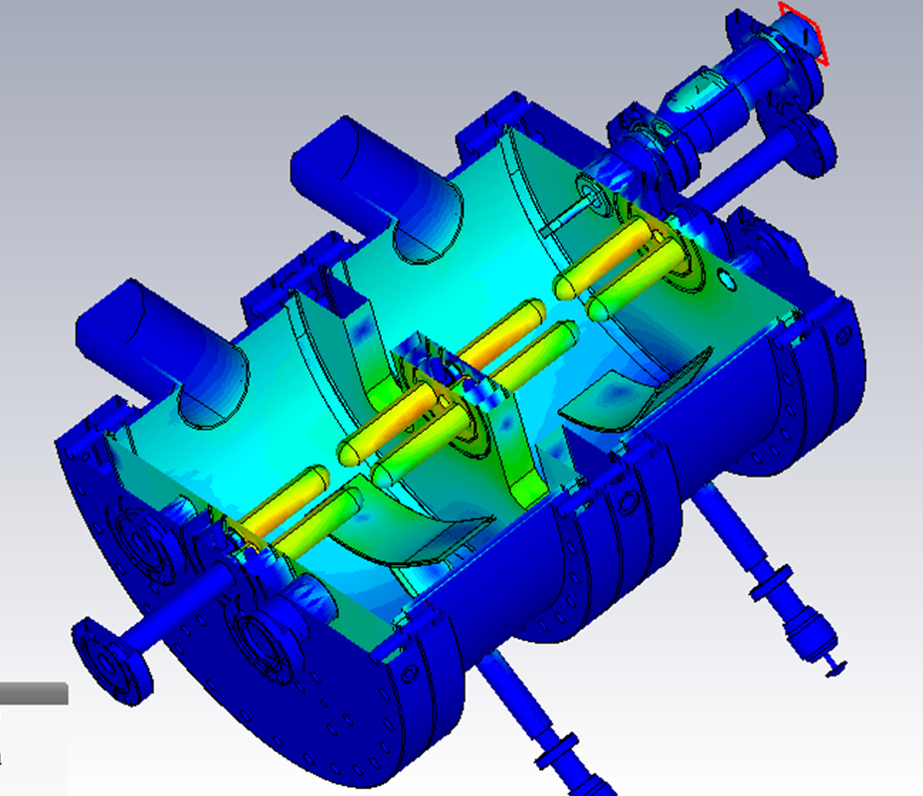
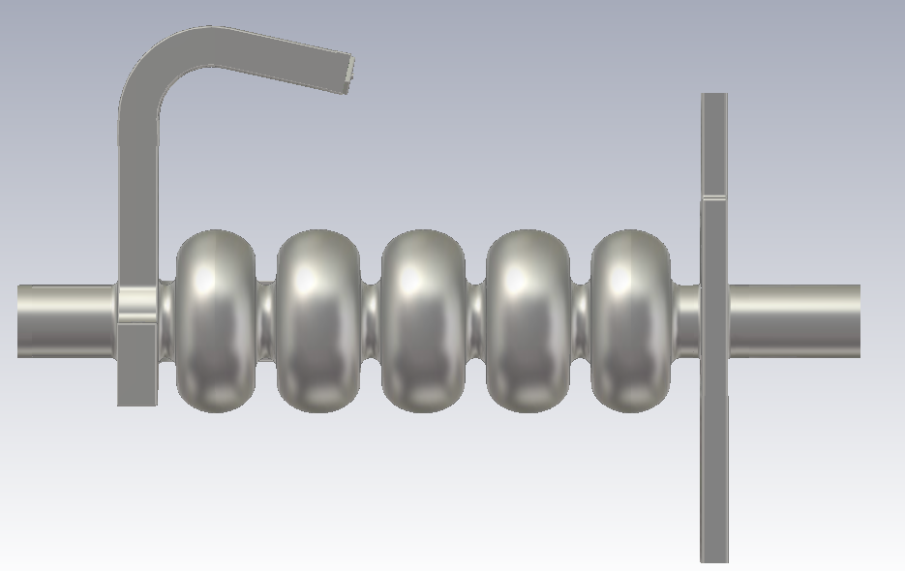
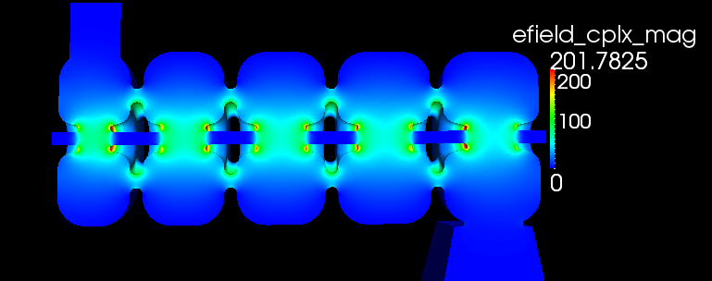
CEBAF RF development projects
Improved “quarter” cryomodule with accelerating capability of up to 10 MeV
750 MHz (4-hall) separator cavities
New graded-beta Cu capture cavity
“new” C75 cavity (HC cell shape)
Low beta 2-cell cavity
C100 style cavity
750 MHz 4-rod
New warm capture cavity
C75
LANL visit 4-26, 2016

Slide 7
JLab EIC RF Systems
JLab EIC baseline design updated in Jan 2015
Electron ring: PEP-II warm RF adopted
  Proven technology, low cost
  Enough cavities and klystrons available
  476.3 MHz buckets can be filled from CEBAF linac with simple timing system
  Upgrade to 952.6 SRF in future
Ion ring: new 952.6 MHz SRF plus ~ 1MHz ramping cavities (e.g. J-Parc Metglas loaded)
Crab cavity system now 952.6 MHz
Cooler source and ERL now 952.6 MHz
  Cooler baseline became 200 mA, no circulator ring
Ion injector chain not affected
Notes:
Update the data for all energy levels

Slide 8
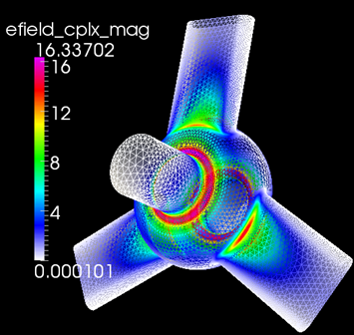
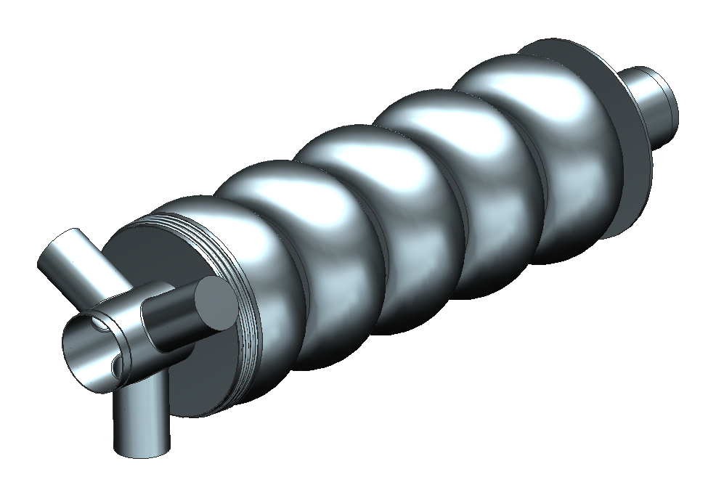
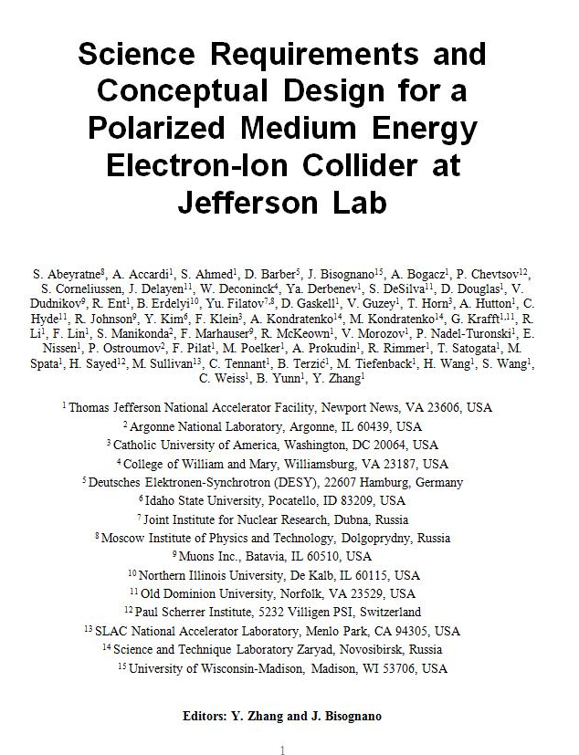
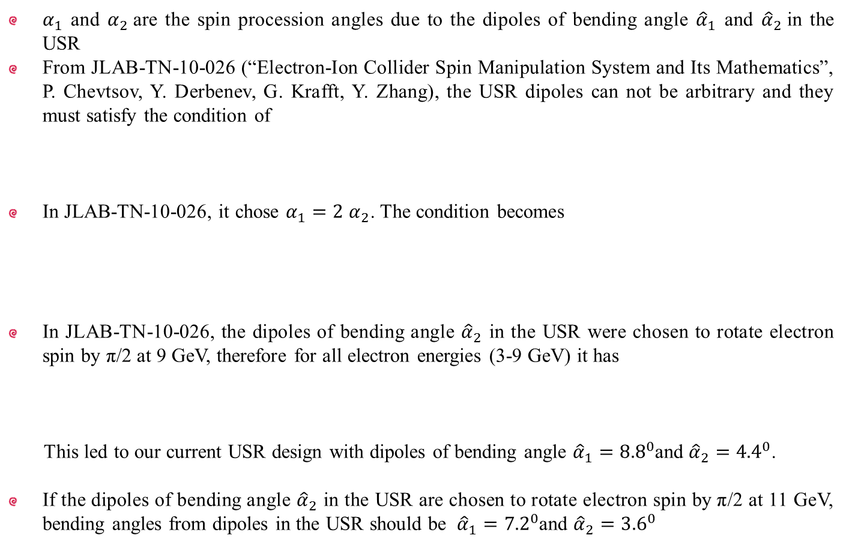
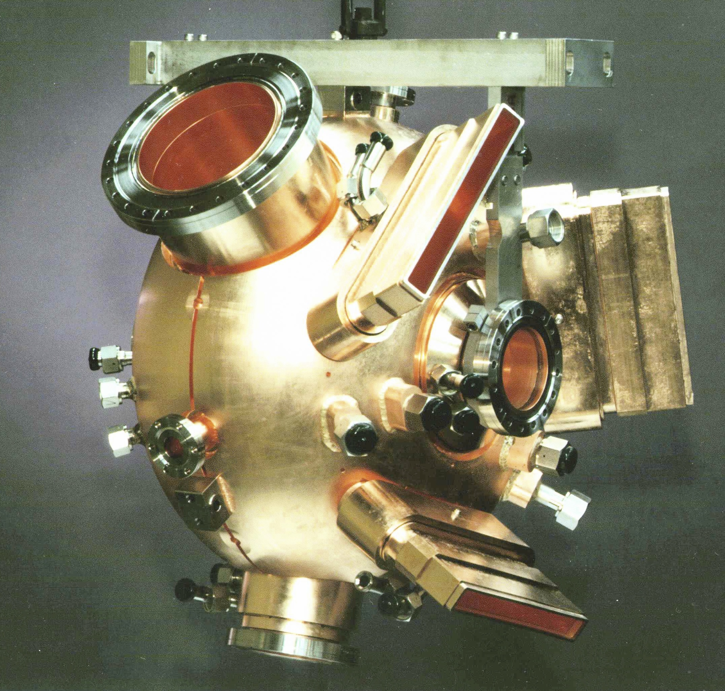
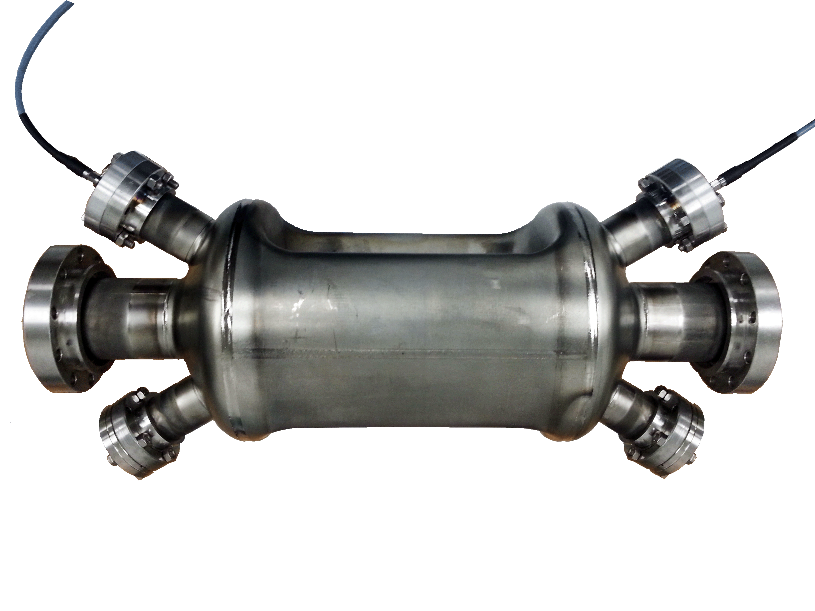
JLab EIC Conceptual Design
EIC
Collider
Rings
i-SRF +
NCRF
ERL
HE Cooling
updated
Crab
IP
e-RF
e-RF
Crab
?
Future IP
Booster
SRF Linac
Stage I EIC
  CEBAF as full-energy e⁻/e⁺ injector
  3-10 GeV e⁻/e⁺
  8-100 GeV protons
  <40 GeV/u ions
Stage II EIC
  up to 20 GeV e⁻/e⁺
  up to 250 GeV protons
  up to 100 GeV/u ions
Ion Source
Electron Injector
Hall D
12 GeV CEBAF
Halls A, B, C

Slide 9
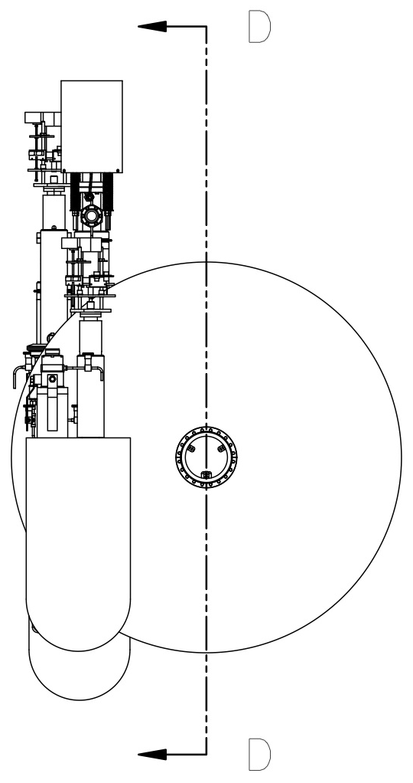
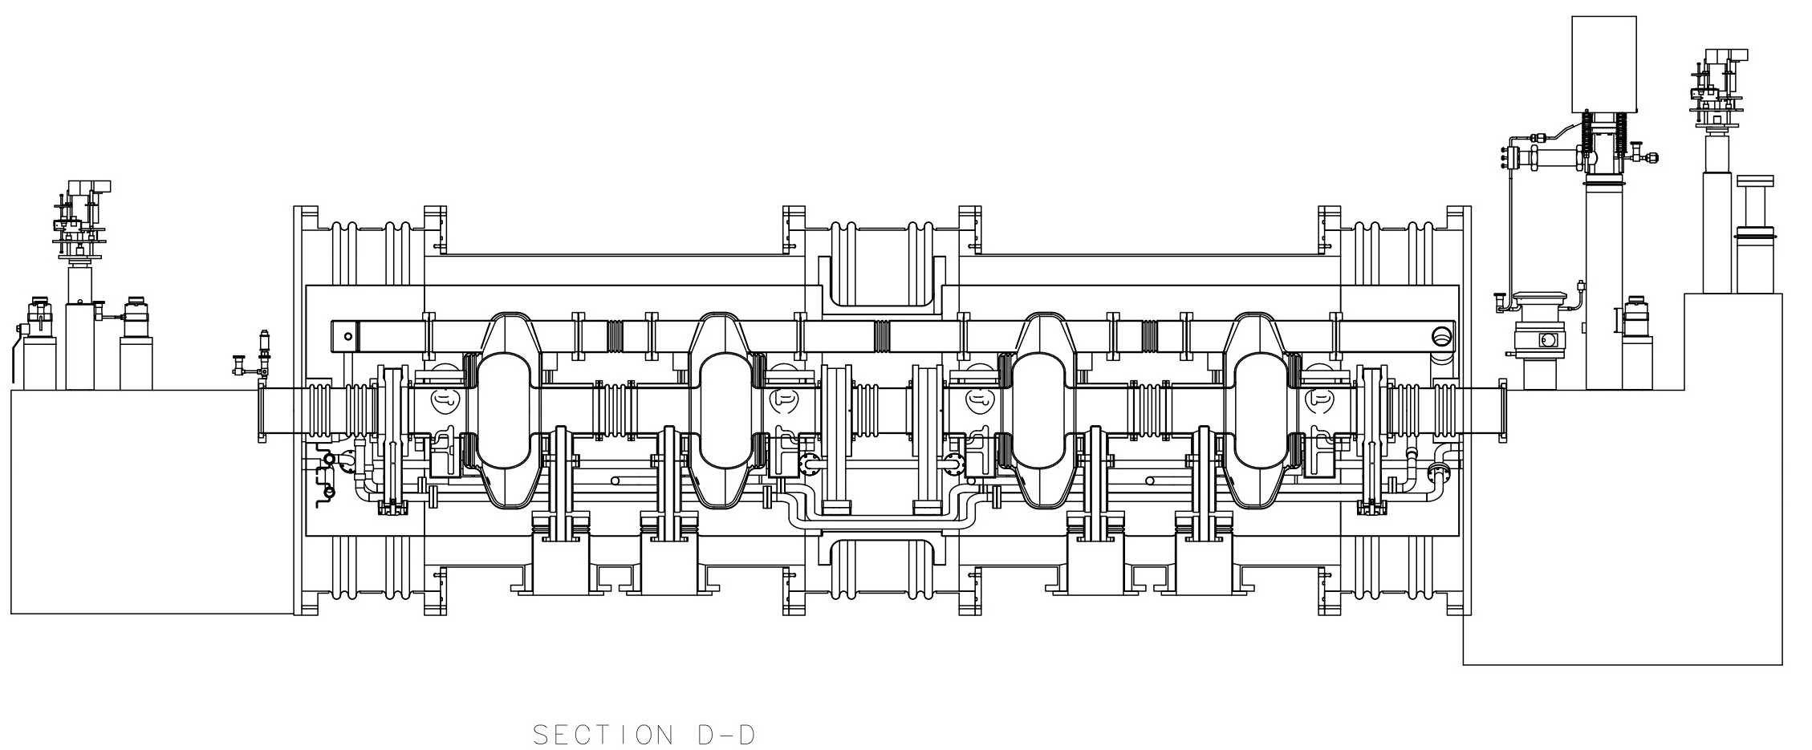
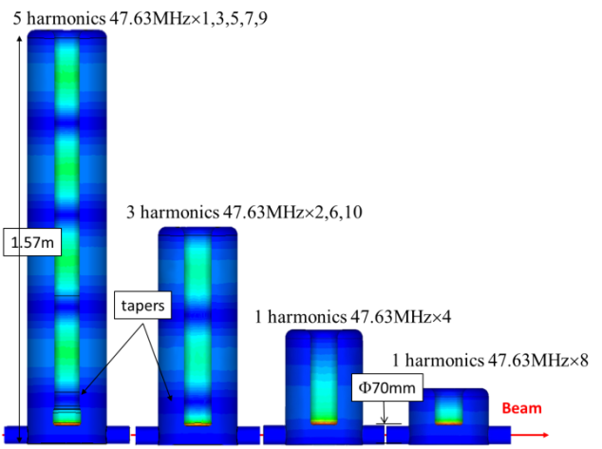
e-cooler ERL
Injector Cromodule similar to storage ring, 1 CM, 4 x 1-cell 952.6 MHz cavities, high- power couplers.
ERL LINAC needs 1 CM with four 5-cell 952.6 MHz cavities, lower-power couplers
Cooling section
ion bunch
electron bunch
solenoid
Future fast kicker
Future fast kicker
Future fast kicker
Future fast kicker
Future circulator ring
Future circulator ring
Gun/ Inj.
SRF Linac
dump
Harmonic kicker system
(Y. Huang)
Notes:
Booster ?

Slide 10
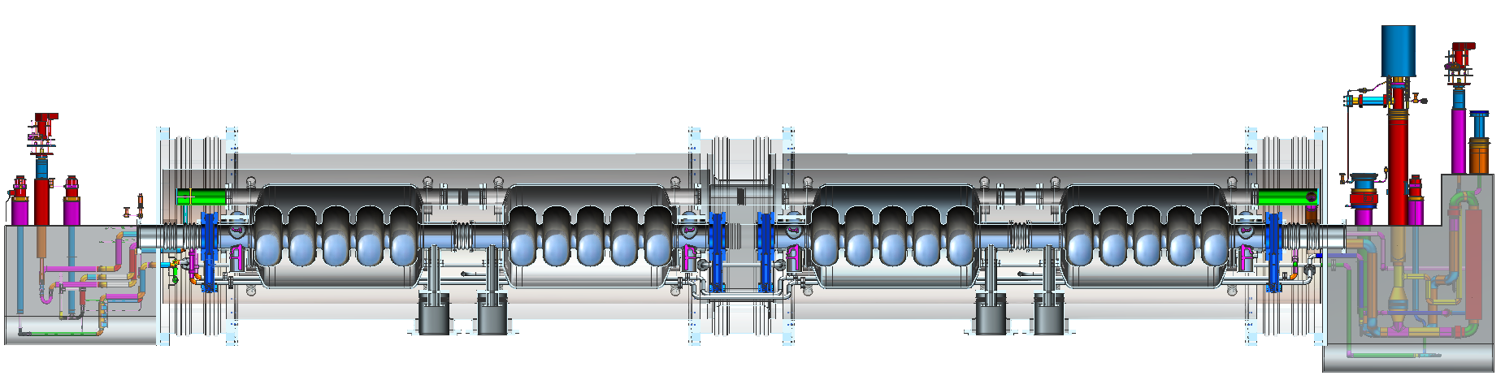
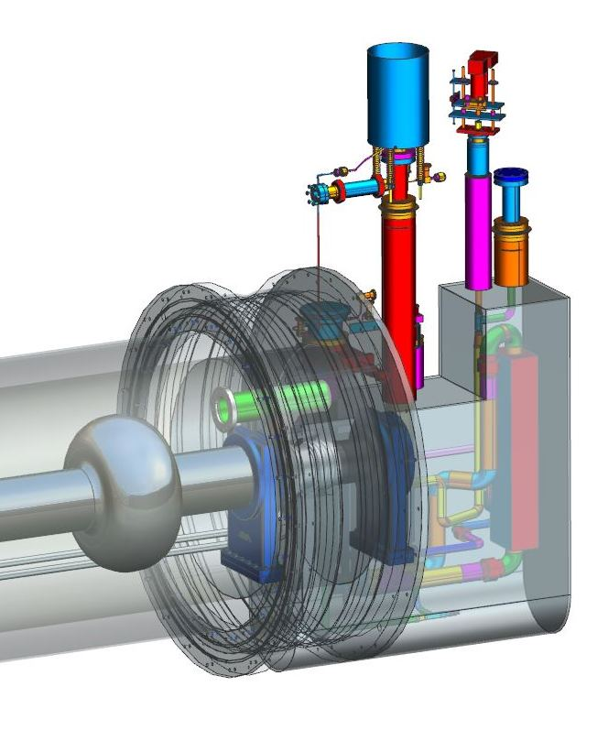
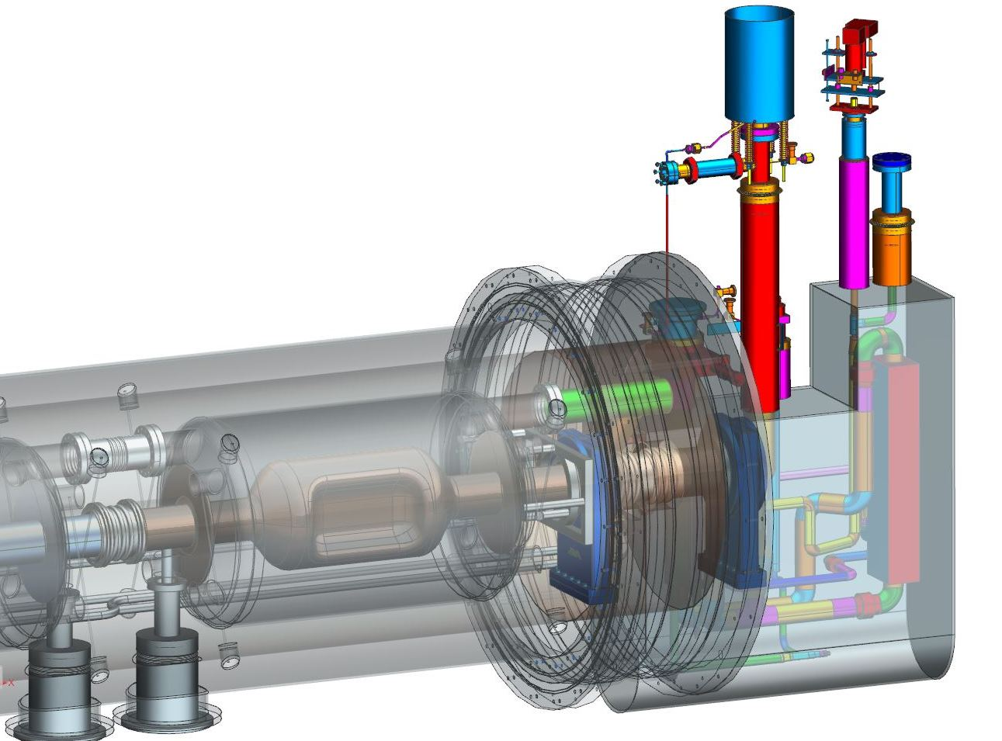
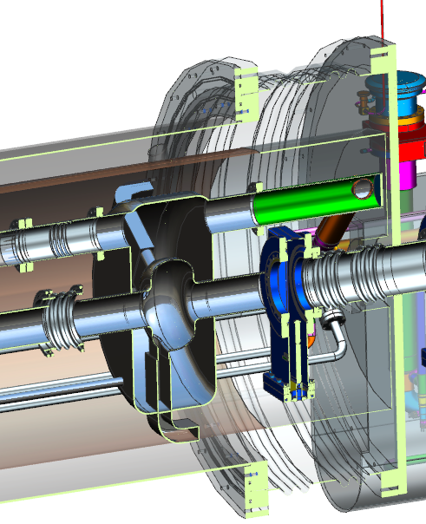
Modular Cryostat
Take the best features of previous JLab designs
Modular approach to hold various different cavities
Design suitable for industrial production
Simple concepts, low parts count to reduce costs
Cooler ERL, 5-cell cavities
476.3 or 952.6 MHz Crab cavity
952.6 MHz Ion ring concept
476.3 MHz 1-cell?

Slide 11
Partnerships / WFO
Support of LCLS-II project at SLAC (Joe’s talk)
  Multi-lab optimization of N₂ doping, vendor qualification, etc.
SRF gun, booster and ERL cavity development with HZB BerlinPro (now also BESSY VSR)
US-LARP and LHeC at CERN – synergy with JLab EIC
Project-E (based on our advanced ERL/FEL technology)
Various small SBIR projects
  Thin film coating
  Hydroformed and 3D printed cavities
  High-efficiency RF source development

Slide 12
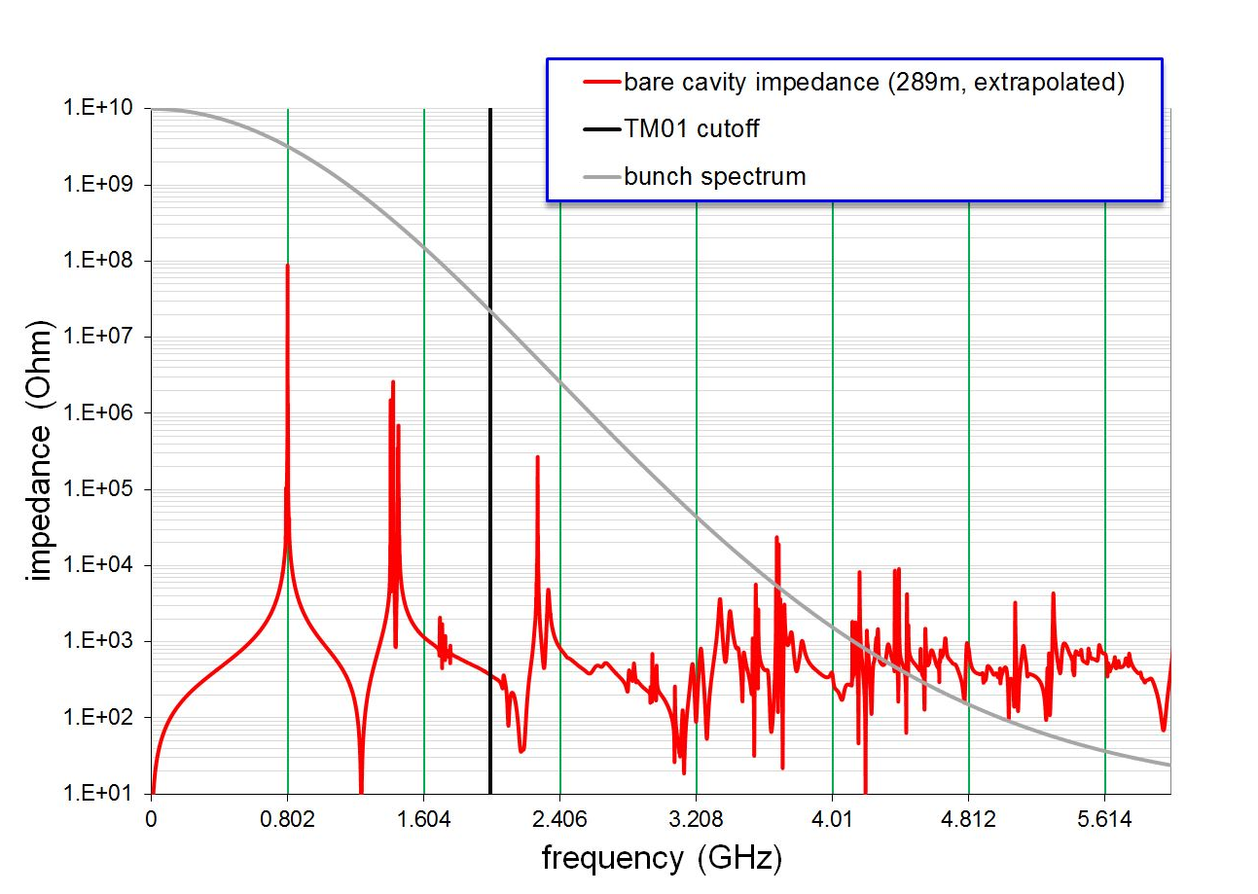
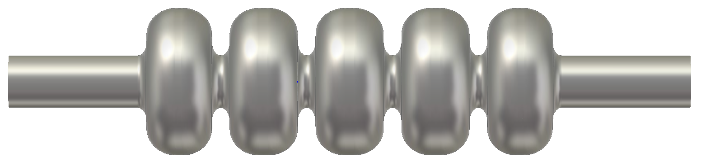
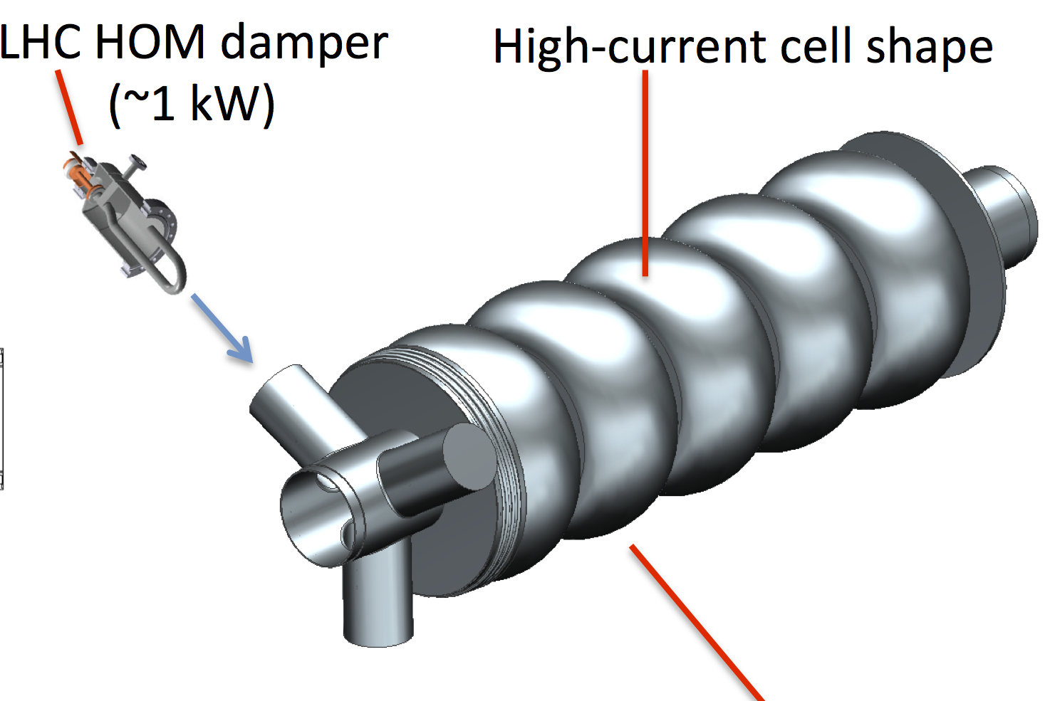
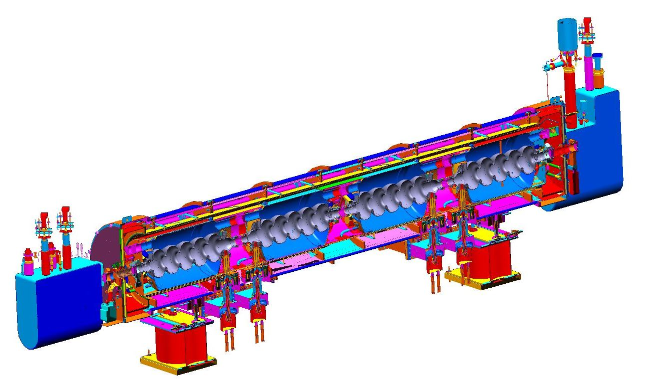
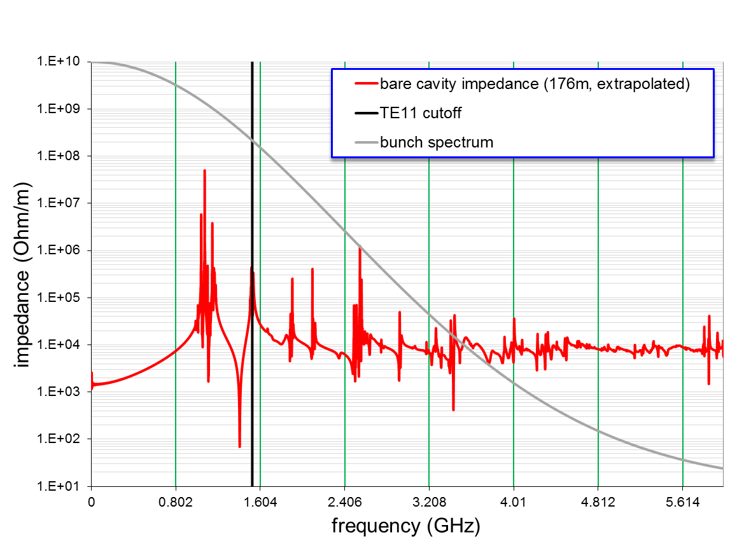
Collaboration with CERN on SRF for LHeC
Collaboration on 802 MHz SRF for LHeC
ERL cavity design and prototype
Joint study on cryomodule
ERL cavity
HOM spectrum looks good
Cryomodule based on SNS
Notes:
Proposed collaboration. Help with design of cavity (25% more efficient than CERN proposed design). Build prototype at JLab (need funds). Work on cryomodule concepts useful to MEIC starting from SNS design

Slide 13
SRF Core R&D
JLab has a long-standing in-depth core competency in SRF in both R&D and projects
  CEBAF, SNS, FEL, ILC, APS-SPX, 12 GeV, LCLS-II, etc.
Main R&D focus areas are:
Improved efficiency:
  Higher Q_{o}, lower costs, safer processes, new materials
High intensity:
  ERL’s, Proton drivers, high current storage rings, now EIC
Higher energy:
  Jlab played a key role in the ILC SRF R&D program
Education:
  This is a great place for students to do SRF R&D!

Slide 14
Improved efficiency: Ti and N doping for Q₀
Ti doping
N doping
Q₀ improved by up to a factor of 2 at medium fields by doping
N-doping recipe more “robust” than Ti-doping
P. Dhakal et al., IEEE Trans. Appl. Supercond. 25, 3500104 (2015)

Slide 15
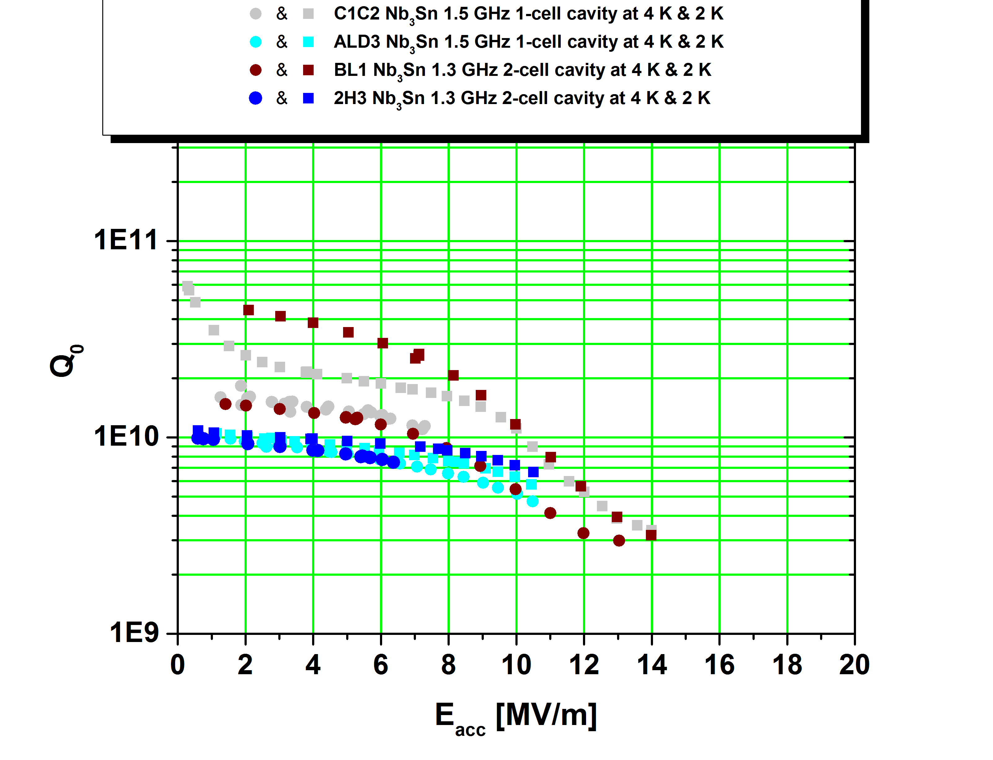
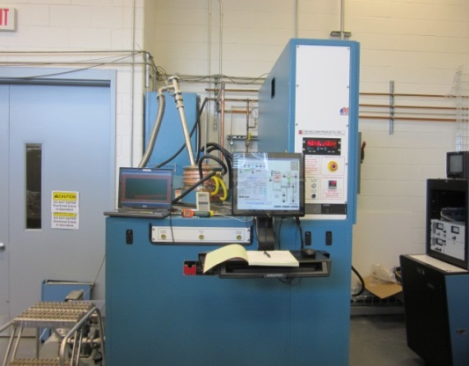
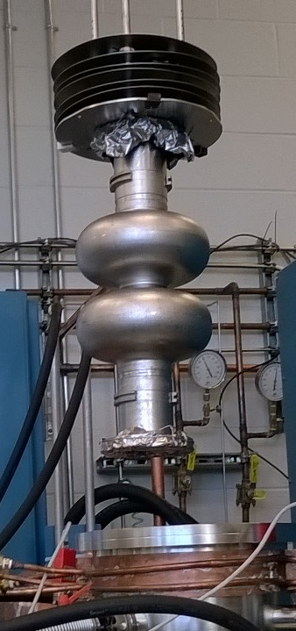
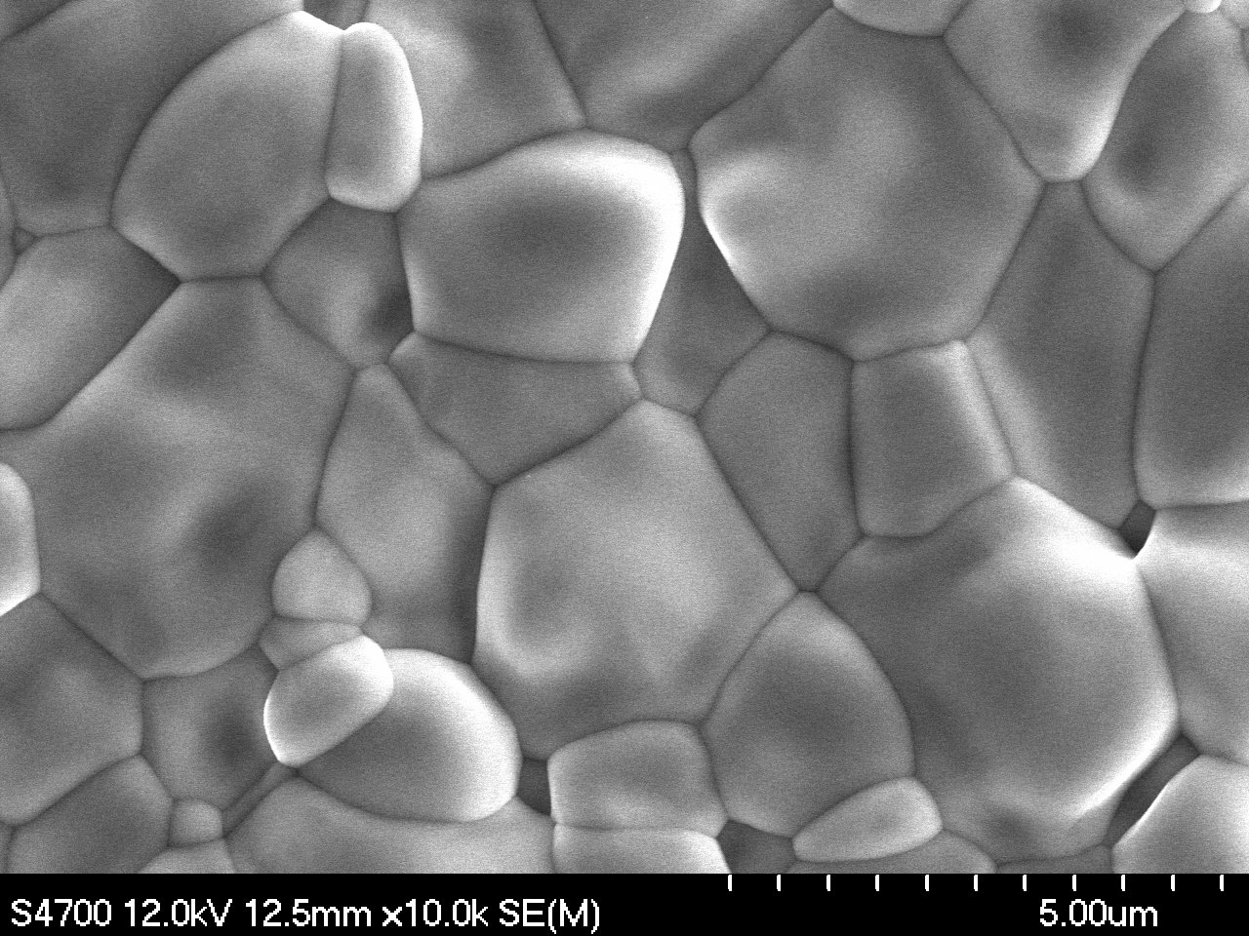
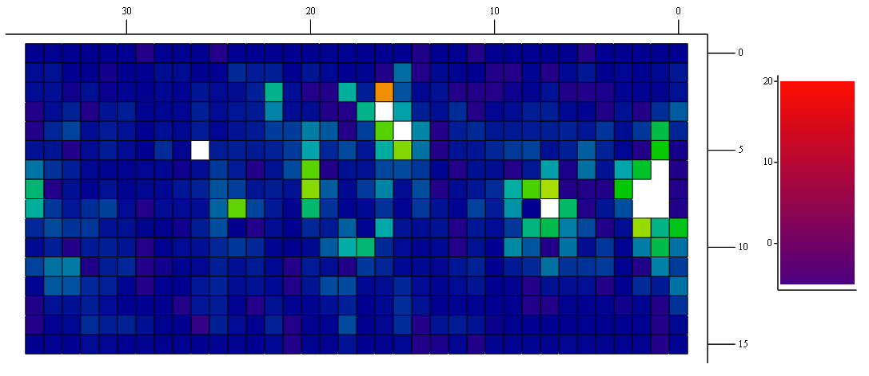
G. Eremeev et. al.
Improved efficiency: Nb₃Sn progress
1.5 GHz 1-cell, 1.3 GHz 1-cell, and 1.3 GHz 2-cell seamless cavities have been coated.
All cavities had the transition temperature of about 18 K with the low field Q₀ of about 10¹⁰ at 4.3 K.
The best cavities reached E_{acc} above 10 MV/m limited by localized defects and “Wuppertal” slope.
Small coated samples and cutouts from a 1.5 GHz cavities are being analyzed towards understanding of present limitations.
“Wuppertal” slope
Nb₃Sn coating system
Original CEBAF 2K spec
BES/ICS 4K goal
WSLH1
WSLH2
HH1
SSHH1
WS2
WSHH2
WS1
QSW3
QSW4
QSW1
SQ02
QSW2
WSHH1
SQ01
Notes:
Good low field Qo achieved, still dominated by Q slope. Understanding and fixing this is main focus of investigation. W&M & VT graduate students involved. 4K Qo’s already usable for some applications (meets old BES/ICS 4K spec). T-map shows Q-slope comes from hot spots, not global. Nb3Sn morphology very different from substrate. First coating of seamless 2-cell cavity. Collaborating with Cornell and Fermi.

Slide 16
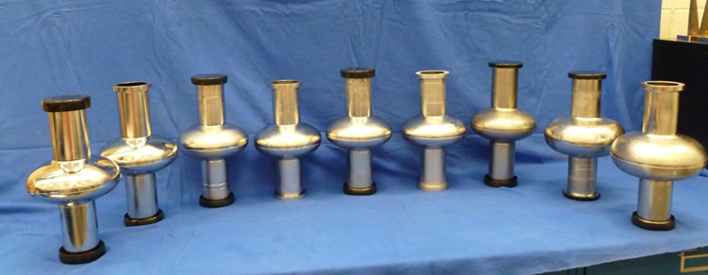
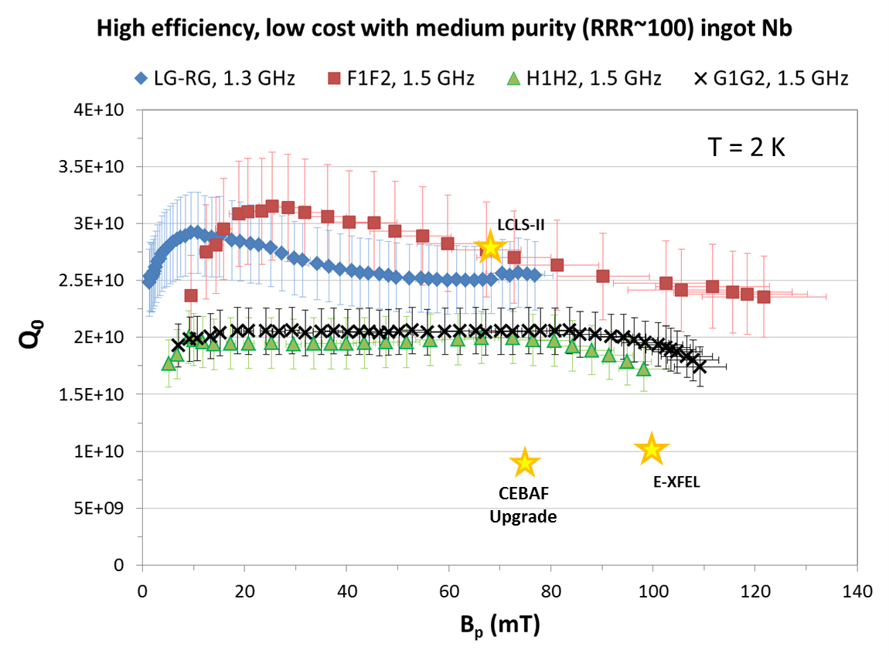
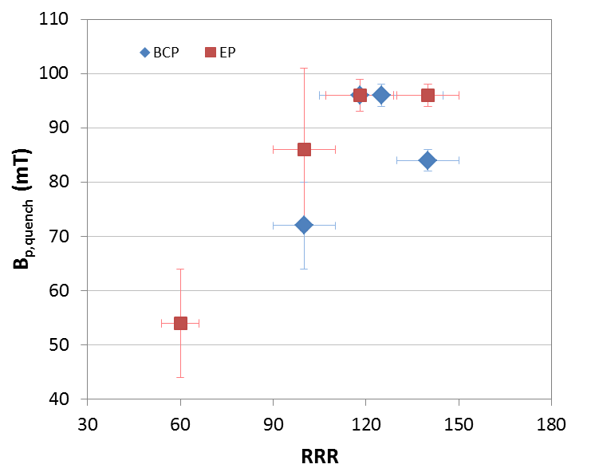
High efficiency at low cost: ingot Nb
Medium-purity ingot Nb is a good material to build SRF cavities operating at medium gradients with higher efficiency and potentially lower cost (~1/3) than standard high-purity, fine-grain cavities.
Proposed for new C75 cells
C75
C75
G. Ciovati et al., SRF’15, MOPB001 (2015).
Notes:
Medium purity (RRR~100) ingot material seems to meet all requirements for moderate gradient CW uses such as CEBAF,X-FEL, LCLS. Uses fewer melts, cheaper material, less waste and fewer process steps using disks direct from ingot. Maybe cut material cost in half in large quantity. Being evaluated by INFN for ESS. High Ta also not a problem (CBMM material).

Slide 17
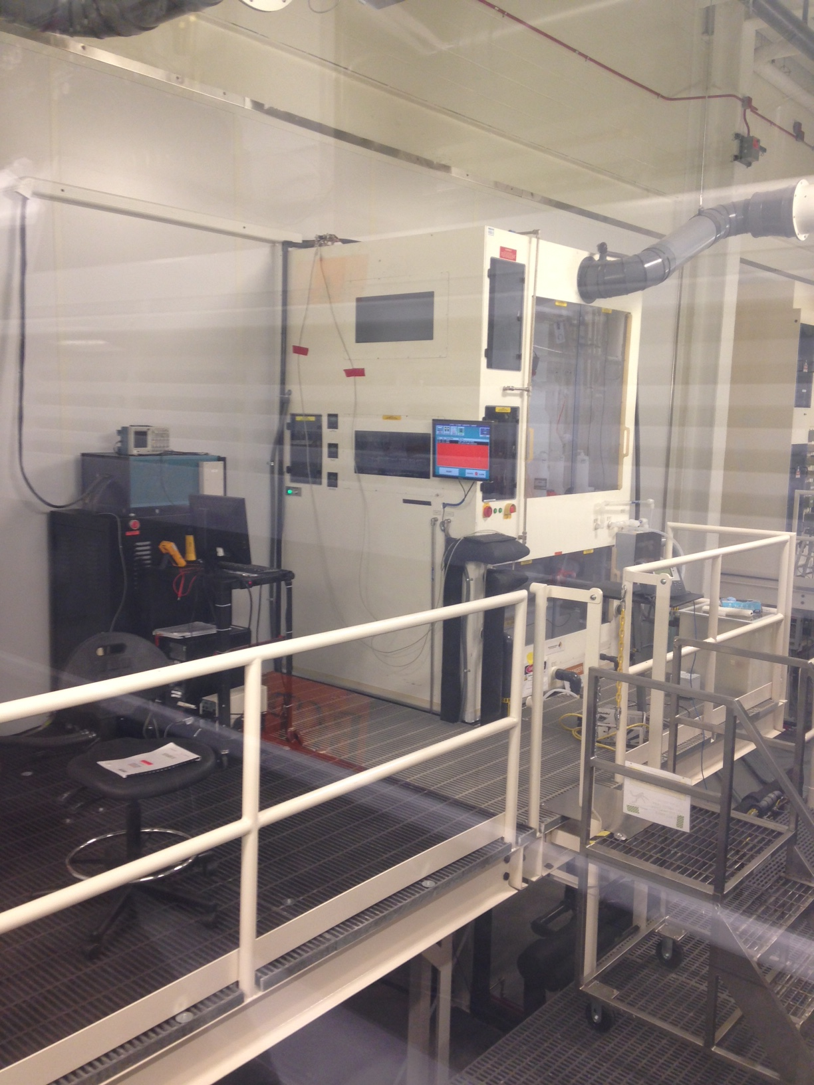
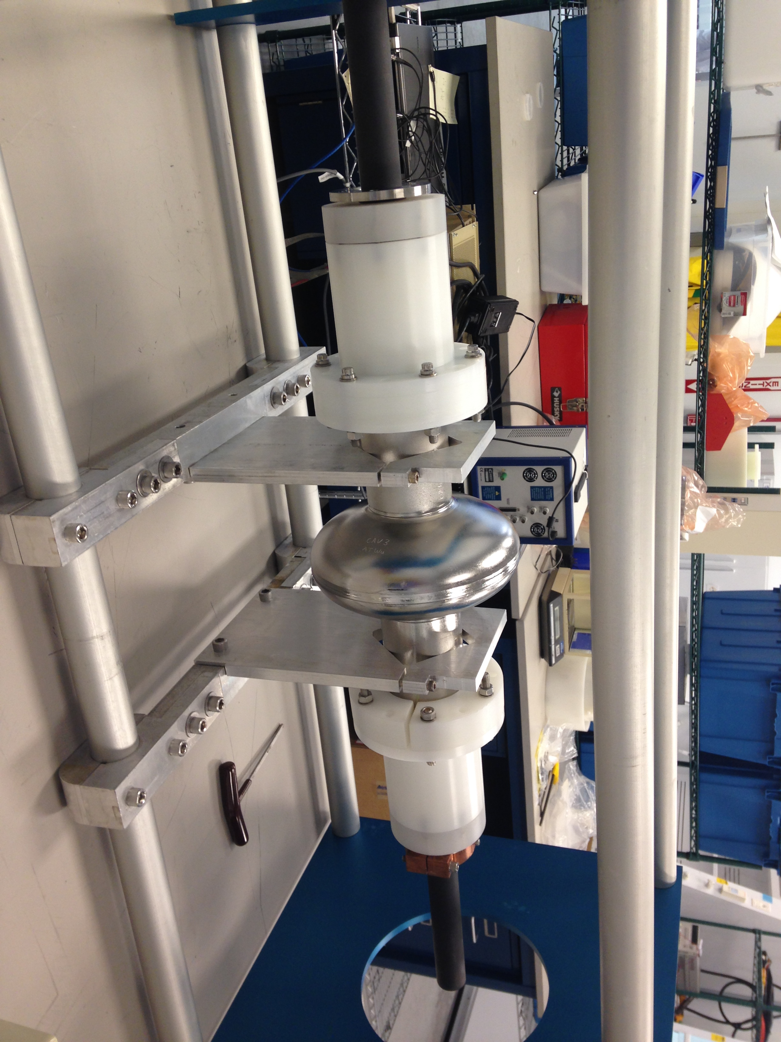
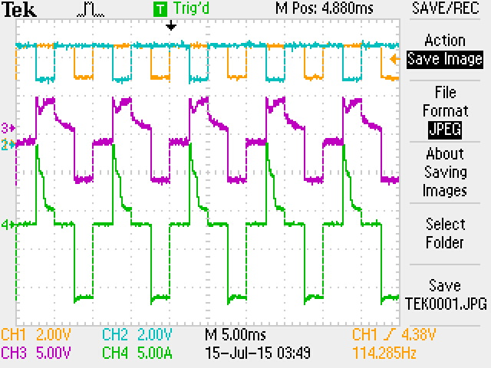
HF-Free Electropolishing Niobium
Pulse-reversed process demonstrated effective on single cell cavity by Faraday Technology using sulfuric acid alone
E.J. Taylor et al., SRF2013
A.M. Rowe et al., SRF2013
Completed setup of first vertical EP cabinet for HF-free cavity processing
Ready for commissioning in FY16
JLab is providing detailed electrochemical analysis and process characterization with varied concentration and pulse structure
H. Tian, et. al.

Slide 18
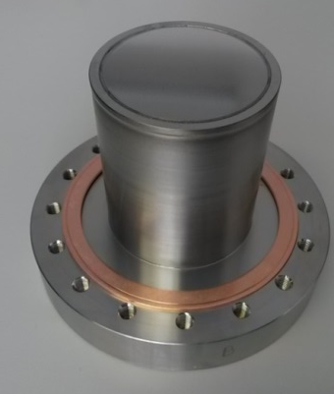
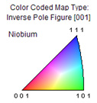
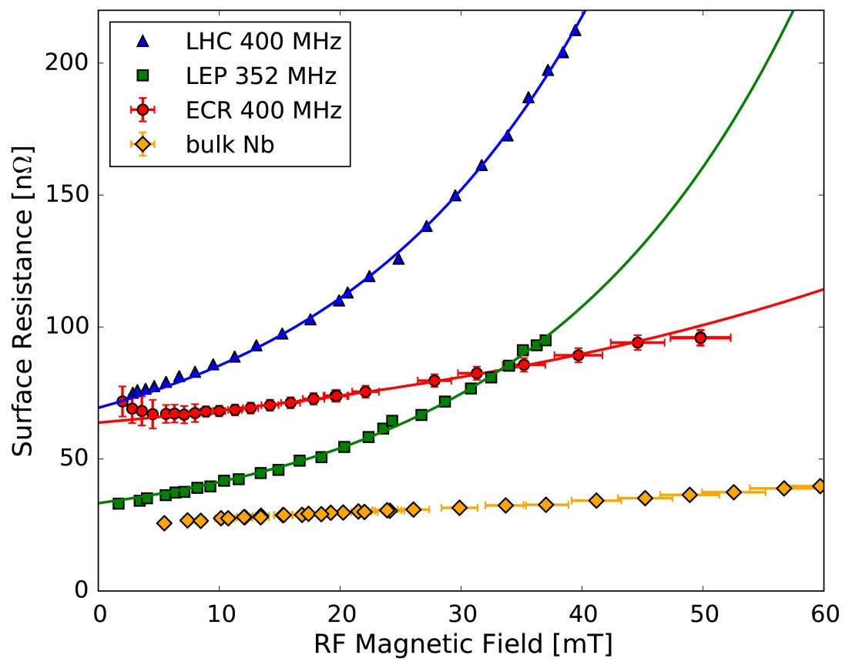
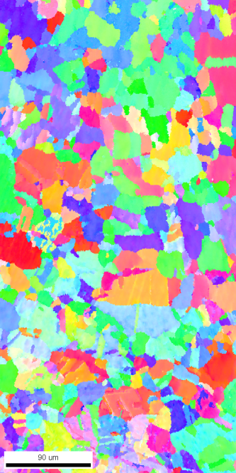
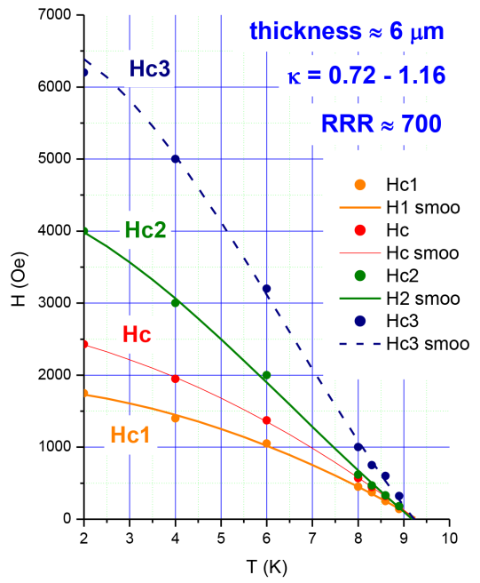
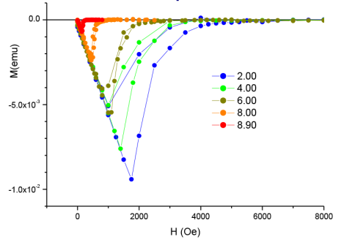
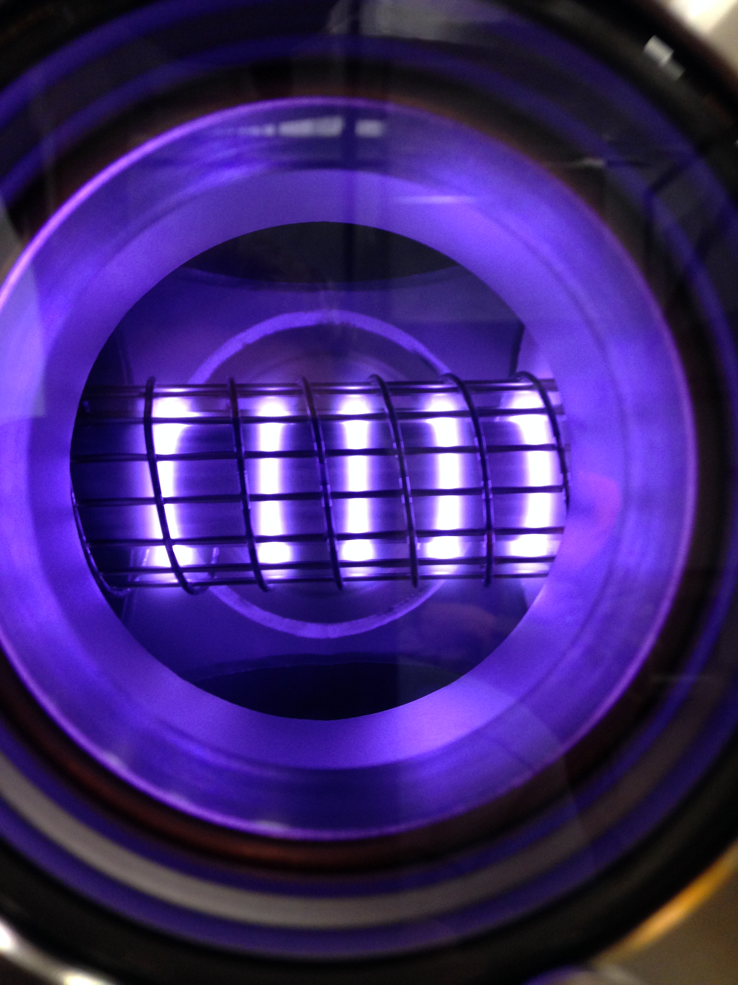
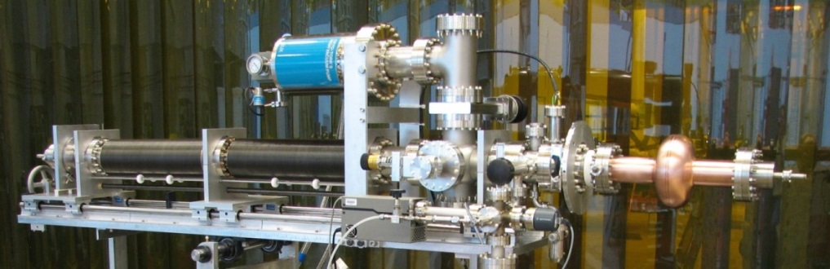
Nb/Cu films by Energetic Condensation
EBW 1
EBW 2
400 MHz, 4 K
 | R_{res} [nΩ] | λ(0K) [nm]
400 MHz | 46.6 ± 0.8 | 40 ± 2
800 MHz | 79 ± 2 | 38 ± 1
1200 MHz | 156 ± 11 | 38 ± 1
ℓ* [nm] | RRR
144 ± 20 | 53 ± 7
* with λ_{L} = 32 nm and ξ₀ = 39 nm
ECR Nb/Cu film shows a much reduced slope compared to sputtered Nb/Cu cavities.
The residual resistance is high due to the post-coating e-beam welding (EBW 2) to the support structure.
Series of QPR sample coating/measurement underway
Magnetic Moment
in parallel field
First HiPIMS Nb/Cu cavities coated
V. Kozhevnikov
Magnetic field phase diagram
for ECR Nb/ (1-120) Al₂O₃
First flux Penetration @ 2 K ~ 180 mT,
showing superior behavior
to measured bulk Nb (130 mT)

Slide 19
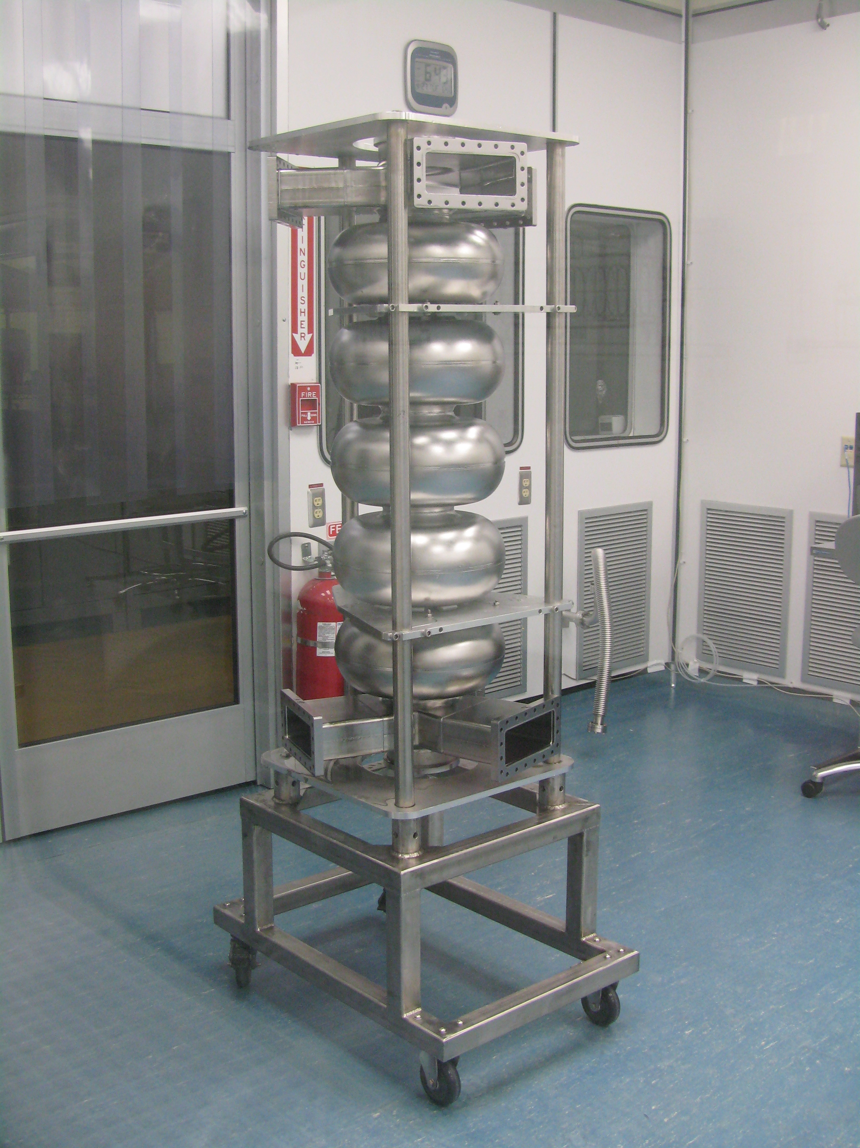


High Intensity: examples
750 MHz MW-class FEL
650 MHz Project X
ANL-SPX storage ring crab cavities
Present focus is on JLab EIC storage rings and electron cooler

Slide 20
ILC High Gradient R&D at JLab
Nearly 60 distinct 9-cell cavities.
120 EP cycles; 200 cryogenic cavity vertical testing.
Cavities manufactured by industries, laboratories and universities in three regions world wide
  Europe: ACCEL/RI, Zanon, DESY
  US: AES, Niowave/Roark, JLAB
  Aisa: MHI, KEK, PKU, IHEP
    Later 7-cell CEBAF upgrade cavities by OSTEC
Personnel exchanges/training with international collaboration
  Many young scientists, including 5 from KEK, came to JLab for extended visit working on SRF technology.

Slide 21
Achieved ILC Cavity Performance at JLAB (2008-2010)
All TESLA-shape fine-grain Nb cavities
1.8K
ILC spec
Q₀=8×10⁹
Eacc=35 MV/m
2K

Slide 22


High Gradient: Recent Results and Next Steps
Purpose: achieve high gradient with high efficiency, at a low cost and high reliability
Approach: Low-Surface-Field Shape* + Large-grain Niobium material + advanced processing
Future cavities:
LSF* cavity
1.3GHz 1-cell
TTF shape
Large-grain Nb
In-house built
In-house proc.
1.4 K
R. Geng
1.8 K
1 TeV
ILC Goal
Prototypes:
Two each 1-cell built and tested
Two each 3-cell and one each 9-cell in process of fabrication.
2.0 K
LCLS-II spec
500 GeV
ILC spec
*Z. Li at SLAC
R.L. Geng, Nov. 13, 2015
Notes:
Very small scale effort remaining due to loss of ILC funds, mainly supported by Japan–USA funds. Low Surface Field (LSF) cavity design from SLAC. We proposed this for LCLS-II but declined. Probably would have met their spec without doping leaving lots of gradient headroom.

Slide 23
Path Forward
High efficiency high gradient (HEHG) SRF a fundamental accelerator physics and technology issue with applications to ILC as well as many other machines
  Better cavity shapes (RE, LL/ICHIRO, LSF)
    “immediate” gain in gradient
    “guaranteed” saving in cryo capital cost & accelerator operation cost
  Better material (Large-Grain/Medium-Grain ingot niobium)
Use the same successful ILC baseline cavity processing technology which is already well practiced in world-wide labs as well as in industry and has been successfully applied to CEBAF accelerator and E-XFEL project.
R.L. Geng, Nov. 13, 2015

Slide 24
HEHG Cavity Shapes: Design
 |  | TESLA | Low-loss/ICHIRO | Re-entrant | Low-surface-field
frequency | MHz | 1300 | 1300 | 1300 | 1300
Aperture | mm | 70 | 60 | 60 | 60
Epk/Eacc | - | 1.98 | 2.36 | 2.28 | 1.98
Hpk/Eacc | mT/(MV/m) | 4.15 | 3.61 | 3.54 | 3.71
Cell-cell coupling | % | 1.90 | 1.52 | 1.57 | 1.27
G*R/Q | Ω² | 30840 | 37970 | 41208 | 36995
Z. Li, C. Adolphsen, A New SRF Cavity Shape with Minimized Surface Electric and Magnetic Fields for the ILC, LINAC08 (2008).
R.L Geng et al., Development of Ultra High Gradient and High Q0 Superconducting Radio Frequency Cavities, IPAC13 (2013).
50 MV/m capable due to lowered Hpk/Eacc
20% more efficient as compared to TESLA shape
Lowered risk in field emission by keeping Epk/Eacc the same as TESLA shape
R.L. Geng, Nov. 13, 2015

Slide 25

LSF
TESLA
R.L. Geng, Nov. 13, 2015

Slide 26




Right Cavity Shape: LSF for ILC
First 5-cell prototype cavity
LSF shape for ILC
In-house fab completed March 2016
to be evaluated in collaboration with KEK
Tesla shape for E-XFEL
LL shape for CEBAF
R.L. Geng, April. 26, 2016

Slide 27
Work to be Done Next
Reduce field emission up to Epk ~ 100 MV/m
  Critical for all SRF machines, in particular stable operation
Eliminate Q-slope up to Hpk ~ 200 mT
  Origins still unclear, even for Nb
  Key issue to viability of any “new” material
Recent progress in high Q₀ cavity for medium gradient (Hpk ~ 70 mT) shown good results
  Can these good results extended to high gradient?
R.L. Geng, Nov. 13, 2015

Slide 28







SRF Student Program 2016
Shichun Huang
Chinese Academy of Sciences, Institute of Modern Physics
Factors limiting the SRF cavity performance
Quintin D. Lassiter, Jr.
New Horizons Governor’s School for Science and Technology
Prototype Electropolishing Wireless Thermometry System
Matthew Burton
The College of William and Mary
Superconducting Thin Films for SRF Cavities
Yulu Huang
Institute of Modern Physics, Chinese Academy of Science
Harmonic Resonant Kicker Design
Salvador Sosa Guitron
Old Dominion University
SRF Materials Characterization
Uttar Pudasaini
The College of William and Mary
Nb₃Sn Material Development
Junki Makita
Old Dominion University
Nitrogen-Doped cavities

Slide 29
Summary
Actively engaged in CEBAF operational support
  12 GeV Commissioning & optimization
  C75 upgrade program
  Other structure development and analysis as needed.
Developing concepts and prototypes for a future EIC at JLab
Ensuring success in our WFO commitments
  Project scale or R&D
Advancing SRF technology through focused R&D
  Efficiency, Energy, Intensity frontiers
Applying lessons learned to future projects
  TESLA > LL (12 GeV/Ichiro) > LSF > MaRIE?
Training the next generation of SRF scientists and engineers

Slide 30
Thank You

