Slide 1
Status Report on Technology Evaluation for JLab Electron Ion Collider (JLEIC) Ion Linac
R.C. York
JLEIC Collaboration Meeting Spring 2016

Slide 2
Outline
Problem – What technology for JLEIC Ion linac
copper (Cu) or niobium (Nb)?
Preliminary Evaluation & Results
Summary
Next Steps

Slide 3
JLEIC Ion Linac Parameters
Ion linac to provide ions to ion booster synchrotron – first step in chain
Ion linac output requirements being developed
Ion booster performance evaluations as function of input beam parameters will determine necessary ion linac beam parameters output
Question now is what is best technology choice?
Room Temperature (copper) based - RT
Superconducting Radio Frequency (niobium) based - SRF
Historically two design points considered
E_final protons ~285 MeV/u, ²⁰⁸Pb ~100 MeV/u
E_final protons ~130 MeV/u, ²⁰⁸Pb ~40 MeV/u
Assumption – can reach decision (RT or SRF) that remains valid even as ion linac beam requirements refined
Focus on E_final protons ~130 MeV/u, ²⁰⁸Pb ~40 MeV/u design point

Slide 4
Parameters for Technology Choice Analysis
Design point considered
E_final => protons ~130 MeV/u, ²⁰⁸Pb ~40 MeV/u
Other high level parameters are
Duty factor of ~0.5% for RT
Duty factor of ~2.5% for SRF (longer fill time)
Example heavy ion ²⁰⁸Pb
Stripped at ~13 MeV/u from 30+ to 67+ (stripping energy part of later optimization)

Slide 5
Analysis Approaches
Primary metric is cost – either RT or SRF can delivery performance
SRF
2-gap (λ/2 & λ/4) structures
Gives broad transit time for large Q/A range of ions
RT
2-gap (λ/2 & λ/4) structures
Gives broad transit time but rf drive high
Multi-gap structures
Narrower transit time but rf drive requirements reduced

Slide 6
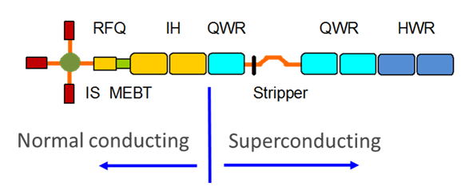
SRF Linac – [1]
ANL Design – P.N. Ostroumouv, et al., “Pulsed SC Ion Linac as Injector to Booster of Electron Ion Collider”, pg. 265-256, Proc. of SRF2015 (Whistler, BC, Canada).
E_final: Protons ~130 MeV/u & ²⁰⁸Pb ~40 MeV/u
Normal conducting section ~5 MeV/u
SRF cavities
21 of QWR βopt ~0.15 at 100 MHz
14 of HWR βopt ~0.3 at 200 MHz

Slide 7
SRF Linac – [2]
SRF Costing - Assume normal conducting front end & stripping section same whether SRF or RT– look at differentials for remainder of linac
Cost tunnel - ~35k$/m x ~47 m ~1.7M$
SRF section - 35 SC cavities ~18.3M$
21 of QWR βopt ~0.15 at 100 MHz ~7.8M$
use cost of FRIB QWR βopt ~0.085 at 80.5 MHz ~$0.37M/cavity
14 of HWR βopt ~0.3 at 200 MHz ~5.6M$
use cost of FRIB HWR βopt ~0.29 at 322 MHz ~$0.40M/cavity
RF (~$7/watt) ~4.9M$
SRF cryoplant ~8.2M$
heat load ~35 cavities x 9 W (at 4.5K)/cavity x 1.5 ~ 473 W
M.A. Green, “The cost of Helium Refrigerators and Coolers for Superconducting Devices as a Function of Cooling at 4K”, http://dx.doi.org/10.1063/1.2908683 => scales as [kW]^{0.63}
Total - tunnel & SRF & cryoplant ~28.2 M$

Slide 8
RT Linac
Following from
Jiquan Guo (Jlab)

Slide 9
RT Linac 2 gap – [1]
E_final: Protons ~130 MeV/u & ²⁰⁸Pb ~40 MeV/u
Normal conducting section ~5 MeV/u – same as SRF
Same as SRF – but use RT
Cavity losses require high rf power – large expense – α gradient² – mitigate by increasing cavities
Scale SRF solution – n x 35 RT cavities
n x 21 of QWR βopt ~0.15 at 100 MHz
n x 14 of HWR βopt ~0.3 at 200 MHz
as n goes up, rf drive /cavity goes down – but – cost per rf watt goes up (~$7/W at ~10s kW to ~$0.5/W at few MW)
=> lowest cost for n=1
Normal Conducting

Slide 10
RT Linac 2 gap – [2]
RT Costing - Assume normal conducting front end & stripping section same whether SRF or RT– look at differentials for remainder of linac
Cost tunnel - ~35k$/m x ~49 m ~1.7M$
RT section - 35 SC cavities ~55.2 M$
~100k$/m x 0.5 m/cavity = ~50k/cavity ~1.75 M$
RF (~$0.3/W) ~52.9M$
$0.3/W lower end – cost information ranged ~0.4±0.1 (25%) $/W
Diagnostics etc (~10k$/m x 49m) ~0.5M$
Total - tunnel & RT section ~55.6 M$
Normal Conducting

Slide 11
Multi-gap RT Approach
Following from
Professor Holger Podlech , Goethe Universitat

Slide 12
Prof. Dr. H. Podlech
LINAC Parameters Considered
²⁰⁸Pb
Energy: 40 MeV/u or higher (e.g. 100 MeV/u)
Current: 0.5 / 0.25 emA (before/after stripping)
Stripping energy: 13 MeV/u (Pb30+ => Pb67+)
Protons
Energy: 130 MeV/u or higher (e.g. 285 MeV/u)
Current: 5emA (before/after stripping)
Other
Duty cycle for RT: 0.5%
Frequency choice will largely be driven by commercial availability of rf drive – following uses 80.5, and 161 MHz
Separate linacs for proton (deuteron) through lower (e.g. <5 MeV/u) energy
Large Q/A range
High proton current
Single linac for higher energies
Multi-gap structures

Slide 13
Prof. Dr. H. Podlech
Room Temperature Multi-gap Linac
Stripper/
Charge state separator
Source
LEBT
RFQ
DTL (IH/CH)
DTL (CH)
Pb
4-10 keV/u
0.4 MeV/u
40 MeV/u (²⁰⁸Pb)
130 MeV/u (proton)
13 MeV/u
Source
LEBT
RFQ
DTL (CH)
p
30 keV/u
1.5 MeV/u
5 MeV/u

Slide 14
Prof. Dr. H. Podlech
Proton 5 MeV/u Injector
Likely should be optimized for deuterons
30 keV/u
1.5 MeV/u
5 MeV/u
RFQ
MEBT
CH-1
RFQ
f=161 MHz
L≈3 m
P≈130 kW
L (m) ≈ 1.0
P(kW) ≈ 250
f(MHz)= 161
Magnetic triplet

Slide 15
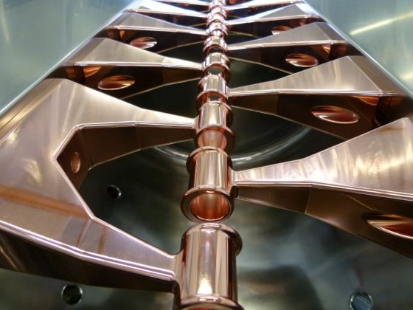
Prof. Dr. H. Podlech
Pb30+ 5 MeV/u Injector
4-10 keV/u
0.4 MeV/u
1.8 MeV/u
3 MeV/u
4 MeV/u
5 MeV/u
IH-1
IH-2
RFQ
MEBT
CH-1
IH-3
IH-4
RFQ
f=80.5 MHz
L≈3.5 m
P≈100 kW
L (m) ≈ 2.4 2 2 2
P(kW) ≈ 300 250 250 250
f(MHz)= 80.5 80.5 80.5 80.5
Magnetic triplet

Slide 16
Prof. Dr. H. Podlech
Linac – 2nd Half
5 MeV/u
4 x CH-T1
7 x CH-T2
9 x CH-T3
12 x CH-T4
L (m) ≈ 0.9 0.65 0.78 0.92
f(MHz) = 161 161 161 161
λ_opt = 0.184 0.225 0.274 0.35
# cells = 5 3 3 3
P(kW) ≈ 550 500 650 880
40 MeV/u (²⁰⁸Pb)
130 MeV/u (proton)
E_{a} (MV/m) cos ϕ incl ≈ 5
Magnetic doublet or triplet – between every 2 to 4 Cavities

Slide 17
Prof. Dr. H. Podlech
Preliminary Costing
Hardware estimates - no manpower & contingency => estimates doubled to approximate
Proton 5 MeV/u Injector Hardware ~ 5M$
Pb 5 MeV/u Injector Hardware ~ 39M$
Remainder (>5 MeV/u) of Linac Costs
To be compared to SRF & RT 2-gap
Linac tunnel - 35$k/m x 58 m ~ $2M
Hardware ~ 62.4M$
(2/3rd of cost is rf)
Could be as low as ~50M$ (rf costs ±25%) OR similar to 2-gap
Total tunnel & hardware ~ 64.4M$

Slide 18
Summary & Next Steps
Technology Choice
Both RT & SRF can deliver performance
Key decision metric is cost
SRF/RT 2-gap/RT multi-gap/ => ~28M$/~56M$/~64M$
RT is about 2x cost of SRF largely due to rf costs
Costing rough but ratio (RT to SRF) large enough to conclude
SRF (with RT front end) is preferred Solution
Next Steps
Final design awaits requirement specification from Booster analyses but start to:
Develop detailed RT front end design
Large Q/A range for H⁻ [1] to D+ [0.5] to ²⁰⁸Pb30+ [0.14]
Possibly require two independent front ends through ~few MeV/u
Develop detailed SRF linac
Develop choice of for RT to SRF transition point
Stripping point for heavy ions
Optimization of cavity choices (QWR/HWR, frequency, β_opt, etc)

