Slide 1
Compensation of Detector Solenoid
G.H. Wei, V.S. Morozov, Fanglei Lin
JLEIC Collaboration Meeting Spring, 2016

Slide 2
Contents
Detector solenoids Effect
Compensation Options
JLEIC Considerations & a Solution
Summary

Slide 3
Detector Solenoid Effect
Coherent orbit distortion
Transverse betatron coupling
Dynamic effect
Coupling resonances
Rotates beam planes at the IP
Breaks Horizontal and vertical dispersion free
Perturbation on lattice tune & W function of the first order chromaticity compensation
Spin effect
Breaks figure 8 symmetry
Crab crossing
Complicates the design if crab cavities are installed in a coupled region

Slide 4
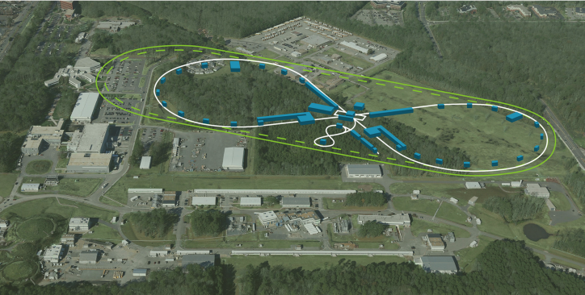
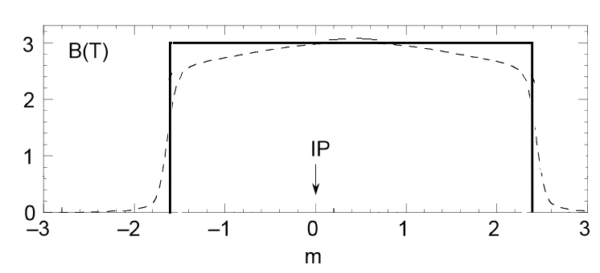
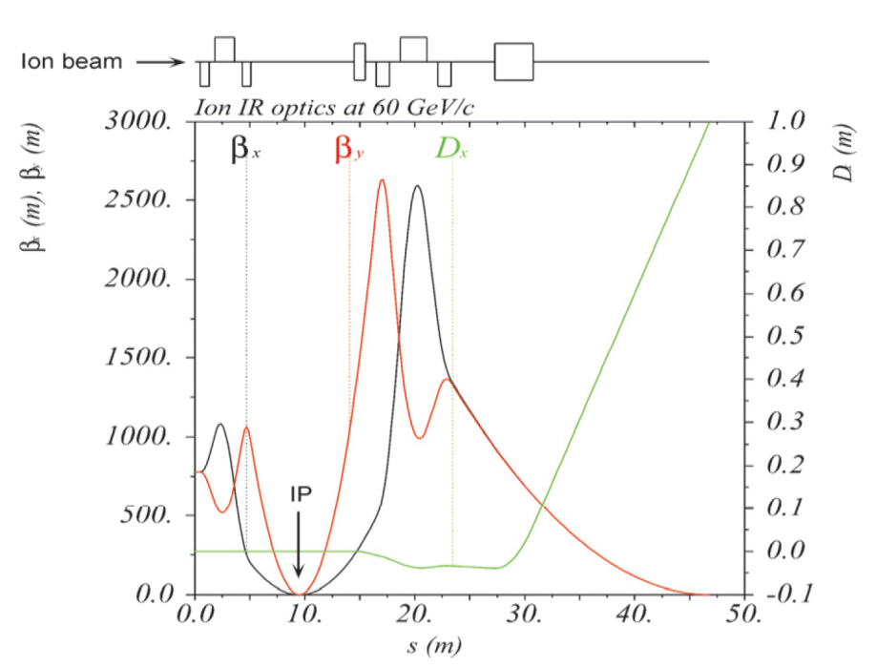
JLEIC and Detector Solenoids
Detector Solenoid | JLEIC
Length | 4 m
Strength | < 3 T
Crossing Angle | 50 mrad

Slide 5
JLEIC and Detector Solenoids
Effects on e ring & ion ring
Effects | e ring | ion ring
Coherent orbit distortion | N | Y
Coupling resonances | Y | Y
Rotates beam planes at the IP | Y | Y
Breaks H & V dispersion free | N | Y
Perturbation on lattice tune & W function | Y | Y
Breaks figure-8 spin symmetry | Y | Y

Slide 6
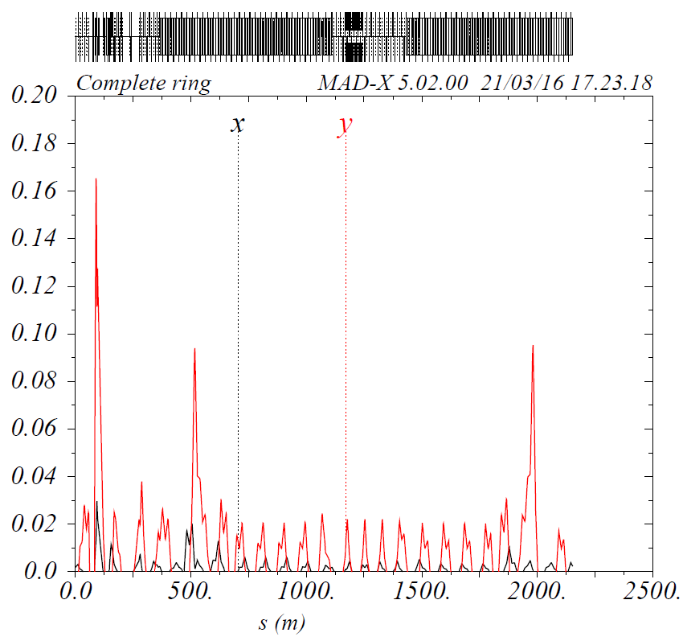
Vertical and horizontal orbit oscillations
Detector Solenoid 1 T: Closed orbit V: ~170 mm, H: ~30 mm
Detector Solenoid > 2 T: No closed orbit

Slide 7
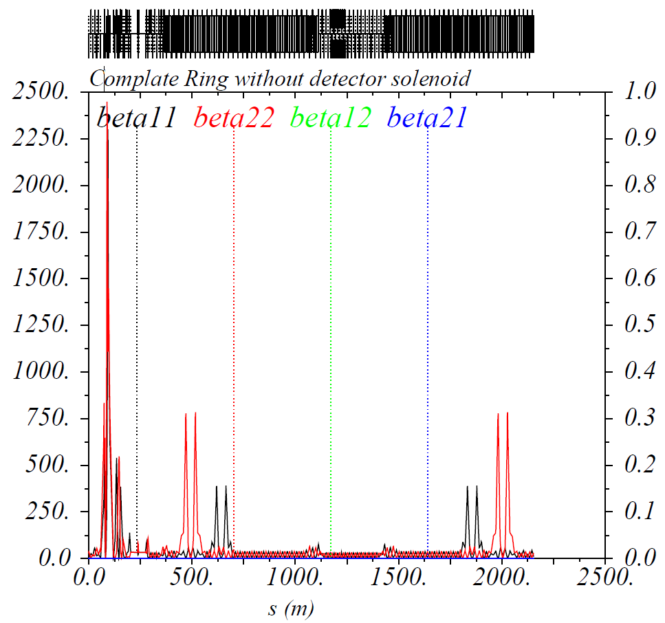
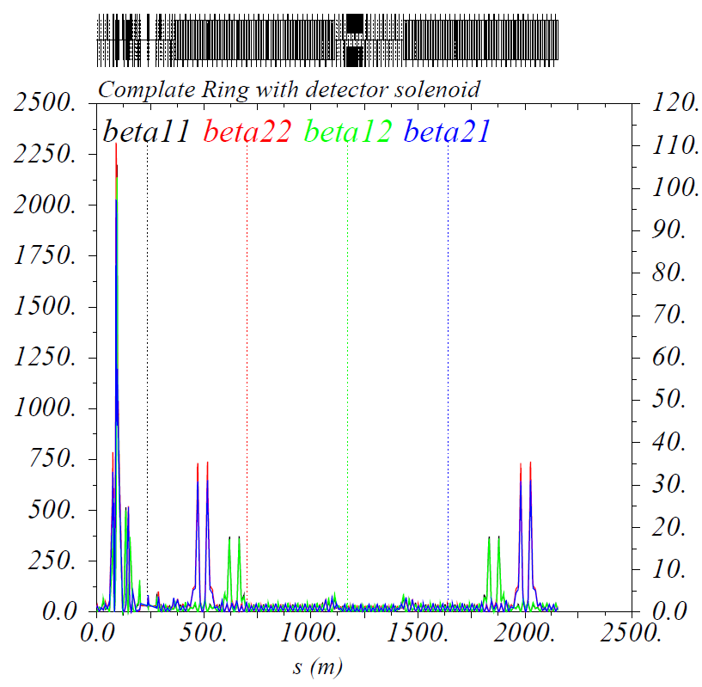
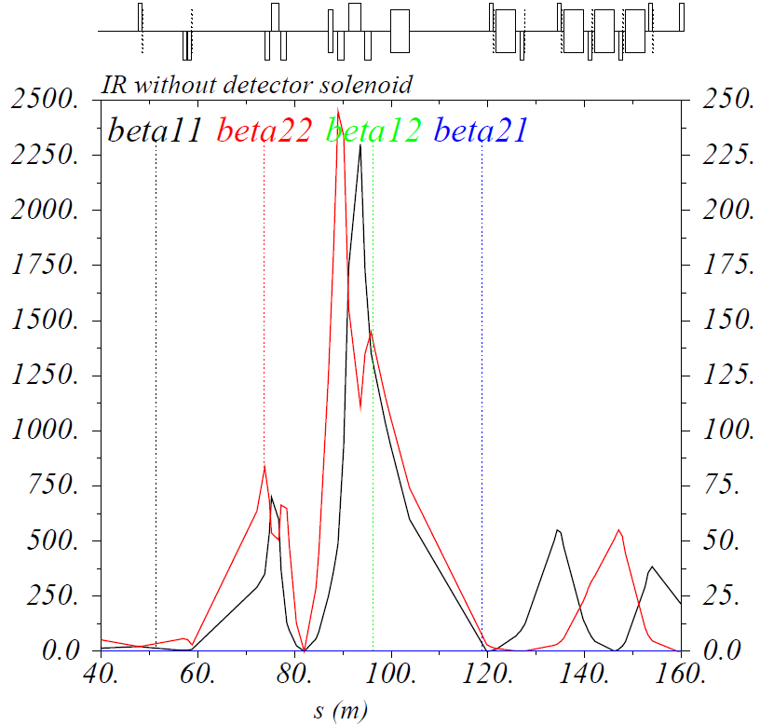
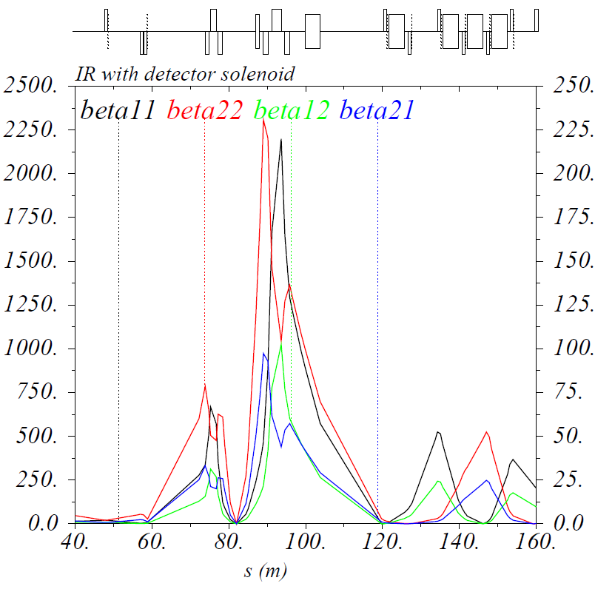
Coupling of X and Y betatron motion
Coupling beta ~ 5 % of nominal beta (Ion Ring, 60 GeV)

Slide 8
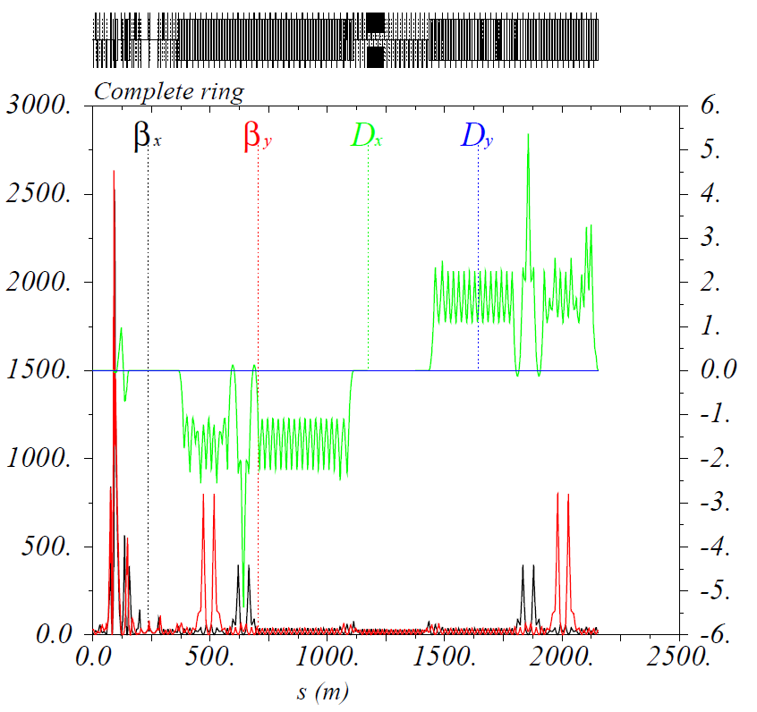
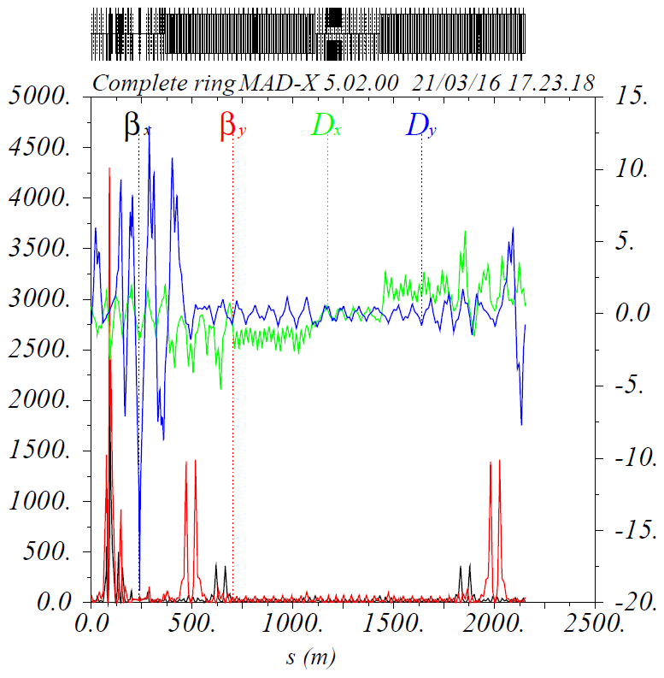
Break of H & V dispersion-free
Left: detector solenoid off
Right: detector solenoid on

Slide 9
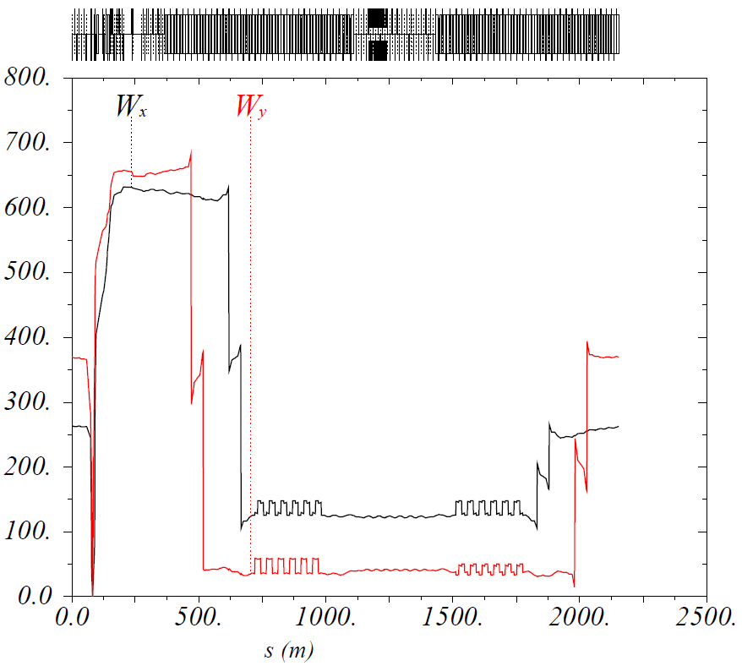
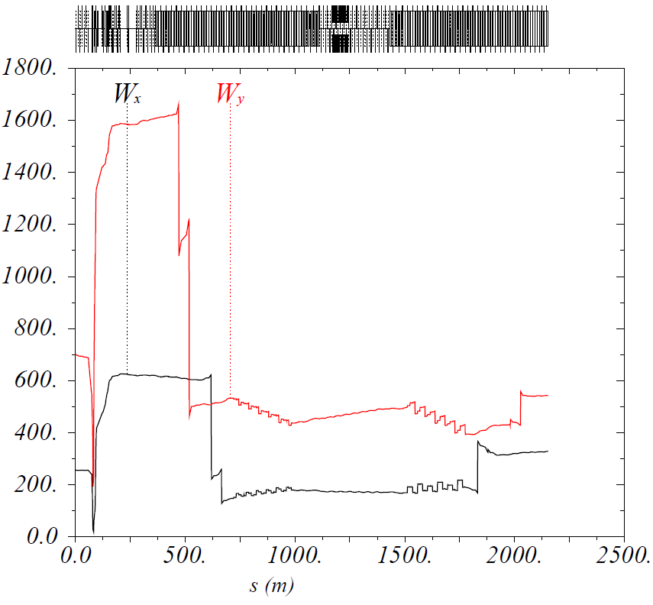
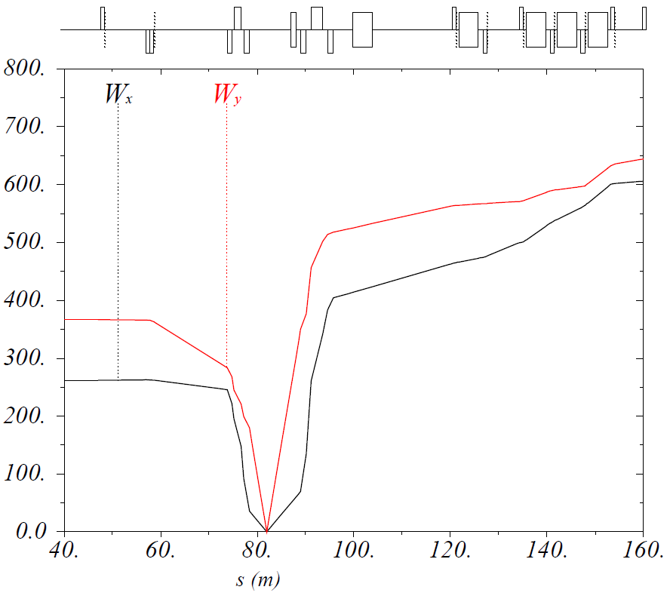
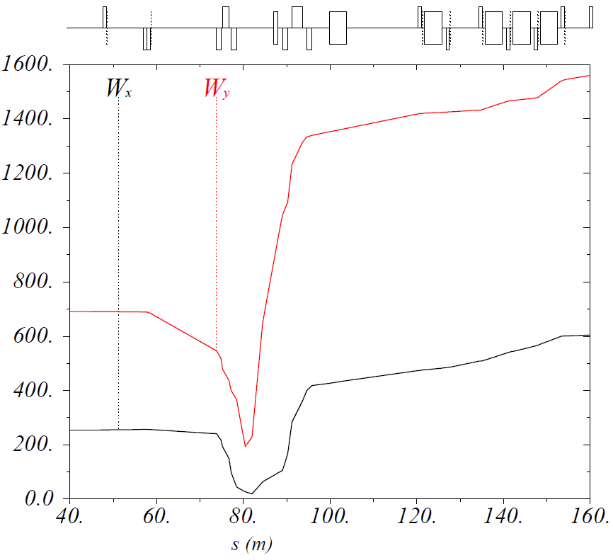
Perturbation on lattice tune & W function
Tune (25.22, 23.16) → (25.20, 23.08)
Detector solenoid status: Left: off; Right: on
IP
IP

Slide 10
Compensation Options
Detector Solenoid + Drift + Anti-Solenoid (a RHIC design)
Pro: dynamically is the best
Con: there seems to be no space in the IR of JLEIC
Detector Solenoid + + same-field-integral solenoid
Cons: long locally coupled section, crab cavity issue, spin effect is not compensated
Detector Solenoid + + Anti-Solenoid
Cons: long locally coupled section, crab cavity issue
V. Garczynsky, RHIC-Notes/AD-AP-37

Slide 11
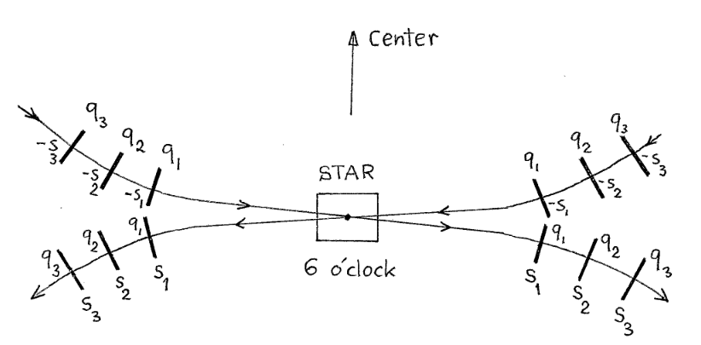
Compensation Options
Distributed skew quadrupole compensation
Pro: less complicated optics than in options 2 & 3
Cons: long locally coupled section, crab cavity issue, spin effect is not compensated
a RHIC design, PEP-II
3 ~ 6 skew quads on each side of IP
V. Garczynsky, RHIC-Notes/AD-AP-38

Slide 12
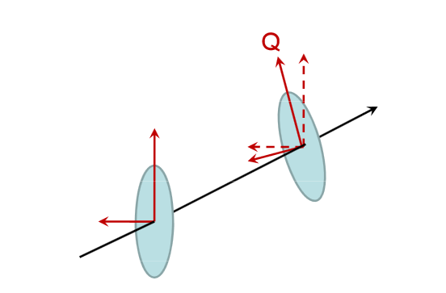
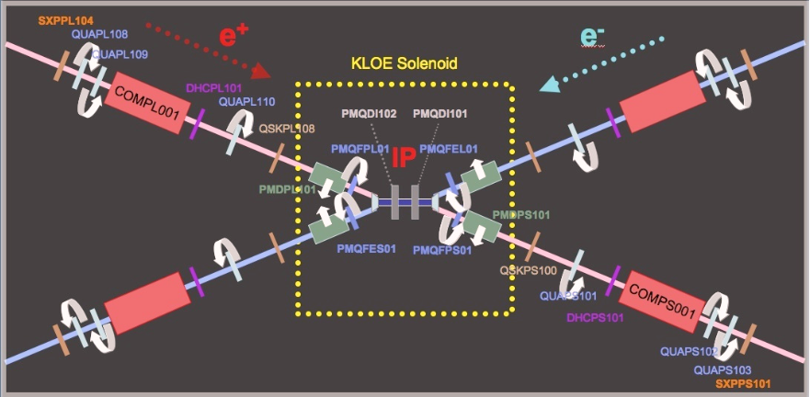
Compensation Options
Solenoid + tilt Quads + Anti-Solenoid
Pros: coupling is localized, no crab cavity problem, spin effect is compensated
Con: more complicated final focus design
Super KEKB & DAFNE

Slide 13
JLEIC Considerations & a Solution
Compensation constraints for both electron and ion rings
Optics fixed and uncoupled at IP due to variety of solenoid fields and energies
Coupling compensated locally and independently on each side of IP
Optics fixed at the entrance into and exit from IR
No coupling elements (for now) dispersive regions
Cancel spin effect to keep figure 8 symmetry
Notes:
13

Slide 14
JLEIC Considerations & a Solution
A solution: Solenoid + Quads(normal+skew) + Anti-Solenoid
Quads(normal+skew): a normal quad with an additional winding or a skew quad next to the normal quad
Dynamical rotation angle α of a normal quad (strength: kn) & a skew component (strength: ks)
Notes:
14

Slide 15
JLEIC Considerations & a Solution
A solution: Solenoid + Quads(normal+skew) + Anti-Solenoid
Quads(normal+skew)
e-ring
Ion ring
IP
: Orbit corrector
Notes:
15

Slide 16
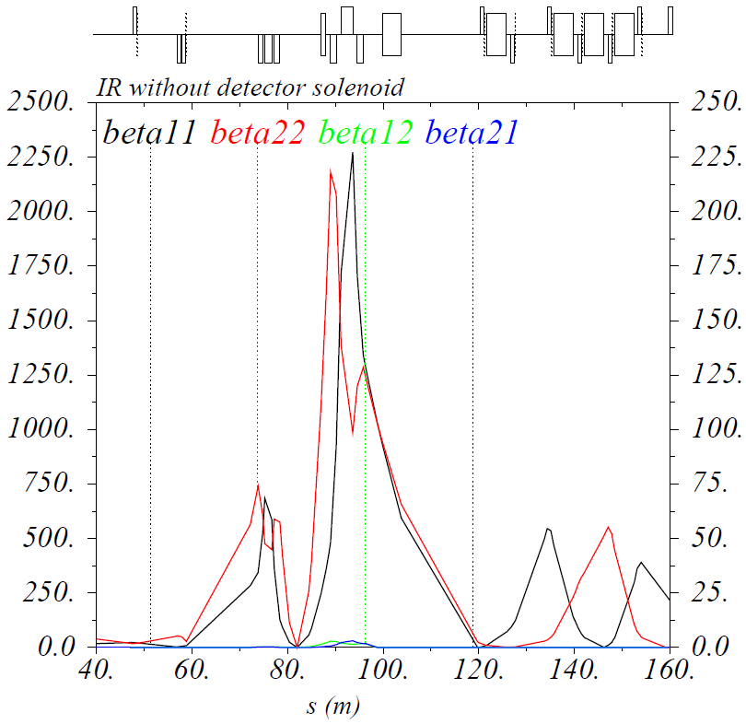
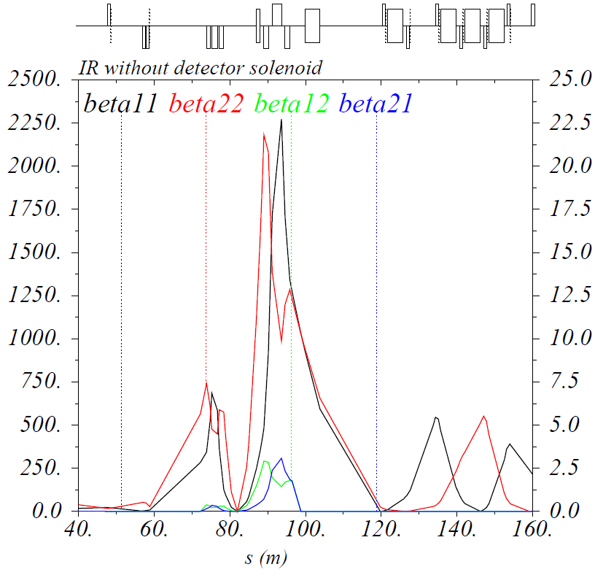
Coupling of X and Y betatron motion
Coupling compensated locally and independently on each side of IP

Slide 17
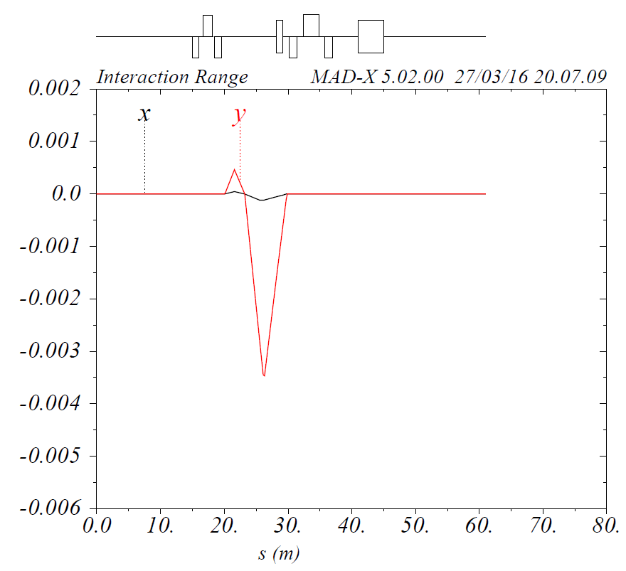
Vertical and horizontal orbit oscillations
Detector Solenoid 3 T: Closed orbit V: < 4 mm, H: < 0.5 mm

Slide 18
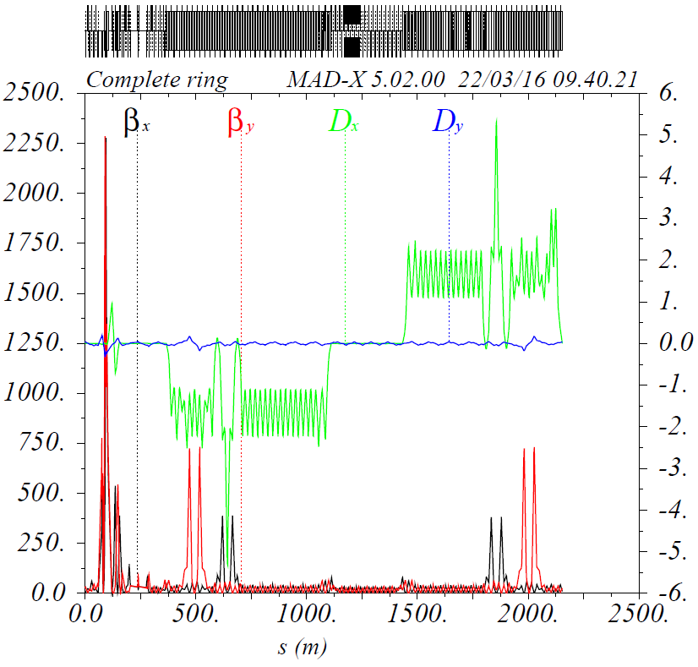
Restoration of H & V dispersion
Left: before restoration
Right: after restoration, Dy < 0.3 m

Slide 19
Summary
Detector solenoid gives effects of orbit distortion, transverse betatron coupling, Rotates beam planes at the IP, Breaks Horizontal and vertical dispersion free, Perturbation on lattice tune & W function of the first order chromaticity compensation, Spin effect to Break figure 8 symmetry.
A solution of ‘Solenoid + Quads(normal+skew) + Anti-Solenoid’ is used to compensate detector solenoid effects. Results are acceptable.
More study should be done on W function restoration.

Slide 20
Thank you

Slide 21
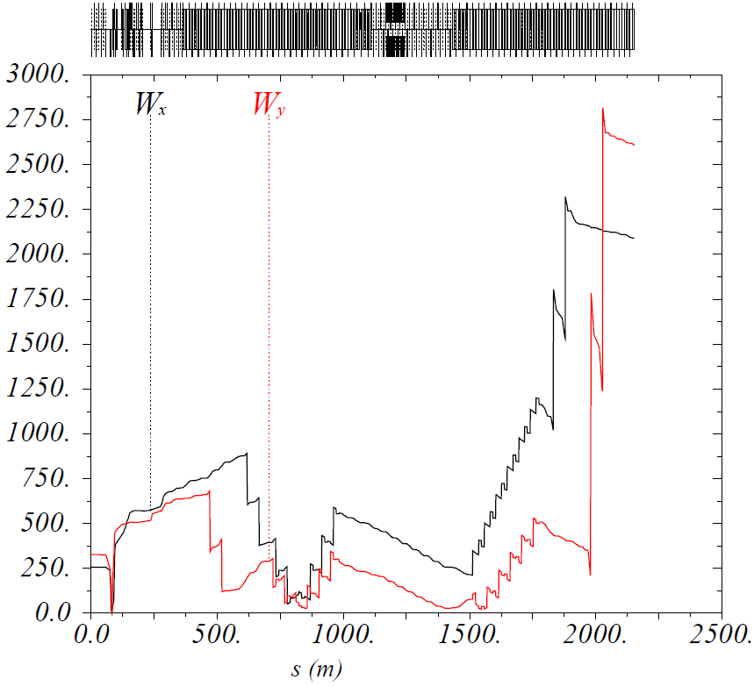
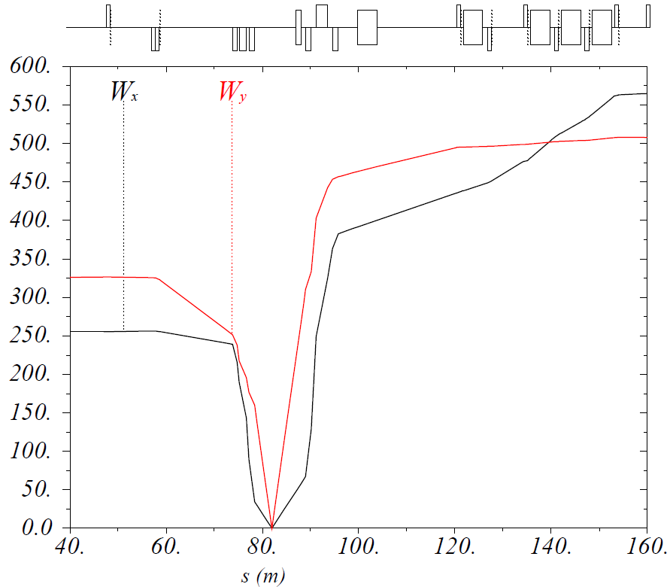
Perturbation on lattice tune & W function
Left: uncorrected; Right: corrected

Slide 22
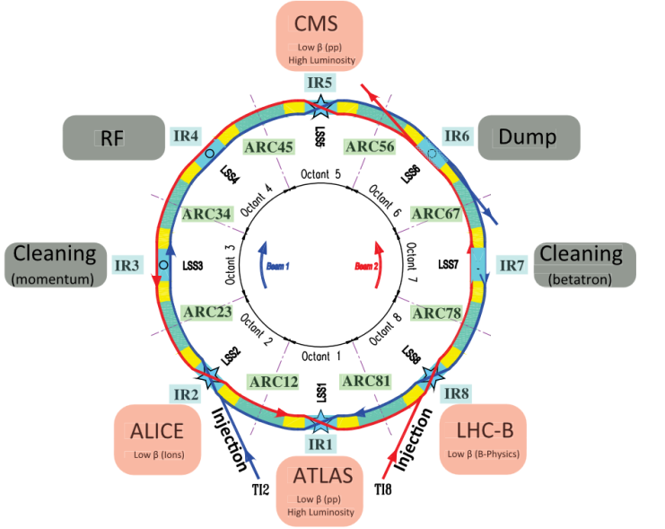
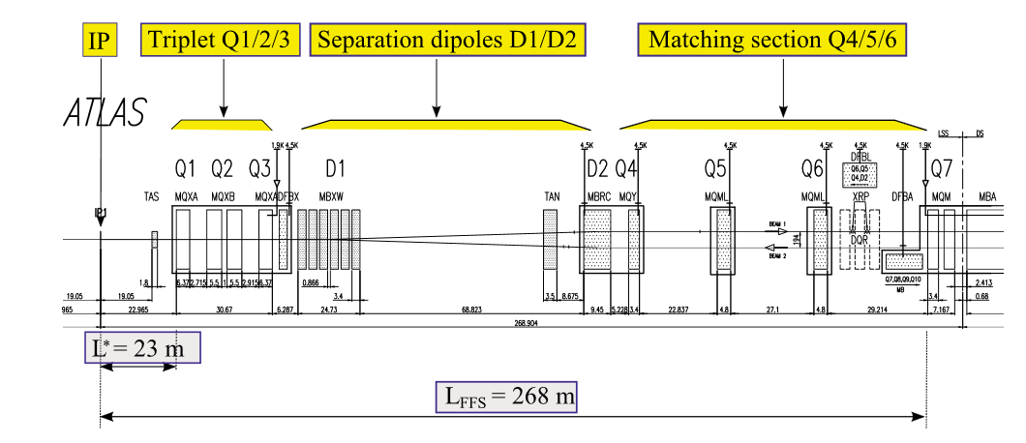
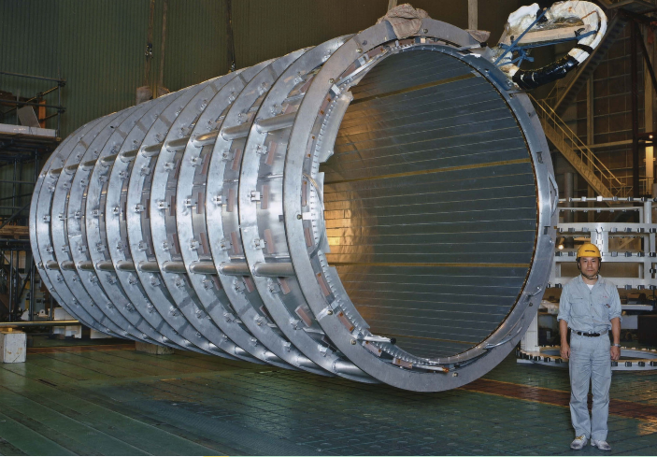
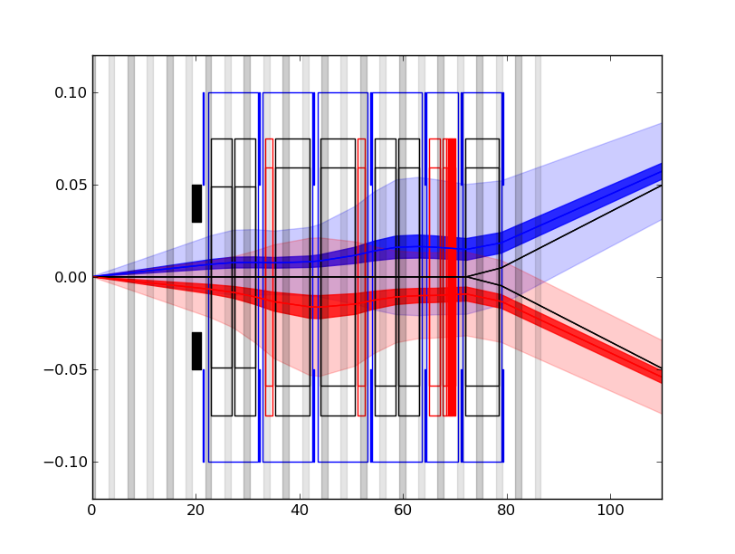
Detector Solenoids in LHC
Detector Solenoid | Old LHC | HL-LHC
Length | 5.3 m | 5.3 m
Strength | 2 T | 2 T
Crossing Angle | 285 μrad | 590 μrad

Slide 23
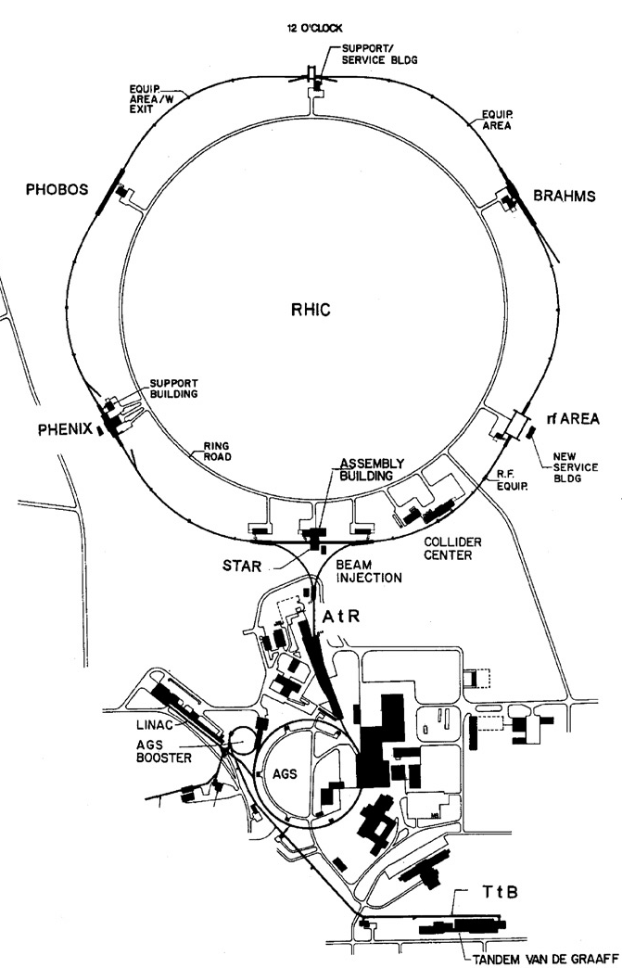
Detector Solenoids in RHIC
Detector Solenoid | RHIC
Length | 6.2 m
Strength | 0.5 T
Crossing Angle | <1.7 mrad

