Slide 1
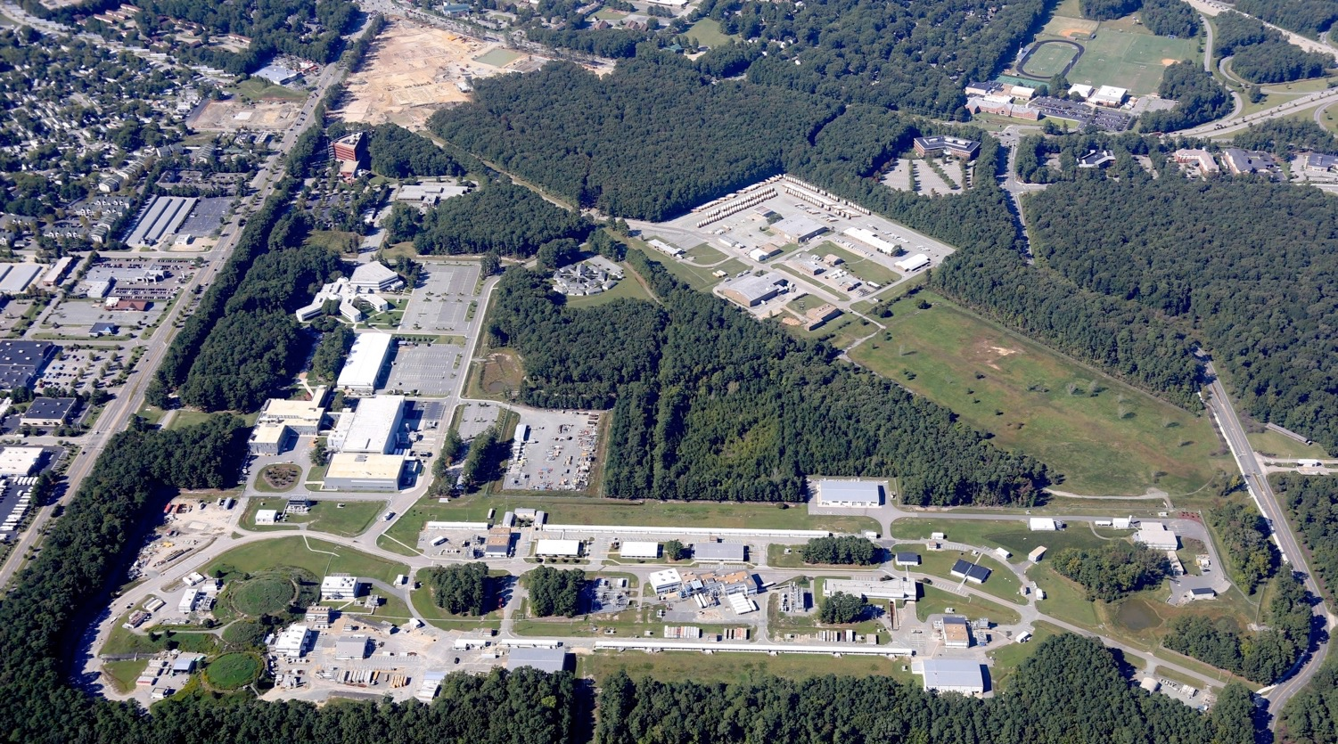
Superferric Magnets for MEIC
Peter McIntyre
Texas A&M University
Peter McIntyre
October 8, 2015

Slide 2
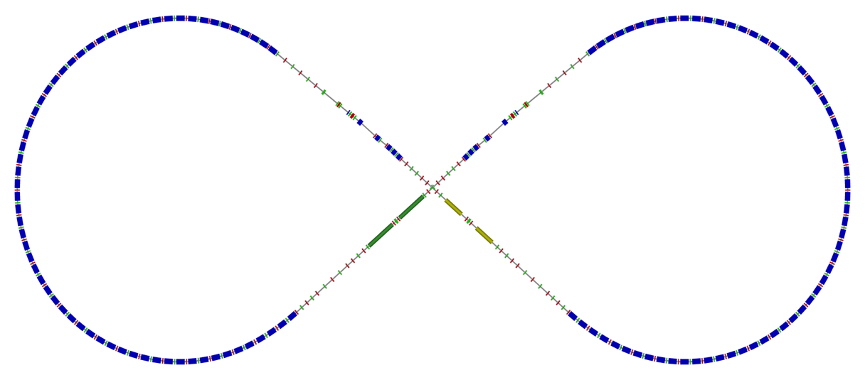
Superferric Magnets for the Ion Ring and Booster
disp. supp./
geom. match #1
disp. supp./
geom. match #1
IPs
beam exp./
match
R = 155.5 m
disp. supp.
det. elem.
rm.+
SRF
Arc, 261.7°
el. cool.
ions
Ion Ring– 128 arc half-cells
Booster – 32 arc half-cells
Superferric magnets have been designed for the requirements of arc half-cells:
Ion Ring: 8-100 GeV protons: 0.25 -- 3 T dipoles, 52 T/m quads
Booster: 0.2-8 GeV protons: 0.24 – 3 T dipoles, 6 T/m quads

Slide 3
Half-cell cryostat geometry for Ion Ring arcs
Dipole aperture requirement: betatron amplitude (15 σ) @ injection: ±3 cm
dispersion of ±0.5% momentum spread: ±1 cm sagitta (with 4 m dipole length): ±1.8 cm
±5 cm
Quad aperture radius requirement: 4 cm
Each half-cell contains two 4 m dipoles, one 0.8 m quadrupole, 1 sextupole to correct body sextupole in dipoles (Neuffer):
11.4 m overall half-cell length
F
S
S
F
F
= leads
= fixed anchor to support post
= sliding anchor to support post
= sliding shroud section of vacuum vessel
F
S

Slide 4
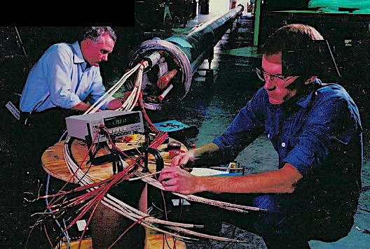
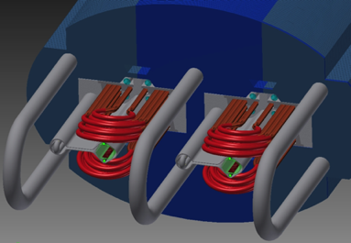
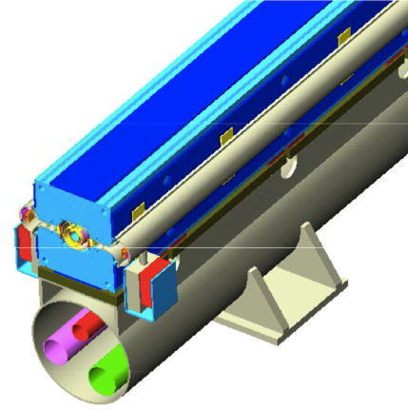
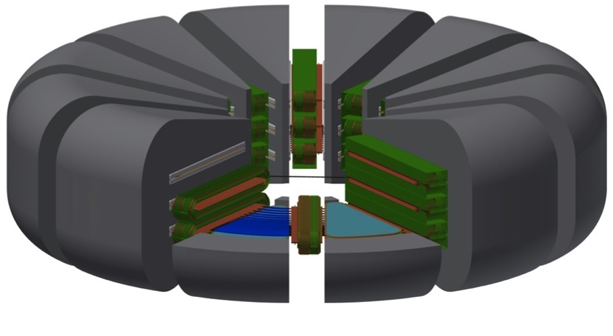
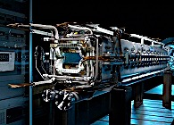
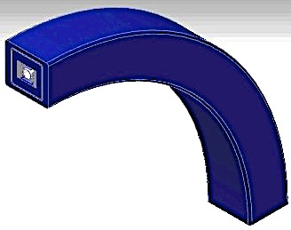
Superferric Magnets – Cost Minimum up to ~4 T
3 T SSC dipole
4.5 T for 100 TeV hadron collider
2 T pipe dipole for VLHC
3 T proton gantry for particle beam therapy
2 T FAIR dipoles
1 T strong-focusing cyclotron

Slide 5
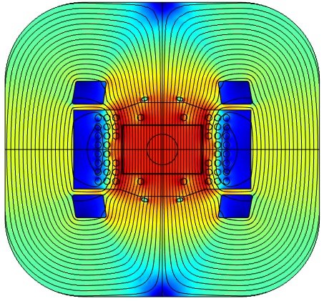
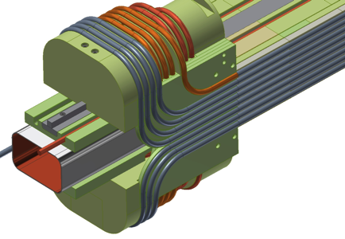
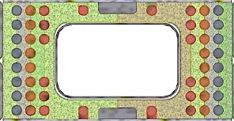
MEIC Arc dipole
The biggest challenge is to create a 10 cm x 6 cm aperture with the field quality needed for high-luminosity collisions with long luminosity lifetime – dynamic aperture

Slide 6
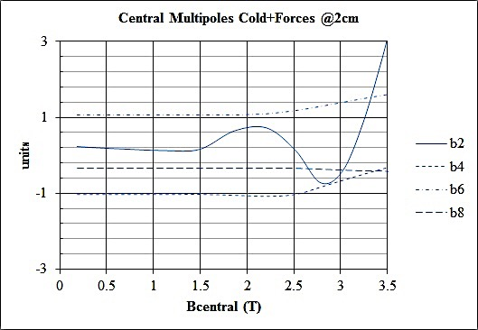
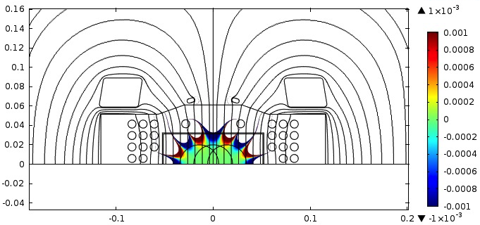
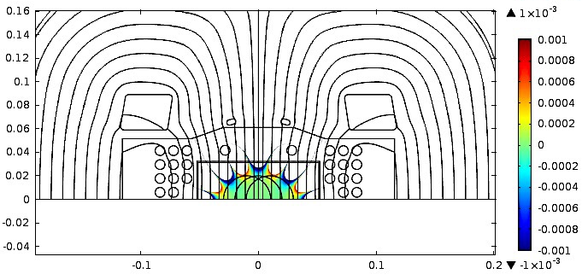
The fields seen by the ion beams…
Multipoles vs. field and load lines for MEIC dipole design.
Injection @ 8 GeV collision @ 100 GeV
10 σ contours,
± sagitta
20 σ contours,
± sagitta
Green is good!

Slide 7
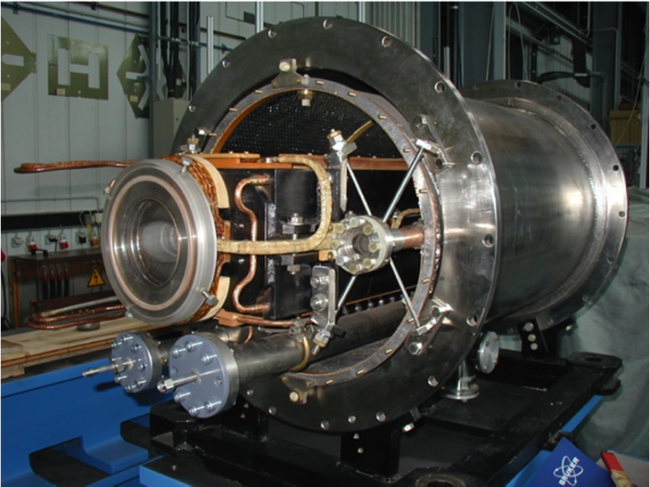
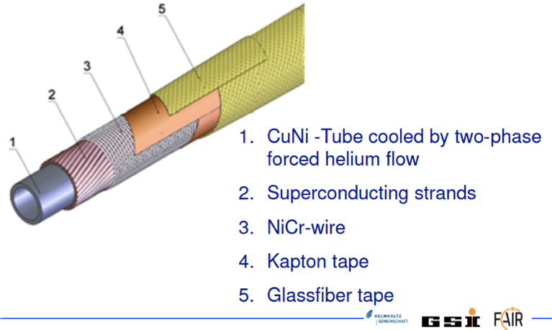
Cable-in-Conduit: Dubna to GSI to MEIC
The SIS-100 ring uses superferric dipoles operating at 1.8 T.
Its conductor is a semi-rigid cable-in-conduit, in which the helium cryogen flows internally so that the magnet is not immersed in liquid helium.
Cable-in-conduit makes a much simpler end geometry for a large-bore dipole. The windings can be supported in a reinforced polymer structure, with tight precision.

Slide 8
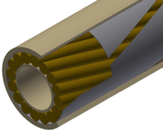
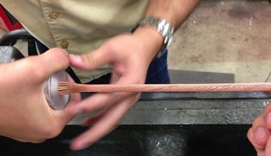
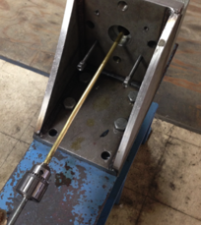
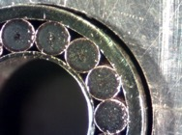
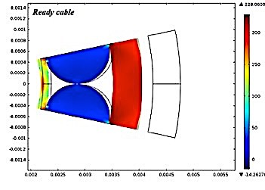
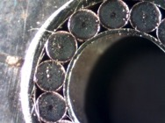
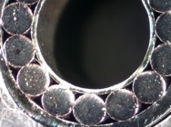
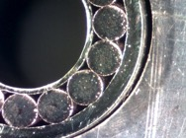
We follow the Dubna/GSI CIC strategy with a few improvements for higher-field operation
15 NbTi/Cu wires are cabled onto a perforated spring tube.
The cable is inserted in a sheath tube, and the sheath is drawn onto the cable to just compress the wires against the spring tube.

Slide 9
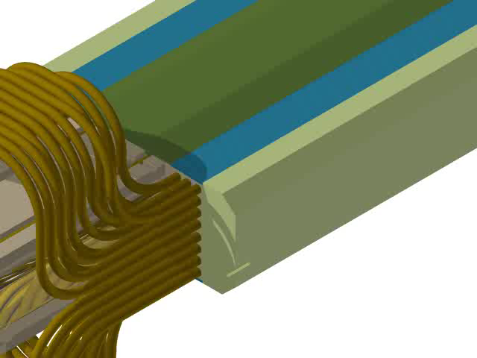
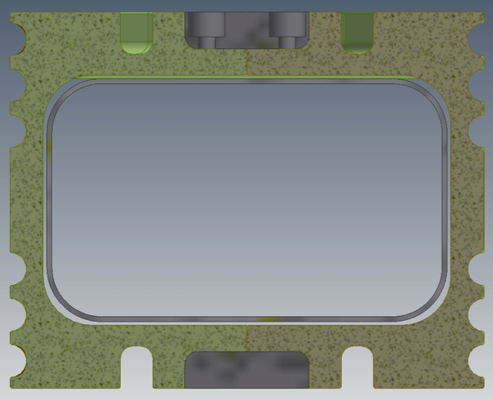
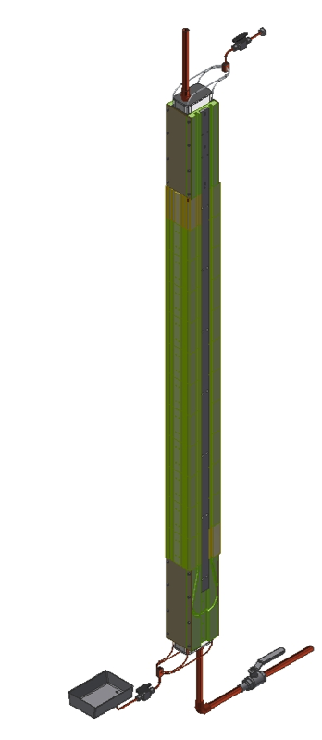
Superferric Dipoles: How we build them
Strategy:
All cables are positioned sandwiched between layers of precision-machined structure.
Ends are formed to the side of the dipole, then popped into place in the structure layer.
Overall coil assembly is preloaded within steel flux return, all windings immobilized.
Fabricate inner form segments from 4”-thick G-11 fiber-reinforced epoxy slab.
Assemble stack of segments for dipole body, using the CIC channels for alignment.
3. Insert the SS beam tube, seal the ends, and epoxy impregnate the gap between segments and beam tube.

Slide 10
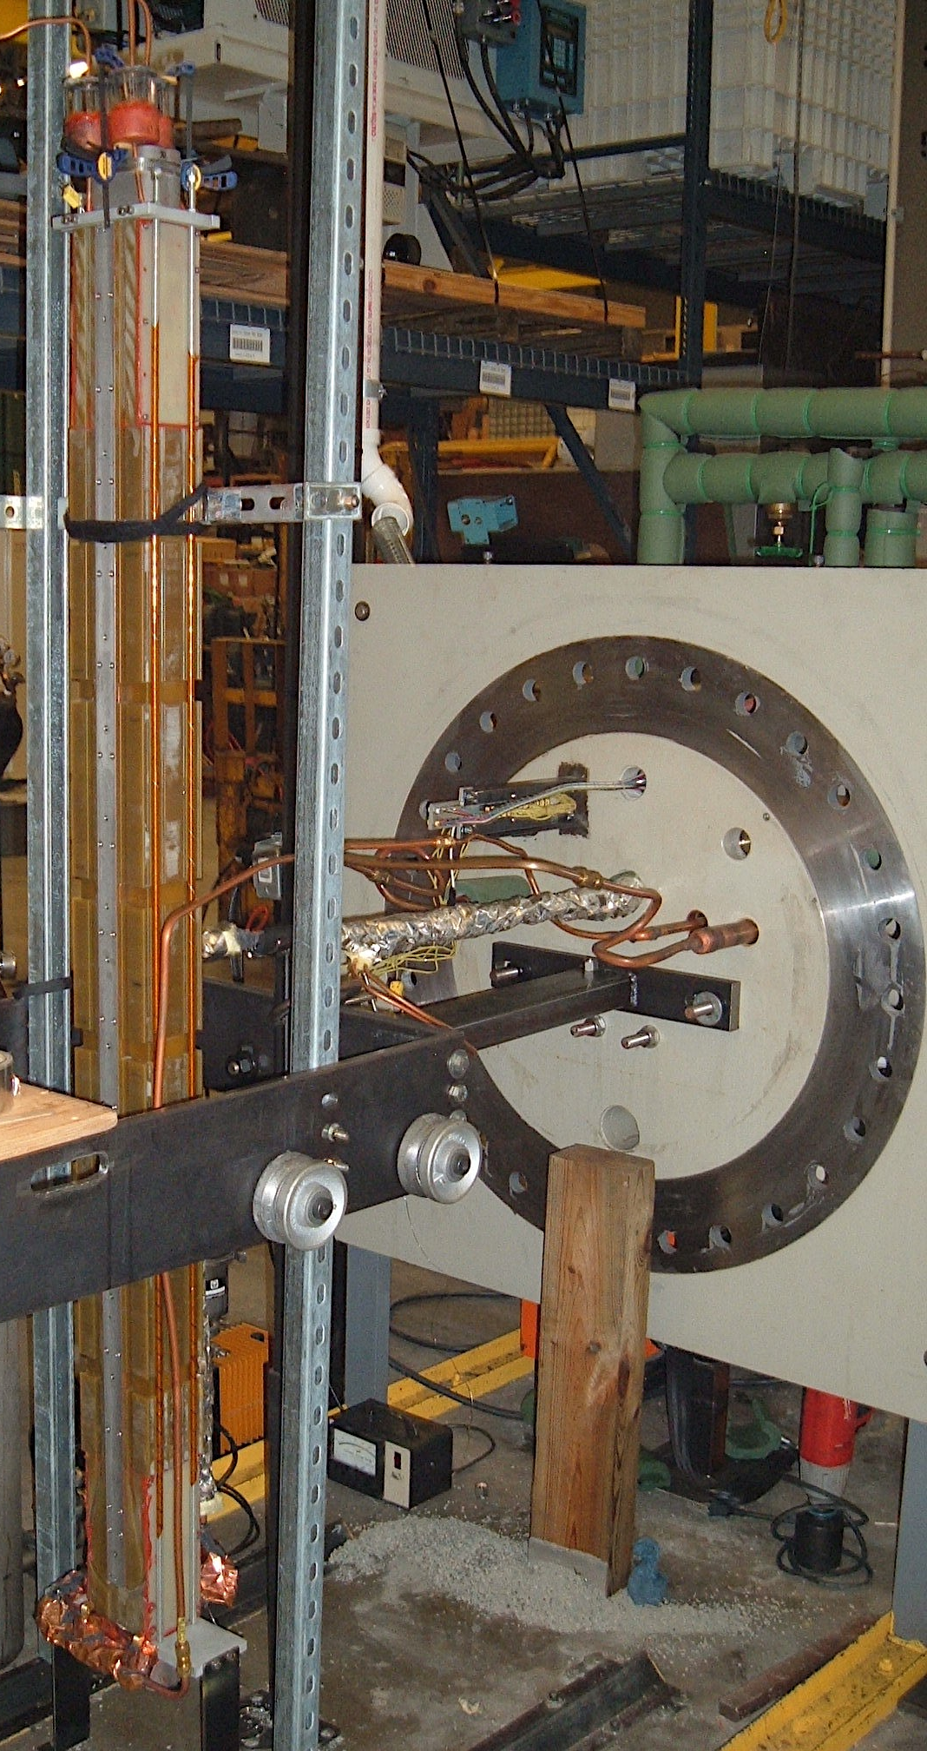
Assembly/alignment / epoxy impregnation of beam tube & winding structure

Slide 11
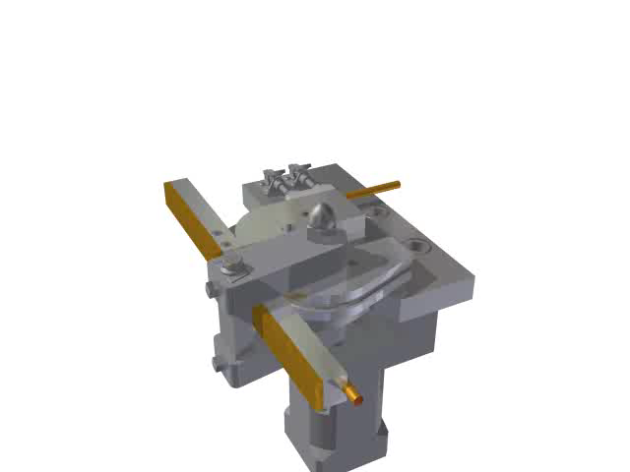
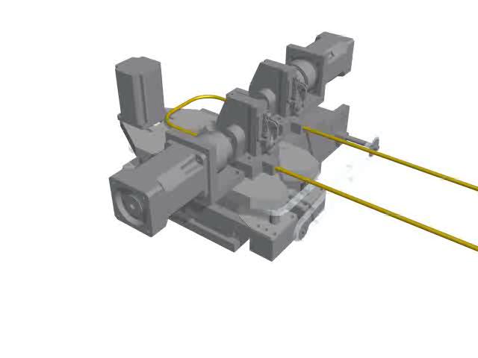
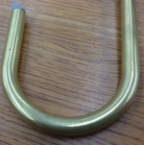
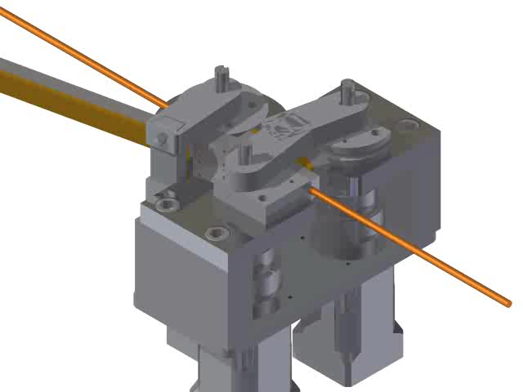
Forming the flared ends requires production tooling
All ends are formed with 2” radius bends.
Bend the U to form a 90° ear, with offset for layer-layer transitions.
1. Bend a U with the correct horizontal spacing.
3. ‘Odd-man’ turns require forming a ‘dog-bone’ end.
We have validated that bends preserve internal structure, do not damage NbTi wires.
See videos of the real tools making these bends at https://goo.gl/VoSDOS

Slide 12
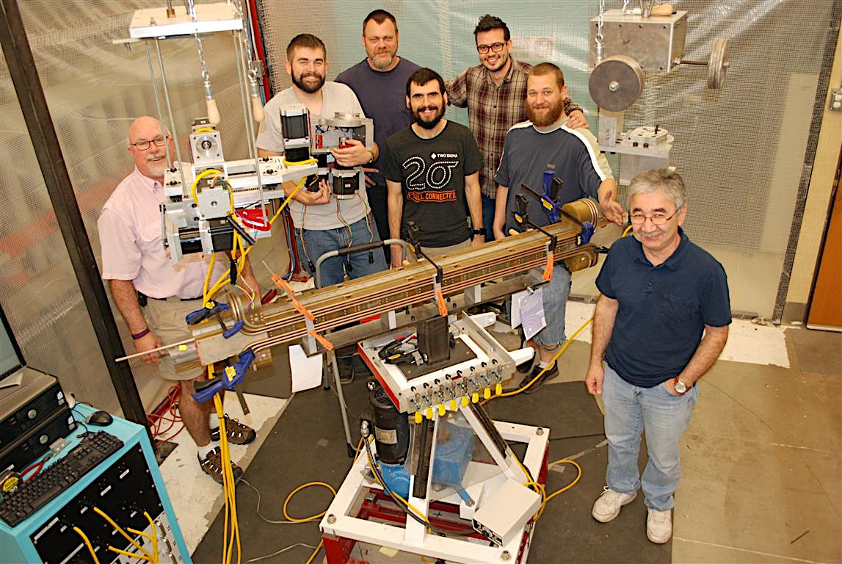
Mockup Winding – Layer 1 wound

Slide 13
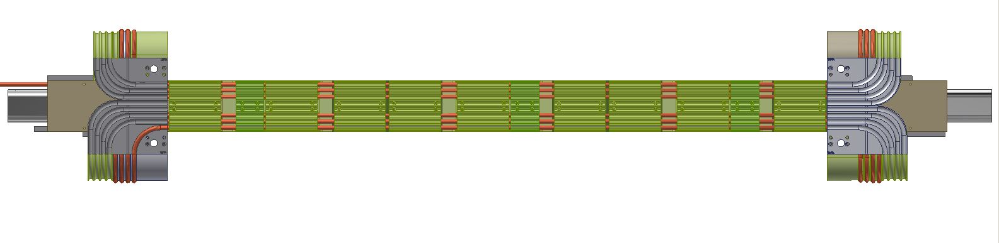
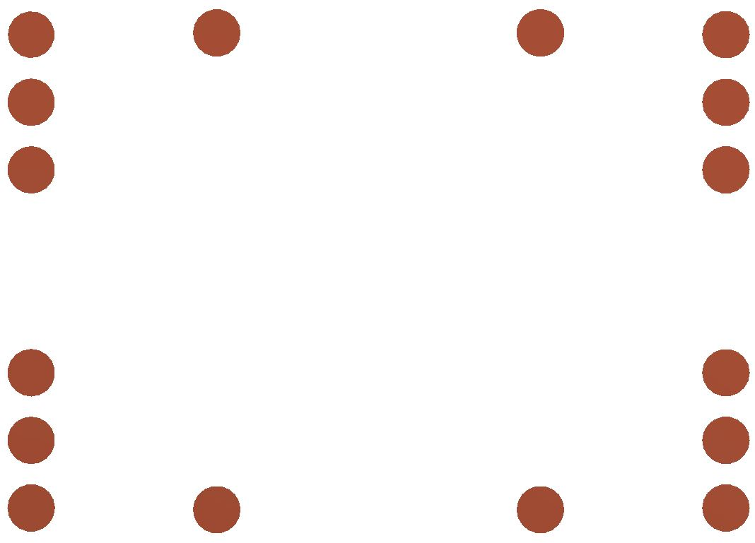
Measurement of cable positions for Layer 1
1
2
3
4
5
6
3
1
2
4
5
6
7
8
Right
left
9
10
11
12
13
15
14
16

Slide 14
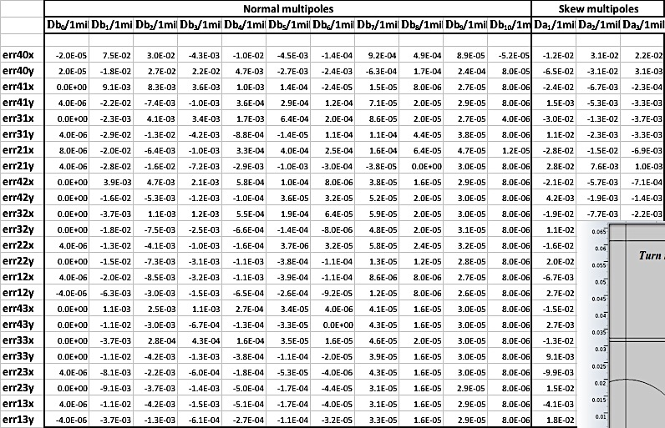
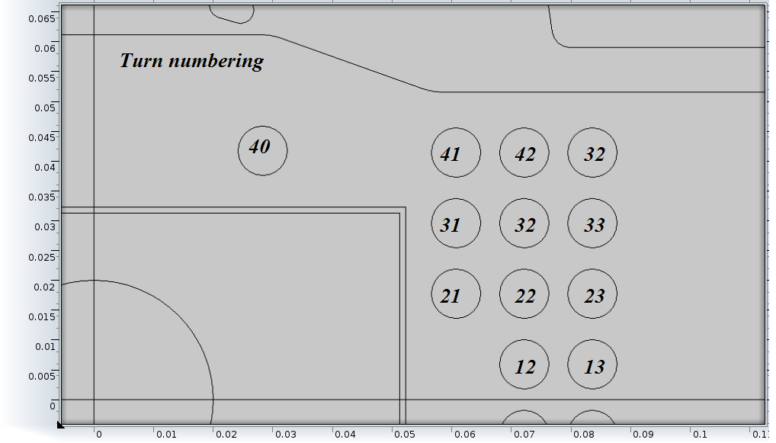
Error matrix from magnetic model: b_{n}, a_{n} from .001” error on each cable x,y

Slide 15
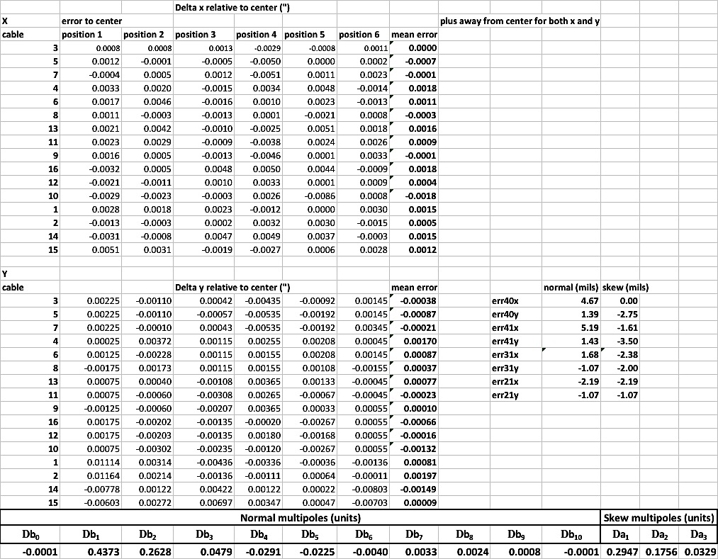
Measure cable positions for Layer 1
Preliminary cable placement measurements for Layer 1:
Extract random multipoles from cable placements in Layer 1:

Slide 16
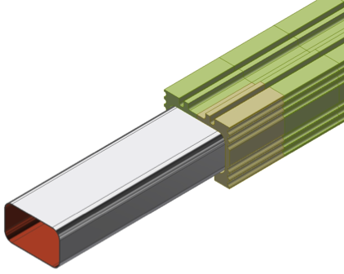
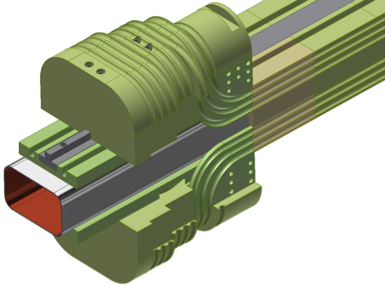
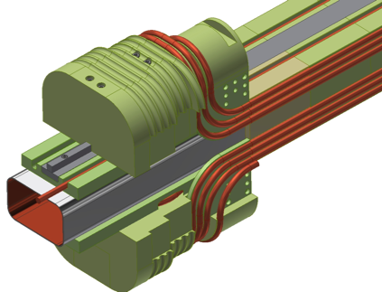
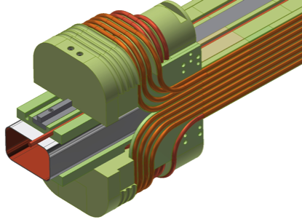
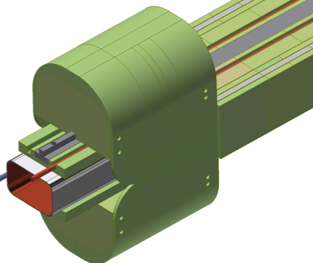
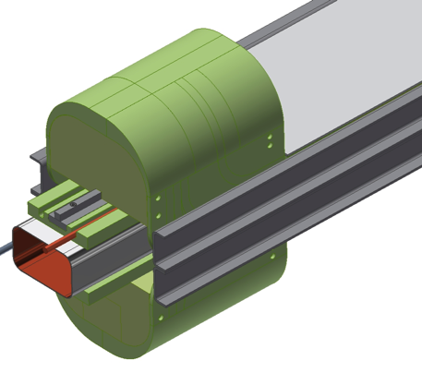
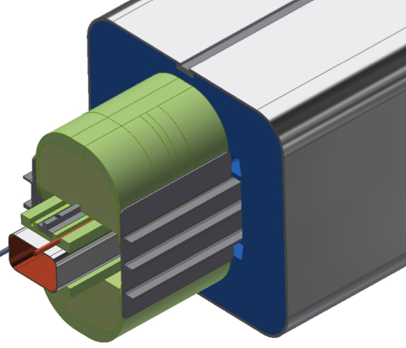
Next: the complete fabrication
Body segments assembled on beam tube, jig-located, epoxy-impregnated
SS bars, end frames installed, ready to wind first layer
First layer wound
Second layer wound
Third layer wound
Cable frame complete, End covers installed
Flux return halves installed and closed, SS shells welded
Ti channels, SS top/bottom skins installed

Slide 17
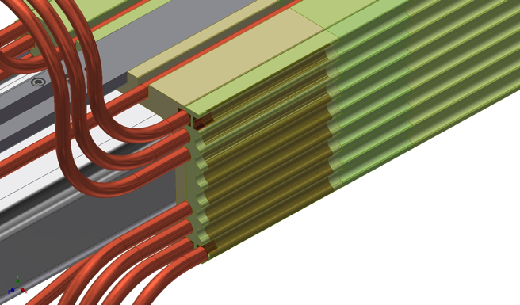
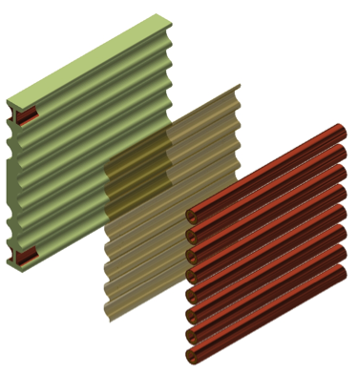
Quench Protection
Quench heater foils are bonded in a 10 cm end segment of the G-11 structure on both ends of the dipole.
Every cable turn is driven normal in ~10 ms by a current pulse to the heater foils.
Maximum pressure during quench in the 250 m length CIC of a 4 m dipole = 41 bar

Slide 18
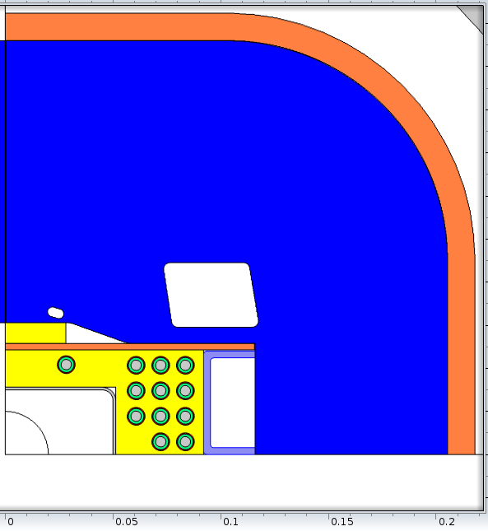
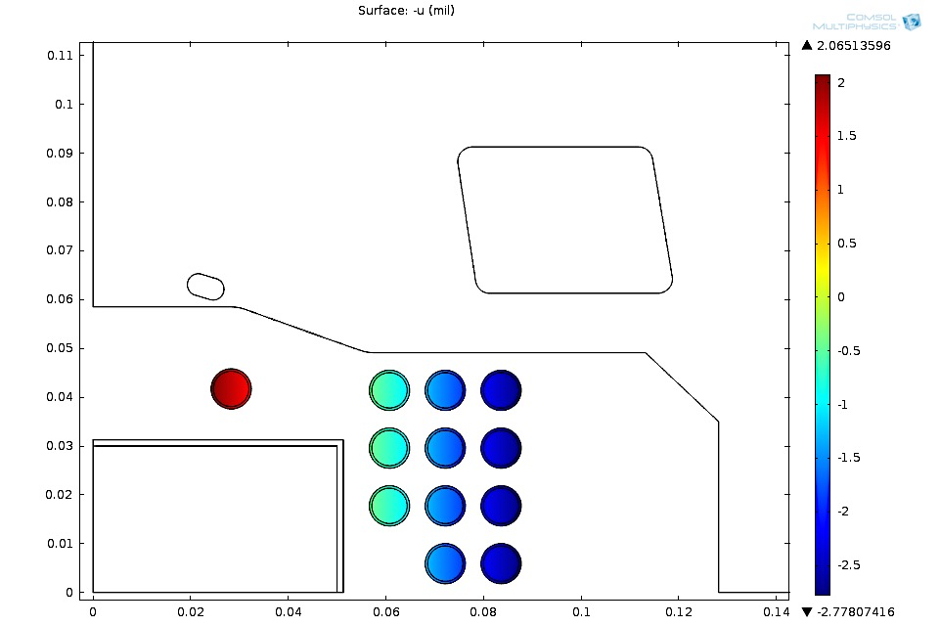
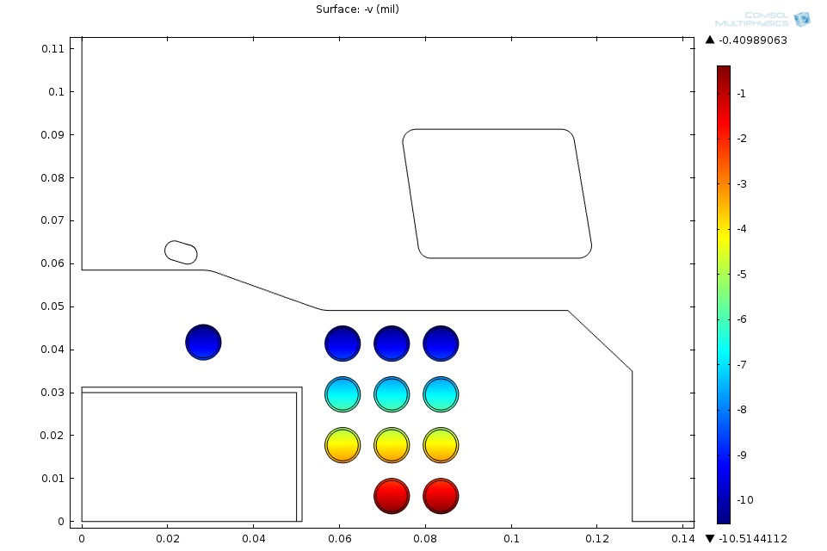
Provision for differential contraction, preload against Lorentz forces in body
Horizontal contraction
Steel
G-11
Ti
316 SS
Orient G-11 with fabric perpendicular to beam tube axis – small contraction.
Locate Ti U-channels to compensate differential contraction – warm-cold ~+.002”
Locate SS/mica paper slip plane between G-11 and steel flux return.

Slide 19



CIC winding limits temperature rise in event of heat from beam losses
4.5 K
4.4
4.3
4.2
Simulated temperature distribution in the presence of 1 W heat deposition in a MEIC dipole winding.
CIC structure controls Lorentz stress, prevents coil motion, error fields
X displacement (RT – 3 T) .001”
Y displacement (RT – 3 T) .001”
Multipole effects <0.2 units

Slide 20


Half-cell cryostat
Support load from 5 reentrant feet.
Supports integrate provisions for precise positioning & internal alignment of all elements.
50 K shield, MLI, and top-half shell go on after all alignment. Ports for checking alignments.
Static heat loads ~0.5 W to 4.5 K, 50 W to 50 K.

Slide 21
Booster (8 GeV, γ_{t} = 16.8 i)
Bogacz
Ring circumference: 273 m
(≈ 2200/8)
E_{kin} = 285 MeV – 7.062 GeV
Injection: multi-turn 6D painting
  0.22-0.25 ms long pulses ~180 turns
  Proton single pulse charge stripping at 285 MeV
  Ion 28-pulse drag-and-cool stacking at ~100 MeV/u
  Ion energies scaled by mas-to-charge ratio to preserve magnetic rigidity
Crossing angle:
79 deg.
injection
RF cavity
extraction
40
5
BETA_X&Y[m]
DISP_X&Y[m]
0
-5
0
BETA_X
BETA_Y
DISP_X
DISP_Y
275.087
Inj. Arc (259⁰)
Straight
Arc (259⁰)
Straight (RF + extraction)
21

Slide 22

Booster arc magnets
For planning purposes we could provide the required fields and apertures for the Booster magnets by building Ion Ring arc dipoles and quads with appropriate lengths:
Dipole 1.2 m Quad 0.4 m
It may likely prove to be the case that making the dipoles of a common design is less expensive than making dedicated designs with smaller quad gradient.

Slide 23
Current Status of Development
We have built a 1.2m mockup winding:
  Developed all tooling for coil fabrication.
  Fabricated all G-11 piece-parts for 3-layer structure.
  Use Cu-Ni tube drawn to same size as CIC.
  Wind the three-layer structure to evaluate methods.
  Map locations of all cables, predict random multipoles.

Slide 24

Texas A&M group will propose NP funding for fabrication of a 1.2 m model dipole
Fabricate CIC cable
Build laminated flux return
QC cable positions of all turns in dipole
Assemble winding in flux return, preload
Measure cable positions under preload
Ready to test model dipole in 2017

Slide 25

JLEIC External Review:
What would be cost impact of 100 GeV ions?
What would a 6 T CIC dipole look like?

Slide 26

6 T CIC dipole
Design field B₀ | 3 T | 6 T
Coil current | 13.7 kA | 17.2 kA
Coil field @ B₀ | 3.5 T | 6.9 T
Bore field @ SS | 3.8 T | 6.2 T
# turns in coil | 24 | 54
Cable:
# strands | 15 | 14
strand dia. | 1.2 mm | 1.5 mm
total s.c. area | 8 cm² | 27 cm²
Flux return size | 20 cm | 33 cm
Magnet cost for a CIC dipole is proportional to # turns, flux return size.
On that basis, 6 T dipoles would cost ~2.25 x cost of 3 T.
Compare to cos θ, for which cost ~ B².

Slide 27
6 T coil structure is same as for 3 T CIC dipole, but 5 layers instead of 3 layers
So building/testing a 3 T model dipole would go far toward validating the 6 T cousin.

Slide 28

Continuous Tube-Forming of Sheath on Cable-in-Conduit
Related SBIR project
Hyper Tech developed a Continuous Tube Forming and Filling machine for continuous multifilament wire encapsulation and laser welding of in-situ MgB₂ wire and multifilament cable.
HyperTech is adapting their CTFF process to continuously form the sheath cable onto long lengths of NbTi CIC.
Key challenge: demonstrate that the laser-weld is He-tight warm and cold.

Slide 29

Compression-molded fiber-reinforced polymer parts for the CIC winding structure
RockWest fabricates FRP components by compression-molding. They have experience with cryo-compatible FRP materials, and holding tight dimensional tolerance.
Expensive at the front end to develop molds, perfect fab process for the desired parts.
Payoff is per-piece cost thereafter is ~$10,000 for 4 m body structure, vs.
~$20,000 for 4 m body structure using NC-machined G-11 parts.

