Slide 1
Progress in Electron Cooling Simulations and Code Development
He Zhang
JLEIC Collaboration Meeting, 03/29/2016

Slide 2
Outline
Staged cooling scheme
Simulation results
Simulation program development

Slide 3
I. Staged cooling scheme

Slide 4
MEIC Design Strategy
The JLEIC conceptual design aims for reaching ultra high luminosity up to 10³⁴ cm⁻²s⁻¹ per interaction point
The JLEIC luminosity concept is based on high repetition rate crab- crossing colliding beams.
This design concept relies on strong cooling of protons & ions
Achieving small transverse emittance (small spot size at IP)
Achieving short bunch (with strong SRF)
Enabling ultra strong final focusing (low β*) and crab crossing
Suppressing IBS, expanding high luminosity lifetime
JLEIC design adopts traditional electron cooling
JLEIC design adopts a multi-phase cooling scheme for high cooling efficiency

Slide 5
Staged Cooling Scheme
JLEIC ion complex layout
Multi-phased scheme takes advantages of high electron cooling efficiency at low energy and/or small 6D emittance
Low energy DC cooler at the booster:
Reduce the emittance
2GeV/u ion beam, 1.6 MeV electron beam
High energy bunched cooling at the collider ring:
Maintain the emittance
Up to 100 GeV/u ion beam, 55 MeV electron beam

Slide 6
DC Cooler and Bunched Beam Cooler
MEIC needs two electron coolers
DC cooler (within state-of-art, a 2 MeV cooler is in commissioning at COSY)
Bunched beam cooler (Needs R&D):
ERL single pass cooler (Q_{e} = 420 pC/buncn, baseline design, no circulator ring)
ERL circulator cooler (Q_{e} = 2 nC/bunch, lower emittance, higher luminosity)
Challenges of the high energy bunched cooler
Cooling by a bunched electron beam
Making and transport of high current/intensity magnetized electron beam
Cooling section
Cooling section
ion bunch
ion bunch
Cooling section
solenoid
electron bunch
solenoid
electron bunch
energy recovery
Fast kicker
circulator ring
Fast kicker
injector
dump
injector
SRF Linac
dump
SRF Linac

Slide 7
II. Electron cooling simulation results

Slide 8
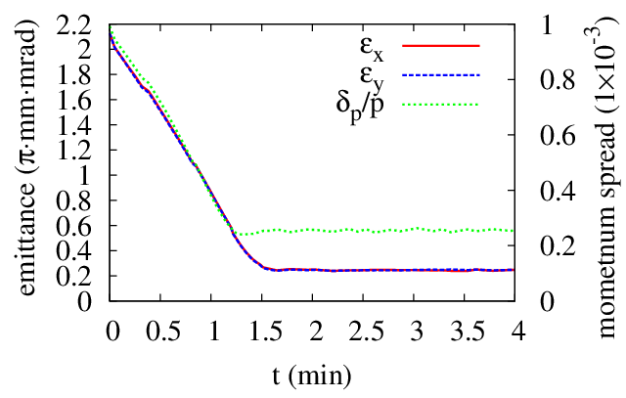
DC Cooling at the Booster
Proton beam:
KE = 2 GeV
Emit = 2.15 mm mrad
dp/p = 0.001
N = 2.8E12
Electron beam:
I = 2 A
T_{tr} = 0.1 eV, T_{s} = 0.1 eV
DC cooler:
L = 10 m
B = 1 T
 |  | IBS | ECOOL | IBS+ECOOL
R_{H} | 1/s | 3.86E-4 | -9.05E-3 | -9.10E-3
R_{V} | 1/s | 3.86E-4 | -9.00E-3 | -8.71E-3
R_{L} | 1/s | 2.27E-4 | -15.3E-3 | -15.3E-3

Slide 9
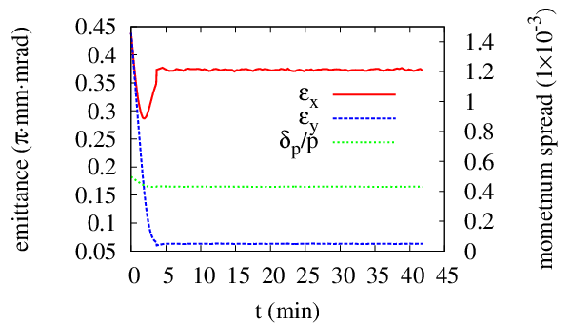
Strong Cooling at the Collider Ring (Q_{e} = 2 nC)
Proton beam:
KE = 30/60/100 GeV
Emit = 0.45/0.35/0.35 $μ$m$⋅$rad
dp/p = 5/4/4 $×{10}^{−4}$
$σ_{s}$ = 2.5/2.75/2.75 cm
N = 6.56E9
Electron beam:
Q_{e} = 2 nC
T_{tr} = 0.5 eV, T_{s} = 0.1 eV
Bunched cooler:
L = 30$×$2 m
B = 1 T
 |  | IBS | ECOOL
R_{H} | 1/s | 4.74E-3 | -8.05E-3
R_{V} | 1/s | -1.59E-5 | -8.05E-3
R_{L} | 1/s | 2.10E-3 | -1.31E-2
KE_{p}=30 GeV

Slide 10
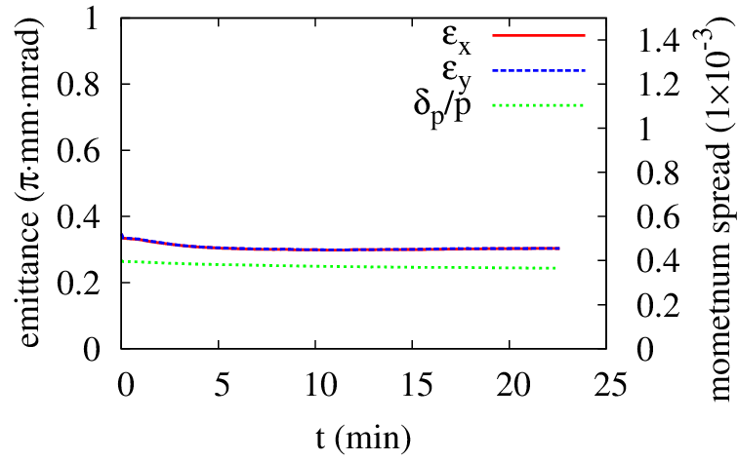
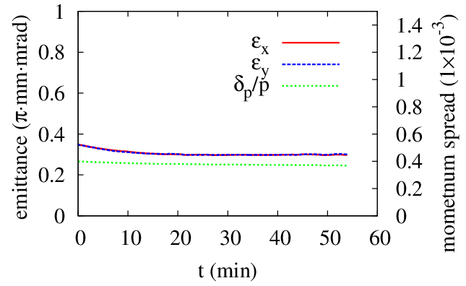
Strong Cooling at the Collider Ring (Q_{e} = 2 nC)
 |  | IBS | ECOOL |  | IBS | ECOOL
R_{H} | 1/s | 6.21E-3 | -3.78E-3 |  | 4.43E-3 | -2.65E-3
R_{V} | 1/s | -4.08E-5 | -3.75E-3 |  | -1.53E-5 | -2.60E-3
R_{L} | 1/s | 2.00E-3 | -8.65E-3 |  | 0.97E-3 | -7.29E-3
KE_{p}=60 GeV
KE_{p}=100 GeV

Slide 11
Weak Cooling at the Collider Ring (Q_{e} = 420 pC)
Lower electron beam current, within the state-of-art technique.
Electron bunch smaller than the proton bunch.
Higher proton beam emittance, lower IBS.
Larger proton beam momentum spread.
Proton beam:
KE = 100 GeV
Emit_x = 1.2 $μ$m$⋅$rad
Emit_y = 0.6 $μ$m$⋅$rad
$σ_{s}$ = 2.5 cm
N = 6.56E9
Electron beam:
Q = 420 pC
T_{tr} = 0.5 eV, T_{s} = 0.1 eV
$σ_{x,y}$ = 0.035 cm
$σ_{s}$ = 0.84 cm
Bunched cooler:
L = 60 m
B = 1 T
Proton beam: Parkhomchuk formula
Horizontal expansion rate decreases as dp/p increases, with $σ_{s}$ = 2.5 cm
dp/p (1E-4) | 5 |  |  | 8 |  |  | 12
IBS (1E-4 1/s) | 5.03 | 0 | 2.26 | 3.39 | 0.01 | 0.63 | 2.35 | 0.01 | 0.20
Cool (1E-4 1/s) | -1.01 | -1.40 | -4.14 | -0.85 | -1.25 | -2.45 | -0.71 | -0.98 | -1.34
Total (1E-4 1/s) | 4.02 | -1.40 | -2.10 | 2.54 | -1.24 | -1.82 | 1.64 | -0.97 | -1.14

Slide 12
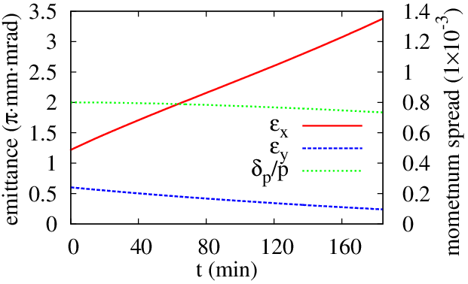
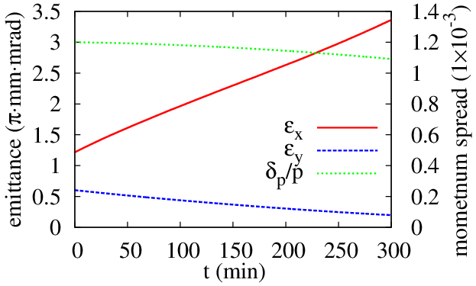
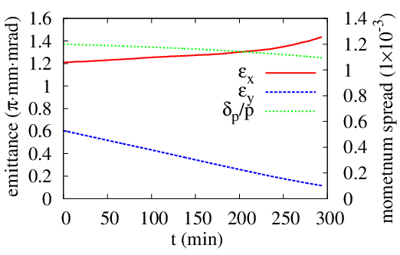
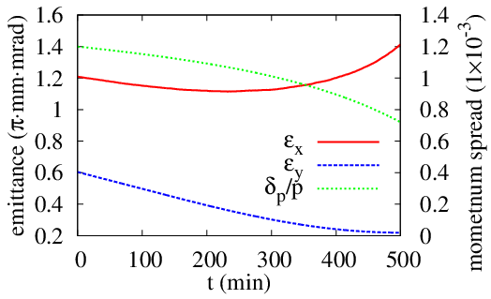
Weak Cooling at the Collider Ring (Q_{e} = 420 pC)
$τ∼$ time to double $ε_{x}$
dp/p=1.2E-3
dp/p=8E-4
$τ∼$ 1.5h
$τ∼$ 2.8h
dp/p=1.2E-3
dp/p=1.2E-3
20% transverse coupling
10% $↑∼$ 4h
10% $↑∼$ 8h
N_{p} = 3.3E9
N_{p} = 3.3E9

Slide 13
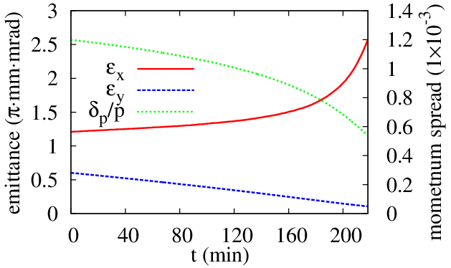
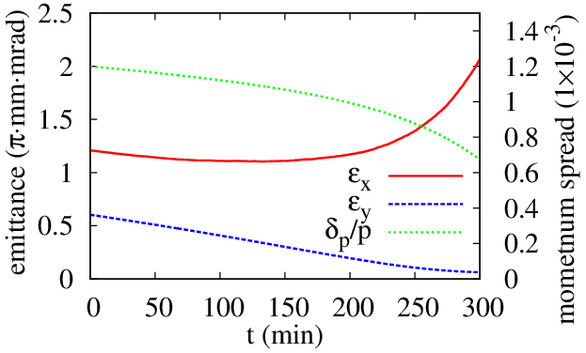
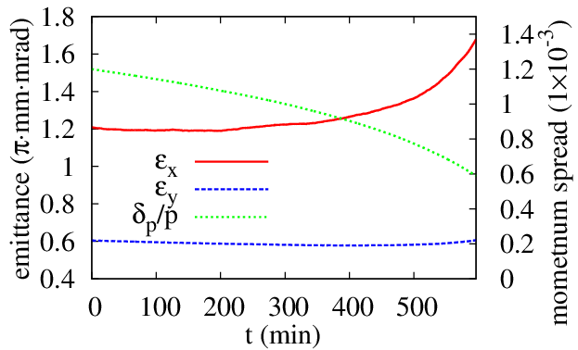
Weak Cooling at the Collider Ring (Q_{e} = 420 pC)
Friction force: Derbenev-Skrinsky-Meshkov formula
dp/p=1.2E-3
dp/p=1.2E-3
$τ∼$ 3.5h
N_{p} = 5.5E9
10% $↑∼$ 3.7h
dp/p=1.2E-3
20% transverse coupling
Not easy to find a stable solution.
Horizontal emittance increases due to cooling in the other two directions.
The proposed parameters of the ERL cooler is in reasonable range.
Needs more study.
10% $↑∼$ 7.6h

Slide 14
III. Electron cooling simulation program development

Slide 15
Goals and Approach
Goals:
Enhance the simulation capability for electron cooling in JLEIC project
Different scenarios: DC cooling, bunched electron to bunched ion cooling, bunched electron to coasting ion cooling
More flexibility, higher efficiency.
Approaches:
Following the models in BETACOOL whenever applicable
Revise the models whenever needed
Improve the efficiency by strategically arrange the computation
Take advantage for modern multi-core hardware
Formulas and models implemented:
IBS: Martini model (no vertical dispersion lattice)
Friction force: Parkhomchuk formula (magnetized cooling)
Cooling rate: single particle model, Monte Carlo model
Cooling dynamics: RMS method (with single particle model or Monte Carlo model), model beam method

Slide 16
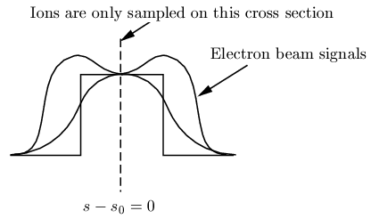
New Model: Small e⁻ Bunch to Coasting Ion Beam
How to sample the coasting beam in the longitudinal direction
Sample the ions in the center plate $s−s_{0}=0$ (Single particle model in BETACOOL)
Ions only see a piece of the
electron beam
Do not include the effect of the
profile of the electron beam
Sample the ions along the ring (MC model in BETACOOL)
Electron beam length << the circumference of the ring
Moderate number of ion samples,
e- bunch CANNOT catch any ion.
Too many ion samples means
a lot of redundant calculation.

Slide 17
New Model: Small e⁻ Bunch to Coasting Ion Beam
How to sample the coasting beam in the longitudinal direction
Only sample the ions that interact with one electron bunch
Calculate the cooling rate in the sampled region
Adjust the cooling rate w.r.t. the duty factor $D=L_{sample}/L_{distance}$
$\frac{1}{τ_{cool}}=\frac{1}{τ_{sample}}⋅D$
Random (uniform distribution) longitudinal position in the sample area.
Avoid redundant calculation
Take account the electron bunch profile

Slide 18
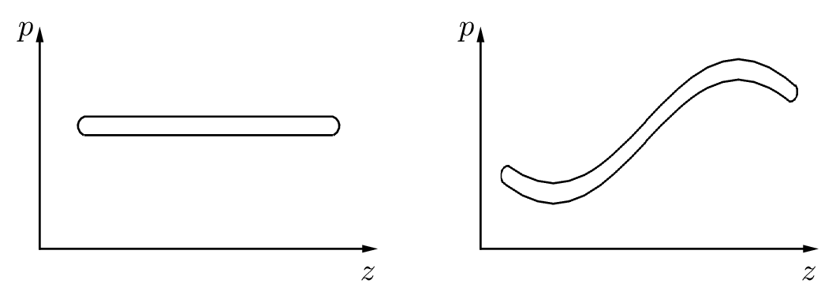
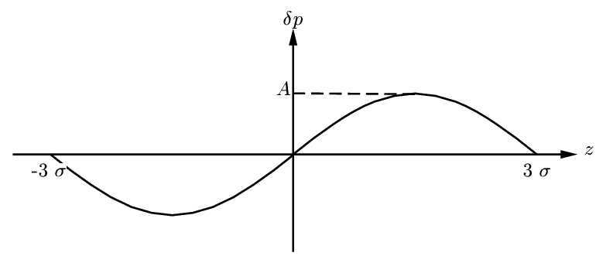
New Model: Correlated e⁻ Bunch
How will the correlation affect cooling rate?
Uncorrelated
Correlated

Slide 19
New Model: Correlated e⁻ Bunch
Parkhomchuk formula: $F=−V\frac{4Z^{2}e^{4}n_{e}L_{p}}{m}\frac{1}{{\left(V^{2}+Δ_{e,eff}^{2}\right)}^{\frac{3}{2}}}$
Ion beam $V^{2}=V_{⊥}^{2}+V_{∥}^{2}$
Electron beam $Δ_{e,eff}^{2}=v_{eff}^{2}+v_{e,∥}^{2}$
L_{p} also depends on $v_{e,∥}^{}$
If the longitudinal momentum is not correlated with longitudinal position, we use the rms of $v_{e,∥}^{}$ for all the ions.
If the longitudinal momentum is correlated with longitudinal position, the local momentum spread is still $v_{e,∥}^{}$, but the electrons have a drift momentum or velocity, which is determined by its longitudinal position.
In the local electron beam frame, the ion get a drift velocity. $V_{∥}$ is replaced as $V_{∥}−v_{d}$, with $v_{d}$ the drift velocity.

Slide 20
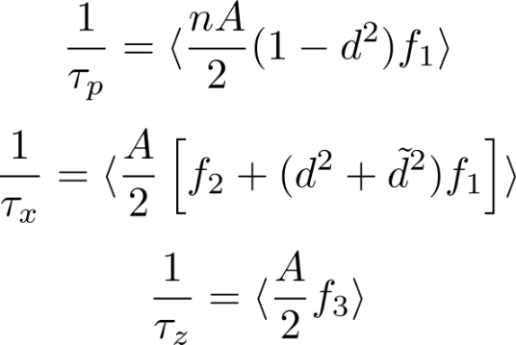
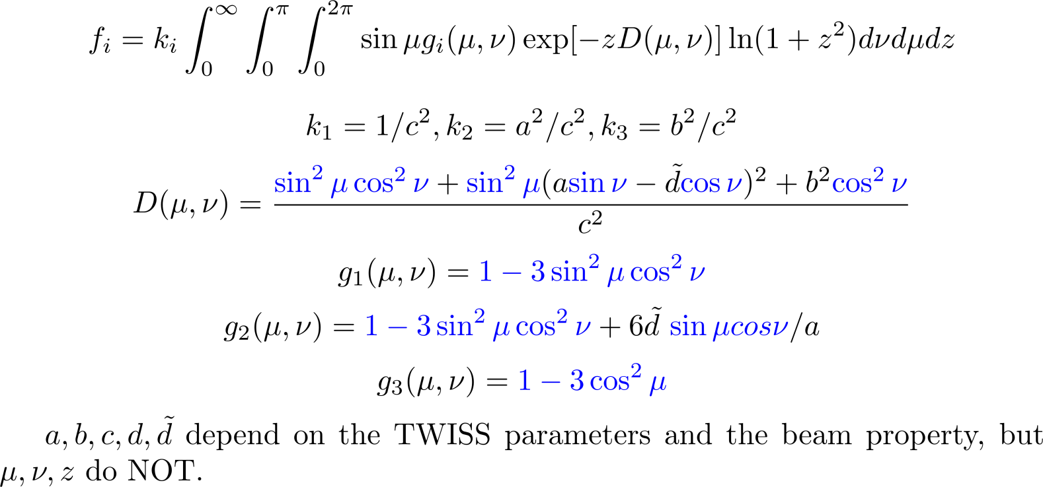
Efficiency: Avoid Redundant Calculation
Martini model for IBS rate calculation (No vertical dispersion, Transverse Gaussian distribution)

Slide 21
Efficiency: Avoid Redundant Calculation
Efficient calculation of the IBS expansion rate using Martini model
Calculate $f_{i}$ and the rates for each element
Take average over the whole ring
In function $f_{i}$, $μ, ν, z$ are the sample points one selects to numerically calculate the integration. They do NOT depend on the TWISS parameters and the beam property.
Significant parts in $g_{1}, g_{2}, g_{3}, D\left(μ,ν\right),$ and $f_{i}$ only depend on $μ, ν$ and $z$. They have the same value for all the elements. So we only need to calculate them once.
It improves the efficiency of the program to avoid the redundant calculation.

Slide 22
Efficiency: Parallelization
Good efficiency of the serial code, so not necessary to run the code on a cluster machine.
Further improve the efficiency for shared memory structure hardware: GPU, Intel Xeon Phi, or just a multi-core PC.
Parallelization is based on thrust, a parallel algorithm library that supports CUDA, TBB (Threading Building Blocks) and OpenMP.
IBS calculation, 100$×$100$×$100 grid:
NVidia GTX 660 ti GPU: 6 s
CPU: 62 s

Slide 23
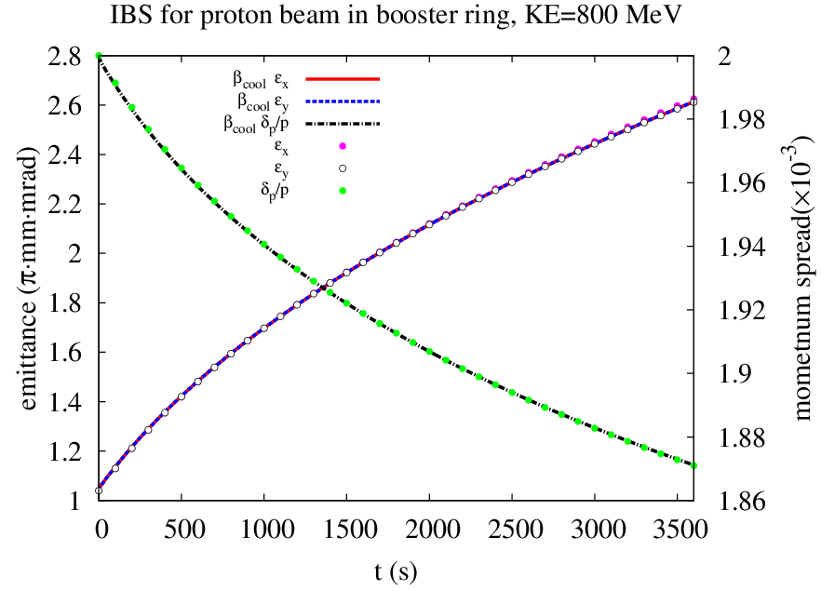
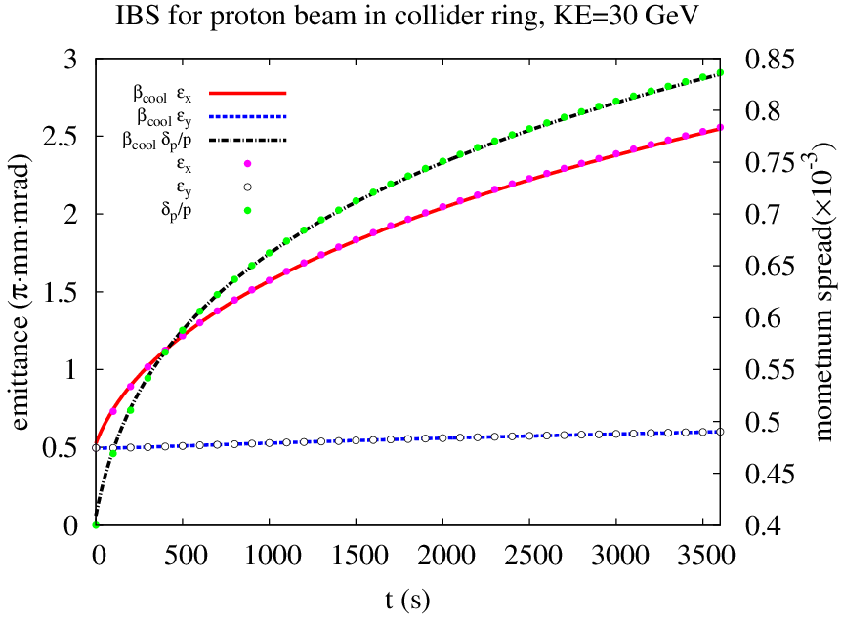
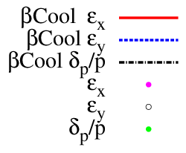
Benchmark
IBS of coasting ion beam
IBS of bunched ion beam

Slide 24
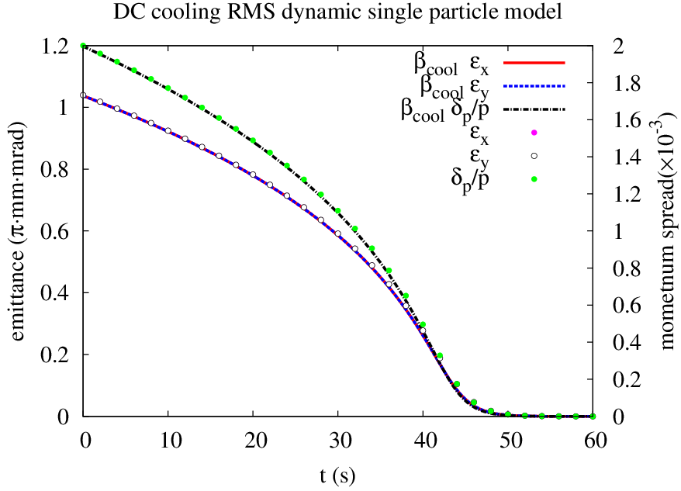
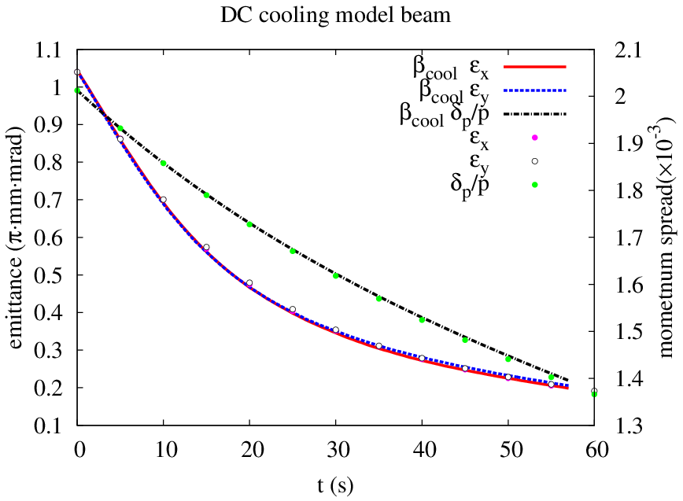
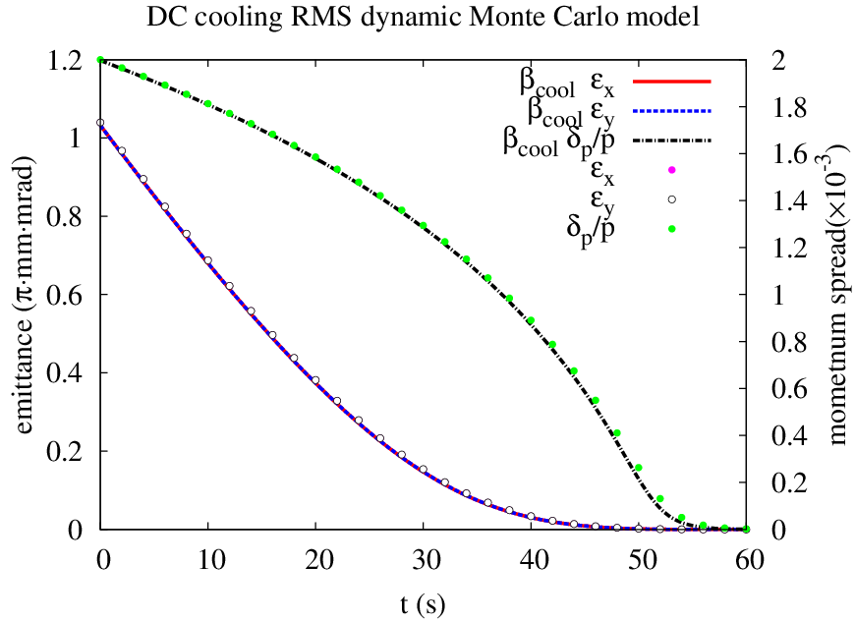
Benchmark
DC Cooling for JLEIC booster ring:
I. RMS dynamic single particle model
II. RMS dynamic Monte Carlo model
III. Model beam method

Slide 25
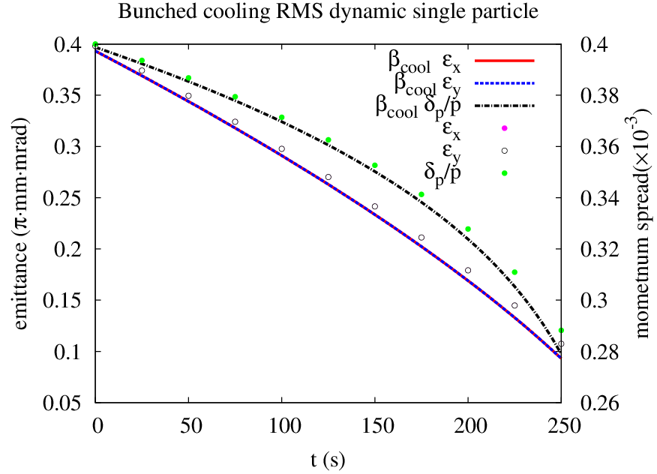
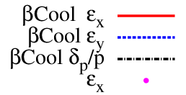
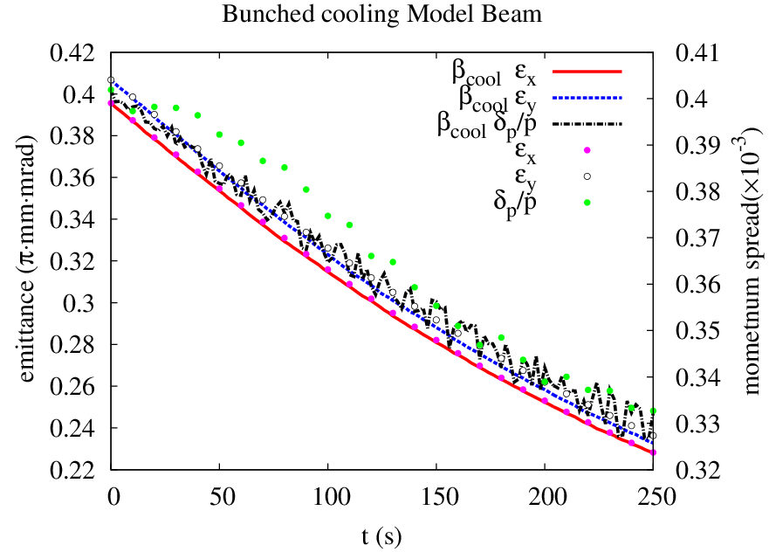
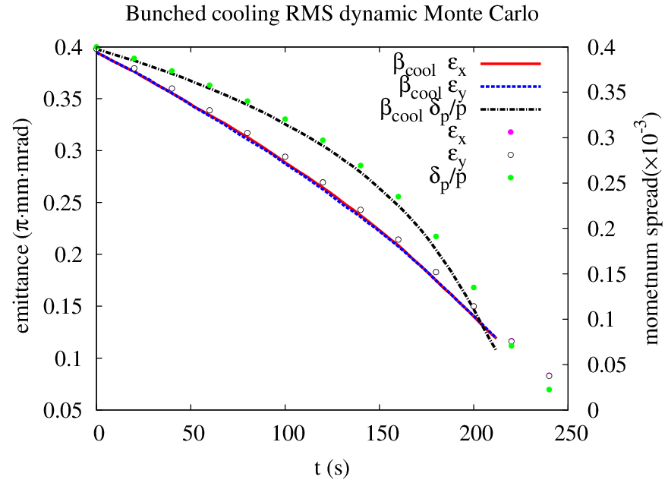
Benchmark
Bunched cooling for JLEIC collider ring:
I. RMS dynamic single particle model
II. RMS dynamic Monte Carlo model
III. Model beam method

Slide 26
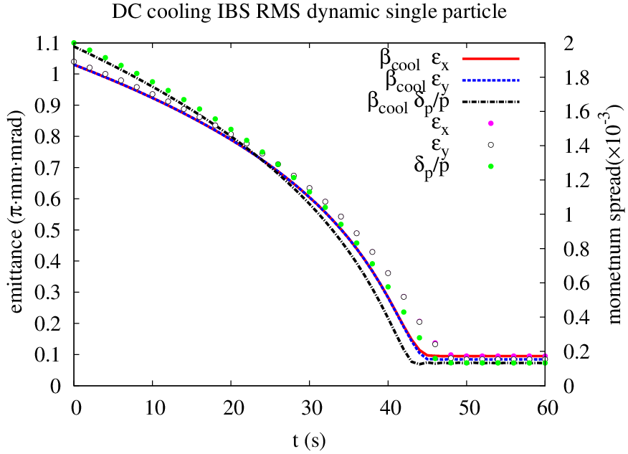
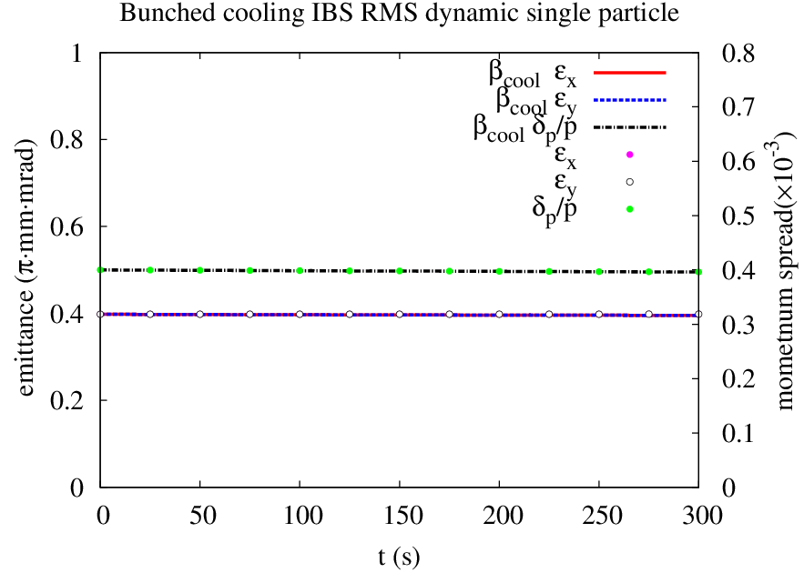
Benchmark
DC cooling and IBS for JLEIC booster ring with KE = 800 MeV
Time cost 133 s (BETACOOL 3060 s)
Bunched cooling and IBS for JLEIC collider ring with KE = 100 GeV
Time cost 30.7 s (BETACOOL 422 s)

Slide 27
Summary
Staged cooling scheme:
Traditional electron cooling
DC cooling reduce the emittance at 2 GeV (booster)
Bunched cooling maintain the emittance at collision energy (collider)
Simulation suggests the design parameters are achievable.
Need more study on the weak cooling with low electron current.
ERL cooler design is in progress.

Slide 29
Backup

Slide 30
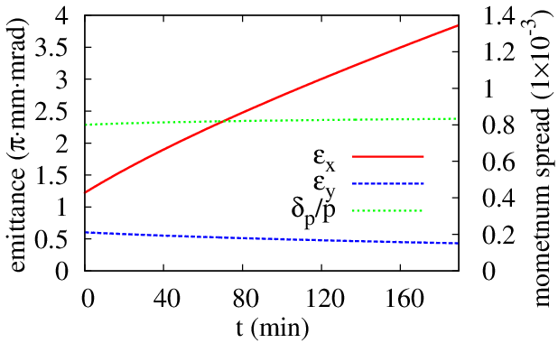
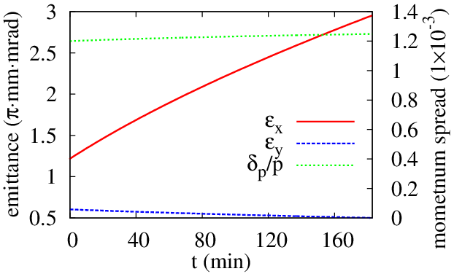
Weak Cooling at the Collider Ring (Q_{e} = 420 pC)
dp/p=8E-4
$τ∼$ time to double $ε_{x}$
dp/p=1.2E-3
$τ∼$ 1.5h
$τ∼$ 2.8h
60 m
cooler
$τ∼$ 2.0h
30 m
cooler
$τ∼$ 1.2h

Slide 31
Weak Cooling at the Collider Ring (Q_{e} = 420 pC)
Lower electron beam current, within the state-of-art technique.
Electron bunch smaller than the proton bunch.
Lower proton beam current, lower IBS.
Larger proton beam momentum spread.
Proton beam:
KE = 100 GeV
Emit_x = 1.2 $μ$m$⋅$rad
Emit_y = 0.6 $μ$m$⋅$rad
$σ_{s}$ = 2.5 cm
N = 6.56E9
Electron beam:
Q = 420 pC
T_{tr} = 0.5 eV, T_{s} = 0.1 eV
$σ_{x,y}$ = 0.036/0.036 cm
$σ_{s}$ = 0.84 cm
Bunched cooler:
L = 30$/$60 m
B = 1 T
Horizontal expansion rate decreases as dp/p increases, with $σ_{s}$ = 2.5 cm
dp/p (1E-4) | 5 |  |  | 8 |  |  | 12
IBS (1E-4 1/s) | 5.03 | 0 | 2.26 | 3.39 | 0.01 | 0.63 | 2.35 | 0.01 | 0.20
Cool (1E-4 1/s) | -0.54 | -0.73 | -4.80 | -0.38 | -0.50 | -2.69 | -0.25 | -0.29 | -1.32
Total (1E-4 1/s) | 4.49 | -0.73 | -2.66 | 3.01 | -0.49 | -2.06 | 2.10 | -0.28 | -1.30

Slide 32
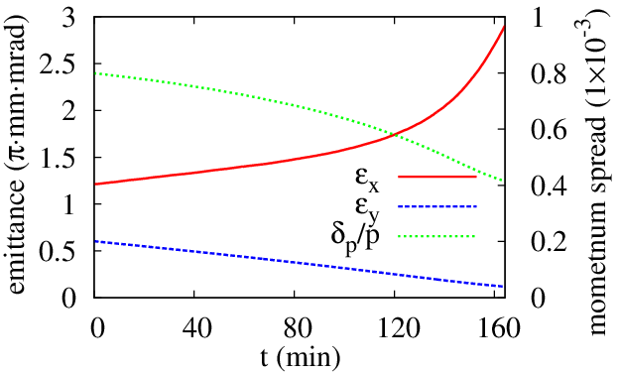
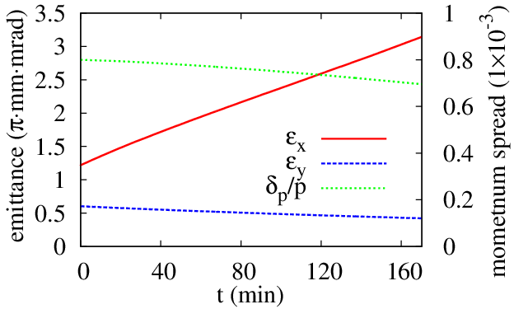
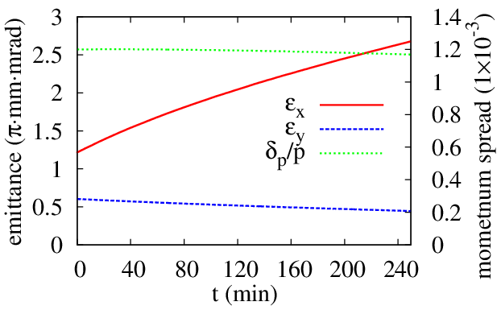
Weak Cooling at the Collider Ring (Q_{e} = 420 pC)
dp/p=8E-4
$τ∼$ time to double $ε_{x}$
dp/p=1.2E-3
$τ∼$ 2.3h
$τ∼$ 3.5h
60 m
cooler
$τ∼$ 3.0h
$τ∼$ 1.7h
30 m
cooler

