Slide 1
Vacuum considerations for JLEIC beamline and Interaction Region Marcy L. Stutzman
Notes:
Title Page Design 3

Slide 2
General considerations for beamline vacuum design
Static vacuum design
Materials: material, heat treat, surface preparation
Pumping systems: distributed and lumped pumps
Dynamic vacuum design
Electron stimulated desorption, secondary electron yield
Photon stimulated desorption
Beamline shape for PSD reduction as needed

Slide 3
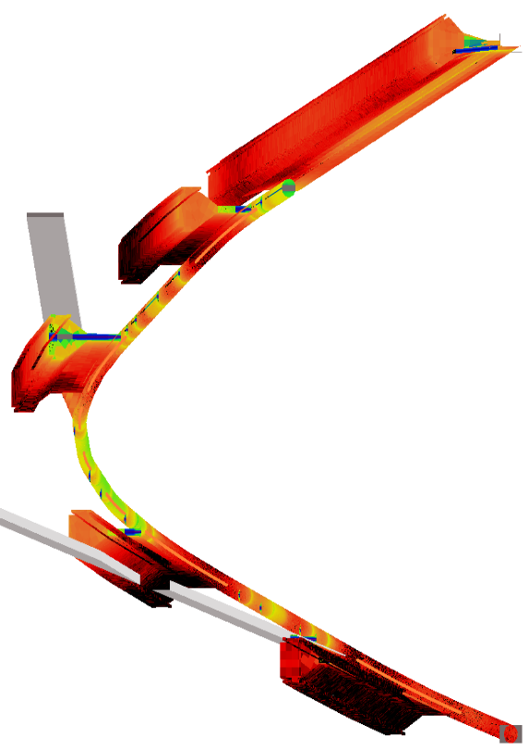
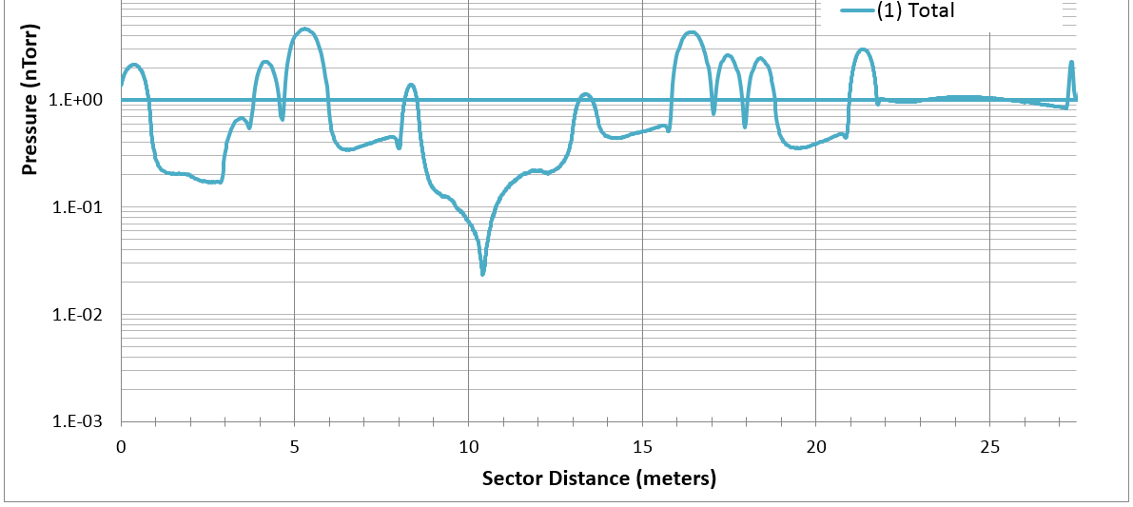
Modeling available for both static vacuum and PSD
Molflow+ and Synrad modeling software developed by Roberto Kersevan
Jason Carter, ANL, used Molflow+/Synrad to model static and dynamic vacuum for APS upgrade
CAD designs of beamline are combined with pumping speeds and outgassing rates of elements yield expected pressure

Slide 4
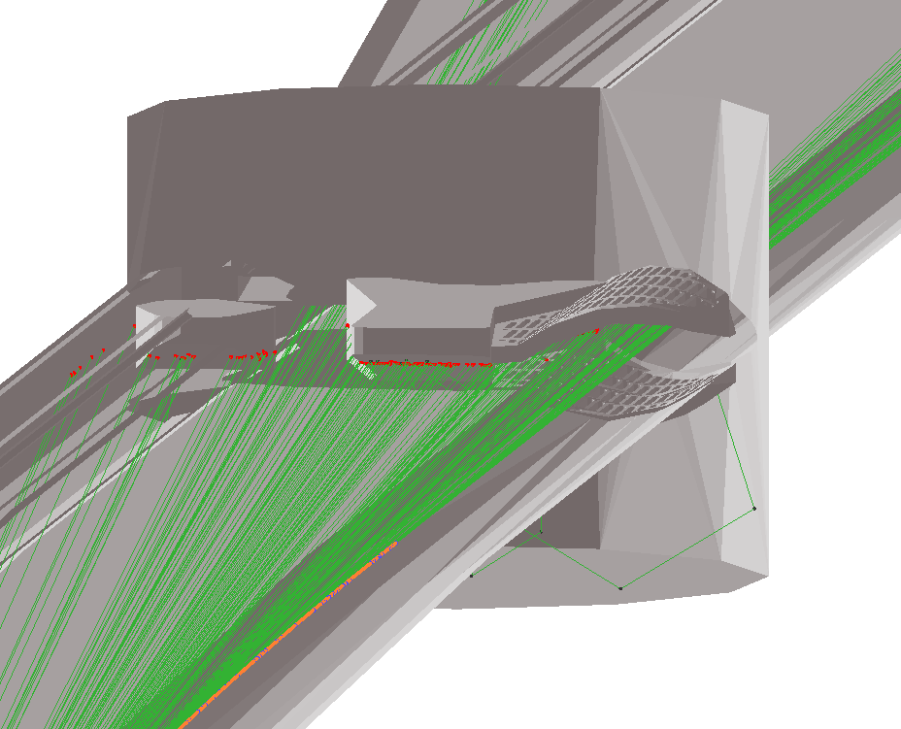
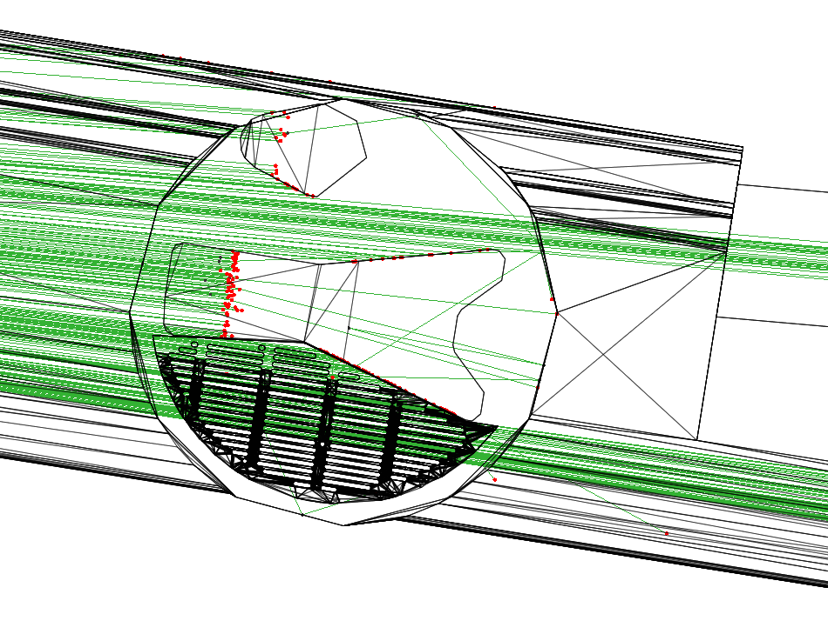
How SynRad works
Magnetic elements generate synchrotron rays within 3D space
BEAM
DIRECTION
Magnetic elements in orange, program generated synchrotron fan in green, surface hit points in red
APS-U storage ring vacuum system design using SynRad/MolFlow+ with photon scattering
Jason Carter, AVS 2015 presentation

Slide 5
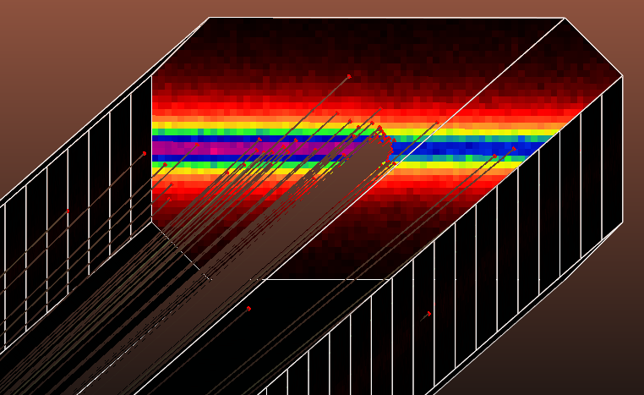
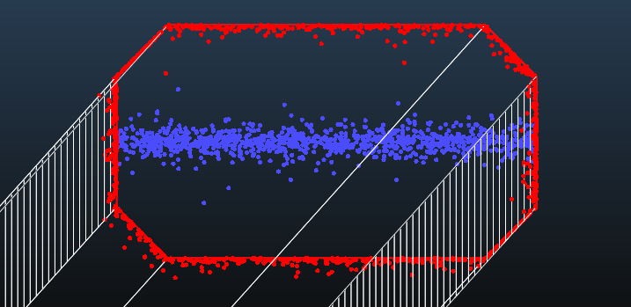
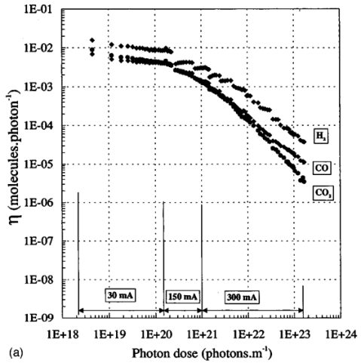
Coupled simulations
Coupling feature translates SynRad flux density rates (photons/cm²/s) to photon stimulated desorption, PSD, outgassing (mbar*L/cm²/s)
Translations based on conditioning time and PSD yield measurements for various vacuum materials
Jason Carter, AVS 2015 presentation

Slide 6
What is needed to use modeling software?
Understanding of materials properties for beamline
Outgassing rates
Pump speeds
Electron/Photon stimulated desorption
Detailed CAD design of the interior of the vacuum space
Accelerator vacuum community are researching these issues
→ This talk summarized recent workshop

Slide 7
Summary of the International Workshop on Functional Surface Coatings and Treatments for UHV/XHV Applications
Workshop hosted by Daresbury Laboratory, September 2015
Coatings
TiN coatings
Carbon coatings
Non-evaporable Getter (NEG) coatings
Surface texturing effects
Tests
Outgassing/pumping
Electron/Photon stimulated desorption
RF surface resistivity
Participants from
Argonne (US)
Brookhaven (US)
CERN (EU)
Cornell (US)
Daresbury/Cockcroft/Astec (UK)
DESY (Germany)
IHEP (China)
LNF-INFN (Italy)
JLab (US)
KEK (Japan)
LBNL (US)
MAX IV (Sweeden)
Pohang (Korea)
SNS (US)
SAES Getters (pump company)
VACOM (pump company)
Presentations available under “program” link at
https://www.cockcroft.ac.uk/events/FSC/index.html

Slide 8
Static vacuum design
Conductance to pumping elements
Reduced outgassing materials
Modeling in Molflow+ or similar can determine requirements for pump sizes

Slide 9
Dynamic vacuum
Measurements of Secondary Electron Yield
Measurements of Electron/Photon Stimulated Desorption (ESD/PSD)
Effect of Coatings and surface treatments
Carbon (amorphous or HOPG)
Titanium Nitride (TiN)
Non-evaporable getters (NEG)
Surface patterning/grooves
Beampipe design for discrete/distributed pumping

Slide 10
Secondary Electron Yield: electron cloud, vacuum excursions
Shigeki Kato, KEK

Slide 11
Patterning of surfaces
Reza Valizadeh, Daresbury
Laser patterning
L. Olano Garcia, CSIC, Spain
wet chemical deposition

Slide 12
SEY: Laser Engineered Surface
Laser engineered surface (LESS)
Relatively new approach
Sergio Calatroni, CERN

Slide 13
TiN Coatings on Aluminum and grooved aluminum: SEY Kyo Shibata SuperKEKB

Slide 14
SEY summary
Bare metals tend to have peak SEY >1, can lead to electron cloud
Coatings (carbon, TiN) or patterning (LESS, grooves) will reduce SEY
Historical measurements of NEG coatings gives SEY slightly >1, new work proceeding on optimizing NEG films
Importance of materials properties (Hydrogen content), standardization of testing protocol (normal vs. grazing incident electron beam)

Slide 15
Pressure increase due to SEY
Shibata, KEK: scrubbing needed for TiN coated pipes in SuperKEKB

Slide 16
Carbon Coatings vs. NEG coatings: Photon Stimulated Desorption Yasunori Tanimoto, KEK
a-Carbon excellent for photon stimulated yield of secondary electrons
However, other gasses desorbed from a-Carbon make it bad for the vacuum (compared to NEG coating)

Slide 17
Distributed NEG pumping
Antechamber designs: NEG strips integrated into beampipe
LEP: early implementation
SuperKEK: recent design

Slide 18
NEG coatings
Non-evaporable getter can be coated onto the beampipes
Provide distributed pumping
Reduce ESD/PSD
Drawbacks
Higher cost than some other coatings
Requires in-situ heating for activations
Structure
columnar vs. amorphous?
Composition: binary-quartenary to optimize activation temperature, pump speed (Daresbury)
Excellent option for areas where discrete pumping impossible

Slide 19
NEG coating for MaxIV: various shapes
Straight segments: ESRF
Curved sections: industry contractor
Special shapes: collaborate with CERN

Slide 20
NEG coating: long thin pipes
LBNL: Narrow chambers
SAES getters: 10 mm – 4 mm
SAES can achieve good adhesion and morphology even on challenging thin pipes
See morphology from twisted wires
Need alloy wire (Andre Anders)

Slide 21
JLEIC vacuum design
Vacuum design must
Limit outgassing
Mitigate ESD, PSD, SEY
Optimize pumping systems
Goal: P~1x10⁻⁹ Torr
Sources of dynamic vacuum loads?

Slide 22
Summary
Molflow+: static vacuum modeling
SynRad: model of vacuum events due to beam
Beam related pressure mitigation
Coatings (TiN, carbon, NEG)
Morphology (grooves, laser patterning)
Antechambers to provide pumping, mitigate PSD
Vacuum system design must take into account
Outgassing
ESD, PSD, SEY induced vacuum
Pump design (distributed and lumped)

