Slide 1
Ion-Side Small Angle Detection
Forward, Far-Forward, & Ultra-Forward
JLEIC Collaboration
29—31 March 2016
Jefferson Lab
Charles Hyde
Old Dominion University

Slide 2
Full Acceptance Detector
(-30m, +50 m)
Comprehensive Integration of Detector with Accelerator Lattice
3-D imaging:
Detect scattered beam particles for |δp|/p > 0.005 and/or θ > 3 mrad
Nuclear Final States in Deep Inelastic Scattering:
Neutrons in cone (0.5 GeV/c)/(50 GeV/c) = 10 mrad
Charged particle fragments from δp/p = -0.5 (protons) to δp/p = +1.5 (³H fragment)
Far-Forward Ion

Slide 3
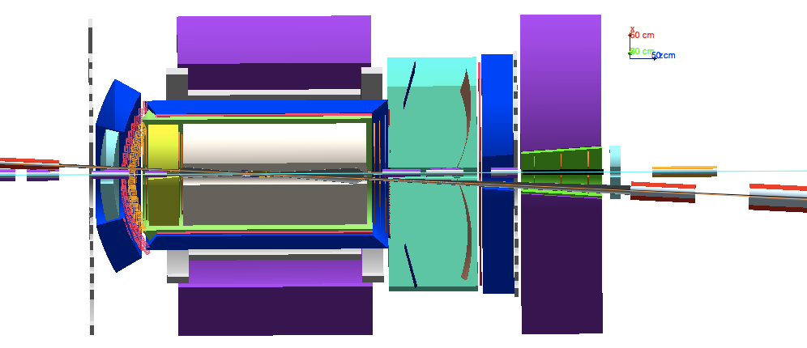
Forward Region
10 mrad < θ < 70 mrad
HCal
D1
iFFQ1
Outside iFFQ Acceptance
2 Tm (@ 100 GeV/c) Forward Dipole
Tracker, PbWO4 EM Calorimeter
Flux-exclusion tube or active anti-dipole shield of electron beam.

Slide 4
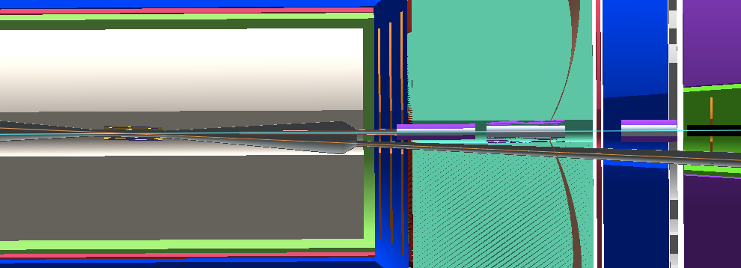
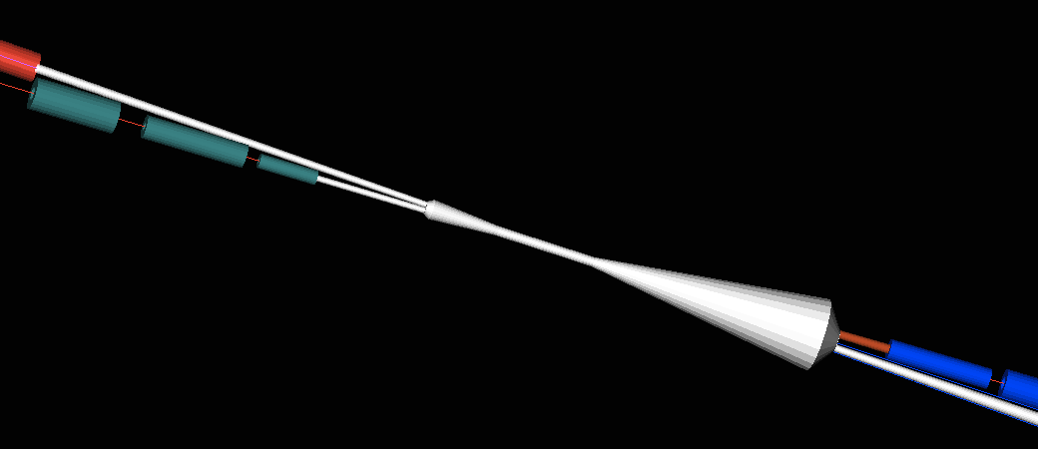
Beam-Pipe Design for Forward Angle Detection
Central beam chamber aligned at -25 mrad.
Particles in iFFQ (±10mrad) acceptance don’t exit until detected after D2 or D3
Particles in D1 acceptance exit through 30° taper at end of 73.5 mrad flare.
30° taper minimizes wake-field
End-cap particles exit at angles > 50 mrad

Slide 5
Far-Forward Tracking
50 m long Magnetic Spectrometer
High dispersion at secondary focus
5 mm separation for dp/p = 0.005
Magnification = -0.5
Tracking resolution compatible with beam emittance
Fixed Tracker at Exit of D2
Pair of horizontal RP between D2 and D3
Single side RP after D3

Slide 6
Transport Examples
(P/z)/(P0/z0)=1.5
Focus—>
P0 = 100 GeV/c
Focus @ 43m
P = 99.5 GeV/c
Focus @ 42m
P = 90. GeV/c
Focus @ 26m
P = 50. GeV/c
Focus @ Q3 exit

Slide 7
Transport near full momentum
<— electron beam
100 tracks P = 99.5 GeV/c
Δx>10σ @ Focus
P0 = 100 GeV/c
iDipole-3
IP+42m
P = 99.5 GeV/c
Horiz motion
Roman Pots

Slide 8
Detection Between D2 and D3
iDipole-2
Exit = IP+22m
100 tracks at p=90 GeV, filling iFFQ Acceptance
Focus @ IP+26 m
RP
1 track @ 100 GeV
1 neutron
4 cm radius beam pipe accommodates 10sigma BSC for P0 from 20 to 100 GeV/c

