Slide 1
New Run Group Proposal
“Color Confinement and Strong QCD”
Hybrid Baryons | Search for new hybrid baryons (qqqg) focusing on 0.05 GeV² < Q² < 2.0 GeV² in mass range from 1.8 to 3 GeV
KY Electroproduction | Study N* structure for states that couple to KY through measurements of cross sections and polarization observables that will yield Q² evolution of electrocoupling amplitudes (Spokespersons: Carman, Gothe, Mokeev)
DVCS | Access GPDs H, E, H, E using DVCS process ep → epγ and the DVMP process ep → epπ⁰
~ ~
Run Group conditions:
E_{b} = 6.6 GeV, 50 days
E_{b} = 8.8 GeV, 50 days
Torus I = -3375 A (negatives outbending)
FT, MM, RICH (if available)
Highly polarized electrons, unpolarized lH₂ target
L = 1x10³⁵ cm⁻²s⁻¹
First run group proposal for less than 5-pass (11 GeV) beam

Slide 2
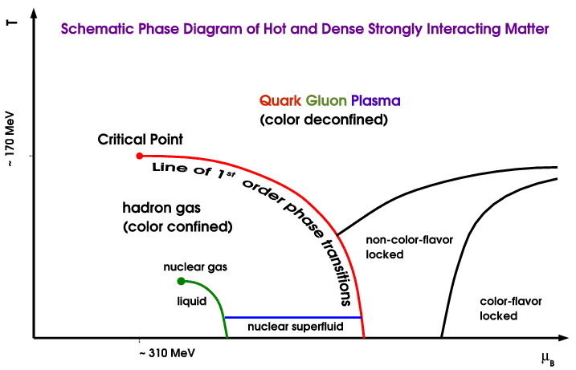
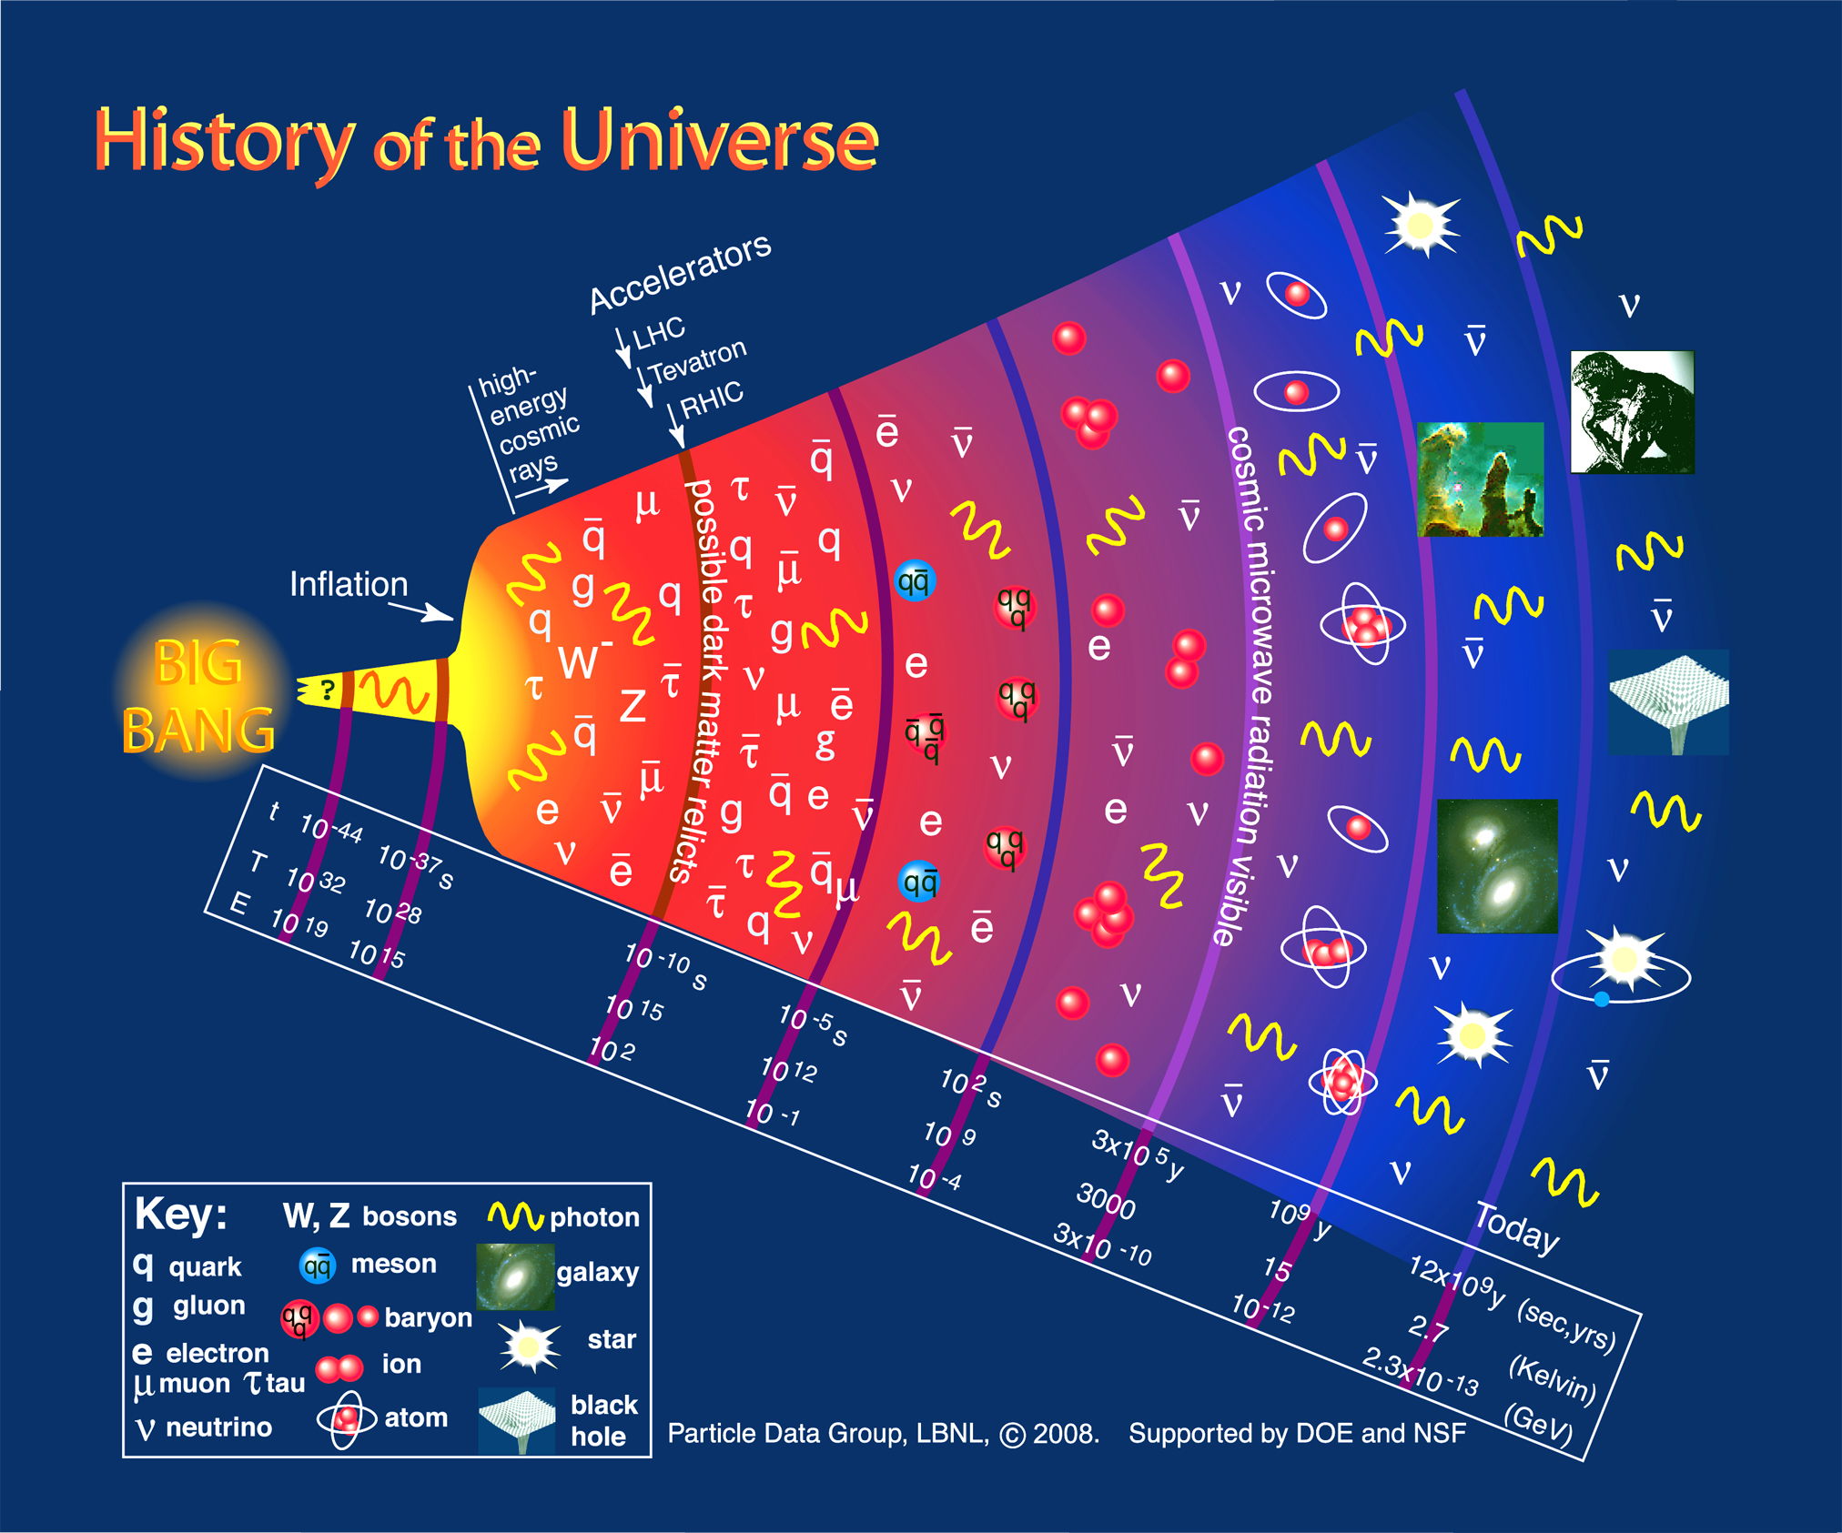
Excited baryons and history of the Universe
CEBAF
N*
N*
Excited nucleons play essential role in crossover from QGP to baryon phase (missing B*).
In the process of cross over the quarks acquire dynamical mass.
In QGP phase “color is de-confined’, in baryon phase “color is confined”.

Slide 3
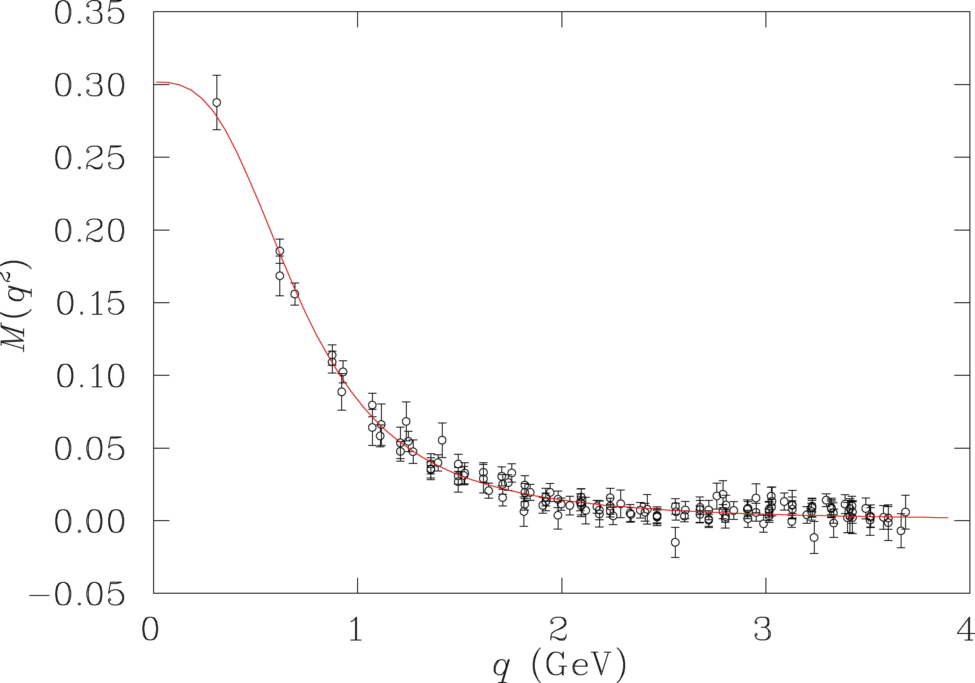
Light quarks acquire mass
T>10¹⁴K
quarks are confined &
massive
DSE/QCD
Lattice QCD
quark mass (GeV)
quarks
deconfined
& massless
As the Universe cools down, the quarks acquire mass and form resonances before stable nucleons are formed.
T<10¹⁰K
Resonance electrocouplings are sensitive to the quark mass.
Notes:
We know that the HIGGS mechanism gives elementary light-quark masses of a few MeV, and these are relevant at the high energies before the transition to stable baryons occur. As the universe cools down quarks acquire dynamical mass through coupling to the gluon field, and finally get fully trapped in the confined space of the nucleon.

Slide 4
Main questions to address
The N* spectrum, and what is the role of glue in it (hybrid baryons)?
How do mass less quarks acquire mass . Probe the Q² dependence of electrocoupling amplitudes?
How is color confinement realized in the force and pressure distribution in stable nucleons (moments of GPDs in DVCS).

Slide 5
Evidence for new N* in KY final state
State N((mass)J^{P} | PDG pre 2010 | PDG 2016 | KΛ | KΣ | Nγ
N(1710)1/2⁺ | *** | **** | **** | ** | ****
N(1880)1/2⁺ |  | ** | ** |  | **
N(1895)1/2⁻ |  | ** | ** | * | **
N(1900)3/2⁺ | ** | *** | *** | ** | ***
N(1875)3/2⁻ |  | *** | *** | ** | ***
N(2150)3/2⁻ |  | ** | ** |  | **
N(2000)5/2⁺ | * | ** | ** | * | **
N(2060)5/2⁻ |  | ** |  | ** | **
Extend this study to higher masses and electroproduction
Notes:
This slides shows a summary of the results in this analysis. The green column shows the rating by the PDG. The two columns show the importance of the strangeness channel in this results.

Slide 6
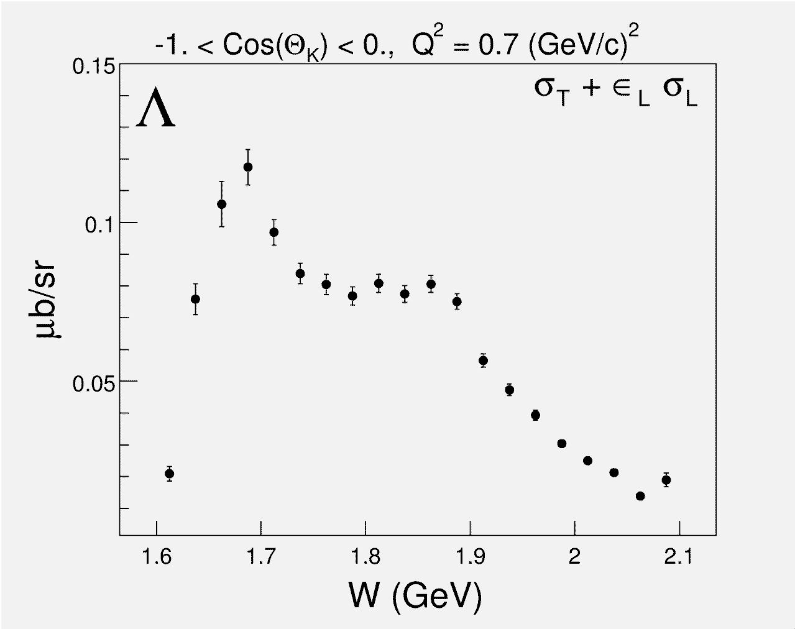
New Baryons in γ*p→KΛ/Σ ?
Electroproduction
backward
hemishere
N(1710)1/2⁺
N(1900)3/2⁺
Strangeness production is a fertile ground in the search for new baryon states.

Slide 7
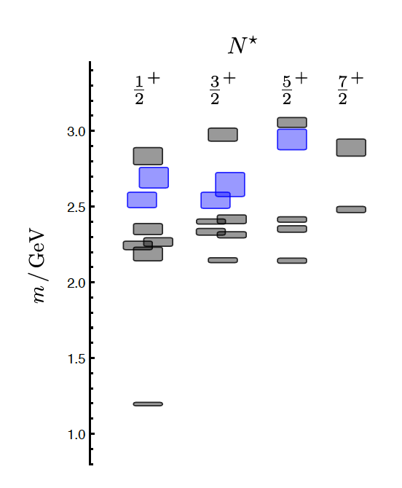
Search for gluonic q³G and high mass q³
J.J. Dudek and R.G. Edwards, PRD 85 (2012) 054016
LQCD
clustered
in mass
‘hybrid’ states
1.3GeV
N
q³G baryons have same J^{P} values as q³ baryons, but are more extended objects
Notes:
The lowest hybrid should be a J^{P} =½ + nucleon state. LQCD projects a mass of 1.3 GeV above the nucleon mass, i.e. ~2.2GeV, and several others should appear close by in ½+ and 3/2+ spin-parity.
Hybrid baryons have same spin-parity as ordinary baryons. How do we identify them as hybrid states? One possibility is to look at the transition form factors where one expects a different Q2 behavior. The sensitivity is demonstrated for the Roper resonance, which was considered as a possible lowest hybrid state with ½+ JP parity. The black lines show quark core based calculations for the A1/2 amplitude, while the dashed red line shows the predictions for the lowest hybrid state.

Slide 8
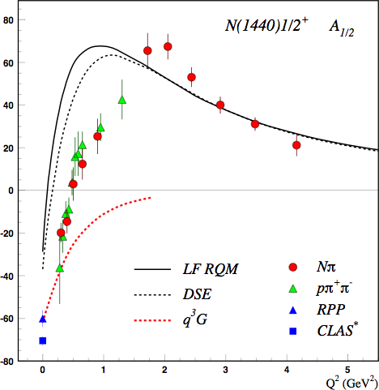
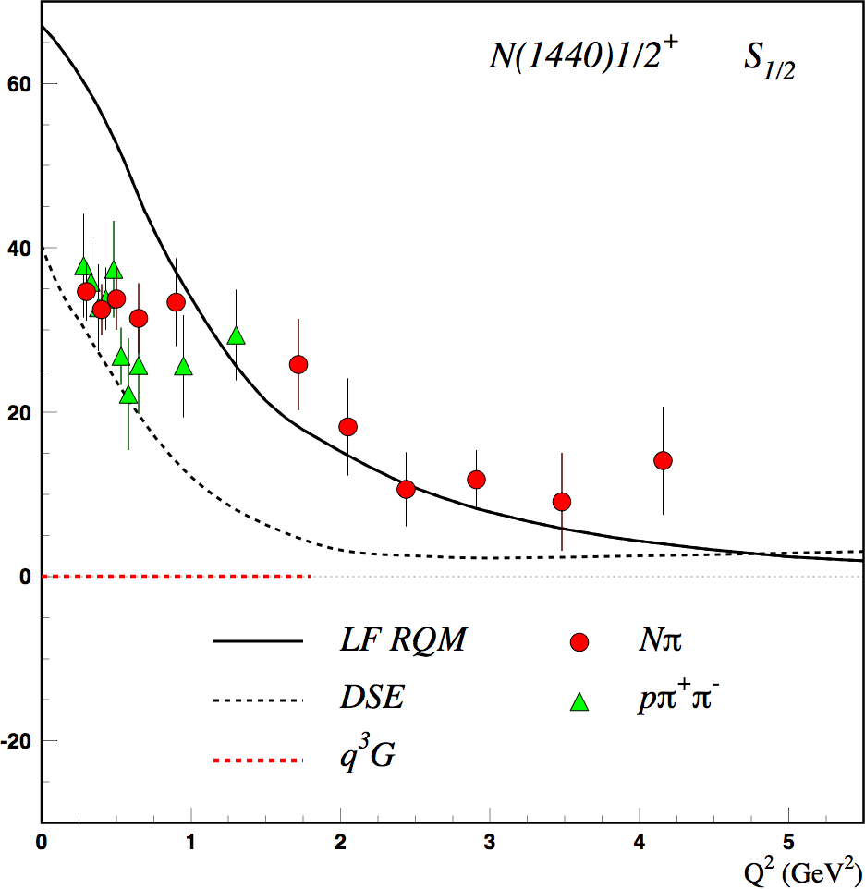
Distinguishing q³ & q³G states
q³
Hybrid Baryons helicity amplitudes are very distinct from regular quark states.

Slide 9
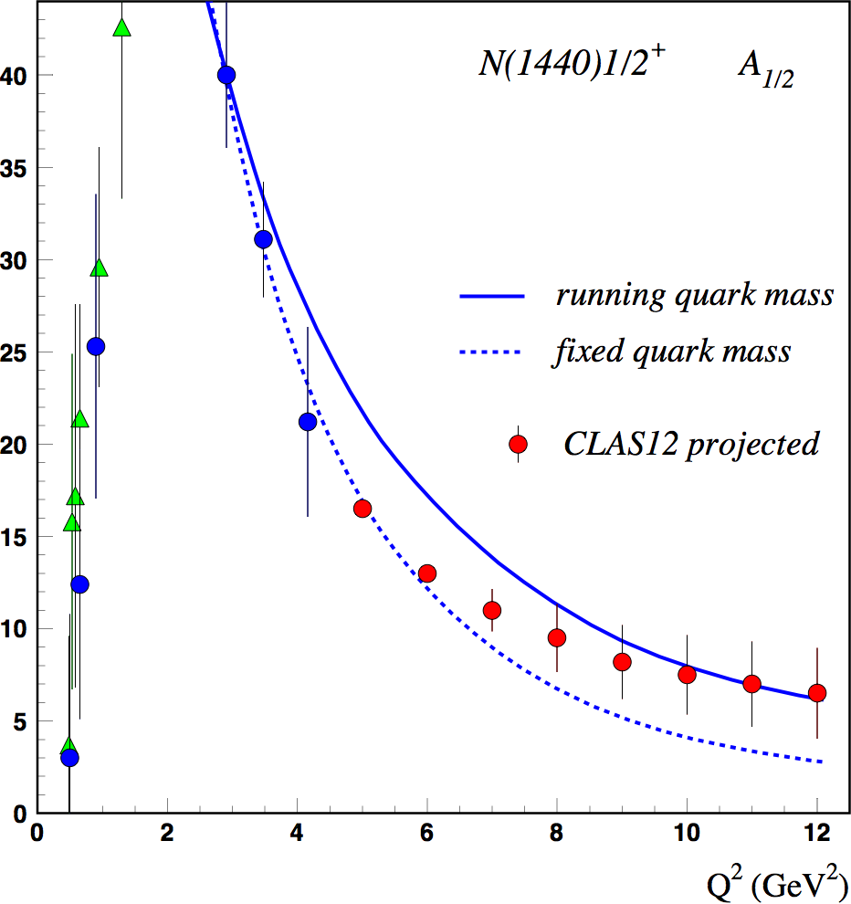
Probing the running quark mass at JLab12
Roper resonance
Running quark mass
accessible
at 6 GeV
LQCD
DSE
accessible at 6.6/ 8.8 GeV
LF RQM
accessible
at 11 GeV
quark mass (GeV)
Probe the transition of dressed quarks to elementary quarks.
Notes:
The extension to higher Q2 will allow measuring transition amplitudes to much higher Q2, which allows probing the running quark mass from a quark momentum of 0.5 GeV to 1.2 GeV/c, which probes the quark mass down to about 50MeV.

Slide 10
GPDs - 3D imaging & confinement
From DVCS to 3D imaging – Separate (DVCS)² in the differential cross section – required Rosenbluth separation of 11 GeV, 8.8 GeV, and 6.6 GeV measurements.
Contribution of H+E
Contribution of E
Use GPD E & H to probe quark confining forces.

