Slide 1
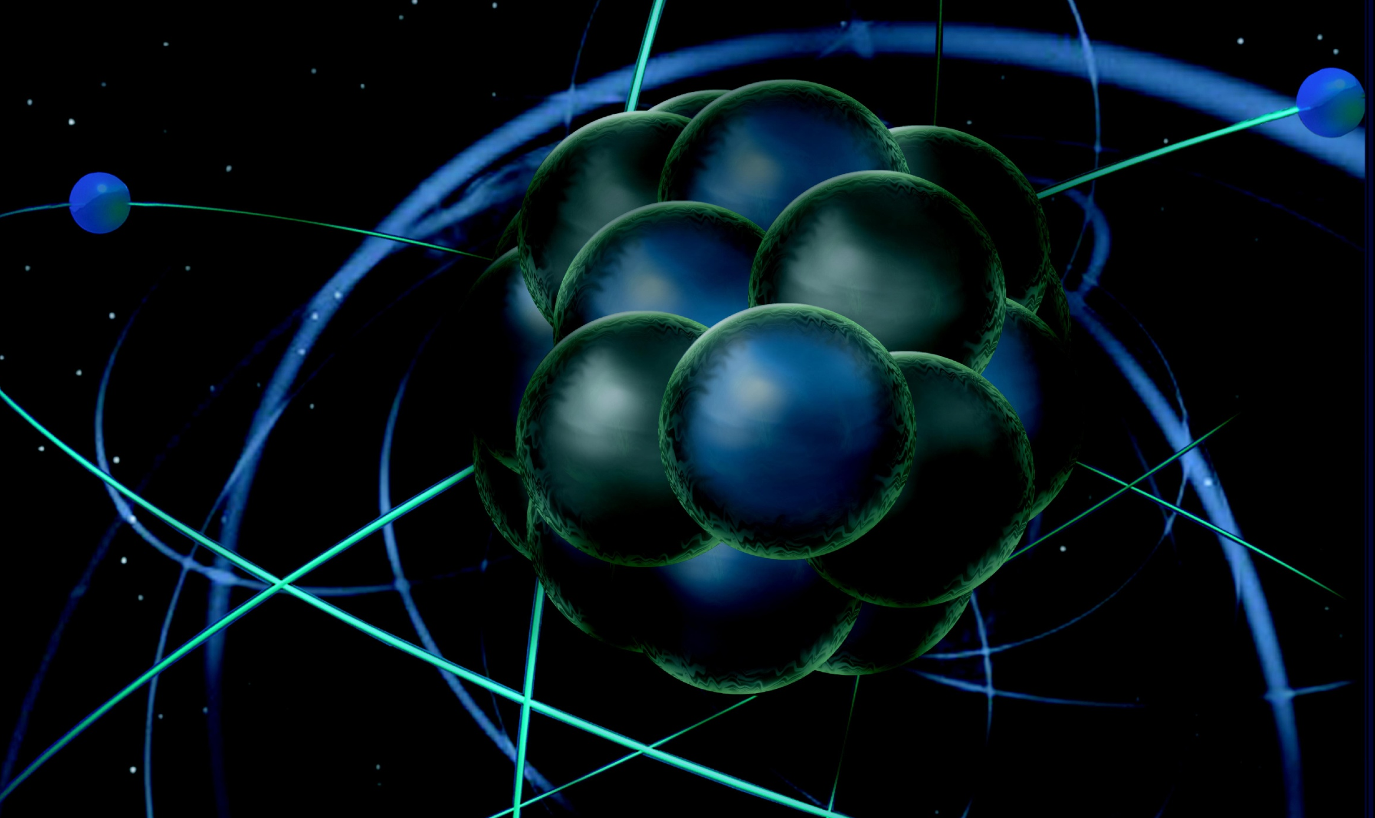
CLAS12 Tracking Overview and Progress
Veronique Ziegler
First Experiment Workshop
CLAS 12 First Experiment Workshop

Slide 2
Central Vertex Tracker Reconstruction
New package clasrec-CVT contains algorithms to reconstruct events using BMT and SVT
SVT can be run stand alone
Raw data translation for both systems
tested on raw data with BMT + SVT hits
new algorithms to use BMT cluster positions
improved BMT (also FMT) clustering algorithm under development (Saclay- Maxime Defurne)
Validation flags can be turned on → layer efficiencies
Alignment code development using Millepede (J. Gilfoyle)
Geometry implementation in common tools package (P. Davies)
Ongoing validation (next slides)

Slide 3
BMT hit info used in pattern recognition
C-detector z information used for reconstructing theta
C-detector cluster position ➔ z information (phi calculated from track )
Z-detector cluster position ➔ phi information (used in fit in xy plane)

Slide 4
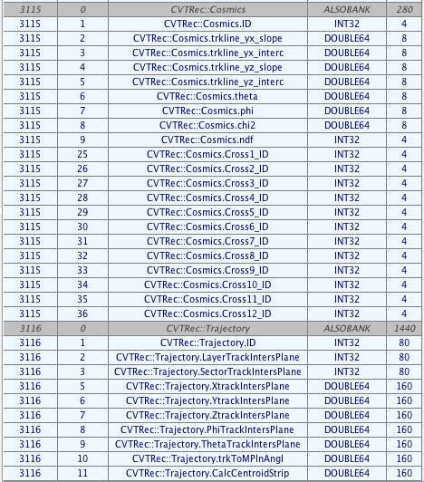
New Banks
CVTRec → reconstruction banks using both BMT + SVT

Slide 5
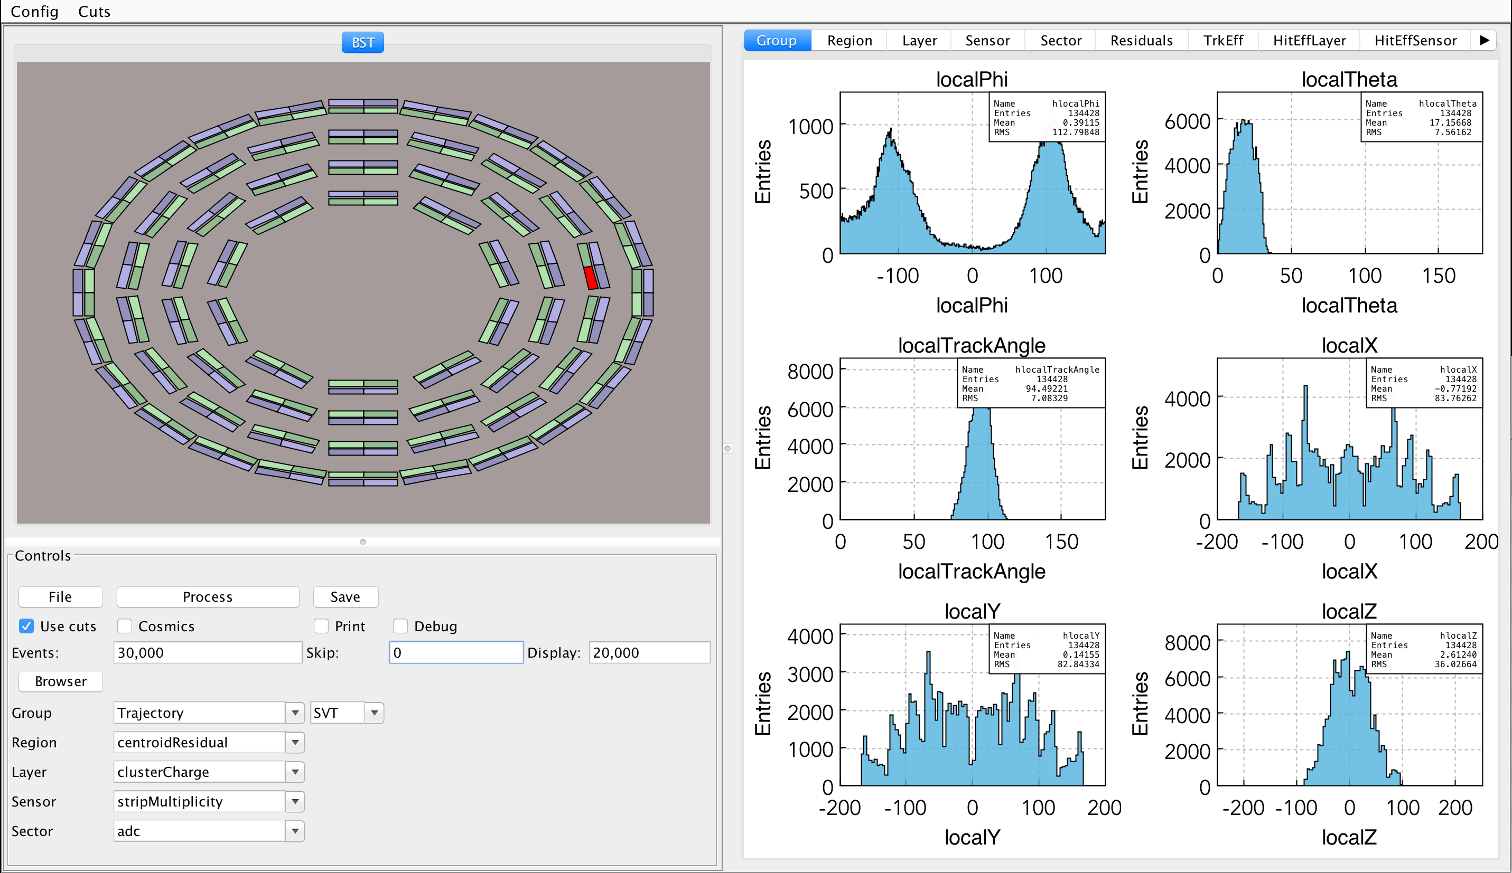
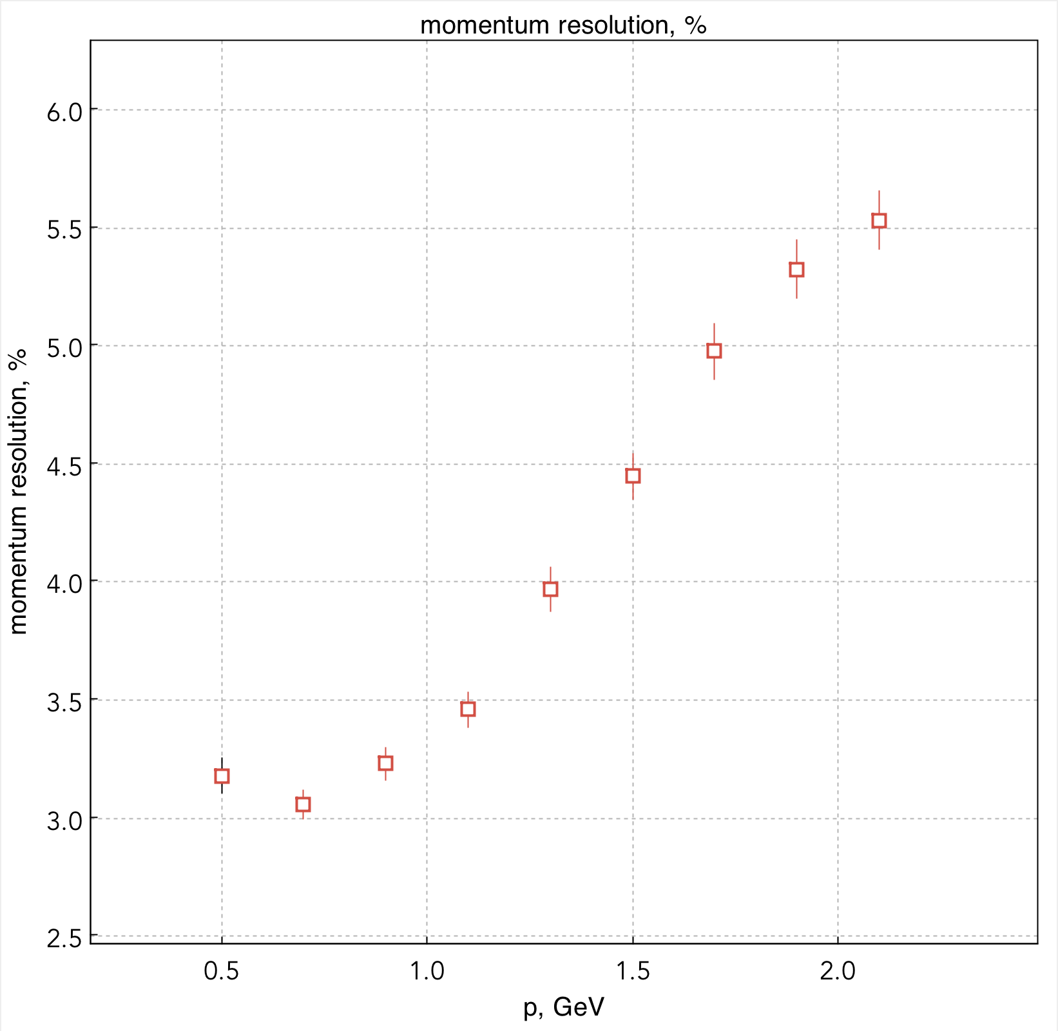
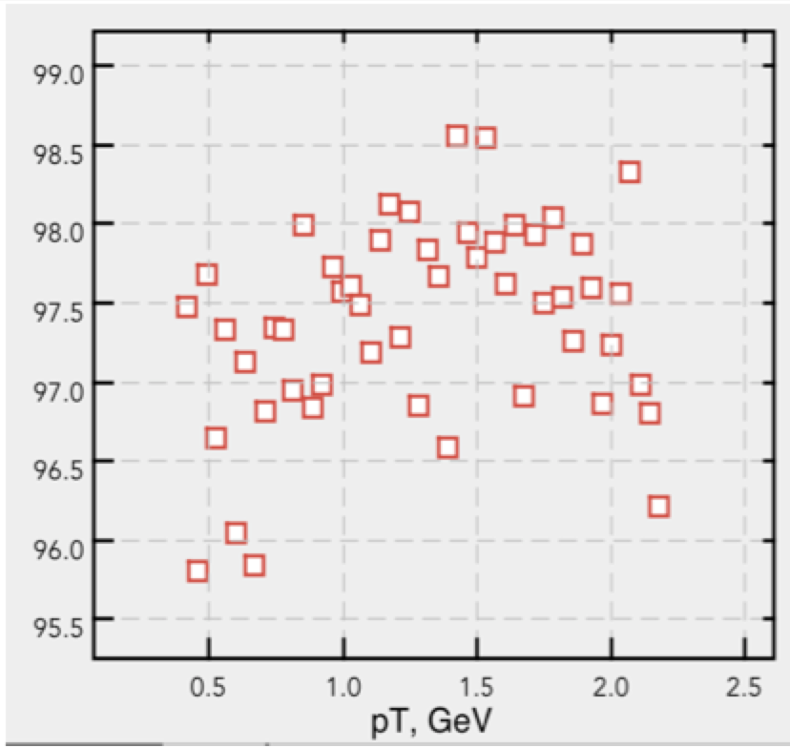
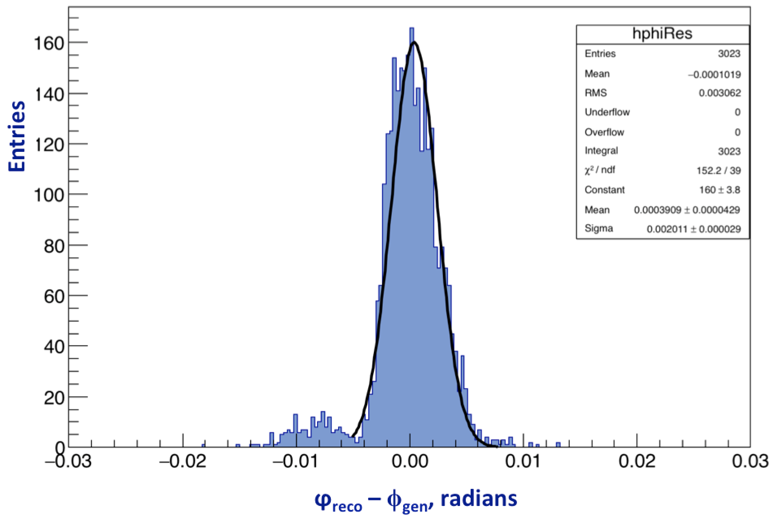
CVT Offline Monitoring and Validation
Y. Gotra
CVT Validation suite
Histogram selection menus added
MVT histograms added
Cut selection menu implemented
Event skimming added
Unbiased centroid residuals added
Efficiencies and resolutions implemented
Hipo and root output format
Validations performed
Reconstruction release validation v0.1 - v0.6
Single track reconstruction
Geantinos, muons, pions
Straight (0T) and helical tracks
Gemc 2.3
Geometric acceptance
Discriminator thresholds
Resolutions (momentum, angular)
Efficiencies (track finding, hit finding)
Occupancies
Work in progress
Misaligned geometry
Multiple tracks
Electronic noise
Local reconstruction
Lorentz angle
Documentation
Track finding efficiency, %

Slide 6
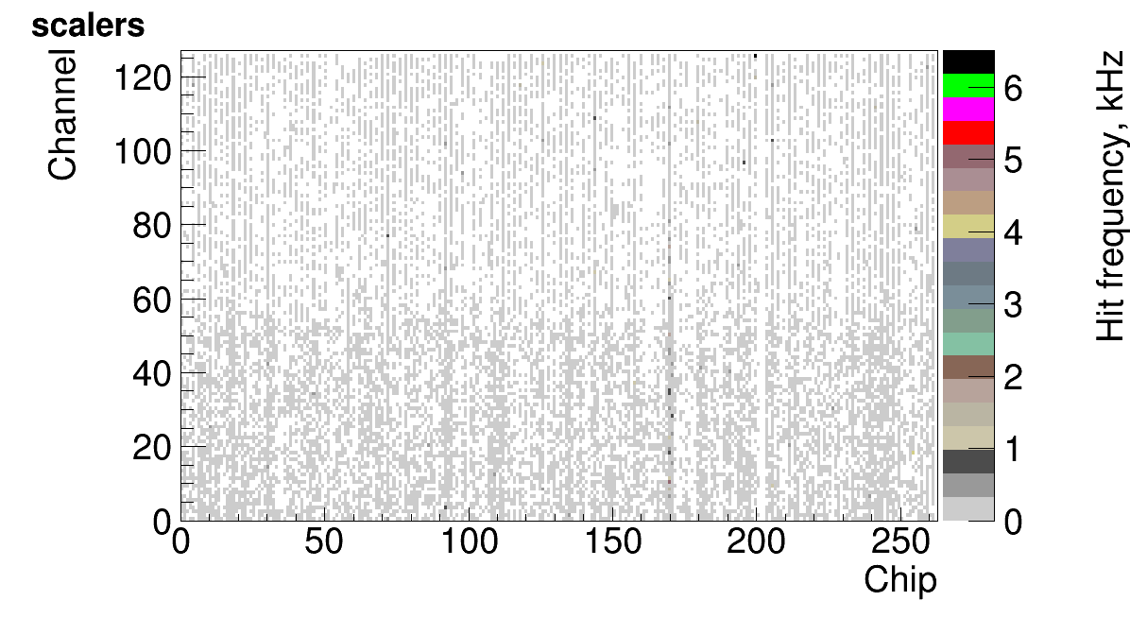
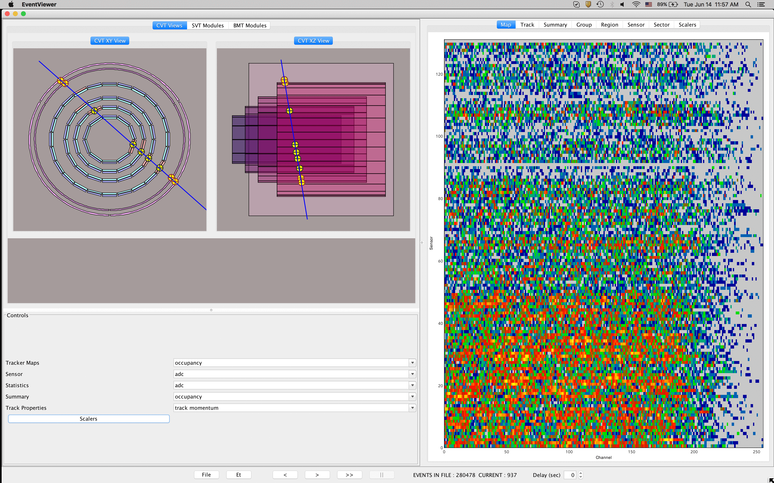
CVT Online Monitoring
Strip Plots/Tracker Maps
2d plot, sensor vs. channel (132x256)
channel status (green: good, yellow: masked, red: noisy)
occupancy in percent vs. the strip number
average strip pulse height in ADC counts
width of pulse height distribution in ADC counts
new bad strip (red: strip marked by data quality algorithm but not marked)
chip status map
Component Plots
Selection of component (sensor) in Detector View, 1D
occupancy, vs. the strip number
ADC
BCO
cluster charge
corrected cluster charge (by cos of the track angle)
strip multiplicity
unbiased centroid residual
local track phi
local track theta
local track 3D angle
Statistics Plots
Mean value and RMS (as error bar) vs. sector, by layer
ADC
occupancy
cluster charge
strip multiplicity
unbiased centroid residual
Summary/Combined Plots
Per layer/region, total
hit finding efficiency, occupancy, norm. by nb of strips (event-by event)
ADC
cluster charge
corrected cluster charge (by cos of the track angle)
unbiased centroid residual
strip multiplicity
hit multiplicity
cluster multiplicity
cross multiplicity
Tracker Object Plots
track p, pt, φ_{0,} θ₀, z_{0,} d₀
track φ₀ vs. track θ₀
track normalized χ²,
track multiplicity
path length
hits per track
Views:
Summary
Report
Shift
Expert
Monitoring Plots:
long-term (statistics accumulated in the run)
short-term (during the last few minutes or over a few most recent events)
history plots (time history of any quantity with long/short-term plot)
periodic plots (averaged over a fixed number of events)
tracker maps
6

Slide 7
Alignment of the SVT
J. Gilfoyle
* Geometry implementation in Java framework & validation ongoing (P. Davis [U. Surrey])

Slide 8
DC Reconstruction
Realistic time smearing and intrinsic inefficiencies in MC
using doca RMS in fit
Time-to-distance parametrization (M. Mestayer & K. Adhikari [U. Miss.])
Improved noise rejection algorithms
secondaries pruner
LR ambiguity resolver
Development of improved Hit-based track parameters (in development)
using KF fitting method
using segment dictionary & Neural Net (D. Heddle [CNU], M. Catelli [CNU student], L. Lorenti [CNU student])

Slide 9
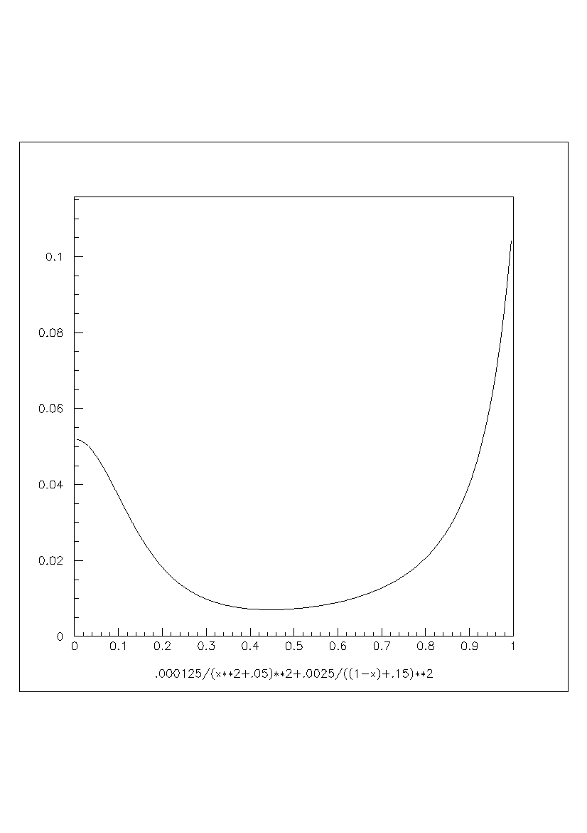
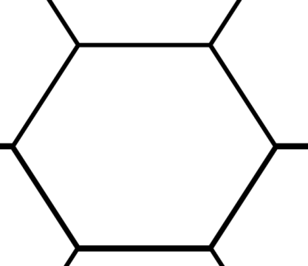
Simulation of intrinsic wire inefficiencies
Three sources of inefficiency:
Intrinsic (applies to all wires) – cells don’t always fire,
Equipment malfunction-related (applies to specifc wires),
Background-related (unavoidable knock-on electrons)
Improved digitization in GEMC
parameters added to CCDB: SQlite
intrinsic inefficiency (distance dependent) is added in GEMC
Inefficiency =
0.000125/(x^2+0.05)^2 + 0.0025/((1-x)+0.15)^2
Inefficiency
not yet calibrated
The intrinsic inefficiency function:
where X = doca/docaMax & docaMax = 2 d_{layer}
X=doca/docaMax
Hit times generated by GEMC digitization routine will be smeared by a random number with position-dependent magnitudes as given by above intrinsic inefficiency function.
Same inefficiency function and parameters are used by the track reconstruction software to form error matrix in the Kalman-filter.
θ=0
θ=30
Notes:
In the case of a track which passes very close (within 1-2 mm) of the wire, the ionization electrons arrive individually, spread out over a long time, and the signal voltage may fail to exceed the discriminator level and so result in no signal.
In case of a track passing close to x=1 (i.e near the hexagon vertices/corners or near field wires), only some ionization electrons will arrive (with most or a lot of them lost to the neighboring cells), thus reducing the signal voltage to have similar effect as near the wire.

Slide 10
Tuning inefficiencies in MC
inefficient wire

Slide 11
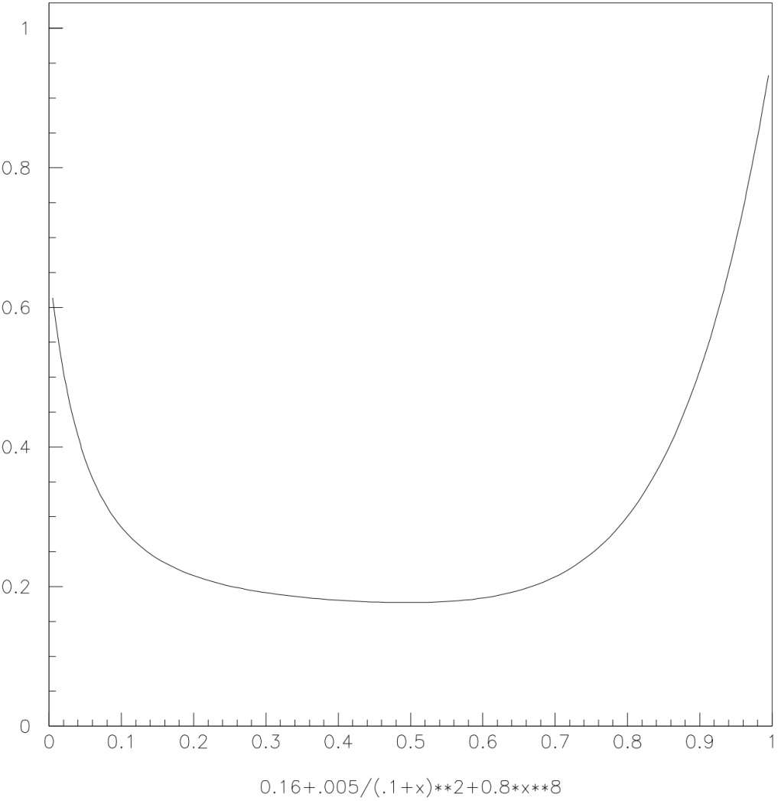
Simulation of doca resolution
Functional form: M. Mestayer & K. Adhikari
GEMC implementation: M. Ungaro
used to smear docas in GEMC
used in reconstruction in measurement error
in Kalman Gain calculation
Resolution in mm =
1.0(0.16 + 0.005/(0.1+x)^2 + 0.8*x^8)
Resolution in mm
X=doca/docaMax
Notes:
In the case of a track which passes very close (within 1-2 mm) of the wire, the ionization electrons arrive individually, spread out over a long time, and the signal voltage may fail to exceed the discriminator level and so result in no signal.
In case of a track passing close to x=1 (i.e near the hexagon vertices/corners or near field wires), only some ionization electrons will arrive (with most or a lot of them lost to the neighboring cells), thus reducing the signal voltage to have similar effect as near the wire.

Slide 12
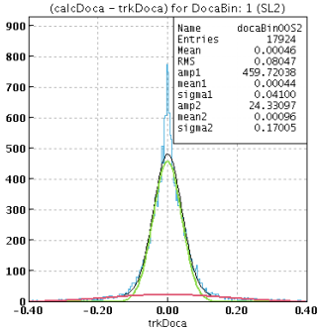
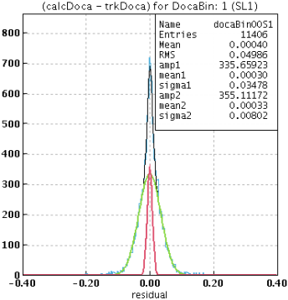
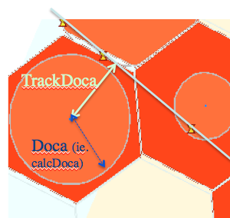
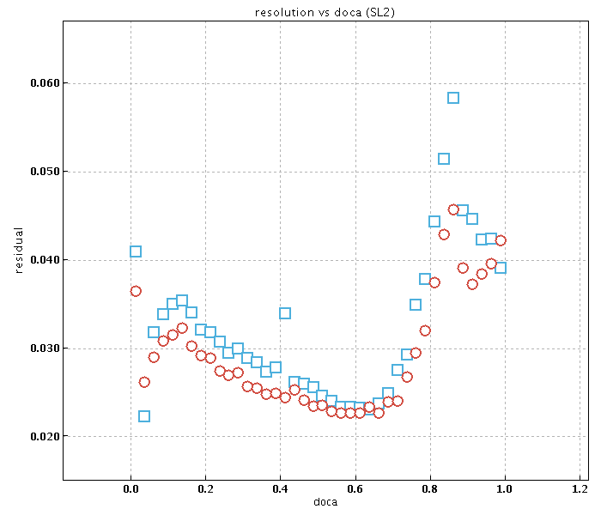
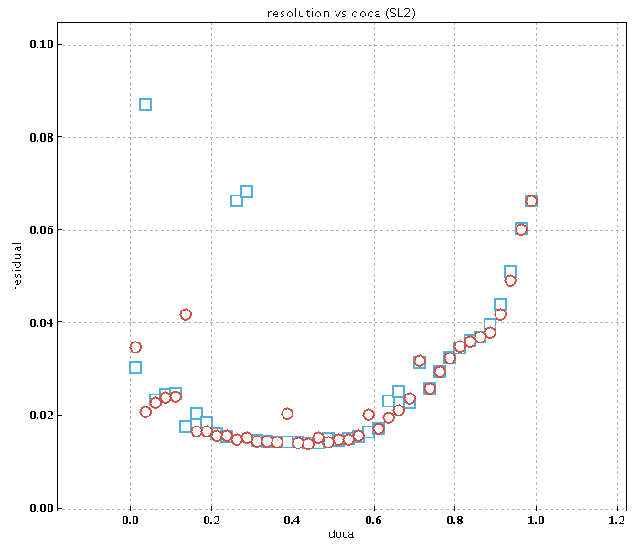
DC-resolution for Cosmics & GEMC
K. Adhikari
Residuals (calcDoca – trkDoca) in 40 trkDoca bins.
Double Gaussian fits on the residuals
Standard deviation of the central/narrower Gaussian taken as the resolution for that bin.
Cosmic data
Gemc data
Cosmic data
GEMC data
Superlayer - 1
Superlayer - 2
Residual in cm
Residual in cm
X=doca/docaMax
X=doca/docaMax
Notes:
Double Gaussian fits (red and green represent the two gaussian components and the blue is for the overall double gaussian). The central/narrower gaussian was used to represent the resolution in the given doca bin.

Slide 13
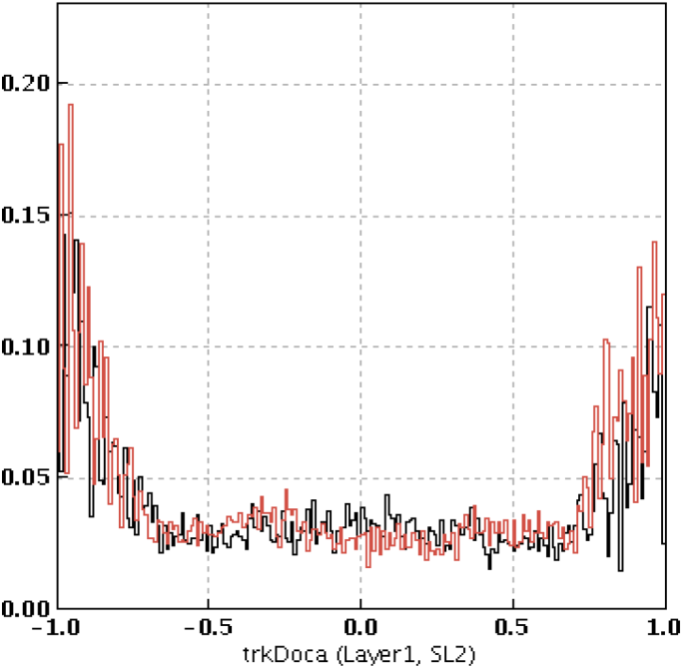
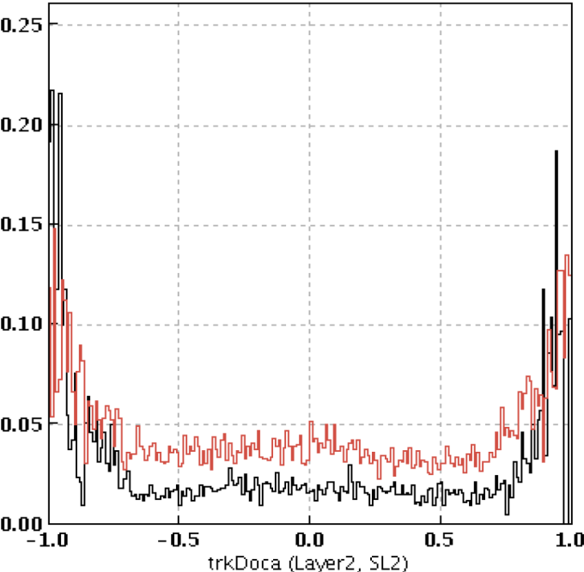
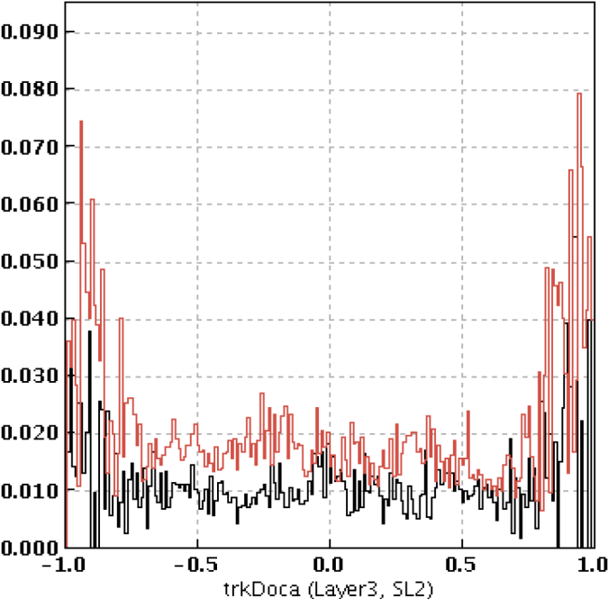
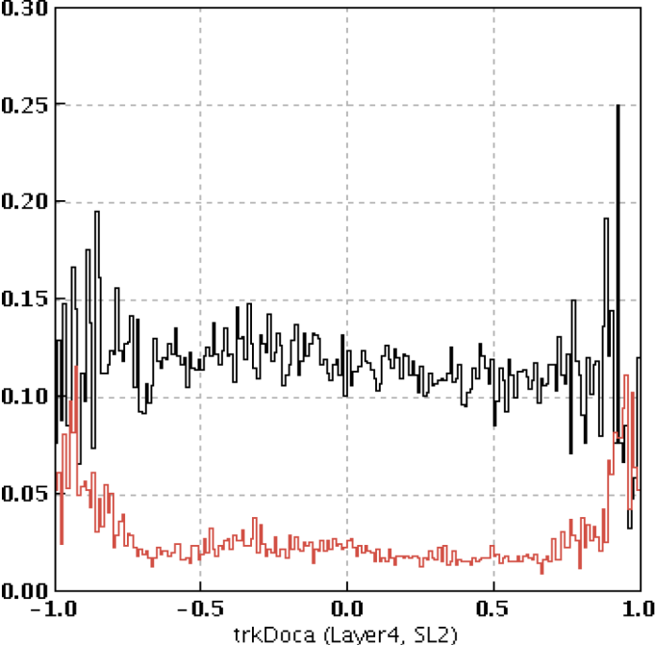
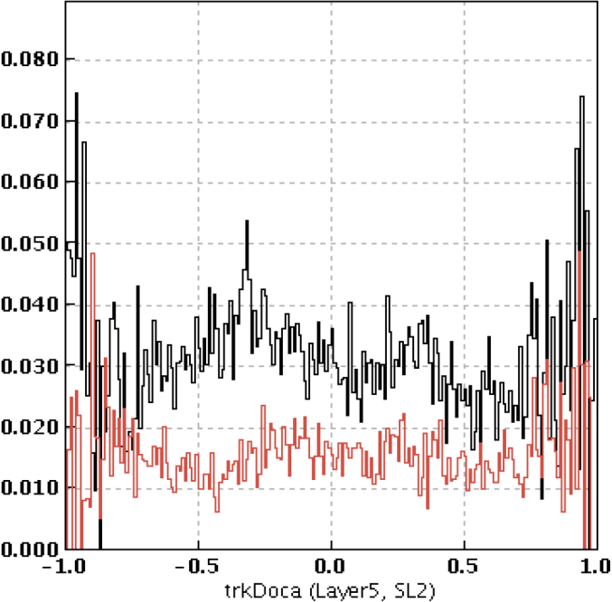
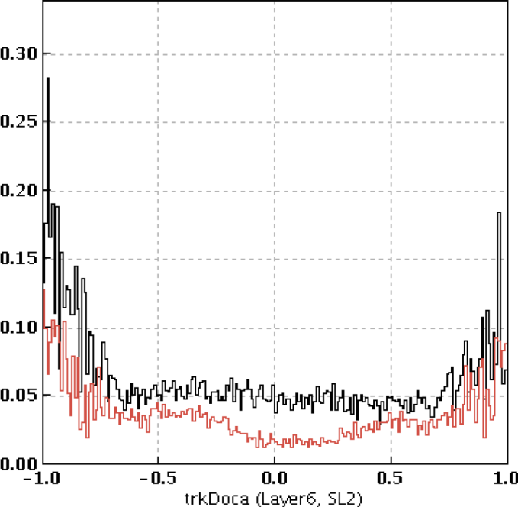
Layer (In)efficiency as function of track DOCA
K. Adhikari
(Cosmic data)
Layer 1
Layer 2
Layer 3
Superlayer 1
Superlayer 2
Superlayer 1
Superlayer 2
Superlayer 1
Superlayer 2
Inefficiency
Inefficiency
Inefficiency
Layer 4
Layer 5
Layer 6
Superlayer 1
Superlayer 2
Superlayer 1
Superlayer 2
Superlayer 1
Superlayer 2
Inefficiency
Inefficiency
Inefficiency
Notes:
Fluctuation in lnefficiency: due to low statistics as some dead areas? (Mac)

Slide 14
Layer inefficiencies
Inefficiency =
0.000125/(x^2+0.05)^2 + 0.0025/((1-x)+0.15)^2
M. Mestayer & K. Adhikari
Studied distance dependence of layer inefficiency for COSMIC data
Except of layer 4 in SL1, inefficiency is about 3 to 4 %
Layer 4 in SL1 has high inefficiency (about 12%) which seems to be due to voltage issues in some of the channels.
Corrections for equipment status (dead channels) not applied yet
Time-to-distance function not calibrated yet. (Linear function being used in reconstruction).
Corresponding study on GEMC data yet to be done.
Inefficiency
not yet calibrated
X=doca/docaMax
Notes:
https://www.jlab.org/Hall-B//secure/eg4/adhikari/myHomeLinked/MyHm/Shared/spikyEvents.txt

Slide 15
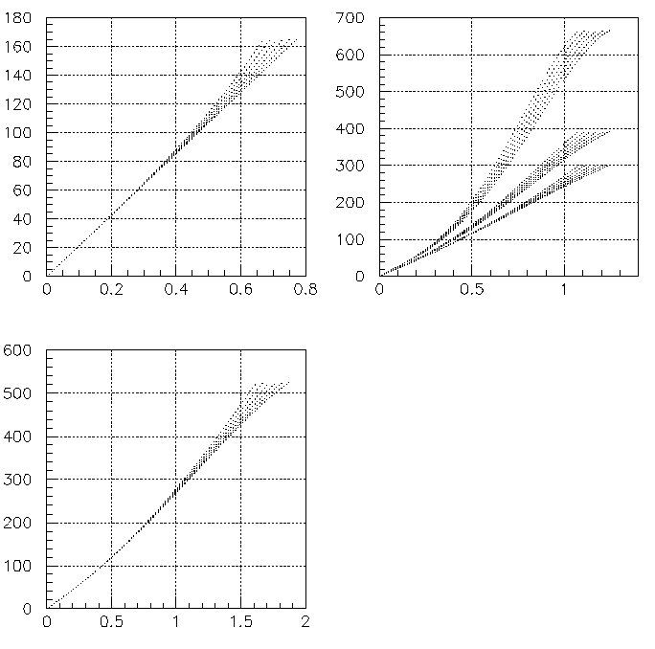
Time-to-distance parameterization
M. Mestayer
B=2T
Region 1
B=1T
Region 2
Time (ns)
B=0T
Distance (cm)
Distance (cm)
local angle = 0⁰
Region 3
Distance → Time
-local-angle and B-field dependence
-consistent with GARFIELD
-inversion done numerically
-thicker wire → more linear
→ easier to calibrate
local angle = 30⁰
Time (ns)
inflection point
Initial parameters & method in software now
Distance (cm)

Slide 16
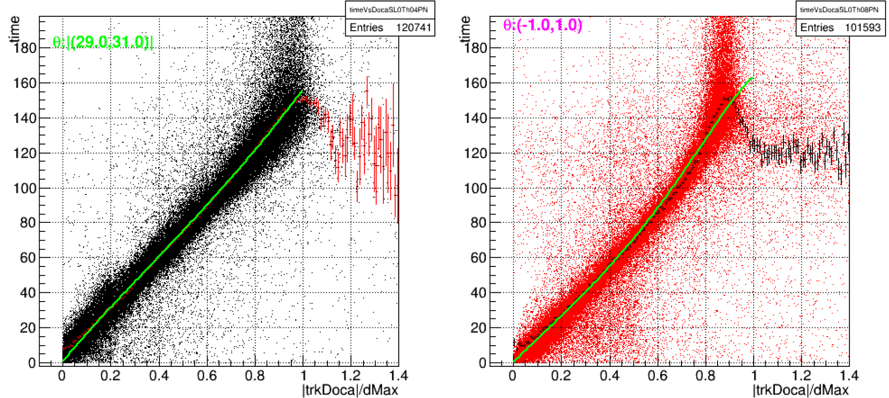
Time-to-distance parameterization
Starting equation for 30 degree tracks:
K. Adhikari
Very preliminary fits on 30 degree & 0 degree tracks respectively

Slide 17
Noise rejection algorithm improvements
Effect of noisy clusters on the reconstruction
MC sample 4.5 GeV e- @ φ =0º, θ = 10º
negative times indicating inefficient cell → not used In reco.
secondaries produce this type of clusters mostly in Region 3

Slide 18
Noisy clusters that do not affect tracking
detached secondary hits
Removed by pruning algorithm

Slide 19
Noisy Clusters
MC sample 4.5 GeV e- @ φ =0º, θ = 10º
not used In reco.
New algorithm:
look for double hits for which the sum of the docas is less than some predefined cut (to be optimized, 1.75*cell-size)
refit the cluster for all combinatorials of hits choosing one of the hits in such doublets
select the best cluster
requires to a priori redo hit-based fits as the LR assignment can be wrong

Slide 20
After algorithm implementation
Cross correctly reconstructed

Slide 21
LR ambiguity not resolved for tracks at ~30º in superlayer local coordinate system
DC cosmic data sample: Region 1 Chamber
LR ambiguity resolved using doublet hits in layers 1--3
LR ambiguity not resolved
New algorithm:
using docas calculated from times save the following segment candidates:
if doca sizes are ~ equal
2 candidates : LR = 1, LR =-1
if docas larger at ends of segment
2 candidates
save all candidates and select the one yielding the best track fit when combined with segments from other regions (for current cosmic sample → save all segment candidates)

Slide 22
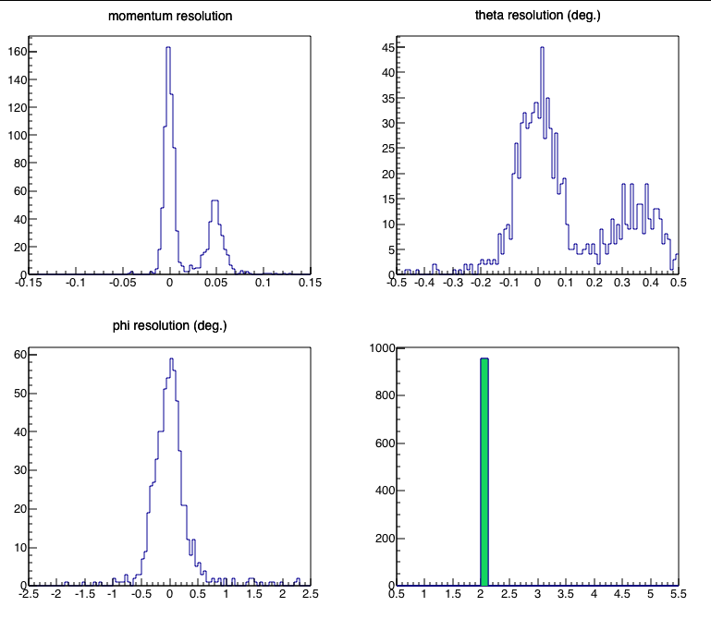
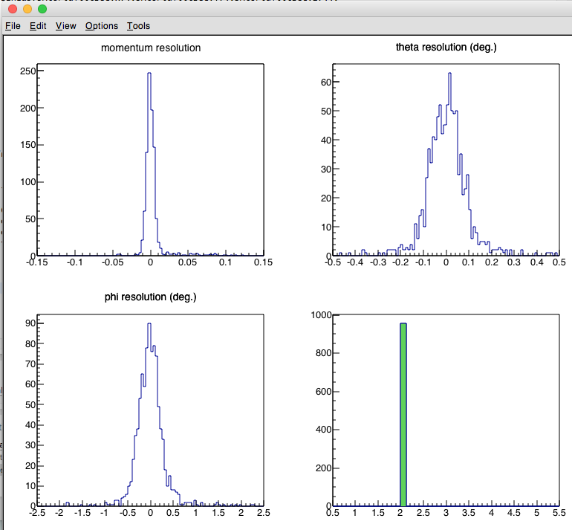
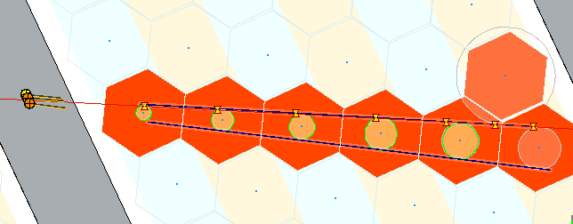
Allowing both segments and picking the correct one
2 track solutions
retain track solution with best chi²
2 crosses → only 1 yields well reco. track

Slide 23
DC new algorithms and code restructuring
ClusterCleaner utility class
called by ClusterFinder
HitBased level
hit list pruner
find clusters
look for // clusters or X clusters → cluster splitter
TimeBased level
recompose HitBased Clusters → read from HB bank
secondaries remover → using sum-docas algorithm
LR ambiguity resolver
Final fit → cluster line → used in cross calculation
Status word for cluster:
Array: → Can be used in analysis to reject poorly reconstructed segments when high sample purity is required…
layer → | 1 | 2 | 3 | 4 | 5 | 6
nb hits in layer | 0,1,2 | 0,1,2 | 0,1,2 | 0,1,2 | 0,1,2 | 0,1,2
LR ambiguity sum | -1,0,1 | -1,0,1 | -1,0,1 | -1,0,1 | -1,0,1 | -1,0,1
Ave. nb hits passing residual cut (350 μ) | 0,1,2 | 0,1,2 | 0,1,2 | 0,1,2 | 0,1,2 | 0,1,2

Slide 24
Hit-based Tracking Improvements
Previously hit-based tracking used only to select a track candidate.
Very rough estimate of track parameters using a simple approximation (next slide) → very poor momentum resolution
Redesign code to improve hit-based track parameters estimates to use them to match track to outer detectors and get start time

Slide 25
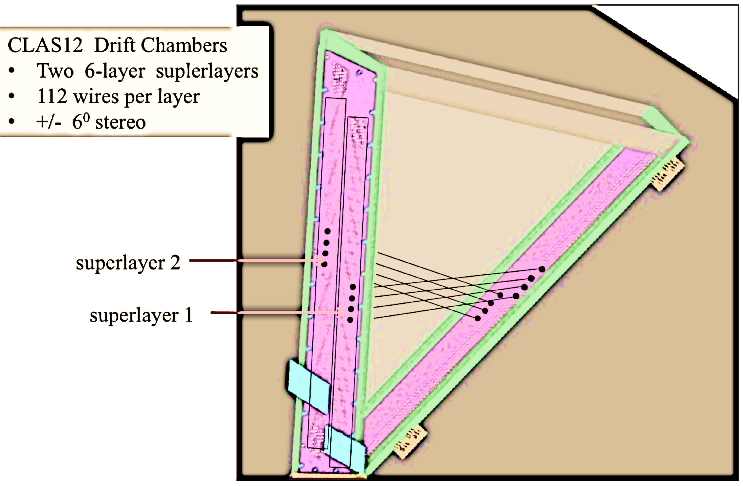
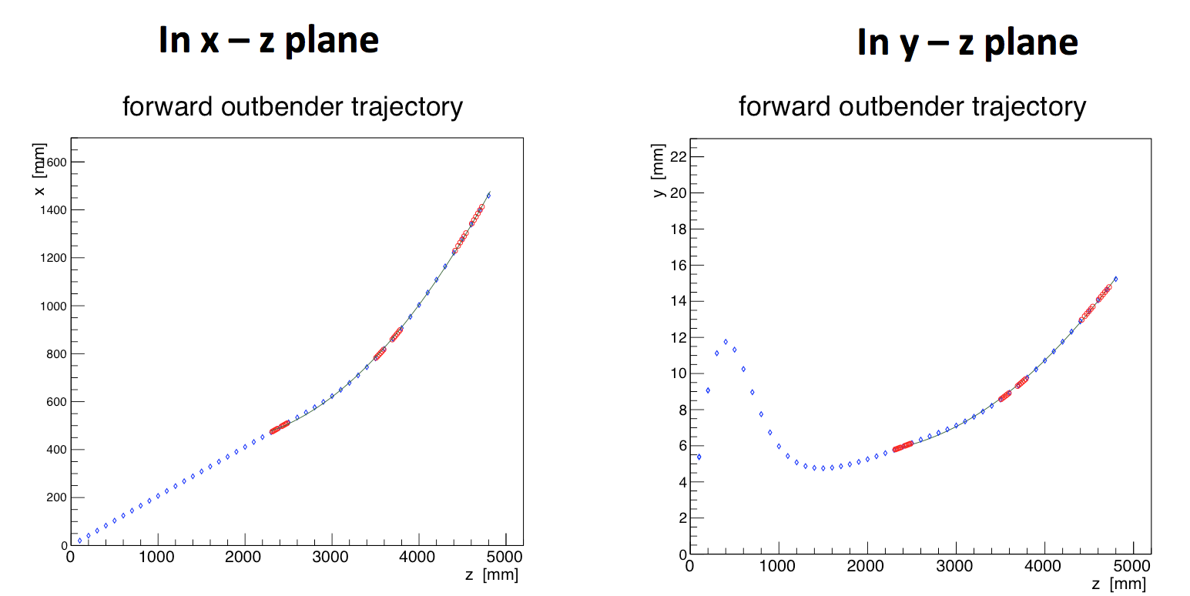
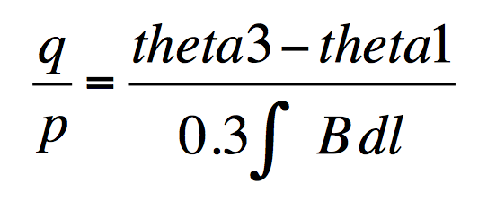
DC Reconstruction Algorithms
(reminder)
Obtain a trajectory from hit-based track segment
reconstruction
Fits to the wires → extended to a plane
→ point & direction
Gives a “cross” object a position and direction vector
Add raw timing information to refine the hit position
Fit to the crosses to obtain a trajectory → Initial parameters to KF
x
x
← Quadratic fit
x
x
x
x
25
Notes:
Segments are linked into region-segments using a wire index proximity condition formula (find another seg within certain number of wires). From this region-segments a point (similar to BST algorithm) is determined. The fit to the wires in each superlayer can be extended to form a plane. Since the orientation of the wires in each superlayer at at +/- 6 degrees stereo angles w.r.t. each other, the 2 planes with intersect. Hence from this intersection a line is formed to yield a direction, and a point can be obtained from the intersection of that line with the plane that lies inbetween the superlayers – so-called middle-plane. This object ( point & direction unit vector ) is what we call a cross. For a good track there are 3 crosses, from which a track trajectory can be estimated.

Slide 26
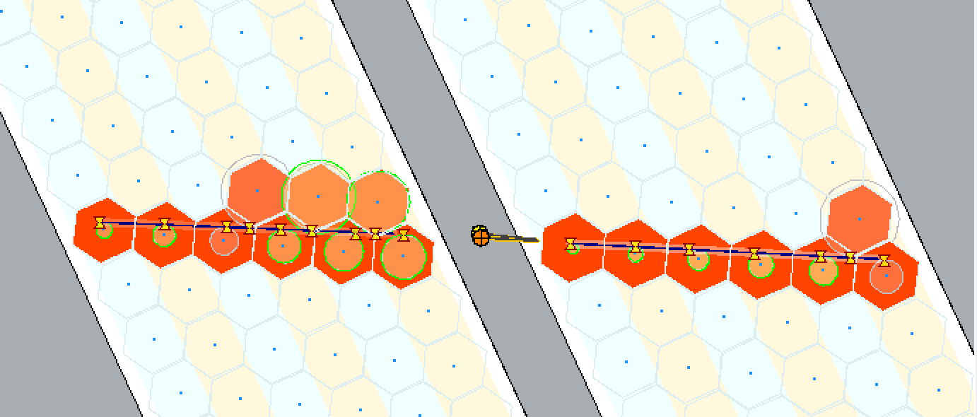
Test of implementation
2 GeV e- @ 15 deg θ, at midplane
Set times to zero (i.e. hit-based) and run KF using wire positions & hit uncertainties of cell-size/sqrt(12) ➔ did not work
Set times to zero and run KF using segment fit values at measurement plane (fixed z) → kinda worked (except for phi)
Δp/p res = 1.33%
θ res = 0.12 deg
Δp/p res = 0.45%
θ res = 0.046 deg
Time-based
Hit-based

Slide 27
Tracking Timeline
Central Tracking: tracker alignment code ready SVT + BMT (4+1) code optimization (unbiased residuals, angular resolution improvements) SVT + BMT (3+3) configuration implementation (geometry & reconstruction) Forward Tracking : Time-to-distance calibration & implementation in reconstruction Hit-based tracking parameters improvements (needed for Event Builder) use of all calibration constants and status tables in reconstruction integration with FMT in reconstruction alignment code and magnet mapping ready FW Trkg & PID: FT-Trk java code ready and integrated with FT system Event Builder: event reconstruction chain ready (e- or hadron id, start time from hit-based tracking, detector matching, full PID using all available detector responses) | 4th quarter 2016 3rd quarter 2016 2nd quarter 2017 4th quarter 2016 3rd quarter 2016 4th quarter 2016 3rd quarter 2016 1st quarter 2017 4th quarter 2016 3rd quarter 2016

