Slide 1
Eta electroproduction at CLAS
Cross sections and structure functions
(analysis of e1-DVCS run)
CLAS Collaboration (Ivan Bedlinsky, Valery Kuberovsky, PS, et al.)
For submission to PRC ( under collaboration-wide review for)

Slide 2
η and π⁰ − elusive transversity GPDs in the nucleon.
η and π⁰ combined - individual u and d quark flavors.
Already published π⁰
Physical Review Letters (2012) and Physical Review C (2014)
These experiments are precursors to exp. E12-06-108
“Hard Exclusive Electroproduction of π⁰ and η with CLAS12”

Slide 3
Measured
for

Slide 4
M(γ, γ)

Slide 5
Virtual photon cross section.
Structure functions

Slide 6
Each structure function has its specific sensitivity to different aspects of transversity GPDs
φ

Slide 8
π⁰ and η structure functions
π⁰
η

Slide 9
Theoretical analyses :
Regge: Laget
Handbag: Goldstein and Luitti, Goloskokov and Kroll
We follow the development Goloskokov and Kroll

Slide 10
Transversity GPDs are initiated by transverse photons
Nucleon Helicity non-flip
Nucleon Helicity flip

Slide 11
Fuchey et al.– Hall A
M. Defurne et al. – Hall A

Slide 12
Generalized form factors (GFF)

Slide 13
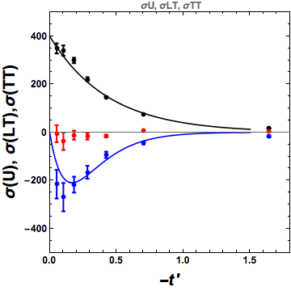
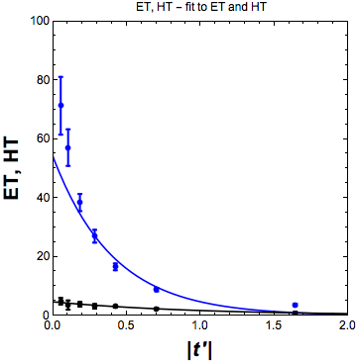
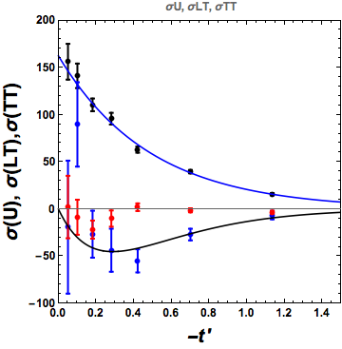
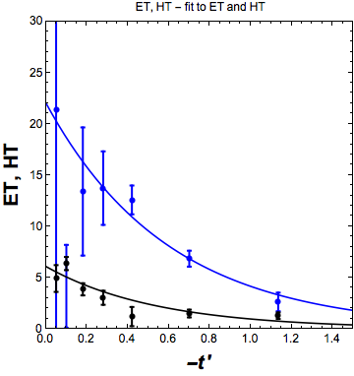
π⁰
π⁰
η
η

Slide 15
Extracting GPDs for individual quark flavors.
π⁰ and η are members of the same meson multiplet.
Deconvolute π⁰ and η to get contributions from quark flavors.
Constituent quark relationships

Slide 16
deconvolution: Valery Kubarovsky

Slide 17
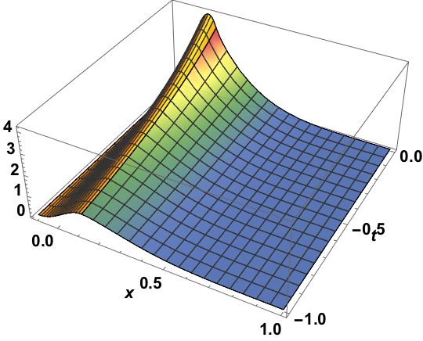
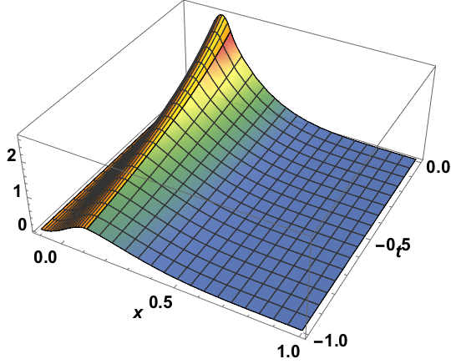
Goloskokov and Kroll – Model GPDs
Example: x_{B}=0.2 Q²=2 ξ=0.11

Slide 18
π⁰ and η structure functions
(Goloskokov and Kroll)
π⁰
η
π⁰
η

Slide 19
But !!!
Ratio η/π⁰

Slide 20
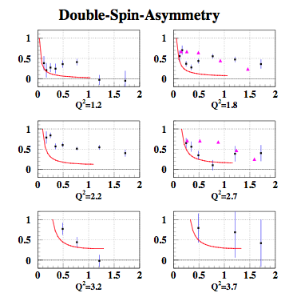
A. Kim PRL-submitted
CLAS – V. Kubarovsky

Slide 21
Conclusion
η electroproduction paper in final ad hoc review – PRC
π⁰ and η electroproduction dominated by transverse amplitudes. Unique window on
Higher Q² and lower –t planned for CLAS12
π⁰ and η cross sections and asymmetries on P and N at higher Q² and lower will enable us to obtain transversity GPDs for individual quark flavors.

Slide 22
Supplemental Slides

Slide 23
Cross Sections and Structure Functions
Measured
19 bins of Q² - x_{B} acceptance
~20 bins in φ, 6 bins in t

Slide 24
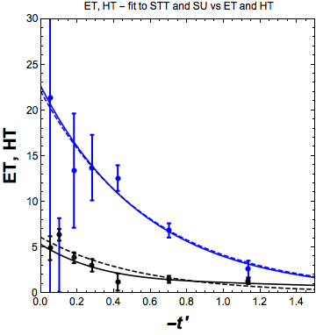
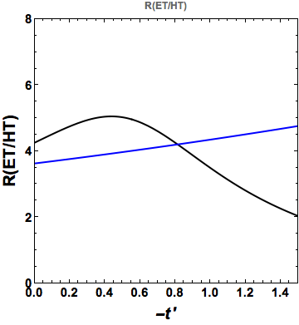
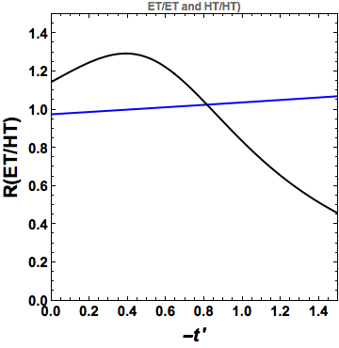
fit to σ_{U}, σ_{TT}
fit to E_{T}, H_{T}

Slide 25
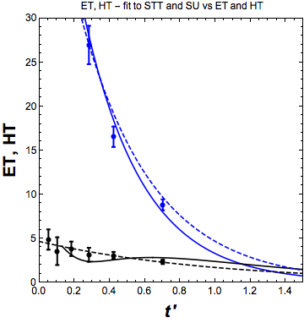
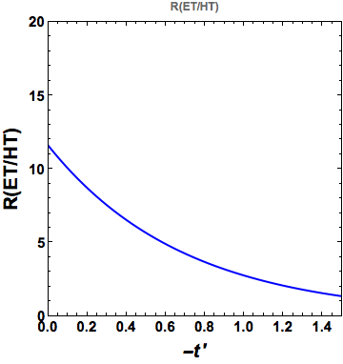

Slide 26
Extracting GPDs for individual quark flavors.
π⁰ and η are members of the same meson multiplet.
Deconvolute π⁰ and η to get contributions from quark flavors.

Slide 28
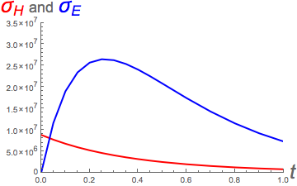
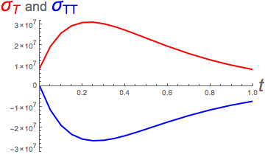
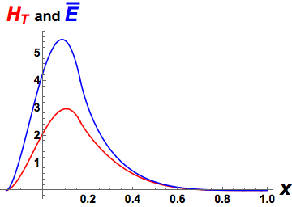
W=2.2 GeV, Q²=1.6 GeV², x_{B}=.284

