Slide 1
SRF C100 Assembly
What are some of the general clean room protocols?
General C100 assembly steps
How do we reduce particulate during assemblies?

Slide 2
General gowning protocol:
Gowning is done in a separate room away from the clean assembly work.
Garment has almost full coverage
Face mask, Bouffant, shoe covers followed by the Clean room Garment, Hood, Coverall and Boot covers
Two pairs of gloves
Frequent change of newly laundered garments

Slide 3
Tooling is cleaned and staged
String lollipop tooling is disassembled, cleaned and staged in the string assembly area.
Ionized nitrogen is used as a final cleaning to remove loose particulate generated from assembly.

Slide 4
Parts cleaning and verification
Parts are cleaned before being passed into the clean room
Parts are verified clean with Ionized Nitrogen and a particle counter
Frequent glove changes to reduce particulate transfer onto critical surfaces

Slide 5
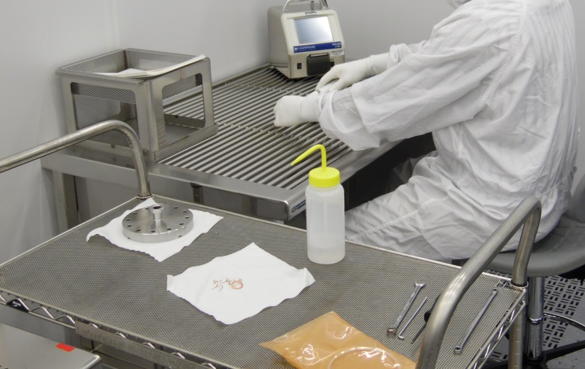
Assembly Preparation
A wire cart is wiped clean with Isopropyl and clean room wipers. The cart is followed up with an Ionized nitrogen cleaning.
Tools are wiped clean with Isopropyl and clean room wipers. They are laid out on the cart ready for use.
Image shows a critical component laid on a clean room wiper as apposed to setting it directly on the metal cart

Slide 6
Sub-Assemblies
Some components are sub-assembled at the bench.
Sub-assembled components are cleaned with ionized nitrogen at various stages of assembly

Slide 7
Cavities are processed
Cavities are installed in cage tooling and processed for assembly.
UPW Degrease
EP
UPW Degrease
HPR with UPW
Clean room air dried

Slide 8
Protect clean surfaces
Cover flanges are used to protect critical internal surfaces. Clamps hold the covers in place until the mating flanges are ready to install.
Covers for prototype C100 were SST with Viton O-rings. Later during C100 production a SST flat plate and metal spring clamps were adopted.

Slide 9
Assemble from underneath
Care is taken to reduce hardware friction during assembly. In this case the valve is held with tooling and aligned to its mating flange.
Workers are not working above the critical open ports.

Slide 10
C100 assembly process
Sub-assemblies:
The waveguide and RF window .
The beam-line valve and CF flanges.
Field probe feedthru and probe tip.
The cavity is sub-assembled with the HOM and Field probe feedthroughs and then receives a second HPR.

Slide 11
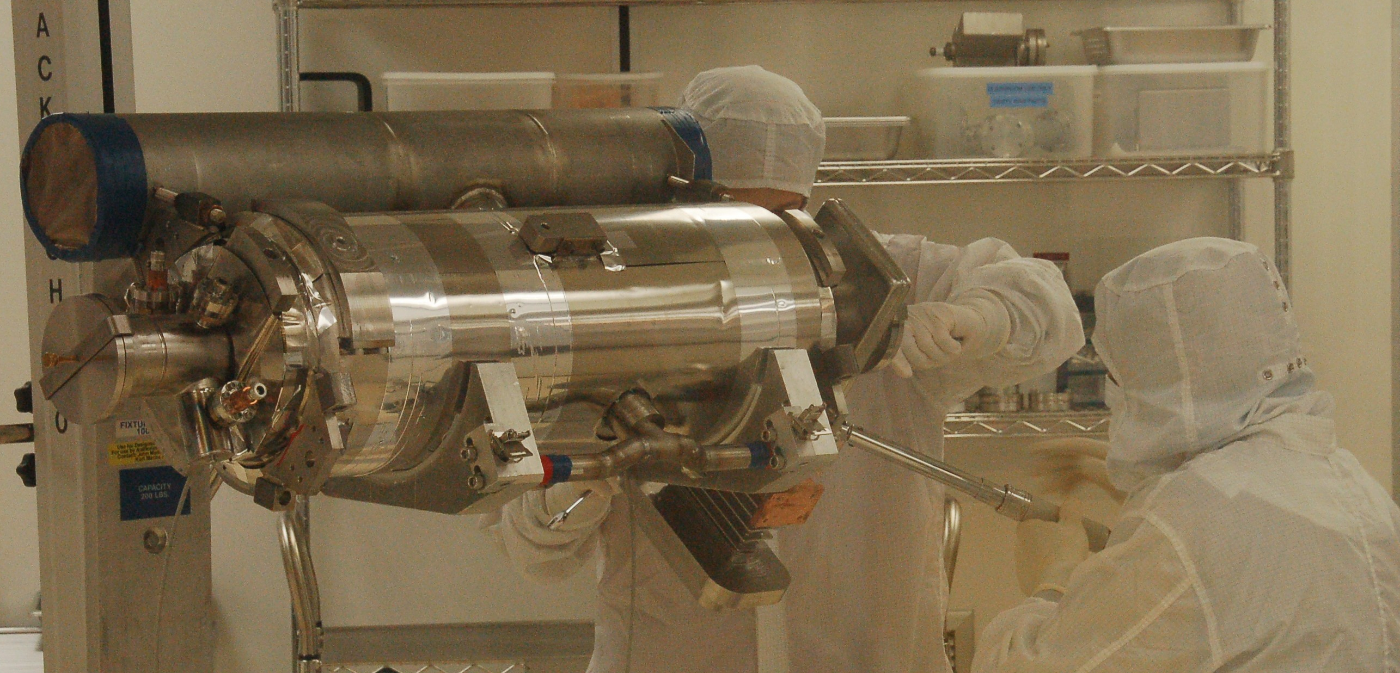
C100 assembly process
The beam-line valve assembly is installed onto the cavity.
The waveguide sub-assembly is assembled to the cavity
The cavity is installed onto the lollipop tooling

Slide 12
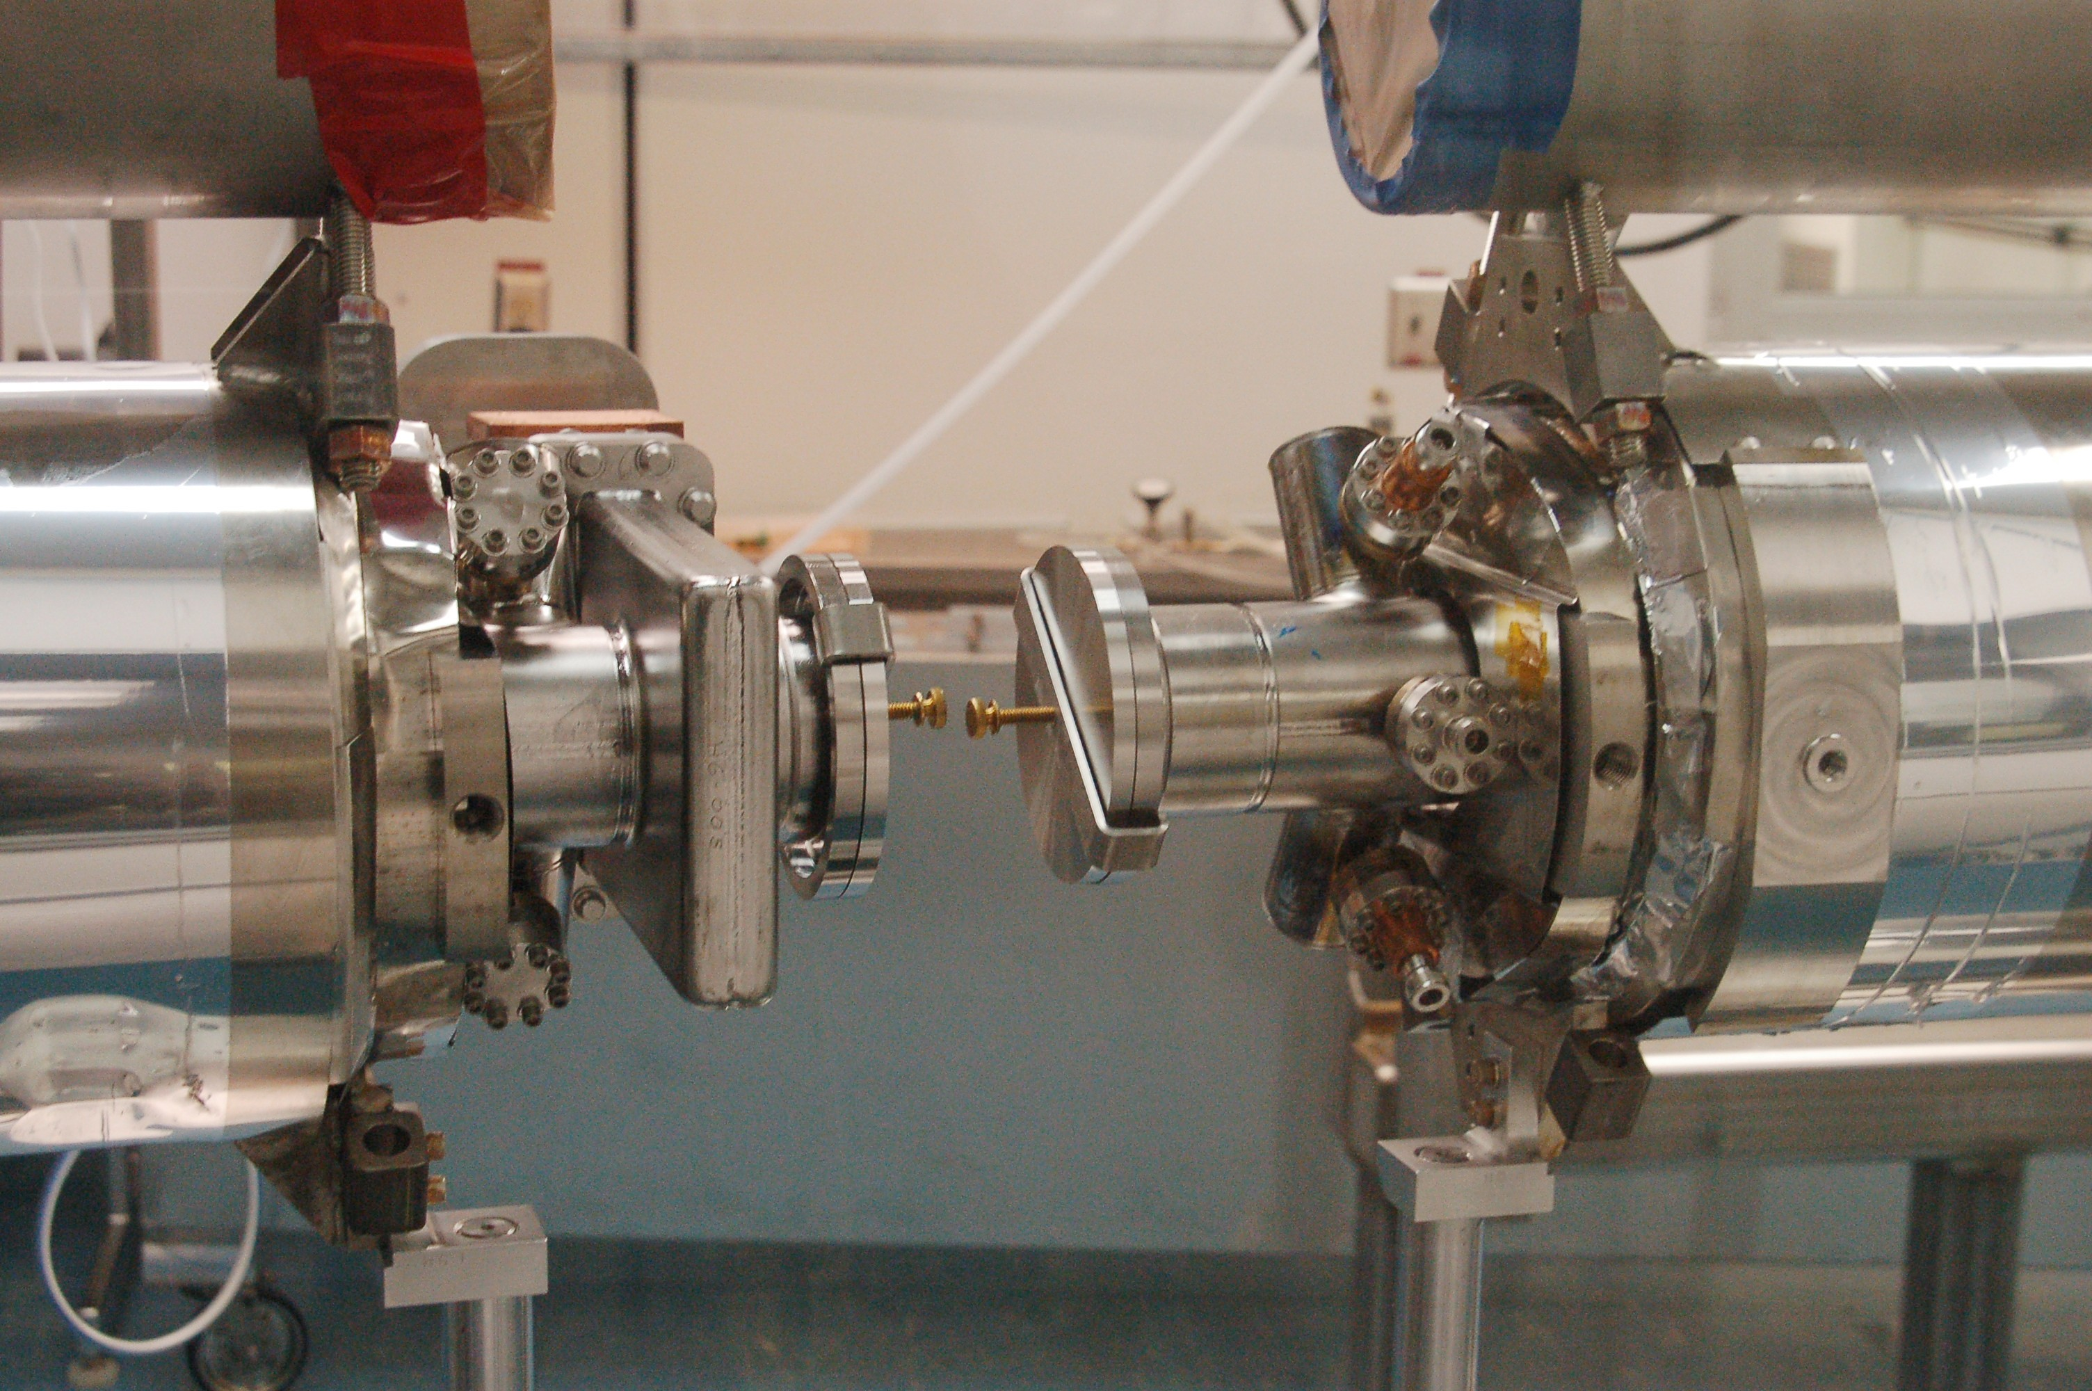
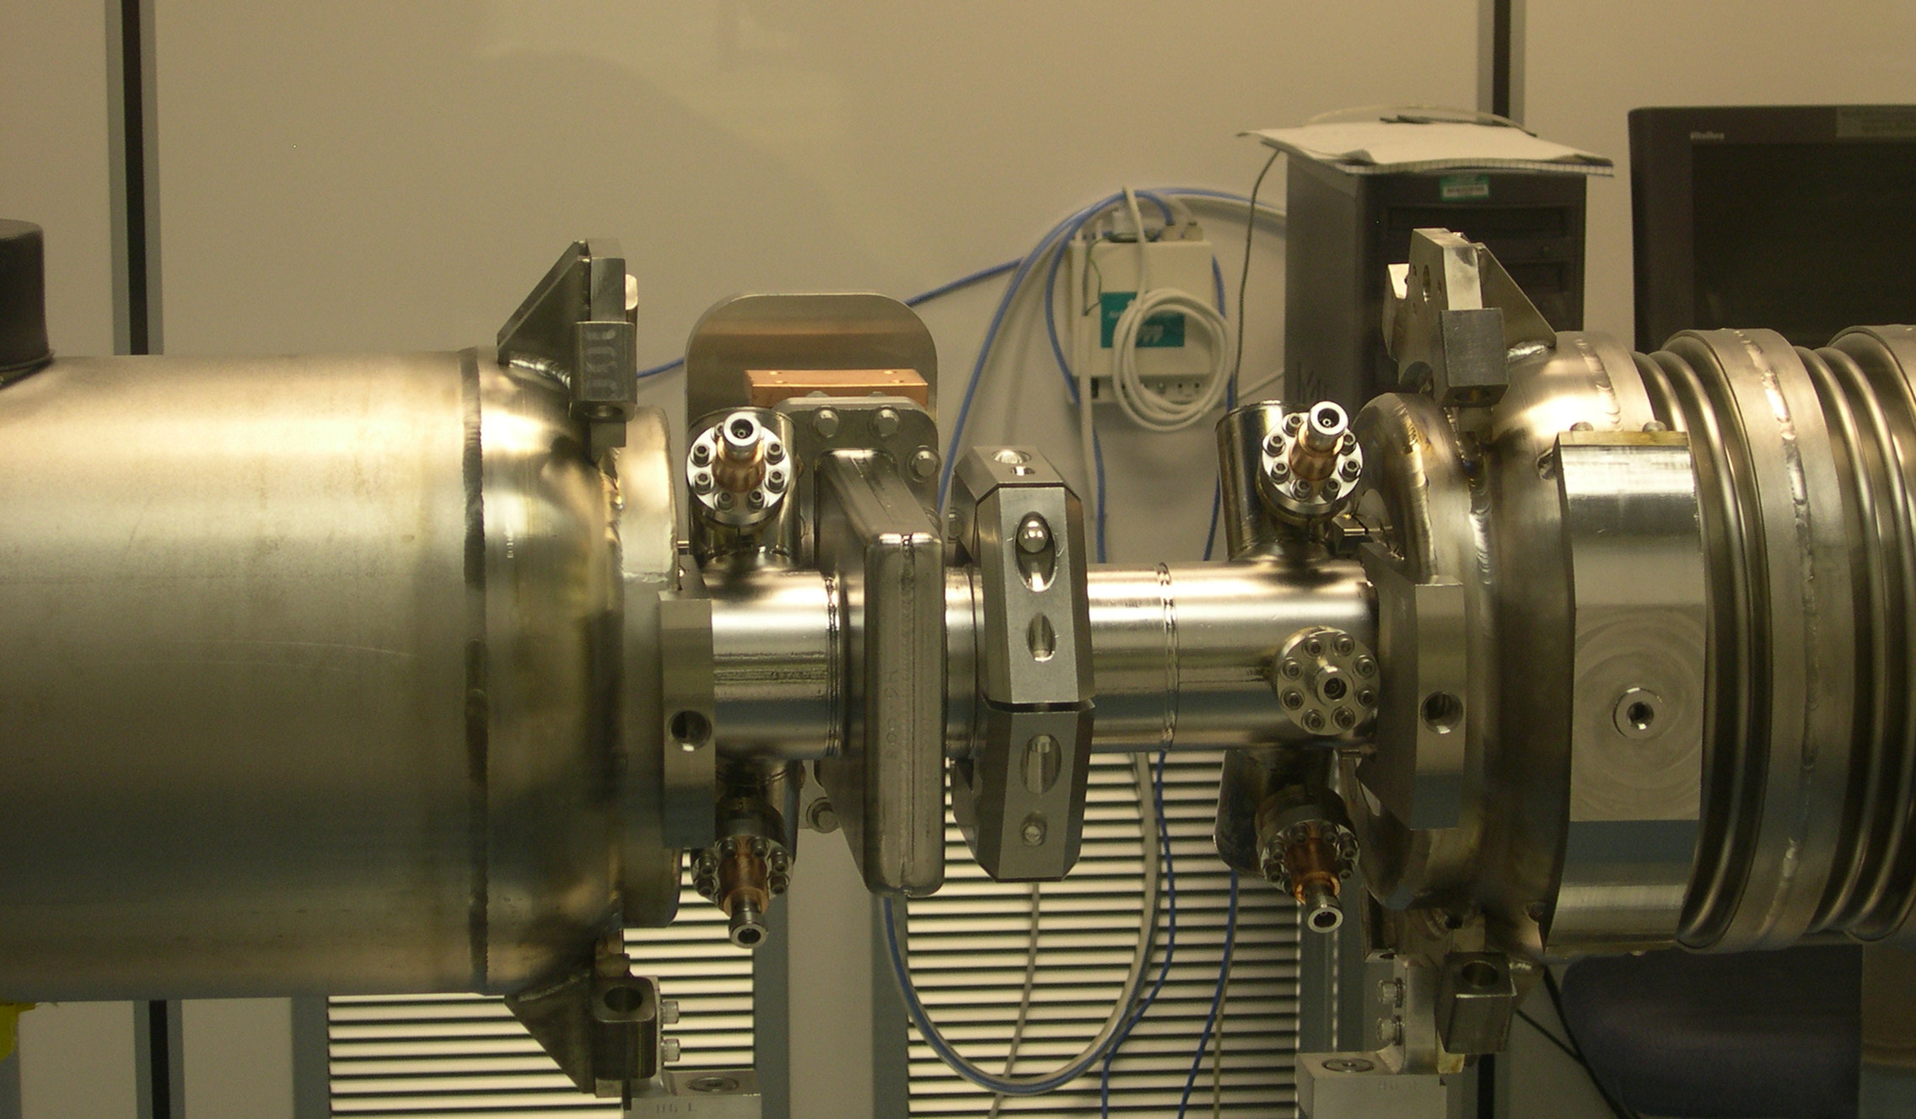
C100 assembly process
Each cavity is sub-assembled and installed onto the lollipop tooling.
The cavities are joined together with a metal seal and radial wedge clamp assembly after an alignment step is completed.

Slide 13
Pump-down and leak test
An Ion pump sub-assembly is installed to the end of the cavity string. A turbo pump is attached.
The cavity string is slow pumped at a target of 6 Torr per minute.

Slide 14
Pump-down and leak test
The slow pump-down is done by restricting the pump flow at the fore-line of the pumping system.
A bypass needle valve is used to manually control the pump-down slope.

Slide 15
Pump-down and leak test
Before leak test all flange hardware was re-torqued.
Using an RGA the cavity string is leak tested.
Each area containing metal seal joints is bagged and filled with helium for leak test.

Slide 16
Pump-down and leak test
Many leaks detected in the C100 strings.
Statistics gathered from 10 strings:
(Does not include reworked strings)
80 Serpentine seals, 7 leaks
56 BL radial wedge seals, 0 leaks
20 BL cavity to valve seals, 1 leak
204 HOM/ FP seals, 1 repaired with using a higher torque
Warm window seals were leak tested at the sub-assembly stage and any leaks were always repaired before string assembly

Slide 17
Pump-down and leak test
Of the 10 C100 Cryomodules:
3 were leak tight.
7 Cryomodules had leaks.
Serpentine seal leak sizes ranged form 3e-9 TL/s to 4e-7 TL/s
The one beam line leak at the VAT valve was 4e-6 TL/s
Unlike the C20 or C50 projects the cavity seals are outside the helium bath.
All leaks in the C100 cavity strings were to be inside the insulating vacuum.

Slide 18
Starting the Ion pump
After leak test the Ion pump is started
Perkin Elmer 11 L/s Diode Ion pump is used
The cavity string is isolated at pump start-up. After the pump is established the string isolation valve is open.
Typical cavity string pressure at the time
of transfer to the cryomodule assembly:
2e-7 Torr

Slide 19
Conclusion:
Some final details were taken before pushing the cavity string out of the clean room.
CF Flange seal joint were taped to ensure particulate didn’t get trapped and transferred during further assembly stages
Travelers were completed and string pressure was noted.
Questions or comments?

