Slide 1
NEG pumps
Used at CEBAF, FEL electron guns for >15 years
Three varieties
Laminated strips: used inserted in CEBAF gun
Sintered disks
Beampipe coating
Laminated strips do produce dust, but good form factor for our guns
Sintered disks should not produce dust – less operational experience at JLab source
Coated beamline used in CEBAF gun designs, gun exit beampipe along with heat treatment of steel
Reduces effective outgassing rate, better ultimate pressure

Slide 2
NEG pumps as an alternative to ion pumps for beamline vacuum
Experience at Cornell Univ. (courtesy of Yulin Li)
these sintered pumps are clean-room compatible (can be solvent cleaned by dipping/rinse and by ultrasonic cleaning; N₂ blowing)
“We have used many CapaciTorr and NexTorr pumps (from 200 l/s to 2000 l/s) on our ERL DC photo-electron gun, and on the SRF cavity’s RF input couplers and we haven’t had any particulate related issues. We also used over 20 these pumps in CESR, near SRF cavities. In my opinion, the cleaned sintered NEG pumps are cleaner than ion pumps, especially when operating at higher pressure.”

Slide 3
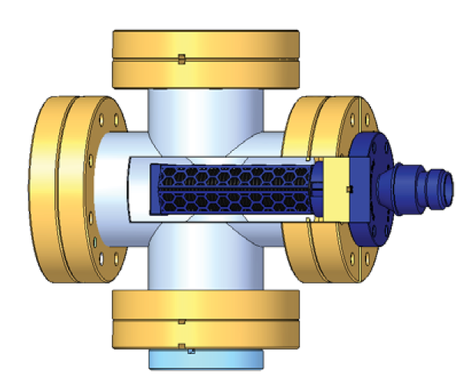
Experience at DESY (courtesy of Sven Lederer)
CapaciTorr D400-2 was ISO 4 clean room compatible after 15 min blowing dry, pressurized, ionized N₂
In-vacuum particle counter
Conditioning: ~200°C/1h bake
Activation: 400-500°C/1h
Summary of the sum of particles measured in vacuum for the four conditioning and activation cycles
“The results show that after proper preparation the pump can be used in particle free vacuum systems of DESY.”

Slide 4
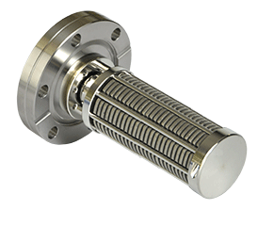
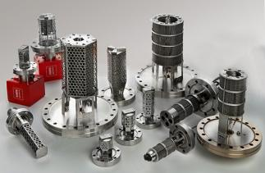
NEG pumps do not absorb noble gases
High pumping speed (>~50 l/s) for H2, N2, H2O, CO/CO2, O2 and up to ~1600 l/s for H2
Ion pump/NEG combination pumps are available on the market (NexTorr)
Additional manufacturer of sintered getter disks: Gamma Vacuum
SAES
Gamma

