Slide 1
g12 procedures review
Eugene Pasyuk
for the review committee

Slide 2
Historical notes
The review committee: Raffaella De Vita, Michael Dugger, Yordanka Ilieva, Eugene Pasyuk (chair) received charge October 20, 2014. (7 years after the data were taken)
The goal: identify, review and approve common procedures relevant to most of the analyses of g12 data set. This would allow to streamline subsequent reviews of individual physycs analyses.
We had three iterations of comments/response since then.

Slide 3
Approved as general
Calibration quality is adequate
Momentum corrections as described in the g12 note
Beam energy correction as described in the g12 note
Inclusive “Good” run list as described in table XX. Individual analysis may use a subset of it.
Target density and its uncertainty as described in the g12 note
Photon flux calculation procedure as described in the g12 note
Lower limit for the systematic uncertainty of normalized yield is 5.7%
Photon polarization calculation procedure as described in the g12 note
Systematic uncertainty of the photon polarization as described in the g12 note.
gsim parameters
gpp smearing parameters
Processing of MC data
DC efficiency map
EC knockout
Minimal TOF knockout
“Lepton ID” is approved as “Di-lepton ID”. For single lepton the cuts should be tighter.

Slide 4
Subject of individual reviews
PID and event selection
Kinematic fit
Fiducial cuts
Acceptance and efficiency calculations
Accounting for multiple photons
Anything else…….

Slide 5
Path forward to fast track review
Analyzers should state which of the approved common prescriptions described in the note and one page summary were followed in the analysis. In this case the steps approved as general may be excluded from individual review. Any deviation from approved prescriptions and analysis specific steps will have to be reviewed.

Slide 6
What happens next
The review committee will produce the final report within a week.
The note still has some wrinkles to be ironed out.
Individual reviews may start as soon as they are ready (today?)

Slide 7
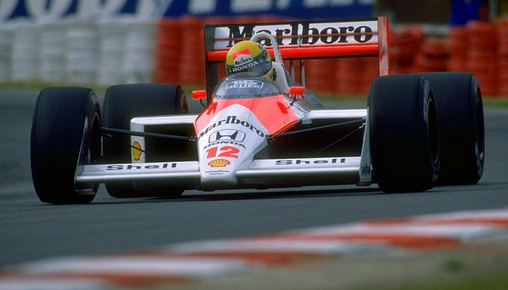
Go!
G
…as fast as Ayrton Senna

