Slide 1
JLab Accelerator Overview
CLAS Collaboration Meeting
Feb 23-26, 2016
Jefferson Lab
Michael Tiefenback, CASA
with grateful acknowledgment of material from others --
“Thank You” to all

Slide 2
Outline:
Accelerator Operations
  Summer 2015 -- Fall 2015
  Outlook for Spring 2016 – Fall 2016
SRF C100 controls improvements
  energy jitter and vibration sensitivity
Support for accelerator operations
  CASA and Engineering/Diagnostics
  Accelerator startup and operational tasks
  Diagnostic systems and applications
  Recent commissioning work/results
Upcoming developments

Slide 7
SRF C100 Improvements
Cavity controls being updated to improve
  Energy jitter
  Vibration sensitivity
Master Oscillator stability improved
  Temperature stability, water flow control
  Improvements in certain narrow-band disturbances (27Hz?)
Collaborative work involves staff from many areas
Significant improvements already seen
More expected

Slide 10
CASA and CEBAF Operations
CASA presently provides 2+ FTEs to CEBAF operations
  Distributed among 6-7 participants
  Commissioning support higher
CEBAF Model Team
  Optics model/lattice layout, design, controls integration
Beam Transport Team (BTeam)
  Operational review of tuning, optics, beam quality
  Beam Studies forum
Weekly optics on call rotation during CEBAF operations
  Primary and backup opticians 24/7 for operations
  Primarily for main accelerator transport retuning issues
    e.g. diagnose beam jitter (identify subsystem support)
    separate on-call support by injector and hall optics (APELs)

Slide 11
APELs
Accelerator Physics Experiment hall Liaisons
  Hall A: Yves Roblin
  Hall B: Michael Tiefenback
  Hall C: Jay Benesch
  Hall D: Todd Satogata
Responsible for beam delivery and hall integration
  Point person for hall beam tuning/beam quality every run
  Evaluate/coordinate all hall experiment beam requirements
  Design and improve beamlines/diagnostics/procedures
  Works closely with similar liaison from Operations
  Often a member of hall experiment collaborations

Slide 12
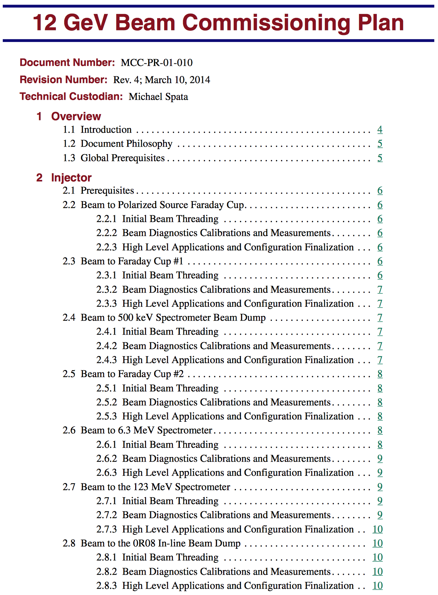
CEBAF 12 GeV Beam Physics
CASA organized the detailed 12 GeV beam commissioning plan
  Multi-year development plan
  Successive beam diagnostics calibrations and measurements throughout
  All CASA personnel engaged
  Updates indicated progress through successive runs
  Planned carefully
  Performed as planned

Slide 13
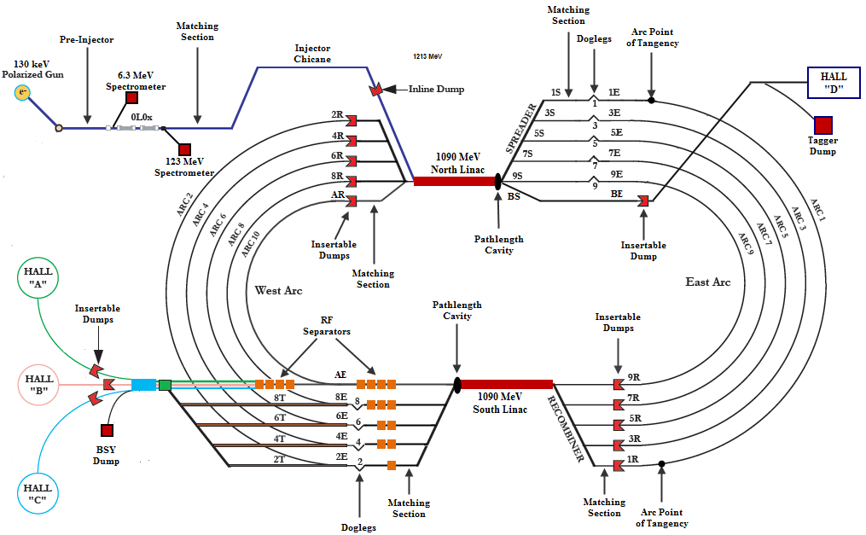
CEBAF Detail Schematic

Slide 14
CEBAF Detail: Transverse Matching

Slide 15
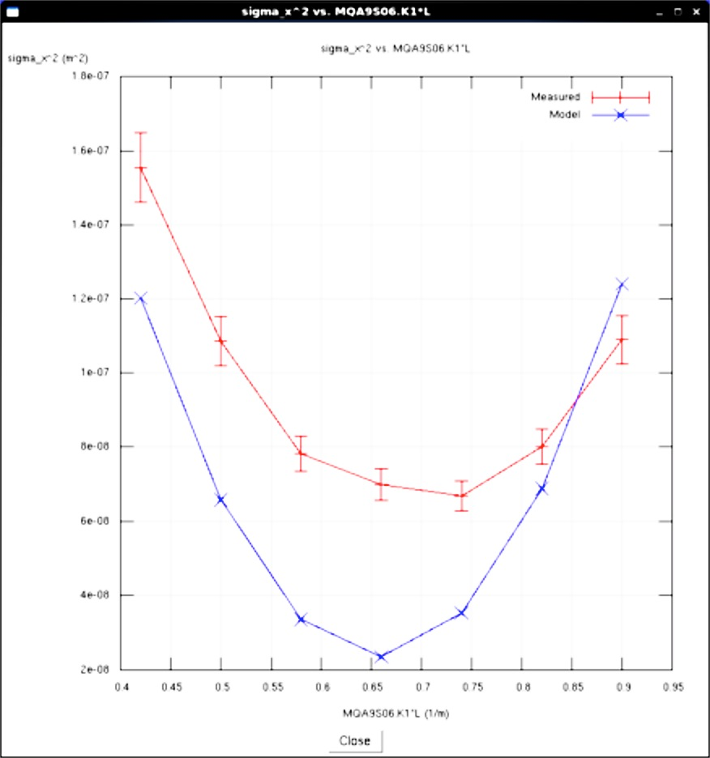
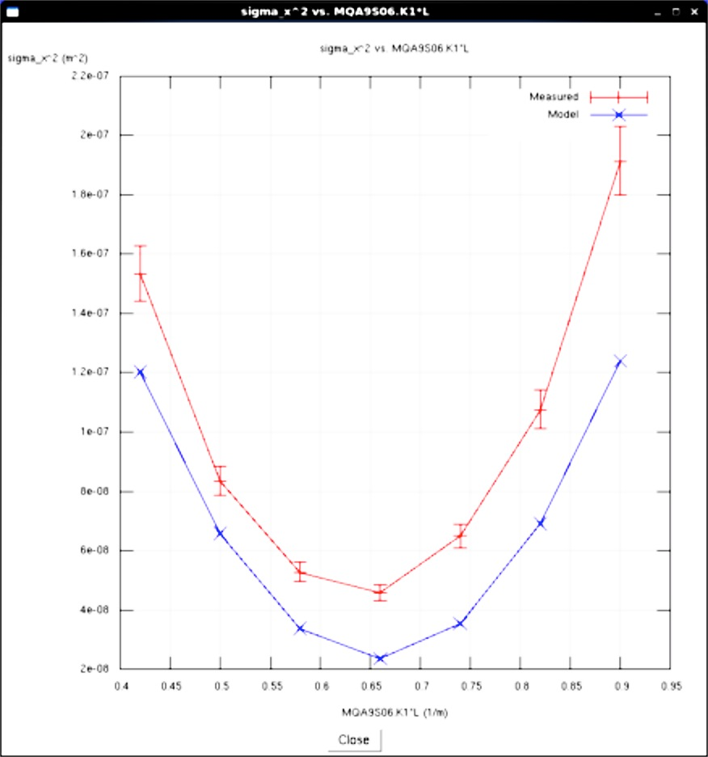
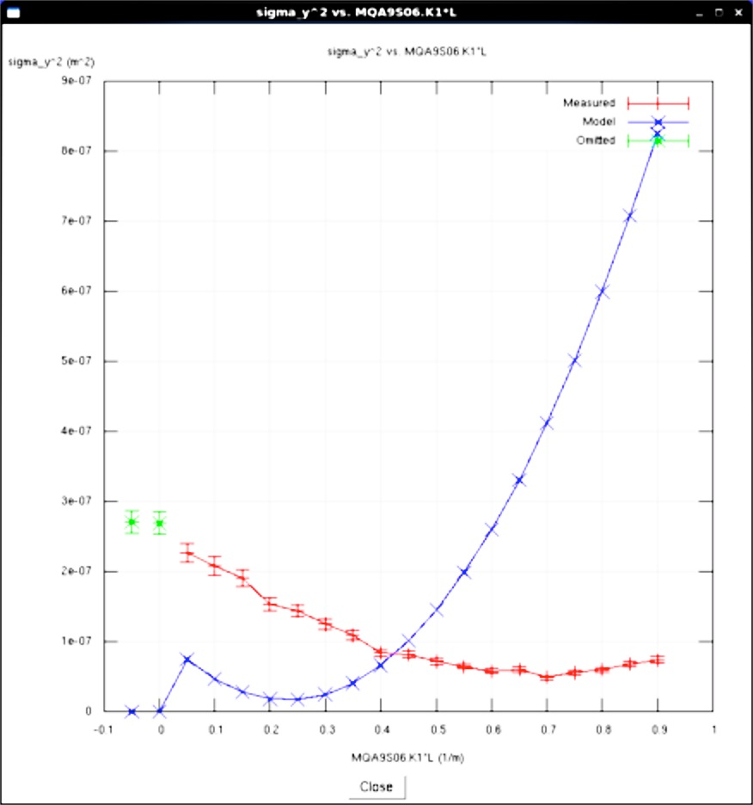
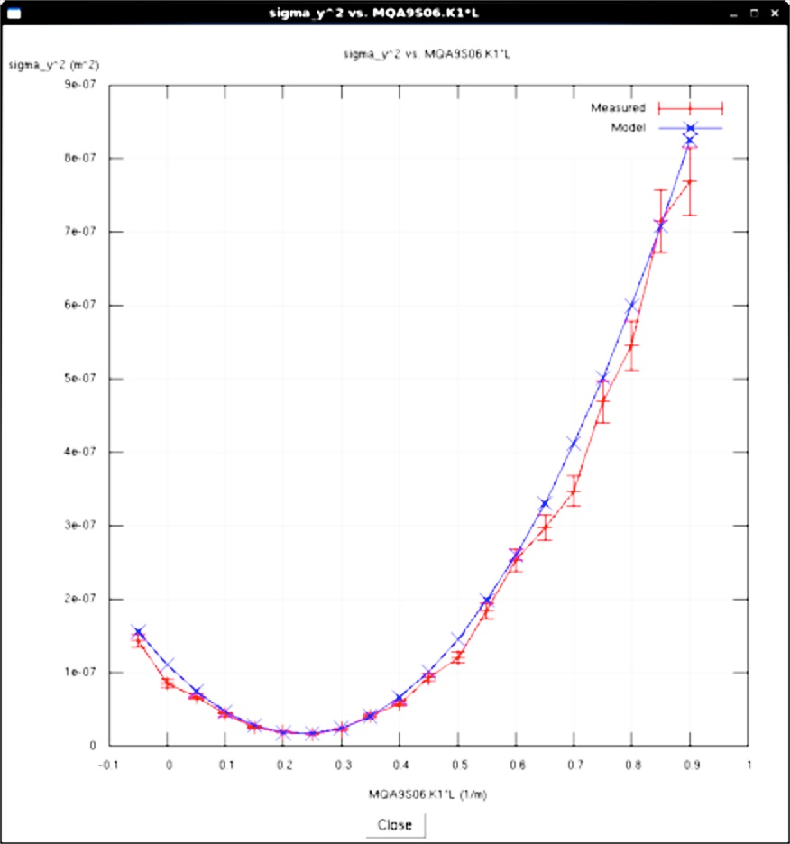
Model-Based Optics Rematch
σ_{X}² [μm²]
Before match, as found
σ_{X}² [μm²]
1.8x10⁵
Horizontal
2.2x10⁵
Horizontal
ε_{x}=2.6 nm-rad
After match
ε_{x}=3.0 nm-rad
All data plotted is
(measured beam σ_{rms})²
vs
(set quadrupole KL)
Blue data is design intent
Red data is measurement
[Horizontal after-match variance is due to measured beam emittance being larger than design expectation]
0
0
0.40
KL [m⁻¹]
0.95
0.40
KL [m⁻¹]
0.95
σ_{Y}² [μm²]
σ_{Y}² [μm²]
9.0x10⁵
Vertical
9.0x10⁵
Vertical
Vertical
ε_{Y}=1.9 nm-rad
ε_{Y}=1.9 nm-rad
0
0
-0.1
KL [m⁻¹]
1.0
-0.1
KL [m⁻¹]
1.0

Slide 16
CEBAF Detail: Bunch Length Compression

Slide 17
CEBAF Detail: Arc Transport and M₅₆

Slide 18
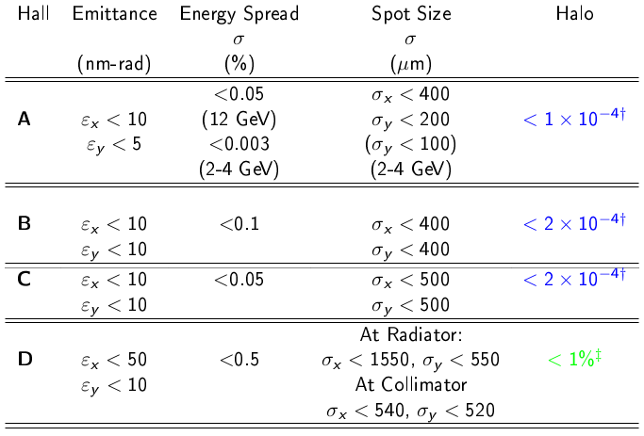
Initial Year’s Beam Requirements
5.0 pass, 11GeV requirements
5.5 pass
12GeV
Physics beam requirements transmitted to CASA in 2007.

Slide 19
Initial Years Beam Requirements Met!
✔
✔
5.0 pass, 11GeV requirements
✔
✔
✔
✔
✔
5.5 pass
12GeV
✔
✔
✔
Physics beam requirements transmitted to CASA in 2007.

Slide 20
Emittance/Optics Campaign Strategy
Incorporated into 12 GeV optics commissioning
  Measure in all (available) matching regions
  Single quad ➔ single wire scanner measurements
  Improve automation, model integration in 6 GeV tools
    Measurement/match: 6-8 hours (expert) ➔ 1 hour (operators)
Additional benefits
  Matching more systematic and consistent through CEBAF
  Faster measurements can be performed more routinely
    e.g. comparison of different lasers, space charge effects
  “Parasitic” beam emittance data from every scan/rematch
12 GeV data shown: Fall 2015-present

Slide 21
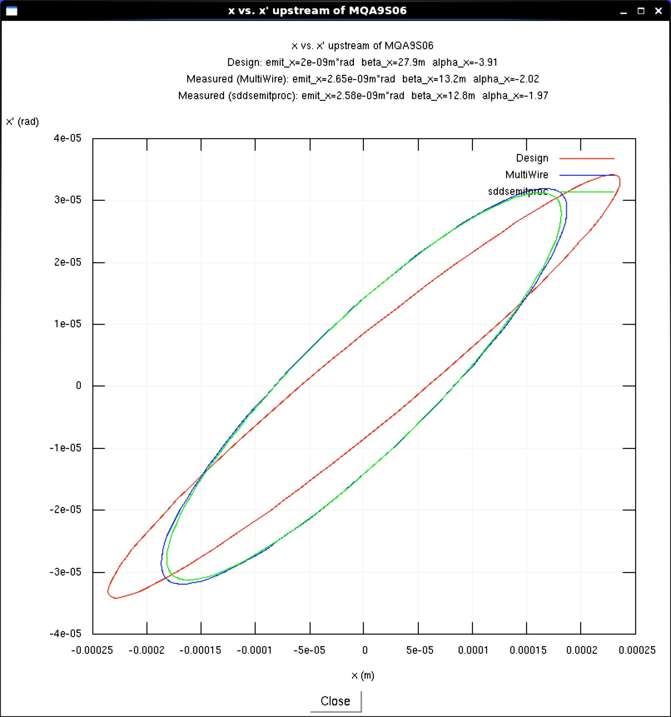
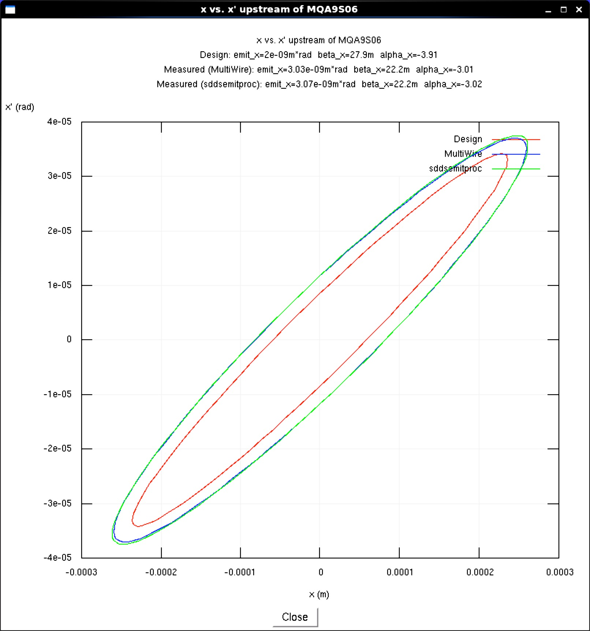
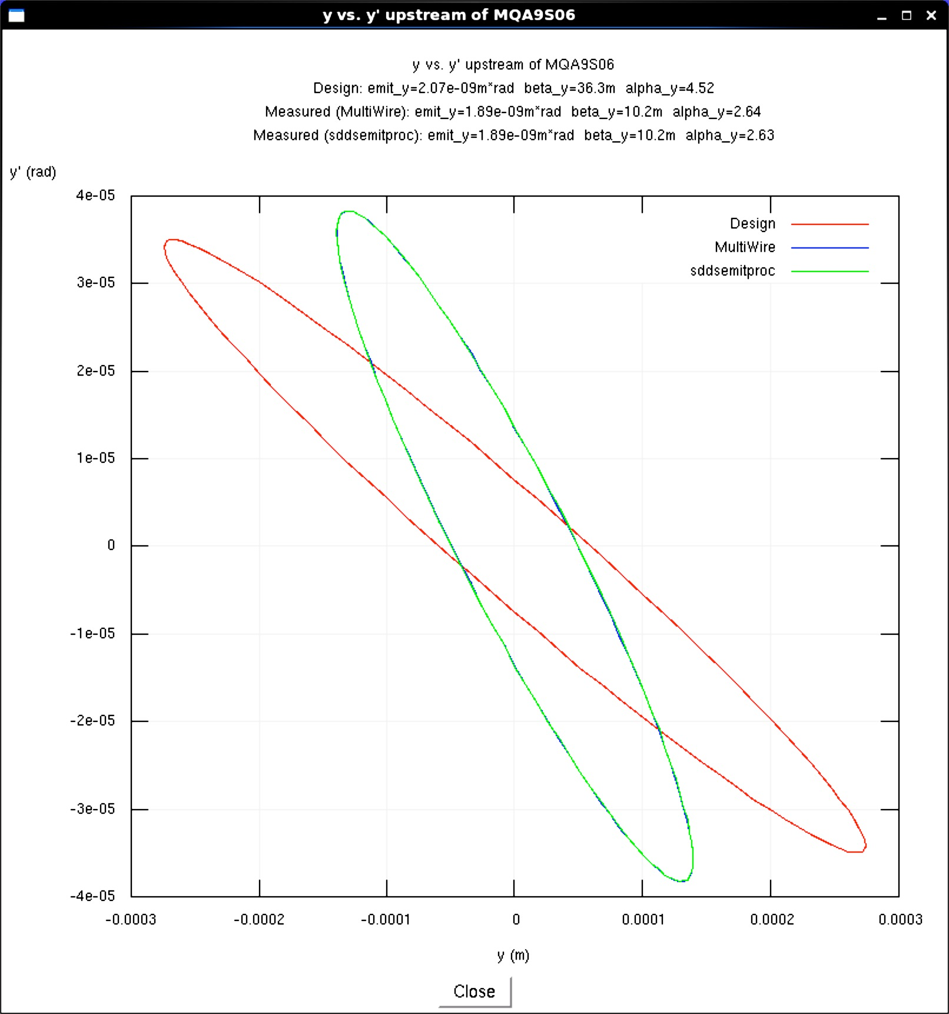
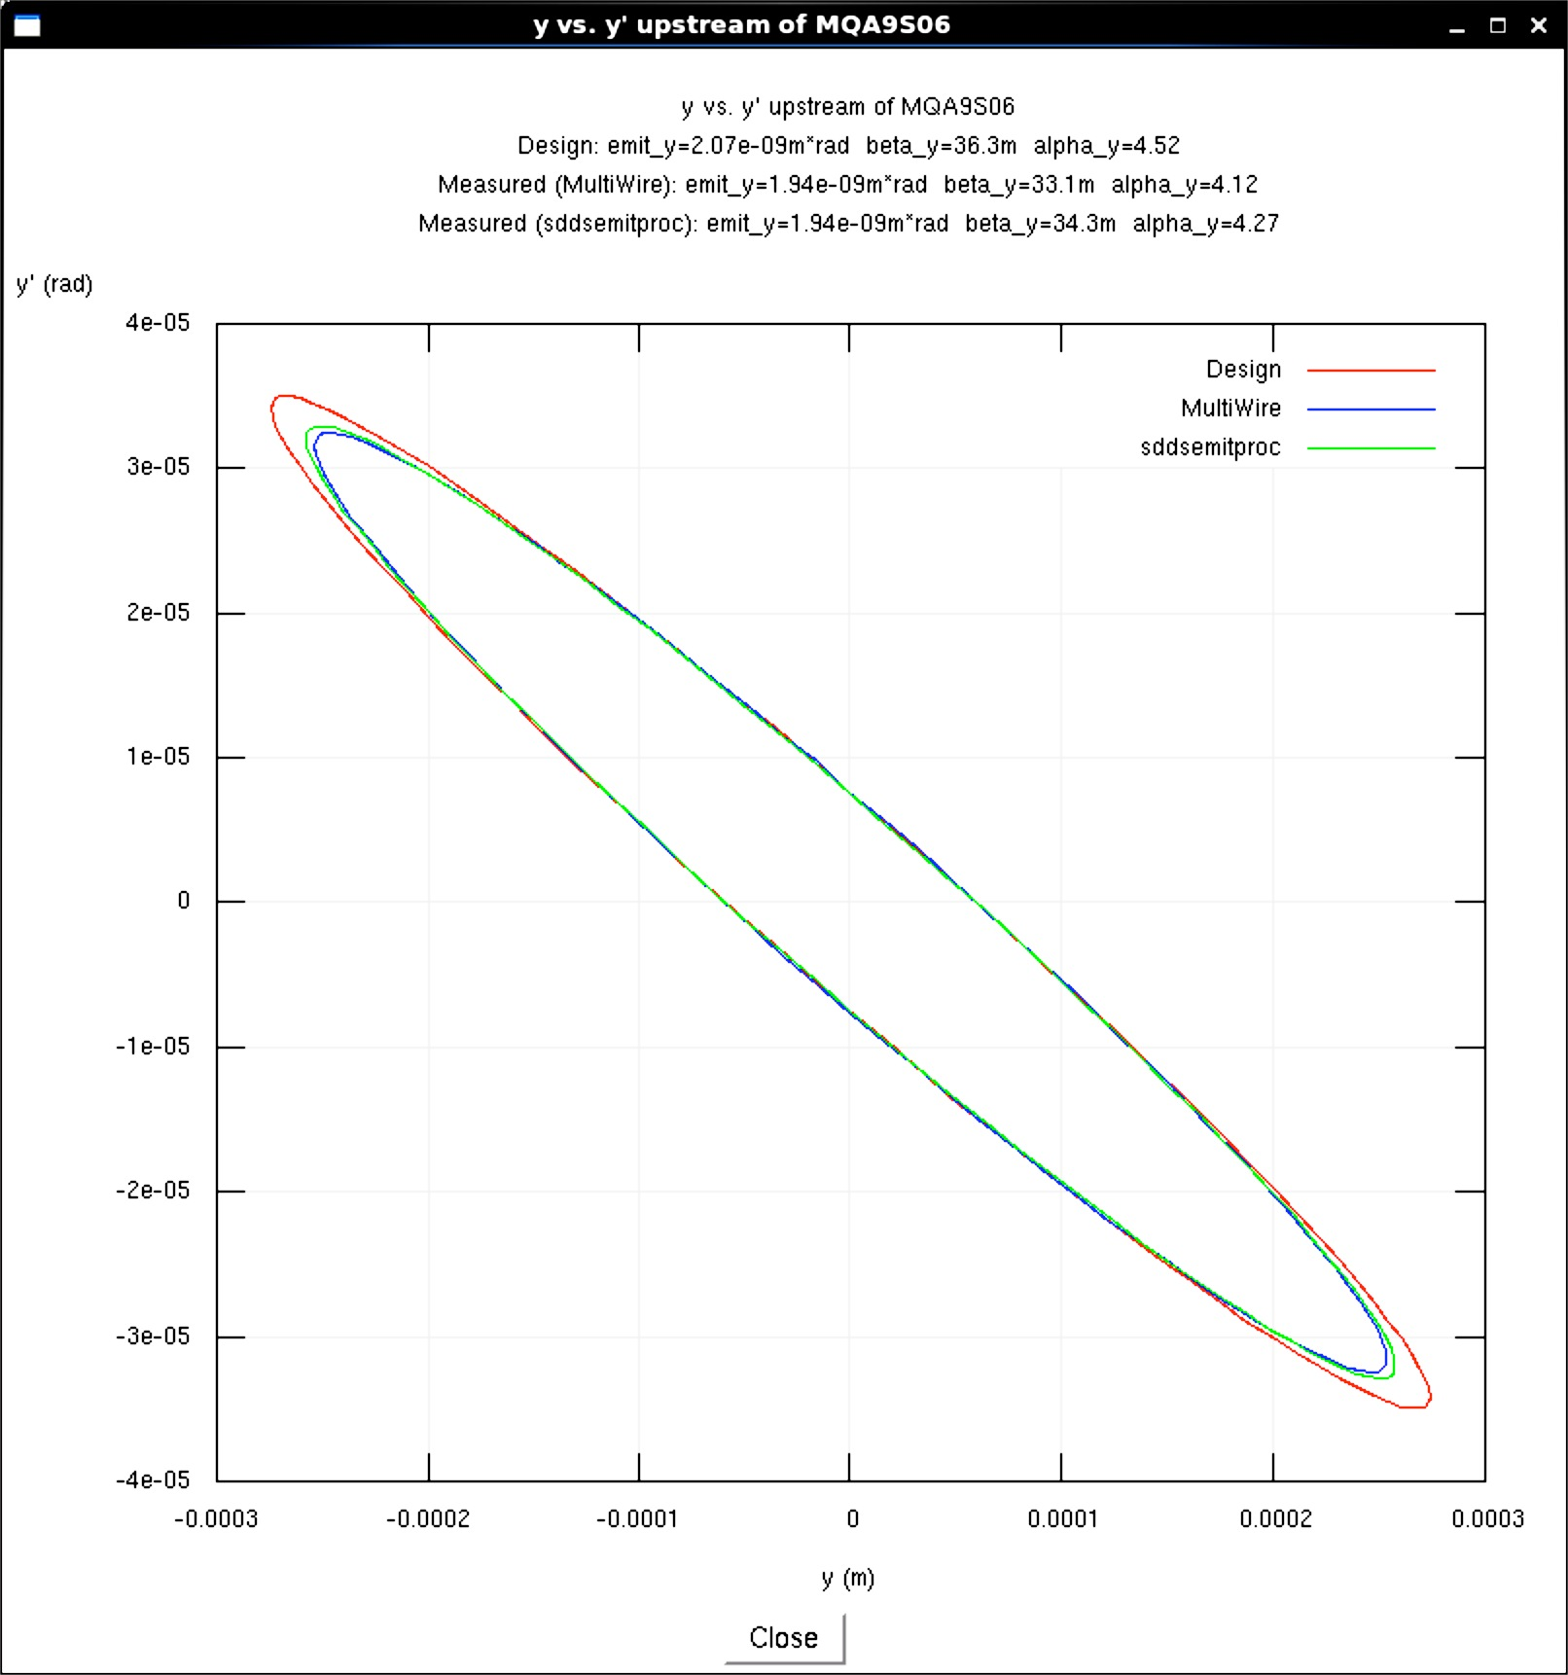
Model-Based Optics Rematch
Before match, as found
x’ [μrad]
x’ [μrad]
40
Horizontal
40
Horizontal
After match
All data plotted is the projected beam ellipse in (x,x’) at start of an upstream scanned quad
This data is for Arc 9 spreader
Blue and green ellipses are measurement
Red is online model prediction
Excellent agreement
ε_{x}=2.6 nm-rad
ε_{x}=3.0 nm-rad
-40
250
-40
300
-250
x [μm]
-300
x [μm]
y’ [μrad]
y’ [μrad]
40
40
ε_{y}=1.9 nm-rad
ε_{y}=1.9 nm-rad
Vertical
Vertical
-40
300
-40
300
-300
y [μm]
-300
y [μm]

Slide 22
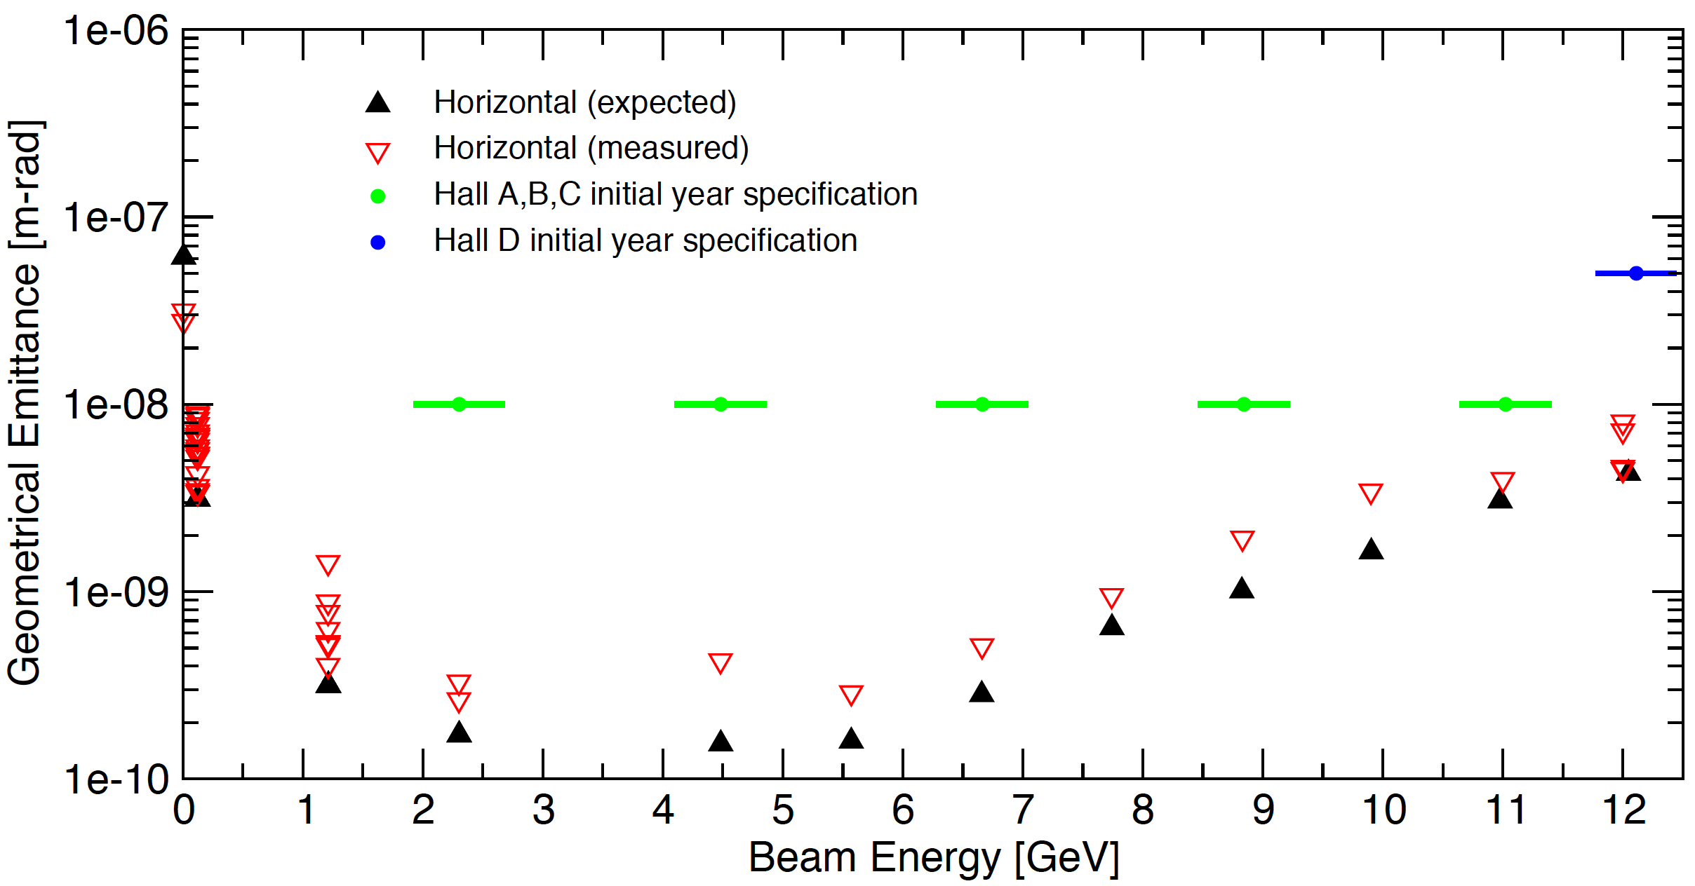
12 GeV Horizontal Emittances
Through present
Corrected for pot/stepper, angle
Horizontal emittances within all specifications
  Usually within factor of two of design (often better)
  Synchrotron radiation-driven emittance growth as predicted
Notes:
Point out 0L04 cryomodule (first data point)

Slide 23
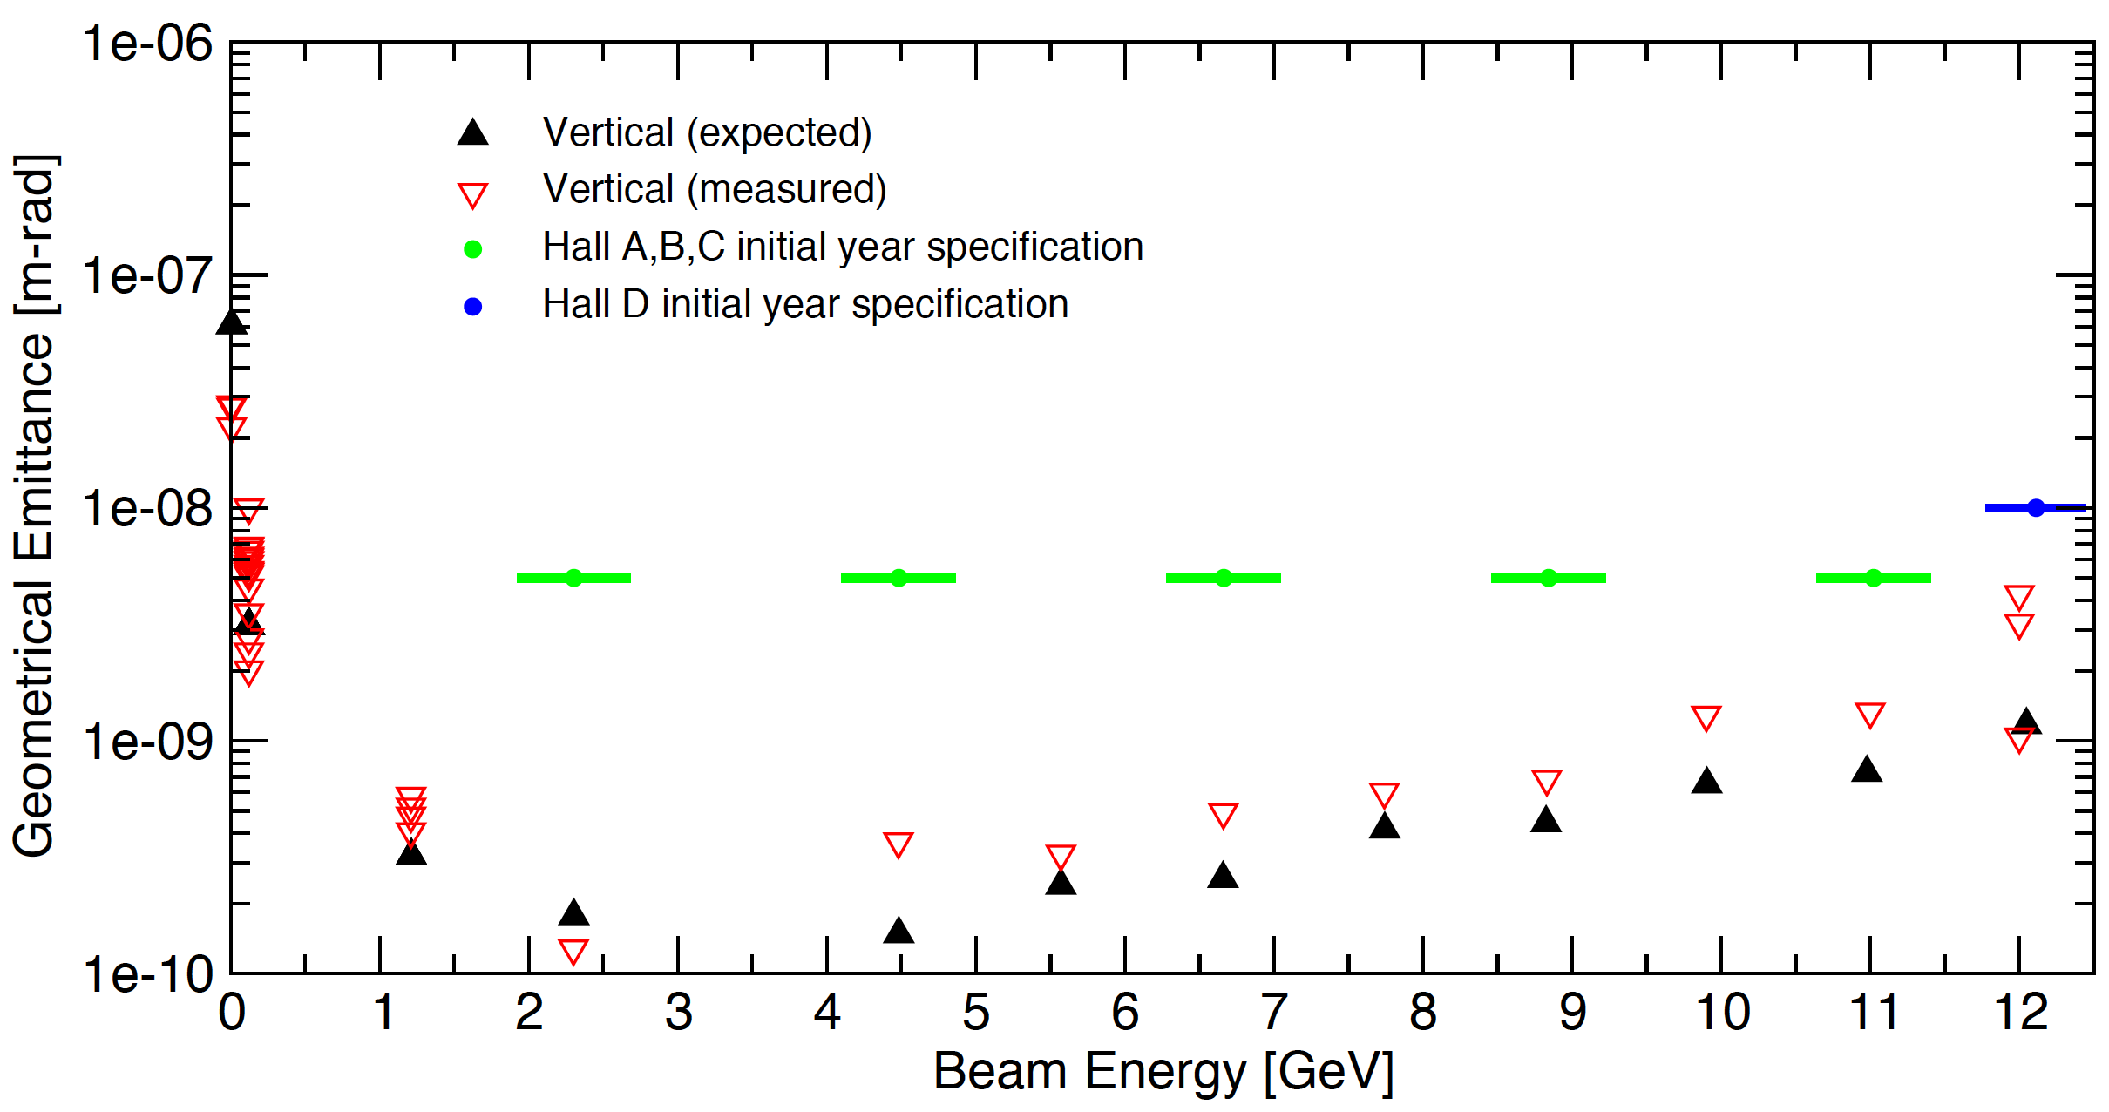
12 GeV Vertical Emittances
Through present
Corrected for pot/stepper, angle
Vertical emittances also within all specifications
  Synchrotron radiation-driven emittance growth also as predicted

Slide 24
Emittance Observations
Detailed top-to-bottom error analysis in progress
  Randoms: harp noise, carriage jitter, magnet regulation
  Systematics: harp scaling, magnet transport, procedural clarity
Randoms are small (~few %) vs potential systematics
Observed large uncertainties in harp carriage transport scaling (up to 50%)
  Miscalibration of linear potentiometer vs stepper travel
  Contributes quadratically to calculated emittance
  Does not substantially alter match parameters
  Data shown includes pot/stepper angle correction
Quantify/cross-calibrate with non-blooming viewers

Slide 25
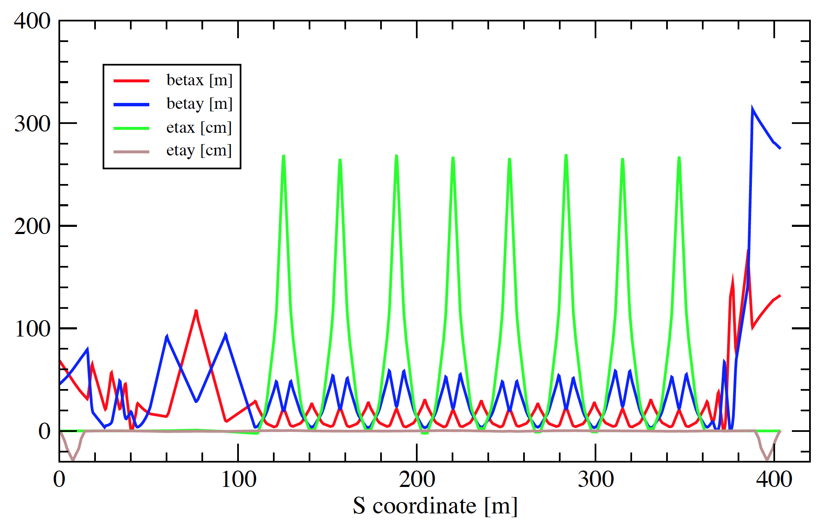
Emittance Growth Scaling and Mitigation
rms, geometric
180° multi-cell bend
Sands 1985, Douglas 1997
Arc focusing very flexible: separate power supplies for all 32 arc quads
Traditional CEBAF FODO cells ➔ DBA cells in higher arcs
30-40% reduction in
Tested in 2013-2014 11 GeV
  Dispersion/pathlength coupling through M₅₆
Arc 10 DBA optics

Slide 26
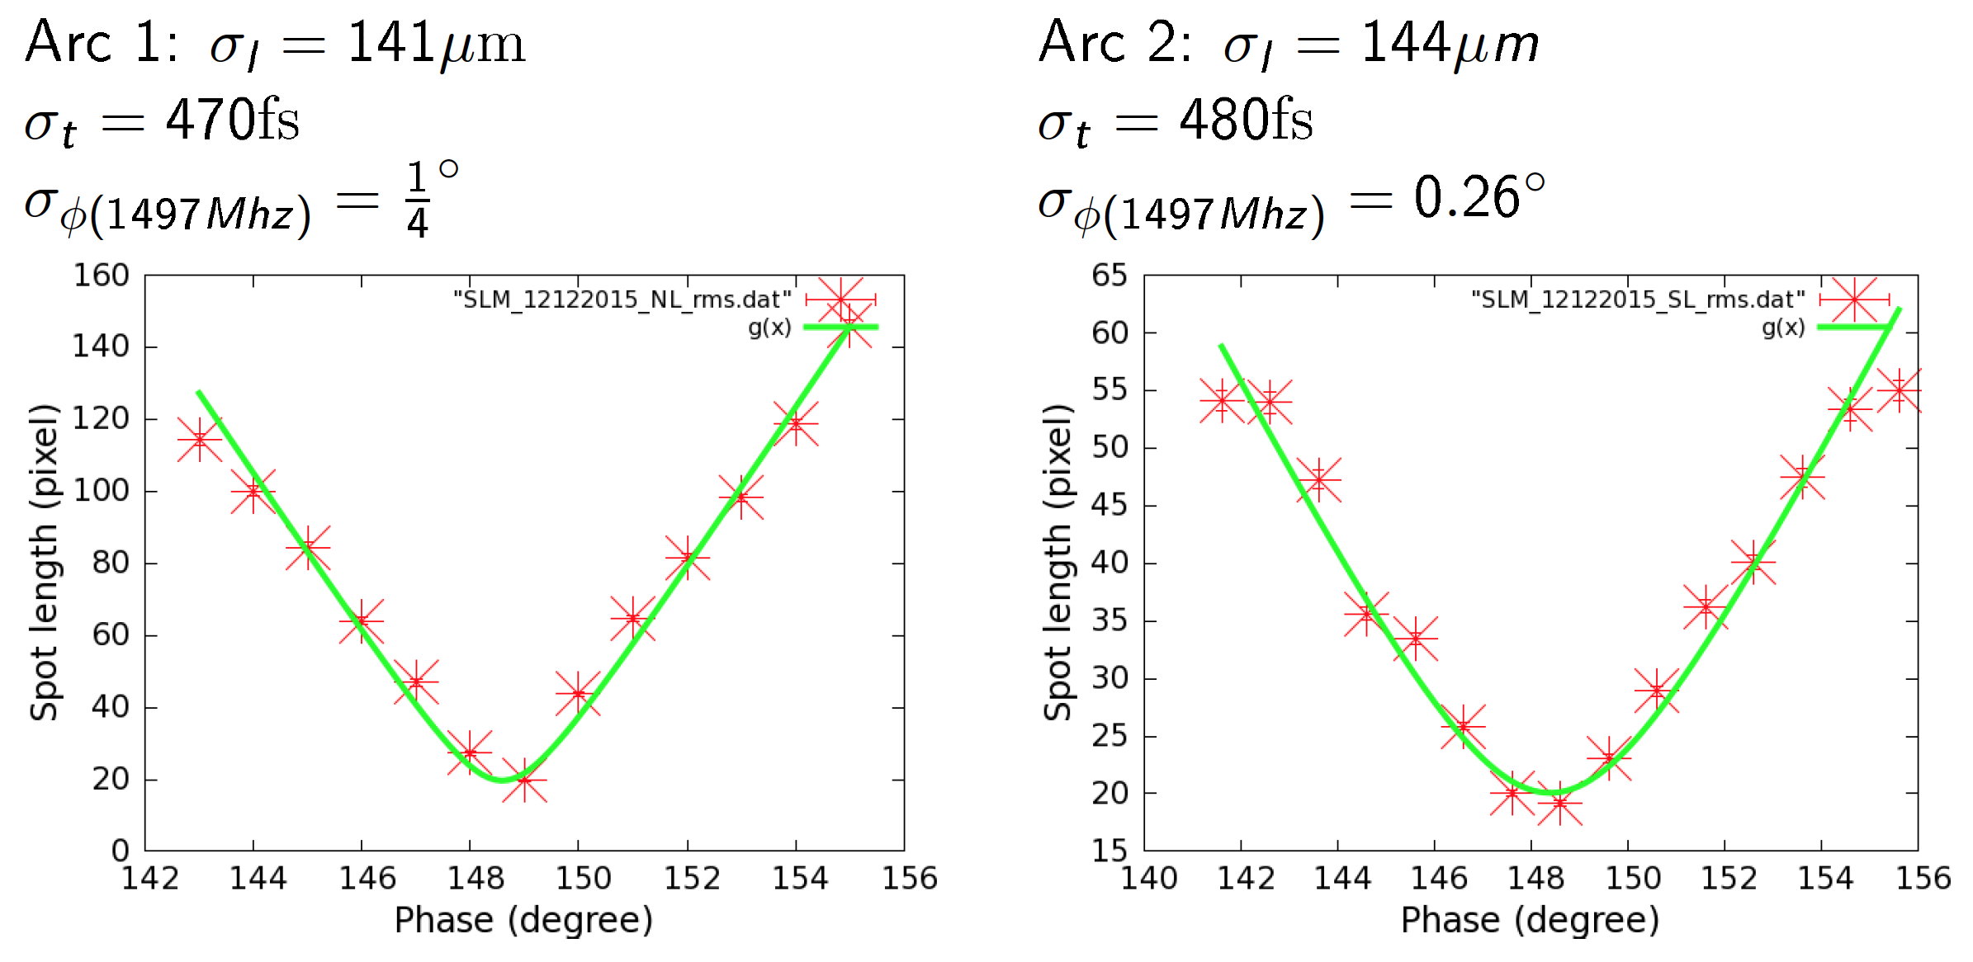
Bunch Length Measurements
M. Ahmad
PhD Student
Linac gang phase vs SLM dispersive bunch size
Short bunches even without injector compression
  Limit nonlinear halo, momentum spread in lower passes

Slide 27
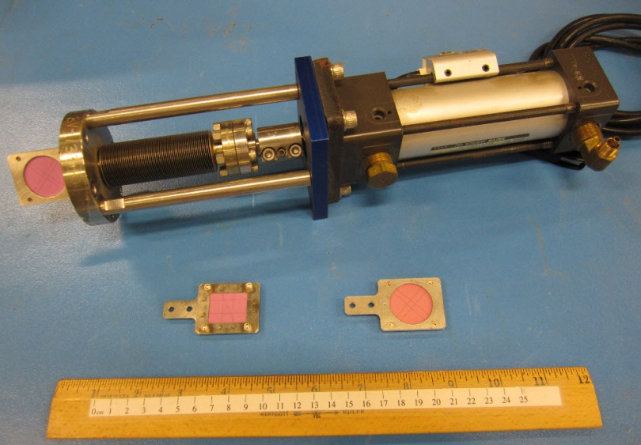
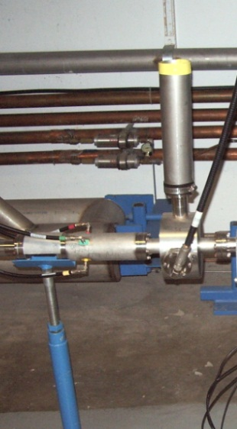
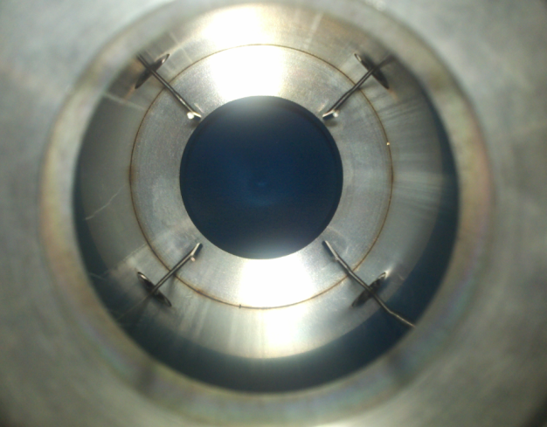
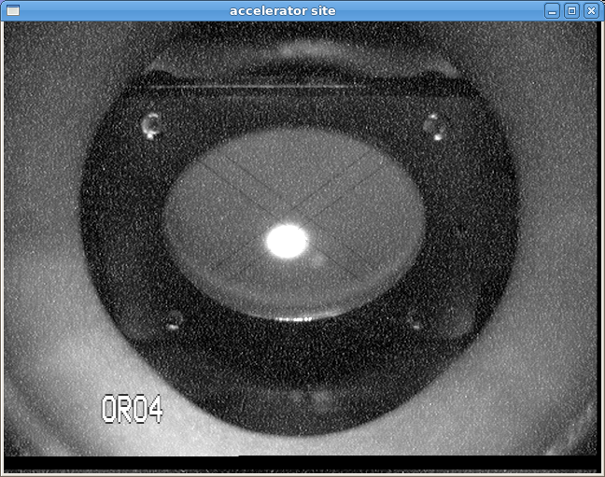
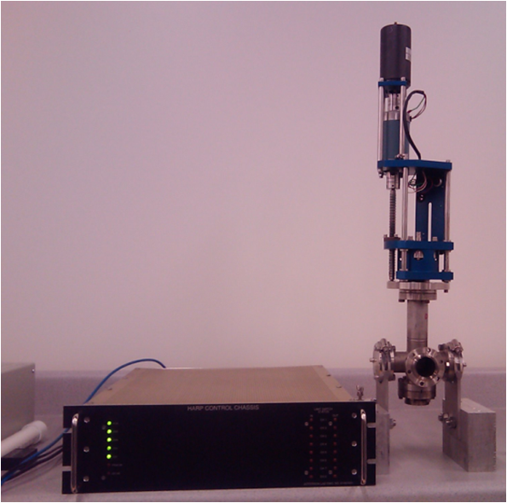
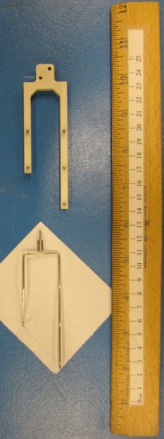
6 GeV Existing Diagnostics
Beam Viewers
Antenna-Style Beam Position Monitor
Pathlength Cavity
New Style
Old Style
Beam on Viewer in Chicane
Wire Scanner and Electronics
Wire Scanner Forks

Slide 28
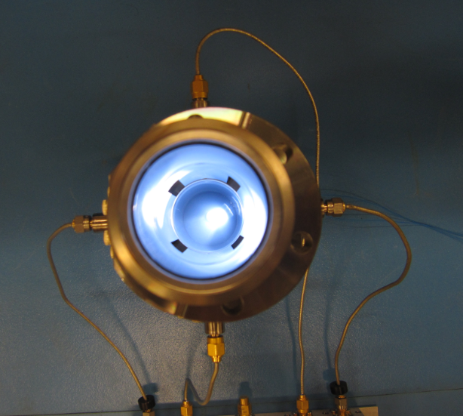
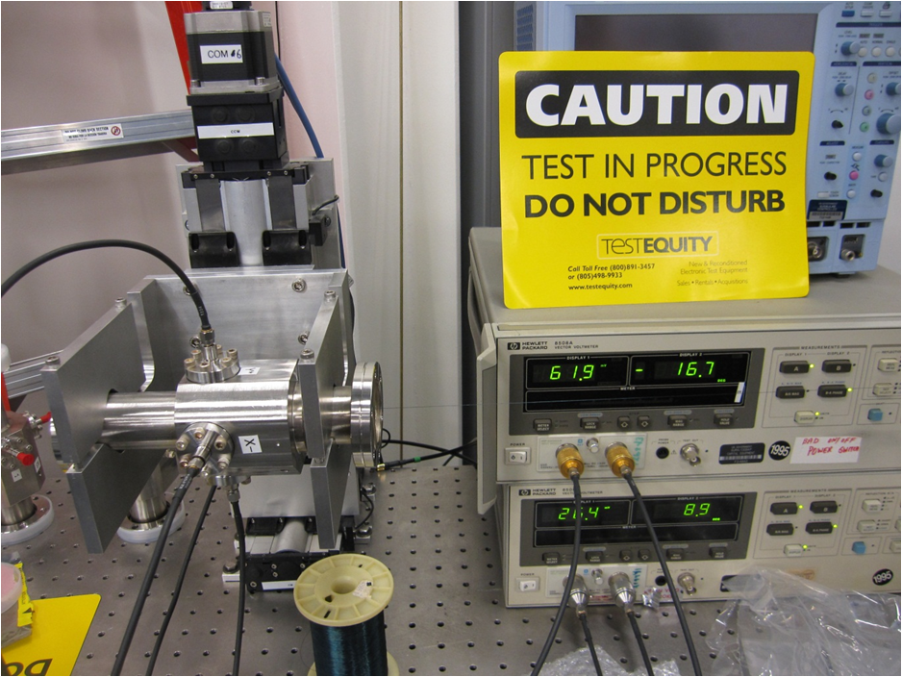
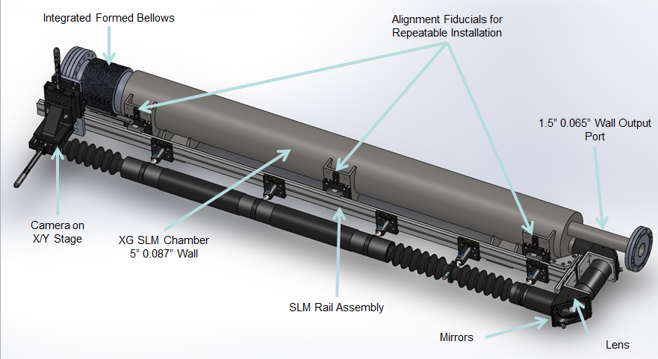
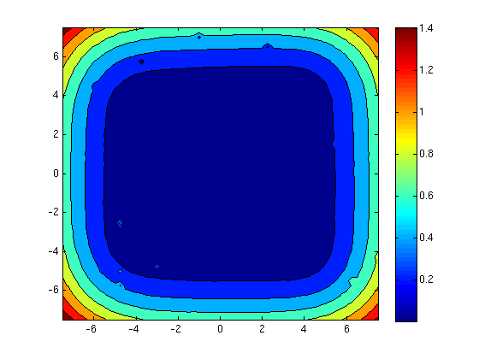
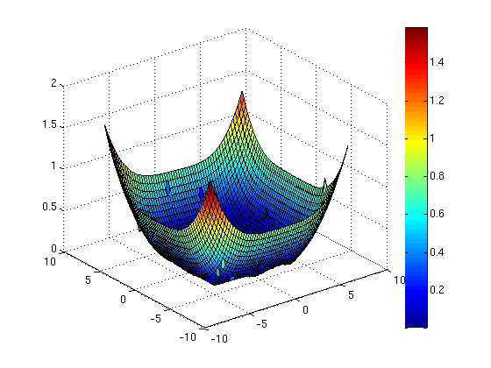
New 12 GeV Diagnostics
Stripline Beam Position Monitor
Stripline BPM on Stretched-Wire Test Stand
Synchrotron Light Monitor
Typical Results from BPM Test Stand

Slide 29
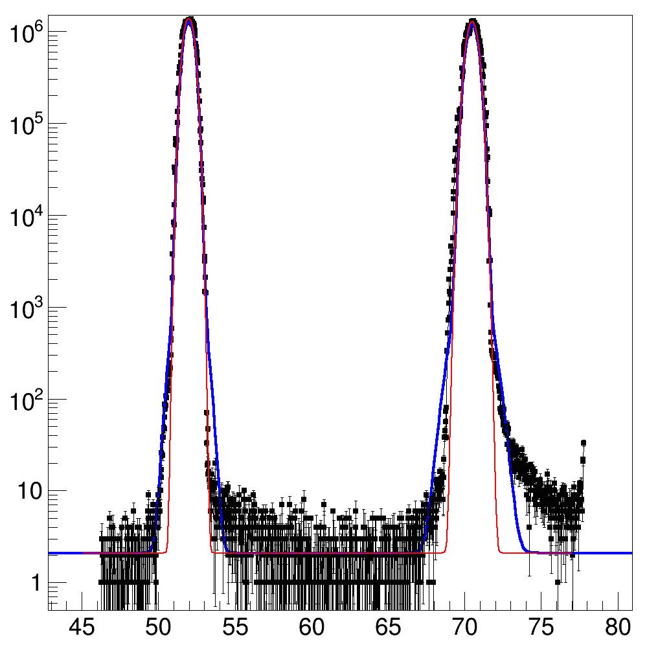
Hall B: 1-pass Halo (1 GeV)
<10⁻⁴
A. Freyberger

Slide 30
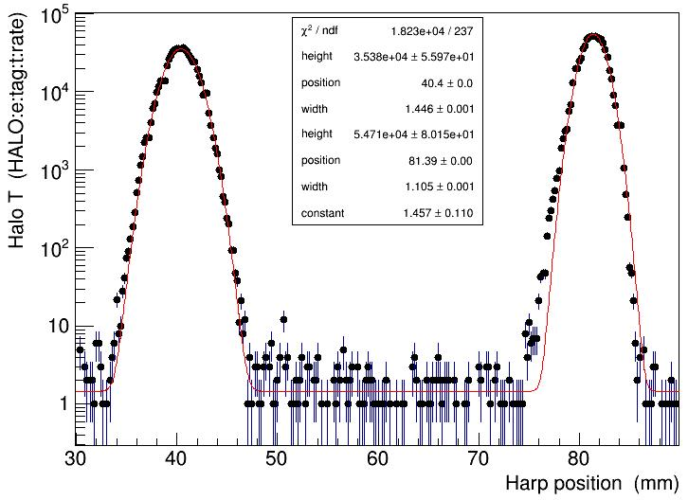
Hall D: 5.5-pass Halo (10.5 GeV)
< 1%
A. Freyberger

Slide 31
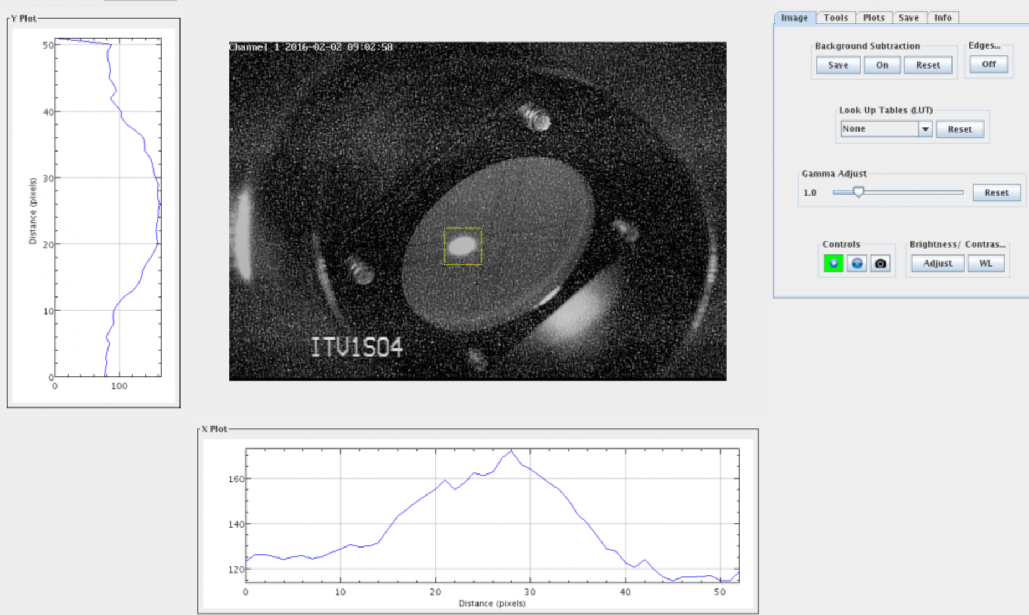
Viewer/SLM Profile Diagnostics
Quantitative tools under development
SLMs provide real-time parasitic jitter comfort display

Slide 32
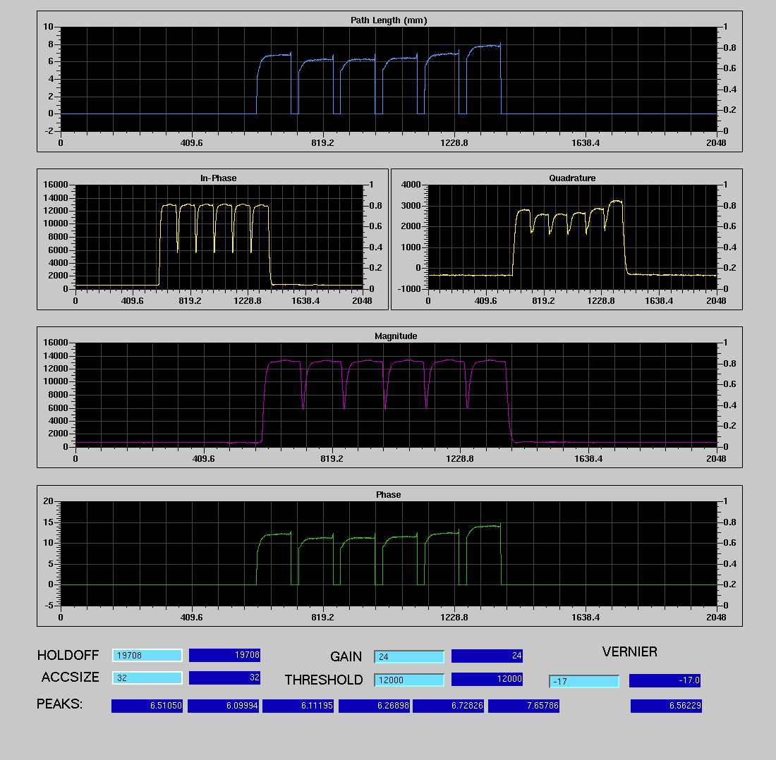
New Pathlength Data System
Pathlength [mm]
Longitudinal 1497 MHz cavities, each linac exit (time of arrival monitor)
Resolution ~50 um
Calibrated this run
EPICS connected to archiver for long-term pathlength studies
Internal current normalization enables laser-to-laser comparison
Differential time of flight, precise time-of-flight cavity gradient checks
Master Oscillator Modula- tion (MOMod) recommis-sioning and RF cresting development upcoming
Magnitude
Phase

Slide 33
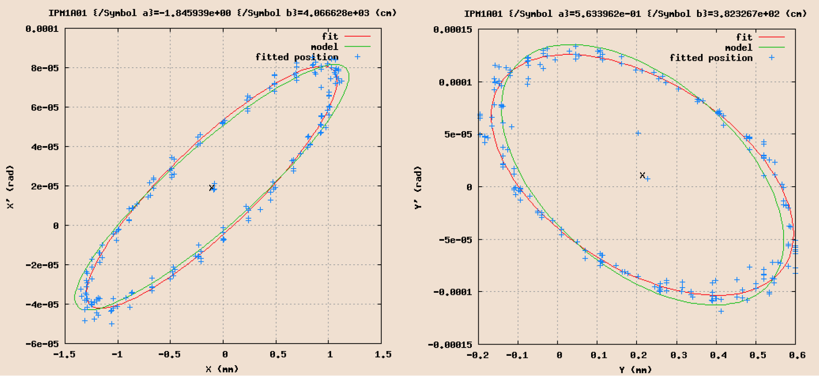
Future: RayTrace
RayTrace: launch/measure pseudo-emittance rays
  Localize errors more precisely than other ORFP techniques
  Can provide robust, fast, large-scale transport matching
  Does not obviate need for beam/transport match
In need of substantial tool development
  Similar to successful evolution of quad scan emittance/matching
R. Bodenstein
Ph.D. Thesis
Fig. 4.3

Slide 34
Diagnostic Developments
Fast FeedBack for Hall D with Digital Receiver BPMs
  Stripline pickups for higher sensitivity
  Cavity pickups for very low currents
  Adaptable to 3 GHz pickup to avoid 1497 pollution?
  Low current implementation (useful for Hall B?)
Additional synchrotron radiation imaging stations
Improving systems for image analysis and use
  providing flexible controls for image aquisition

Slide 35
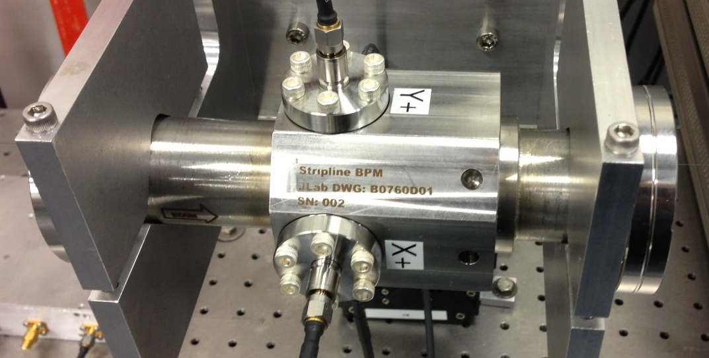
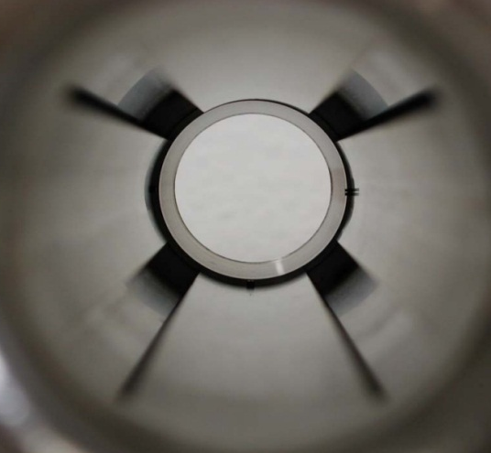
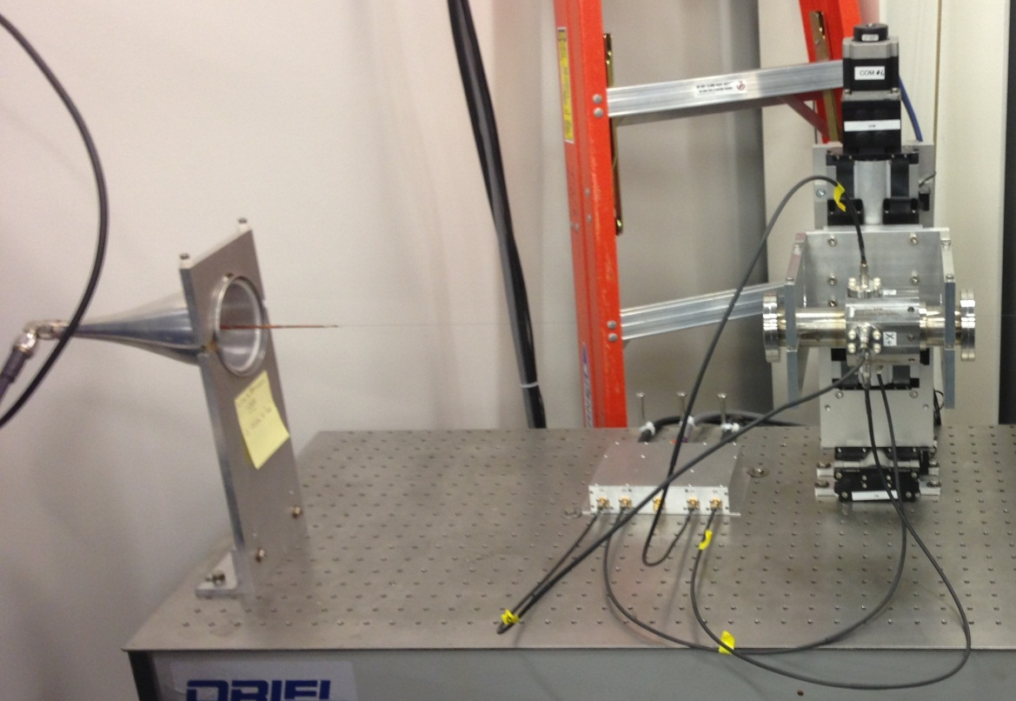
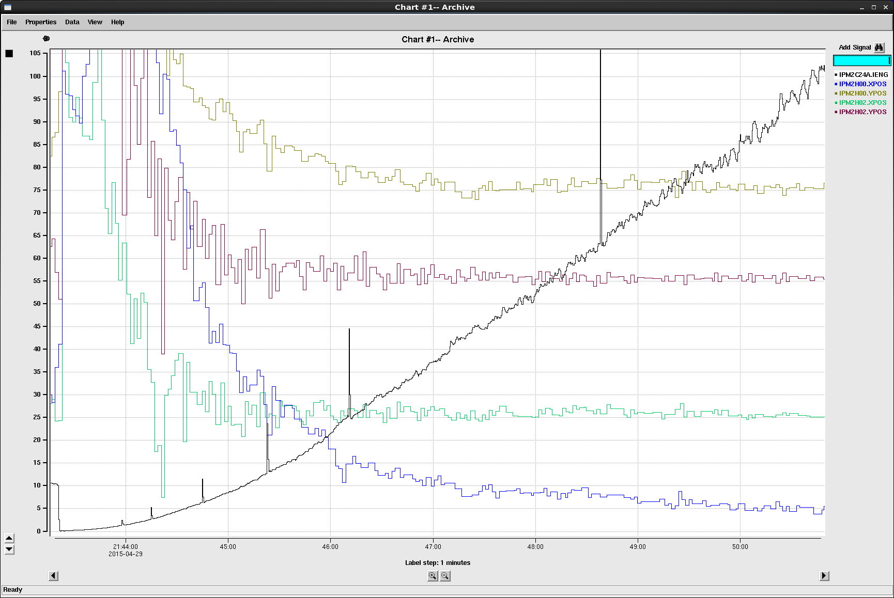
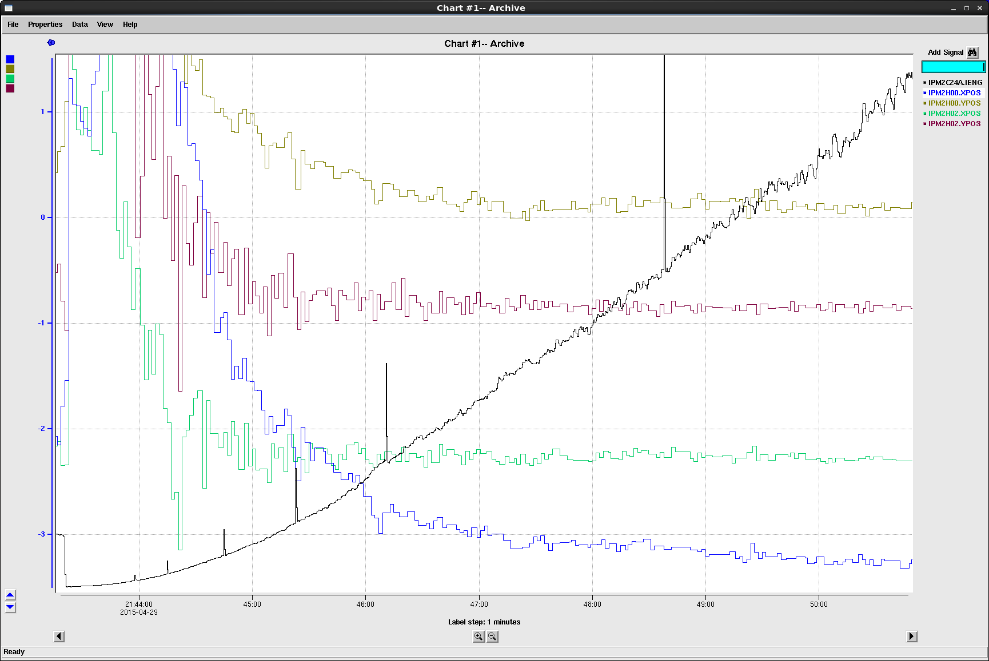
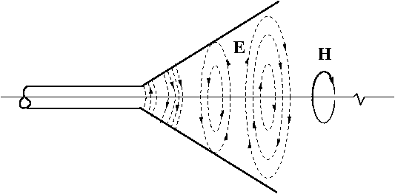
Stripline BPMs
Position calculated as difference-over-sum
100um resolution 120Hz bandwidth 330 nA of beam
26 Striplines
IPMBS00
IPMBS01
IPMBS02
IPMBS03
IPMBS04
IPMBE01
IPMBE02
IPMBE03
IPMBE04
IPMBT01
IPMBT02
IPMBT03
IPM5C00
IPM5C01
IPM5C02
IPM5C03
IPM5C04
IPM5C05
IPM5C06
IPM5C07
IPM5C08
IPM5C09
IPM5C10
IPM5C11
IPM5C11B
IPMAD00C
Y Stepper
Ladder
YPOS
Goubau Line
Beam Current (nA)
YPOS
BPM
XPOS
X Stepper
XPOS

Slide 36
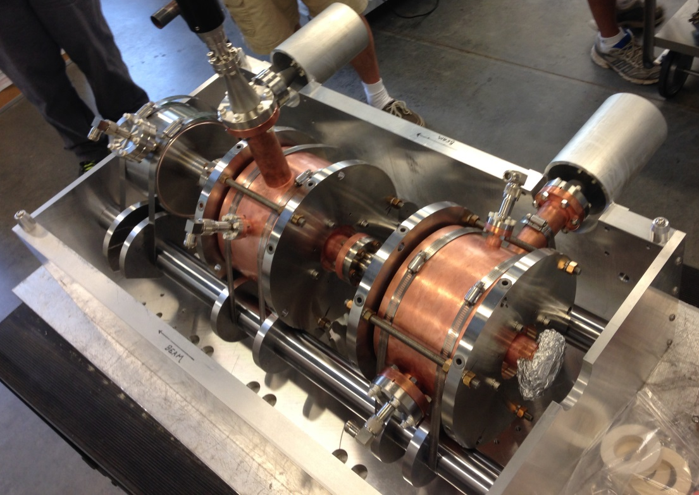
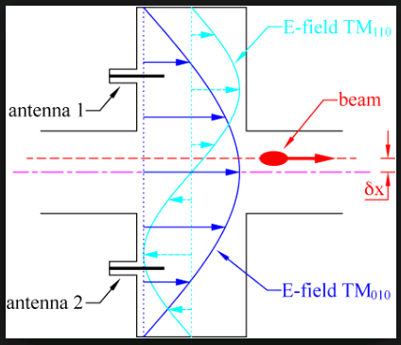
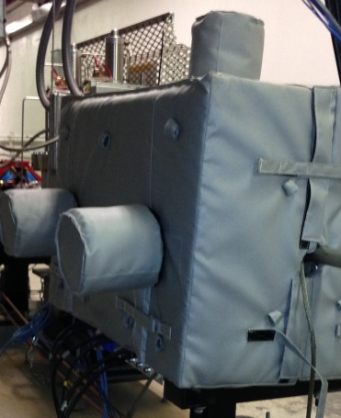
Cavity BPMs
IPM5C11A at shield wall, IPMAD00 at Goniometer
Positions calculated as X/I & Y/I
  Signal disappear at boresight
  X&Y phase shift 180⁰ at zero crossing
  Phase indicates positive or negative position
100um resolution 120Hz bandwidth 1nA of beam
Beam time needed for commissioning and response characterization
Foot
Tuners
I
Y
X
Probes & Test Ports
Blanket w/ Heat Tape

Slide 37
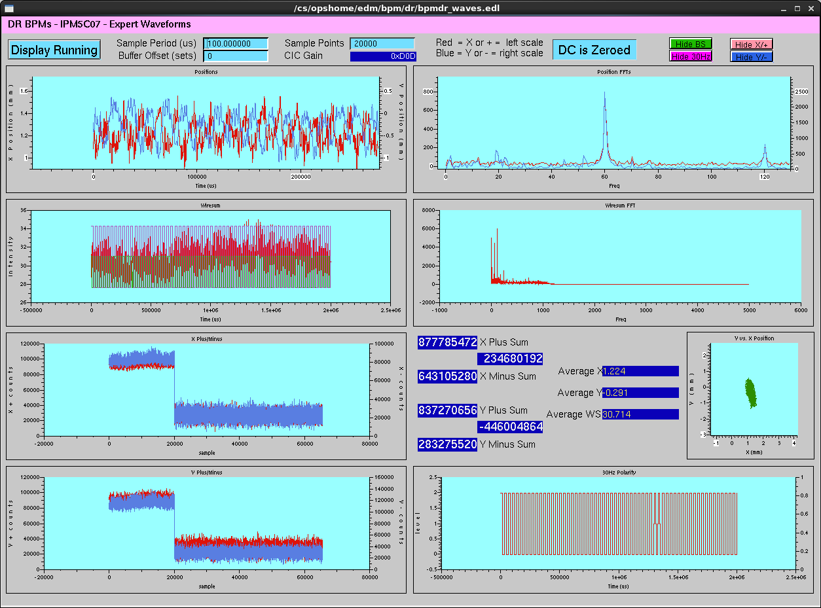
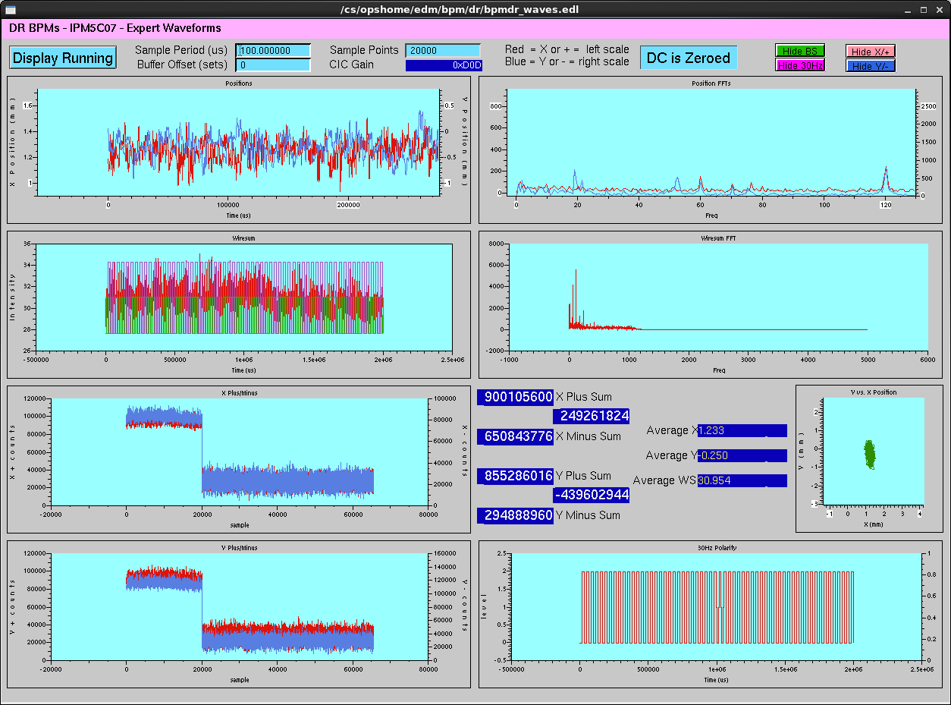
HW Testing: 60Hz Suppression
Line-synchronized Feedforward suppression
Proved hardware capable of canceling motion
60Hz Suppression
OFF
IPM5C07 Stripline Frequency Response
60Hz Suppression
ON

Slide 38
Accelerator Physics Summary
CASA continuously supports 12 GeV CEBAF operations
  Optics and analysis support, beam studies program
12 GeV CEBAF program meets beam requirements
  Systematic transverse match, emittance, bunch length measurements
  Synchrotron-radiation emittance growth understood
12 GeV diagnostics being re-commissioned, newly commissioned, and in continuing development
  SLMs, stripline BPMs are operational successes
  Working towards 6D tomography, rayTrace global match

Slide 39
Accelerator Status
Meeting requirements
Developing plans to handle emerging issues
  Vibration sensitivity
  More rapid recovery to gradient for C100s
Developing procedures to use new capabilities
  Improved beam timing diagnostics
  FFB expansion to HallD
  Additional features of new BPMs
The land of opportunity

