Slide 1
12 GeV Project Status
Glenn R. Young
12 GeV Project Status
CLAS Collaboration Meeting
Jefferson Lab
October 20-21, 2015

Slide 2
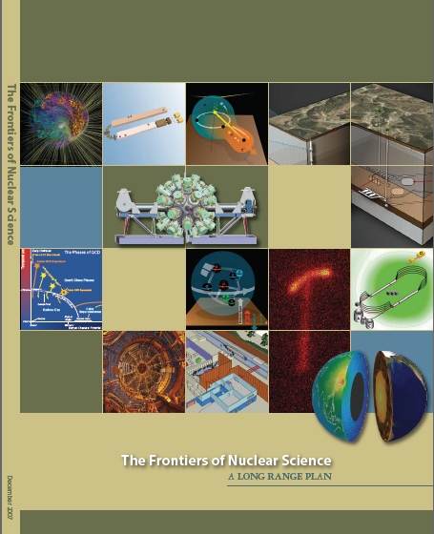
12 GeV Upgrade Project
Completion of the
12 GeV CEBAF Upgrade was ranked the highest priority in the 2007 NSAC Long Range Plan.
Upgrade is designed to build on existing facility: vast majority of accelerator and experimental equipment have continued use.
New Hall
Upgrade arc magnets
and supplies
Add 5 cryomodules
20 cryomodules
CHL upgrade
Add arc
20 cryomodules
TPC = $338M
ETC = ~$10M
Add 5 cryomodules
Project Scope (~97% complete)
Doubling the accelerator beam energy - DONE
New experimental Hall D and beam line - DONE
Civil construction including Utilities - DONE
Upgrades to Experimental Halls B & C - ~92%
Enhanced capabilities
in existing Halls
Maintain capability to deliver lower pass beam energies: 2.2, 4.4, 6.6….

Slide 3
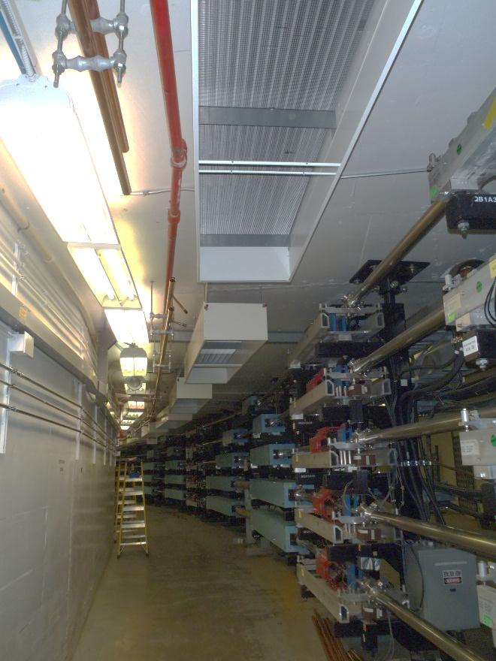
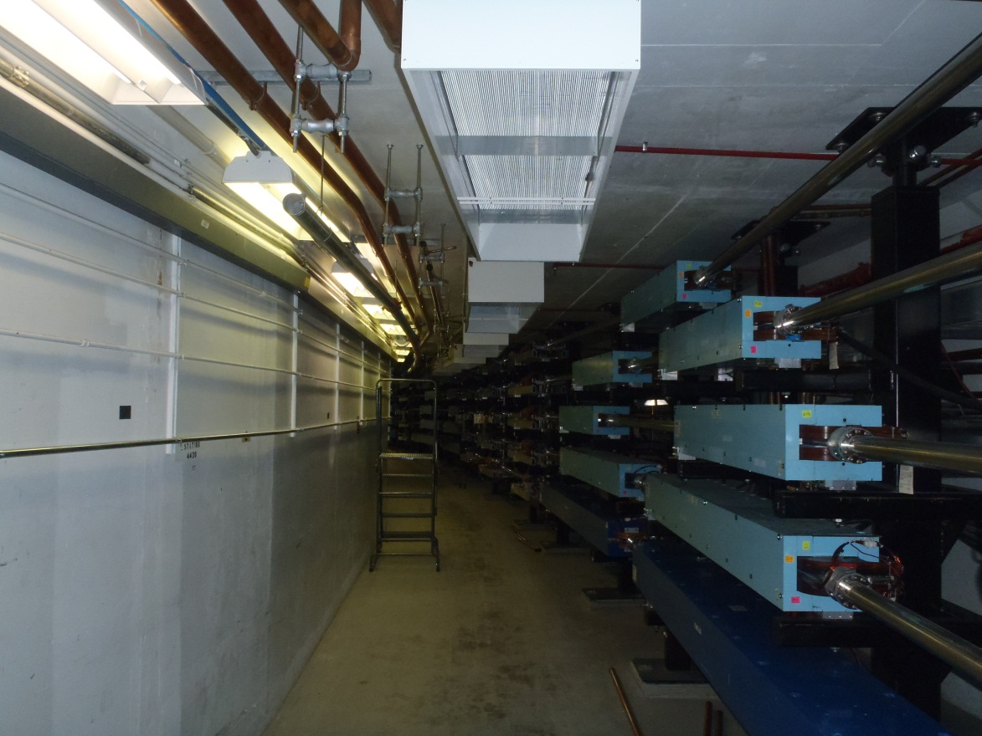
Civil Construction Progress
Complete
FY2015 Utilities Work:
Tunnel AC contract work started in January 2015 during the Accelerator shutdown.
Backup cooling towers were commissioned in February.
Installation of chilled beams in the tunnel arcs.

Slide 4
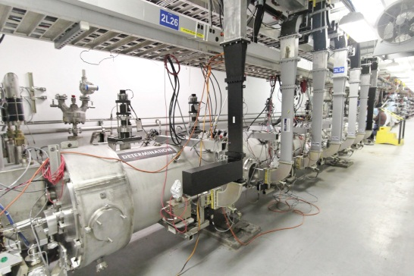
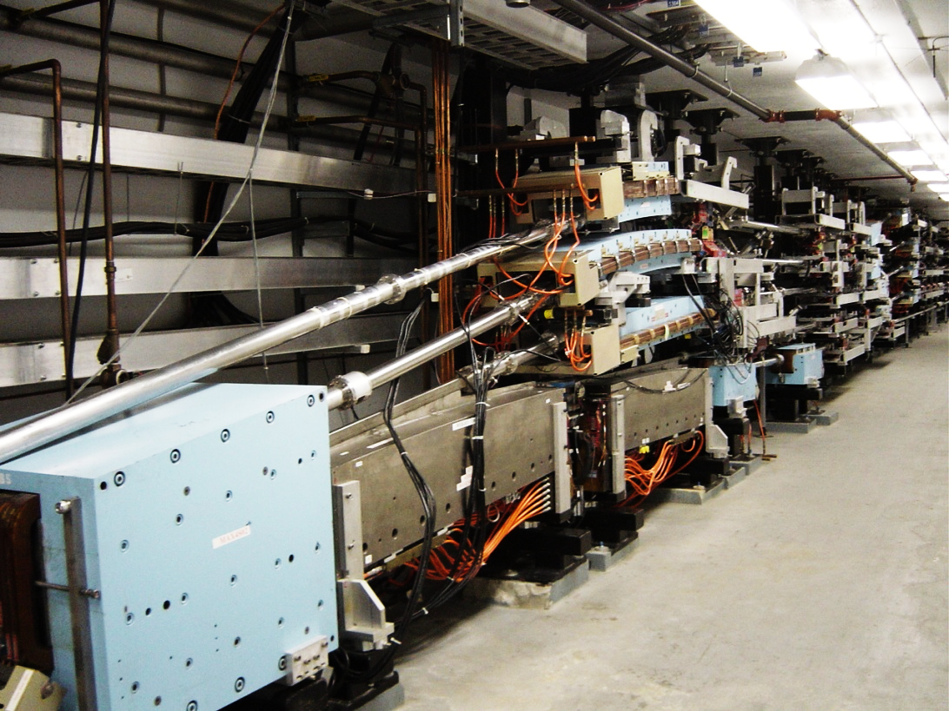
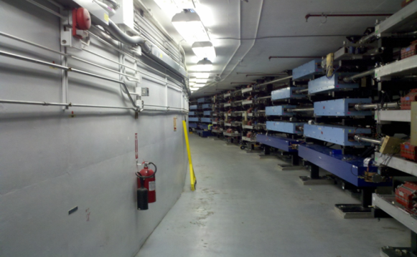
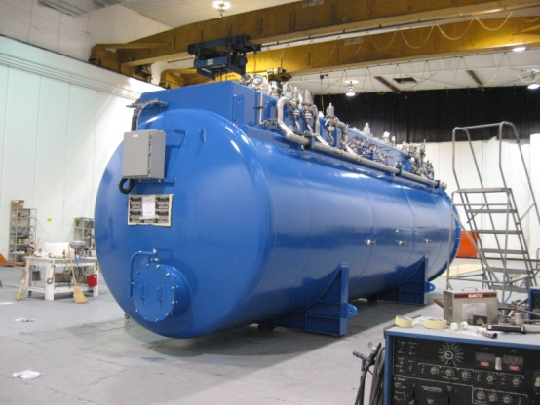
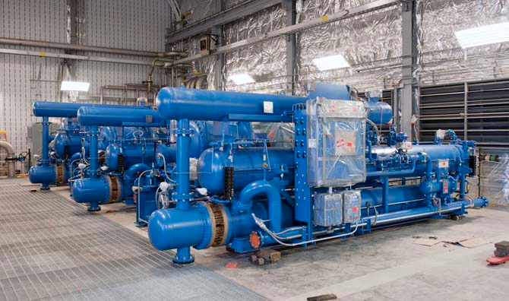
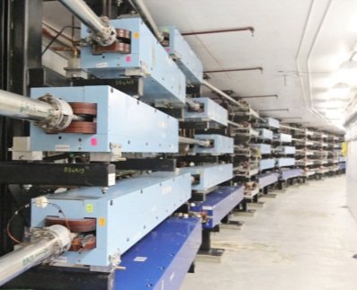
Accelerator Construction: 100% Complete
~$104M EAC
12 GeV Beam Achieved

Slide 5
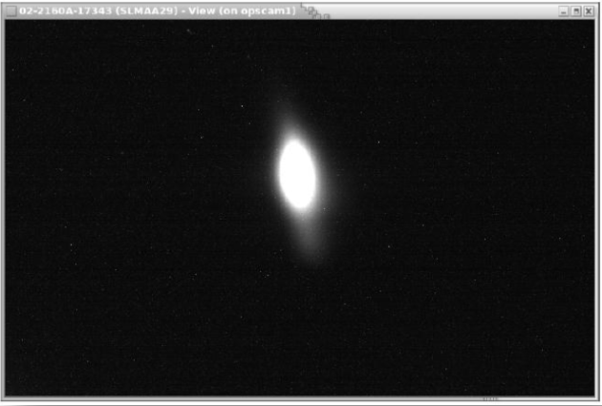
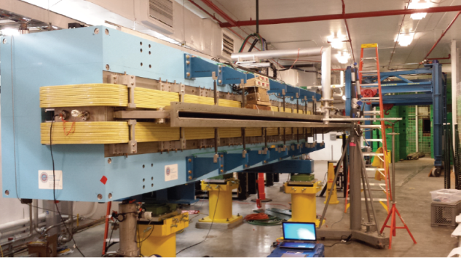
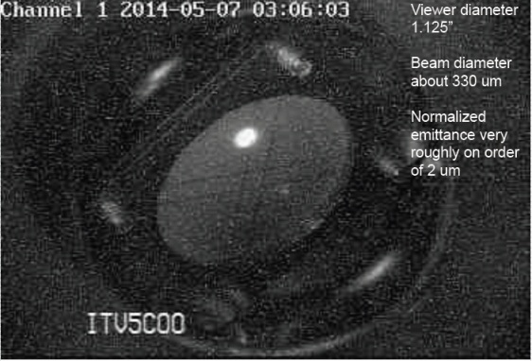
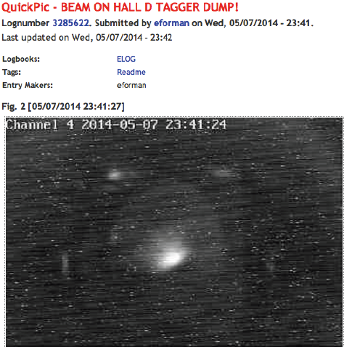
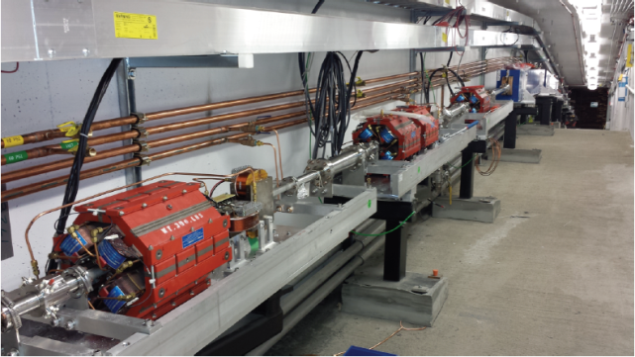
5.5 Pass: 10.5 GeV to Hall D Tagger
Arc 10
5.5 pass
10.5 GeV
Hall D Tagger Dump
Hall D Beamline
May 2014
Nov 2014
2-day running period: 50-100nA, 10.08 GeV electrons

Slide 6
Physics Detectors Progress Overall
Detectors and electronics at 99.7% complete
Halls C, D complete
DAQ/Computing (software/firmware) at 97%
Halls C, D complete
Hall B last procurement underway
Beamline at 97%
Hall C at 91%, Hall D complete
Hall B at 60%
Infrastructure at 93%
Hall D complete
Hall B & C remaining detector installations follow final magnet installations
C: Dipole, then Drift Chambers, NGC
B: Torus, then Drift Chambers, HTCC
B: Solenoid, then CTOF, SVT, HTCC

Slide 7
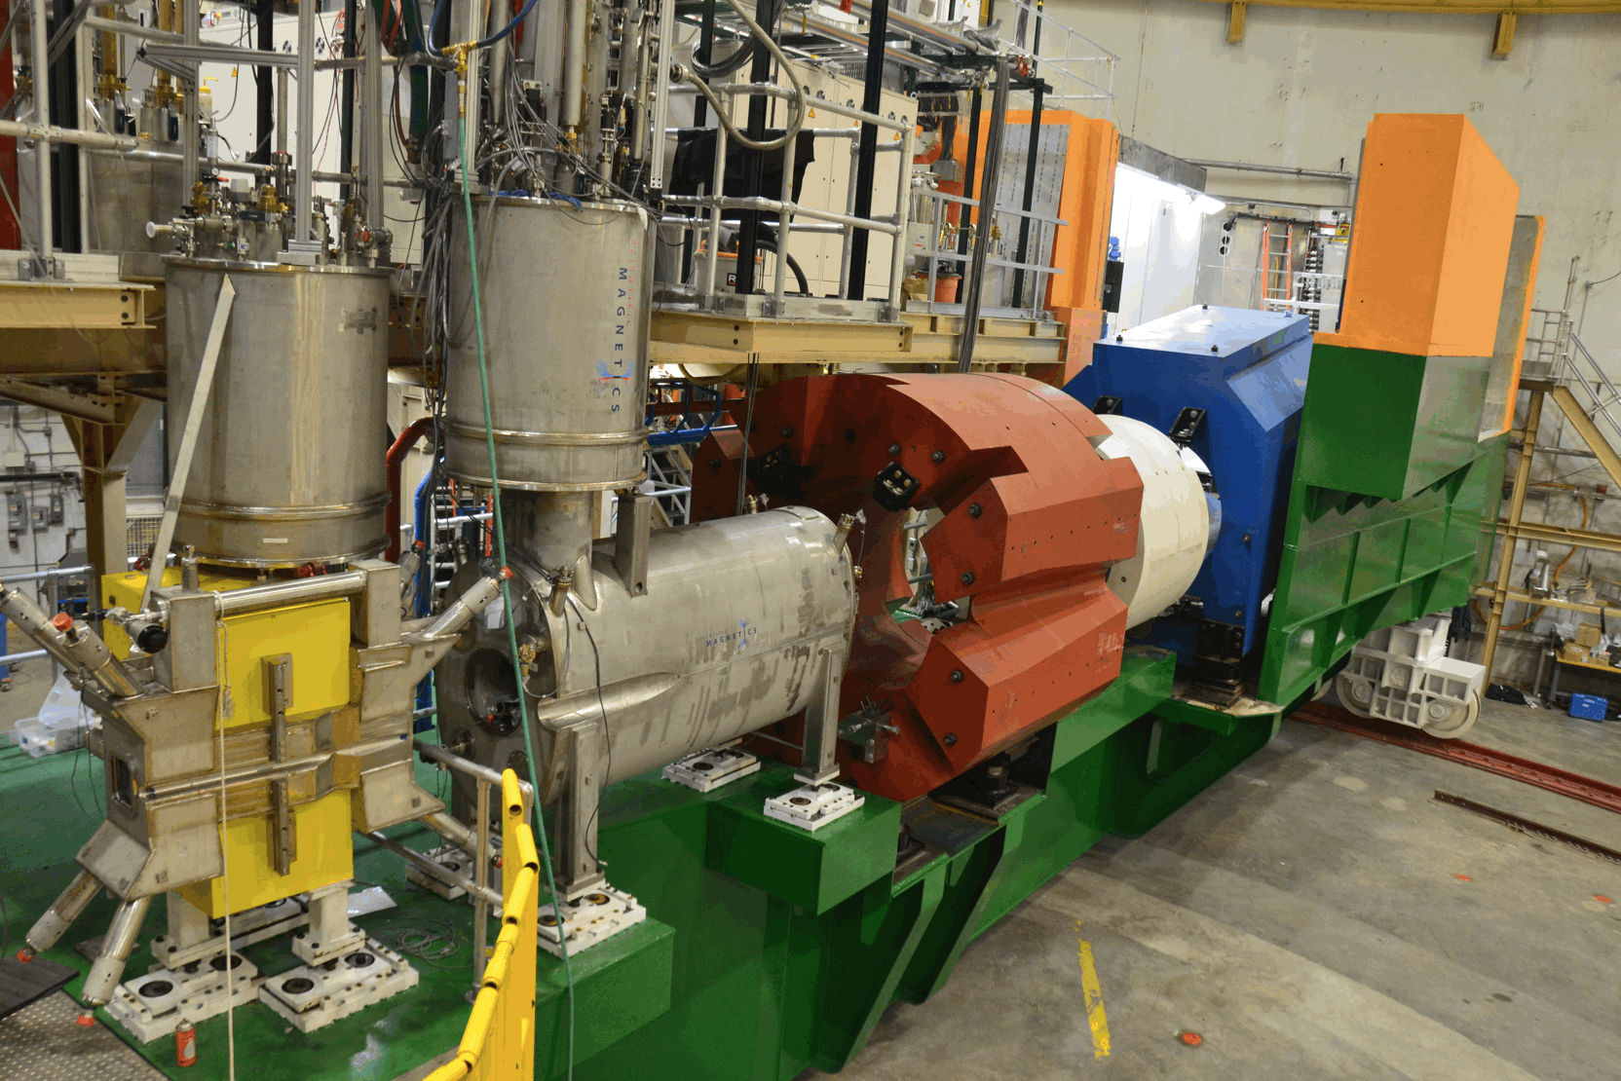
Hall C: SHMS Progress
HB and Q1 magnets installed, operated, accepted
Yokes ready for final three magnet cryostated cold masses

Slide 8
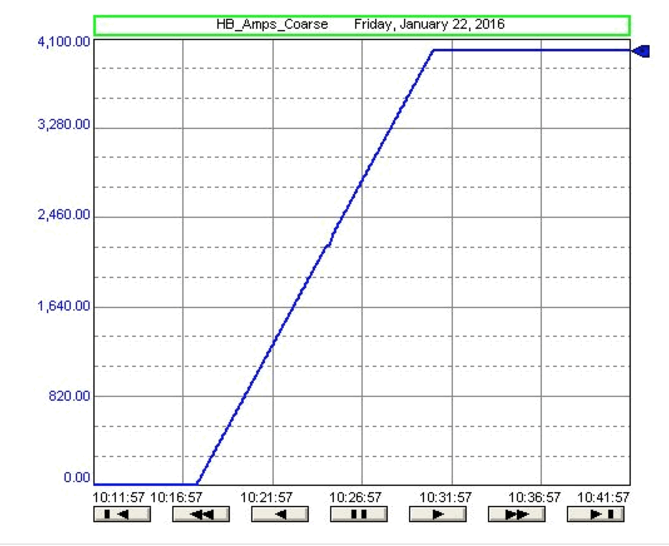
4000A in HB Magnet in Hall C

Slide 9
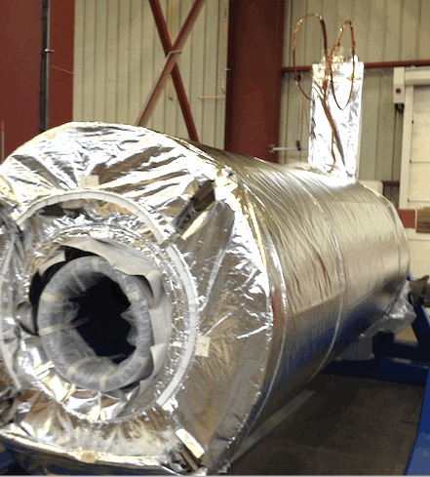
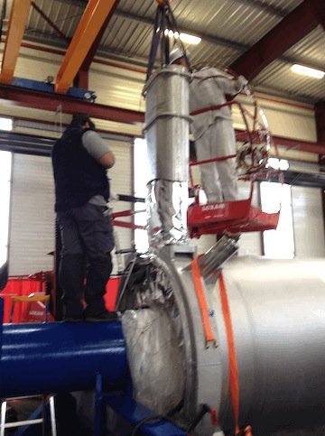
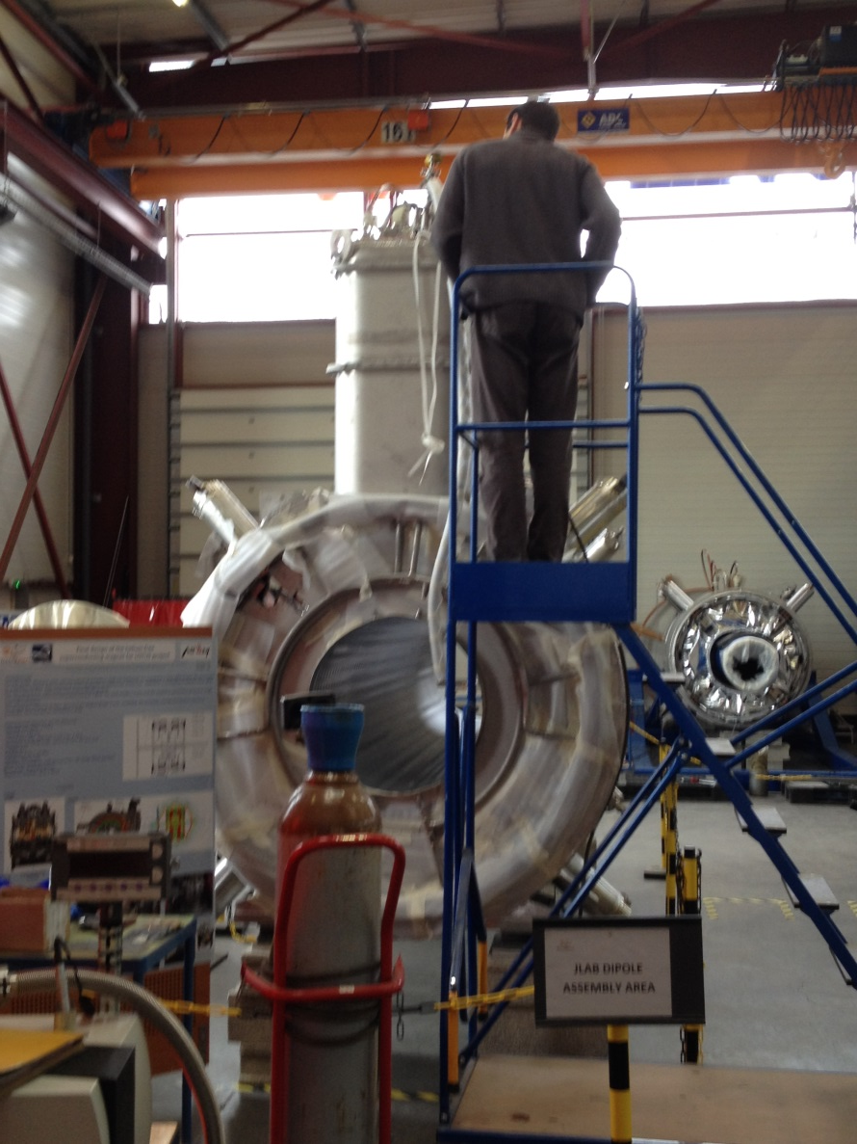
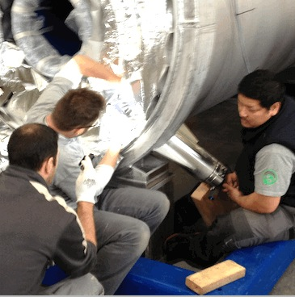
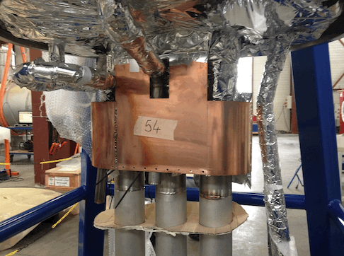
Hall C Dipole: Lots of 2016 Progress!
MLI and Outer Screen
Outer Vacuum Cryostat (!!)
and Chimney
Leak Checking Dipole LN2 Circuit
Preparing CCR Interfaces
Support LInks

Slide 10
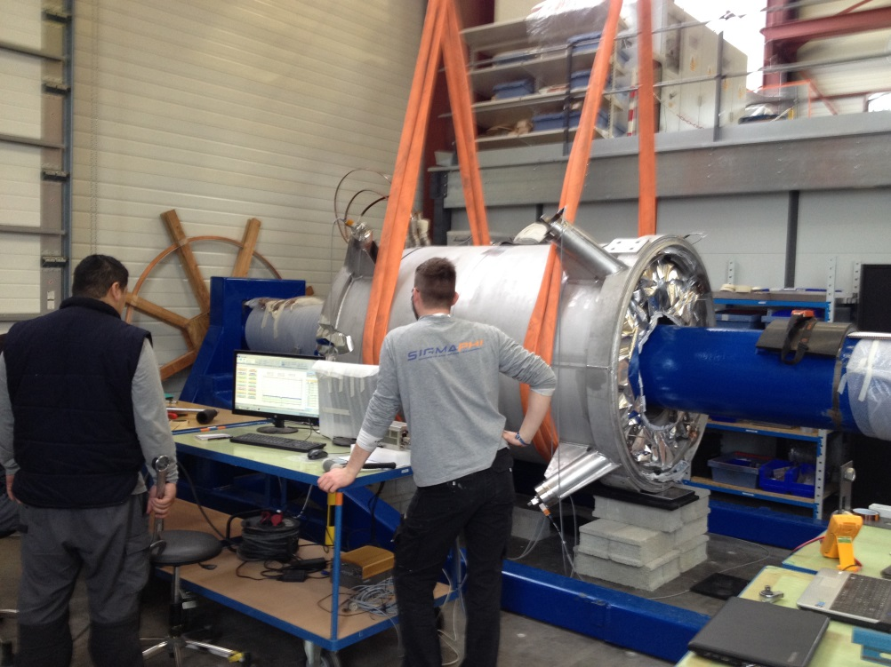
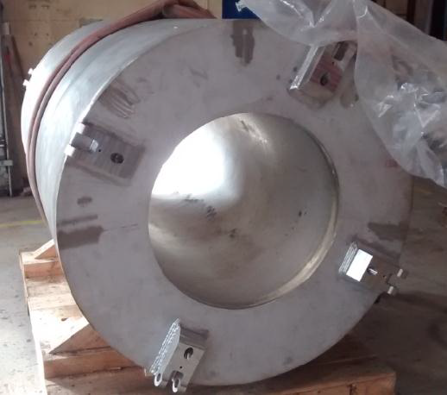
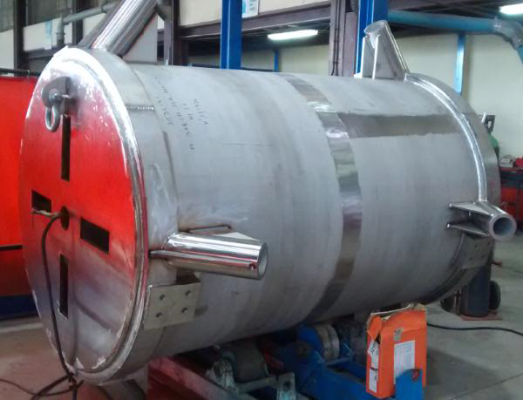
Hall C Q2 and Q3 Progress
Q3 in its Helium Vessel
Q2 in its Cryostat
Being Centered
Q3 Cryostat Being Welded

Slide 11
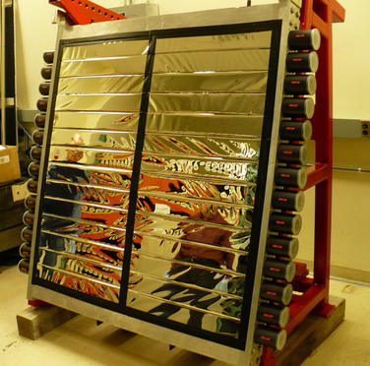
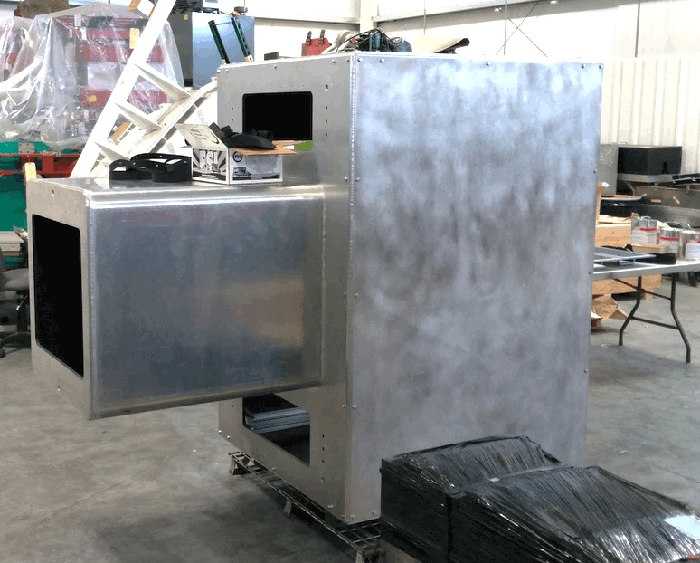
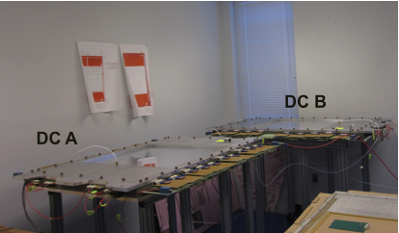
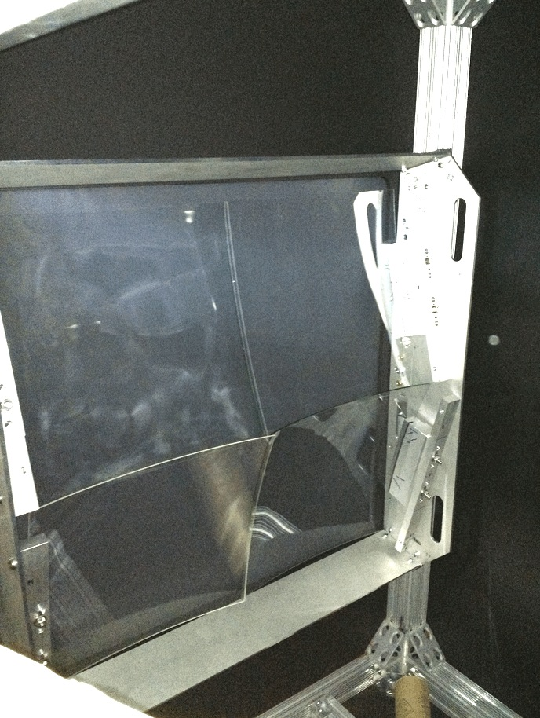
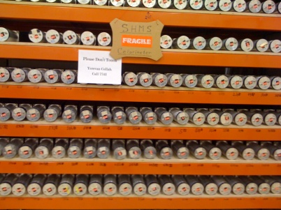
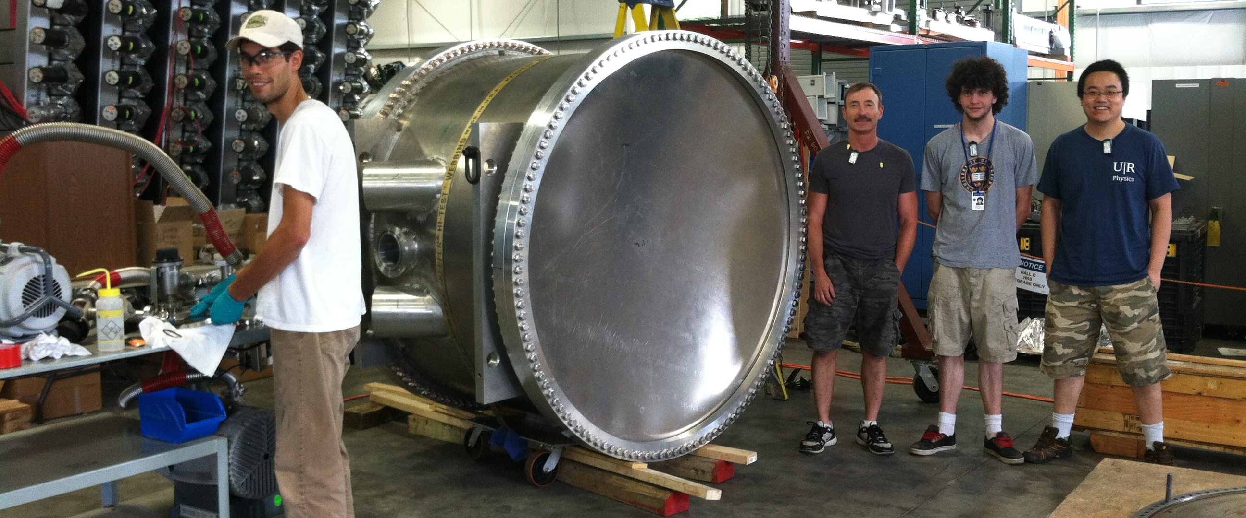
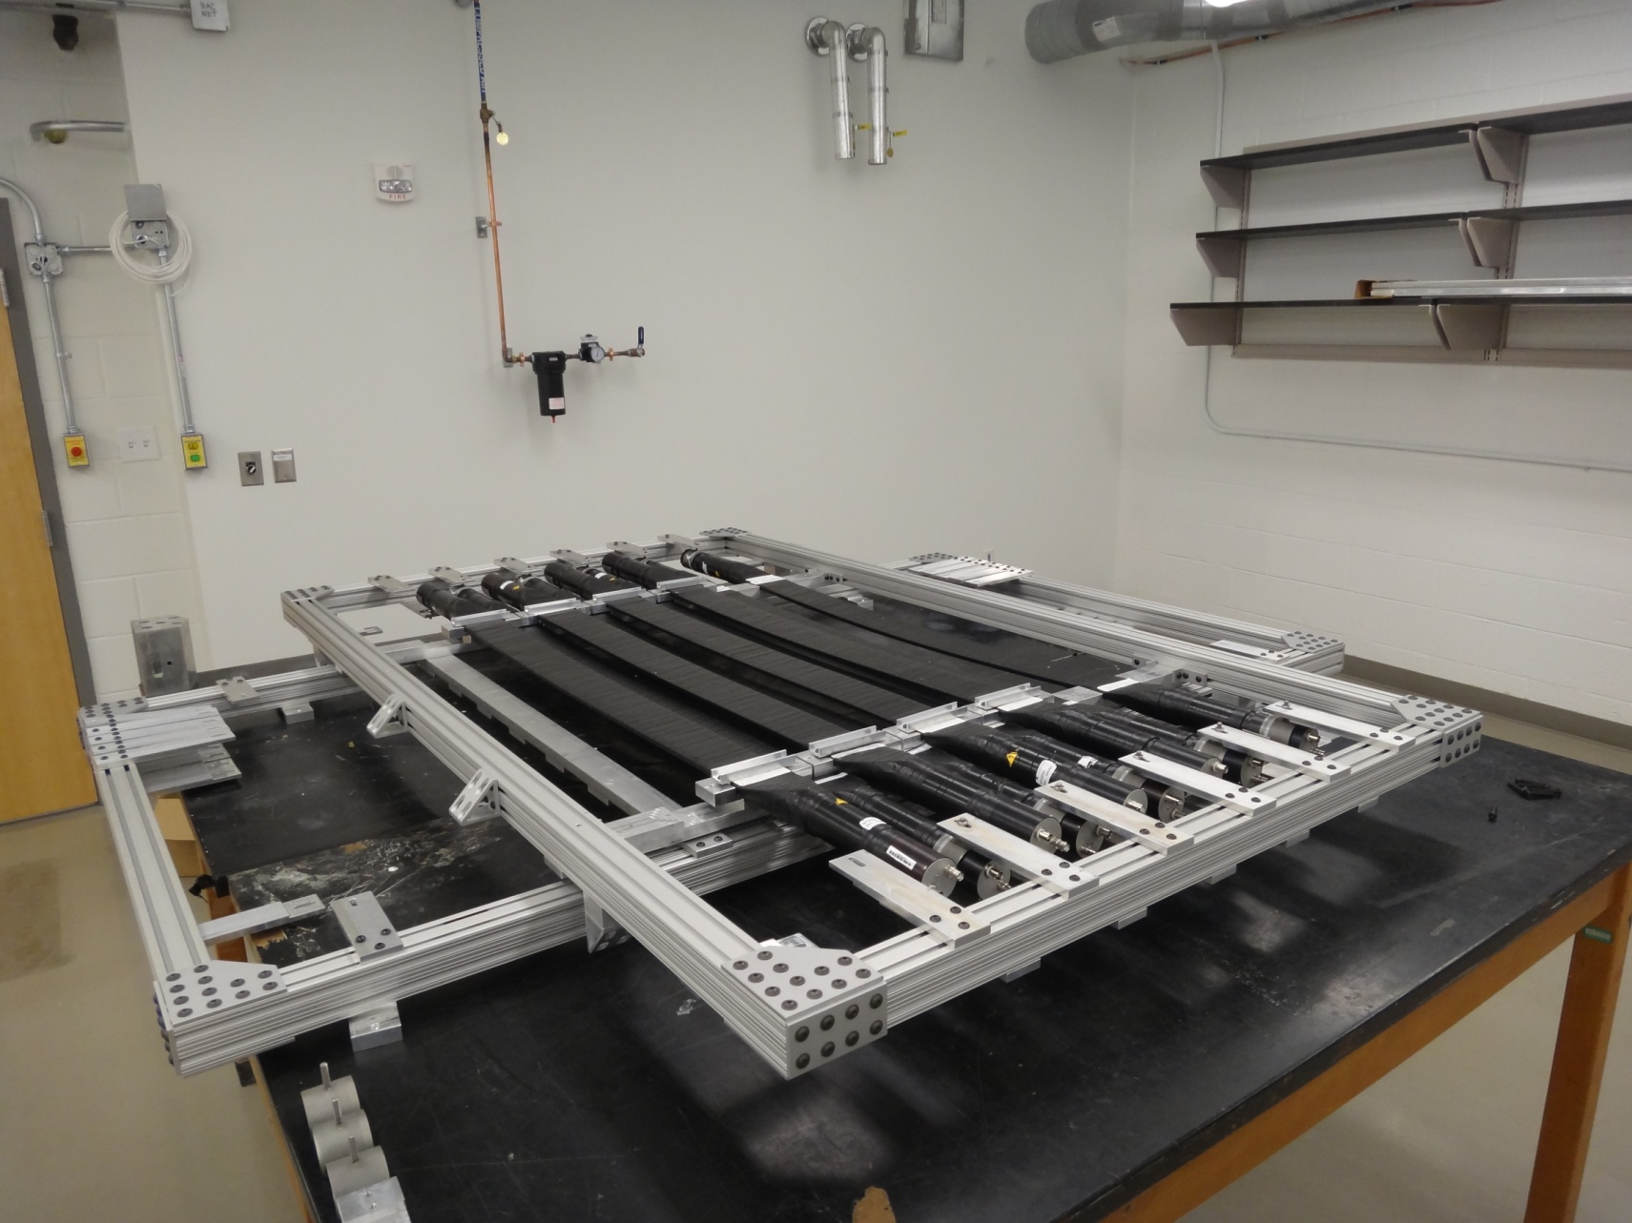
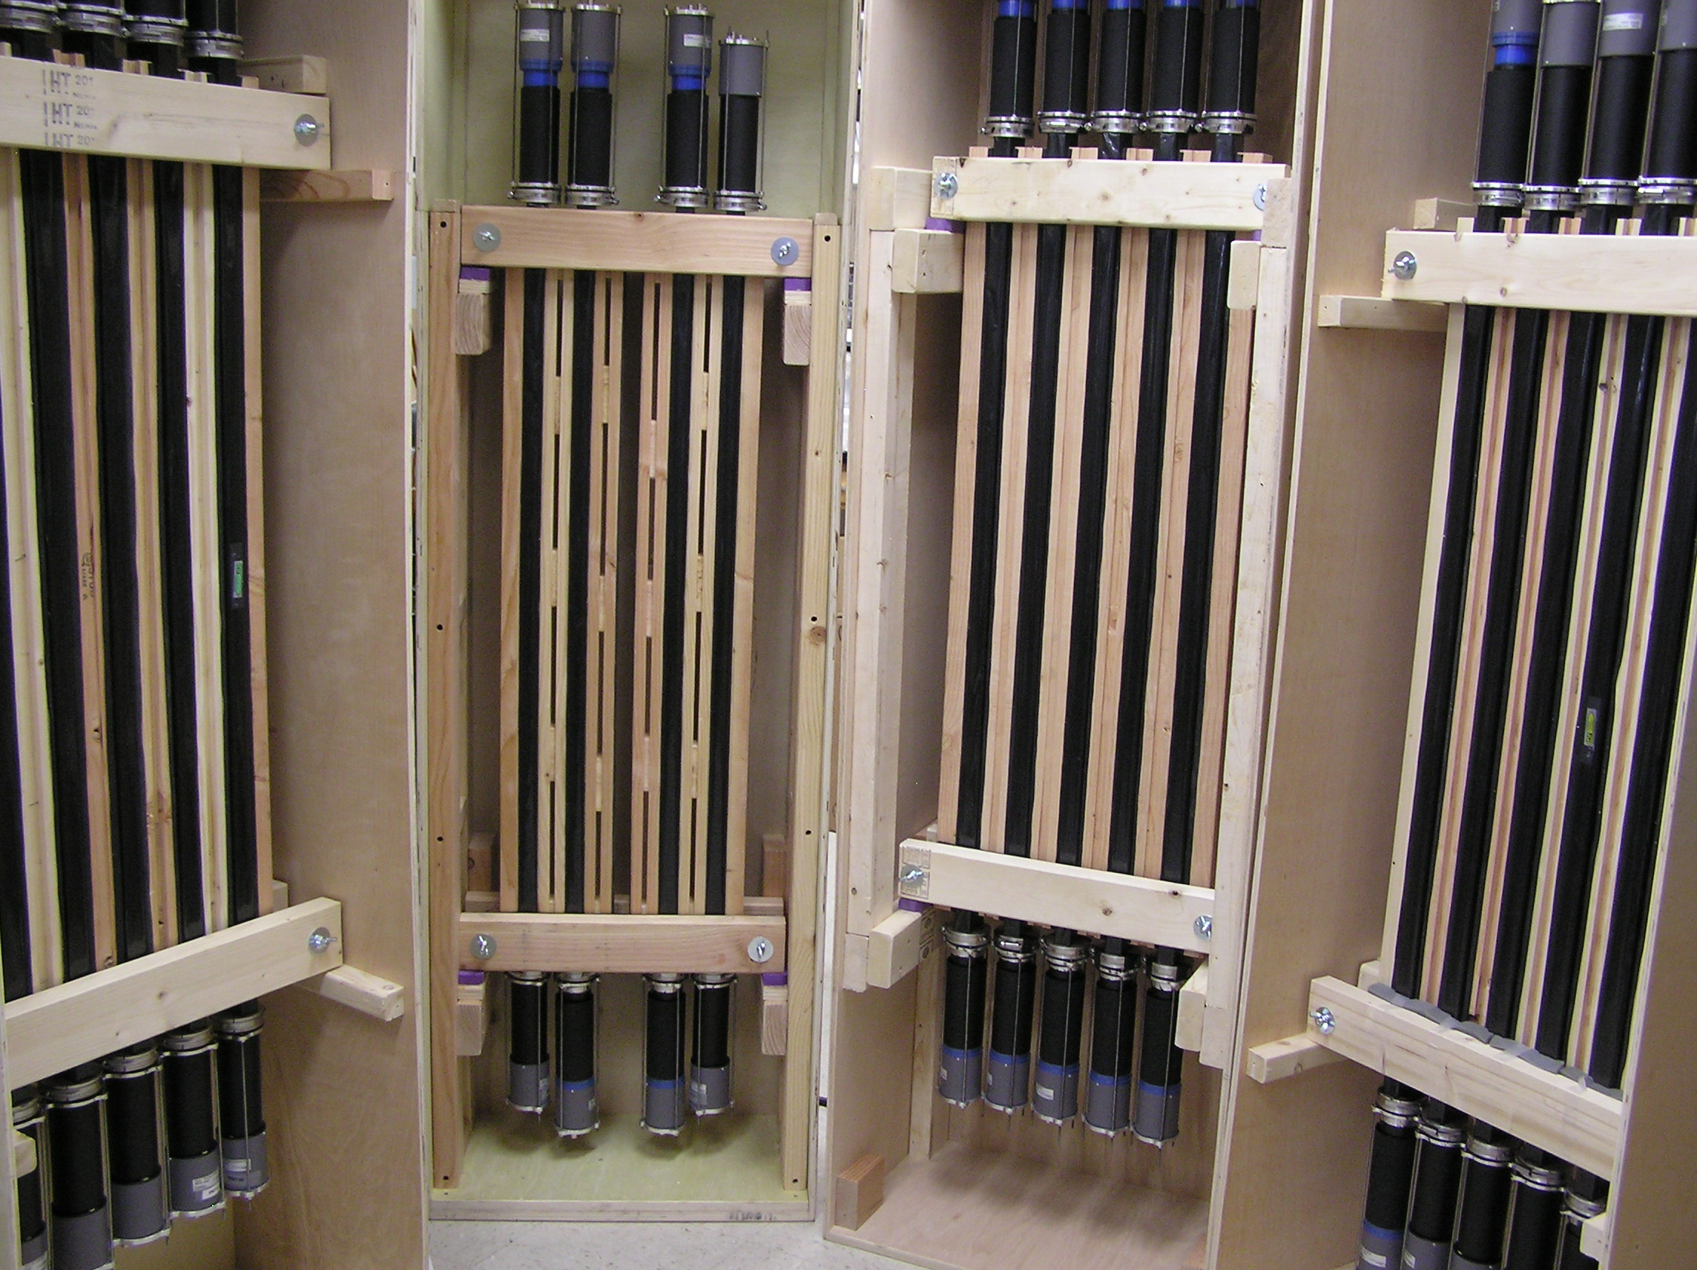
Hall C: Detector Progress
Complete
Complete
Complete
PreShower Counters
Noble Gas Cerenkov
Drift Chambers
Complete
Complete
Shower Counters
Heavy Gas Cerenkov
Complete
Complete
Quartz Hodoscope
Scintillator Hodoscopes

Slide 12
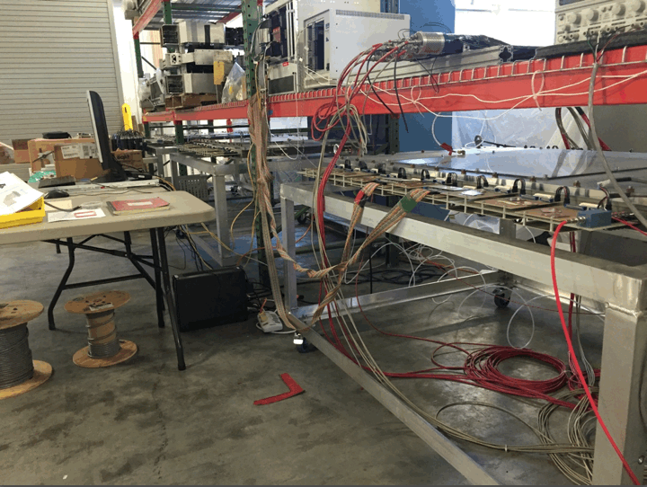
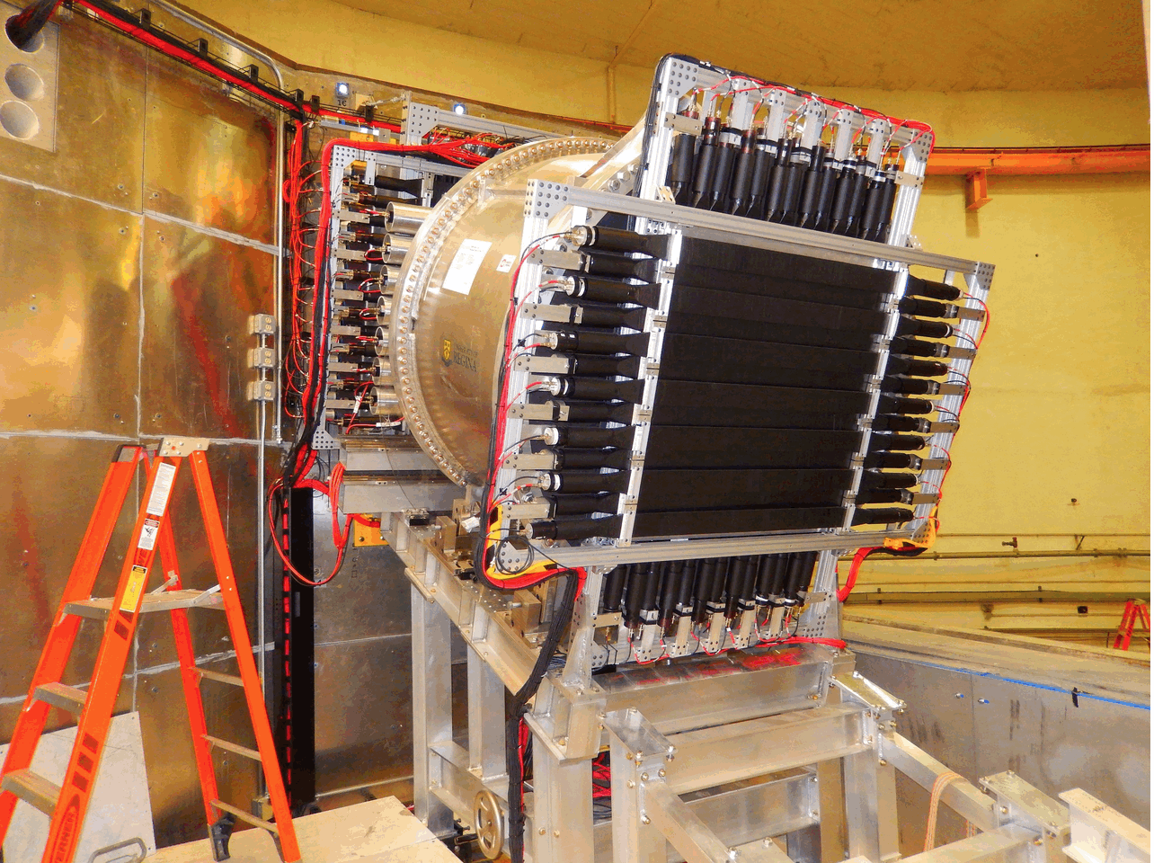
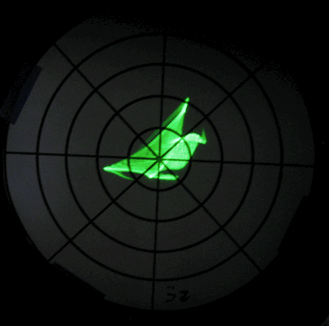
Hall C Detector Progress
Drift Chambers Completed.
Cosmic testing in Bldg. 23
Detectors
All Detector Construction is now Complete.
All Detectors are On Site.
All ‘rear’ detectors have been installed.
Rear Detectors Installed
Noble-Gas Cerenkov Construction Finished.
Box, Mirrors Optical test

Slide 13
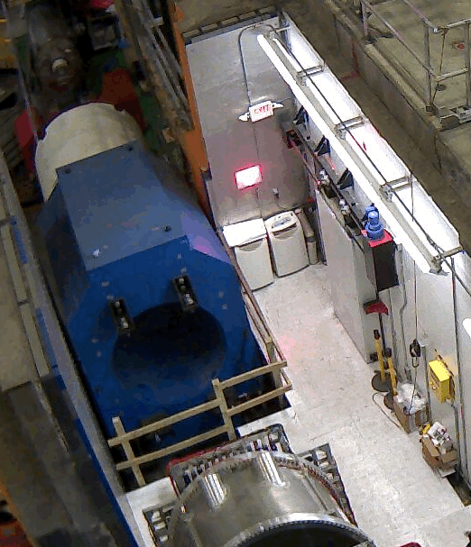
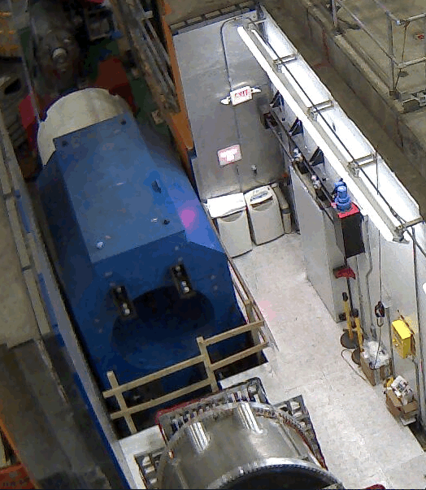
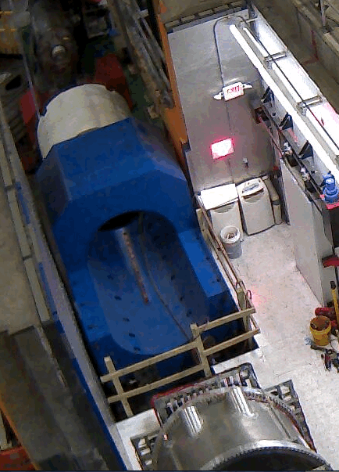
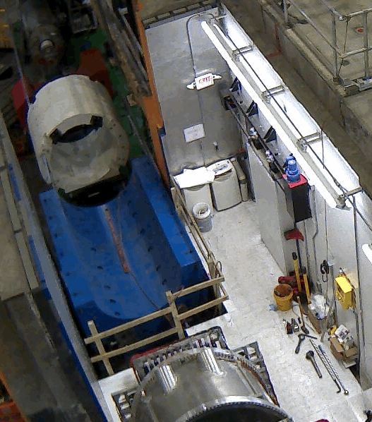
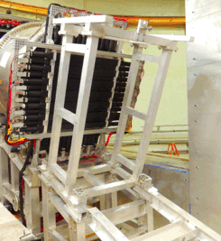
SHMS work in the Hall
Dipole Yoke Raised to Level, Top Half Removed. Ready for magnet to be delivered.
Drift Chamber Frame Test-Fit onto Stand before chambers are attached to it.

Slide 14
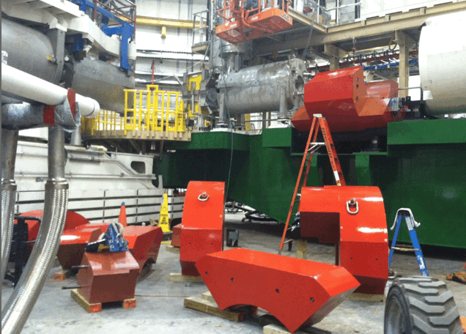
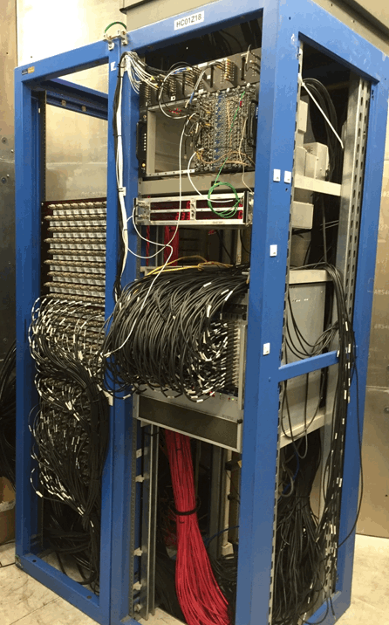
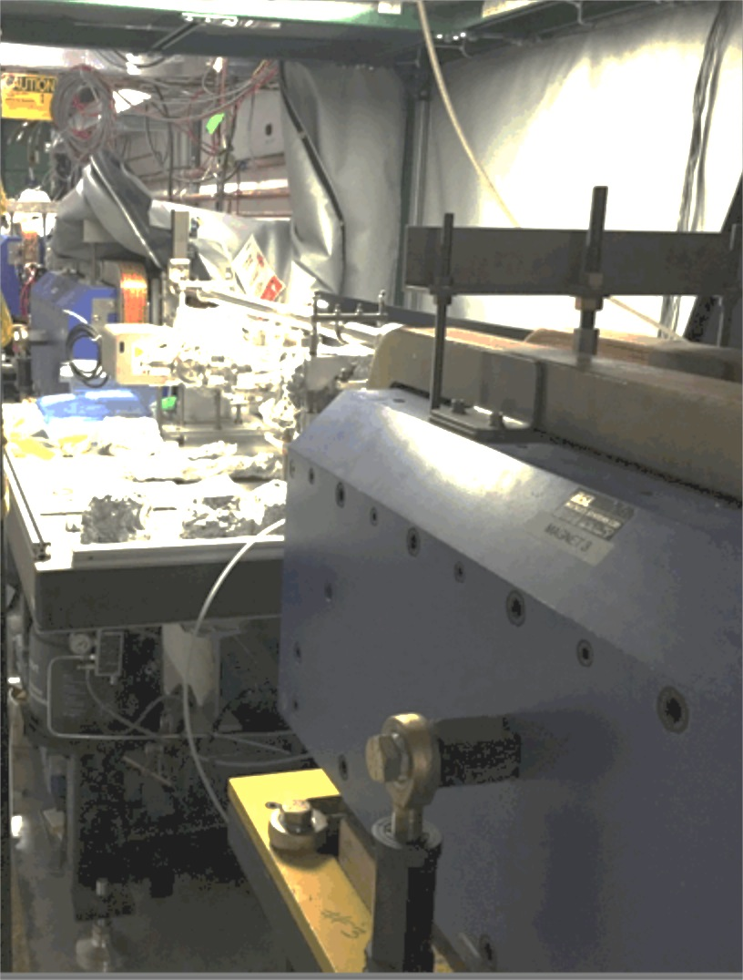
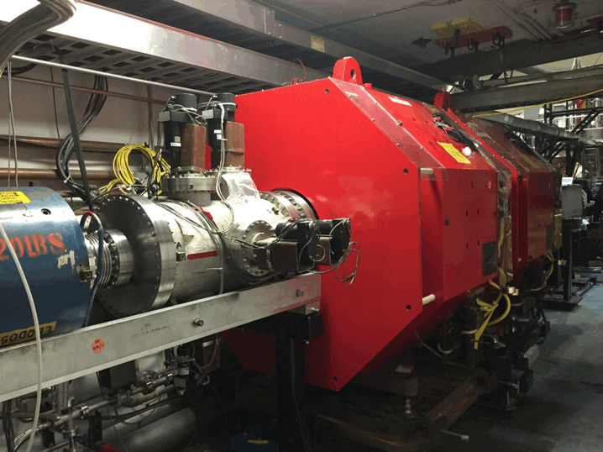
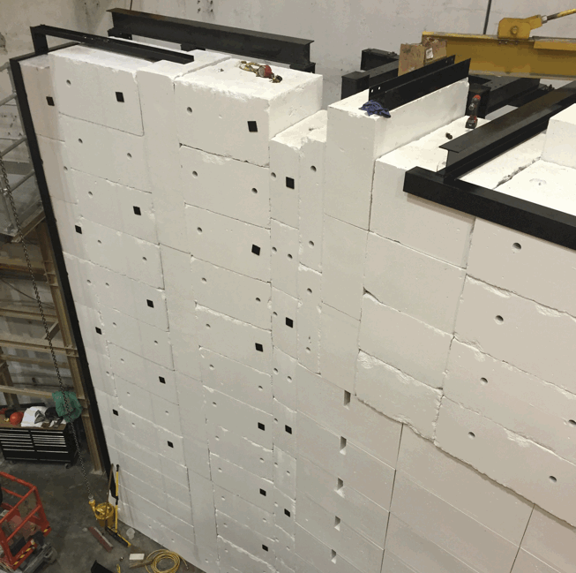
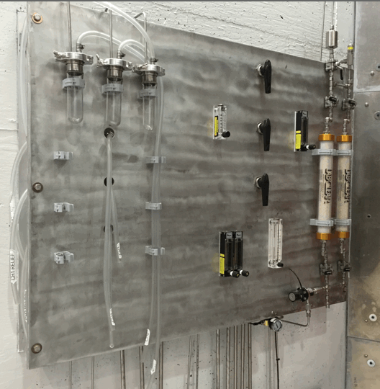
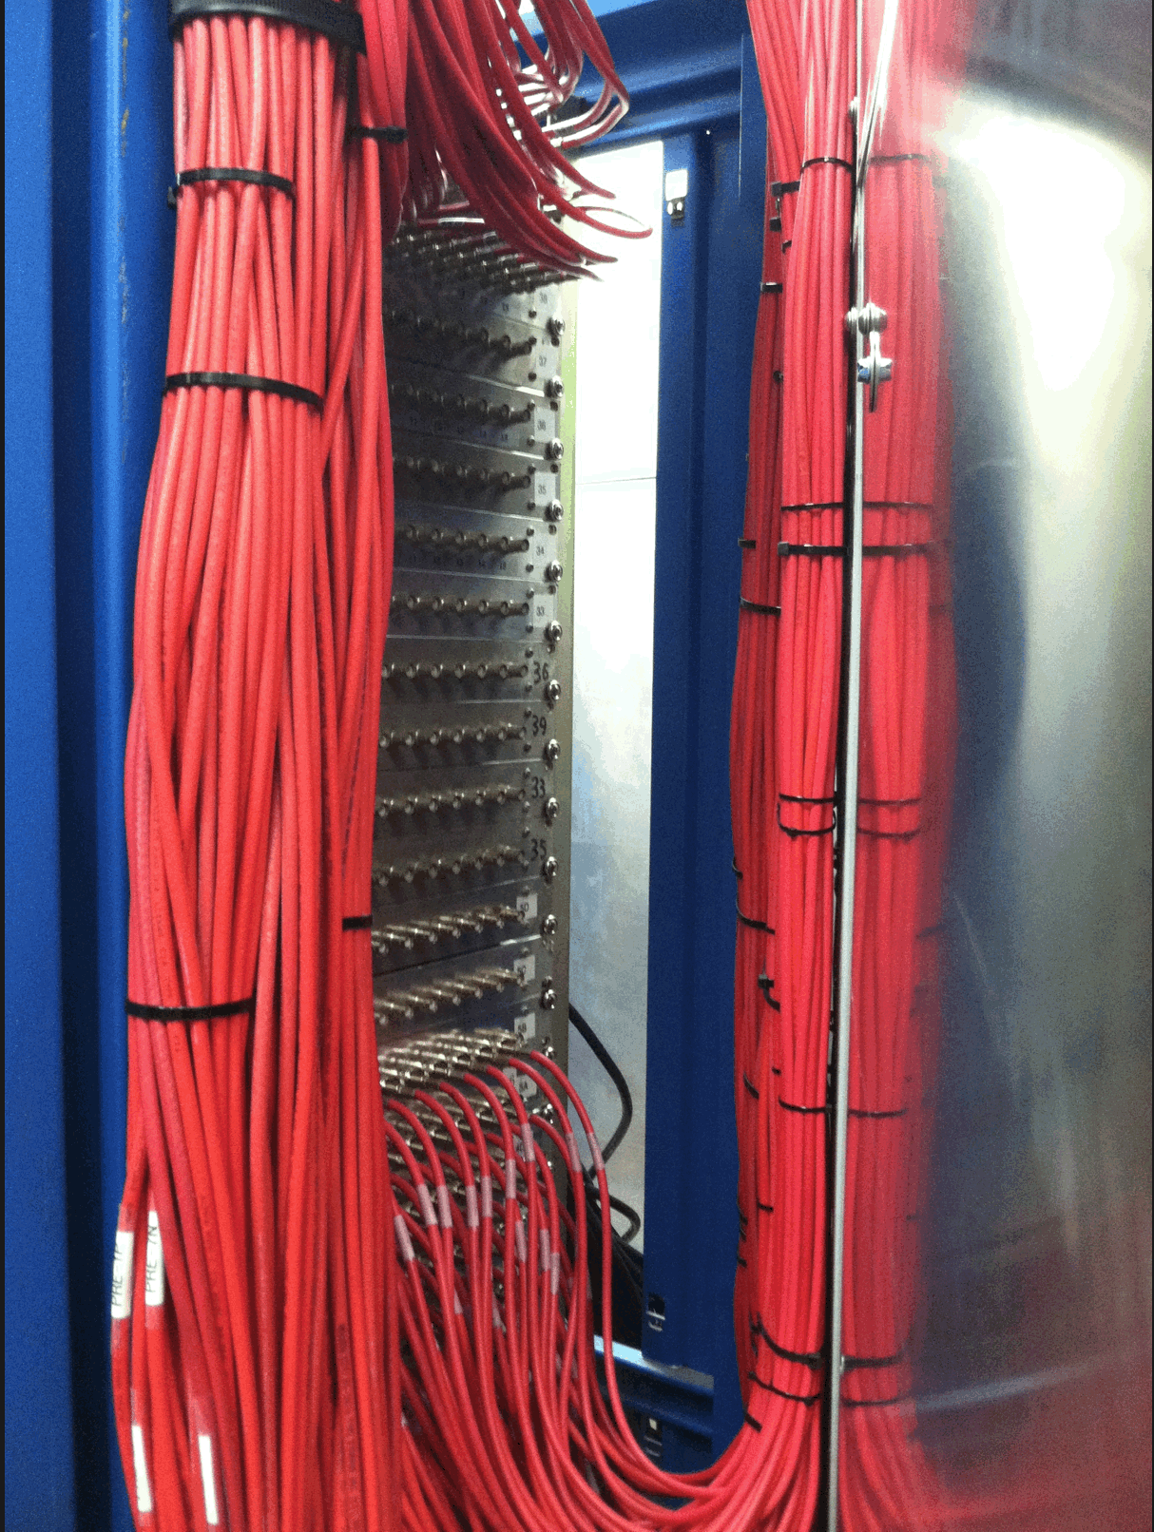
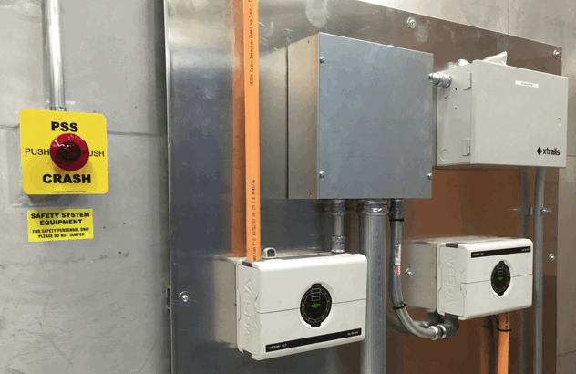
Hall C: Installation Progress
Installations Completed:
Moller & Compton Polarimeters in place.
HV & Signal Patch Cables completed. DAQ in use for cosmic tests.
Personnel Safety System. Gas supply & Gas leak detection.
Shield Wall. Shield house doors. Q2 yoke support.
Compton Stands
Moller Quads
DAQ in Shield House
Q2 Yoke Support
Gas sniffer & PSS
Gas Supply Panel
Patch Cables
Rear SHMS Shield Wall

Slide 15
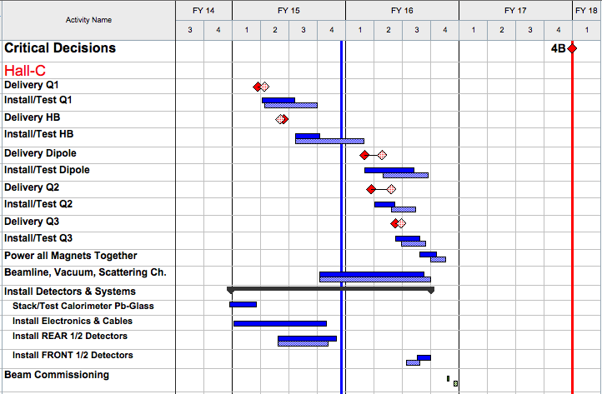
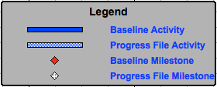
Hall C Schedule
“Baseline” = 31-Jan-2015 Re-Plan
“Progress File” = 31-Aug-2015 Status
>12 Months

Slide 16
Hall B: Detector Progress
Complete
Complete
Drift Chambers
Complete
Complete
FTOF 1-a, 1-b Installed
PCAL Installed
LTCC – 5th Box Being Installed
Complete
Complete
CTOF Counters Under Test
HTCC
SVT All 4 Regions

Slide 17
Torus Magnet Progress
Coil Cold Mass (CCM) fabrication at FNAL is complete
CCM cryostating in JLab factory is complete
Main assembly of Torus in Hall B is nearing completion
Expect to start pump-down April 2016, cool-down in May 2016
Assembly Spit Installation 10/23/2014
Free-Standing Torus on Support Legs February 1 2016

Slide 18
Solenoid Magnet Progress
Two Inner Coils wound, potted, machined to final dimensions
Two Intermediate Coils wound, potted, preparing to insert two Inner Coils
Shield coil winding underway (LAST COIL FOR 12 GEV PROJECT)
Cold Mass assembly in May, insertion into Cryostat during Summer
Delivery to JLab in September 2016 now expected; sets schedule for last detector installations
First Turn on C5 Shield Coil
Intermediate Coils and 1st Inner Coil Preparing for Shrink Fit

Slide 19
Magnet Cryogenics and I&C Progress
Cryogenics (92%) and I&C (89%) infrastructure for Torus is well along, entering final assembly stages
Cryogenics (62%) and I&C (48%) infrastructure for Solenoid is advancing and builds on designs, firmware, controls being done for Torus

Slide 20
Procurements Over $100K Remaining
Hall | Item | $K | Status
B | Cryogenic Distribution Can | 405 | Awarded, ship Mar 2016
B | CTPs for DAQ | 106 | Awarded, due Mar 2016

Slide 21
Hall B Schedule
Torus Assembly, Install + Test
Solenoid Install + Test
5.5 months to CD-4B
(as of 31-Jan-2016)

Slide 22
Key Upcoming Dates
Hall | Key Event | Date
B | Torus 1st CCM Arrives | November 2014
B | Torus 6th Cryostat Done | June 2015
B | Torus Installation | October 2014 – May 2016
B | Solenoid Coil Winding | December 2014 – April 2016
B | Solenoid Cryostated Coil Delivered | September 2016
B | Detector Commission with Beam | April 2017
C | 1st Magnet Arrives | January 2015
C | 2nd Magnet Arrives | February 2015
C | Last Magnet Arrives | June 2016
C | Last Magnet Tested | September 2016
C | Detector Commission with Beam | November 2016

Slide 23
Key Activities: Path to CD-4B
Level 2 Milestones (PEP)
Number | Milestone Description | Baseline | Projected | Actual | Status
2-12 | Hall D Equipment Installation Completed | Sep-14 |  | Oct-14 | CD-4B
2-13 | Hall D Beam Commissioning Completed | Dec-14 |  | Dec-14 | CD-4B
2-27 | Hall C Q1 Magnet Delivered | Oct-14 |  | Jan-15 | CD-4B
2-28 | Hall C HB Magnet Delivered | Mar-15 |  | Mar-15 | CD-4B
2-34 | Hall B Torus Cold Mass Delivered | Apr-15 |  | Apr-15 | CD-4B
2-38 | Conventional Facilities Complete | Dec-15 |  | Nov-15 | CD-4B
2-29 | Hall C Dipole Magnet Delivered | Dec-15 | Apr-16 |  | CD-4B
2-30 | Hall C Q2 Magnet Delivered | Dec-15 | Jun-16 |  | CD-4B
2-31 | Hall C Q3 Magnet Delivered | Mar-16 | Jun-16 |  | CD-4B
2-35 | Hall B Solenoid Cryostated Coil Delivered | Mar-16 | Sep-16 |  | CD-4B
2-32 | Hall C Equipment Installation Complete | Jul-16 | Nov-16 |  | CD-4B
2-33 | Hall C Beam Commissioning Complete | Aug-16 | Jan-17 |  | CD-4B
2-36 | Hall B Equipment Installation Complete | Oct-16 | Mar-17 |  | CD-4B
2-37 | Hall B Beam Commissioning Complete | Dec-16 | Apr-17 |  | CD-4B

Slide 24
Scope Remaining: Path to CD-4B
# | System | Technical Definition | PEP Date
1 | Hall B | Detector operational: events recorded with a > 2 nA electron beam at > 6 GeV beam energy (3 pass) | Sep 2017
2 | Hall C | Detector operational: events recorded with a > 2 nA electron beam at > 6 GeV beam energy (3 pass) | Sep 2017
3 | Hall D | Detector operational: events recorded with a > 2 nA electron beam at > 10 GeV beam energy (5.5 pass) | Sep 2017 Dec 2014 (A)
Hall D 100% complete:
Hall C 91% complete:
Hall B 95% complete:

Slide 25
HALL B Key Performance Parameter (Draft)
Detector operational: events recorded with a > 2nA electron beam at > 6 GeV beam energy (3 pass).
KPP Demonstration:
1. Detector running for 8 hours recording data from all subsystems.
2. Screenshots of beam status and/or accelerator e-logs entries demonstrating electron beam current, beam energy, and beam profiles.
3. Plots showing relative timing of calorimetry, time-of-flight, and Cerenkov detectors.
4. Event displays showing correlated particle hits in the forward detectors.
5. Plots of particle trajectories showing target position.
6. Particle identification plots using signals from calorimetry and Cerenkov detectors.
Similar demonstration criteria led to Hall D KPP approval

Slide 26
Path to CD-4B: Hall D KPP
Project Execution Plan: Table 5.1B
# | System | Technical Definition – Key Performance Parameter | PEP Date
3 | Hall D | Detector operational: events recorded with a > 2 nA electron beam at > 10 GeV beam energy (5.5 pass) | Dec 2014 (A)
KPP achieved – December 2014
Neutral particle
Charged particle
Event Display
Drift chambers
Target location
Z,cm
Electromagnetic calorimeters
(rough calibration; preliminary alignment)

Slide 27
Summary
Detector production in last stages, with Halls C, D complete
Electronics complete
Last trigger/DAQ procurement in process, for Hall B, will complete Spring 2016
Detector commissioning started, concomitant exercising of software
Installation well along in Halls B & C
Plan being formed to transition to operations and demonstrate KPP

