Slide 1
Helicity Formalism and the Extraction of Orbital Angular Momentum from Experiment
Simonetta Liuti
University of Virginia
Hall B Collaboration meeting
Jefferson Lab, February 25th, 2016

Slide 2
Outline
Accessing Angular Momentum and Orbital Angular Momentum in the Proton
Helicity Amplitude Formalism

Slide 3

DVCS, DVMP, TCS and related processes were originally introduced to access Orbital Angular Momentum (OAM) in the proton
X. Ji, PRL78 (1997)
e’
e
q’= q+Δ
q
k+q
k
H,E
p’ = p-Δ
p
t=Δ²

Slide 4
Ji Sum Rule relates GPDs to the total angular momentum:
Helicity distribution singles out the contribution of spin:
The orbital contribution can be obtained indirectly through:
?
However, to verify the (quark part of) the spin sum rule one needs to perform three independent measurements

Slide 5


SPIN 1/2
SPIN 1
F₁+F₂= G_{M}
G_{M}
Deuteron Angular Momentum Sum Rule
S. Taneja, K. Kathuria, S. Liuti, G. Goldstein, PRD86 (2012)

Slide 6
What gives L?
OAM is measured through a Wigner Distribution/GTMD
Lorce, Pasquini, Hatta, Meissner, Metz, Schlegel
z_{T}
P
P’
b
b
P-P’=Δ
2/25/16
6

Slide 7
OAM is also obtained through a twist three GPD
Polyakov et al.
To understand how it is possible that the same quantity is given by two different observables one needs to derive a relation at the unintegrated in k_{T} level
A. Rajan, A. Courtoy, M. Engelhardt, S.L. arXiv:1602.00160
LIR

Slide 8
We now know how to access L_{q} experimentally (in principle…)
A. Rajan, A. Courtoy, M. Engelhardt, S.L. arXiv:1602.00160
Model Calculation
O. Gonzalez Hernandez et al., Phys. Rev. C88; arXiv:1206.1876
M. Diehl and P. Kroll, Eur. Phys. J. C73; arXiv:1302.4604
Mazous et al. PRL (2007)
DVCS + VGG
d₂ from SLAC

Slide 9
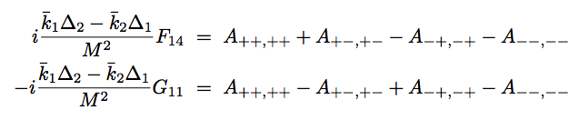
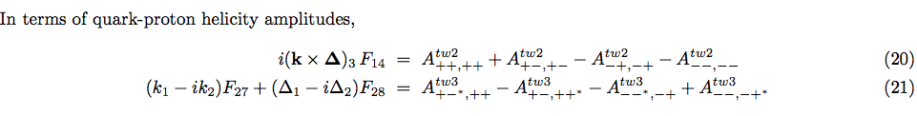
We identified the quark-proton helicity amplitudes combinations
A.Courtoy, G.Goldstein, O.Gonzalez Hernandez, S.Liuti and A.Rajan, PLB 731(2014)
A_{UL} correlation
G₂
A_{Λ’λ’,Λλ}=quark-proton helicity ampltidue
2/25/16
Simonetta Liuti
9

Slide 10
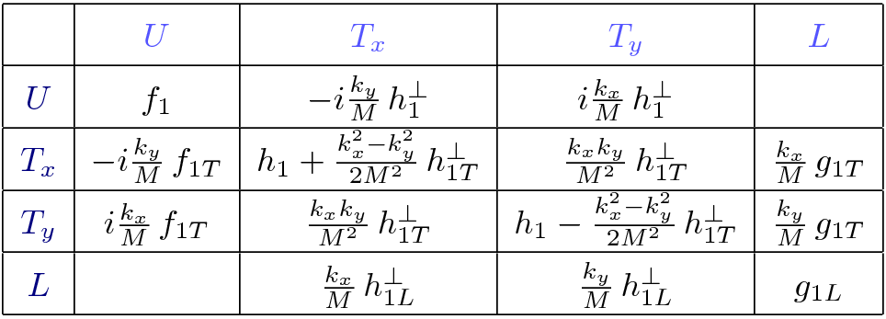
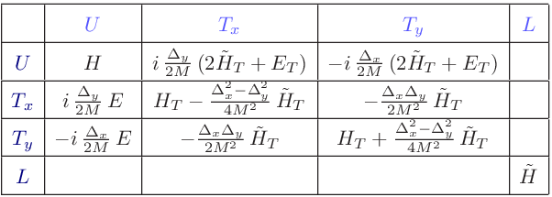
UL correlation
Direct measurement of UL correlation
p
OAM is Parity even: its corresponding matrix element
transforms like:
S
x
However, because it transforms opposite to helicity, it can only correspond to a twist three object
Parity predicts a lack of UL correlation at twist 2
TMDs
GPDs
2/25/16
10

Slide 11
In order to understand how twist three GPDs can be measured one needs to develop the appropriate formalism
We are developing the framework for extracting OAM and the 3D Structure of the nucleon from experimental data

Slide 12
Increased Complexity compared to PDFs (restrict to GPD sector)
Theoretical Framework:
Observables in terms of GPDs satisfy more complex constraints
(polynomiality, positivity)
Global Fit:
Increase in number of observables
unpolarized and polarized observables, together!
processes, DVCS, various DVMP, TCS, Recoil Polarization CS (RPCS)…
more kinematical variables

Slide 13
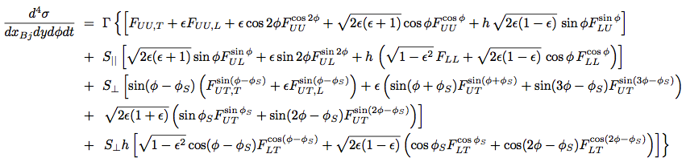


Theoretical Framework: Cross section for semi-inclusive/exclusive processes
This framework was fully developed for TMDs and SIDIS: we are working out a similar, unified approach for GPDs and Exclusive processes ➔Supersedes BKM

Slide 14
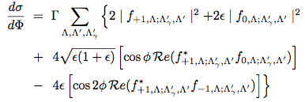
It is important to write each component of the cross section in terms of helicity amplitudes (missing in BKM formalism)
Example from upcoming manuscript
Unpolarized DVCS
Work in progress with Gary Goldstein and Abha Rajan + Jefferson Lab GPD Analysis group extending the helicity amplitudes formalism to DVCS, TCS, and RPCS

Slide 15
A few details:
General structure of structure function (for example a chiral odd term in DVMP) constructed in terms of helicity amplitudes
*
0
0
-1
+1
Λ’
+
Λ’
+
Example of observable:

Slide 16

Factorization in exclusive processes (DVCS, DVMP…)
t
q'=q+Δ, Λ_{γ}’
q, Λ_{γ}
g
k, λ
k’= k –Δ. λ’
k, λ
A
k’= k –Δ. λ’
P, Λ
P’= P-Δ, Λ’
Convolution of “hard part” with quark-proton amplitudes

Slide 17

q, Λ_{γ}
q'=q+Δ, Λ_{γ}’
g
k, λ
k’= k –Δ. λ’

Slide 18
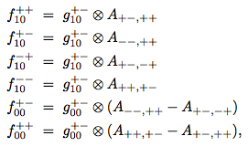

Quark-proton helicity amplitudes
t
k, λ
A
k’= k –Δ. λ’
P, Λ
P’= P-Δ, Λ’

Slide 19
Write observables in terms of GPDs: convolution analogous to PDF sector
g
Compton Form Factors: both Real and Imaginary parts

Slide 20
Global Fitting Procedure

Slide 21
Compton Form Factors
Helicity Amplitudes
A_{LU}
A_{UL,} A_{LL}
A_{UT}
Generalized Parton Distributions

Slide 22
1st practical problem: Finding a parametric functional form given the enhanced complexity
From DIS
to DVCS, DVMP
?

Slide 23
GPD Parametrizations
Double distributions (Radyushkin, Kroll, Goloskokov, VGG, Moutarde, Sabatie)
LF Wave Function Overlap (Diehl,Kroll)
Conformal Moments (Kumericki, Muller)
Covariant Scattering Matrix (Brodsky, Llanes-Estrada, Sczcepaniak,
Goldstein, Gonzalez Hernandez, Liuti)
State of the art in a nutshell
Double distributions, Conformal Moments aim at getting ξ dependence correctly (polynomiality and positivity can be satisfied a priori) but introduce t dependence empirically
Partonic picture based have to implement polynomiality order by order, but t dependence is built in from the beginning

Slide 24
From DIS
to DVCS, DVMP
Covariant Scattering Matrix Framework
Reggeized diquark model
2/25/16
24

Slide 25
GPDs (with error, Hessian, not shown)
t

Slide 26
Chiral odd GPDs

Slide 27
Compton Form Factors

Slide 28
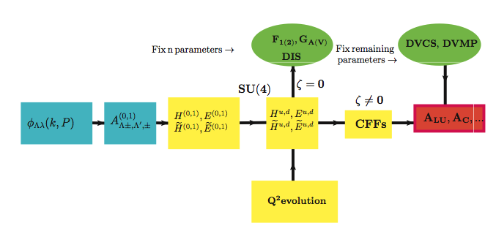
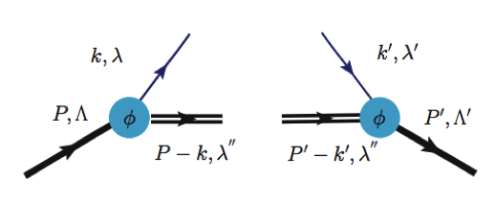
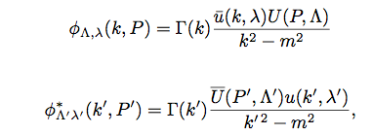
O. Gonzalez Hernandez et al., Phys. Rev. C88; arXiv:1206.1876
Recursive Fit
readjust
“model”
S=0,1
2/25/16
28

Slide 29
Comparison with Hall B DVCS data (Girod et al.)
Before fitting
additional parameters
After fit

Slide 30
Conclusions
I discussed how OAM is directly obtained from LONGITUDINAL spin correlations, not transverse
I outlined a framework to extract 3D functions (in particular GPDs) from data.
In establishing benchmarks attention must be paid to:
helicity structure and twist expansion
kinematical dependence in both models and general formalism, in particular t-dependence and interference with the twist expansion
sl4y@virginia.edu

Slide 31
Backup

Slide 32
Polynomiality in the reggeized quark-diquark approach ➔arXiv:1012.3776
ξ⁰
ξ²
ξ⁴
ξ⁶
ξ⁸
x_{Bj}=0.7

Slide 33
Compare to constraint for PDFs
The extent to which baryon number is conserved by PDF parametrizations

