Slide 1
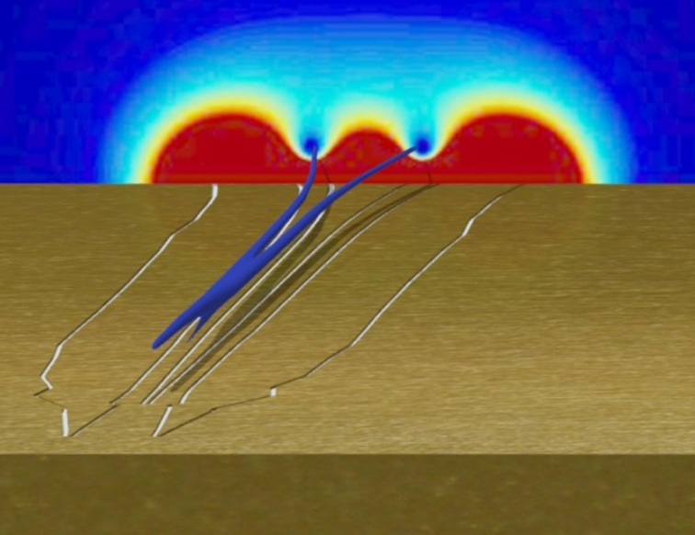
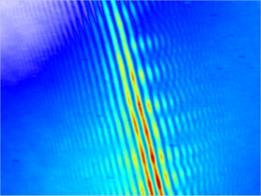
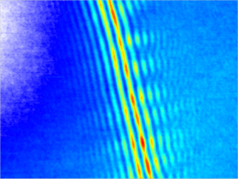
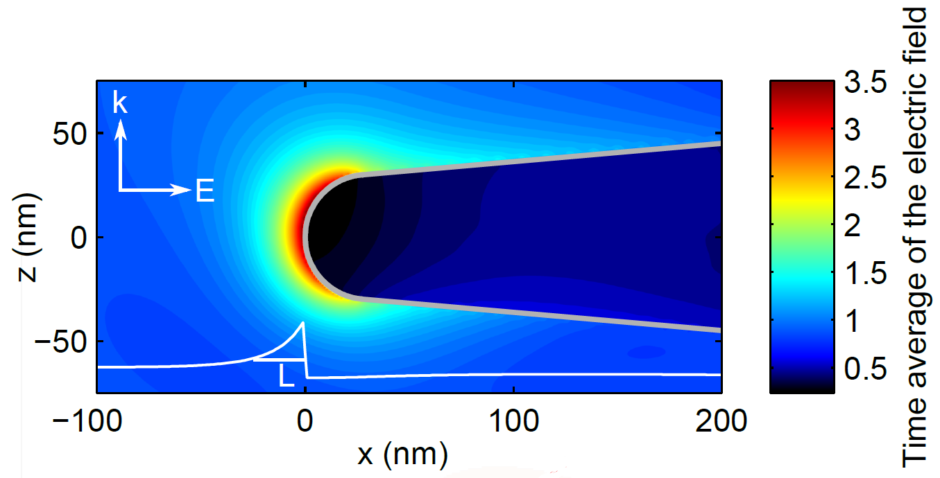
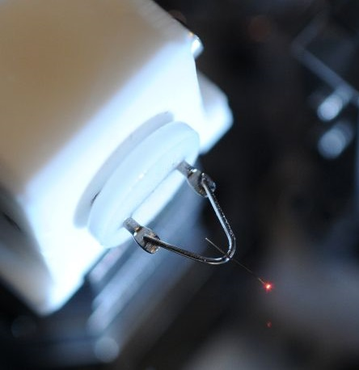
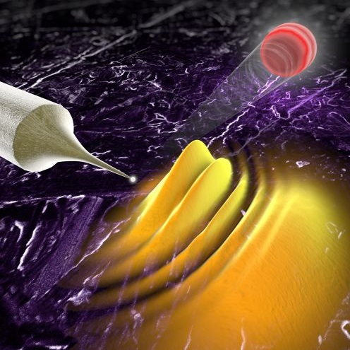
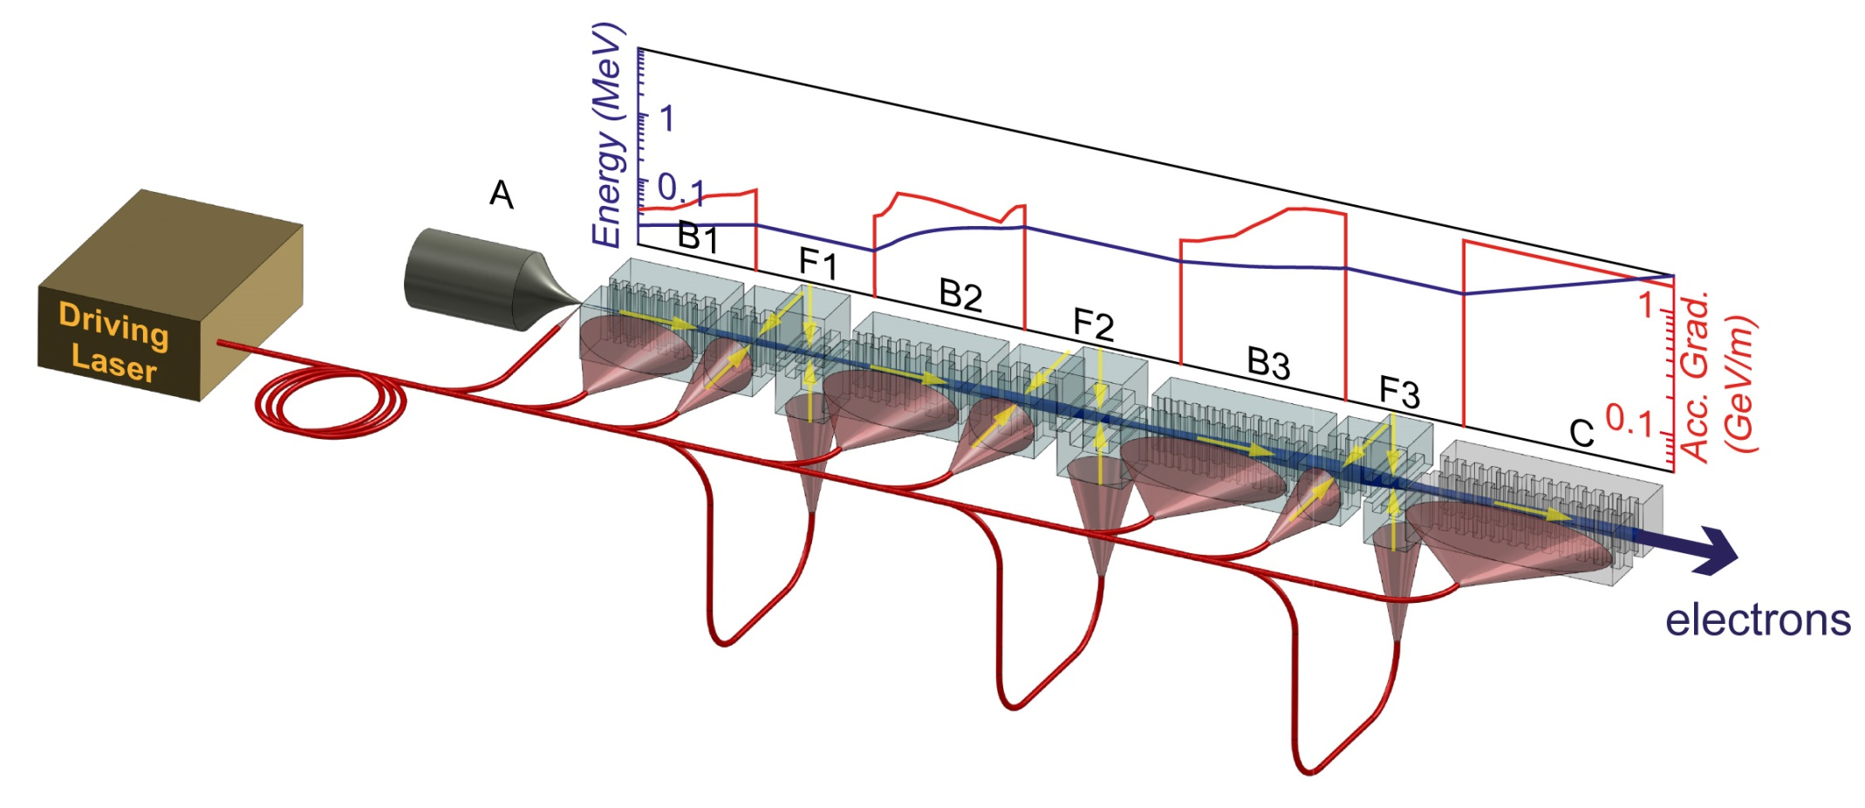
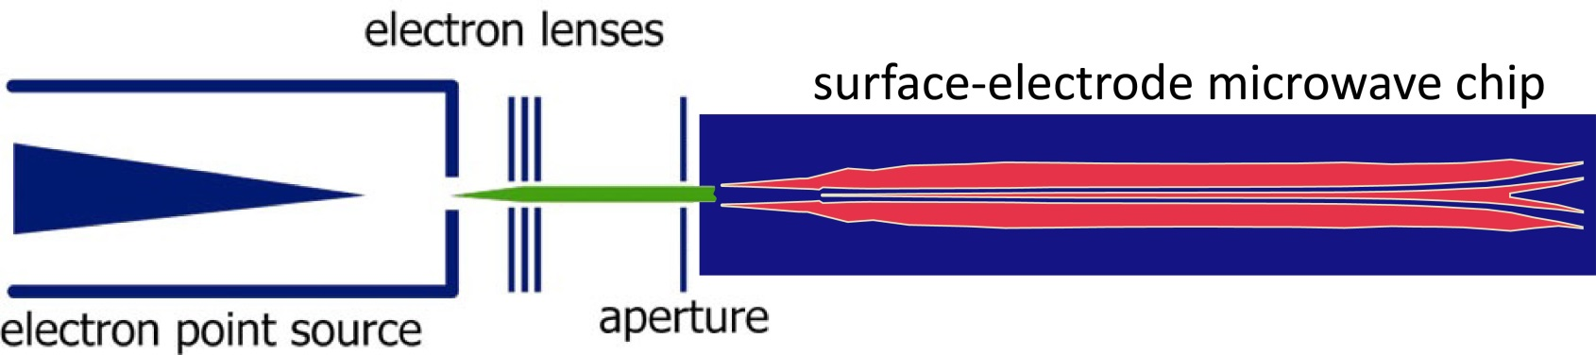
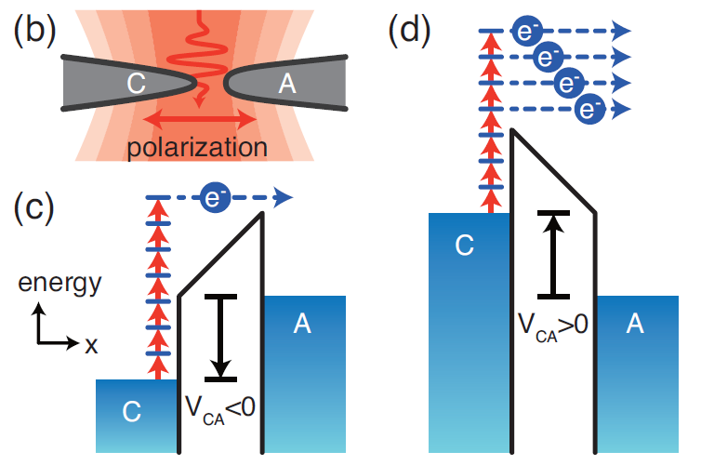

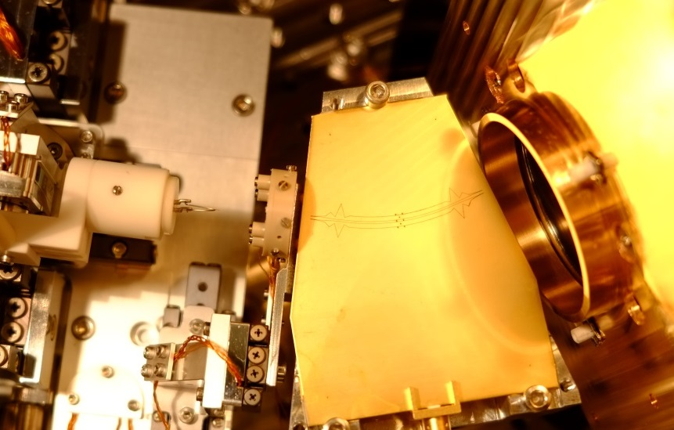
J. Breuer, M. Förster, J. Hammer, J. Hoffrogge, M. Krüger, L. Maisenbacher, S. Thomas
Peter Hommelhoff
Max-Planck-Institut für Quantenoptik, Garching bei München
Peter Hommelhoff
Department of Physics
Friedrich-Alexander-Universität Erlangen-Nürnberg (FAU), Erlangen
DC
laser
Ultrashort laser oscillator pulses meet nano-structures:
from attosecond physics at metal tips to
dielectric laser accelerators
Attosecond physics at a nanoscale metal tip
Photoemission of electrons from sharp needle tips
driven by femtosecond laser pulses: a tutorial
T. Higuchi, M. Förster, T. Paschen, Chr. Heide, P. Yousefi, P. Hommelhoff
Friedrich-Alexander-Universität Erlangen-Nürnberg (FAU), Erlangen, Germany
Max Planck Institute of Quantum Optics, Garching / Munich, Germany
Max Planck Institute for the Science of Light, Erlangen, Germany
G. Wachter, Chr. Lemell, J. Burgdörfer
TU Wien, Vienna, Austria
Martin Kozák (on behalf of Peter Hommelhoff)
Friedrich-Alexander-Universität Erlangen-Nürnberg (FAU), Erlangen, Germany
Lehrstuhl für Laserphysik, IPKM, FAU
M. Krüger, J. Hoffrogge, J. Breuer, M. Förster, J. Hammer, L. Maisenbacher,
D. Ehberger, S. Thomas, P. Dombi, P. Hommelhoff
University of Erlangen-Nuremberg, Erlangen, Germany, EU
Max Planck Institute of Quantum Optics, Garching / Munich, Germany, EU
From attosecond physics at nanotips
via photonic accelerators
to dielectric laser accelerators
Peter Hommelhoff
Friedrich-Alexander-Universität Erlangen-Nürnberg (FAU), Erlangen, Germany
Photocathode Physics for Photoinjectors (P3), 19.10.2016
to quantum-
enhanced electron
microscopy
TexPoint fonts used in EMF.
Read the TexPoint manual before you delete this box.: AAAAAAAAA
… and a 2d-Paul
trap for electrons

Slide 2
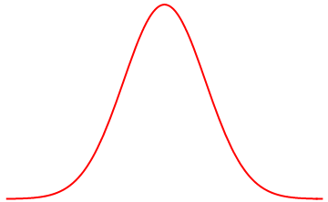
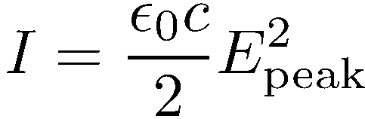

From pulsed energy to large field strengths
Pulse duration / 2
Energy constant
Pulse duration / 2
Energy constant
nJ
P (or I)
t ~ fs
P ~ MW
Focus hard:
I ~ 10¹² W/cm²
Peak electric
field ~ GV/m
t

Slide 3
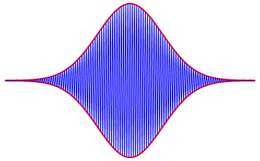

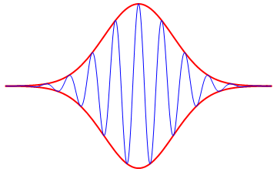
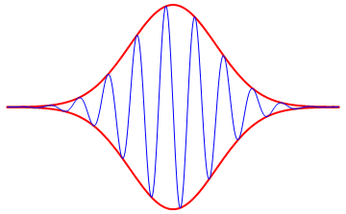
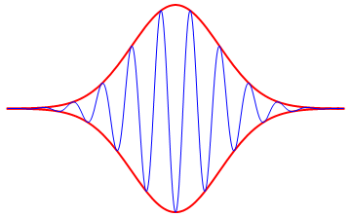

Femtosecond and few-cycle laser pulses
Field strengths of GV/m easily attainable
Peak intensities of 10¹⁵ W/cm²
Peak power: MW, GW, up to PW today
Energy
Duration
Repetition rate
Carrier-envelope phase: control over optical electric field
Carrier
Envelope
65 fs
laser pulse
Near infrared light:
One optical period at 800 nm (375 THz): 2.7 fs
Energy of a 800nm photon: 1.5 eV
800nm 375 THz | 2.7 fs 1.5 eV
Carrier-envelope phase
Optical (electric) field control at frequencies of around 1 PHz (10¹⁵ Hz); timescales of (sub-) 1 fs!
6.5 fs
laser pulses
Femtosecond frequency comb.
Invented in 1998,
2005 Nobel Prize
in Physics

Slide 4
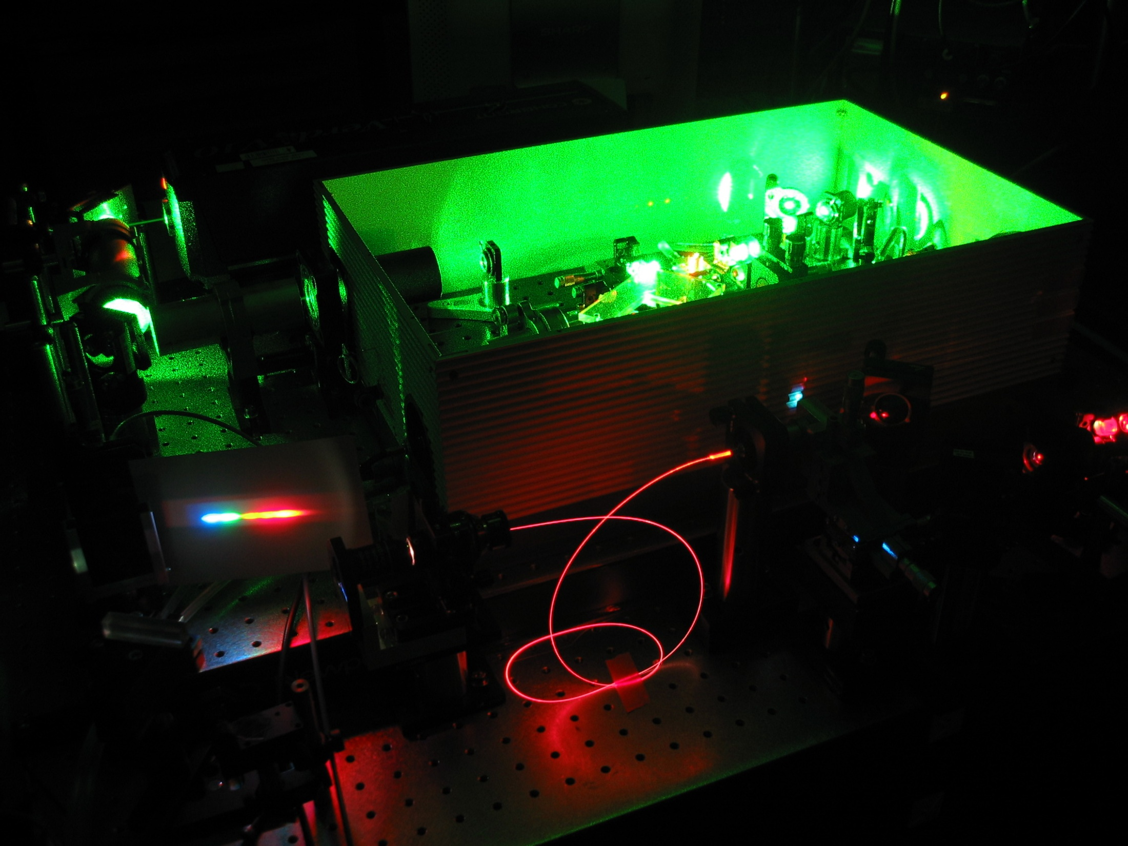
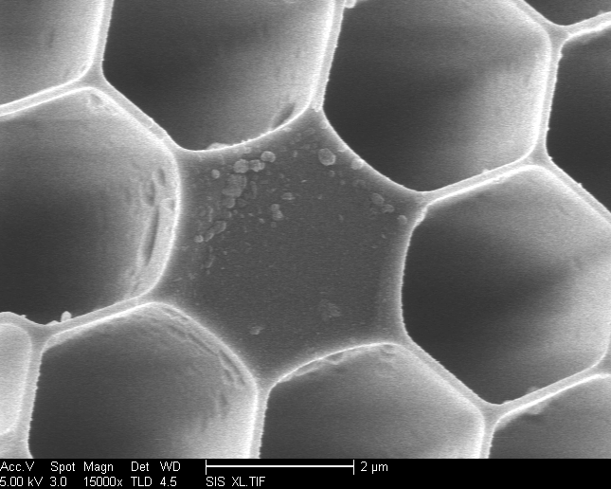
Frequency comb

Slide 5
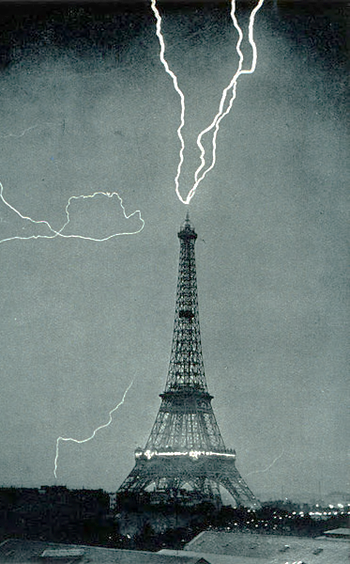
Nano-optics or near-field optics
“Plasmonics” is closely related
800 nm laser wavelength
focused on 30nm radius tip
Nano-optics & field enhancement overviews (small selection of recent literature):
Novotny, Hecht, Principles of nano-optics, Cambridge Univ. Press
Hartschuh, Tip-enhanced near-field optical microscopy, Ang. Chem. 2008
Novotny, van Hulst, Antennas for light, Nat. Phot. 2011
S. Thomas , M. Krüger. M. Förster, M. Schenk, P. Hommelhoff, NanoLett. 13, 4790 (2013)
S. Thomas, G. Wachter, Chr. Lemell, J. Burgdörfer, P. Hommelhoff, NJP 17, 063010 (2015)

Slide 6
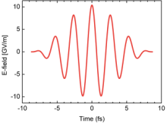
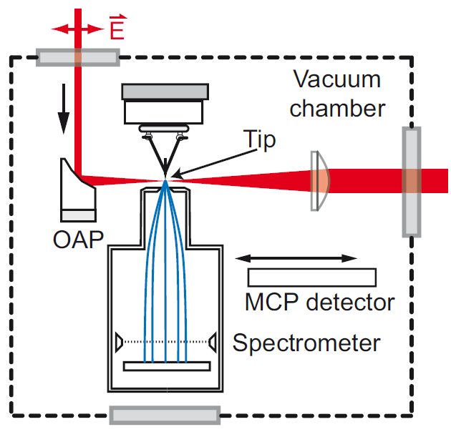
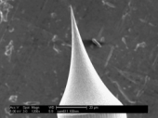
Experimental setup
sketch
Ti:sa oscillator
pulse duration 6.5 fs
central wavelength 800nm (1.56eV)
repetition rate 80MHz
max. output 750mW
max. pulse energy 9 nJ
Tungsten tip
etched from single crystal
wire in W(310) orientation
apex radius 5… 50nm
clean surface by field evaporation
Typical operating parameters:
up to 0.5nJ, 10¹¹W/cm²
Keldysh parameter (incl. FE): γ = 2
yield of <1 electron/pulse (several pA)
Focal parameters
f = 15 mm; w₀=2.2µm
max. intensity: 10¹²W/cm²

Slide 7
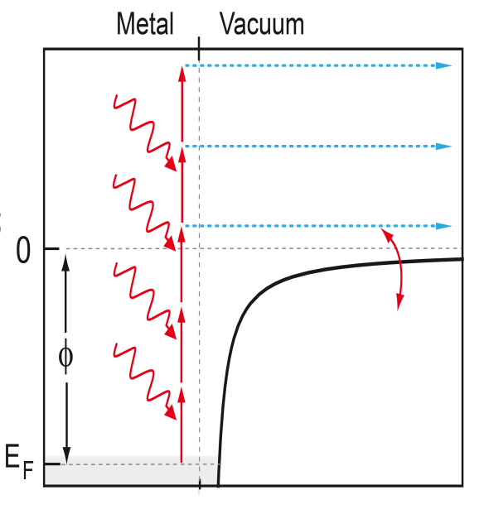
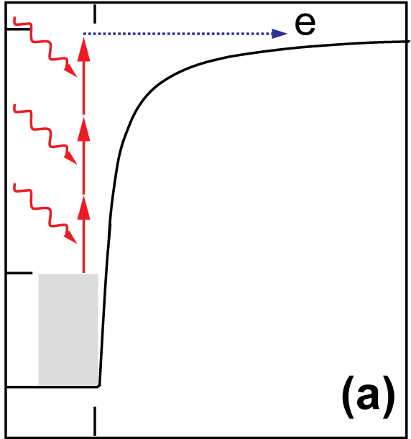
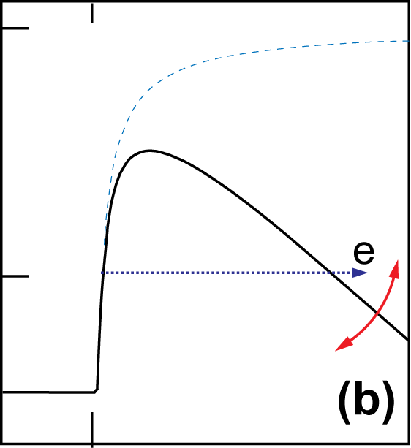
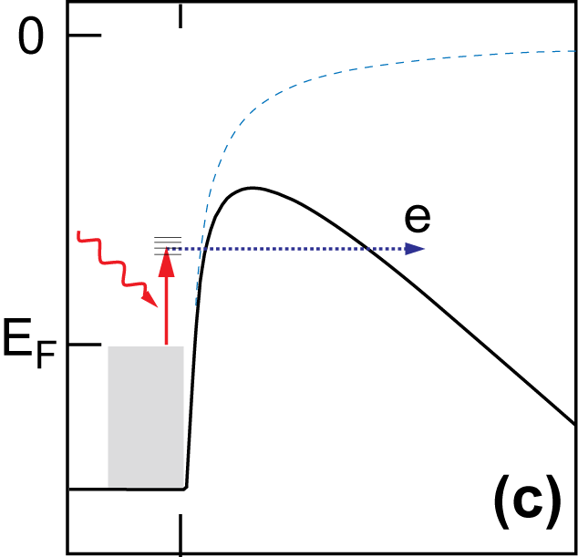
Photoemission from a metal
Multiphoton
photoemission
Above-threshold-photoemission
Light-induced direct tunneling
Photo-assisted
field emission
n-photon-
photoelectric effect:
n*E_{ph} > φ
photocurrent ~ I_{laser}
perturbative regime
Photo-assisted field emission & thermal emission not discussed today
n+1 and higher
orders of photon
absorption
potential AC-modulated
quasi-static tunneling
current resolves field
G. Farkas et al., Opt. Comm. 1983
R. Bormann et al., PRL 2010
P. Dombi et al., Opt. Expr. 2010
Strong-field regime
Increasing I_{laser}
(beyond perturbative approach)
generate static tunnel barrier
absorption of 1 photon subsequent tunneling
nonlinear in applied DC field
linear in laser intensity
n-photon-photoelectric effect: n*E_{ph}> Φ
photocurrent ~ I_{laser}^{n}
perturbative regime
intermediate regime (perturbative vs. strong-field regime)
n+1 and higher orders of photon absorption observed
potential is AC-modulated with optical frequency
electron current temporally resolves laser field
increasing I_{laser}
increasing U_{tip}

Slide 8
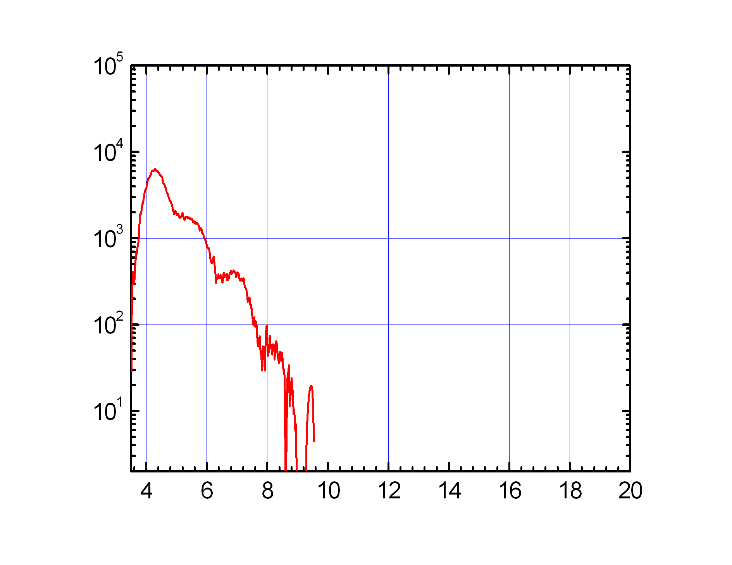
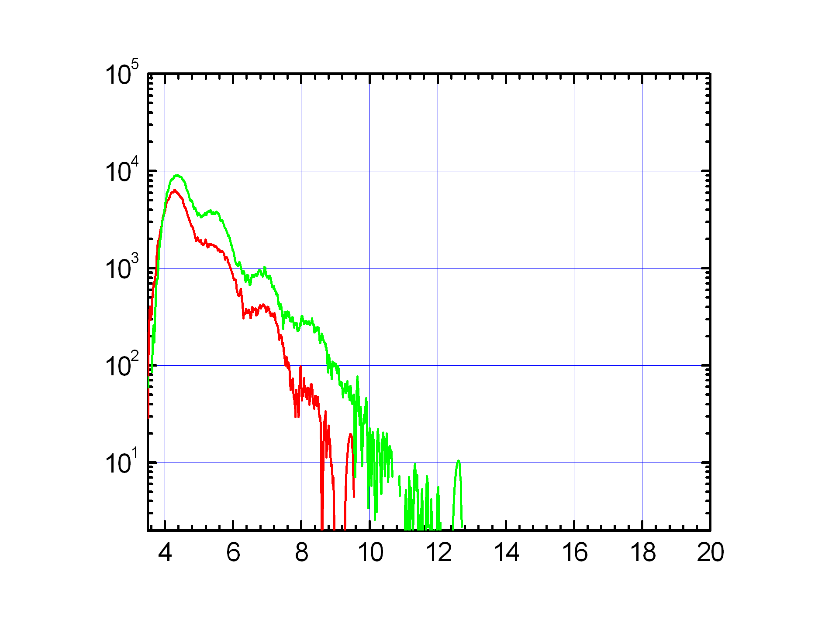
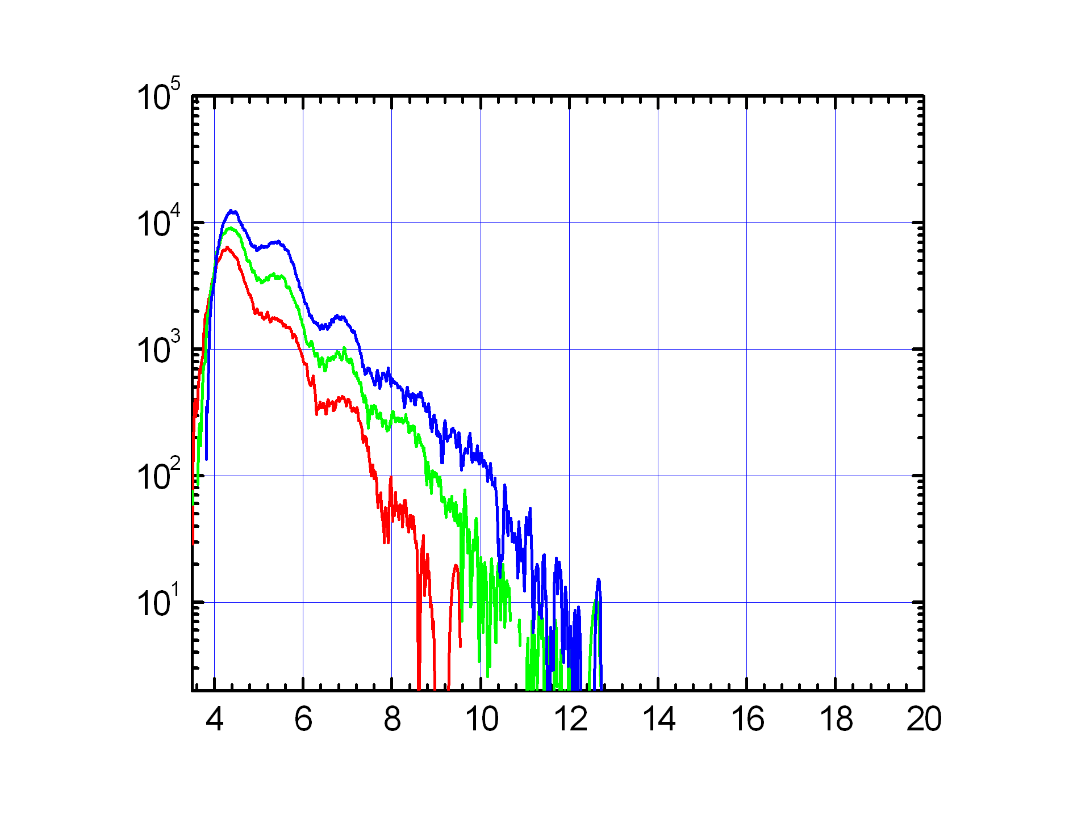
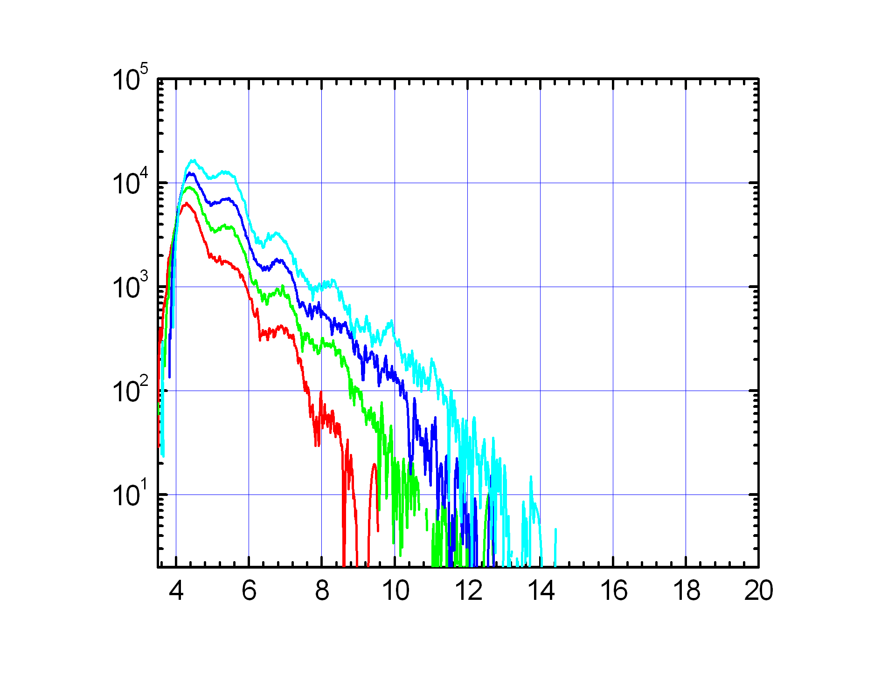
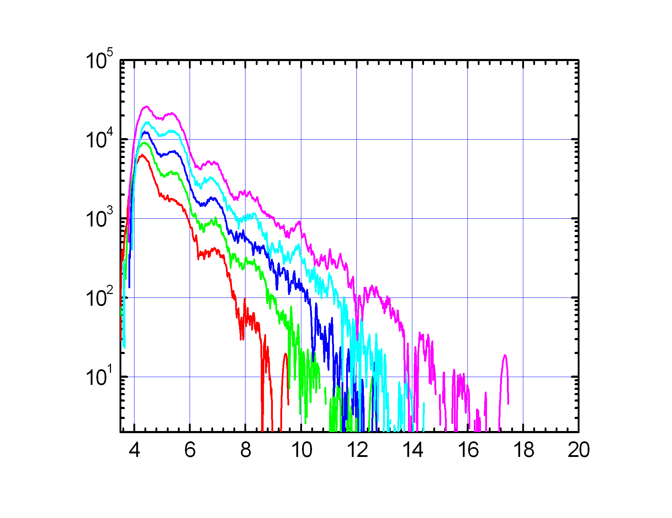
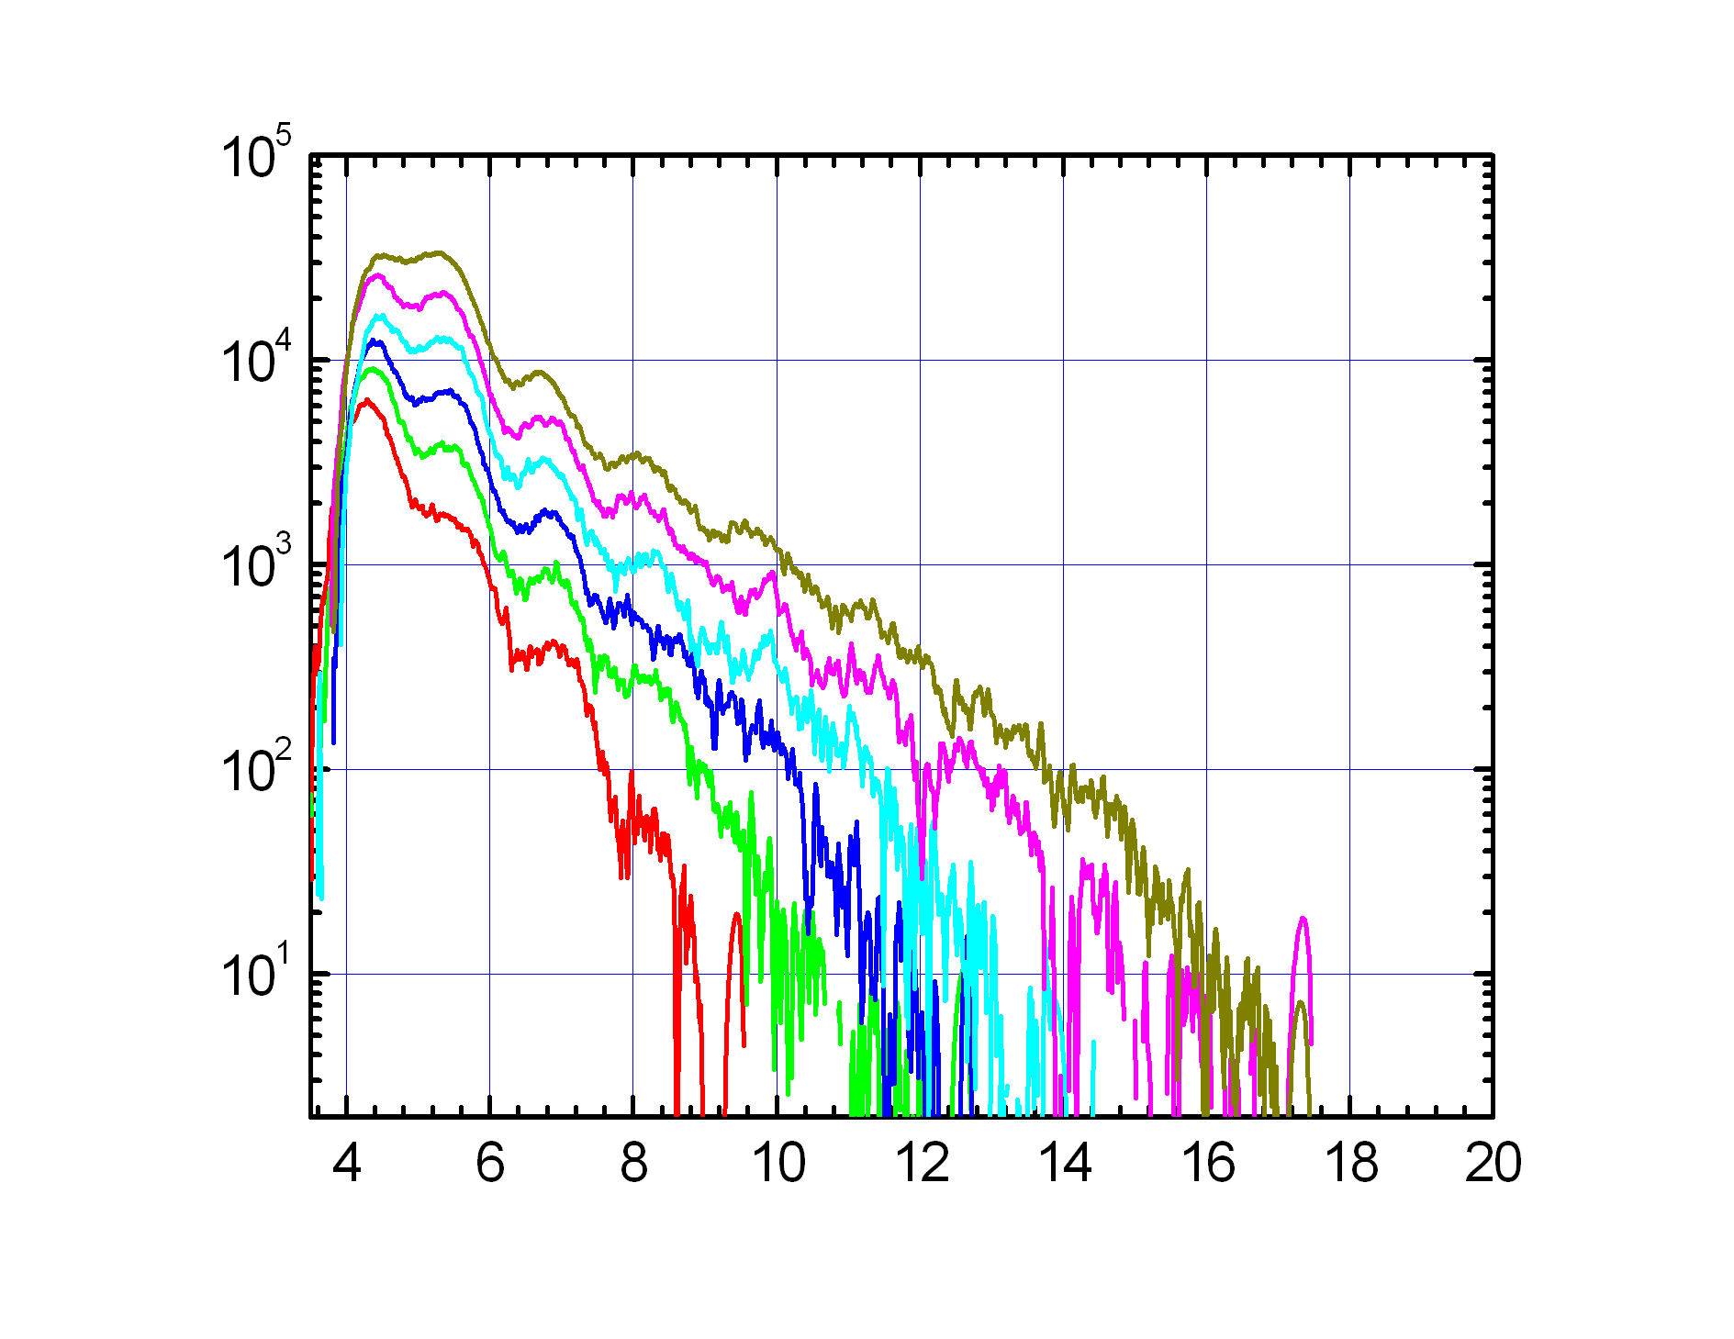
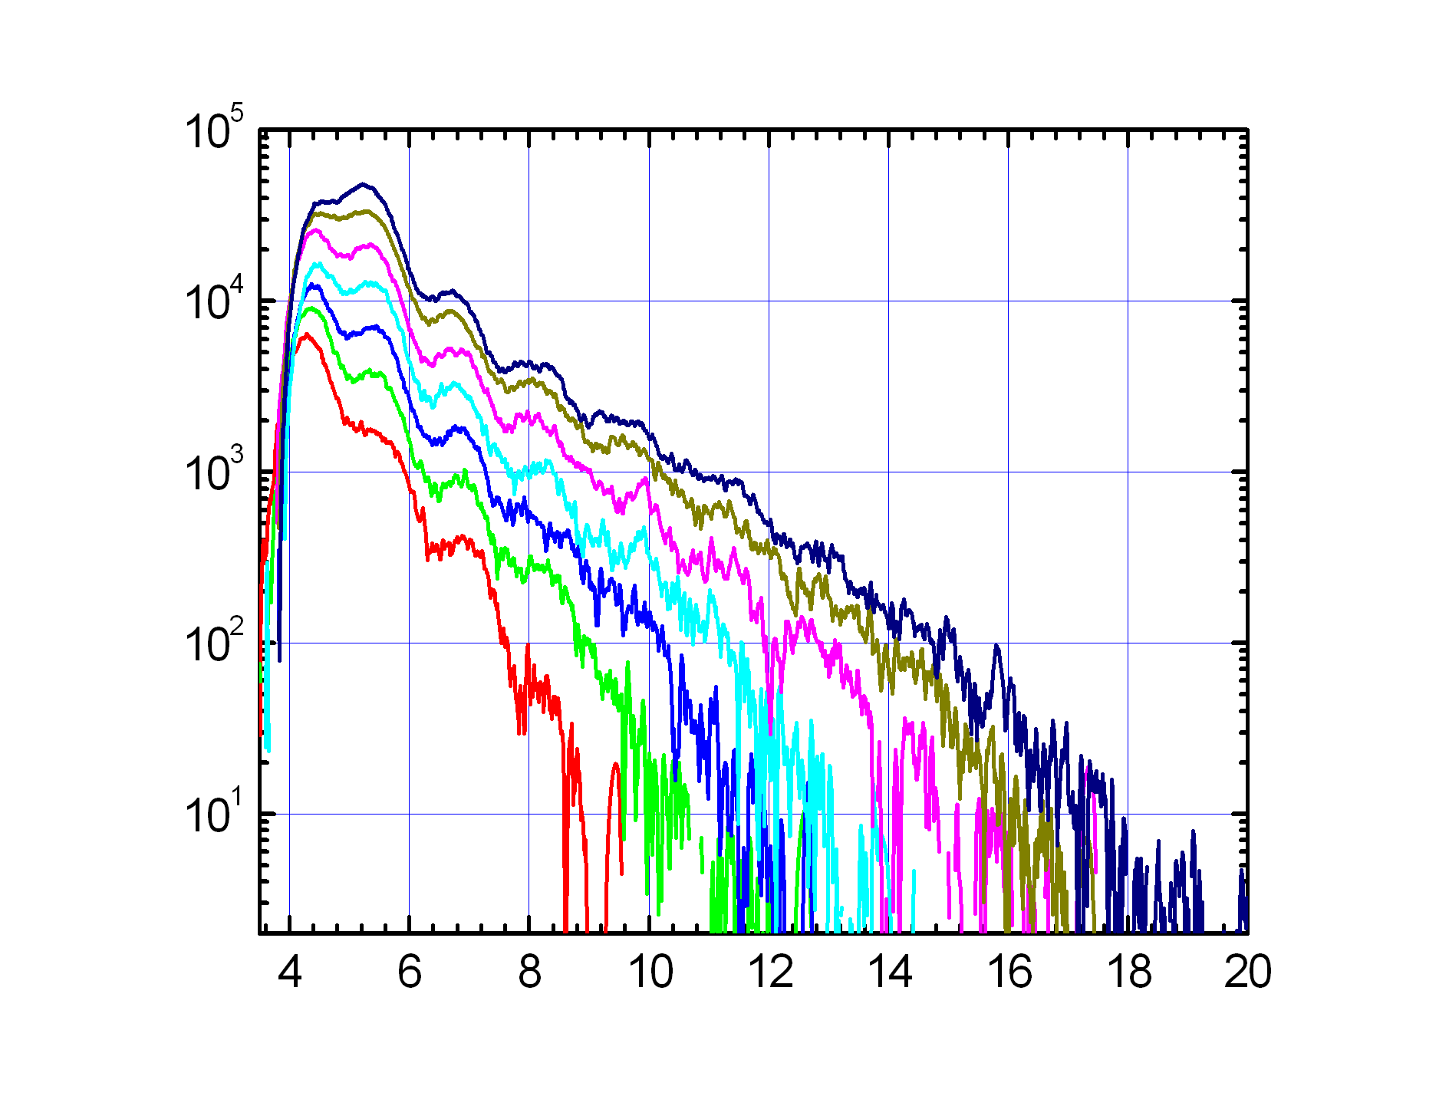
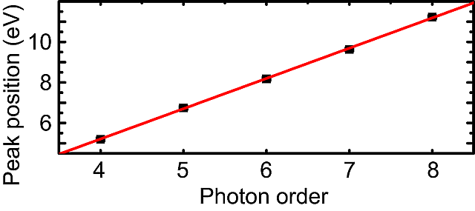
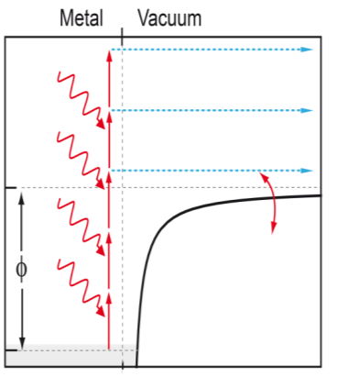
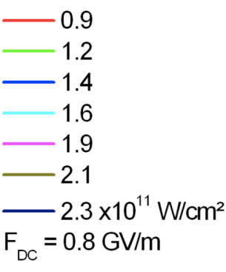
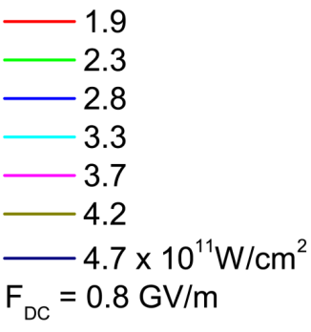
Above-threshold photoemission
3
4
5
6
7
8
Count rate / (s⁻¹ eV⁻¹)
9
ATP with 1.46 eV photons
Clear peaks because of
single clean nanoemitter
Energy (E - E_{Fermi}) / eV
M. Schenk, M. Krüger, P. Hommelhoff, Phys. Rev. Lett. 105, 257601 (2010)
1.2 GV/m (150V)

Slide 9
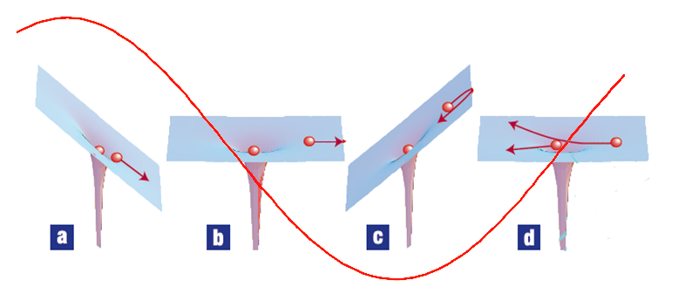
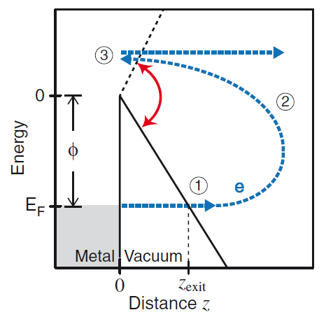
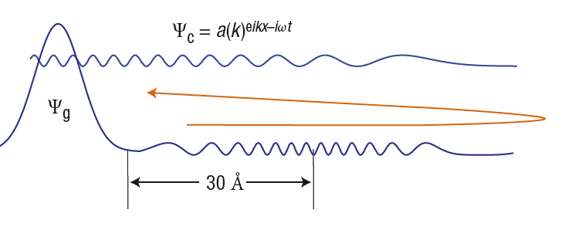
Attosecond physics – at a metal tip?
Corkum, Krausz, Nat. Phys. 2009

Slide 10
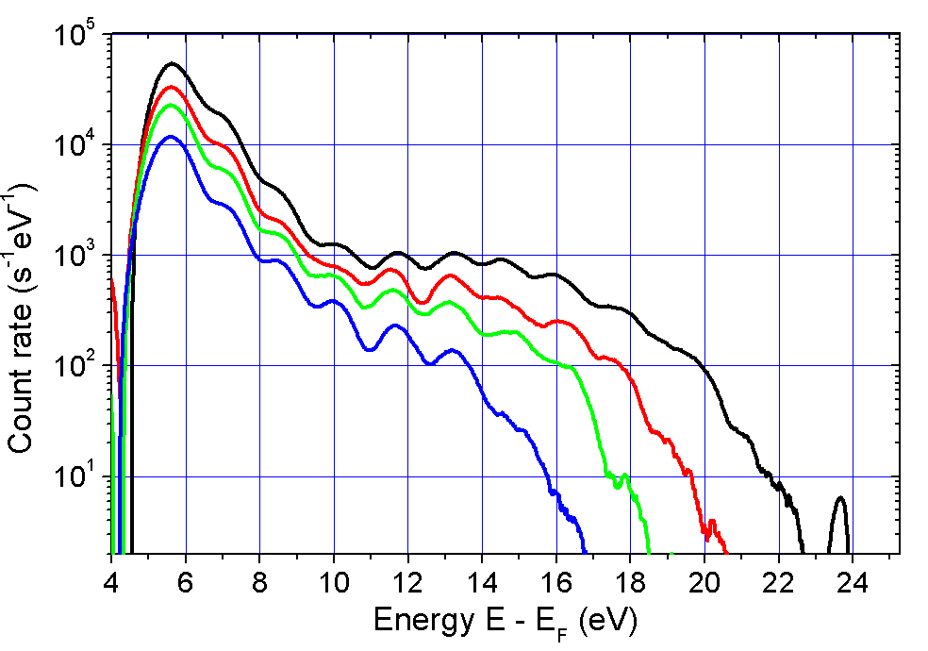
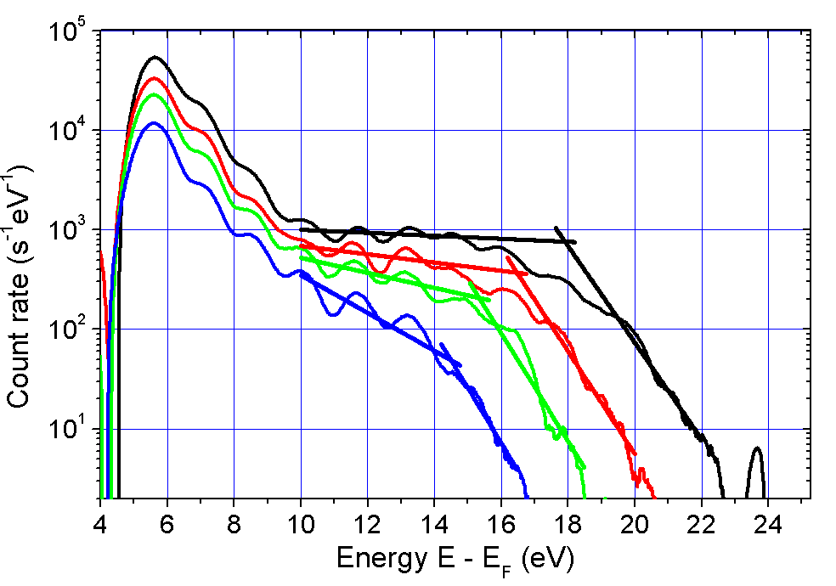
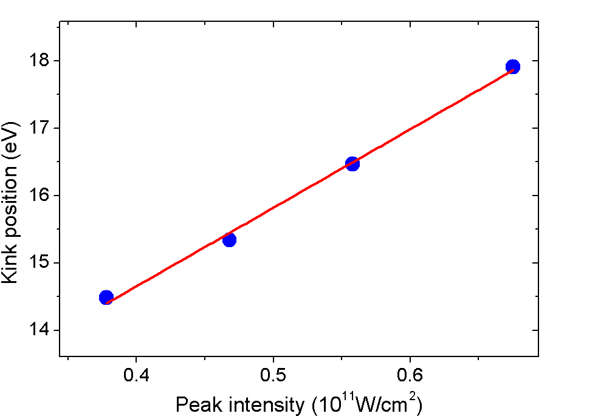
Plateau and high-energy cutoff
Indicative of (elastic) electronic recollision
F_{DC} = 0.7 GV/m (50V)
Related work:
Plateau first observed in atoms: Paulus et al., PRL 1994
Zherebtsov et al., Nature Physics 2011 (clusters)
Herink et al., Nature 2012 (tips)
Park et al. PRL 2012 (tips)
Piglosiewicz et al., Nat. Phys. (2013)
M. Krüger, M. Schenk, P. Hommelhoff, Nature 78, 475 (2011)
G. Wachter, Chr. Lemell, J. Burgdörfer, M. Schenk, M. Krüger, P. Hommelhoff,
Phys. Rev. B 86, 035402 (2012)
Notes:
Daten vom 2010-06-11

Slide 11
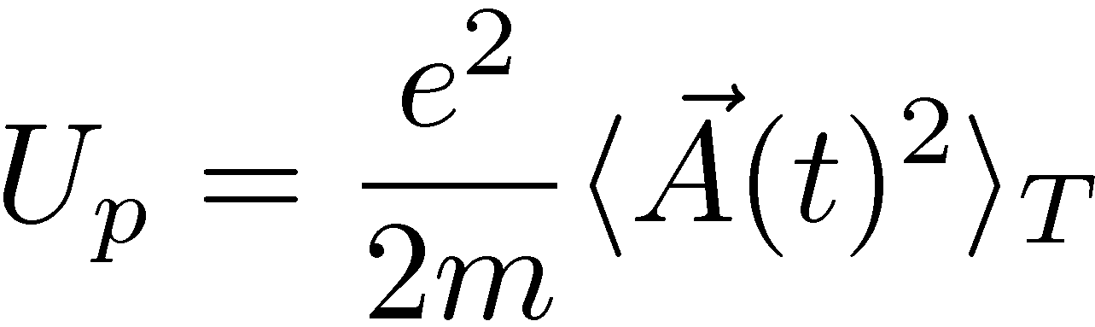
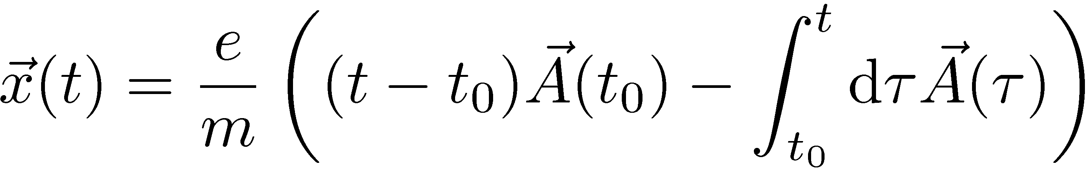
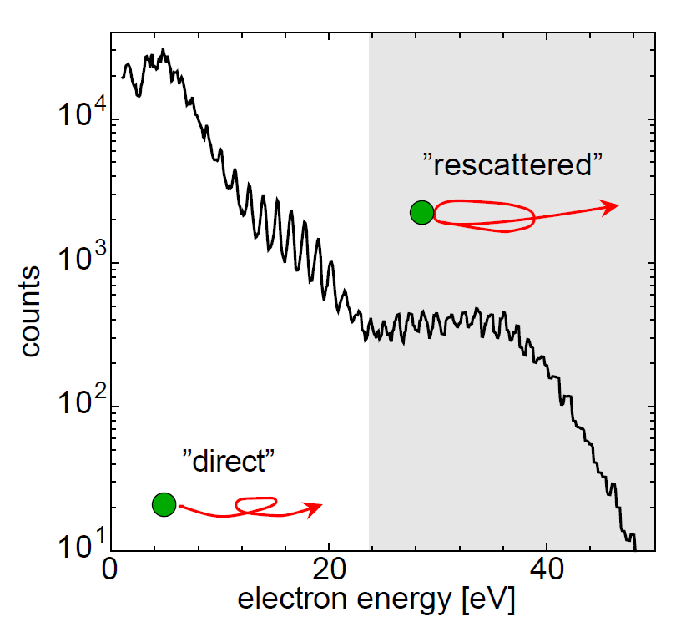
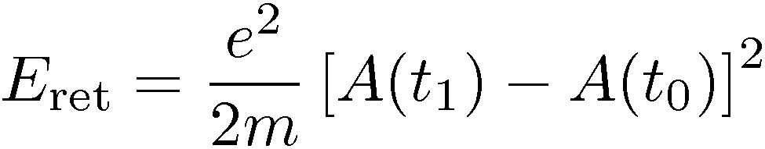


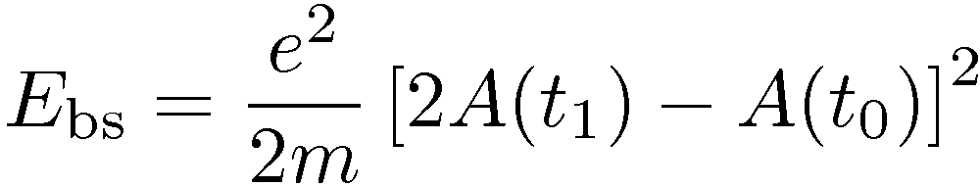


Strong-field effects: elastic rescattering
Liberated electron’s motion governed by
light field’s vector potential (and binding potential). Classically:
Cut-off
Electron scatters elastically:
Plateau
ATI spectrum of Xe, 7 x 10¹³ W/cm², 50 fs
from G. Paulus et al., Phys. Scr. 2004
Corkum 1993, Paulus et al. 1994,
W. Becker et al., Adv. At. Mol. Opt. Phys. 2002
D. Milošević et al. J. Phys. B. 2006

Slide 12
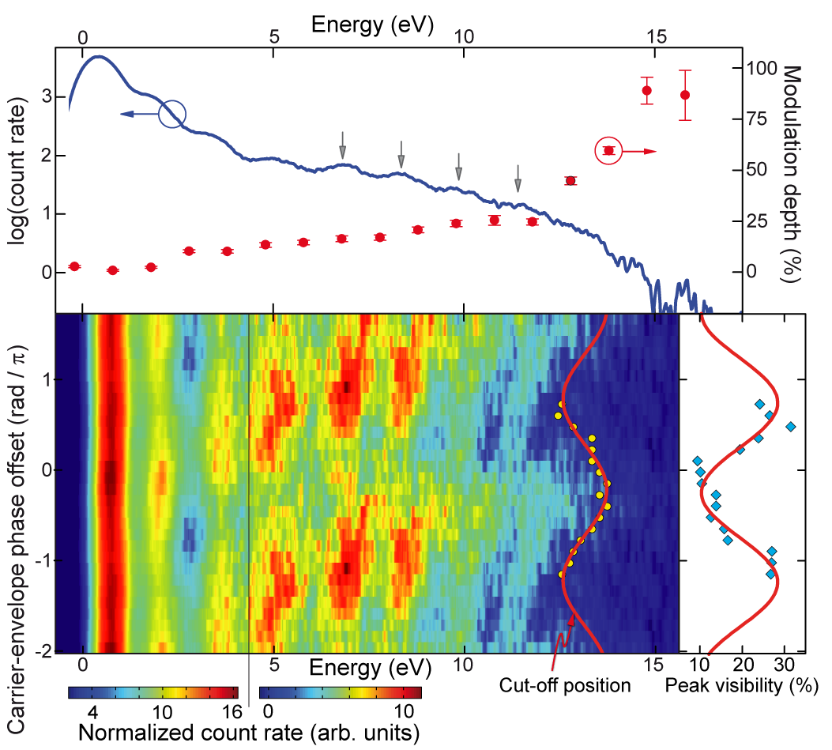
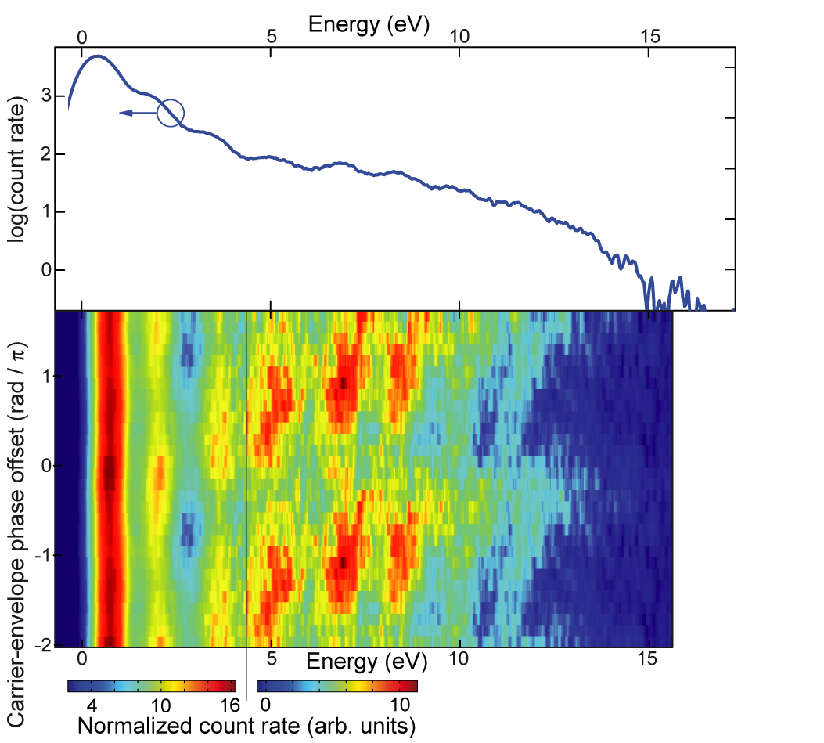




CEP effects: Cut-off and peak contrast
Cut-off position varies
– switching behavior
Peak contrast in the plateau
varies
Highest peak contrast at lowest cut-off position and vice versa
cut-off
Cut-off position
M. Krüger, M. Schenk, P. Hommelhoff, Nature 78, 475 (2011)

Slide 13

C-E phase effects moving: cutoff and peak visibility at plateau energies
highest peak contrast at lowest cutoff-position and vice versa
strong modulation in high energy part
(CEP-0 from theory)

Slide 14





Three step model (TSM)
Separate process into steps:
Emission at t₀ (emission probability
follows, e.g., ADK rate, follows electric field)
Classical propagation in light field
(Newtonian equation of motion) + accumulation of quantum-mechanical phase during propagation
Fully elastic collision with the metal and further propagation in light field => Final kinetic energy
4. Sum coherently all trajectories that lead to a given final energy
For details: D. Milosevic et al.
J. Phys.B 39, R203 (2006)
P. Corkum, PRL 71, 1994 (1993)

Slide 15




Three step model (TSM): matter wave interference
Single-vs-double slit: quantum interference; explains behavior of cutoff-position and peak contrast
Matter-wave control through C-E phase
Fully coherent matter wave control at a soild
Classical electron excursion ≈3Å
Electron emission duration: 450 as (Fourier limit of cut-off part)
Three-step model: P. Corkum, PRL 71, 1994 (1993)
M. Krüger, M. Schenk, P. Hommelhoff, Nature 78, 475 (2011)
M. Krüger, M. Schenk, M. Förster, P. Hommelhoff, J. Phys. B 45, 074006 (2012)
M. Krüger et al., J. Phys. B 47, 124022 (2014)
Matches photon picture
Related work:
Zherebtsov et al., Nature Physics 2011 (clusters)
Herink et al., Nature 2012 (tips)
Park et al. PRL 2012 (tips)
Piglosiewicz et al., Nat. Phys. (2013)

Slide 16




Electron emission modeled with TDDFT
length scale λ_{Fermi} = 0.1 nm << tip radius: → 1D ok
Time-dependent density functional theory (TDDFT)
conduction band with n_{occ}=50
Surface potential:
Jellium model
+
soft-core Coulomb potential at first layer (to enable backscattering)
Notes:
what is the result?

Slide 17



Rescattering: results of TDDFT
Change in electron density
slope corresponds to momentum
plateau builds up
interference visible
overall shape reproduced
plateau and photon orders visible
electric field strength can be extracted
TDSE calculations:
S.V. Yalunin et al., PRB 84, 195426 (2011)
S.V. Yalunin et al., Ann. Phys. 525, L12 (2013)
G. Wachter, Chr. Lemell, J. Burgdörfer, M. Schenk, M. Krüger, P. Hommelhoff, Phys. Rev. B 86, 035402 (2012)

Slide 18

A model system for strong-field physics
Tip surface breaks symmetry: fewer trajectory classes
Slightly extended simple man’s model: Gaussian wavepacket in laser field.
M. Krüger, M. Schenk, P. Hommelhoff, G. Wachter, Chr. Lemell, J. Burgdörfer, New J. Phys. 14, 085019 (2012)

Slide 19


Are laser-triggered electrons spatially coherent?
Carbon nanotube
electron beamsplitter
394nm and
405nm
(~3.2eV
photon energy)
See also work by Morin, Fink, Oshima

Slide 20


Fringes: DC vs. photo-emitted
DC
laser-triggered

Slide 21
















Line profiles in DC and laser-triggered emission
(at 40V)
laser-triggered electron emisison with near-UV pulses almost
as spatially coherent as DC-field emission
Ehberger, Hammer, Eisele, Krüger, Noe, Högele, Hommelhoff, PRL 114, 227601 (2015)

Slide 22
Quantum path interference in two-color experiment
Coherent control of electron excitation pathways in needle tips
Large visibility of 94%
M. Förster at al., arXiv:1603:01516

Slide 23
Modeling field enhancement
Dielectric function determines optical material properties

Slide 24
Field enhancement results
S. Thomas, G. Wachter, Chr. Lemell, J. Burgdörfer, P. Hommelhoff, New J. Phys. 17, 063010 (2015)

Slide 25

fs-laser driven electron emission from nanoscale tips
P. Hommelhoff et al., PRL 96, 077401 (2006)
P. Hommelhoff et al., PRL 97, 247402 (2006)
C. Ropers et al., PRL 98, 043907 (2007)
B. Barwick et al., NJP 9, 142 (2007)
S. Tsujino et al., APL 92, 193501 (2008)
R. Ganter et al., PRL 100, 064801 (2008)
S. Tsujino et al., APL 94, 093508 (2009)
H. Yanagisawa et al., PRL 103, 257603 (2009)
H. Yanagisawa et al., PRB 81, 115429 (2010)
J. Spence et al., Phil. Mag. 90, 4691 (2010)
… …
M. Merschdorf et al., APL 81, 286 (2002)
P. Hommelhoff et al., PRL 96, 077401 (2006)
P. Hommelhoff et al., PRL 97, 247402 (2006)
C. Ropers et al., PRL 98, 043907 (2007)
B. Barwick et al., NJP 9, 142 (2007)
A. Caprez et al., PRL 99, 210401 (2007)
S. Tsujino et al., APL 92, 193501 (2008)
R. Ganter et al., PRL 100, 064801 (2008)
S. Tsujino et al., APL 94, 093508 (2009)
H. Yanagisawa et al., PRL 103, 257603 (2009)
J. Spence et al., Phil. Mag. 90, 4691 (2010)
C. Kealhofer, PRB 86, 035405 (2012)
….
Time-resolved scanning tunneling micr.
Femtosecond nanometric electron
emission of free electrons: processes etc.
Aharonov-Bohm physics
Advanced electron source applications
Surface field effects
Time-resolved point projection
Thermal vs. multi-photon emission
Stanford group (Kasevich, PH)
Göttingen group (Ropers)
Nebraska group (Batelaan)
Zurich group (Yanagisawa)
PSI group (Tsujino)
Oldenburg group (Lienau)
MIT group (Berggren)
Toulouse group (Chatel, Arbout, Chalopin)
FHI group (Ernstorfer)
DESY group (Kaertner)
Trinity group (Barwick)
Konstanz group (Leitenstorfer)
…
Tsujino, PSI
Schäfer, Ropers, Göttingen

Slide 26












FAUs Lehrstuhl für Laserphysik
Peter Hommelhoff
Philip Dienstbier
Michael Förster
Christian Heide
Takuya Higuchi
Martin Hundhausen
Johannes Illmer
Martin Kozak
Ang Li
Joshua McNeur
Stefan Meier
Anna Mittelbach
Timo Paschen
Jürgen Ristein
Constanze Sturm
Alexander Tafel
Norbert Schönenberger
Philipp Weber
Peyman Yousefi
Robert Zimmermann
Open
positions!
Partners/
collaborations:
QEM collaboration
ACHIP collaboration
D. Bykov, P. Russell, MPL
R. L. Byer + coll., Stanford / SLAC
I. Hartl, F. Kärtner, R. Aßmann, DESY
R. Holzwarth, MenloSystems
Chr. Lemell, J. Burgdörfer, TU Vienna
M. Kling, F. Krausz, LMU/MPQ
G. G. Paulus, Jena
J. Rosenzweig, P. Musumeci, UCLA
M. Stockman, Georgia State
Former members:
A. Aghajani-Talesh J. Breuer P. Dombi D. Ehberger M. Eisele R. Fröhlich J. Hammer S. Heinrich J. Hoffrogge H. Kaupp M. Krüger A. Liehl L. Maisenbacher F. Najafi H. Ramadas T. Sattler Ella Schmidt M. Schenk L. Seitz J.-P. Stein H. Strzalka Y.-H. M. Tan S. Thomas Di Zhang

Slide 27

M. Kling, PH (eds.)
392 pages, appeared in March 2015.
Nine chapters by authors including
M. Kovacev, U. Morgner
P. Dombi, A. Elezzabi
U. Saalmann, J. M. Rost
Th. Brabec, Th. Fennel
M. F. Kling, P. Hommelhoff
V. Apalkov, M. I. Stockman
A. Schiffrin, M. Schultze
Chr. Lienau, M. Raschke, C. Ropers
J. Mauritsson, A. L’Huillier, A. Mikkelsen

Slide 28








Summary and outlook
Laser acceleration of electrons at a dielectric photonic structure
  Works! Max. gradient of >200 MeV/m observed
  At relativistic energies: GeV/m expected very soon
  Sub-cycle bunching: sub-femtosecond pulse structure
  Staging, tapering, deflection, focusing demonstrated
  Take advantage of
  Fast progress in (fiber) laser technology
  Existing nano-fabrication technology (silicon ok
  at wavelengths > 1.5μm!)
Towards free space quantum electron optics
  Ground state guiding; mode filters
  Coherent addition of electron wavefcts.
  Resonator experiments w/ samples
  Towards quant. electron microscope
Strong-field physics in an at nanoscale materials
  Coherent electron control: matter wave interference
  Optical-field driven control on the sub-fs time scales
  Optical field enhancement can be probed
  Various models capture the main features:
    Three-step (semi-classical)
    TDDFT, TDSE
    Simple propagation of a Gaussian wavepacket
    Quantum orbit theory
  Fully self-consistent model far off – many questions open
  Further experiments
  High degree of spatial coherence of laser-triggered electrons, virtual source size <1 nm
  Quantum interference with two-color pulses
Paul trap for electrons
  Works!
  Approaching a new quantum optics system
Free space quantum electron optics
  Ground state injection soon?
  Guided matter wave interferometer?
  Quantum electron microscope?
Field controlled electrons:
approaching light-field driven electronics?
  Strong-field physics: all well-known effects show up
  Coherent electron dynamics on attosecond time scales
  (Fourier limit of cut-off part: 450 as)
  Nanoscale vacuum tube diode
  Graphene nanojunction ideally suited?
  Attosecond field effect transistor
  Cooperative electron effects
  AC Stark based molecular wire switches
Nanoscale femtosecond electron sources
  (Almost) fully coherent electron emission
  Interesting as a source for high rep. rate experiments?

