Slide 1
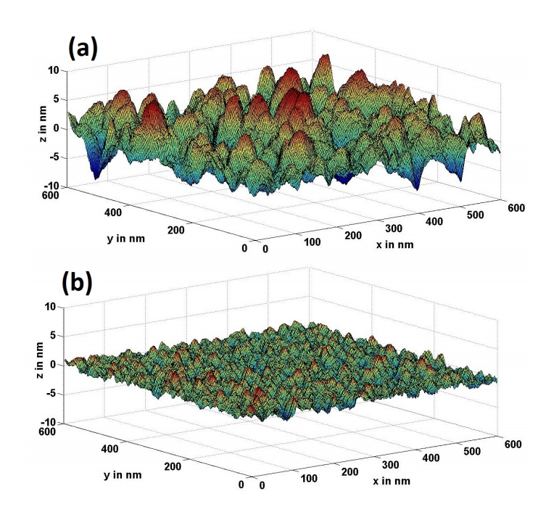
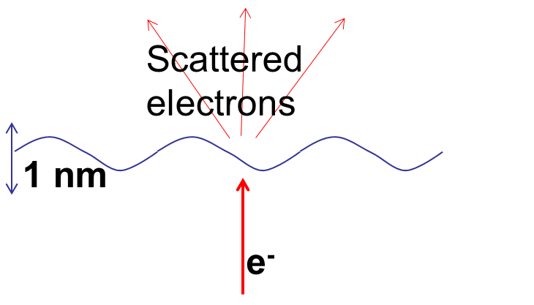
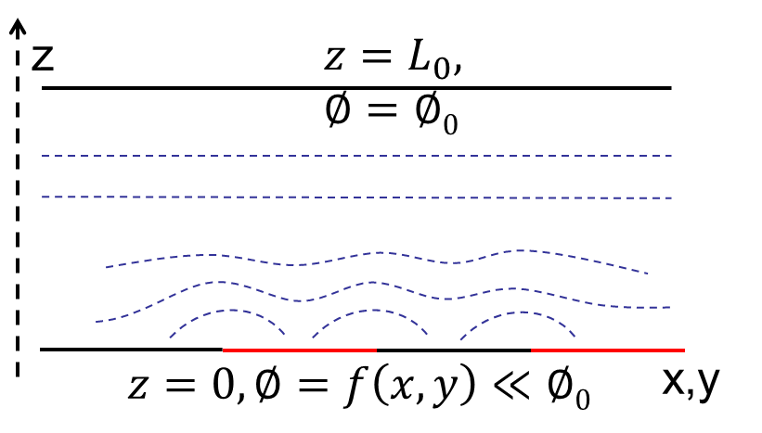
Limits on emittance from solid photocathodes due to surface non-uniformities
- Siddharth Karkare
Physical Roughness
Quantum scale effects
Chemical roughness
Acknowledgements –
Ivan Bazarov (Cornell)
Howard Padmore (LBNL)
Zihao Ding (LBNL)
Susanne Schubert (LBNL)
Jun Feng (LBNL)
Notes:
We saw several ways to obtain ultra low emittances (tips, ultracold atoms etc). In this talk, I will give a perspective about what problems we should expect while attempting to achieve ultralow emittances from solid state photocathodes. Strategies to reduce emittance, then talk about various factors that will limit emittance – physical roughness, chemical roughness and quantum scale effects.

Slide 2
Where we are?
$$MTE$$
${(ε}_{nx}/σ_{x}$)
$$\frac{ε_{nx}}{σ_{x}}=\sqrt{\frac{MTE}{mc^{2}}}$$
$$MTE=\frac{1}{2}m\left\langle v_{⊥}^{2}\right\rangle$$
1 eV
(1.4 μm/mm)
Practically used in most photoinjectors
100 meV
25-40 meV – near threshold
Metals
Very low QE<10⁻⁷
Alkali-antimonides
Low QE <10⁻⁴.
GaAs/(Cs,O)
Very long response time
(0.44 μm/mm)
10 meV
(0.14 μm/mm)
ULTRACOLD ELECTRONS
1 meV
(0.04 μm/mm)

Slide 3
Strategies to reduce emittance
Disordered surfaces –
Disordered over layers on ordered materials (GaAs(Cs/O))
Polycrystalline/amorphous materials (alkali antimonides, polished metals)
Emission best explained by 3-step model
Dowell’s theory for polycrystalline metals and alkali antimonides
Monte-Carlo simulations for GaAs(Cs/O)
Both assume isotropic emission of electrons ➔ $MTE∝E_{excess}$
$∝kT$ if $E_{excess}$→ 0
Strategy: Operate at near threshold and cryo-cool cathodes
Physical and chemical roughness both will be an issue
Notes:
Ordered surfaces – Conservation of transverse momentum, small transverse effective mass – are physically atomically smooth by definition, may still have chemical roughness- may show directed emission (eg – narrow cone from GaAs)

Slide 4
Strategies to reduce emittance
Ordered surfaces –
Can obtain LEED pattern, Clean auger spectrum
Have not been demonstrated in guns so far
Emittance given by band-structure –
Use low transverse effective mass
Surface states
Hole-like bands
Physical roughness by definition not an issue for most ordered materials
Chemical roughness may be present due to varying surface terminations

Slide 5
Limits on emittance from solid photocathodes due to surface non-uniformities
- Siddharth Karkare
Physical Roughness
Quantum scale effects
Chemical roughness
Notes:
We saw several ways to obtain ultra low emittances (tips, ultracold atoms etc). In this talk, I will give a perspective about what problems we should expect while attempting to achieve ultralow emittances from solid state photocathodes. Strategies to reduce emittance, then talk about various factors that will limit emittance – physical roughness, chemical roughness and quantum scale effects.

Slide 6
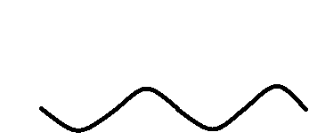
Physical roughness
First discussed by Bradley – Slope effect and Field Effect
For disordered surfaces
– isotropic emission
– near 0 K.E at emission
D.J. Bradley et al., J. Phys. D: Appl. Phys 10, 111 (1977)
➔ Negligible slope effect
Consider only field effect

Slide 7
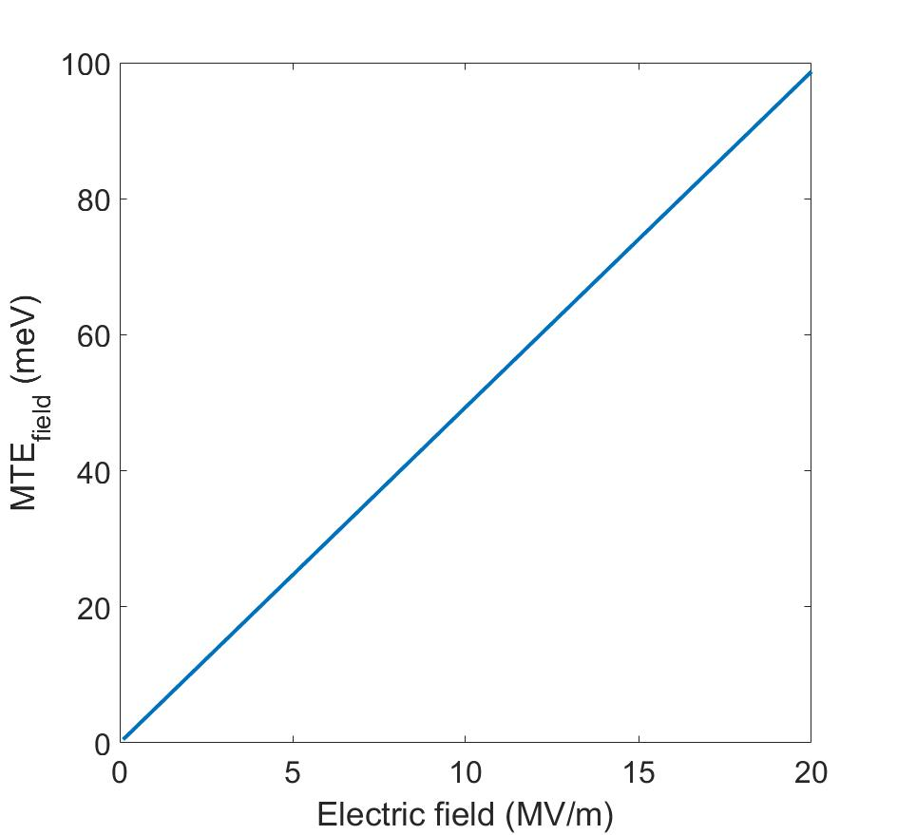
Field effect
Calculate electron trajectories in roughness distorted field to obtain increase in MTE
$$2a$$
$$λ$$
$$a=10 nm,$$
$$λ=100 nm$$
$${MTE}_{field}=\frac{π^{2}a^{2}Ee}{2λ}$$
for $a≪λ$
$$MTE={MTE}_{kT}+{MTE}_{field}$$

Slide 8
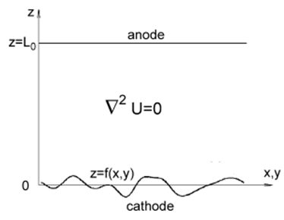
Modelling field effect
Possible to calculate this for any surface by decomposing the field into Fourier components
$$U=zE_{0}+\sum_{n}{C_{n}e^{\frac{z}{p_{n}}}φ_{n}(x,y)}$$
$$p_{n}^{−1}=\sqrt{p_{nx}^{−2}+p_{ny}^{−2}}$$
Accelerating field
>>
Distortions due to
surface roughness
$$MTE_{field}=\frac{eπ^{2}}{2E_{0}}\sum_{n}{C_{n}^{2}p_{n}/p_{nx}^{2}}$$
$$z=\sum_{n}{A_{n}φ_{n}\left(x,y\right)}$$
$$φ_{n}\left(x,y\right)=\cos\left(p_{nx}x+ψ_{nx}\right)cos⁡(p_{ny}y+ψ_{ny})$$
T. Gorlov, Journal of Electrostatics 65, 735 (2007)
S. Karkare et al., Proceedings of 2011 Particle Accelerator Conference, New York, NY, USA, THP192

Slide 9
Alkali antimonide example
UHV-AFM measurements
Sequential deposition – 2.5 nm rms
Electric field | 5 MV/m | 20 MV/m | 100 MV/m
Rough cathode (sequential deposition) | 16.6 meV | 66.6 meV | 333 meV
Smooth cathode (Co-deposition) | 2.1 meV | 8.3 meV | 41.5 meV
Co-deposition – 0.6 nm rms
~ 25K
~ 100K
For ultra-cold electrons (~2 meV)
Need atomically smooth cathodes!!

Slide 10
Limits on emittance from solid photocathodes due surface non-uniformities
- Siddharth Karkare
Physical Roughness
Chemical roughness
Quantum scale effects
Notes:
We saw several ways to obtain ultra low emittances (tips, ultracold atoms etc). In this talk, I will give a perspective about what problems we should expect while attempting to achieve ultralow emittances from solid state photocathodes. Strategies to reduce emittance, then talk about various factors that will limit emittance – physical roughness, chemical roughness and quantum scale effects.

Slide 11
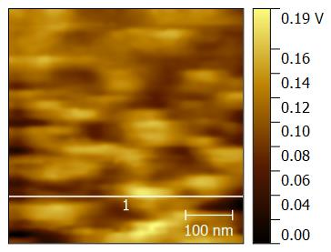
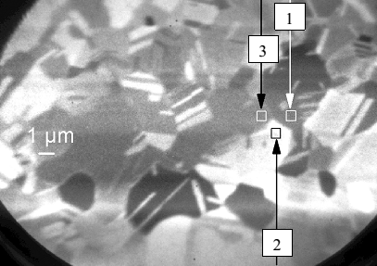
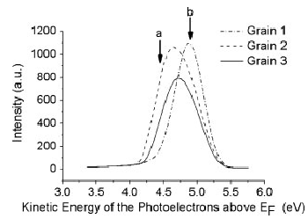
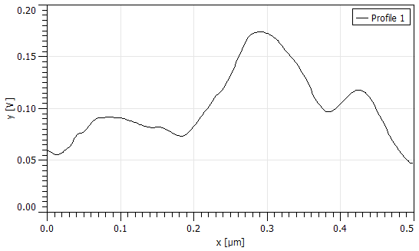
Chemical roughness
surface adsorbates
different grain orientations
different surface terminations
Kelvin Probe Force Microscopy on CsKSb
Energy Resolved or Tunable wavelength PEEM
Surface potential (V)
~0.5 V variations on clean polished Cu
Measured at LBNL
⁺Renault et al. Surf. Interface Anal. 2006; 38: 375–377

Slide 12
Modelling chemical roughness effect
Electric field $E_{0}=\frac{∅0}{L_{0}}$
z
$$z=L_{0}, ∅=∅0$$
$$f\left(x,y\right)=h sin\left(\frac{2π}{a}x\right)\sin\left(\frac{2π}{a}y\right)$$
$h$ is potential variation
$$z=0, ∅=f\left(x,y\right)≪∅0$$
x,y
$a$ is periodicity
Say $h=0.1$ V, $a=100$ nm
$γh=8$ MV/m
$MTE_{wf}$= 17 meV @ $E_{0}=10$MV/m
= 8 meV @ $E_{0}=20$MV/m
$$∅\left(x,y,z\right)=zE_{0}+h\left(e^{−zγ}\right)\sin\left(\frac{2π}{a}x\right)\sin\left(\frac{2π}{a}y\right)$$
$$MTE_{wf}=\frac{π^{2}h^{2}e}{4\sqrt{2}aE_{0}}$$
$γh≪E_{0}$ and $∆x≪a$
$$γ=\frac{2π\sqrt{2}}{a}$$
Karkare and Bazarov, Phys. Rev Applied, 4, 024015 (2015)

Slide 13
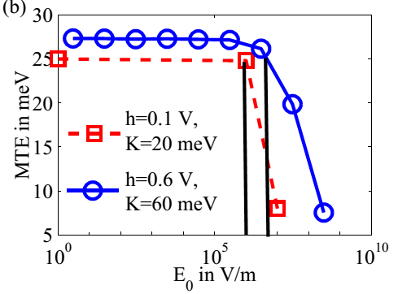
Complications in modelling
$$∅\left(x,y,z\right)=zE_{0}+h\left(e^{−zγ}\right)\sin\left(\frac{2π}{a}x\right)\sin\left(\frac{2π}{a}y\right)$$
For $γh≫E_{0}$ - Emitted electrons can re-enter the cathode
Electron emission is also non-uniform –
Low work function regions emit more electrons
Increased space charge effects
Can result in electric fields inside
cathode surfaces
More complications if physical
and chemical roughness are
present
Karkare et al. Phys. Rev Applied, 4, 024015(2015)

Slide 14
Limits on emittance from solid photocathodes due surface non-uniformities
- Siddharth Karkare
Physical Roughness
Chemical roughness
Quantum scale effects
Notes:
We saw several ways to obtain ultra low emittances (tips, ultracold atoms etc). In this talk, I will give a perspective about what problems we should expect while attempting to achieve ultralow emittances from solid state photocathodes. Strategies to reduce emittance, then talk about various factors that will limit emittance – physical roughness, chemical roughness and quantum scale effects.

Slide 15
Quantum scale effects
100 meV electrons → Wavelength > 4 nm
10 meV electrons → Wavelength > 10 nm
For surface variations with period of few nm quantum interference matters
Scattered electrons
1 nm
For example –
Sub-nm scale surface roughness can act as a diffraction grating to scatter emitted electrons
e⁻

Slide 16
GaAs example
Simplified surface – no Cs barrier, no work function variation
$$V_{h}\left(x,y\right)=Vf(x,y)$$
$$z_{interface}=f\left(x,y\right)=cos⁡(kx)$$
$$ψ_{2}$$
$$f\left(x,y\right)≪λ$$
$$ψ_{1}$$
$V=0.5$V
$$V$$
z_{min}
0
z_{max}
GaAs
Interface
Vacuum
$$m=m_{e}$$
GaAs
$$z=0$$
Vacuum
1 nm
$$H=−\frac{ℏ^{2}}{2}∇\left(\frac{1}{m}∇\right)+V∗S\left(z\right)+V_{h}\left(x,y\right)δ(z)$$
Karkare and Bazarov, Phys. Rev Applied, 4, 024015 (2015)
S(z) is the heavy-side function

Slide 17
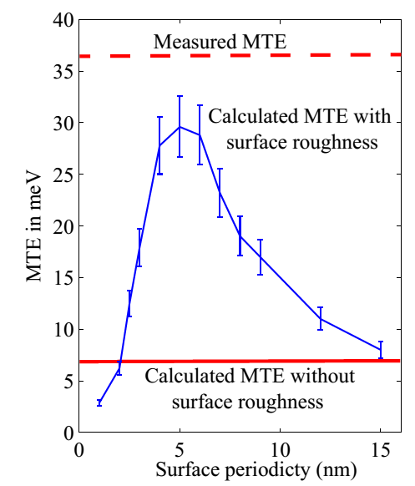
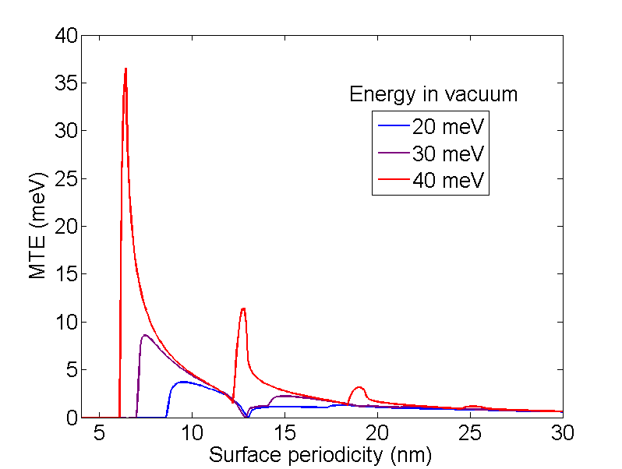
GaAs example
Scattered electrons
1 nm
Sub-nm scale roughness can be due to surface reconstructions, atomic steps or surface defects
Can explain experimental results
Karkare and Bazarov, Phys. Rev Applied, 4, 024015 (2015)

Slide 18
Conclusions
To achieve 1-2 meV scale MTE need atomically smooth cathodes
Chemical roughness or work function variations can be a major obstacle
Need to measure chemical roughness on cathode surfaces and develop simulations to calculate its effects on electron emission
Understand quantum scale effects in photoemission

