Slide 1
The effects of ion bombardment on bulk GaAs photocathodes with different surface-cleavage planes
Wei Liu
Shukui Zhang, Matt Poelker, Marcy Stutzman
Jefferson Lab

Slide 2
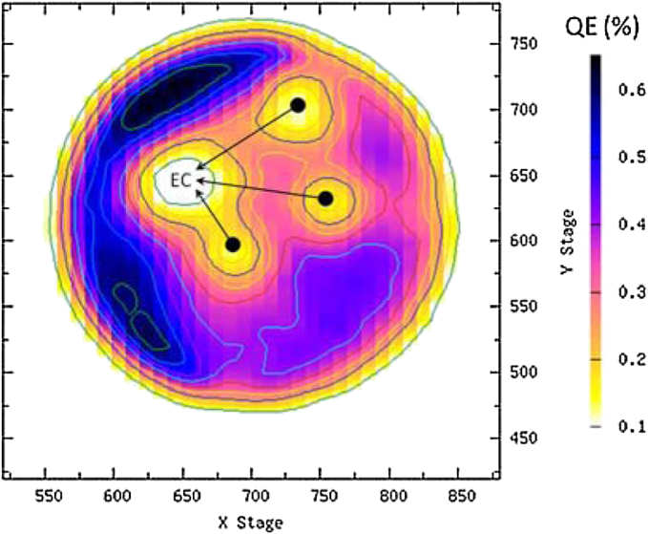
Ion back-bombardment in photo-gun
Ion back-bombardment is the dominant lifetime-limiting mechanism of modern DC high voltage photo-gun
Ion back-bombardment: the residual gas within the cathode/anode gap → ionized by the electron beam → accelerated to and implanted into photocathode → decrease the QE of photocathode (reduce the operating lifetime of photocathode)
The electron ionization cross section change with the electron kinetic energy that ranges from 0 to 100 (even to 350) keV.
Hydrogen is the dominant gas species inside a modern photo-gun
QE map of photocathode in CEBAF
J. Grames, PRST-AB 14, 043501 (2011)
Electron impact ionization cross section for $H_{2}$

Slide 3
H-ions implantation into GaAs photocathode
H-ions implant into the GaAs with different depth that depend on the H-ions energy
When H-ions energy > 500 eV, they knock out the Ga or As atom leaving the vacancy in these positions
Higher energy ions penetrate deeper into the GaAs and do more damage to the crystal structure compared to lower energy ions
Hydrogen ion distribution within GaAs
Vacancy distribution within GaAs

Slide 4
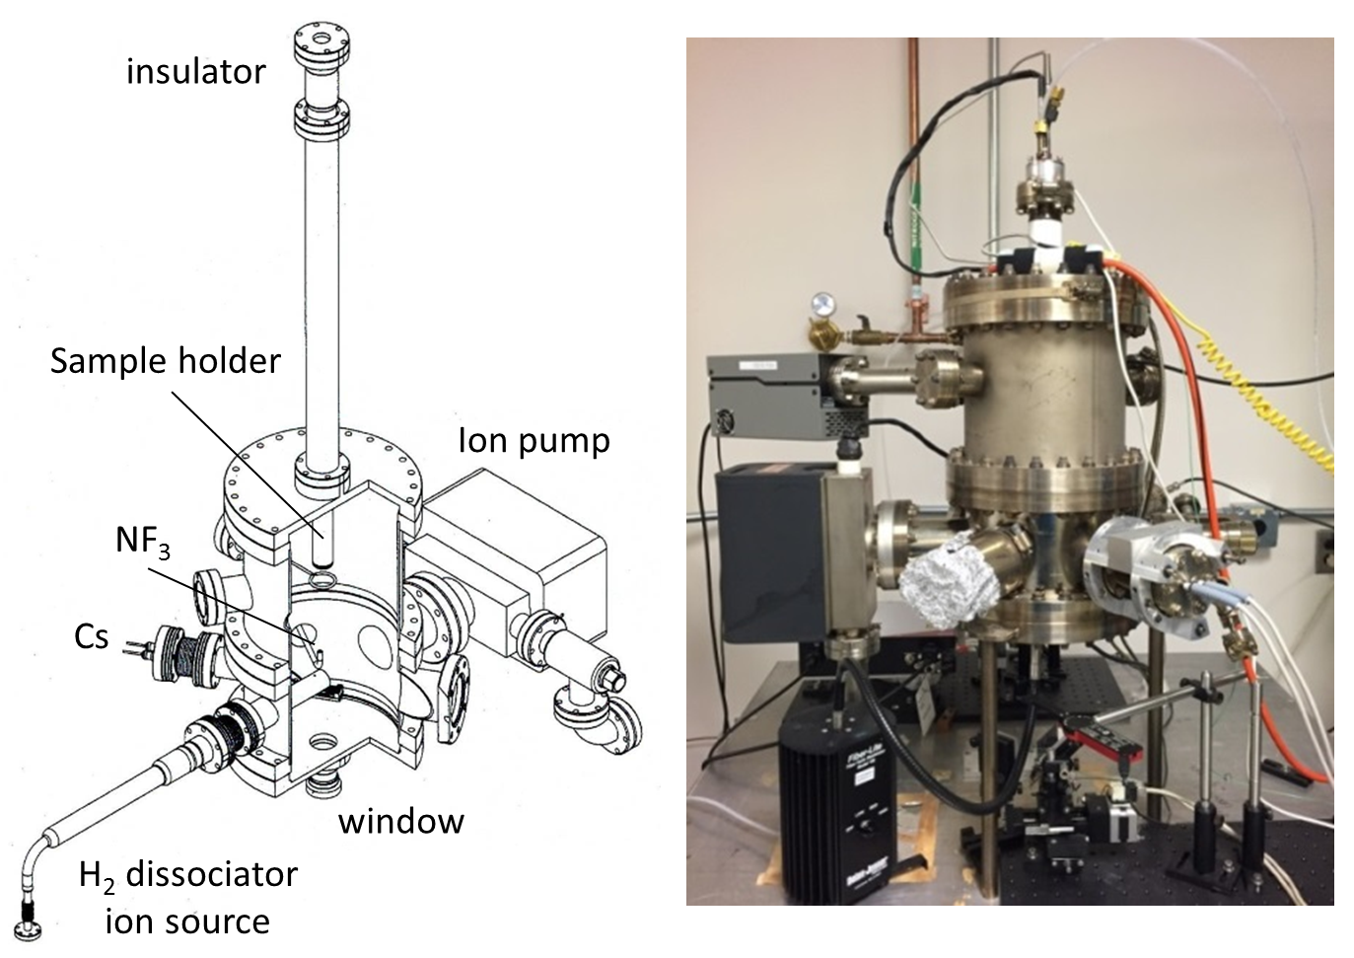
Experimental apparatus
The chamber was baked at 200°C for 36 hours to achieve a high vacuum pressure: ${10}^{−11}$ Torr
The H-ion was provided by a Pyrex glass dissociator in which the molecular hydrogen was dissociated using an RF-inductive discharge created by a 12 turn coils
The H-ion was accelerated by the negative voltage on the cathode and implanted into the photocathode
Schematic and photograph of the UHV test apparatus

Slide 5
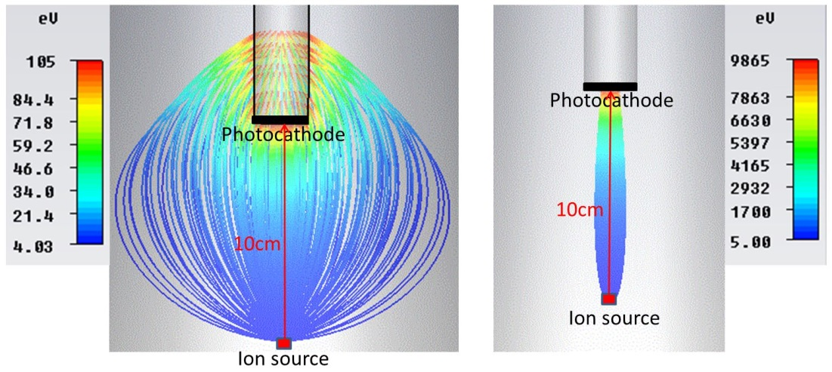
Ion trajectory from ion source to cathode
The ions have initial energy with different directions
Two bias-voltage are supplied on the cathode independently, and a picoammeter connected the voltage power supply to monitor the ion current (dose) at the cathode.
The ion trajectory at different bias-voltage are different
-100 V on the cathode
-10 kV on the cathode

Slide 6
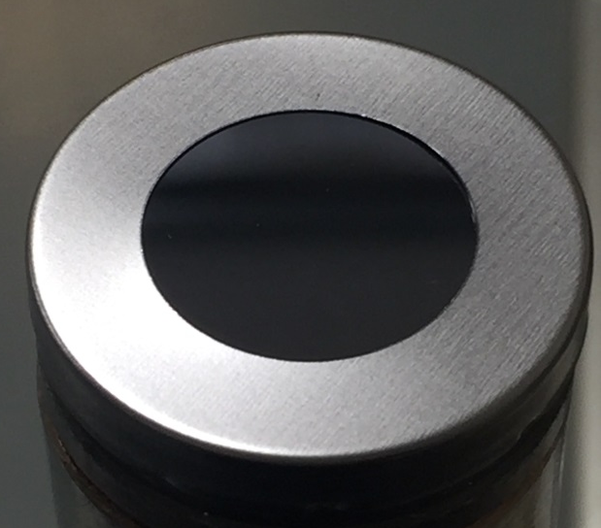
Experimental Photocathode samples
 | (100) | (110) | (111A)
Dopant | GaAs-Zn | GaAs-Zn | GaAs-Zn
Orientation | (100) ±0.5° | (110) ±0.5° | (111A) ±0.5°
Carrier concentration (a./c.c.) | 1.0~1.3E19 | 1.3~1.4E19 | 1.1~1.14E19
Resistivity (ohm.cm) | 6.6~7.7E-3 | 6.1~6.6E-3 | 7.17~7.38E-3
Mobility (cm²/v.s.) | 74~80 | 71~74 | 77~78
Thickness (µm) | 600~650 | 475~525 | 500~550
The samples were cleaved into $15×15 mm$ squares and attached to a sample holder fixed by a tantalum cap
The specifications of three bulk GaAs samples with different surface-cleavage planes
Three bulk GaAs samples with different surface-cleavage planes were used for this work
This work serves to assess which cleave plane surface provides the highest QE and best resistance to ion implantation damage
13mm

Slide 7
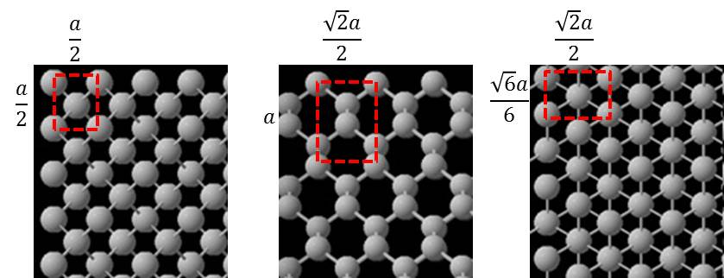
Ion channeling for three GaAs surfaces
Ion channeling: the positively charged particles (like the hydrogen ions) tend to follow the direction between two neighboring crystal planes
The effective atomic number density for the (100), (110) and (111A) GaAs cleave planes are $8/a^{2}$, $4\sqrt{2}/a^{2}$, and $4\sqrt{3}/a^{2}$, respectively.
Ion channeling would be enhanced for GaAs (110) which possesses the smallest atomic number density (i.e., the most open space between crystalline layers)
Schematic of the GaAs crystal for three surface-cleavage planes, viewed at normal incidence. From left to right, (100), (110) and (111A). $a=5.6535Å$

Slide 8
Experiment process
Heat sample to 550°C for 1 hour and then cool to room temperature (RT)
Activate the photocathode by applying Cs and $NF_{3}$ to the surface using a standard yo-yo activation protocol
QE was mapped using a low power green laser beam and QE vs wavelength was measured
Heat sample to 200°C for 30 minutes and then cool to RT
The sample was biased at either 100 or 10,000 V and exposed to H-ions of a prescribed dose
The sample was heated and re-activated multiple times to observe QE evolution

Slide 9
QE Vs wavelength for three samples
The cleave planes (100) and (110), with equal amounts of Ga and As atoms at the surface, provided the highest QE, approximately 21% at the laser wavelength of 532 nm
The cleave plane (111A), comprised of only Ga atoms at the surface, provided the lowest QE, approximately 19% at 532 nm
QE versus laser wavelength for three bulk GaAs with different surface-cleavage planes, measured before ion implantation

Slide 10
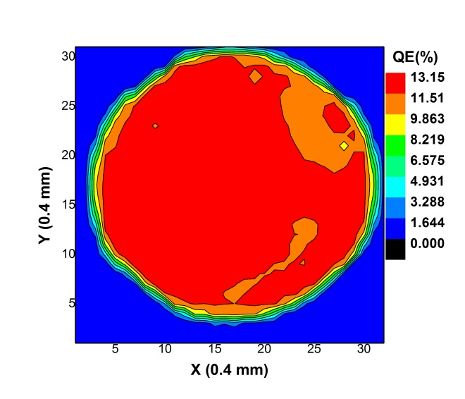
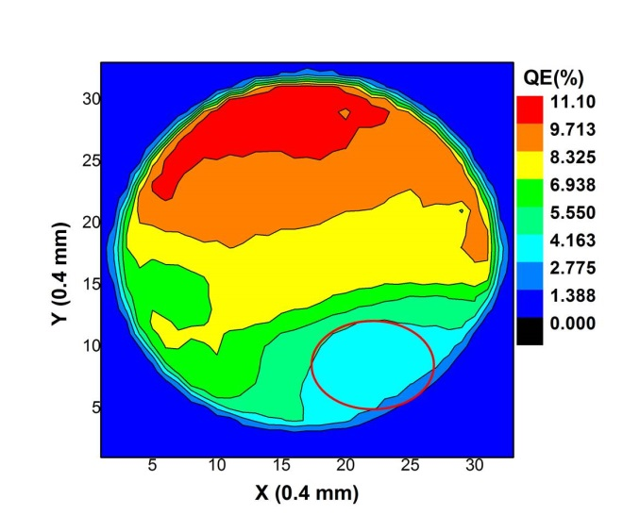
Typical QE map of photocathode
For 100 V ions: QE degradation was uniformly distributed across the sample
For 10,000 V ions: QE degradation was focused on to a specific region of the sample
Typical QE maps for bulk GaAs (111A) sample. (left) after third activation following implantation with 100 V H-ions. (right) after the third activation following implantation with 10,000 V H-ions

Slide 11
QE evolution for three samples
Both 100 V and 10,000 V H-ions degrade the QE
The QE degradation associated with 10,000 V ions was significantly greater than caused by 100 V ions
Heating the sample to higher temperature and for long time restore QE
For 100 V ions: QE could be completely restored by heating sample; For 10,000 V ions: only a fraction of the QE could be restored
T (°C) | 250 | 370 | 490 | 550 | 550
t (min) | 20 | 30 | 60 | 60 | 60
QE (532 nm) versus heat cycles for bulk GaAs with three different surface cleave planes

Slide 12
QE ratio evolution for three samples
The GaAs (110) - i.e., the sample with the most open space between atoms, and therefore the sample supporting the highest level of ion channeling - exhibited the highest QE ratio
The GaAs (100) - i.e., the sample with the least open space between atoms, and therefore the sample supporting the lowest level of ion channeling - exhibited the lowest QE ratio
QE ratio (532 nm) - samples implanted with 10,000 V H-ions to samples that were not exposed to H-ions for bulk GaAs with three different surface cleave planes
T (°C) | 250 | 370 | 490 | 550 | 550
t (min) | 20 | 30 | 60 | 60 | 60

Slide 13
Summary
Bulk GaAs was activated to QE near 20% at 532 nm. GaAs (100) provide the highest QE, and GaAs (111A) provide the lowest QE
Both high and low energy H-ion implantation reduce QE
Cleave plane (110) was the least sensitive to ion bombardment and cleave plane (100) was the most sensitive
The best choice for a photo-gun using bulk GaAs would be cleave plane (110)
Plane | Max QE (532 nm) | Recovered QE (100 V) | Recovered QE (10,000 V)
(100) | 21.16 | 19.09 | 6.27
(110) | 20.89 | 20.18 | 7.58
(111A) | 18.67 | 18.4 | 6.34

Slide 14
Thank you for your attention

