Slide 1

Simulation photo-emission from K₂CsSb photocathode
Erdong Wang on behalf of electron source group
BNL

Slide 2
Outline
Motivation
A preliminary analytical model
Monte-Carlo simulation
Three step model
Simulation results
Compare to experiment
Schottky effect

Slide 3
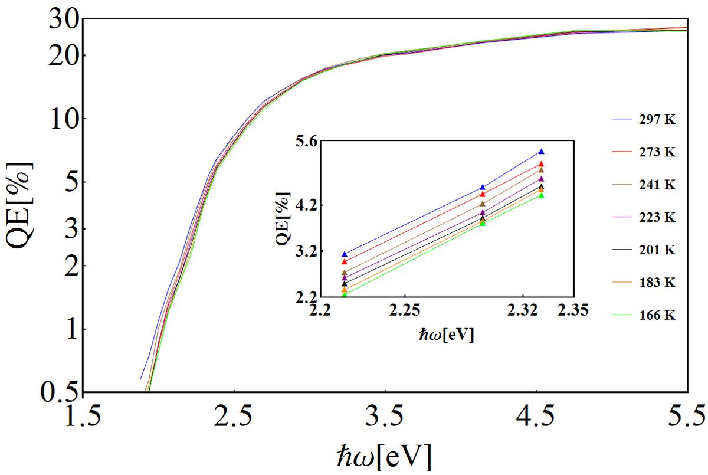
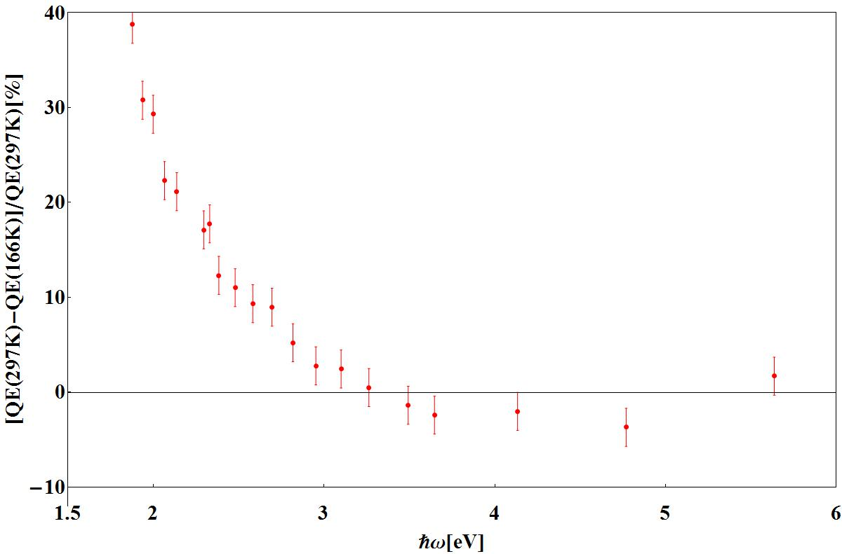
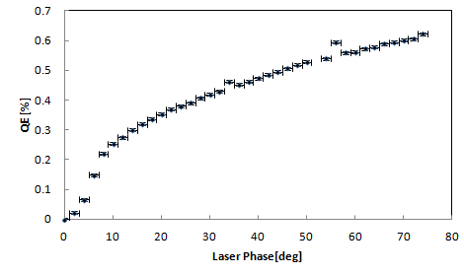
Motivation
We observed strong QE decay when cool down the cathode to 77K.
Schottky effect was observed in 704MHz gun beam test.
To understand the photoemission and cathode performance inside the gun.
Spectrum response
QE change at different temperature
Schottky effect

Slide 4
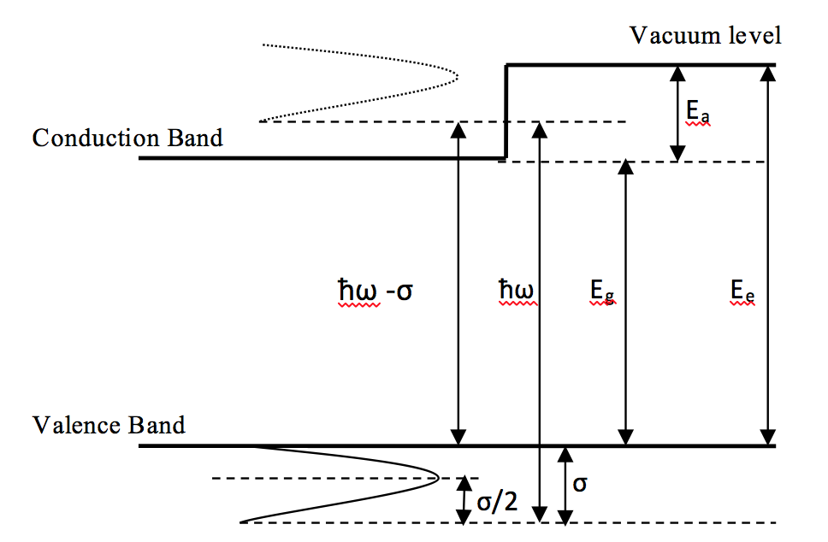
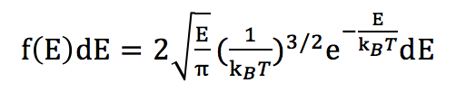
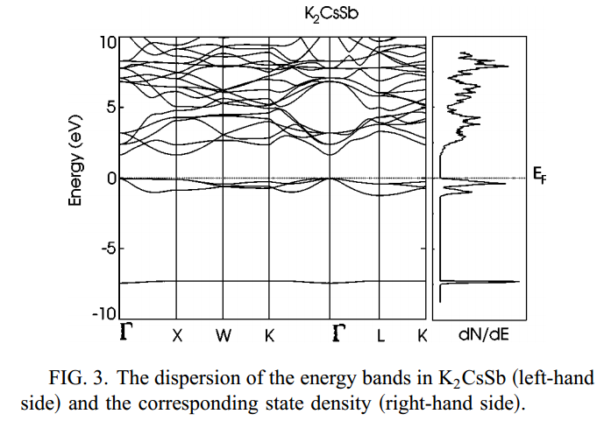
An analytical model
1. Assumed a Maxwell-Boltzmann distribution,
With k_{B}T equals to σ
2. Due to low laser power, the conduction band has sufficient states to accept the excited electrons.
3. Scattering or collision is not considered explicitly during the transport step. However, the tail in the density distribution takes these effects into consideration implicitly.
4. the energy is conserved. Momentum conservation is not considered here.
PHYSICAL REVIEW B 66, 115102(2002)

Slide 5
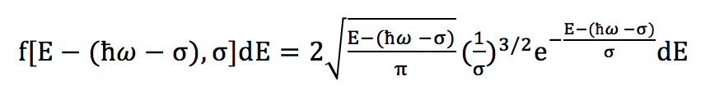

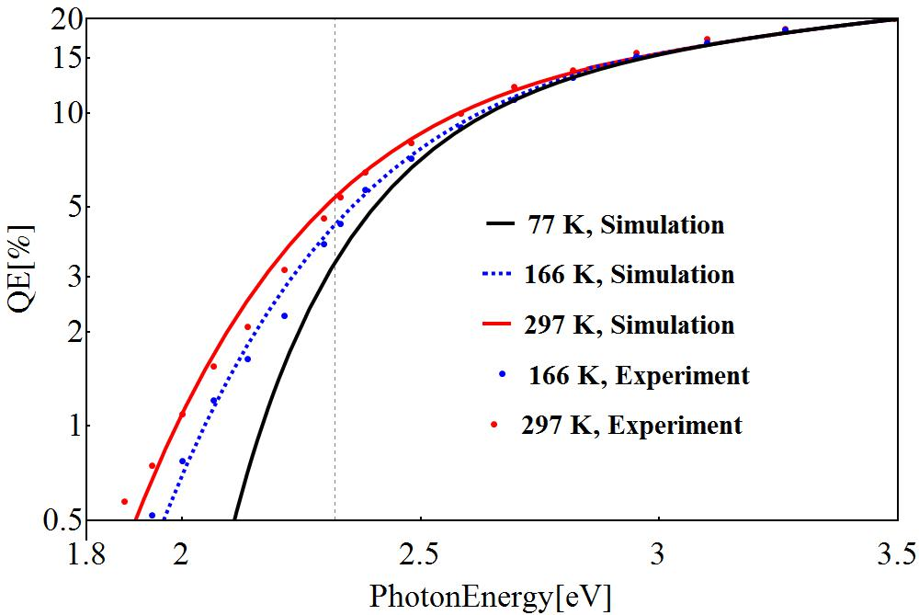


Results
Electron distribution above the conduction band
By fitting the analytical model with the experimental data (297K to 166K), we got:
Varshni. Y. P. physica (1967) 34 149-154
Fitting parameters for absorption:
B. K. Chang, et al., Proc. SPIE 1982, Photoelectronic Detection and Imaging: Technology and Applications 174 (1993)

Slide 6
Monte-Carlo simulation
To understand the K₂CsSb photocathode photoemission, we developed a python-based 2.5 D Monte-Carlo simulation code based on Spicer’s three step model. To reduce the assumptions in analytical model.
Using referenced density of states .
Considering carrier scattering and the electron-phonon scattering
Considering momentum conservation.
Could we know the thermal emittance and temporal response from the code?
How the thickness effect the QE?
This code pre-set parameters came from many references.

Slide 7
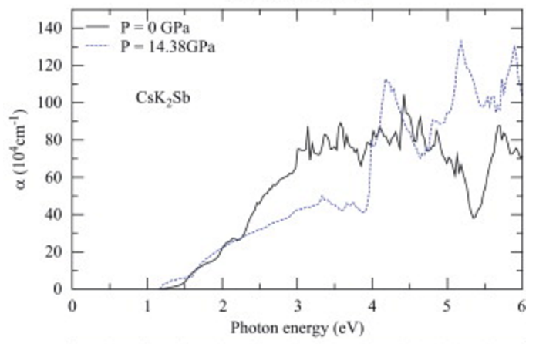
Electrons excitation
PHYSICAL REVIEW B 66, 115102(2002)
J. Phys. Chem. Solid. 71, 1732 (2010)
L.Kalarasse et al., J. Phys. Chem. Solid. 71, 1732 (2010)
We used K₂CsSb density of state. The energy distribution of excited electron is DoS_{VB} DoS_{CB}(hv)
CsK2Sb photon absorption coefficients
ERL 2015

Slide 8
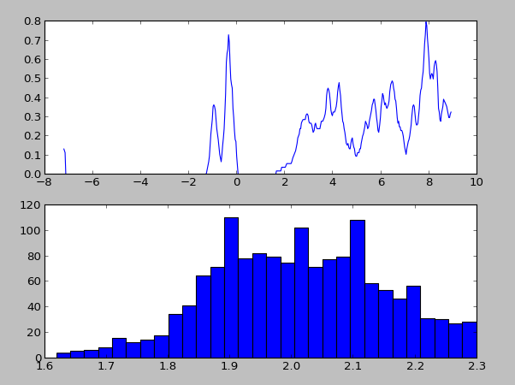
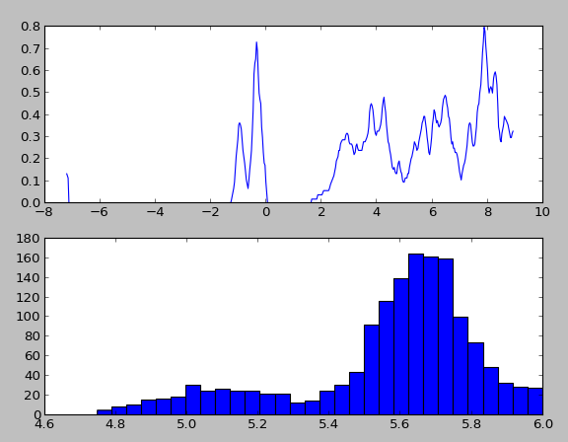
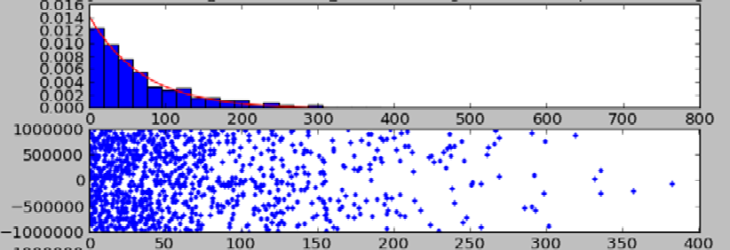
Initial electrons distribution
2.3 eV
6 eV
532nm

Slide 9

Some useful data
Effective mass
e-e scattering
K. L. Jensen, et al., J. Appl. Phys 104, 044907 (2008)
W. E. Spicer, SLAC Report NO.SLAC-PUB-6306(1993).
Eg(eV) | Ea(eV)
1.1 | 0.65 | NRL
1.2 | 0.7 | Ghosh C and Varma B P. J. Appl. Phys, 1978, 49 (8): 4549-4553
1.2 | 0.7 | CPC(HEP & NP), 2012, 36(6): 531–537
1.6 | 0.2 | A. R. H. F. Ettema , PHYSICAL REVIEW B 66, 115102 ~2002
1 |  | Nathan, R., Mee, C. H. B.: Int. J. Electron. 23 (1967) 349
1.2 |  | Sommer, A. H.: Photoemissive Materials, John Wiley, New York 1968
1.4 |  | Kalarasse et al, Journal of Physics and Chemistry of Solids 71 (2010) 314–322

Slide 10
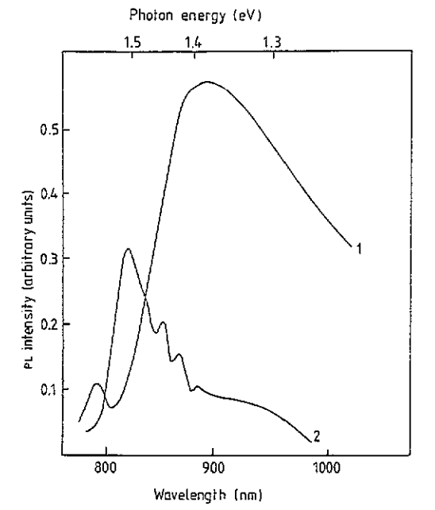
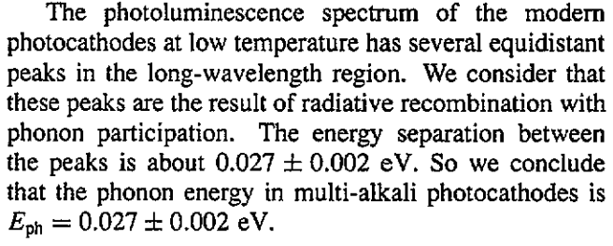
Phonon scattering in electrons transport
V. Beguchev J. Phys. : Apl. Phys. 26 (1993) 4499-4502
Electron phonon scattering:
Electrons scatter from one valley to another by absorbing or emitting an optical phonon of energy.
E_{k’} = E_{k}+-hω where hw is the phonon energy (0.027eV)
Electron will not loss energy in scattering once the energy of the electron is less than one phonon energy above the minimum of the conduction band.
Each scattering-> change energy-> change angle-> update (px, py,pz)->update (y,z)

Slide 11
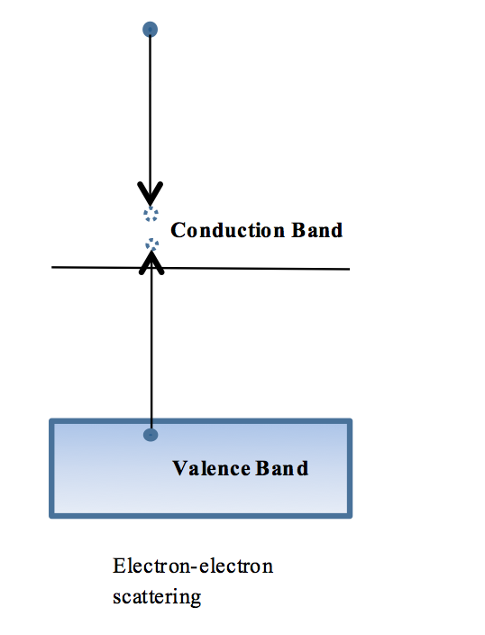
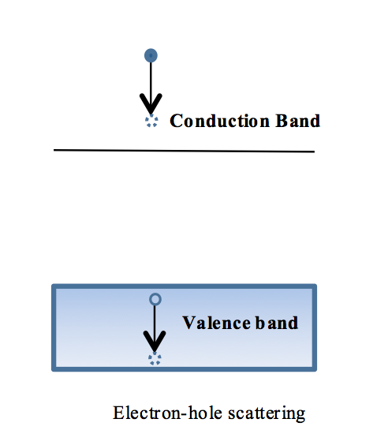
Electron –electron/hole scattering
Electron-electron scattering:
Electron-hole scattering:
E_{e}-E_{CB}>E_{bandgap}
If the energy of electrons is higher than the minimum of the conduction band by n E,E:[Eg,Eg+VB width] it is possible that e-e scattering can happen up to n times.
The surface defects could result in p-doping, and then the Fermi level could lie closer to the maximum of the valence band, enabling holes to exist in the valence band.
the electron will lose energy in the range of zero to the width of the valence band from the DoS of K₂CsSb to the hole.

Slide 12
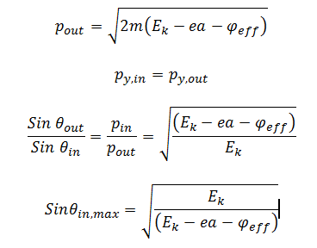
Emission
If the electron’s energy is less than the electron affinity, electrons come back and encounter another diffusion iteration.
CB
VB
Cathode
Vacuum
If the electron’s energy is more than the electron affinity, consider the transverse momentum continuity.
p_{y,out}
Vacuum
p_{out}
Cathode
p_{in}
p_{y,in}

Slide 13

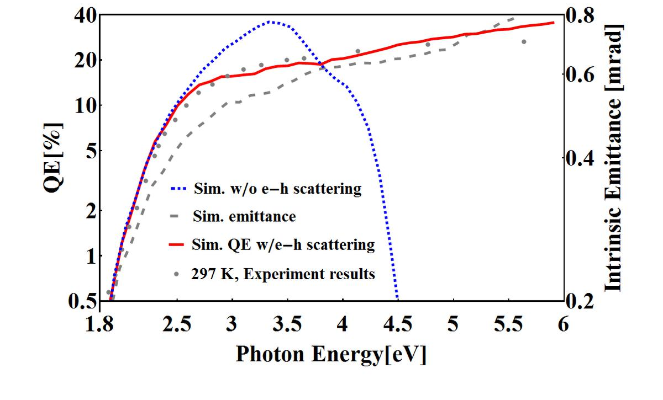
QE , thermal emittance vs wavelength
QE: # emitted electrons / # incident photons
Thermal Emittance:
e-e scattering energy loss:
n * energy gap+width; n=1,2…
e-h scattering energy loss:
0~1.2 eV, VB width
e-p scattering:0.027eV
The EA is 0.5 eV by fitting.
e-e and e-h scattering : continuous increase
e-e scattering: QE drop at high photon side.

Slide 14
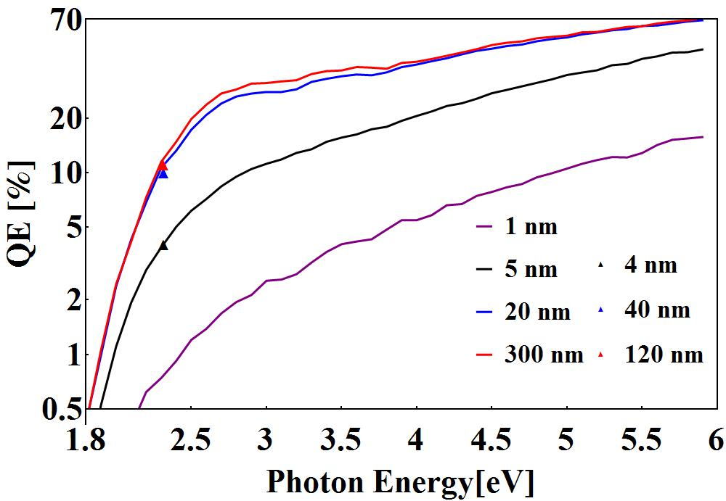
QE vs thickness
For a thickness ≥ 20 nm, the QE is independent of the cathode’s thickness.
Three cathodes were made in Sb thickness of 1.3nm, 15nm and 41nm. We also tried 60nm of Sb, QE is about 10%.

Slide 15
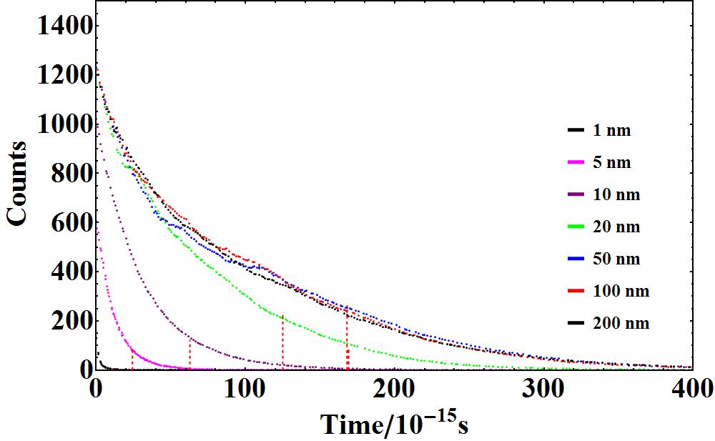
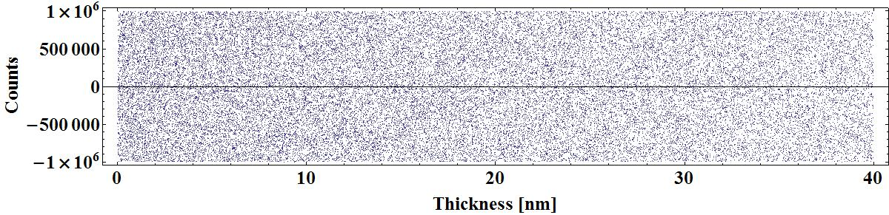
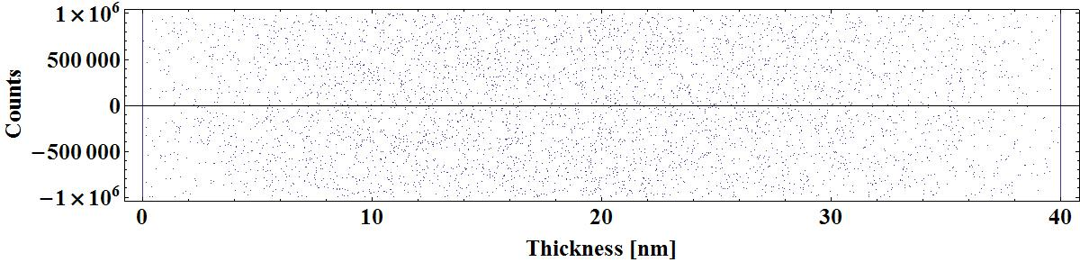
Thickness vs temporal response
For the typical 50 nm thickness cathode, the simulated response time is 170 fs (90% of the electrons emitted) from the curve

Slide 16
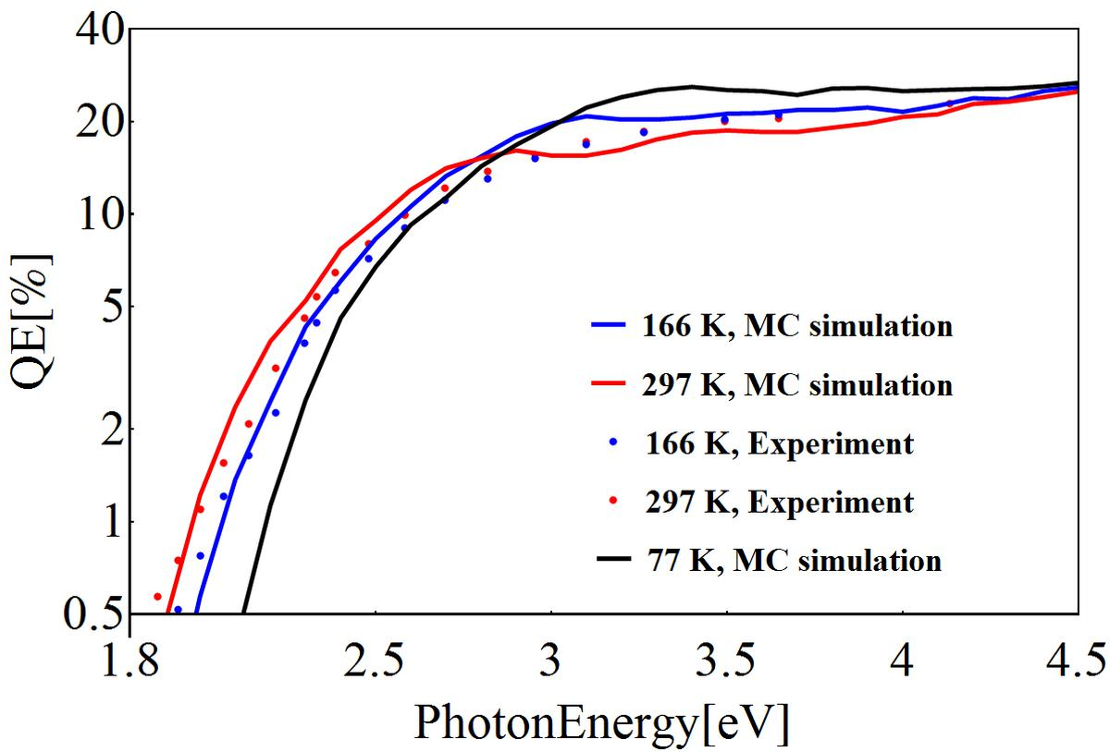
QE in 77K

Slide 17


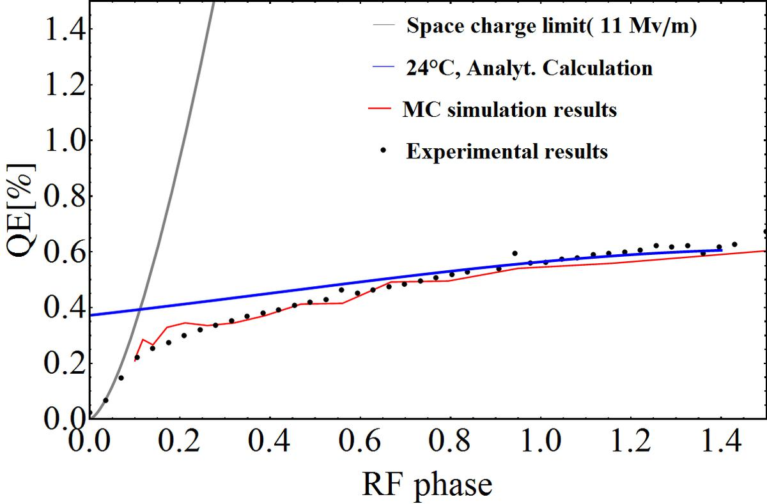
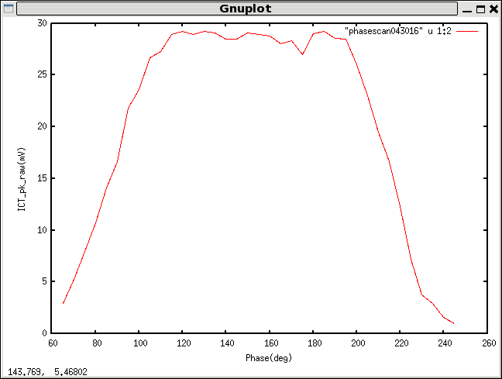
Schottky effect compensates the band gap change
Surface barrier change due to Schottky effect:
K₂CsSb relative permittivity: 9.2
L. Kalarasse, B. Bennecer Journal of Physics and Chemistry of Solids Volume 71, Issue 12, December 2010, Pages 1732–1741
With 20MV/m gradient , from the Schottky effect induced potential change is above 0.08eV
Peak current 1.65A
Gradient 12 MV/m
If cathode at 300K, no Schottky effect

Slide 18
Summary
The QE degradation due to cold cathode was studied. Our conclusion is that QE decay is induced by band gap(ionization energy) change. We observed the Schottky effect by scanning the RF phase.
A preliminary analytical model was developed.
One Monte-Carlo code was developed to simulate photoemission from the multi-alkali photocathode.
The performance of considering e-h ,e-e and e-p scattering match to our spectrum response curve and thickness dependence.
The code could estimate the temporal response.
It could generate particles for Parmela or Astra simulation.
Thanks to J. Smedley and D. A. Dimitrov on cathode modeling discussion!

Slide 19
Thanks for you attention!

