Slide 1
CERN Alkali Antimonide Experience
Christoph Hessler
On behalf of the CERN lasers and photocathode team
Photocathode Physics for Photoinjectors (P3) Workshop,
17 - 19 October 2015, Jefferson Lab, Newport News, USA

Slide 2
Outline
Overview on CLIC photoinjector activities
Why do we study alkali antimonide cathodes?
Photocathode production
Alkali antimonide lifetime studies in RF and DC gun
XPS surface analysis studies
Outlook

Slide 3

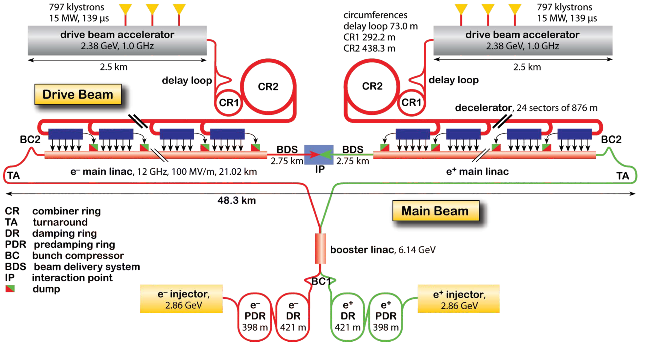
CLIC

Slide 4
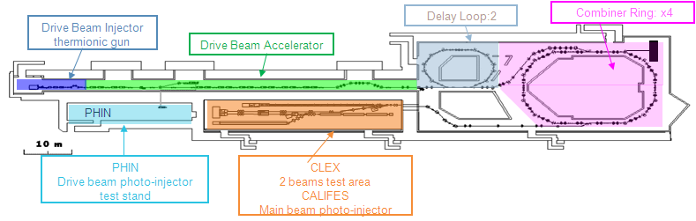
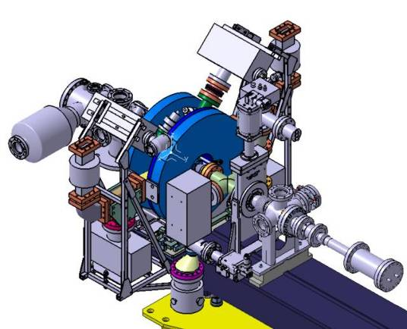
Photoinjectors at CTF3
CLIC Test Facility 3 (CTF3):
PHIN
Photoinjector laser lab (1st floor) and optical transfer line to PHIN and CALIFES
Dedicated photoemission laboratory for photocathode production, testing and R&D

Slide 5
Photoinjector Parameters
 | Main beam | Drive beam
Parameter | CALIFES (CTF3) | PHIN (CTF3) | CLIC requirem.
Charge per bunch (nC) | 0.6 | 2.3 (9.2) | 8.4
Macro pulse length (μs) | <0.2 | 1.2 (1.6) | 140
Bunch spacing (ns) | 0.66 | 0.66 | 2.0
Gun RF / bunch rep. rate (GHz) | 3 / 1.5 | 3 / 1.5 | 1 / 0.5
Number of bunches in macro pulse | 1 – 300 | 1800 (2400) | 70000
Macro pulse rep. rate (Hz) | 5 | 5 (5) | 50
Charge per macro pulse (μC) | <0.18 | 4.1 (5.5) | 590
Beam current in macro pulse (A) | 0.9 | 3.5 | 4.2
Bunch length (ps) | 10 | 10 | 10
Charge stability | <3% | <0.25% (<1%) | <0.1%
Cathode lifetime (Cs₂Te) | 1 y (QE>0.3%) | >50 h (QE>3%) (>300 h) | >150 h (QE>3%)
Cathode type | Cs₂Te (in-situ, dual layer) | Cs₂Te, Cs₃Sb (co-deposition) | To be defined
Norm. emittance (μm) | <20 | <25 (14) | <100
O. Mete et al., “Production of long bunch trains with 4.5 µC total charge using a photoinjector”, Phys. Rev. ST Accel. Beams 15 (2012), 022803.

Slide 6
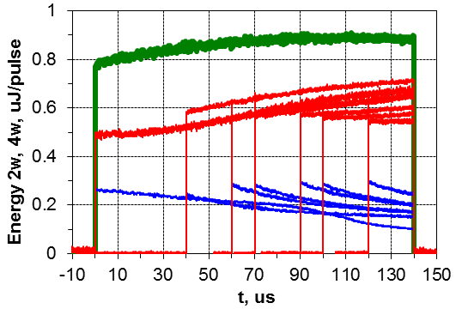

Long Train Harmonics Generation
FHG, BBO 12 mm
Degradation of UV beam has been observed for long pulse trains due to photo-elastic effects caused by two-photon absorption in the FHG crystal.
Problem does not exist for SHG.
Possible solutions:
  Usage of photocathodes sensitive to visible light.
  New harmonics generation schemes with multiple crystals.
10us, 4.4mJ
80us, 25mJ
140us, 41mJ
Figures courtesy M. Martyanov

Slide 7
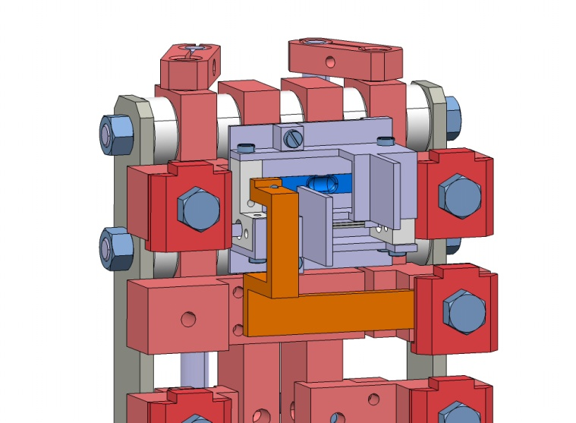
Photocathode Production and R&D
Dedicated photoemission laboratory available at CERN for photocathode production and R&D.
Equipped with preparation system for co-evaporation of Cs and Te/Sb.
70 keV DC gun and diagnostic beam line for measuring the photocathode properties.
Transport of photocathodes under vacuum to PHIN photoinjector, CERN XPS laboratory and LAL (Orsay) possible. And soon to ASTeC Daresbury (special samples only).
Achieved quantum efficiency (QE):
>20% (Cs₂Te), 7.5% (Cs₃Sb)
Te/Sb evaporator
Masks
Cs dispenser

Slide 8
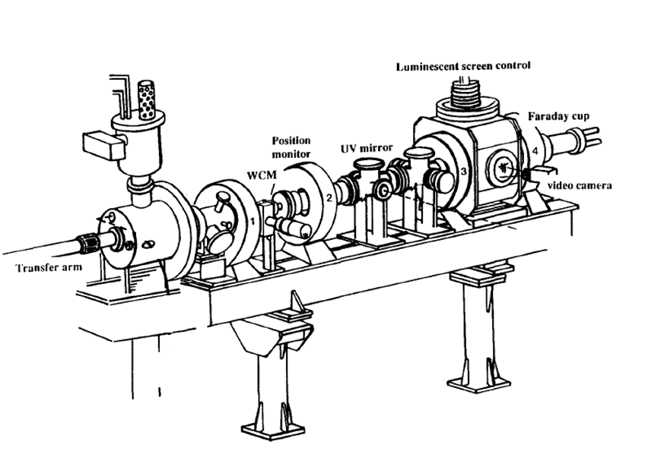
Preparation System and Test Beam Line
Beam line
Preparation
chamber
DC gun
electron beam
LASER:
Q-switched Nd:YAG λ=532 nm or 266 nm
CATHODE position during PRODUCTION
Bunch charge measured by:
Wall Current Monitor (WCM)
Fast Current Transformer (FCT)
Faraday Cup (FC)
CATHODE position during TEST

Slide 9
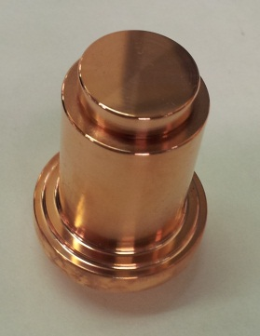
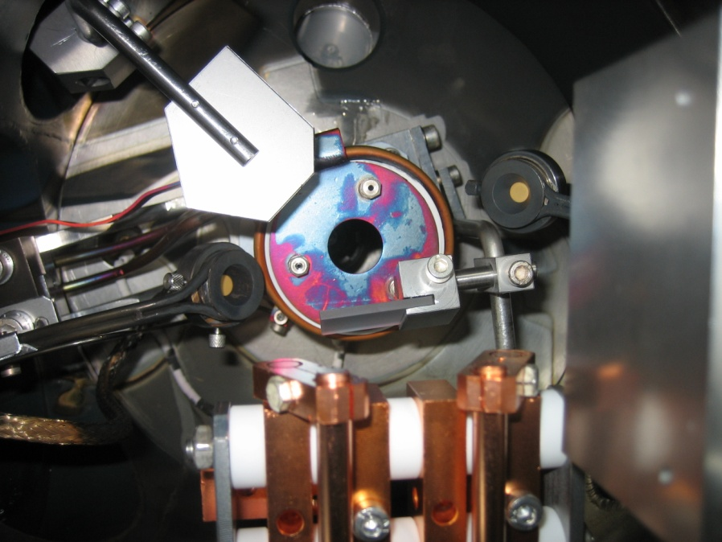
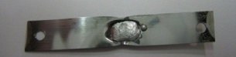
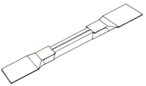
Co-Deposition Setup
Substrate: Copper with diamond powder polished surface
Substrate is heated to 125⁰C for Cs₃Sb, and not heated for Cs₂Te.
Thickness monitors: Quartz microbalances for Cs and Te/Sb. Masks allow to measure both evaporation rates separately.
Online QE measurement: Main tool for optimizing the deposition process → mandatory for co-deposition
Ø ~ 19 mm
Shutter
Laser beam
Te/Sb
microbalance
Te/Sb evaporator
Masks
Plug
position
Cs microbalance
Cs dispenser
SAES®getters
Evaporators
E. Chevallay, “Experimental Results at the CERN Photoemission Laboratory with Co-deposition Photocathodes in the Frame of the CLIC Studies”, CTF3 Note 104, 2012

Slide 10
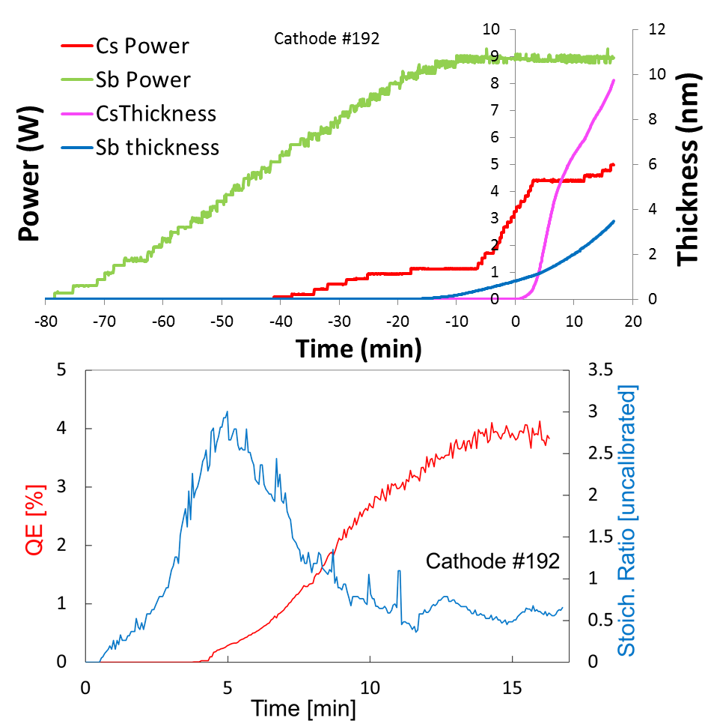
Co-Deposition Process
Co-deposition:
Cs and Sb (or Te) evaporated at the same time. The metallic elements can mix together in the vapour phase.
The evaporators power is adjusted in order to reach a maximum value of the QE.
Average pressure during the process ~1E-8 mbar
Courtesy I. Martini

Slide 11
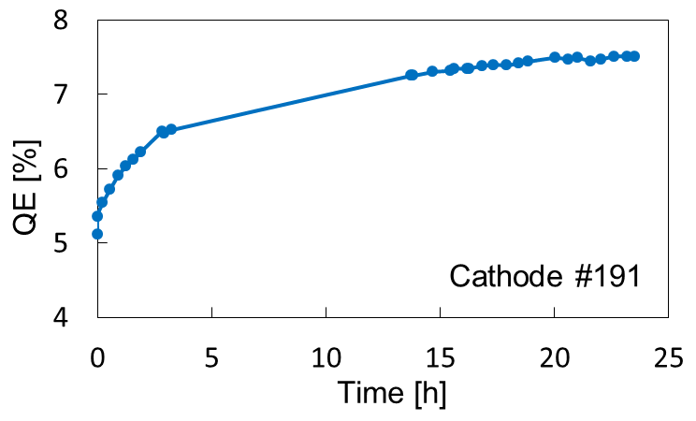
Deposition Results for Cs₃Sb
After stopping the evaporation, the QE of Cs₃Sb cathodes initially continues to increase during beam production in DC gun (not observed for Cs₂Te).
Reason for this behavior still unclear, maybe due to re-organization of Cs and Sb atoms.
QE mapping shows a uniform photoemissive layer.
Continuous beam operation
No. | Initial QE (%) | Max QE (%) | Evaporated Cs (nm)* | Evaporated Sb (nm)* | Final stoich. ratio*
178 | 0.3 | 0.5 | 120 | 18.4 | 2.9
179 | 1.4 | 2.3 | 156 | 24.5 | 1.74
180 | 0.6 | 1.0 | 52 | 14.4 | 3.1
187 | 0.3 | 0.4 | 67.6 | 4.7 | 18.9
188 | 1.3 | 2.2 | 152 | 17.8 | 8.84
189 | 2.3 | 4.4 | 64 | 15 | 1
191 | 5.4 | 7.5 | 156 | 14 | 1.7
192 | 2.0 | 2.7 | 9.7 | 3.5 | 0.66
193 | 4.2 | 5.8 | 10.8 | 7.6 | 0.65
194 | 2.7 | 4.5 | 18.7 | 20.7 | 0.9
199 | 3.5 | 5.2 | 269 | 22.7 | 2.9
200 | 3.4 | 5.5 | 83.3 | 23.5 | 0.98
Max. achieved QE = 7.5%.
No obvious correlation between QE and the final stoichiometric ratio or the evaporated quantity.
I. Martini et al., Proc. of IPAC’13, Shanghai (2013), p. 413.
Courtesy I. Martini

Slide 12
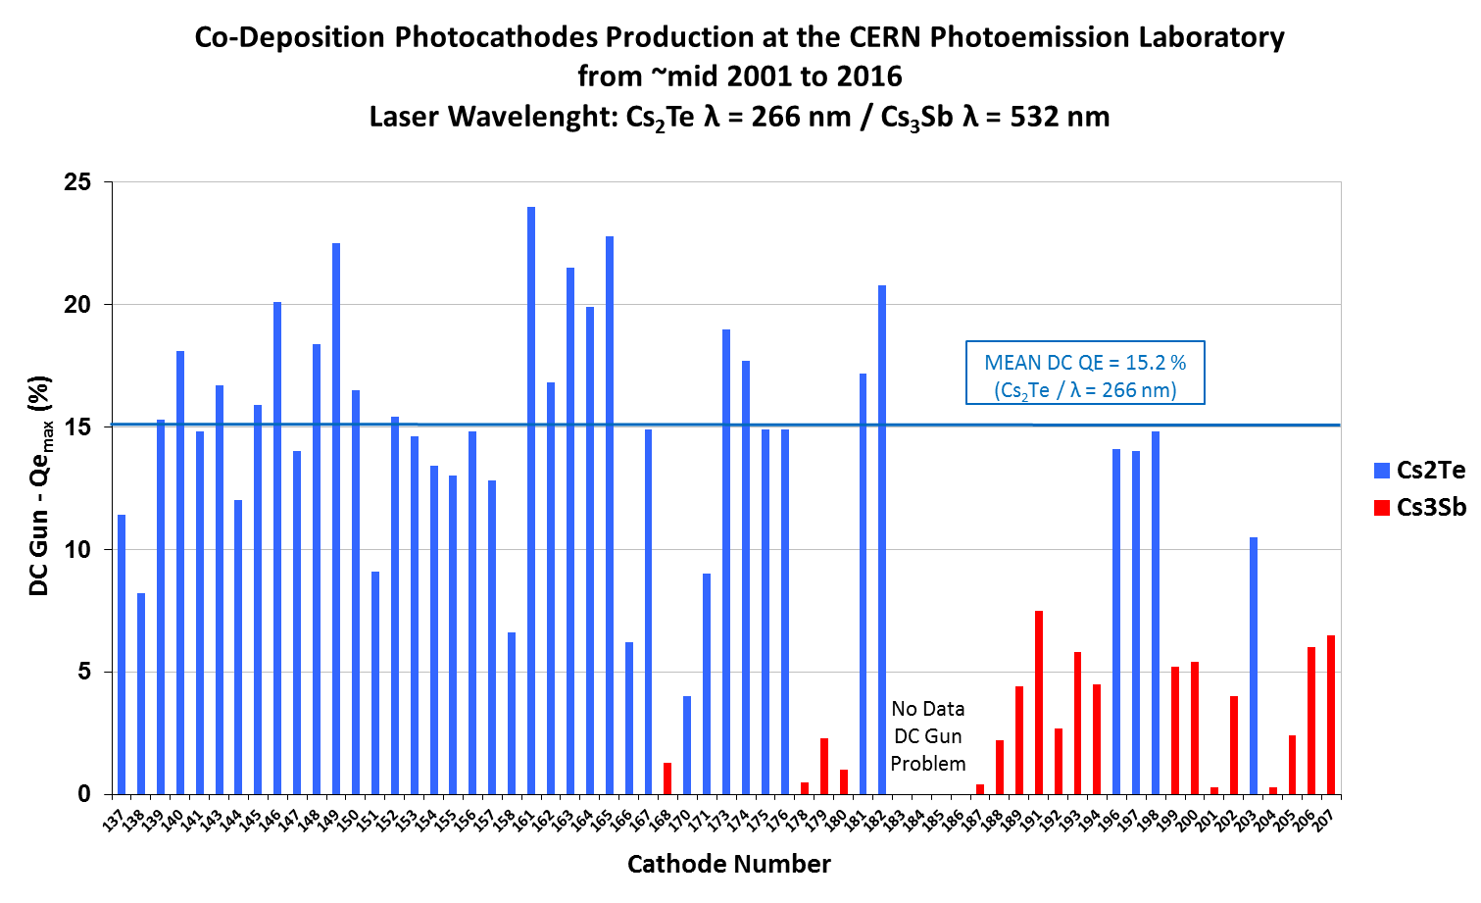
Produced Co-Deposition Cathodes
Courtesy E. Chevallay

Slide 13
Summary: Preparation System
Main advantages of CERN preparation setup:
  Online QE monitoring allows precise tuning of evaporation rates to achieve good QE values.
  Availability of DC gun and test beam line at the preparation system allows an immediate control of the QE in a reliable way (incl. QE map).
  DC gun allows the initial operation of Cs₃Sb cathodes to increase their QE.
  Transport of cathode samples under UHV possible to PHIN photoinjector, CERN XPS lab, LAL and soon to ASTeC Daresbury lab for surface studies.
Room for improvements:
  One complete equipped evaporator setup lasts only for ~3 cathodes.
  → New evaporator setups has been designed for double capacity SAES Cs
  dispensers, for Alvatec Cs dispensers and for 3 component cathodes.
  For changing evaporators and cathode substrates the preparation chamber must be opened and afterwards baked, which in total takes several weeks.
  → To improve situation a load-lock system has been studied.
  Vacuum mirror in preparation chamber gets coated with the time and needs to be exchanged frequently.

Slide 14
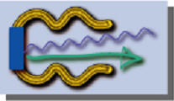
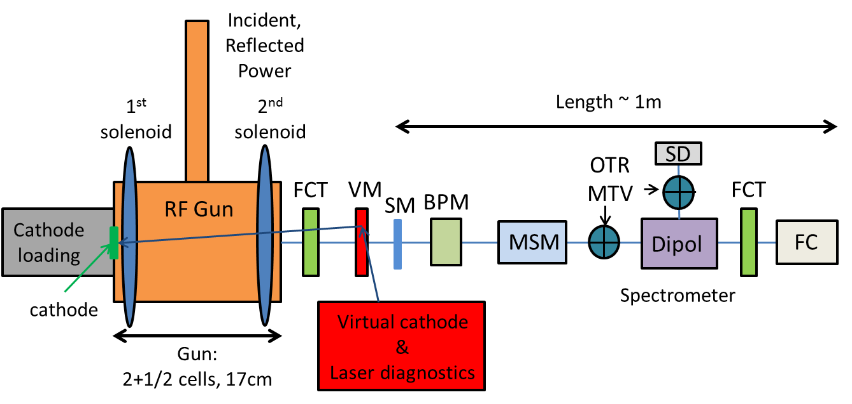
PHIN Layout
FCT: Fast current transformer
VM: Vacuum mirror
SM: Steering magnet
BPM: Beam position monitor
MSM: Multi-slit Mask
OTR: Optical transition radiation screen
MTV: Gated cameras
SD: Segmented dump
FC: Faraday cup
VW: Vacuum window
VW
Mode of operation:
One PHIN run per year (~4 weeks)

Slide 15
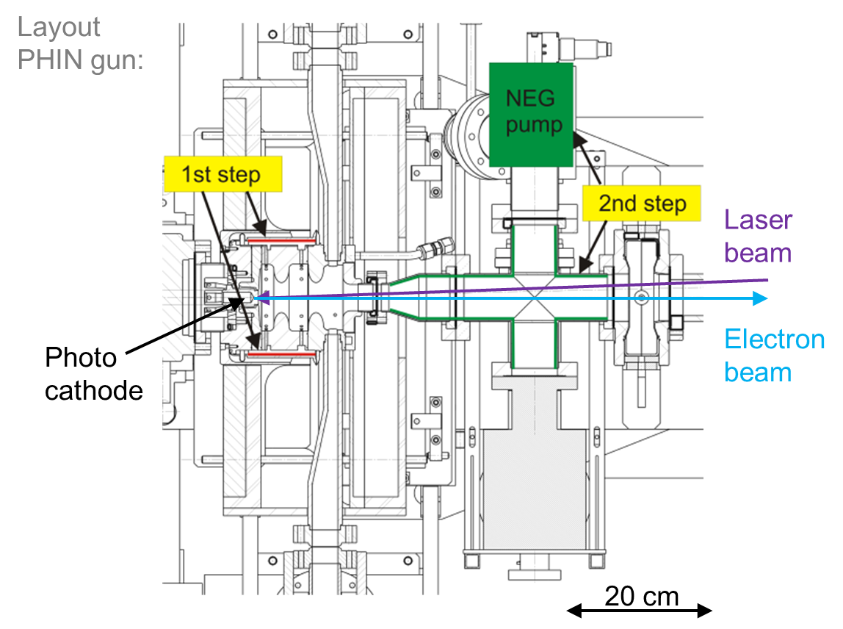
Vacuum Improvement at PHIN
March 2011
March 2012
July 2013
Dynamic vacuum level:
4e-9 mbar
Static vacuum level:
2.2e-10 mbar
Step 1:
Activation of NEG chamber around gun
Step 2:
Installation of additional NEG pump
7e-10 mbar
1.3e-10 mbar
2e-10 mbar
2.4e-11 mbar
Step 3:
Separation of Faraday cup by vacuum window
August 2015
Same minimum vacuum level, but also for long train operation

Slide 16
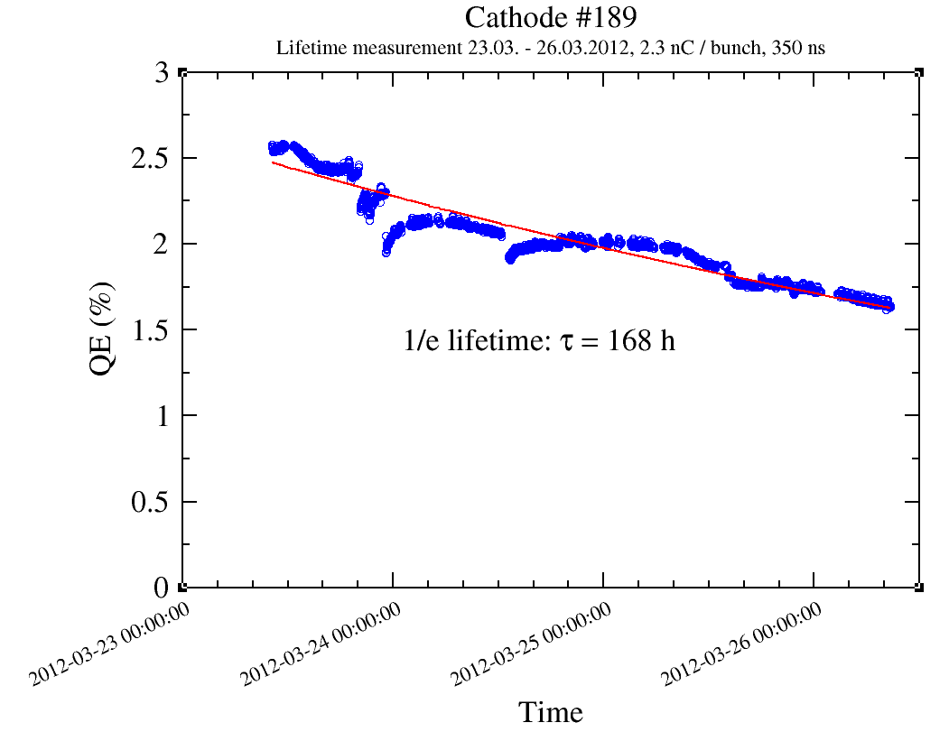
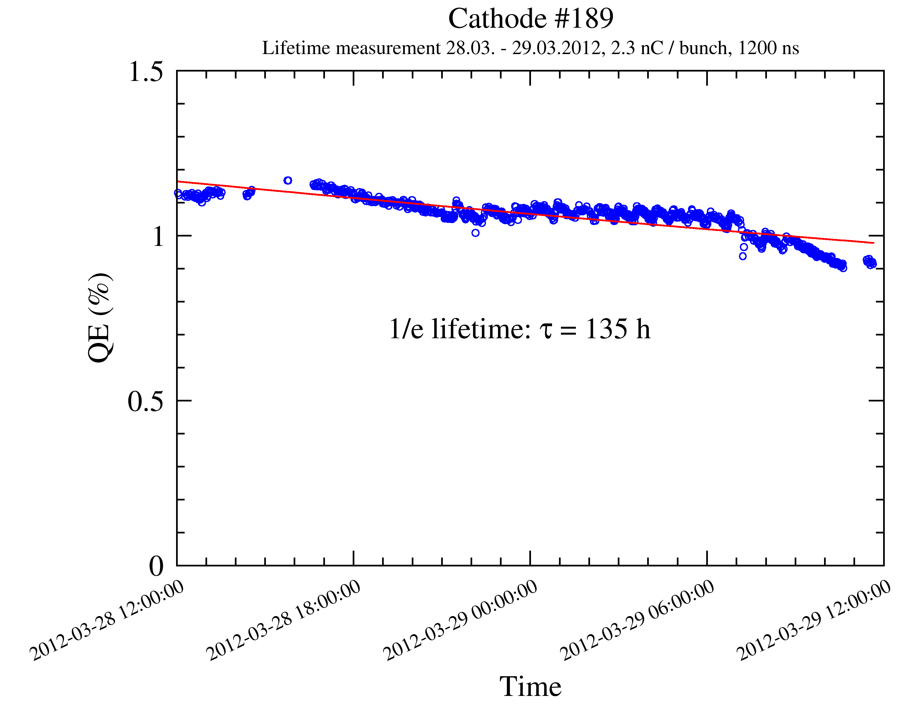
Cs₃Sb Lifetimes after 1st Vacuum Improvement
Measurements taken during PHIN run March 2012 after activation of NEG chamber.
Excellent lifetimes obtained, much better than expected.
Long-time operation over 10 days with one cathode!
Operation of 1.2 µs long trains yield similar lifetime as for short trains.
Lifetimes similar as for Cs₂Te at that time (for same setup without vacuum window) and within CLIC specifications.
2012
2012
1/e lifetime 168 h
(corresponds to 270 h
above 0.5% QE)
1/e lifetime 135 h
9e-10 mbar
1e-9 mbar
2.3 nC, 350 ns, λ=524 nm
2.3 nC, 1200 ns, λ=524 nm

Slide 17
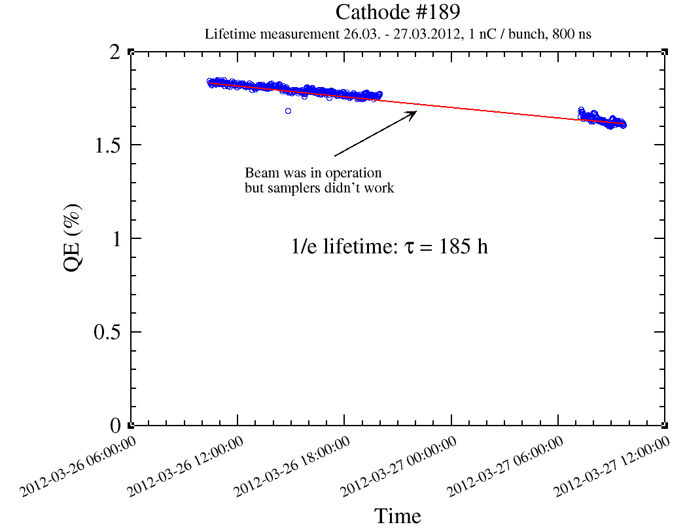
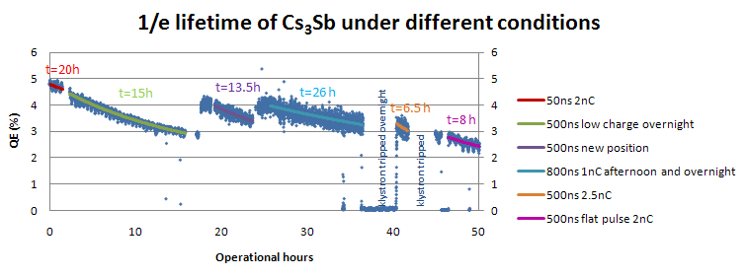
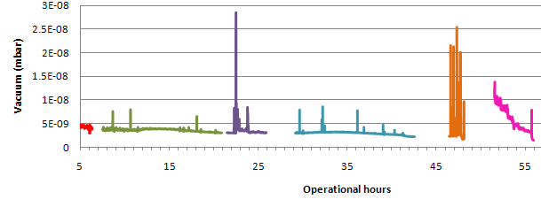
Impact of Vacuum on Cs₃Sb Cathode Lifetime
Comparison with earlier measurements of Cs₃Sb cathodes with UV light and worse vacuum conditions before the 1st step of vacuum improvement (same beam parameters).
Lifetime has drastically improved from 26 to 185 h.
Improved vacuum condition due to activation of NEG chamber around the gun.
March 2012
March 2011
1/e lifetime 26 h
1/e lifetime 185 h
1 nC, 800 ns, λ=262 nm
4e-9 mbar
1 nC, 800 ns, λ=524 nm
7e-10 mbar

Slide 18
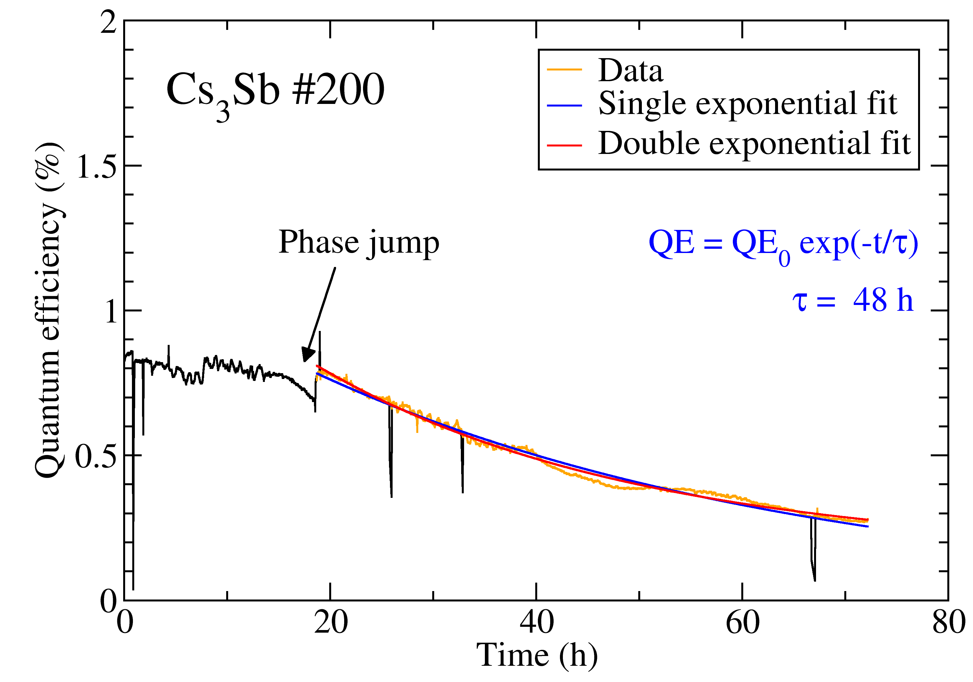
Cs₃Sb Lifetimes after 2nd Vacuum Improvement
Investigation of Cs₃Sb lifetimes after installation of additional NEG pump:
Dynamic pressure: 2.3e-10 mbar
Despite better vacuum level the lifetime is significantly shorter.
This can be explained with a problem of the phase:
The phase was jumping by ~180 degrees several times a day, which caused strong breakdowns.
Strong QE decrease started after a phase jump.
2014
1 nC, 800 ns, Cs₃Sb #200
C. Hessler et al., “Recent Results on the Performance of Cs3Sb Photocathodes
in the PHIN RF-Gun”, Proc. of IPAC’15, Richmond (2015), p. 1699.

Slide 19
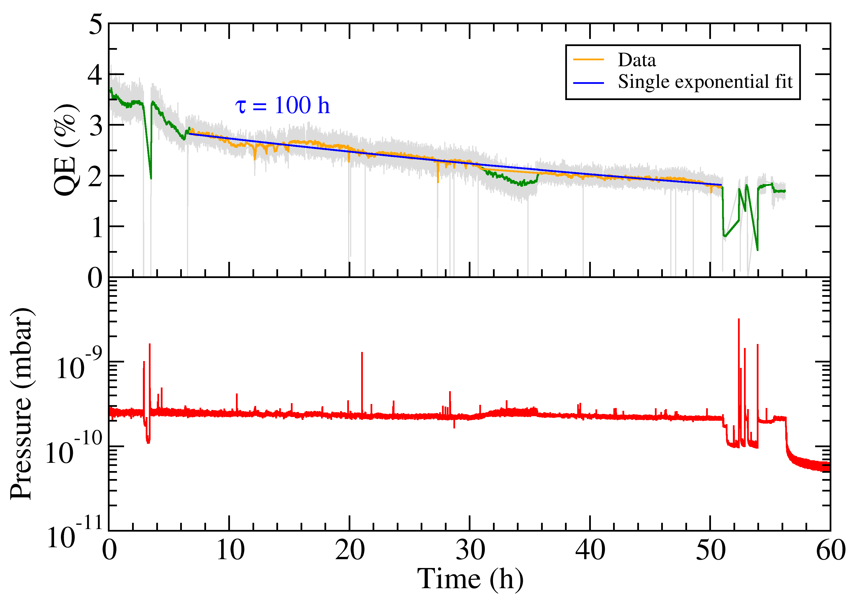
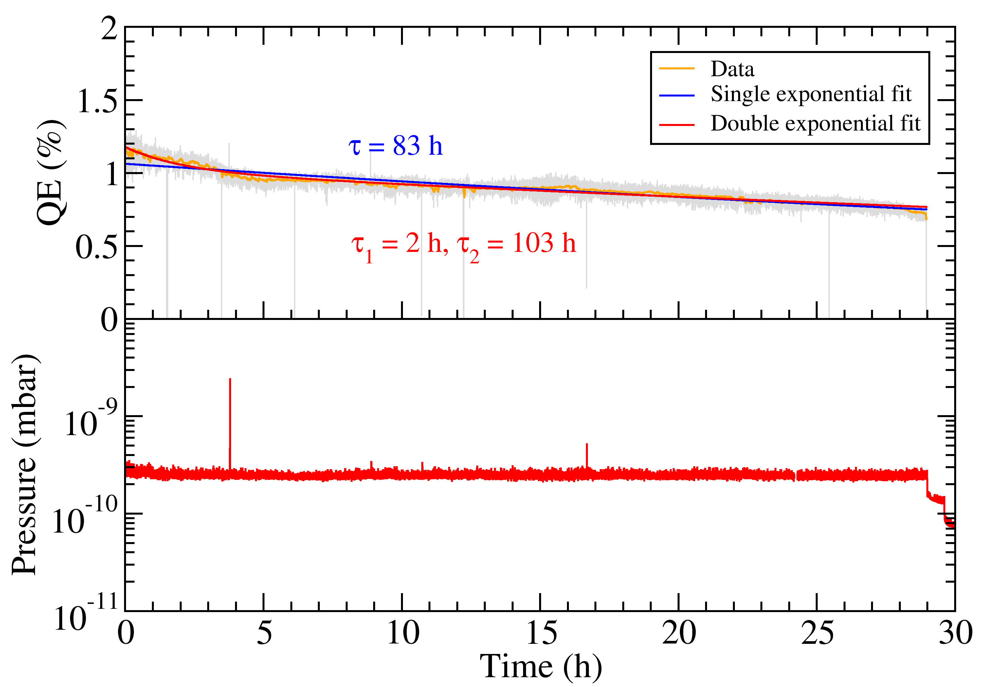
Cs₃Sb Lifetimes after Installation of Vacuum Window
Phase was strongly drifting and therefore (occasionally) corrected manually and with new klystron phase loop.
Vacuum conditions very stable, only very rarely breakdowns.
1/e lifetime ~100 h, corresponds to lifetime of 170 h above QE=0.5%
Not as good as in 2012, maybe related to poor laser spot shape
2016
2016
Phase loop switched on
Cs₃Sb #207
2.3 nC, 350 ns, λ=524 nm
Cs₃Sb #207
2.3 nC, 1.2 µs, λ=524 nm

Slide 20
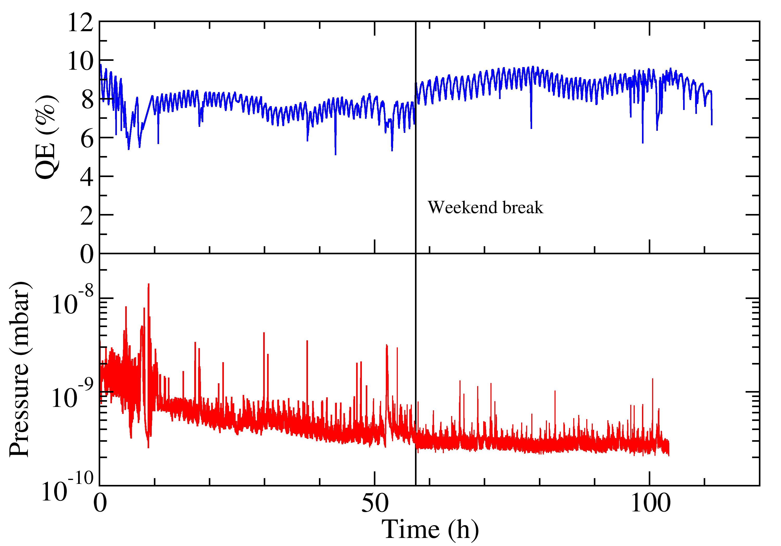
Comparison with Cs₂Te Lifetime
Measurement taken after separation of Faraday cup from the rest of the beam line by a vacuum window.
Operation with 1.6 µs (beyond PHIN specs), 2.3 nC/bunch and 0.8 Hz rep rate.
Vacuum at the exit of the gun stayed at low e-10 mbar level, whereas the vacuum in the new Faraday cup sector increased up to 4e-6 mbar.
No real decrease of the QE visible over 100h of beam operation!
Oscillations on the measured QE curve are due to problems with the temperature stability in the laser lab.
The phase was slowly drifting, probably also due to the problems with the temperature stability.
2015
2.3 nC, 1.6 µs, 0.8 Hz, Cs₂Te #203
C. Hessler et al., “Study of the Performance of Cs2Te Cathodes in the PHIN RF
Photoinjector using Long Pulse Trains”, Proc. of IPAC’16, Busan (2016), p. 3960.

Slide 21
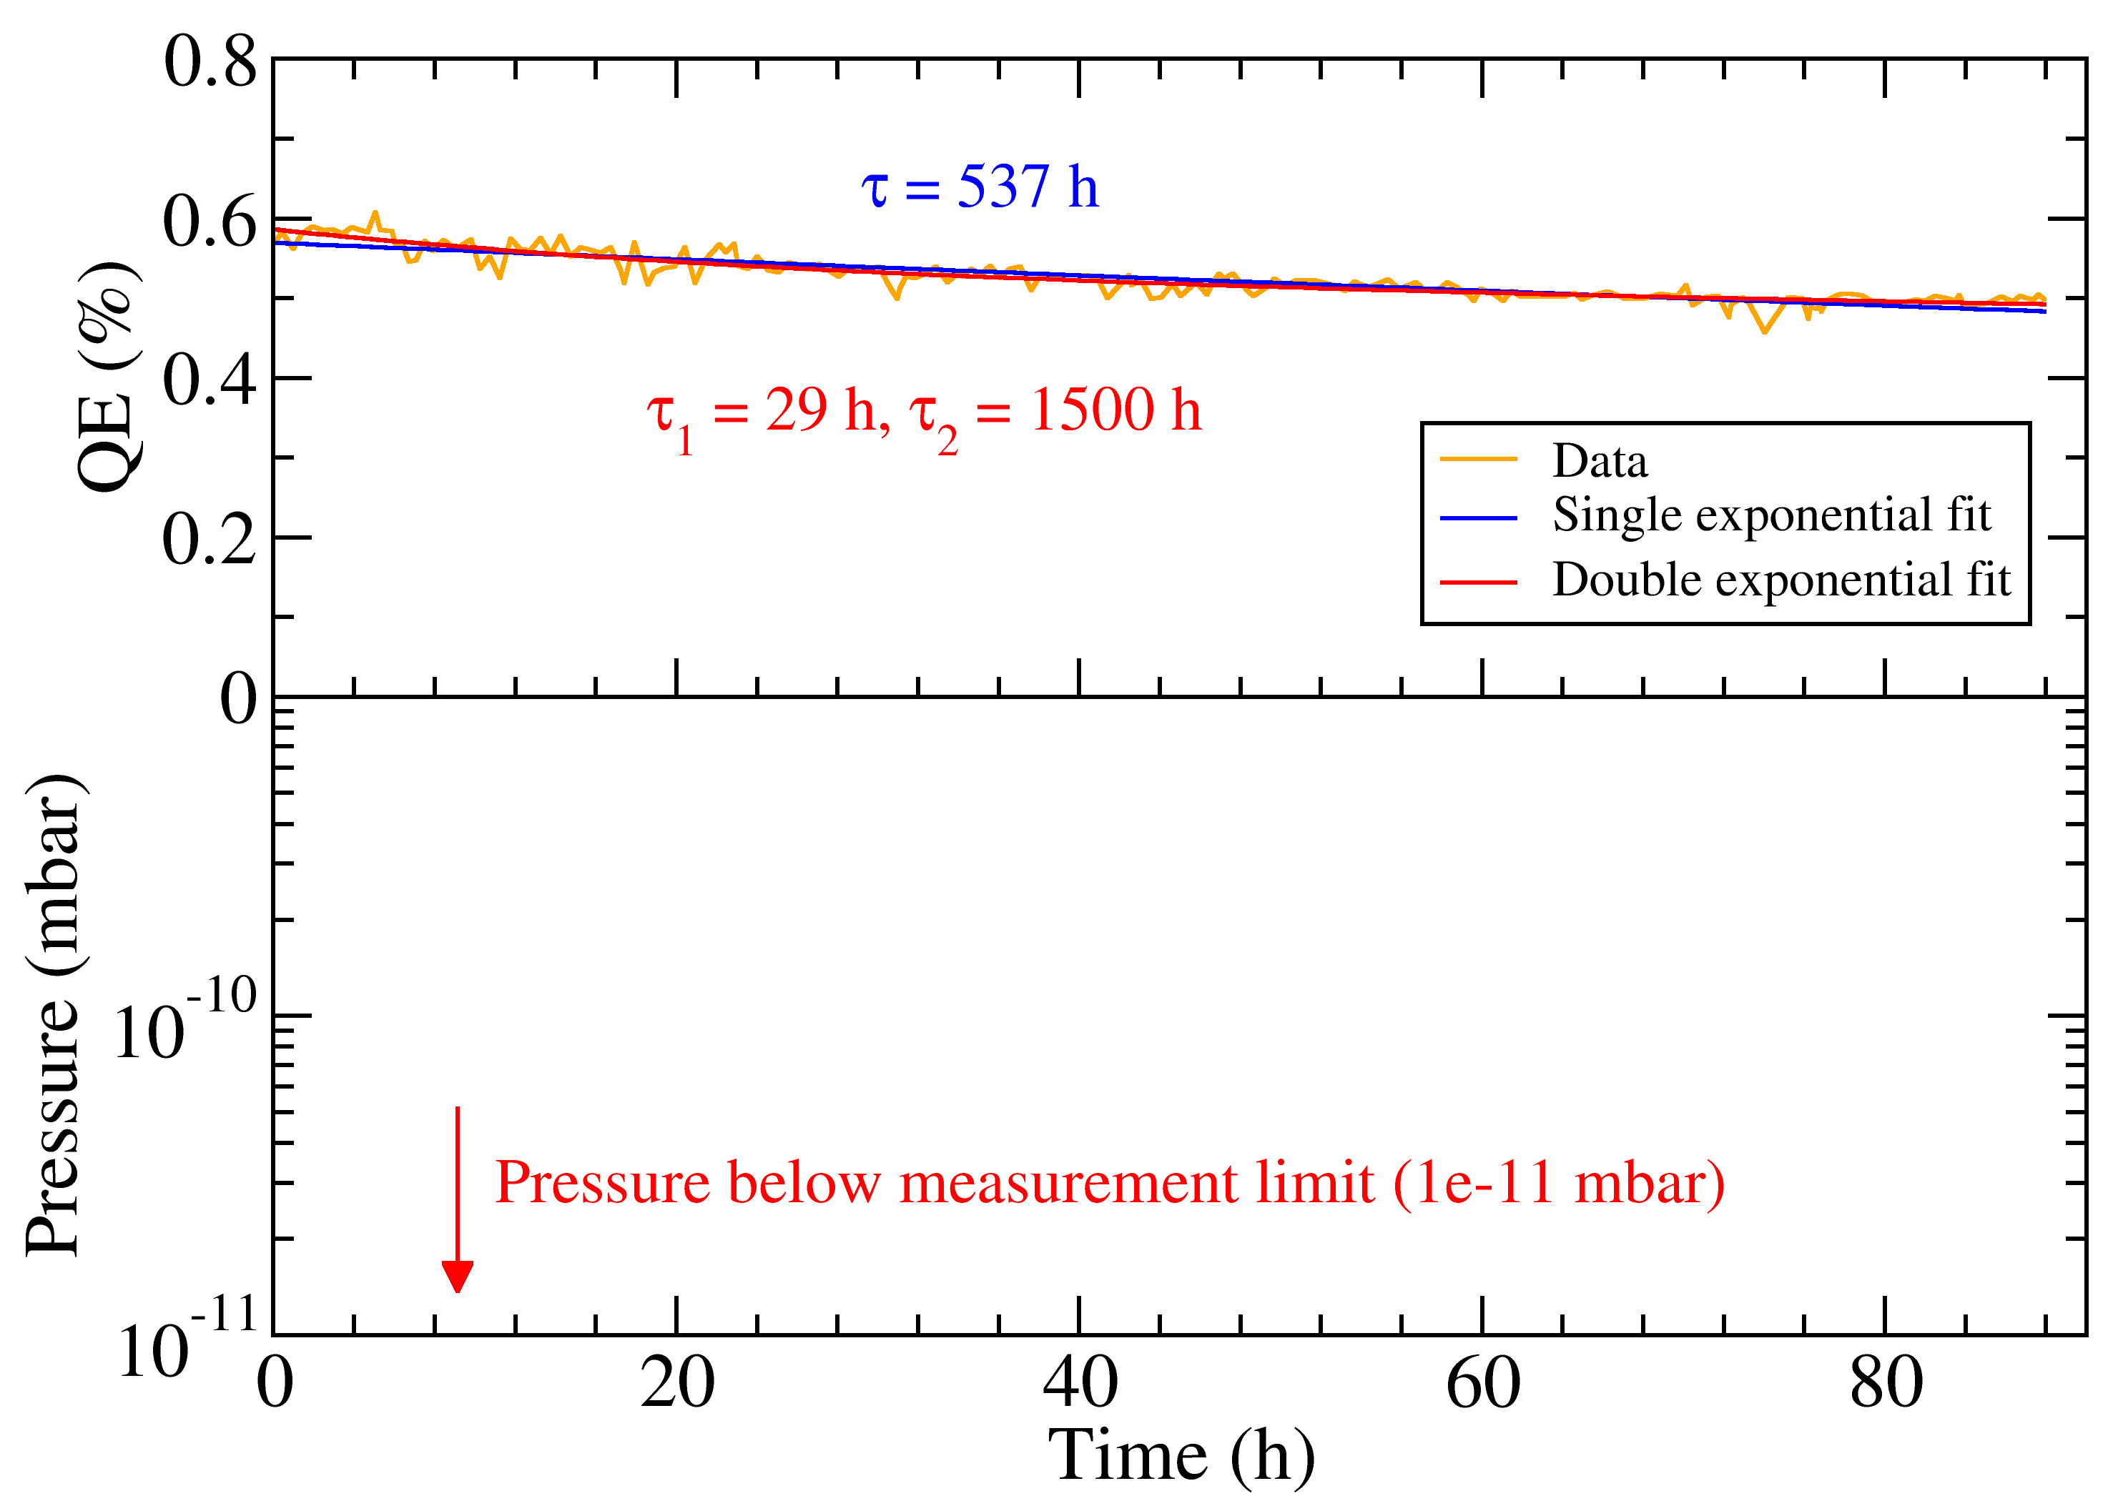
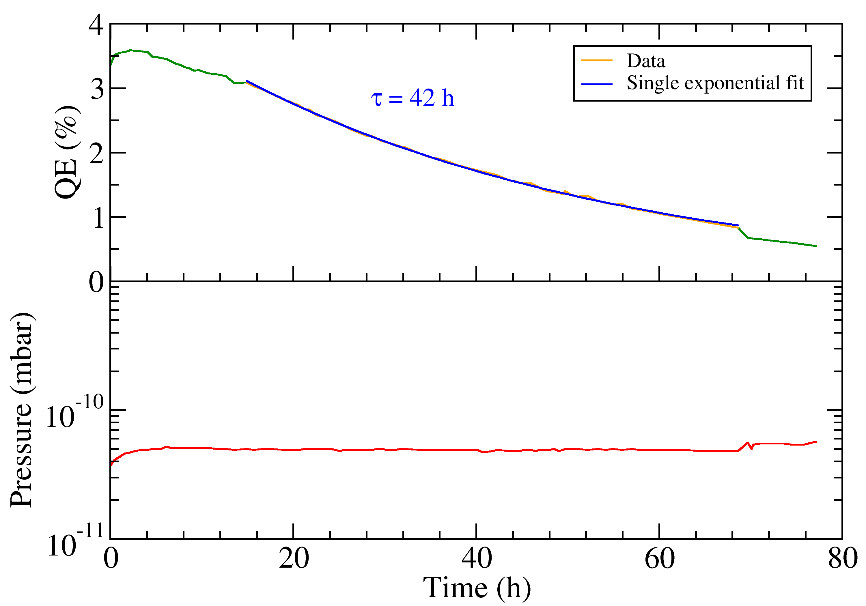
Cs₃Sb Lifetime Studies in DC Gun
Measurement in DC gun with 1 kHz / 2 kHz laser beam and Cs₃Sb cathodes :
Total integrated charge produced: 321 mC (cathode #188), 35 C (cathode #202).
For low charge lifetime is significantly longer than in PHIN with same average current.
For high charge vacuum is still better than in PHIN, but lifetime worse.
2013
Cs₃Sb #188
2015
Cs₃Sb #202
1 µA average current, 1 nC/bunch
120 µA average current, 60 nC/bunch
I. Martini et al., “Studies of Cs3Sb Cathodes for the CLIC Drive Beam Photoinjector Option”, Proc. of IPAC’13, Shanghai (2013), p. 413.

Slide 22
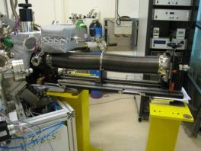
XPS Surface Analysis Studies of Photocathodes
Surface analysis of photocathode materials with XPS and their impact on the cathode performance studied in collaboration with CERN vacuum group.
New UHV carrier vessel (designed by and built in collaboration with LAL) allows to transfer cathodes under vacuum from production laboratory to the XPS setup.
XPS measurement allows material characterization of the surface. Together with qualitative elemental composition also chemical and quantitative information can be obtained (not straightforward).
  In this study a correlation between
  the chemical composition of the
  surface and the QE has been found.
  The poor photoemissive properties (of used
  cathodes) are accompanied by surface
  contamination and not good stoichiometry
  of the cathodes composition.
I. Martini et al., “X-ray Photoemission Spectroscopy Studies of Cesium Antimonide Photocathodes for Photoinjector Applications”, Phys. Proc. 77 (2015) 34 - 41.
Transfer vessel
Courtesy I. Martini

Slide 23
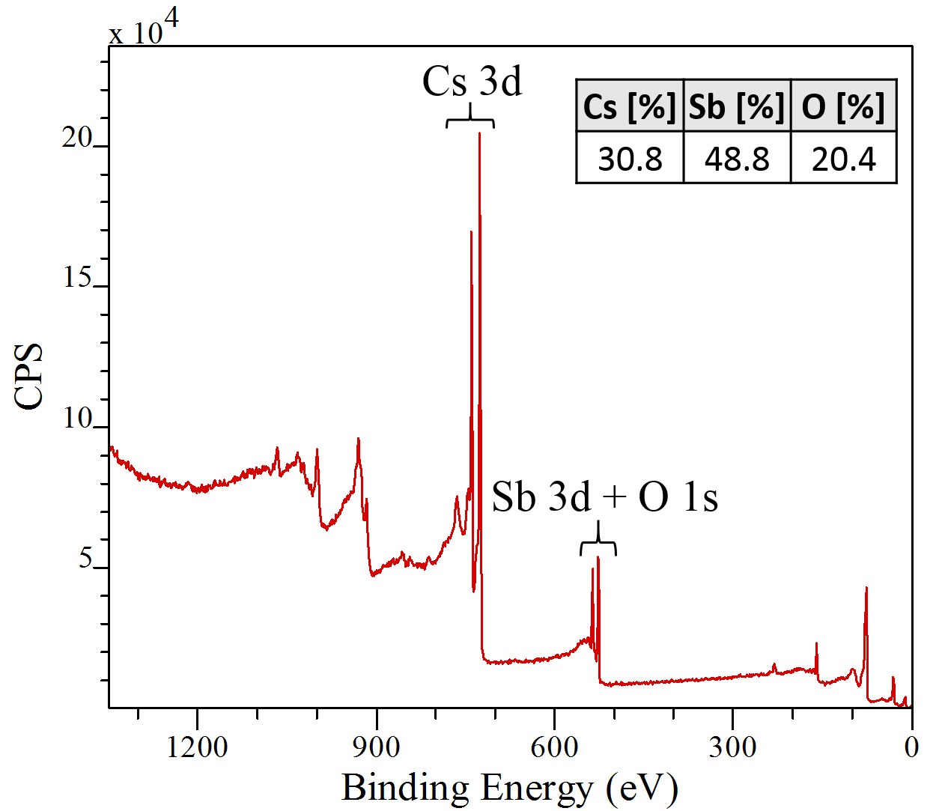
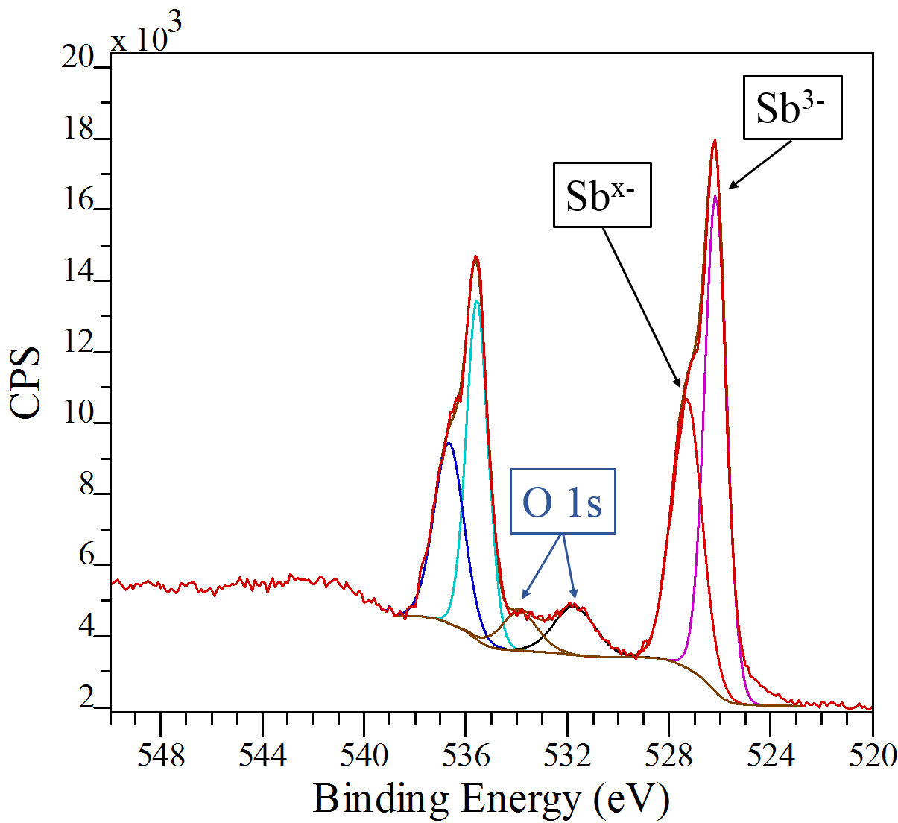
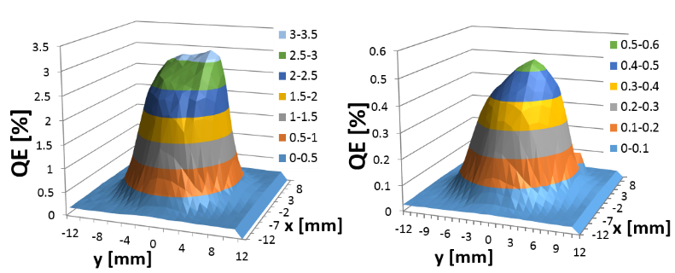
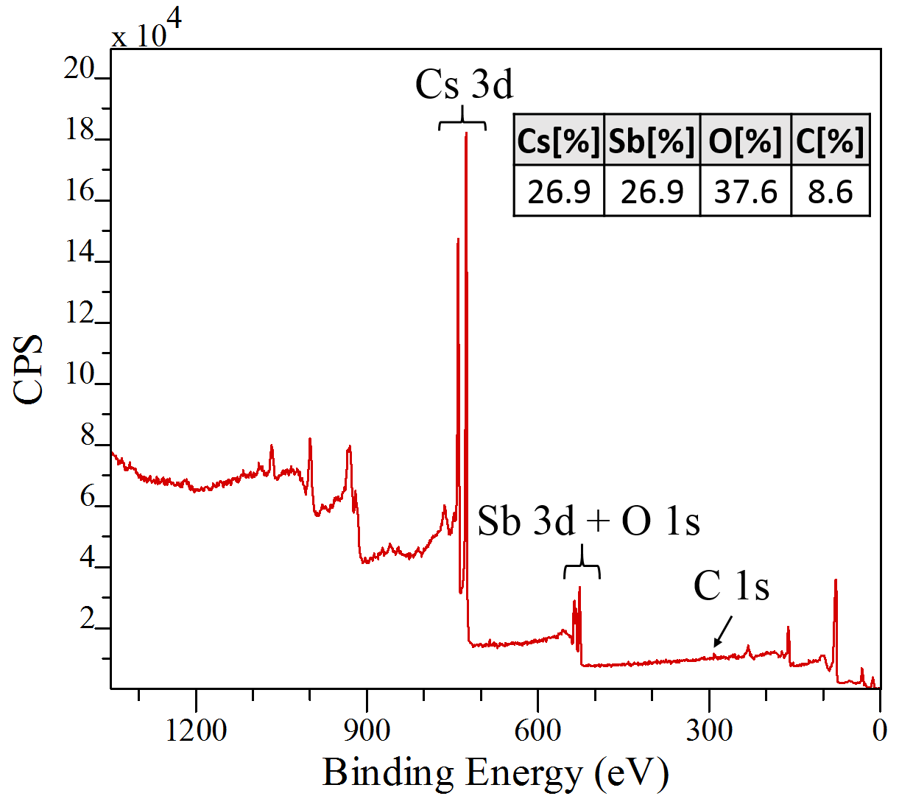
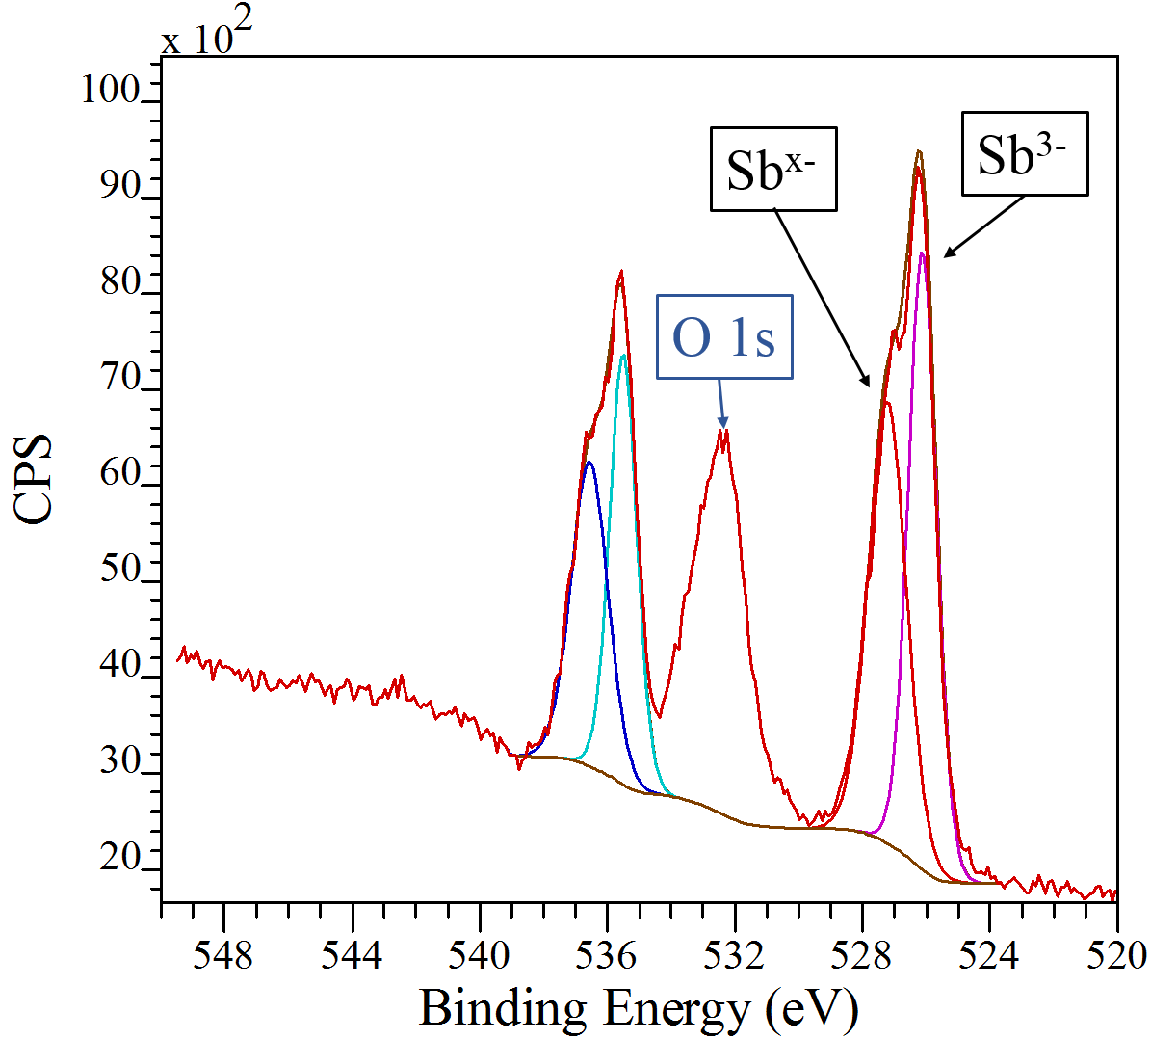
XPS Analysis of Cs₃Sb Cathodes
Cs₃Sb cathode #202 after production:
  Sb-rich phase
  O 1s peaks could be explained
  by Cs₃O₁₁ and H₂O
After operation in DC gun:
  Sb-rich peak has increased
  Oxygen and carbon
  contamination is present and
  can be explained by CO₃²⁻:
  Cs has probably reacted with
  CO₂ to Cs₂CO₃
  Cs₃O₁₁ or H₂O not excluded
fresh
used
I. Martini, “Characterization of Cs-Sb cathodes for high charge RF photoinjectors”, PHD Thesis, Politecnico di Milano, 2016
Courtesy I. Martini

Slide 24
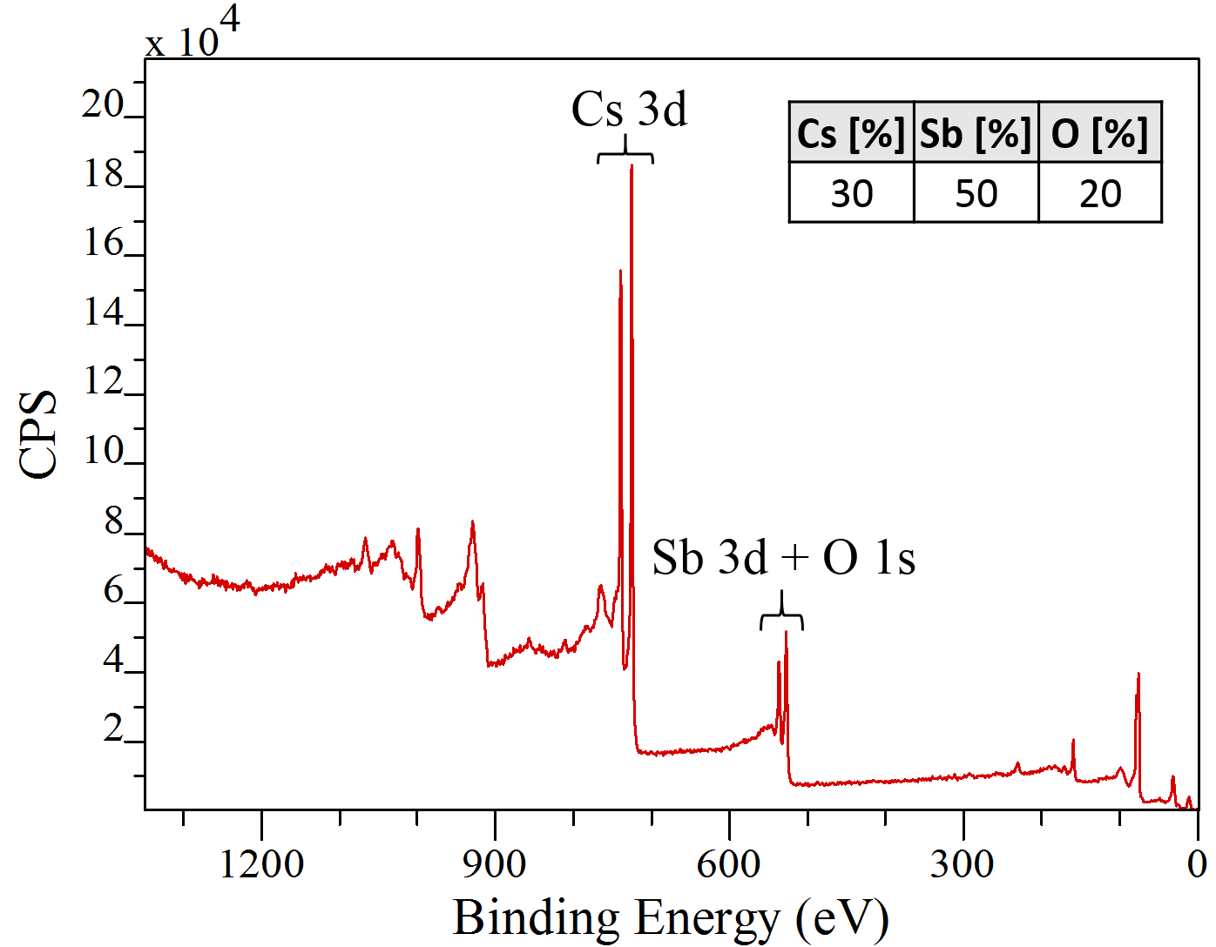
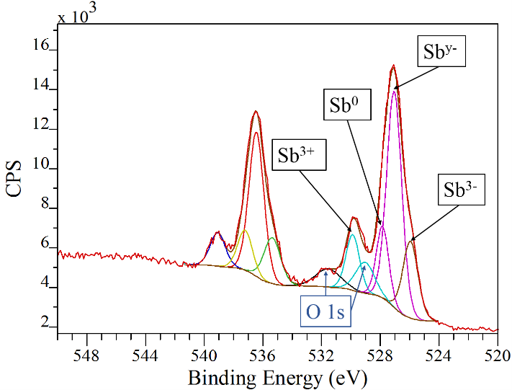
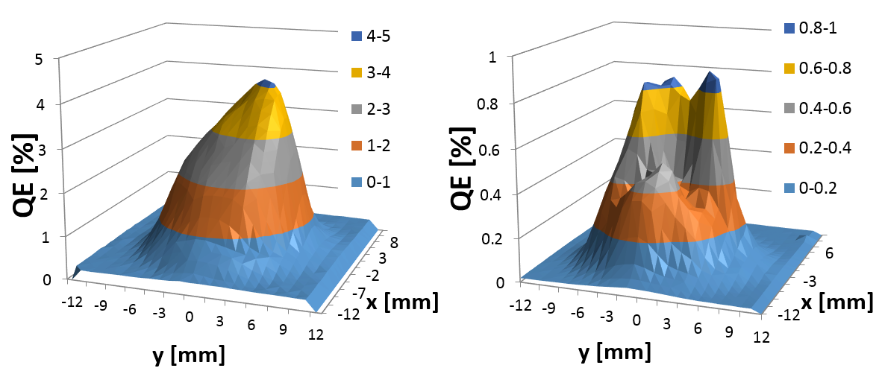
XPS Analysis of Cs₃Sb Cathodes
Cs₃Sb cathode #199 after operation in PHIN RF gun:
  Oxygen is the only contaminant.
  4 different states of Sb:
  Cs₃Sb, alkali-deficient component,
  metallic Sb, Sb₂O₃
  O 1s level → Cs₃O_{11 ,} Sb₂O₃
  Strong QE degradation is related
  to the oxidation.
  Sb-rich phase could either be created
  during production (no XPS measurement
  of this cathode before usage in PHIN available)
  or due to high energy ions/electrons impinging
  the cathode surface.
fresh
used
Courtesy I. Martini
I. Martini, “Characterization of Cs-Sb cathodes for high charge RF photoinjectors”, PHD Thesis, Politecnico di Milano, 2016

Slide 25
Conclusion
Cs₃Sb seems to be less robust than Cs₂Te and more sensitive to non-optimal operation conditions.
For obtaining good lifetimes with Cs₃Sb cathodes it is important to have the following conditions:
  Excellent vacuum conditions.
  A stable phase between the RF arriving in the gun and the laser arriving in the gun (no phase jumps, no slow drifts).
  To be in the linear charge extraction regime of the gun. Otherwise the non-extracted electrons cause desorption in the gun, which affects the cathode health.
  Probably a good laser beam shape.
In a stable environment, which is currently not available at CTF3, a sufficient performance with Cs₃Sb cathodes might be still achievable.
More studies would be needed.

Slide 26
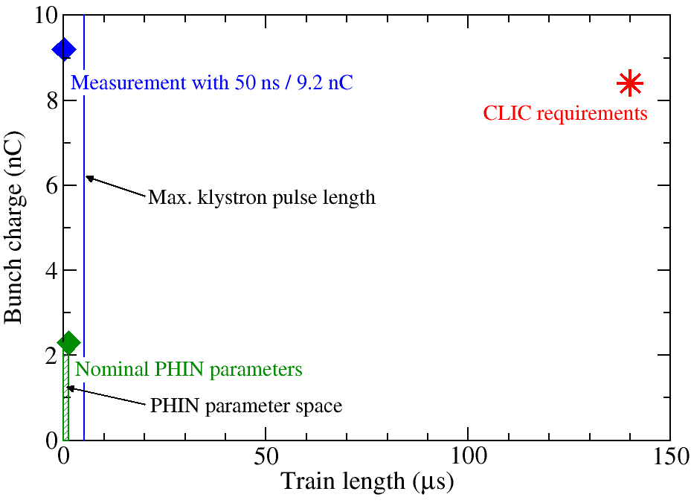
Outlook
  CTF3 will be closed end of this year.
  PHIN program has come to its end. PHIN will be used for AWAKE project.
  → No real possibility to continue then CLIC drive beam photoinjector
  studies at PHIN due to different time structure of electron beam.
  Continue photocathode studies on a lower level. Photocathodes still needed for AWAKE, but with other properties.
  Final proof of feasibility of a
  photoinjector for CLIC drive
  beam anyway cannot be
  achieved with PHIN, due to
  its different parameters.
  New 1 GHz RF gun specially
  designed for the CLIC
  requirements needed.
  Probably new ideas needed,
  how to make photocathodes more robust.
Different macro-pulse repetition rates:
0.8 – 5 Hz (PHIN)
50 Hz (CLIC)

Slide 27

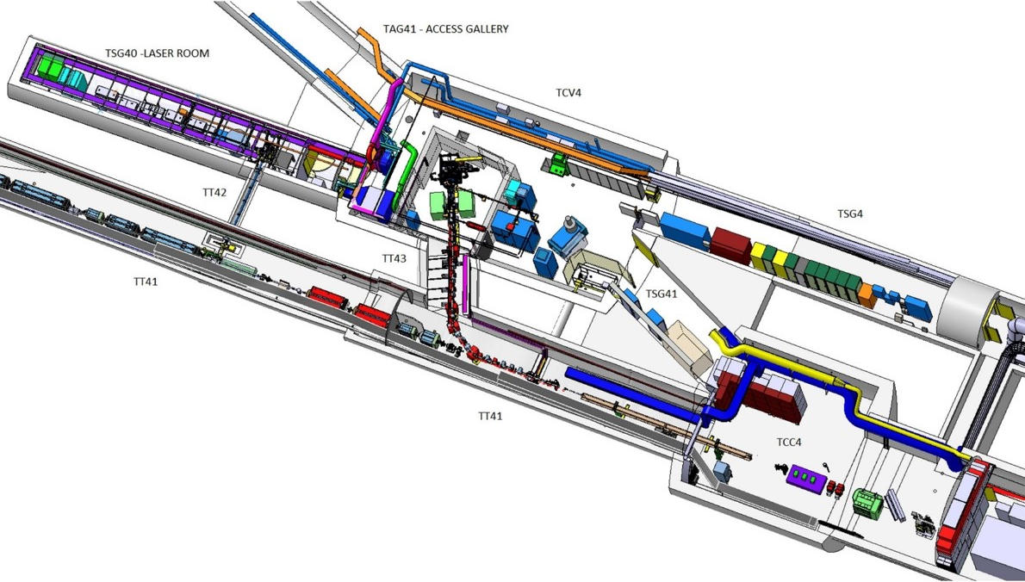
AWAKE Project
e⁻ spectrometer
Laser
RF gun
e⁻
10m plasma
p
Proton
beam
dump
SPS
protons
Proton diagnostics
BTV,OTR, CTR
Laser
dump
SMI
Acceleration
Laser room
Proton driven plasma wake-field acceleration experiment.
Electron gun needed for witness beam.
Installation at the former CNGS underground area.
Challenging space constraints.
RF gun
Klystron
Proton beam line
Electron beam line
Plasma cell
Experimental diagnostics

Slide 28
AWAKE Electron Gun
Electron beam parameter requirements:
PHIN gun was chosen for AWAKE.
Challenging to achieve 1 nC bunch charge, small emittance and short bunch length at the same time with copper cathodes (Ablation seems to be an issue).
Parameter | Baseline | Range to check
Beam Energy | 16 MeV | 10- 20 MeV
Energy spread (σ) | 0.5% | < 0.5% ?
Bunch Length (FWHM) | 10 ps | 0.3-10 ps
Beam Focus Size (σ) | 250 µm | 0.25 – 1 mm
Normalized Emittance (rms) | 2 mm mrad | 0.5 - 5 mm mrad
Bunch Charge | 1 nC | 0.1 - 1 nC
Photocathode type | Cs₂Te | Cu (or other metal) ?

Slide 29






Acknowledgement
Collaborating CERN groups:
Lasers and photocathode section, equipment control section, vacuum group, beam instrumentation group, RF group, CTF3 operation team,
and many others
Collaborating institutes:
… and thank you for your attention!
LA3NET is funded by European Commission
under Grant Agreement Number GA-ITN-2011-28919

Slide 31
Backup Slides

Slide 32
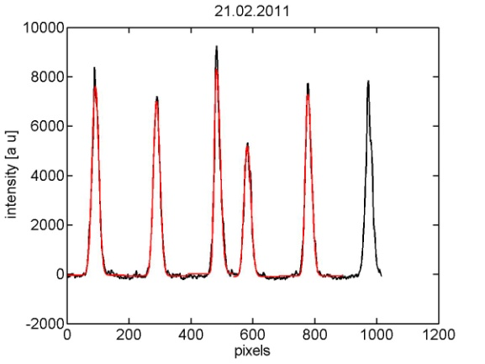
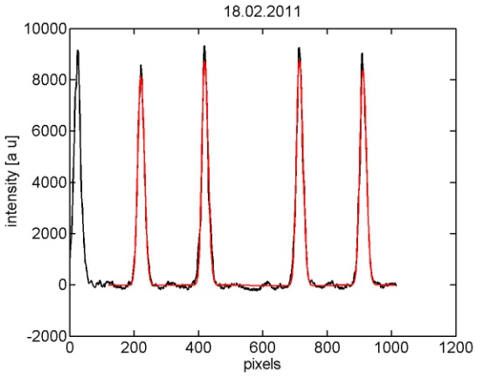
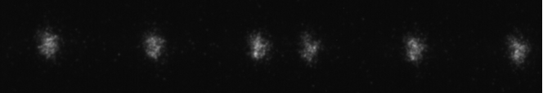

Motivation for a Drive-Beam Photoinjector
To generate the 12 GHz time structure of the drive beam, several fast 180 degree phase switches are needed, which is presently done by a sub-harmonic bunching system.
However, this system generates parasitic satellite pulses, which produce beam losses.
  Reduced system power efficiency
  Radiation issues due to the beam losses of the satellite pulses
These problems can be avoided using a photoinjector, where the phase-coding can be done on the laser side and only the needed electron bunches are produced with the needed time structure.
Satellite-free beam production at
PHIN using laser phase-coding
based on fiber-modulator
technology has been
demonstrated in 2011.
⇒ Satellites <0.1%
M.Csatari Divall et al., “Fast phase switching within the bunch train of the PHIN photo-injector at CERN using
fiber-optic modulators on the drive laser”, Nucl. Instr. And Meth. A 659 (2011) p. 1.
Figure courtesy M. Divall

Slide 33
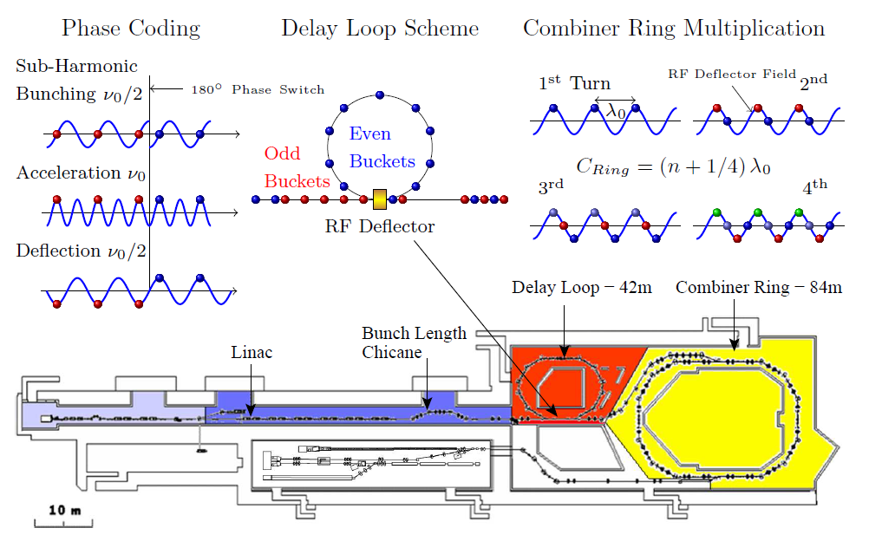
CTF3 Beam Combination Scheme

Slide 34
Challenges for CLIC Drive-Beam Photoinjector
Achieve long cathode lifetimes (>150 h) together with high bunch charge (8.4 nC) and high average current (30 mA)
Produce UV laser beam with high power and long train lengths (140 µs)
  UV beam degradation in long trains
  Thermal lensing and heat load effects?
High charge stability (<0,1%)
→ Vacuum improvement, new cathode materials
→ Usage of Cs₃Sb cathodes sensitive to green light
→ New UV conversion schemes with multiple crystals
→ Study the dynamics of laser system with full CLIC specs
→ Feedback stabilisation,
→ New fiber-based laser front end
Photocathode R&D
Photoinjector optimization and beam studies
Laser R&D

Slide 35
Laser System
1.5 GHz
Synched HighQ
oscillator
Cw
HighQ pre-amplifier
10W
3-pass amplifier
2ω
4ω
To CALIFES
photoinjector
450μJ in 100ns
(=3μJ / laser pulse)
3.5kW
8.3kW
500 MHz synched
Fiber oscillator
Phase coding setup
100 W burst fiber pre-amplifier
100W
3-pass amplifier
2-pass amplifier
7.8kW
14.8mJ in 1.2μs
2ω
3.6kW
4.67mJ
in 1.2μs
4ω
New fiber-based front-end
1.25kW
1.5mJ in 1.2μs
(=800nJ / laser pulse)
To PHIN
Photoinjector /
Future 1 GHz gun
M. Petrarca et al., “Study of the Powerful Nd:YLF Laser Amplifiers for the CTF3 Photoinjectors”, IEEE J. Quant. Electr. 47 (2011), p. 306.

Slide 36
PHIN and CLIC Parameters
 |  | DRIVE beam
Electrons |  | PHIN | CLIC
 | charge/bunch (nC) | 2.3 | 8.4
 | train length (ns) | 1200 | 140371
 | bunch spacing(ns) | 0.666 | 1.992
 | bunch length (ps) | 10 | 10
 | bunch rep rate (GHz) | 1.5 | 0.5
 | number of bunches | 1802 | 70467
 | machine rep rate (Hz) | 5 | 100
 | margine for the laser | 1.5 | 2.9
 | charge stability | <0.25% | <0.1%
 | Cathode lifetime (h) at QE > 3% | >50 | >150
Laser in UV | laser wavelegth (nm) | 262 | 262
 | energy/micropulse on cathode (nJ) | 363 | 1988
 | energy/micropulse laserroom (nJ) | 544 | 5765
 | energy/macrop. laserroom (uJ) | 9.8E+02 | 4.1E+05
 | mean power (kW) | 0.8 | 2.9
 | average power at cathode wavelength(W) | 0.005 | 41
 | micro/macropulse stability | 1.30% | <0.1%
Laser in IR | conversion efficiency | 0.1 | 0.1
 | energy/macropulse in IR (mJ) | 9.8 | 4062.2
 | energy/micropulse in IR (uJ) | 5.4 | 57.6
 | mean power in IR (kW) | 8.2 | 28.9
 | average power on second harmonic (W) | 0.49 | 406
 | average power in final amplifier (W) | 9 | 608

Slide 37
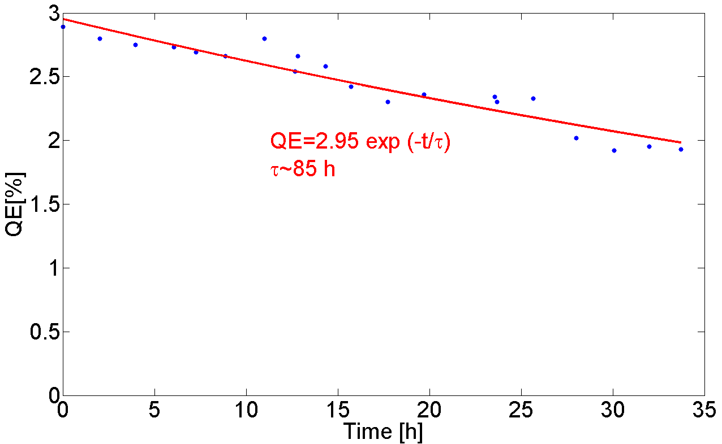
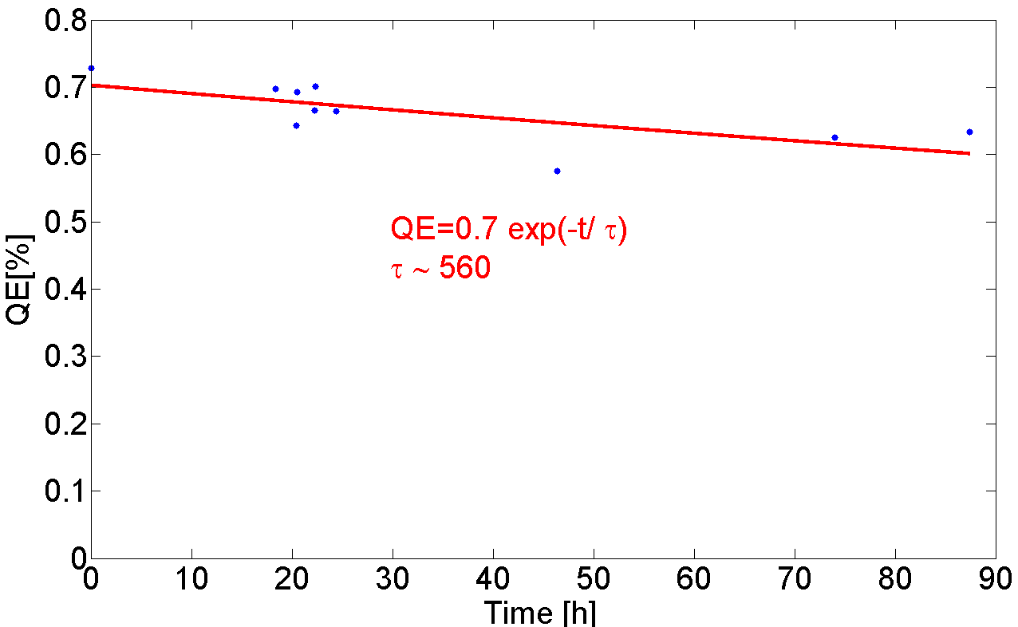
RF Lifetime of Cs₃Sb Cathodes
Dynamic vacuum level: 3e-10 mbar
Dynamic vacuum level: 2.5e-10 mbar
2014
2014
Fresh cathode
Cathode #200 (Cs₃Sb)
Used cathode
Cathode #199 (Cs₃Sb)
Courtesy I. Martini
Fast and slow decay visible as during beam operation.
In both cases longer lifetimes as during beam operation.
Lower vacuum level than during beam operation.
Conclusion: RF has a non-negligible influence on lifetime, but it is not the dominant factor.

Slide 38
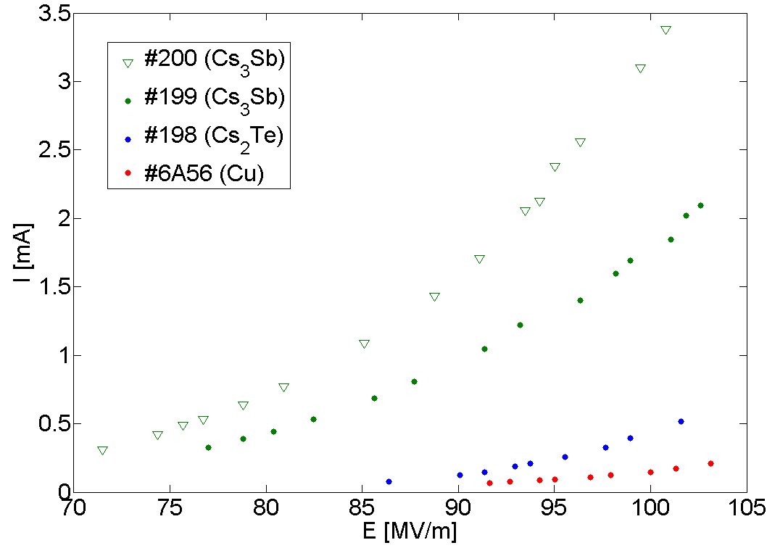
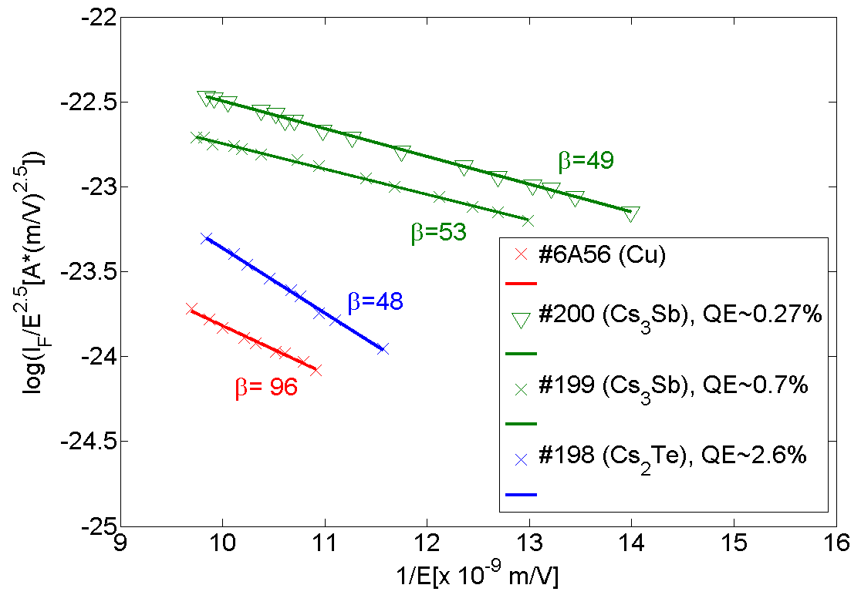
Dark Current Studies
Courtesy I. Martini
Field emission contribution from gun cavity (Cu) and cathode.
Cs₃Sb cathodes (Φ~2 eV) produce higher dark current than Cs₂Te (Φ~3.5 eV) and copper (Φ~4.5 eV).
→ Higher vacuum level for Cs₃Sb than Cs₂Te under same beam conditions.
The low dark current measured with copper confirms that the major contribution is coming from the cathode.

Slide 39
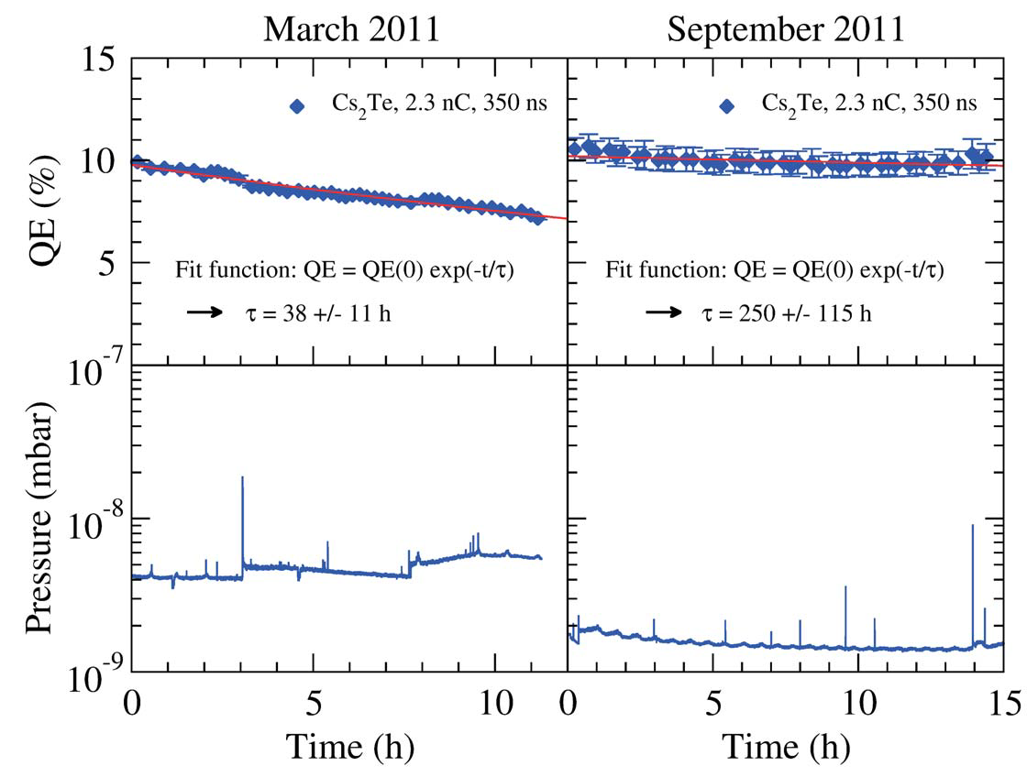
Cs₂Te Lifetimes after 1st Vacuum Improvement
Lifetime measurements before and after the activation of the NEG chamber surrounding the gun cavity:
Substantial improvement of dynamic vacuum level has resulted in drastic increase of 1/e lifetime from 38 to 250 h.
Corresponds to total cathode lifetime of 300 h above 3% QE.
λ=262 nm
λ=262 nm
Cathode #185
C. Hessler et al., “Lifetime Studies of Cs2Te Cathodes at the PHIN RF Photoinjector at CERN”, Proc. of IPAC’12, New Orleans (2012), p. 1554.

Slide 40
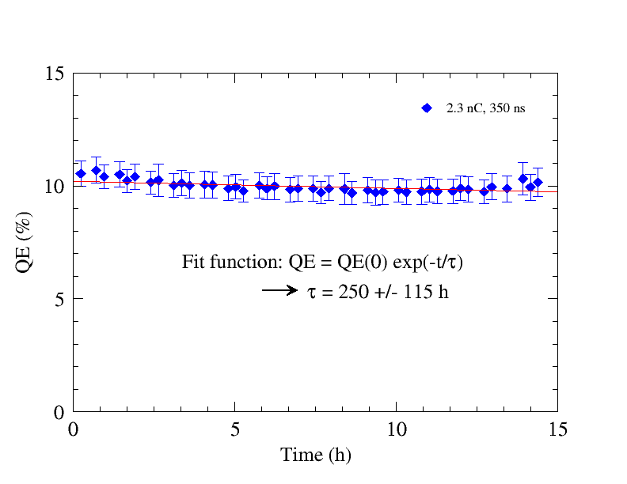
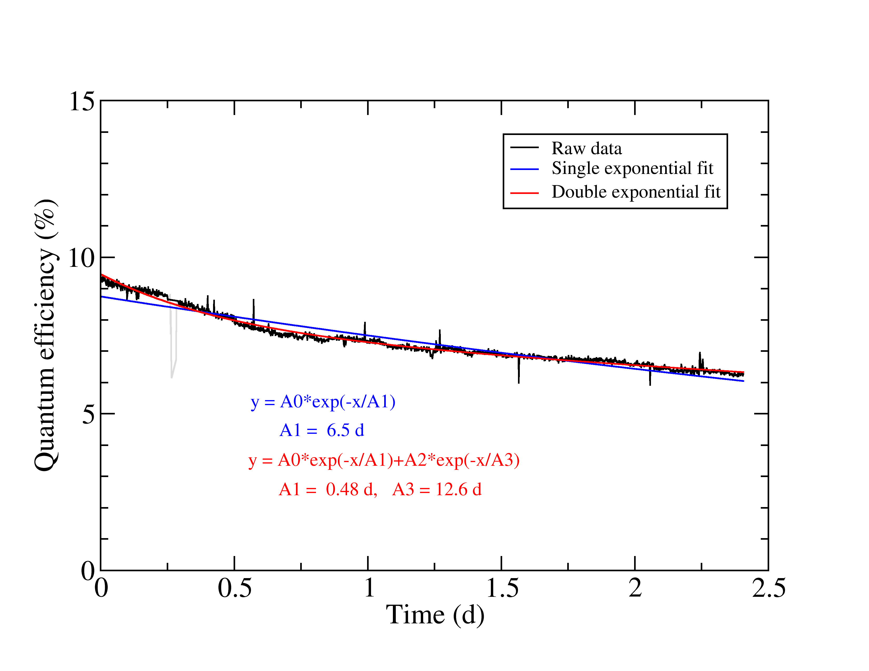
Cs₂Te Lifetimes after 2nd Vacuum Improvement
After the installation of an additional NEG pump:
Double exponential fit represents well the data
Lifetime similar to previous measurement.
Cs₂Te is not ultra-sensitive against non-optimal vacuum conditions
Dynamic pressure: 1.5e-9 mbar 3e-10 mbar
2011
2014
τ₂ = 300 h
2.3 nC, 350 ns, Cs₂Te #185
2.3 nC, 350 ns, Cs₂Te #198

Slide 41
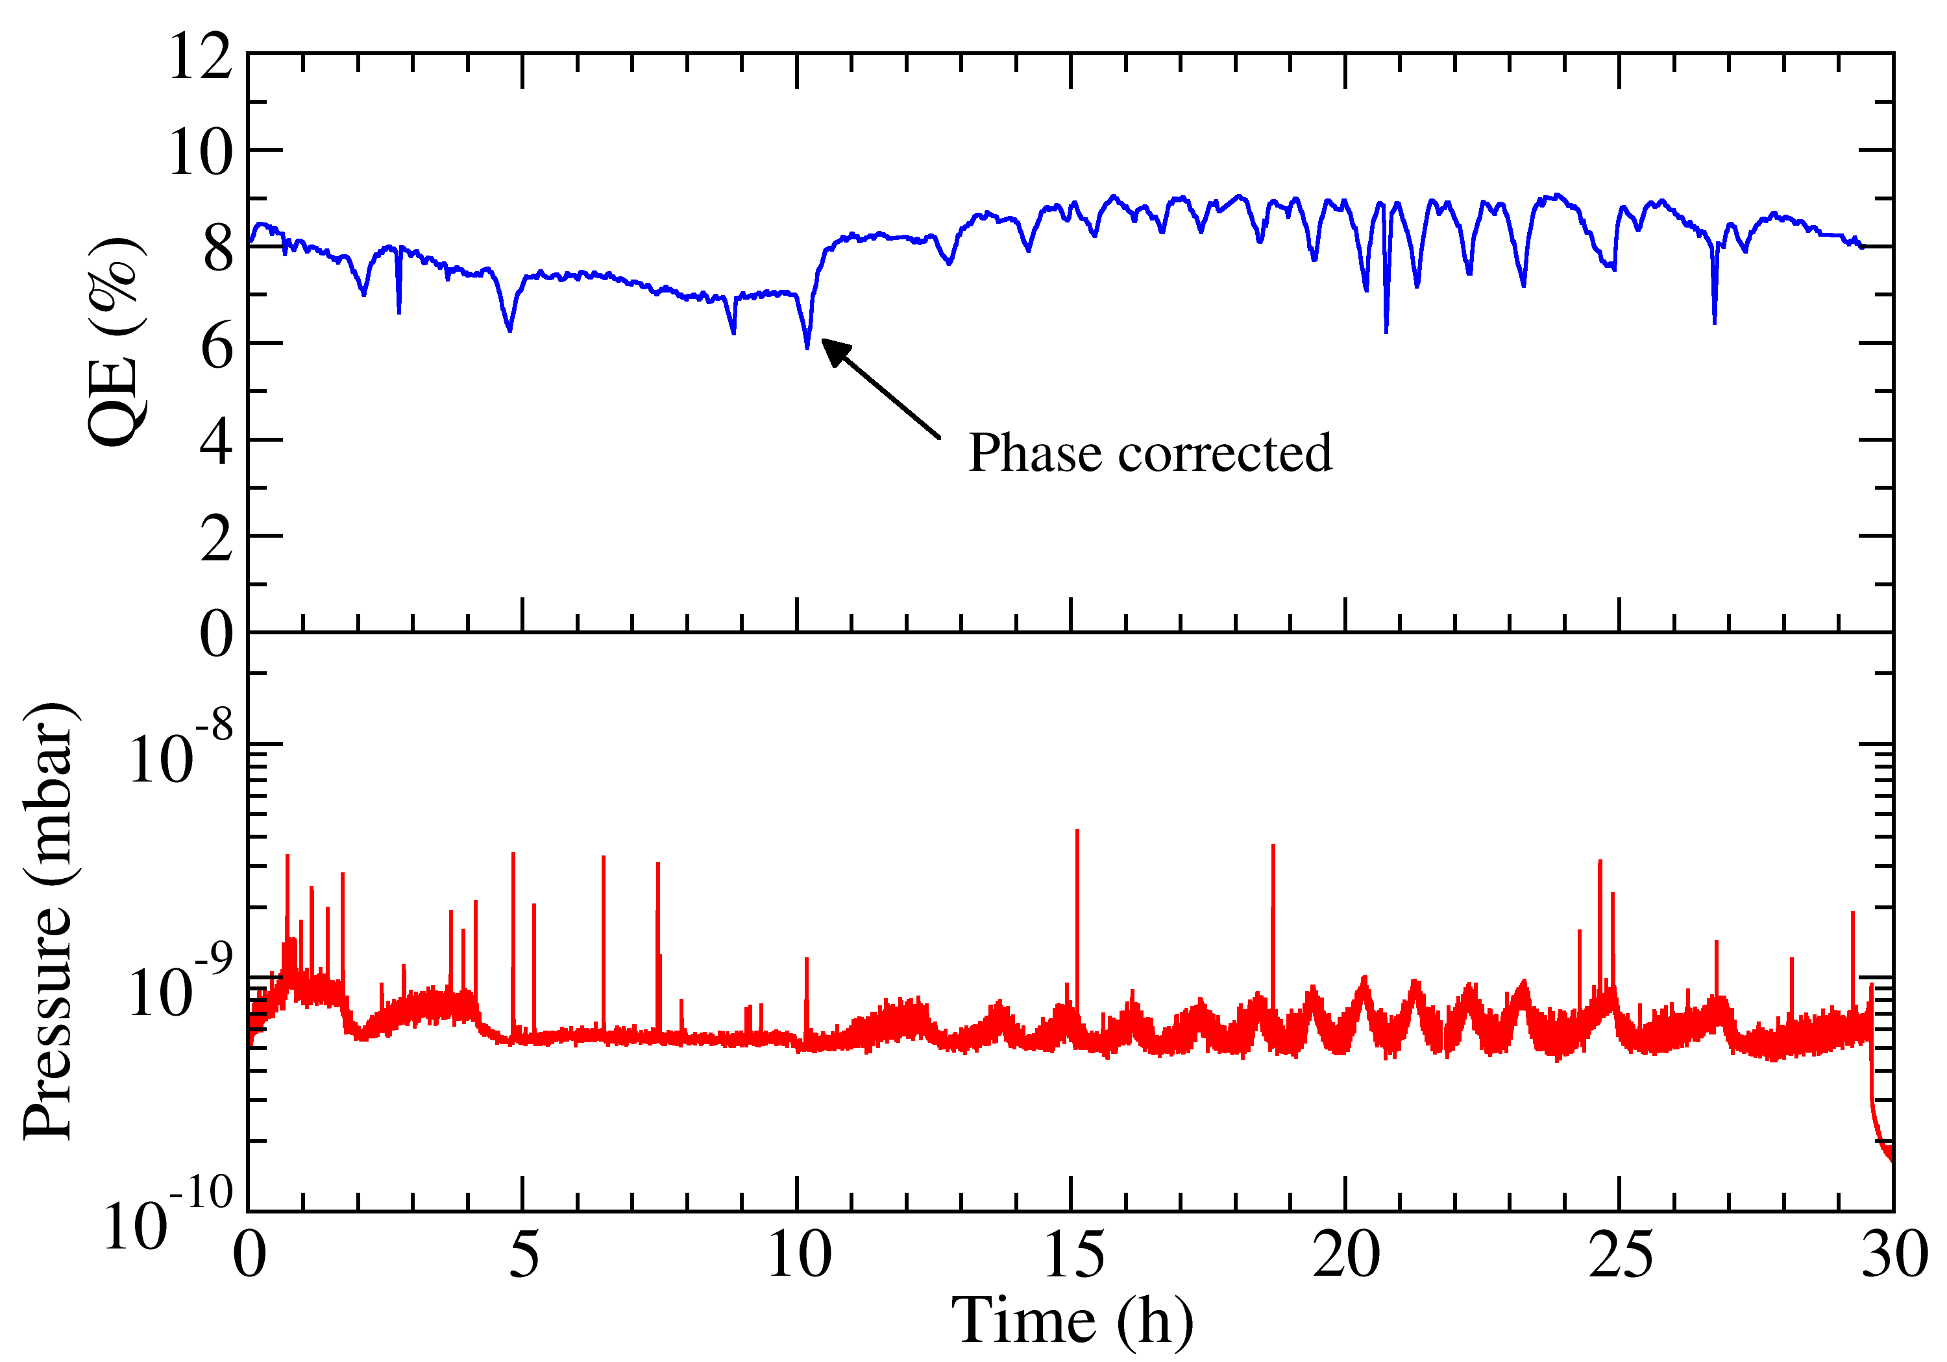
5 Hz Operation with Cs₂Te Cathode
Operation with 1.6 µs (beyond PHIN specs), 2.0 nC/bunch and 5 Hz rep rate.
2015
2.0 nC, 1.6 µs, 5 Hz, Cs₂Te #203
QE seemed initially to decrease, but could be restored by changing the phase.
→ Evident that phase is drifting.
Also in this measurement, QE seems to be constant.
C. Hessler et al., “Study of the Performance of Cs2Te Cathodes in the PHIN RF
Photoinjector using Long Pulse Trains”, Proc. of IPAC’16, Busan (2016), p. 3960.

Slide 42




XPS Analysis of Cs₂Te Cathode
Cs₂Te cathode #203 after production:
  No oxygen or oxide contamination
  visible.
  Good stoichiometry n(Cs)/n(Te)=~2
  Copper from substrate visible
After operation in PHIN:
  TeO₃ and metallic Te were
  formed during degradation process
  Larger quantity of Cu visible,
  probably coating has been
  partially removed by ion
  bombardment.
I. Martini, “Characterization of Cs-Sb cathodes for high charge RF photoinjectors”, PHD Thesis, Politecnico di Milano, 2016
Courtesy I. Martini

