Slide 1
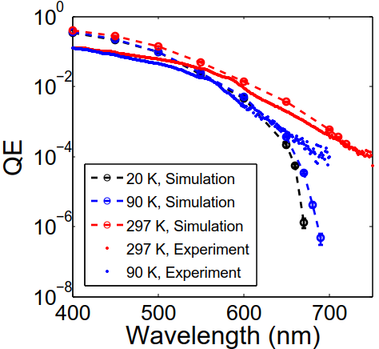
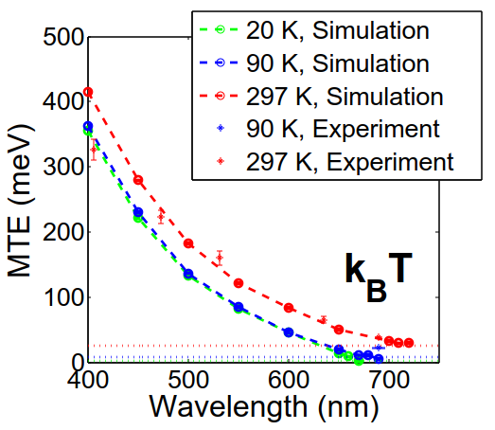
Monte Carlo Simulation of Electron Photoemission from Alkali Antimonide Semiconductors
Pranav Gupta
Cornell University
October 18, 2016

Slide 2
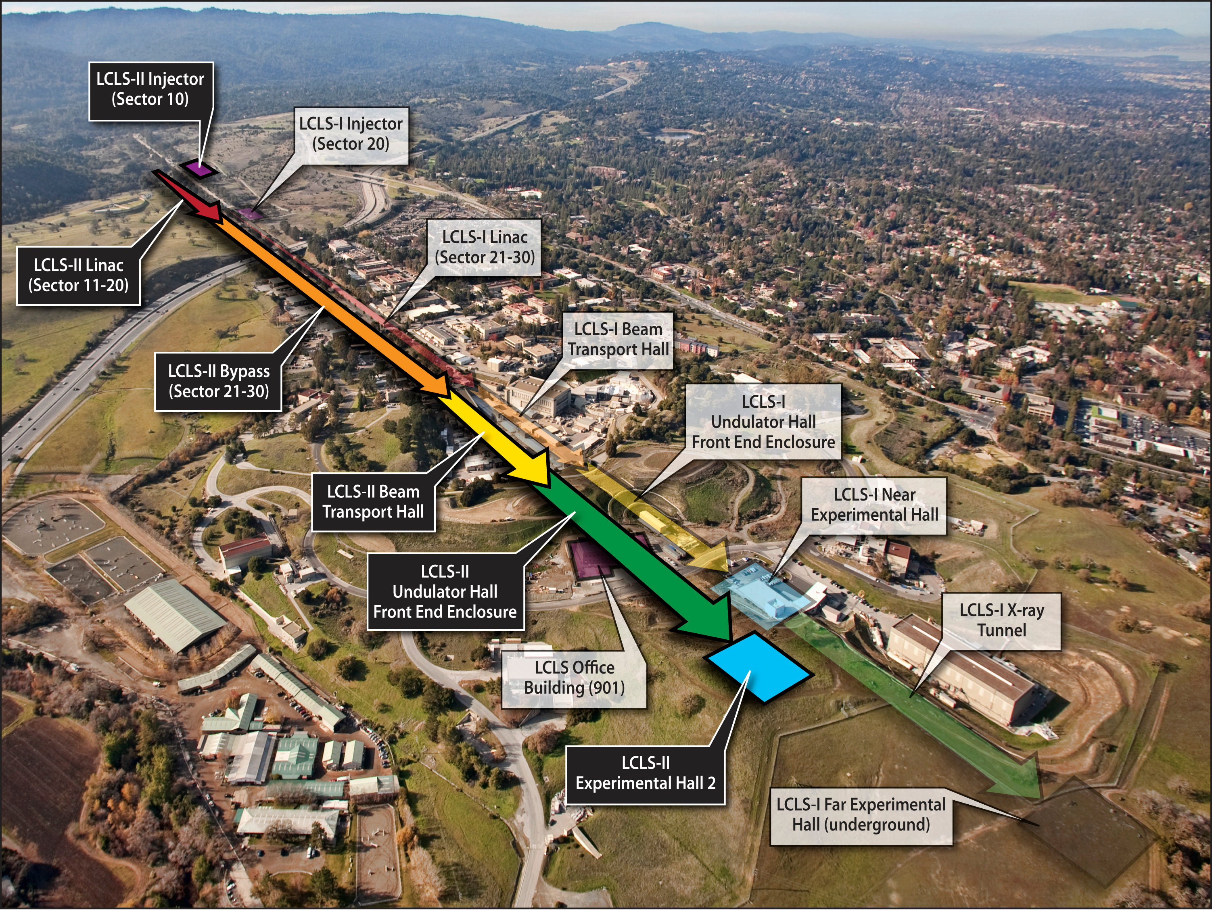
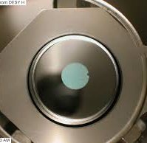
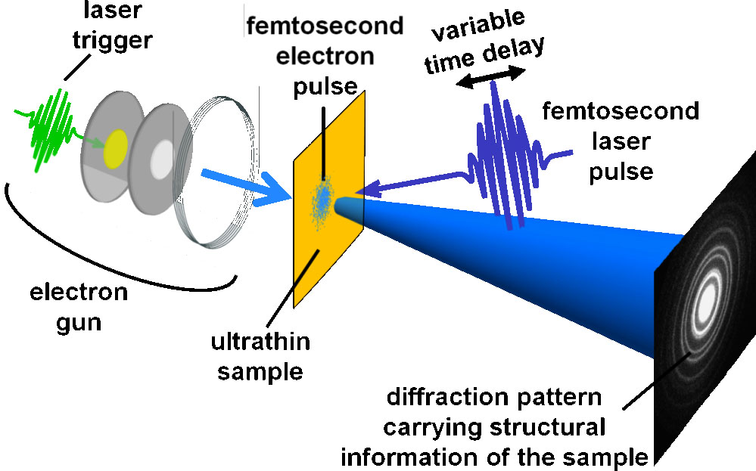
Electron Beam Brightness
“Density in the phase space of electrons in the beam”
$$B_{x}∝\frac{I}{ε_{x}}$$
$$<Mean Transverse Energy>=m_{e}c^{2}{\left(ε_{x}\right)}^{2}$$
LCLS II Free Electron Laser
Photocathode properties:
QE (electrons/photon)
MTE (mean transverse energy of electrons coming out)
Response time
Lifetime (days, months, etc.)
Ultrafast Electron Diffraction
Notes:
What do we mean by brightness? It is the density in phase space.
Why do we care for bright electron beams?
Limit on the shortest FEL wavelength is set by the beam brightness. (Point laser to the formula and tell the improvement you can have if beam brightness could go up by an order of magnitude, or you can reduce the length of the linac by cutting down on gamma, the relativistic electron energy)
Also, easier to create short, coherent bunches of electrons in order to perform single shot electron diffraction of samples within small setups (lower de Broglie wavelength?), compared to traditional X-rays. (Give an idea of how difficult it is to use X-rays.)
How do we create beams? From photocathodes (define “photocathode”).
What else do we care for? (define each term: QE, MTE in brightness➔ obvious, UED→ response time should be sub-ps)
From an operating point of view, we want them to last long
%%
Brightness definition
Applications of bright e beams
How bright beams help litho, fel?
State of the art
Higher energy of X-ray photons if beam bright
Single shot ultrafast electron diffraction, 10^5 e per bunch coherent over 10 nm; time sub-ps
Electrons have higher scatt cross section
UV metals, visible light possible, MTE better than metals

Slide 3
Why Alkali Antimonides?
Material | Quantum Efficiency | MTE | Response time | Lifetime
Metal: Cu @ 266 nm | ~10⁻⁵ | ~330 meV | << 1 ps | Months in 10⁻⁹ torr
Negative electron-affinity semiconductor Cesium-activated GaAs @ 532 nm | ~0.1 | ~120 meV | < 1 ps | Days in 10⁻¹¹ torr
Positive Electron Affinity Semiconductor Alkali antimonides @ 532 nm | ~0.1 | ~200 meV | < 1 ps | Cs₃Sb: months in 10⁻⁹ torr
Can ask the fundamental question:
what is the ultimate limit to emittance?
QE higher than metals
Sub-picosecond response time, faster than NEA GaAs→ used in streak cameras
Lifetime longer than cesium-activated GaAs photocathodes

Slide 4
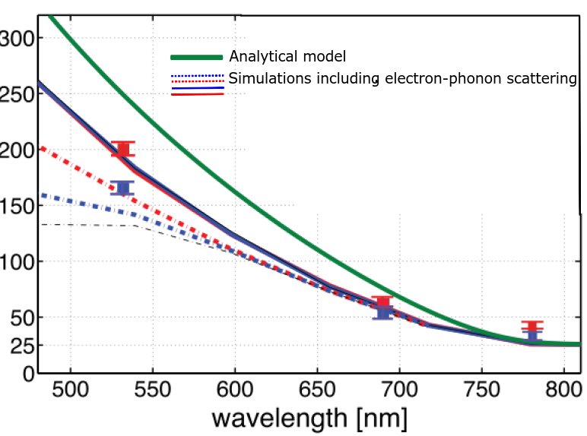
Why a Monte Carlo Simulation?
Reproduce the measured photoemission properties
QE, Mean Transverse Energy, Response Time
Predict photoemission properties in unexplored experimental conditions (mostly ultracold temperatures)
Include relevant physics: e-ph scattering, band bending, temperature effects (going beyond analytical models)
Put forward experimental measurements aimed at understanding photoemission in alkali antimonides
Analytical (green) not adequate; but
simulations match
MTE (meV)
Lee et al, APL
Notes:
GaAs response time may be very high (what conditions?); vacuum sensitive
Can play with band bending profiles
Study effect of temperature
Same energy as X-rays but lower de Broglie wavelength
The code is “alive” and allows implementation of other physics like scattering at the surface during the emission step
%%

Slide 5
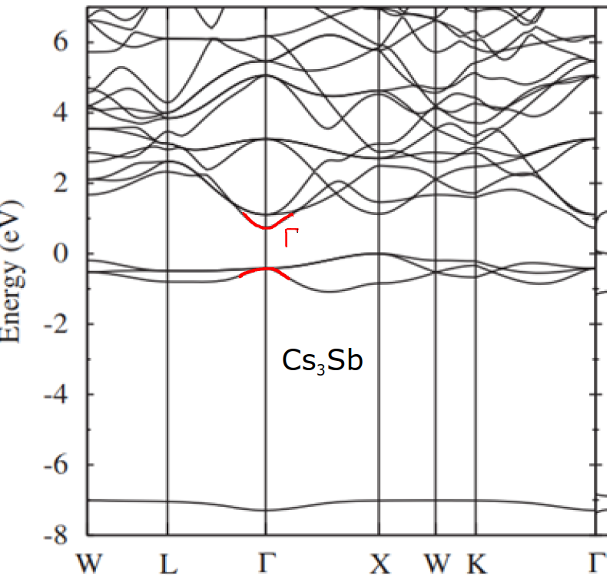
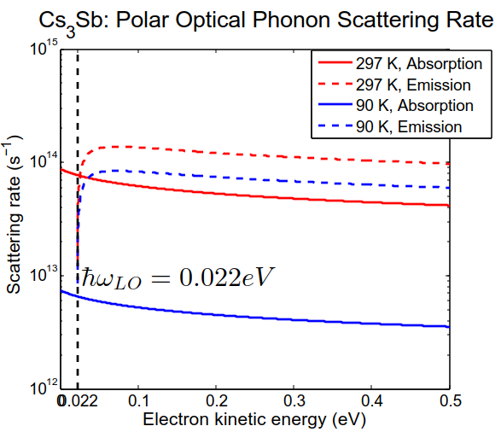
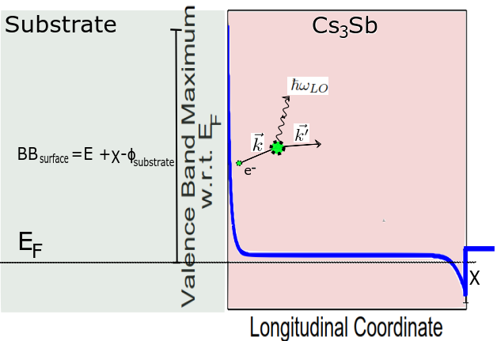
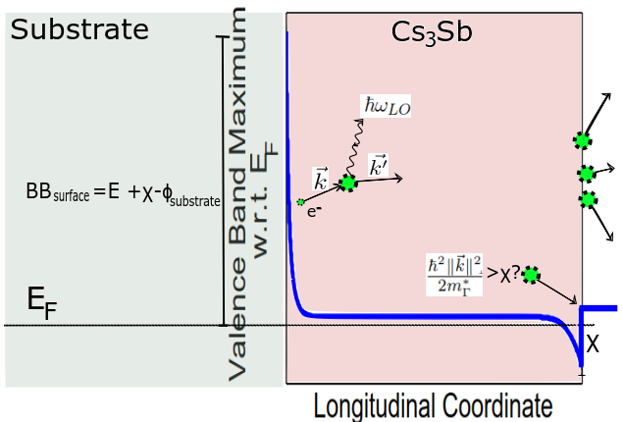
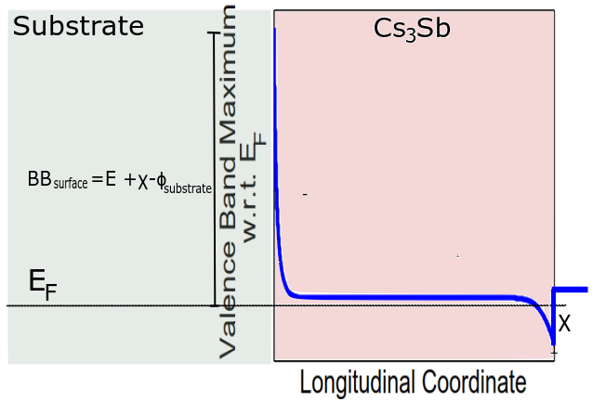
Photoemission model
3-step photoelectric emission process (Spicer) for Cs₃Sb-
Absorption of light to create electrons in the conduction band (consider only Г valley)
Transport of electrons within the cathode; scatter with polar optical phonons (dominant scattering mechanism in Cs₃Sb)
Emission of electrons from surface
Band gap corrected to actual band gap from the DFT value 0.9 eV
Scattering angles depend on electron energy: energy ↑ then angles↓
Crystal polarization properties from Lorentz oscillator model
hν
Notes:
The workhorse for the community is a semi-classical, 3-step model of photoemission. First we generate out-of-equilibrium electrons that scatter via phonons; e-e scattering is negligible in semiconductors
Be slow in the transition from chunk 1 to chunk 2
They move to the surface- a 1d rectangular barrier (affinity). Let me walk you through the algorithm I use. Generate electron positions , then assign initial energies; single, isotropic, parabolic valley, so initial directions isotropic; kill electrons with energies less than phonon energy (a little caveat there)

Slide 6
Photoemission model
3-step photoelectric emission process (Spicer) for Cs₃Sb-
Absorption of light to create electrons in the conduction band (consider only Г valley)
Transport of electrons within the cathode; scatter with polar optical phonons (dominant scattering mechanism in Cs₃Sb)
Emission of electrons from surface
Band gap corrected to actual band gap from the DFT value 0.9 eV
hν
Scattering angles depend on electron energy; energy ↑➔angles↓
Crystal polarization properties from Lorentz oscillator model
Notes:
The workhorse for the community is a semi-classical, 3-step model of photoemission. First we generate out-of-equilibrium electrons that scatter via phonons; e-e scattering is negligible in semiconductors
They move to the surface- a 1d rectangular barrier (affinity). Let me walk you through the algorithm I use. Generate electron positions , then assign initial energies; single, isotropic, parabolic valley, so initial directions isotropic; kill electrons with energies less than phonon energy (a little caveat there)

Slide 7
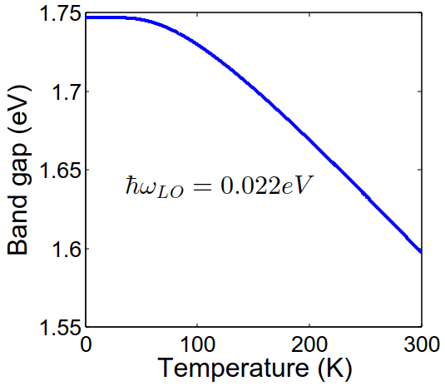
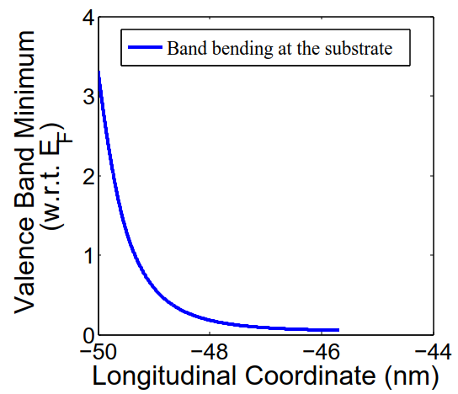
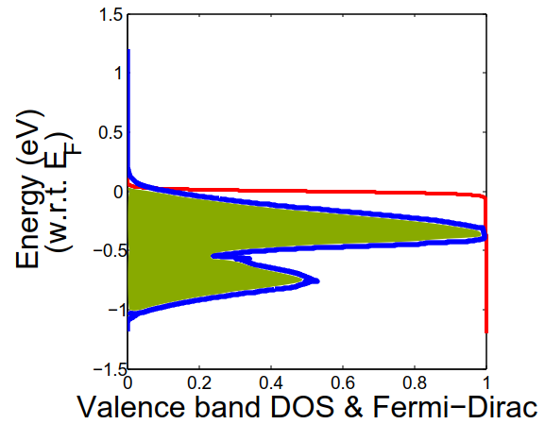
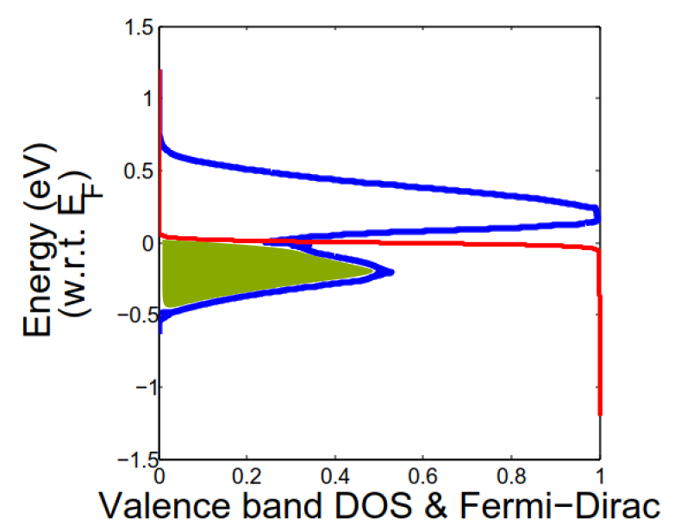
Absorption of Electrons
Absorption coefficient from Lorentz oscillator model fit
Charge transfer from substrate and surface states cause bending of bands
Tweaks absorption of light; electrons get an acceleration
Cs₃Sb naturally p-type; notice the Fermi level existing below the VBM, due to high p-doping (n_{A})!
Band gap versus temperature from electron-phonon coupling; no appreciable change in band gap below 50 K
Density of states with Urbach tail to account for disorder
Absorption coefficient a function of depth

Slide 8
Emission
Longitudinal momentum should be enough to overcome the electron affinity- 1D tunneling problem (χ=0.45 eV from experiments [Spicer])
IMPORTANT: transverse momentum is not conserved during emission
GaAs has a pristine surface, but does NOT show momentum conservation
We assume conservation of transverse energy instead
Effective affinity depends on band bending at the vacuum interface (BB_{surface}): crucial for determining the true work function
True work function E_{g}+χ-BB_{surface}, instead of just E_{g}+χ
BB_{surface}=-0.35 eV (ad-hoc parameter)
Notes:
Momentum conservation not seen to be true, even for pristine surfaces. So need not conserve momentum. But transverse energy conservation works.
Effective affinity: surface band bending amount important, as affinity defined from CBM (or VBM, difference is only Eg) at the surface
0.067 m_e effective mass of GaAs, but still MTE not doing crazy stuff due to the hugely different masses

Slide 9
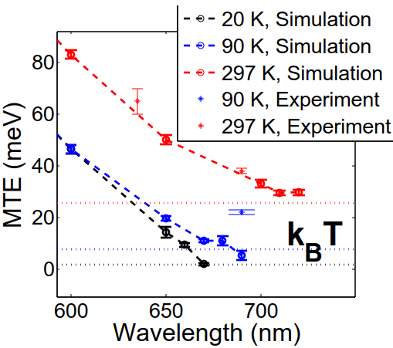
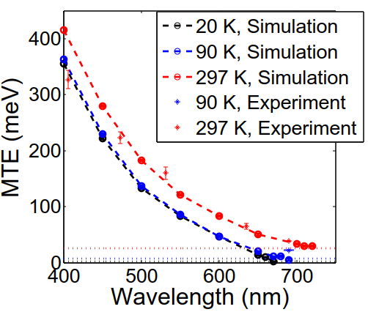
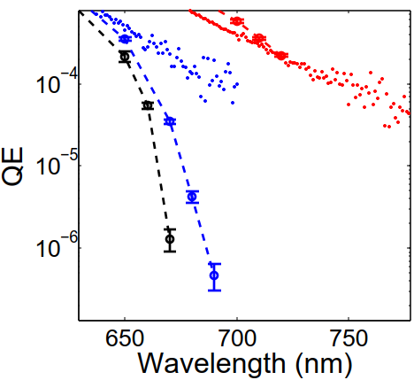
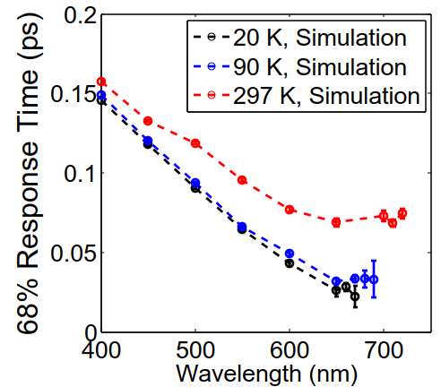
Front illumination/ ’reflection’ mode
QE, MTE match; MTE→ kT
Response time ~ 100 fs;
faster response at longer wavelengths!
Thickness 150 nm
Reflection mode
Notes:
20 K slightly lower than 90 K in qe , but MTE much lower due to kT asymptote. Show the 3 horizontal lines on the plot.

Slide 10
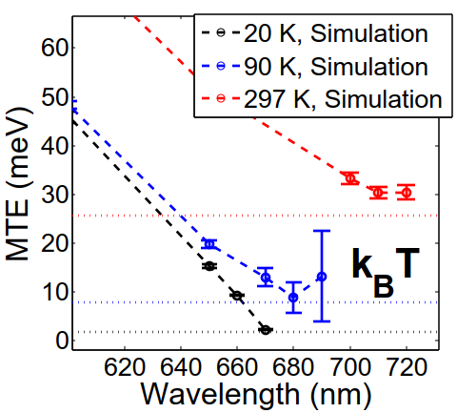
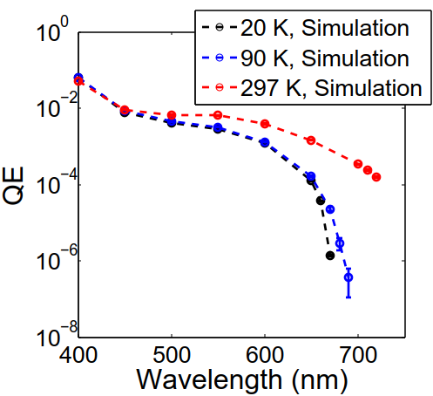
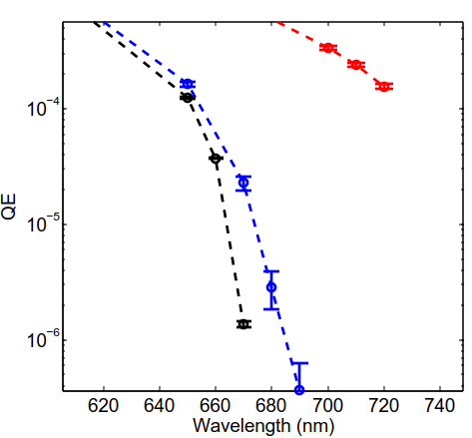
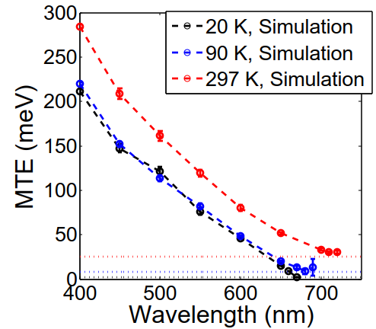
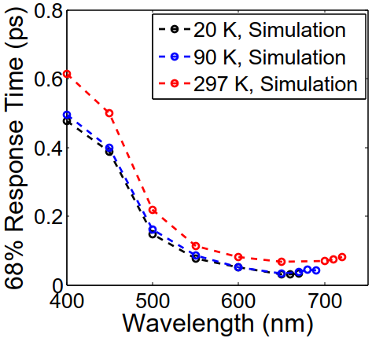
Back illumination/ ’transmission’ mode
Thickness 150 nm
Transmission mode
QE lower
MTE lower, still goes to kT
Notes:
QE lower, MTE also lower, response time higher as electrons come all the way from the back to the surface

Slide 11
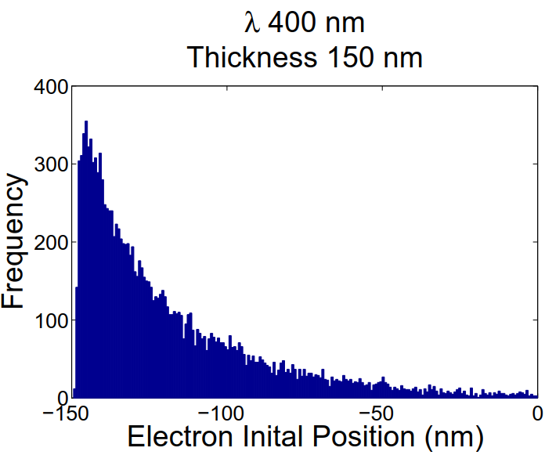
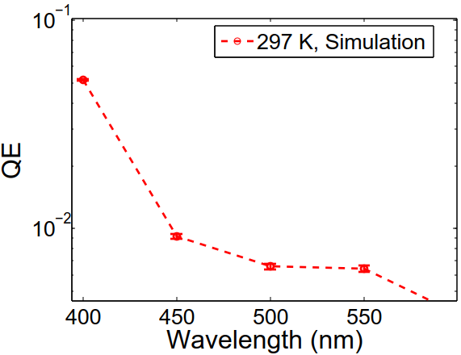
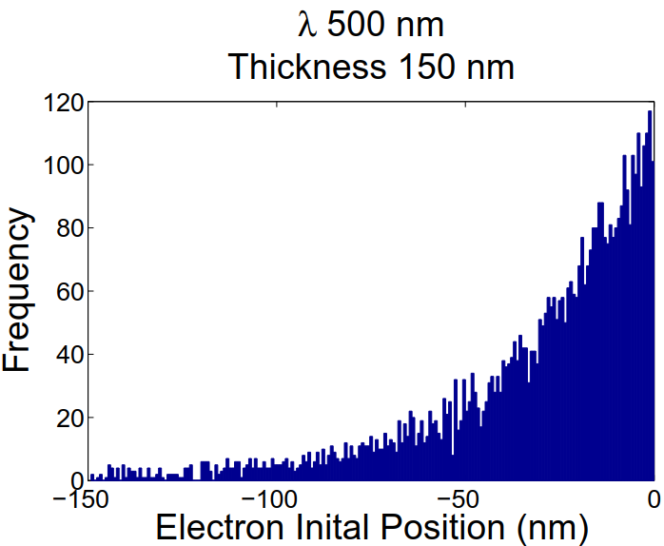
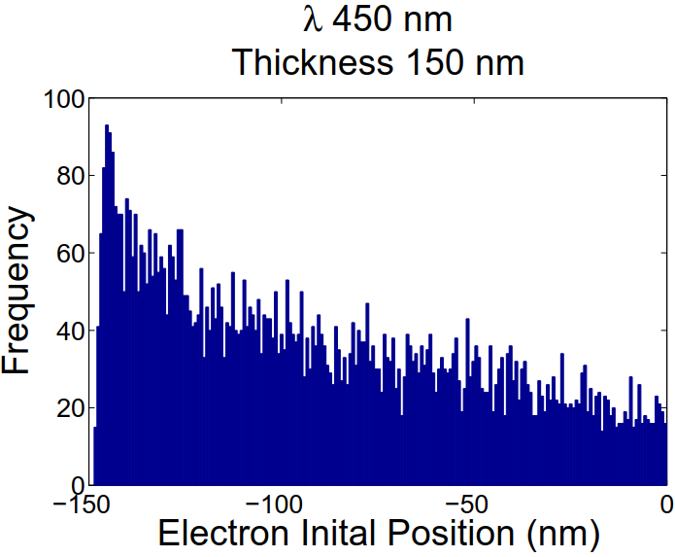
Why does QE drop so much?
Successful electrons from front, not back, when λ > 500 nm in transmission mode for 150 nm thickness

Slide 12
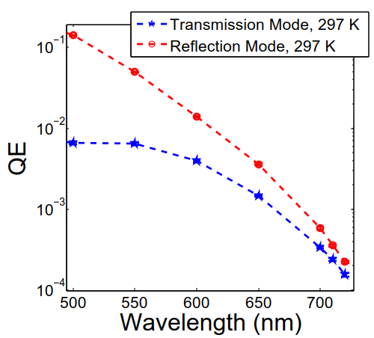
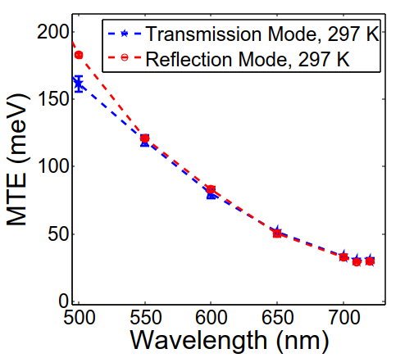
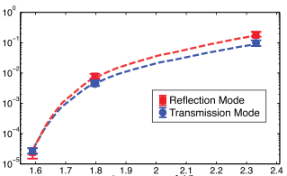
Comparing reflection, transmission modes
Qualitative agreement!
QE
MTE (meV)
Photon energy (eV)
Lee et al

Slide 13
Conclusion and future work
Conclusions
Agreement with experiments for reflection mode at long wavelengths;
Predict MTE lowering in transmission mode, as seen in experiments
Ad-hoc parameters like surface band bending value of -0.35 eV (corresponds to a surface state density of ~10¹³/cm⁻² for the given experimental data); electron-phonon coupling strength; optical phonon energy
Predictions for the upcoming 20 K electron gun
Future work
Extend model to other materials
Predict photoemission from new candidates near emission threshold
Need experiments measuring
phonon energy (Raman spectra);
band gap as a function of temperature (band gap crucial for determining emission threshold as a function of temperature),
doping, surface states (important for determining effective surface barrier faced by electrons)
Notes:
Tell about weak links in the model; say about the new 20 K gun that will act as a test for our hypothesus.
What we learn from this simulation about alkali antimonides? still thinking, no words yet

Slide 14
Thanks for your patience!
Questions?
Contact me at ppg22@cornell.edu .
Acknowledgements:
Dr. Luca Cultrera, Prof. Ivan Bazarov, Hyeri Lee

Slide 19
Back-up slides

Slide 20
MTE v/s thickness

Slide 21
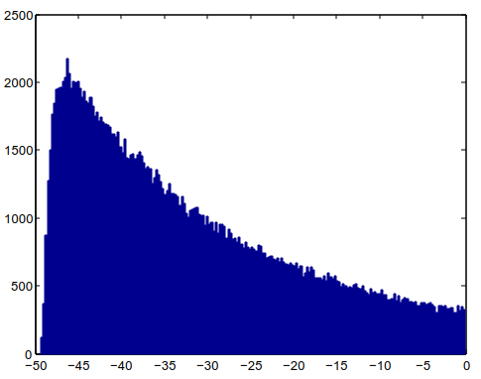
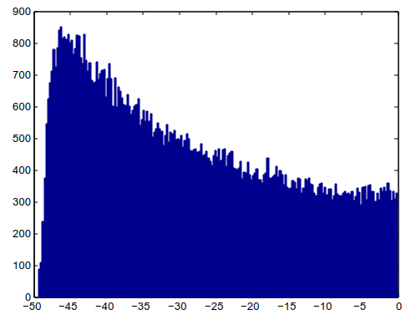
600 nm
400 nm
450 nm
50 nm thickness, transmission, 5.5 eV WFs

Slide 22
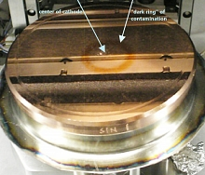
Common cathode materials
Metal: Cu (UED, LCLS, BNL…)
QE: ~10⁻⁵ @ 266 nm
Response time: << 1 ps
Lifetime: months in 10⁻⁹ Torr (compatible with very high gradients)
Intrinsic emittance: 0.8 mm-mrad/mm rms
PEA Semiconductor: Cs₂Te (FLASH, XFEL….)
QE: ~10⁻¹ @ 266 nm
Response time: < 1 ps
Lifetime: months in 10⁻⁹ Torr (compatible with high gradients)
Intrinsic emittance: 1 mm-mrad/mm rms
NEA Semiconductors: Cs:GaAs (Jlab…)
QE: ~10⁻¹ @ 520 nm
Response time: <1 ps
Lifetime: days in 10⁻¹¹ Torr (operated only in low gradient DC guns)
Intrinsic emittance: 0.48 mm-mrad/mm rms
Notes:
What photocathode materials do the leading facilities in the world use?
You can classify into 3 categories-
Metal, PEA Semi, NEA Semi
(this slide will confuse; people may think that QE is 0.1 at 266 nm even for Cs3Sb)
%%
Metal->Cu:(MTE=330meV => T=3800 K)
PEA:(MTE=500meV => T=6000 K)
NEA:(MTE=120meV => T=1400 K)

Slide 23
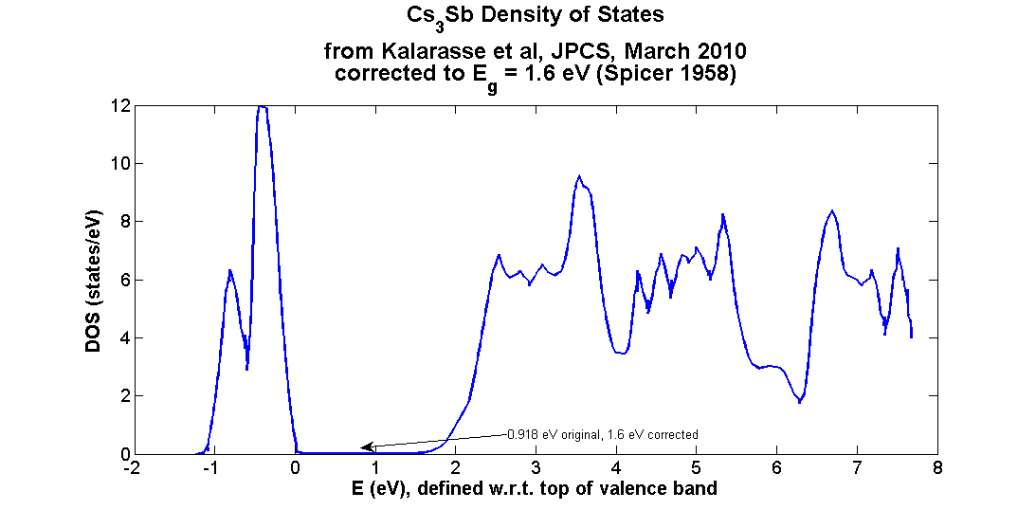
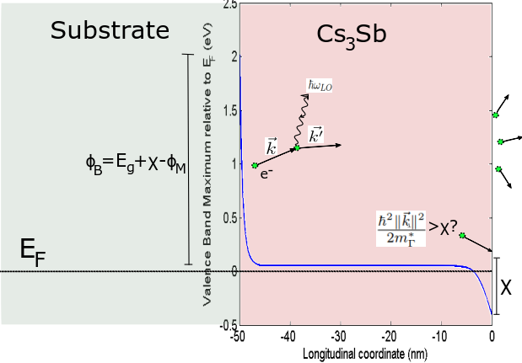
Photoemission Model
3-step photoelectric emission process (Spicer) for Cs₃Sb
Absorption of light to generate electron positions and energies
Transport of electrons; scatter with polar optical phonons (only Г valley)
Emission from surface
Band gap corrected to 1.6 eV
from the DFT value 0.9 eV
hν
back-illumination (‘transmission mode’)
Notes:
The workhorse for the community is a semi-classical, 3-step model of photoemission. First we generate out-of-equilibrium electrons that scatter via phonons; e-e scattering is negligible in semiconductors
They move to the surface- a 1d rectangular barrier (affinity). Let me walk you through the algorithm I use. Generate electron positions , then assign initial energies; single, isotropic, parabolic valley, so initial directions isotropic; kill electrons with energies less than phonon energy (a little caveat there)

Slide 24
Outline
Background and motivation
Photoemission model
Simulation results versus experiments
Conclusion and future work

Slide 25
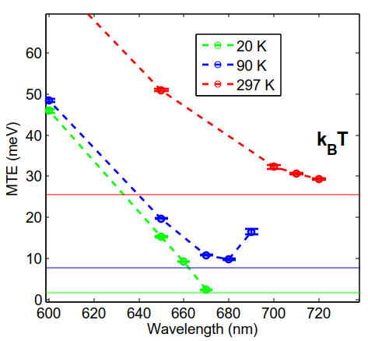
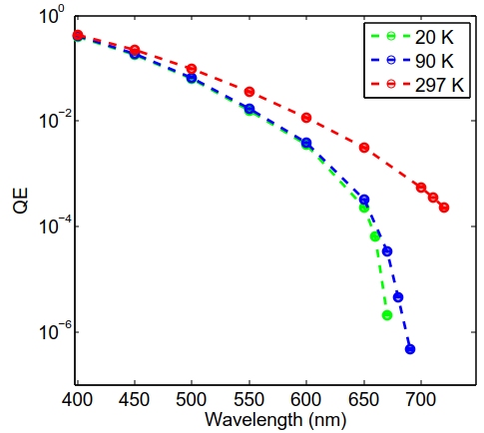
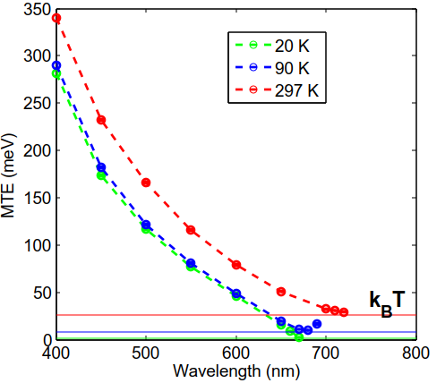
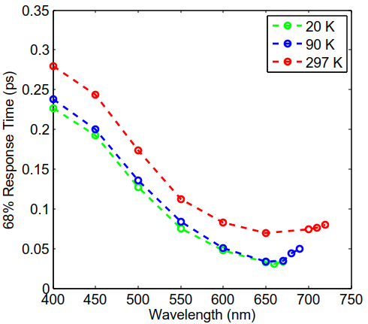
Back illumination/ ’transmission’ mode
Thickness 50 nm
Transmission mode
Glass substrate: φ_{s}=5.5 eV
QE lower
MTE lower, still goes to kT
Response slower than reflection mode
Notes:
QE lower, MTE also lower, response time higher as electrons come all the way from the back to the surface

Slide 26
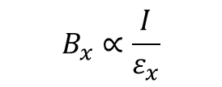
Electron beam brightness
Electron beam brightness
$$B_{x}∝\frac{I}{ε_{x}}$$
“Density in the phase space”
$$MTE=m_{e}c^{2}{\left(ε_{x}\right)}^{2}$$
$$\frac{ε_{x}}{γ}<\frac{λ_{FEL}}{4π}$$
FEL lasing condition
Photocathode properties:
QE
MTE
Response time
Lifetime
$$\frac{L_{c,x}}{λ_{e}}=\frac{σ_{x}}{ε_{x}}$$
Notes:
What do we mean by brightness? It is the density in phase space.
Why do we care for bright electron beams?
Limit on the shortest FEL wavelength is set by the beam brightness. (Point laser to the formula and tell the improvement you can have if beam brightness could go up by an order of magnitude, or you can reduce the length of the linac by cutting down on gamma, the relativistic electron energy)
Also, easier to create short, coherent bunches of electrons in order to perform single shot electron diffraction of samples within small setups (lower de Broglie wavelength?), compared to traditional X-rays. (Give an idea of how difficult it is to use X-rays.)
How do we create beams? From photocathodes (define “photocathode”).
What else do we care for? (define each term: QE, MTE in brightness➔ obvious, UED→ response time should be sub-ps)
From an operating point of view, we want them to last long
%%
Brightness definition
Applications of bright e beams
How bright beams help litho, fel?
State of the art
Higher energy of X-ray photons if beam bright
Single shot ultrafast electron diffraction, 10^5 e per bunch coherent over 10 nm; time sub-ps
Electrons have higher scatt cross section
UV metals, visible light possible, MTE better than metals

Slide 27
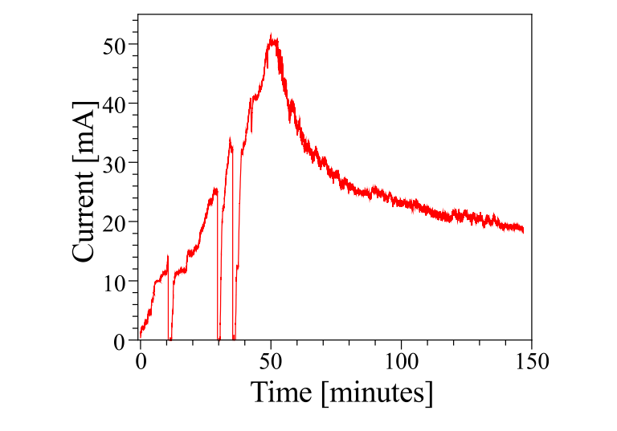
Why Alkali Antimonides?
Table
QE higher than metals for the same emittance
Sub-picosecond response time→ used in streak cameras
Lifetime longer than cesium-activated GaAs photocathodes
Few 100s of fs
Beam current versus time using a GaAs cathode:
lifetime only a few minutes,
against ~2 days for alkali antimonide at high beam current
Notes:
Given all these other photocathodes, why would we want to study this particular class of materials?
There are 3 important reasons-
Alkali antimonides give you beams brighter than metals
Response time also sub-ps (and hence they have been exploited extensively by the streak camera industry)

Slide 28
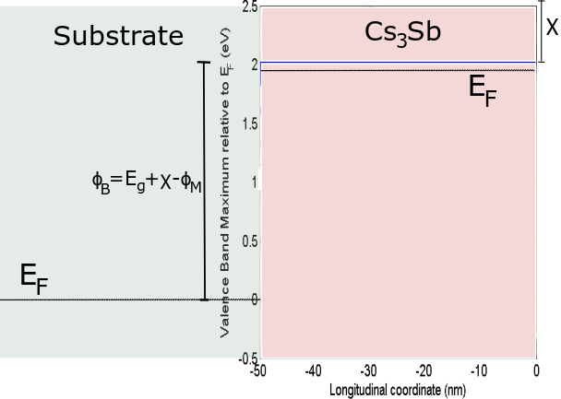
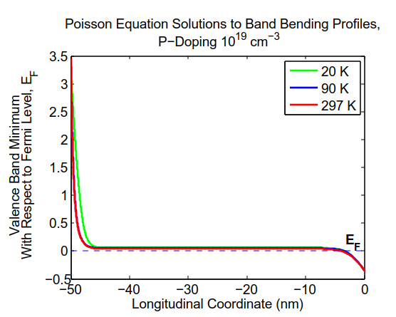
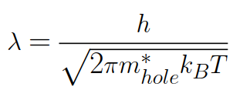
Photocathode Energy Band Diagram
Charge transfer from substrate and surface states cause bending of bands
Tweaks absorption of light
Electrons get an acceleration
Cs₃Sb naturally p-type, so band bending downwards
Notice the Fermi level existing below the VBM, due to high p-doping (n_{A})!
POISSON EQUATION FOR BAND BENDING PROFILE
Notes:
Band bending and impurities important; 1950s Hall measurements show natural p-type conductivity of Cs3Sb. Spicer says that doping density (same as impurity density?) should be of the order of 1e19 per cc based on Sakata’s Hall measurements. Can convert this into an electrostatic problem- where does charge come from or go to? Think of 2 electron reservoirs and their thermal equilibrium. Charge goes from the p-type semiconductor valence band to the substrate. Acceptors uniformly dense, always filled with electrons. So the poisson equation should be (point to the equation and explain term by term). Show a couple of solutions of the second order differential equation.

Slide 29
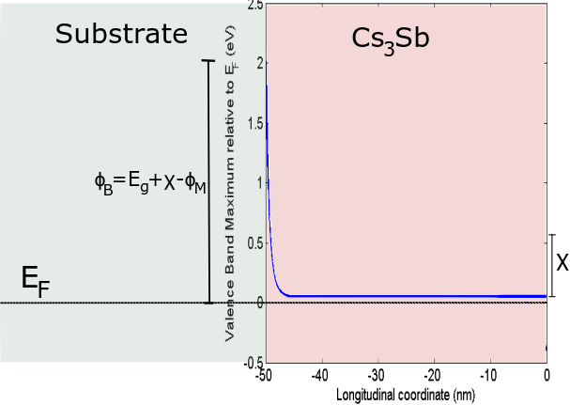
Photocathode Energy Band Diagram
Charge transfer from substrate and surface states cause bending of bands
Tweaks absorption of light
Electrons get an acceleration
Cs₃Sb naturally p-type, so band bending downwards
Notice the Fermi level existing below the VBM, due to high p-doping (n_{A})!
POISSON EQUATION FOR BAND BENDING PROFILE
Notes:
Band bending and impurities important; 1950s Hall measurements show natural p-type conductivity of Cs3Sb. Spicer says that doping density (same as impurity density?) should be of the order of 1e19 per cc based on Sakata’s Hall measurements. Can convert this into an electrostatic problem- where does charge come from or go to? Think of 2 electron reservoirs and their thermal equilibrium. Charge goes from the p-type semiconductor valence band to the substrate. Acceptors uniformly dense, always filled with electrons. So the poisson equation should be (point to the equation and explain term by term). Show a couple of solutions of the second order differential equation.

Slide 30
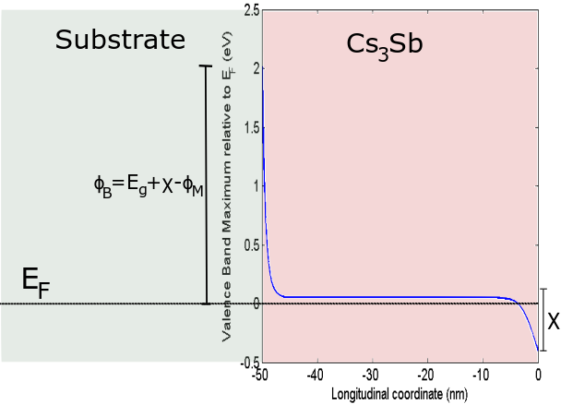
Photocathode Energy Band Diagram
Charge transfer from substrate and surface states cause bending of bands
Tweaks absorption of light
Electrons get an acceleration
Cs₃Sb naturally p-type, so band bending downwards
Notice the Fermi level existing below the VBM, due to high p-doping (n_{A})!
POISSON EQUATION FOR BAND BENDING PROFILE
Notes:
Band bending and impurities important; 1950s Hall measurements show natural p-type conductivity of Cs3Sb. Spicer says that doping density (same as impurity density?) should be of the order of 1e19 per cc based on Sakata’s Hall measurements. Can convert this into an electrostatic problem- where does charge come from or go to? Think of 2 electron reservoirs and their thermal equilibrium. Charge goes from the p-type semiconductor valence band to the substrate. Acceptors uniformly dense, always filled with electrons. So the poisson equation should be (point to the equation and explain term by term). Show a couple of solutions of the second order differential equation.

Slide 31
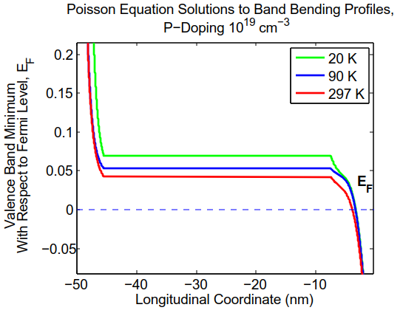
Photocathode Energy Band Diagram
Charge transfer from substrate and surface states cause bending of bands
Electrons get an acceleration
Tweaks absorption of light
Cs₃Sb naturally p-type, so band bending downwards
Notice the Fermi level existing below the VBM, due to high p-doping (n_{A})!
POISSON EQUATION FOR BAND BENDING PROFILE
Notes:
Band bending and impurities important; 1950s Hall measurements show natural p-type conductivity of Cs3Sb. Spicer says that doping density (same as impurity density?) should be of the order of 1e19 per cc based on Sakata’s Hall measurements. Can convert this into an electrostatic problem- where does charge come from or go to? Think of 2 electron reservoirs and their thermal equilibrium. Charge goes from the p-type semiconductor valence band to the substrate. Acceptors uniformly dense, always filled with electrons. So the poisson equation should be (point to the equation and explain term by term). Show a couple of solutions of the second order differential equation.

Slide 32
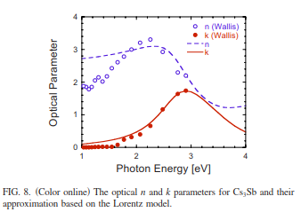
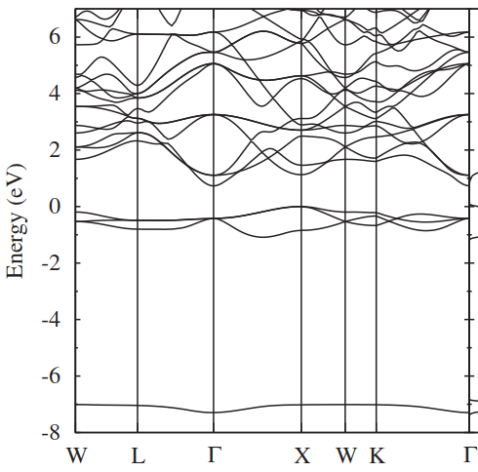
1. Generation of electrons
n and k are used to estimate reflectivity and absorption as function of wavelength
Band structure from DFT
Initial energy distribution: DFT density of states, with a 0.05 eV exponential tail (Urbach tail) to account for disorder
The probability of having an electron excited at a depth z with initial energy E (E_{F}:=0) is:
: absorption coefficient at depth z; BB: band bending magnitude
: valence band density of states, defined with respect to valence band maximum
Band gap corrected to 1.6 eV
from the DFT value 0.9 eV
Notes:
Lorentz model for optical data
Band structure: show, point out the Gamma valley
Urbach tail: typical 0.05 eV tail value for amorphous semiconductors
Need to account for depletion of states dur to upward band bending
Alpha0 is Lorentz oscillator value of 4 pi k/lambda
to generate distributions of initial energies
, as number of excitable electrons now a function of position

Slide 33
1. Generation of electrons
Band bending changes absorption; regions with too much upward band bending won’t absorb electrons
: absorption coefficient from the Lorentz oscillator model
Use to calculate the probability distribution of positions
To calculate the distribution of energies at every position, shift the density of states appropriately and multiply the Fermi-Dirac distribution
Notes:
We have positions, now we need energies
Need to also consider offset due to bb(z), making distributions a function of z. In the left case, a good chunk of the valence band remains empty.
Right-> fine, as upward band bending is small

Slide 34
Effect of temperature on band gap
Experiments suggest work function being a function of temperature
Assuming electron affinity to not change significantly with temperature, only choice- band gap change
Electron-phonon coupling can lead to appreciable temperature dependence of band gap
Fix room temperature band gap to experimental value of 1.6 eV
Use the generic for now
Prediction: Band gap flattens below 50 K, so work function doesn’t change significantly below liquid nitrogen temperature
Equation from Guistino et al
Empirical model with generic semiconductor parameters
Notes:
Certain compounds have dramatically different
Doesn’t change between 20 K and 90 K, means a lot for QE and MTE.
Assuming generic parameters for the time being, calculations hard quantitatively
Surface reconstruction can be a lot different at different temperatures, but in our case we use a surface state picture. So drastic changes in electron affinity not possible by going from 297 K to 90 K.

Slide 35
2. Semiclassical Transport
Scattering only with polar optical phonons (ħω_{LO}=0.022 eV, approximate value from Raman spectra of alkali antimonides)- the dominant mechanism in Cs₃Sb
Ionized impurity and acoustic scattering rates are negligible; don’t lead to significant energy losses
Single valley model (Г valley) as we look at near-threshold emission, causing the remaining band structure to not matter)
Isotropic initial velocities, due to isotropic single valley assumption
Scattering angles depend on electron energy; energy ↑➔angles↓
Effective mass: 0.85 m_{e} (from DFT band structure)
Scattering rate
(from Tomizawa)
LORENTZ OSCILLATOR MODEL
Electron kinetic energy
Static dielectric constant
High frequency dielectric constant
Notes:
An electron can emit/absorb a phonon. 10:1 ratio.
Parameters from Lorentz model, so actual values may be different
K: electron kinetic energy
Other scattering mechanisms are negligible in terms of energy loss as well as scattering rates. Reason: Cs3Sb is a polar semiconductor (have to understand this part better)? Scattering angles diverse for low-energy electrons (show the rgb plot and point out this fact)
Qmax and qmin are (don’t have a good explanation, working on it)
K: kinetic energy, es, e_inf come from lorentz oscillator model, so may be different. We need to measure e and es (what measurement/apparatus?)
%%
(Is everybody able to see clearly? Anything confusing to anybody? Know your audience.)

Slide 36
3. Emission
Longitudinal momentum should be enough to overcome the electron affinity- 1D tunneling problem
IMPORTANT: transverse momentum in not conserved at emission
GaAs that has a pristine surface, but does not show momentum conservation
but can assume conservation of transverse energy
Effective affinity depends on band bending at the vacuum interface (B): crucial for determining the true work function
True work function E_{g}+χ-B, instead of just E_{g}+χ
Notes:
Momentum conservation not seen to be true, even for pristine surfaces. So need not conserve momentum. But transverse energy conservation works.
Effective affinity: surface band bending amount important, as affinity defined from CBM (or VBM, difference is only Eg) at the surface
0.067 m_e effective mass of GaAs, but still MTE not doing crazy stuff due to the hugely different masses

Slide 37
Photoemission model
3-step photoelectric emission process (Spicer) for Cs₃Sb, a representative alkali antimonide-
Absorption of light to generate electron positions and energies
Transport of electrons under semi-classical approximation
Emission from surface
Notes:
The workhorse for the community is a semi-classical, 3-step model of photoemission. First we generate out-of-equilibrium electrons that scatter via phonons; e-e scattering is negligible in semiconductors
They move to the surface- a 1d rectangular barrier (affinity). Let me walk you through the algorithm I use. Generate electron positions , then assign initial energies; single, isotropic, parabolic valley, so initial directions isotropic; kill electrons with energies less than phonon energy (a little caveat there)

