Slide 1
Pb photocathodes in SRF Guns
J. Sekutowicz
DESY/SLAC
P3
Newport News, October 17th, 2016

Slide 2
Outline
Brief Introduction
Target Parameters
SRF-gun; A different design
What Has Been Demonstrated
Quality of Pb-coating
Final Remarks and Future Plans

Slide 3
Brief Introduction
Motivation
Since 2006 DESY investigates feasibility of continuous wave (cw) and long pulse (lp) operation modes for FLASH and E-XFEL to enhance flexibility in time structure of their photon beams.
Layout of the XFEL sc linac
σ_{s} ≤ 2 mm
σ_{s}≤ 0.02 mm
Injector linac 4 cryomodules
BC1
Booster Linac 12 cryomodules
BC2
3rd harmonic RF section
Undulators
e- gun
E=5MeV
E=2 GeV
Slice energy spread: 50 keV
Slice: ε_{x,y}~1µmrad
σ_{x,y} < 0.8 mm
1 nC: Slice energy spread: 1 MeV
Slice: ε_{x,y}~1.4 µmrad
σ_{x,y} < 30 µm
101 cryomodules in total: Nominal mode E ≥ 17.5 GeV, cw mode ~ 7.5 GeV

Slide 4
Brief Introduction
Motivation, cont.
In the nominal operation mode (short pulse, sp) with 1.4 ms long RF-pulses and rep. rate of 10 Hz, both linacs can run at high Eacc, but time structure of the electron and photon beams is limited.
The new operation modes will offer more flexibility in photon beam but at lower beam energy, mainly due to the cryogenics.
DESY consensus is that:
Both facilities should be operable in all 3 modes: sp, lp and cw.
Modifications should be done at possibly low cost.
In the frame of the cw feasibility R&D program, we work on a low emittance, cw SRF electron gun.

Slide 5
Target Parameters
Target parameters of DESY SRF gun
 | Unit | Nominal | Maximal
Bunch charge | pC | 100 | 250
Bunch rep. rate | kHz | 100 | 100
Trans. emittance | mm·mrad | < 0.5 | < 0.8
Gradient on cathode | MV/m | 40 | 40
Beam energy | MeV | 3.6 | 3.6
Beam current | µA | 10 | 25
Beam power | W | 36 | 90
Very low current

Slide 6
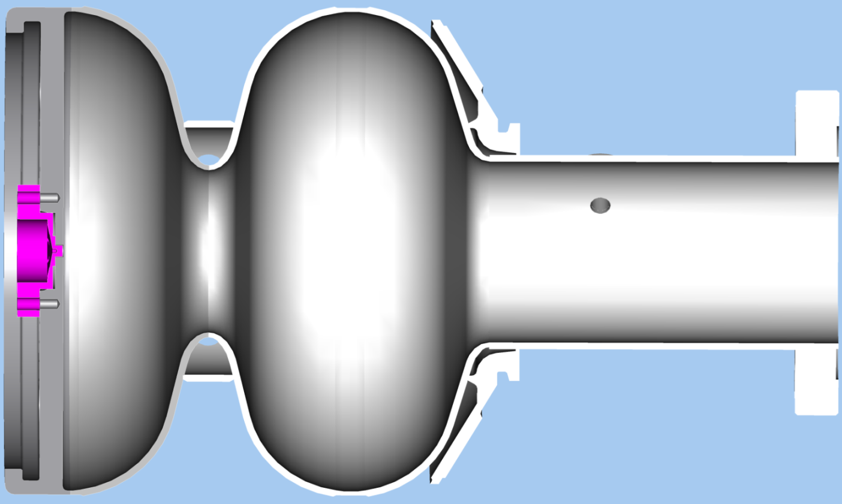
3. SRF-gun; A different design
The DESY design is so called all superconducting gun with a superconducting metallic Pb cathode.
In gasket (Tc=3.4K, Bc=28mT)
Nb Plug
Nb (Tc=9.2K, Bc= 180mT)
Pb coating (Tc=7.2K, Bc=80mT)

Slide 7
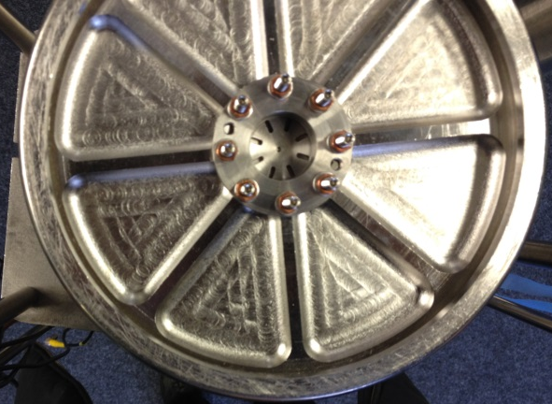
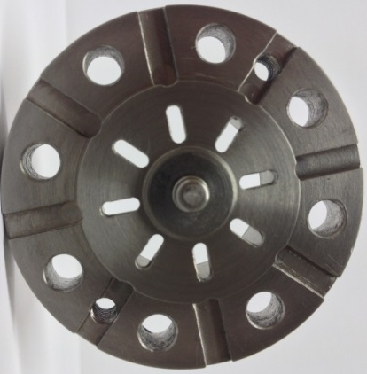
3. SRF-gun; A different design
Two prototypes of 1.5-cell gun cavity were built at TJNAF.
Nb plug
Nb/Pb
cathode
2nd prototype of 1.3 GHz gun cavity

Slide 8
3. SRF-gun; A different design
Target QE of the Pb cathode and spec for the irradiating laser
 | Unit | Spec
QE | % | 0.018 @ 266nm
Irradiating pulse energy on cathode | µJ | 2 for 100pC 5 for 250pC
Laser P at 266 nm on cathode | W | 0.2 for 100pC 0.5 for 250pC
Laser P at 1060 nm (conversion ƞ ~ 1%) | W | 20 for 100pC 50 for 250pC

Slide 9
4. What Has Been Demonstrated
Test results for 1.5-cell gun cavity with Nb and Pb-coated cathode.

Slide 10
4. What Has Been Demonstrated
QE test at BNL of the Pb coating on the plug
QE Spec 1.8E-4 @266nm
Courtesy J. Smedley, J. Sinsheimer,
M. Gaowei and V. Gofron
Laser cleaning: 1st 1000 shots with 0.06 mJ/mm²,
2nd 10000 shots with 0.06 mJ/mm², all at 248nm

Slide 11
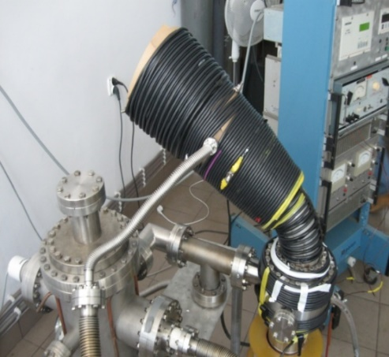
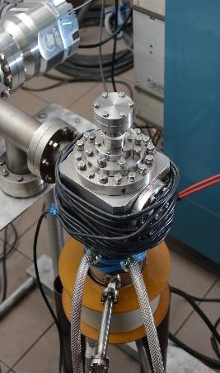
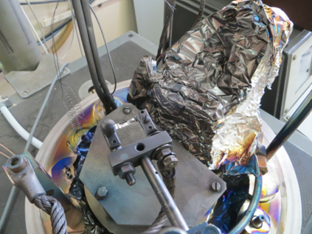
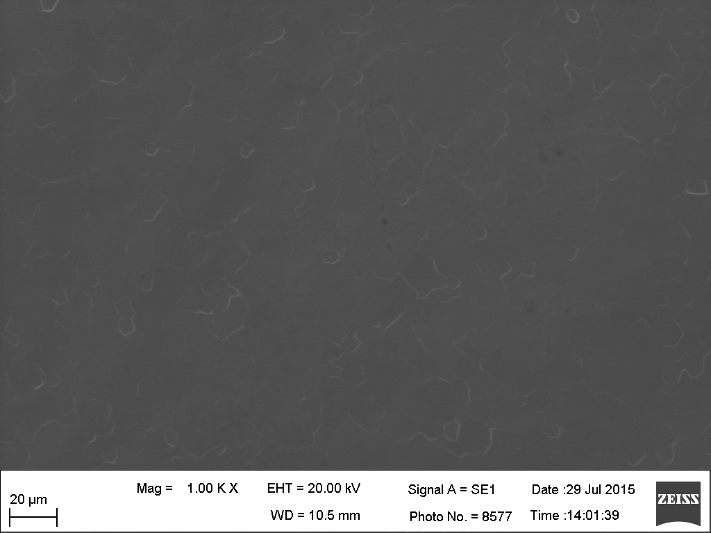
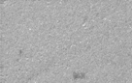
5. Quality of Pb-coating
Coating techniques
Preparation
Arc deposition with filter
Arc deposition w/o filter
Evaporation
Melting * & recrystallizations
Heat treatment in vacuum
Laser cleaning
*Ar plasma is used to melt the surface: One Rod Plasma Injector pulse, with 1.5J/cm² fluence and 1μs long, melts 7µm of the layer. The layer stays liquid ca. 8µs at flat area and 12µs at droplets, which is long enough to start smearing and flattering.

Slide 12
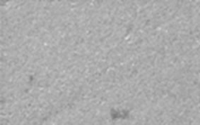
5. Quality of Pb-coating
Morphology and content of other elements
Coating Method | Coat. Rate [nm/min] | Content* [% weight] | Morphology of Pb-layer** | Comment
Evaporation | 60 | Pb ≈ 90 C ≈ 3 O ≈ 3 N ≈ 2 |  | Half-spherical extrusions, r < 5 µm , ca. 50/mm⁻²
Arc-deposition with filter | 200 | Pb ≈ 93 C ≈ 2 O ≈ 1 |  | Spherical extrusions r < 30 µm , ca. 50/mm²
Arc-deposition w/o filter + plasma treatment | 3000 | Pb ≈ 94 C ≈ 2 O ≈ 1 |  | Surface after 5 pulses of 1.5 J/cm² Smooth extrusions with r < 15 µm ca. 1-2/mm²
Thickness 2 µm
Thickness 2 µm
Thickness 20 µm
*EDS (20 keV), **SEM
Smoothness observed locally not on the whole cathode

Slide 13
5. Quality of Pb-coating
Dark current
Cathode preparation method | Emax [MV/m] | Imax [nA/cm²] | Emin [MV/m] | Imin [nA/cm²]
Filtered arc | 200 | 1600 | 30 | 142
Filtered arc + conditioning | 200 | 412 | 30 | 110
Non-filtered arc + plasma | 200 | 294 | 30 | 18
Evaporation | 200 | 195 | 30 | 30
Evaporation + conditioning | 200 | 200 | 30 | 28
Surface of the Nb-Pb cathode ca. 0.5 cm²
Pulsed E in 100 µm gap
Pulse duration 1 µs, repetition rate 2kHz

Slide 14
6. Final Remarks and Future Plans
Thermal emittance
QE Spec 1.8E-4 @266nm
0.23 @266nm
r_{c}=0.6mm, 40MV/m
Preferred are lower energy irradiating photons, on the contrary what is needed to increase QE.

Slide 15
6. Final Remarks and Future Plans
Superconducting state of the cathode
How does intrinsic Q changes when laser irradiates the Pb cathode?
An example: QE=1.8E-4@266nm → q=0.25 nC requires 5µJ/pulse.
Photon penetration depth is ~10 nm
Nb at 2K
Pb
All CPs in the 10 nm layer are broken.
The layer is in the normal-conducting state after the laser pulse.
N_{Cooper pairs} = 1.5∙10¹²
Ø ~ 1 mm
5 µJ →Nγ = 6.7∙10¹²
F= 40 MeV/m
T_{rf}/4=200ps later the diffusion and recombination of quasiparticles in the Pb layer start.

Slide 16
6. Final Remarks and Future Plans
Superconducting state of the cathode, cont.:
1. Relaxation of Cooper pairs to the equilibrium is self-stabilizing process
2. Cathode is located in very low B flux (0 on axis).

Slide 17
6. Final Remarks and Future Plans
Present Activities
DESY: Last baseline test showed, that 1.5-cell cavity performed worse and needs now visual inspection, probably additional EP and HPR.
NCBJ: New test stand for the QE measurement is in commissioning stage. Further studies of the arc- deposition method and plasma treatment of the coated surface are ongoing.
HZDR: New chamber for the lifetime test of Pb-layer deposited on DESY plugs has been built by HZDR. The first test will begin as soon as the irradiating laser will be fixed.
Future plans: improve smoothness of the Pb-layer

Slide 18
Acknowledgments
Many thanks to
A. Arnold, M. Barlak, D. Klinke, A. Kosińska, D. Kostin, J. Lorkiewicz, A. Matheisen, R. Mirowski, R. Nietubyć, M. Schmökel, J. Teichert, B. van der Horst, J. Witkowski, R. Xiang
and to BNL Colleagues
J. Smedley, J. Sinsheimer, M. Gaowei and V. Gofron
for their contribution to the DESY SRF-gun program.

