Slide 1
Surface analysis and n-machining of the copper photocathode at SPARC_LAB
Jessica Scifo
On behalf of SPARC_LAB collaboration
Notes:
Our work

Slide 2
Outline
Motivation
Surface Analysis Techiques
  Scanning Electron Microscopy with Energy Dispersive Spectroscopy
  Atomic Force Microscopy
Machining and Results
Conclusions
Notes:
This is the outline

Slide 3
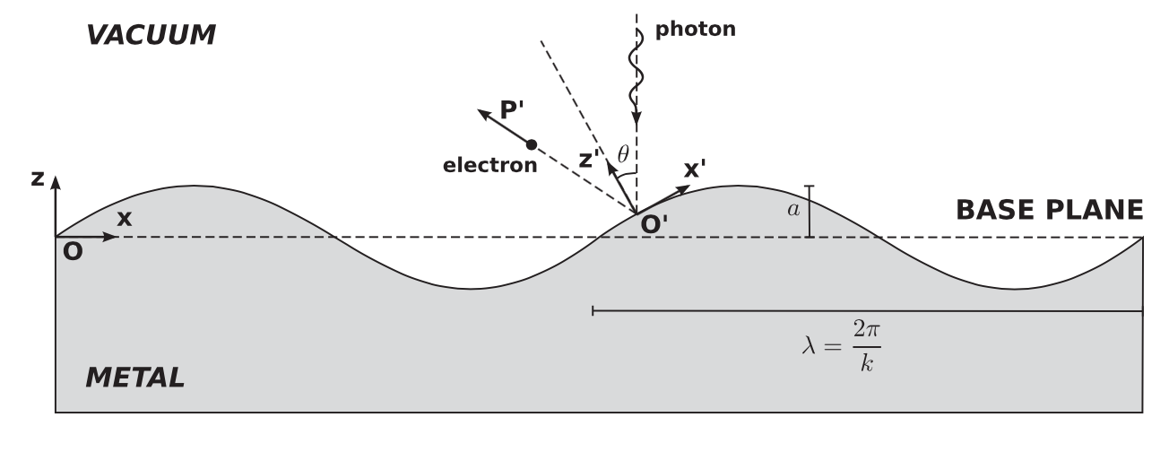
Motivation
High brightness (high current, low emittance) electron beam production by photoinjector at SPARC_LAB
Surface roughness on cathode introduces a transverse electric field that increases the transverse momentum, causing emittance growth
a, amplitude of the uneven surface
λ, period of fluctuation
Z. Zhang and C. Tang, Analytical study on emittance growth caused by roughness of a metallic photocathode,
PRST-AB 18, 053401 (2015)
D. Xiang et al., First principle measurements of thermal emittance for copper and magnesium, Proc. of PAC07, Albuquerque, New Mexico, USA

Slide 4
Motivation
A R&D activity on photocathodes is under development at the SPARC_LAB test facility in order to fully know and characterize each stage of the photocathode “life”
The n-machining is useful to reduce roughness and to avoid surface contamination caused by other procedures, for example the polishing with diamond paste or the machining with oil
Notes:
A R&D activity on photocathodes is under development at the SPARC_LAB test facility in order to fully know and characterize each stage of the photocathode “life” and to improve their performances in term of quantum efficiency and electron beam thermal emittance.
The n-machining is useful to reduce roughness and to avoid surface contamination caused by other procedures, for example the polishing with diamond paste or the machining with oil.

Slide 5
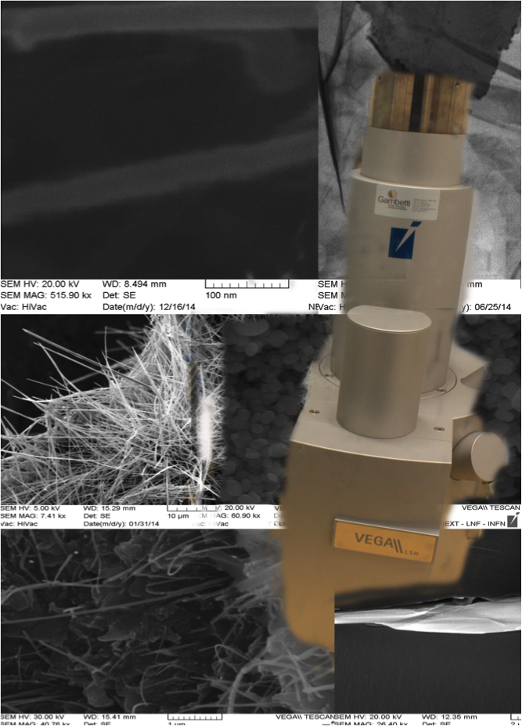
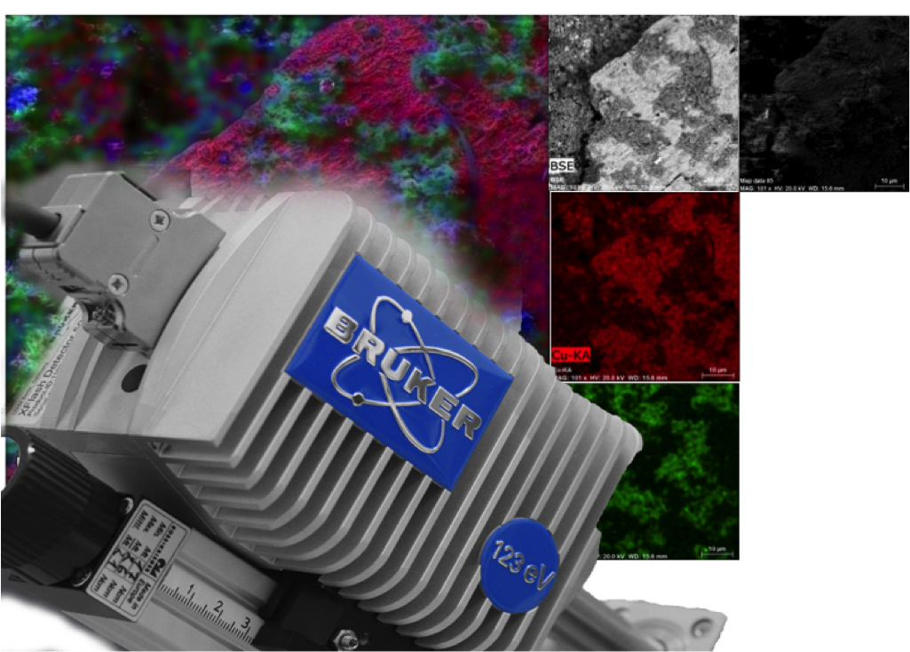
DIAGNOSTIC TOOLS: SEM and EDS
The types of signals produced by a SEM include:
secondary electrons (SE), emitted from very close to the sample surface (morphology);
back scattered electrons (BSE): electrons beam that are reflected from the sample by elastic scattering (atomic number, Z).
We are able to determine the chemical composition of the test sample with the Energy Dispersive Spectroscopy ( EDS ).

Slide 6
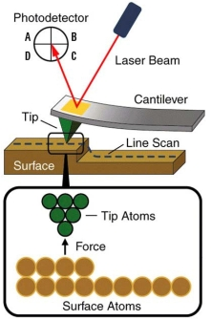
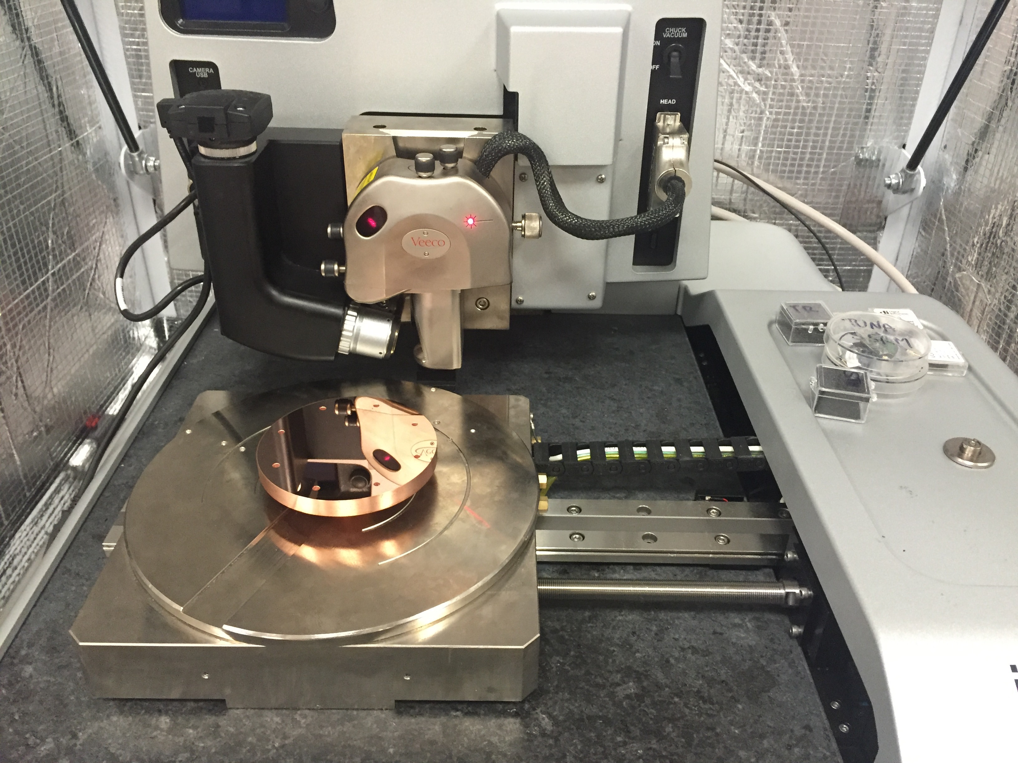
DIAGNOSTIC TOOLS: AFM
The surface roughness is represented by
L, evaluation length
Z(x), the profile height function
Notes:
RMS is the root mean square average of the profile height deviations from the mean line, recorded within the evalution length.
Ra is the arithmetic average of the absolute values of the profile height deviations from the mean line, recorded within the evaluation length.

Slide 7
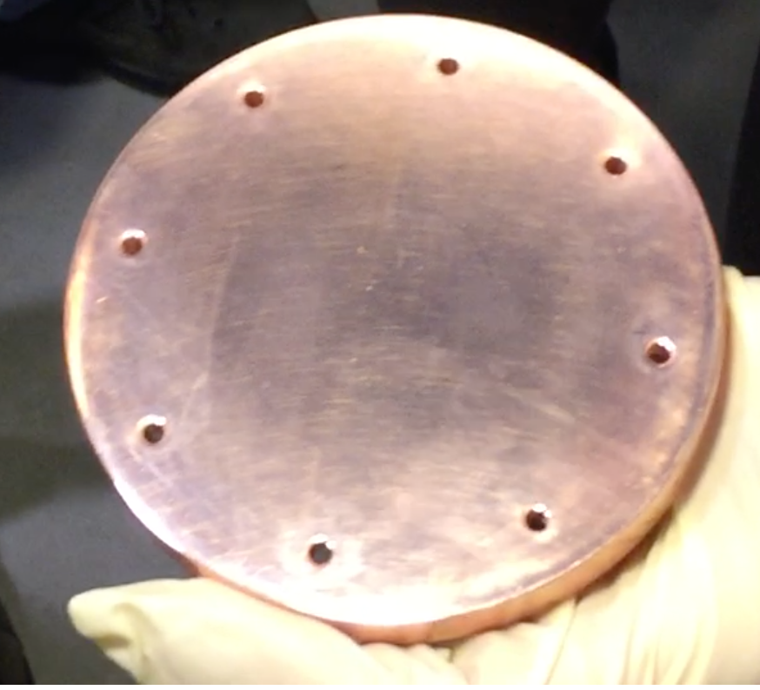
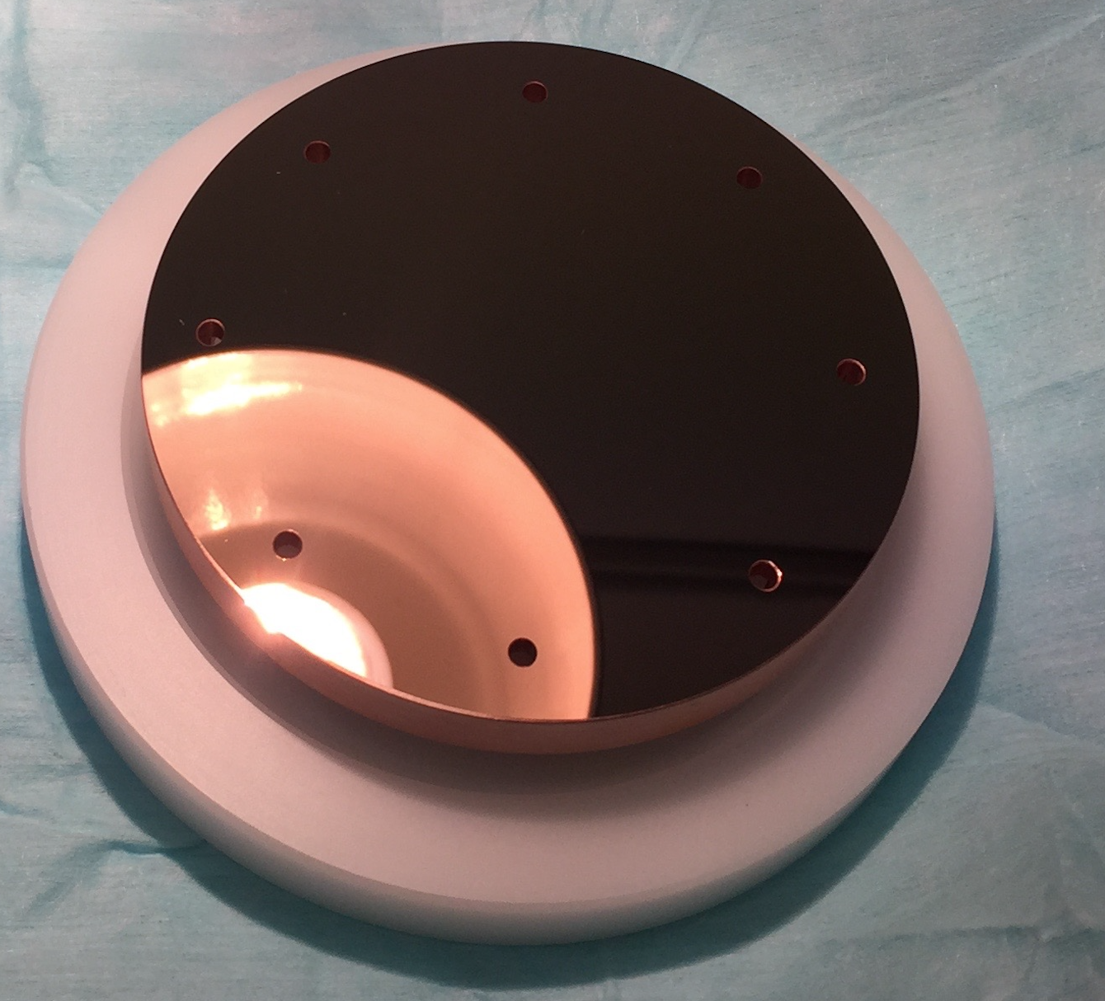
The Machining
The cathode surface has been machined by means of diamond milling and blowed with nitrogen. The machining has been done without the use of any oil or cooling fluid (dry machining).
BEFORE MACHINING
AFTER MACHINING
Our cathode time life was about 6 years

Slide 8
The Machining
BEFORE MACHINING
AFTER MACHINING
Time
Space
Notes:
On the right we can see the photocathode surface before machining. We see many craters, likely dust and other particles. This kind of craters are tipically caused by RF field breakdowns.
On the left we can see the photocathode surface after machining. The machining removed craters and any other impurities.
The machining removed about 100 μm of the surface.

Slide 9
Measurements before machining
Notes:
Once again we can see craters but with two different magnifications. In addition to craters there are other scratches. Given dimensions we can hypothesize that are due to diamond pastes wherewith the photocathodes surface was polished about 6 years ago.

Slide 10
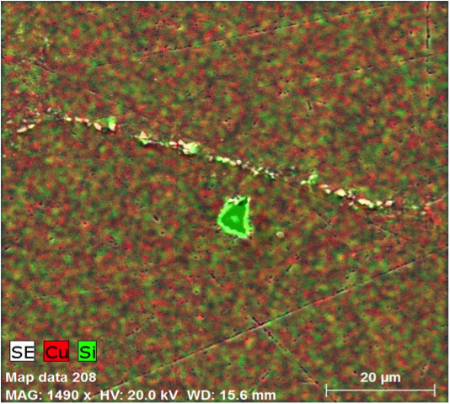
Chemical composition
Time
Spectrum: Acquisition 862 - particella.spx
El AN Series unn. C norm. C Atom. C Error (1 Sigma) K fact. Z corr. A corr. F corr.
[wt.%] [wt.%] [at.%] [wt.%]
-------------------------------------------------------------------------------------
Cu 29 K-series 62.20 63.79 34.62 1.72 0.548 1.114 1.000 1.044
O 8 K-series 17.08 17.51 37.76 2.31 0.377 0.464 1.000 1.000
Si 14 K-series 15.46 15.86 19.47 0.69 0.131 1.203 1.000 1.004
C 6 K-series 2.77 2.84 8.15 0.76 0.077 0.369 1.000 1.000
-------------------------------------------------------------------------------------
Total: 97.51 100.00 100.00
Space
Notes:
We analized two different areas of surface with the Energy Dispersive Spectroscopy to determine the chemical composition. In this analysis, how we can see in this slide, we found traces of silicon in addition to copper, carbon and oxigen. Carbon and oxigen are due to oxidation.
We didn’t expect find silicon but we think that is an “ingredient” of diamond paste.

Slide 11
Chemical composition
Spectrum: Acquisition 861-Generale.spx
El AN Series unn. C norm. C Atom. C Error (1 Sigma) K fact. Z corr. A corr. F corr.
[wt.%] [wt.%] [at.%] [wt.%]
-------------------------------------------------------------------------------------
Cu 29 K-series 88.20 96.47 83.80 2.42 0.862 1.078 1.000 1.039
C 6 K-series 3.22 3.53 16.20 0.86 0.091 0.387 1.000 1.000
-------------------------------------------------------------------------------------
Total: 91.43 100.00 100.00
Notes:
In this area we found only copper and carbon.

Slide 12
Measurements after machining
Notes:
The surface after machining is clean and flat

Slide 13
Chemical composition
Spectrum: Acquisition 877
El AN Series Net unn. C norm. C Atom. C Error (1 Sigma)
[wt.%] [wt.%] [at.%] [wt.%]
------------------------------------------------------------
Cu 29 L-series 289089 98.81 98.81 95.69 10.64
C 6 K-series 1280 0.47 0.47 2.39 0.12
Ni 28 L-series 1453 0.34 0.34 0.35 0.09
O 8 K-series 1150 0.22 0.22 0.86 0.07
N 7 K-series 466 0.16 0.16 0.71 0.07
------------------------------------------------------------
Total: 100.00 100.00 100.00
Notes:
The analysis with the Energy Dispersive Spectroscopy shows a clean surface and purity about 99%.
The other elements are probably due to the contact with air before SEM and EDS analysis.

Slide 14
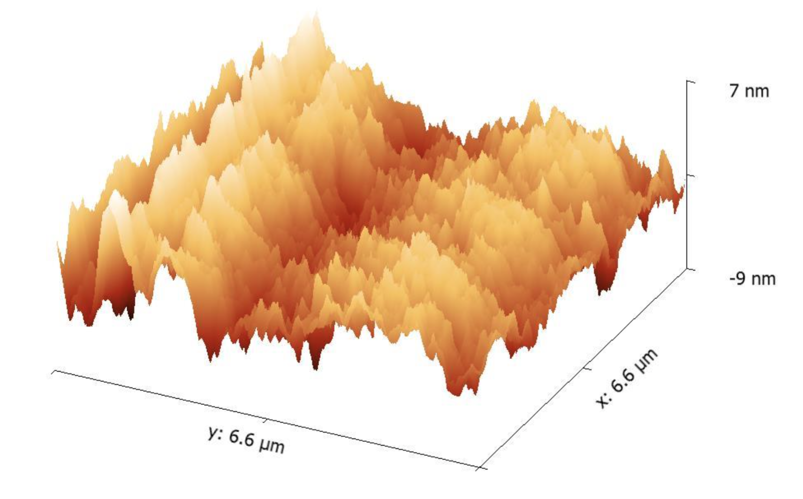
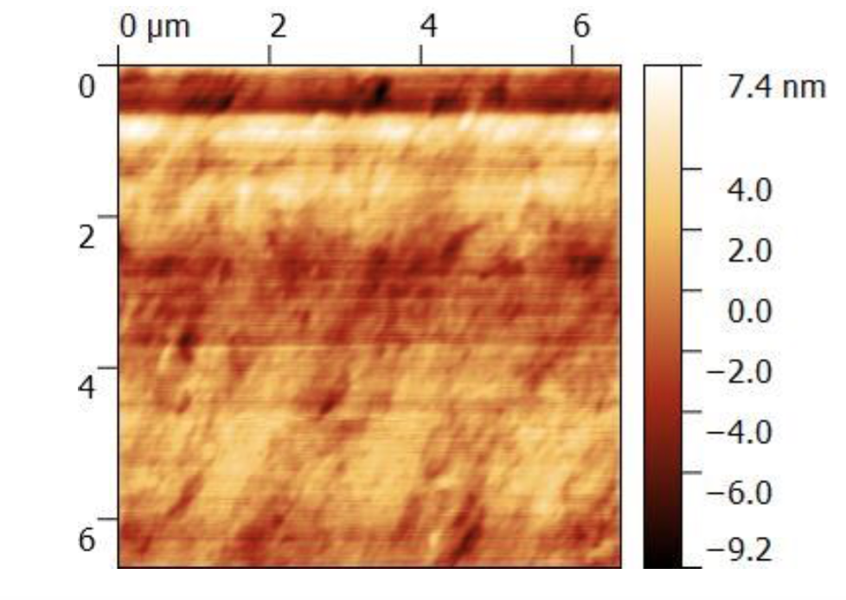
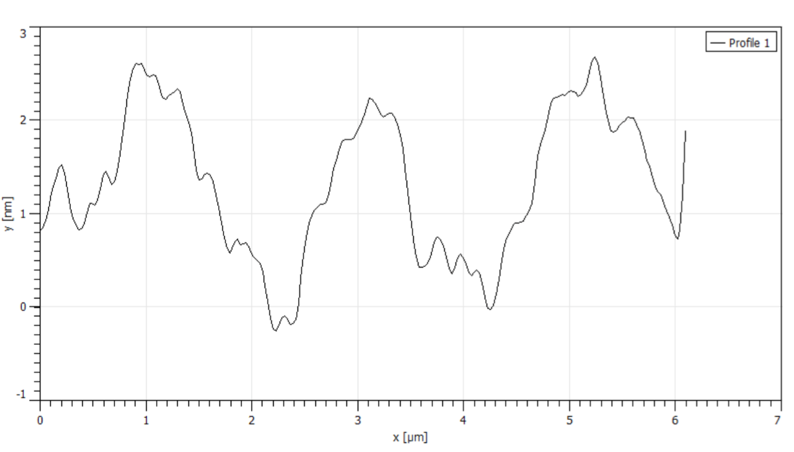
AFM analysis
R_{a} = 1.1802 nm
Rms (R_{q})=1.5041 nm
Notes:
The analysis with AFM gives us the surface profile in terms of amplitude and period of fluctuations.
From the analysis we can have Ra and RMS.

Slide 15
SURFACE ROUGHNESS INDUCED EMITTANCE
After machining the expected emittance contribution due to surface roughness for the copper photocathode at SPARC_LAB is negligible
λ
a
D. Xiang et al., First principle measurements of thermal emittance for copper and magnesium, Proc. of PAC07, Albuquerque, New Mexico, USA
Notes:
We can estimate the surface roughness induced emittance in this way…

Slide 16
Conclusions
For our applications the dry machining is a good procedure because we don’t have traces of diamond paste or oil
We obtain an excellent roughness (≤ 2nm) typical of monocrystalline copper cathode
Likely a surface roughness induced emittance will be negligible

Slide 17
Thanks to
D. Alesini, S. Bellucci, A. Biagioni, E. Chiadroni, R. Di Raddo, M. Ferrario, F. Micciulla (INFN-LNF)
A. Cianchi (INFN-Roma Tor Vergata and Università di Roma “Tor Vergata”)
A. Lorusso (Università del Salento, Dipartimento di Matematica e Fisica “E. De Giorgi”, INFN-Sezione di Lecce)
Daniele Passeri (SBAI- Università di Roma “La Sapienza”)

Slide 18
Finally it’s over
Thank you for your attention

