Slide 1
Recent research on high yield metallic cathodes – An overview of plasmonic cathodes for industry
Hoson To
Development Engineer
Notes:
Good morning everyone. My name is Hoson To, and I’m a Development Engineer at RadiaBeam Technologies. Today I’ll be talking about our recent research on high yield metallic cathodes and giving an overview of the plasmonic cathodes we’re working on.

Slide 2
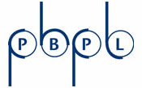
Outline
Intro/Background
RadiaBeam/UCLA collaboration highlights
Plasmonic Cu cathodes tests at UCLA PBPL Pegasus
Plasmonic Nb cathode preparation results (JLab collab)
Alternative patterns (Bowties)
Exotic applications: multi-beam ICS
Notes:
This project is a collaboration between Radiabeam and UCLA. The outline of this presentation is as follows. First, I’ll give a very brief intro about plasmonics. Then I’ll talk about the copper cathode tests we’ve done at UCLA. Then I’ll go over some preliminary results from Niobium cathodes, and this is in collaboration with JLab. Then I’ll discuss QE and field enhancement from nanobowtie patterns. And finally, I’ll give a brief mention about [multi-beam inverse compton scattering].

Slide 3
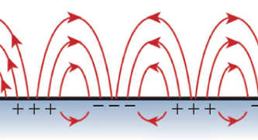
Background
Plasmonics – study of interaction between electromagnetic fields and free electrons in a metal
Subwavelength nanofeatures can be used to control optical response (reflection, absorption, transmission) of metals at specific wavelengths and can dramatically increase local optical intensity near the nanofeatures
Special application: increasing QE of metal photocathodes
decreasing the reflectivity of our photocathodes (metal is typically ~90% reflective)
local field enhancement at the surface of the cathode to increase photoelectron generation
Dielectric
Plasmons (electron oscillations)
Metal
Notes:
As most of you already know, plasmonics is the study of the interaction between electromagnetic fields and free electrons in a metal. By using subwavelength nanostructures, we can control the reflectivity, absorption, and transmission of metals at specific wavelengths, and we can also dramatically increase the local optical intensity or field near the nanostructures.
In the context of this project, we’re using plasmonics for a very specific application. And that is: to increase the QE of metallic photocathodes.
Now, there are two ways plasmonics can increase QE. Number 1, we can decrease the reflectivity of our cathodes (which are normally around 90% reflective) down to 20%, 10%, and lower. And number 2, we can also increase the local field at the cathode surface. And both of these effects contribute to increased electron generation.

Slide 4
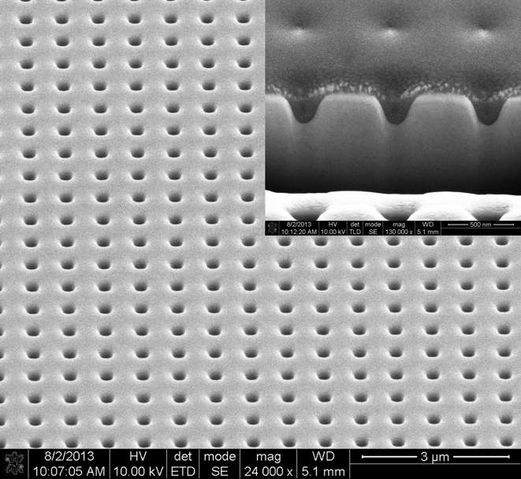
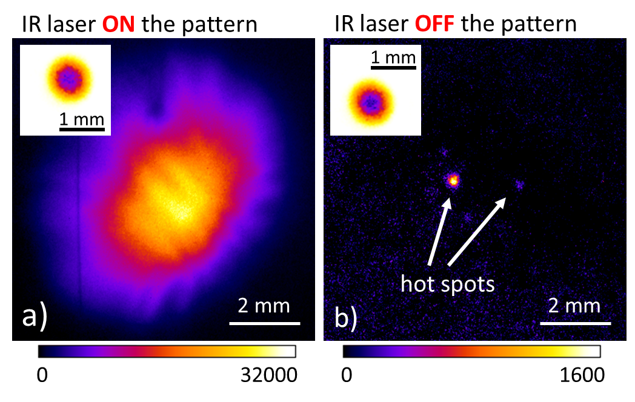
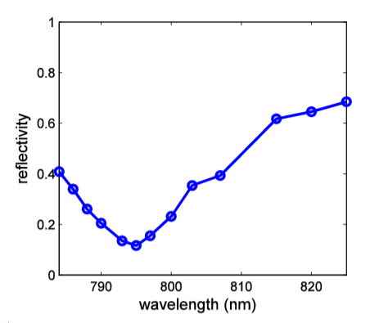
Previous experiments
Increasing quantum efficiency of copper RF photocathodes
Past results
Li, Renkai, et al. "Surface-plasmon resonance-enhanced multiphoton emission of high-brightness electron beams from a nanostructured copper cathode." Physical review letters 110.7 (2013): 074801.
PRL results (Feb 2013): Charge yield/QE increased by >100
Further tests (2014-present): QE increased by ~3000! (QE~10⁻²)
Notes:
And so far, we’ve had great success in experiments done on single crystal copper cathodes at UCLA. We published our first paper, written by Renkai Li, in PRL in 2013. The major result was that by putting a nanohole array on a copper cathode, we were able to increase its charge yield or QE by more than a factor of 100 compared to a flat copper surface.
And later, with further optimization and testing, we were able to increase the QE by a factor of 3000. That’s 3000 times more charge compared to a flat surface.
On the left is an SEM image of our best pattern so far, which was produced using Focused Ion Beam milling. We measured this pattern and found it was resonant close to 800 nm. And at 800 nm, the reflectivity was close to 20%. Now, on a flat surface, this would be 90%.
To the right, we can see a direct comparison of the beams generated from a patterned surface and a flat surface. The left is what we see with the pump laser directly on the pattern, and the right is what we see with the laser off the pattern on a flat part of the surface. And as you can see, we do have over 3000 times more charge.
So we have shown that this works very well, and these are significant results that already have an impact as they are being used at Pegasus at UCLA. Using our experience and knowledge, we want to extend this to other applications.
-----------
Stress the fact that the comparison is on the same cathode for bare/flat Cu vs. NPC.
“paper by renkai” first work
Inset is laser spot image, position
(is this the end)
How are we continuing to improve this? Stuff like polishing, polarization, etc. talk about the process. Need to transition to new stuff smoothly.

Slide 5
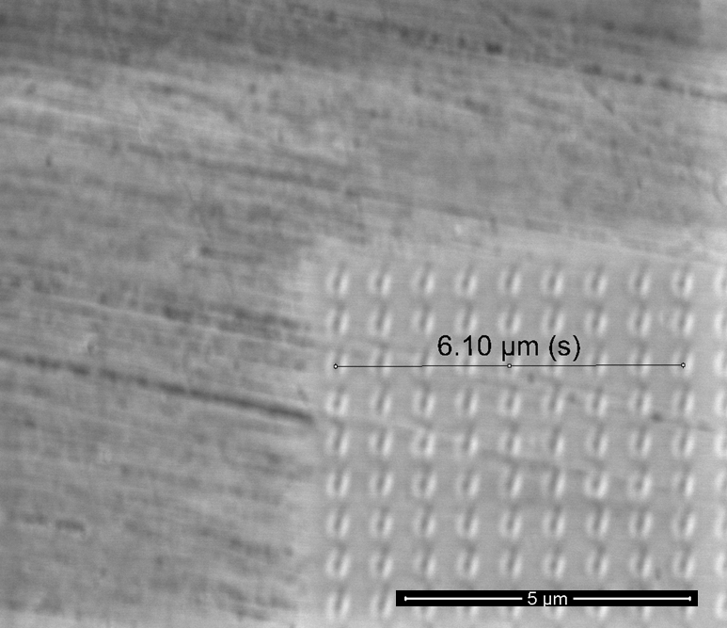
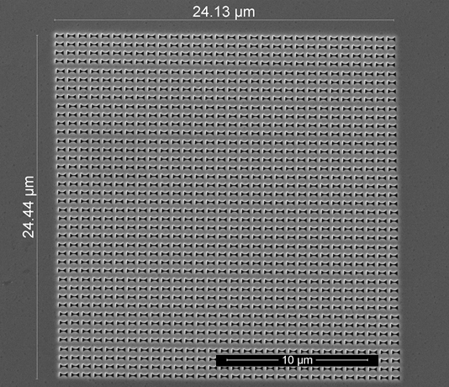
Current/ongoing efforts
Different material: niobium (Fay Hannon, JLab)
For super conducting guns to get to high average power
Different nanostructure: nano-bowtie apertures (NBA)
Significantly enhanced charge yield at a larger bandwidth compared to nanoholes
Niobium
Nano-bowtie apertures
Notes:
Currently, we have efforts in two different avenues. One is using a different material.
We’ve done copper and silver, and now we are applying what we learned to niobium for super conducting RF guns for higher average power.
Two, we’re also trying out a different nanostructure: nano-bowtie apertures instead of nanoholes.
The advantage here, as you will see, is that these bowties can produce much higher plasmonic field enhancement than nanoholes.

Slide 6
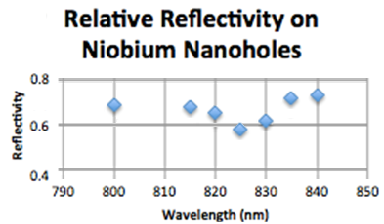
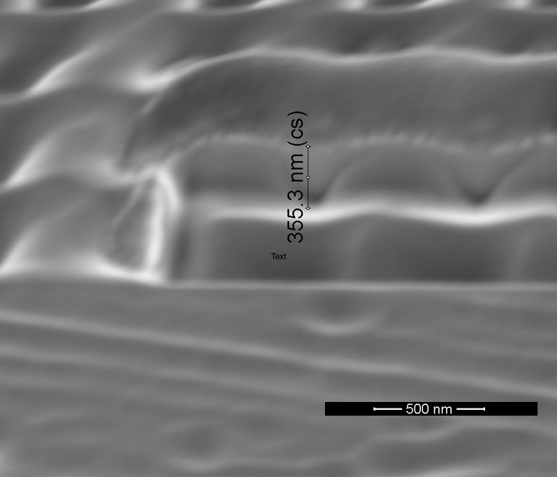
Plasmonic Nb cathodes
Nanohole arrays on niobium substrate
Working with Fay Hannon at JLab to test in the cold gun at the Vertical Test stand
Enhanced absorption observed at 825 nm
Next step: produce higher quality nanohole arrays
Surface finish
Notes:
Regarding niobium cathodes, this is something we’re working on together with Fay Hannon here at Jlab. Once we fabricate a high quality nanopatterned niobium sample, the plan is to test it here at Jlab in the cold gun at the Vertical Test Stand.
This is an SEM image of a recently produced nanohole array on a niobium sample. For a preliminary test, we are pleased that we measured a small drop in reflectivity at 825 nm. We’re pretty confident we can improve on this, based on our past success with copper.
An obvious area of improvement is the surface quality of the niobium substrate, which as you can see in this image, is pretty bad.
But we do have two additional niobium samples that have just been polished by an external vendor, and we should be getting them back this week. And these have been polished to about 40 nm surface roughness.
Once we dial down the process and produce a resonant niobium sample, we can put it on the vertical test stand on the cold gun at JLab, and we already have preliminary engineering to mount this sample onto a cathode.
After that, our main task is to measure beam charge at a downstream faraday cup and see how much we can get from a nanopatterned niobium cathode.

Slide 7
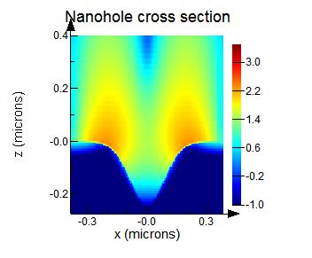
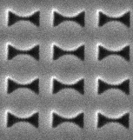
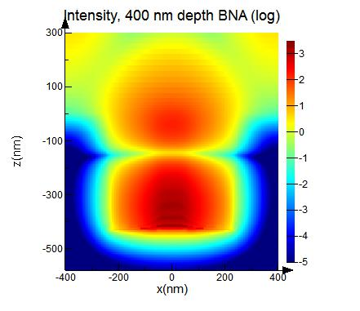
Nano-bowtie Apertures in Copper
Well known antenna pattern: nano-bowties
Doron Bar-Lev (Tel Aviv University)
From simulation: NBA field enhancement an order of magnitude higher than nanoholes
Charge proportional to intensity^3
nanoholes
bowties
Notes:
In addition to making plasmonic cathodes out of niobium, we’re also exploring making nano-bowtie patterns instead of nanoholes in copper.
Nano-bowtie apertures are well known resonant structures, and the hope is that we can extend that to the application of plasmonic cathodes. You can see the shape of these structures on a closeup SEM image here.
The primary advantage of bowties is that they can exhibit much higher field enhancement than nanoholes.
These two images on the right are simulated intensity profiles. With nanoholes, you can get up to two orders of magnitude of enhancement, but with bowties, you can get ten times that, at three orders of magnitude.

Slide 8
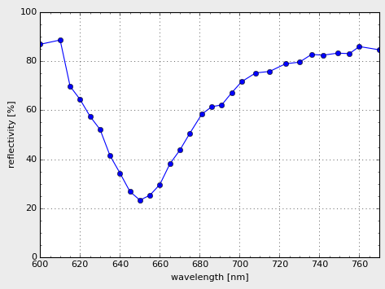
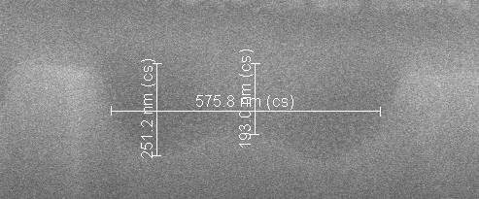
NBA Challenges
Nano-bowties take >10 times longer to make and are hard to produce accurately
Very low ion beam current must be used in order to produce the fine detail of the NBAs, which increases fabrication time
Solution: make NBAs with shallow depths
Initial test pattern did not exhibit the predicted reflectivity response
Hard to characterize realistic NBAs in simulation due to rounded edges and rounded bottom, so simulations might not be accurate
Solution: rid ourselves of rounded bottoms completely
Measured Reflectivity, resonant at ~650nm instead of 800nm
Bowtie cross section
Notes:
But as expected, this approach comes with its own set of challenges. Finely detailed bowties are, as you can imagine, harder to make than simple holes. Though it could ten times better, it also takes ten times longer to produce.
The main reason is that very low ion beam currents must be used in order to produce the fine detail of the bowties, which increases fabrication time. One solution here is to just make holes that don’t require as much processing time. Basically, holes that are shallower or not as deep.
Another challenge was that the initial test pattern did not exhibit the predicted reflectivity response. When we measured it, we found that it was resonant near 650 nm instead of 800 nm. We think this is from our simulation being inaccurate, since it’s hard to characterize these bowties accurately due to rounded edges and rounded bottoms produced from Focused Ion Beam milling… as shown in the cross section image. Notice the round edges and bottom.
But, we can work our way around this too by just getting rid of rounded bottoms altogether and making an even simpler geometry. And I’ll show you what I mean.

Slide 9
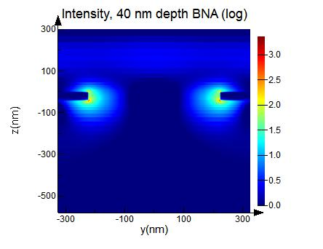
Different NBA Approach
Doron Bar-Lev (Tel Aviv University)
Instead of deep NBA in purely copper substrate, we are testing NBAs fabricated on a thin layer of copper on a silicon dioxide substrate.
These also exhibit a plasmonic response in simulation, but requires a hole depth of only ~40 nm.
Top: original NBA. 400 nm deep pattern on Cu substrate
Bottom: NBA on 40 nm layer of Cu on glass substrate
Notes:
Our alternate approach is this: Instead of deep bowties on a full copper substrate, we are testing bowties made on a thin layer of copper deposited on a silicon dioxide substrate. This solves our two previous problems simultaneously. In this approach, the copper layer only needs to be around 40 nm thick, whereas the hole depth for the previous approach needed to be roughly between 250-400 nm. So just by shrinking the bowties, we’re reducing the fabrication time by up to a factor of 10.
Bowties of this geometry are also effectively through-holes, since the glass substrate has no effect on the plasmonic response. So we can treat this as a through-aperture in simulation and not worry about any rounding in the geometry. This should help our simulations become much more accurate.
As you can see, this geometry also exhibits a plasmonic response in simulation. So far, it shows around 2 orders of magnitude of field enhancement. When we optimize this, we believe we can see more.
Also, a side benefit of this geometry is that it opens up the possibility of using other perhaps more efficient methods of nanofabrication, aside just Focused Ion Beam milling. These could be e-beam lithography, material deposition, wet etching, and so on.

Slide 10
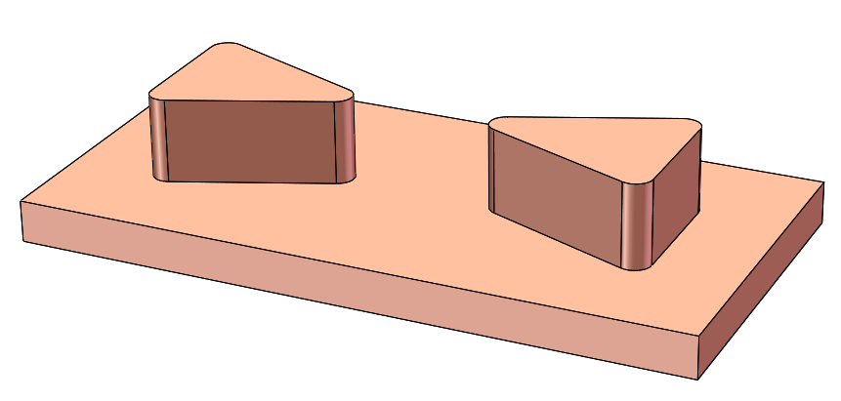
Different NBA Approach
Doron Bar-Lev (Tel Aviv University)
Instead of deep NBA in purely copper substrate, we are testing NBAs fabricated on a thin layer of copper on a silicon dioxide substrate.
These also exhibit a plasmonic response in simulation, but requires a hole depth of only ~40 nm.
3rd approach: protruding bowtie antennas
Top: original NBA. 400 nm deep pattern on Cu substrate
Bottom: NBA on 40 nm layer of Cu on glass substrate
Notes:
In addition, we’ve also thought about doing this: using protruding bowtie antennas instead of holes. We haven’t simulated this yet, but we’re planning to explore this option as well.
So we have quite a few avenues to look at, but we’re making good progress. Once we finish making new nanobowties, we’ll test them for resonance and charge yield, and if everything is manufactured to spec and everything runs smoothly, then we can expect better results, at which point, we can probably move onto pushing this out as a true solution for industrial use. So that’s the extent of plasmonic cathodes for industrial and research applications.

Slide 11
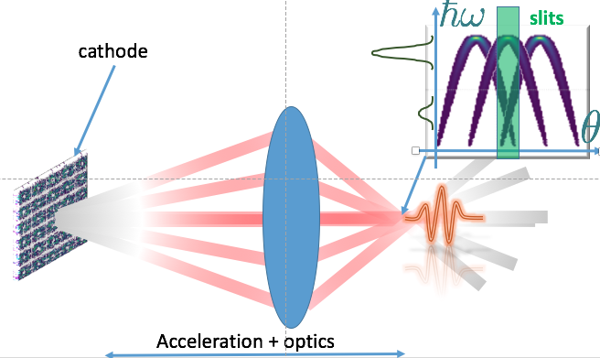
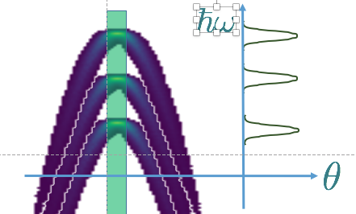
Exotic Application: Structured Beams
When imaged to higher energies can be used in multi- color X-ray via ICS
Philippe Piot (Northern Illinois University)
Several schemes under studies:
Crossing beamlets with large crossing angle at IP combined with X-ray collimation
Forming beamlets with different energies (e.g. use laser-front tilt)
Combination + imaging in the temporal coordinate using emit. exchanger
Notes:
There are also alternative applications other than just higher QE. For example, Philippe Piot and his group at NIU are looking at this more exotic application in beam manipulation, where we can exploit the microstructure of the beam from the patterned cathodes. A patterned cathode should in theory produce a patterned beam. In this scenario, if we use a periodic nanopattern array, we might expect a transversely modulated beam.
If we send this beam through an emittance exchanger, we can potentially get a beam that is microbunched longitudinally at the periodicity of the pattern. At higher energies, this can be used in a multi-color x-ray via inverse compton scattering.
There are several schemes under study right now. 1 is crossing beamlets with large crossing angles at the interaction point combined with x-ray collimation. 2 is forming beamlets with different energies using a laser-front tilt and using a slit to collimate for one specific angle for a specific frequency. And 3 is, as mentioned, doing tricks using an emittance exchanger.
Currently, this is really just on the conceptual level. We’re still working on the simulation, and we do anticipate some hiccups. For example, we’re worried about space charge, we're worried about the beam structure getting washed out, and we really need a way to “freeze” the transverse profile of the beam for any of this to work.
------------------------------------------
There are alternative applications other than just higher charge yeild. We exploit microstructures on the beam from the patterned cathodes. A patterned cathode should in theory give a patterned beam. (transversly modulated beam)
Use npc. Piot made a periodic structure. Ebeam emitted from cathode has periodicity to it in the transverse plane. If you send it through an emittance exchange, you can get a beam that is microbunched longidutnal at the periodicity.
Say: This is really on the conceptual level. we’re still working on simulation. We’re worried about space charge. Worried about washing out structure. Really need a way to freeze the transverse profile of the beam.
Use a slit to collimate for one specific angle. Can get multiple frequencies.
CNT cathode could do something similar. But the transverse periodicity beam gets washed out quickly.
Credit to Piot, A. Lueangaramwong1,a), D. Mihalcea1 NIU, Fermilab

Slide 12
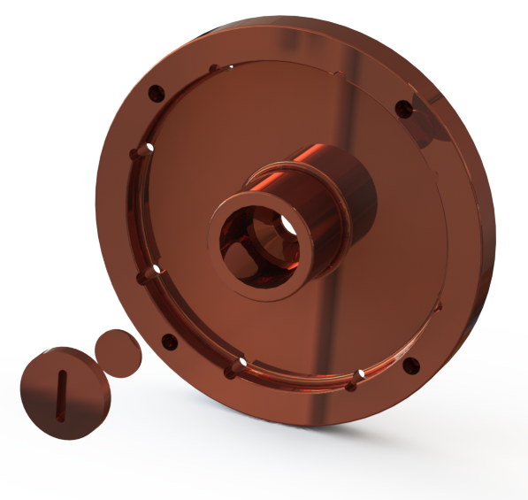
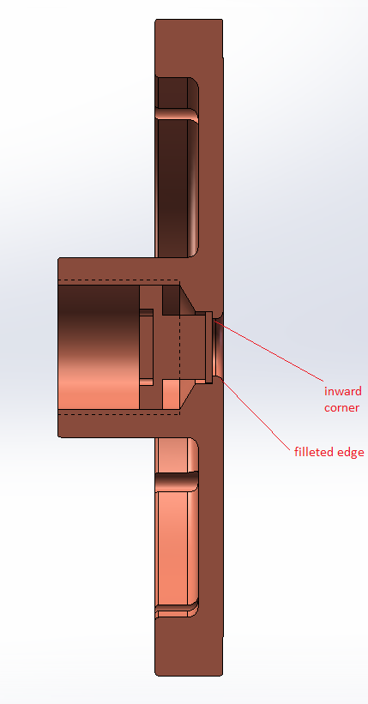
Summary
Plasmonic cathodes via direct machining
Nano-patterns (hole array, bowties)
NBA’s for enhanced field emission
Full experimental suite established at NCRF
Optical spectral measurements (UCLA)
Beam tests (UCLA Pegasus)
Direct applications to existing NC injectors
Industrial motivation
Enhanced QE with metal
Lower vacuum requirements
Longer lifetimes ? (first measurements w/ DC gun upcoming)
Application to SRF technology
JLAB proof-of-principle measurements upcoming soon
Notes:
To conclude, our ultimate goal for industry is the ability to just replace an existing cathode with a plasmon enhanced one to get higher QE immediately.
We’ve shown that we’re able to make high QE plasmonic cathodes via direct machining of nanopatterns onto a cathode surface. So far we’ve done nanohole arrays with success and are working on nanobowties for even higher performance.
We have a full experimental suite established for normal conducting RF. First, we make the structures, measure their geometry under SEM imaging, measure the reflectivity with our setup, and then do beam tests to measure beam properties such as charge, emittance, and so on.
The primary benefits for industry are enhanced QE with metal cathodes, lower vacuum requirements compared to semiconductor cathodes, and potentially longer lifetimes. And we’re measuring the lifetime of nanopatterned cathodes over the next few months with a DC gun.
And we already have preliminary engineering so that integrating these enhanced cathodes onto existing systems is as painless as possible.
We’re also extending this to super conducting RF using niobium cathodes, and we’re pretty excited for our upcoming proof-of-principle measurements at JLab.
And that concludes the content of this presentation.

Slide 13
Acknowledgements
Supported by DOE:BES Grant No. DE-SC0009656
H. To, G. Andonian (RadiaBeam Technologies)
P. Musumeci, E. Perez, D. Meade, J. Maxson, E. Kropp, (UCLA Particle Beam Physics Lab)
Renkai Li (Stanford Linear Accelerator SLAC National Accelerator Laboratory)
Fay Hannon (Jefferson Lab)
P. Piot, A. Luaengaramwonga, D. Mihalceaa (Northern Illinois University)
Doron Bar-Lev (Tel Aviv University)
Zhe Zhang (Tsinghua University)
Notes:
I’d like to thank the DOE for supporting us, and I want to thank and acknowledge these following people for their contributions to this research. Thank you all for your attention.

