Slide 1

Cathode Requirements for
Ultrafast Electron Scattering
Renkai Li
P3 2016, JLab, Newport News, VA
Oct 17–19, 2016

Slide 2


Acknowledgement
  SLAC UED/UEM team (X. J. Wang etc.) and collaborators
  Helpful discussions with Pietro Musumeci, Daniele Filippetto and many others
  Strong support from SLAC management. Technical support from SLAC AD, TID, LCLS and TF Department
  Work supported in part by the U.S. Department of Energy Contract No. DE-AC02-76SF00515 and the SLAC UED/UEM Initiative Program Development Fund.

Slide 3
Outline
  Background and status
  Photocathodes requirements for
    Diffraction
    Microscopy
    Energy-loss spectroscopy
  Summary

Slide 4
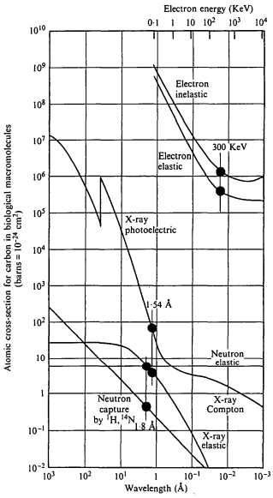
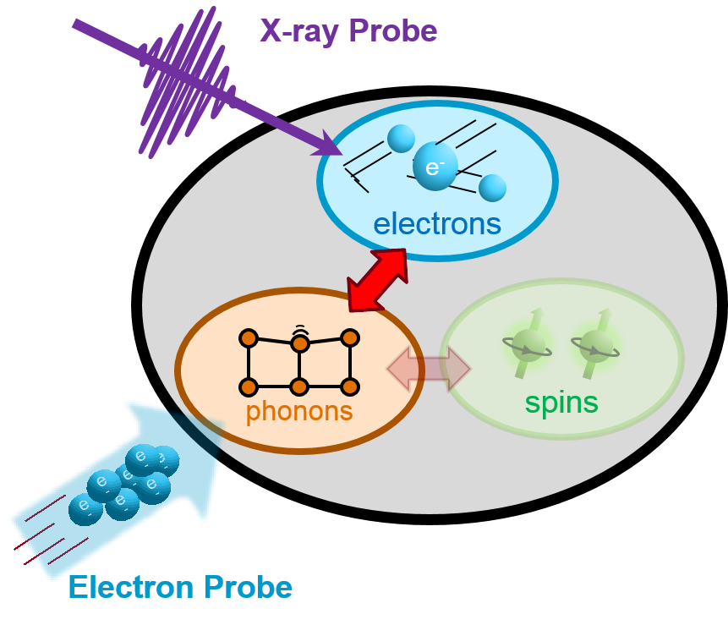
Probing the ‘ultrasmall’ and ‘ultrafast’
R. Henderson, Quarterly Rev. Biophys. 28, 171 (1995)
UED
XFEL
X-ray (XFEL) and electron (UED/UEM) probes are complementary tools towards a complete picture of the fundamental processes.

Slide 5
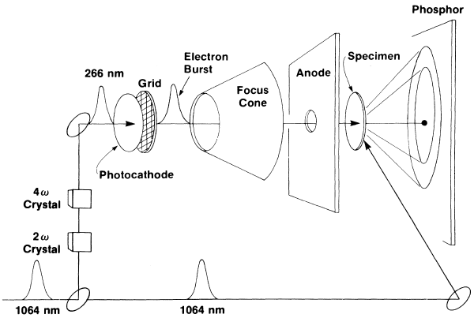
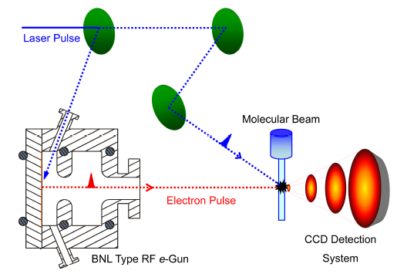
Ultrafast electron diffraction: keV and MeV
G. Mourou and S. Williamson, APL 41, 44 (1982)
S. Williamson, G. Mourou and J. C. M. Li, PRL 52, 2364 (1984)
Science outcome:
M. Chergui and A. H. Zewail, ChemPhysChem 10, 28 (2009).
R J D. Miller, Science. 343, 1108 (2014).
And many others…
MeV electron sources
Shorter, brighter electron beams
Less velocity mismatch, thick samples
X. J. Wang, Z. Wu, H. Ihee, PAC’03, 420-422 (2003).
X. J. Wang, et al., J. Korean Phys. Soc. 48, 390-396 (2006).
World-wide R&D since then …
RF photocathode gun

Slide 6

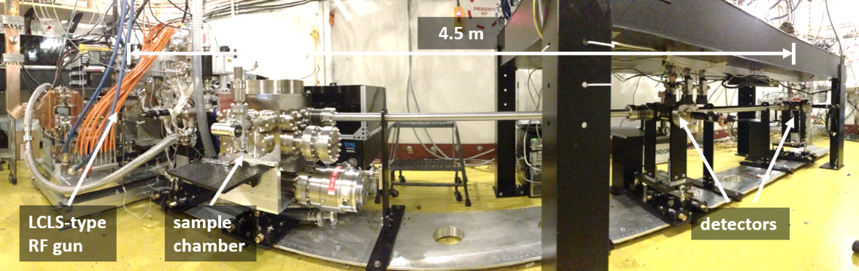
SLAC’s effort on UED and UEM
SLAC UED/UEM Initiative:
“… to provide the world’s leading ultrafast electron scattering instrumentation.”
UEM
User Facility
Ultrafast Electron
Microscopy
  Complementarity with LCLS
  Ultrafast science community
  Expertise in electron beam physics and technology
  Pumping capabilities: ultrafast laser, extremely intense THz from FACET, and X-ray from LCLS
  Decades' R&D worldwide
Nano-UED
User Facility
S. P. Weathersby et al., RSI 86, 073702 (2015)
Step I: MeV Ultrafast Electron Diffraction

Slide 7
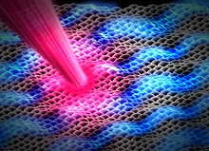
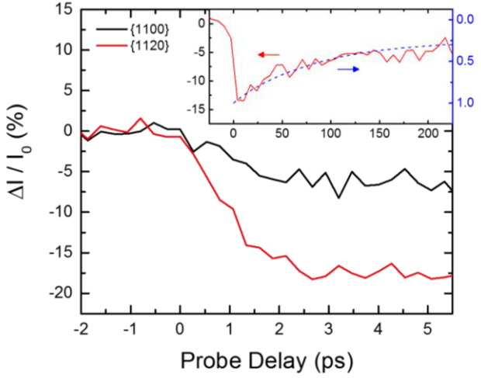
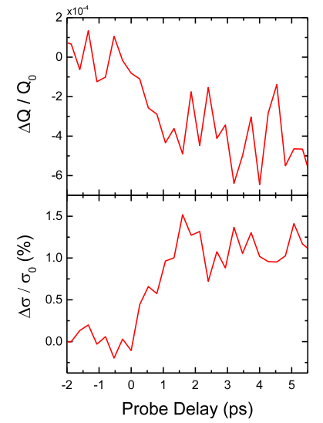
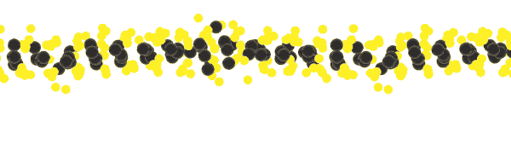
Ultrafast structural deformations in monolayer MoS₂
position
intensity
width
- Large-amplitude in-plane displacements and ultrafast wrinkling of the monolayer
- Time-scale ~1 ps (direct measurements of e-ph coupling time-scales)
- Long-time recovery consistent with interfacial thermal coupling into underlying substrate
E. M. Mannebach, R. K. Li et al., Nano Letters 15, 6889 (2015)

Slide 8
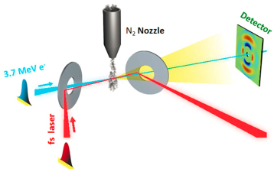
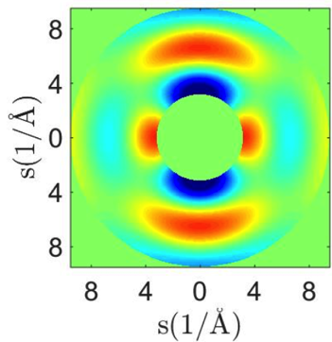
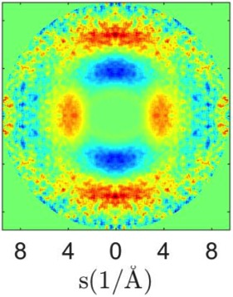
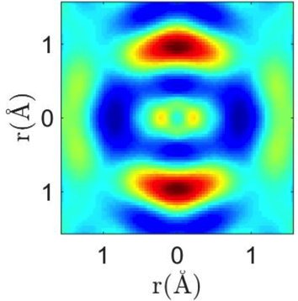
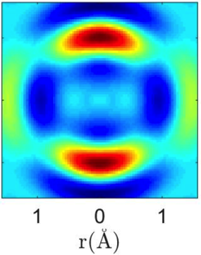
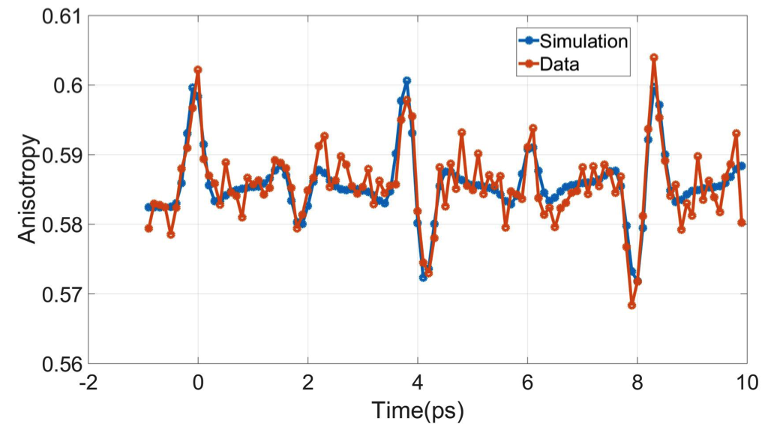
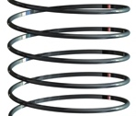
Gas-Phase MeV UED
  First gas-phase UED with 100-fs temporal resolution
Gas nozzle
Rotational revival of N₂ molecule
Diffraction pattern
Real space
Sim
Exp
Exp
Sim
Vibration of I₂ molecule
J. Yang et al., PRL 117, 153002 (2016).
J. Yang et al., Nature Commun. 7, 11232 (2016).

Slide 9
Outline
  Electron probes and UED status
  Photocathodes requirements for
    Diffraction
    Microscopy
    Energy-loss spectroscopy
  Summary

Slide 10
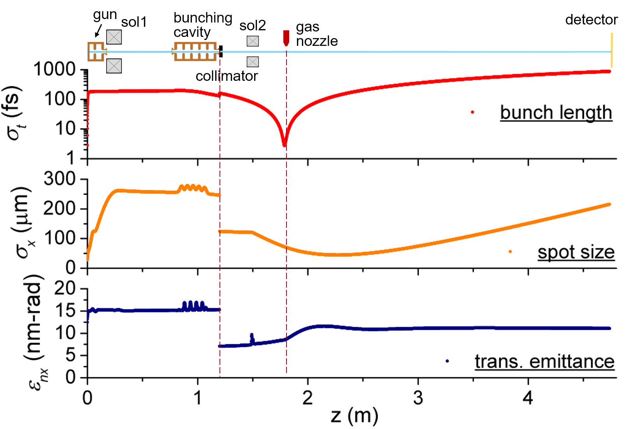
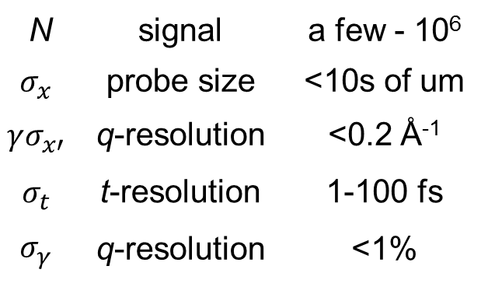
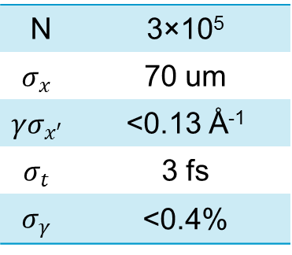
Beam requirement for UED
An example (for gas phase):
N | signal | a few - 10⁶
$$σ_{x}$$ | probe size | <10s of um
$$γσ_{x′}$$ | q-resolution | <0.2 Å⁻¹
$$σ_{t}$$ | t-resolution | 1-100 fs
$$σ_{γ}$$ | q-resolution | <1%
N | 3×10⁵
$$σ_{x}$$ | 70 um
$$γσ_{x′}$$ | <0.13 Å⁻¹
$$σ_{t}$$ | 3 fs
$$σ_{γ}$$ | <0.4%
Trans. and longi. dynamics are controlled separately:
- transverse: lenses
- longitudinal: bunching cavity

Slide 11
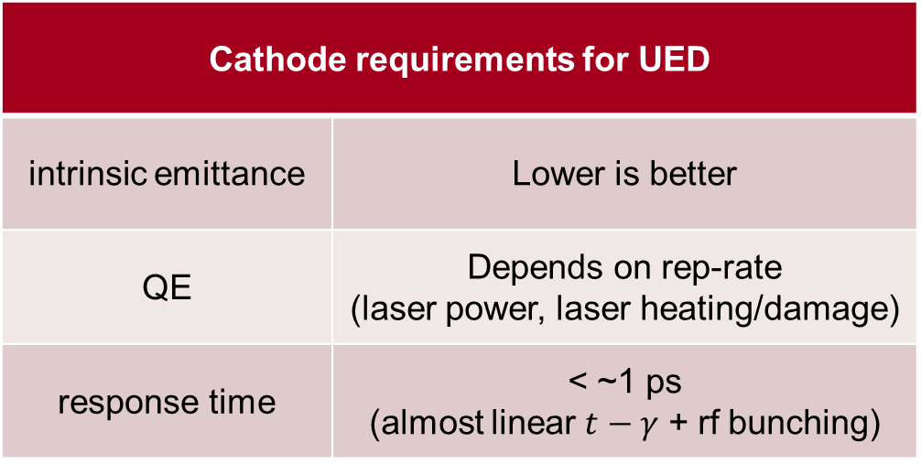

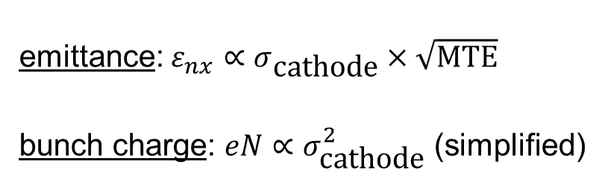
Cathodes for UED
emittance: $ε_{nx}∝σ_{\text{cathode}}×\sqrt{\text{MTE}}$
bunch charge: $eN∝σ_{\text{cathode}}^{2}$ (simplified)
$$\frac{1}{MTE }∝\frac{N}{ε_{nx}^{2}}$$
Cathode requirements for UED
intrinsic emittance | Lower is better
QE | Depends on rep-rate (laser power, laser heating/damage)
response time | < ~1 ps (almost linear $t−γ$ + rf bunching)

Slide 12
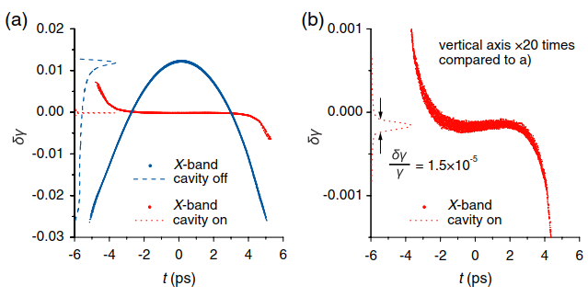
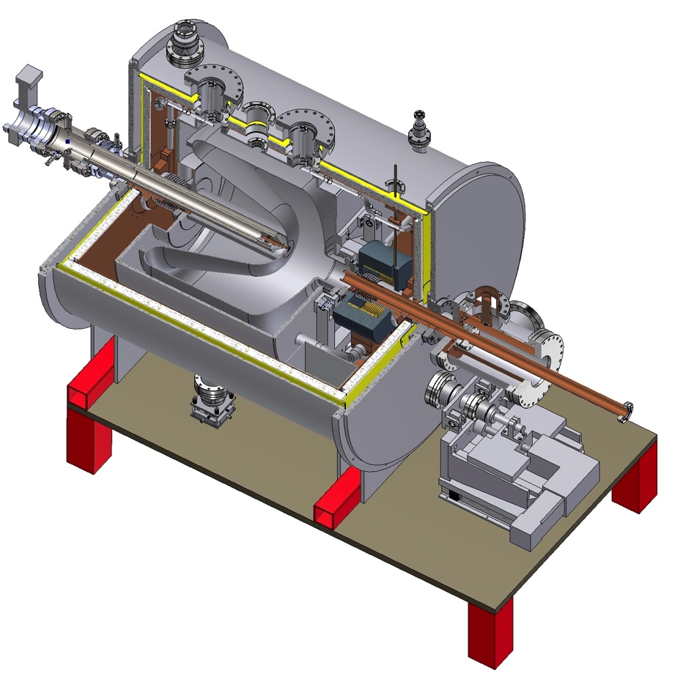
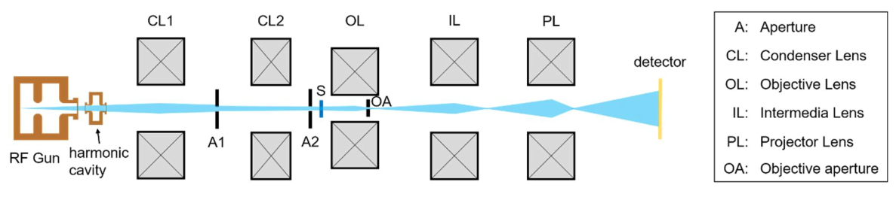
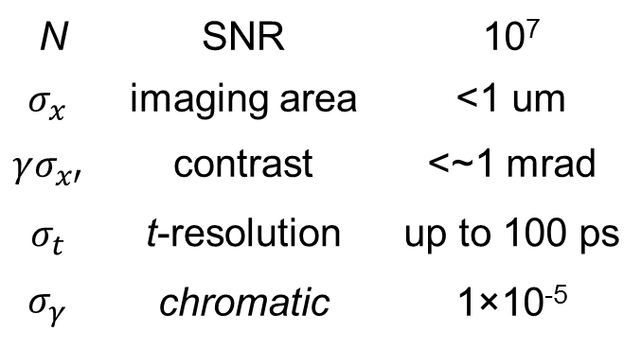
Beam requirement for UEM (single shot)
<1 nm emittance with >1 pC
Flattened longi. phase space for 1×10⁻⁵ energy spread
N | SNR | 10⁷
$$σ_{x}$$ | imaging area | <1 um
$$γσ_{x′}$$ | contrast | <~1 mrad
$$σ_{t}$$ | t-resolution | up to 100 ps
$$σ_{γ}$$ | chromatic | 1×10⁻⁵
WiFEL gun
R. K. Li and P. Musumeci, PRApplied 2, 024003 (2014)

Slide 13
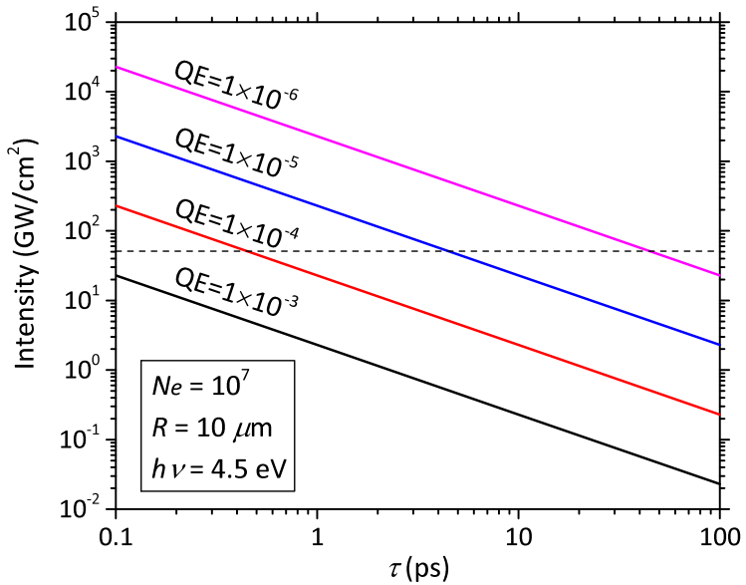
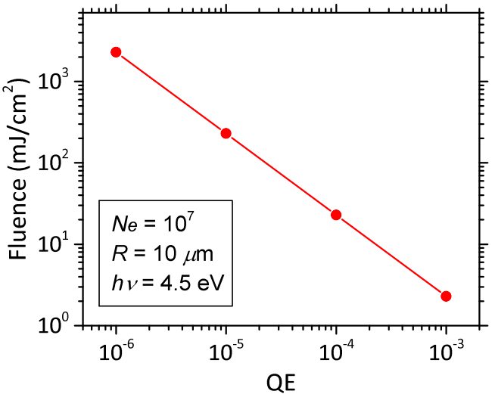
Cathode requirement for UEM
Intensity and multiphoton
fluence and damage
multiphoton regime
damage threshold for short laser
max. I₀ at 50 MV/m*
*D. Filippetto et al., PRSTAB 17, 024201 (2014)
Cathode requirements for UEM
Support <1 nm-rad, >1 pC beam High QE to avoid laser damage

Slide 14
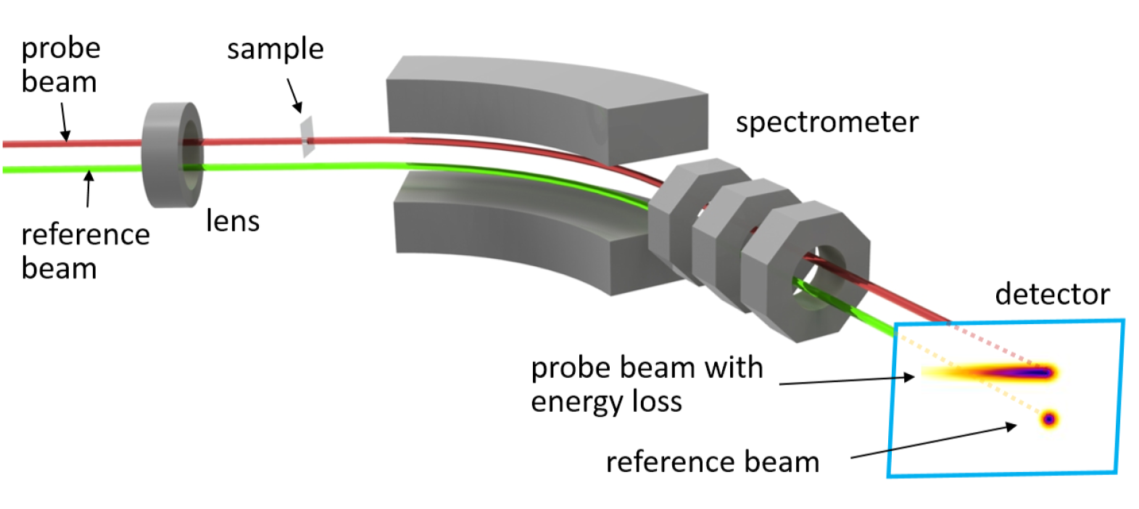
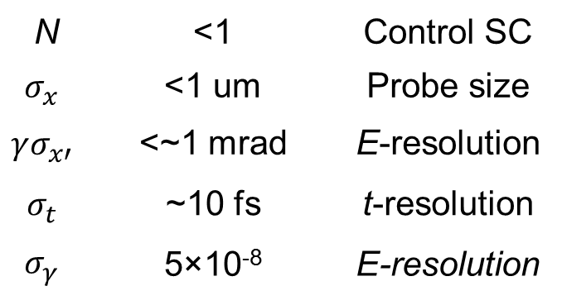
Beam requirement for fs MeV EELS
Electronic dynamics is fs fast
High gradient and MeV energy rf gun to generate fs beam
‘reference beam technique’: achieve sub-eV resolution with 50 eV jitter (1×10⁻⁵ of 5 MeV)
N | <1 | Control SC
$$σ_{x}$$ | <1 um | Probe size
$$γσ_{x′}$$ | <~1 mrad | E-resolution
$$σ_{t}$$ | ~10 fs | t-resolution
$$σ_{γ}$$ | 5×10⁻⁸ | E-resolution
R. K. Li et al., to be submitted

Slide 15
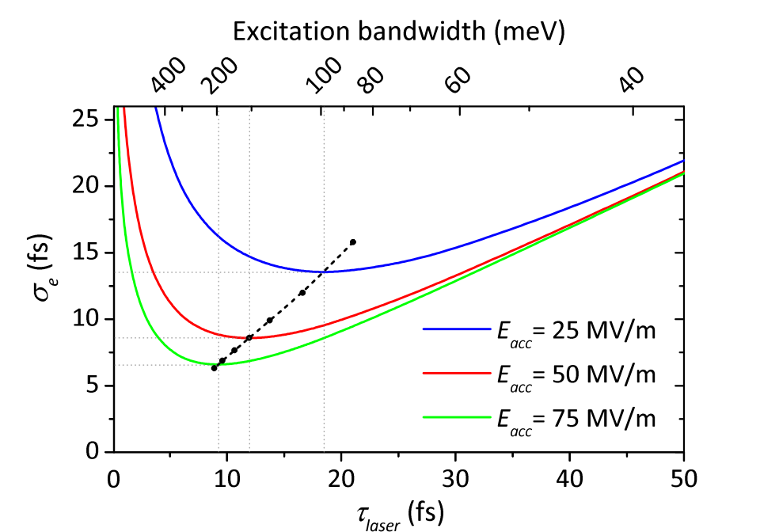
Cathode requirement for fs EELS
fs response
Spread of the excess energy dominated by laser bandwidth
What is the longitudinal emittance limit of photocathode?
Cathode requirements for fs EELS
Prompt response (a few fs) with high rep-rate Small spread of the excess energy

Slide 16
Cathode requirement for ultrafast electron scattering
Application | Requirements
UED | low intrinsic emittance (true for all) ps response time is fine
UEM | support <1 nm-rad, >1 pC beam high QE to avoid laser damage
fs EELS | prompt response (a few fs) with high rep-rate small spread of the excess energy
Of course, compatible with high acceleration field !!

Slide 17
Summary and outlook
UED demonstrated to be unique and powerful research tools
UEM and fs MeV EELS are exciting and feasible
All is possible due to cathode and electron source work
Unlimited possibilities for further improvement, challenging but fun
Breakthrough science opportunities with UES
Benefit FEL, DLA, external-injection for LPWA etc. as well
Thank you for your attention!

