Slide 1
Ultrafast laser heating in copper photocathodes: minimum intrinsic emittance
J. Maxson, P. Musumeci (UCLA)
L.Cultrera (Cornell University)
Siddharth Karkare, Howard Padmore (LBNL)
P3 2016, Jefferson Laboratory

Slide 2
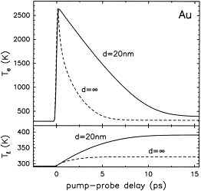
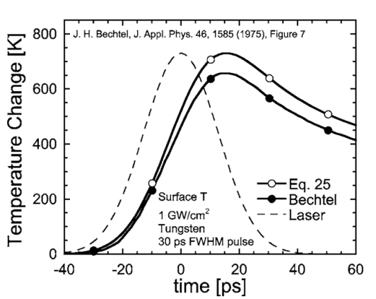
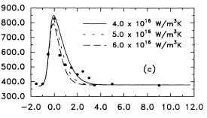
Ultrafast laser heating of electrons in metals
In Cu, the electronic heat capacity is roughly 1/100th of the lattice heat capacity: $C_{e}= γT_{e}$~0.01$C_{l}$
Intense, ultrafast photoexcitation can heat the electronic distribution very rapidly, leaving the lattice relatively cold!
Well studied effect! Examples:
Equilibration with lattice can take multiple ps.
Low QE of metals often requires fluences ~10 mJ/$cm^{2}$
What are the consequences of this heating on emittance?
J. Hohlfeld et al, Chem Phys. (2000)
K. Jensen et al,
J. Appl. Phys. 99, 124905 (2006)
Fann et al, PRL 68, 18 1992
1.9 mJ/$cm^{2}$
Time (ps)

Slide 3
Timeline of thermalization and equilibration
Excitation at the surface and ballistic electron motion. Ballistic electron motion increases effective penetration depth of excitation.
Electrons reform a hotter FD-distribution from e-e scattering, after a finite thermalization time, and begin diffusion into the bulk
On the ps timescale, electrons and phonons scatter, and equilibrate. Standard heat diffusion thereafter.
Figure from: J. Hohlfeld et al, Chem Phys. (2000).

Slide 4
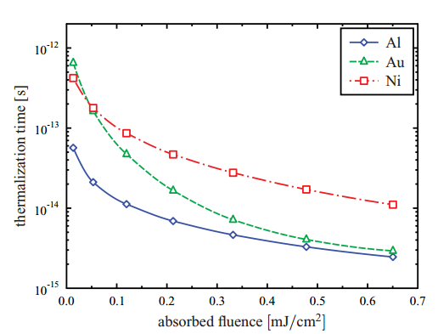
Electron Thermalization time
If the laser heats the electrons it emits, you can pay a big price in MTE due to low QE at threshold.
However, are the electrons photoemitted from RT or excited distribution? How long does electron thermalization take?
Answer: Thermalization is fast, and depends on excitation fluence.
Figure from: Mueller & Rethfeld, PRB 87, 035139 (2013)
1 mJ/$cm^{2}$ thermalizes in <10fs!
For our case, $≥$100 fs pulses with multiple mJ/$cm^{2}$
→Assume immediate thermalization

Slide 5
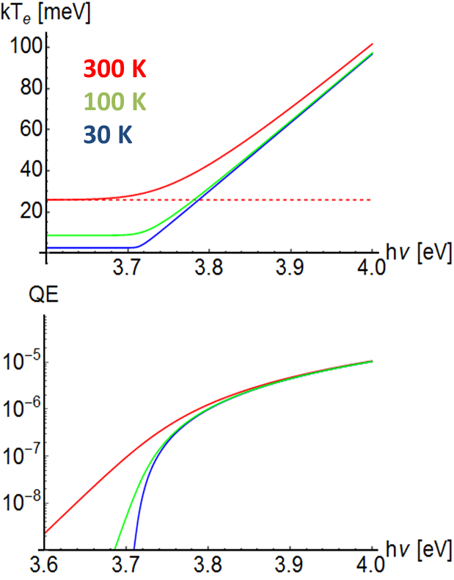
QE and MTE vs Temperature
Electron temperature plays a critical role in MTE and QE:
Finite-temperature extended Dowell formulae [T. Vecchione, FEL2013]
$$E_{ex}= hν−φ_{eff}$$
MTE (meV)
$$ε_{n}/σ_{x}→\sqrt{\frac{E_{ex}}{3}}$$
QE at threshold strongly dependent on temperature
$$ε_{min}/σ_{x}→\sqrt{\frac{kT_{e}}{mc^{2}}}$$
J.B. Rosenzweig et al, arXiv:1603.01657 (2016)

Slide 6
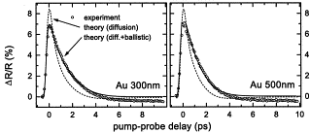
Two-temperature model
We use the two-temperature model to calculate emittance growth due to ultrafast heating in Cu.
Electrons and lattice are treated as interacting thermalized subsystems
Electron thermal conduction
Electron-phonon coupling
Laser source term
Electron $T_{e}$:
L$attice T_{l}$:
Source term:
Penetration depth
J. Hohlfeld et al, Chem Phys. (2000).
$d_{p}$ must be increased by electron ballistic range. $d_{p}=α^{−1}+λ_{ball}∼100 nm$
… it works!
Phenomenological, but…

Slide 7
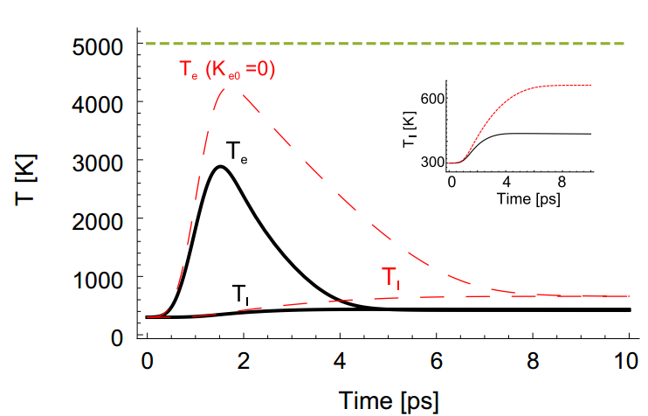
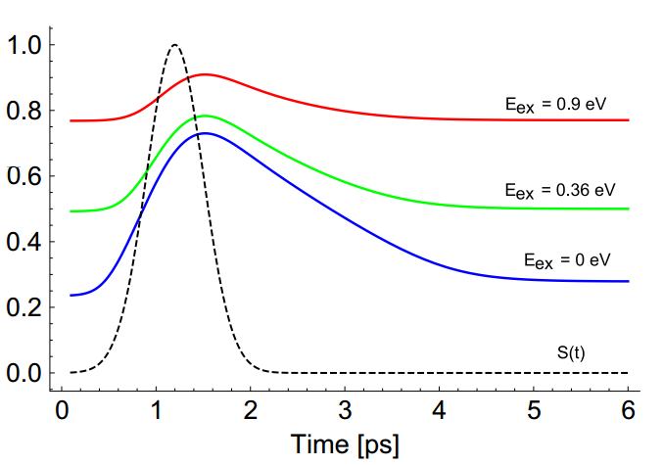
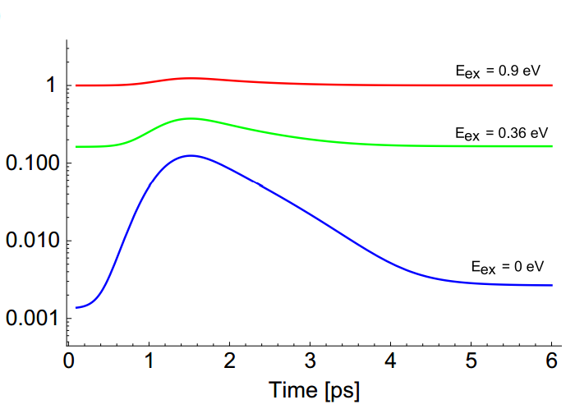
TTM on Cu photocathodes (1)
10 mJ/$cm^{2}$ absorbed on Cu, with a rms duration of $σ_{t}=300$ fs.
$$E_{ex}=0.9 eV$$
$$E_{ex}=0.36 eV$$
$$E_{ex}=0 eV$$
J. Maxson et al.,
NIMA (2016)

Slide 8
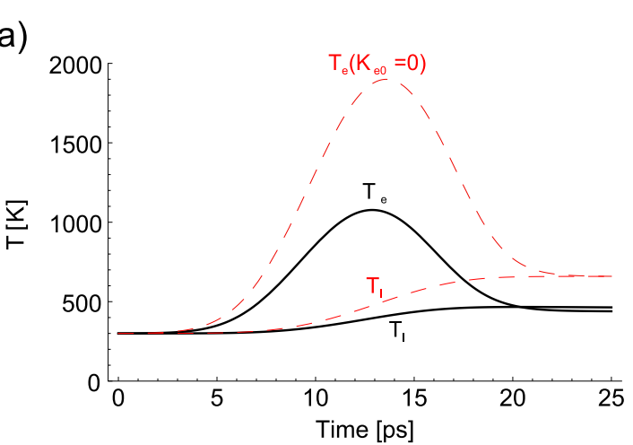
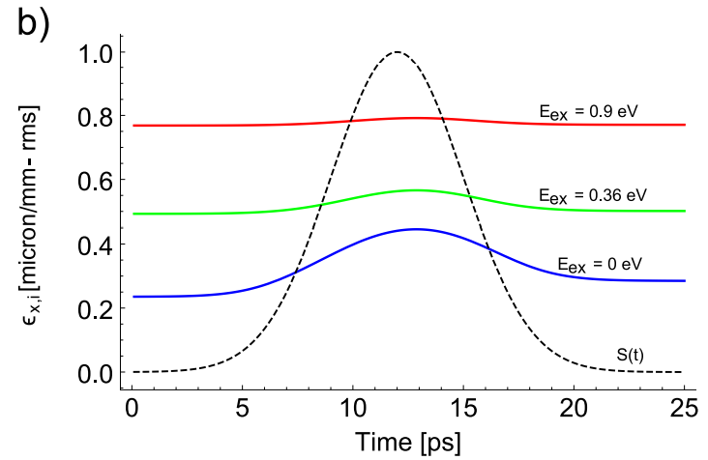
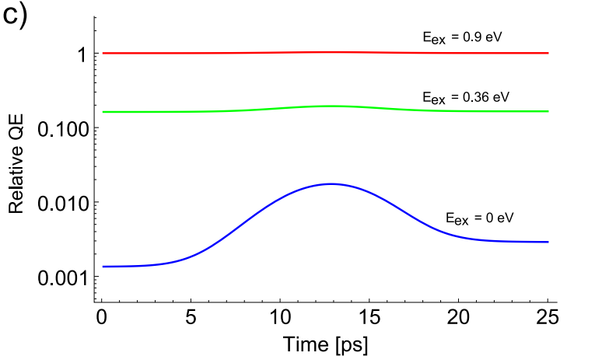
TTM on Cu photocathodes (2)
Same case as before, but stretch pulse length to $σ_{t}$= 3 ps. Takes advantage of e-phonon coupling to reduce peak T!
$$E_{ex}=0.9 eV$$
$$E_{ex}=0.36 eV$$
$$E_{ex}=0 eV$$
J. Maxson et al.,
NIMA (2016)

Slide 9
Minimum achievable emittance in practice
Define a mean QE and mean MTE over the whole pulse:
MTE is dominated by when QE is high—when the distribution is hot
Typically one sets the charge density for a given application in practice by the proximity to the space charge limit.
Pancake regime: $σ<ε_{0}E_{acc}$, typically $σ=0.1×ε_{0}E_{acc}$ to avoid space charge distortion issues.
This relates the required (absorbed) fluence and QE:
$$0.1$$
$$hν$$
reflectivity

Slide 10
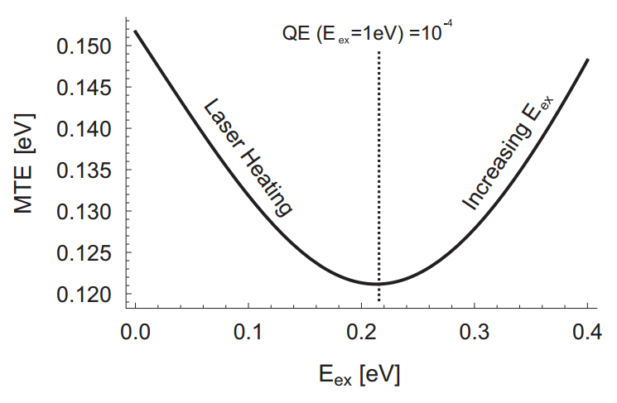
Minimum achievable emittance in practice
With the charge density set constant, intrinsic emittance vs. excess energy is not monotonic!
Example: Extract $44\frac{pC}{mm^{2}}=0.1×ε_{0}E_{acc}$ for 50 MV/m extraction field on clean copper ($φ_{0}=4.31 eV, R∼0.35$ in the UV)
An optimum wavelength exists!
Here, optimum fluence (~2 mJ/$cm^2$)
QE at zero fluence set comparable to:
Dowell et al, PRSTAB 9 063502 (2006)
0.5 $μm/mm$
(307 nm)
(279 nm)

Slide 11
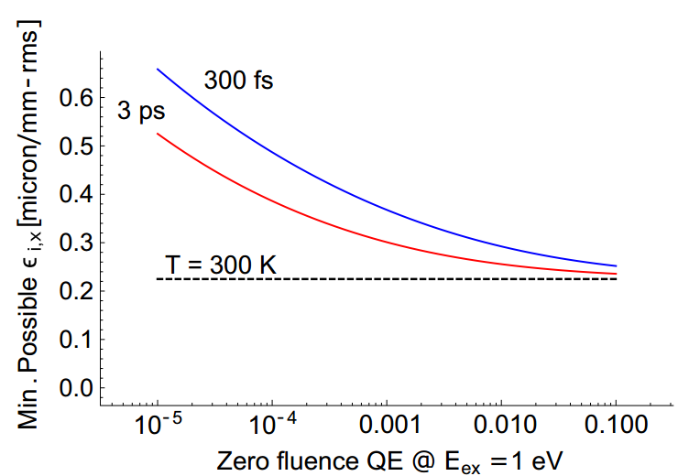
Minimum achievable emittance in practice
What if the QE is lower, or you want to extract more charge?
(Decreasing QE equivalent to
Increasing charge density)
Approaching threshold to get emittance gains only when QE is high or required charge density is low!

Slide 12
Summary
Intense lasers will generate hot electrons out of equilibrium with lattice.
Thermalize quickly for photoinjector fluences
TTM model shows that laser heating can spoil near-threshold emittance gains due to low QE.
An optimum wavelength exists that minimizes $E_{ex}$ and heating.
New regime of operation where charge setpoint controls intrinsic emittance
In the future:
Pump-probe measurements in a photogun are planned: emittance measurement as time resolved two photon spectroscopy!

Slide 13
Acknowledgements
This work was supported by the DOE STTR award DE-SC0009656 and NSFPHY-1415583.
Many thanks to helpful conversations with Daniele Filippetto and Renkai Li, and David Cesar
Thanks!

Slide 14
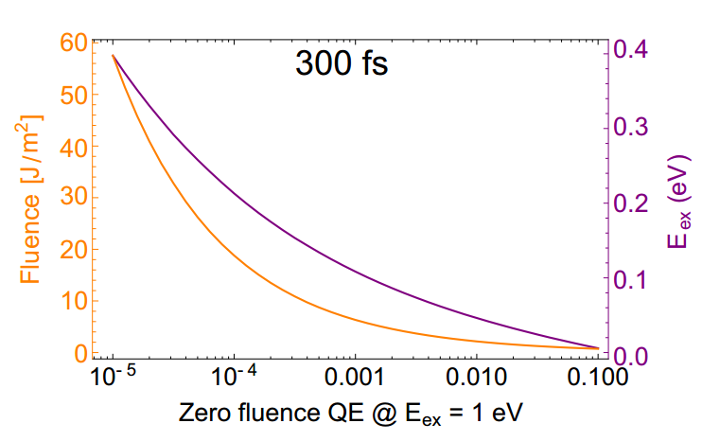
Bonus Material

Slide 15
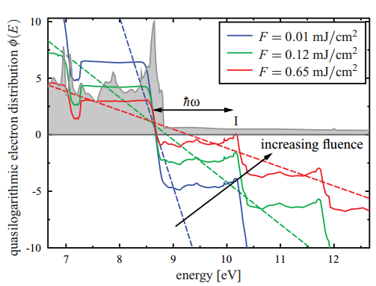
If the distribution isn’t in equilibrium…
….it is still wide.
Figure from: Mueller & Rethfeld, PRB 87, 035139 (2013)
Ni

