Slide 1
FRIB Cryogenic Support
Kelly Dixon, JLab Project Engineer for Cryo Plant & Distribution System

Slide 2
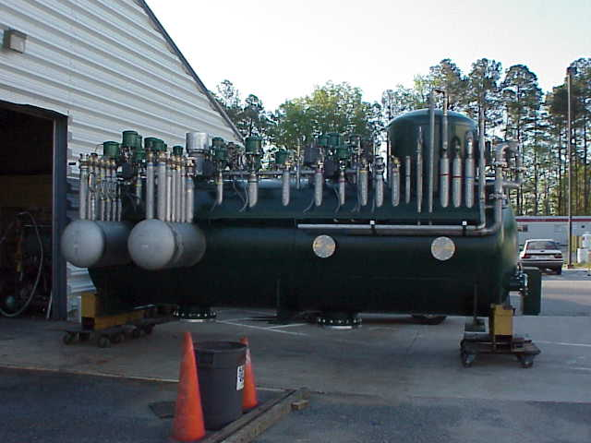
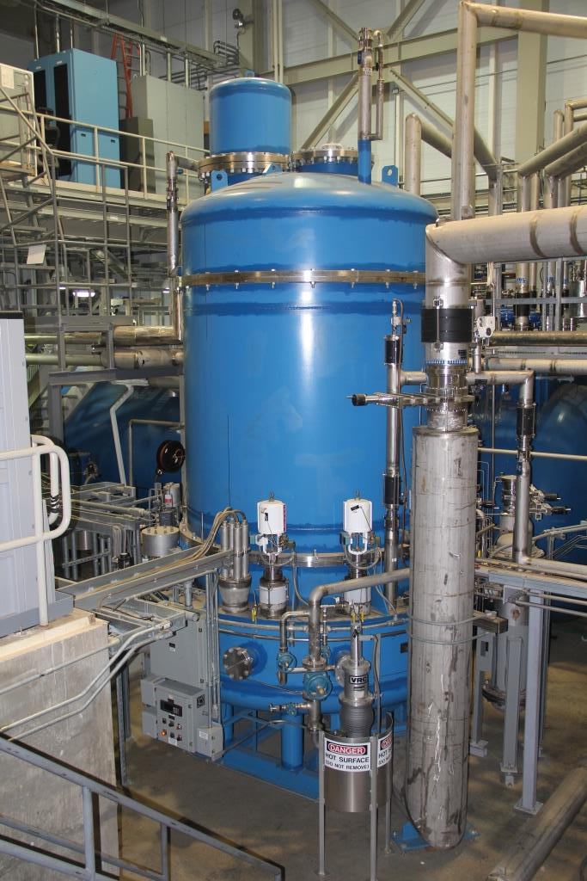
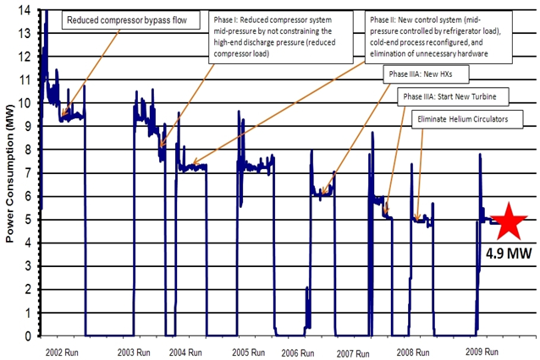
Cryo Support to Other Labs & Agencies
1998-2000: Support upgrade of NSCL Cryo System.
2000-2005: Designed, built and commissioned the 2K cryo system for SNS at ORNL
  Continuation of supporting the technical needs of the SNS cryogenic 2K helium system through collaboration
  2004-2007: JLab modified the operational process at BNL cryo system to Ganni Cycle-Floating pressure technology, resulting in a power reduction from 9.4 MW to 4.8 MW for the same load
NSCL Distribution Box
SNS ‘2 K’ Cold Box
BNL Power Profile

Slide 3
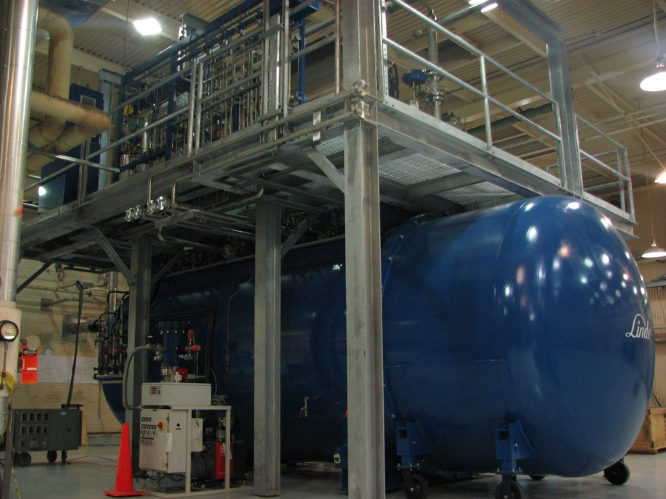
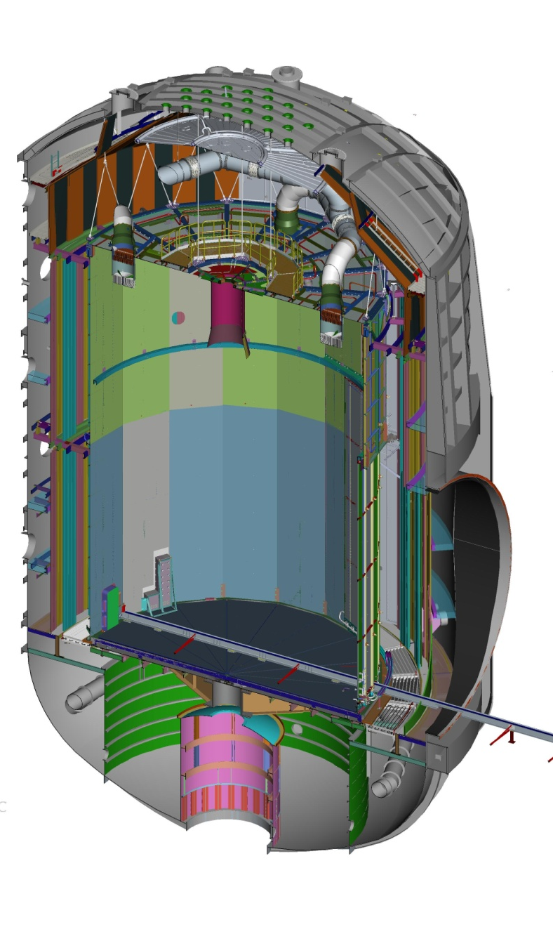
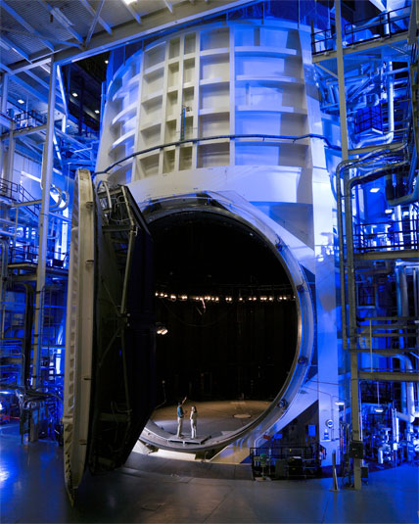
Cryo Support to Other Labs & Agencies
2006-2012: JLab designed, built and commissioned the cryo systems to support James Webb telescope testing at JSC-NASA
  LN2 consumption cut in half (91 vs 182 m³/day)
  12.5 kW, 20 K plant
    input power/load ~ 50% from original (125 to 65 W/W)
    Constant efficiency to 33% of full load
12.5 kW, 20 K Cold Box
NASA JSC Chamber-A

Slide 4
FRIB Plant Support
  In 2012, JLab came up with a plan to use the flexible CHL2 Cryo system with minor modifications due to added shield and 4.5K loads; this brought the cryo system costs back to the baseline
JLab provided the bottoms up estimate for the loads and other cryo requirements
Equipment to provide includes:
  4K and sub-atmospheric (SA) cold boxes
  main and recovery compressors
  liquid and gas storage
  oil removal
  warm and cryogenic piping
  guard vacuum, instrument air, purifier, ambient air heat exchangers
4-5 JLab FTE’s dedicated to the design +2.0 contractors + 1 FRIB designer/engineer at JLab
Goal is to provide 4 K in Dec ‘17 and 2 K in Mar ‘18
Work for Others Agreement No. JSA 2012W003, Mod 6
(MSU Reference No. MSU RC063215-JSA-6)

Slide 5
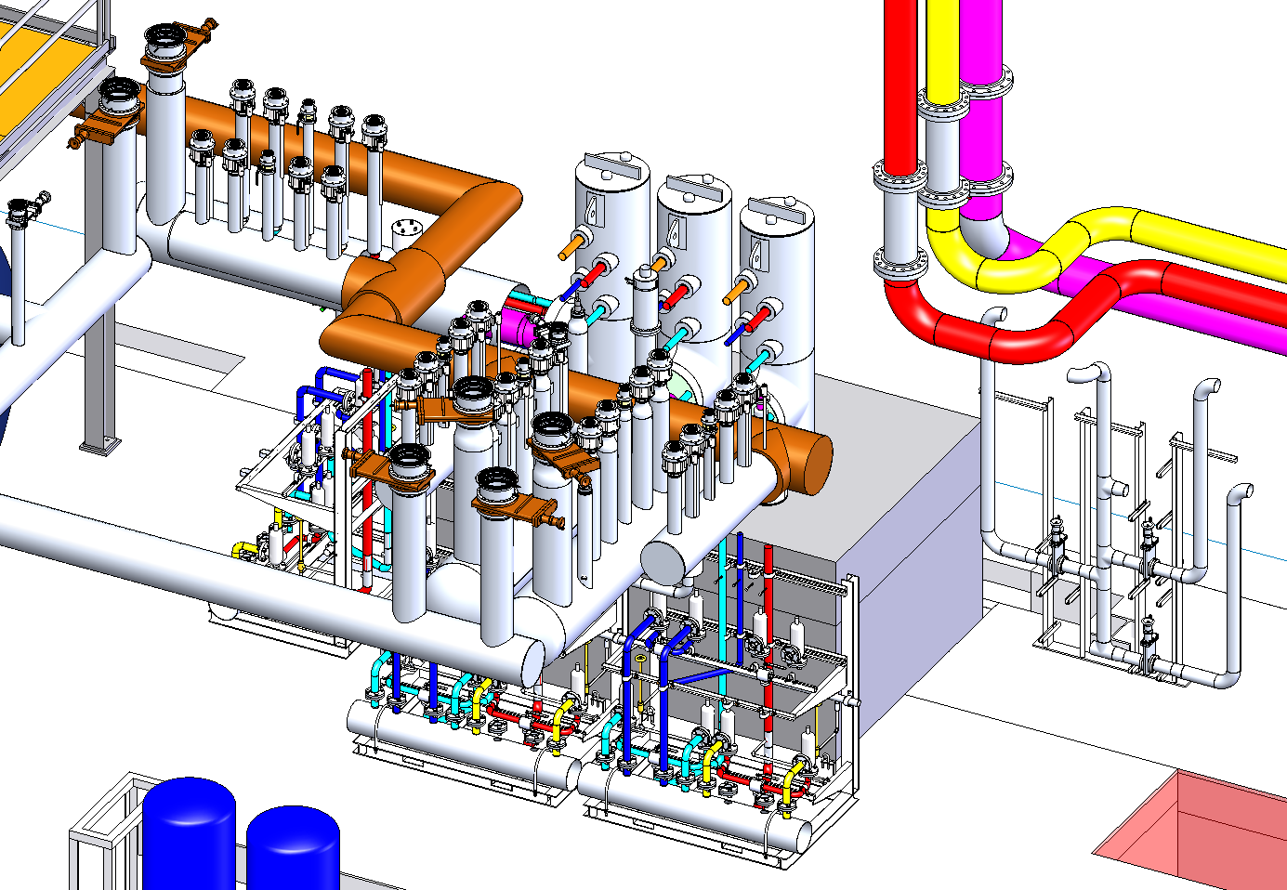
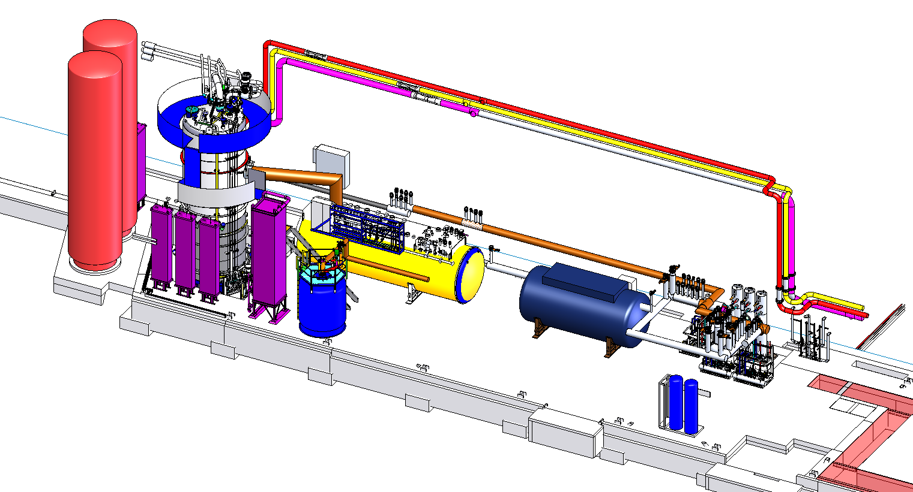
Plant Layout - Cold Box Room
N2 Dewar(s)
Upper Cold Box
Distribution to Linacs
Heat Exchangers
Lower Cold Box
He Dewar
SA Cold Box

Slide 6
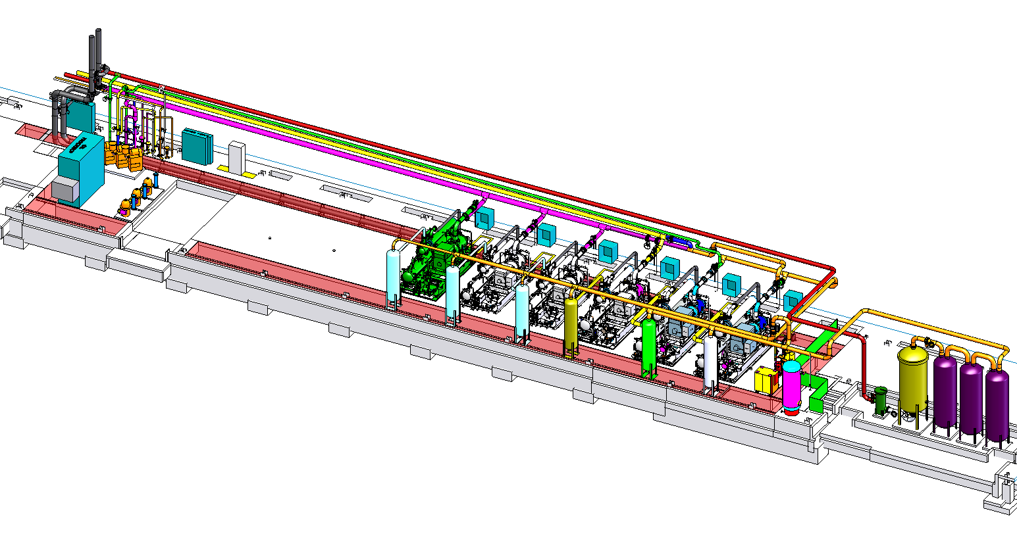
Plant Layout - Compressor Room
Gas Mgmt Rack
Guard Vacuum &
Recovery Compressors
Final Oil Removal
LP-L
LP
LP
MP
HP
HP

Slide 7
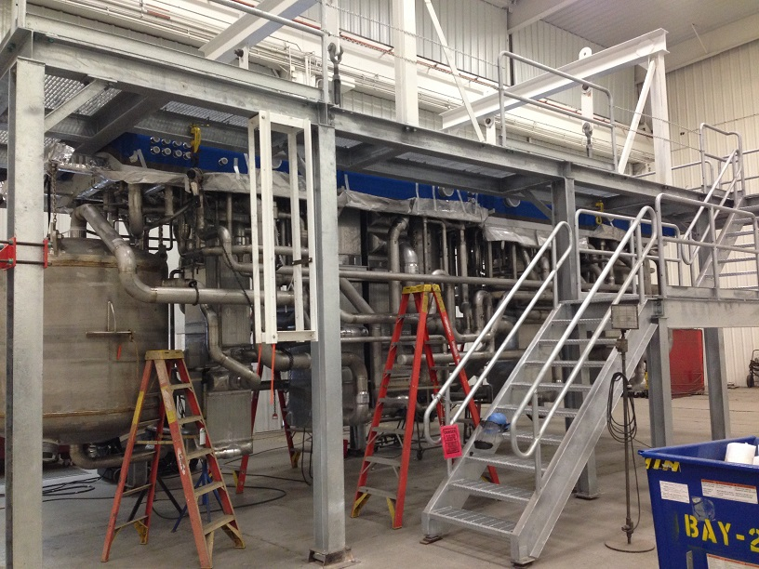
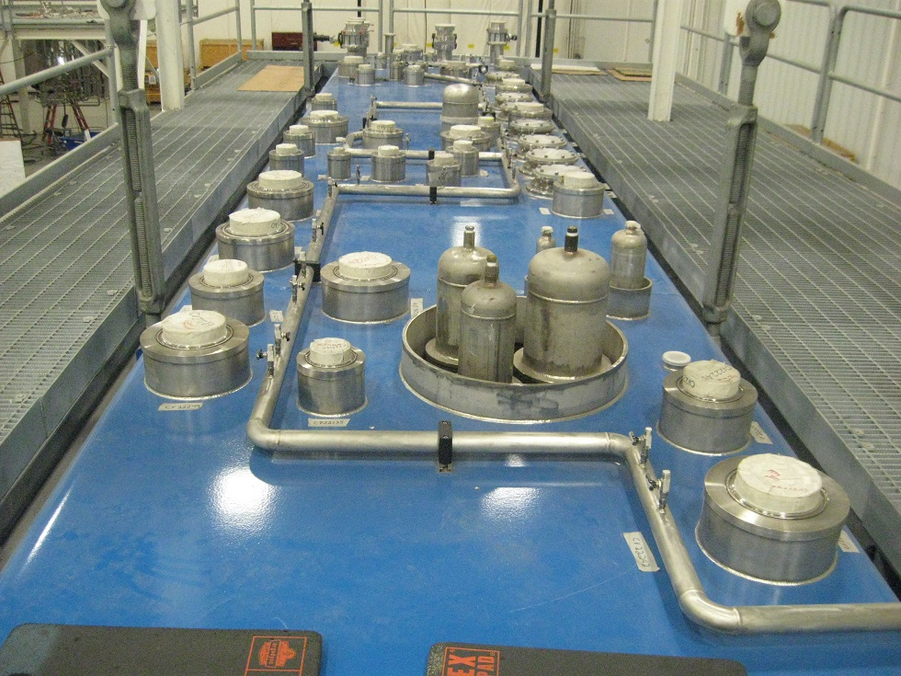
Cold Boxes
4 K cold boxes based on JLab CHL2
  Larger shield flow
  Specific 4 K load from magnets
  Increased 300-80 K heat exchangers
  Provides 50% design margin
  Designed and built by vendor
Sub-atmospheric (SA) cold box design by JLab
  120 g/s nominal flow vs 215 g/s CEBAF (@0.028 atm)
  Allows cold compressor upgrade to 225 g/s
  Water cooled motors
  Horizontal configuration
  Heat exchanger moved to CM level

Slide 8
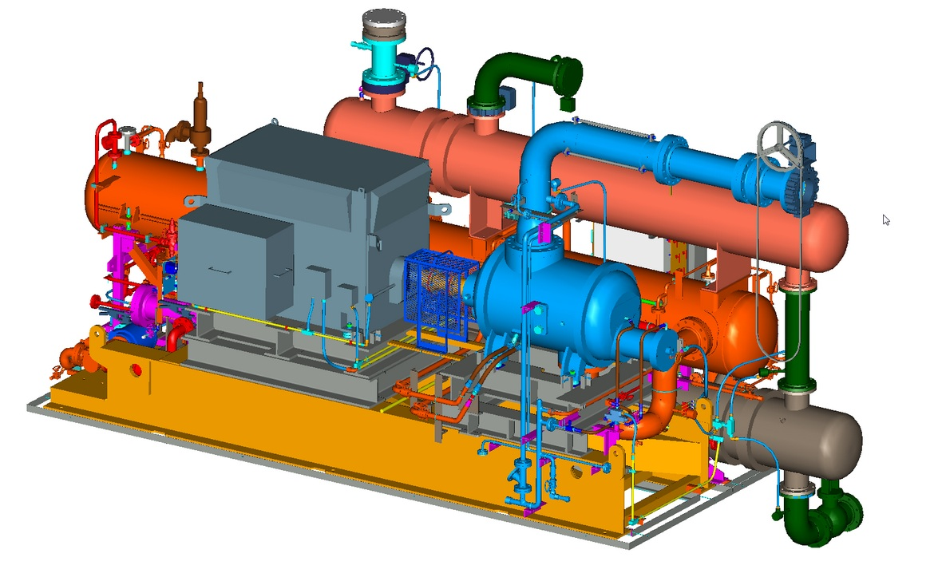
Main Compressors
Baseline design funded by NASA-JSC
Number and size selection based on Ganni Cycle
50% less maintenance to CHL2
Improved efficiency to 51% (highest compared to current industrial systems)
Low equipment cost
Recent changes from CHL2
  oil separation and removal
  HP frame stiffened
  corrugated lines removed
  power increased to one LP unit to handle the 4 K load

Slide 9
Misc. Equipment
Gas and liquid storage
  Mostly standard equipment. Helium dewar requires neck insert for heaters, valves, and bayonets
Guard vacuum skid
  Provides SA seal protection and low CM relief valve backpressure
  Based on JLab/SNS design
Purifier
  JLab integrates compressor and HX/adsorber skids
Oil removal
  Builds upon previous CHL designs with recent experience

Slide 10
JLab Designed Piping
Warm piping
  Various valve & instr racks
  Helium, water, oil, instrument air layouts
Cold piping
  Helium & nitrogen
  Distribution headers and bayonets
  U-tubes

Slide 11
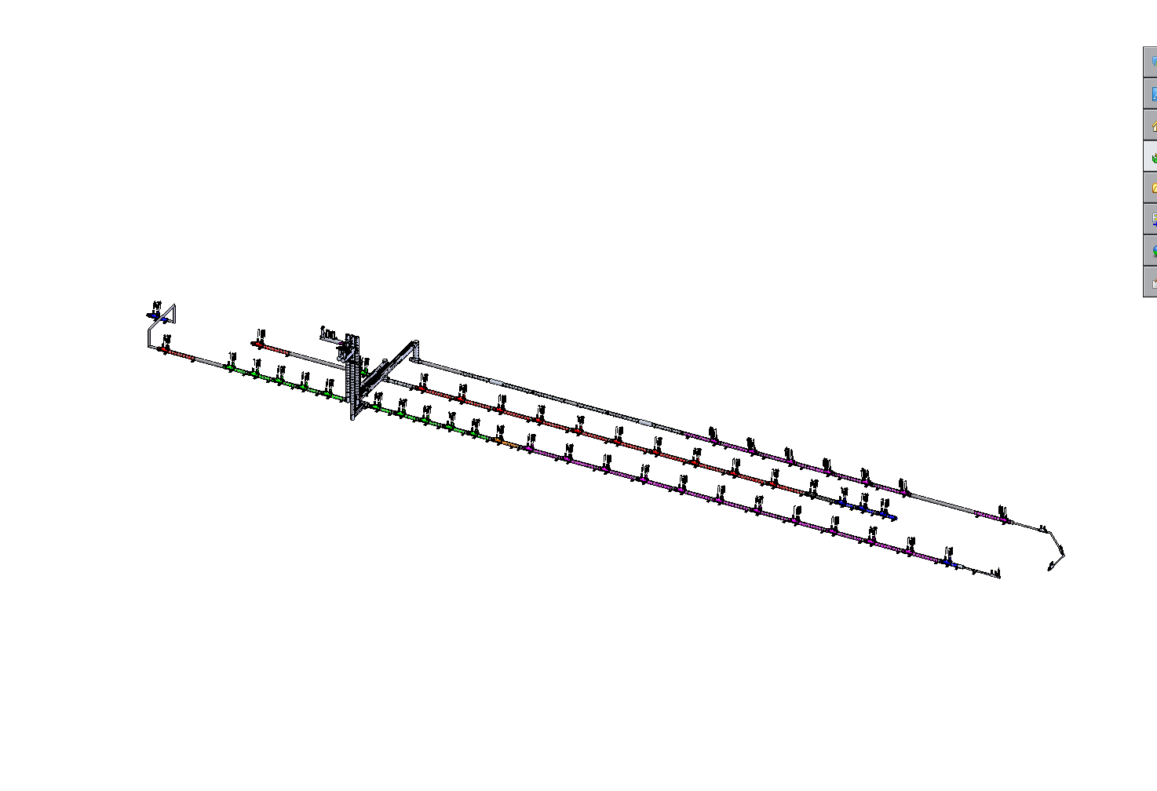
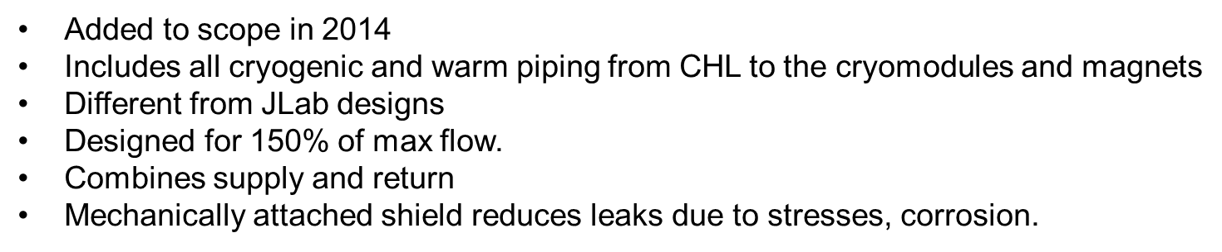
Distribution System
Cryogenic Distribution at FRIB Linacs
S and T Review July 28-30 2015

Slide 12
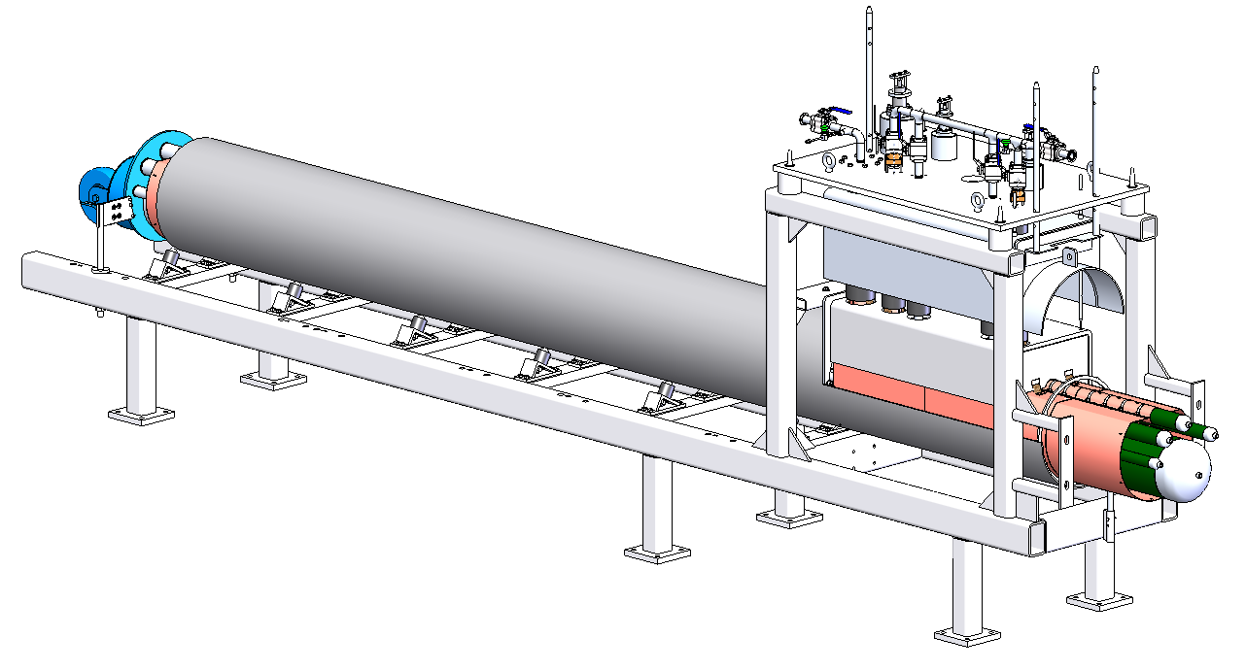
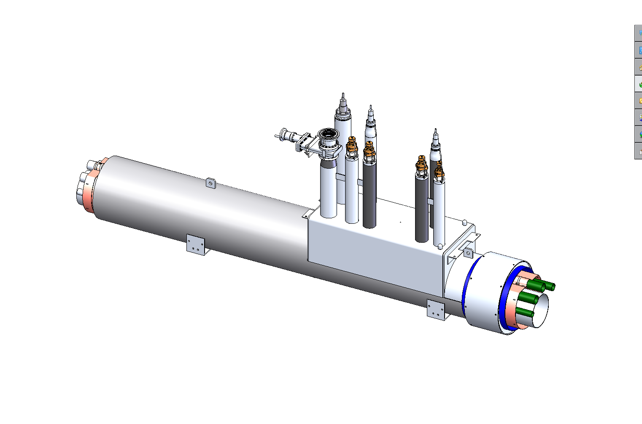
Distribution System
Prototype and standard transfer line sections designed and built by JLab
  Includes detailed drawings, assembly procedure and fixtures
  49 standard sections have several different lengths
Now providing support to ensure supplier meets technical and schedule goals
Prototype during construction
A standard TL section
S and T Review July 28-30 2015

Slide 13
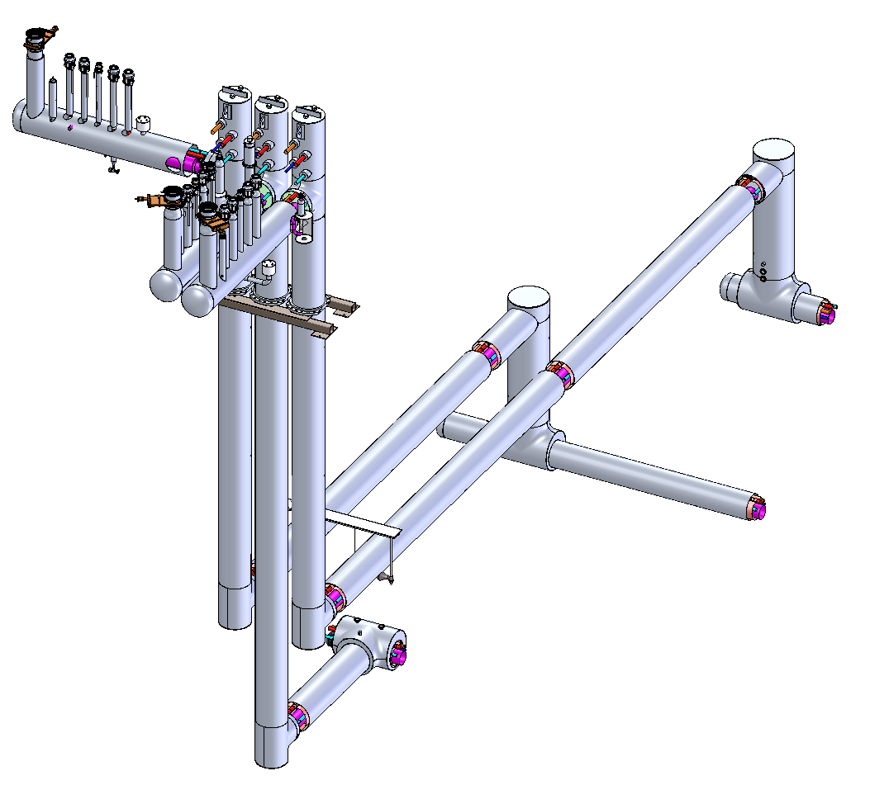
Distribution System
CHL to Linac Piping
  Allows independent operations of 3 linacs
  JLab design, some similarity to standard sections
  Relief piping & valves moved from tunnel
  JLab presently constructing some sections for summer ‘15 installation

Slide 14
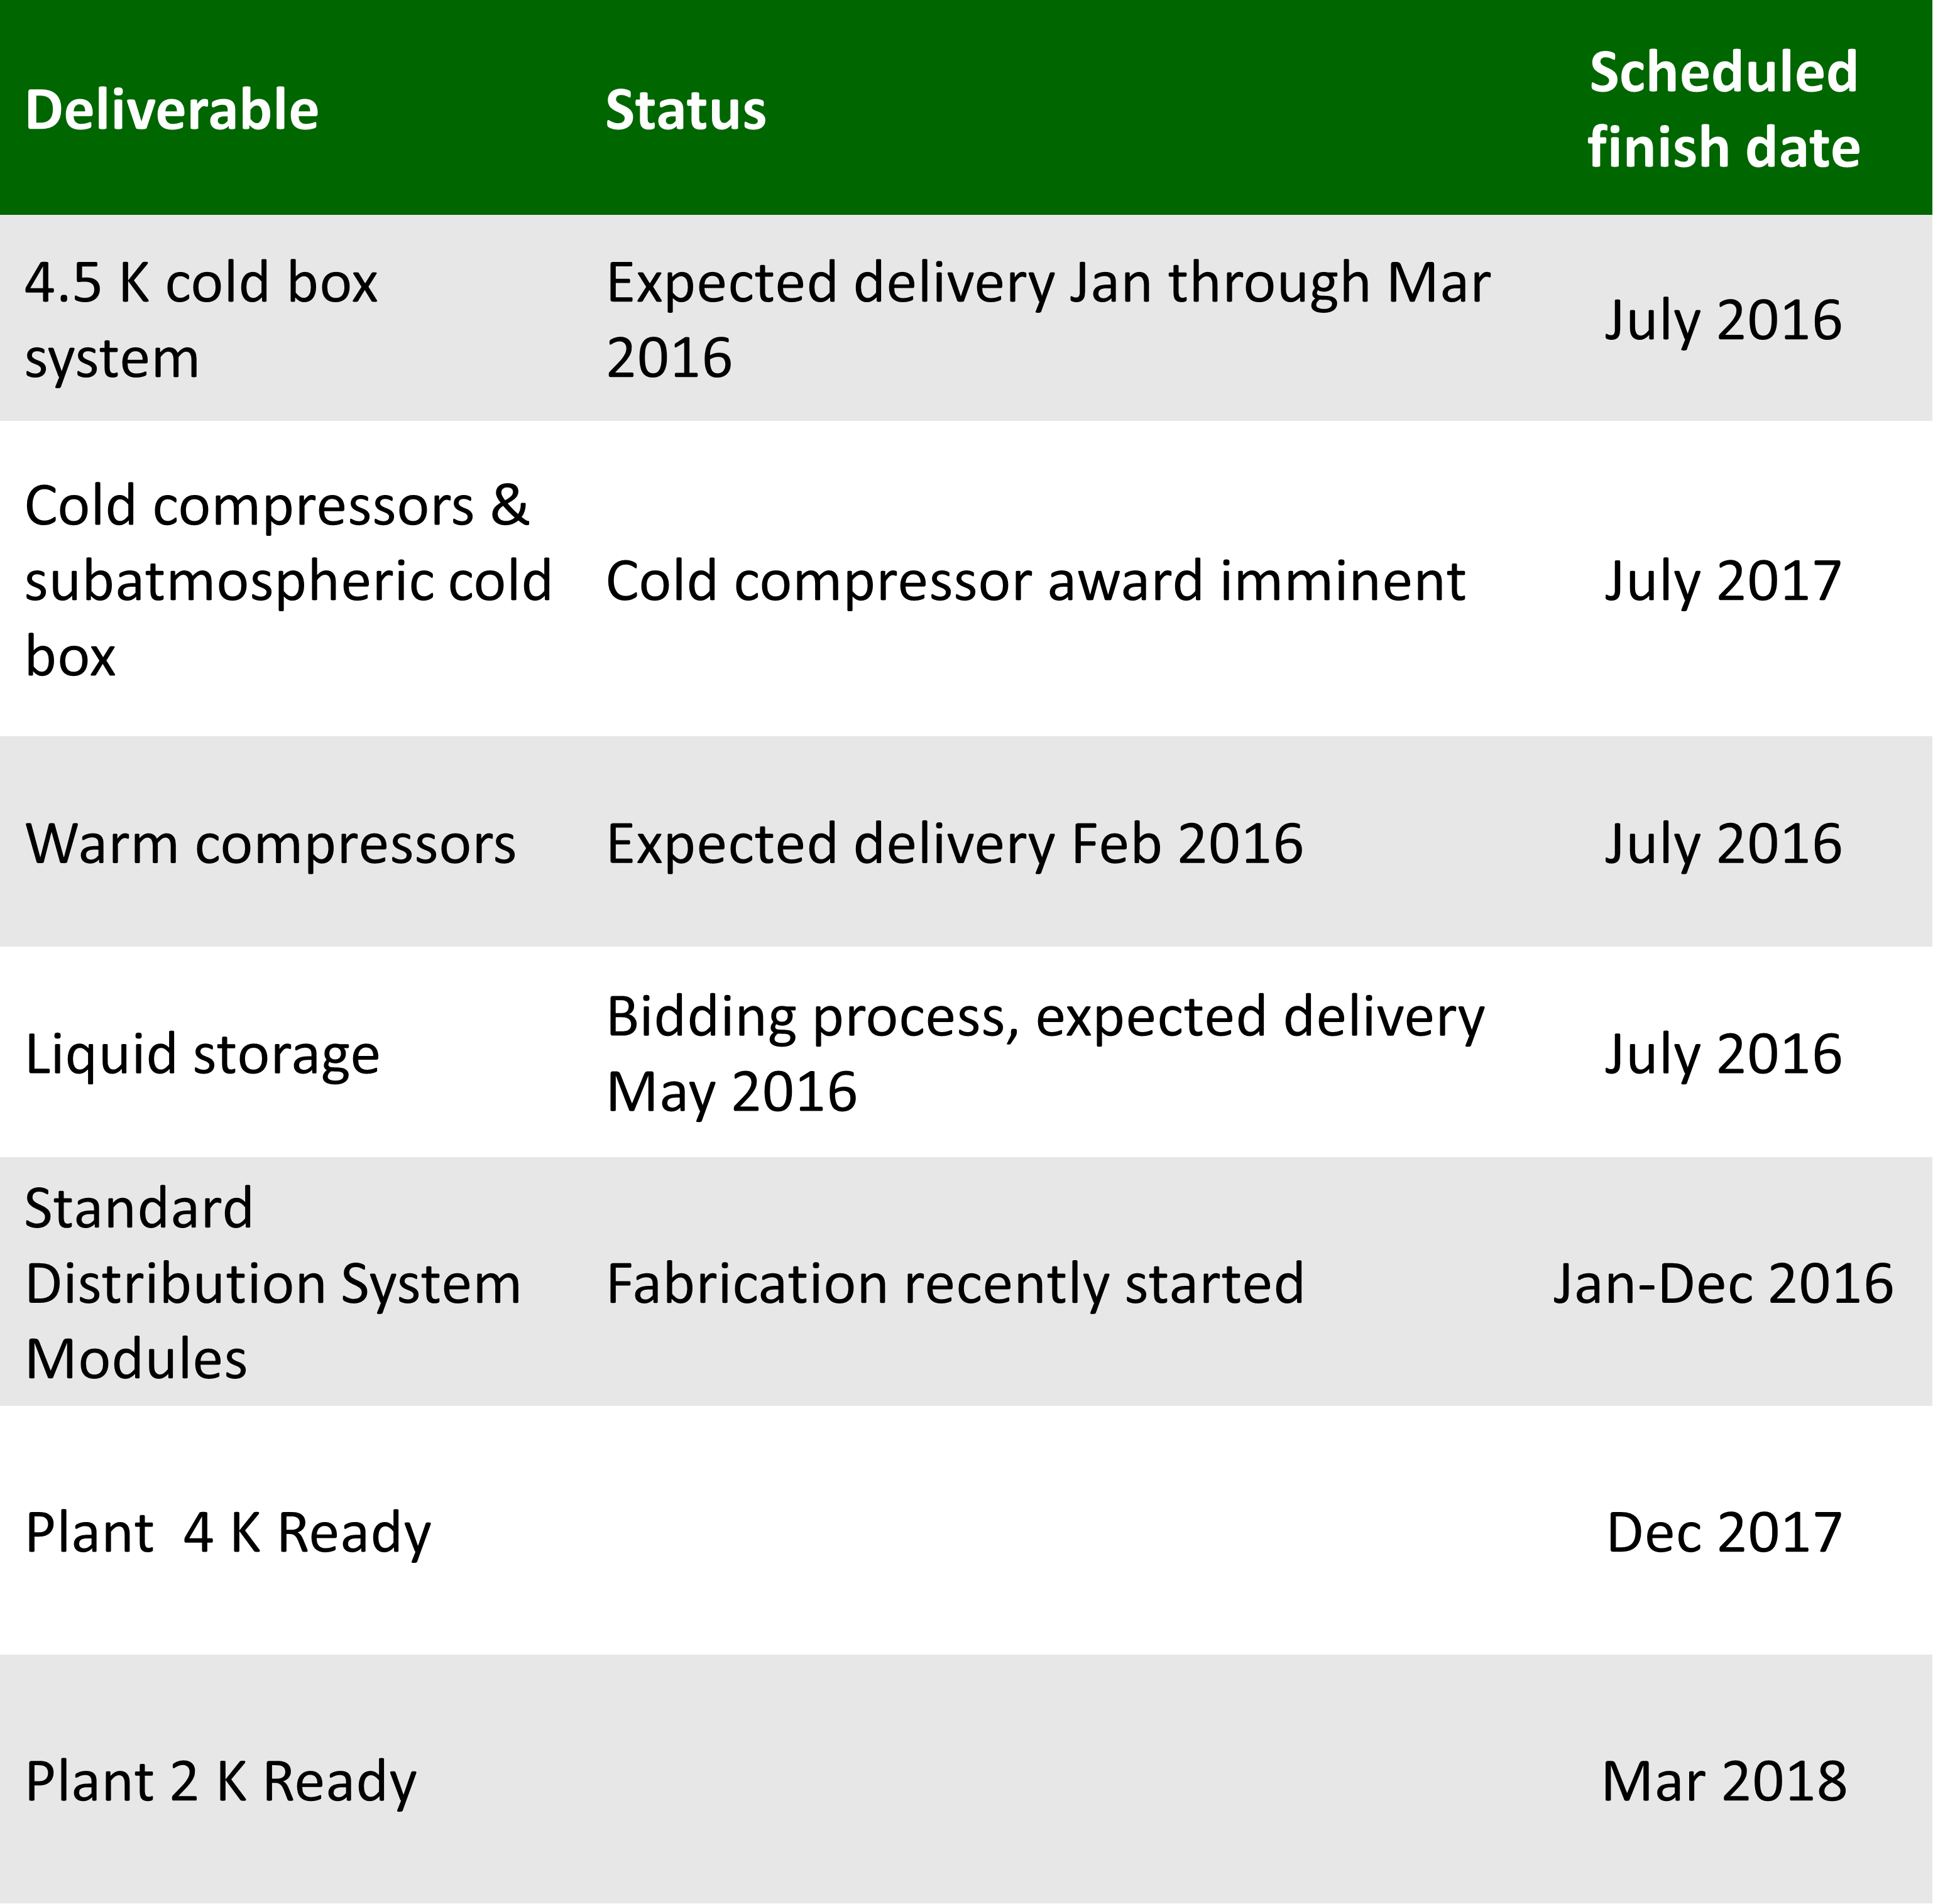
Plant and Distribution Schedule

Slide 15

FRIB Cryomodule Design
FRIB Cryomodule Engineering and Design
  Using the conceptual design models and assemblies already developed by FRIB staff, develop complete engineering packages ready for cryomodule fabrication
  The SRF cavities, power couplers, cavity tuners, solenoids and vacuum beam lines are being developed and designed by FRIB
  JLab will final design the cryogenic distribution piping, thermal and magnetic shielding, vacuum vessel, alignment rails and complete assembly drawings for the cryomodules.
The Work For Others agreement began in 2015 and runs through December 2018
The WFO covers an average of 7 FTE’s through CY 2017 and ~2 FTE’s in CY 2018
WFO Agreement No. JSA 2015W002
(MSU Reference No. MSU RC063215-JSA-5)

Slide 16
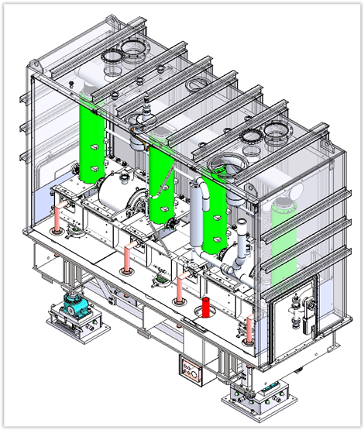
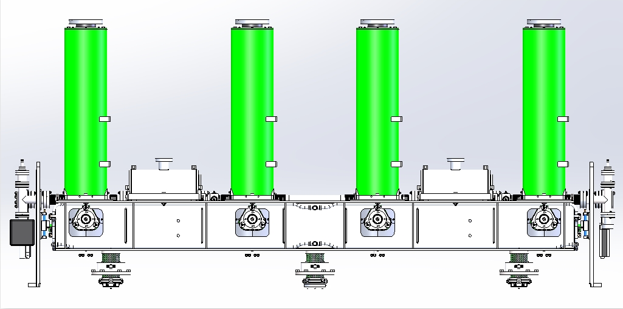
FRIB Cryomodule Design
JLab is currently reviewing the FRIB β=0.085 design and designing the β=0.041 cryomodule
  Provides a great opportunity for both labs to benefit from the others experience
  Expected finish date in February 2016
JLab will then review the FRIB β=0.53 design and design the β=0.29 cryomodule
Other design assignments will follow as agreed upon with FRIB
Cavity #4
Cavity #3
Cavity #2
Cavity #1
Solenoid #2
Solenoid #1
Beam
β=0.041 Clean Room Assembly plus G10 support posts
β=0.041 Sectioned View of Vacuum Vessel

Slide 17
Summary
JLab supporting FRIB cryogenics based on past design and operating experience
JLab able to use or adapt existing equipment and develop new designs
Plant and cryogenic design support still on schedule

Slide 18
Backup Slides

Slide 19
2 K System Development at JLab
The initial system built by industry took ~3 years to commission and its availability was ~70%
1998 a new 2 K cold box was designed and built by Jlab that was brought on line in 2 weeks
The new 2 K system efficiency, stability and availability (>99% to support beam operations) are vastly improved compared to the original industry supplied 2 K system
CEBAF beam energy was increased from 4 GeV to 6 GeV with out any additional cryo capacity because of the new 2 K system improved efficiency

Slide 20
JLab CHL2 Helium Refr System Commissioning
  New 12 GeV CHL-2 compressor system provided the helium at the required temperature, pressure and flow rate for the 12 GeV CHL-2 cold box commissioning in all the design modes
  12 GeV cold box system demonstrated its ability to meet all modes of operation at the guaranteed capacities with high efficiency, including the warm-up and cool-down utility modes.
Results for Mode-1 (max. capacity)

Slide 21
FRIB Cryogenic Support
Cryo Plant and Distribution
  Overall layout
  Equipment design and procurement
  Training
  Commissioning
Cryo Module Packaging
  Vacuum shell
  Thermal and magnetic shielding
  Piping
  Component alignment
Contracts complete in 2018

