Slide 1
SRF Facilities and Operations Resources
Nomura Research Institute Visit
November 12th 2015

Slide 2
Outline
SRF Facilities
Description of the SRF facilities
  Overall square footage
  List of the capabilities/work centers
  Breakout of primary work centers listing primary pieces of equipment and people resources
  Description and capabilities of technical facility support systems
High level throughput, installed and at full build out
Overview of age of major equipment
Challenges
People
Number of people and structure of SRF Operations Group
Mix of resource types summarized by work center
Depth of experience in terms of years at the Lab and Total
Preliminary support needs for LCLS II production
Challenges
Brief overview of maintenance cost
  4 year historical, plus forecast for FY14

Slide 3
Overview of SRF Facilities
SRF Facilities occupy about 60,000 sq.ft. of space in Building 58 – Test Lab
About 30,000 sq.ft. provided by the TEDF project (known as the TLA)
About 25,000 sq.ft renovated by the TEDF Project (known as the Test Lab High Bay which includes the VTA and CMTF)
About 5,000 sq.ft. in the North Annex
  Inventory and R&D space

Slide 4
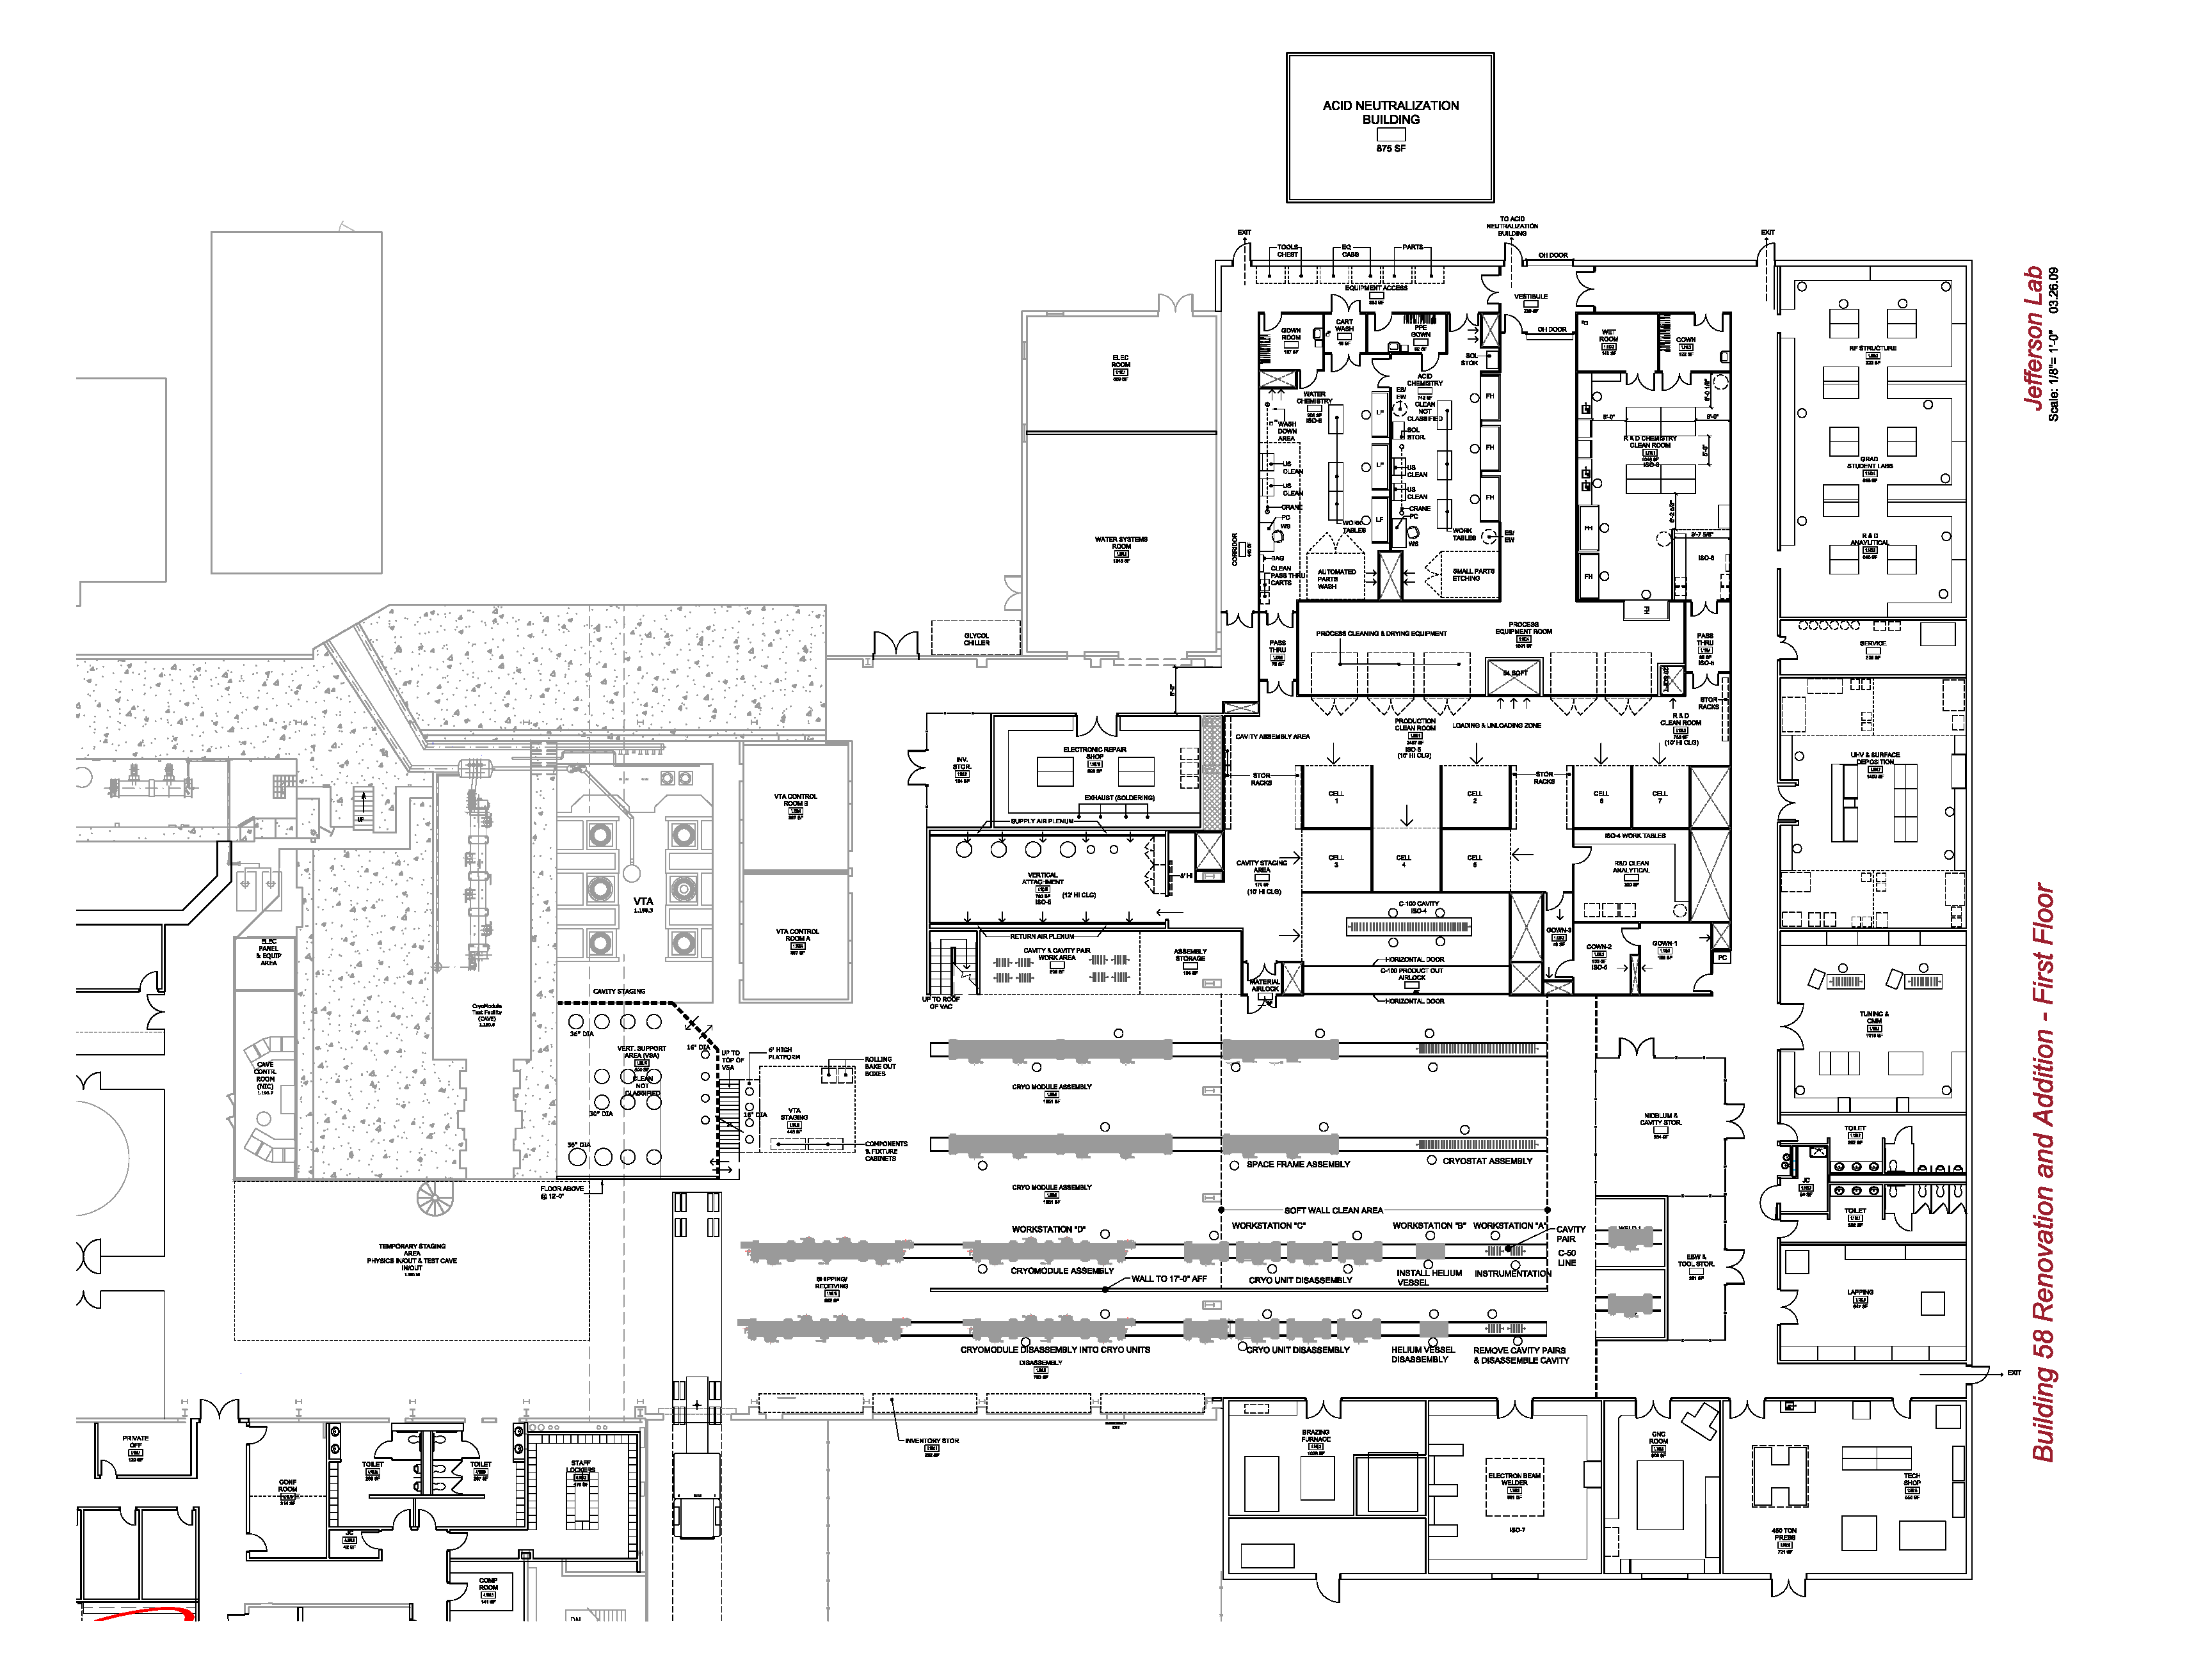
SRF Facilities in JLab TEDF
SRF Facilities
Chemistry, cavity treatments, and support areas
R&D
Cavity and cryomodule cryo/RF testing
Cleanroom
Cryomodule assembly
Fabrication
New

Slide 5
SRF Work Centers in New Test Lab
Inventory and R&D
Vertical Test Area & Electronics Shop
Parts Clean and Etch
R&D Chem Lab
Process Support Area
Physics
Cryomodule Test
R&D Labs
Clean Room
Vertical Attachment
QA/CMM & Tuning
R&D Clean Lab
1st and 2nd Floor Offices
Furnaces
Fabrication
Cryomodule Assembly
Machine Shop
Electron beam Welding

Slide 6
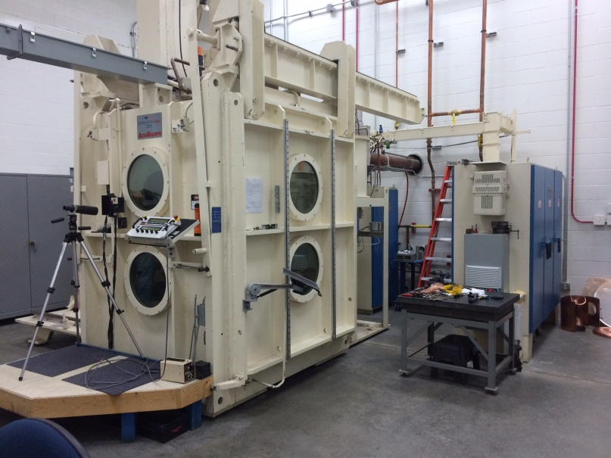
Fabrication
Equipment and Infrastructure
450 and 150 ton presses
Electron beam welder
Brazing vacuum furnaces
Machine shop (CNC, Milling, ect.)
Conventional power tools
(saws, lathes, drill presses, shears, ect.)
People
2 FTEs (1 for EBW, 1 Brazing & Sputtering)
Others as needed (machinist as Prod Technicians)

Slide 7
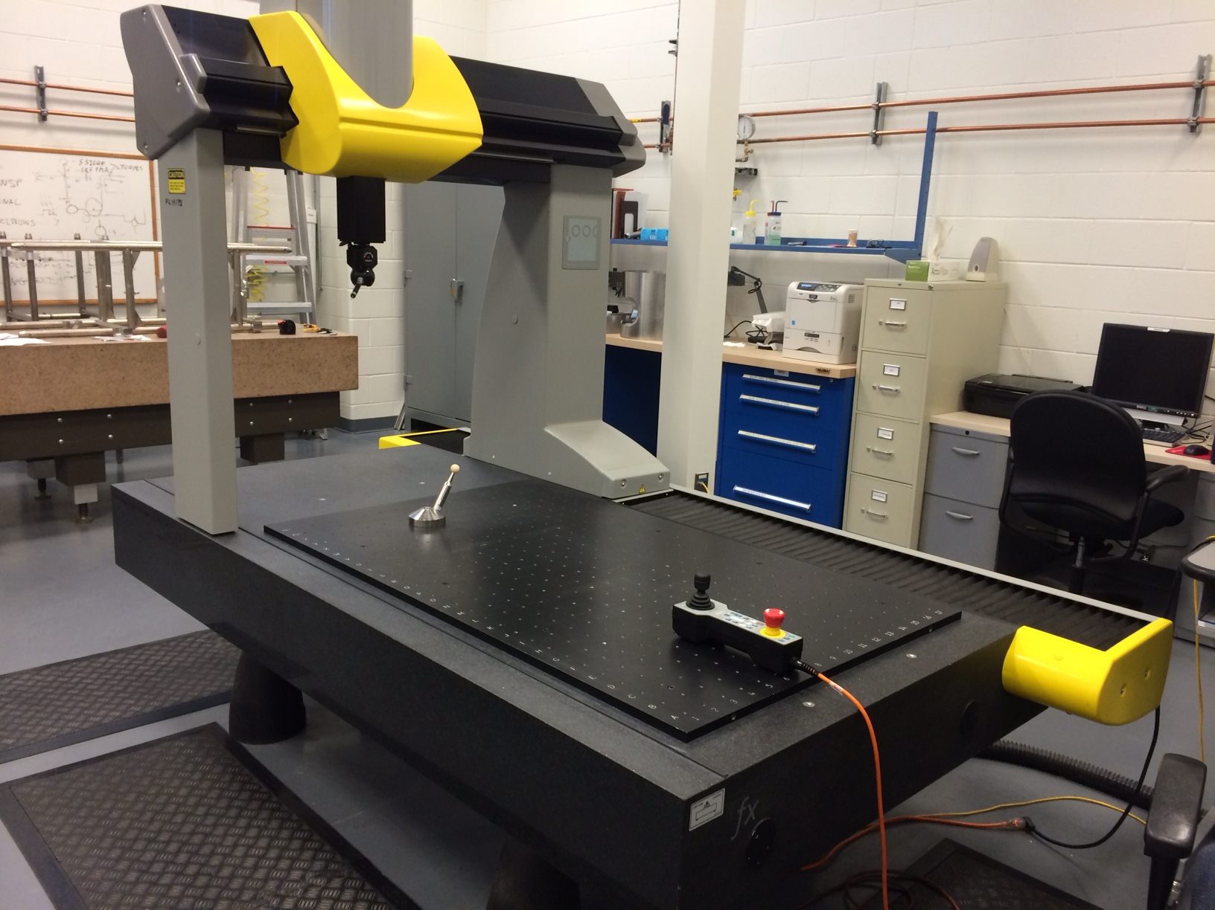
CMM/Inspection
Equipment and Infrastructure
Brown and Sharp Coordinate Measurement Machine
Kyoto Camera internal Inspection system
Cyclops Internal inspection system
  First of a kind, development
Assortment of other hand held, desk top QA tools (e.g. profilometers)
People
2 FTEs
Other QA inspections completed by Prod. Staff as prescribed

Slide 8
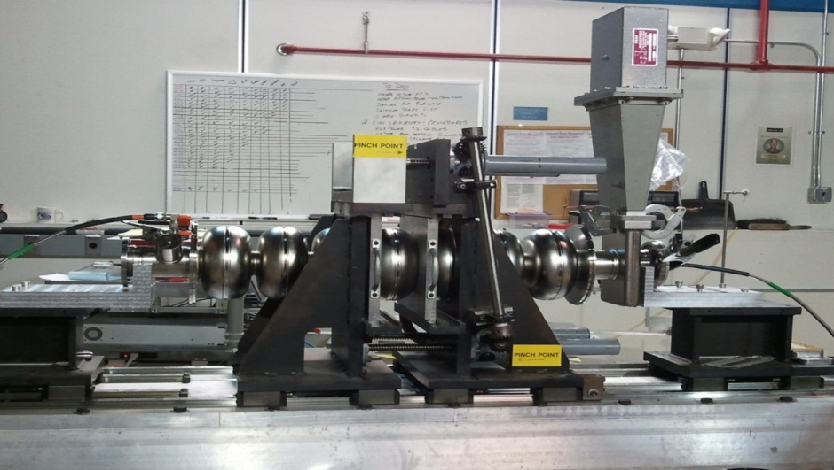
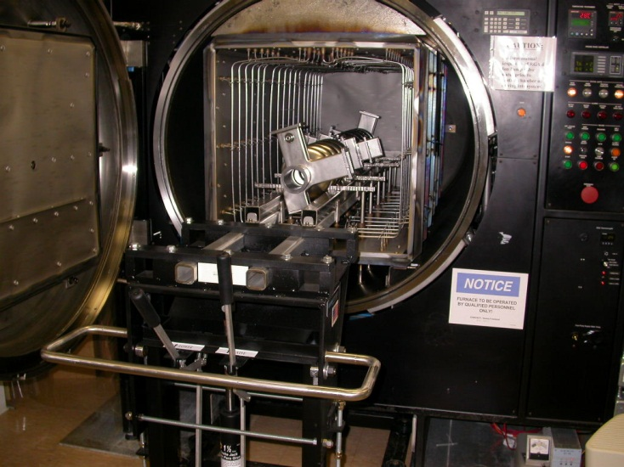
Tuning, Cavity Prep and Heat Treatment
Equipment and Infrastructure
Tuning and Cavity Prep
  Tuning benches (5, 7, and 9-cell)
  Bead pull system
  Variety of network analyzers
  Laminar flow hood
Heat Treatment
  Elnik Vacuum Furnace
    Recently modified for N2 Doping
People
1.5 FTEs
Shared resources with clean assembly

Slide 9
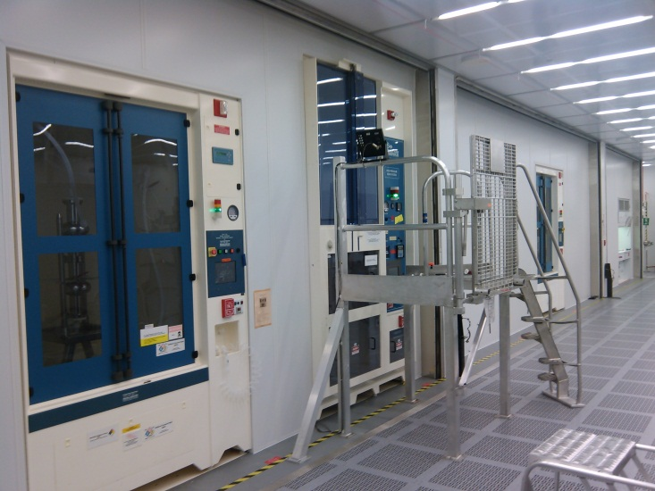
Chemistry and UHV Cleaning
Equipment and Infrastructure
Buffered Chemical Polish (BCP) Tool
Horizontal Electropolish (HEP) Tool
Vertical Electropolish (VEP) Tool (development)
High Pressure Rinse (HPR) Tool
(2) Acid Wet Stations (small parts etch)
(2) UHV Cleaning Stations
(3) Large capacity Ultrasonic Systems
Large Parts Cleaning Station
People
4 FTEs (1 working lead, 3 technicians)

Slide 10
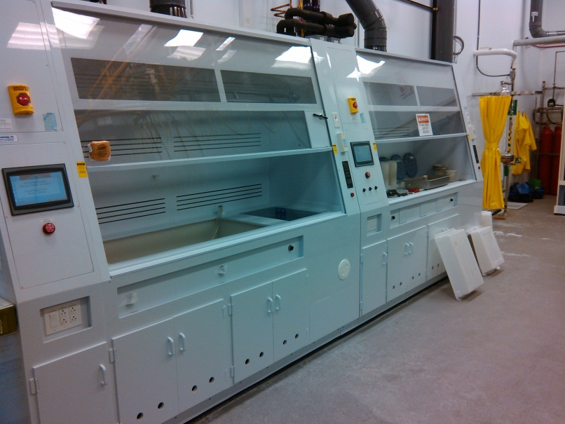
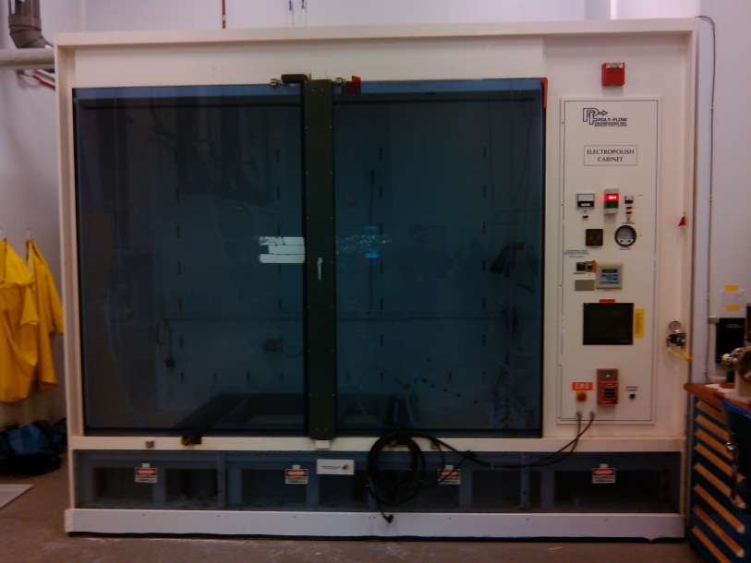
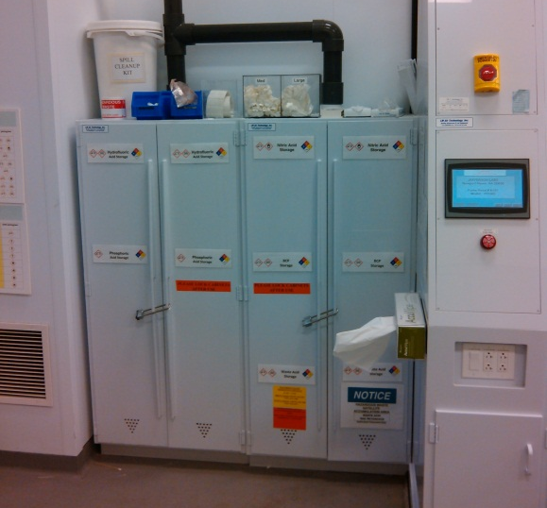
Production Chemistry
Acid Tools – 2 Fume Hoods, Horizontal Electro Polish, Acid Storage
  Small scale wet-bench acid work < 2 gal containers
  Fume hood acid sumps (future)
  Horizontal EP: 60 gal (10% HF, 90% sulfuric acid)
New

Slide 11
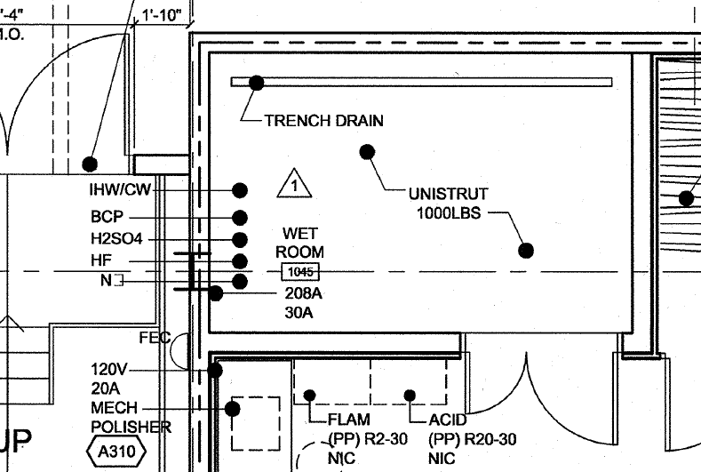
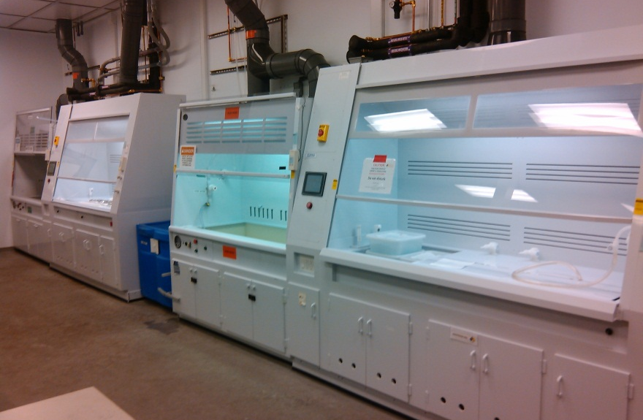
R&D Chemistry
Acid Tools – 4 Fume Hoods + Walk-in Fume Hood Room
  Small scale wet-bench acid work < 2 gal containers
  Max. inventory ~30 gallons
  Walk-in fume hood room is for larger development projects and has piped acid delivery from PSB
  Fume hood acid sumps (in progress)
New

Slide 12
Clean Room Assembly And Vertical Attach
From Air Handlers
Equipment and Infrastructure
Main Clean Room
  2500 sq.ft., Class ISO-4, 100% HEPA
  Primary Process tools (BCP, HPR, VEP bulk headed)
  5 multi-cell assembly chambers
  3 single-cell assembly chambers
  String assembly chamber, with air lock
Vertical Attachment Clean Room
  900 sq.ft, Class ISO-5, horizontal flow
  (6) Insert Stations
People
1.5 FTEs
Shares with Tuning and Heat Treatment, total of 3
HEPA Filters
Clean Room
Perforated Raised Floor
Process Support Area “dirty”
Clean Room
Process Tool

Slide 13
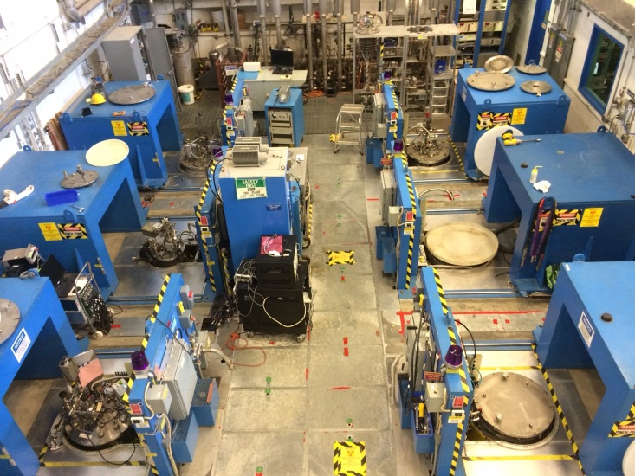
Cavity Vertical Test (a.k.a VTA)
Equipment and Infrastructure
Test Dewars, shielded, below grade
  (2) 16” wide, 72” deep, 136 liter (w.v.)
  (2) 28” wide, 108” deep, 648 liter w.v.
  (1) 34” wide, 132” deep, 1197 liter w.v.
  (1) 16” wide, 108” deep, 212 liter w.v.
  (2) 28” wide, 132” deep, 812 liter w.v.
RF Amplifier Capabilities
  "805 System" 500MHz - 1000MHz, 500 Watts (hard routed to dewars 7 & 8)
  "1497 System" 1425MHz - 1510MHz, up to 500 Watts (dewars 3 - 8)
  Portable 1.3GHz amplifiers, 250 Watt and 500 Watts
  Portable 1.5GHz amplifiers, up to 200 Watts
  Portable 2 - 4 GHz amplifier, 200 Watts
People
1 FTE (cryo operator)
Assortment of cavity testers, none dedicated
Over 4000 test completed since 1991

Slide 14
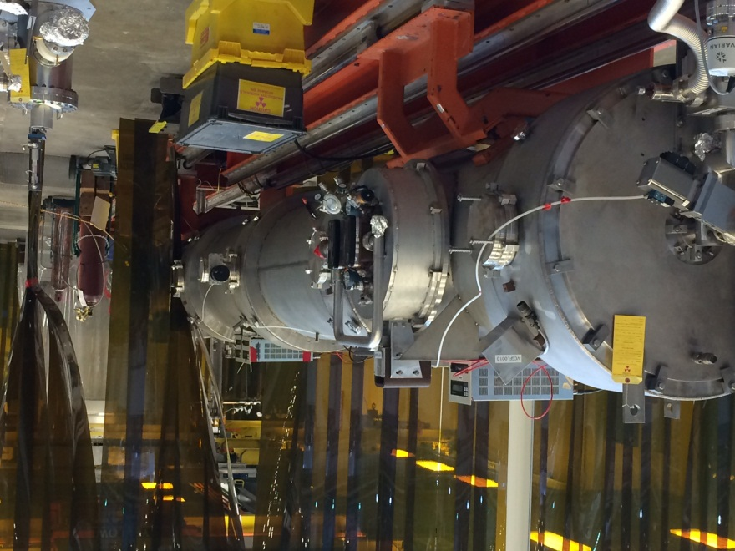
Cryomodule Assembly
Equipment and Infrastructure
(3) Assembly Bays
  Canopied and curtained (clean area)
  (2) Assembly rail systems installed
  Space for one more assembly rail systems
(1) Disassembly Bay
People
10 FTEs (1 Lead, 9 technicians)

Slide 15
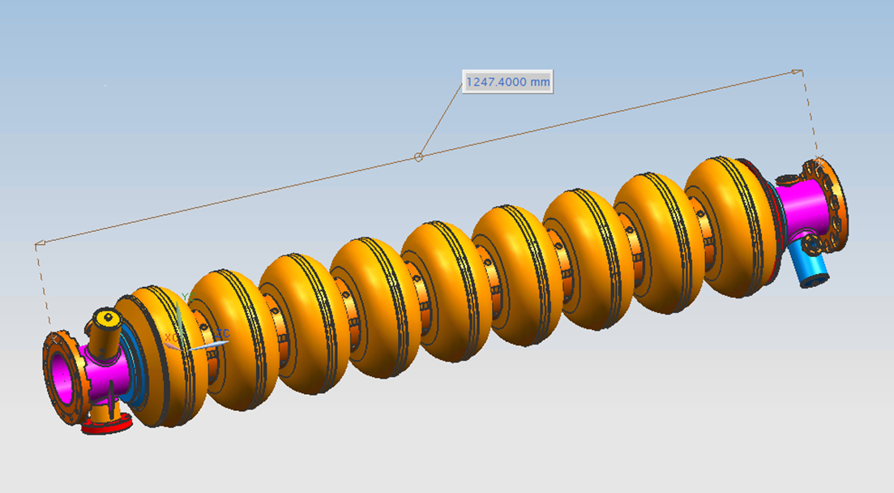
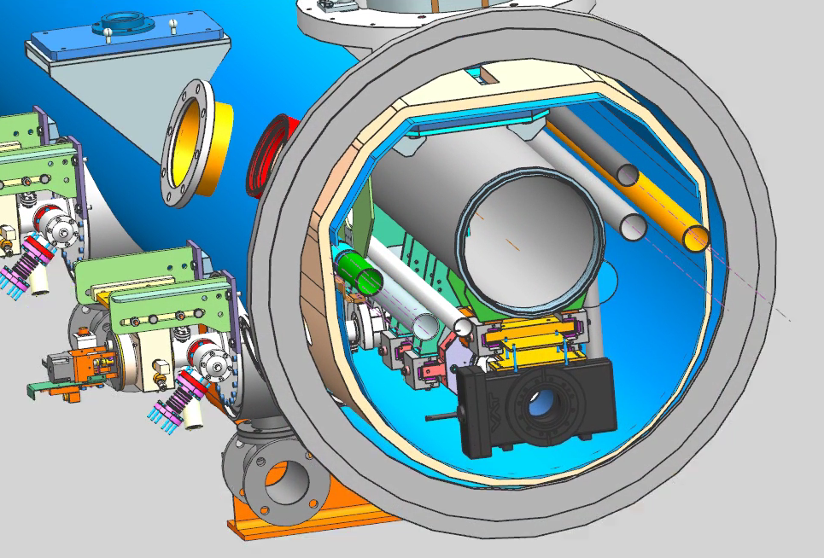
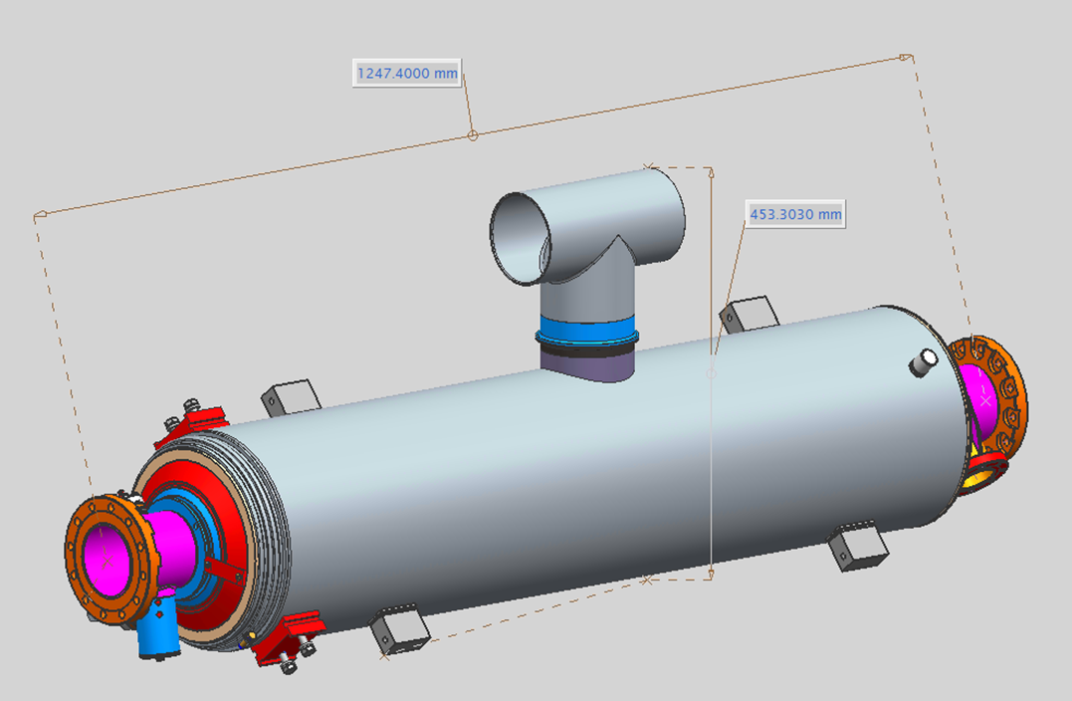
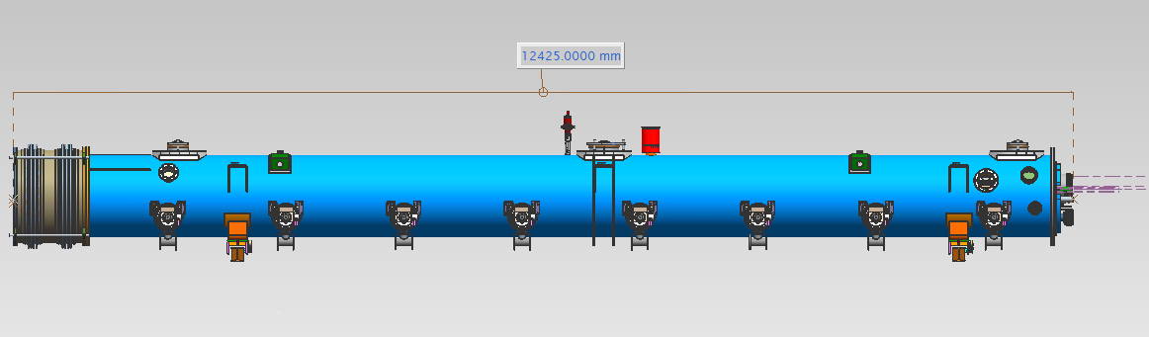
SLAC LCLS-II Cryomodule Assembly
Cryomodule Scope
9-cell cavity and cryomodule design is similar to XFEL
(1) Prototype units
(17) Production units
  April 2017 through Sept 2018

Slide 16
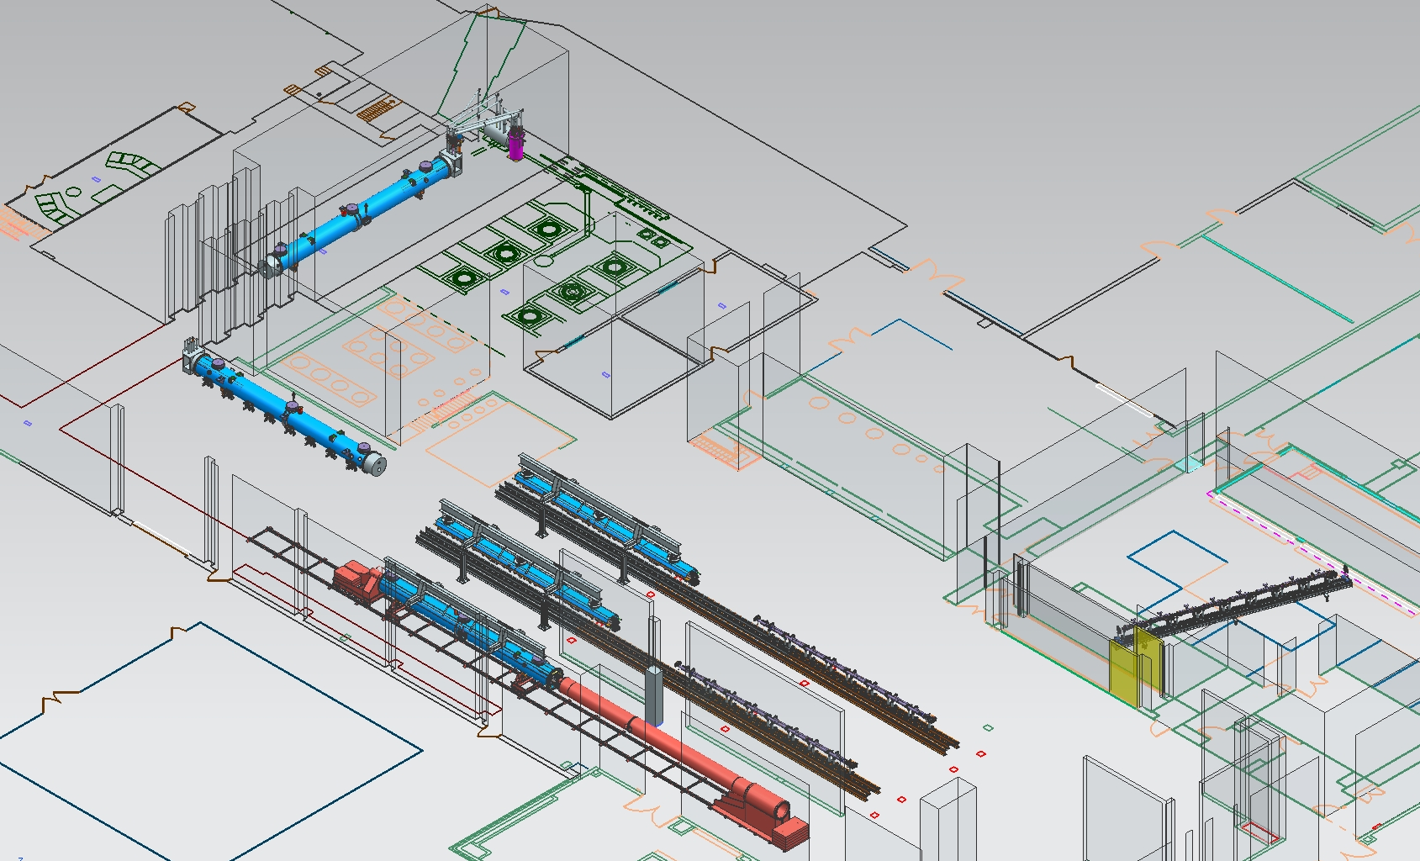
Cryomodule Assembly for LCLS II

Slide 17
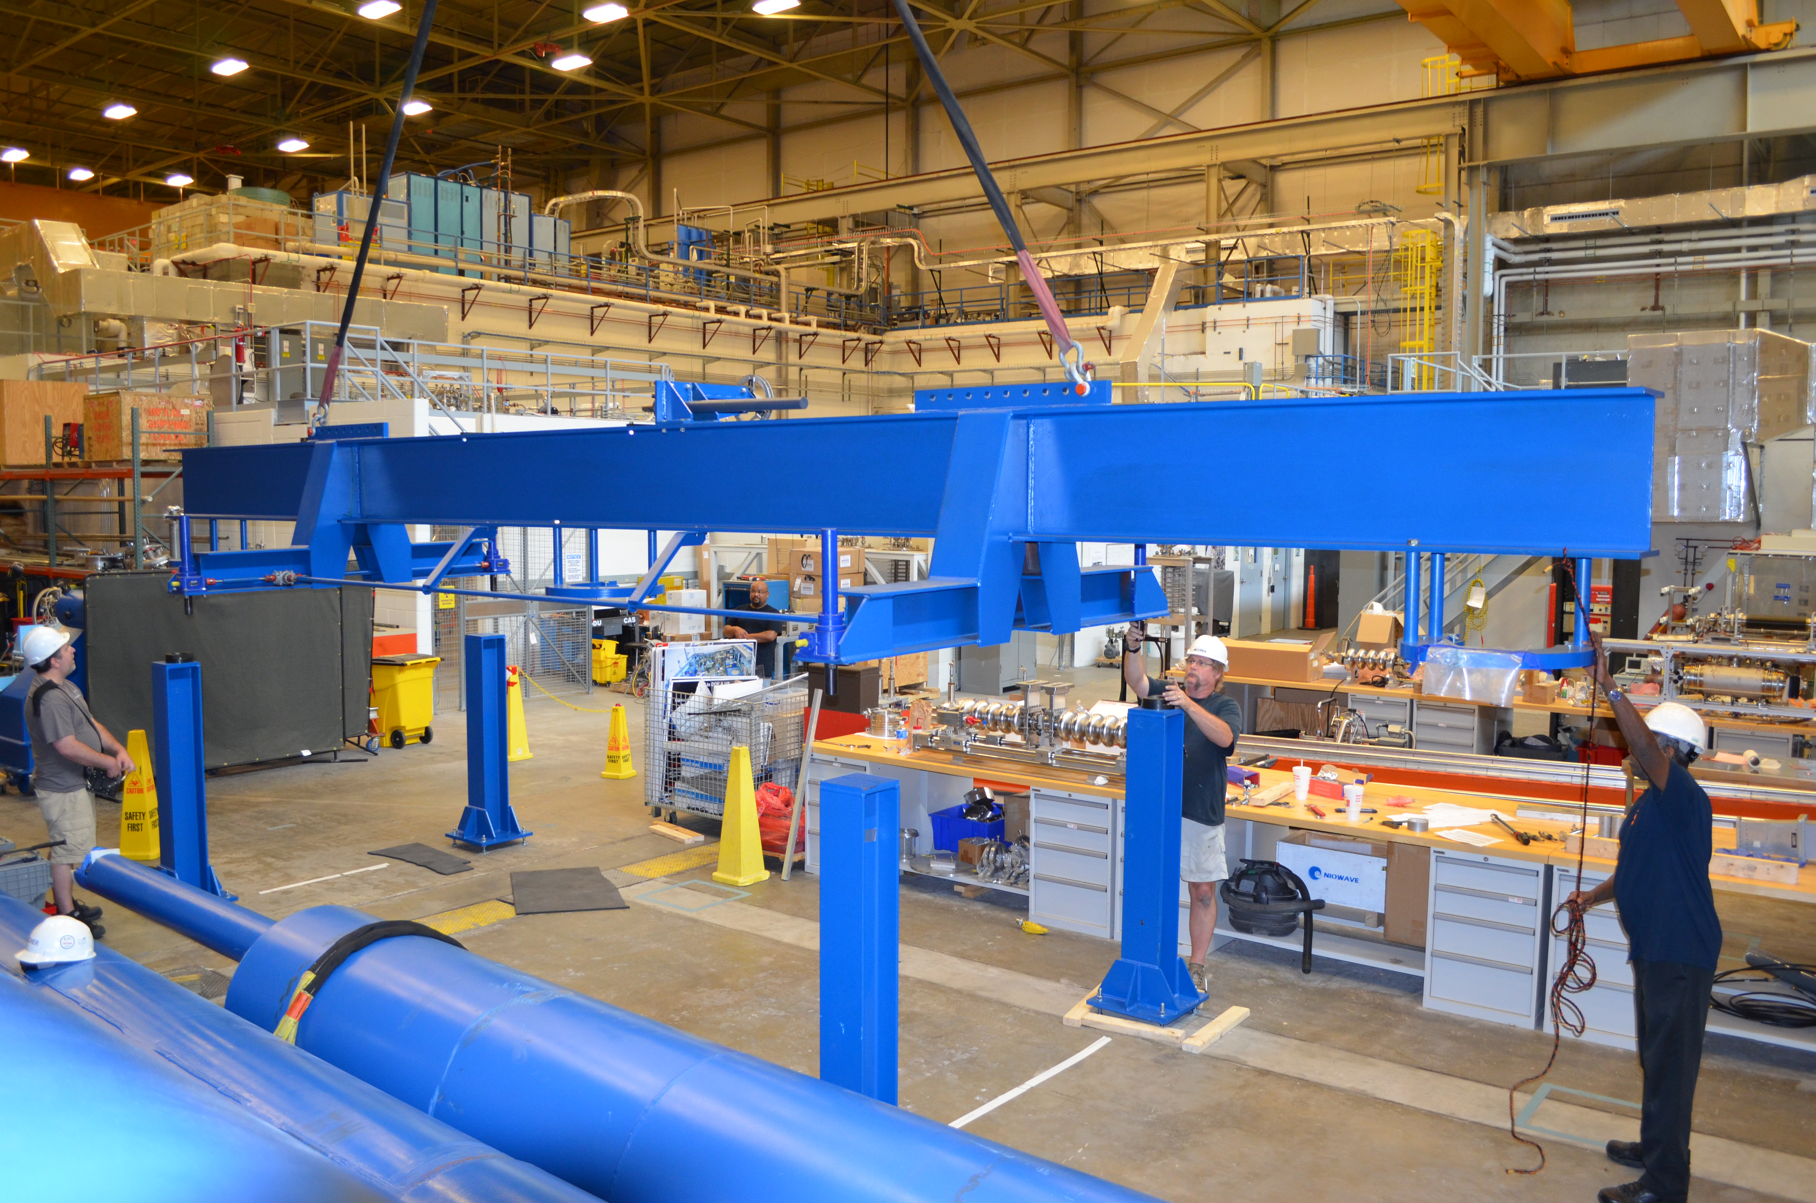
JLab LCLS-II Cold Mass Spreader Bar

Slide 18
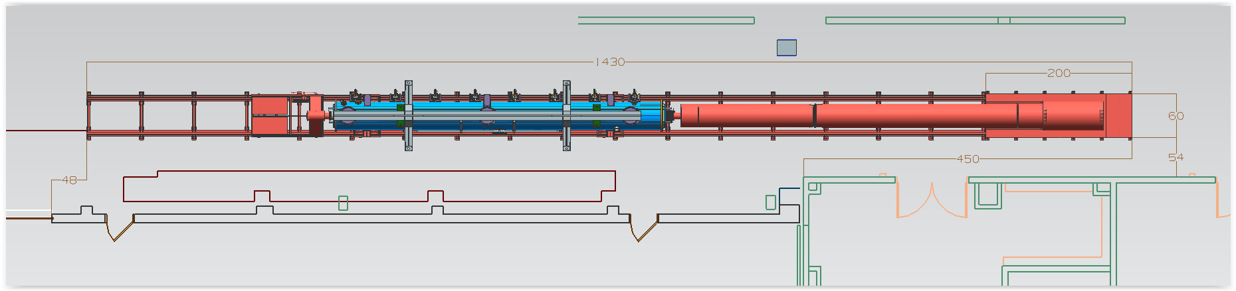
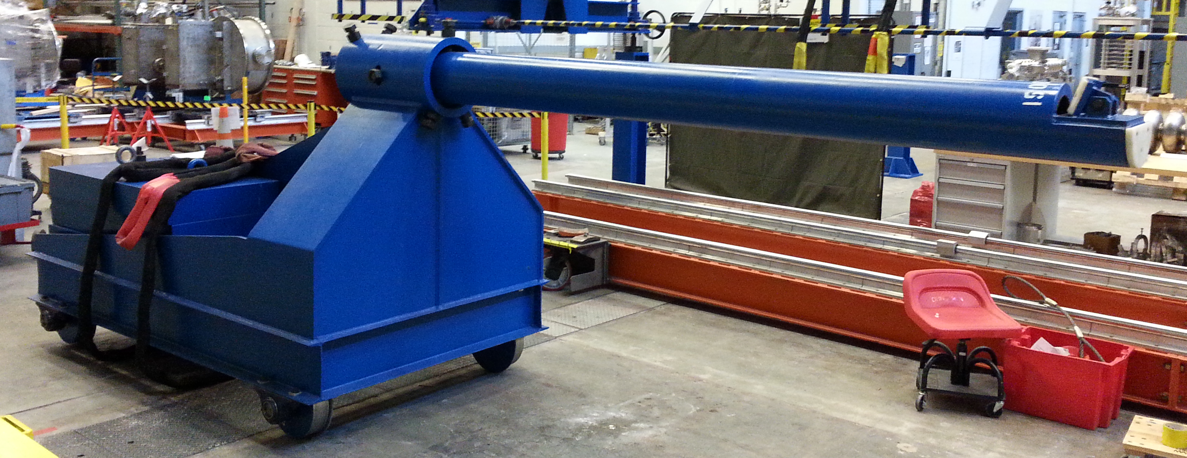
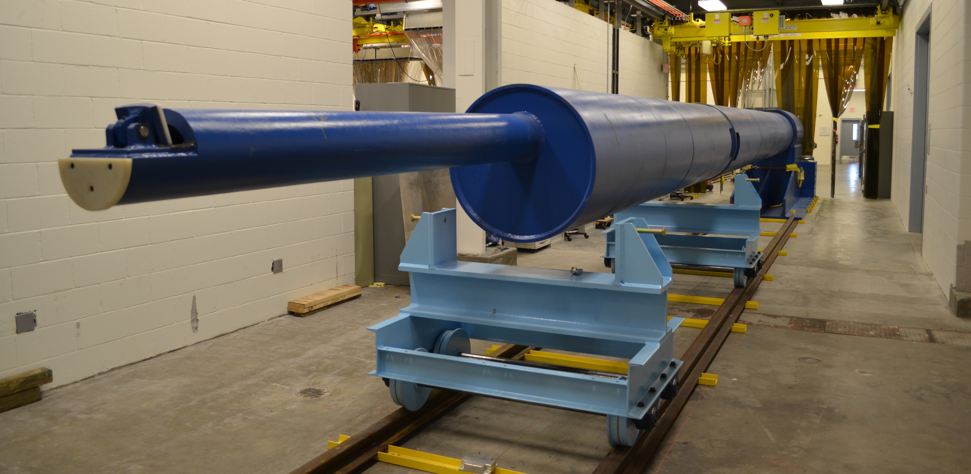
JLab LCLS II Cantilever Fixture

Slide 19
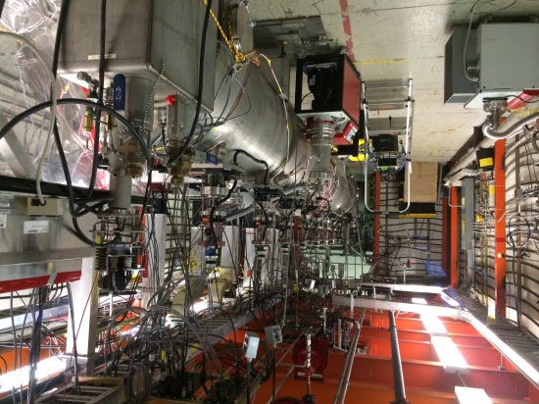
Cryomodule Test Facility
Dedicated Cryomodule Test Facility
Personnel Safety System (PSS)
Close loop 2K helium refrigerator shared with the VTA
  Primary circuit supply up to 7-8 g/s, 2.8 Bar 4K supply for cooldown, steady state ~2-3 g/s
  50 K shield circuit, several g/s (not a limit to operations)
Cooling water (was used for SNS Power Couplers)
Cryomodule housed in a Magnetic Shielding Box
  Measured field of 30 milligauss when empty
High Power RF
  Four 8 kW klystrons operating in pairs-each pair delivers up to 12 kW
LLRF
  VXI based- homegrown 1497 MHz / 805 MHz VCO.
  Migrating to C100 style digital system later this year

Slide 20
  Technical Facilities
  Equipment and Infrastructure
  Ultrapure Water Systems
    60 gpm ambient UPW system
    20 gpm centralized hot UPW system
  Process Support Building
    Bulk Chemical Management
  Process Support Area (a.k.a. T-trench)
    Utility side of clean room process equipment
  Acid Waste Treatment
    60 gpm automated neutralization system
People
    4 FTEs (1 Engineer (Supervisor), 2 Technicians, 1 Bldg Mgr)

Slide 21
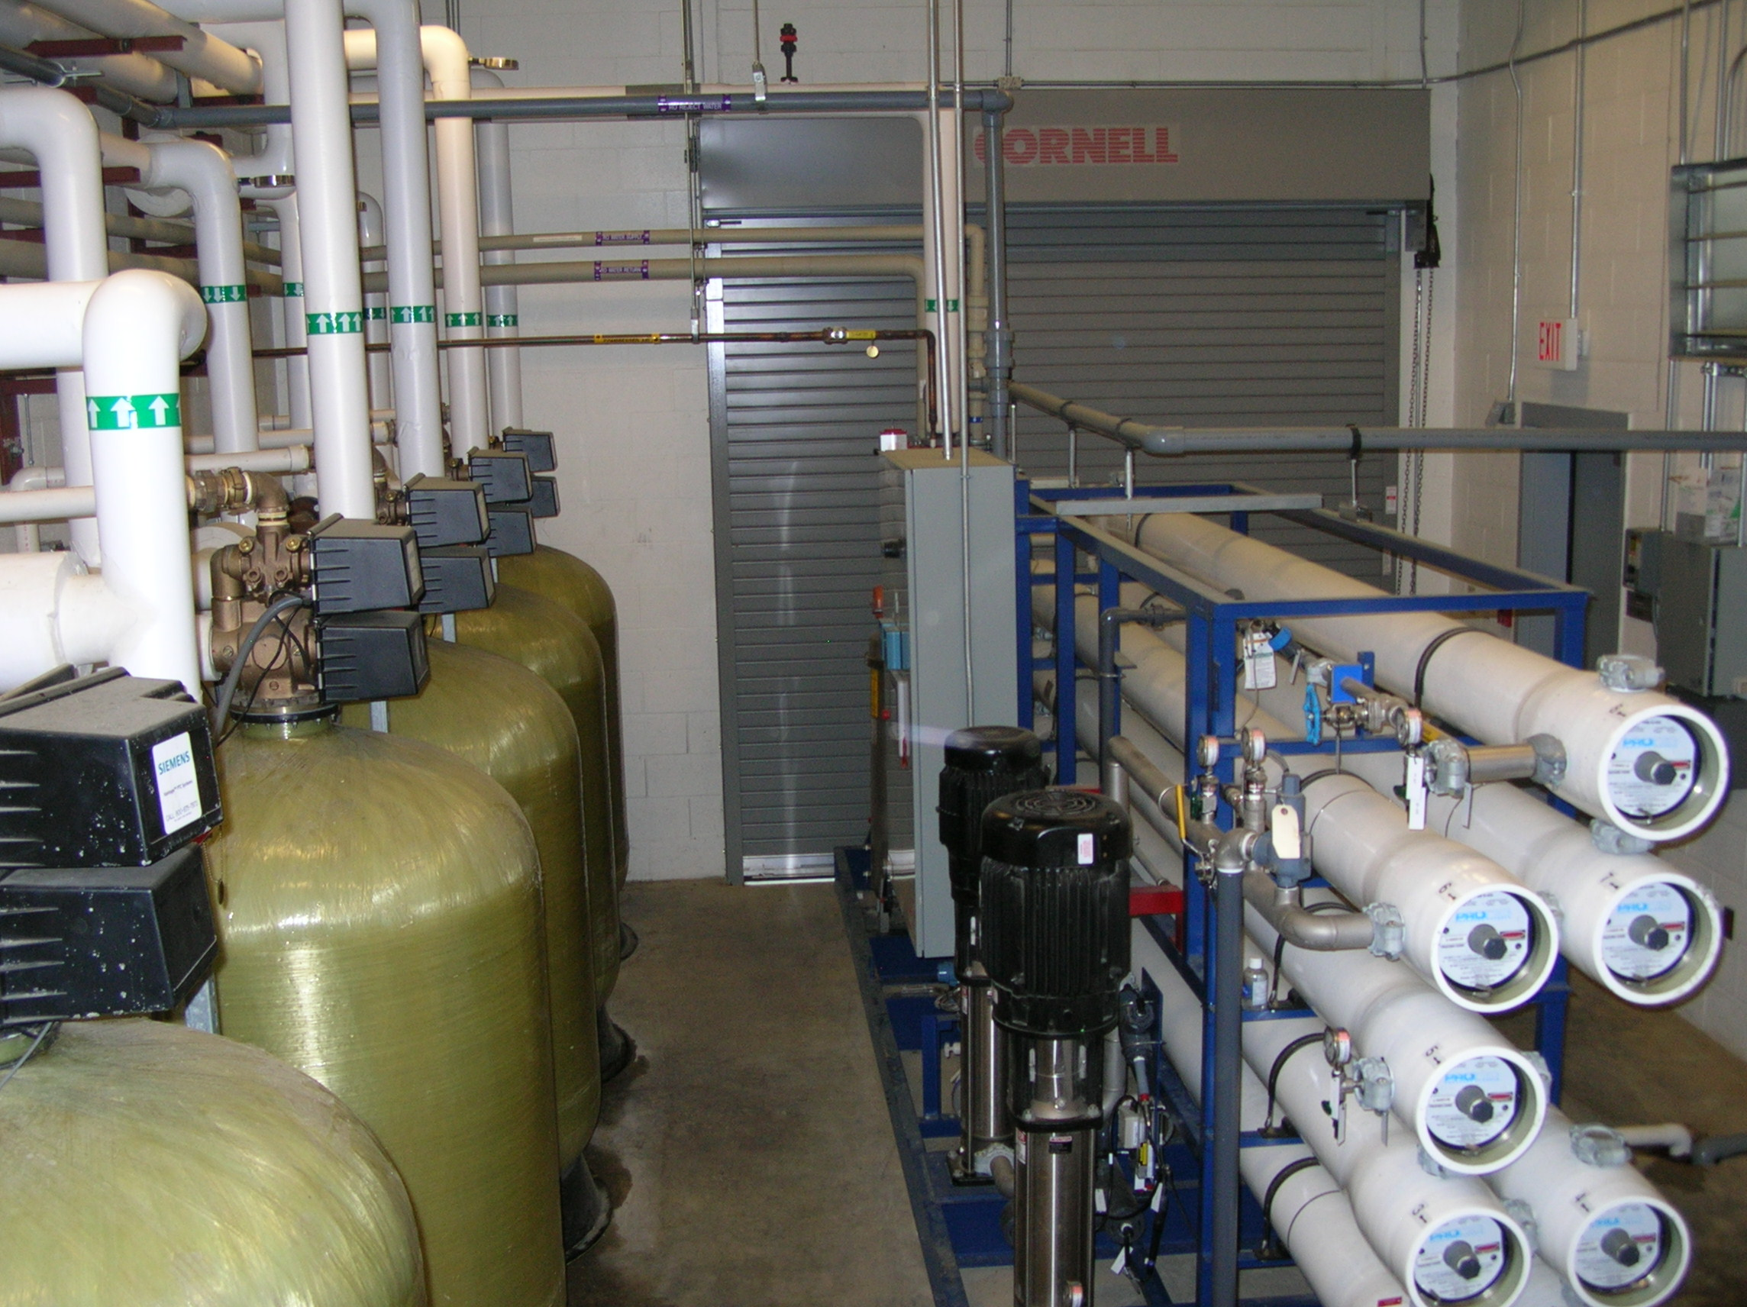
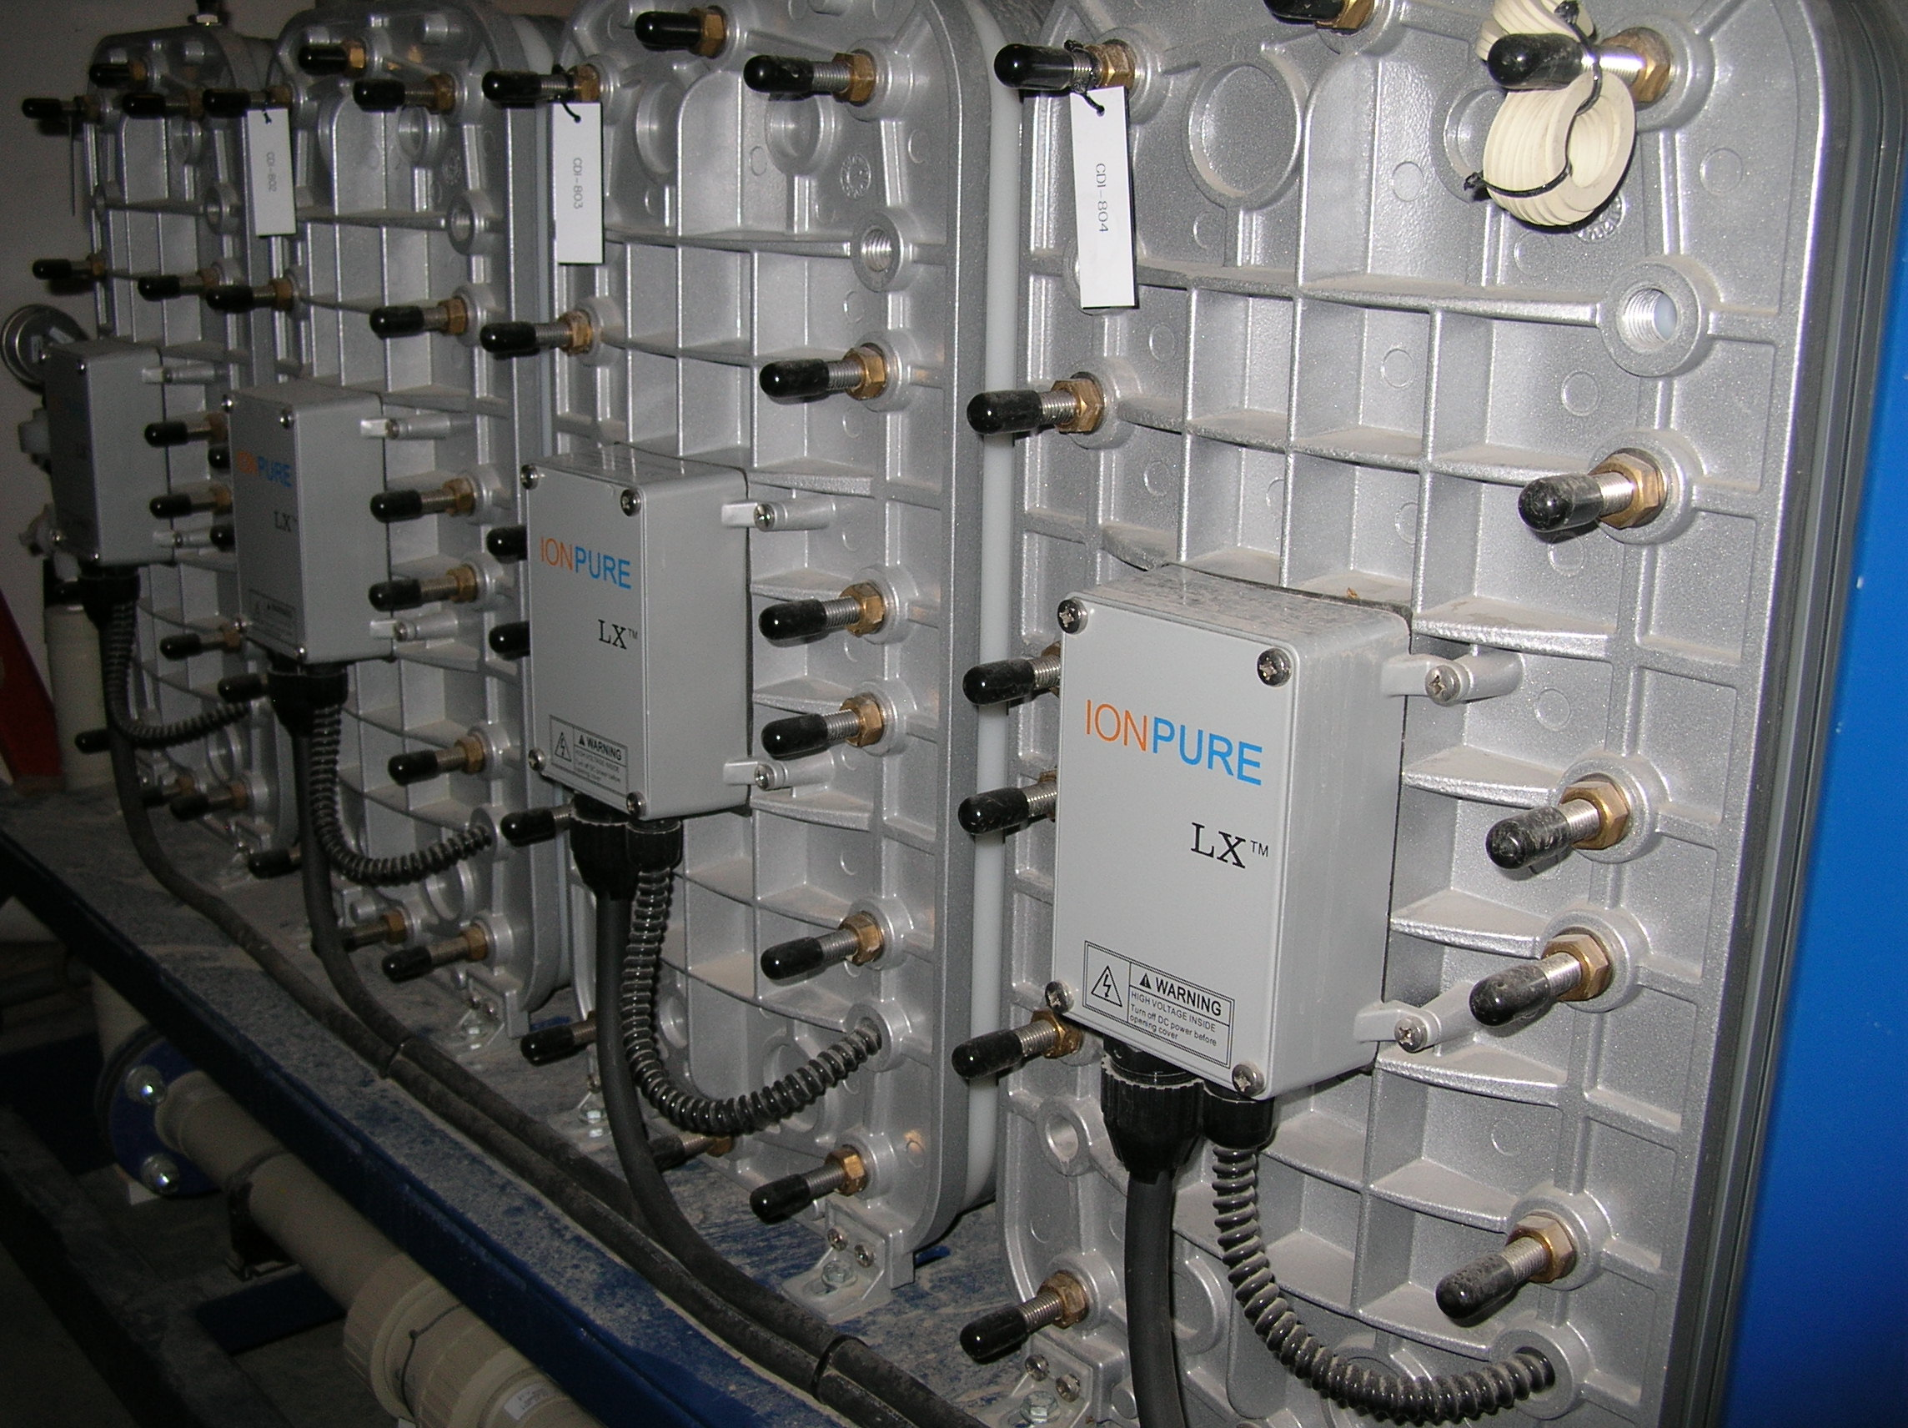
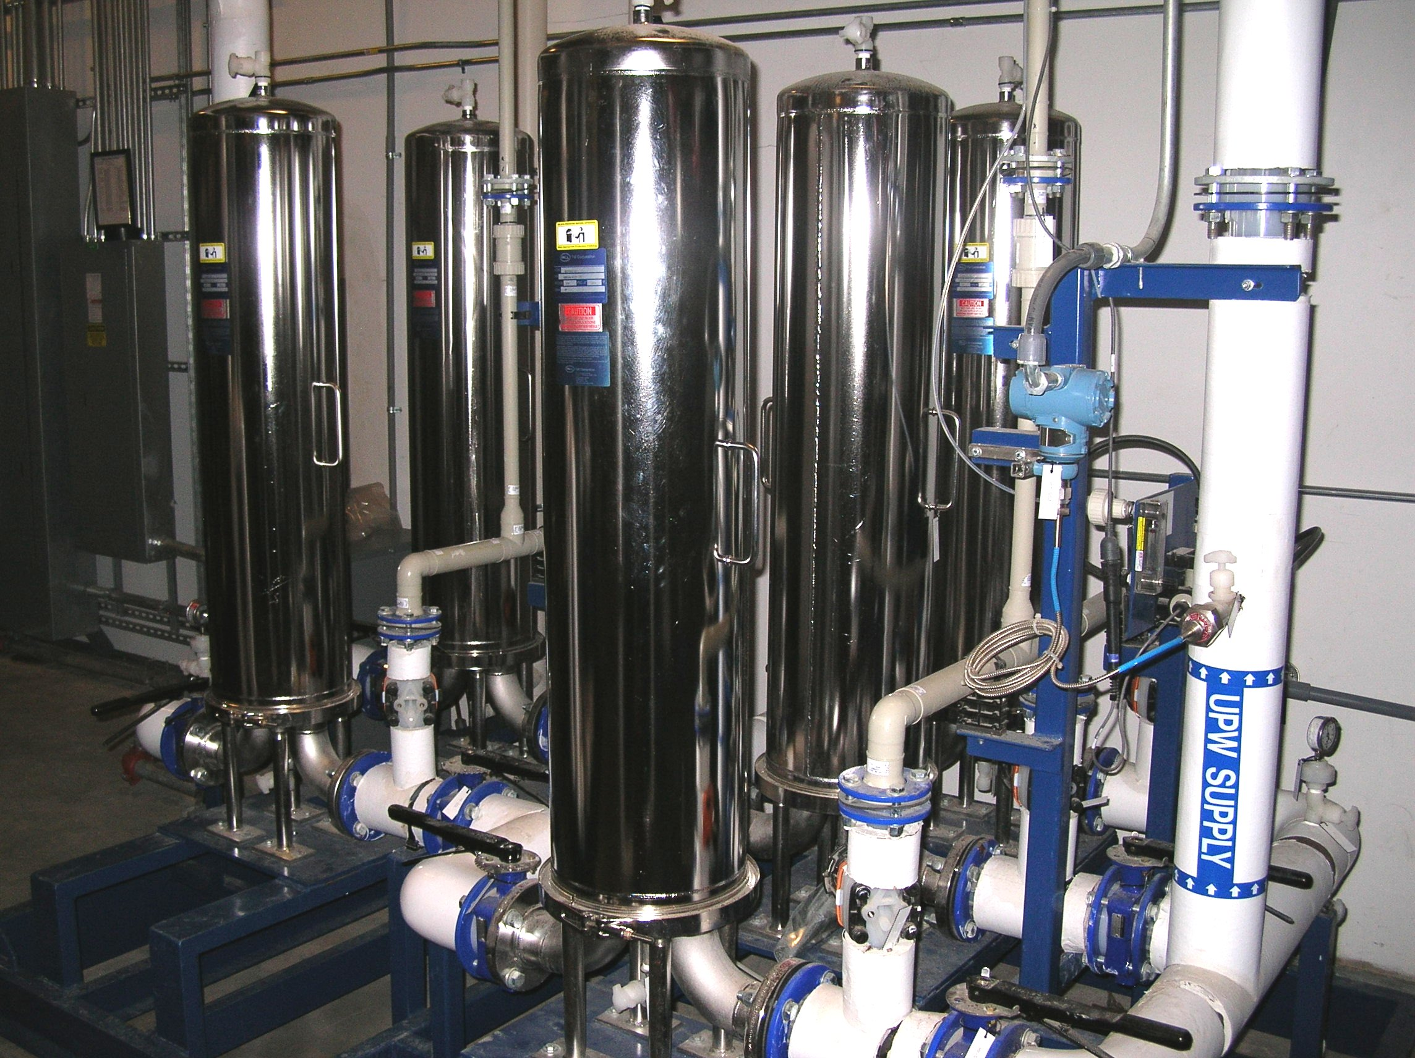
Ultrapure Water Systems
State of the Art
Main UPW System
Microelectronic Type E-1.1
  > 18.2 Mohm/cm², < 2 ppb TOC, < 2 ppb silica, < 1ppb all other ions
60 gpm make-up capacity to loop (shared with HUPW)
90 gpm polish loop
Provides water to the HPR, BCP, HEP, VEP tools
Provides water to all chemistry rooms
~ 50 psig Nominal (55 psig measured)
Centralized Hot UPW System
20 gpm make-up capacity to loop
30 gpm polish loop
~ 50 psig Nominal
80 C (176 F)
Primary RO Storage: 3000 gal.
UPW Storage: 2500 gal.

Slide 22
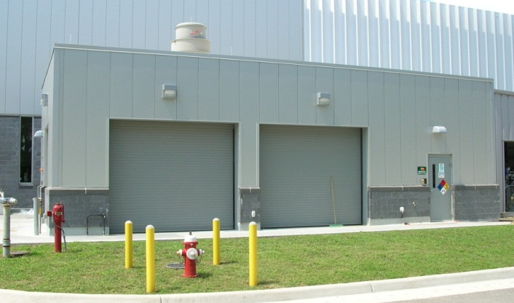
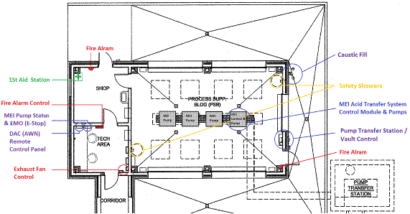
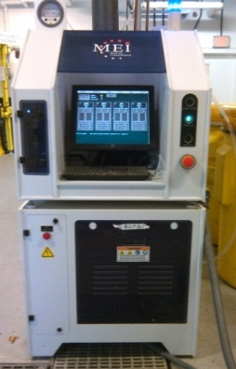
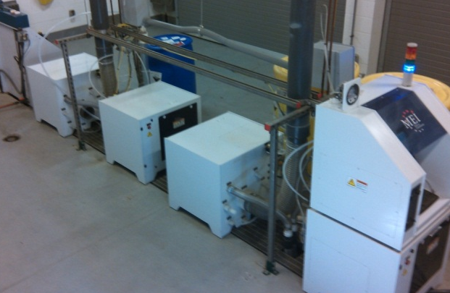
Process Support Building
PSB purpose is to store and supply bulk acid to the test lab chemistry’s major tools.
  PSB contain 4 pumping stations, of which 2 are used for periodic acid transfers. (~1/month at current production rates)
  Bulk 55 gallon drums of BCP & Sulfuric.
  PSB is stationed and monitored by chemistry/equipment technician

Slide 23
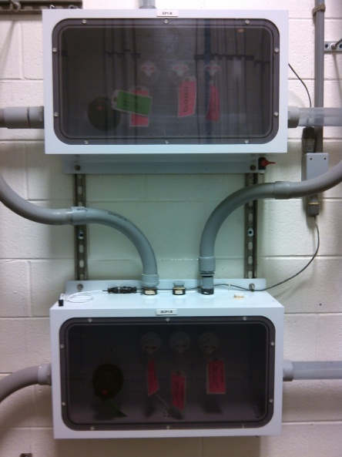
Bulk Acid Delivery Systems
Dedicated acid delivery systems for H2SO4 and BCP
PFA tubing is used from point of supply to point of connection at tool
All tubing, supply and discharge, is double contained in clear PVC (some non-clear at bends)
All valves are contained in valve manifold boxes
System is equipped with low-point leak detection interlocked to pumping modules
Connected to process tools for bulk delivery and acid hoods in labs to minimize handling
SAFETY 1st

Slide 24
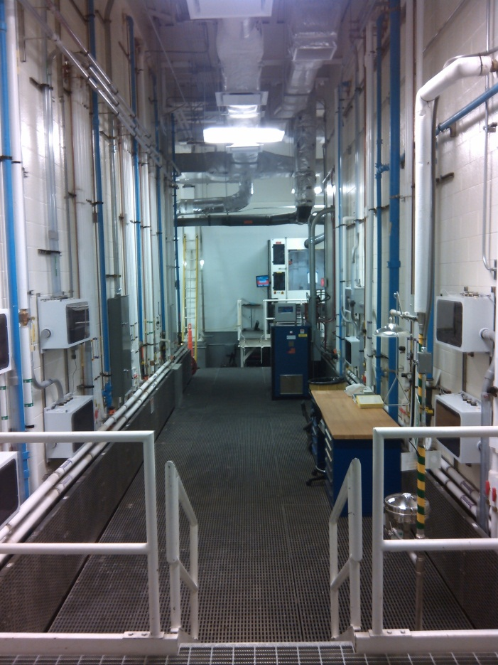
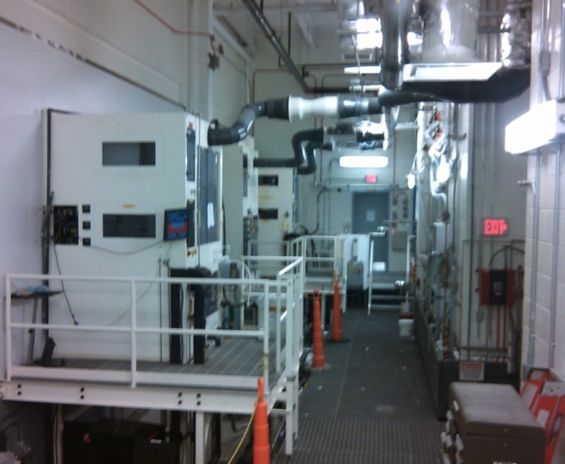
Process Support Area (a.k.a the T-Trench)
PSA purpose is to house the large tools and serves as a utility space for adjacent chemistry areas.
  Tools located in the PSA:
    Buffered Chemical Polish “BCP Tool”
    High Pressure Rinse “HPR”
    Vertical Electro Polish VEP
    Laminar flow wet bench & power supplies.
Designed for future tool move-in
Bays for future tools
New HPR in Q2 FY2015!
Process tools bulk headed into Clean Room

Slide 25
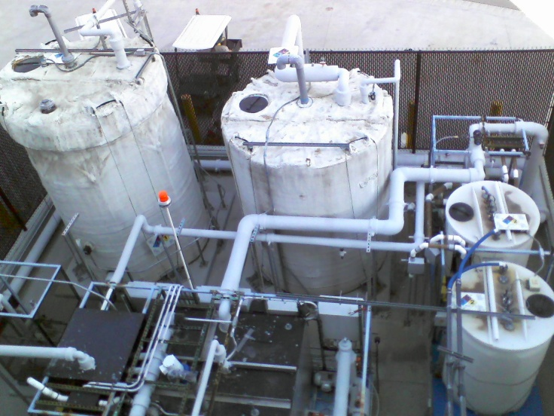
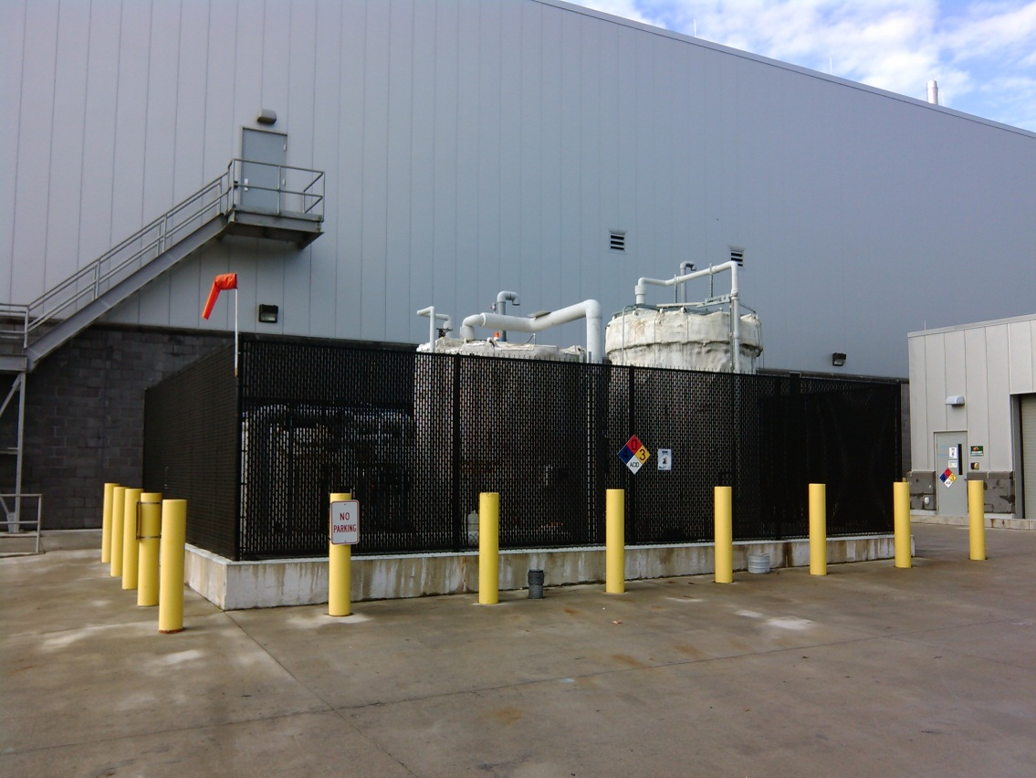
Acid Waste Neutralization (DAC)
  Dilute acidic waste water and concentrated acids are blended and neutralized using 25% NaOH in a semi-automated batch process
Minimizes Hazardous Waste
Tank name | Chemical stored | Tank capacity | Typical inventory | Material construction
Caustic Day Tank | 25% sodium hydroxide | 110 gallons | 110 gallons | Foam encapsulated Polyethylene (PE)
EP Spent Acid | EP Acid | 500 gallons | 60 gallons | Double wall PE
BCP Spent Acid | BCP acid | 500 gallons | 90 gallons | Double wall PE
Treatment Tank | Industrial wastewater/caustic/acid wastewater mixture | 1000 gallons | 1000 gallons | Foam encapsulated Polypropylene (PP)
Caustic storage tank | 25% sodium hydroxide | 3500 gallons | 3500 gallons | Double wall HDPE
Equalization tank | Acidic wastewater (pH varies) | 4100 gallons | 4100 gallons | HDPE
Notes:
pH adjust industrial wastewater for release to sanitary sewer (HRSD)

Slide 26
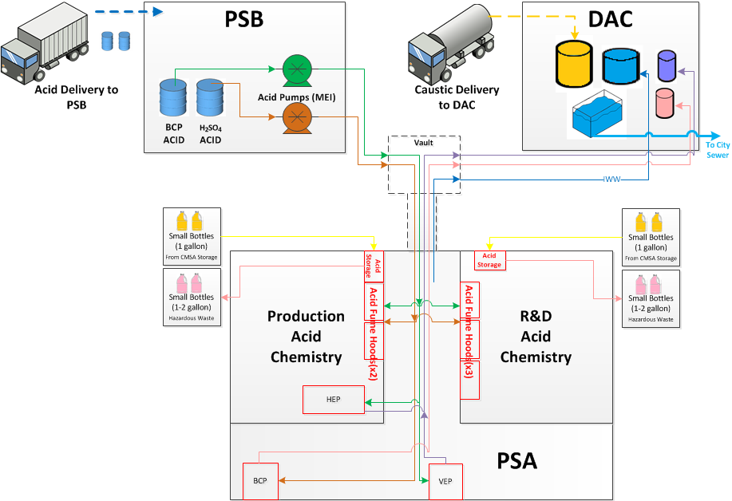
SRF Acid Life Cycle

Slide 27
Production Throughput
Area | Installed Capability per Month Current Staff Current Tool set 40 hr work week | Constraints | Full Build Out Capability per Month | FBO Comments
Cavity Processing | 10.5 cycles per month | Bottle Neck - HEP tool @ 2.5 cycles per week Staff | 25 cycles per month | Space for (1) add’l HEP tool Does not account for Vertical EP
VTA | (20) Multi-cell Test (20) Single-cell Test (D6 only) (20) Inst./Mat’ls Test | Staff Time Cryogens | (72) Multi-cell Test (20) Single-cell Test (D6 only) (32) Inst./Mat’ls Test | No additional VTA Dewars Limited by Time
CM Assembly | 0.3 per month 3.5 annually | Staff | 1.8 per month 22 annually | Assumes C100 style 3 rails installed
CMTF | 0.83 per month 10 per year | Staff Bottle Neck - Single Test Cave Cryogens | 1 per month 12 per year | Limited by single Test Cave

Slide 28
Typical Infrastructure Expenditures
Materials and Services
Consumables
  All chemicals
  All vacuum seal hardware (gaskets, nuts, bolts, etc..)
  Work Center supplies (garments, wipes,
  Welding supplies
Materials
  Tools
  Vacuum pumps and vacuum hardware
  Cavity process and test hardware
Maintenance
  Service contracts (e.g. UPW)
  Software licenses
  Repair and replacement of equipment, process tools and components
Infrastructure Improvements (recent)
  VTA cryo controls PLCs
  Elnik vacuum furnace upgrade (N2 doping)
  Network analyzers
  Vacuum pump carts
Labor
All labor associated with the maintenance and improvement of infrastructure
Maintenance and improvement of Pansophy and Pansophy based systems such as SRF Project inventory system

Slide 29
SRF Operations Staff
Consist of a mix of Engineers, Computer Scientist, Associate Coordinators and Technicians
Technical disciplines include mechanical, electrical and chemical
Years of experience, both in total and in SRF, range from 2 to more than 30 years

Slide 30
SRF Operations Core Competencies
Areas of Expertise Include
  Cryomodule Engineering and Design
  Cryomodule Operations
  RF Engineering
  Quality Systems and Engineering
  Ultra High Vacuum Systems
  Chemical Process Engineering
  Equipment Engineering
  Electron Beam Welding
  Brazing and Sputtering
  Chemical Wet Etching
  Clean Mechanical Assembly
  Welding and Welding Certification (SS, Al, Ti, CS)
Experience base includes
  SRF (JLab)
  Automotive Industry
  Semiconductor Industry
  Traditional Trades

Slide 31
SRF Operations Staff
Work Center | Engineers | Scientist (Computer) | Associate Coordinators | Technicians | Total
QA/CMM/ Pansophy | 1 matrixed | 1 | 1 | 1 | 4
Fabrication |  |  | 2 | 1 | 3
Tuning/Heat Treatment |  |  | 0.5 | 0.5 | 1
Chemistry |  |  | 1 | 3 | 4
Clean Room Assembly |  |  | 0.5 | 1.5 | 2
CM Assembly |  |  | 1 | 9 | 10
Test & Measurement | 3 | 1 | 3 | 1 | 8
Ops Support |  |  | 1 | 1 | 2
SRF Engineering | 1 |  | 1 |  | 2
Production Support |  |  | 1 |  | 1
Technical Support | 1 |  | 1 | 3 (1 term) | 5
Leadership | 5 |  |  |  | 5
 | 9 | 2 | 12 | 23
47 Total

Slide 32
SRF Structure

Slide 33
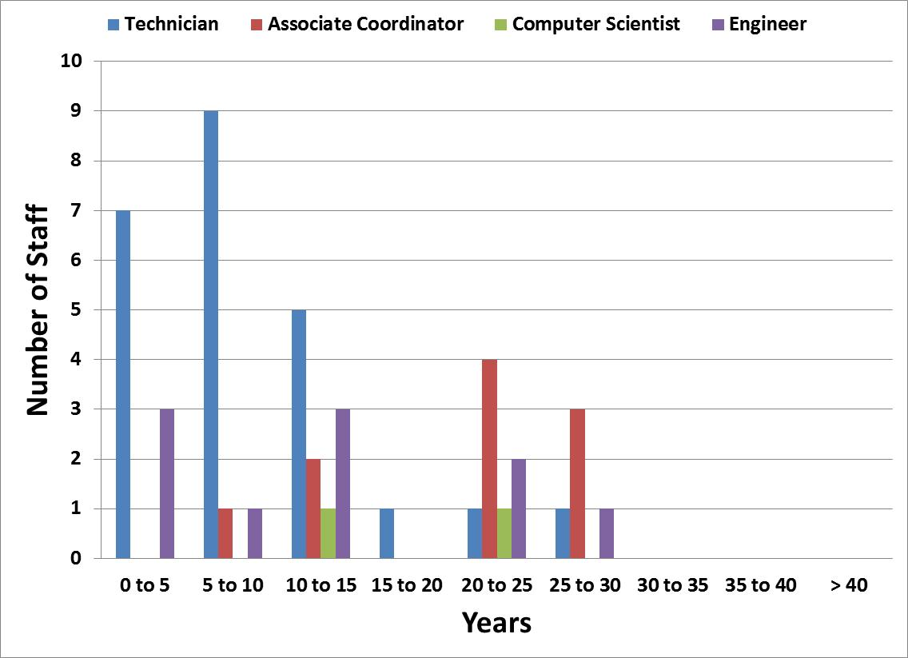
SRF Operations Staff Years of Experience at JLab

Slide 34
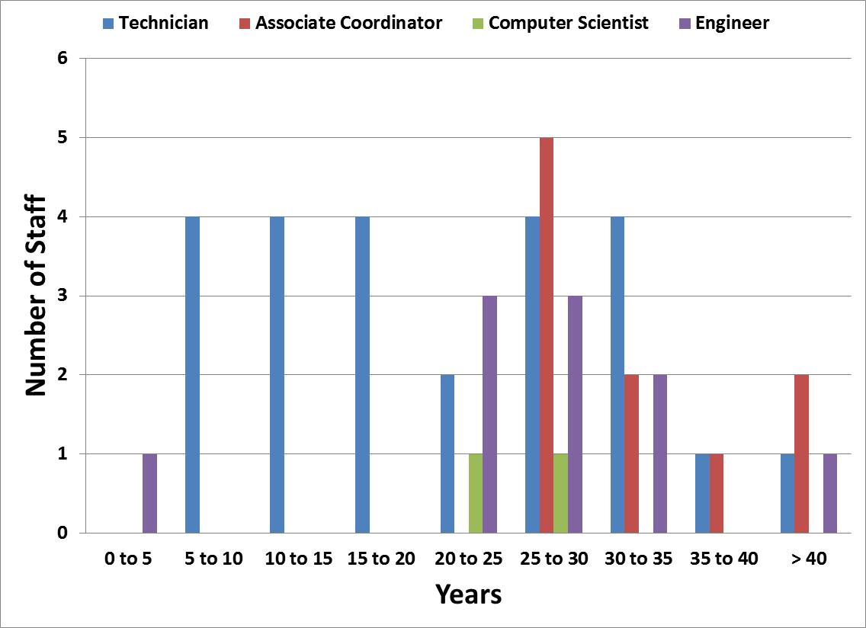
SRF Operations Staff Years of Experience in Total

Slide 35
SRF Ops Staff Comparison of Years at JLab to Total Years
SRF Operations Staff Years of Experience at JLab
SRF Operations Staff Years of Experience in Total

Slide 36
Resource Challenges
SRF Operations organization is lean
  Necessitates prudent forecasting, planning and prioritizing to ensure we are working on the right stuff
Operate and upgrade the JLab accelerator facilities
    Operations support, turn C20’s into C50’s, building cryostats for 12 GeV project, new injector ¼ CM, rework FEL CM
Sustain Jefferson Lab’s core accelerator competencies to support DOE Office of Science projects and other partnerships
    LCLS II production, High Q0, High gradient
    International collaborations
The complexion of our workforce leans towards the mature
  Succession planning is becoming more important

Slide 37
In Closing
SRF Facilities
“New” ~ 60,000 sq. ft. SRF complex
Full service capabilities from sheet niobium to qualified cryomodule and everything in between
Installed throughput meets forecasted needs including LCLS II with stated additions
Full build out capacity would enable higher throughput if needed
People
Currently a lean organization (not a bad thing)
An appropriate balance of skills and experience, including industry outside of the Lab
  Good balance of SRF centric skills and experience
  Seasoned group of engineers and ACs in leadership roles
Core competencies to meet the Lab's strategic objectives and the needs of the SRF community

Slide 38
Backup Material

Slide 39
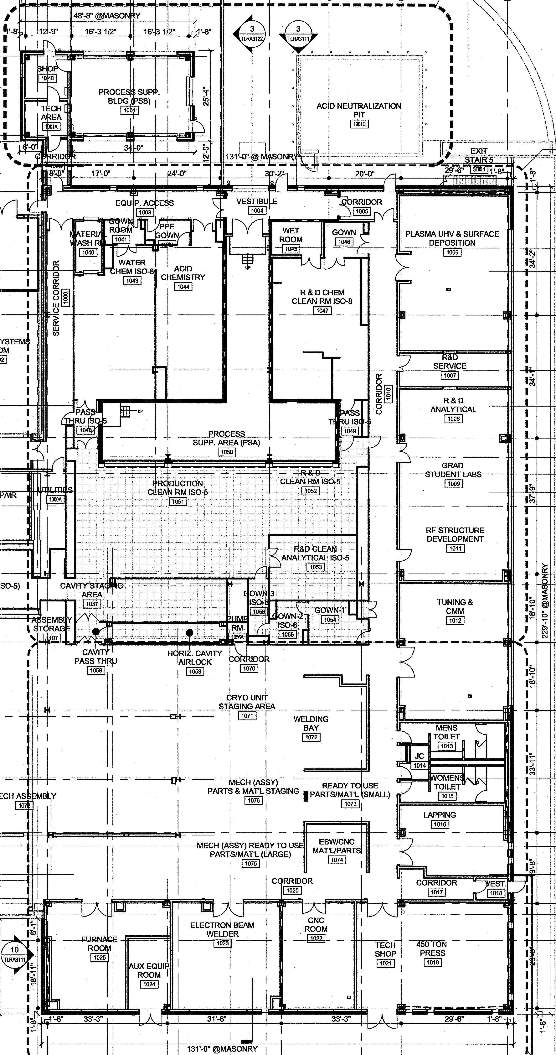
TEDF SRF Infrastructure Design
  30,000 sf – all new
  RF structure development
  Cavity fabrication (presses, EBW…)
  QC/ Inspection
  Integrated cleanroom suite
  Production chemroom
  R&D chemroom
  Flexible ISO 4 assembly areas
  Clean material analysis lab
  New materials R&D lab
  Dedicated CEBAF-support CM assembly lines
  Expansion assembly space for other DOE project support

Slide 40
  SRF Work Centers in Test Lab
Cryomodule Test
Vertical Test Area & Electronics Shop
Fabrication
Cryomodule Assembly
Physics
Weld Shop
Test Lab 1st Floor
QA/CMM
Electropolish
Clean Room(s)
Electron Beam Welding
Parts Clean & Etch
Machine Shop
R&D Chem Lab
R&D Lab
R&D Clean Labs
Offices
Tuning & Furnace
Work Stations
(3rd flr)
Test Lab 2nd Floor
R&D Labs
Offices

Slide 41
Typical Cryomodule Test
Low Power
  RF coupling
  Tuner performance
  HOM surveys
High Power
  Max gradient, limits (quench, FE, waveguide arcing, warm window temp)
  Max stable operations - 1 Hour Run
  Q₀, calorimetric measurement with ~ 3/4 watt resolution
  Field emission
  Lorentz force detuning / microphonics
  Limited to one cavity at a time
Throughput: 4-6 weeks per cryomodule from installation to removal
  Dependent on level of detail required

Slide 42
Chemistry Associated Areas
Within the bounds of SRF (Test-Lab) are 7 acid areas;
  Process Support Building ‘PSB’
  Acid Waste Neutralization ‘AWN or DAC skid’
  Process Support Area ‘PSA or T-trench’
  Production Chemistry
  R&D Chemistry
  CAA & Acid Storage
  Clean Room
Access to chemistry areas is restricted to trained personnel, controlled through CAN system

Slide 43
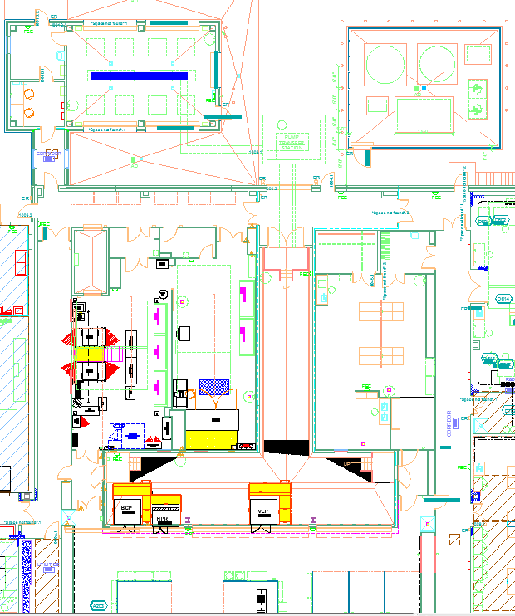
Chemistry Operations Areas
CMSA
PSB
AWN
Prod Chem.
R&D Chem.
PSA
Cleanroom

Slide 44
Typical Chemicals and Waste Products
Large Volume Acids for Tools (~50 gal Drums)
  EP Acid = 90% Sulfuric + 10% Hydrofluoric (HF)
  BCP Acid 1:1:2 = 25% Nitric + 25% HF +50% Phosphoric
Concentrated Small Volume Acids (1 gal bottles)
  96-98% Sulfuric
  70% Nitric
  85% Phosphoric
  49% Hydrofluoric
  37% Hydrochloric
  99.7% Acetic
Bases: Sodium Hydroxide (25%)
Small quantities of solvents (IPA, methanol, acetone)
Industrial wastewater
  Acidic wastewater
Waste Acid

Slide 45
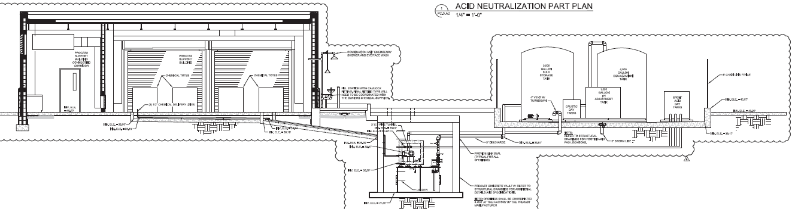
DAC Vault (underground)
Secondary containment provided by berm areas with floor trenches draining to a vault
Tank name | Chemical stored | Maximum capacity | Material construction
Vault | Storm water PSB trench Overflow (IWW) | ~8800 gallons | Precast concrete
Lift station tank (contained inside underground vault) | Acidic wastewater | 660 gallons | PE
Notes:
Vault contains a lift station tank for industrial wastewater
Overflow protection to vault and then to T-Trench

Slide 46
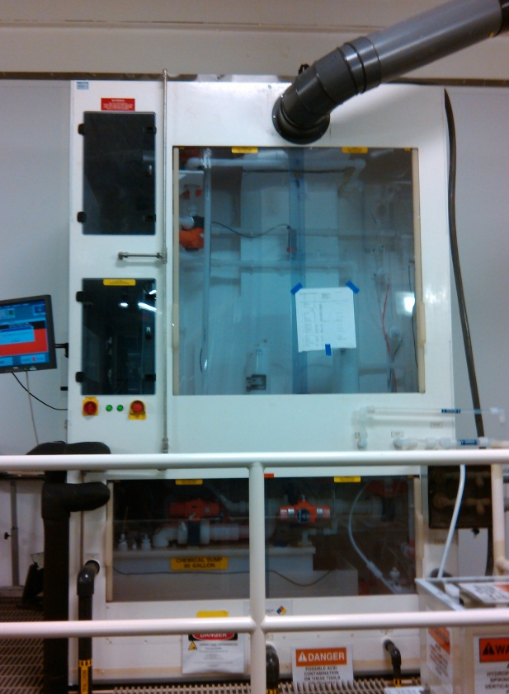
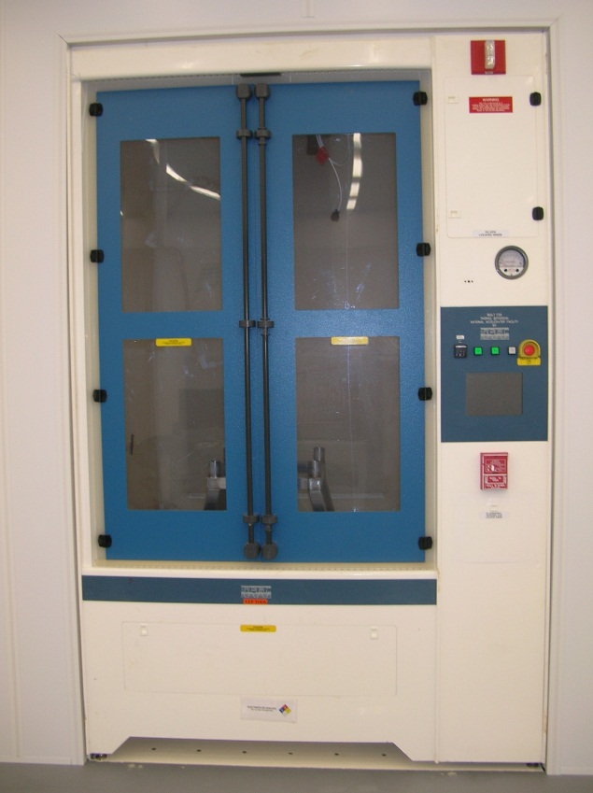
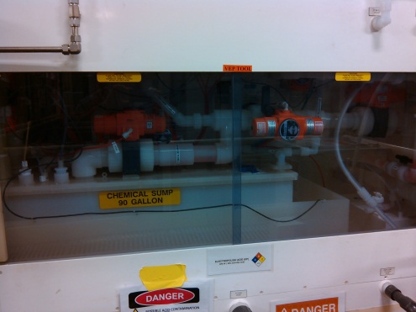
Equipment/Tools Features
PVDF / PFA piping and tubing
FRPP Construction
Liquid Leak Alarms
Scrubbed exhaust for working chamber, plumbing areas, and sump
N2 Leak test prior to process
Various Safety interlocks for doors, panels, etc..
Multiple Overflow, High and low Level fill protection.
CO2 Fire suppression connected to bldg. fire alarm system
Double (Triple) Contained Sump

Slide 47
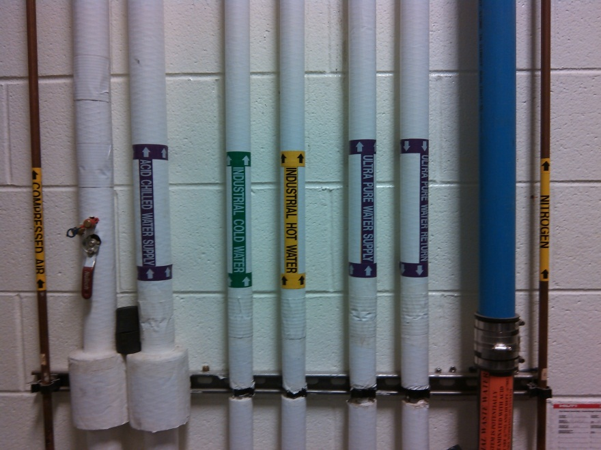
Process Support Area – Utilities/Systems
Systems in PSA
  Acid Supply/Waste (Sulfuric, BCP, +2 future acids)
  Acidic Waste Water (Drain System)
  Scrubber Exhaust
  Gases - N2, CDA
  UPW, HUPW
  Industrial H/C Water,
  Tepid Water
  Acid Chilled Water
  Safety Showers

Slide 48
Production Chemistry
Acid Tools – 2 Fume Hoods, Horizontal Electro Polish, Acid Storage
  Small scale wet-bench acid work < 2 gal containers
  Fume hood acid sumps (future)
  Horizontal EP: 60 gal (10% HF, 90% sulfuric acid)

Slide 49
R&D Chemistry
Acid Tools – 4 Fume Hoods + Walk-in Fume Hood Room
  Small scale wet-bench acid work < 2 gal containers
  Max. inventory ~30 gallons
  Walk-in fume hood room is for larger development projects and has piped acid delivery from PSB
  Fume hood acid sumps (in progess)

Slide 50
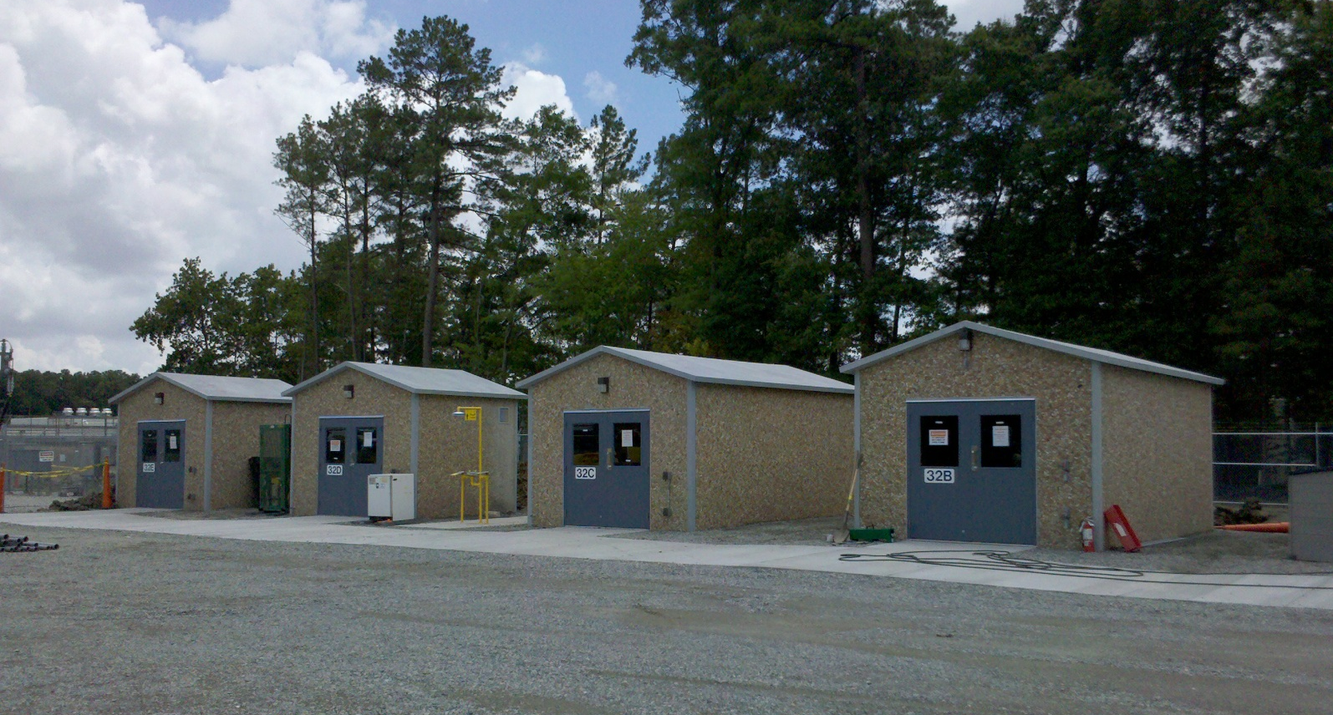
Central Accumulation Area & Storage
CMSA is a secured area controlled access
Hazardous Waste Central Accumulation Area
  Managed by ESH&Q
  Non-bulk waste acid (mainly lab packs)
Acid Storage “Virgin”
  Managed by SRF Production Chemistry Group
  Small container & bulk storage.
Notes:
Waste acid, waste flammable solvents, lead debris
Used oil

Slide 51
Work Planning and Control
Daily and Weekly Scheduling Meetings
  Weekly planning meeting to schedule and coordinate work
  Daily morning meeting to review plans and validate coordination
Test Area Task List “TATL”
  Used for non-standard work or outages. Communicates and authorizes work
Tool Box Meetings
  “WORK PLANNING, CONTROL AND AUTHORIZATION FLOW DIAGRAM”
  ESH&Q Manual – Chapter 3210 Work Planning, Control, and Authorization Process “3210 Appendix T3 Risk Code”
  Lesson Learned from Jlab and other labs

Slide 52
Work Planning and Control
OSP/TOSP in accordance with ESH&Q manual Chapter 3310 Operational Safety Procedure (OSP) Program
  Operations in Production Chemistry, R&D Chemistry, Clean Room, PSB, PSA and DAC System
  Chemical Transport and Handling
  HEP, VEP, BCP tools
    SOP converting to OSP
SOP established for standard and R&D bench chemical processes
Trained Staff
  Core Training Sampling (JTA process)
    SELF CONTAINED BREATHING APPAR (SCBA) - SAF109
    FIRST AID FOR CHEMICAL EXPOSURES - SAF125
    R&D Chemical Room Safety - SAF129
    DOT HAZARDOUS MATERIALS SHIPPING - SAF305
    PRESSURE SYSTEMS SAFETY AWARENESS - SAF130A
    CONFINED SPACE ENTRY - SAF907
  Chemical procedure specific training by SRF Staff

