Slide 1
Pyrochlore Ingot Niobium SRF Technology for
Next Generation Accelerators
Ganapati Myneni
November 13, 2015
Presentation for Nomura JLab Visitors

Slide 2
Overview
Introduction
Fine grain - ingot niobium technologies
Cavity process optimization
Accelerator cost and sustainable operation
Summary and outlook

Slide 3
Introduction
Processes – Procedures
SRF cavity performance mainly depends on the Processes – Procedures
used in the production of the niobium slices.
* EDM single wire slicing is expensive & affecting the niobium quality
* Multi-wire slurry slicing is cost effective & indicating the best results (DESY)
Again Processes – Procedures implementation applied in the cavity
fabrication dictates the final performance of the SRF linac performance.
* Diamond fly machining of half cells to remove the damage layer could
have several advantages (reduced hydrogen and lower stress gradients)
So we are in the process of improving the Processes – Procedures to confirm
the lower RRR niobium improves the cavity performance

Slide 4
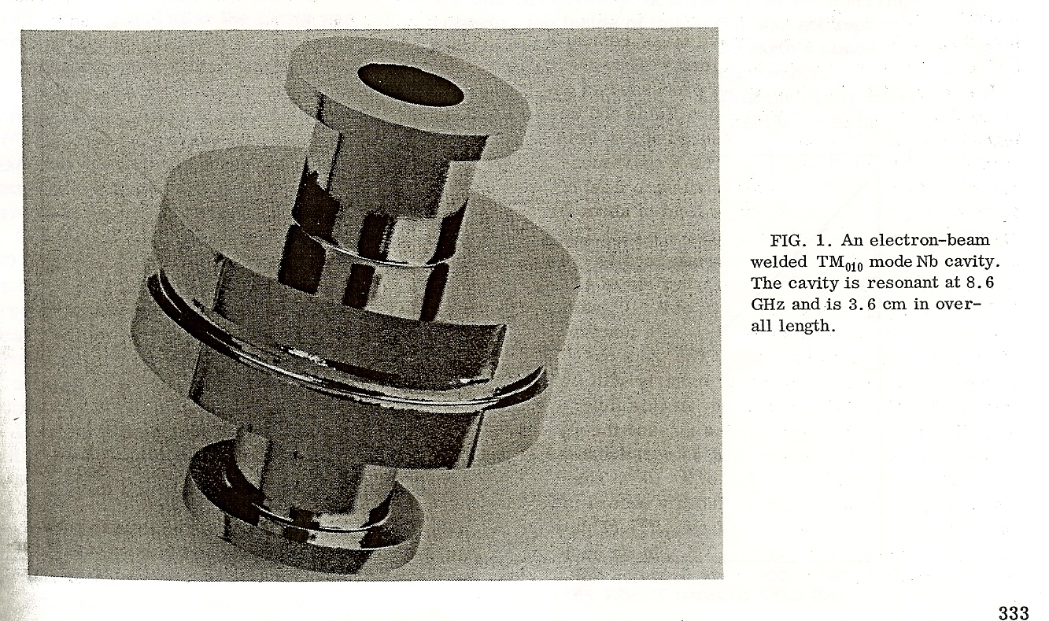
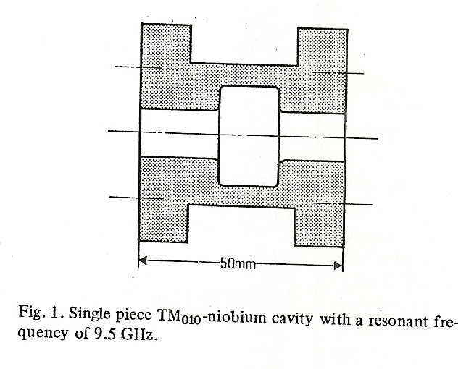
Early ingot niobium SRF technology
B_{pk}~ 109 mT with BCP
with heat treatments
B_{pk}~ 130 mT with EP
B_{pk}~ 108 mT with BCP
After 1800° C heat treatment
Note:
B_{pk} ~ 159 mT with EP for reactor grade polycrystalline cavity - no heat treatment
G. R. Myneni, “SRF Technology Comes Full Circle” CERN Courier - Viewpoint, October 20, 2008
G. R. Myneni and A. Hutton, “SRF Technology—Past, Present and Future Options, Proc. EPAC08, 865-867, 2008

Slide 5
Highlights of Early SRF Technology
Cavities were mostly made from ingot niobium
  Process and procedures were similar and as varied as today
Reactor grade Niobium material in ingot, bar, plate sheet and tube form was available
Achievable gradient limited by multipacting and/or field emission
Residual surface resistance (~ 1nΩ) was not well understood
  Still the case
At highest frequencies (Electropolished fine grain, X-band) Hpk ~ 159 mT Q0 ~5x10⁹
(BCP’d ingot Nb, 1970’s) Hpk ~ 108 mT & Q0 ~1×10¹¹ @ 1.2 K CW
For comparison (CEBAF upgrade spec.) Hpk ~ 76 mT Q0 ~ 7×10⁹ @ 2 K CW (2008)

Slide 6
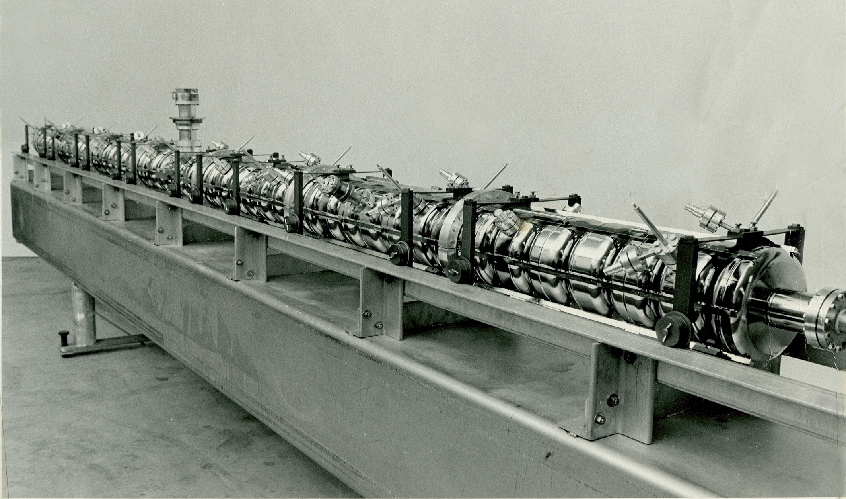
Ingot niobium 1.3 GHz SRF technology
UIUC HEPL 49 Pill Box Cavities
Photo Courtesy of Larry Cardman

Slide 7
Multipactoring problem reappears (2006)
T-map showing MP at equator
Gigi Ciovati
Re-contaminating vacuum systems drastically degrade the performance
of the cavities

Slide 8
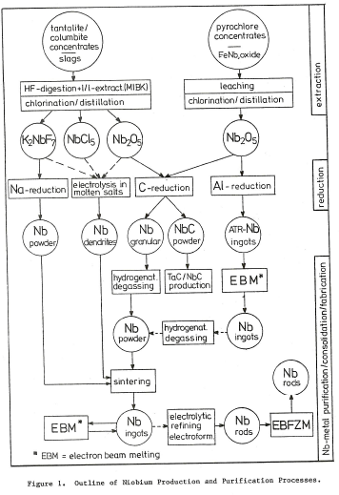
CEBAF niobium (Wah Chang and Fansteel)
ASTM ~5 fine grain
Nb sheets
Ta <1000 wt. ppm
90% from CBMM
Pyrochlore Ore
10% form Cabot
Columbite/Tantalite Ore

Slide 9
Technical specifications of niobium for future SRF linacs
Material parameter | TESLA/XFEL Pulsed/CW | CW/Pulsed SRF Linac (proposed)
Type | Polycrystalline | Ingot
RRR | > 300 | > 40
Grain Size | ~ 50 μm | > 1 cm
Yield Strength | > 50 N/mm² | > 50 N/mm²
Tensile Strength | > 100 N/mm² | > 100 N/mm²
Elongation | 30% | 30%
Contents of the Impurities wt. ppm | Ta ≤ 500 O ≤ 10 N ≤ 10 C ≤ 10 H ≤ 2 | Ta ≤ 1300 O ≤30 N ≤ 30 C ≤ 40 H ≤ 5
Vickers Hardness | ≤ 50 | ~ 50
Note: nominally present low metallic impurities in niobium does not affect the RRR significantly

Slide 10
Fundamental Issues
Efficiency, affordability, sustainability
Main Niobium Sources for SRF Cavities
Columbite/Tantalite Ore Tantalum can be specified to be low as niobium is by product
Ingot
Pyrochlore Ore
Tantalum fixed
800 – 1500 wt. ppm
Fine Grain
Ingot
Fine Grain
International Developments
DESY CM
90% of CEBAF was built with
JLab, Indian Institutions , KEK & MSU R&D
XFEL, CEBAF Upgrade & FRIB
Purity specification determines # of E-beam melting cycles and cost

Slide 11
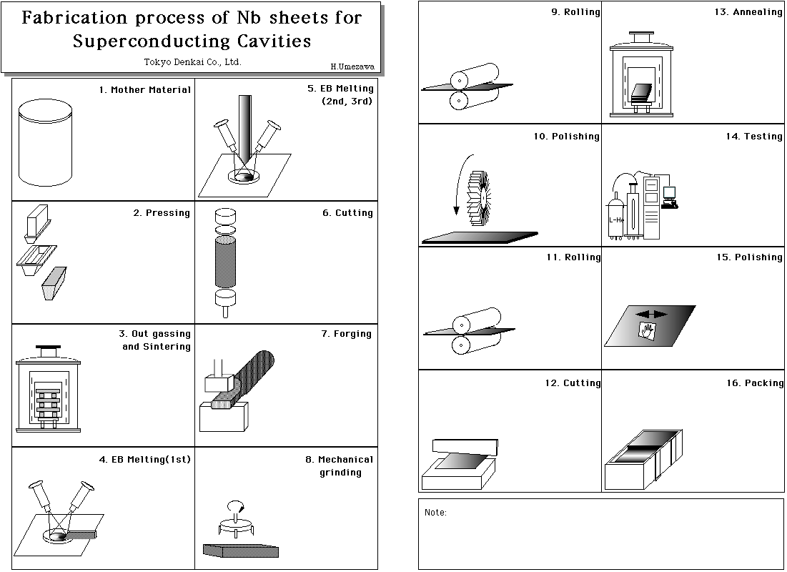
Economic, efficient and sustainable path for SRF technology
Cost of the ingot sliced Nb sheets anticipated
to be less than a third of polycrystalline Nb & no QA
Expected material cost savings at least 65%

Slide 12
Present state of the art
Our Goal
*
Current CW cryo limit
Ingot niobium Rs is low and phonon peak improves thermal stability
Our goal is to improve both Q₀ and E_{acc}

Slide 13
DESY Ingot Niobium Cryomodule Results
Greater than 25% Q₀ is demonstrated in cryomodule with high RRR ingot niobium compared to conventional fine-grain niobium during operations
* This will be huge cost saving in cryogenic plant cost as well as operations cost
As high as 45 MV/m accelerating gradient has been achieved in the cryomodule with ingot niobium

Slide 14
Worlds Largest High Purity Niobium Ingot (CBMM) for ESS prototypes (up to ~ 530 mm)

Slide 15
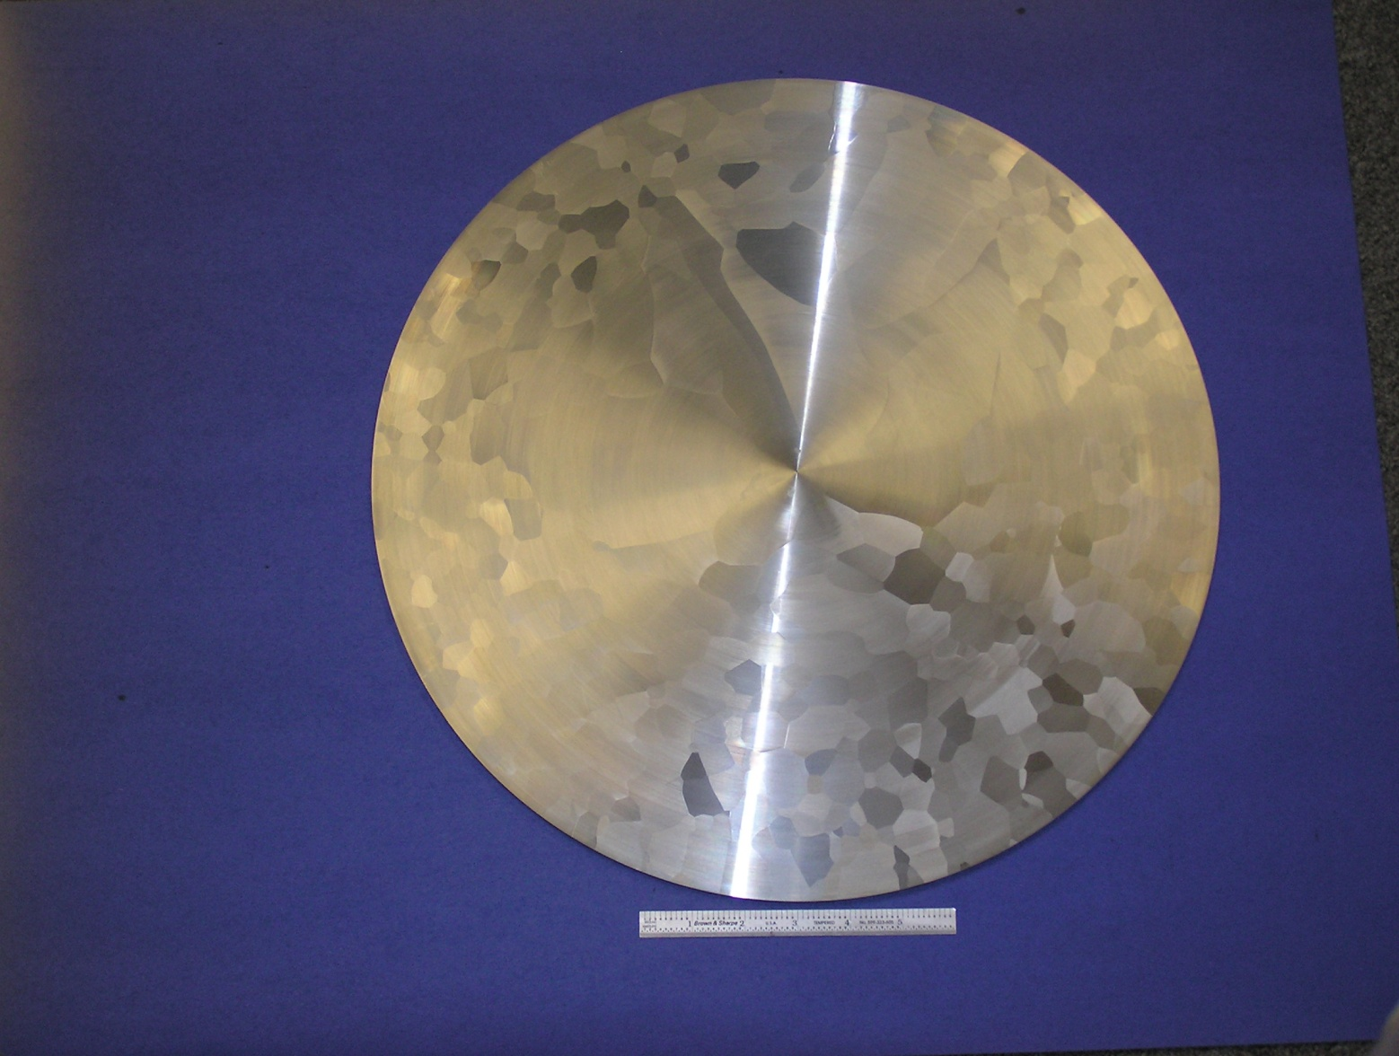
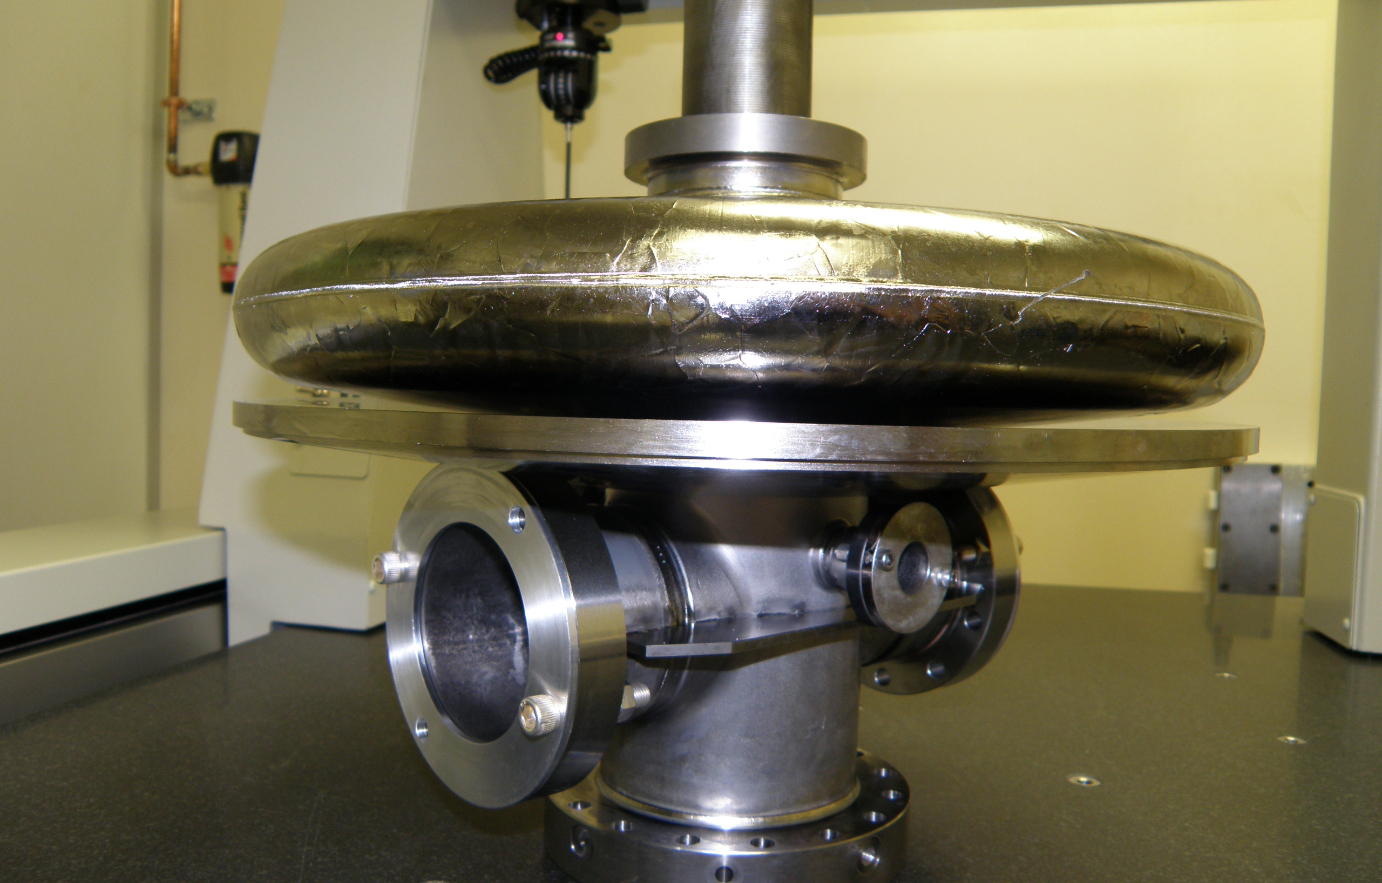
Reactor grade ingot niobium slice
Uniform grain reactor grade ingot niobium technology
Ingot niobium gun cavity

Slide 16
Conclusions
Ingot niobium technology (low RRR, high tantalum content) would be ideal for ILC to lower the cost of construction and operations
We expect that this technology will be the preferred choice for building ILC on a fast time scale
JLab Ingot Niobium Summary workshop is being hosted on December 4, 2015. An AIP publication entitled “Science and Technology of Ingot Niobium for Superconducting Radio Frequency Applications” will be released at the beginning of the workshop by JLab Director.
https://www.jlab.org/conferences/ingot/index.html
You are all cordially invited

Slide 17
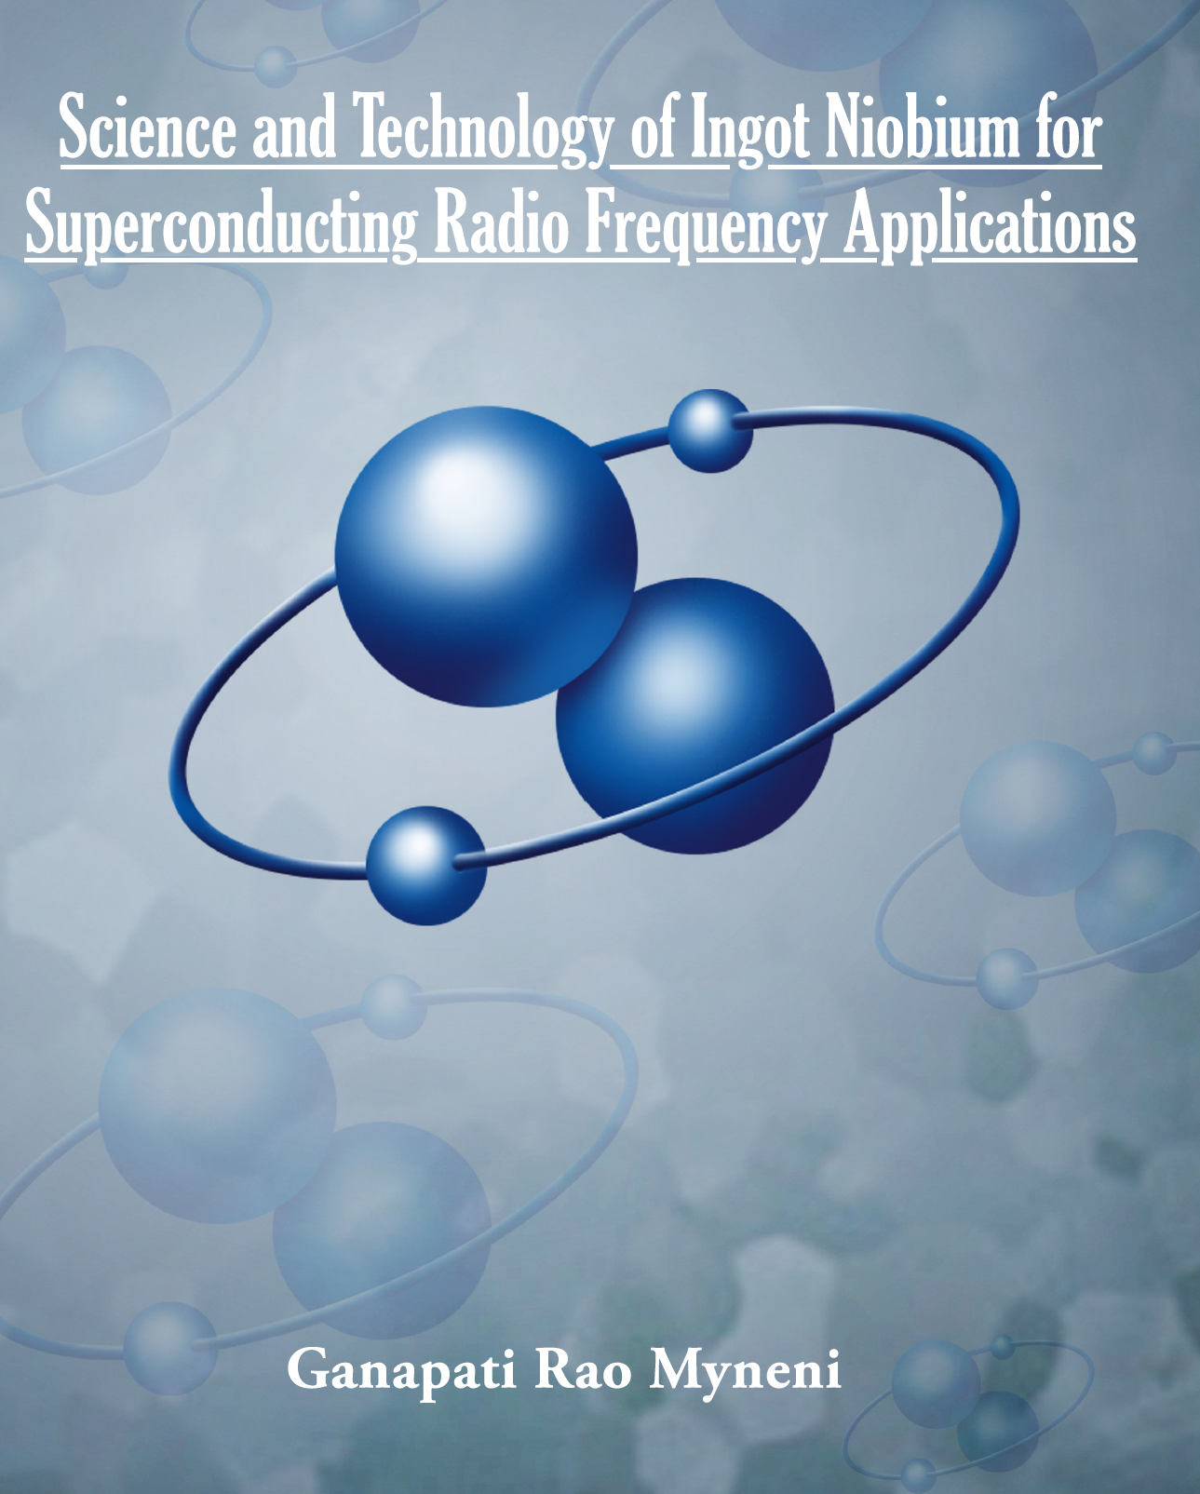

Slide 18
Name of Article PDF File | Name of the article | Author (S)
1_Ingot Niobium - Physical Properties
001_abdo_INGNB.pdf | Recent Developments in High Purity Niobium Metal Production at CBMM (Brazil) | Abdo et al
002_Bieler_INGNB.pdf | Deformation Mechanisms, Defects, Heat Treatment, and Thermal Conductivity in Large Grain Niobium | Bieler et al
003_Elsayed-Ali_INGNB.pdf | Pulsed Laser Deposition of Niobium Nitride Thin Films | Ashraf Hassan Farha et al
004_Lee_INGNB.pdf | Large Grain CBMM Nb Ingot Slices: An Ideal Test Bed for Exploring the Microstructure-Electromagnetic Property Relationships Relevant to SRF | Lee et al
005_Ricker_INGNB.pdf | Mechanical Properties as an Indicator of Interstitials in Niobium for Superconducting Accelerator Cavities | Ricker et al
006_Roy_INGNB.pdf | Qualification of Niobium Materials for Superconducting Radio Frequency Cavity applications: View of a Condensed Matter Physicist (India) | Roy et al
007_Stevie_INGNB | SRF Niobium Characterization Using SIMS and FIB-TEM | Stevie
2_Cavities - Cryomodules Related Projects
008_Ciovati_INGNB.pdf | Summary of Performance of Superconducting Radio-Frequency Cavities built from CBMM Niobium Ingots | Ciovati et al
009_Dhakal_INGNB.pdf | High Performance Superconducting Radio Frequency Ingot Niobium Technology for Continuous Wave Applications | Dhakal et al
010_Nivitski_INGNB.pdf | Review of R&D at DESY on ingot niobium for accelerators (Germany) | Navitski et al
011_Wallace1_INGNB.pdf | Cold Energy | Wallace
012_Yamamoto_INGNB.pdf | Ingot Nb based SRF Technology for the International Linear Collider (Japan) | Yamamoto et al
3_Interdiciplinary Advances
013_Ganni_INGNB.pdf | Helium Refrigeration Systems for Super-Conducting Accelerators | Ganni
014_Kimber_INGNB.pdf | Comparisons of Radio Frequency Technology for Superconducting Accelerating Structures | Kimber
015_Mahzad_INGNB.pdf | Ingot Niobium as Candidate Electrode Material for Jefferson Lab 200 kV Inverted Electron Photogun | Mahzad et al
016_Wallace2_INGNB.pdf | Electrostatics | Wallace et al

Slide 19
Back up slides

Slide 20
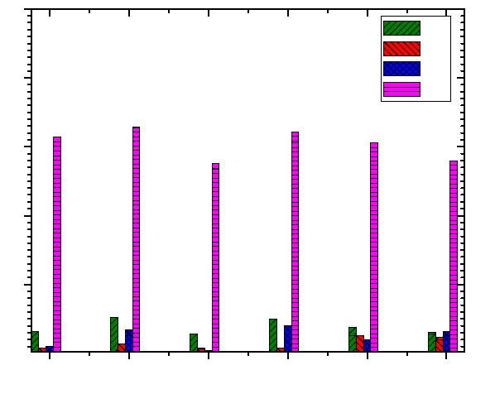
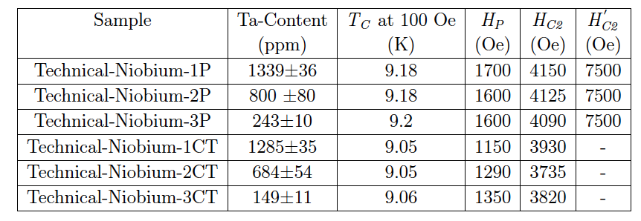
Uniform distribution of Ta has no effect on SC Parameters, BCP has large effect
Fe
Cu
Zn
Ta
S. B. Roy et al Supercond. Sci. Technol. 25 (2012) 115020

Slide 21
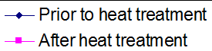
Tantalum does not affect the performance
Ingot niobium has superior performance
Large grain ingot niobium
Polycrystalline niobium
Empirically FOM ~ 1.0 x10¹³
Influence of Ta content in high purity niobium on cavity performance
P. Kneisel, G. Myneni, G. Ciovati, D. Proch, W. Singer, T. Carneiro et al in Proceedings of PAC 2005

Slide 22
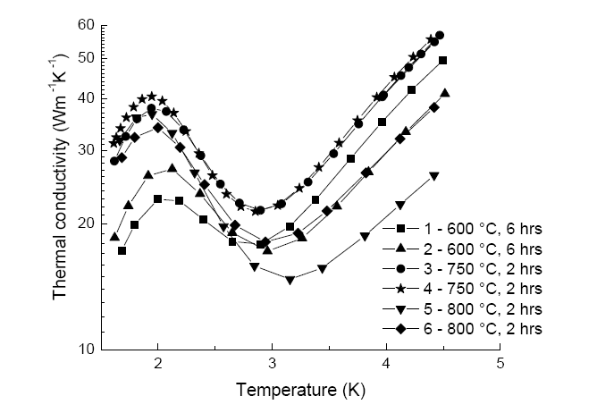
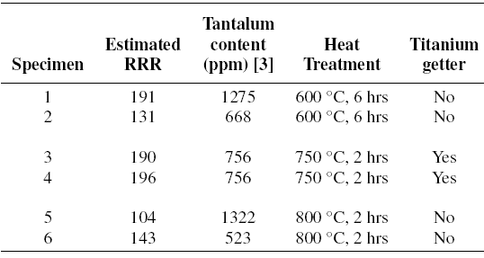
Tantalum and RRR have minimal influence on phonon peak
Ingot niobium
Saravan
PhD student at MSU

Slide 23
Extrinsic contamination of cavity surfaces dominates the performance limitation
Surface contamination
  Molecular and particulate

Slide 24
Hydrogen absorption with BCP and EP
Very high equilibrium hydrogen activities (fugacity) have been estimated when Nb metal is in contact with water or BCP solution
Hydrogen is readily absorbed into Nb when the protective oxide layer is removed
Lower H fugacity's are obtained due to an anodic polarization of Nb during EP and hence lower hydrogen absorption
R.E. Ricker, G. R. Myneni, J. Res. Natl. Inst. Stand. Technol. 115, 353-371 (2010)
NIST/JLab

Slide 25
Environmental contamination of Nb surfaces determines the performance of the cavities
Extrinsic
Intrinsic
Surface contamination
  Molecular and particulate
  During cavity processes
  Cryomodule assembly
  Operations (field emission enhancement)
Magnetic flux trapping
Niobium is a prolific hydrogen absorber in the absence of the natural surface oxide
  Hydride formation
  (Ti and N alloying help
  to prevent hydrides)
  Dislocations (residual stress)

Slide 26
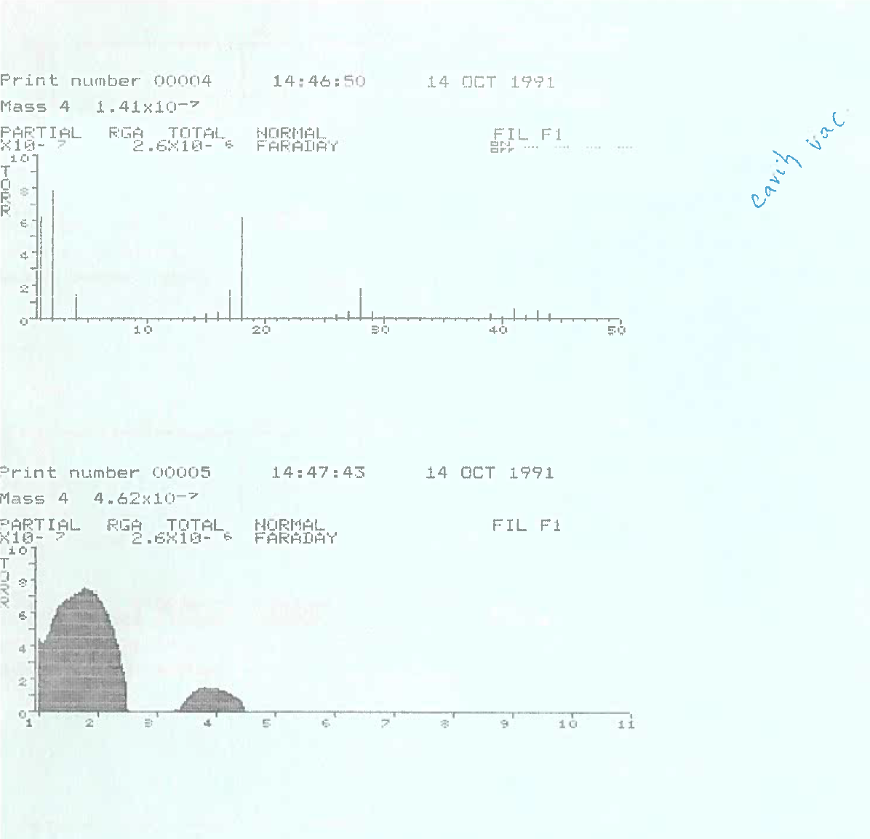
Oil contamination and vacuum leaks

Slide 27
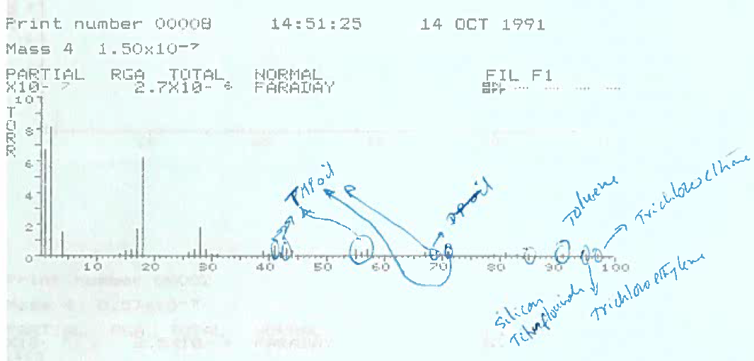

Slide 28
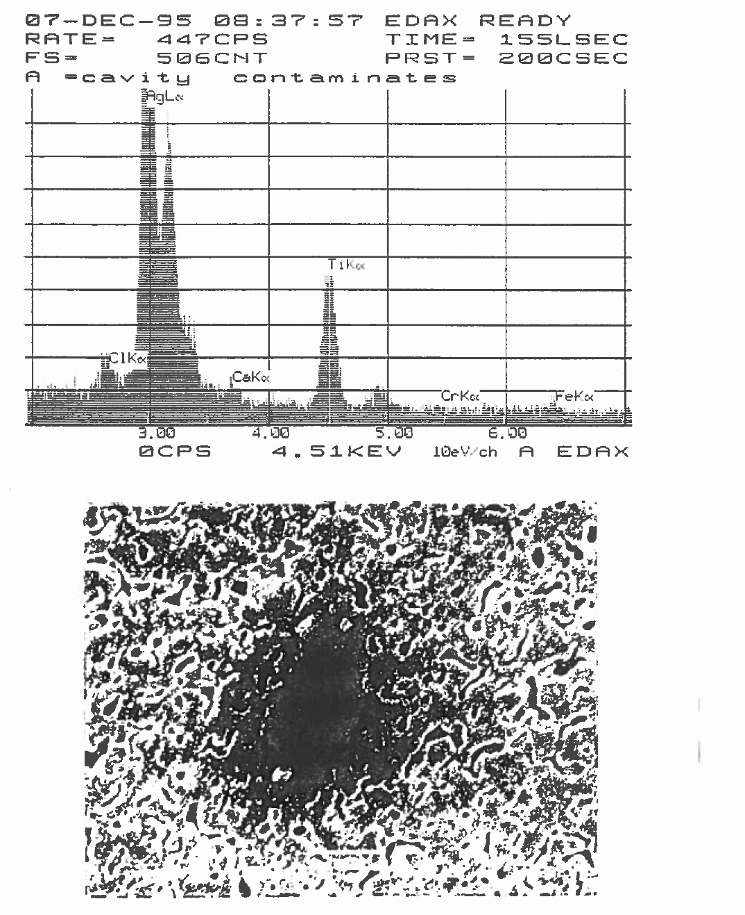

Slide 29
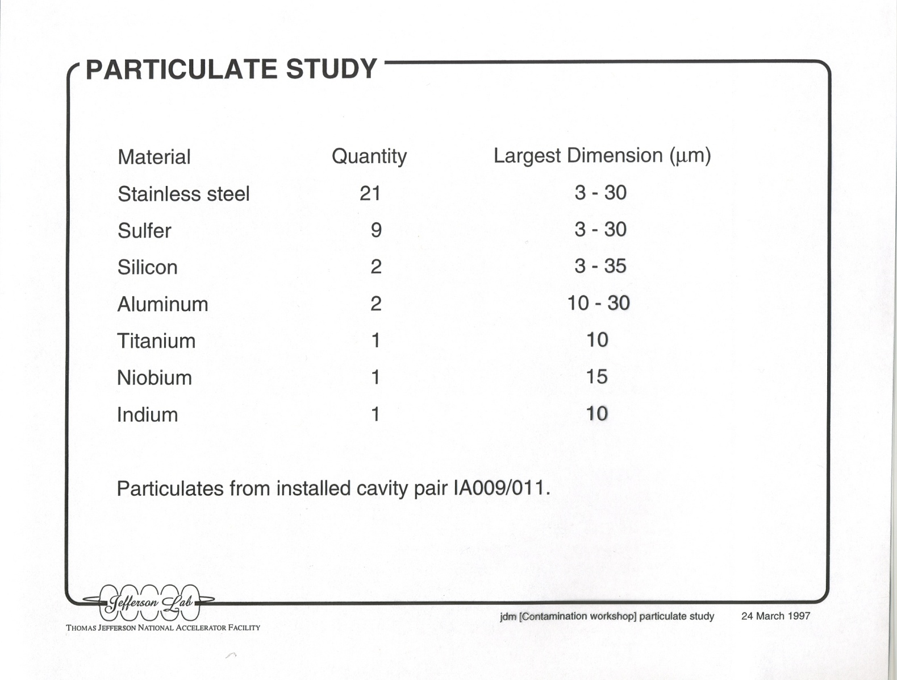
Particulates in the Cavity Pair

Slide 30
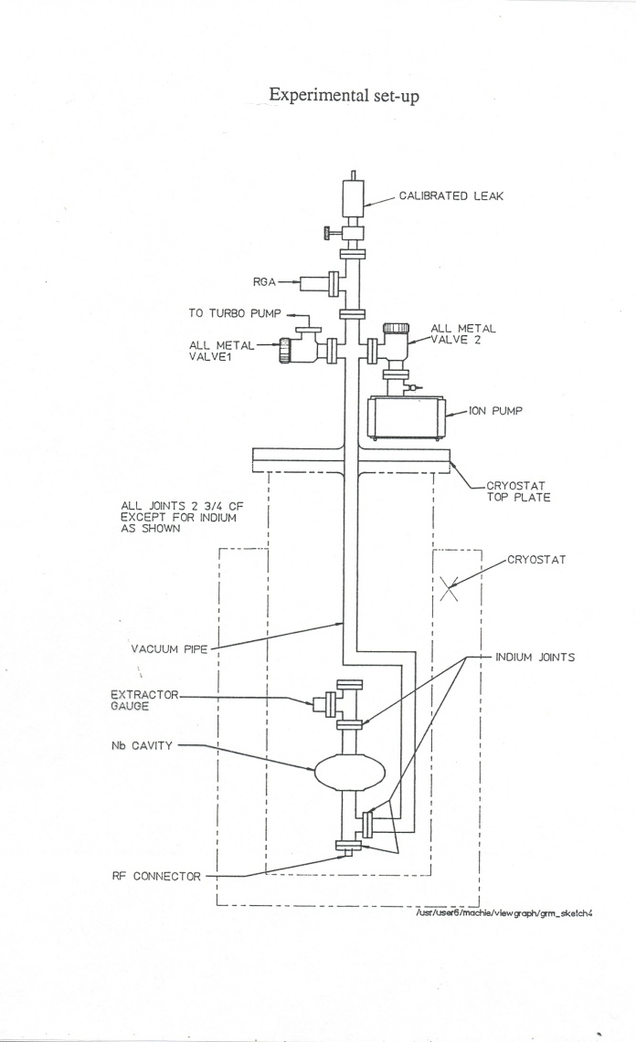
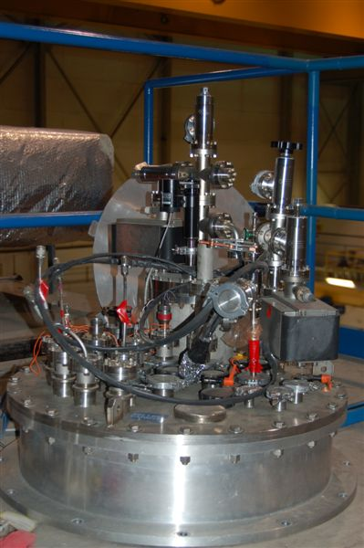
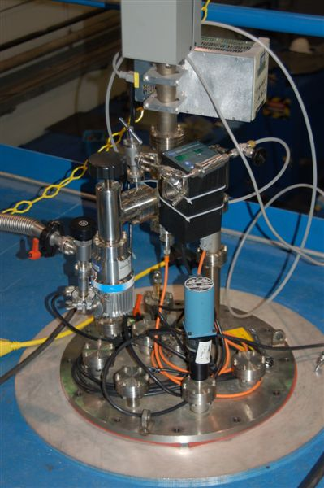
Evacuation is the Final Process step
Schematic of the cavity
test system
Ion-Turbo system
cross contamination,
particulate & hydro carbon problems
Improved turbo
pump system with minimum
contamination
Recontamination from vacuum systems is a major problem with SRF linacs

Slide 31
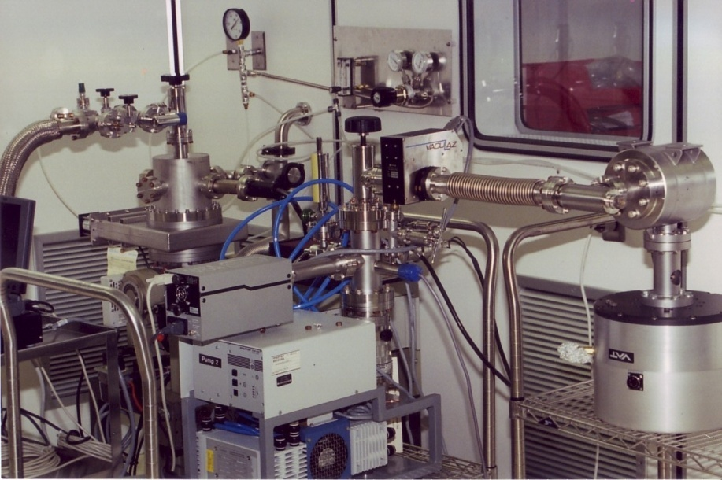
Comparison of oil and oil free vacuum systems
Minimizing organic and particulate recontamination is crucial

Slide 32
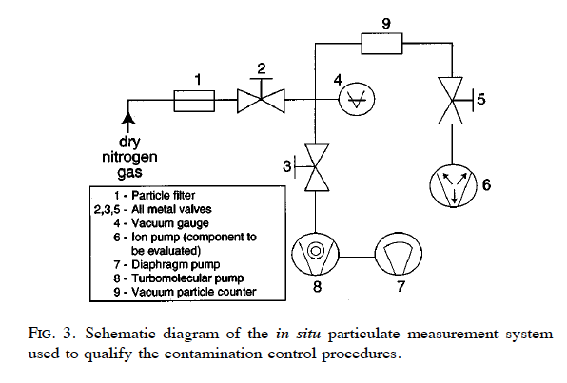
JLab’s FEL was the first SRF linac that implemented contamination control procedures

Slide 33
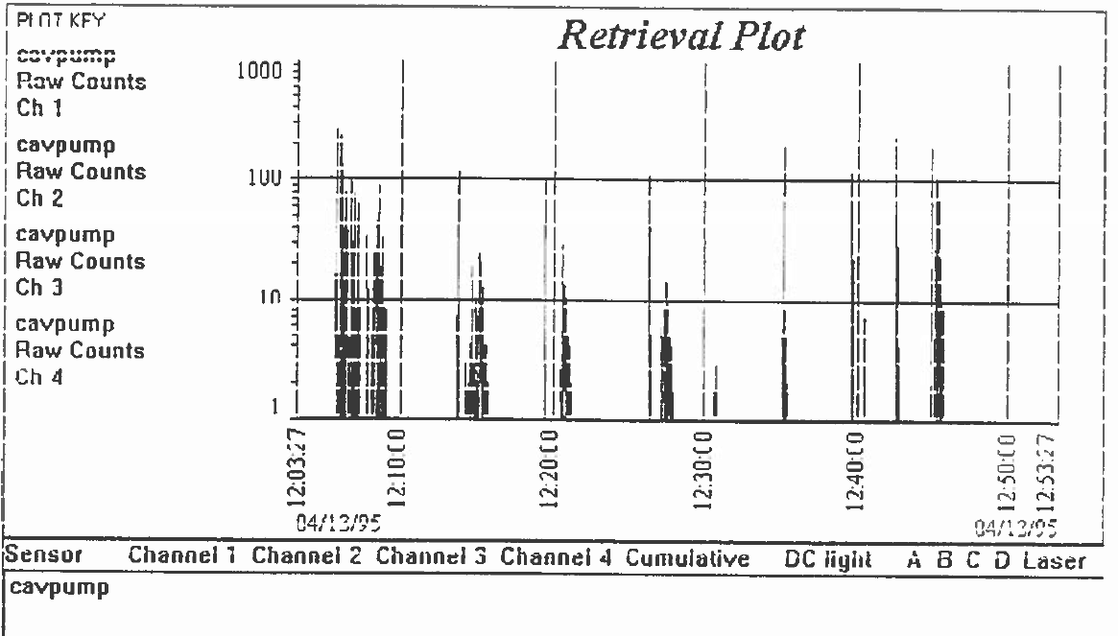

Slide 34
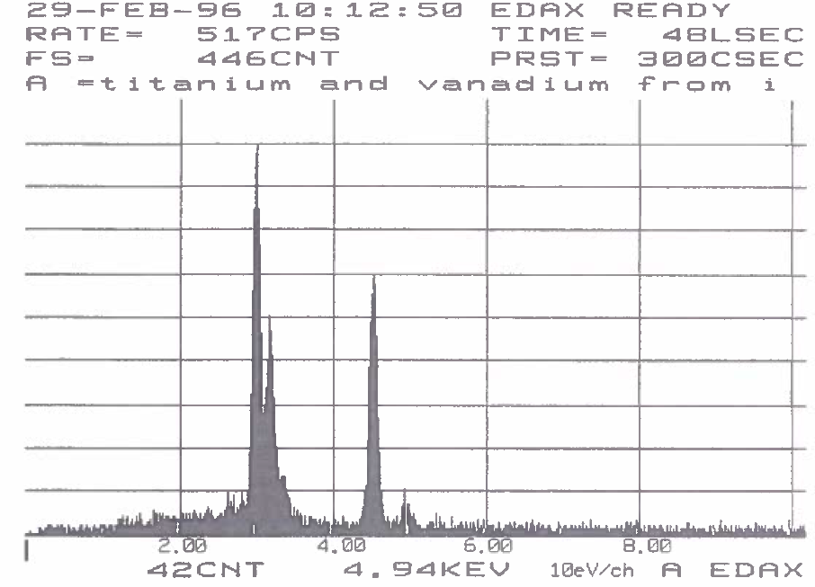

Slide 35
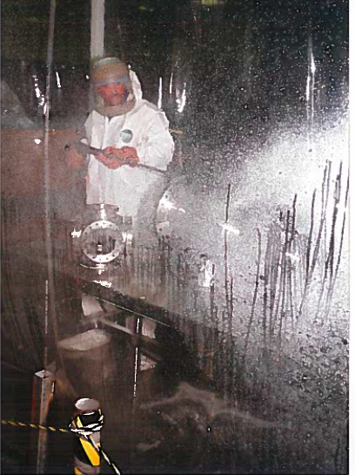

Slide 36
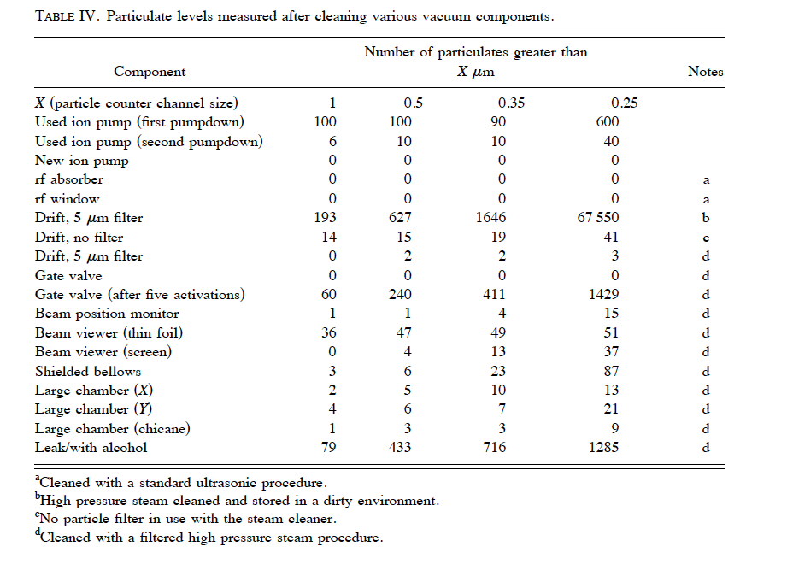

Slide 37
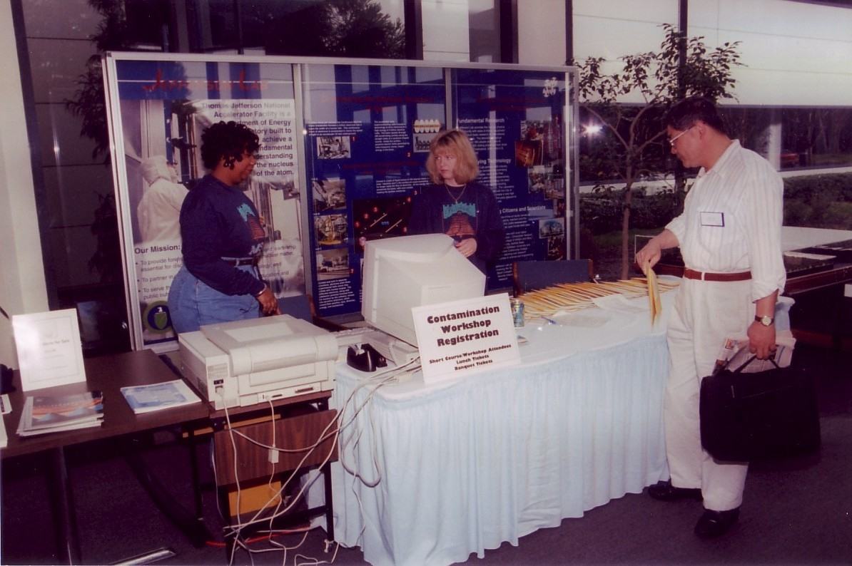
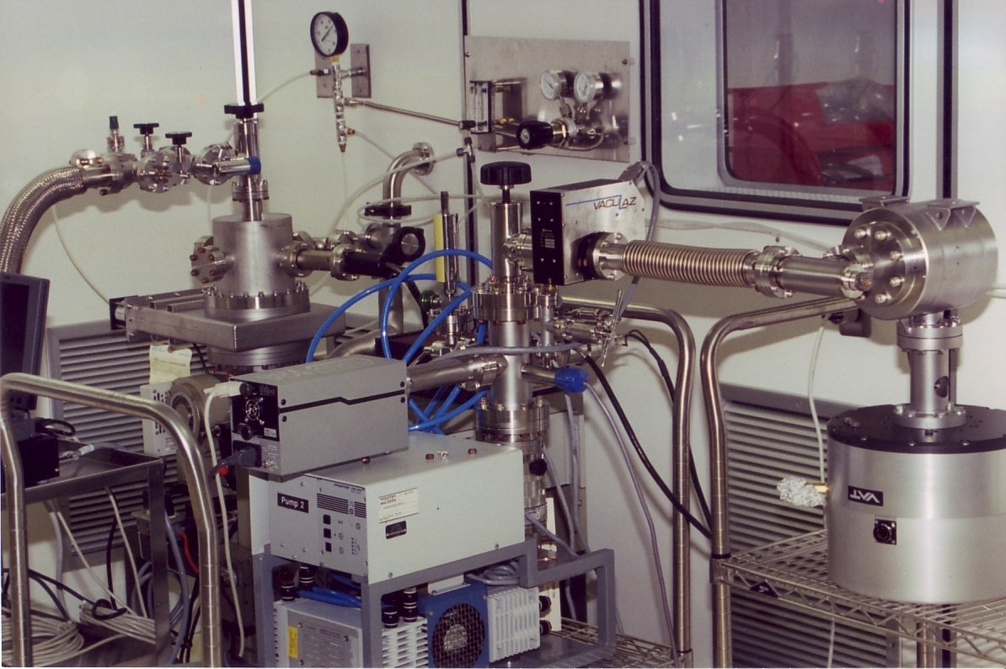
Contamination Control Work Shop at JLab 1997
Minimizing organic and particulate recontamination addressed,
several courses were held in subsequent years

Slide 38
Conclusions
Contamination free vacuum systems & particulate free components and processes are crucial for creating and sustaining high performance SRF linacs
Magnetic shielding sub-systems must be annealed for minimizing the trapped flux
Uniform grained ingot niobium technology can be expected to generate high performance, low cost and sustainable SRF accelerator systems

Slide 39
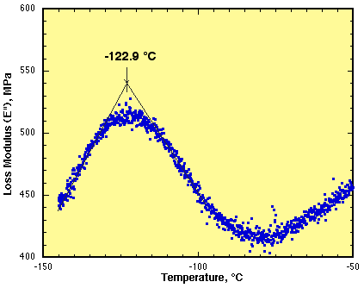
Hydrogen Interactions
N15 nuclear reaction analysis - UNY, Albany
Internal friction data - NIST, Gaithersburg
O-H Interaction Peak
Hydrogen is most mobile at room temperature, interacts with defects, interstitials and is
influenced by residual stress concentration gradients and affects the magnetic properties

Slide 40
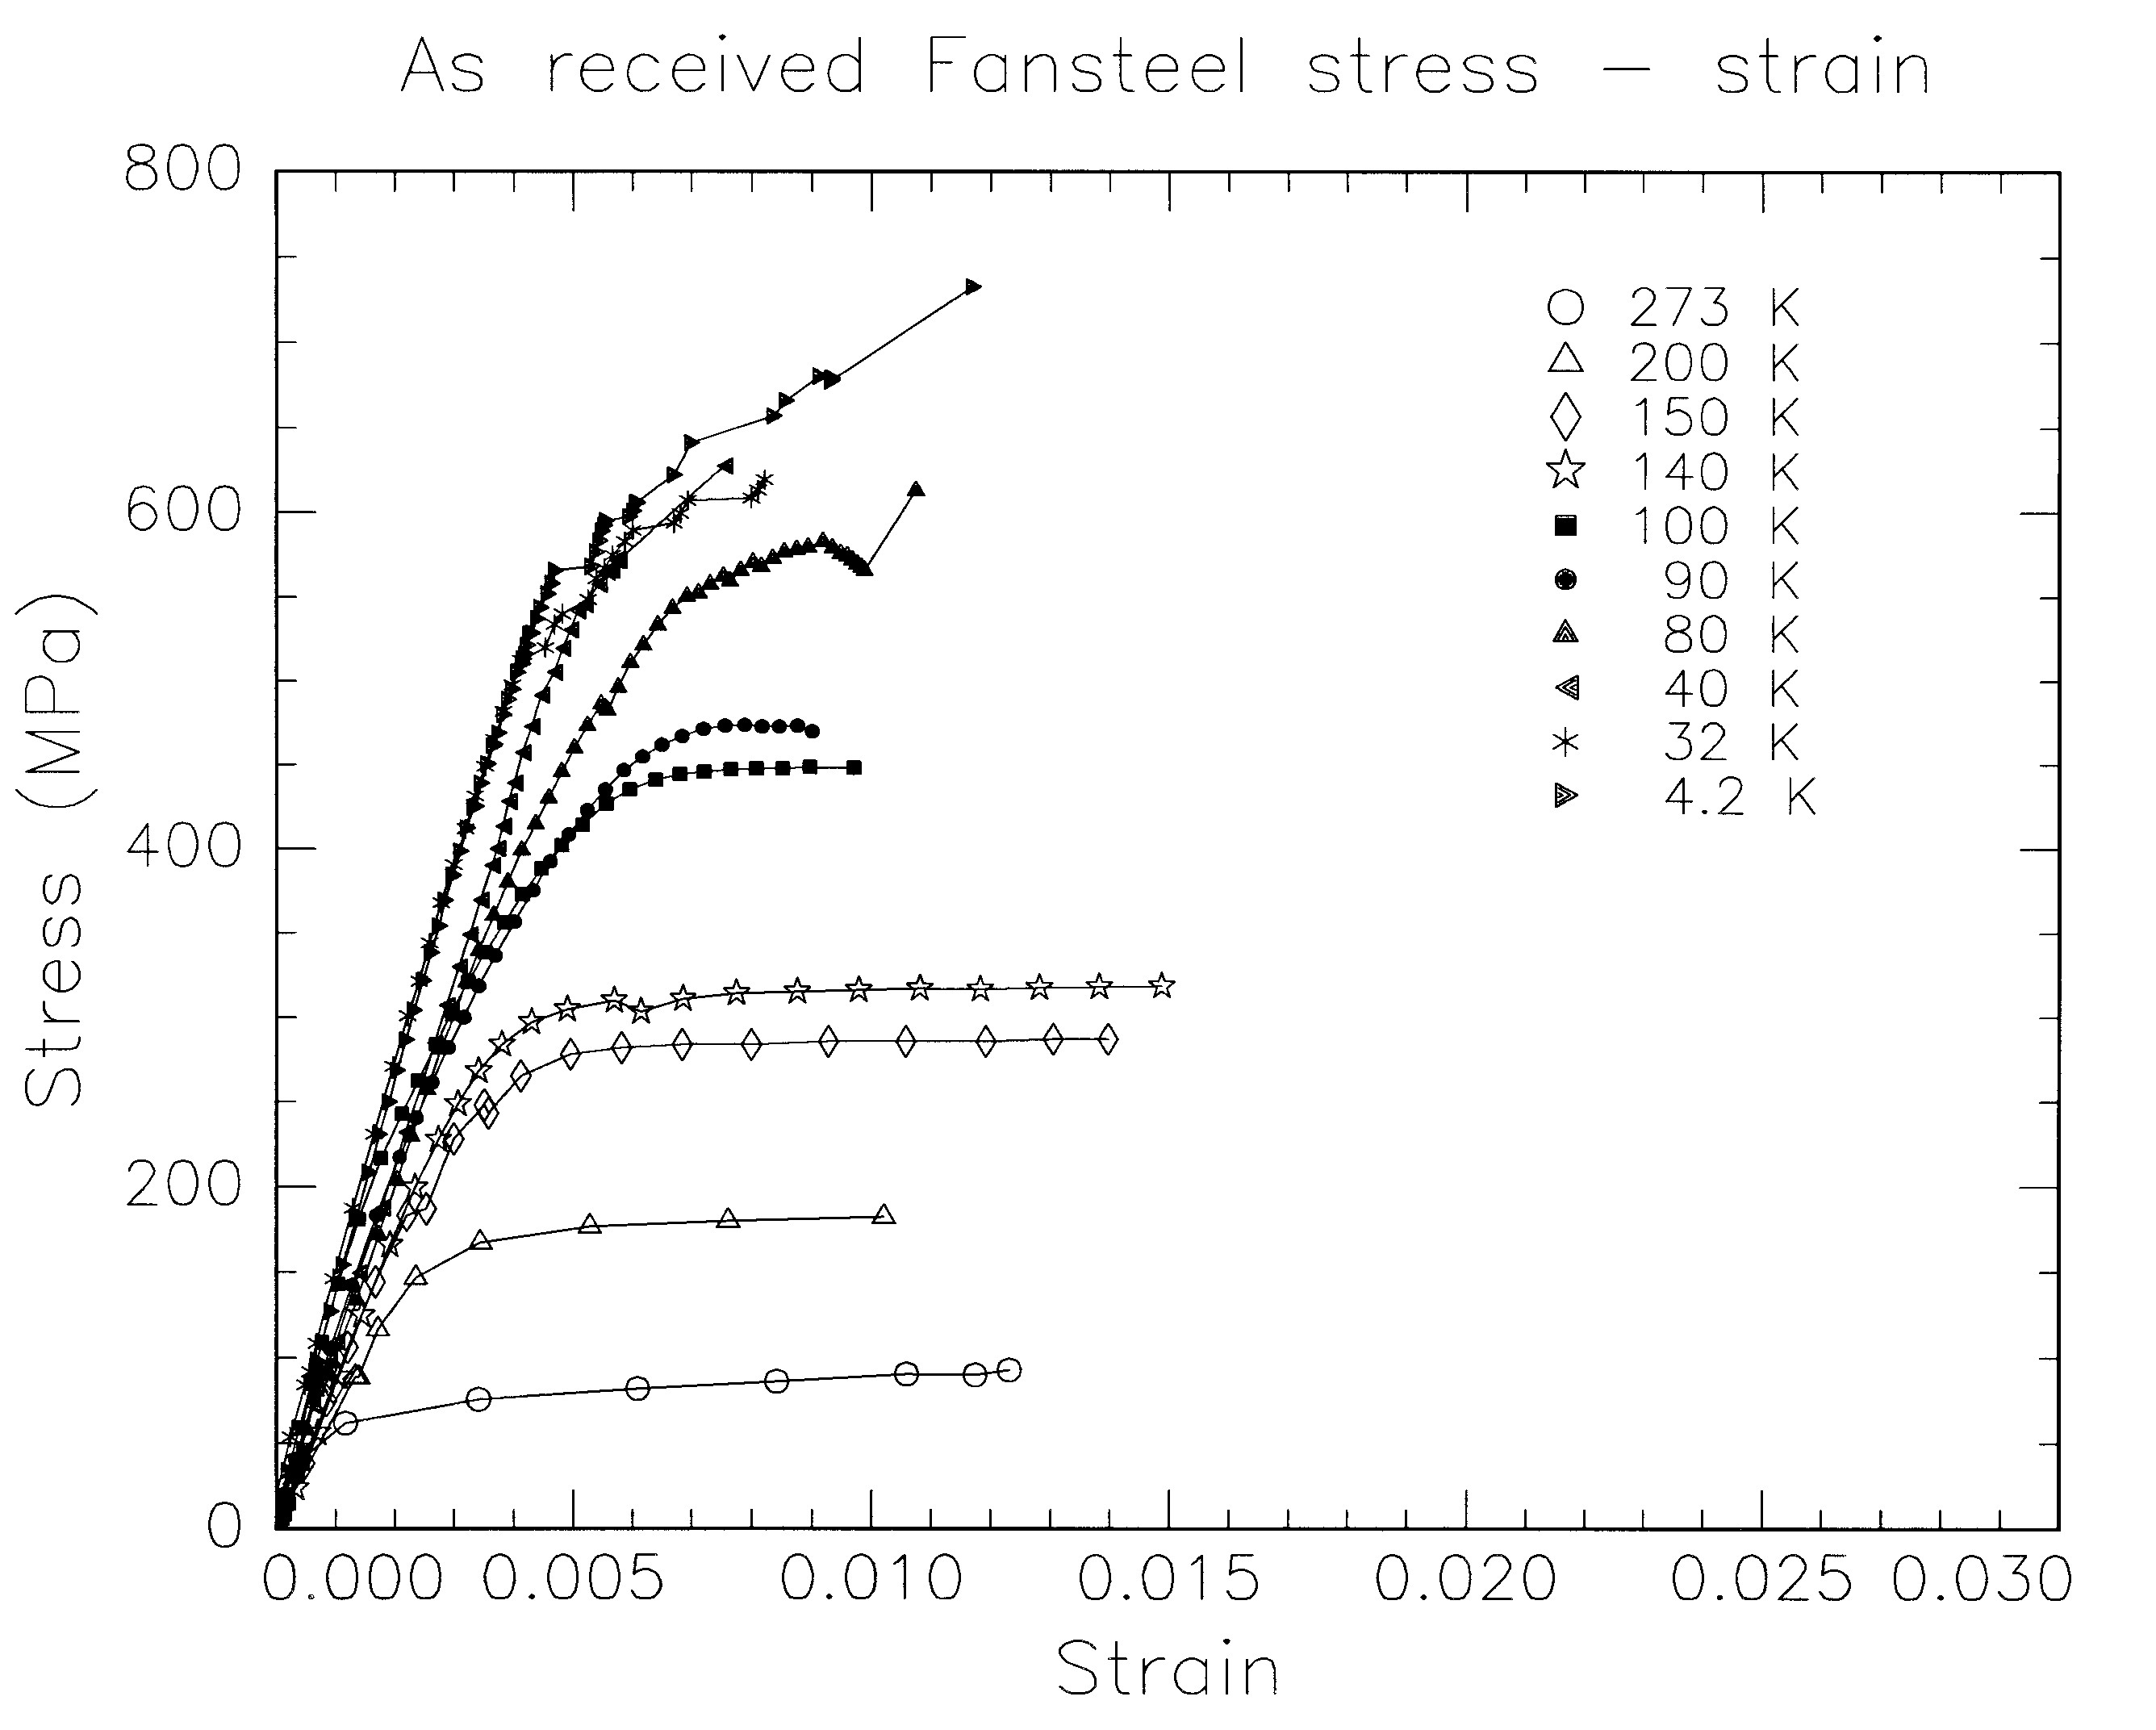
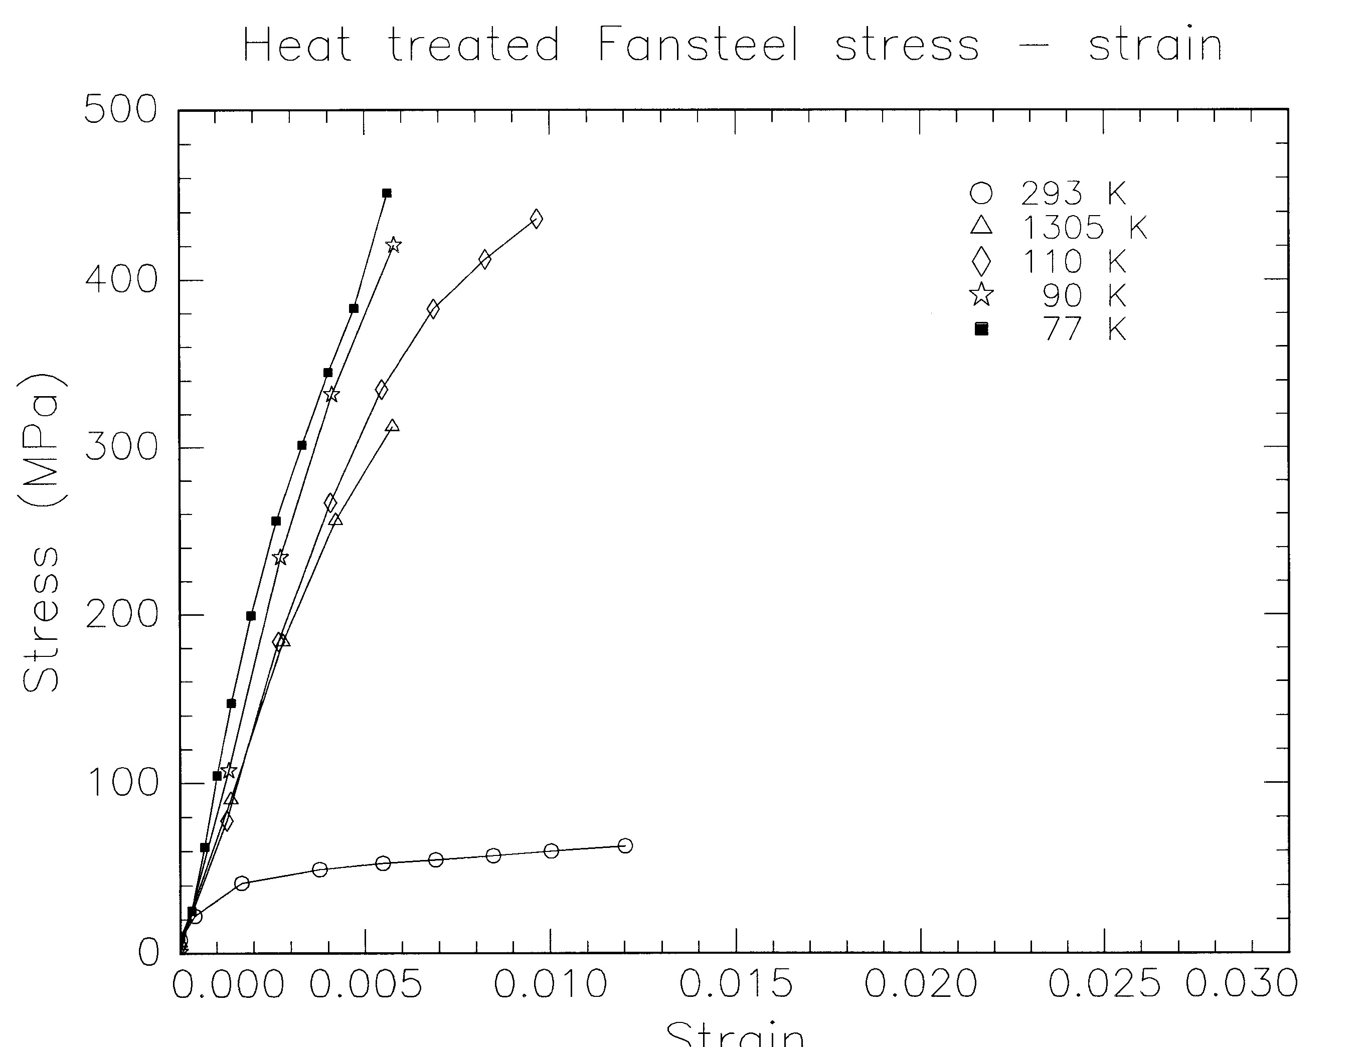
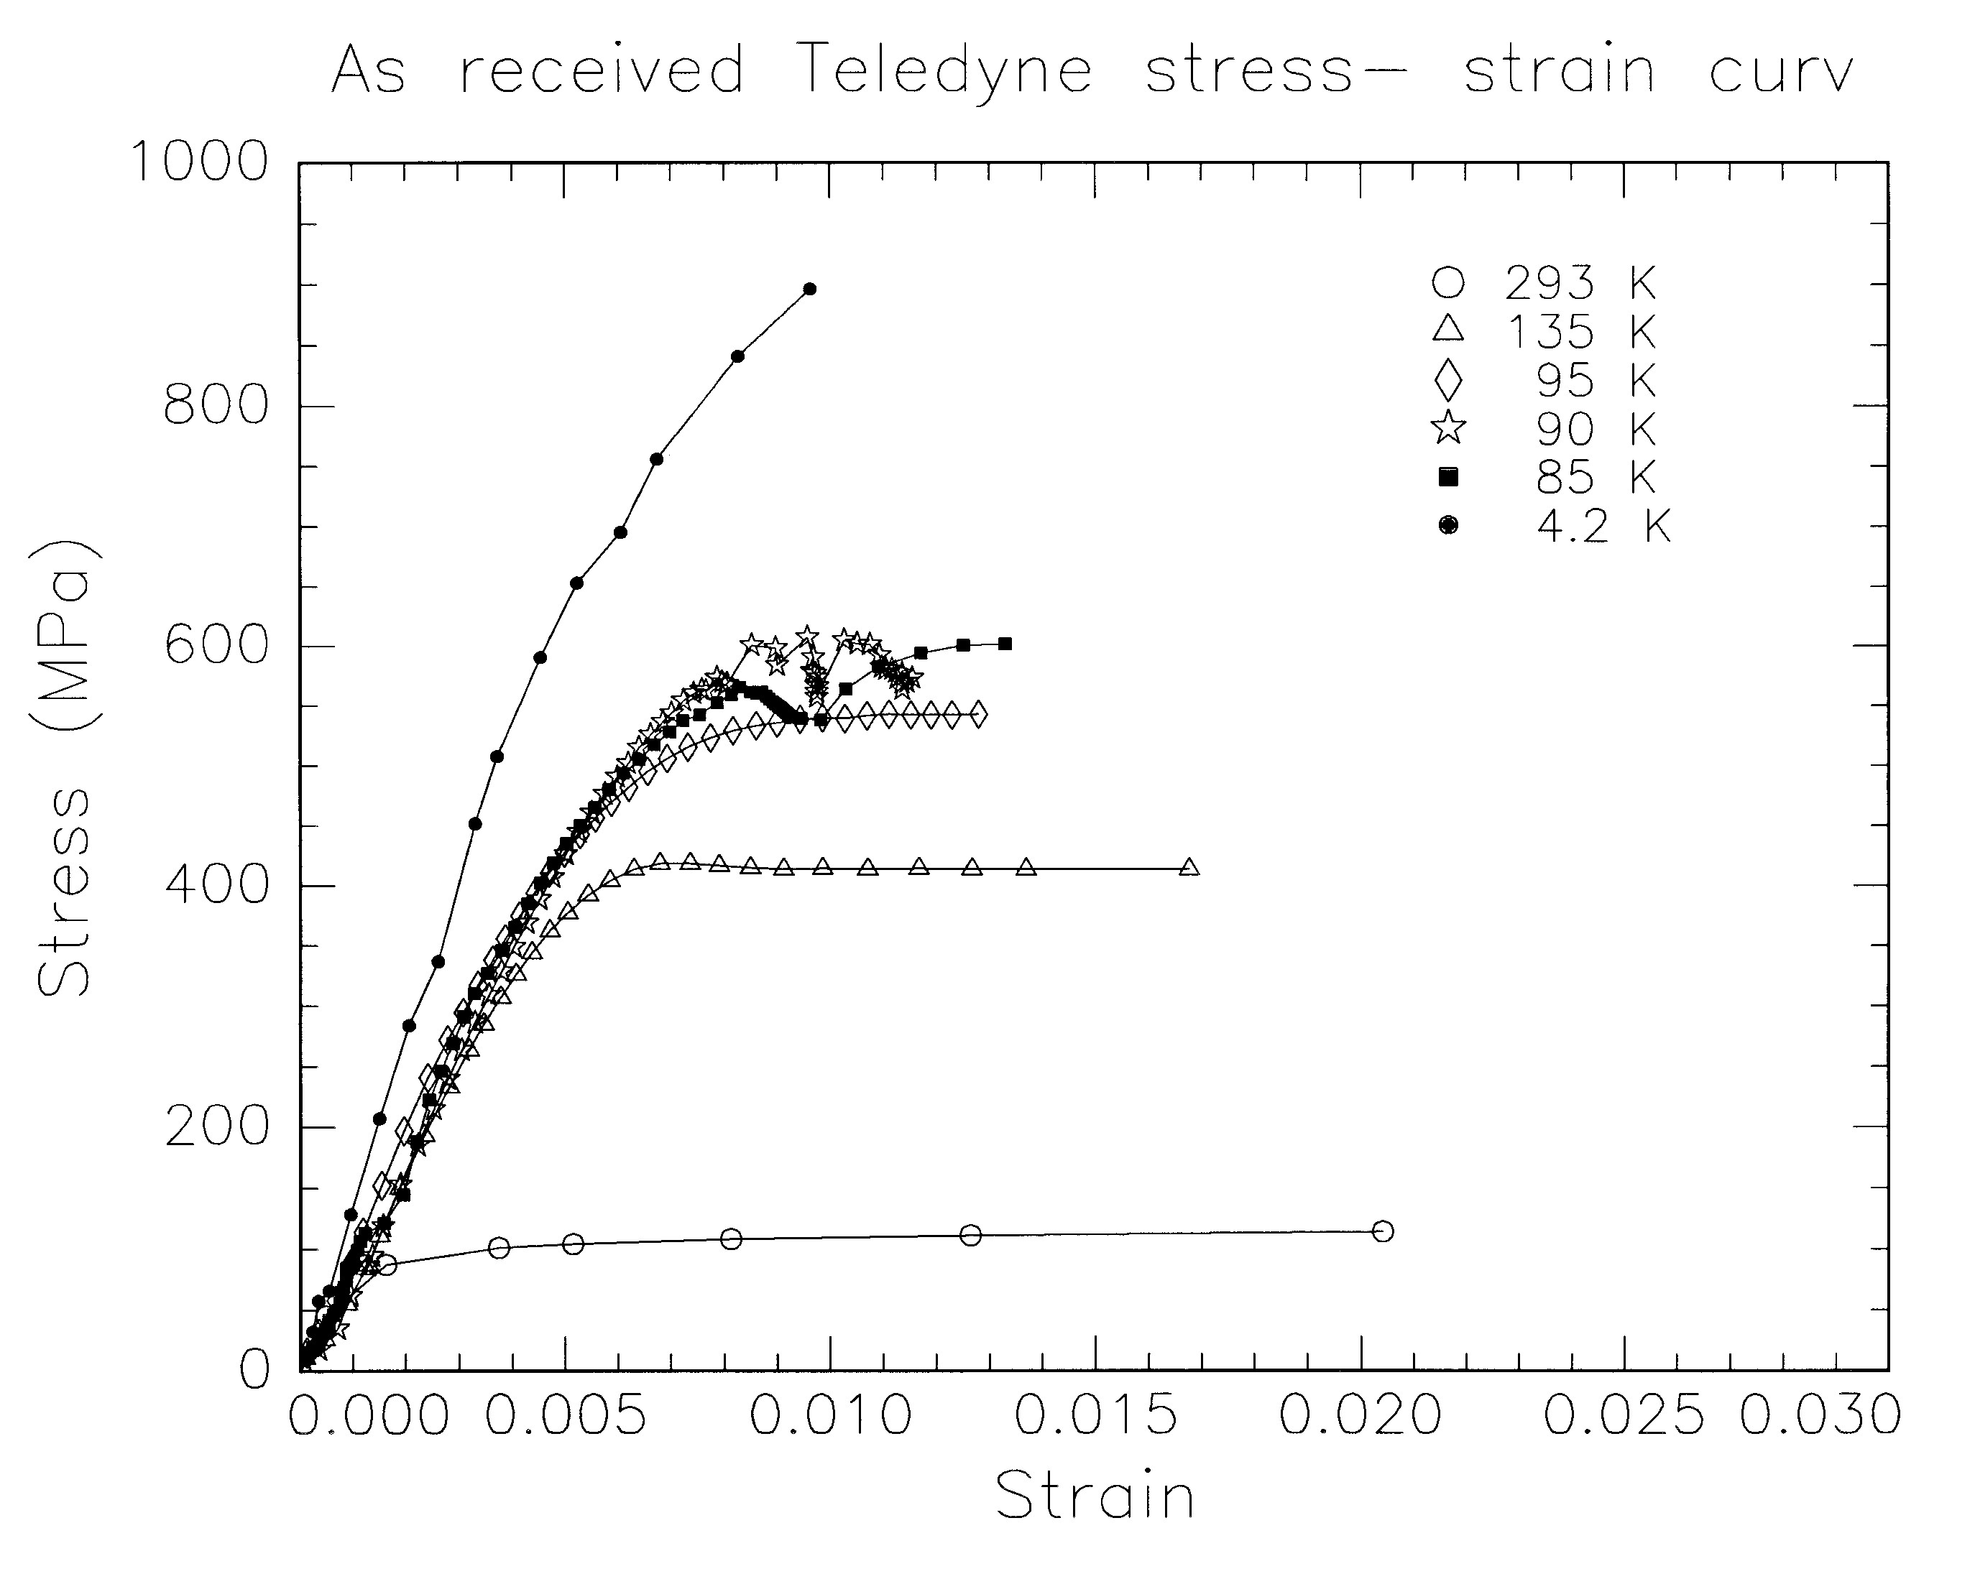
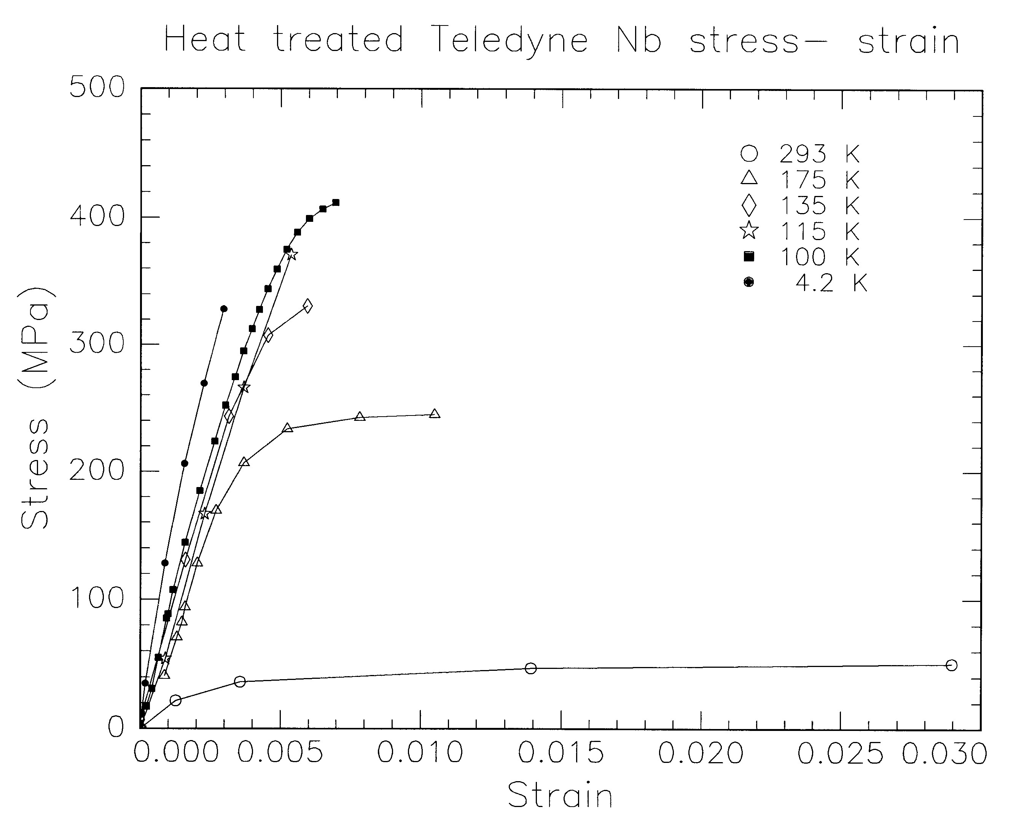
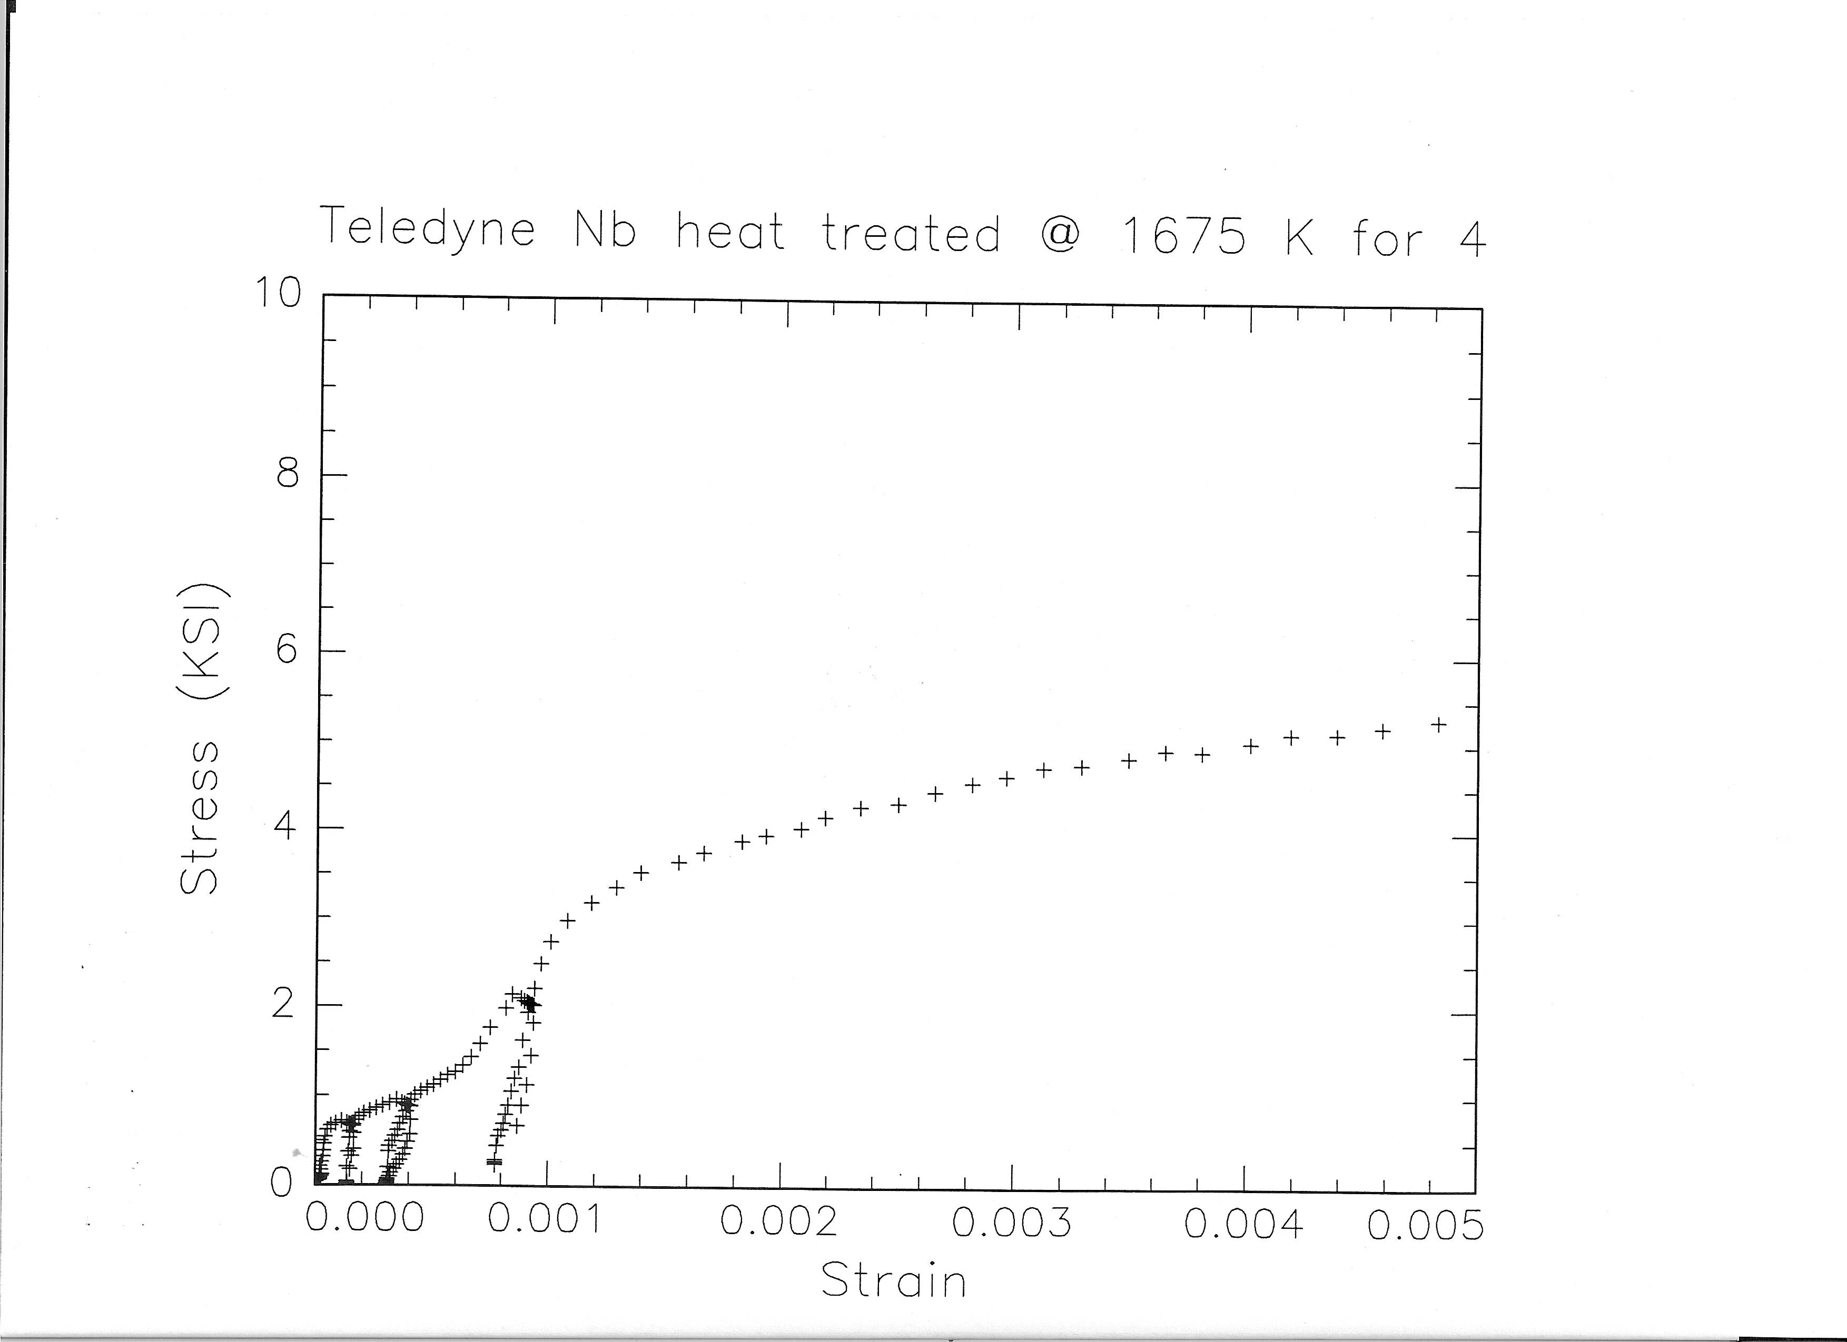
Pyrochlore Vs Columbite Nb
Pyrochlore
CBMM
Ta < 1000 wt ppm
Columbite
Ta ~ 200 wt ppm

Slide 41
Improved mechanical properties with 1400 C HT
R.P Walsh and D. M. McRae NHMFL 2012

Slide 42
What has been demonstrated
High RRR (~>300) is not essential
Fourth melt ingot Nb is OK
Tantalum up to 1300 wt ppm is fine
Ingot niobium technology demonstrated by DESY with conventional processes
Simplified JLab new processes provide a factor of ~ 4 Q₀ improvement

Slide 43
Cryogenic Refrigeration Cost Reduction with improved Qo (~factor of 3) CW SRF Cavities
A 10 kW 2 K refrigerator costs ~ 100 M$
A factor of 3 improvement in Qo will lower this to ~ 45 M$
The power consumption and hence the operating costs will be reduced by a third

Slide 44
Simplified process steps
Minimize the process steps
  Centrifugal barrel polishing ~ 100 micro meters
  High pressure ultra pure water rinse
  > 1400 C heat treatment
  High pressure ultra pure water rinse
  RF test
These simple steps are expected to minimize hydrogen
absorption

Slide 45
Process steps - fine grain Niobium
During this process foreign materials
can be embedded so QA is required

Slide 46
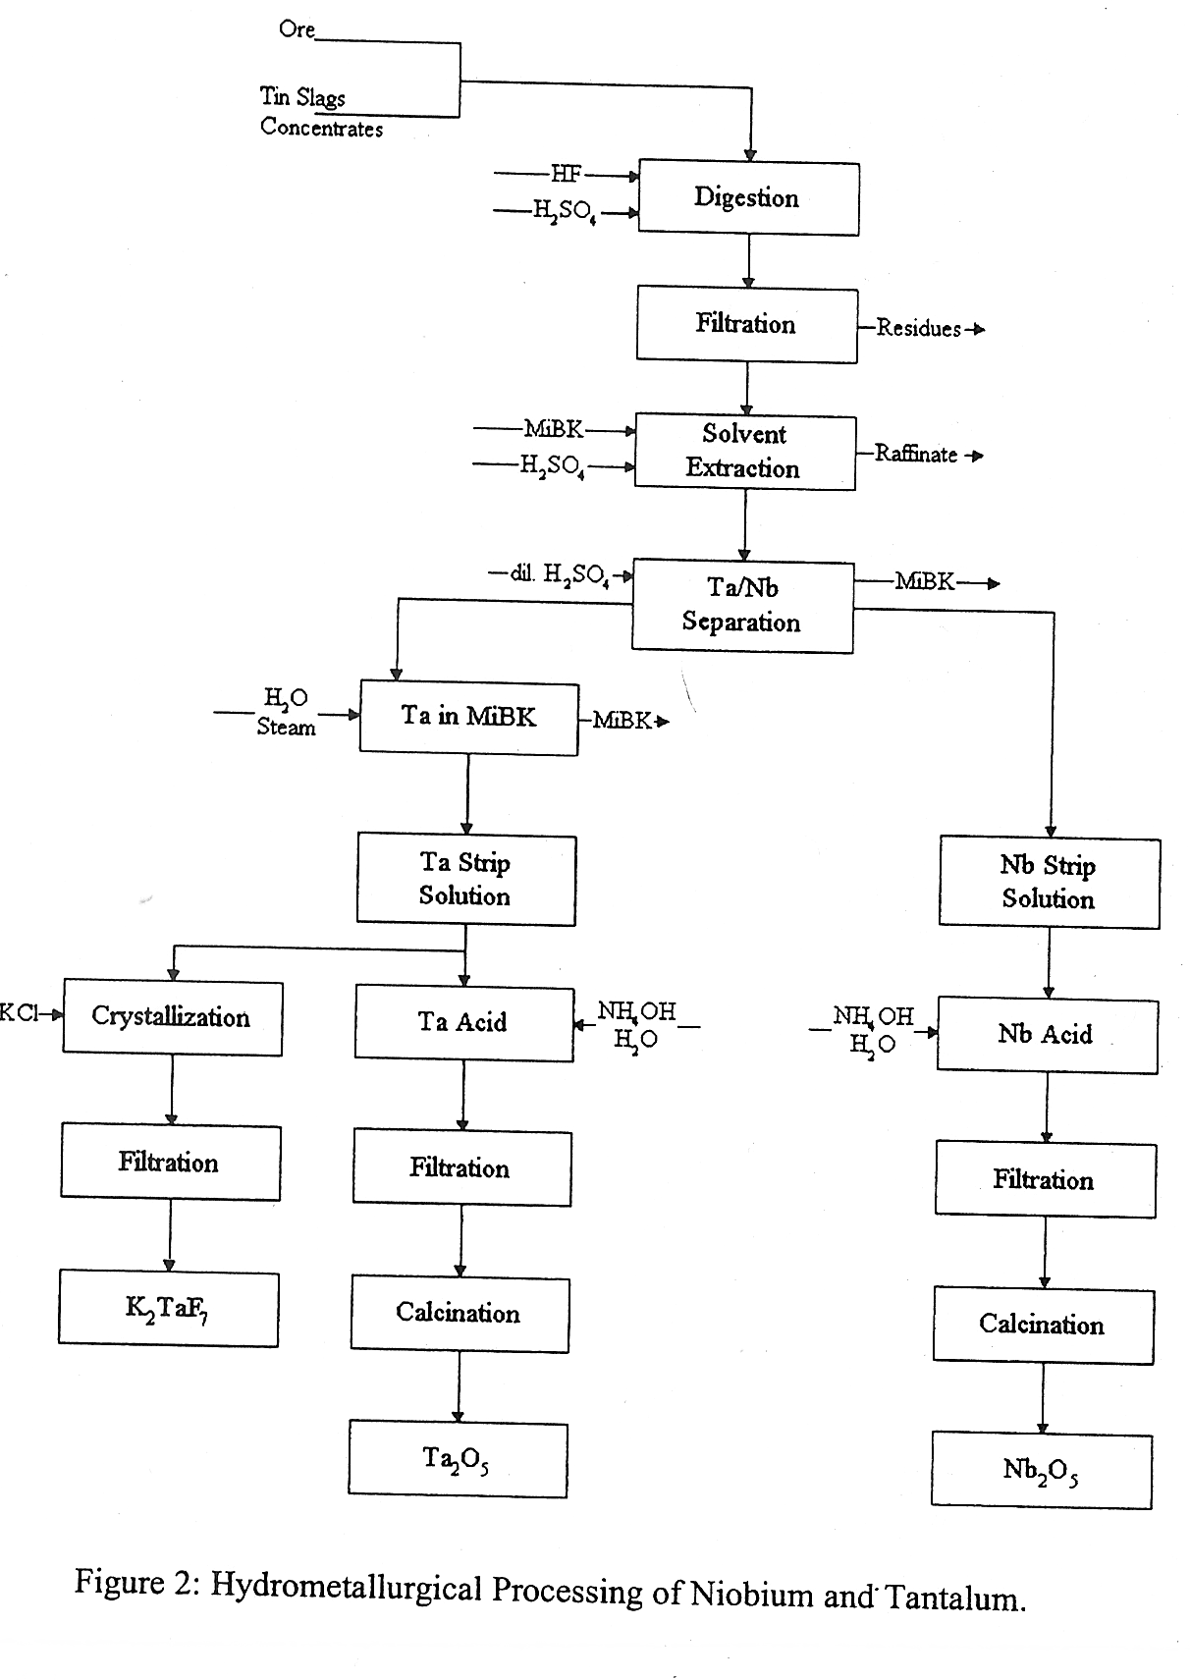
Current niobium derived from Cm/Ta Ore
Ta < 500 wt. ppm
Heraeus, Ninxia, Plansee, Tokyo Denkai and Wah Chang
Eckert et al in Niobium Science and Technology 2001

Slide 47
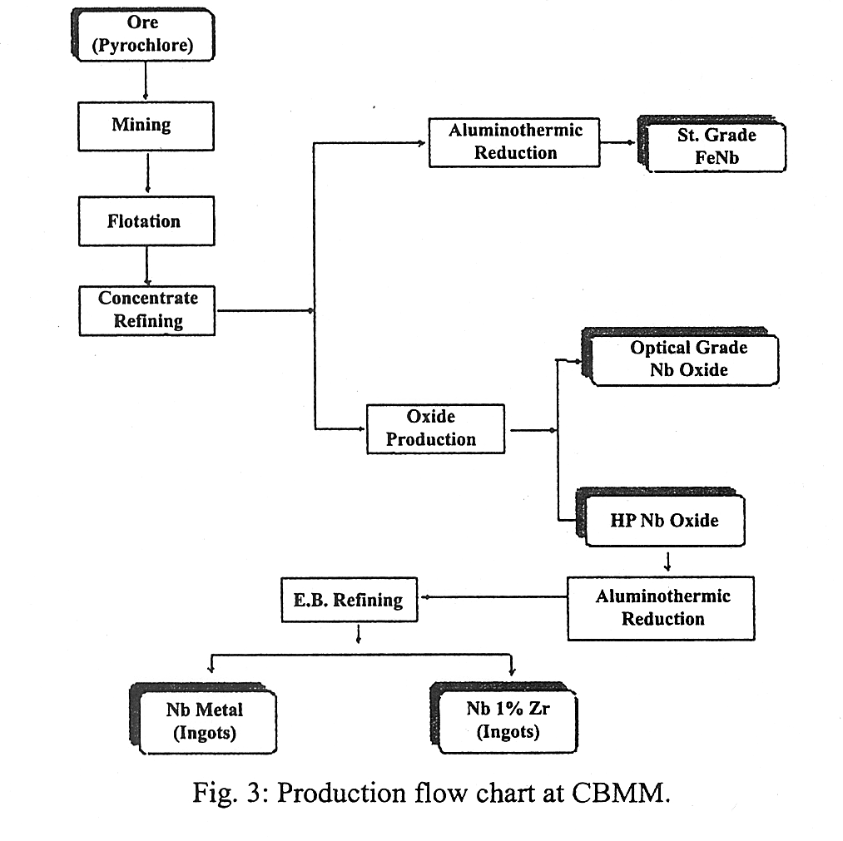
Ingot niobium from Pyrochlore Ore CBMM
Ta up to ~ 1500 wt. ppm
H. R. S. Moura in Niobium Science and Technology 2001

