Slide 1

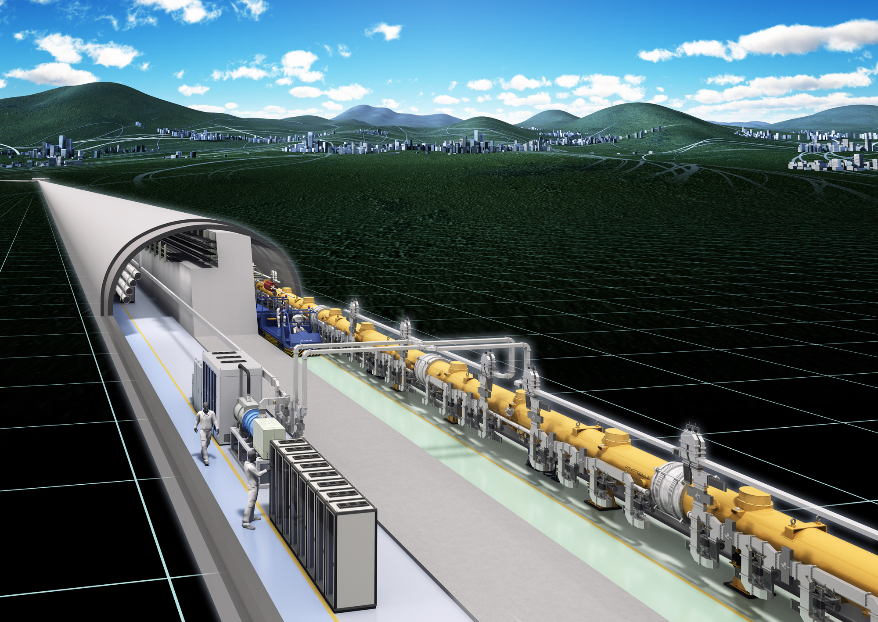
SRF Cavity Processing and Cavity Shape in Context of ILC in Japan
Reduce technical risk
Enhance discovery capability
Reduce cost
Rong-Li Geng
Jefferson Lab
NRI visit of JLab, November 13, 2015

Slide 2
Outline
Brief review and ILC TDR
New progress since TDR
Path forward and bright future
Conclusion

Slide 3
Brief Review
There is a long history of SRF technology development for a linear collider
  2013-present, ongoing effort coordinated by LCC
  2005-2013, intensive ILC high gradient coordinated by GDE
    JLab played a major role in collaboration with FNAL, KEK …
  1990-2005, TESLA collaboration
    now TTC collaboration
Successful SRF-based linear accelerator projects follow
  CEBAF 12 GeV upgrade
    80 new Low-loss cavities plus original 320 cavities in operation since early 90’s
  European XFEL
  LCLS-II

Slide 4
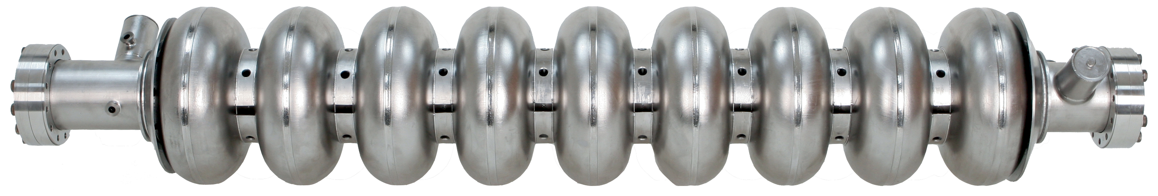
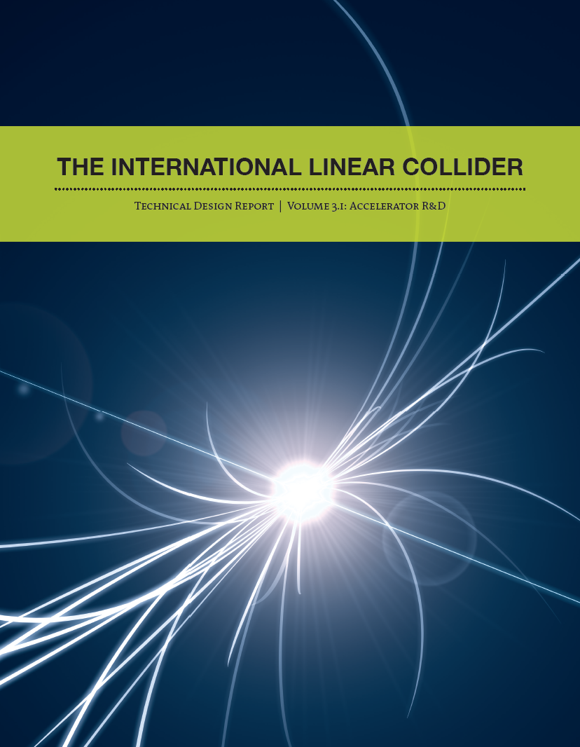
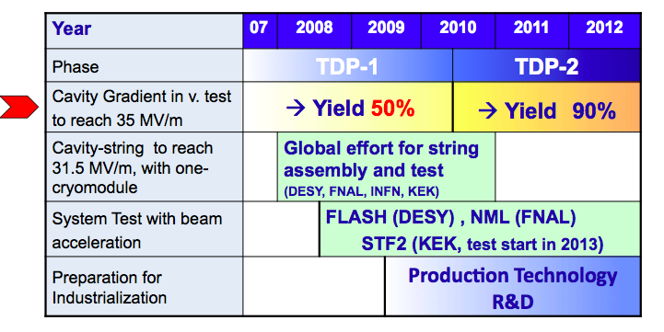
ILC TDR
There were competing technologies for future linear collider
  “warm” copper cavity
  “cold” SRF niobium cavity
2005 ITRP -> SRF technology
  Formation of GDE
Critical technology R&D topics/goals
June 12, 2013
ILC TDR published
S0
S1
S2

Slide 5
S0 – High Gradient Yield
Gradient is the single most important cost driver for ILC.
An ambitious goal was set in 2005: 35 MV/m!
With a yield of 90%!
Intensive gradient R&D effort coordinated by GDE Cavity Group: ANL, Cornell, DESY, FNAL, JLab, KEK…
Initially focused on cavity processing and handling.
  Repeatable electropolishing (EP)
  Reliable cleaning and handling
Later on expanded to include fabrication also.
Tracking progress by a dedicated cavity data base (134 cavities contained by time of TDR).

Slide 6
ILC High Gradient R&D at JLab
Nearly 60 distinct 9-cell cavities.
120 EP cycles; 200 cryogenic cavity vertical testing.
Cavities manufactured by industries, laboratories and universities in three regions world wide
  Europe: ACCEL/RI, Zanon, DESY
  US: AES, Niowave/Roark, JLAB
  Aisa: MHI, KEK, PKU, IHEP
    Later 7-cell CEBAF upgrade cavities by OSTEC
Personnel exchanges/training with international collaboration
  Many young scientists, including 5 from KEK, came to JLab for extended visit working on SRF technology.

Slide 7
Achieved ILC Cavity Performance at JLAB (2008-2010)
All TESLA-shape fine-grain Nb cavities
1.8K
ILC spec
Q₀=8×10⁹
Eacc=35 MV/m
2K

Slide 8
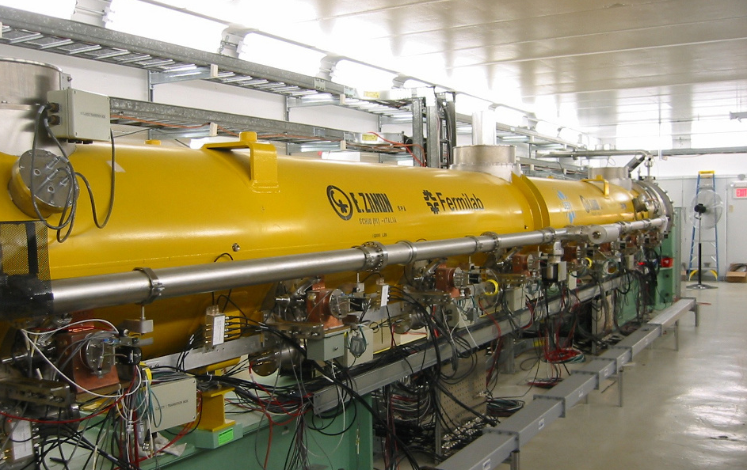
Achieving S1 Gradient Goal in the US
JLab delivered 8 qualified cavities, all exceeding 35 MV/m, to Fermilab for placement in CM2
Courtesy Elvin Harms, FNAL

Slide 9
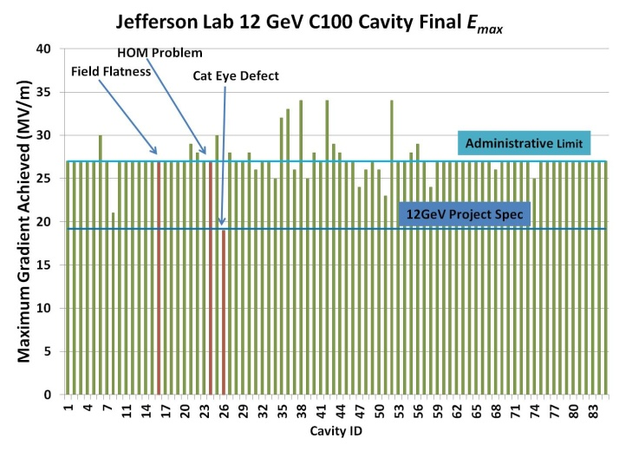
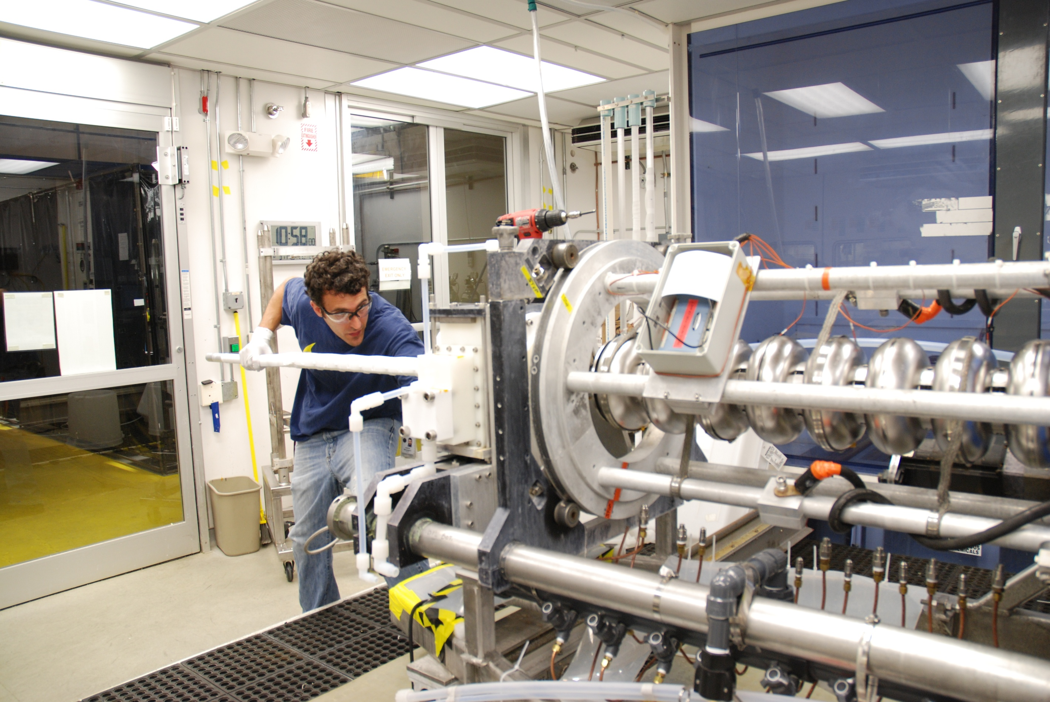
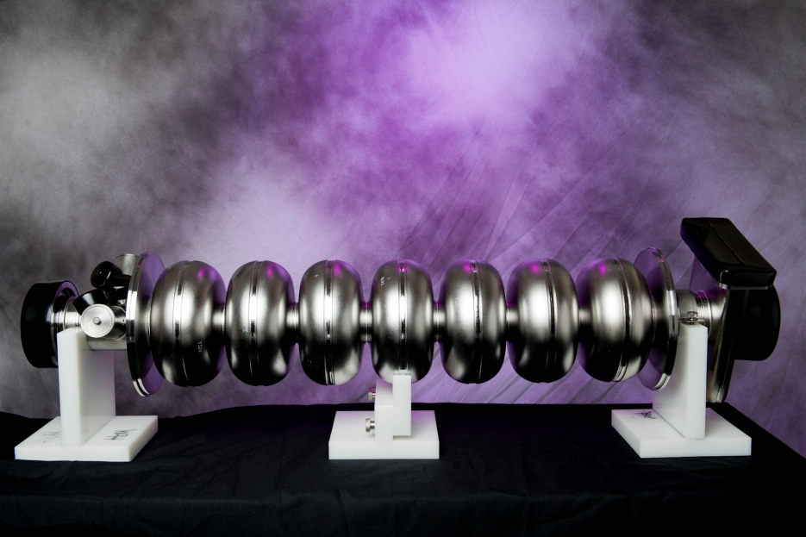
Application of ILC Proc. Recipe at JLab
80 7-cell Nb cavities for CEBAF 12 GeV upgrade project

Slide 10
S0 Conclusion & TDR Gradient Spec.
ILC gradient 35 MV/m on average for vertical qualification testing.
Allowing ±20% spread in gradient.
Allowing second-pass reprocessing:
  Re-HPR.
  Re-EP.
Allowing “repair” of cavities quenching at lower gradient
  Whole cavity barrel polishing
  Local grinding

Slide 11
New Progress since TDR Publication 2013
European XFEL cavity production in full swing
  800 TESLA shape cavities (ILC baseline shape)
  Validating ILC gradient production yield
CEBAF 12 GeV upgrade project completion
  80 new 7-cell Low-Loss shape cavities
  Validating ILC alternate cavity shapes
LCLS-II project switching from normal conducting RF to SRF technology
  Driving SRF R&D to raise Q0
  Synergy with concept of “Green ILC”

Slide 12
E-XFEL: Achieving ILC Gradient Spec in Real Production
For RI cavities, which are processed using the ILC style recipe.
As received, avg 33 MV/m with 86% yield at Eacc≥ 28 MV/m.
With second-pass reprocessing, average 33-36 MV/m anticipated.
Demonstrating ILC gradient spec in real production
738 cavities as of September 2015
  from two vendors, RI and EZ
EZ vendor used Bulk EP and Final BCP
RI vendor use Bulk EP & Final EP (as for ILC)
Final EP gives 3 – 4 MV/m higher performance

Slide 13
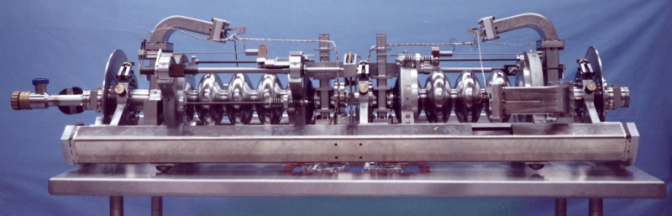
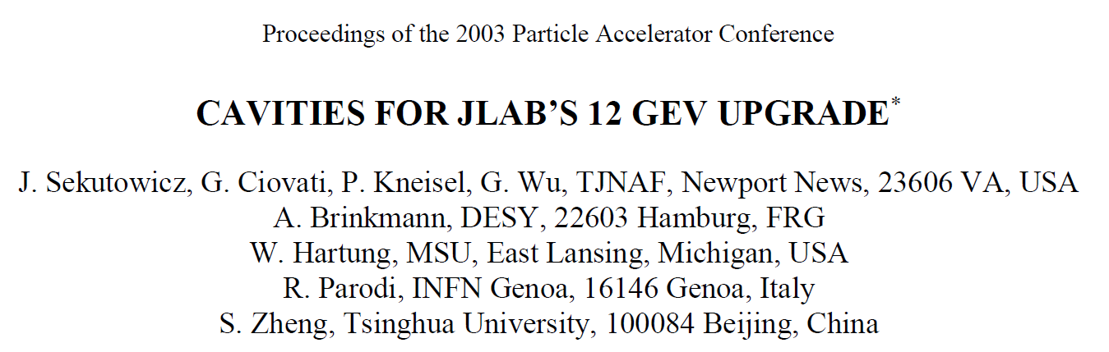
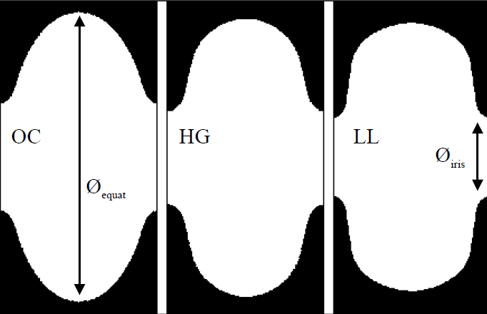
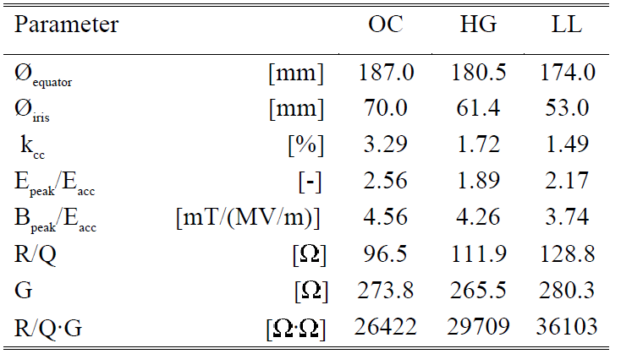
CEBAF Cavity Shape Evolution

Slide 14
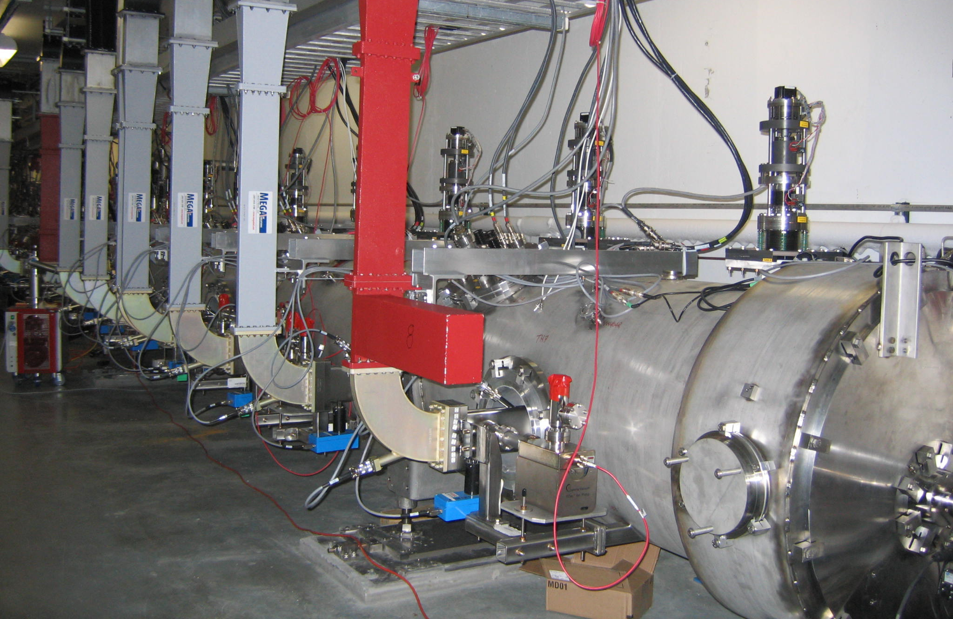
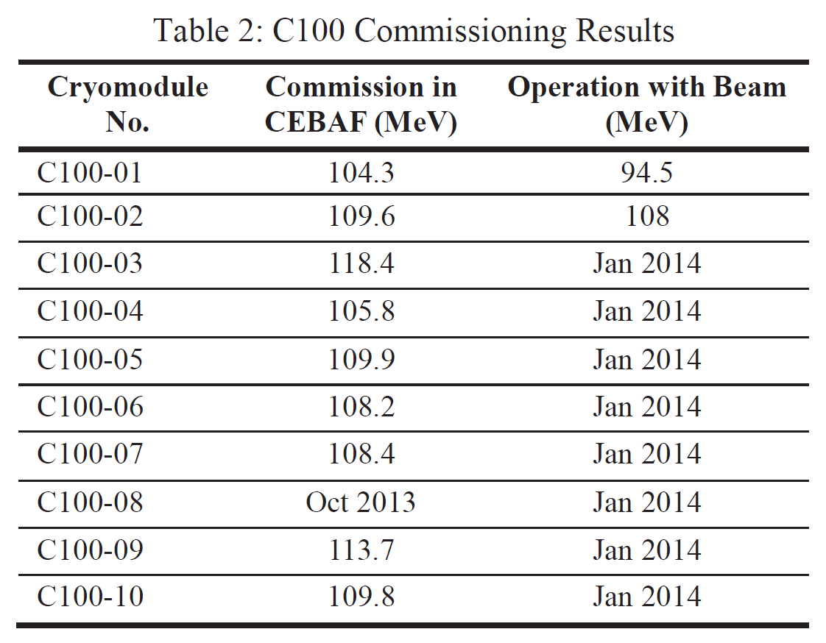
CEBAF LL Shape Cavity Accelerating Beam
J. Hogan et al., PAC2013, WEZAA2

Slide 15
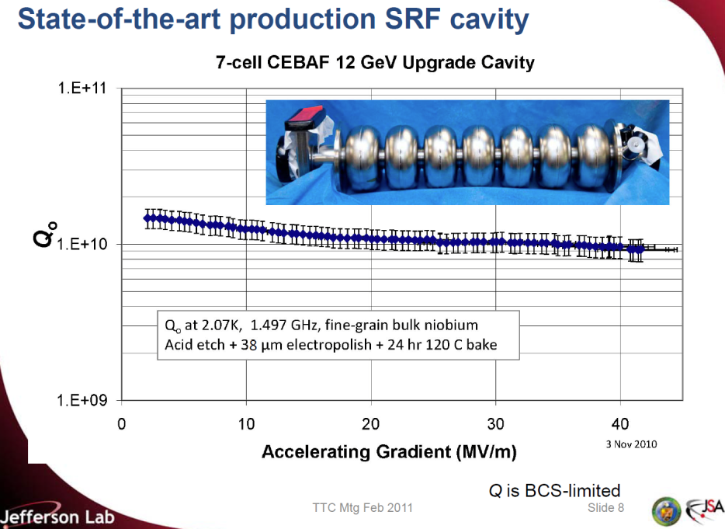
CEBAF LL Shape Cavity Reaching High Gradient
ILC-style final surface processing
C. Reece, TTC Meeting, Feb. 28-Mar.3, 2011

Slide 16
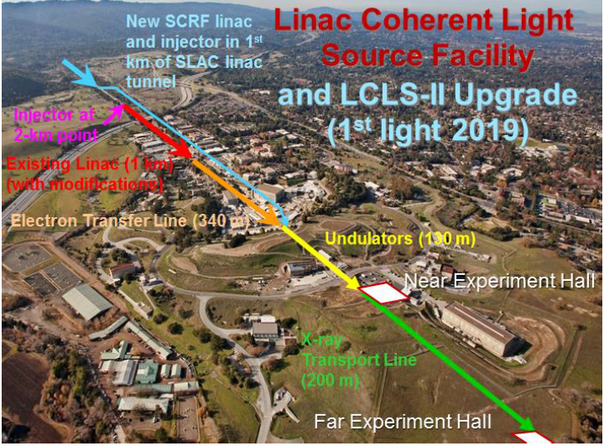
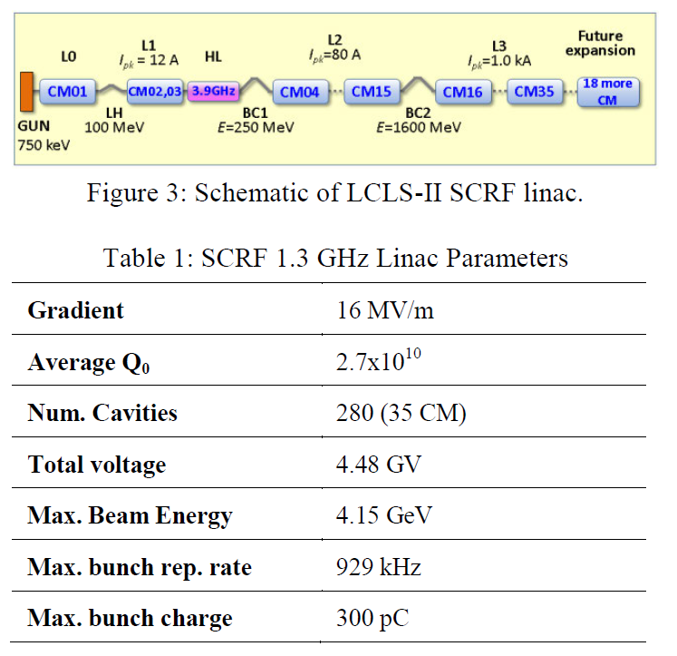
LCLS-II Extension
Adapt TTF/XFEL/ILC 9-cell cavity for CW operation
Nitrogen doping
for high Q0
T. Raubenheimer, IPAC15

Slide 17
Path Forward
High efficiency high gradient (HEHG) SRF a fundamental accelerator physics and technology issue with applications to ILC as well as many other machines
  Better cavity shapes (RE, LL/ICHIRO, LSF)
    “immediate” gain in gradient
    “guaranteed” saving in cryo capital cost & accelerator operation cost
  Better material (Large-Grain/Medium-Grain ingot niobium)
Use the same successful ILC baseline cavity processing technology which is already well practiced in world-wide labs as well as in industry and has been successfully applied to CEBAF accelerator and E-XFEL project.

Slide 18
HEHG Cavity Shapes: Design
 |  | TESLA | Low-loss/ICHIRO | Re-entrant | Low-surface-field
frequency | MHz | 1300 | 1300 | 1300 | 1300
Aperture | mm | 70 | 60 | 60 | 60
Epk/Eacc | - | 1.98 | 2.36 | 2.28 | 1.98
Hpk/Eacc | mT/(MV/m) | 4.15 | 3.61 | 3.54 | 3.71
Cell-cell coupling | % | 1.90 | 1.52 | 1.57 | 1.27
G*R/Q | Ω² | 30840 | 37970 | 41208 | 36995
Z. Li, C. Adolphsen, A New SRF Cavity Shape with Minimized Surface Electric and Magnetic Fields for the ILC, LINAC08 (2008).
R.L Geng et al., Development of Ultra High Gradient and High Q0 Superconducting Radio Frequency Cavities, IPAC13 (2013).
50 MV/m capable due to lowered Hpk/Eacc
20% more efficient as compared to TESLA shape
Lowered risk in field emission by keeping Epk/Eacc the same as TESLA shape
“Stupid not to do this!” Hitoshi Murayama @ LCWS15

Slide 19
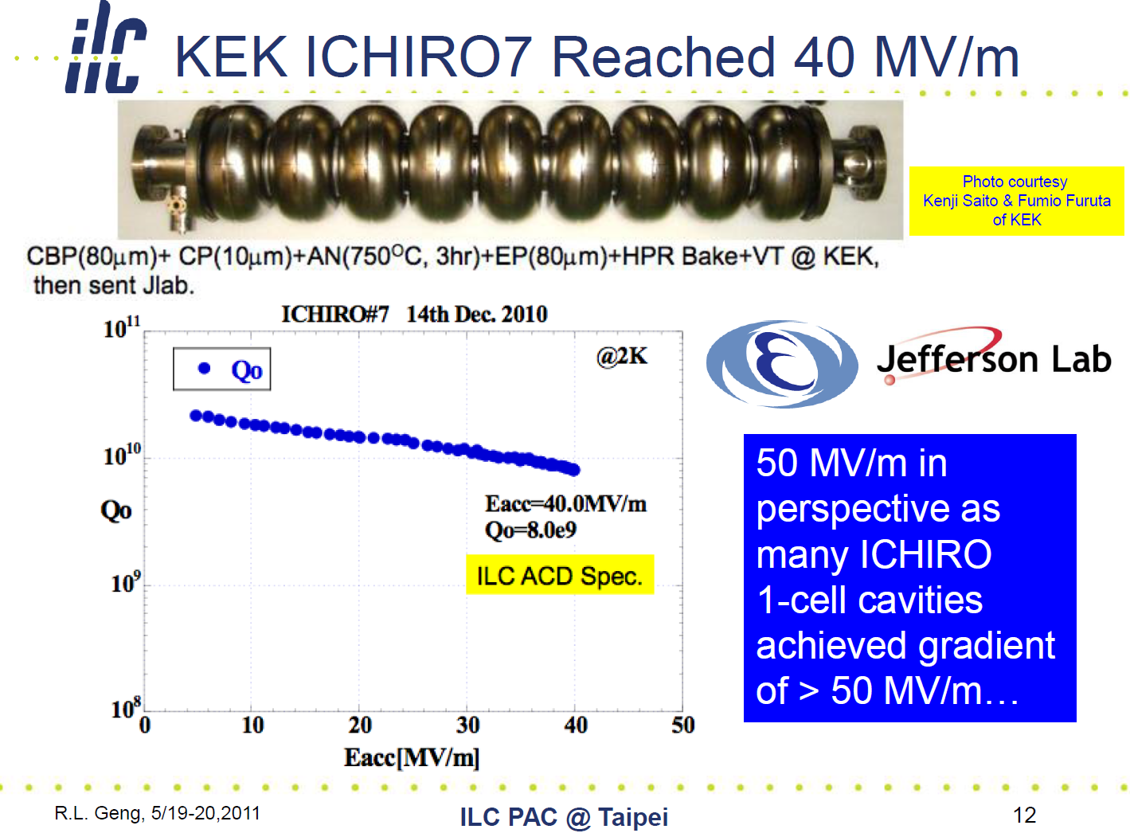
HEHG Cavities Lessons Learned:
LSF shape
Lowering Hpk/Eacc without sacrificing Epk/Eacc
Field emission can not be ignored!

Slide 20
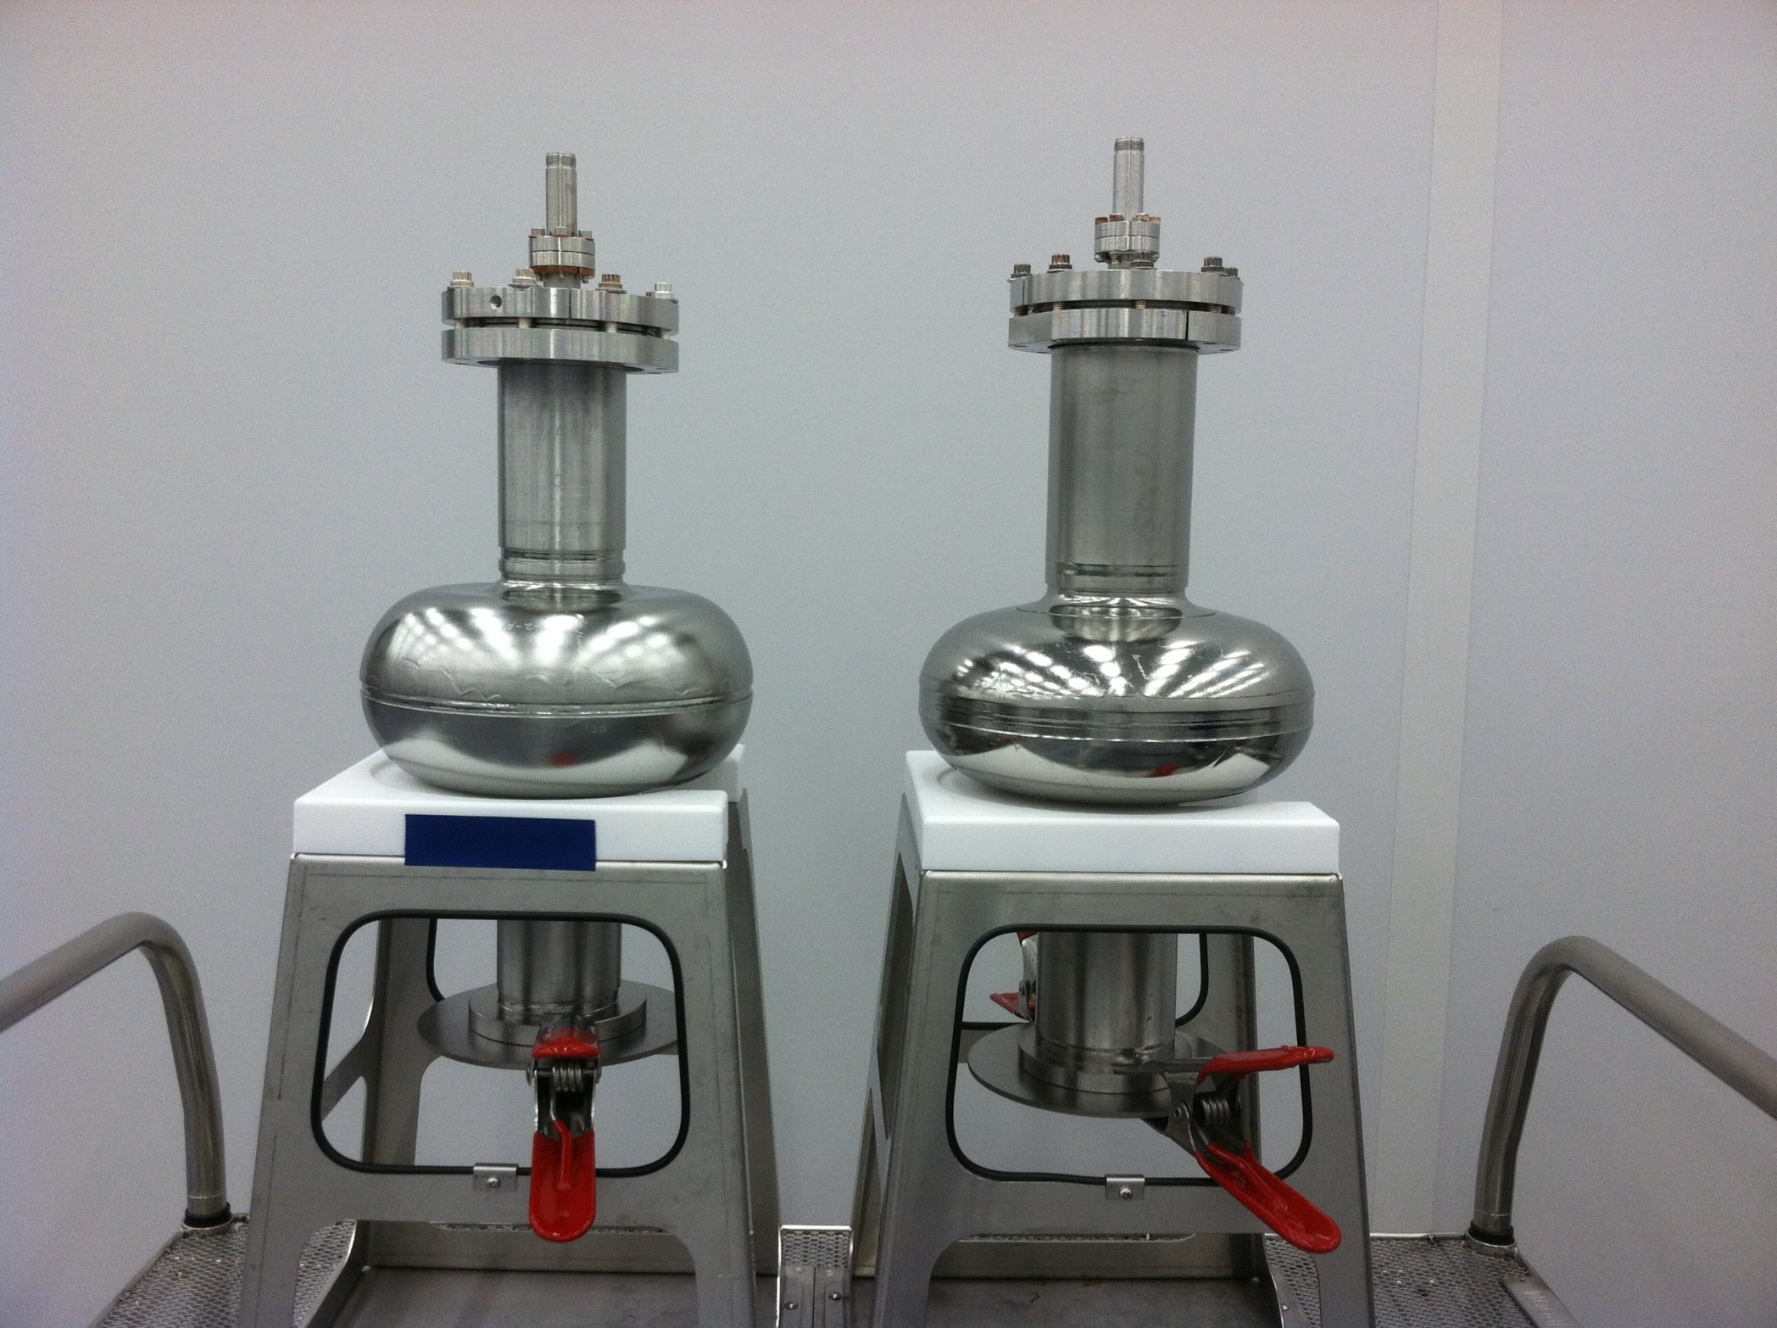
LSF
TESLA

Slide 21
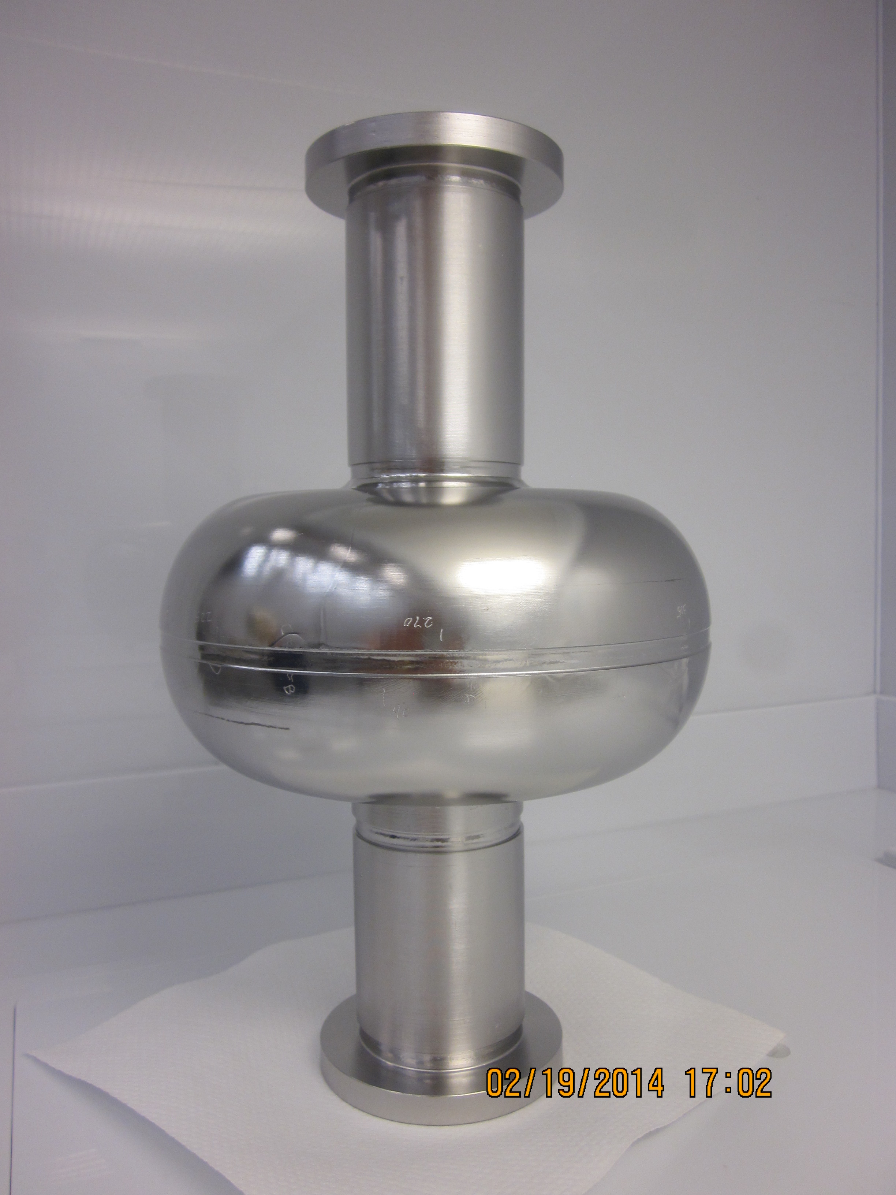
LSF Prototype Cavities
Two single-cell LSF shape cavities built and tested.
Large-grain Nb.
Both reached 37-38 MV/m without field emission
  BCP so far.
  EP next to raise gradient.
Parts for first 9-cell prototype in hand, seeking funding to continue.

Slide 22
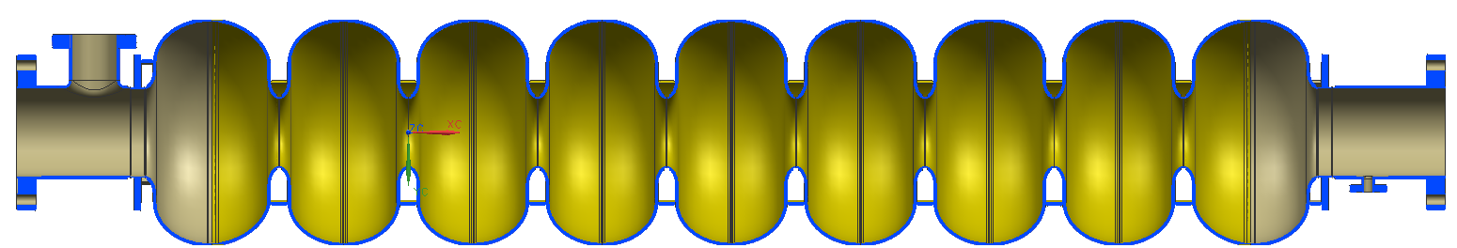
Right Cavity Shape: LSF for ILC
LSF shape for ILC
TTF shape for E-XFEL
LL shape for CEBAF

Slide 23
Work to be Done Next
Reduce field emission up to Epk ~ 100 MV/m
  Critical for all SRF machines, in particular stable operation
Eliminate Q-slope up to Hpk ~ 200 mT
  Origins still unclear, even for Nb
  Key issue to viability of any “new” material
Recent progress in high Q₀ cavity for medium gradient (Hpk ~ 70 mT) shown good results
  Can these good results extended to high gradient?

Slide 24
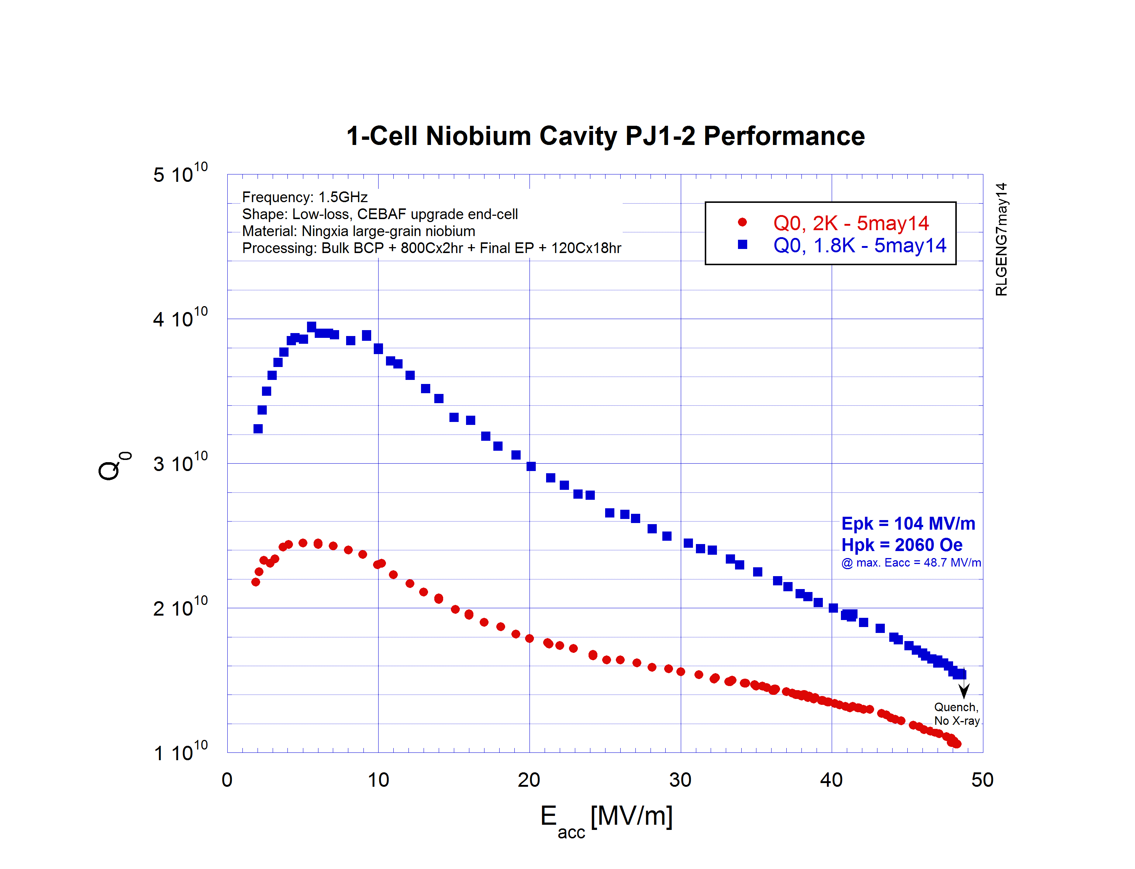
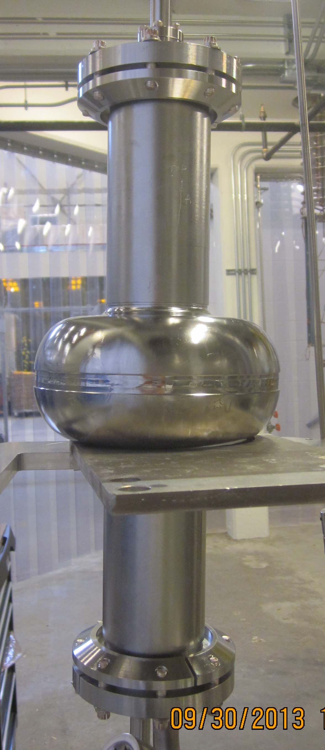
Most Recent Progress (1)
LG cavity PJ1-2 (JLab-PKU-OTIC collaboration)
1.5 GHz, CEBAF upgrade Low-Loss Shape
OTIC Large Grain Nb
Cavity processing: Bulk BCP + 800Cx2hr
Final Processing: EP 30 um + 120Cx18hr
IPAC15, WEPWI013

Slide 25
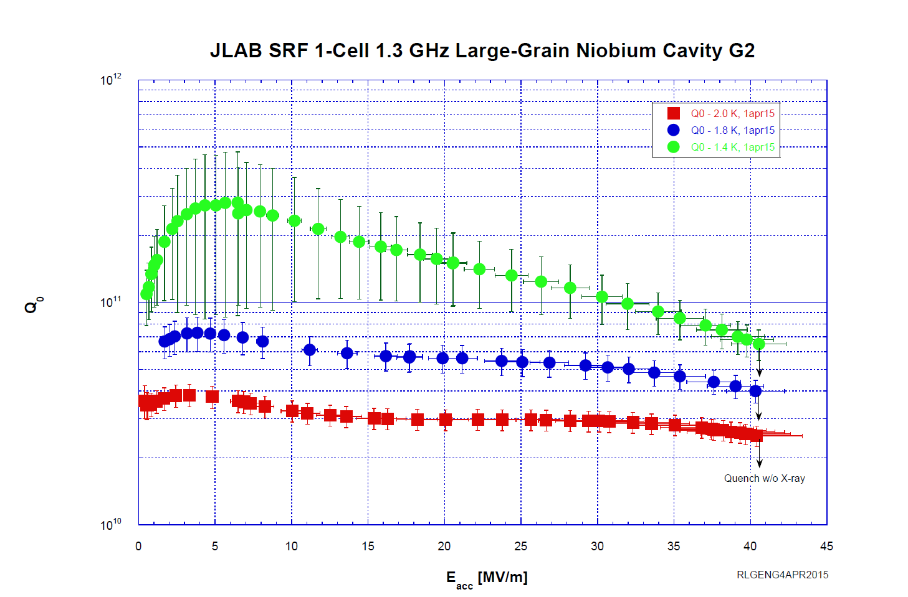
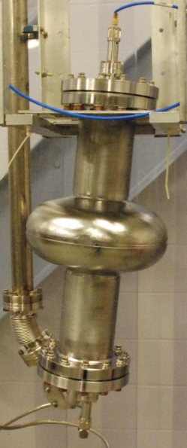
Most Recent Progress (2)
1.3 GHz, TTF shape
Tokyo-Denkai Large-Grain Nb
IPAC15, WEPWI013

Slide 26
FG Single + EP
FG End-single + EP
Bright future
FG 9-cell + EP
LG single + BCP
LG 9-cell + BCP
G2 1.8K
PJ1-2 1.8K
1 TeV ILC
Goal set in TDR
ILC baseline (2.0K)
F. Furuta et al., International Symp. On Supercond. Sci. & Tech. of Ingot Niobium, Sept. 22-24, 2010.

Slide 27
ILC is inevitable
next machine!

Slide 28
Conclusion
ILC baseline SRF cavity technology firmly established. SRF Technology is ready to go!
New SRF progresses in better alternative cavity shape and material since TDR publication point to strong evidence that enormous rooms are out there for evolving the ILC SRF technology to (1) save cost; (2) enhance capability; (3) reduce risk.
2-3 years needed for negotiation between Japanese and other governments provide perfect time for completing the alternative cavity work before ILC construction start in Japan.
HEHG SRF cavity has many applications besides ILC, its development will continue anyway.
Best wishes for ILC in Japan!

