Slide 1
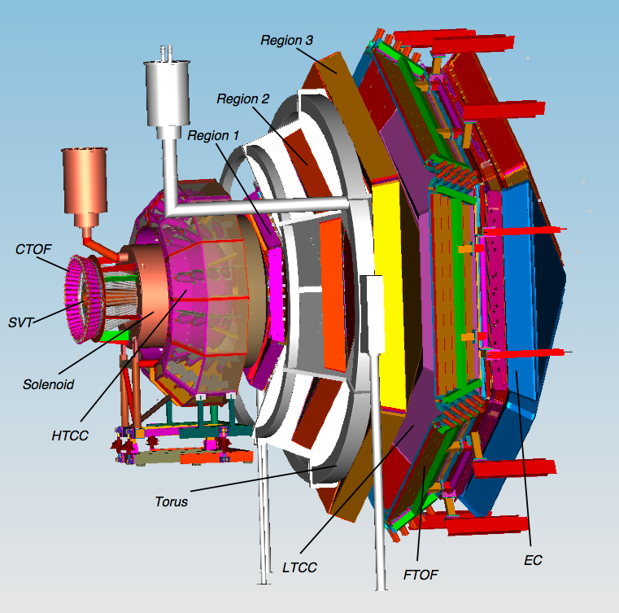
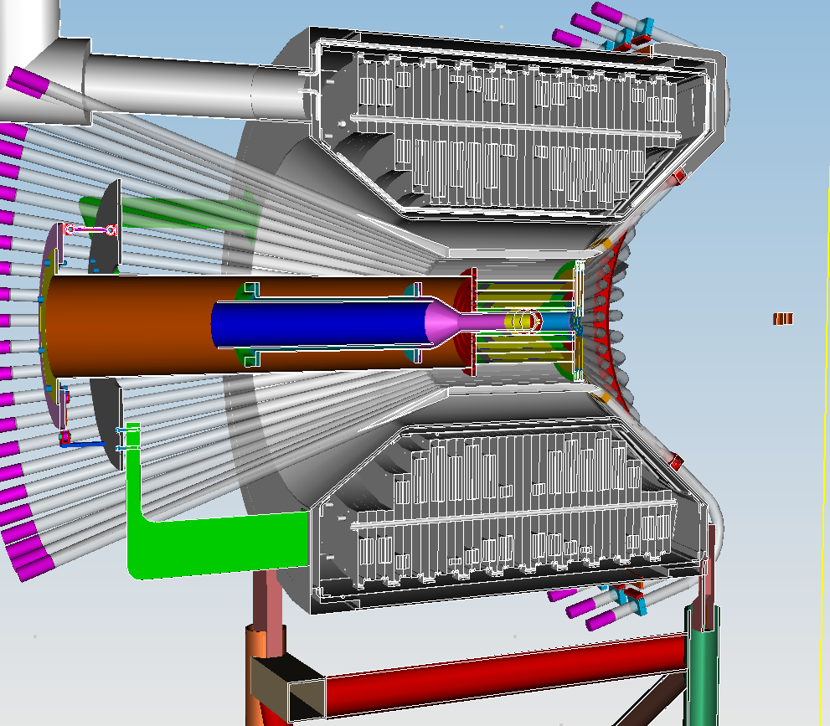
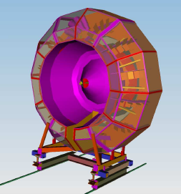
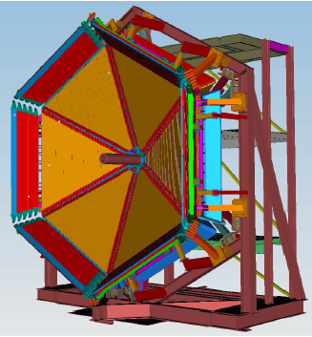

CLAS12 Subsystem Calibration Status and Plans
(An Overview)
Daniel S. Carman
Jefferson Laboratory
First CLAS12 Experiment Workshop
October 20, 2015

Slide 2
CLAS12 CALCOM
The CLAS Collaboration has developed a comprehensive plan to commission the CLAS12 spectrometer and its subsystems
An essential part of this work is the development
of the approaches and software for calibrations
Three phases:
  Quality assurance and system checkout
  Commissioning without beam
  Commissioning with beam
Detailed plan for each CLAS12 subsystem based on input from detector groups
  Procedures and tasks
  Manpower and time
  Software resources

Slide 3
Forward Carriage EC/PCAL/FTOF

Slide 4
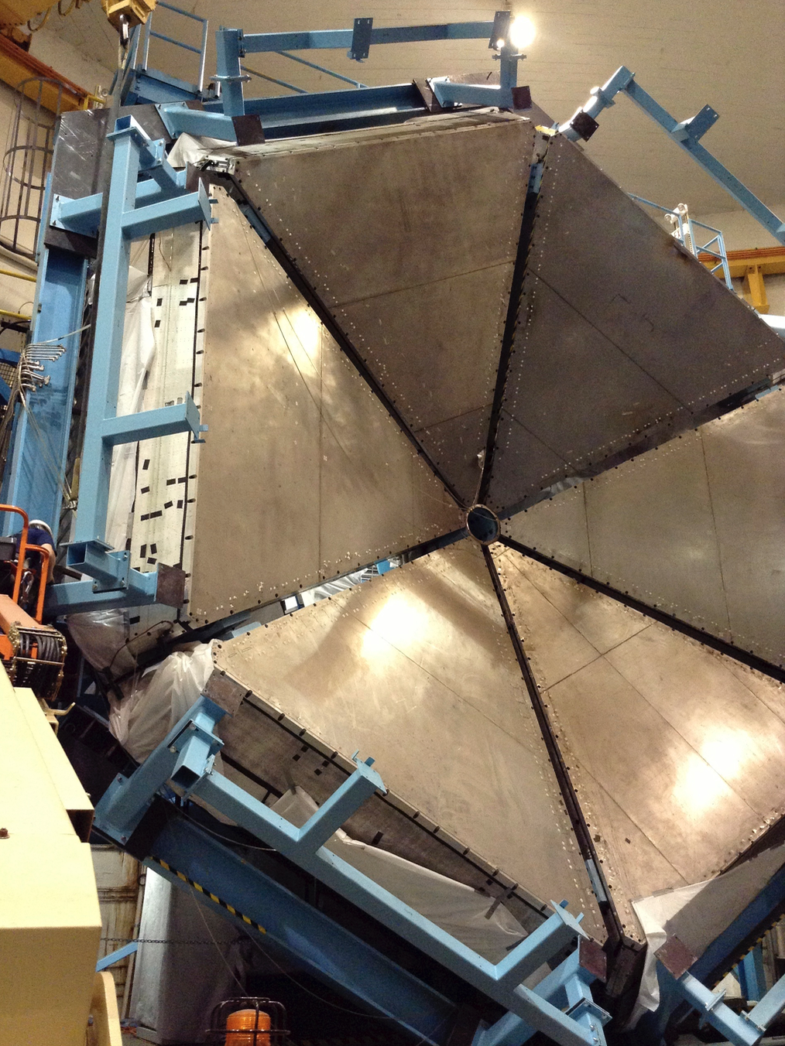
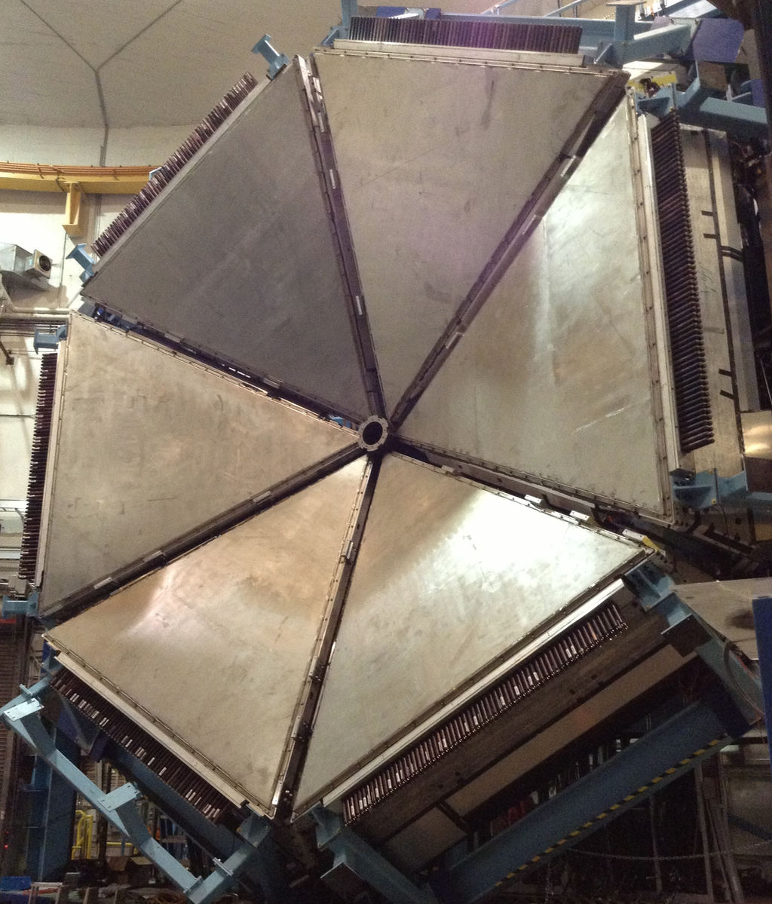
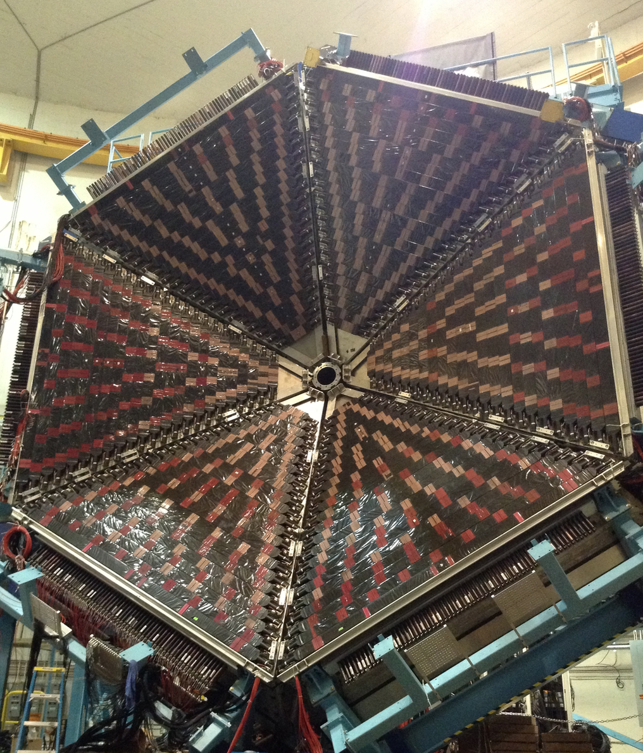
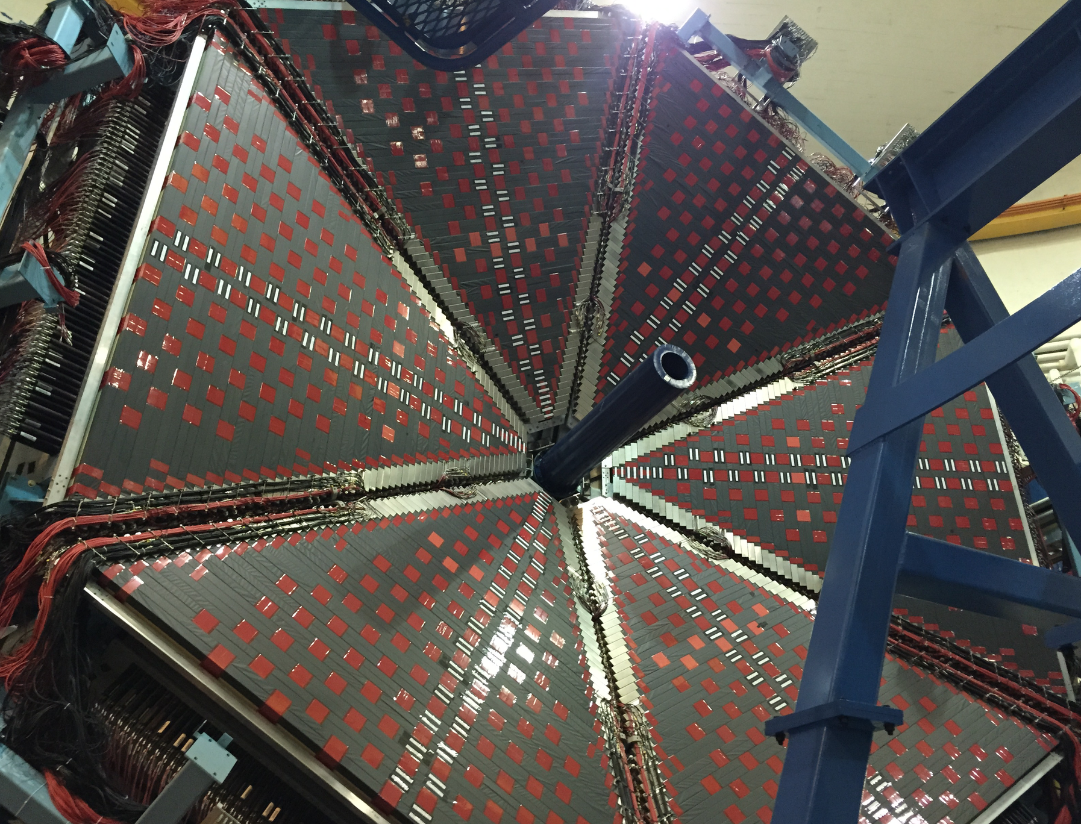
Forward Carriage Commissioning
EC
PCAL
FTOF Panel 1A
FTOF Panel 1B
Detector Status:
PMT gains and occupancy of PCAL and FTOF largely stable after 1½ years of running
EC issues:
  Light leaks opened up due to disturbance of taped seams during cable installation
  CAEN HV repairs (5 boards and a power supply returned)
  Some electronics cabling was postponed until patch cables were available; now mostly finished and full checkout of EC should be completed by end of 2015.
Next major goal is development of energy sum / cluster trigger in Crate Trigger Processor (CTP) when hardware becomes available in early 2016
“Final” EC/PCAL cosmic calibration will use CTP-based trigger for greater flexibility and efficiency studies of both detectors and trigger
Notes:
This is to show an example of a detector where experts are in the process of developing the algorithms starting from legacy software
One of the first efforts that was started is focused on the development of energy calibration tools for the forward em calorimeters, the EC-Pcal systems
This work Is critical because these system are the basis for the CLAS12 electron trigger that requires online cluster recognition with good and uniform spatial and energy resolution
For this reason, it is necessary to know and monitor online calibration parameters such as ….
The calibration software has to be run online, being able to…

Slide 5
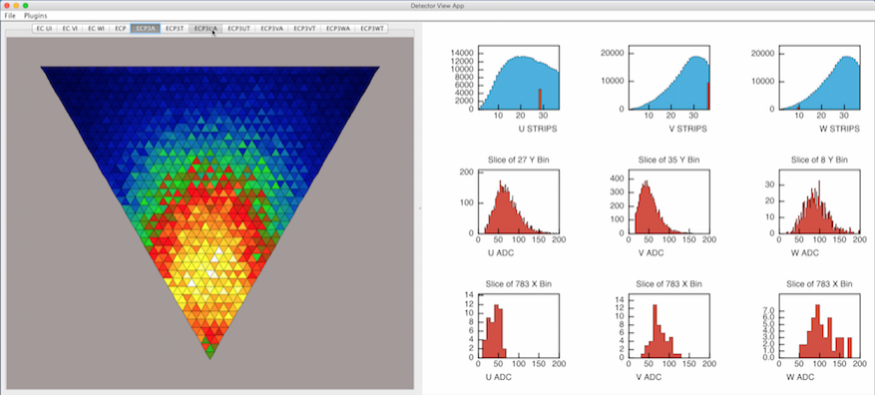
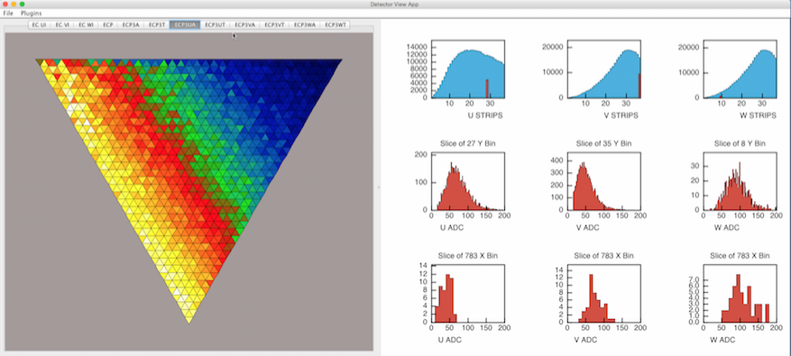
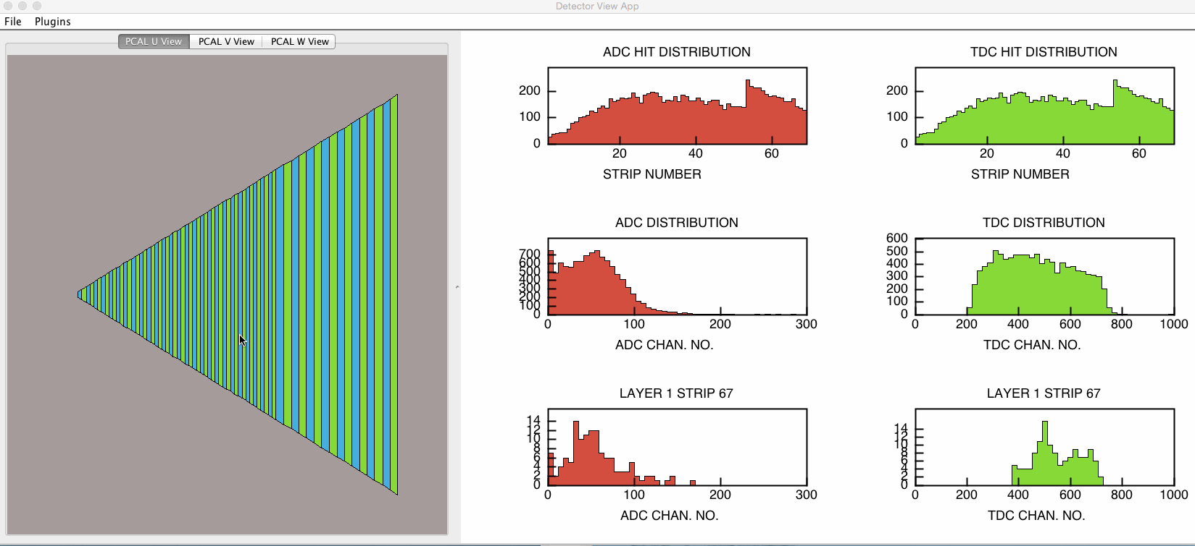
EC/PCAL Calibration
EC: Number of events per pixel
COATJava GUIs developed to display raw and filtered data relevant to EC / PCAL energy and timing calibration
GUIs currently use legacy code for isolating suitable muon tracks (pixel cut) - plan is to replace this code with online ECReconstruction service (EcRec)
EC Calibrator (EcCal) will perform fitting and display of calibration results (gains, attenuation lengths, timing offsets, and other constants)
EC: Average ADC per pixel
ETJava
EcRec
EcCal
CCDB
Work in progress:
ETJava service, DAQ/CLON prep (Gagik G., Sergei B.)
EcRec, CCDB tables (Cole Smith)
Schedule:
Oct-Nov: Forward Carriage testing of ETJava + event decoder + EcRec
End of 2015: EcCal ready for testing service chain outlined above - needs to be in place for testing CTP trigger (EcRec vs. FPGA based cluster finding) in 2016.
PCAL:
Browser

Slide 6
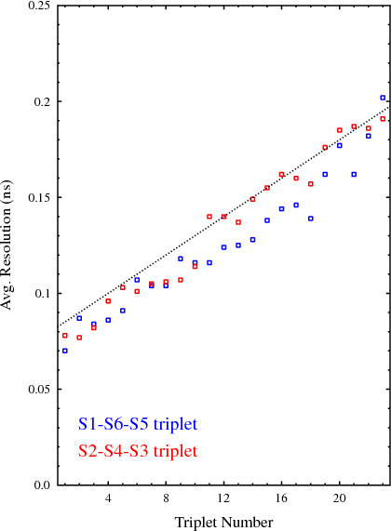
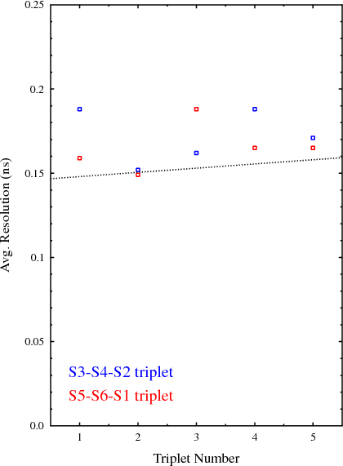
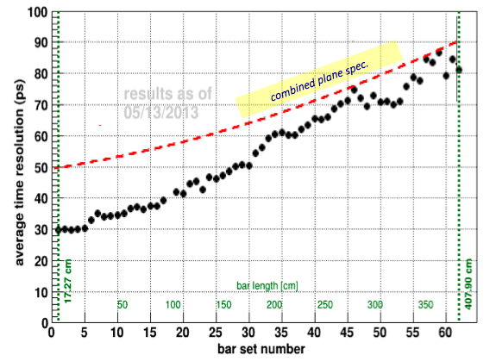
FTOF Status Overview
Panel-1a
Panel-2
FTOF Timing Calibrations
Bench testing with cosmic rays showed that all counters met or exceeded design requirements
FTOF Calibration Status:
Forward Carriage cosmic tests in progress:
  Noise studies
  Gain matching
  Attenuation length measurements
  Efficiency measurements
  Geometrical matching (EC,PCAL,FTOF)
  Long-term stability studies
  Calibration tools development
Panel-1b

Slide 7
FTOF Calibration COATJAVA Suite
Development status:
Calibration area | COATJAVA development status
Geometric mean / Log ratio | In progress
Effective velocity | In progress
Left-right adjustment | In progress
Attenuation length | In progress
Time-walk correction | Planned
Counter status | Planned
TDC | Planned
RF offset | Planned
P2P constants | Planned
⬅
Developing algorithm in C++/Root framework
Haiyun Lu, Louise Clark
Notes:
7

Slide 8
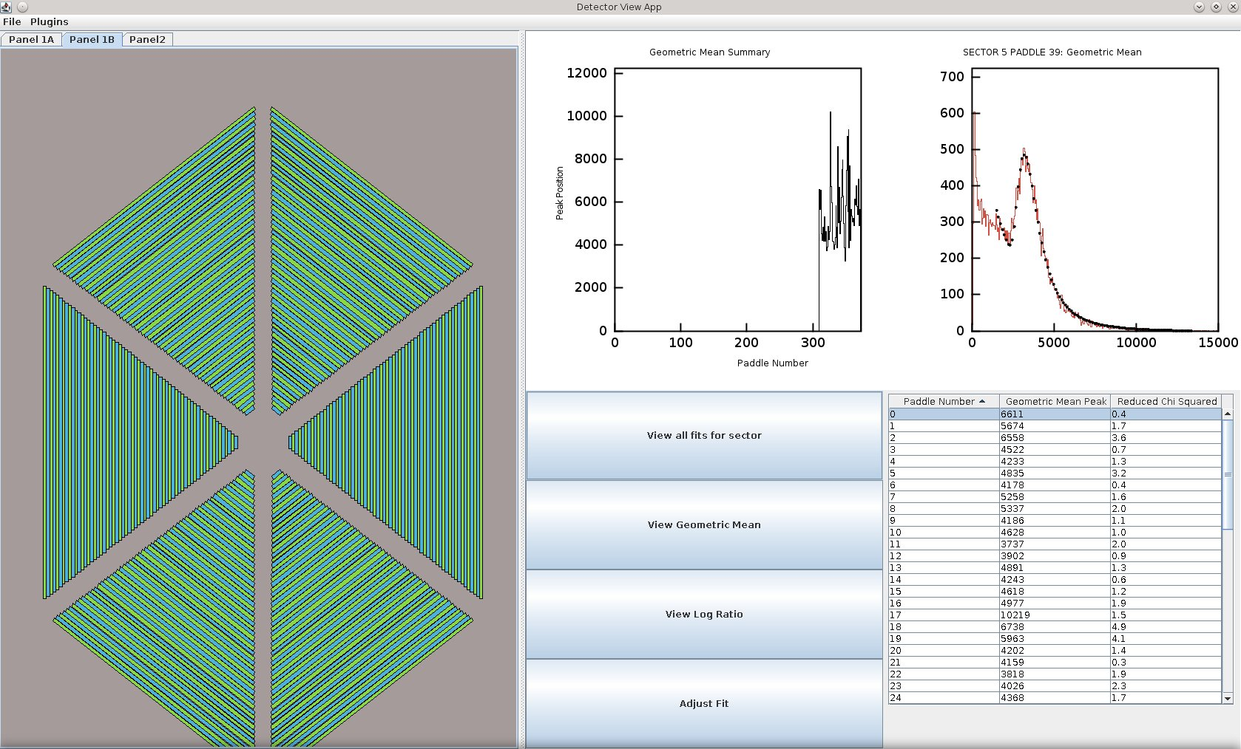
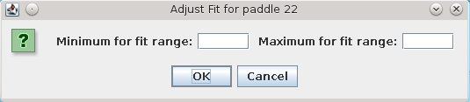
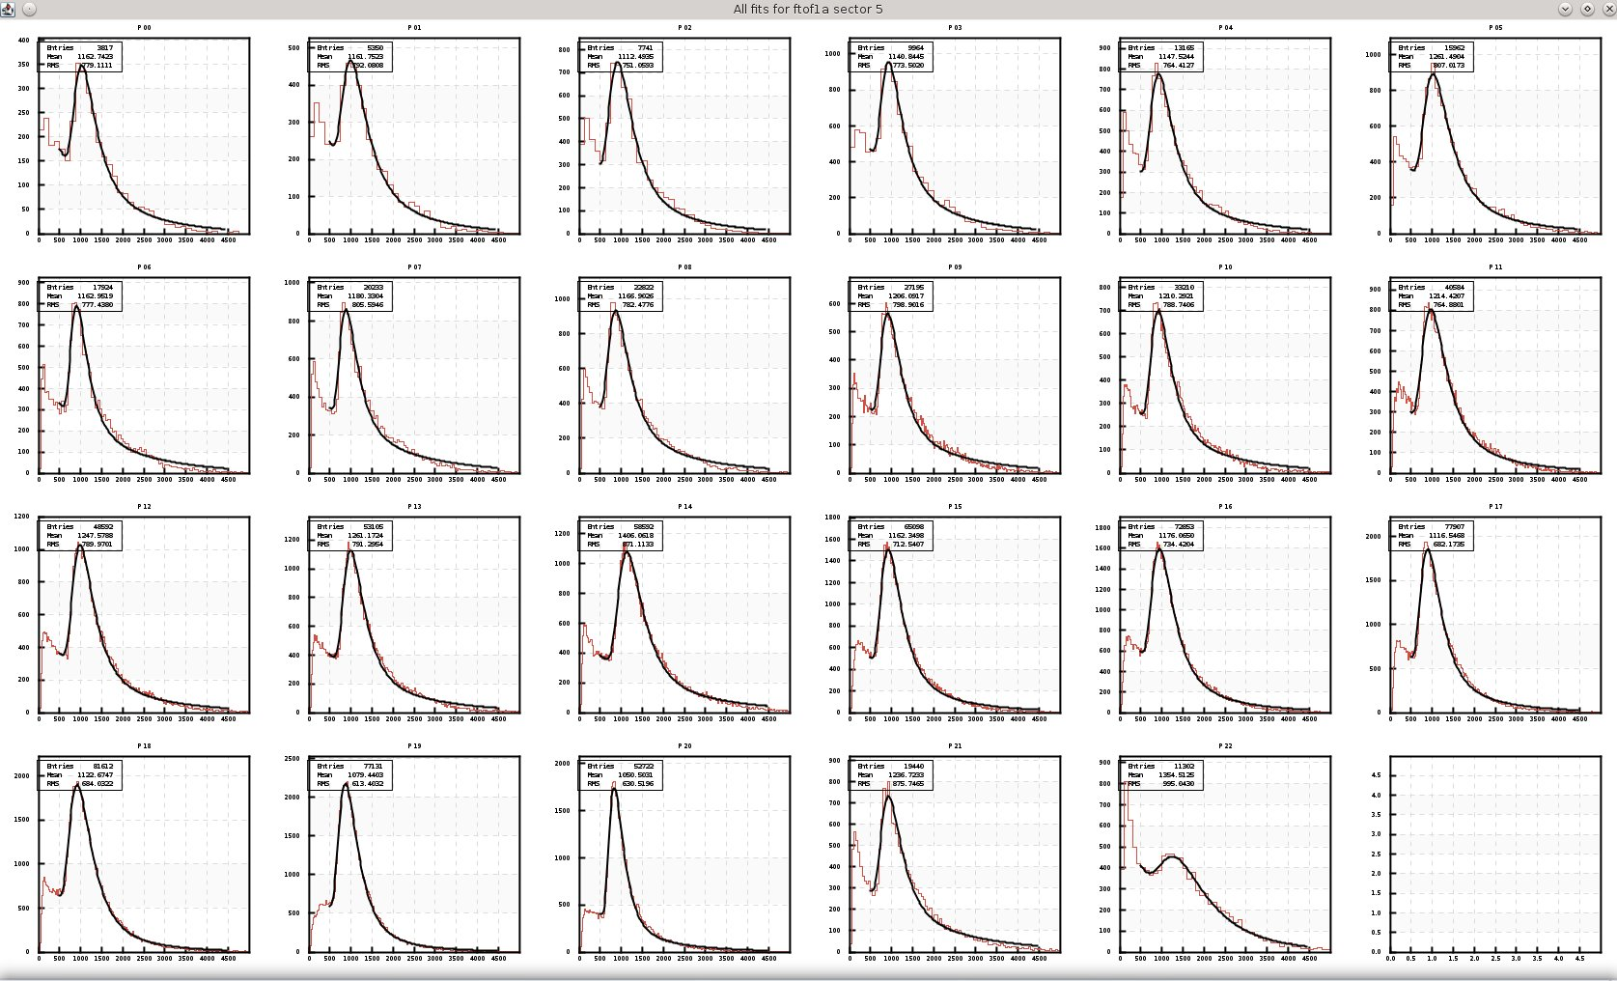
FTOF Calibration COATJAVA Suite
Development of FTOF calibration plugin for detector monitoring interface
View individual plots and table of calibration values
Adjust fits
View all plots for sector
Write constants to file
Color code to indicate success of calibration algorithm (planned)
Notes:
8

Slide 9
FTOF Software and Documentation
Calibration procedures in development for 3+ years:
  Haiyun Lu (ROOT/C++) and Louise Clark (Integrated Java version)
  Daniel Carman and Gagik Gavalian providing orchestration and oversight
  Code designed to complete gain matching calibration (for online HV adjustments)
  Code designed to complete timing calibration (offline calibration)
      Time-walk correction
      Left-right adjustment
      Energy loss
      Attenuation length
  Work plan includes development of tutorials for training
  Software tested on FTOF cosmic data, CLAS g14 data, and will include testing using MC data
Documentation for FTOF:
  Geometry document
  Calibration constants document
  Monte Carlo simulation baseline
Calibration software on track to be ready (in beta version) by spring 2016
Effective velocity
RF parameters
Counter-to-counter delays
RF offsets

Slide 10
DC

Slide 11
DC Calibration Status
DC Calibration Categories:
Translation Tables – …WELL UNDERWAY…
  associate each wire with its electronics; STB → DCRB; CAEN → HVTB, etc.
Geometry –
  ideal wire positions …DONE…
  misalignment …Procedure established…
Time Delays – …Procedure established…
  cable delays
  signal velocity along wire
  time difference between DCRB and FTOF
Status Tables –
  keep time history of HV, LV, wire status …GUI’s, Maps built…
Drift Velocity –
  parameters to determine DOCA as a function of time … Studies begun…
Krishna Adhikari, Olga Cortes, Johann Goetz, Brook Byrd

Slide 12
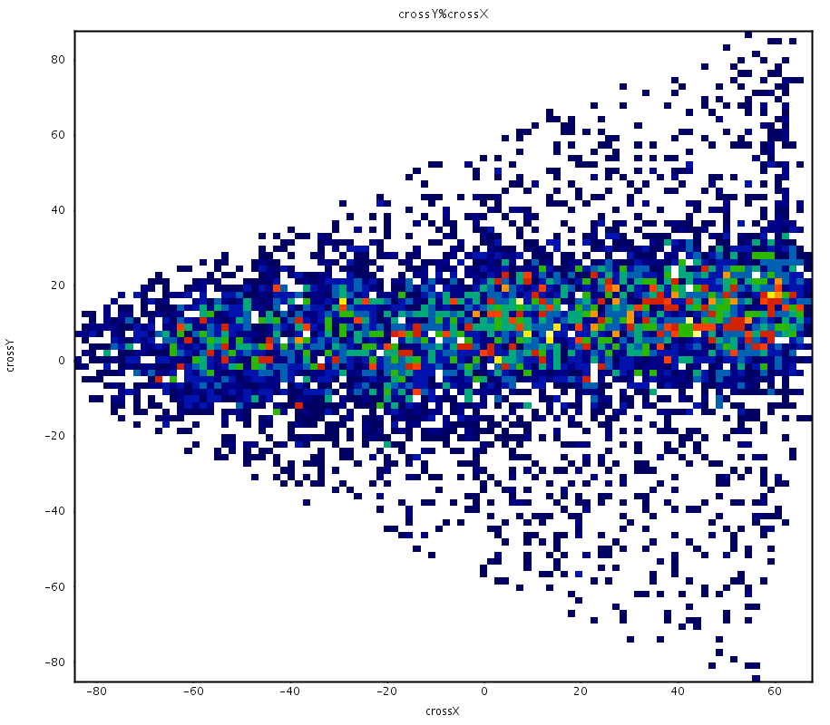
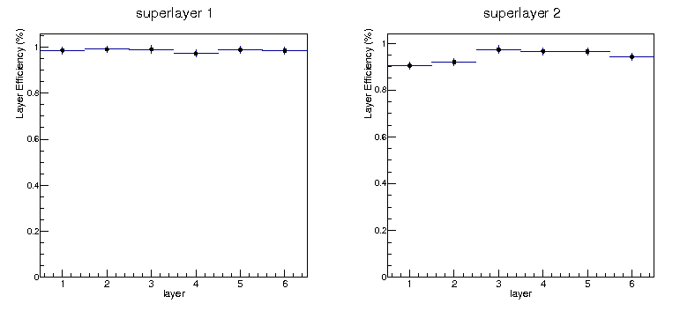
DC Cosmic Studies: Efficiency
Location of 2-superlayer ‘crosses’
image of scintillator paddle
reg.1 chamber
ε > 98%
Layer efficiencies at 2250 V

Slide 13
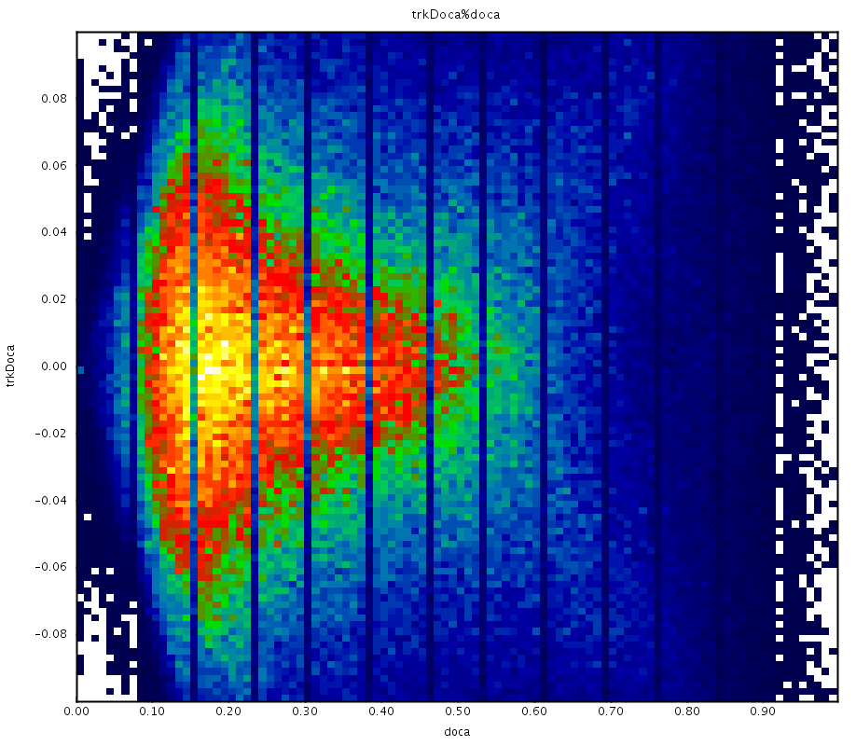
DC Cosmic Studies: X vs. T Calibration
0.5 mm
Residuals from un-calibrated data;
using same T → X curve as GEMC
Residual
0.5 mm
0
5 mm
DOCA

Slide 14
FT

Slide 15
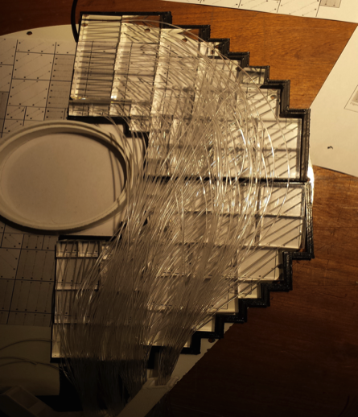
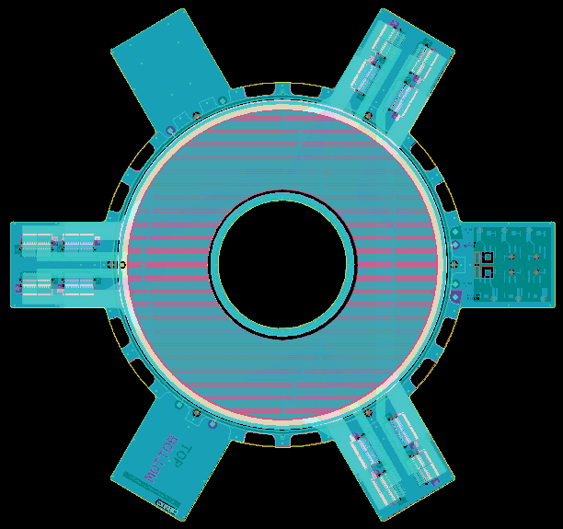
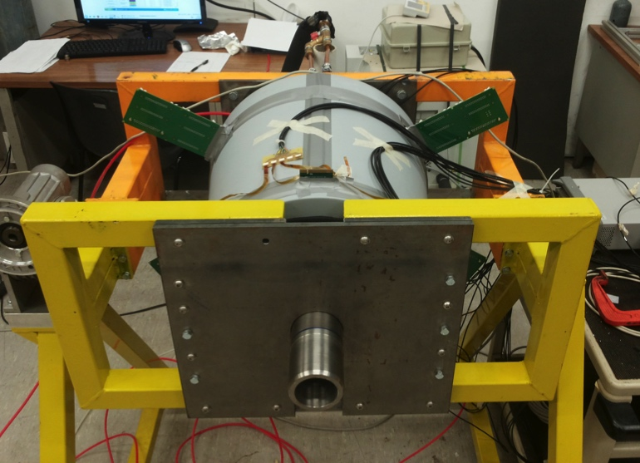
FT Status
Coordination: INFN-Genova
Contributors: CEA, INFN-Ge, INFN-Roma2, U. Edinburgh, U. Glasgow, JLab, James Madison U., Norfolk State U., Ohio U.
FT-Hodo
FT-Trk
Construction of detectors in final stage
FT-Cal assembled and being tested
FT-Hodo in final assembly stage
FT-Trk detector elements in production stage
FT-Cal
15

Slide 16
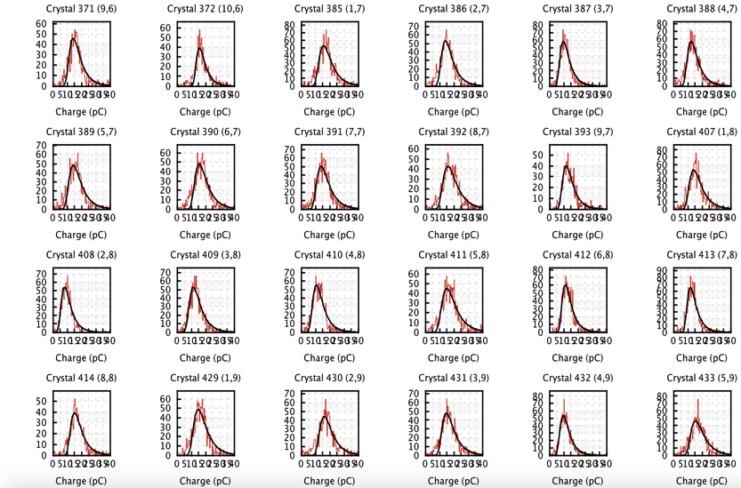
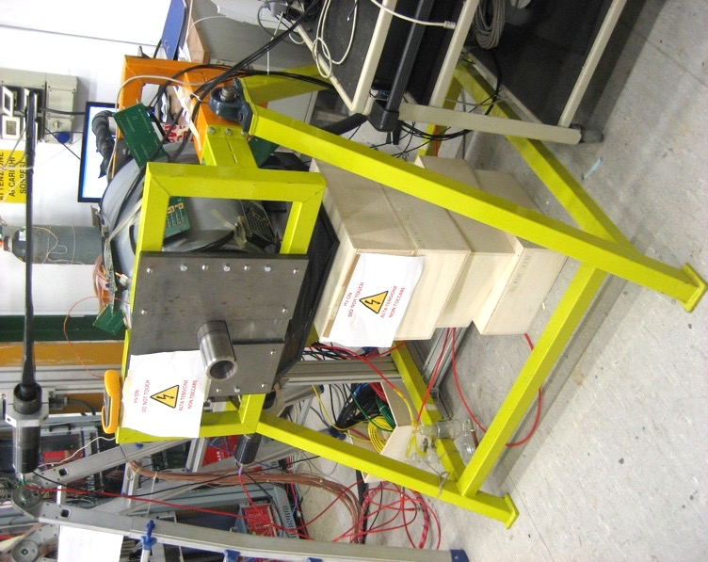
FT-Cal Cosmic Ray Calibration
Data collected for each quadrant with the calorimeter in its horizontal (production) position
Charge spectra built for each crystal
Distribution fitted with Landau to determine means
Analysis repeated at different operating temperatures
Scintillator paddles
Cosmic rays can be used for initial FT-Cal energy calibration
Response uniformity consistent with expectations (~20%)
Increase of LY at low temperature in agreement with prototype tests
Cosmic ray spectra (0° C)
y
0° vs. 18° C

Slide 17
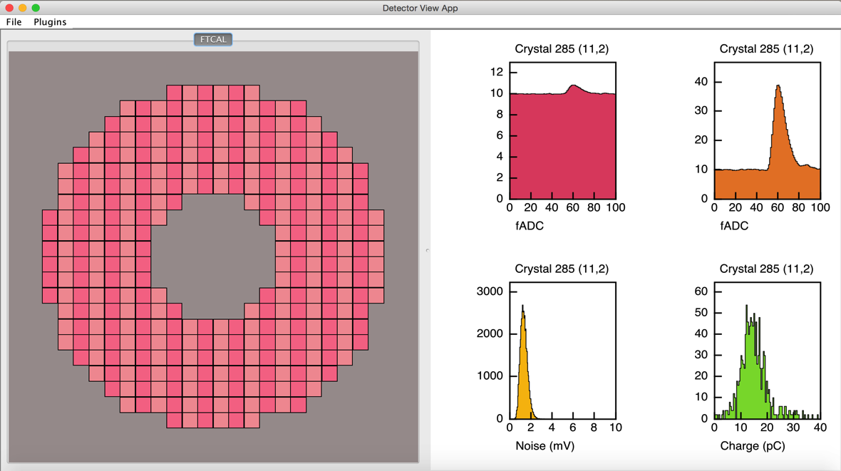
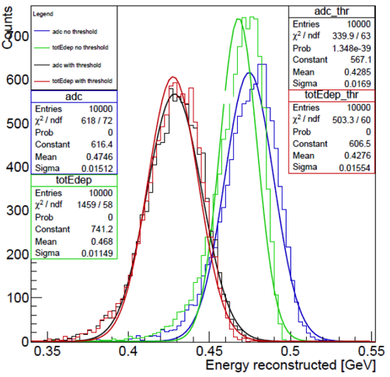
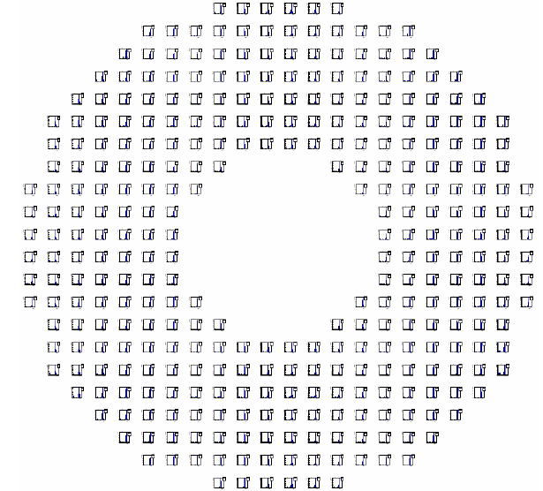
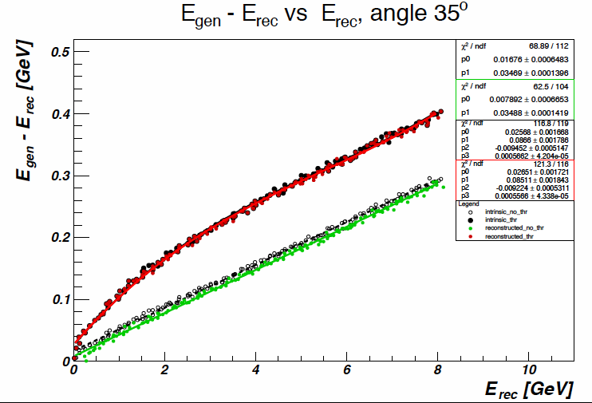
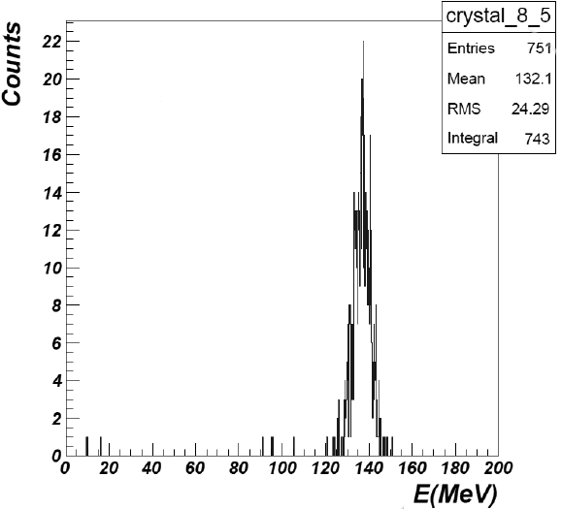
FT-Cal Calibration Software
Monitoring GUI for cosmic ray commissioning studies under development
fADC
Cluster energy correction been estimated from simulations
(L. Lanza)
noise
π⁰ energy calibration (L. Lanza)

Slide 18
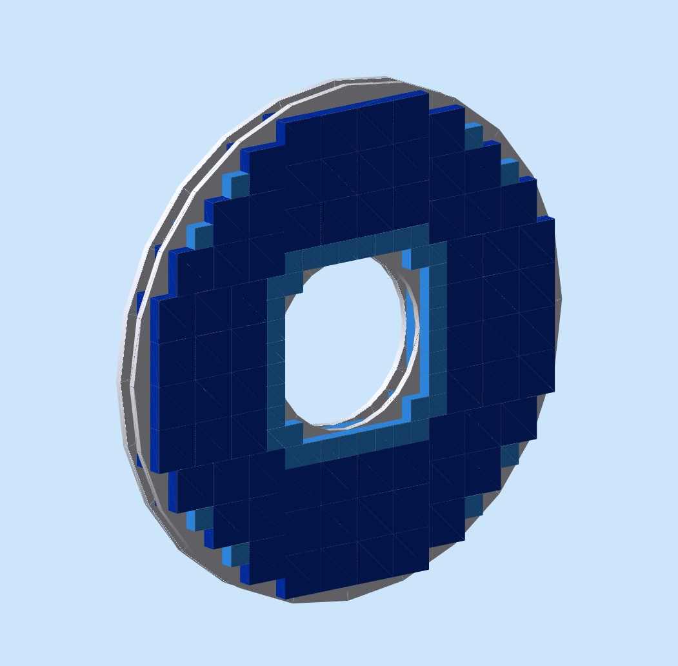
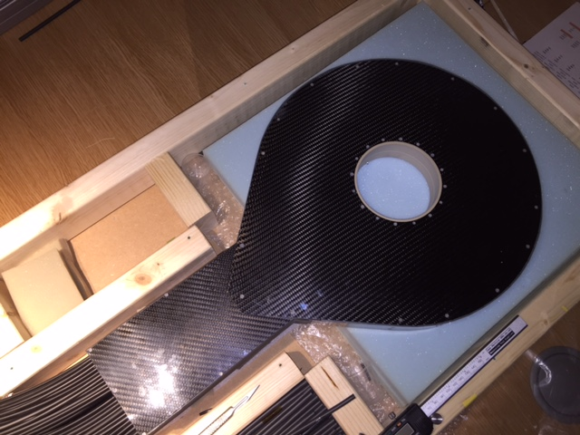
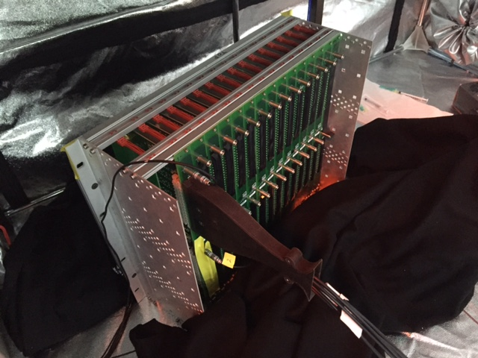
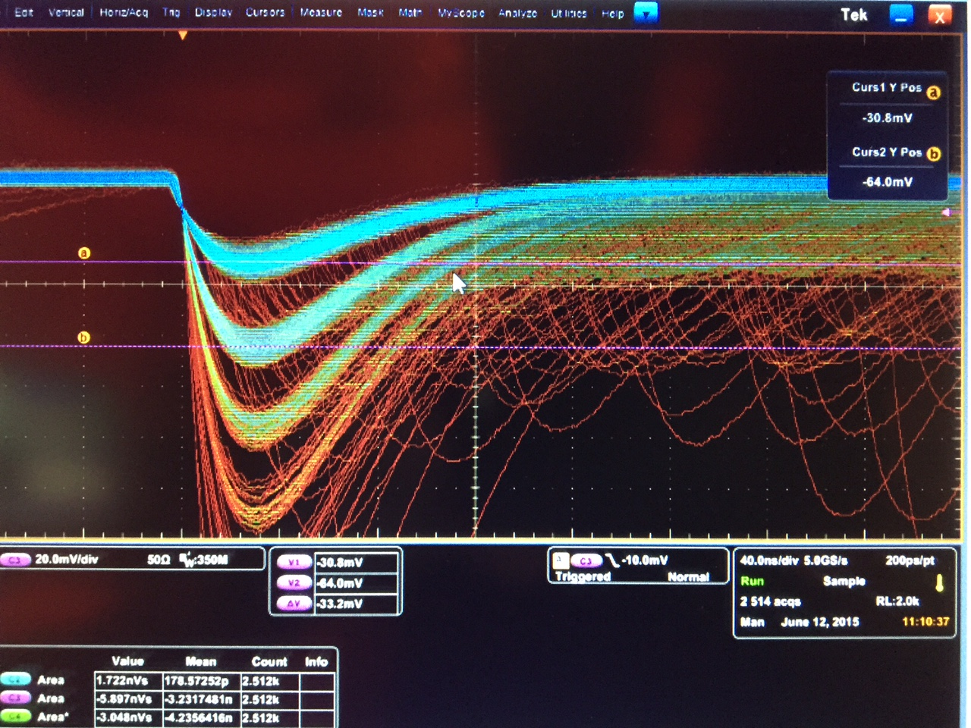
FT-Hodo Checkout
Photon / electron discriminator
Two layers of scintillator arrays with timing and position resolution to match FT-Cal
Shipped to JLab - to arrive in November
thin layer results
cosmics
source
Two layers of crystal arrays
final assembly
electronics and SiPM connector

Slide 19
FT Calibration Plans
Hardware work:
FT detectors transferred to JLab in fall/winter
Installation in test area (possibly close to SVT/MM clean room)
Checkout and calibration with cosmic rays (energy and time) with full readout system
Manpower from contributing institutions (Edinburgh, INFN, JMU, Saclay, NSU, Ohio, with support from JLab)
Checkout completed in spring, calibration before summer
Software development:
Calibration suite development within CLAS12 framework in progress
First prototype for cosmic ray calibration of FT-Cal tested on real data
Development of full calibration algorithm based on simulated data in progress
Complete cosmic ray calibration suite by end of 2015
Full calibration suite by spring 2016
Tuning, documentation, and training in summer 2016

Slide 20
LTCC / HTCC

Slide 21
HTCC Status and Plans
Current Status
  The HTCC is fully assembled
  Currently several activities are going on in parallel:
    Tests of the modified active HV-dividers
    Tests of the Light Monitoring System (LMS) installed in the detector
    Preliminary gain match of 48 channels using LMS
    Stability tests
Plans before installation in fall 2016
  Improving existing temporary gas supply system (monitoring) by implementation of new equipment for comprehensive control of working parameters (relative humidity, pressure, temperature, gas flow rate controls on input and exhaust lines
  Tests to establish working parameters of the major components
Monitor long term stability of the HTCC Combined Mirror’s geometry
Develop ways of the installing laser for alignment checks in the HTCC target position without survey
Define requirements (procedures, controls, limits) for transporting HTCC from TEDF to the Hall B
Development and integration of the HTCC software package into the CLAS12 monitoring and calibration framework
Tests of PMT linearity using LMS to define currents for the Compensation Coils of the PMT magnetic shields

Slide 22
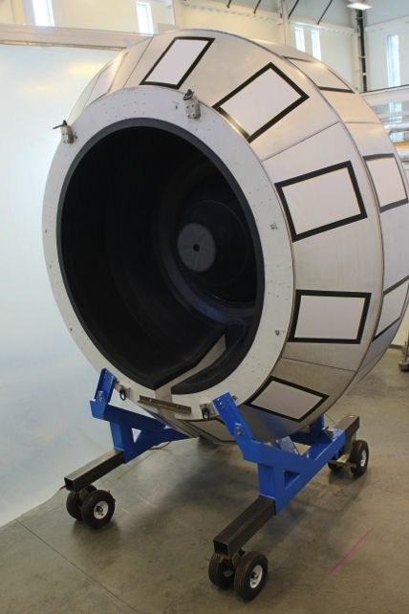
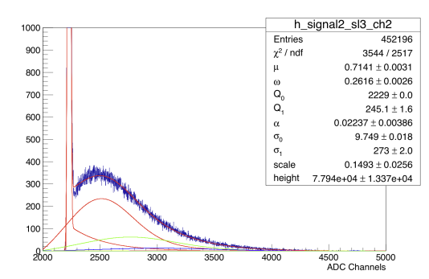
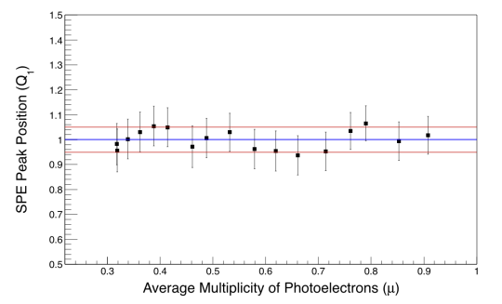
HTCC Calibration
Status
N. Markov, W. Phelps
  VME Fast LED pulser DAQ trigger integration software (Brian Motiff)
  SPE fitting routines have been developed and successfully tested, but are still being developed in C++/ROOT and Java
  Parallelization of fitting program, for fast online calibration
  Calibration database interaction software
Calibration
Individual fit
Fitting with Different Intensities
Typical Fit Result at low intensity of LED light
Fitting function is stable across a wide range of intensities
Fit function accurately describes PMT response at low intensities (µ<1.0)
Position of the Peak stays within 5% of mean

Slide 23
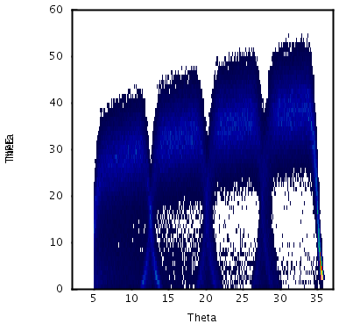
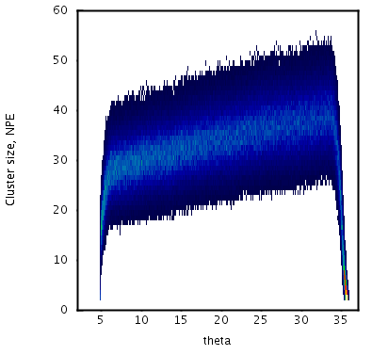
HTCC Reconstruction Status
Detector is incorporated into simulation
Reconstruction is developed and being improved
R1
R2
R3
R4
Simulation
NPE
NPE
Reconstruction
Theta gen
Theta gen
NPE grows with θ_{e} since path in CO₂ increases
Drops in NPE due to events split between mirrors
Drops in NPE at the edges between the rings are gone after cluster reconstruction
Low NPE-tails at high and low θ_{e} due to events for which Cerenkov radiation is partially emitted outside of the mirror
Plans:
Include timing information in simulation and reconstruction;
Improve resolution of cluster reconstruction based on the size of Cherenkov radiation cone

Slide 24
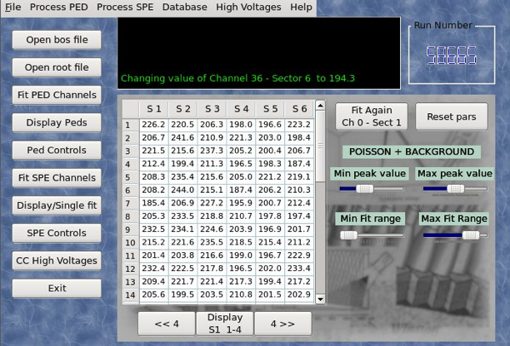
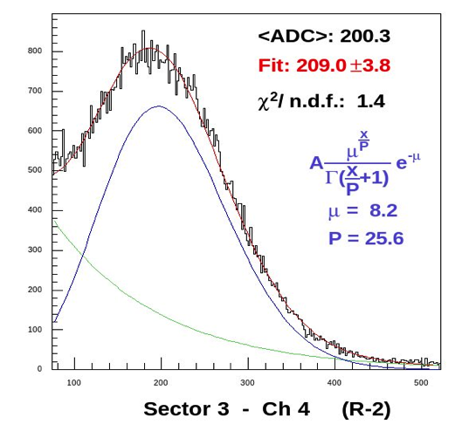
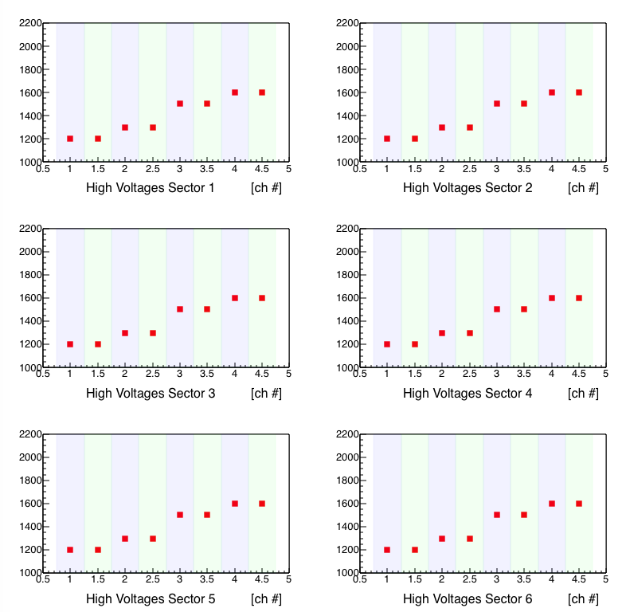
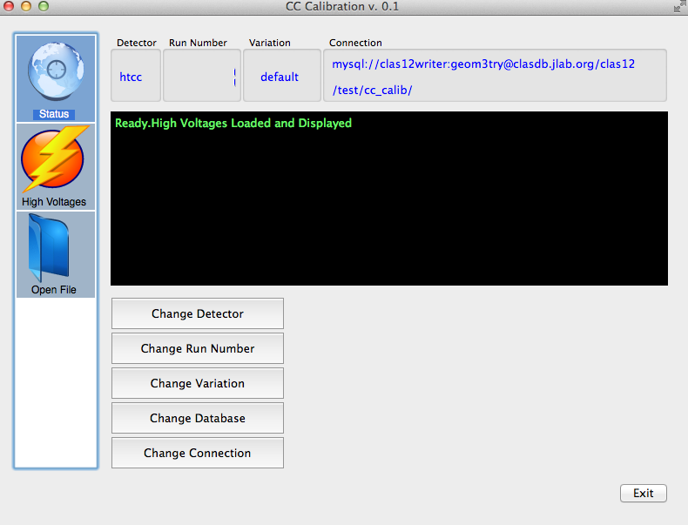
HTCC/LTCC Calibration
CLAS Calibrations:
HV Matching
Pedestals
SPE calibration
CALDB I/O
ROOT Output
CLAS12 Calibrations:
HTCC and LTCC
HV Matching
SPE analysis
CCDB I/O
CAEN SY4527 HV I/O
ROOT Output
M. Ungaro and N. Markov
Status:
GUI started
CCDB I/O
Working on CAEN I/O
Starting actual FADC acquisition, HTCC and LTCC calibrations
Will also use Java framework
Notes:
Recently calibration development has started also for the Cerenkov Counters
This is another example of a calibration suite which is designed to cover the needs of different detectors. In CLAS12 in fact there will be two Cerenkov counters the HTCC which together with the EM calorimeters is designed to identify electrons and provide the main trigger and the LTCC which was already used in CLAS and that in CLAS12 will complete the time of flights systems to provide the particle identification.
The new calibration suite is designed the expertise based on the expertise developed in the CLAS calibration, where a graphical tool capable to perform …. was used
The new tools will provide similar functionalities for both HTCC and LTCC with the additional capability of communicate with the hardware system supplying voltage to the detector to perform HV matching automatically on the based of the calibration results.
As I mentioned, work has begin few weeks ago and in particular the development of the graphical interface has started, the capability of communicating with the DB has been implemented and developers are working the communication with the HV supply system

Slide 25
CND

Slide 26
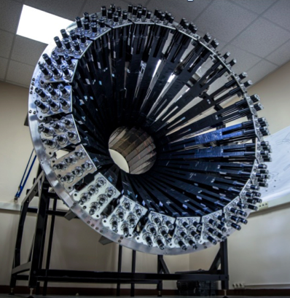
CND Status and Plans
Status:
All 24 2x3 blocks built, tested, and calibrated with cosmic rays at Orsay
all counters meet specifications
Mechanical structure assembled and tested with solenoid mock-up
Thanks to Giulia Hull, Julien Bettane, Alain Maroni, Miktat Imre, Claude Thèneau (IPNO)
Detector shipped to JLab and stored in ESB building
Work plan:
Tests with cosmic rays at JLab with CLAS12 electronics & DAQ (spring)
Installation in the CD as soon as the solenoid is ready (fall 2016?) – the CND is the first to go in; installation should take about one week

Slide 27
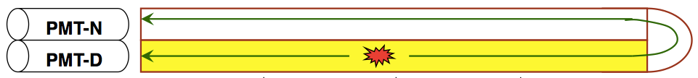
CND Calibrations
Effective velocity
Attenuation length
PMT Gain
TDC and ADC slope, pedestals and offsets
Time of propagation through u-turn
Light loss in u-turn
Calibration parameters:
Procedure similar to that of CTOF/FTOF; complicated by the u-turn geometry of the CND
Cosmic ray data taken in Orsay, in triple-coincidence mode, are being used to develop calibration algorithms (at this stage stand-alone functions in ROOT)
Giulia Hull, Gavin Murdoch, and Daria Sokhan
Plans:
optimize algorithms (by end of year)
implement the methods within the COATJAVA framework (early 2016)
test on simulations and cosmic ray data to be acquired in JLab in spring 2016
27

Slide 28
CTOF

Slide 29
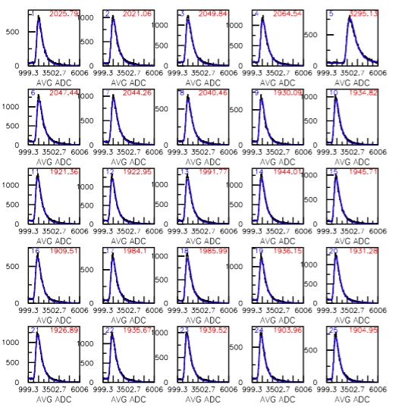
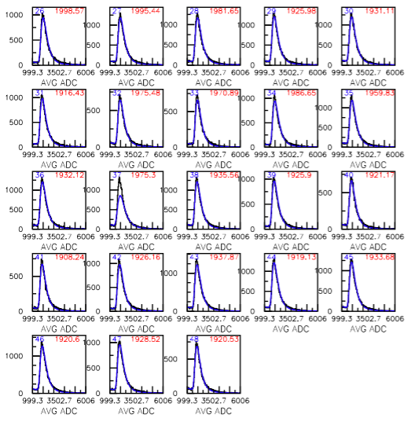
CTOF Gain Matching
Cosmic ray calibrations in progress since mid-June
~20% of the counters showed problems with “crazing” and were resurfaced; need to monitor counter response until installation time to see if issues recur

Slide 30
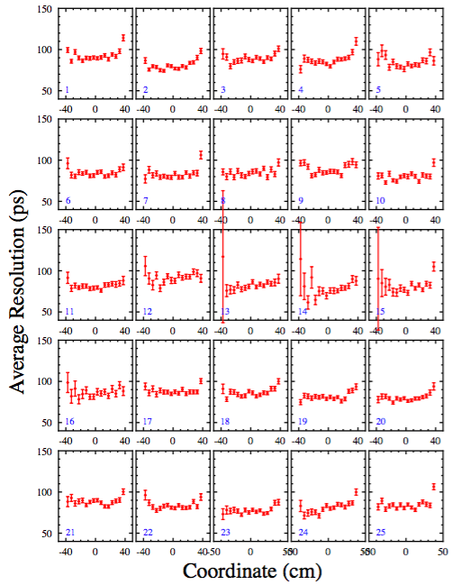
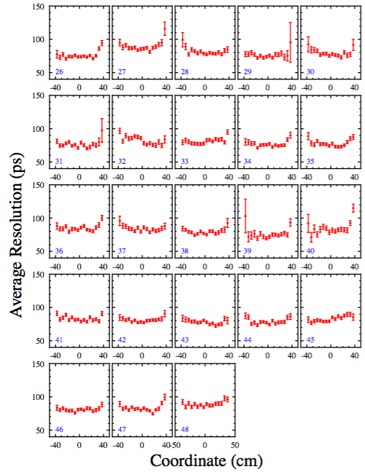
CTOF Resolution vs. Coordinate
“raw” distributions
Cosmic calibrations in progress
Present resolutions 70 → 75 ps (design spec = 60 ps)

Slide 31
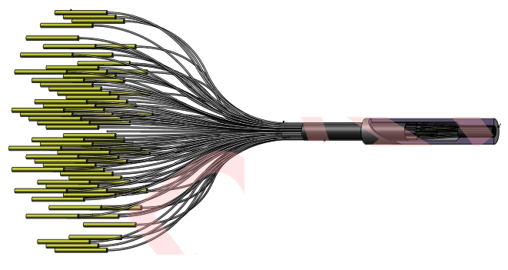




CTOF System Work
Light Monitoring System:
PR submitted for fiber assembly
Fiber attachment blocks and cutting templates delivered; blocks being mounted to light guides
Need to understand how to configuration and use this system to maintain calibration vs. time
System Calibration and Monitoring:
Optimize time resolution of system
Develop time-walk corrections; compare LED to CFD discriminator performance
Monitor stability over next 6 → 8 months
Calibration Software Suite:
Calibration software developed by Andrey Ni
Continue development and testing over next 8 months
Develop integrated system for CTOF, FTOF, CND
LED driver

Slide 32
CTOF Software and Documentation
Calibration Suite development in progress for ~2 months:
  Andrey Ni (Integrated Java version)
  Daniel Carman and Gagik Gavalian providing orchestration and oversight
  Code designed to complete gain matching calibration (for online HV adjustments)
  Code designed to complete timing calibration (offline calibration)
      Time-walk correction*
      Left-right adjustment
      Energy loss
      Attenuation length
  Work plan includes development of tutorials for training
  Software tested on CTOF cosmic data and will include testing using MC data
Documentation for CTOF:
  Geometry document
  Calibration constants document
  Monte Carlo simulation baseline
Calibration software suite should be ready by early summer if we can find manpower to sustain the effort
Effective velocity
RF parameters
Counter-to-counter delays
RF offsets

Slide 33
SVT

Slide 34







SVT Calibration Status
Absolute gain calibration and signal-to-noise measurements using sources and cosmics
Systematic calibration scans during SVT module QA, barrel assembly and integration
Periodic calibration runs on 33792 channels to check stability
Automated posting of the calibration data and plots to the logbook by the calibration scan scripts
γ source
muons
34

Slide 35



SVT Calibration Path Forward
Work before installation
Complete Java-based SVT calibration suite
Periodic calibration runs on SVT barrel using SVT calibration Suite
Design SVT calibration DB; develop interface from CLARA to SVT DB
Development of the SVT calibration suite
A c++ ROOT based calibration package with automated logbook posting in use
CoatJava based analysis package using multi-threading being developed
Justin Ruger developed calibration; remaining work to finish in progress
Post-installation plans
Periodic calibration runs on SVT barrel using SVT Calibration Suite
Automated filling of the SVT calibration DB used in reconstruction

Slide 36
Summary
With the detector subsystem assembly complete, groups now focusing on detailed cosmic, laser, pulser, and source calibrations
Calibration suites for detector subsystems at different levels of development and completion:
  SVT – most developed platform
  FTOF – well underway but still significant work to complete
  CTOF – just started but should develop rapidly following FTOF development
  DC, LTCC/HTCC, CND – getting underway
Our goals should be:
  to have all codes at beta level by the end of spring
  to have all documentation and tutorials in place by the end of summer
  to train calibrators/cookers in the fall (starting well before the commissioning runs)
Monitoring/tracking of progress through several mechanisms:
  CALCOM group
  Software group
  Experiment run group

Slide 37


Slide 38



FT-Cal Checkout
Preamplifier
APD
Crystal
LED
FT-Cal checkout at 20° and 0°C using the LED monitoring system:
332 blue LEDs (one LED per crystal) placed on the front face of the calorimeter
Independent control of each LED using 6 driver boards
Capability of varying pulse light intensity and pulse frequency
Useful to identify cable swaps, faulty channels
Summer students:
Max Camp (Ohio)
Ian Davenport (JMU)
Harkirat Singh-Manns (JMU)
Marys Yates (JMU)
Typical signals
150 ns

Slide 39

DC12 Cosmic Studies: Time Delays
SL 1
time
SL 2
different length
cables;
~ 5 – 10 ns diff.
wire number

Slide 40

Reconstruction
EcRec / COATJava / Common Tools
G. Gavalian
Detector Factory
J. Hankins
EC / Fortran
K. Beard
S. Stepanyan
W. Brooks
ECAL / Java
S. Mancilla
PCAL / Java
M. Wood
1996-present
2010-2014
2014-2015
EC reconstruction package currently being evaluated by C. Smith in collaboration with Gagik.
Under COATJava EC is a unified detector with 3 superlayers: 0=PCAL 1=ECAL inner 2=ECAL outer.
Output bank consists of lists of hits, peaks and clusters for each superlayer.
  ECReconstruction class does not attempt cluster matching between superlayers (job of event builder?).
Some missing elements need to be re-implemented:
  Introduction of calibration constants from CCDB (in work).
  Re-entry points in code for attenuation correction and iteration of reconstruction (in work).
  Indexing to allow identification of hit members in clusters, peaks (for iteration, calibration).
  Configuration parameters (thresholds, peak/cluster/iteration options, etc.)
  Methods for handling two-cluster identification with shared energy in peaks (for pi-zeros).
Priorities and Schedule
Get elements 1-4 working for cosmic CTP trigger studies (Jan 2016).
Implement two-cluster algorithm and test with GEMC studies (Spring 2016).
Issue for trigger: How to do geometry-based cluster matching in FPGA trigger?

Slide 41

Forward Carriage Commissioning
Up to now cosmic data taken with FADC raw mode (mode 1) with pedestal subtraction, thresholds and peak summing performed in event decoder and DST ntuples written to disk.
Currently we are evaluating pulse mode (mode 3) to enable better data compression and write EVIO files for testing COATJava calibration suites.
This requires fine tuning FADC NSA,NSB window parameters and TET thresholds to take into account different pulse shapes in PMTs and optimize pulse integral.
FTOF1A
FTOF1B
PCAL
ECAL
Raw
Integral

Slide 42


EC/PCAL Simulations
GEMC now includes time propagation of light along strips for EC and PCAL.
DGTZ banks: Raw counts x 24 ps/count to simulate both V1190 / V1290 TDCs.
Simulation checked against data using time differences between cosmic muon hits in different U,V,W layers (below).
Forward Carriage data show effect of different cable and light guide lengths and provide estimate of time resolution for simulation.
U
Effective velocity 16 cm/ns
V
Δt (U-V) vs. V PMT
GEMC
Forward Carriage EC Sector 1

Slide 43


FTOF Simulations
GEMC now properly simulates gain matching algorithm for FTOF
PMTs are not gain matched to each other, but L/R PMTs adjusted so geometric mean is independent of counter length z
Overall attenuation factor of exp(- 0.5 z/λ) is built into HV adjustment, in addition to L,R gain balancing
This factor was added to FTOF hitprocess.cc in GEMC
GEMC
Data
Panel
1A
sqrt(L×R) from GEMC
before
after
Panel
1B

Slide 44

DC Cosmic Studies: Status
unplugged connectors?
SL1
1 wire number 112
SL2
swapped connectors?

