Slide 1

CLAS12 Slow Controls
1st Experiment Readiness Workshop
October 20, 2015
N. Baltzell

Slide 2
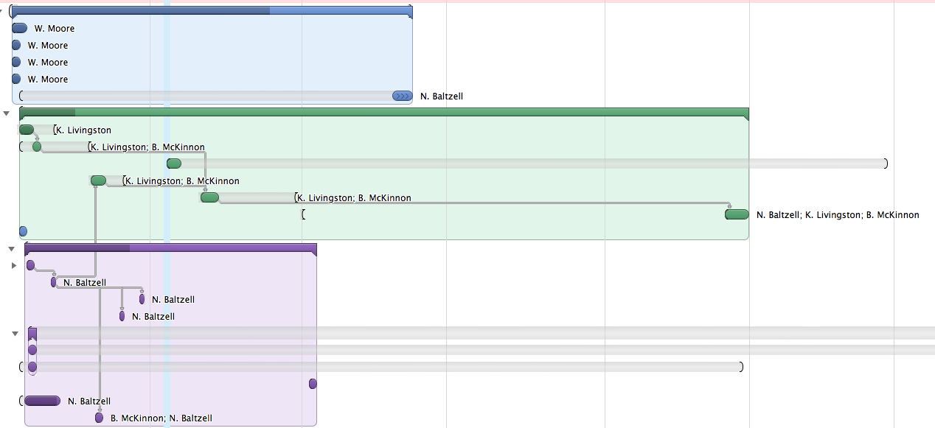
Organization
Main CLAS12 group: N.Baltzell (Hall-B), K.Livingston, B.McKinnon (Glasgow), W.Moore (JLab)
  with lots of help & advice from Sergey, Hovanes, Stepan, etc
  responsible for majority of CLAS12 slow controls
    software infrastructure, EPICS, hardware interfaces, UI
    controls/monitoring/alarms for detectors, beamline, DAQ
      e.g. HV, LV, Motors, Scalers, Temperatures, Vacuum, Weather, …
Wiki page: https://clasweb.jlab.org/wiki/index.php/CLAS12_Slow_Controls
Biweekly meetings and lots of progress since July (Fridays @ 9:00 in F228)
Progress charts with timeline and FTE, with goal of end of summer 2016
Using github for all online software (with epics/coda/etc submodules)
  https://github.com/JeffersonLab/clas12-online

Slide 3
More Groups Involved
JLab
  Engineering
    Detector Gas and Magnet Cryo (D. Butler, J. Ballard, …)
      In progress, installing of components in Hall-B in coming few months
      Allen-Bradley PLCs and CompactRIO
      EPICS interfaces to be developed with/by CLAS12 group
  Accelerator
    SVT (S. Witherspoon)
      99% Complete, currently a standalone system (with edm frontend)
Saclay
  Cryo Target (D. Bouziat, M. Garçon, F. Sabatié)
    Same system as 6 GeV with refurbished components
    Prepared and ready to ship; to be installed in late-2015/early-2016
    EPICS support/interface remains to be investigated

Slide 4
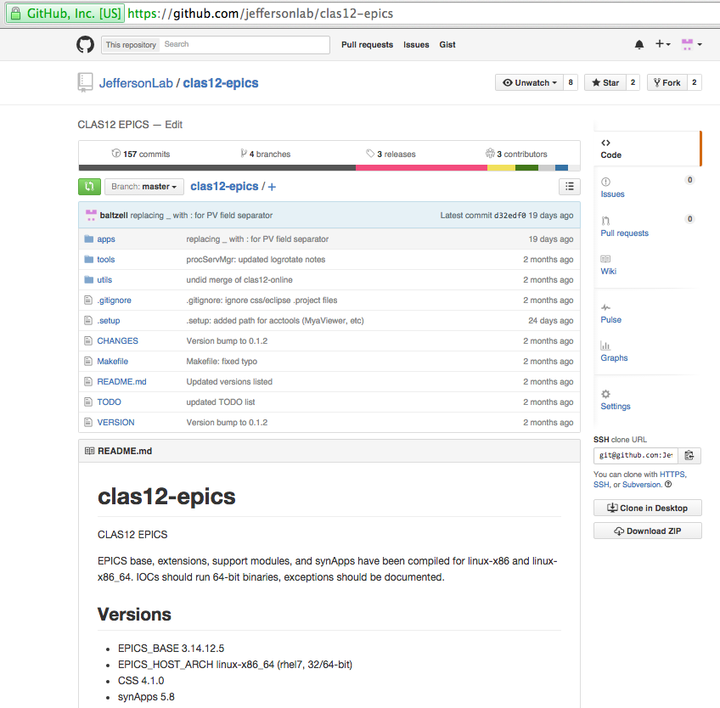
Software Framework
Based on EPICS
  R3.14.12.5, modern release
  fully support the various hardware controlller I/O needs in Hall-B
RHEL7, JLab-supported OS
  Choose only 64-bit apps when possible
Cleaned software tree
  Using JeffersonLab/clas12-epics github
  Pulling in only the essentials from CLAS6
  Maintain consistent build system, environment setup, …
  just checkout & build
Control-System-Studio
  frontend UI, replacing the no longer supported & maintained medm/edm
  developed & supported by other labs (SNS, DESY) and used by Hall-D
  more integrated, unified user interface
Utilize JLab-Accelerator supported tools
  Mya archiver and related clients
  JTabs for accelerator screens

Slide 5
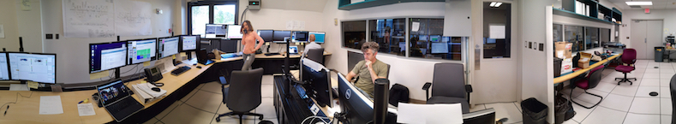
Computing Overview
9 user workstations (clonpc##)
  for running clients, GUIs, run_control
  each will have 2x2 monitors (currently still 2x1, need graphics cards)
8 servers for running IOCs, databases: (clonioc#/clonsl#/clondb#)
Tested “all” software on new OS, moving all to 64-bit RHEL7
  for now leaving a couple on old RHEL5 OS for testing
Hall-B Counting House during HPS 2015 Run

Slide 6
Inventory

Slide 7
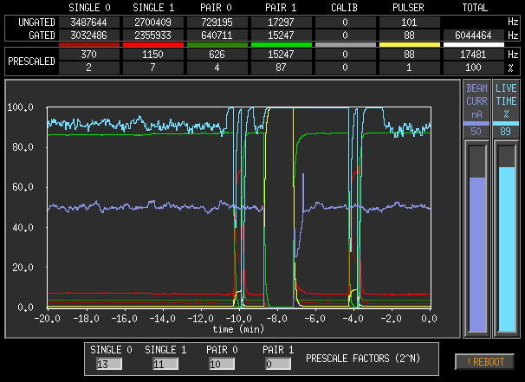
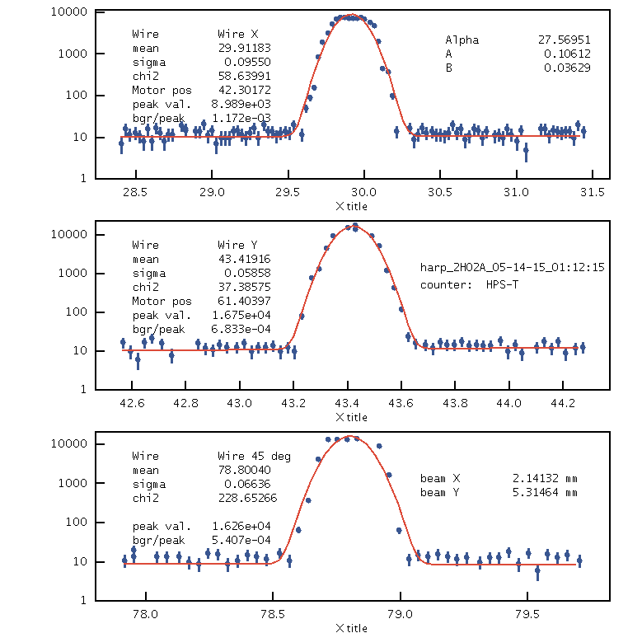
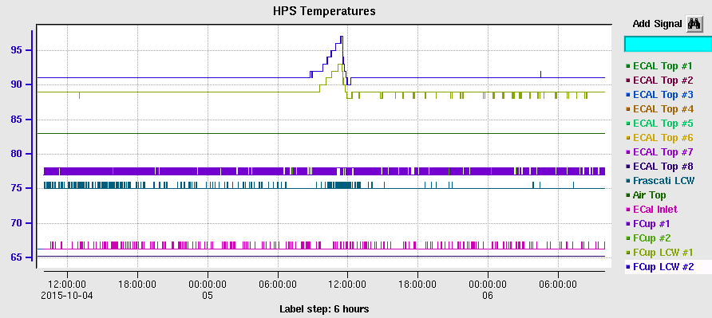
Pre-CLAS12 Commissioning
HPS has effectively commissioned some aspects of CLAS12 slow controls
  counting house workstations
  64 bit, RHEL7, EPICS upgrades
  Beamline
    beam viewers (tagger, fcup)
    harp scans
      motors, scalers, analysis, archiving
    BPMs, BLMs, FSD
  MYA archiving & strip charts
  Trigger Rates / DAQ Livetime Monitoring

Slide 8
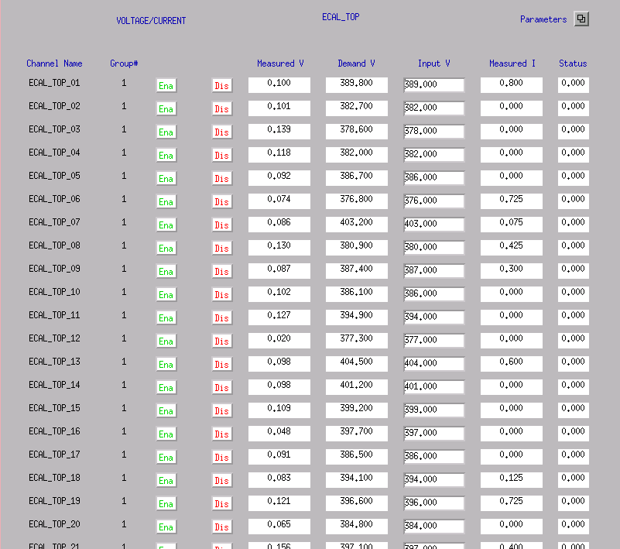
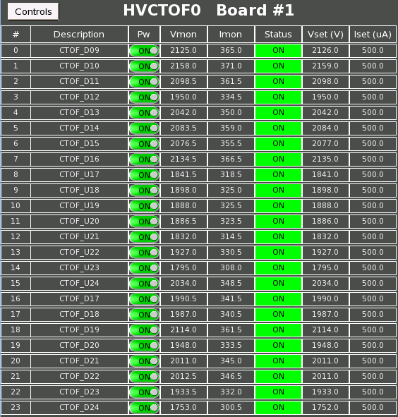
CS-Studio
http://controlsystemstudio.org/
New more-unified GUI system; dropping old unmaintained medm & edm
  Adopted and developed/maintained by some other large labs, and Hall-D
Incorporates lots of tools that would otherwise be standalone apps
  alarm handler, dynamic graphing/stripcharts, archive access, …
Based on java/eclipse, can be run/developed on linux/osx/windows
Provides a easy method for web-browser access (read-only without 2-factor already approved by JLab)
Allows integrated scripting to generate repetitious screens on the fly
    tabs, scrolling, panes, make for less disorganized and scattered windows
Some aspects appear like a straight replacement, although much easier in CS-Studio, e.g.:
medm
CS-Studio

Slide 9
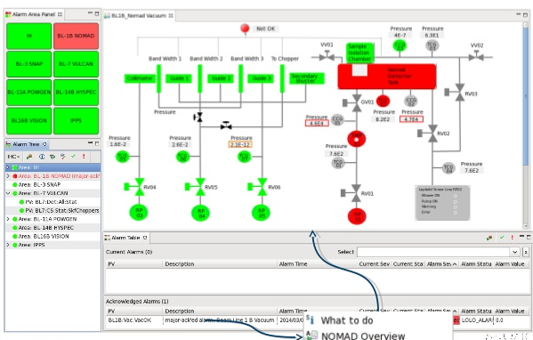
Alarm System
CS-Studio has builtin alarm system: BEAST
  Single server with alarms configured in database
    server deals with automatic responses (e.g. paging experts)
  GUI is just a client to display alarms in same framework as rest of slow controls
  Old CLAS6 alh was a standalone app, every instance of it was another alarm handler
Example from SNS
Tested at Glasgow, B. McKinnon installing at JLab this week

Slide 10
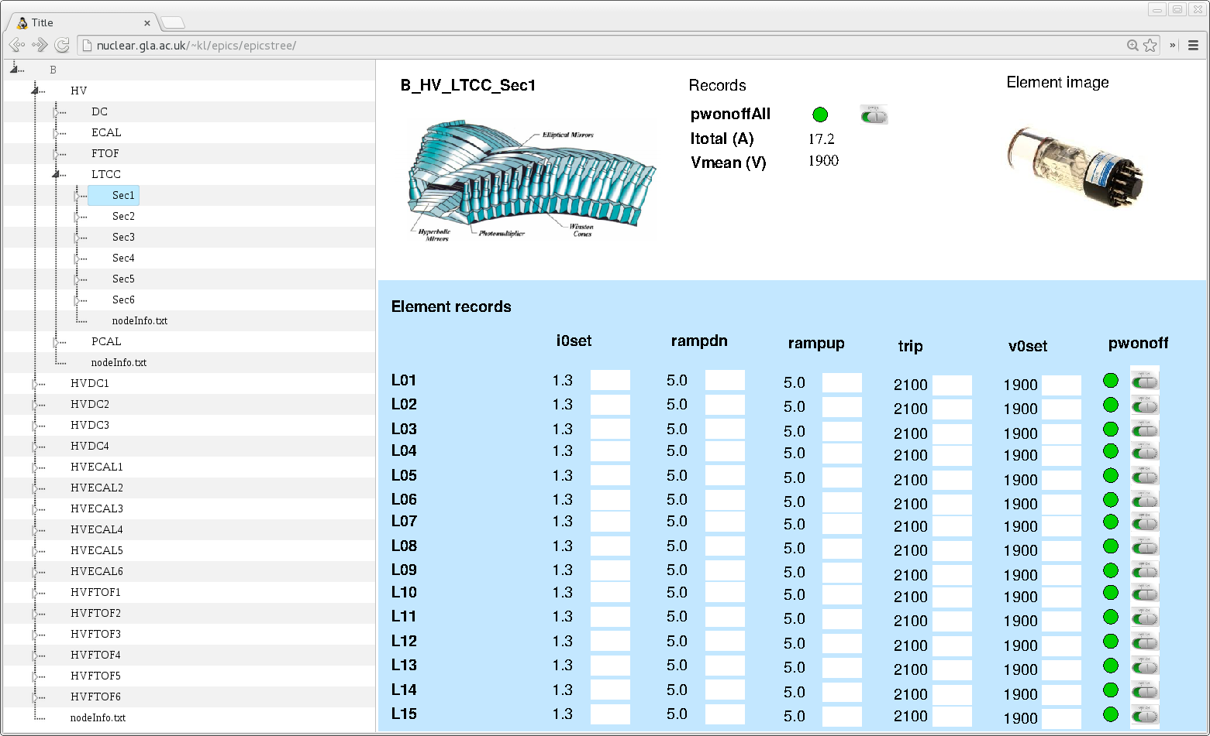
Hierarchical Access
Allow to navigate through a heirarchical menu
  and perform actions on all channels below any point in the hierarchy)
  e.g. “turn off all HV in sector 1”, “turn on DC region 2”
  e.g. drill down to only HTCC-related items (gas/pressure/temp/HV/LV)
  etc …
“Detector” based or “Hardware” based
  e.g. sector/layer/channel vs crate/slot/channel
Foundation is in place to generate the hierarchy and propogate commands down
Need to incorporate into our standard GUI system
K. Livingston

Slide 11
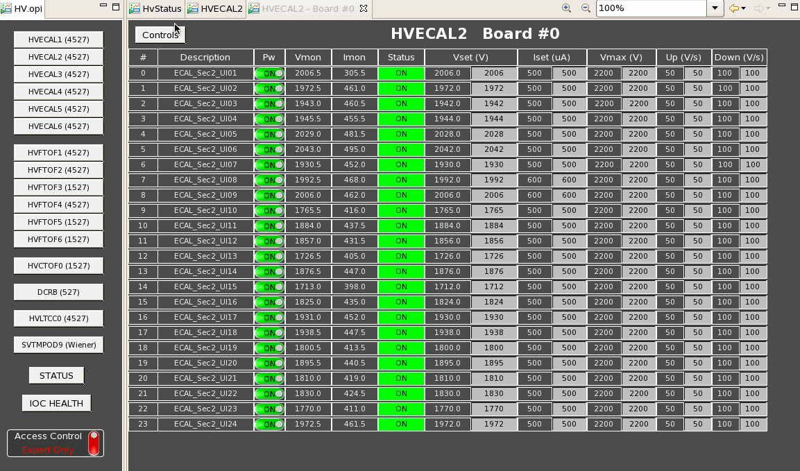
CS-Studio Example (Expert HV)

Slide 12
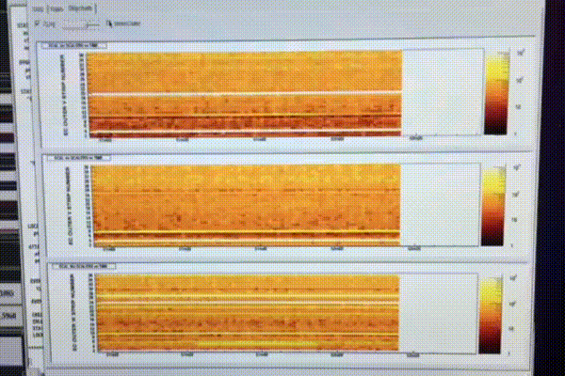
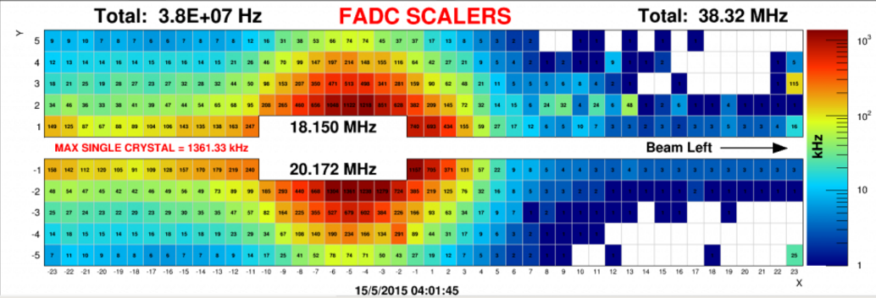
Open Items
A few of the bigger things that we haven’t started to really tackle yet:
Detector specialized GUIs
  e.g. DC HV/LV status for all regions/sectors, HTCC gas/voltage/pressure …
  How to display HV status for a whole detector (some w/ 100s/1000s of channels)
    can’t display every channel, need some grouping and boolean logic
      e.g. green is all on, black is all off, red is any tripped, yellow is mix of on/off
    should choose a uniform convention for all detectors
  Live scaler displays from JLab FADC/DSC boards
    can be read through EPICS or directly from hardware
    Cole has one for CLAS12 P/ECAL (a 2-D stripchart)
    example from HPS’s ECAL
Moller polarimeter system
  Starting work on this in early 2016, after hardware is fully reestablished
Incorporating access to the MYA archive in CS-Studio
  Just a nicety – already have MyaViewer, but may not actually be that much work
  could be a good student project

Slide 13
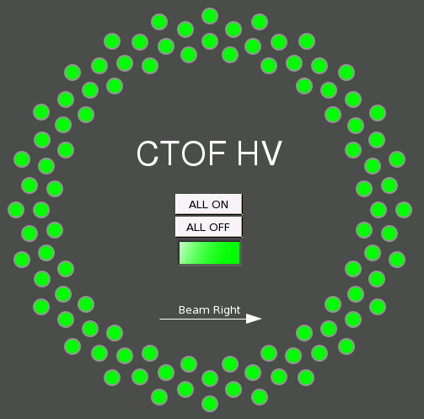
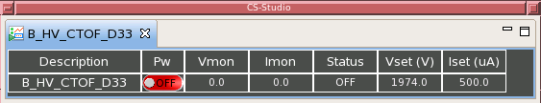
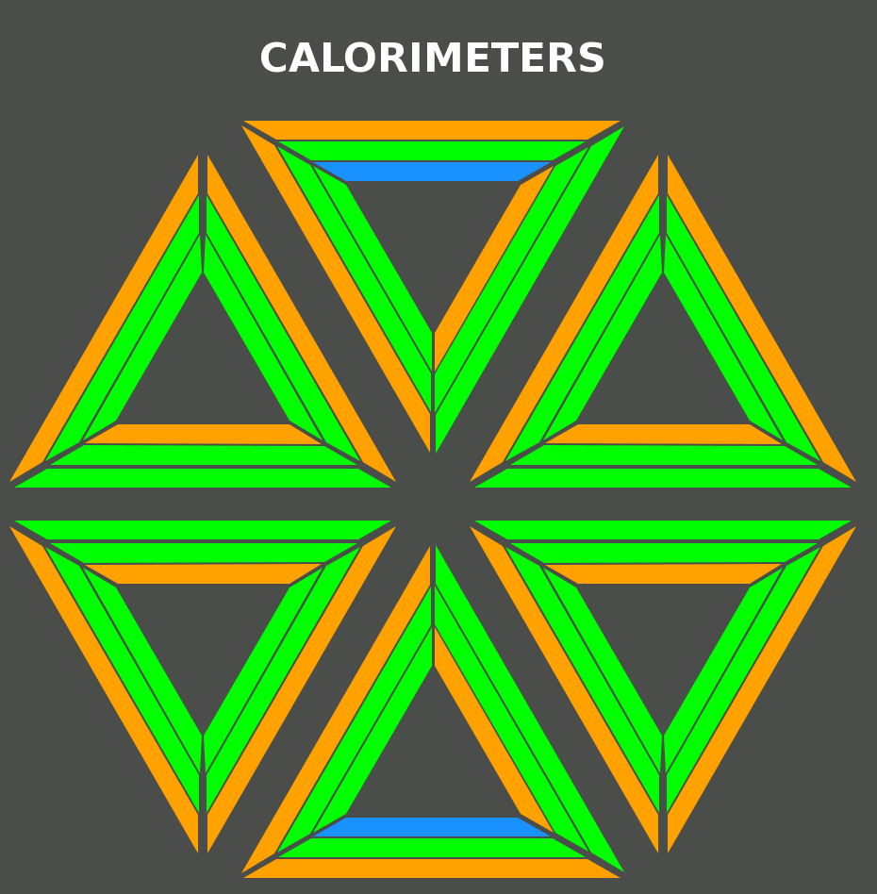
Specialized Detector Screens
Only a few CLAS12 examples exist so far
  This CTOF HV one is functional
    48 channels arranged geometrically “correctly”
    color shows HV status
    clicking on a channel open its individual controls screen
  This ECAL/PCAL one is just for show
    one way to summarize status for CLAS12 calorimeters
      3 triangle sides are U/V/W
      3 layers on each triangles’ side are PCAL/INNER/OUTER
These can be hand-edited or script-generated
Time soon to start working with detector groups to determine what is needed

Slide 14
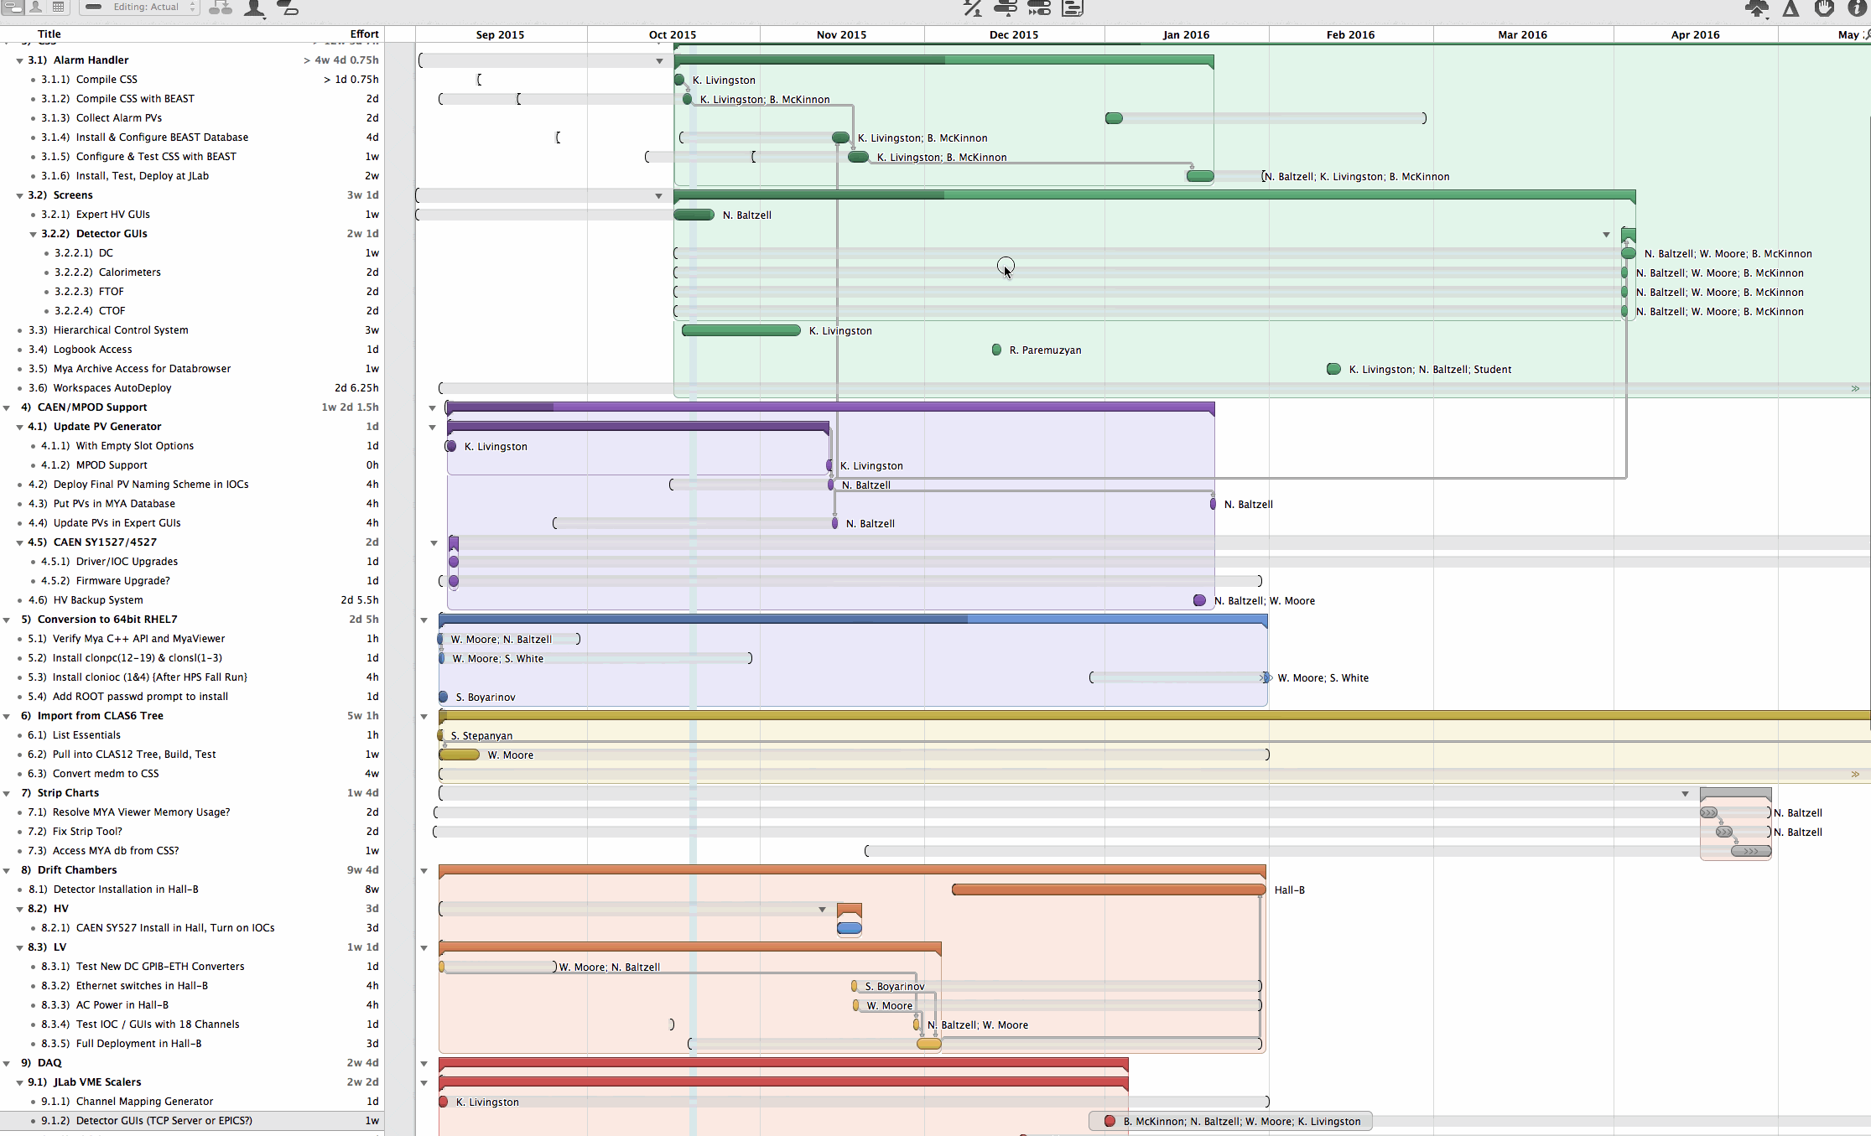
Outlook
Goal to be ready by end of summer 2016.
We have a good understanding of most of the work involved, timelines, and people / FTEs to do it
Lots of progress already on the infrastructure, EPICS/OS upgrades, existing hardware support/upgrades, HV/LV apps, porting of old CLAS6 apps
Time soon to start ramping up communication with baseline detector groups on their specific controls/monitoring needs

Slide 16
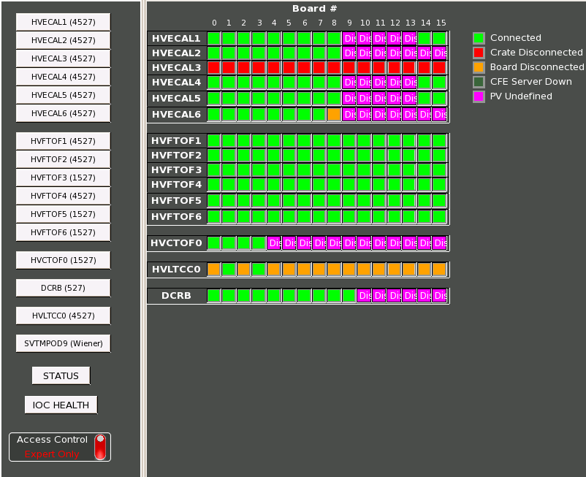
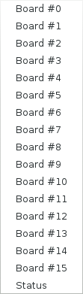
HV Controls: “Hardware” View
Overview screen
Based on HV crate/slot/channel
  important while diagnosing HV hardware problems
Already in use

Slide 17
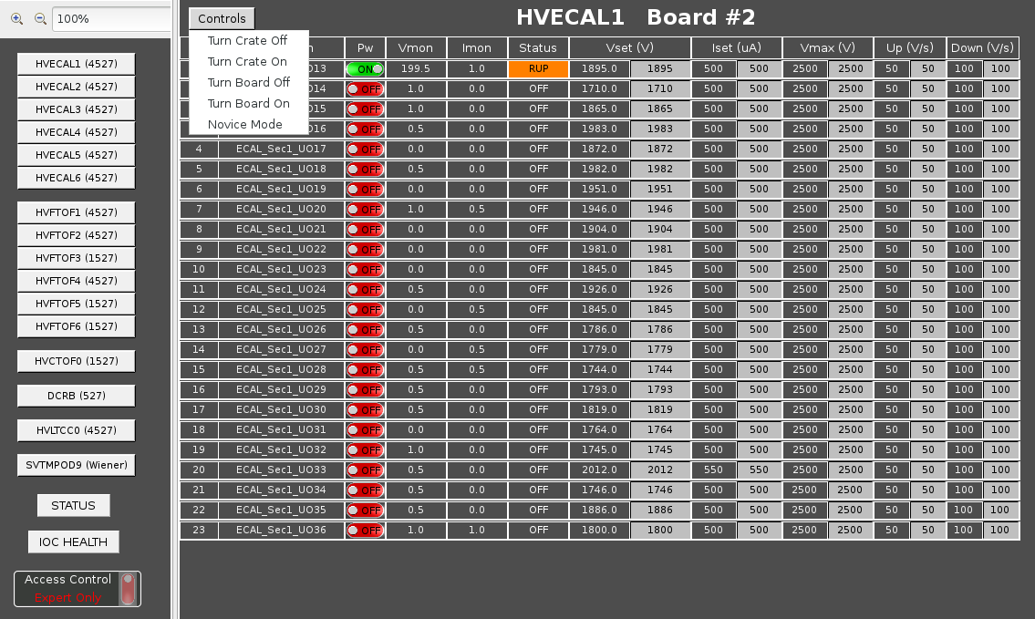
More HV “Hardware” views
Expert Perspective
Simple
View

Slide 18
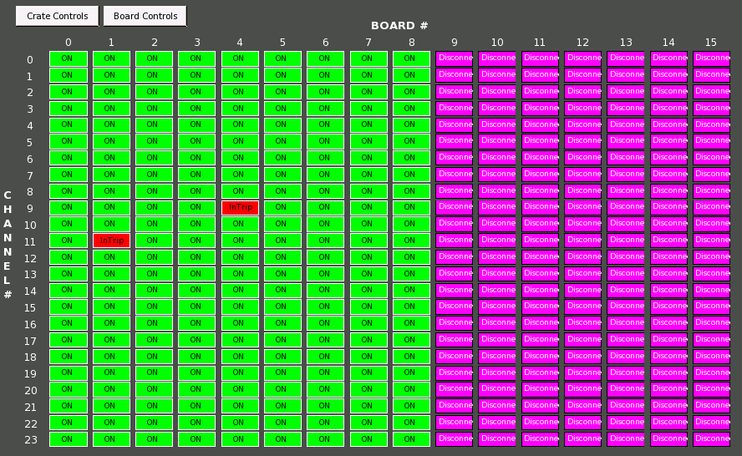
More HV “Expert” views
See status of all channels in one crate simultaneously.

