Slide 1
CLAS12 Longitudinally Polarized Target R&D Update
Chris Keith

Slide 2
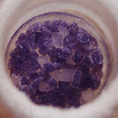
PolTar12: components for a dnp target
ammonia
ODU
Pumping system
1K Refrigerator
NMR
ODU
Field
Beam
Microwaves
(140 GHz @ 5T)
Polarizing
Magnet
UVA/JLab
CNU
CLAS12 Solenoid (not to scale)

Slide 3
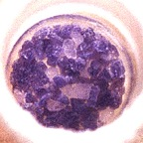
PolTar12: components for a dnp target
ammonia
Magnet
Microwaves
Target Sample
ODU
Pumping system
1K Refrigerator
NMR
ODU
Field
Microwaves
(140 GHz @ 5T)
Polarizing
Magnet
UVA/JLab
CNU
CLAS12 Solenoid (not to scale)

Slide 4
PolTar12: magnet
CLAS12 solenoid design specs
  5.0 tesla
  ΔB/B ≤ 10⁻⁴ (Ø2.5 x 4 cm central volume)
Polarization v. field dependence for NH₃ and ND₃ @ 136 GHz M. Seely, Yale 1982
ΔB/B = 10⁻³
Proton reduced ~20%
Deuteron reduced ~50%
ΔB/B = 10⁻⁴
negligible effect
If necessary we can add small shim coils inside the target cryostat to improve the uniformity…

Slide 5
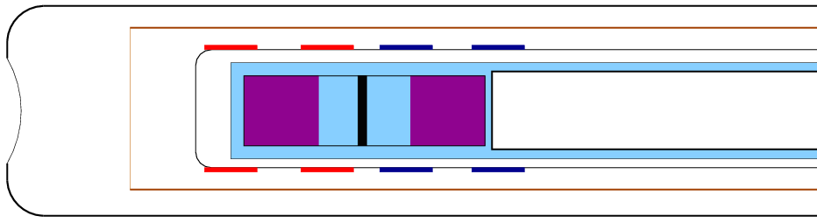
PolTar12: magnet
Sebastian Kuhn: We can also use internal, superconducting coils to adjust the polarizing field for two target samples, and take data on both polarizations simultaneously.
Pumping tube
Vacuum can
Coil 1 & 1A
Coil 2 & 2A
1K LHe
Beam
Target 1
(-80 gauss)
Target 2
(+80 gauss)
5 Tesla
Heat shield
Carbon Foil
Question: Can we uniformly irradiate both samples with one microwave source?

Slide 6
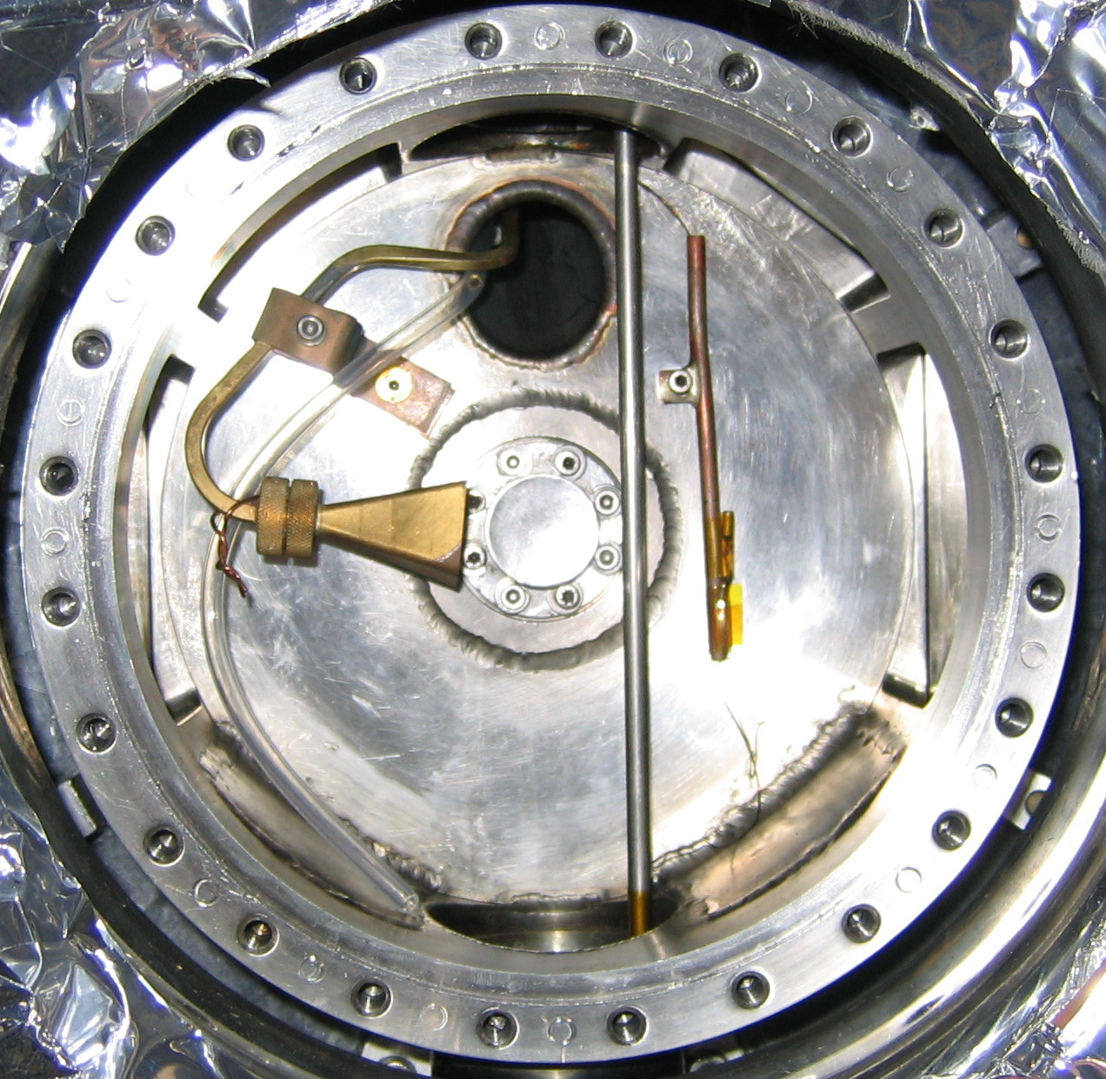
PolTar12: microwaves
And how can we do it if there is no room for a microwave horn?

Slide 7
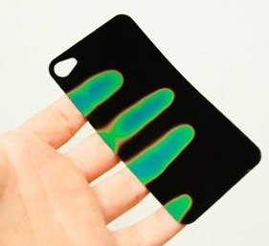
PolTar12: microwaves
Measure the
REFLECTED power
Measure the
frequency (137 GHz)
3 ft oversized circular waveguide
2 ft WR-6 rect. waveguide
Liquid crystal film
Various cavities
(copper, aluminum, etc)
Liquid crystal film changes color according to temperature.
Three sensitivities:
  25 C
  30 C
  35 C

Slide 8
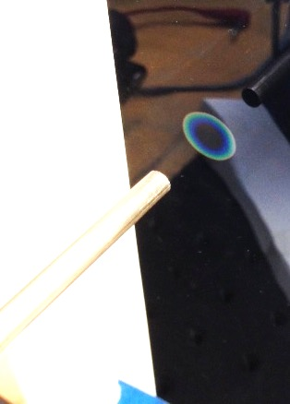
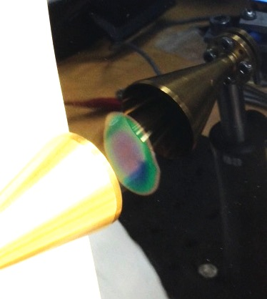
PolTar12: microwaves
Radiation pattern from unterminated waveguide.
Reflected power ~2 mW.
Radiation pattern from a conical horn. Reflected power ~2 mW.

Slide 9
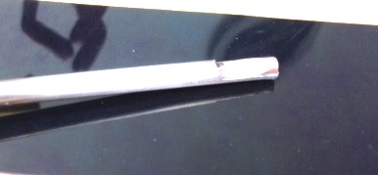
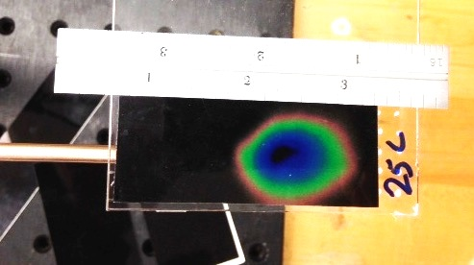
PolTar12: microwaves
Attempts to make slotted-style antennae in the circular waveguide were unsuccessful. Very little power transmission, and very large reflected power.
➔ Waveguide “reflectors” worked much better.
LC film
Wedge-shaped reflector soldered into the circular waveguide.
Radiation pattern from the wedge.
Reflected power ~ 2 mW.

Slide 10
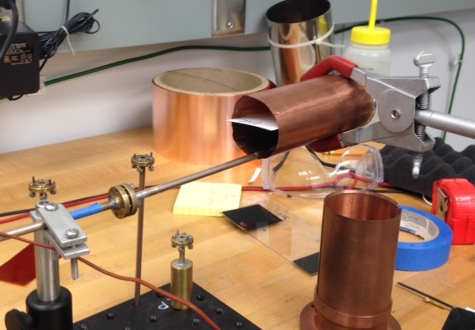
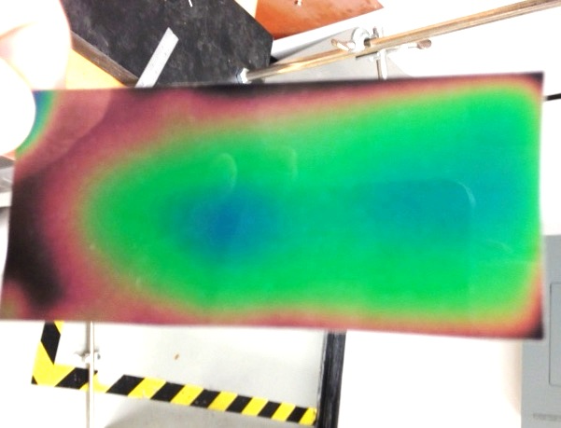
PolTar12: microwaves
Using a metal cavity makes a tremendous difference. The power is much more uniformly distributed, and reflected power continues to be minimal.
Wedge-shaped reflector inside a copper cavity, OD ~ 4.5 cm
LC Film
Radiation pattern after a 15 s exposure, 25 C film (most sensitive). Note the two “hot spots”.

Slide 11
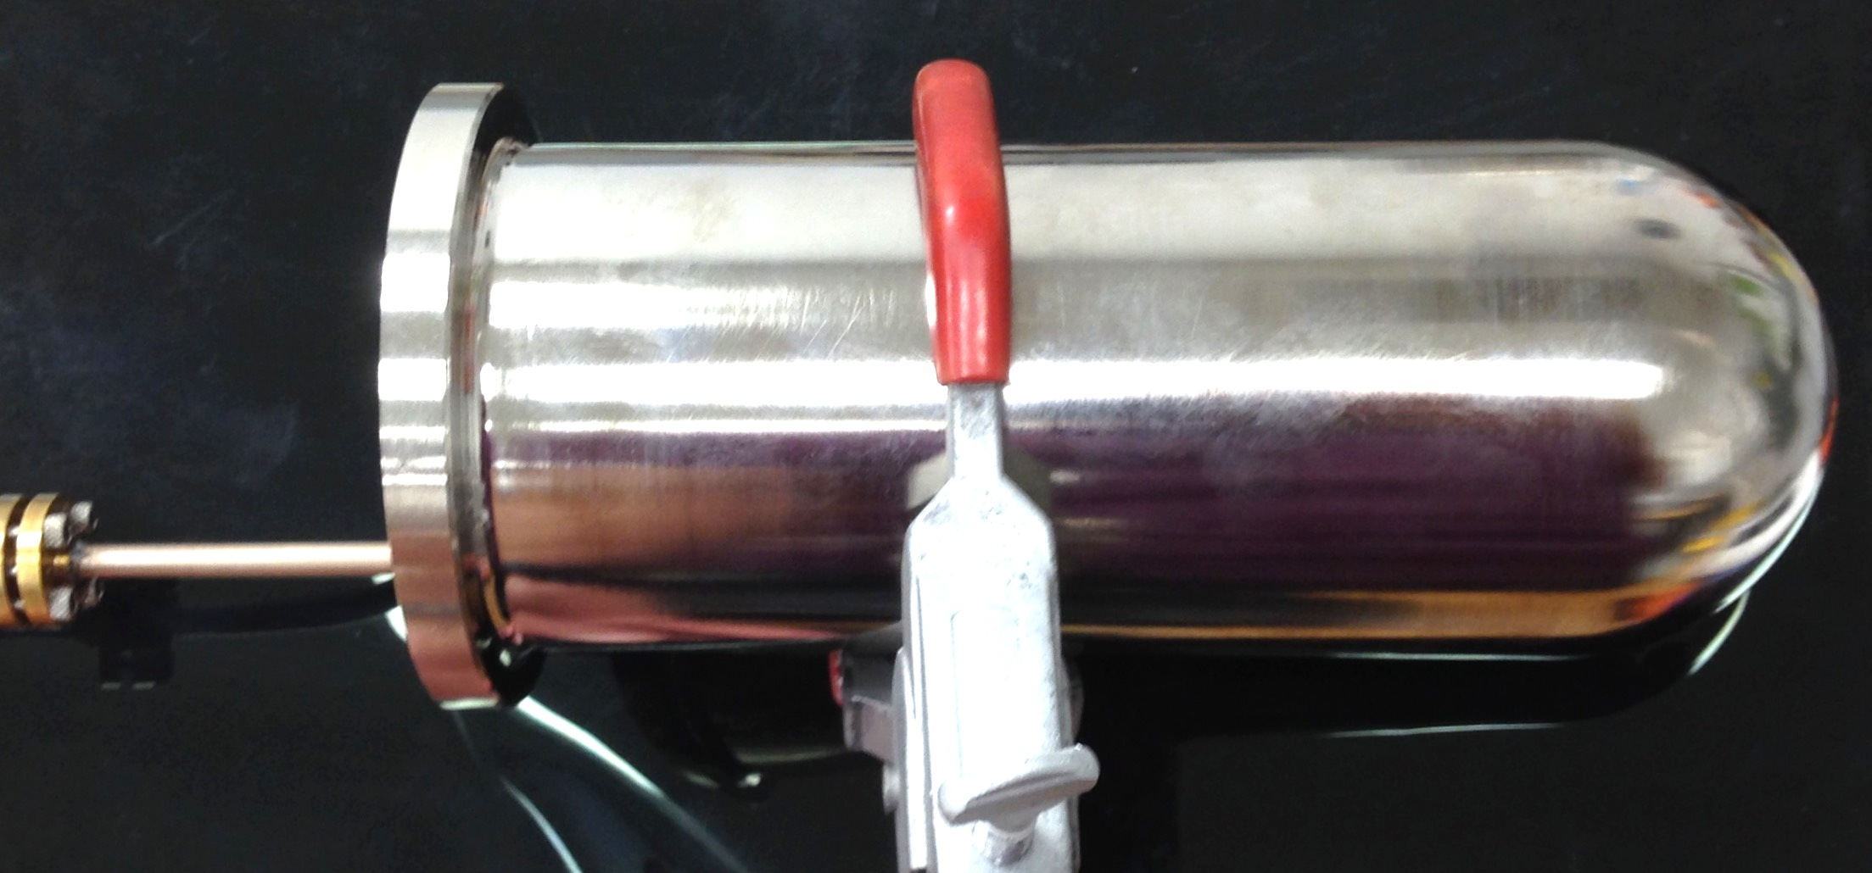
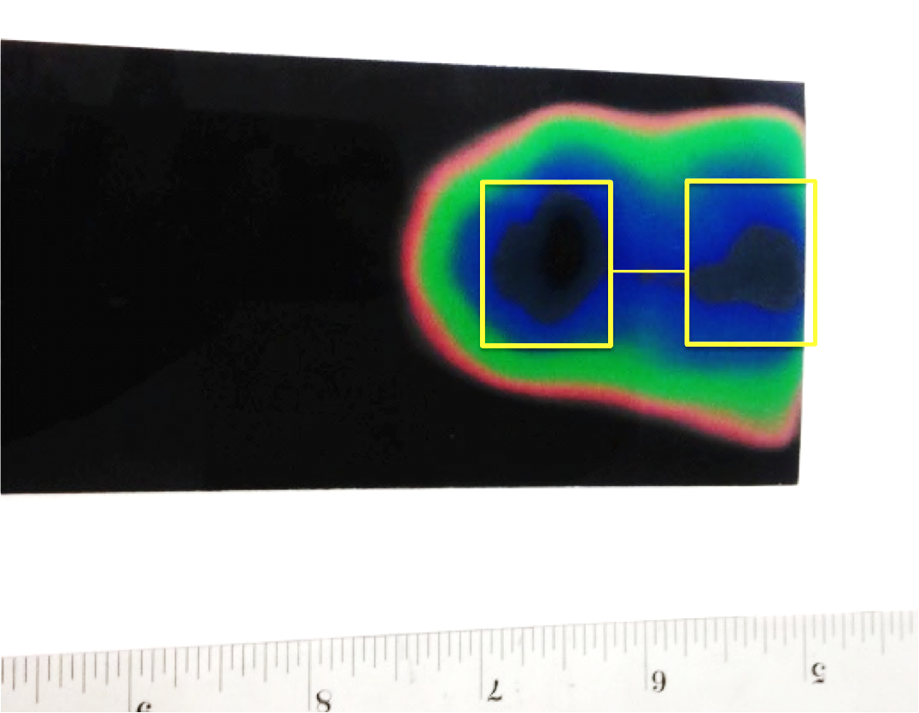
PolTar12: microwaves
Microwave pattern can be tailored to the desired target geometry.
60 s exposure on 35 C film (least sensitive)
Aluminum cavity w/ hemispherical end cap, diameter ~ 7.5 cm
Approximate size of two 2.5 x 2.0 cm target cells, w/ 2 cm separation

Slide 12
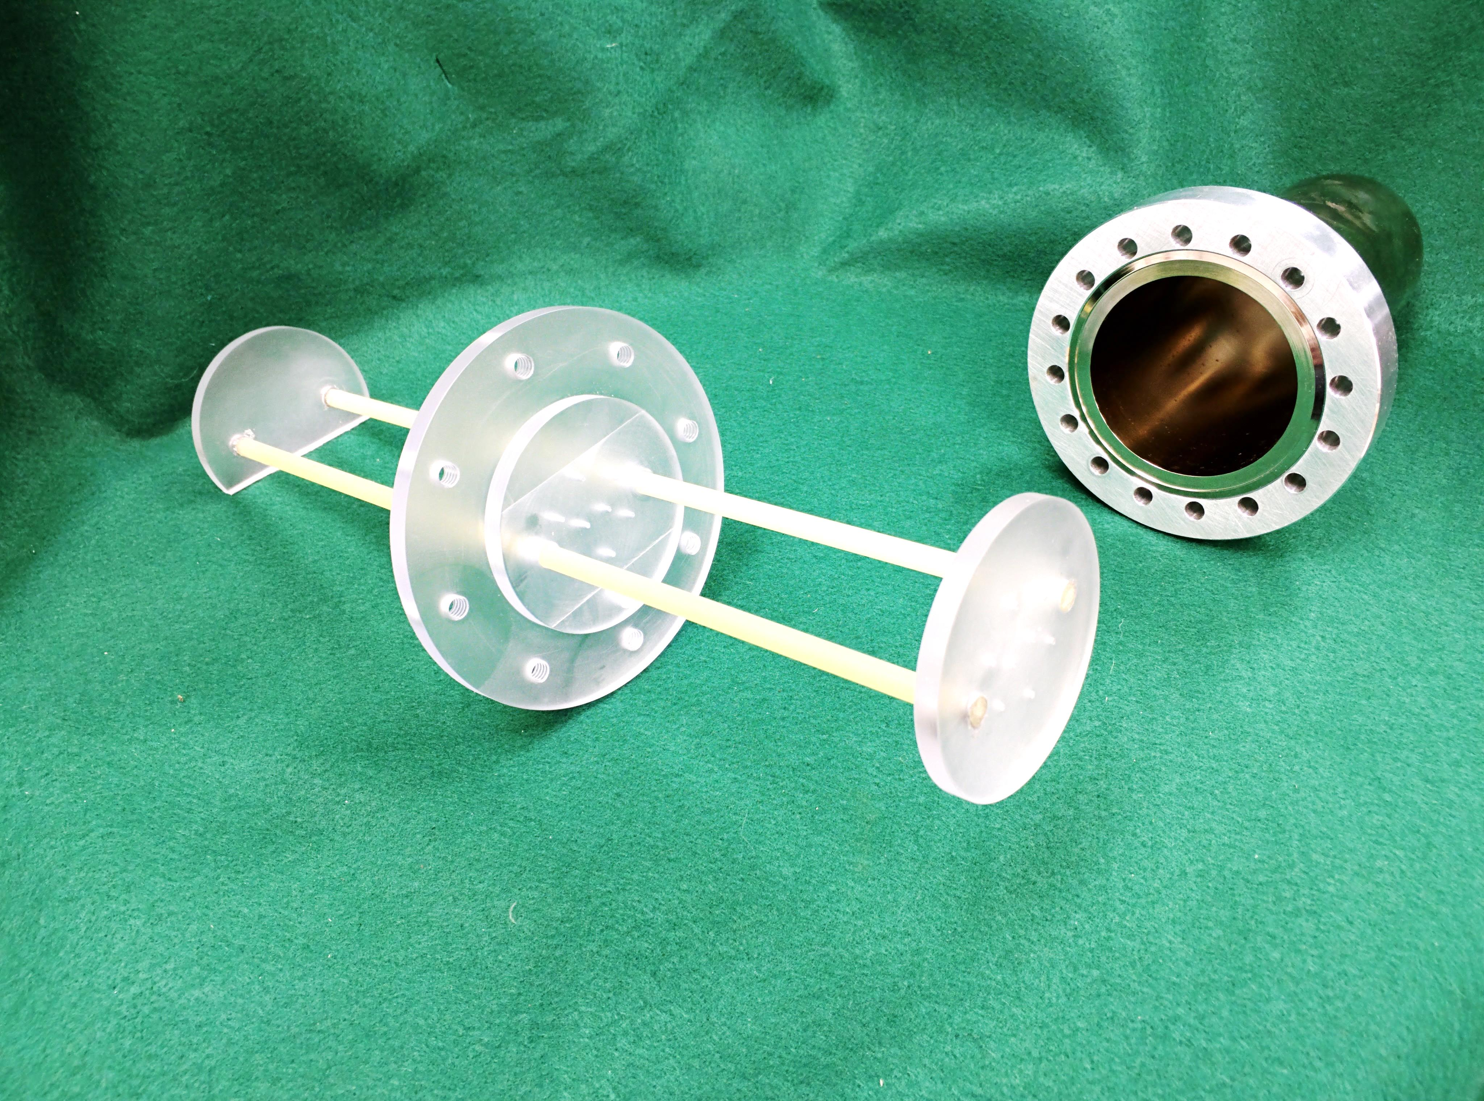
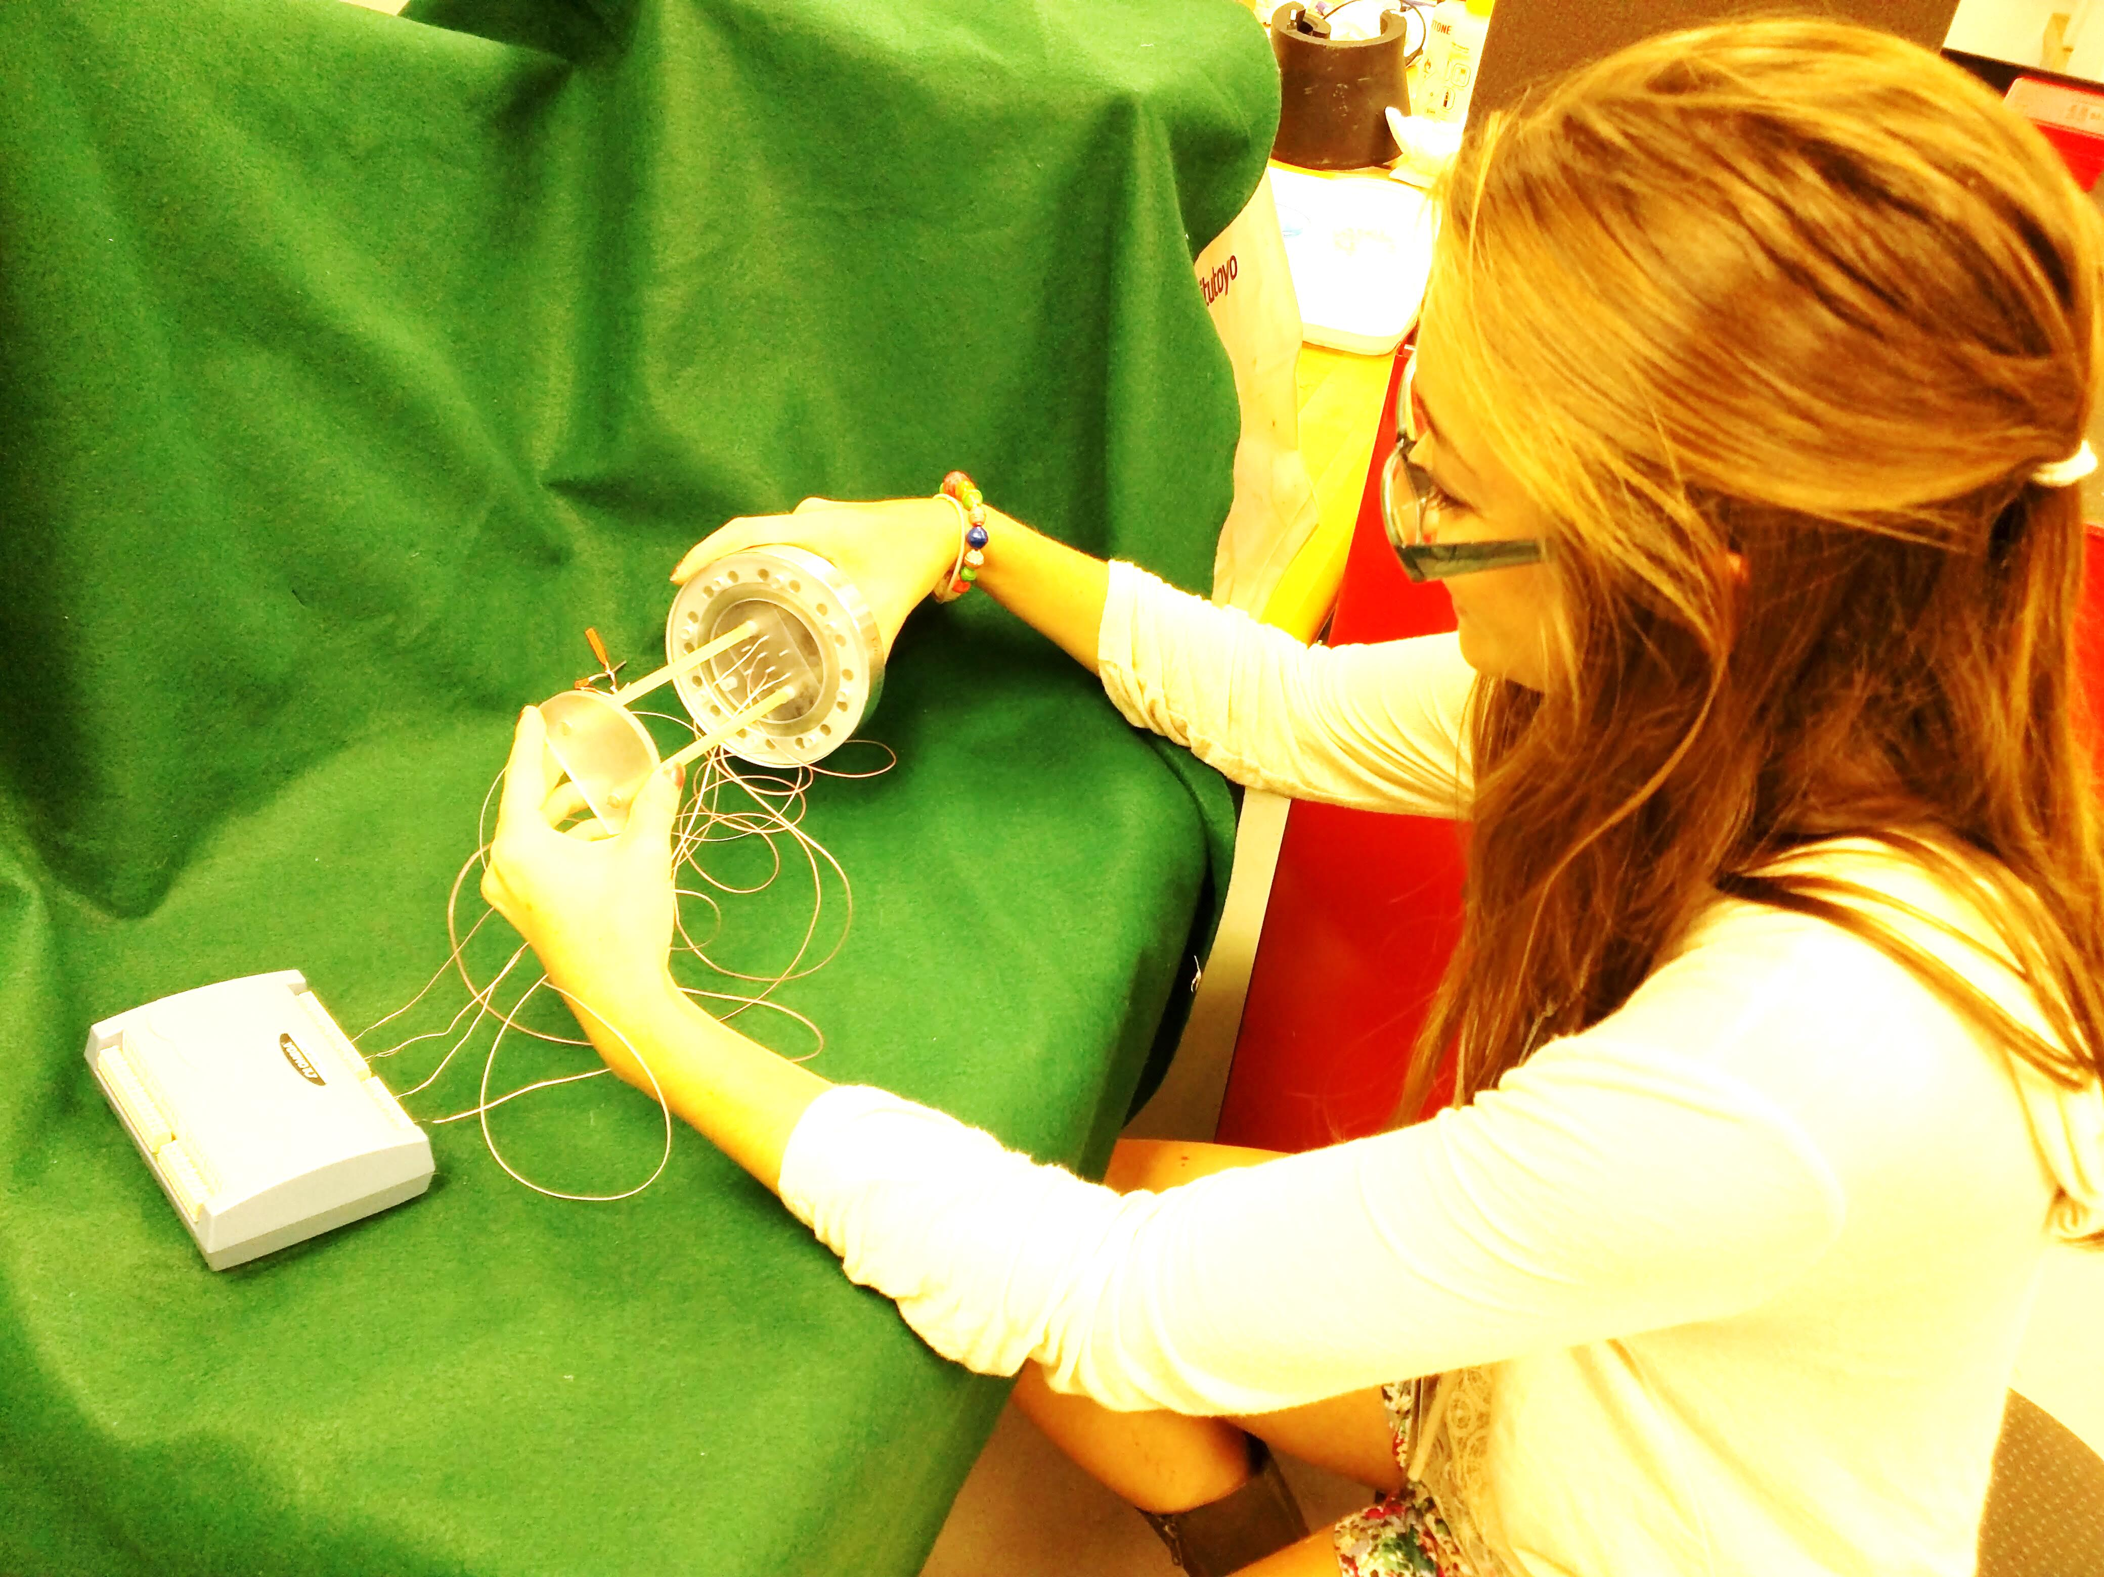
PolTar12: microwaves
The next step is to make more quantitative measurements
  Use a grid of 8 thermocouples to map the power distribution inside a 6 cm aluminum cavity
  Thermocouple junctions are covered by a microwave absorber
  Assembly is complete
  Tests are underway

Slide 13
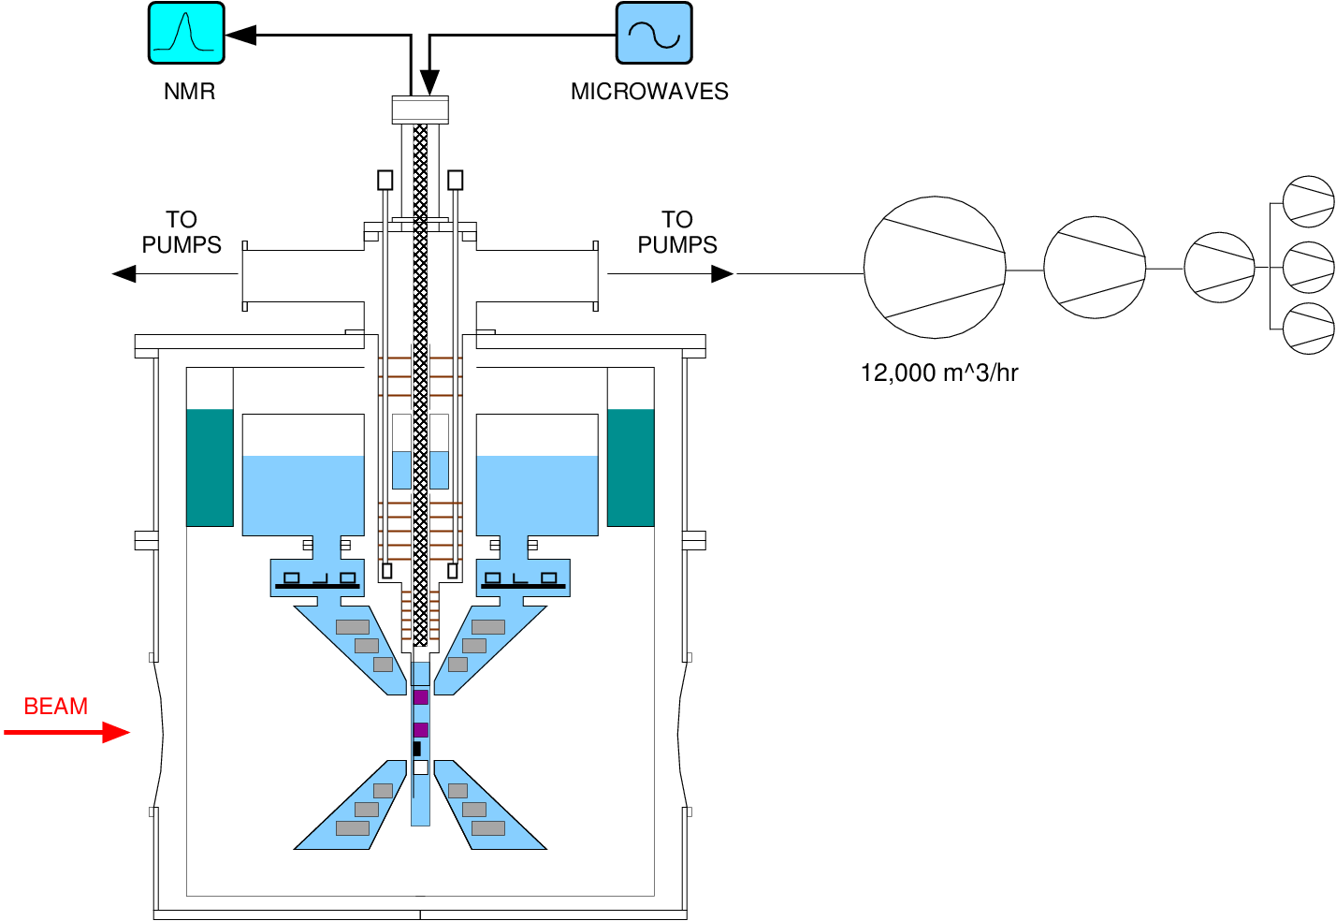
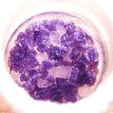
PolTar12: target insert
Ammonia samples are placed into the target cryostat with a sample insert.
It usually contains the microwave and NMR services as well.
The UVa polarized target

Slide 14
PolTar12: target insert
A major obstacle in the design of the CLAS12 polarized target is its overall length, almost 3 meters.
This will make installation and replacement of the target sample very unwieldy and more subject to damage and frost.
James Brock has introduced a new design that has the potential to alleviate this problem. A proof-of-principle prototype has been constructed and looks very promising.

Slide 15
PolTar12: target insert
In the new design a single, removable insert is replaced by two inserts that remain inside the cryostat.
1. NMR & Microwave insert: a hollow tube with NMR cables & coils, microwave waveguide, and a beam entrance window at the warm end.
NMR coil & cable
Beam
window
Waveguide
Helium vapor (gray)
LHe fill tube
Microwave cavity
4K LHe
Outer vac. can
Helium pumping tube
1K refrigerator
To pumps

Slide 16
PolTar12: target insert
In the new design a single, removable insert is replaced by two inserts that remain inside the cryostat.
2. Sample insert: small container for ammonia sample(s) and liquid helium, with a re-entrant beam window.
To pumps

Slide 17
PolTar12: target insert
Preloaded ammonia “cartridges” are placed into the sample insert in the retracted position via a dedicated loading port.
The sample is then moved into the center of the microwave cavity and NMR coil.
To pumps

Slide 18
PolTar12: target insert
The sample insert is fill with 1K LHe from the refrigerator and the ammonia is dynamically polarized.
Ready for beam!
Beam
To pumps

Slide 19
PolTar12: target insert
The sample is unloaded and replaced by a fresh sample in the same manner.
Repeat as necessary…
To pumps

Slide 20
PolTar12: summary
Most recent activity on PolTar12 has been on the microwave & target insert subsystems
Good progress on the microwaves
➔ results are very promising for the double-cell design
New insert design promises to make sample loading and unloading easier
➔ prototype has been constructed & successfully tested
Work will now focus on other subsystems
➔ NMR system (remote frequency tuning, optimize coil design)
➔ 1 K refrigerator (finalize design & engineering)

Slide 21
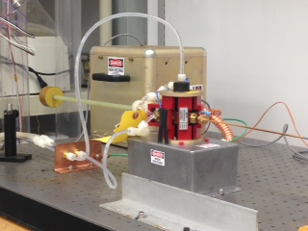
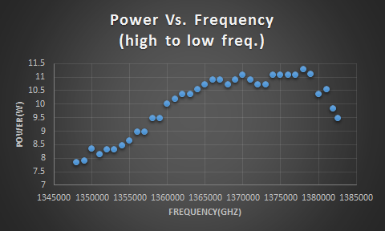
PolTar12: microwaves
EIO microwave tube
  136.5 ± 2 GHz (4.87 ± .07 tesla)
  34 W max power!
  No tuning motor
Power v. Frequency (CNU measurements)
Graph by Sarah Clark

