Slide 1
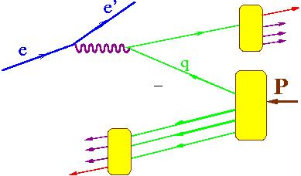
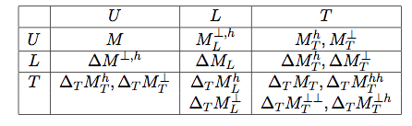
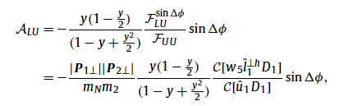
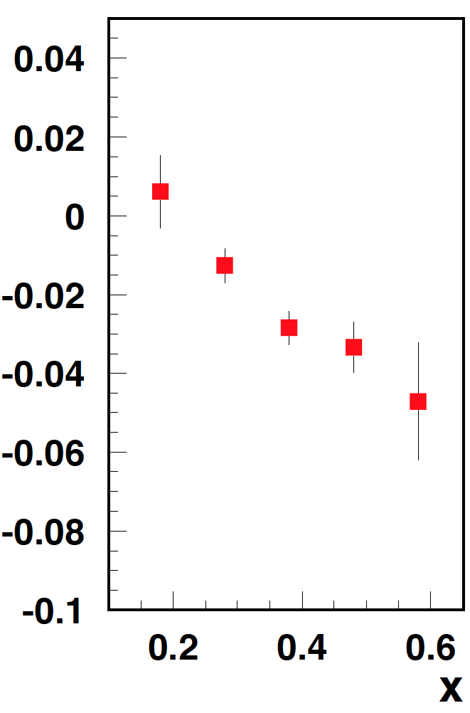
B2B hadron production in SIDIS
P₁
P₂
M. Anselmino, V. Barone and A. Kotzinian, Physics Letters B 713 (2012)
CLAS PRELIMINARY
The single beam and target spin asymmetries appear, at leading twist and low transverse momenta, in the deep inelastic inclusive lepto-production of two hadrons, one in the target fragmentation region and one in the current fragmentation region.
PAC2016: Submit a CLAS12 proposal for studies of b2b with polarized and unpolarized targets.
Significant asymmetries observed in b2b proton-pion by CLAS at 6 GeV
Notes:
{\cal{F}}_{LU}^{\sin(\phi_1-\phi_2)}=\frac{\mid\vec{P}_{1\perp}\vec{P}_{2\perp}\mid}{m_Nm_2} {\cal{C}}[w_5M_L^{\perp,h}D_1]

Slide 2
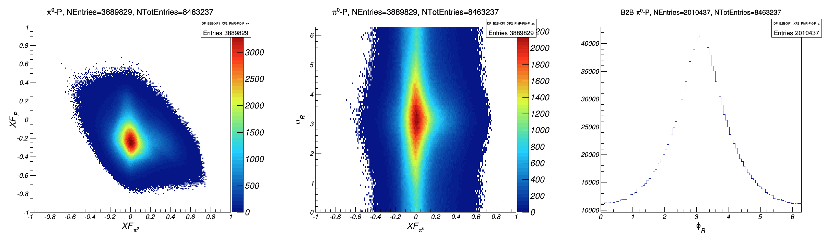
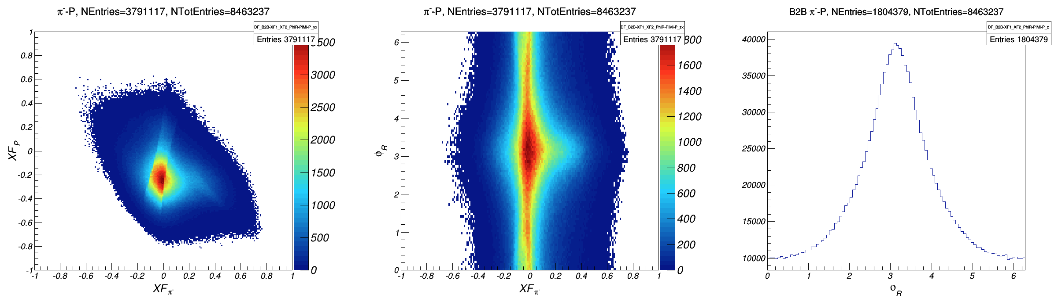

b2b distributions: CLAS12 (proton-pion)

Slide 3
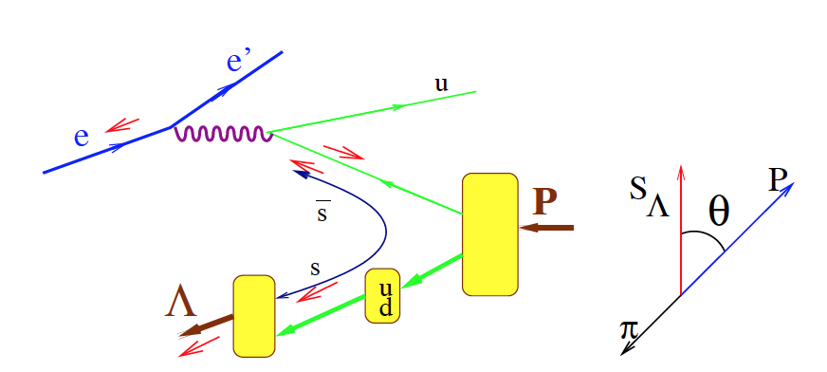

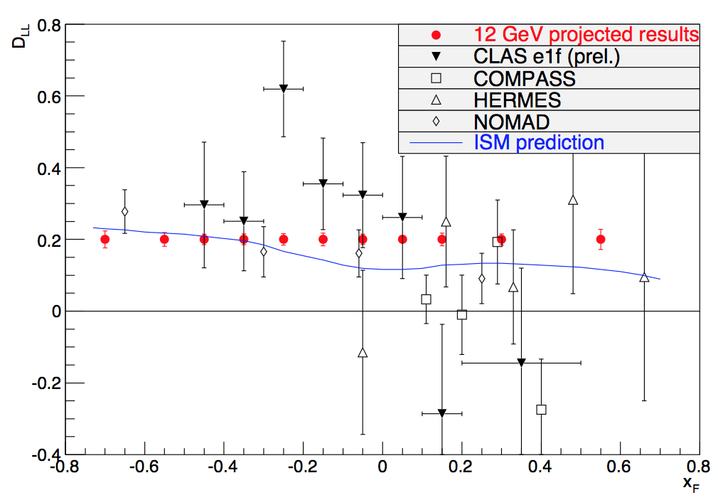
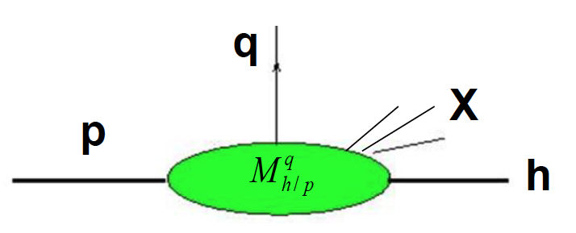
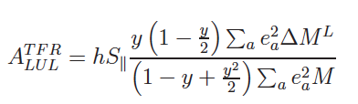
Target fragmentation region: Λ production
polarization transfer coefficient
probability to produce the hadron h
when a quark q is struck in a proton target
E12-06-112A/E12-09-008A
Measurements of fracture functions opens a new avenue in studies of the structure of the nucleon in general and correlations between current and target fragmentation in particular
60 days of CLAS12
Large acceptance of CLAS12 and EIC provide a unique possibility to study the nucleon structure in target fragmentation region
First measurements already performed using the CLAS data at 6 GeV.

Slide 4

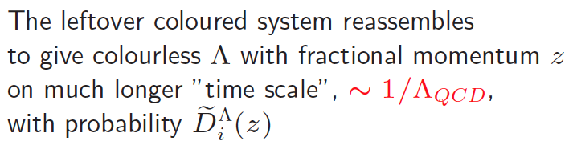
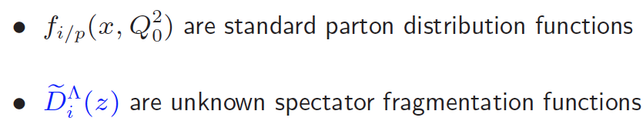
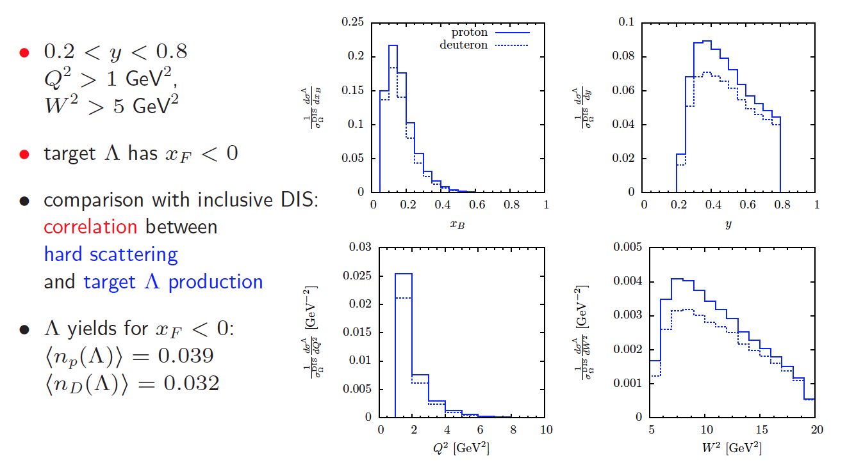
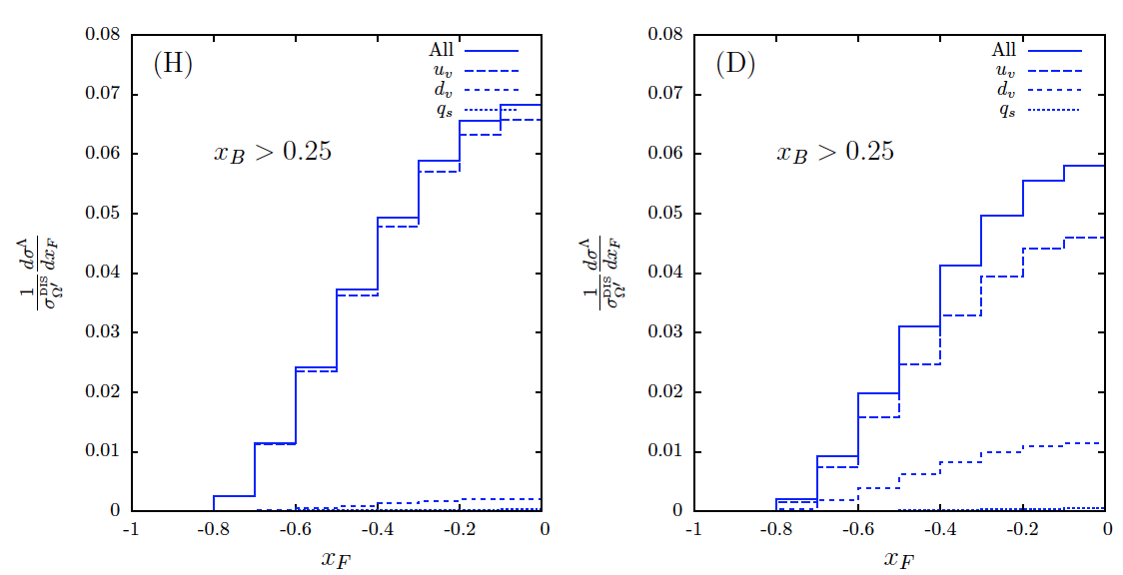
Predictions for CLAS12
proton and deuteron targets provide good valence quark-flavour sensitivity to disentangle Muv from Mdv

Slide 5
Support slides….

Slide 6
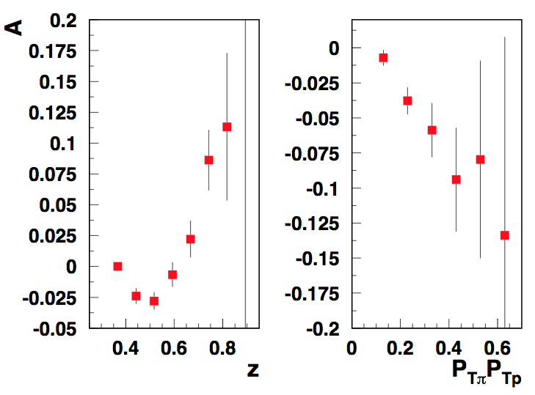
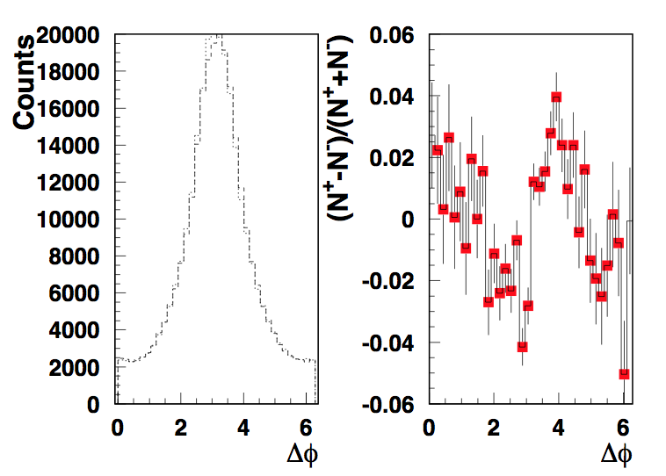
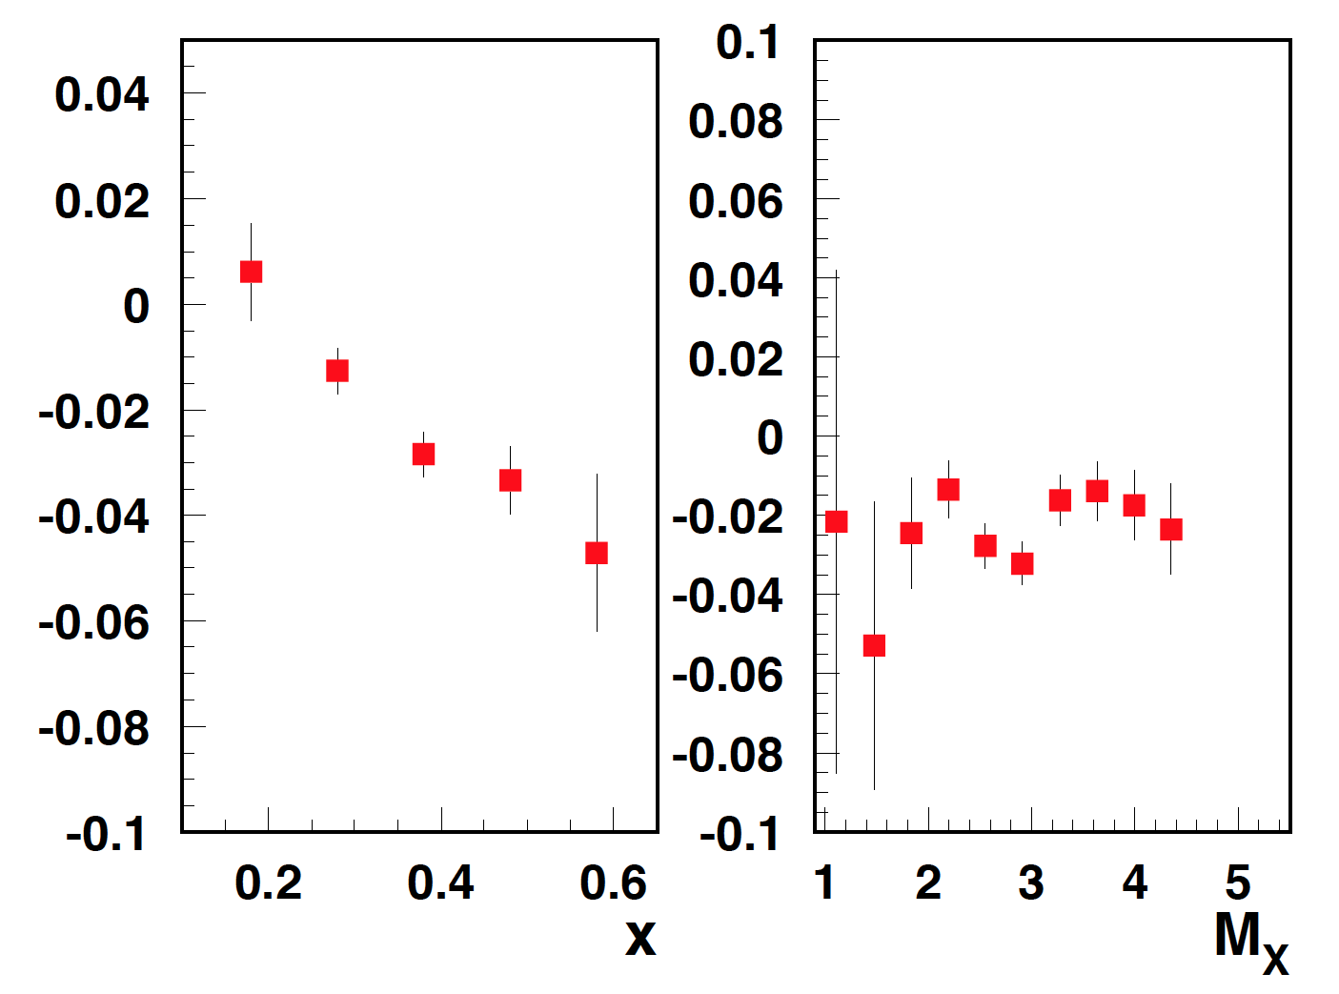
b2b SSAs

Slide 7
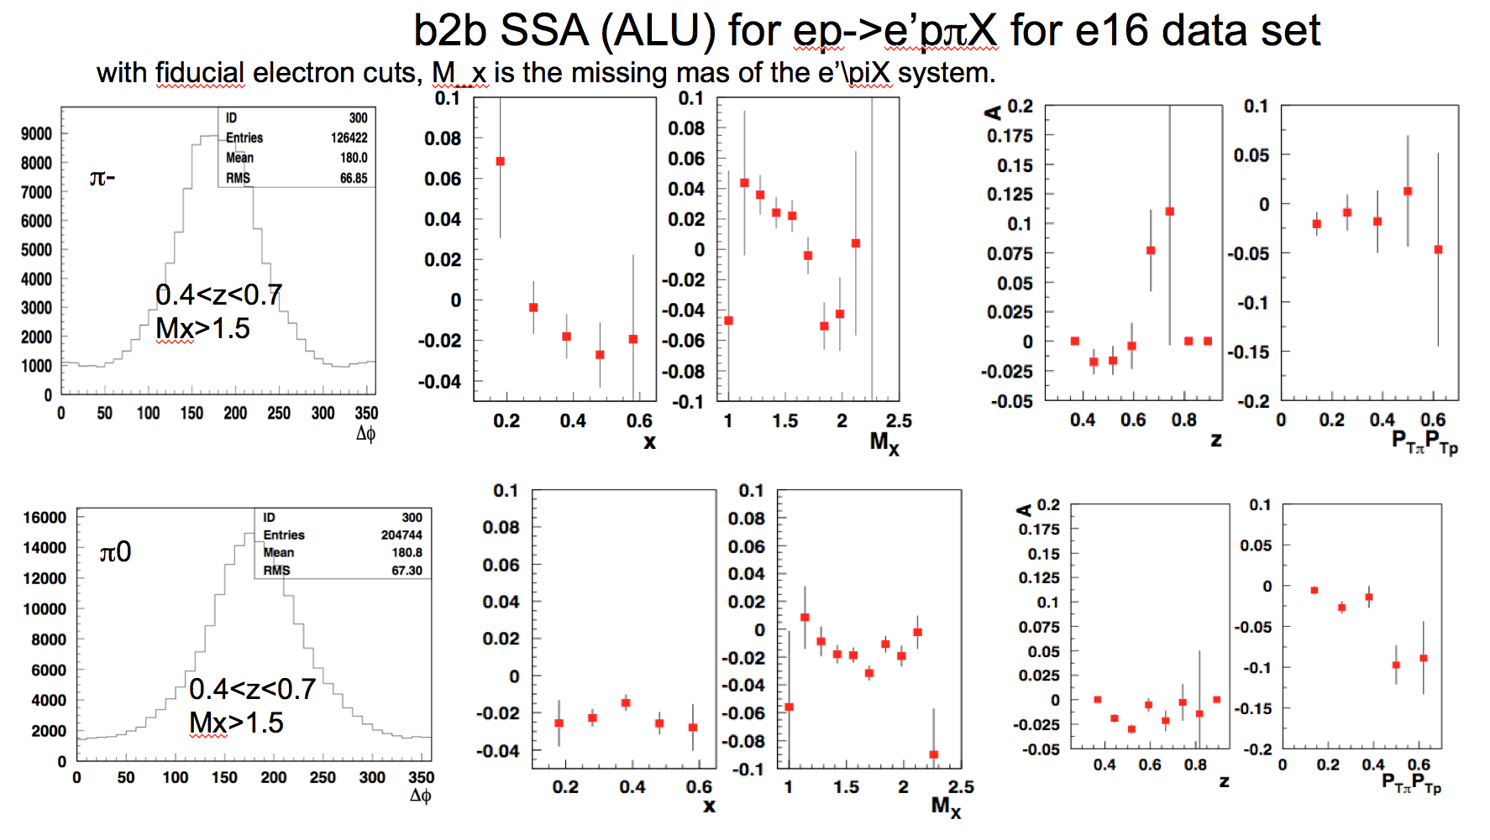
b2b SSAs

Slide 8
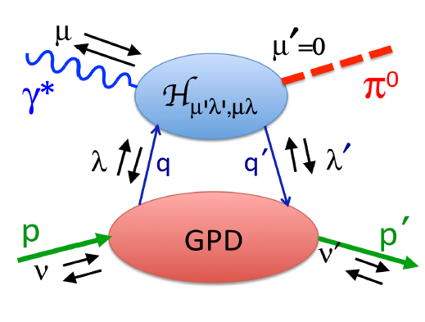
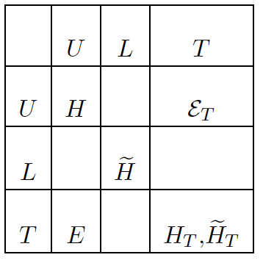

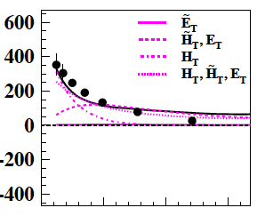
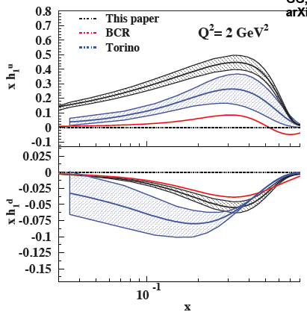
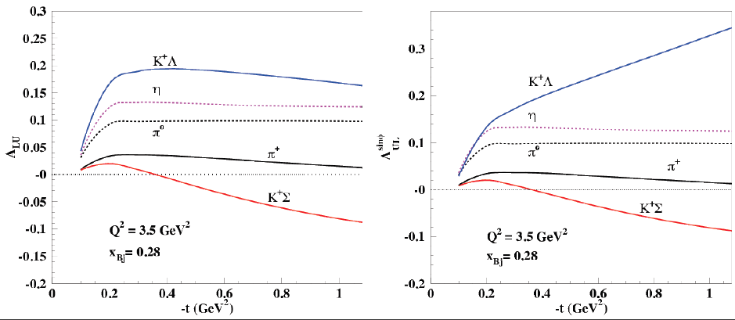
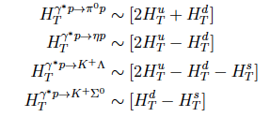
SSAs in exclusive pseudoscalar meson production
transverse x-section dominates, providing access to chiral-odd GPDs
Beam and target asymmetries in exclusive production of KΛ and KΣ are very sensitive to chiral-odd GPDs.
0.5 1.0
KΣ asymmetries are predicted to be large and with opposite sign to KΛ
Goloskokov&Kroll
Goldstein, Hernandez, & Liuti
Proposal for PAC44
Exclusive production of KΛ and KΣ provide access to different combinations of chiral-odd GPDs

Slide 9
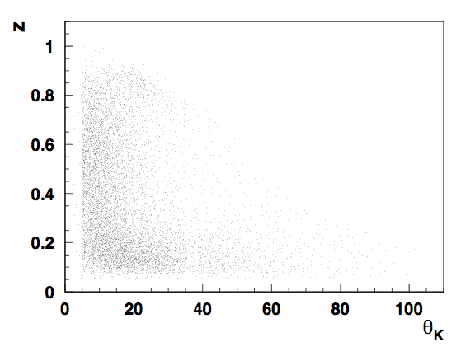
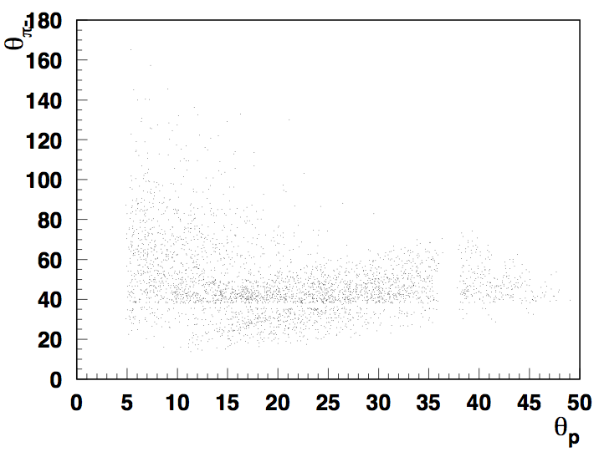
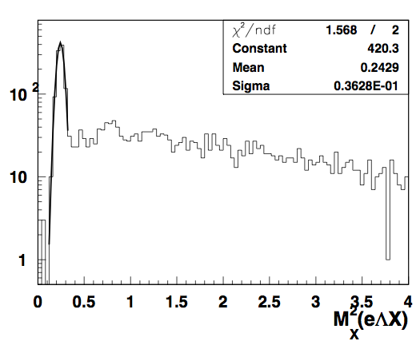
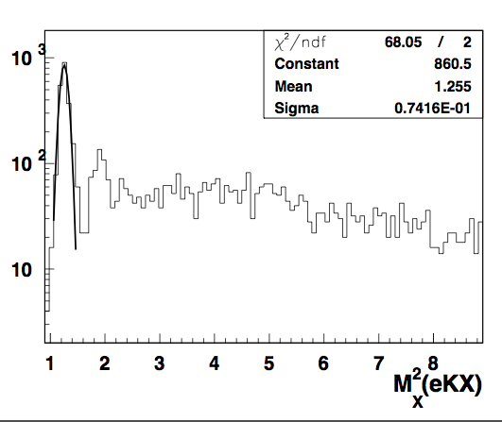
Controlling the flavor content with target-current correlations
e
e’
X
p
π
K
x_{F}
Large acceptance of CLAS12 (and EIC) provide a unique possibility to detect simultaneously hadrons in the forward and backward regions

