Slide 1
BBU Measurements for ER@CEBAF
Objectives for experimental proposal (from Francois):
  Estimate BBU thresholds from measurements below breakup during ER study
  Push ER@CEBAF to BBU and compare to estimates
Scope of this presentation
  CEBAF BBU history
    Theses: Sereno (1994), Tennant (2006), Shin (2013)
    2008 Observed multipass BBU (Renascance)
  C100 cavity HOM spectral survey
  Methods to measure below threshold
  Pushing towards BBU
  Discussion

Slide 2
Nick Sereno Thesis (1994)
http://casa.jlab.org/publications/CASA_PhDs/Sereno_Dissertation.pdf
Experimental Studies of Multipass Beam Breakup and Energy Recovery using the CEBAF Injector Linac
CEBAF injector: 5.6 MeV to 42.8 MeV single-pass
  Designed/built/modeled injector recirculator optics
  Simulated/calculated BBU thresholds for CEBAF
  Recirculated >200 uA to 80.1 MeV (2-pass)
  ERL: 30 uA 5.6 MeV to 42.8 MeV and back
  Measured HOM spectra with stripline kicks, HOM pickups
  Indirect BBU thresholds (no BBU experimentally observed)

Slide 3
Chris Tennant Thesis (2006)
http://casa.jlab.org/publications/CASA_PhDs/Tennant_Dissertation.pdf
1 GeV Demonstration of Energy Recovery at CEBAF and Studies of the Multibunch, Multipass Beam Breakup Instability in the 10 kW FEL Upgrade Driver
1 GeV CEBAF ER
  Participated in study, beam measurements
  Injector/max energy ratio: 1/51
BBU in FEL Upgrade Driver
  Benchmarked TDBBU codes, agreement o(10%)
  Isolated HOM frequency model validated
  Several (single-recirculation) BBU mitigation methods suggested

Slide 4
Ilkyoung Shin Thesis (2013)
http://casa.jlab.org/publications/CASA_PhDs/Shin_Dissertation.pdf
Multipass Beam Breakup Study at Jefferson Lab for the 12 GeV CEBAF Upgrade
12 GeV upgrade BBU analysis/experiment
  C100 HOM survey/analysis (C100-1 and C100-2)
  Injector upgrade cumulative BBU analysis
  Experimental evaluation of C100 HOM power
    Direct HOM excitation with HOM couplers
    Derived BBU threshold in frequency domain
    2 passes through C100 cavities only
  Indirect BBU thresholds (no BBU experimentally observed)

Slide 5
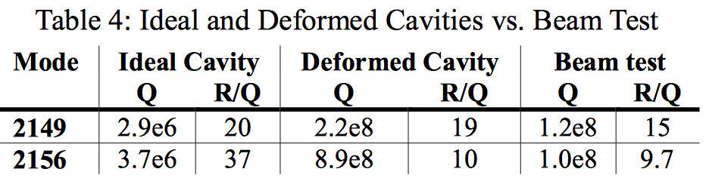
2008 Multipass (3-pass) BBU
https://accelconf.web.cern.ch/accelconf/e08/papers/wepp087.pdf Kazimi et al EPAC’08
BBU observed as low as 40 uA (vs design 20 mA)
  Renascance cryomodule installed in NL04 Aug 2007
  NL4-5 cavity shortened in fabrication
    Shifted/tilted dipole HOMs away from HOM couplers
    Problematic due to low-energy location of cryomodule/cavity
  Recirculation optics modified to explore/mitigate problem
    Included evaluation of effects of higher-pass (multipass) optics

Slide 6
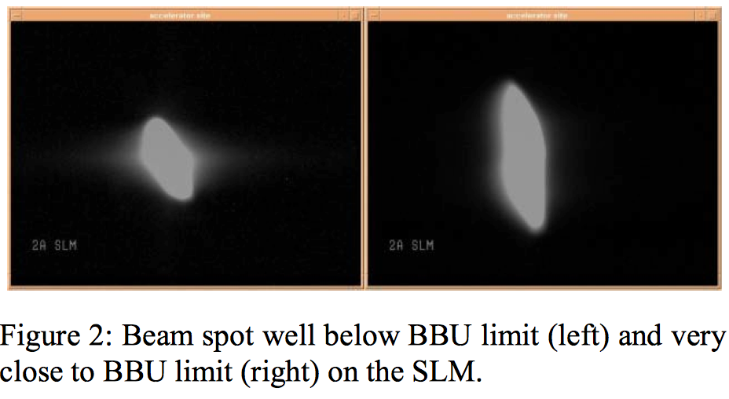
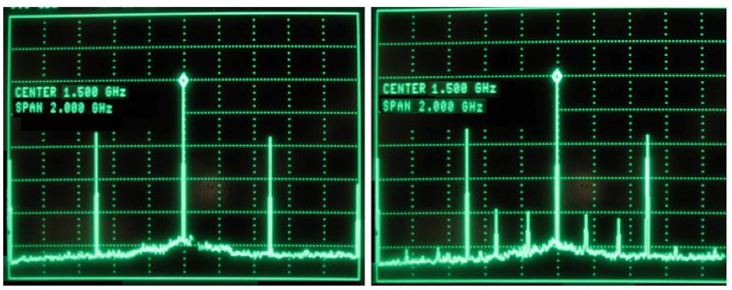
2008 Multipass BBU
SLM in arc 2
Left: below I_{th}
Right: very close to I_{th}
BPM spectrum at end of NL
Left: bunch frequency harmonics only below I_{th}
Right: bunch frequency harmonics plus 2.149 GHz sidebands above I_{th}

Slide 7
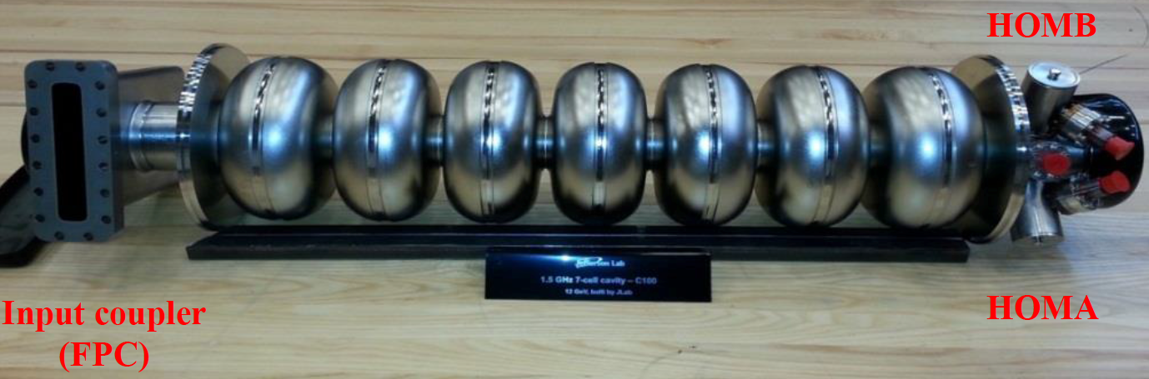
C100 Cavities (overview)
TM010: 1474-1497 MHz
TE111: 1850-2050 MHz
TM110: 2050-2250 MHz
TM111: 2850-3000 MHz
7-cell 1499 MHz
External HOM loads: cryomodule HOM ports accessible
Cryomodule HOM surveys: network analyzer S₁₂ port to port
C100-1/2 explored on bench, 2-pass beam studies (Shin thesis)
All C100s: HOMSC14 workshop paper attached to InDiCo
  Cavity 6 TM111 pi/7 V only mode to exceed HOM budget
  Reduced with coaxial stub tuners
    https://logbooks.jlab.org/entry/3250844

Slide 8
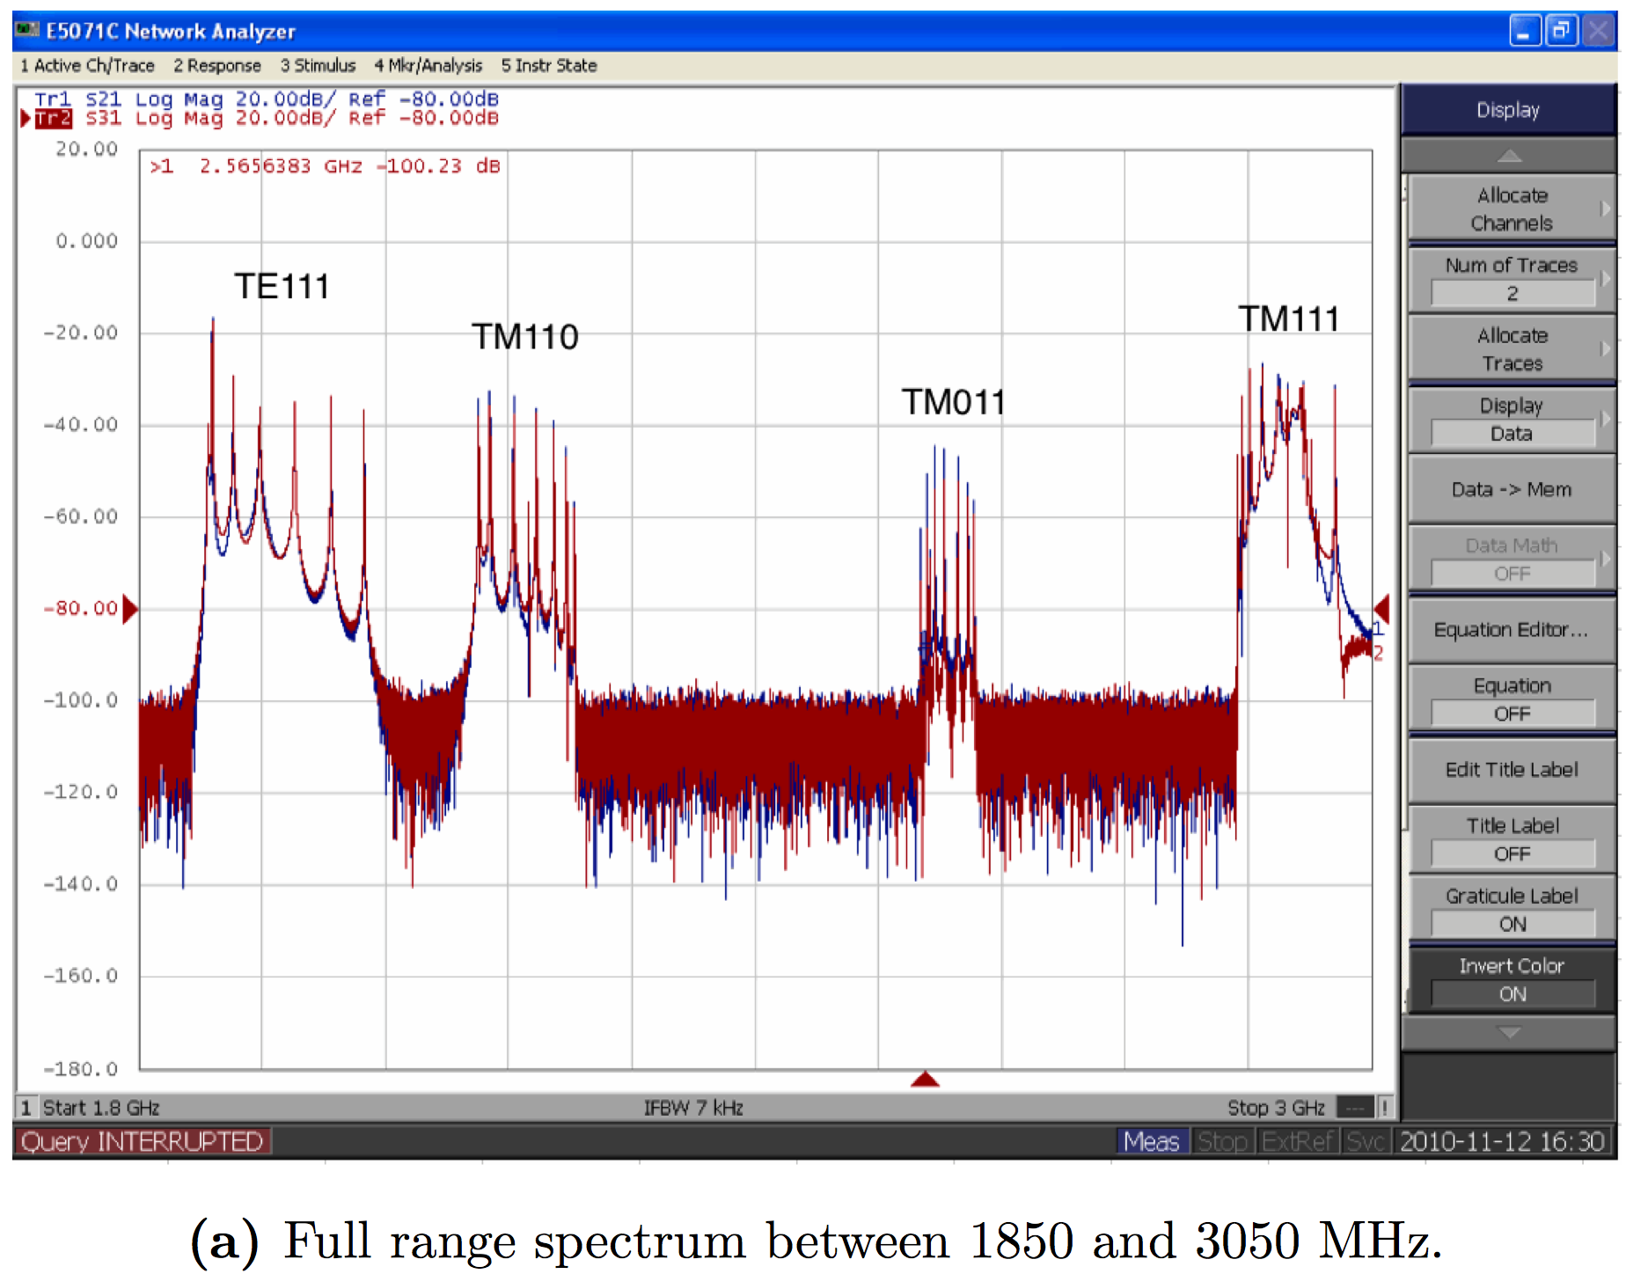
C100 HOM Spectrum

Slide 9
400 uA baseline impedance threshold=1e10
C100-1 (SL24)
RI-004 early
production
400 uA baseline impedance threshold=1e10
C100-2 (SL25)
C100-1/2 HOM survey and beam-based beam breakup tests (Nov 2011)
- All consistent with design predictions, BBU thresholds >5 mA
- No BBU observed in any beam studies
- Large BBU threshold extrapolated with nominal 180 uA beam to Hall C
- Low-frequency TM111 modes of most concern, but well within threshold
- Validates approach of HOM survey/analysis of all C100s in CMTF

Slide 10
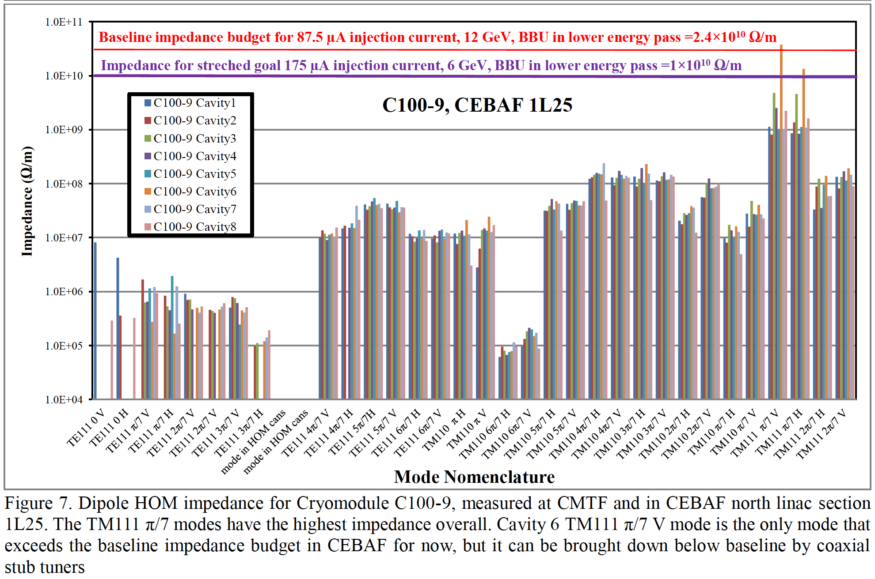

Slide 11
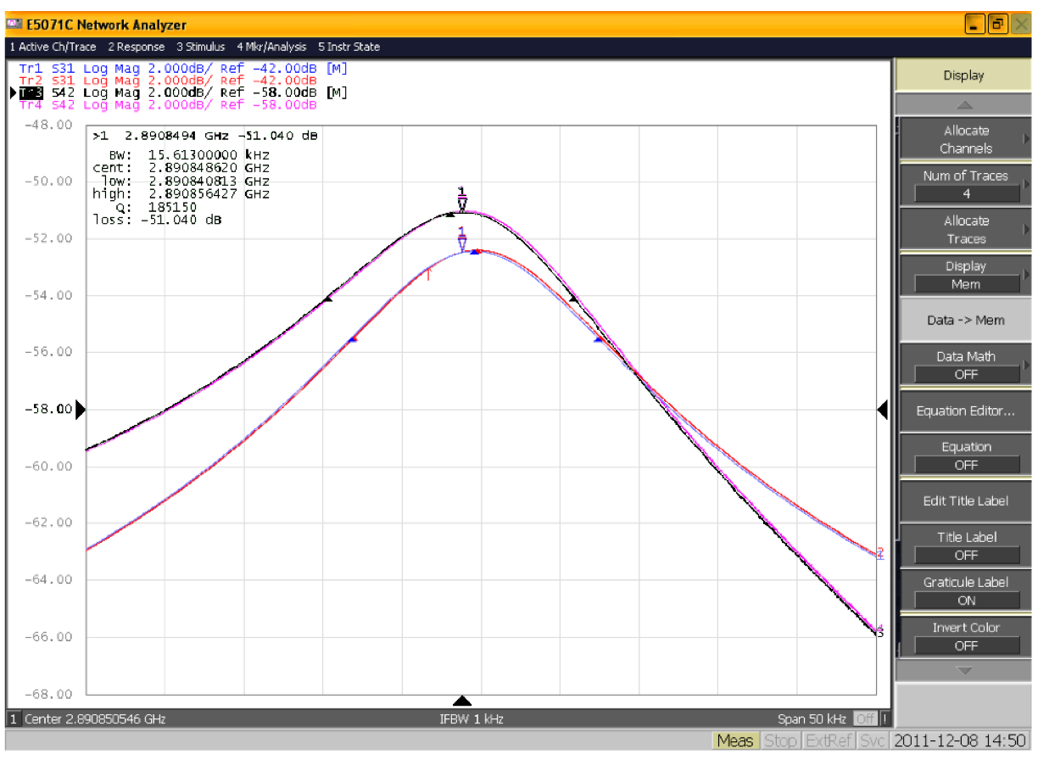
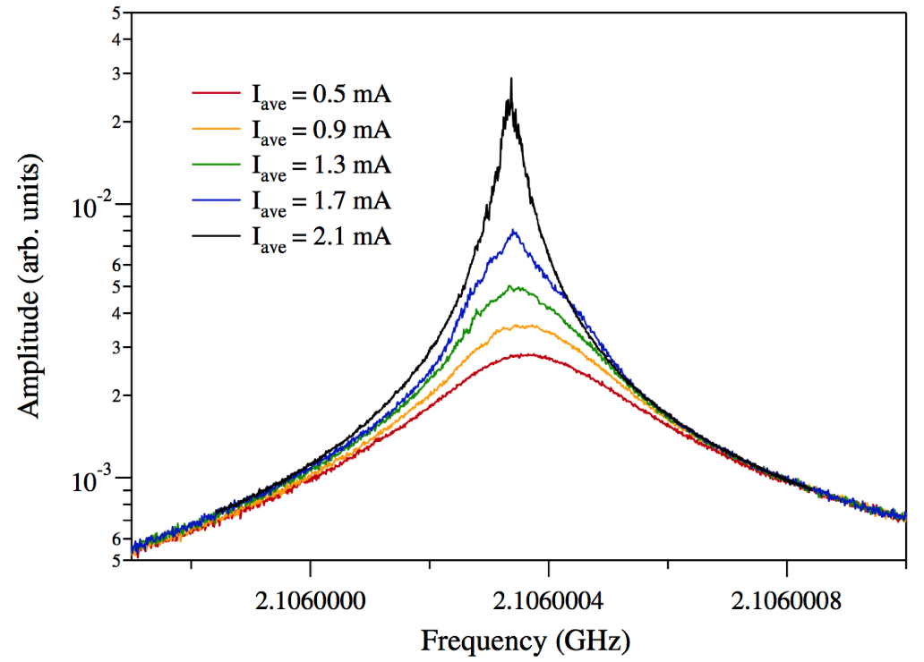
Measurements Below Threshold
Shin thesis also extrapolated BBU threshold current from direct NWA scans of individual HOM peaks while varying beam current
  But large uncertainties when far below threshold current
  Also done in Tennant thesis for FEL Upgrade Driver

Slide 12
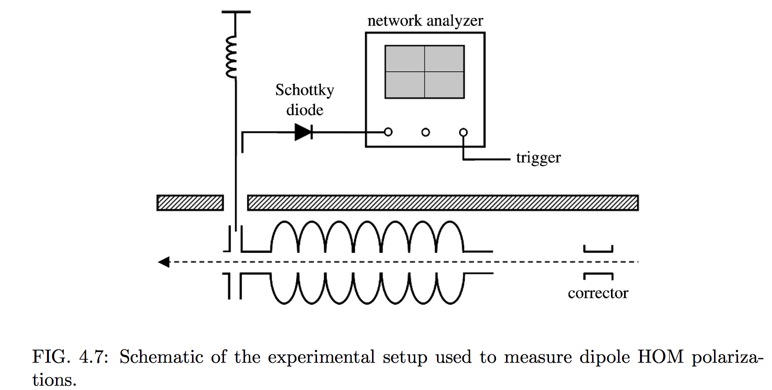
Measurements Below Threshold
Much of the CEBAF BBU thesis work focused on ways to measure BBU thresholds without actually generating BBU
E.g. Tennant thesis: measuring dipole modes and polarizations – measure HOM voltage vs position scan

Slide 13
Discussion Ideas
Characterizing BBU
  Existing thesis work and characterization has covered BBU code verification, HOM survey techniques to maturity
Driving BBU: Elevating beam current
  Higher current gun? But likely limits on, e.g., dump power
  Suitability of CSR LDRD proposed gun?
Driving BBU: Elevating HOM impedances
  Detune 1L25-6 with stub tuners?
  Short HOM ports?
  Direct driving of HOM through HOM port?

