Slide 1
A brief Introduction of eRHIC
N. Tsoupas, F Meot

Slide 2
eRHIC at BNL
Add an electron accelerator to the existing $2.5B RHIC
including existing RHIC tunnel, detector buildings and cryo facility
p
70% polarized protons
25 - 250 (275*) GeV
Luminosity:
10³³ – 10³⁴ cm⁻² s⁻¹
Light ions (d, Si, Cu)
Heavy ions (Au, U)
10 - 100 (110*) GeV/u
80% polarized electrons:
1.3 – 21.2 GeV
e⁻
Pol. light ions (He-3)
17 - 167 (184*) GeV/u
Center-of-mass energy range: 20 – 145 GeV
Full electron polarization at all energies
Full proton and He-3 polarization with six Siberian snakes
Any polarization direction in electron-hadron collisions:
protons
electrons
* It is possible to increase RHIC ring energy by 10%

Slide 3
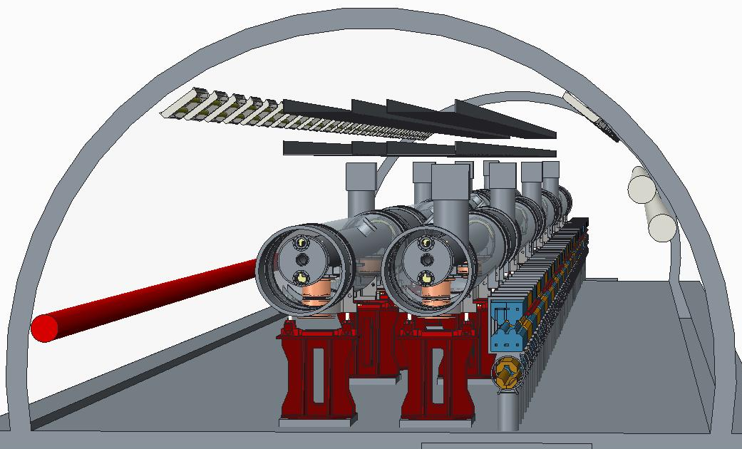
ERL-based eRHIC
arXiv:1409.1633
Novel FFAG lattice allows 16 beam re-circulations using only two beam transport loops

Slide 4
Parameter Table
Parameters | eRHIC
 | e | p
Energy (GeV) | 15.9 | 250
Bunch spacing (ns) | 106
Intensity, 10¹¹ | 0.07 | 3.0
Current (mA) | 10 | 415
rms norm. emit. (mm-mrad) | 23 | 0.2
β _{x/y} * (cm) | 5 | 5
rms bunch length (cm) | 0.4 | 5
IP rms spot size (μ m) | 6.1
Polarization, % | 80 | 70
Luminosity, 10³³cm⁻²s⁻¹ | 3.3

Slide 5
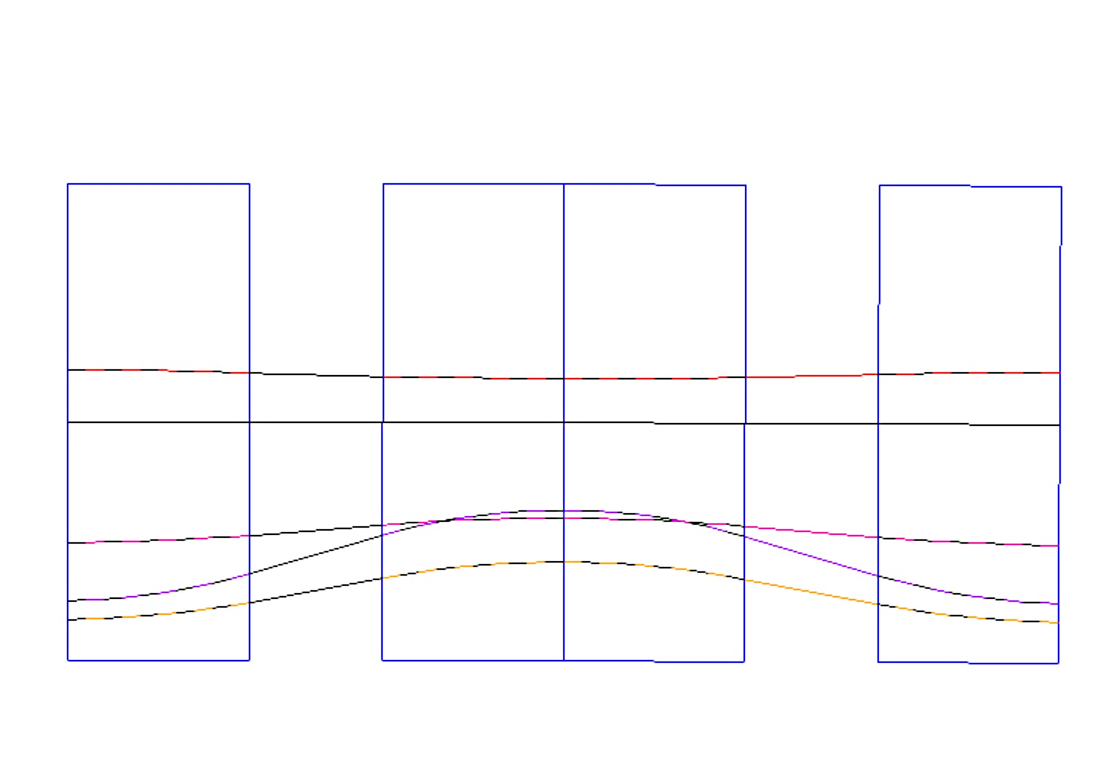
Low energy cell (N=160.1888 cells per arc), L_{CELL}=2.2242 m
B_{Fmax,min} =[0.1211, -0.1744] T
B_{D} =0.05941,
G_{d} = -10.6 T/m
x_{Doffset}=+5.6 mm
B_{Dmax,min}=[0.0047, 0.2442] T
x(mm)
B_{f}= 0.05941 T,
G_{f}= 10.6 T/m x_{Foffset}= -5.6 mm
F/2
D
F/2
0.4
Quad center
5.300 GeV
5.8
5.2
5.6 mm
ECEN=4.97 GeV
11.14
0
-11.2
-5.6
-10
Quad center
22.6
-17.4
-22.06
3.978 GeV
-16.46
-20
1.334 GeV
2.656 GeV
-30
θ_{F/2}=2.9103/2 mrad
θ_{D}= 2.910343 mrad
θ_{F/2}=2.9103/2.0 mrad
ρ_{F}= 279.048 m
ρ_{D}= 279.048 m
ρ_{F}= 279.048 m
0.8121/2 m
0.30 m
0.8121 m
0.30 m
0.8121/2 m

Slide 6
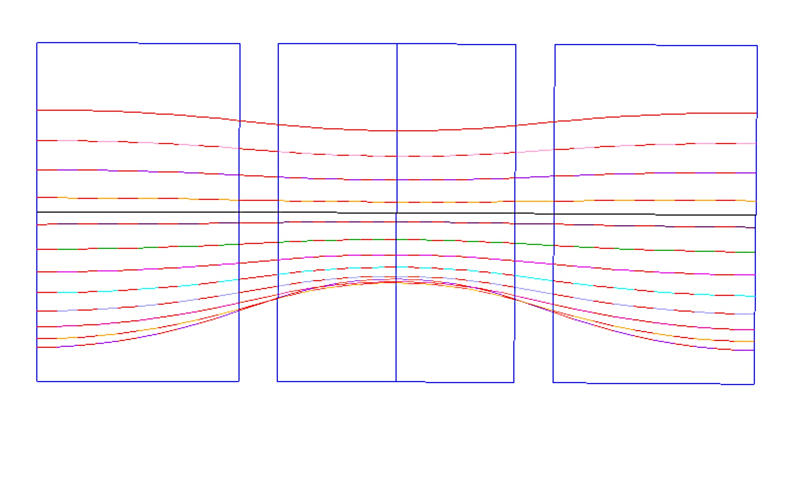
Synchrotron Radiation
for 16 mA 21.2 GeV 11.45 MW
for 10mA 15.9 GeV 7.16 MW
For 10 mA @ 15.9 GeV 2.65 MW
L = 3.33638 m, 106.79 arc cells, ξ_{TOTAL}=-305.4
x(mm)
B_{Fo}= 0.161451 T,
G_{F}= 20.6 T/m
x_{Foffset}= -8.4 mm
B_{Do} = 0.161451 T,
G_{D} = -28.87 T/m
x_{Doffset}=+5.895 mm
B_{Fmax,min} =[0.442, -0.187] T
B_{Dmax,min}=[-0.179, 0.482] T
QF/2
BD
QF/2
B_{Fmax} = 0.442 T
B_{Dmin} = -0.18 T
21.16 GeV
10
6.2
Quad center
Quad center
19.84 GeV
13.5
21.4
11.6
18.52 GeV
0
+5.59
17.20 GeV
-16.7
15.88 GeV
-7.8
Quad center
-10.8
14.55 GeV
13.23 GeV
-10
11.91 GeV
-9.1
-16.8
10.59 GeV
B_{Dmax} = 0.482 T
9.27 GeV
7.94 GeV
B_{Fmin} = -0.187
6.62 GeV
-20
θ_{F}=5.41806/2 mrad
18 cm
θ_{D}=3.312967 mrad
θ_{F}=5.41806/2 mrad
1.847/2 m
1.1294 m
18 cm
1.847/2 m
ρ_{F}=340.8968 m
ρ_{D}=340.8968 m
ρ_{F}=340.8968 m
B_{F}=B_{Fo} + G_{F}•x
B_{D}=B_{Do} + G_{D}•x

Slide 7
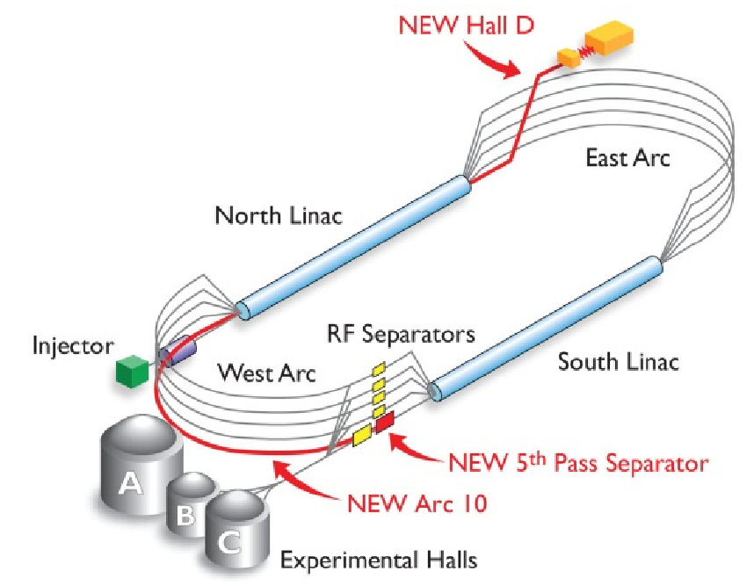
Fallback options (2/2)
A more global viewpoint, an “all-in-one” option :
"Pre-commissioning of eRHIC multi-pass FFAG-optics ER"
A full-scale construction and beam experiment based on an FFAG arc, using eRHIC style permanent magnets, placed in CEBAF arc 9 area
Including :
- Multiple-pass in the FFAG arc
- possibility of eRHIC instrumentation and diagnostics R&D (including, e.g., beam position and TOF measurements, full-scale chromatic effects)
- multiple-pass ER, RF systems response
- SR effects on beam emittance
- and on transport of polarization
It would allow teams to form and acquire experience
Cost estimate : under discussion with JLab (cf. backup slide)

Slide 8
Fallback options (2/2)
A more global viewpoint, an “all-in-one” option :
"Pre-commissioning of eRHIC multi-pass FFAG-optics ER"
A full-scale construction and beam experiment based on an FFAG arc, using eRHIC style permanent magnets, placed in CEBAF arc 9 area
Including :
- Multiple-pass in the FFAG arc
- possibility of eRHIC instrumentation and diagnostics R&D (including, e.g., beam position and TOF measurements, full-scale chromatic effects)
- multiple-pass ER, RF systems response
- SR effects on beam emittance
- and on transport of polarization
It would allow teams to form and acquire experience
Cost estimate : under discussion with JLab (cf. backup slide)

Slide 9
The End

